Slide 1


BOC
RF Measurement
17.02.2025
MARTINEZ REVIRIEGO, Pablo; ALONSO ARIAS, Paz; WANG, Ping
pablo.martinez.reviriego@cern.ch, paz.alonso.arias@cern.ch, ping.wang@cern.ch

Slide 2
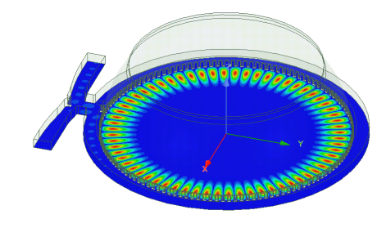
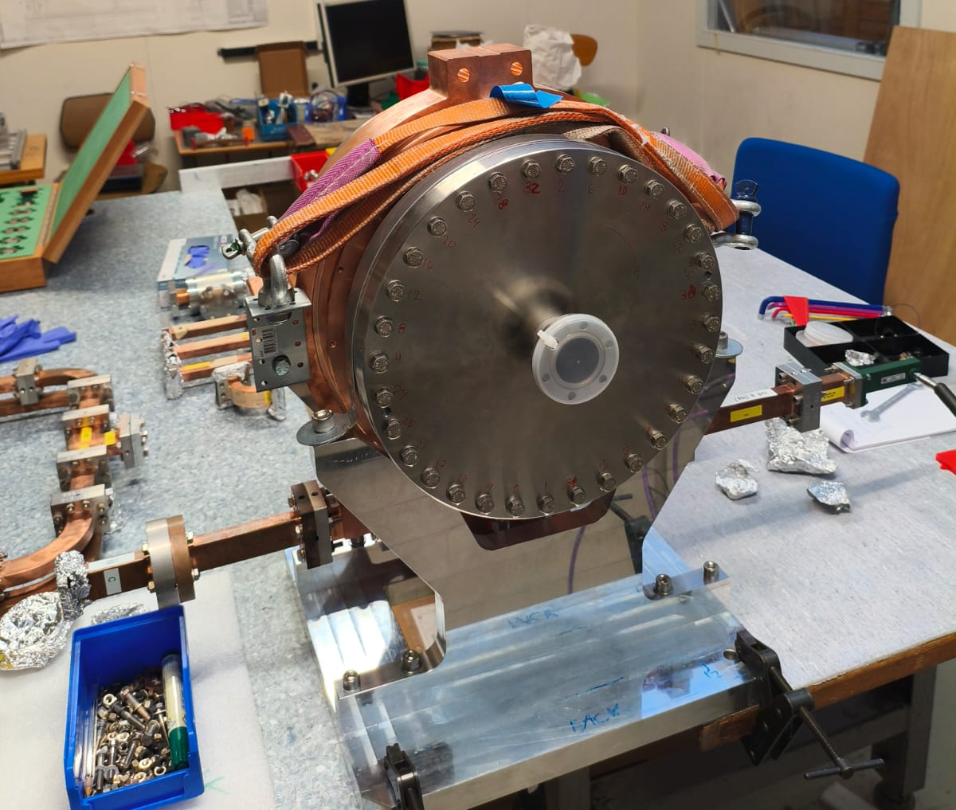
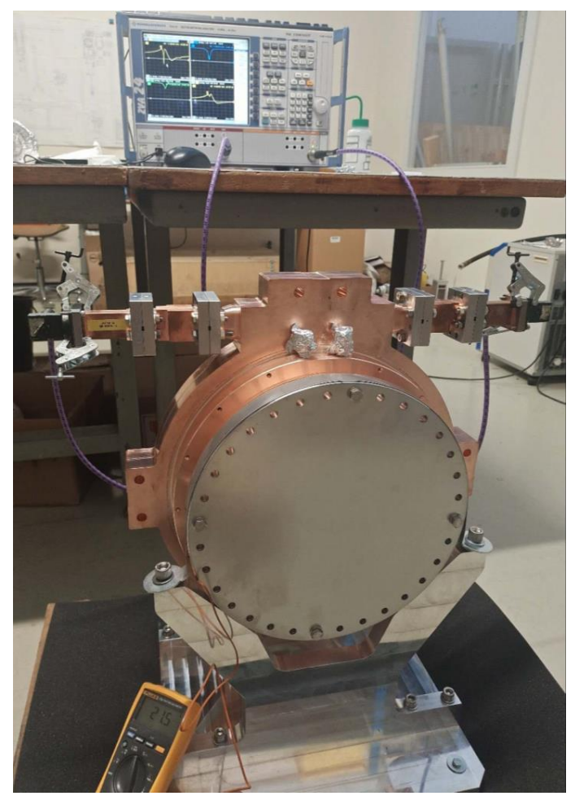
BOC
Our measurement
Ping’s measurement

Slide 3
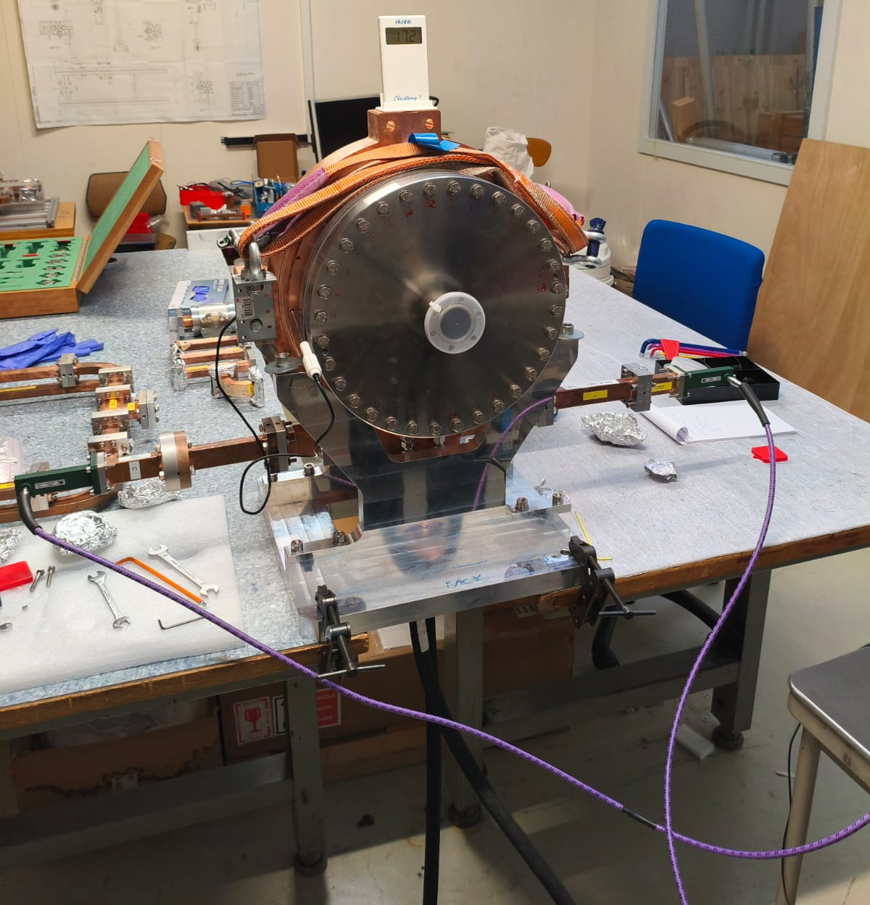
Measurement Setup – VNA settings
S-parameters measurement made with Rohde&Schwarz ZVA24 10MHz..24GHz
VNA settings:
Central freq: 11.994 GHz
Span 10 MHz
Spectral resolution: 500 Hz
No. of points: 20001
IF Bandwidth: 1 kHz

Slide 4
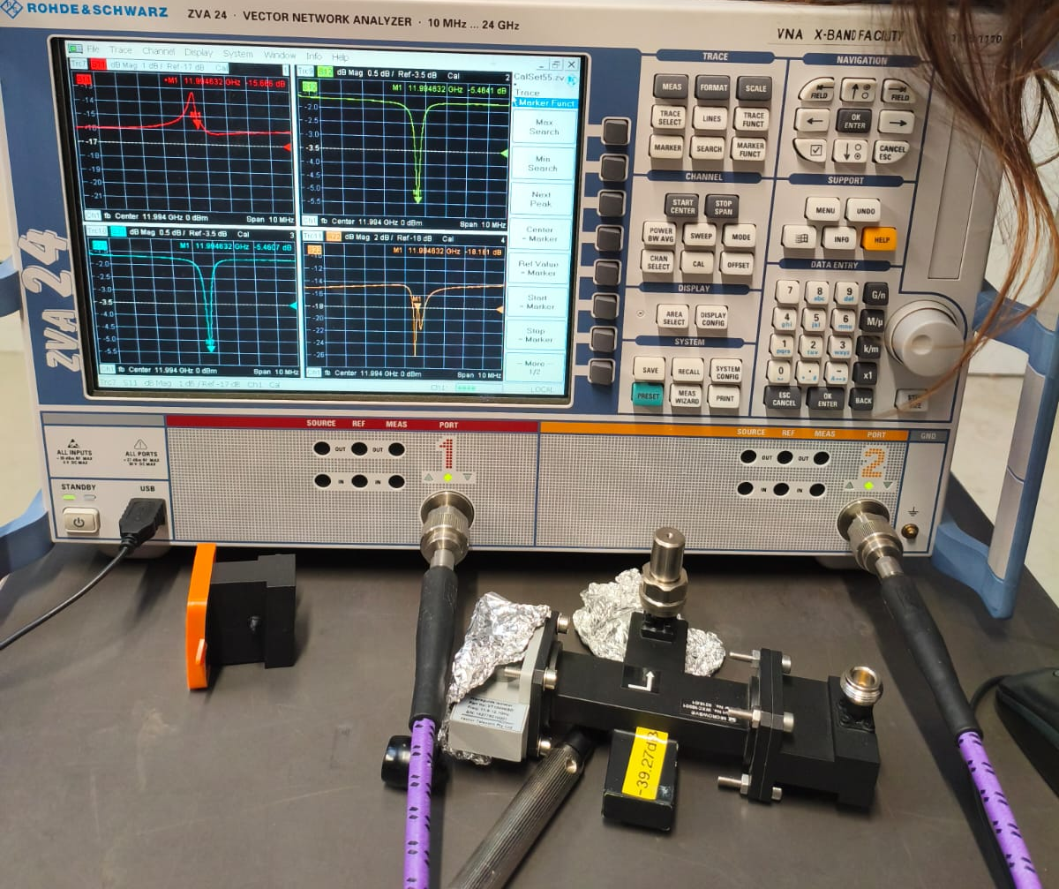
Measurement Setup – VNA calibration
Full 2 ports calibration (TRL)

Slide 5
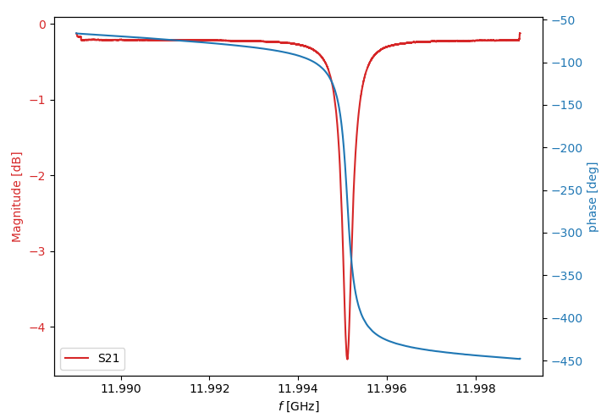
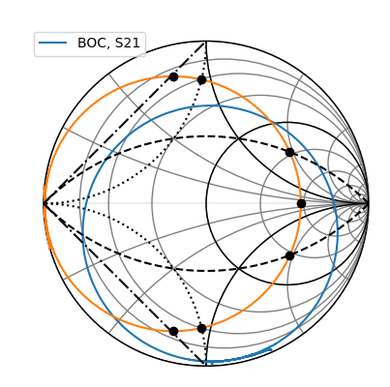
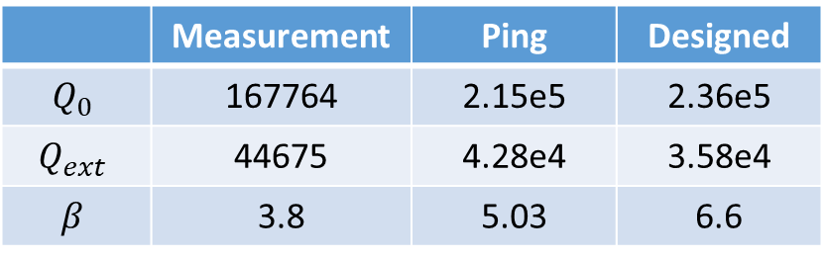
S-matrix
Parameters | Frequency [GHz]
Air & 16.0 °C | 11.9951
Vacuum & 16.0 °C | 11.9986
Vacuum & 38.8 °C | 11.994
 | Measurement | Ping | Designed
$$Q_{0}$$ | 167764 | 2.15e5 | 2.36e5
$$Q_{ext}$$ | 44675 | 4.28e4 | 3.58e4
$$β$$ | 3.8 | 5.03 | 6.6

Slide 6
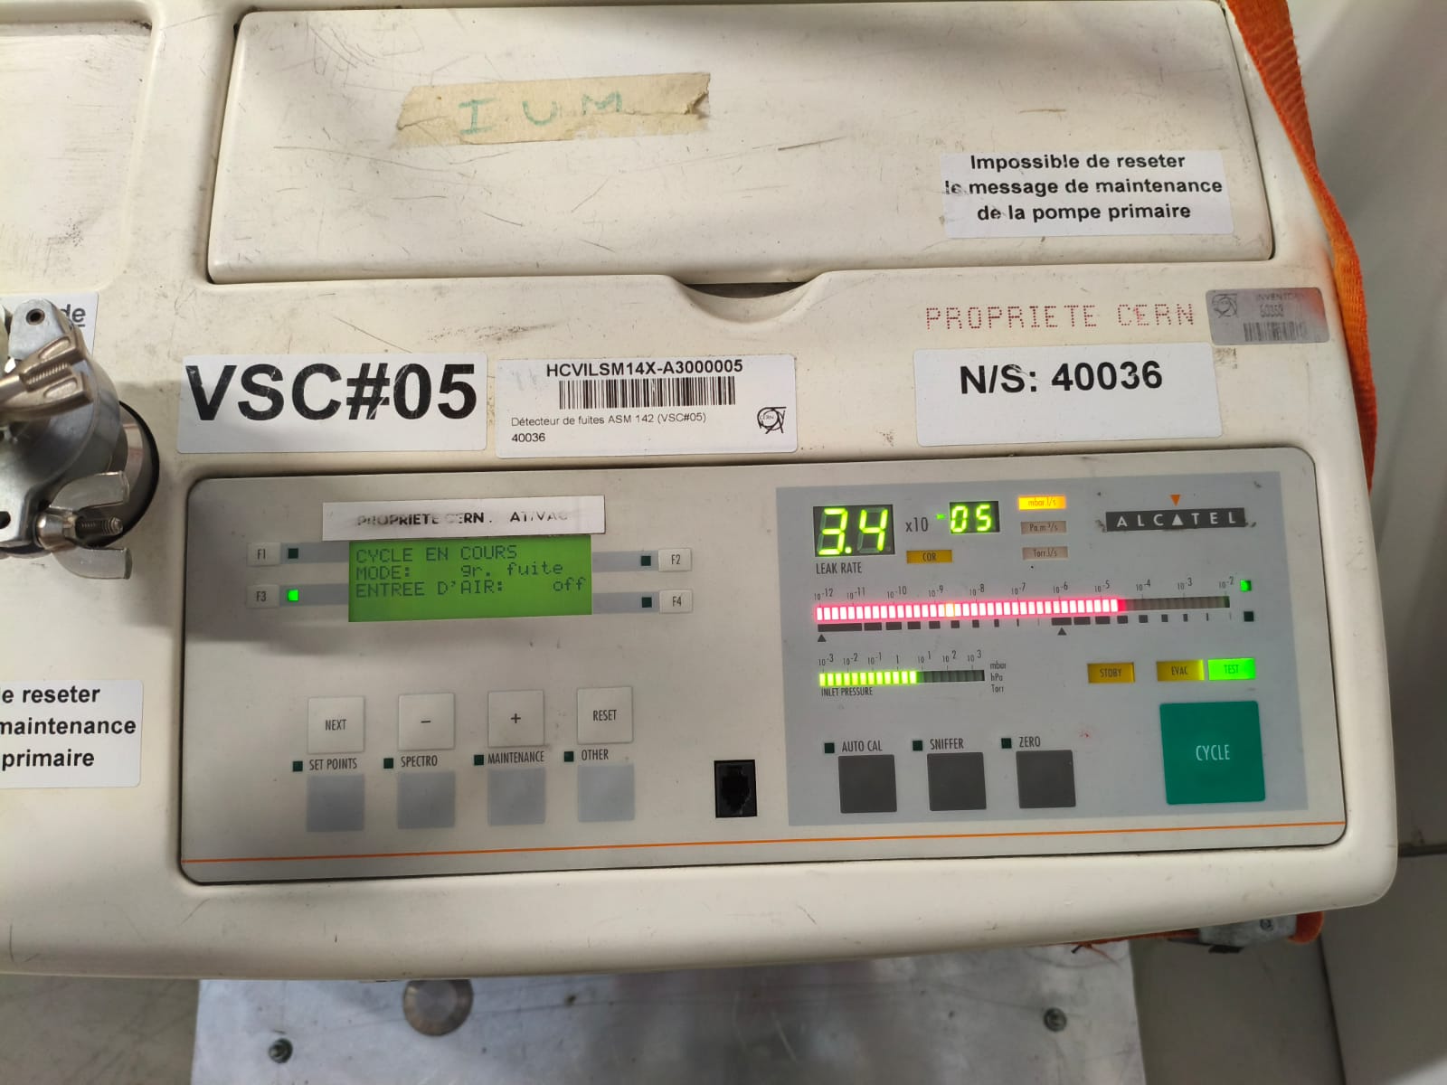
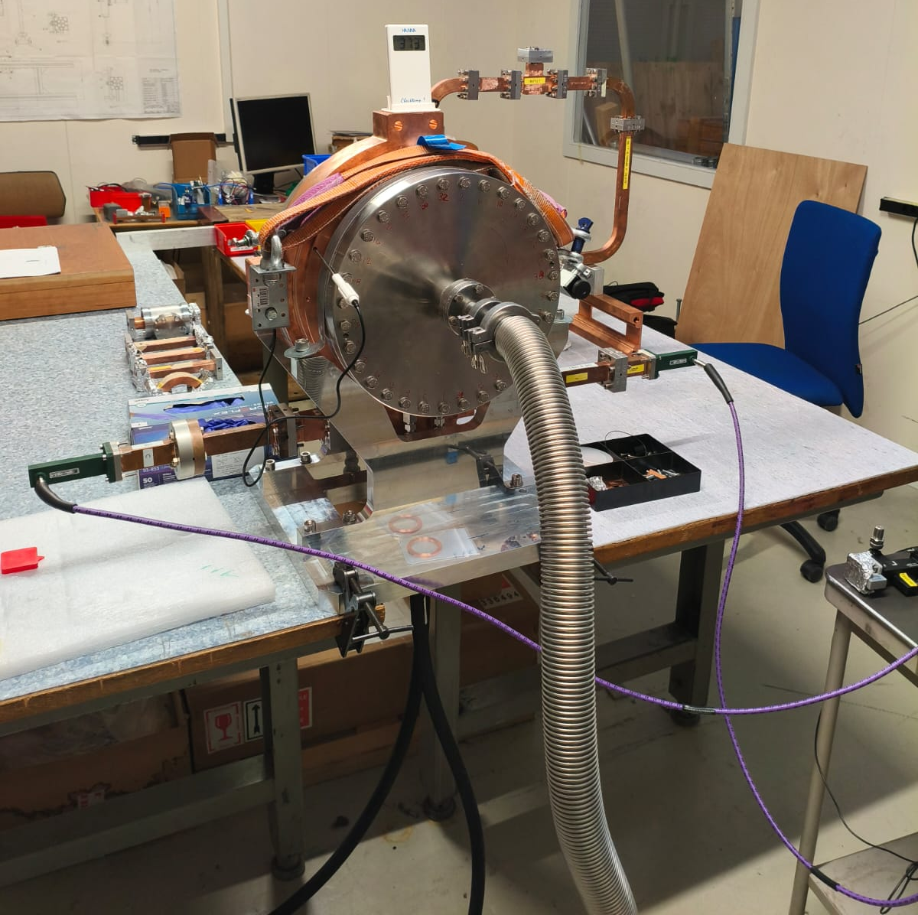
Vacuum and temperature regulation

Slide 7
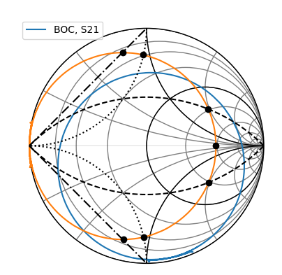
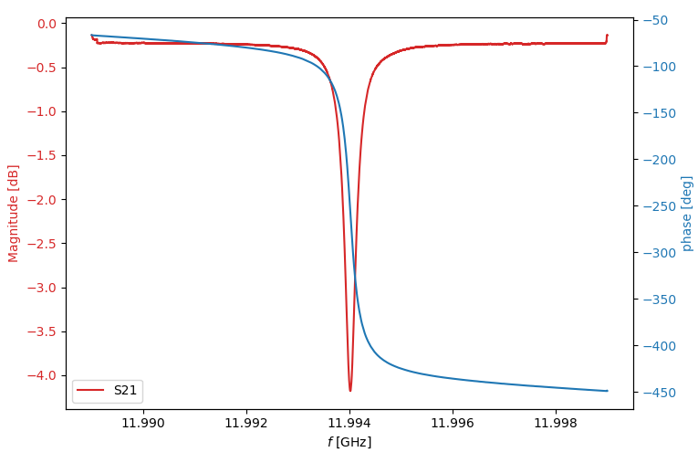

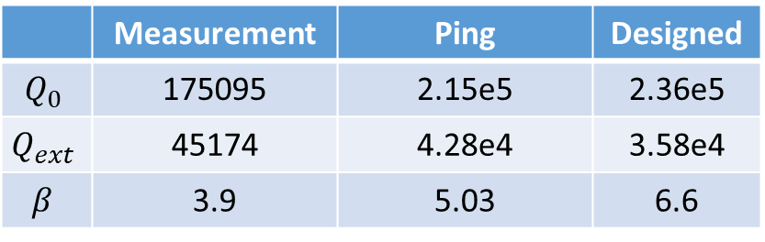

$ε_{r}=1.00058986$ (internet)
S-matrix
$ε_{r}=1.00053884$ (calculated)
Parameters | Frequency [GHz]
Air & 16.0 °C | 11.9951
Vacuum & 16.0 °C (theory) | 11.9986
Vacuum & 38.8 °C (theory) | 11.994
Vacuum & 37.3 °C | 11.994016
 | Measurement | Ping | Designed
$$Q_{0}$$ | 175095 | 2.15e5 | 2.36e5
$$Q_{ext}$$ | 45174 | 4.28e4 | 3.58e4
$$β$$ | 3.9 | 5.03 | 6.6

