Slide 1


TD26 R11 CC Ciemat
RF measurements
17.02.2025
ALONSO ARIAS, Paz; GONZALEZ ANTON, Sergio; MARTINEZ REVIRIEGO, Pablo

Slide 2
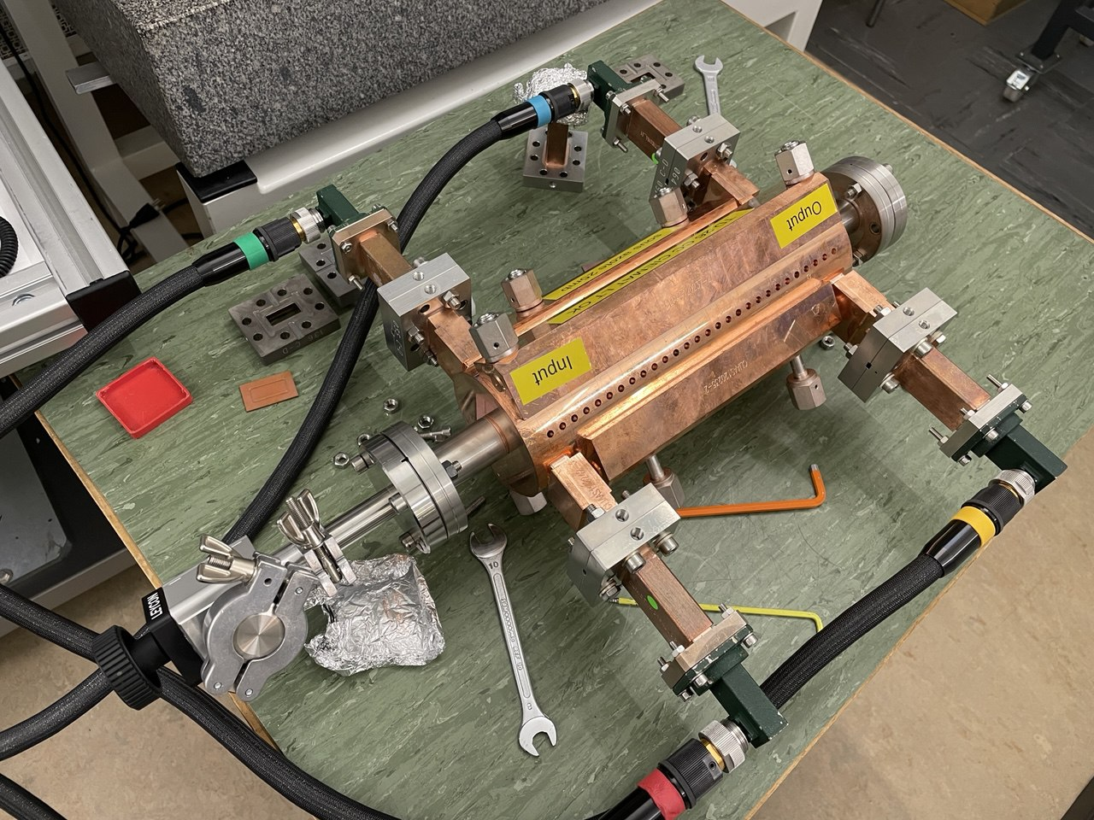
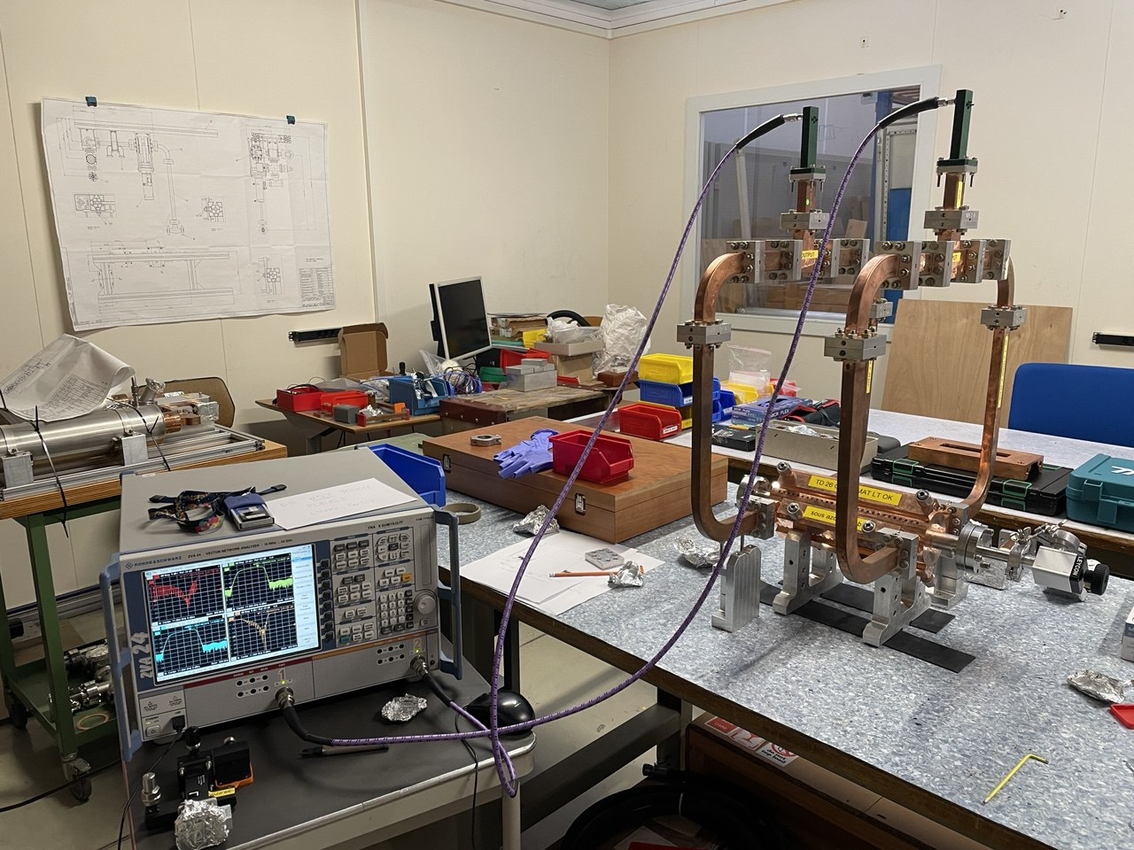
TD26 R11 CC Ciemat
S-matrix measurements of TD26 with 4-port VNA
Mounting of manifolds (*)
S-matrix measurements with 2-port VNA
(*) Measured by M. Boronat; cleaning of waveguides: TBD

Slide 3
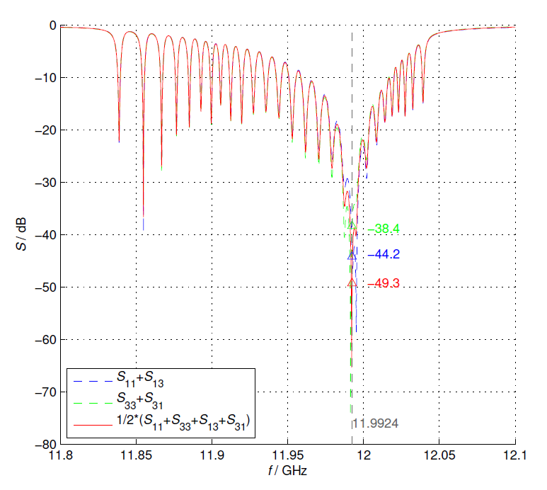
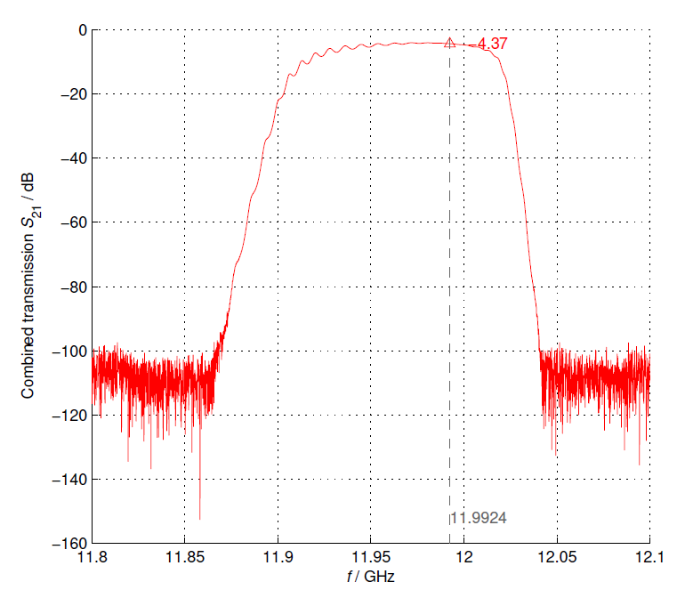
TD26 R11 CC Ciemat
Meas. reported by Rolf, Hikmet after tuning [25 Oct, 2021]
Structure in N2
Temperature 20.4⁰C

Slide 4
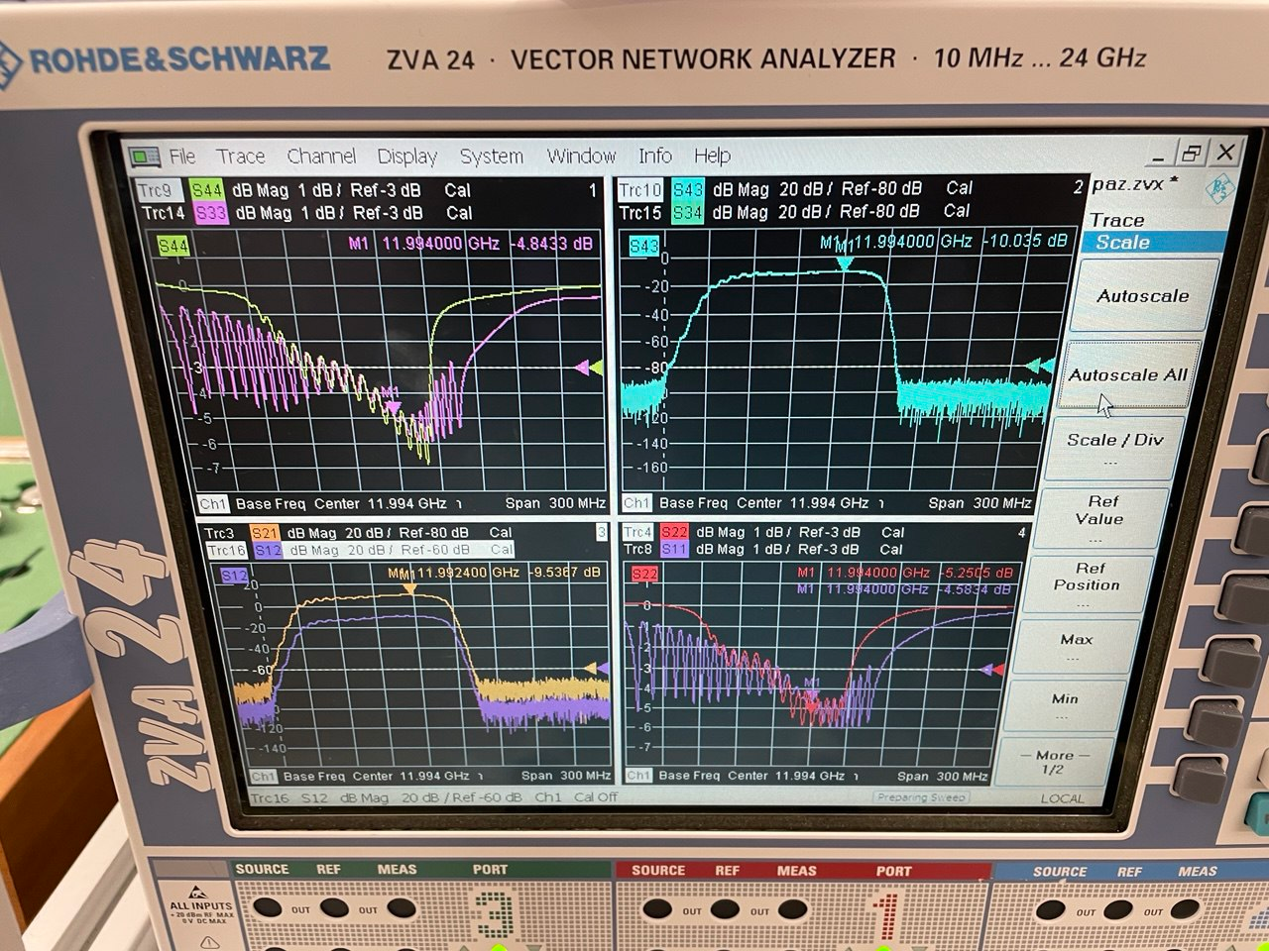
Measurement Setup – VNA calibration
For both VNAs:
Central freq: 11.994 GHz
Span 300 MHz
No. of points: 20001
IF Bandwidth: 1 kHz
Full 4-ports/2-ports calibration
Configuration of 2xbalanced ports (logical ports) in ZVA24

Slide 5
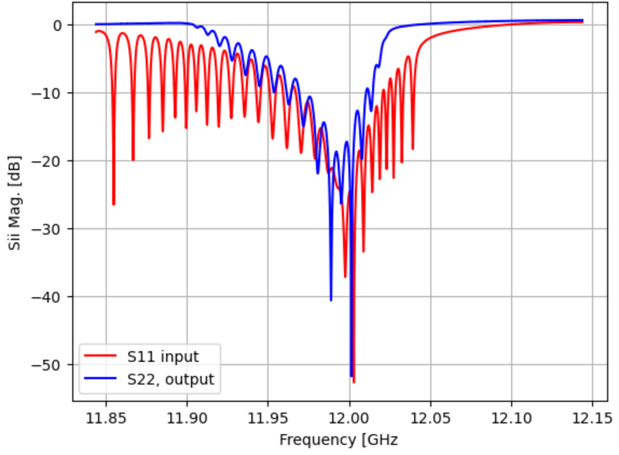
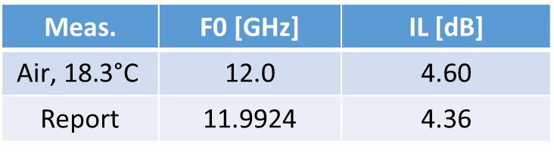
S-matrix TD26
Meas. | F0 [GHz] | IL [dB]
$$\text{Air}\text{,}\text{ 18.3}\text{°}\text{C}$$ | 12.0 | 4.60
Report | 11.9924 | 4.36

Slide 6
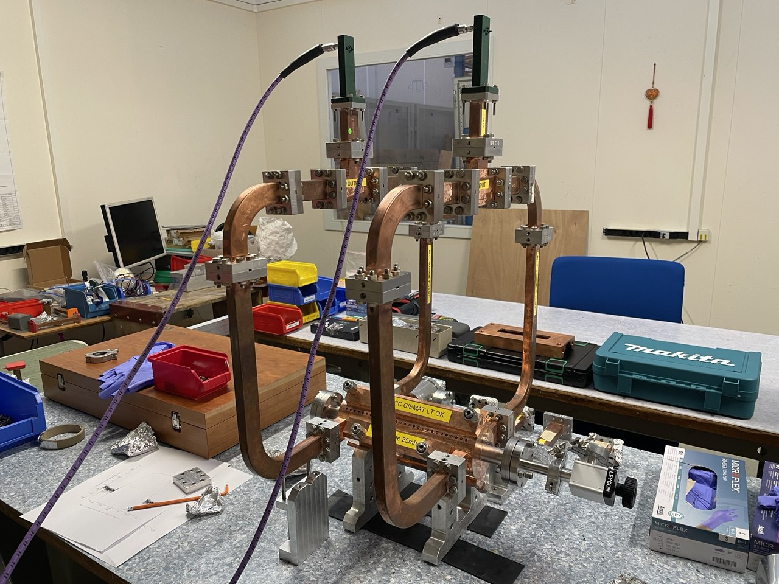
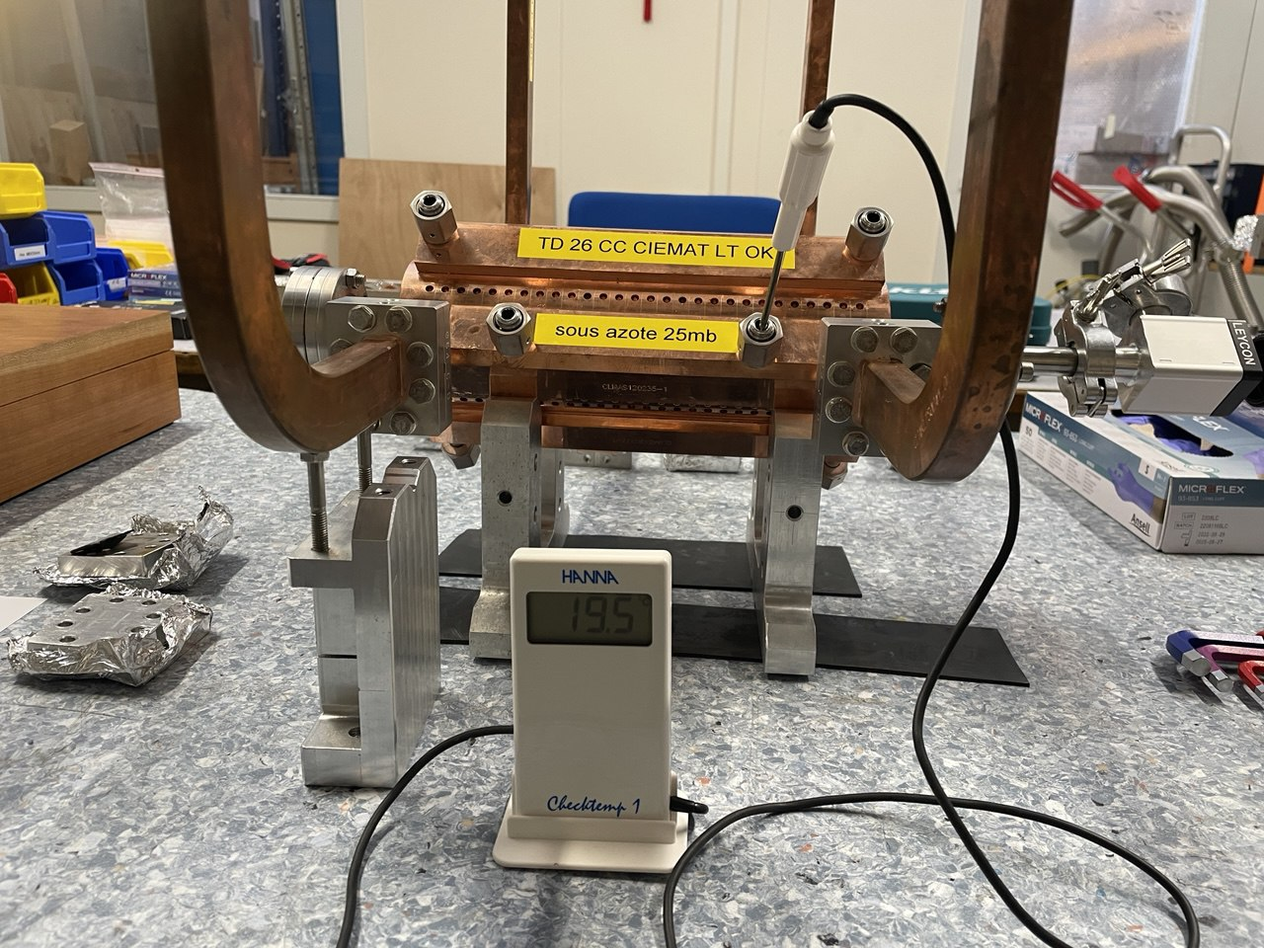
S-matrix TD26+manifolds
Temperature 19.5 ⁰C

Slide 7
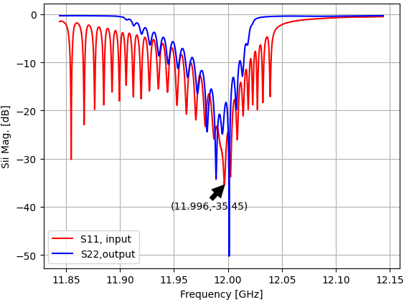
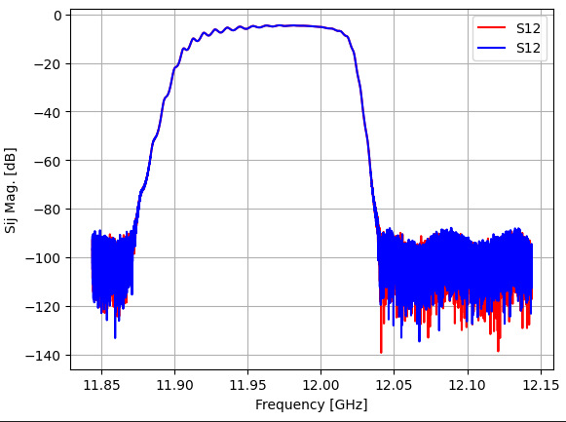
S-matrix TD26+manifolds
Air/vacuum correction f≈11.9933 GHz
Insertion Loss@f0 = -5.03 dB

Slide 8
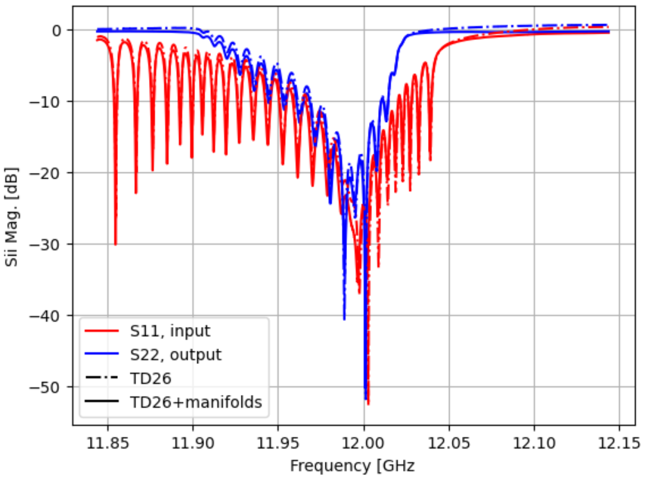
S-matrix TD26+manifolds

