Slide 1
X-Boxes Update
19.03.2025

Slide 2
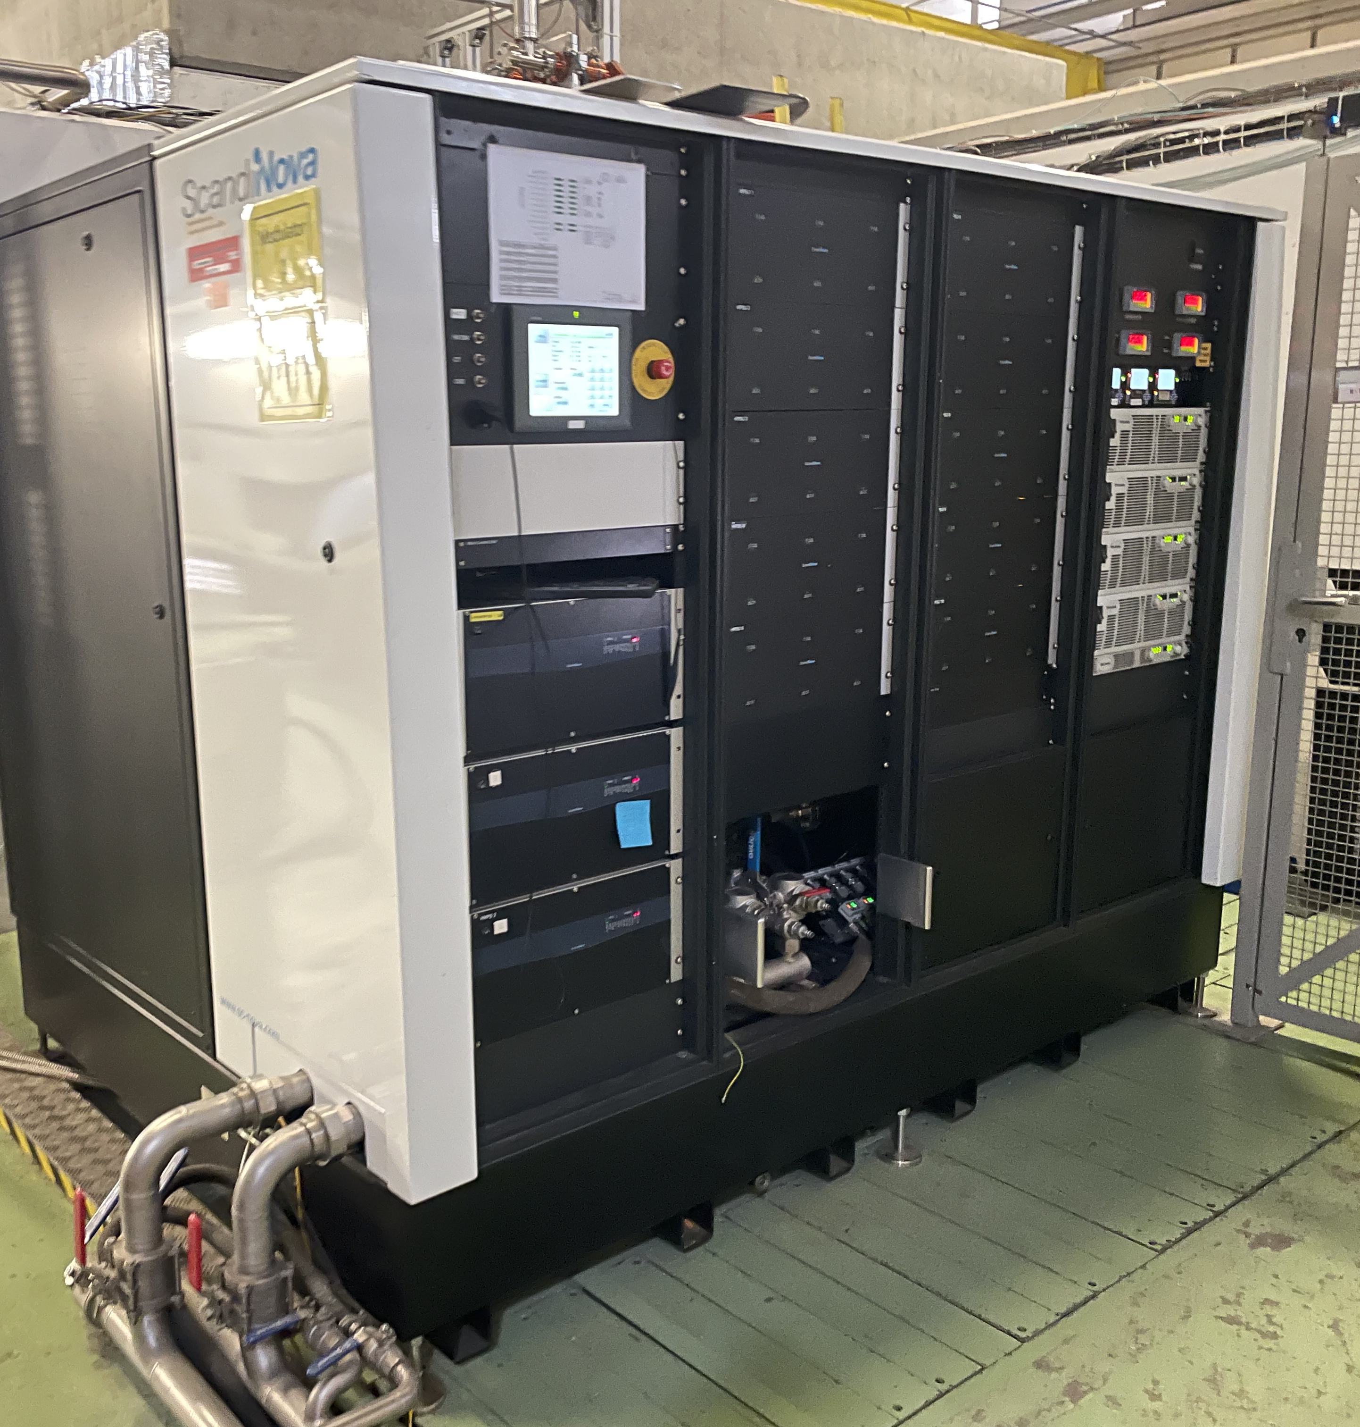
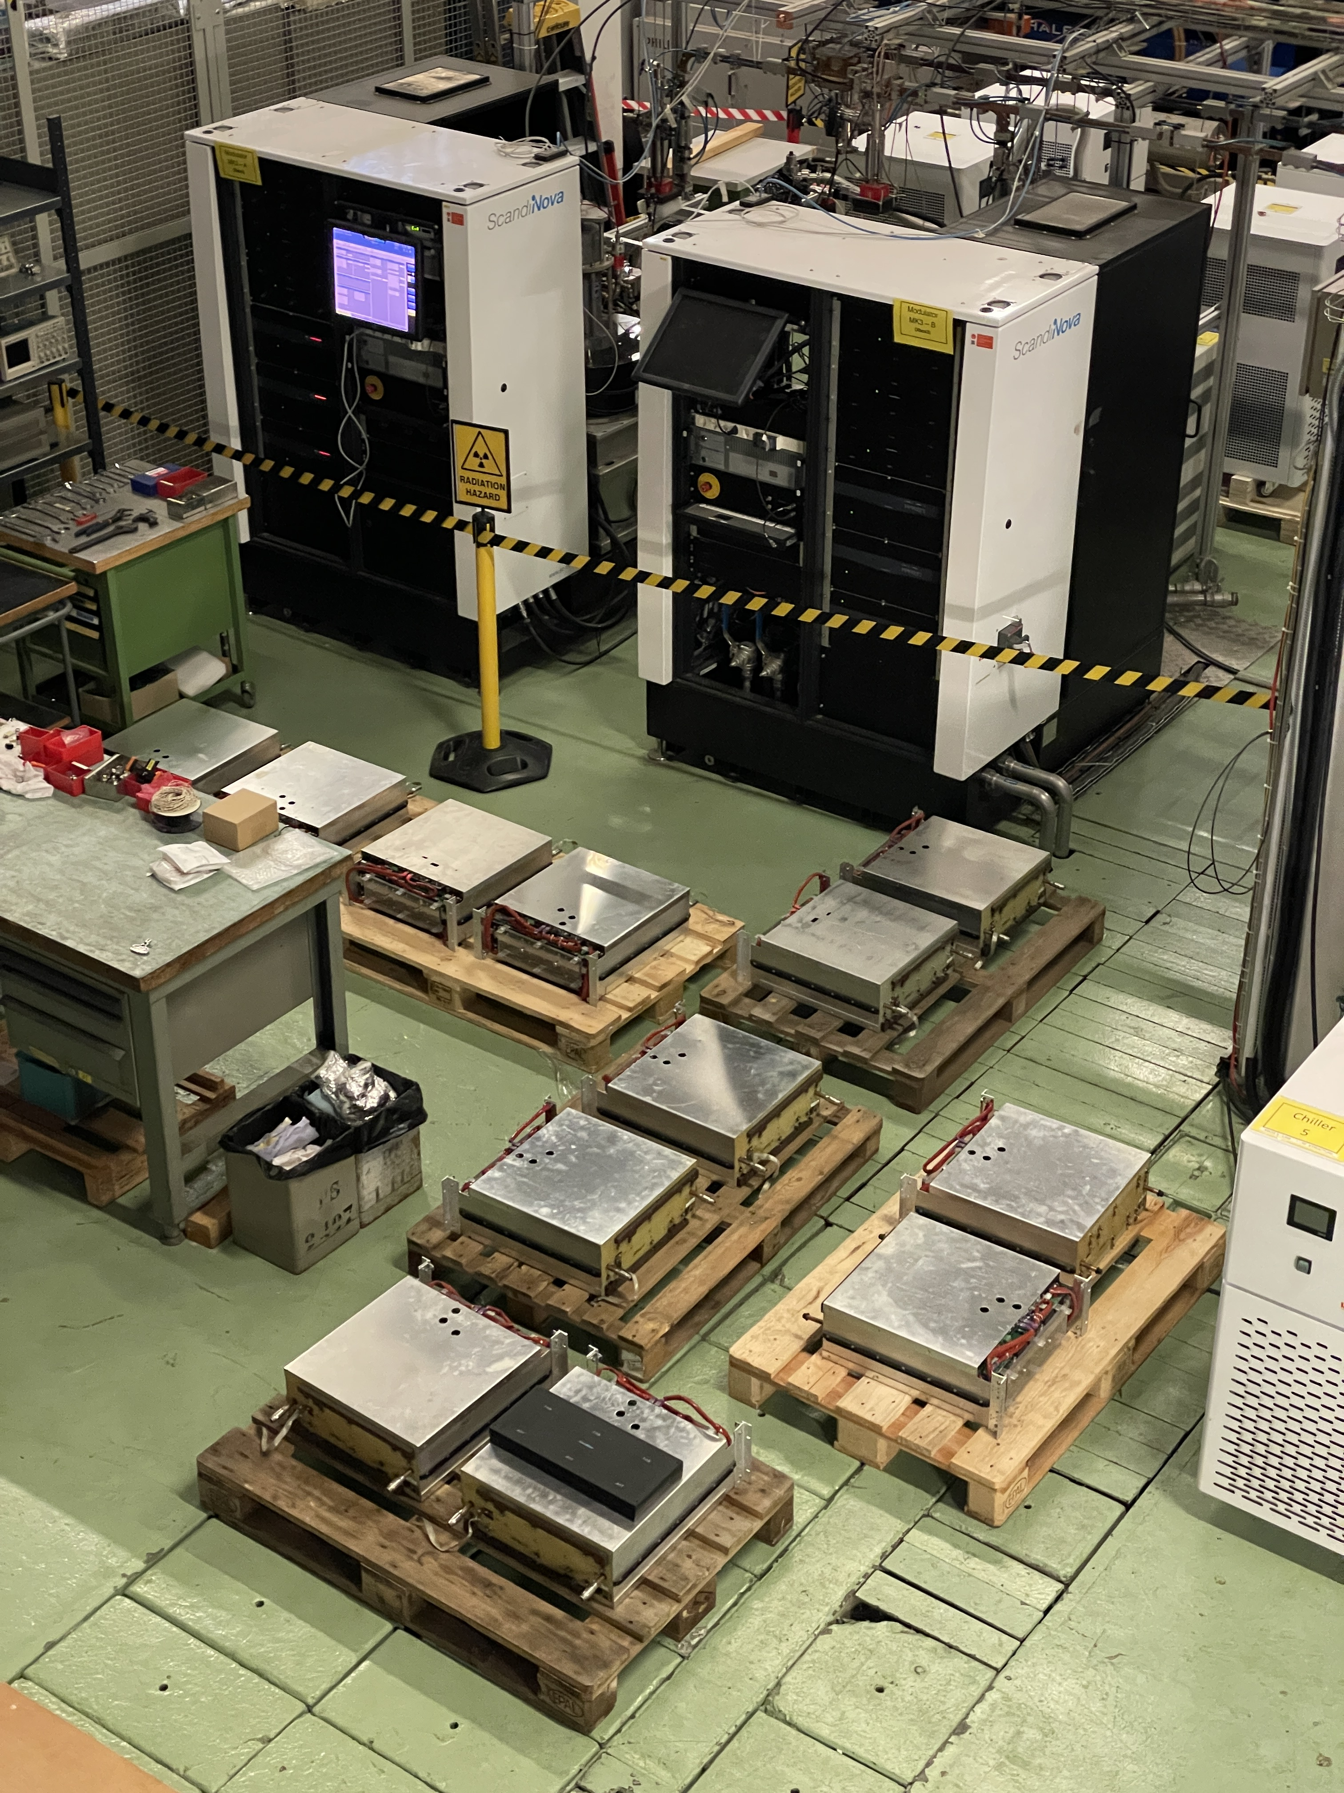
Currently in XBox2: updgrading of modulator
Dismounted SUs 1-10 from modulator + 2 spares
In Scandinova
Refurbishment of Scandinova modulator to improve operation at higher voltages
Integration of Barrel Open Cavity pulse compressor for high power testing
Integration and high power testing of Smartcell

Slide 3
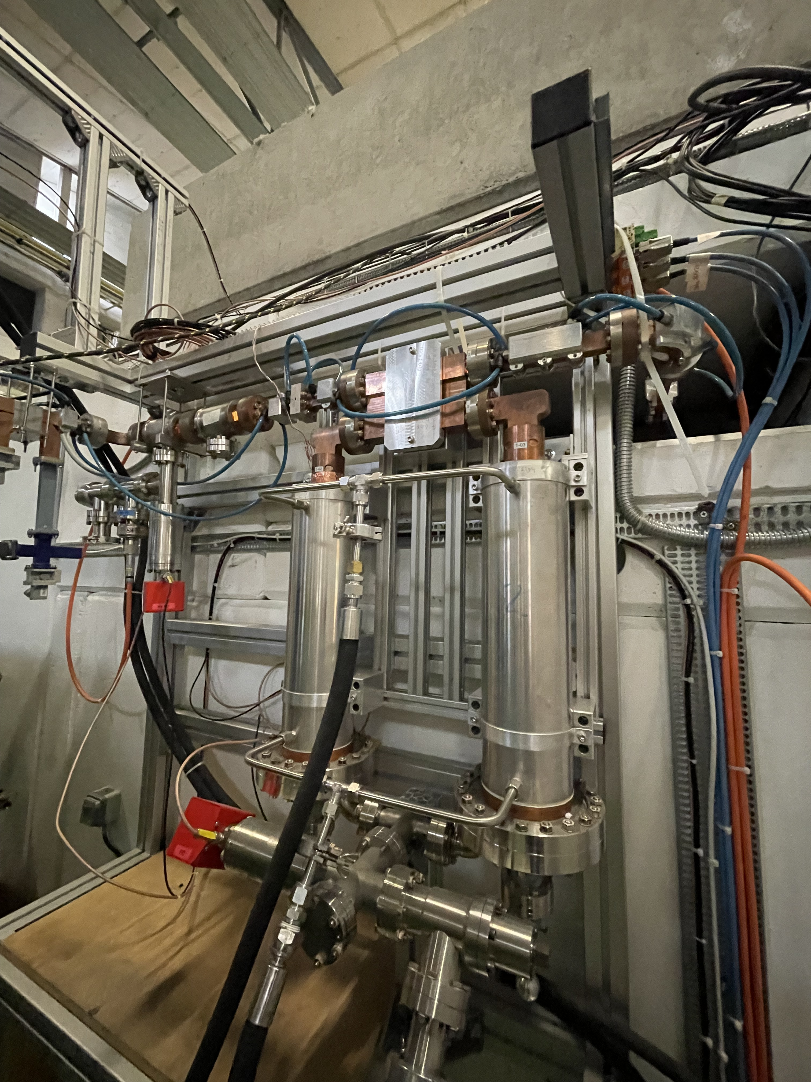
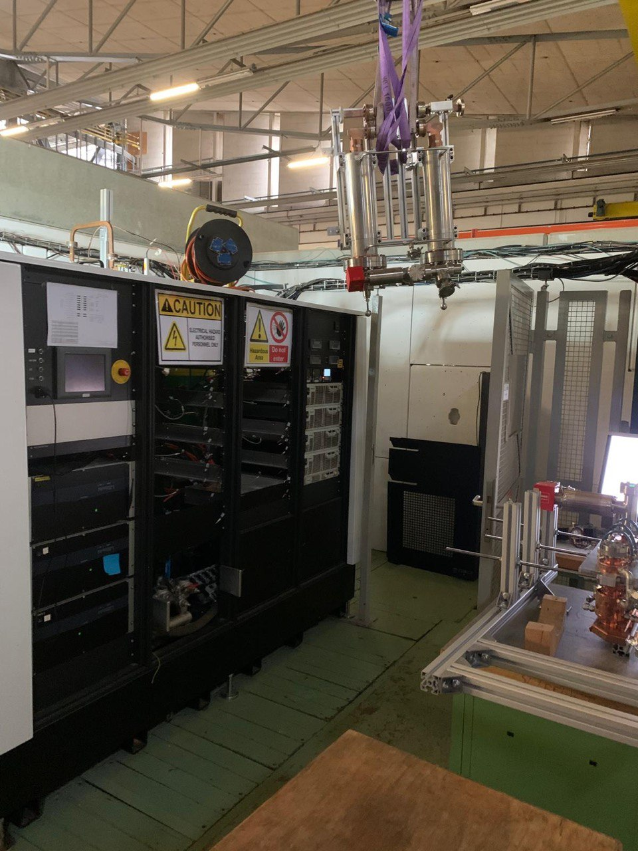
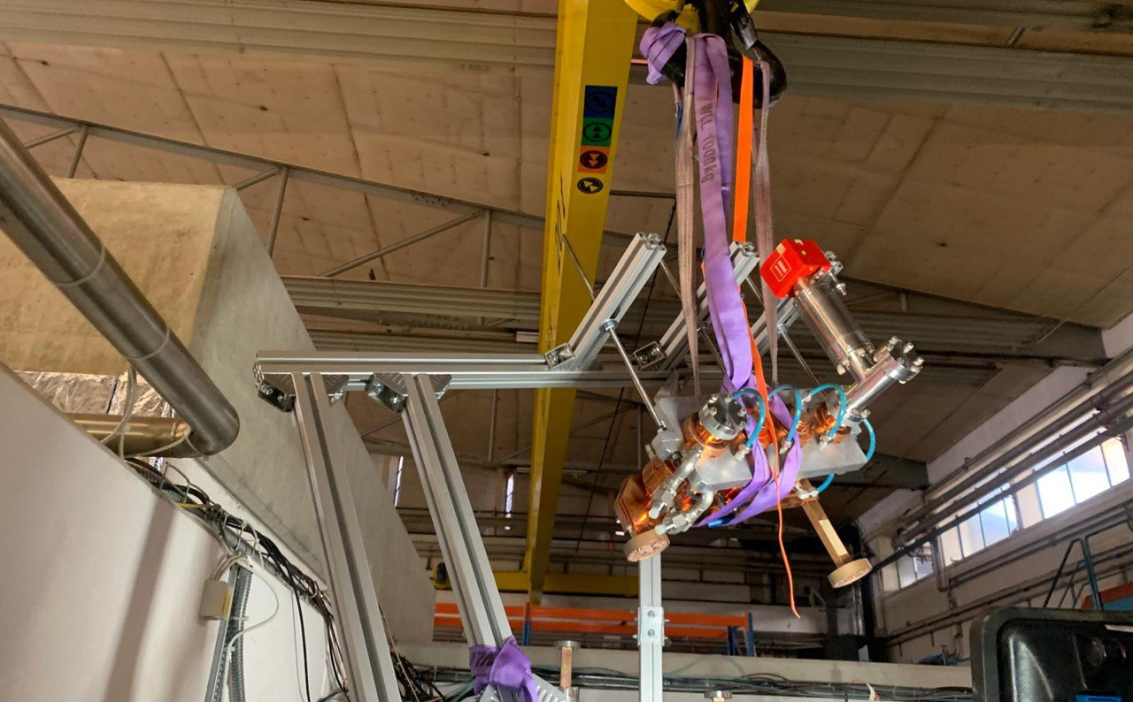
Currently in XBox2: installation of BOC
Deinstallation of current pulse compressor system
SLED
2 correction cavities chains
Integration of Barrel Open Cavity pulse compressor for high power testing
Integration and high power testing of Smartcell

Slide 4
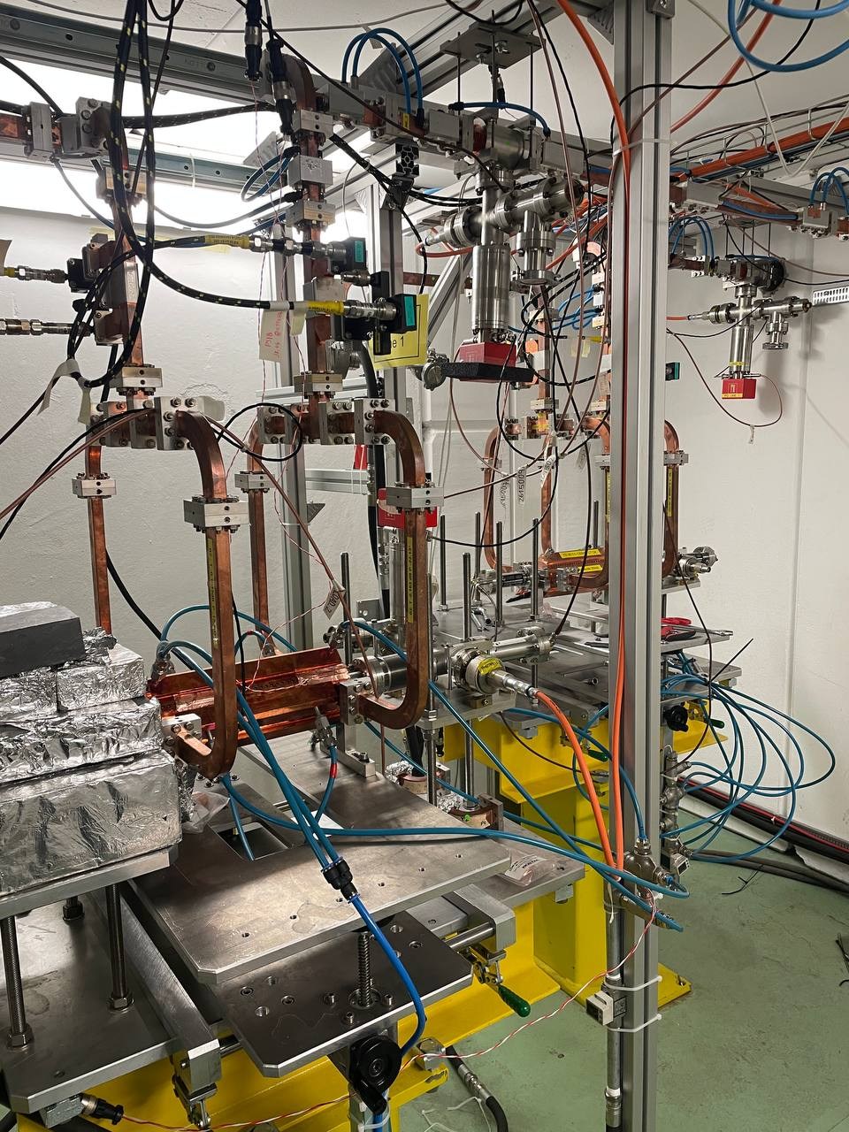
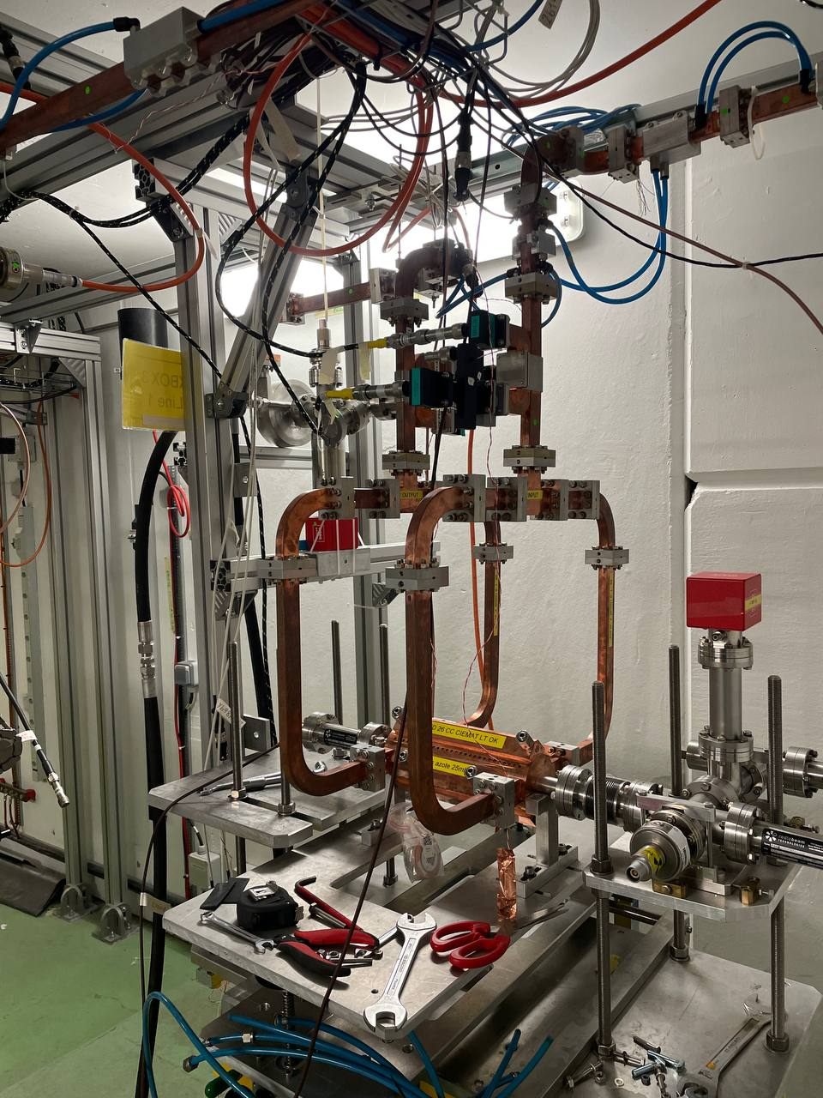
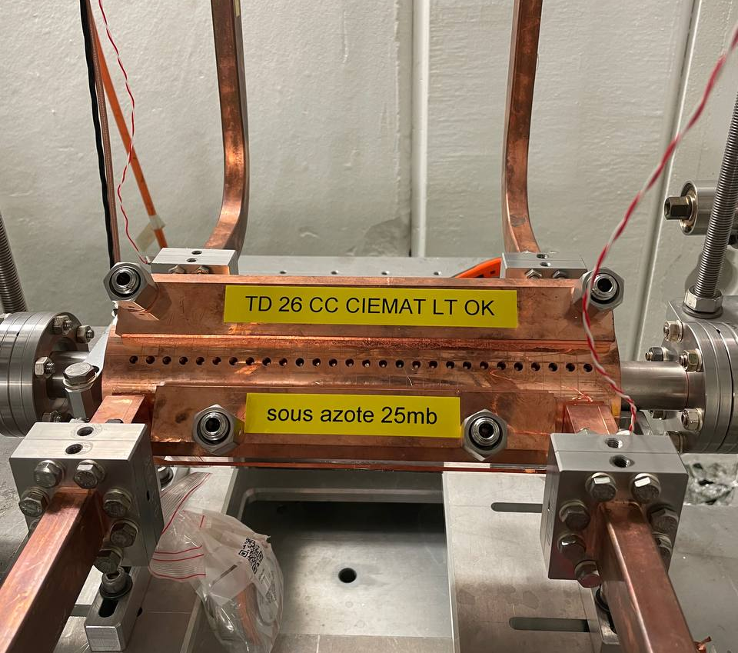
Currently in XBox3: installation of TD26 Ciemat
Installation in Xbox3, line 2
Connected to spiral load
Integration of Barrel Open Cavity pulse compressor for high power testing

Slide 5
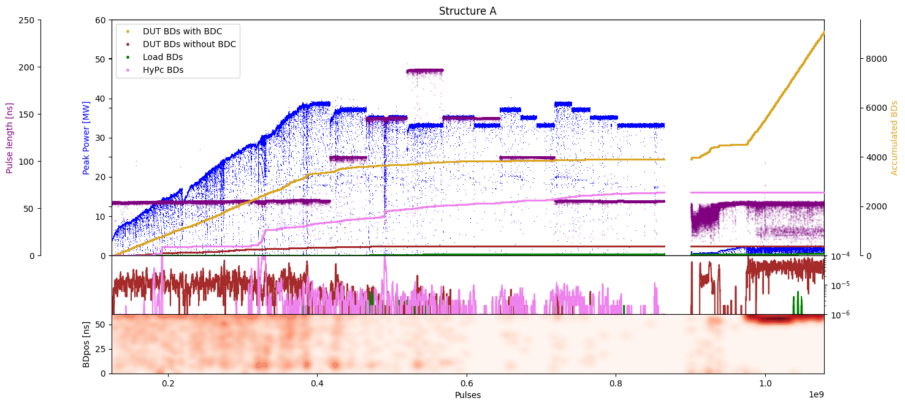
Prototype TD31N1
TD31N1 conditioning history
Achieved Peak Power 36.1MW
Broken and uninstalled!

Slide 6
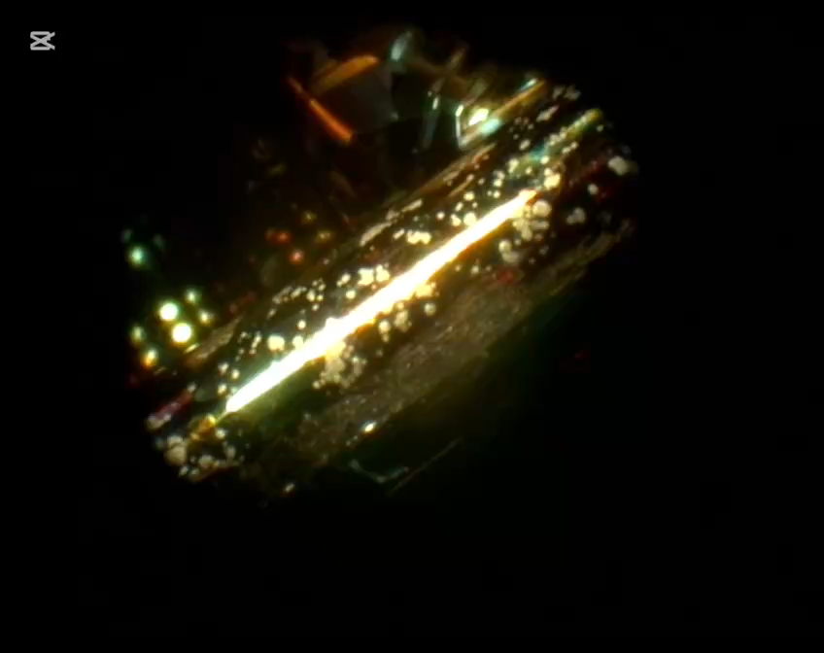
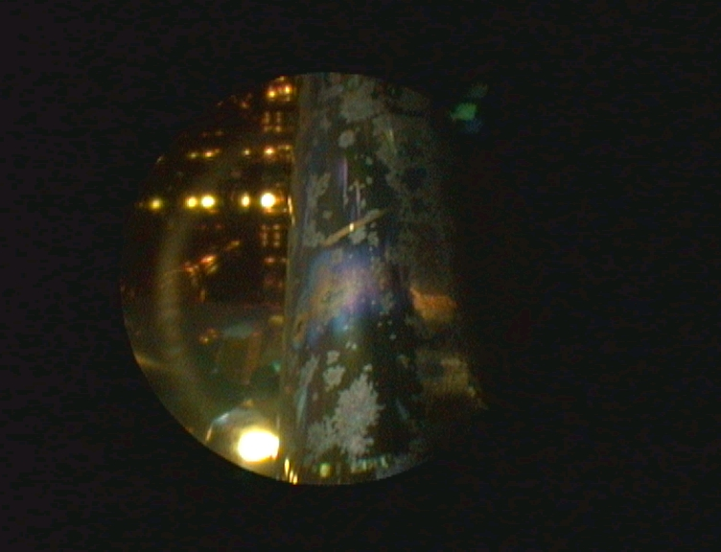
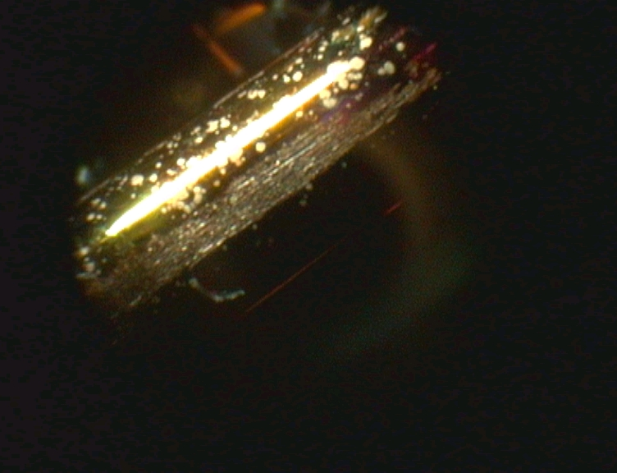
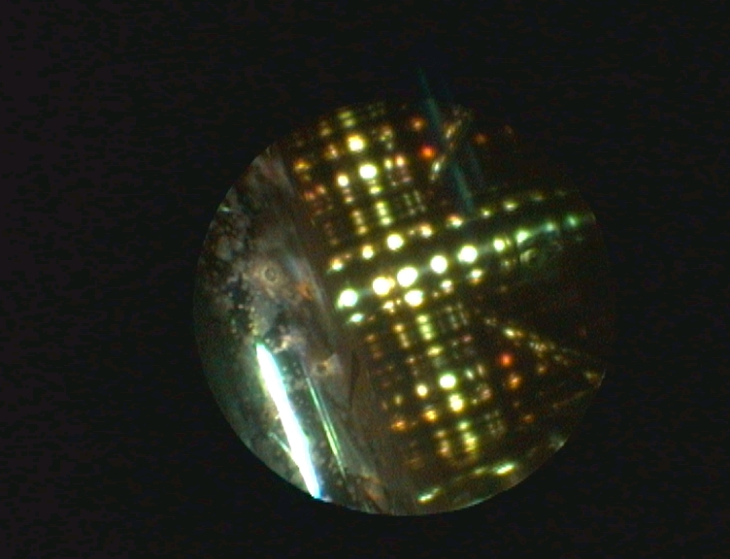
Prototype TD31N1
TD31N1 postmortem
Huge concentration of breakdowns in last cell (iris and disk joints)
Craters (isolated and clusters) + oxidation signs

Slide 7
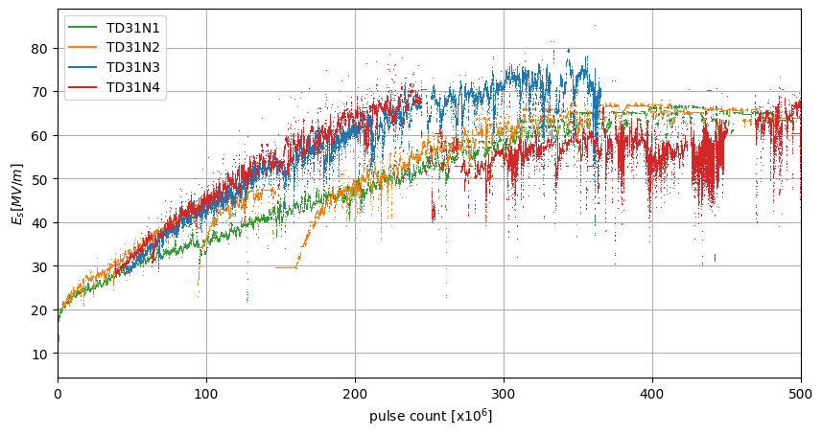
TD31s
Normalised gradient

Slide 8
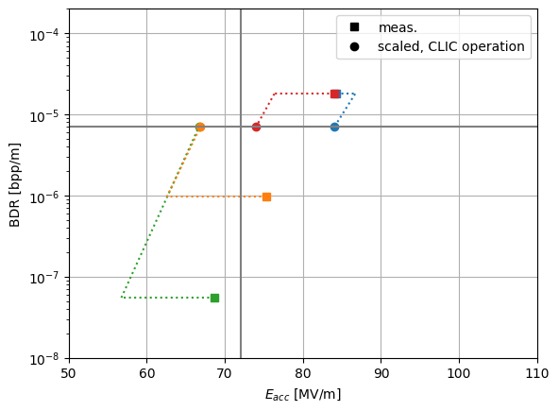
TD31s
Performance
“the conservative estimate is used in the current CLIC design which assumes that kicks due to breakdown will result in a full loss of luminosity of the pulse in which the breakdown occurs. CLIC parameters budget a 1% luminosity loss due to this effect.
Since the active length of acceleration is 3×10⁴ m the breakdown rate must be limited to
0.01 events/pulse x 3×10⁴ m = 3×10⁻⁷ events/pulse”
72 MV/m
TD31N3
TD31N4
BDR 7x10⁻⁶
TD31N2
TD31N1
But CLIC now will be 15 km!

Slide 10
X-Box 2: Reminder on BD classification
BD_Flag_PER_log
BD Load
TRUE
BD_Flag_DC_DOWN
DC Up >=140
DC Down>=100
BD DUT w. BDC
BD_Flag_DC_UP
FALSE
BD_Flag_PSR_log
BD DUT wo. BDC
BD_Flag_PKR_log
BD HyPC
No BD

