Slide 1
X-Boxes Update
16.04.2025

Slide 2
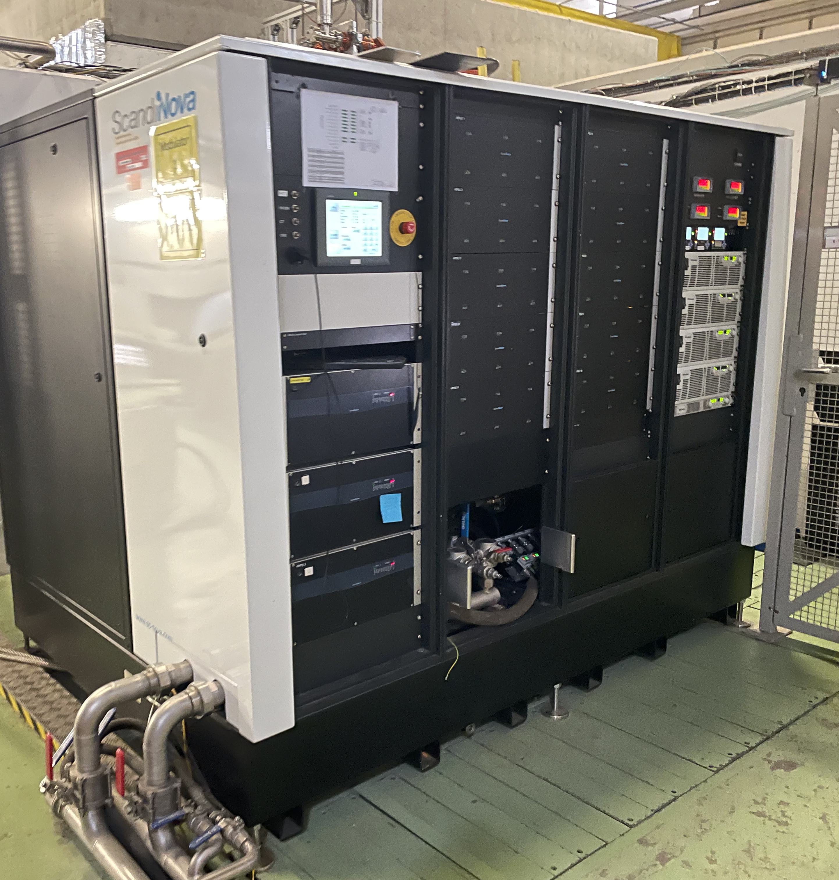
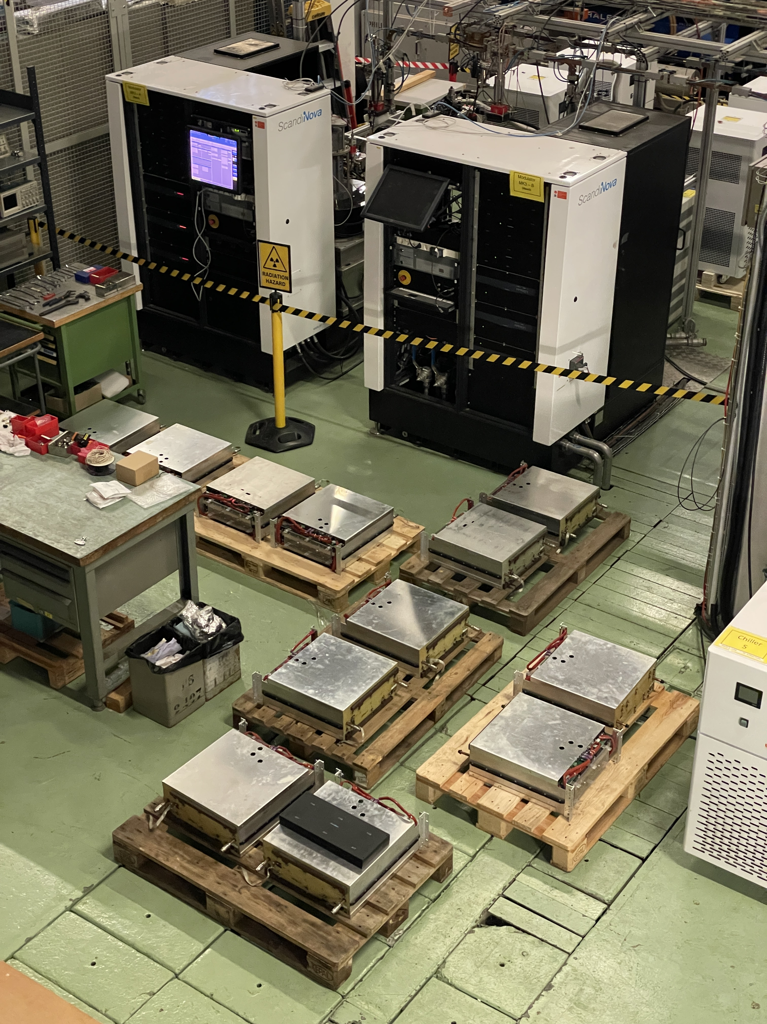
XBox2: updgrading of modulator
Visit from Scandinova to commission modulator last week
Not possible to pulse due to high vacuum of klystron
Maintenance of Xbox3 modulators done as well
Refurbishment of Scandinova modulator to improve operation at higher voltages
Integration of Barrel Open Cavity pulse compressor for high power testing
Integration and high power testing of Smartcell

Slide 3
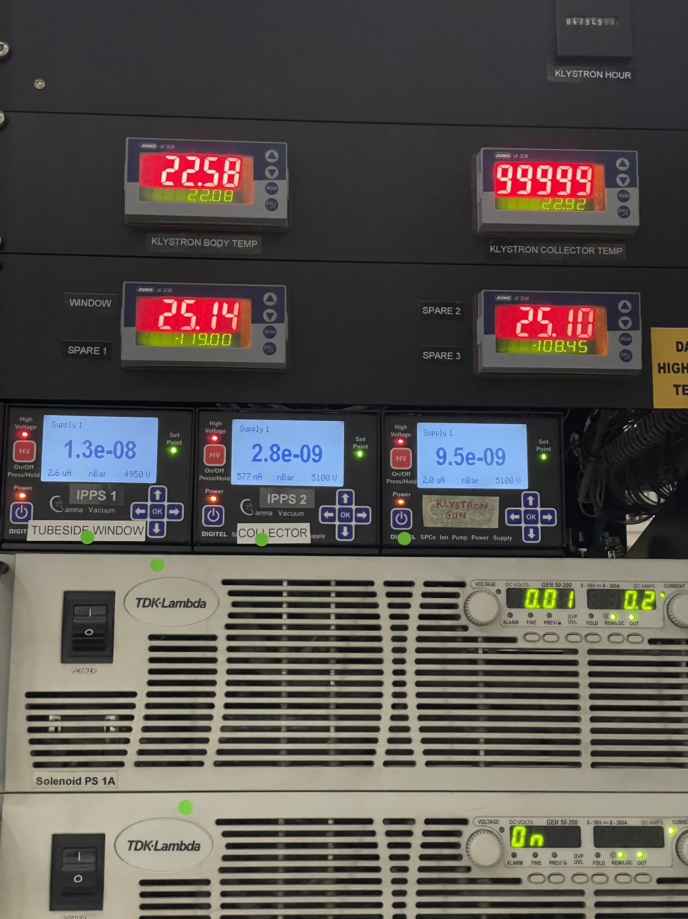
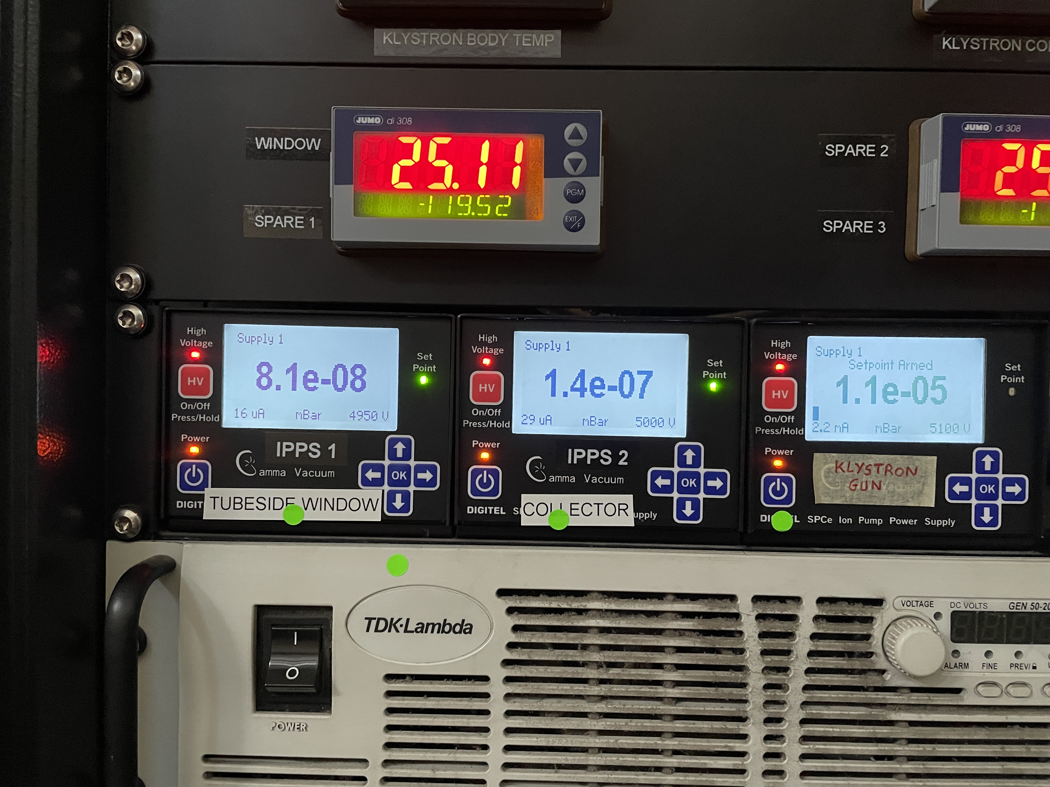
XBox2: CPI klystron vacuum
Last week
This week
Refurbishment of Scandinova modulator to improve operation at higher voltages
Integration of Barrel Open Cavity pulse compressor for high power testing
Integration and high power testing of Smartcell

Slide 4
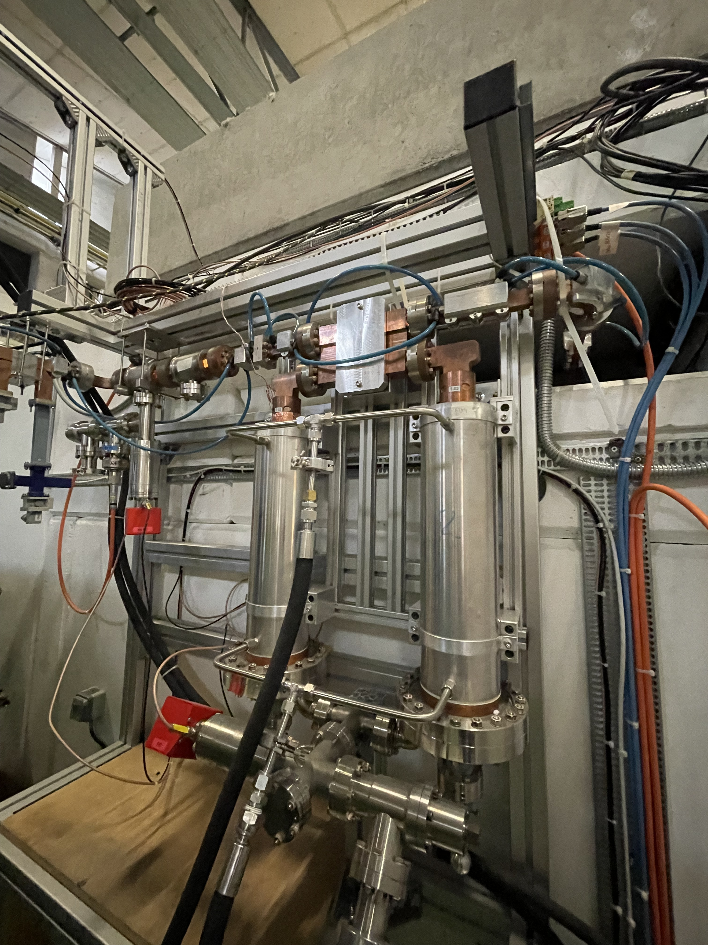
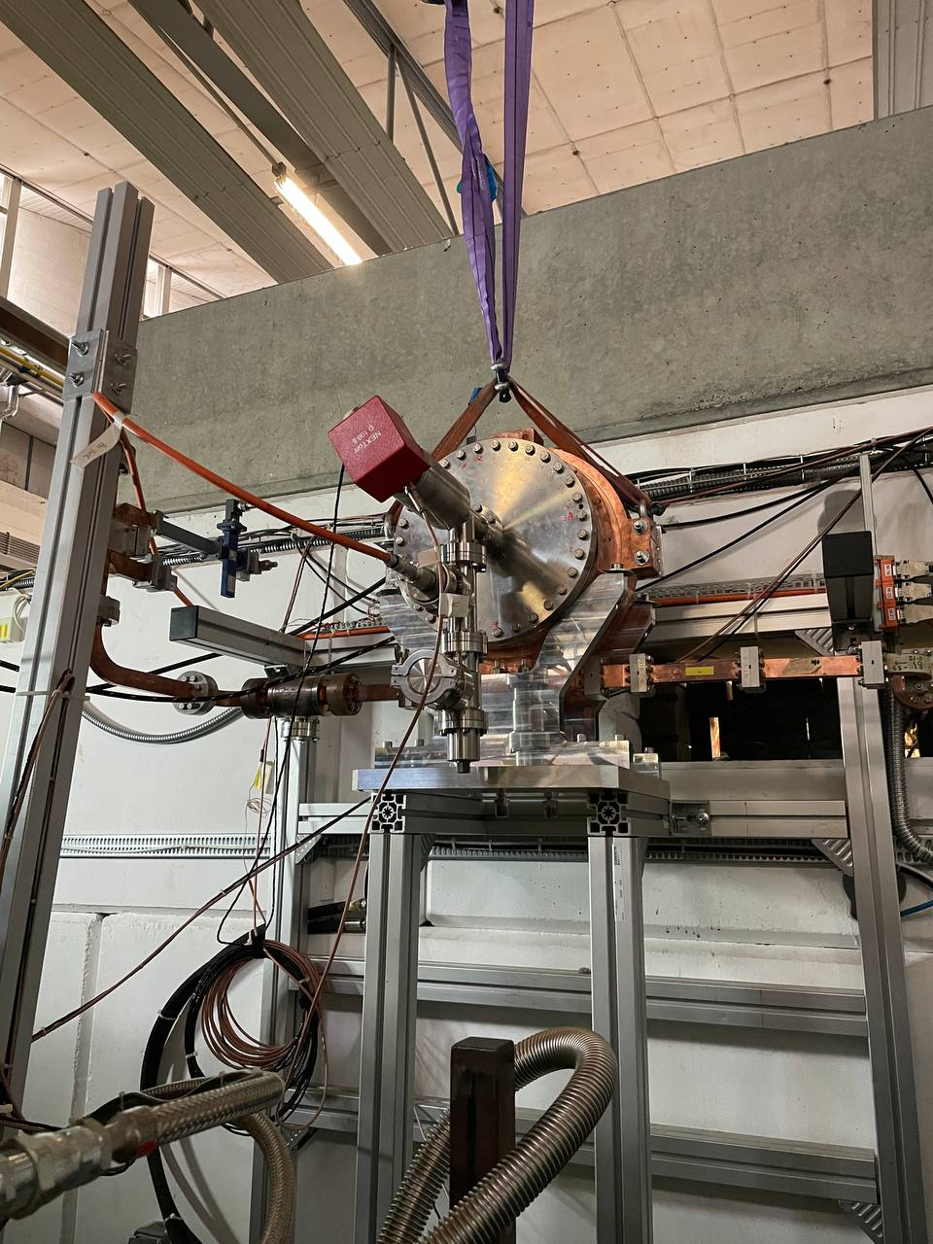
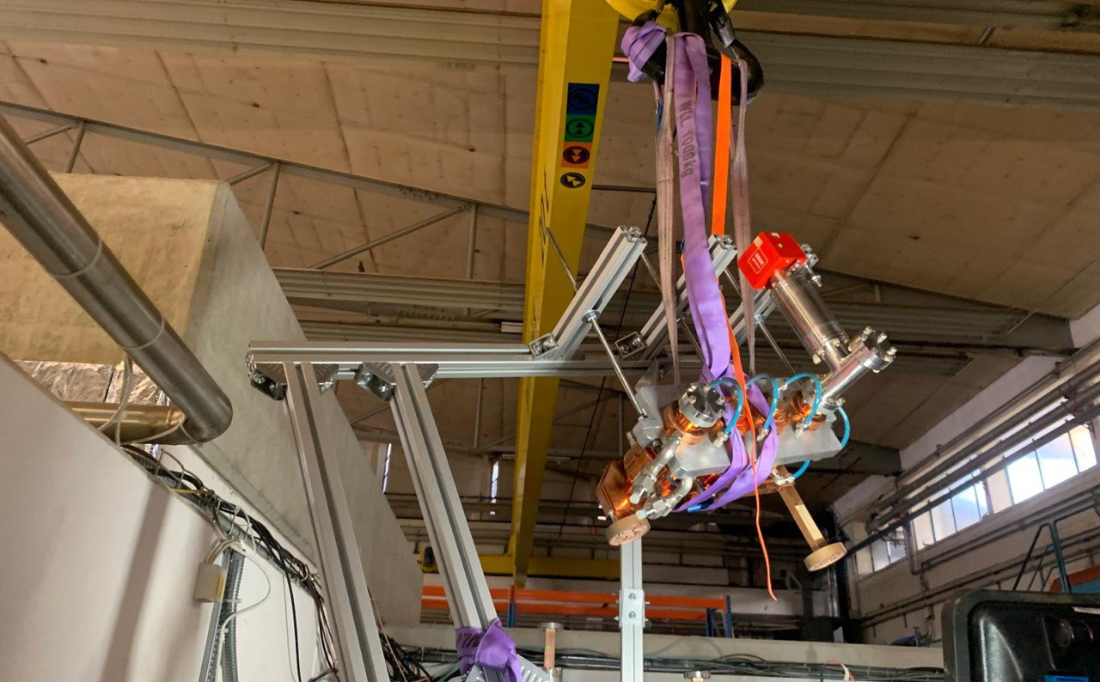
XBox2: installation of BOC
Deinstallation of current pulse compressor system
SLED
2 correction cavities chains
Installation of BOC
Vacuum at 1E-5mbar -> need a leak test
Integration of Barrel Open Cavity pulse compressor for high power testing
Integration and high power testing of Smartcell

Slide 5
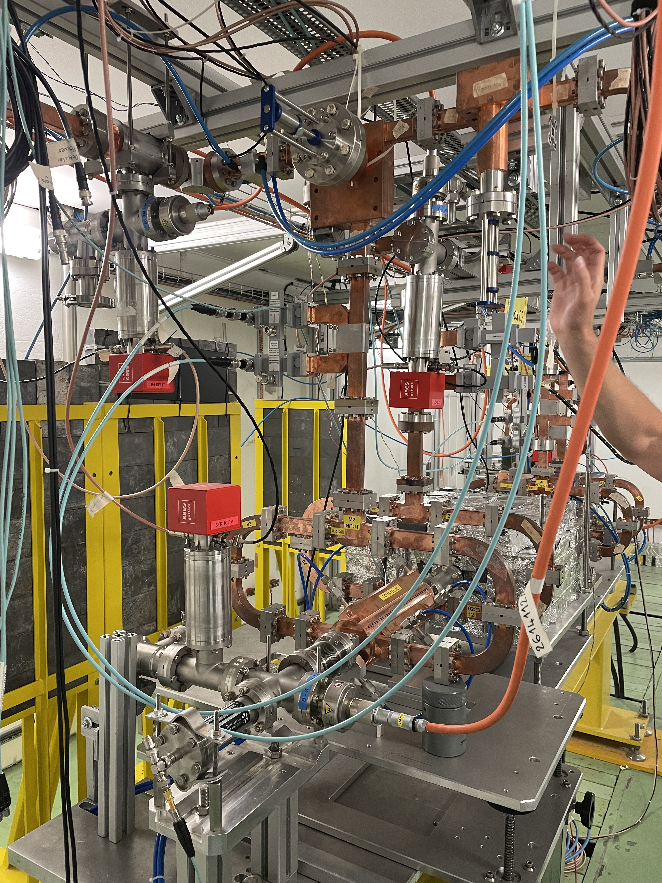
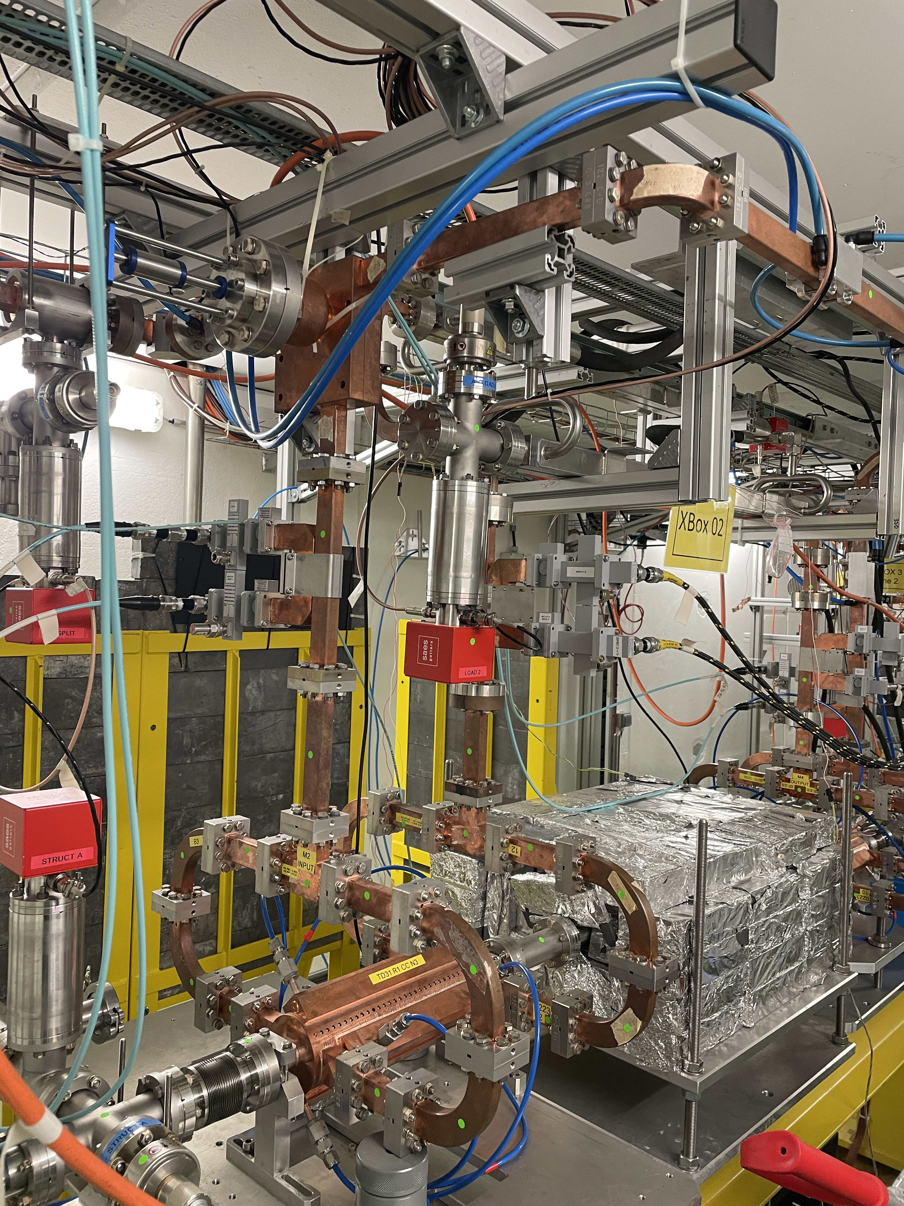
XBox2: spot the 7 differences
It was decided to remove the phase shifter from the line, as it was only adding complexity to the system
Currently, between BOC and structures, there is only the power splitter
HDPC is just before structure
Integration of Barrel Open Cavity pulse compressor for high power testing
Integration and high power testing of Smartcell

Slide 6
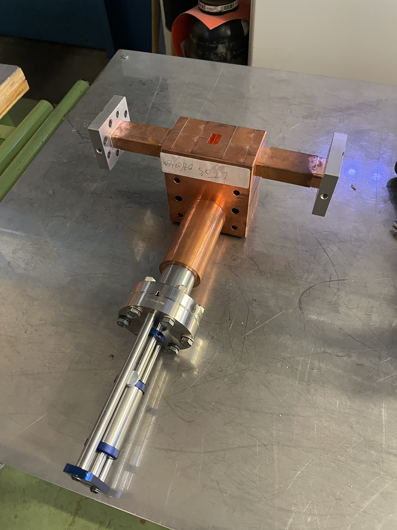
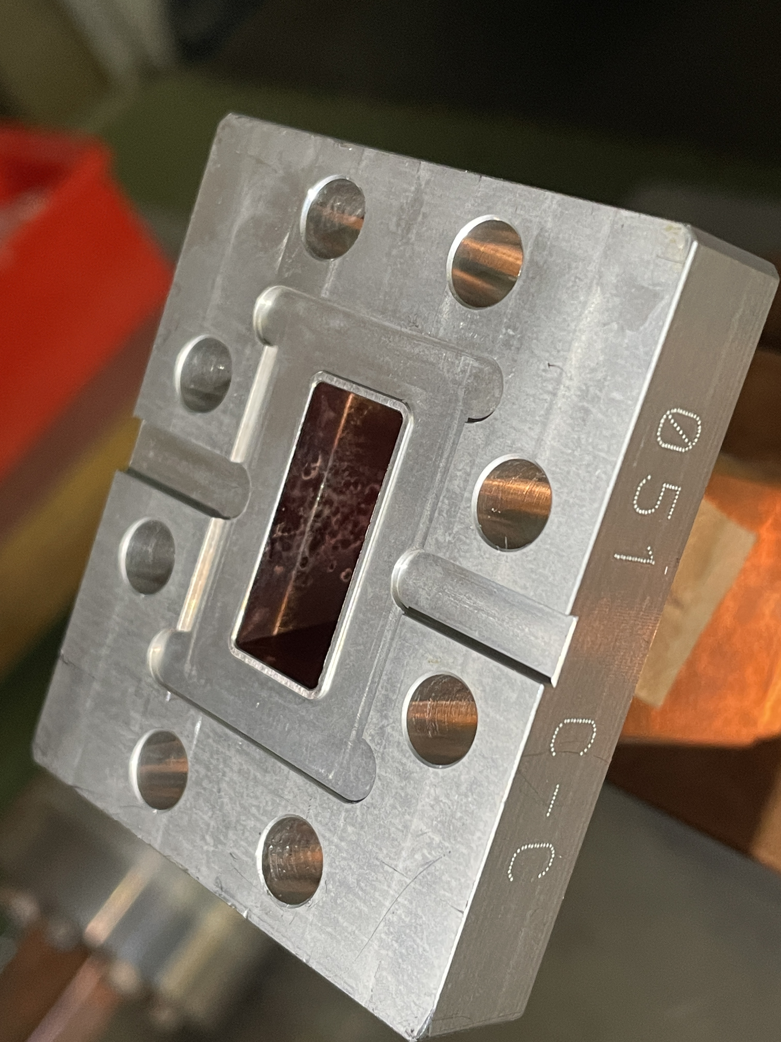
XBox2: removal of phase shifter
It was decided to remove the phase shifter from the line, as it was only adding complexity to the system
Some signs of burning at plain sight
Preparing the shifter to do an endoscopy
Integration of Barrel Open Cavity pulse compressor for high power testing
Integration and high power testing of Smartcell

Slide 7
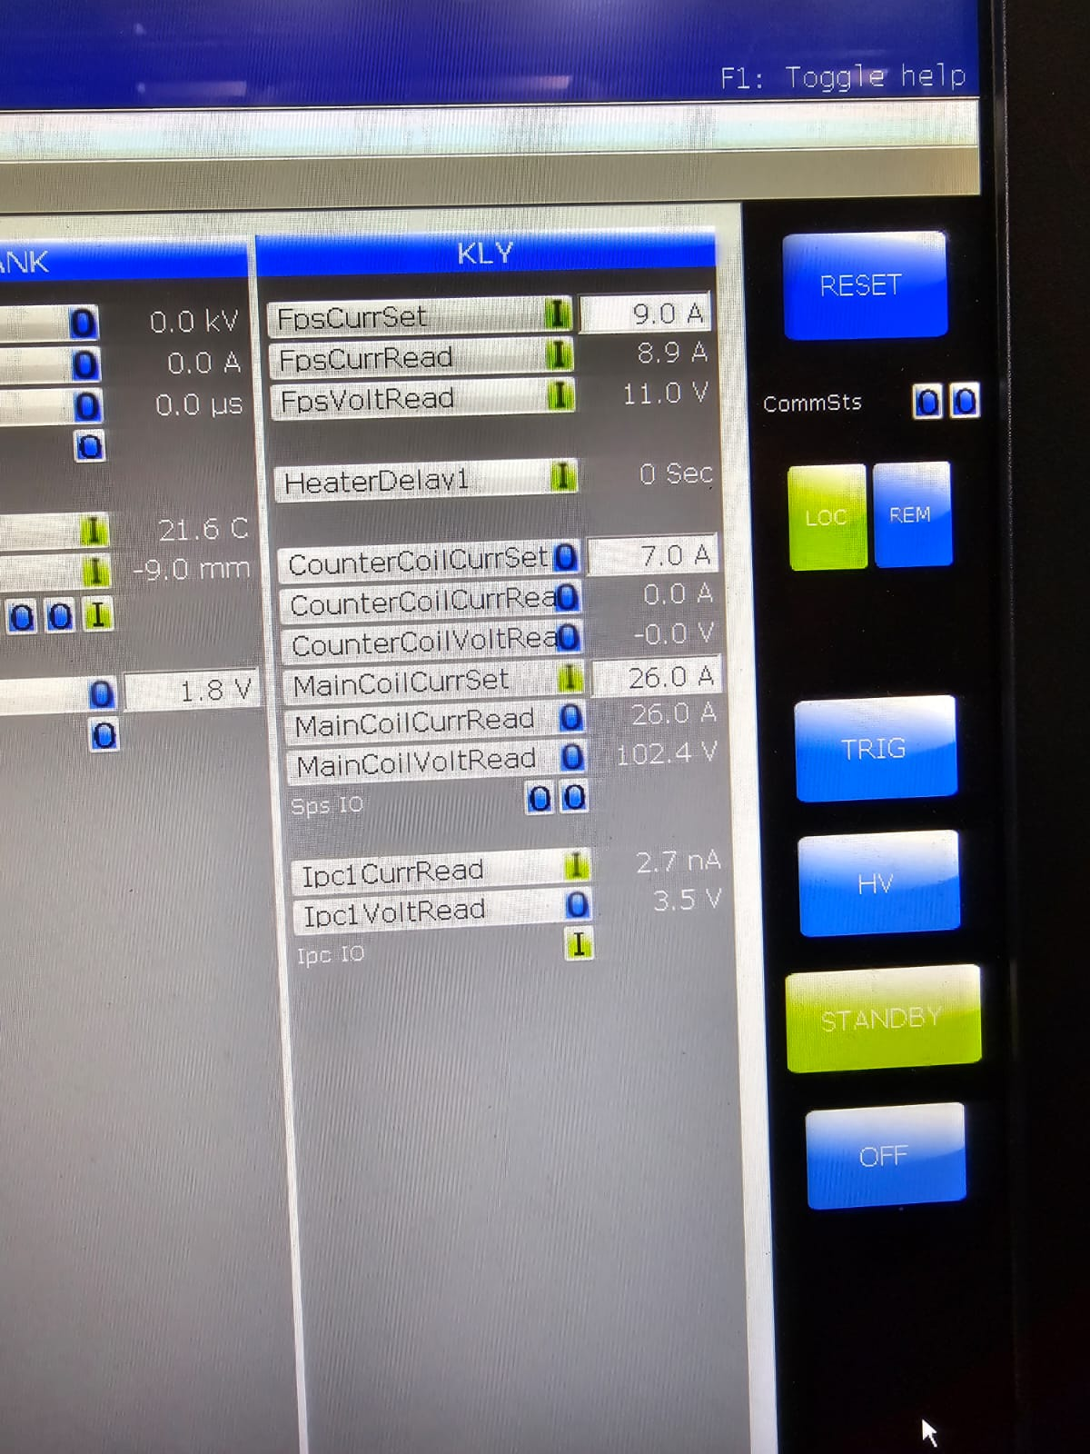
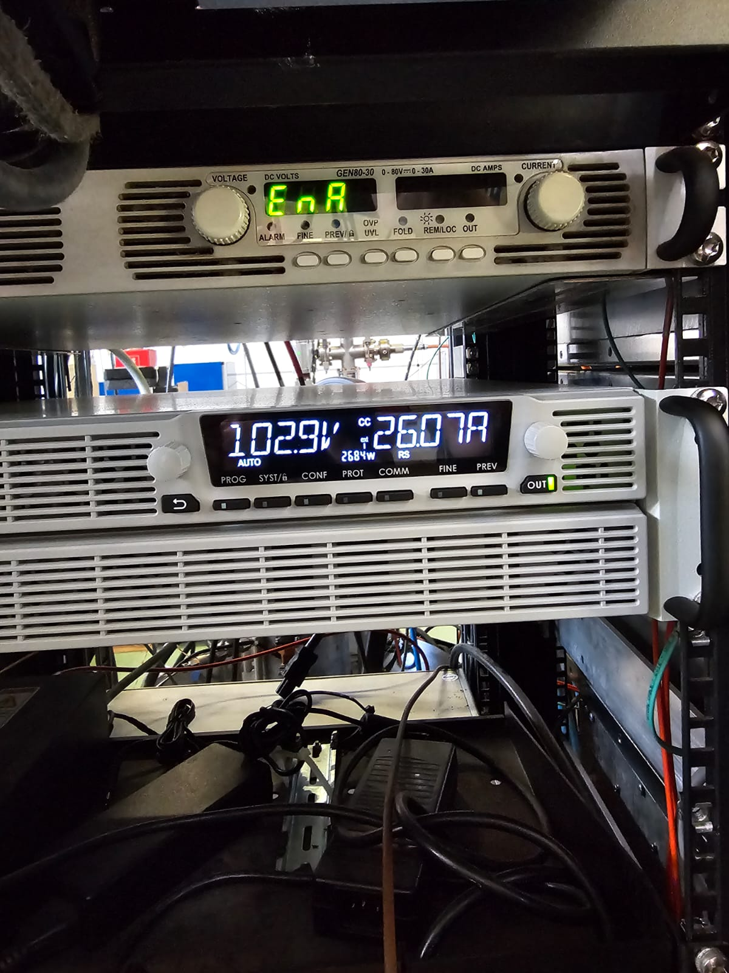
XBox3: installation of new power supply for focusing
Genesys vs Genesys+ compatibility
Adaptor for 3 phase
Adaptor for remote control
Remote control confirmed!
Integration of Barrel Open Cavity pulse compressor for high power testing

Slide 8
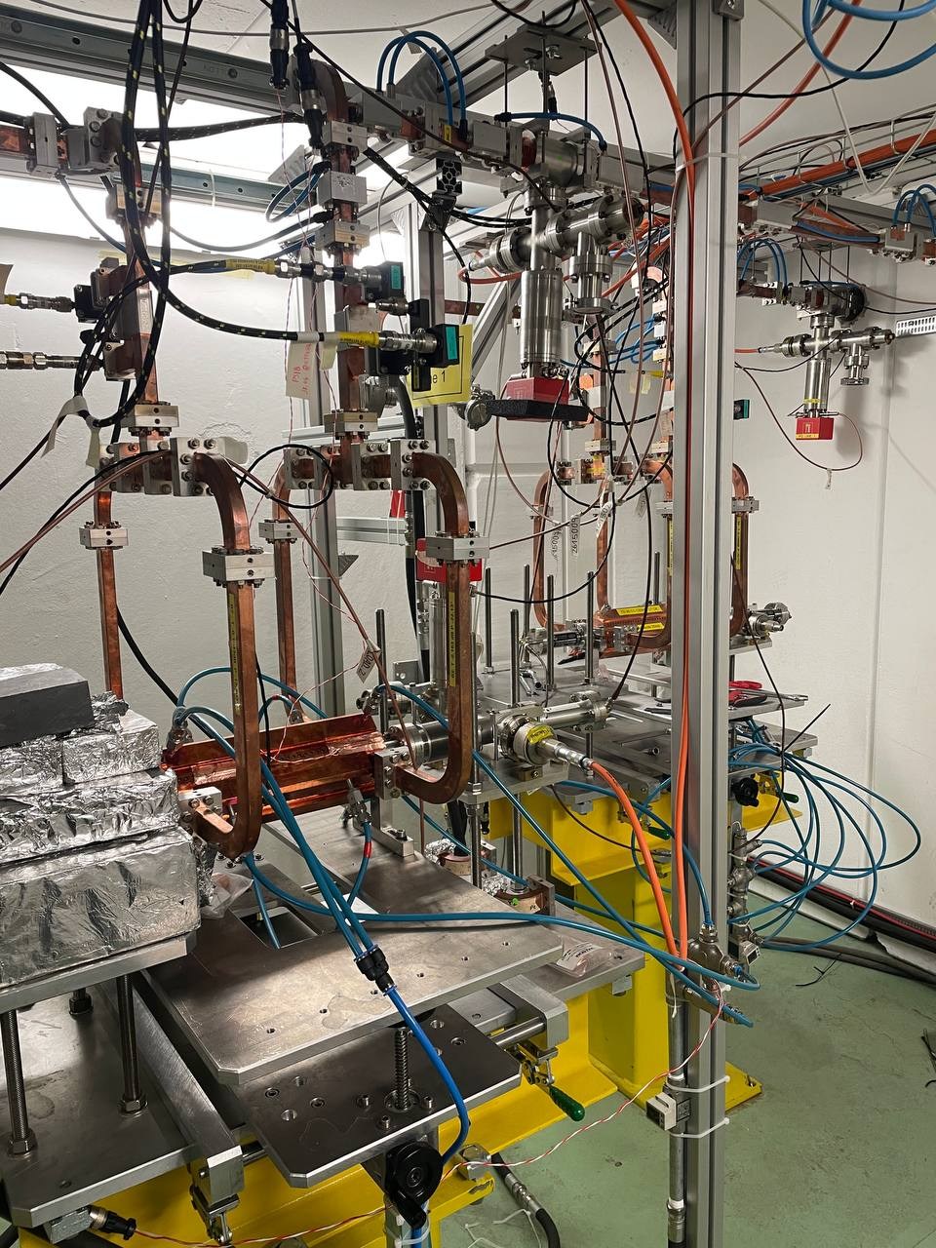
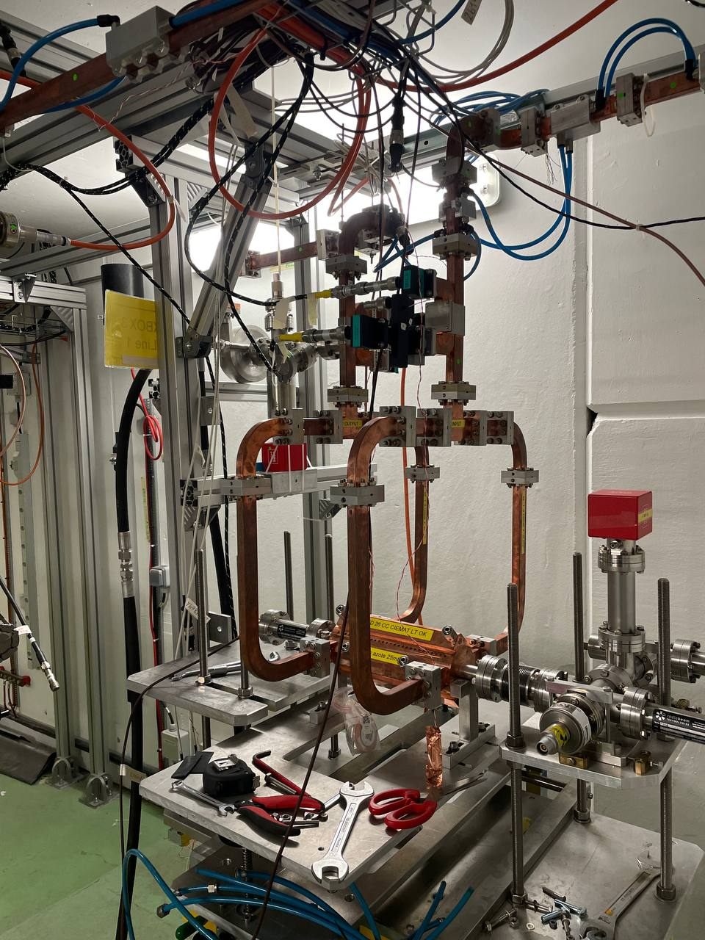
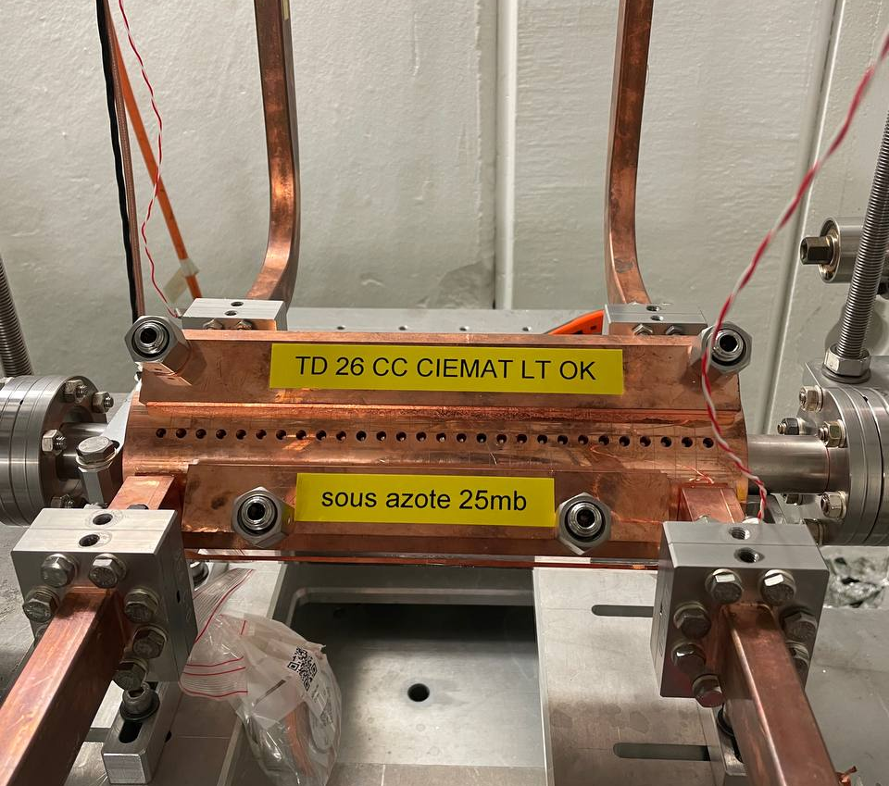
XBox3: installation of TD26 Ciemat
Installation in Xbox3, line 2
Connected to spiral load
Vacuum at 1E-4mbar
Integration of Barrel Open Cavity pulse compressor for high power testing

Slide 9
XBOXES: To do
XBOX2:
Vacuum leak test + pump and wait for vacuum
Condition klystron at HV
Klystron gain curves and (maybe?) perveance
Bypass unused vacuum interlocks
Recalibrate lines
Bypass interlock of unused chiller
XBOX3:
Vacuum leak test + pump and wait for vacuum
Connect water pipes in structure
Electrical connections of chillers
Check again every interlock (especially vacuum interlocks)
Integration of Barrel Open Cavity pulse compressor for high power testing

Slide 11
X-Box 2: Reminder on BD classification
BD_Flag_PER_log
BD Load
TRUE
BD_Flag_DC_DOWN
DC Up >=140
DC Down>=100
BD DUT w. BDC
BD_Flag_DC_UP
FALSE
BD_Flag_PSR_log
BD DUT wo. BDC
BD_Flag_PKR_log
BD HyPC
No BD

