Slide 1


BOC
RF Measurement
16.04.2025
Pablo Martinez Reviriego; Paz Alonso Arias; Alexej Grudiev

Slide 2
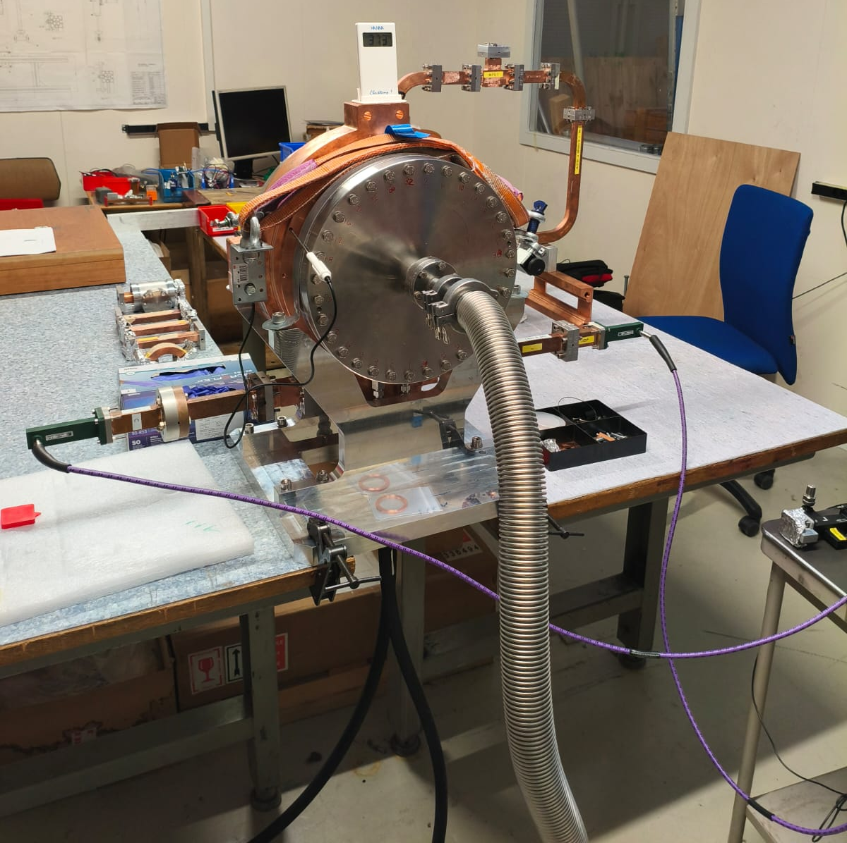
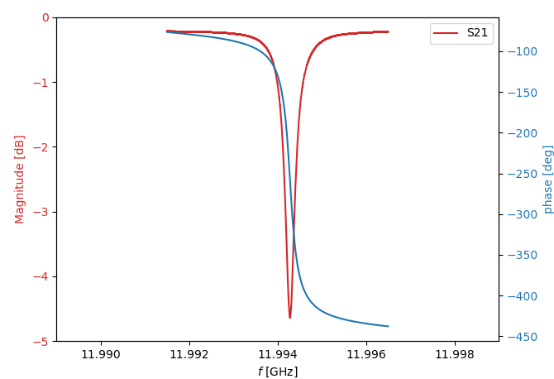
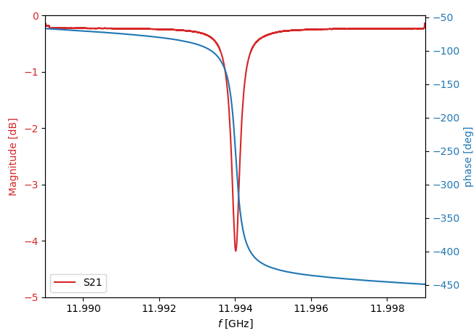
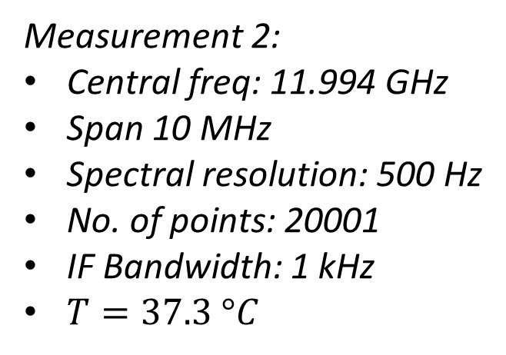
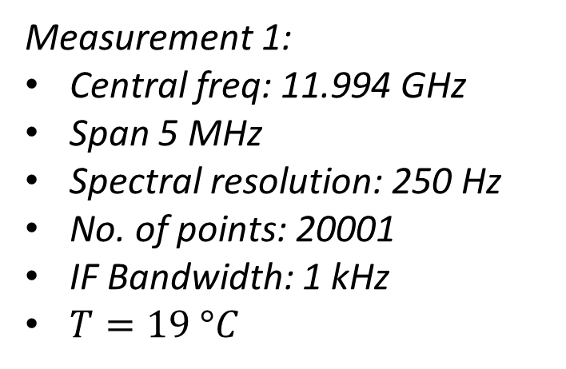
Measurement Setup – VNA settings
Measurement 1:
Central freq: 11.994 GHz
Span 5 MHz
Spectral resolution: 250 Hz
No. of points: 20001
IF Bandwidth: 1 kHz
$T=19 °C$
Measurement 2:
Central freq: 11.994 GHz
Span 10 MHz
Spectral resolution: 500 Hz
No. of points: 20001
IF Bandwidth: 1 kHz
$T=37.3 °C$

Slide 3
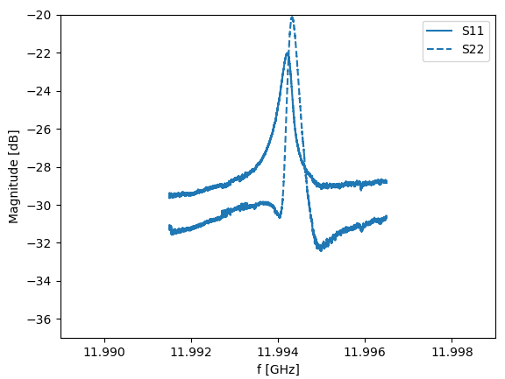
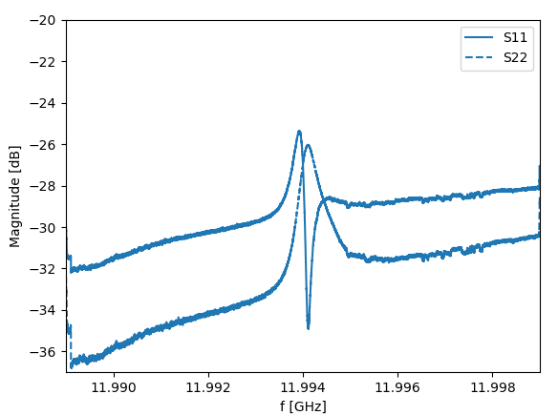
S-parameters
Measurement 1
Measurement 2

Slide 4
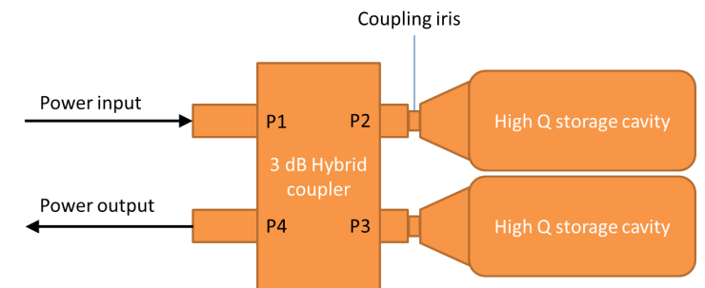
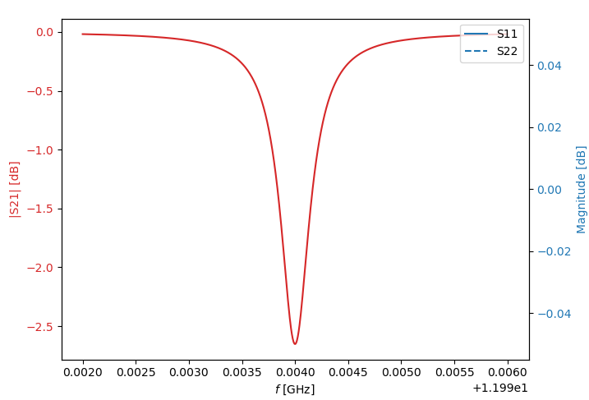
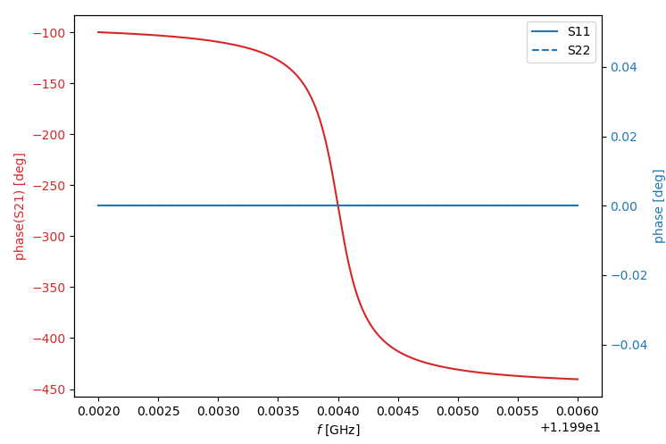

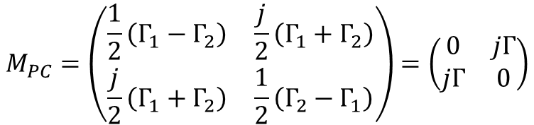

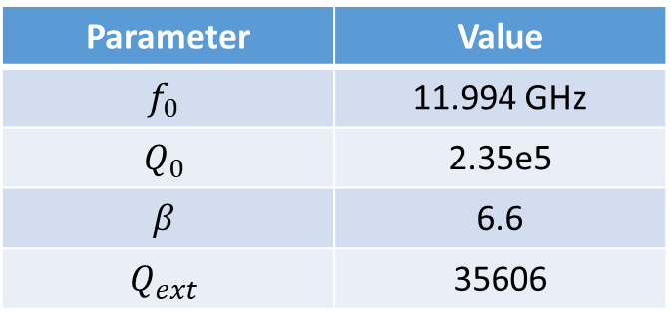
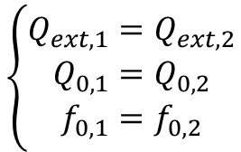
1 cavity model
$$ξ_{i}=\frac{ω}{ω_{0,i}}−\frac{ω_{0,i}}{ω}$$
$$\left\{\begin{aligned}Q_{ext,1}=Q_{ext,2} \\ Q_{0,1}=Q_{0,2} \\ f_{0,1}=f_{0,2}\end{aligned}\right.$$
$$Γ_{i}=\frac{(β_{i}−1)−jQ_{0,i}ξ_{i} }{(β_{i}+1)+jQ_{0,i}ξ_{i}}$$
$$M_{PC}=\left(\begin{matrix}\frac{1}{2}\left(Γ_{1}−Γ_{2}\right) & \frac{j}{2}\left(Γ_{1}+Γ_{2}\right) \\ \frac{j}{2}\left(Γ_{1}+Γ_{2}\right) & \frac{1}{2}\left(Γ_{2}−Γ_{1}\right)\end{matrix}\right)=\left(\begin{matrix}0 & jΓ \\ jΓ & 0\end{matrix}\right)$$
Parameter | Value
$$f_{0}$$ | 11.994 GHz
$$Q_{0}$$ | 2.35e5
$$β$$ | 6.6
$$Q_{ext}$$ | 35606

Slide 5
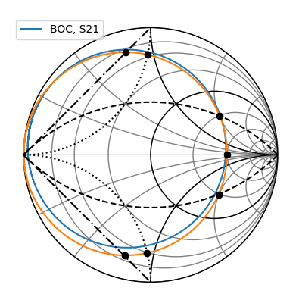
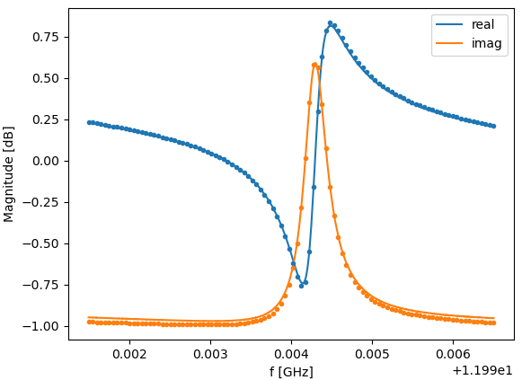
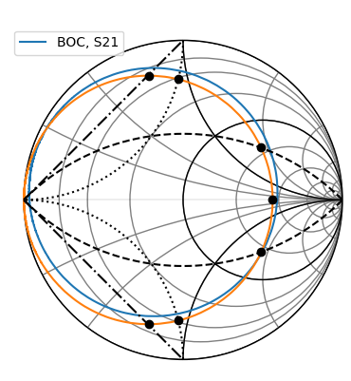
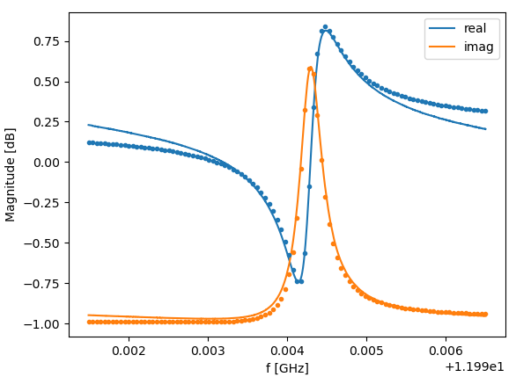

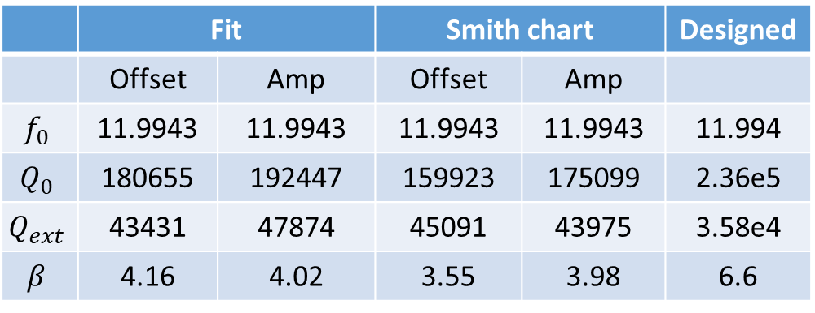


 | Fit |  | Smith chart |  | Designed
 | Offset | Amp | Offset | Amp
$$f_{0}$$ | 11.9943 | 11.9943 | 11.9943 | 11.9943 | 11.994
$$Q_{0}$$ | 180655 | 192447 | 159923 | 175099 | 2.36e5
$$Q_{ext}$$ | 43431 | 47874 | 45091 | 43975 | 3.58e4
$$β$$ | 4.16 | 4.02 | 3.55 | 3.98 | 6.6
Measurement fit
$$ξ=\frac{ω}{ω_{0}}−\frac{ω_{0}}{ω}$$
Offset model
Amplitude model
$$S_{21}=\frac{(β−1)−jQ_{0}ξ }{(β+1)+jQ_{0}ξ}e^{jδ}+aω+b$$
$$S_{21}=\frac{(β−1)−jQ_{0}ξ }{(β+1)+jQ_{0}ξ}Ae^{jδ}$$
S21
S21

Slide 6
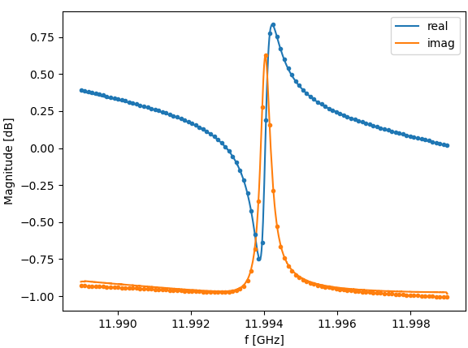
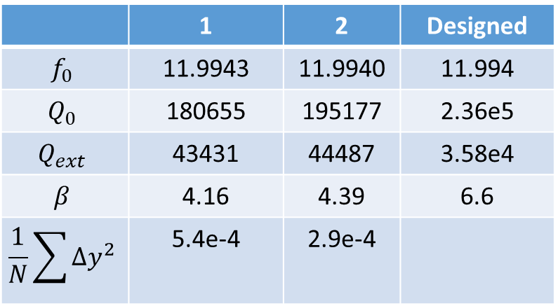
Measurement comparison
1
S21
 | 1 | 2 | Designed
$$f_{0}$$ | 11.9943 | 11.9940 | 11.994
$$Q_{0}$$ | 180655 | 195177 | 2.36e5
$$Q_{ext}$$ | 43431 | 44487 | 3.58e4
$$β$$ | 4.16 | 4.39 | 6.6
$$\frac{1}{N}\sum{Δy^{2}}$$ | 5.4e-4 | 2.9e-4
2
S21

Slide 7

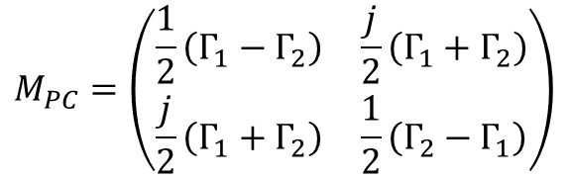
General model
$$ξ_{i}=\frac{ω}{ω_{0,i}}−\frac{ω_{0,i}}{ω}$$
$$Γ_{i}=\frac{(β_{i}−1)−jQ_{0,i}ξ_{i} }{(β_{i}+1)+jQ_{0,i}ξ_{i}}$$
$$M_{PC}=\left(\begin{matrix}\frac{1}{2}\left(Γ_{1}−Γ_{2}\right) & \frac{j}{2}\left(Γ_{1}+Γ_{2}\right) \\ \frac{j}{2}\left(Γ_{1}+Γ_{2}\right) & \frac{1}{2}\left(Γ_{2}−Γ_{1}\right)\end{matrix}\right)$$
Parameter | Value
$$f_{0}$$ | 11.994 GHz
$$Q_{0}$$ | 2.35e5
$$β$$ | 6.6
$$Q_{ext}$$ | 35606

Slide 8
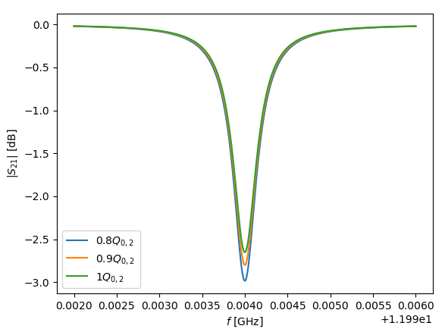
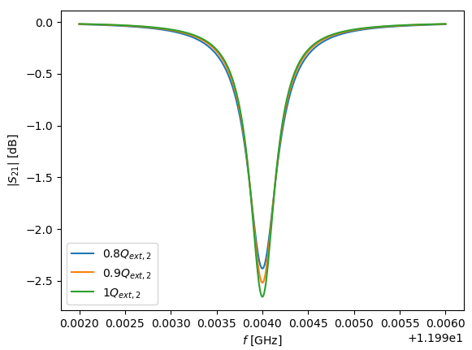
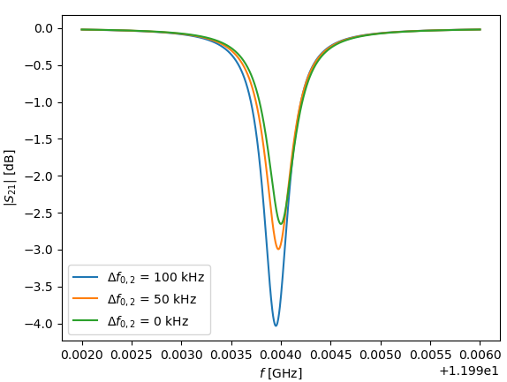
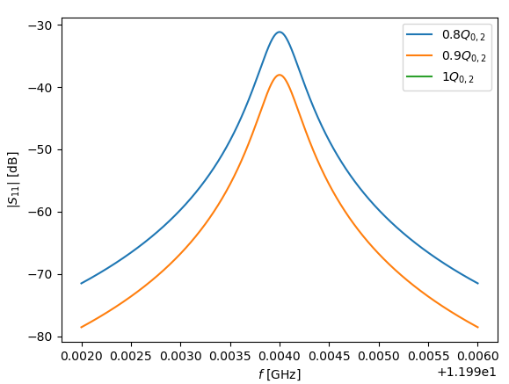
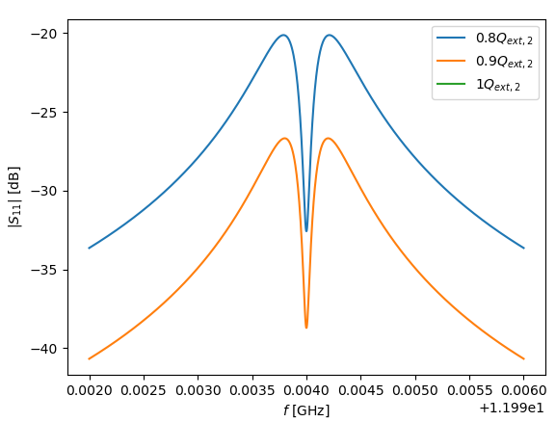
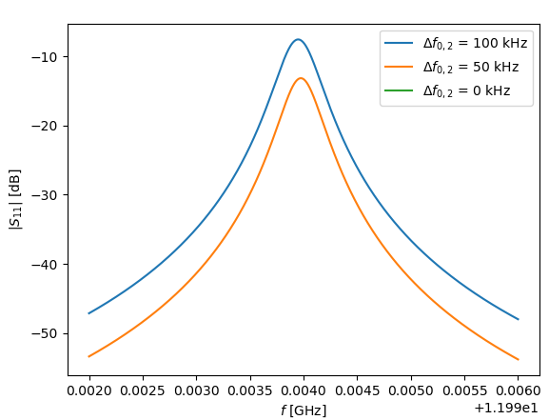
Simulation

Slide 9
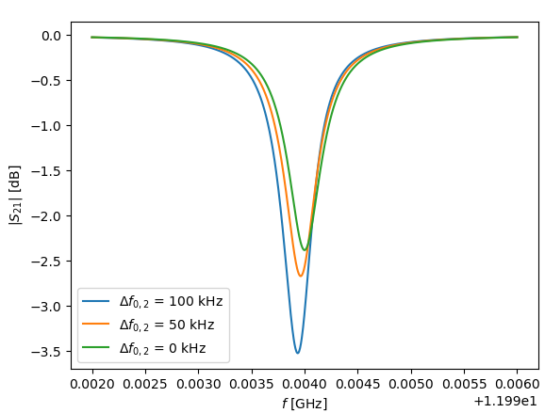
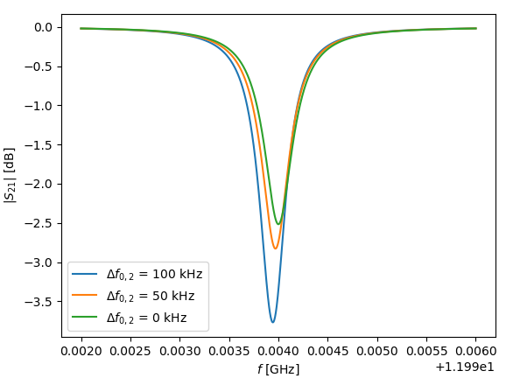
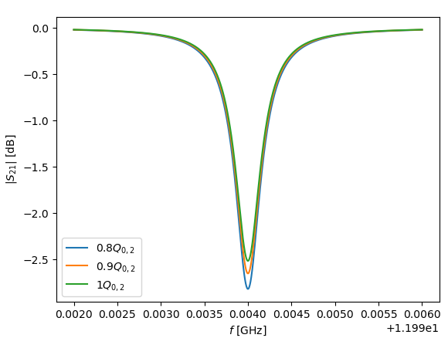
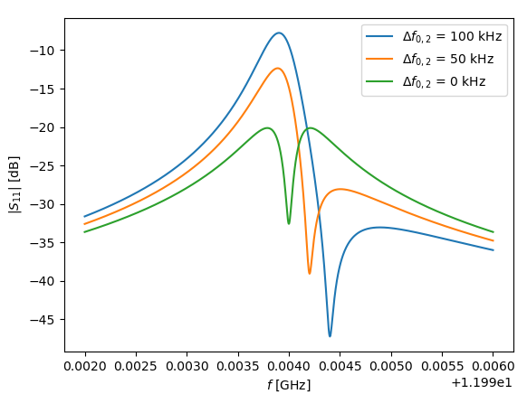
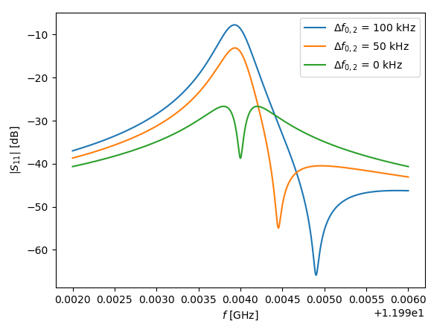
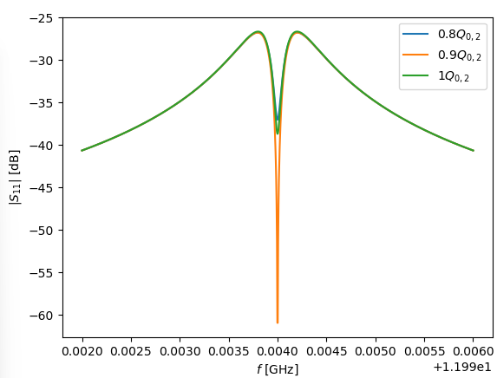



Simulation
$$Q_{ext,2}=0.8Q_{ext,1}$$
$$Q_{ext,2}=0.9Q_{ext,1}$$
$$Q_{ext,2}=0.9Q_{ext,1}$$

Slide 10
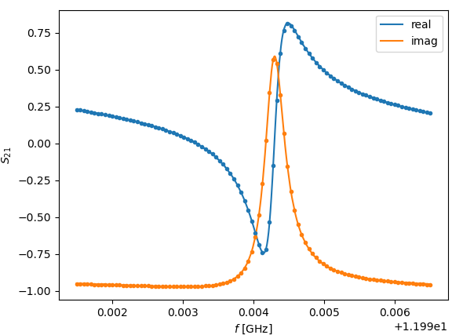
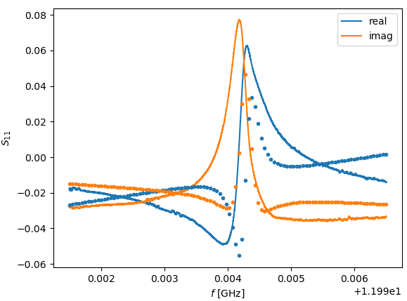

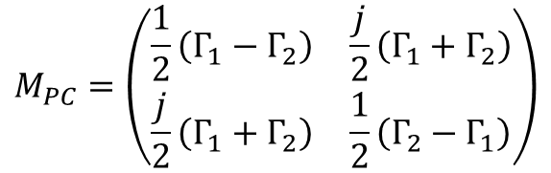

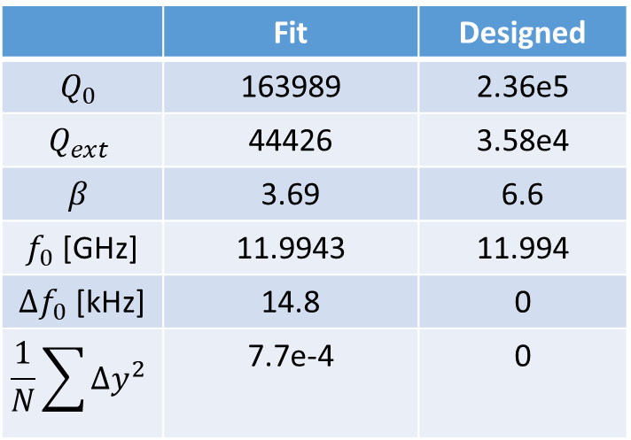

4-params fit
$$\left\{\begin{aligned}Q_{ext,1}=Q_{ext,2} \\ Q_{0,1}=Q_{0,2} \\ f_{0,1}≠f_{0,2}\end{aligned}\right.$$
$$Γ_{i}=\frac{(β_{i}−1)−jQ_{0,i}ξ_{i} }{(β_{i}+1)+jQ_{0,i}ξ_{i}}e^{jδ_{i}}+a_{i}ω+b_{i}$$
$$ξ_{i}=\frac{ω}{ω_{0,i}}−\frac{ω_{0,i}}{ω}$$
$$M_{PC}=\left(\begin{matrix}\frac{1}{2}\left(Γ_{1}−Γ_{2}\right) & \frac{j}{2}\left(Γ_{1}+Γ_{2}\right) \\ \frac{j}{2}\left(Γ_{1}+Γ_{2}\right) & \frac{1}{2}\left(Γ_{2}−Γ_{1}\right)\end{matrix}\right)$$
 | Fit | Designed
$$Q_{0}$$ | 163989 | 2.36e5
$$Q_{ext}$$ | 44426 | 3.58e4
$$β$$ | 3.69 | 6.6
$f_{0}$ [GHz] | 11.9943 | 11.994
$Δf_{0}$ [kHz] | 14.8 | 0
$$\frac{1}{N}\sum{Δy^{2}}$$ | 7.7e-4 | 0

Slide 11
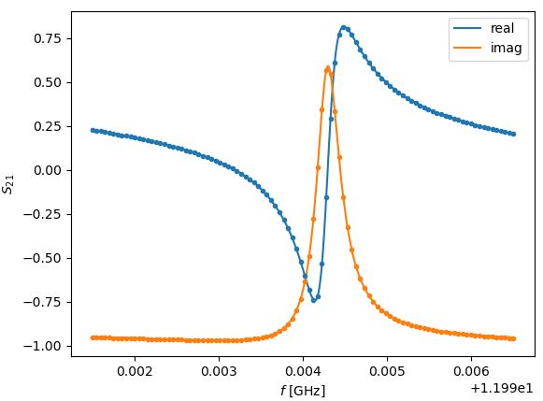
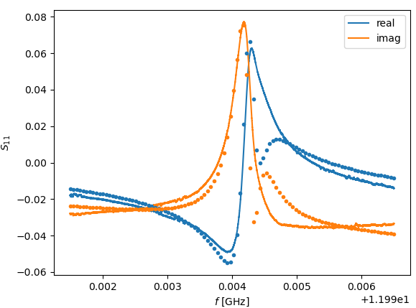

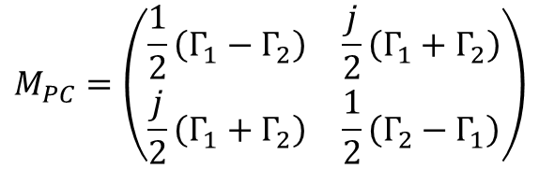

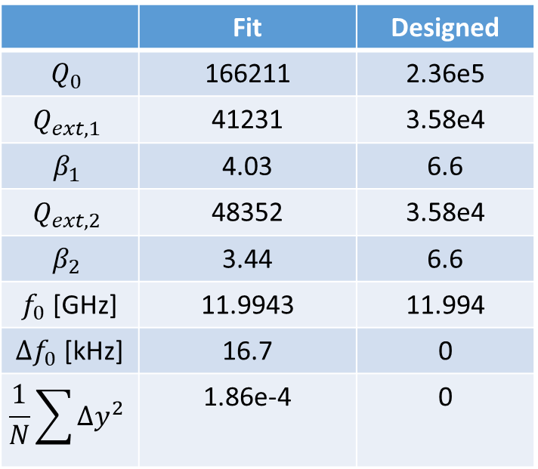

5-params fit
$$\left\{\begin{aligned}Q_{ext,1}≠Q_{ext,2} \\ Q_{0,1}=Q_{0,2} \\ f_{0,1}≠f_{0,2}\end{aligned}\right.$$
$$ξ_{i}=\frac{ω}{ω_{0,i}}−\frac{ω_{0,i}}{ω}$$
$$M_{PC}=\left(\begin{matrix}\frac{1}{2}\left(Γ_{1}−Γ_{2}\right) & \frac{j}{2}\left(Γ_{1}+Γ_{2}\right) \\ \frac{j}{2}\left(Γ_{1}+Γ_{2}\right) & \frac{1}{2}\left(Γ_{2}−Γ_{1}\right)\end{matrix}\right)$$
$$Γ_{i}=\frac{(β_{i}−1)−jQ_{0,i}ξ_{i} }{(β_{i}+1)+jQ_{0,i}ξ_{i}}e^{jδ_{i}}+a_{i}ω+b_{i}$$
 | Fit | Designed
$$Q_{0}$$ | 166211 | 2.36e5
$$Q_{ext,1}$$ | 41231 | 3.58e4
$$β_{1}$$ | 4.03 | 6.6
$$Q_{ext,2}$$ | 48352 | 3.58e4
$$β_{2}$$ | 3.44 | 6.6
$f_{0}$ [GHz] | 11.9943 | 11.994
$Δf_{0}$ [kHz] | 16.7 | 0
$$\frac{1}{N}\sum{Δy^{2}}$$ | 1.86e-4 | 0

Slide 12
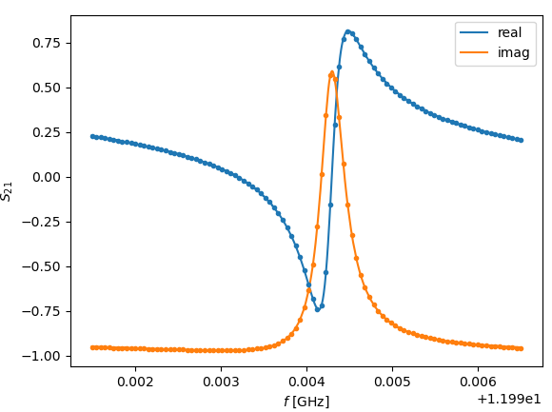
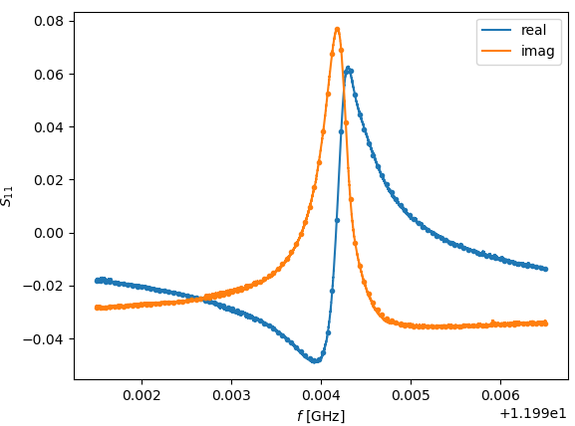

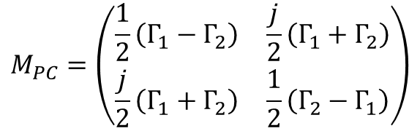

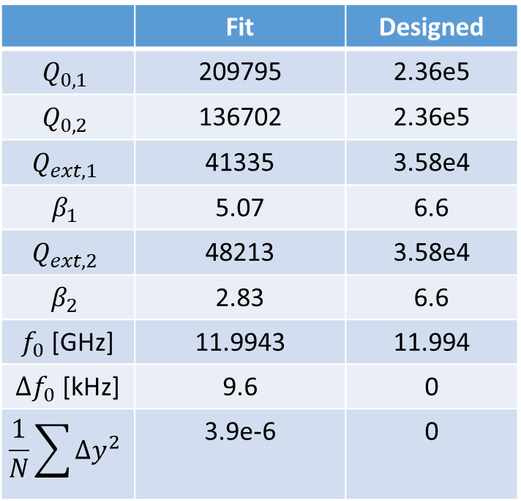

6-params fit
$$\left\{\begin{aligned}Q_{ext,1}≠Q_{ext,2} \\ Q_{0,1}≠Q_{0,2} \\ f_{0,1}≠f_{0,2}\end{aligned}\right.$$
$$ξ_{i}=\frac{ω}{ω_{0,i}}−\frac{ω_{0,i}}{ω}$$
$$M_{PC}=\left(\begin{matrix}\frac{1}{2}\left(Γ_{1}−Γ_{2}\right) & \frac{j}{2}\left(Γ_{1}+Γ_{2}\right) \\ \frac{j}{2}\left(Γ_{1}+Γ_{2}\right) & \frac{1}{2}\left(Γ_{2}−Γ_{1}\right)\end{matrix}\right)$$
$$Γ_{i}=\frac{(β_{i}−1)−jQ_{0,i}ξ_{i} }{(β_{i}+1)+jQ_{0,i}ξ_{i}}e^{jδ_{i}}+a_{i}ω+b_{i}$$
 | Fit | Designed
$$Q_{0,1}$$ | 209795 | 2.36e5
$$Q_{0,2}$$ | 136702 | 2.36e5
$$Q_{ext,1}$$ | 41335 | 3.58e4
$$β_{1}$$ | 5.07 | 6.6
$$Q_{ext,2}$$ | 48213 | 3.58e4
$$β_{2}$$ | 2.83 | 6.6
$f_{0}$ [GHz] | 11.9943 | 11.994
$Δf_{0}$ [kHz] | 9.6 | 0
$$\frac{1}{N}\sum{Δy^{2}}$$ | 3.9e-6 | 0

Slide 13
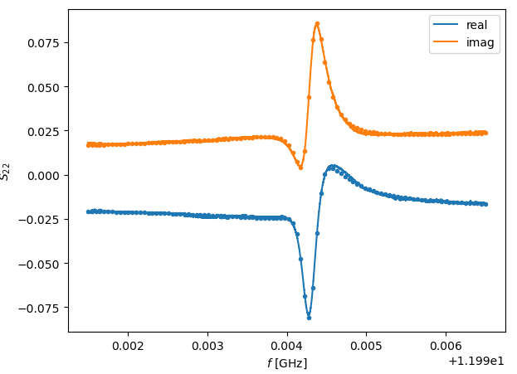
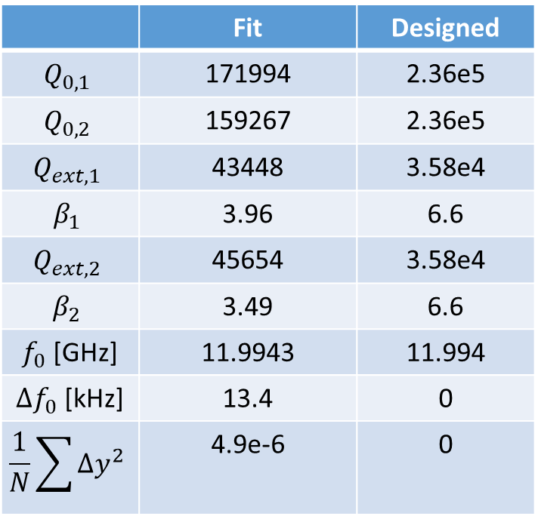
6-params fit S22
$$\left\{\begin{aligned}Q_{ext,1}≠Q_{ext,2} \\ Q_{0,1}≠Q_{0,2} \\ f_{0,1}≠f_{0,2}\end{aligned}\right.$$
$$ξ_{i}=\frac{ω}{ω_{0,i}}−\frac{ω_{0,i}}{ω}$$
$$M_{PC}=\left(\begin{matrix}\frac{1}{2}\left(Γ_{1}−Γ_{2}\right) & \frac{j}{2}\left(Γ_{1}+Γ_{2}\right) \\ \frac{j}{2}\left(Γ_{1}+Γ_{2}\right) & \frac{1}{2}\left(Γ_{2}−Γ_{1}\right)\end{matrix}\right)$$
$$Γ_{i}=\frac{(β_{i}−1)−jQ_{0,i}ξ_{i} }{(β_{i}+1)+jQ_{0,i}ξ_{i}}e^{jδ_{i}}+a_{i}ω+b_{i}$$
 | Fit | Designed
$$Q_{0,1}$$ | 171994 | 2.36e5
$$Q_{0,2}$$ | 159267 | 2.36e5
$$Q_{ext,1}$$ | 43448 | 3.58e4
$$β_{1}$$ | 3.96 | 6.6
$$Q_{ext,2}$$ | 45654 | 3.58e4
$$β_{2}$$ | 3.49 | 6.6
$f_{0}$ [GHz] | 11.9943 | 11.994
$Δf_{0}$ [kHz] | 13.4 | 0
$$\frac{1}{N}\sum{Δy^{2}}$$ | 4.9e-6 | 0

Slide 14

Measurement 1: Summary
 | 6-params fit (S22) | 6-params fit | 5-params fit | 4-params fit | 3-params fit | Designed
$$Q_{0,1}$$ | 171994 | 209795 | 166211 | 163989 | 175099 | 2.36e5
$$Q_{0,2}$$ | 159267 | 136702
$$Q_{ext,1}$$ | 43448 | 41335 | 41231 | 44426 | 43975 | 3.58e4
$$Q_{ext,2}$$ | 45654 | 48213 | 48352
$$β_{1}$$ | 3.96 | 5.07 | 4.03 | 3.69 | 3.98 | 6.6
$$β_{2}$$ | 3.49 | 2.83 | 3.44
$f_{0}$ [GHz] | 11.9943 | 11.9943 | 11.9943 | 11.9943 | 11.9943 | 11.994
$Δf_{0}$ [kHz] | 13.4 | 9.6 | 16.7 | 14.8 | 0 | 0
$$\frac{1}{N}\sum{Δy^{2}}$$ | 4.9e-6 | 3.9e-6 | 1.86e-4 | 7.7e-4 | 2.2e-3

Slide 15







4-params fit
$$\left\{\begin{aligned}Q_{ext,1}=Q_{ext,2} \\ Q_{0,1}=Q_{0,2} \\ f_{0,1}≠f_{0,2}\end{aligned}\right.$$
$$Γ_{i}=\frac{(β_{i}−1)−jQ_{0,i}ξ_{i} }{(β_{i}+1)+jQ_{0,i}ξ_{i}}e^{jδ_{i}}+a_{i}ω+b_{i}$$
$$ξ_{i}=\frac{ω}{ω_{0,i}}−\frac{ω_{0,i}}{ω}$$
$$M_{PC}=\left(\begin{matrix}\frac{1}{2}\left(Γ_{1}−Γ_{2}\right) & \frac{j}{2}\left(Γ_{1}+Γ_{2}\right) \\ \frac{j}{2}\left(Γ_{1}+Γ_{2}\right) & \frac{1}{2}\left(Γ_{2}−Γ_{1}\right)\end{matrix}\right)$$
 | Fit | Designed
$$Q_{0}$$ | 182190 | 2.36e5
$$Q_{ext}$$ | 45133 | 3.58e4
$$β$$ | 4.0 | 6.6
$f_{0}$ [GHz] | 11.9940 | 11.994
$Δf_{0}$ [kHz] | 9.3 | 0
$$\frac{1}{N}\sum{Δy^{2}}$$ | 3.9e-4 | 0

Slide 16







5-params fit
$$\left\{\begin{aligned}Q_{ext,1}≠Q_{ext,2} \\ Q_{0,1}=Q_{0,2} \\ f_{0,1}≠f_{0,2}\end{aligned}\right.$$
$$ξ_{i}=\frac{ω}{ω_{0,i}}−\frac{ω_{0,i}}{ω}$$
$$M_{PC}=\left(\begin{matrix}\frac{1}{2}\left(Γ_{1}−Γ_{2}\right) & \frac{j}{2}\left(Γ_{1}+Γ_{2}\right) \\ \frac{j}{2}\left(Γ_{1}+Γ_{2}\right) & \frac{1}{2}\left(Γ_{2}−Γ_{1}\right)\end{matrix}\right)$$
$$Γ_{i}=\frac{(β_{i}−1)−jQ_{0,i}ξ_{i} }{(β_{i}+1)+jQ_{0,i}ξ_{i}}e^{jδ_{i}}+a_{i}ω+b_{i}$$
 | Fit | Designed
$$Q_{0}$$ | 184693 | 2.36e5
$$Q_{ext,1}$$ | 41933 | 3.58e4
$$β_{1}$$ | 4.4 | 6.6
$$Q_{ext,2}$$ | 48940 | 3.58e4
$$β_{2}$$ | 3.8 | 6.6
$f_{0}$ [GHz] | 11.9940 | 11.994
$Δf_{0}$ [kHz] | 8.1 | 0
$$\frac{1}{N}\sum{Δy^{2}}$$ | 8e-5 | 0

Slide 17







6-params fit
$$\left\{\begin{aligned}Q_{ext,1}≠Q_{ext,2} \\ Q_{0,1}≠Q_{0,2} \\ f_{0,1}≠f_{0,2}\end{aligned}\right.$$
$$ξ_{i}=\frac{ω}{ω_{0,i}}−\frac{ω_{0,i}}{ω}$$
$$M_{PC}=\left(\begin{matrix}\frac{1}{2}\left(Γ_{1}−Γ_{2}\right) & \frac{j}{2}\left(Γ_{1}+Γ_{2}\right) \\ \frac{j}{2}\left(Γ_{1}+Γ_{2}\right) & \frac{1}{2}\left(Γ_{2}−Γ_{1}\right)\end{matrix}\right)$$
$$Γ_{i}=\frac{(β_{i}−1)−jQ_{0,i}ξ_{i} }{(β_{i}+1)+jQ_{0,i}ξ_{i}}e^{jδ_{i}}+a_{i}ω+b_{i}$$
 | Fit | Designed
$$Q_{0,1}$$ | 199522 | 2.36e5
$$Q_{0,2}$$ | 172207 | 2.36e5
$$Q_{ext,1}$$ | 42040 | 3.58e4
$$β_{1}$$ | 4.7 | 6.6
$$Q_{ext,2}$$ | 48791 | 3.58e4
$$β_{2}$$ | 3.5 | 6.6
$f_{0}$ [GHz] | 11.9940 | 11.994
$Δf_{0}$ [kHz] | 7.5 | 0
$$\frac{1}{N}\sum{Δy^{2}}$$ | 6.8e-5 | 0

Slide 18


6-params fit S22
$$\left\{\begin{aligned}Q_{ext,1}≠Q_{ext,2} \\ Q_{0,1}≠Q_{0,2} \\ f_{0,1}≠f_{0,2}\end{aligned}\right.$$
$$ξ_{i}=\frac{ω}{ω_{0,i}}−\frac{ω_{0,i}}{ω}$$
$$M_{PC}=\left(\begin{matrix}\frac{1}{2}\left(Γ_{1}−Γ_{2}\right) & \frac{j}{2}\left(Γ_{1}+Γ_{2}\right) \\ \frac{j}{2}\left(Γ_{1}+Γ_{2}\right) & \frac{1}{2}\left(Γ_{2}−Γ_{1}\right)\end{matrix}\right)$$
$$Γ_{i}=\frac{(β_{i}−1)−jQ_{0,i}ξ_{i} }{(β_{i}+1)+jQ_{0,i}ξ_{i}}e^{jδ_{i}}+a_{i}ω+b_{i}$$
 | Fit | Designed
$$Q_{0,1}$$ | 194156 | 2.36e5
$$Q_{0,2}$$ | 172911 | 2.36e5
$$Q_{ext,1}$$ | 44210 | 3.58e4
$$β_{1}$$ | 4.39 | 6.6
$$Q_{ext,2}$$ | 46200 | 3.58e4
$$β_{2}$$ | 3.74 | 6.6
$f_{0}$ [GHz] | 11.9940 | 11.994
$Δf_{0}$ [kHz] | 1.8 | 0
$$\frac{1}{N}\sum{Δy^{2}}$$ | 6.6e-5 | 0

Slide 19



Measurement 2: Summary
 | 6-params fit S22 | 6-params fit | 5-params fit | 4-params fit | 3-params fit | Designed
$$Q_{0,1}$$ | 194156 | 199522 | 184693 | 182190 | 195177 | 2.36e5
$$Q_{0,2}$$ | 172911 | 172207
$$Q_{ext,1}$$ | 44210 | 42040 | 41933 | 45133 | 44487 | 3.58e4
$$Q_{ext,2}$$ | 46200 | 48791 | 48940
$$β_{1}$$ | 4.39 | 4.7 | 4.4 | 4.04 | 4.39 | 6.6
$$β_{2}$$ | 3.74 | 3.5 | 3.8
$f_{0}$ [GHz] | 11.9940 | 11.9940 | 11.9940 | 11.9940 | 11.9940 | 11.994
$Δf_{0}$ [kHz] | 1.8 | 7.5 | 8.1 | 9.3 | 0 | 0
$$\frac{1}{N}\sum{Δy^{2}}$$ | 6.6e-5 | 6.8e-5 | 8e-5 | 3.9e-4 | 1.4e-3

Slide 20

Summary
1
 | Measurement 1 |  | Measurement 2
 | 6-params fit S22 | 6-params fit | 6-params fit S22 | 6-params fit
$$Q_{0,1}$$ | 171994 | 209795 | 194156 | 199522
$$Q_{0,2}$$ | 159267 | 136702 | 172911 | 172207
$$Q_{ext,1}$$ | 43448 | 41335 | 44210 | 42040
$$Q_{ext,2}$$ | 45654 | 48213 | 46200 | 48791
$$β_{1}$$ | 3.96 | 5.07 | 4.39 | 4.7
$$β_{2}$$ | 3.49 | 2.83 | 3.74 | 3.5
$f_{0}$ [GHz] | 11.9943 | 11.9943 | 11.9940 | 11.9940
$Δf_{0}$ [kHz] | 13.4 | 9.6 | 1.8 | 7.5
$$\frac{1}{N}\sum{Δy^{2}}$$ | 4.9e-6 | 3.9e-6 | 6.6e-5 | 6.8e-5
2

