Slide 1
X-Boxes Update
10.06.2025

Slide 2
XBOXES Summary
XBOX2 (Not operative)
XBOX3 (Operative)
No superconductivity (faulty cryocooler)
Changed cryocooler filters, still not working
S. Calatroni provided the contact of the provider. Asked for repair options
Started pulsing two weeks ago (13th February)
PRR 50 Hz --> 25 Hz in each line
1us RF pulse
50ns compressed pulse length
Setpoint DUT 1MW
Vacuum level limit 1e-7mbar

Slide 3
XBOX3 Configuration
Bunker
KLY A
PC 1
DUT 1
Load 1
SSA A
KLYINA
PKRA
PKIA
PLRA
PLIA
PSRA
PSIA
PERA
PEIA
HYB
DC
HPDC
HPDC
HPDC
HPDC
Faraday Cups
SSA B
KLYINB
PKRB
PKIB
PLRB
PLIB
PSRB
PSIB
PERB
PEIB
DC
HPDC
HPDC
HPDC
HPDC
PC 2
DUT 2
Load 2
KLY B
DCUP
DCDOWN

Slide 4
XBOX3 Configuration
Bunker
E37117
PC 1
DUT 1
Load 1
SSA A
KLYINA
PKRA
PKIA
PLRA
PLIA
PSRA
PSIA
PERA
PEIA
HYB
DC
HPDC
HPDC
HPDC
HPDC
Faraday Cups
SSA B
KLYINB
PKRB
PKIB
PLRB
PLIB
PSRB
PSIB
PERB
PEIB
DC
HPDC
HPDC
HPDC
HPDC
PC 2
DUT 2
Load 2
E37123
DCUP
DCDOWN

Slide 5
XBOX3 Configuration – Line 1
Bunker
KLY A
new PC
TD26 CIEMAT
Spiral Load
SSA A
KLYINA
PKRA
PKIA
PLRA
PLIA
PSRA
PSIA
PERA
PEIA
HYB
DC
HPDC
HPDC
HPDC
HPDC
Faraday Cups
SSA B
KLYINB
PKRB
PKIB
PLRB
PLIB
PSRB
PSIB
PERB
PEIB
DC
HPDC
HPDC
HPDC
HPDC
PC 2
DUT 2
Load 2
KLY B
DCUP
DCDOWN

Slide 6
XBOX3 Configuration – Line 2
Bunker
KLY A
PC 1
DUT 1
Load 1
SSA A
KLYINA
PKRA
PKIA
PLRA
PLIA
PSRA
PSIA
PERA
PEIA
HYB
DC
HPDC
HPDC
HPDC
HPDC
Faraday Cups
SSA B
KLYINB
PKRB
PKIB
PLRB
PLIB
PSRB
PSIB
PERB
PEIB
DC
HPDC
HPDC
HPDC
HPDC
Old PC
TD31N1
Load
KLY B
DCUP
DCDOWN

Slide 7
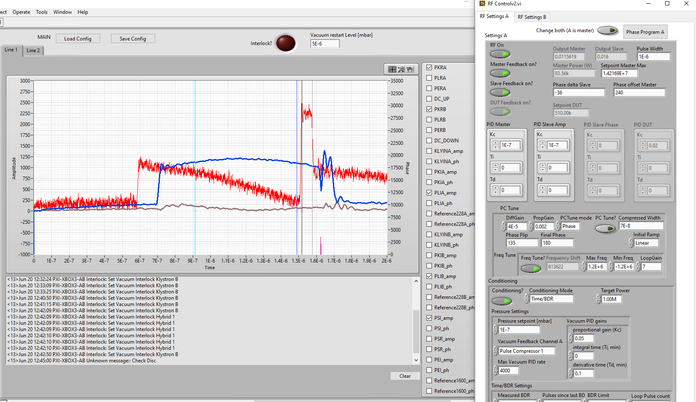
XBOX3 Line 1 - pulses
Integration of Barrel Open Cavity pulse compressor for high power testing
Integration and high power testing of Smartcell

Slide 8
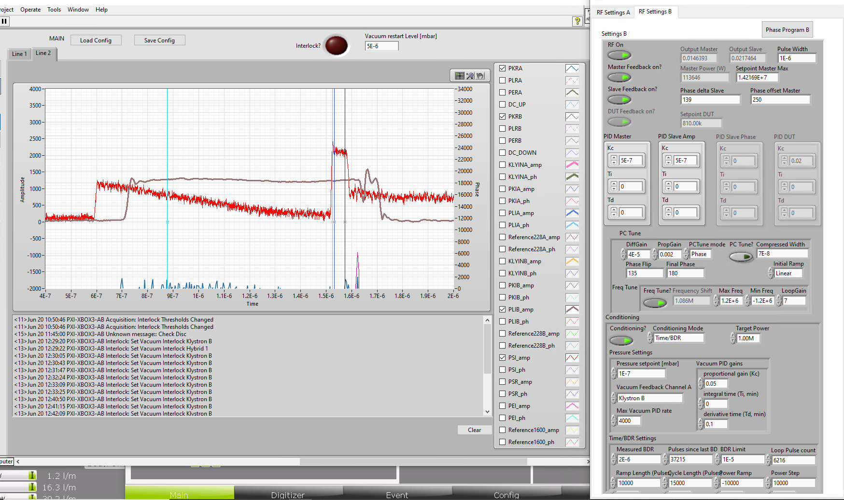
XBOX3 Line 2 - pulses
Integration of Barrel Open Cavity pulse compressor for high power testing
Integration and high power testing of Smartcell

Slide 9
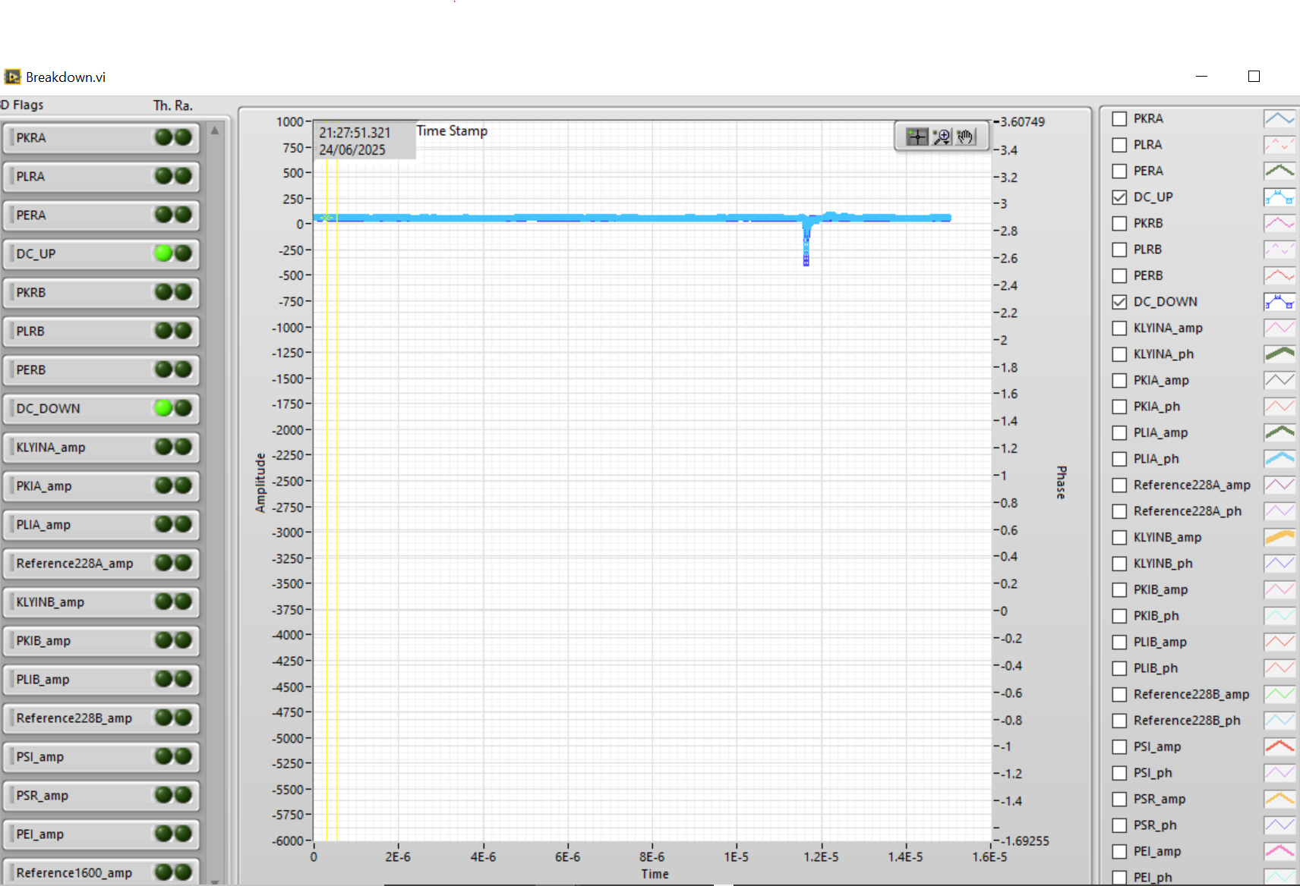
XBOX3 Line 1 Breakdown pulses

Slide 10
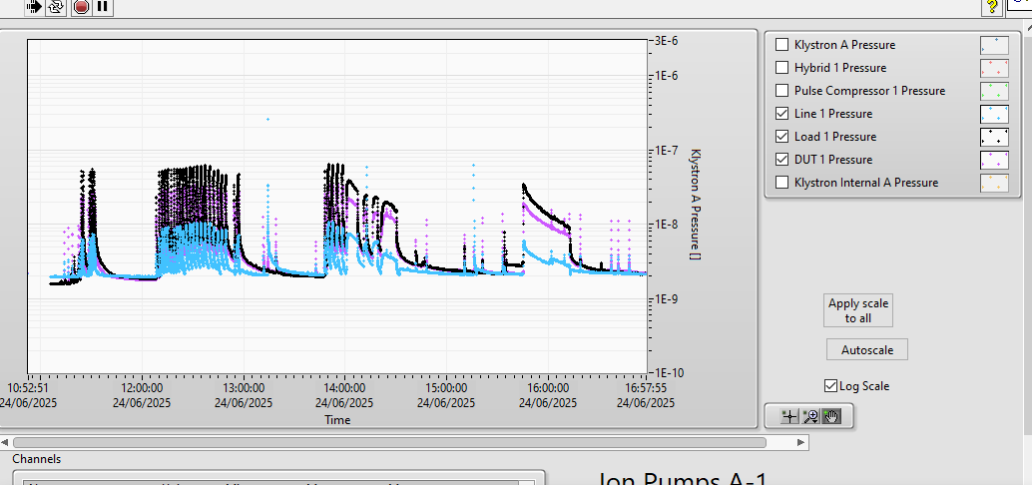
XBOX3 Line 1 Trends – vacuum levels

Slide 11
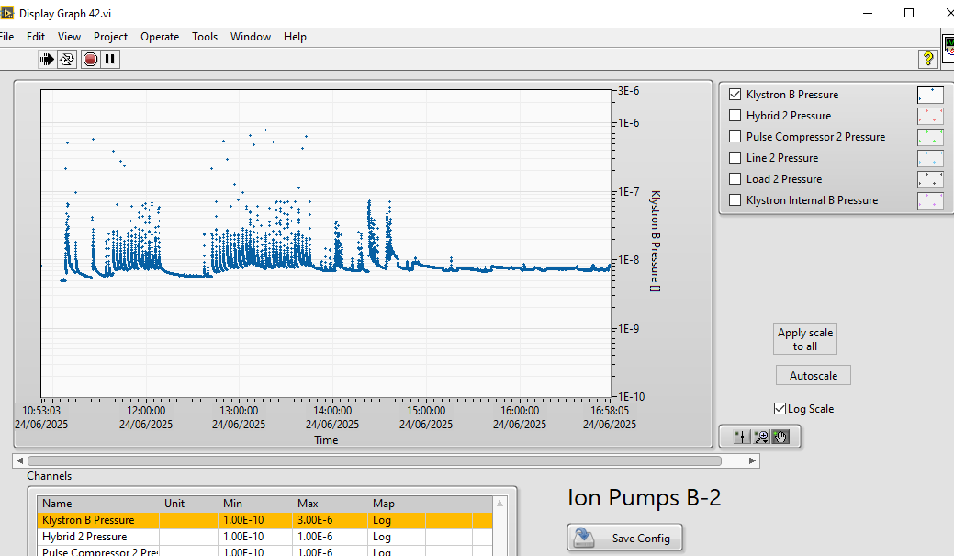
XBOX3 Line 2 Trends – vacuum levels

Slide 12
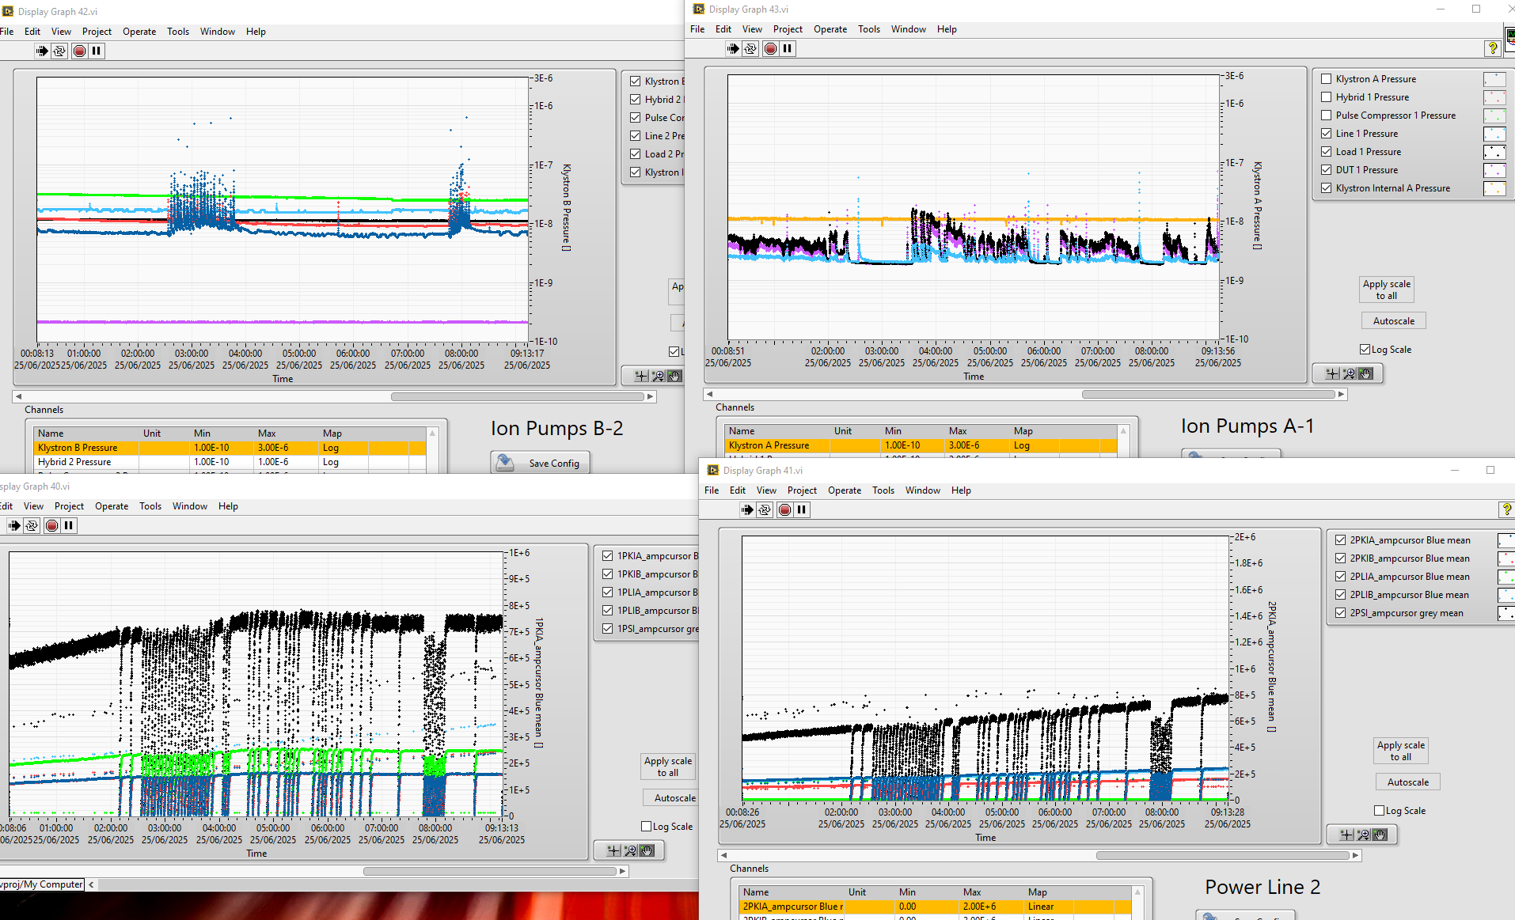
XBOX3 Line 1 and 2- Summary

Slide 13
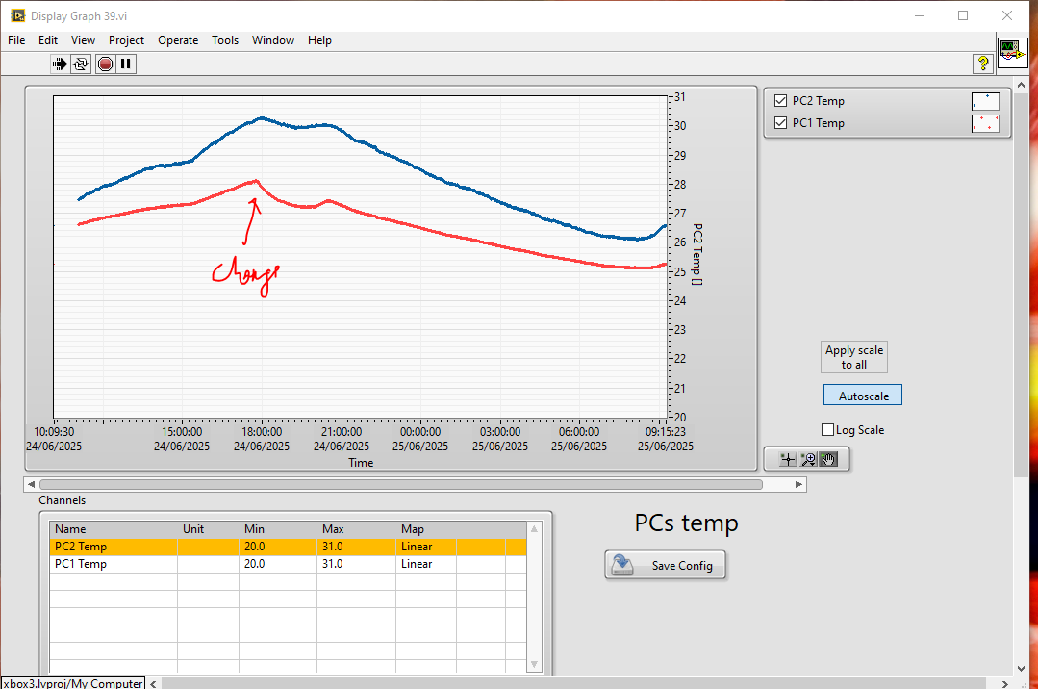
XBOX3 - Temperature

Slide 14
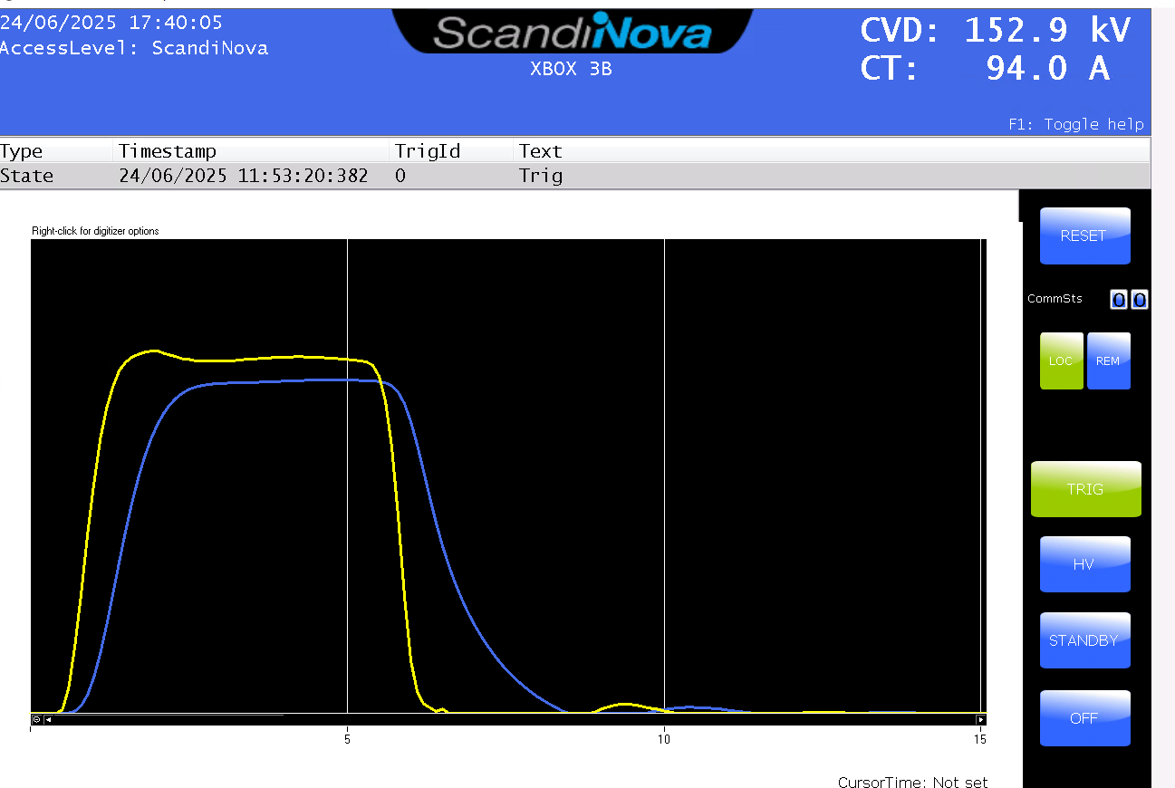
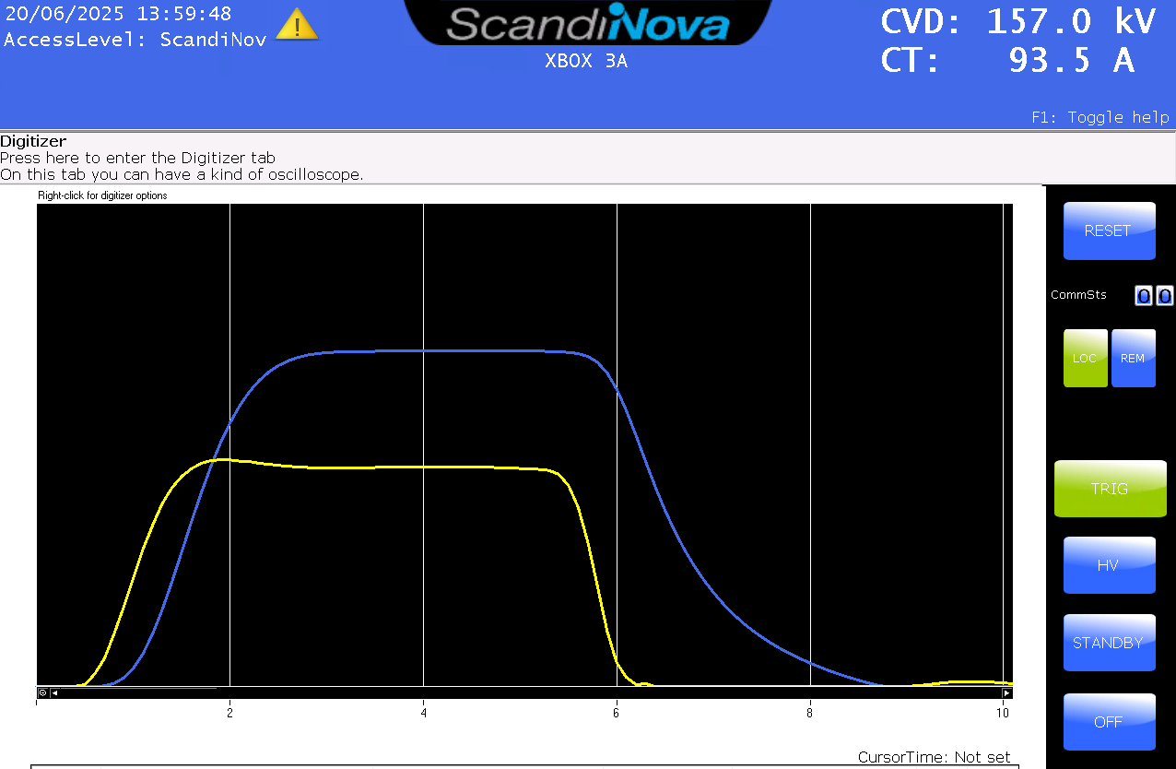
XBOX3 klystron pulses

Slide 16
X-Box 2: Reminder on BD classification
BD_Flag_PER_log
BD Load
TRUE
BD_Flag_DC_DOWN
DC Up >=140
DC Down>=100
BD DUT w. BDC
BD_Flag_DC_UP
FALSE
BD_Flag_PSR_log
BD DUT wo. BDC
BD_Flag_PKR_log
BD HyPC
No BD

