Slide 1


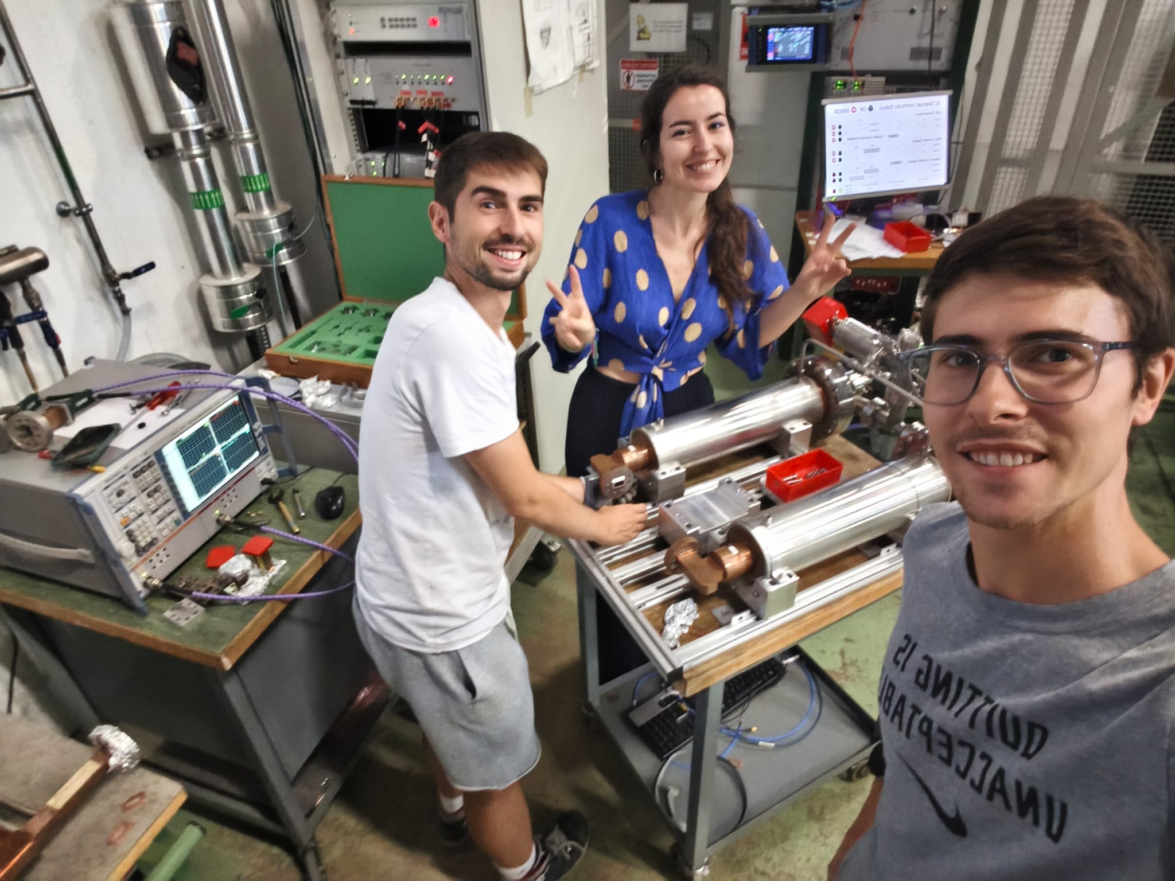
SLED RF Measurement
23.07.2025
Pablo Martinez Reviriego; Paz Alonso Arias; Dario Soriano Guillen

Slide 2
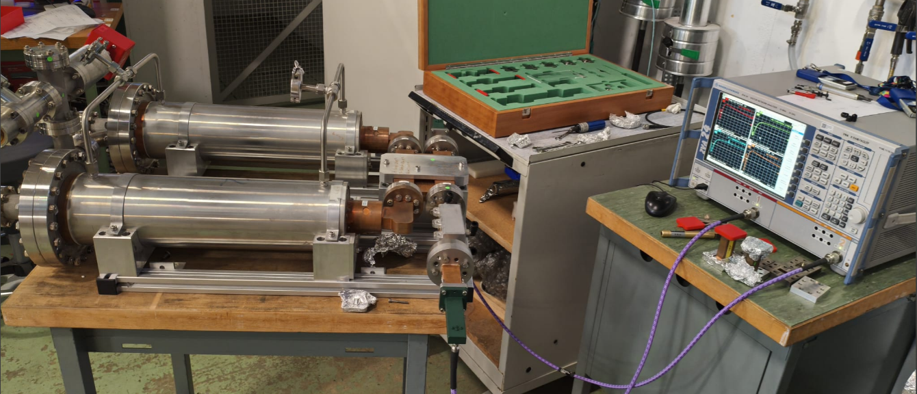
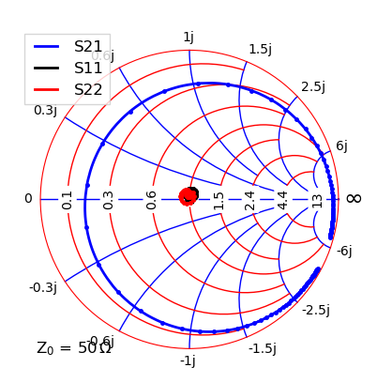
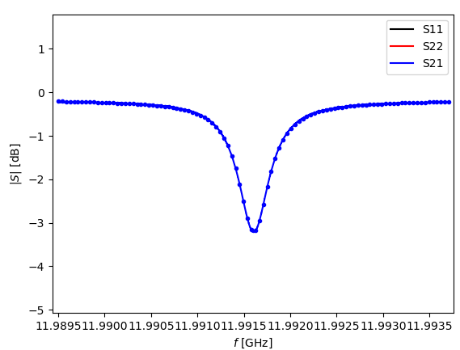
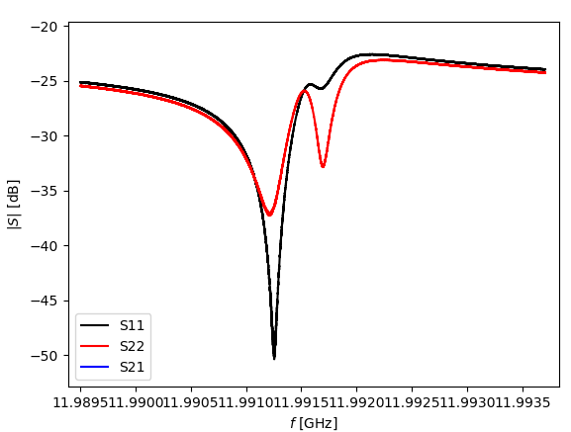
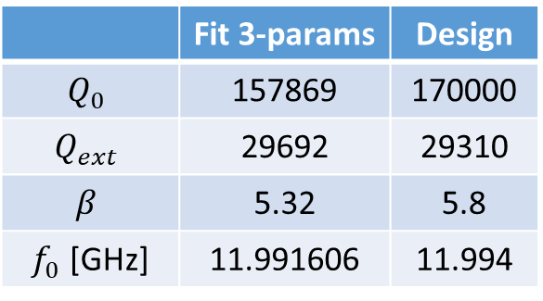
Sled measurements
 | Fit 3-params | Design
$$Q_{0}$$ | 157869 | 170000
$$Q_{ext}$$ | 29692 | 29310
$$β$$ | 5.32 | 5.8
$f_{0}$ [GHz] | 11.991606 | 11.994

Slide 3
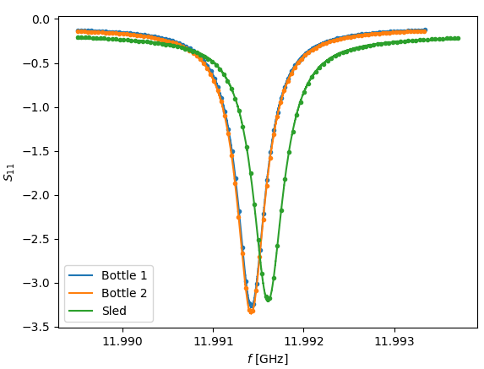
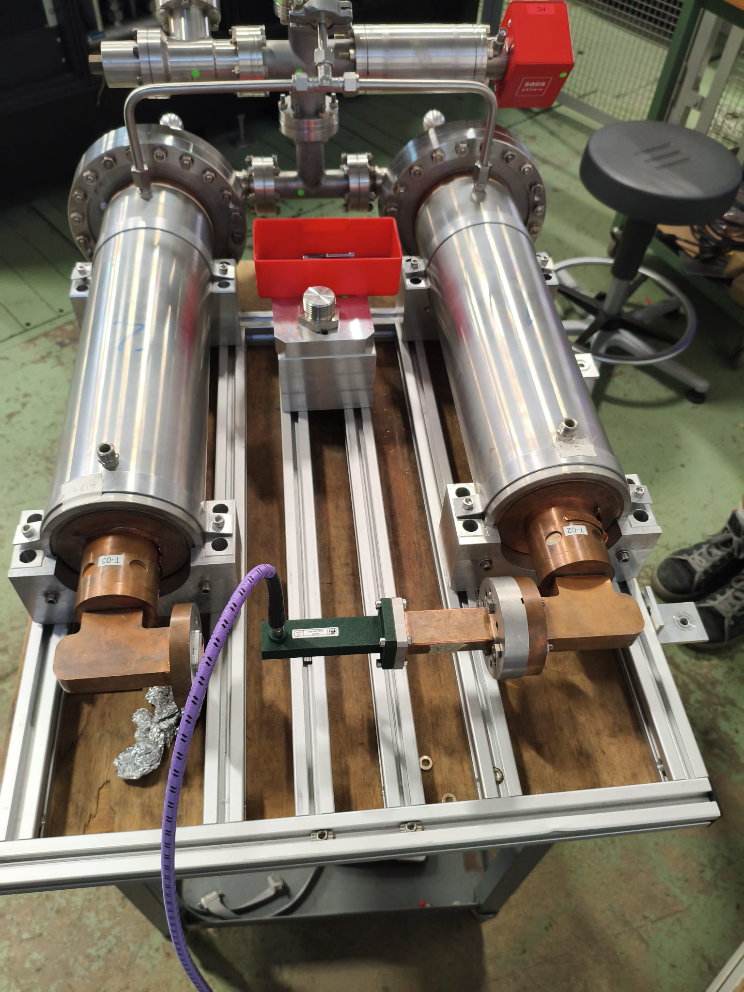
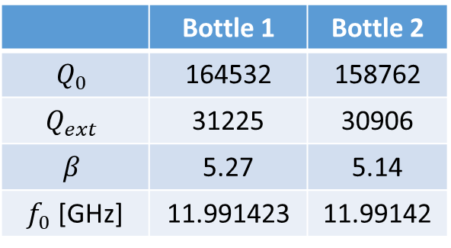
Bottle measurements
1
2
 | Bottle 1 | Bottle 2
$$Q_{0}$$ | 164532 | 158762
$$Q_{ext}$$ | 31225 | 30906
$$β$$ | 5.27 | 5.14
$f_{0}$ [GHz] | 11.991423 | 11.99142

Slide 4
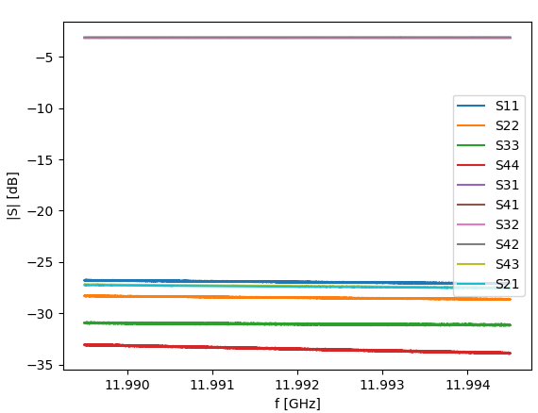
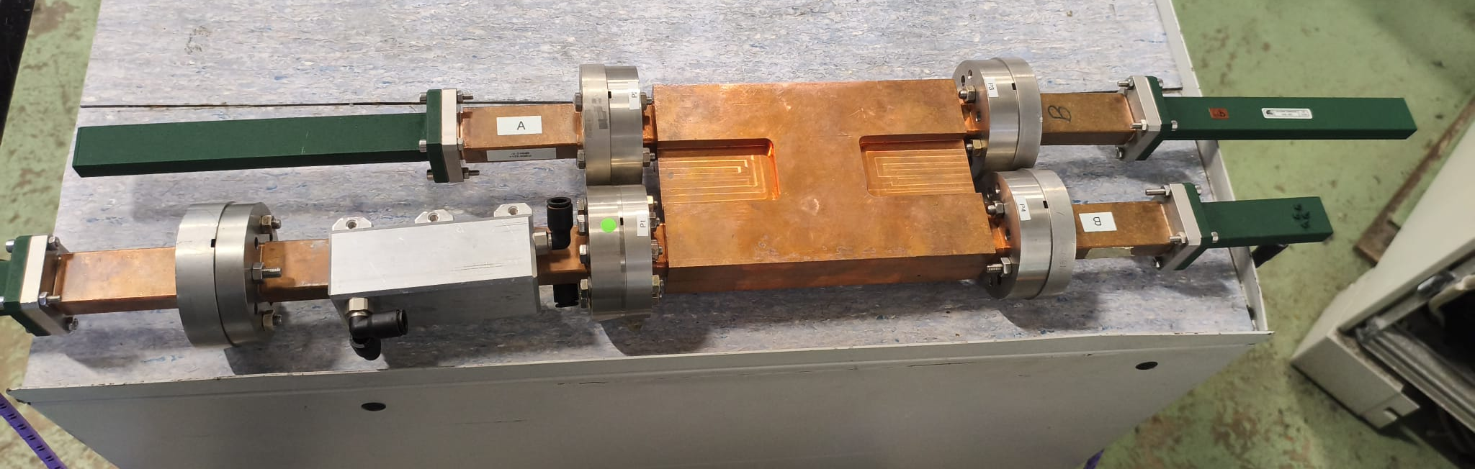
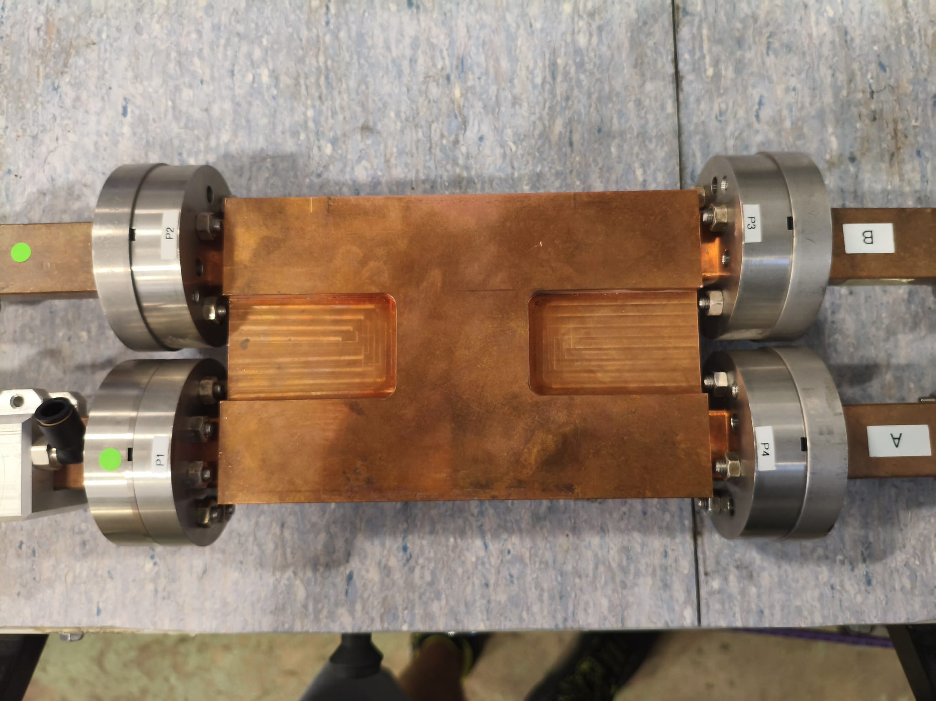
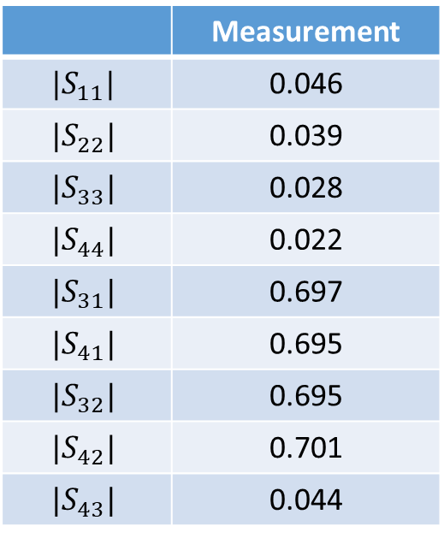
Hybrid measurements
 | Measurement
$$|S_{11}|$$ | 0.046
$$|S_{22}|$$ | 0.039
$$|S_{33}|$$ | 0.028
$$|S_{44}|$$ | 0.022
$$|S_{31}|$$ | 0.697
$$|S_{41}|$$ | 0.695
$$|S_{32}|$$ | 0.695
$$|S_{42}|$$ | 0.701
$$|S_{43}|$$ | 0.044
3
4
1
2

Slide 5
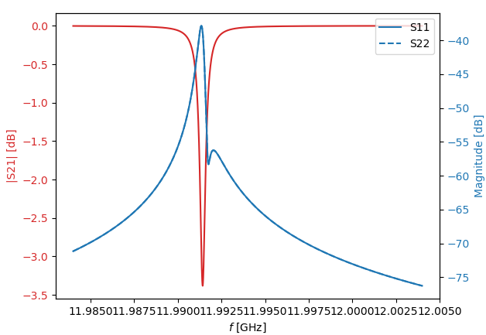
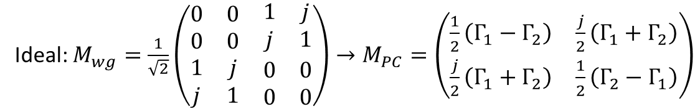
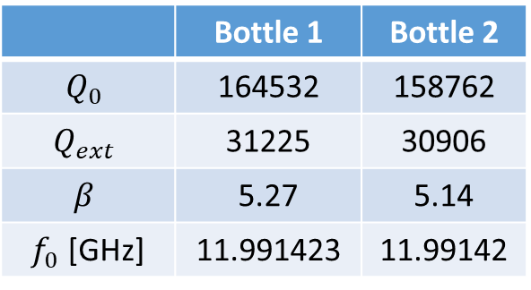
Sled simulation
 | Bottle 1 | Bottle 2
$$Q_{0}$$ | 164532 | 158762
$$Q_{ext}$$ | 31225 | 30906
$$β$$ | 5.27 | 5.14
$f_{0}$ [GHz] | 11.991423 | 11.99142
Ideal: $M_{wg}=\frac{1}{\sqrt{2}}\left(\begin{matrix}\begin{matrix}0 & 0 \\ 0 & 0\end{matrix} & \begin{matrix}1 & j \\ j & 1\end{matrix} \\ \begin{matrix}1 & j \\ j & 1\end{matrix} & \begin{matrix}0 & 0 \\ 0 & 0\end{matrix}\end{matrix}\right)→M_{PC}=\left(\begin{matrix}\frac{1}{2}\left(Γ_{1}−Γ_{2}\right) & \frac{j}{2}\left(Γ_{1}+Γ_{2}\right) \\ \frac{j}{2}\left(Γ_{1}+Γ_{2}\right) & \frac{1}{2}\left(Γ_{2}−Γ_{1}\right)\end{matrix}\right)$
Measurement
Simulation ideal hybrid

Slide 6
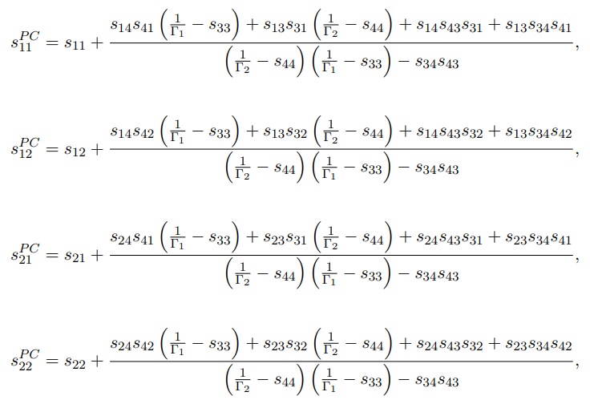
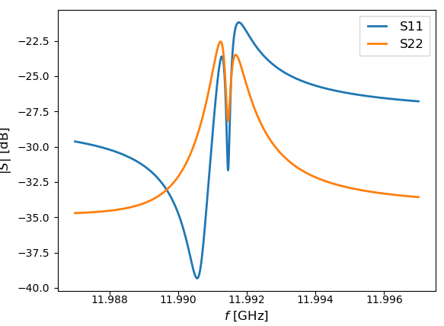
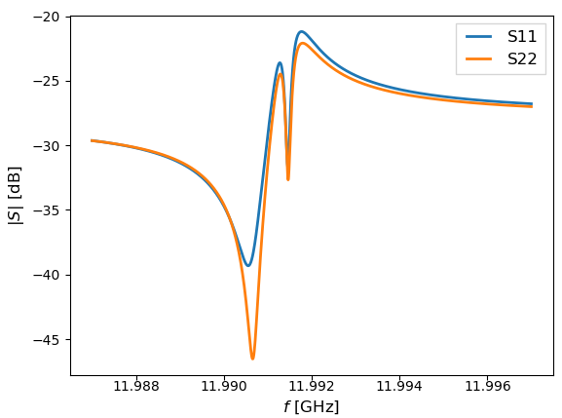
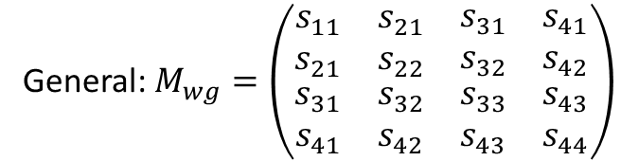
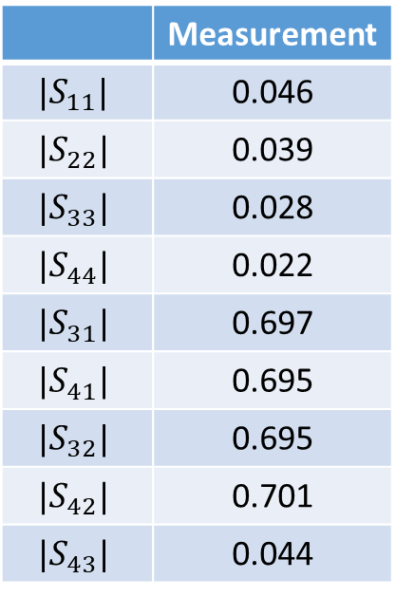
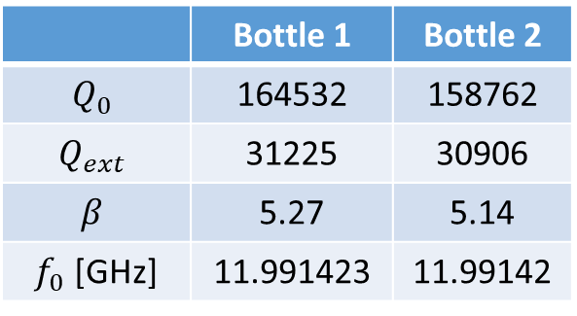

Sled simulation
General: $M_{wg}=\left(\begin{matrix}\begin{matrix}s_{11} & s_{21} \\ s_{21} & s_{22}\end{matrix} & \begin{matrix}s_{31} & s_{41} \\ s_{32} & s_{42}\end{matrix} \\ \begin{matrix}s_{31} & s_{32} \\ s_{41} & s_{42}\end{matrix} & \begin{matrix}s_{33} & s_{43} \\ s_{43} & s_{44}\end{matrix}\end{matrix}\right)$
Measurement
 | Bottle 1 | Bottle 2
$$Q_{0}$$ | 164532 | 158762
$$Q_{ext}$$ | 31225 | 30906
$$β$$ | 5.27 | 5.14
$f_{0}$ [GHz] | 11.991423 | 11.99142
 | Measurement
$$|S_{11}|$$ | 0.046
$$|S_{22}|$$ | 0.039
$$|S_{33}|$$ | 0.028
$$|S_{44}|$$ | 0.022
$$|S_{31}|$$ | 0.697
$$|S_{41}|$$ | 0.695
$$|S_{32}|$$ | 0.695
$$|S_{42}|$$ | 0.701
$$|S_{43}|$$ | 0.044
$$S_{32}=S_{41}, S_{42}=S_{31}$$
Simulation all parameters

