Slide 1
X-Boxes Update
01.10.2025

Slide 2
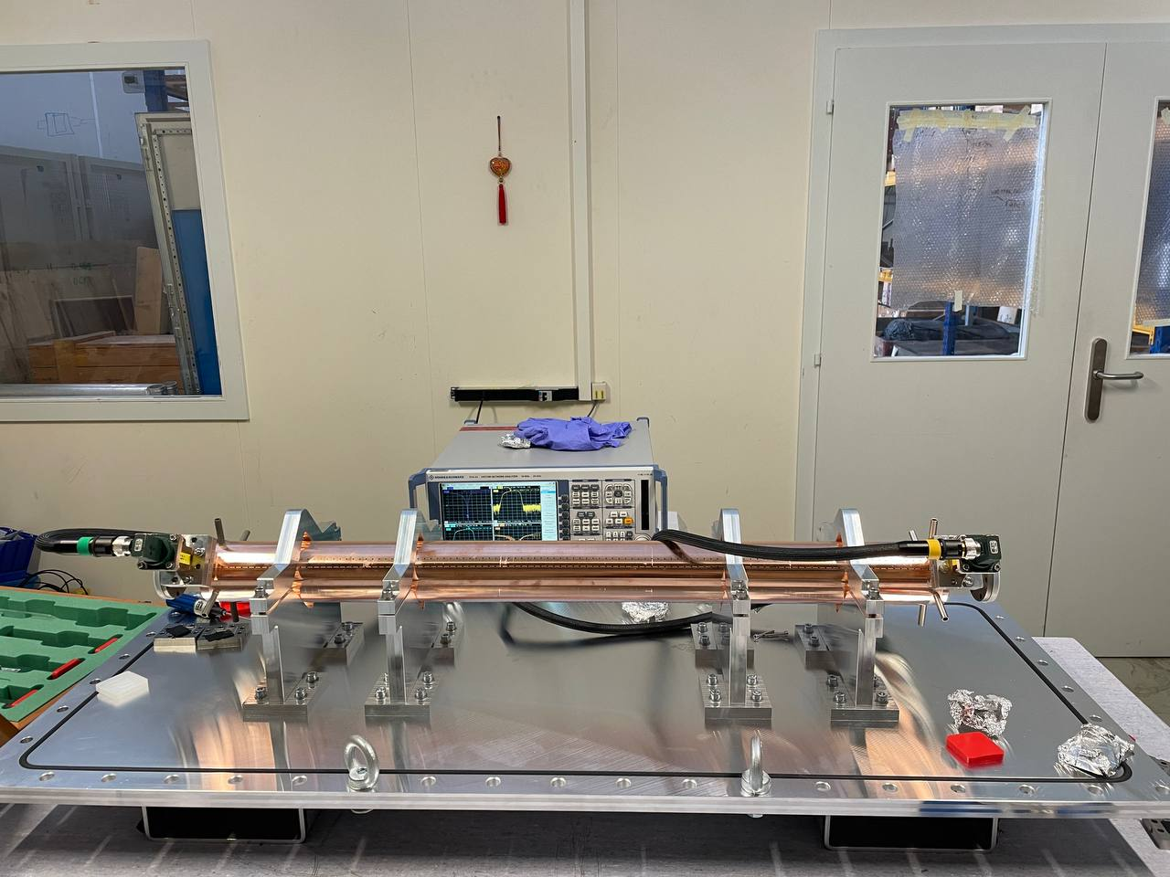
iFast structure – Low Power Measurements
S parameters measurement
300 MHz span
11.994 GHz center frequency
No. points 10001
IF Bandwidth 1 kHz
4 ports full-calibration
No vacuum
Port 1, Output
Port 2, Input

Slide 3
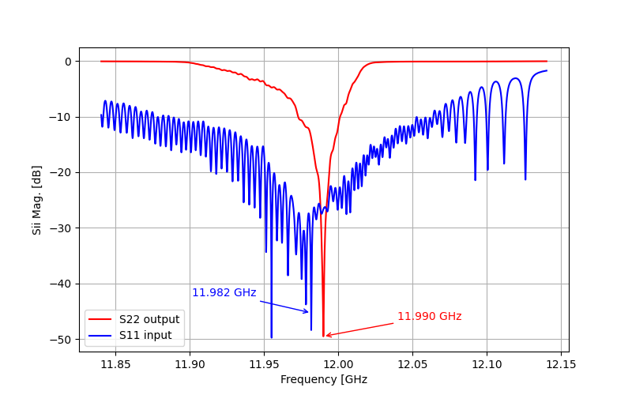
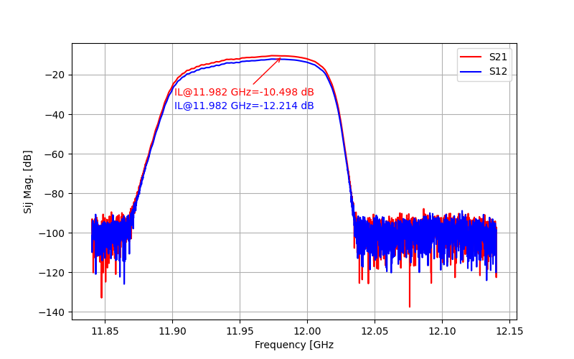
iFast structure – Low Power Measurements
S parameters measurement
300 MHz span
11.994 GHz center frequency
No. points 10001
IF Bandwidth 1 kHz
4 ports full-calibration
Including air correction

Slide 4
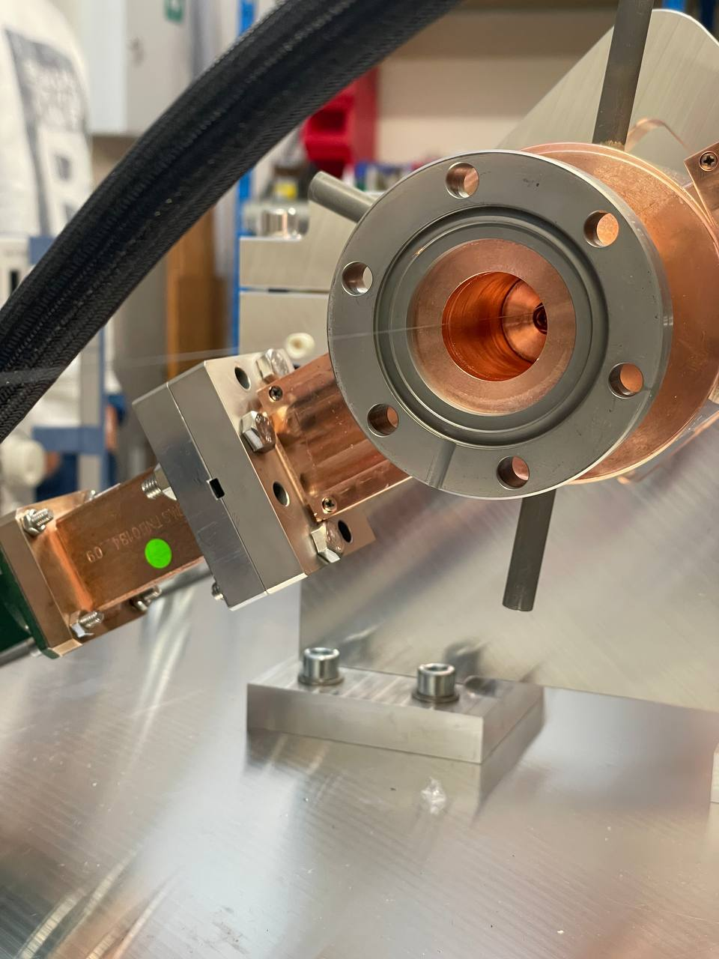
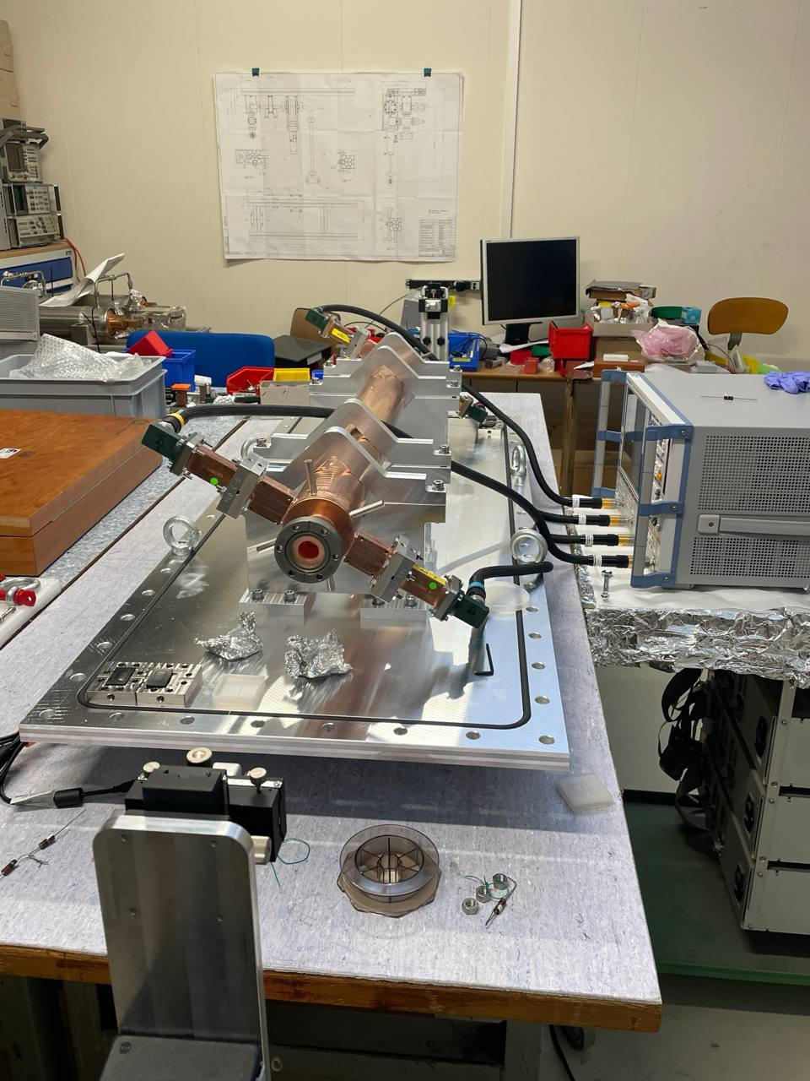
iFast structure – Low Power Measurements
Bead pull
CW mode
No. points 8001
IF Bandwidth 100 Hz
Time sweep 65 s

Slide 5
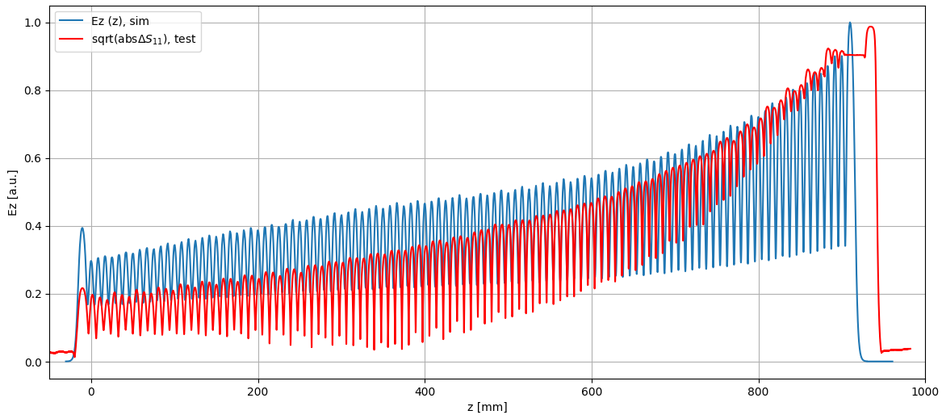
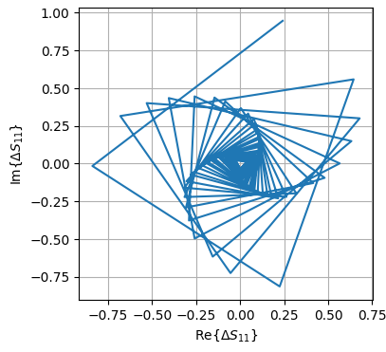
iFast structure – Low Power Measurements
Plateau probably due to motor stuck
Bead pull @11.994GHz
11.994 GHz CW mode
No. points 8001
IF Bandwidth 100 Hz
Time sweep 65 s
Number of peaks: 113= 111 cells + 2 coupler cells?

Slide 6
XBOXES Summary
XBOX2 (Not operative)
XBOX3 (Operative)
No superconductivity (faulty cryocooler)
Changed cryocooler filters, still not working
S. Calatroni provided the contact of the provider. Asked for repair options
Waiting for klystron (in Italy)
Cryocooler sent for repair
Started pulsing 13th June
150 Hz in each line
50ns RF pulse, no compression
Setpoint DUT 8MW in both lines
Compressed pulse 50ns
RF pulse 2us
Setpoint DUT 2MW (limited by Pulse compressor)

Slide 7
XBOX3 Configuration
Bunker
KLY A
PC 1
DUT 1
Load 1
SSA A
KLYINA
PKRA
PKIA
PLRA
PLIA
PSRA
PSIA
PERA
PEIA
HYB
DC
HPDC
HPDC
HPDC
HPDC
Faraday Cups
SSA B
KLYINB
PKRB
PKIB
PLRB
PLIB
PSRB
PSIB
PERB
PEIB
DC
HPDC
HPDC
HPDC
HPDC
PC 2
DUT 2
Load 2
KLY B
DCUP
DCDOWN

Slide 8
XBOX3 Configuration – Line 2
Bunker
KLY A
PC 1
DUT 1
Load 1
SSA A
KLYINA
PKRA
PKIA
PLRA
PLIA
PSRA
PSIA
PERA
PEIA
HYB
DC
HPDC
HPDC
HPDC
HPDC
Faraday Cups
SSA B
KLYINB
PKRB
PKIB
PLRB
PLIB
PSRB
PSIB
PERB
PEIB
DC
HPDC
HPDC
HPDC
HPDC
Old PC
TD31N1
Load
KLY B
DCUP
DCDOWN

Slide 9
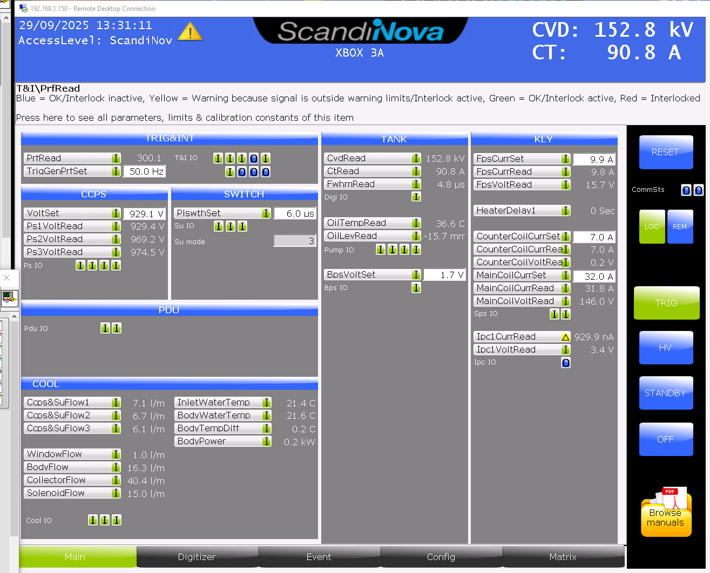
XBOX3 Configuration – HEK klystron

Slide 10
XBOXES TO DO list
Finishing paper on High power tests
Knowledge transfer to next Grad, starting January
Writing documentation on Xboxes (guidelines)
Calibration of RF lines before leaving (at least PSI signals)
Changing a PXI card in XBOX3 (acquisition of pulse compressor chillers information) and making sure everything works
Not breaking a klystron during my last month

Slide 12
XBOX3 Configuration
Bunker
KLY A
PC 1
DUT 1
Load 1
SSA A
KLYINA
PKRA
PKIA
PLRA
PLIA
PSRA
PSIA
PERA
PEIA
HYB
DC
HPDC
HPDC
HPDC
HPDC
Faraday Cups
SSA B
KLYINB
PKRB
PKIB
PLRB
PLIB
PSRB
PSIB
PERB
PEIB
DC
HPDC
HPDC
HPDC
HPDC
PC 2
DUT 2
Load 2
KLY B
DCUP
DCDOWN

Slide 13
XBOX3 Configuration
Bunker
E37117
PC 1
DUT 1
Load 1
SSA A
KLYINA
PKRA
PKIA
PLRA
PLIA
PSRA
PSIA
PERA
PEIA
HYB
DC
HPDC
HPDC
HPDC
HPDC
Faraday Cups
SSA B
KLYINB
PKRB
PKIB
PLRB
PLIB
PSRB
PSIB
PERB
PEIB
DC
HPDC
HPDC
HPDC
HPDC
PC 2
DUT 2
Load 2
E37123
DCUP
DCDOWN

Slide 14
X-Box 2: Reminder on BD classification
BD_Flag_PER_log
BD Load
TRUE
BD_Flag_DC_DOWN
DC Up >=140
DC Down>=100
BD DUT w. BDC
BD_Flag_DC_UP
FALSE
BD_Flag_PSR_log
BD DUT wo. BDC
BD_Flag_PKR_log
BD HyPC
No BD

