Slide 1
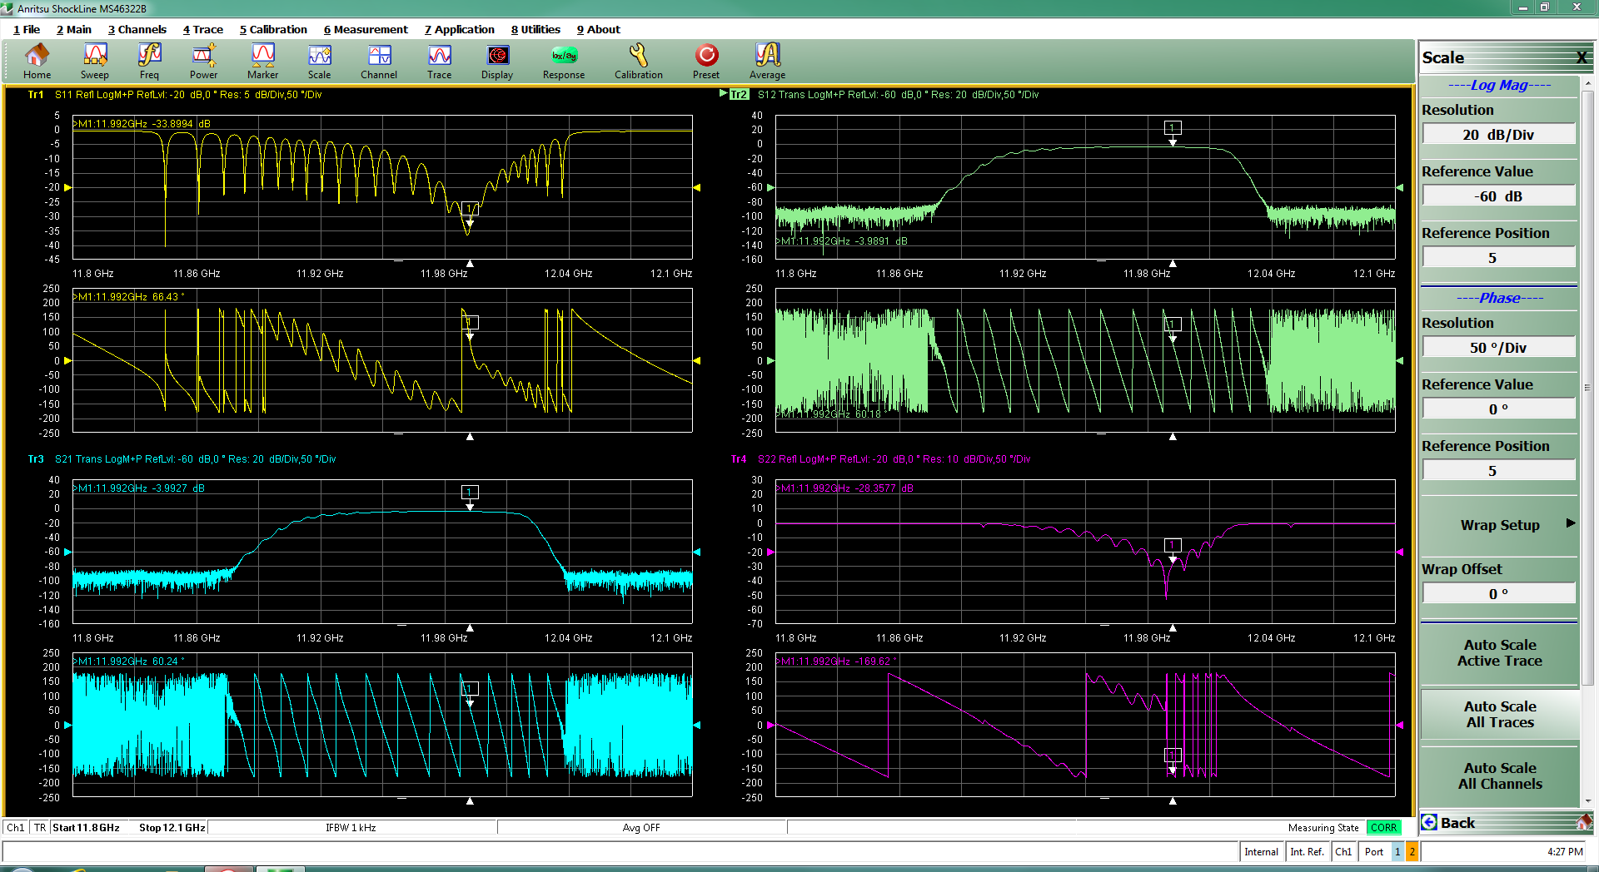
Mel-BOX Summary
Line 3 - PC (new cups) => ~23MW conditioning
Hot spot ~ 40C @ piston flange
Line 4 - TD24 N1 No BO conditioning:
Reach 38MW
Pulsing 24/7
LABview update: choose line, EPIC interface… etc
Oil leak (modulator)
VNA measurement + bead pool (preliminary) of TD24 N2 BO (seams good)
Linkage grant application & Australia’s Economic Accelerator (AEA) grant submitted

Slide 2
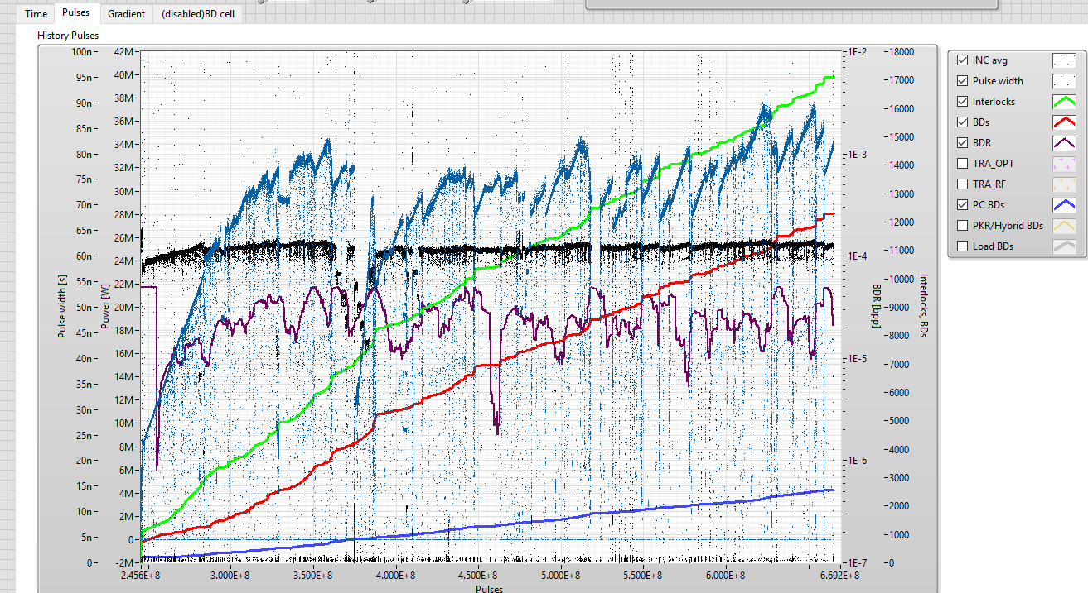
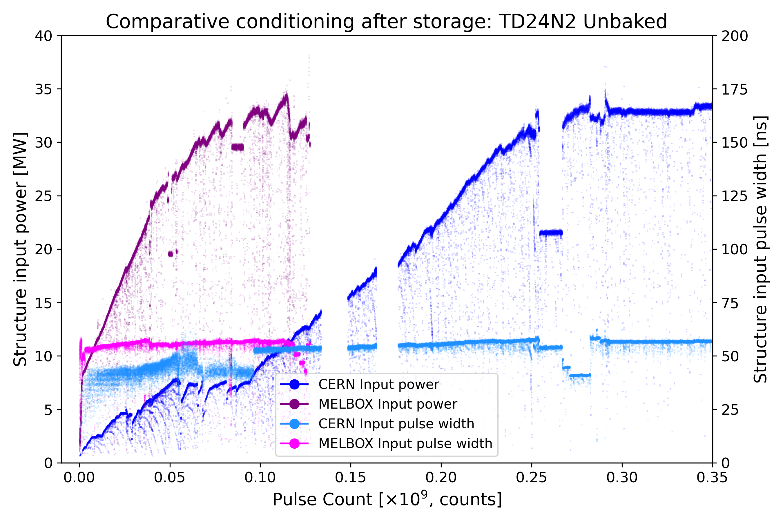
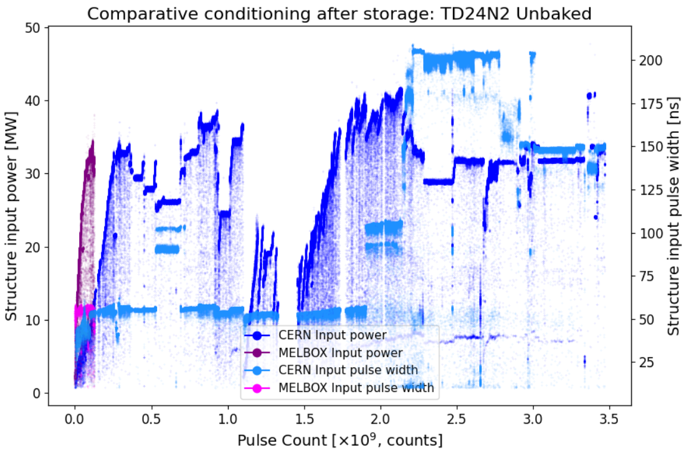
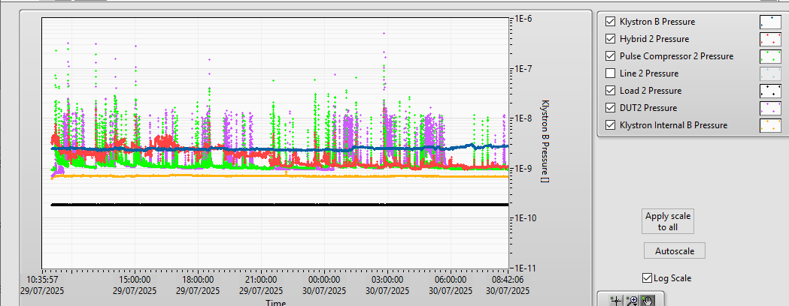
TD24 N2 Conditioning plot (Update Code)
Melbourne
350 M Pulses
CERN
Now is back to 33MW
TD24 BDs
450M Pulses
PC BDs
~450M
Structure BDs
PC BDs

Slide 3
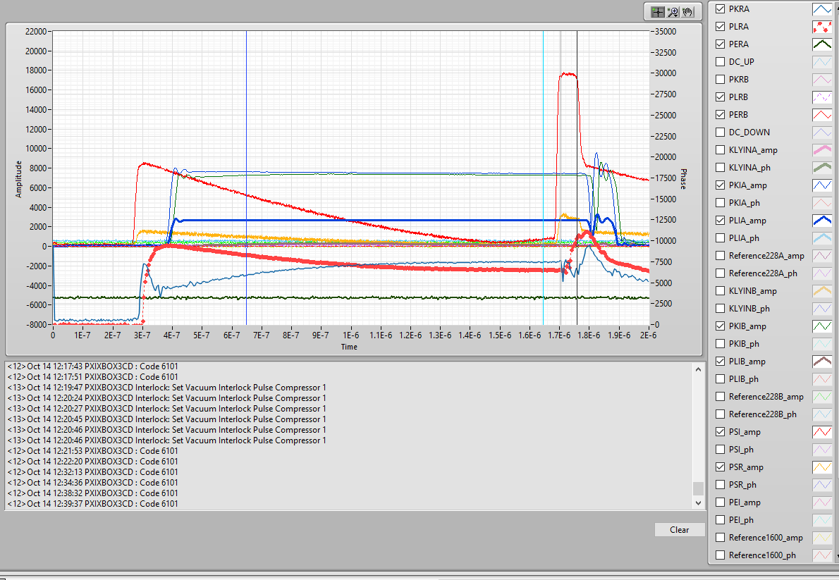
New cups pulse compressor conditioing
Unusual reflection (~15 dB) and outgassing have been observed on the new PC cups.
The reflection follows the PSI pulse shape ⇒ the issue is likely downstream of the PC (possibly a bad gasket?).
Stop condition occurred around 10 MW.
TD24 was pulsed alone for a long period (~300 M pulses).
The PC was sharing vacuum and power; leaks were observed only at the hybrid.
A few days ago, we restarted PC conditioning, within one day, we reached 23 MW.
Interlocks were triggered due only to vacuum.
Vacuum conditioning algorithm is being used.
PSI
PLR
Gain factor ≈ 3 at 1.5 µs pulse width, flat-top ≈ 50 ns.
Gain factor ≈ 4 at 2.5 µs pulse width, flat top ≈ 50 ns.
Vacuum conditioning only so far; only a few breakdowns

Slide 4
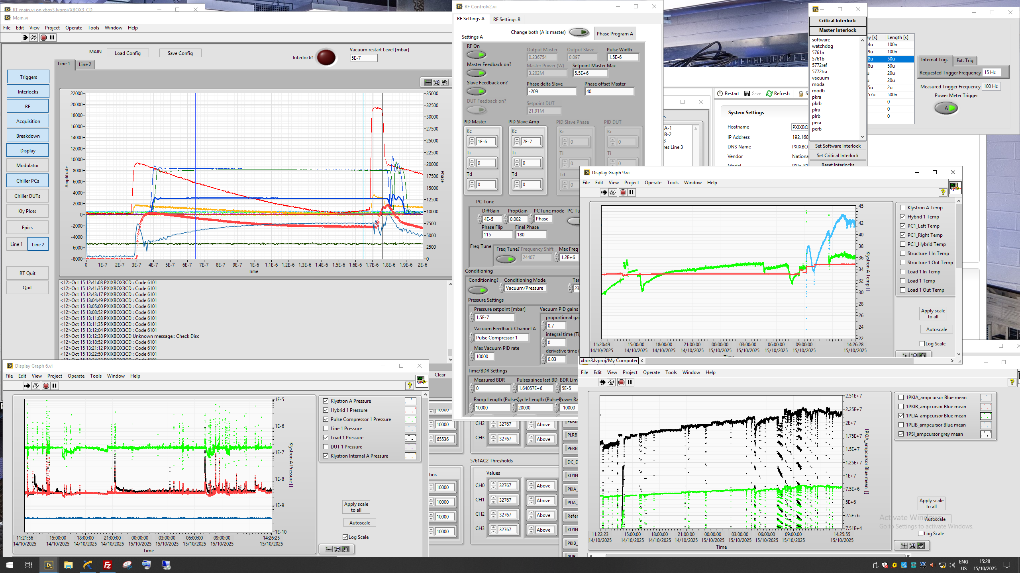
Power & Vacuum

Slide 5
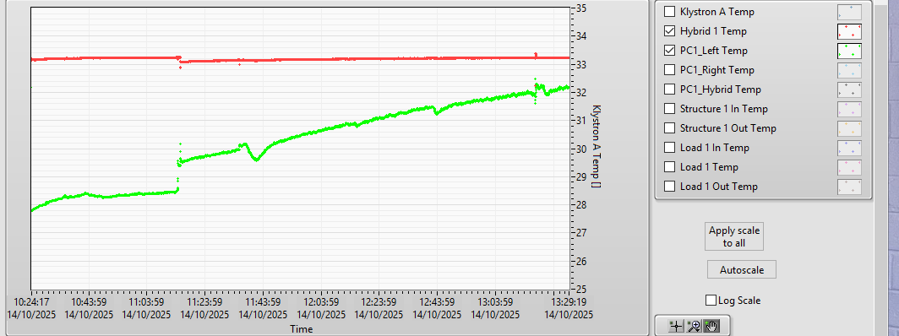
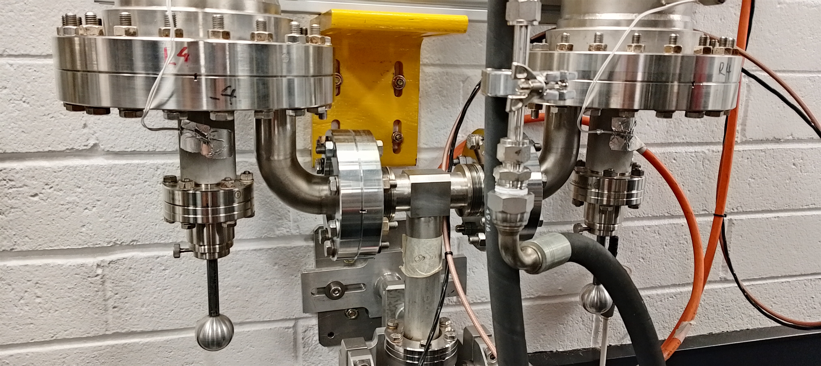
Hot plunger
We observe different temperature on the left and right plunger; the hottest point isn’t at the cup level but on the plunger flange of the left cavity
Right Cavity (R) NOT Calibrated should be -5C
Start pulsing chiller temperature
~ 30C, power ~16MW
Left (L) Cavity ~ Calibrated
L
R
Calibration done with FLUKE Thermo-Gun

Slide 6
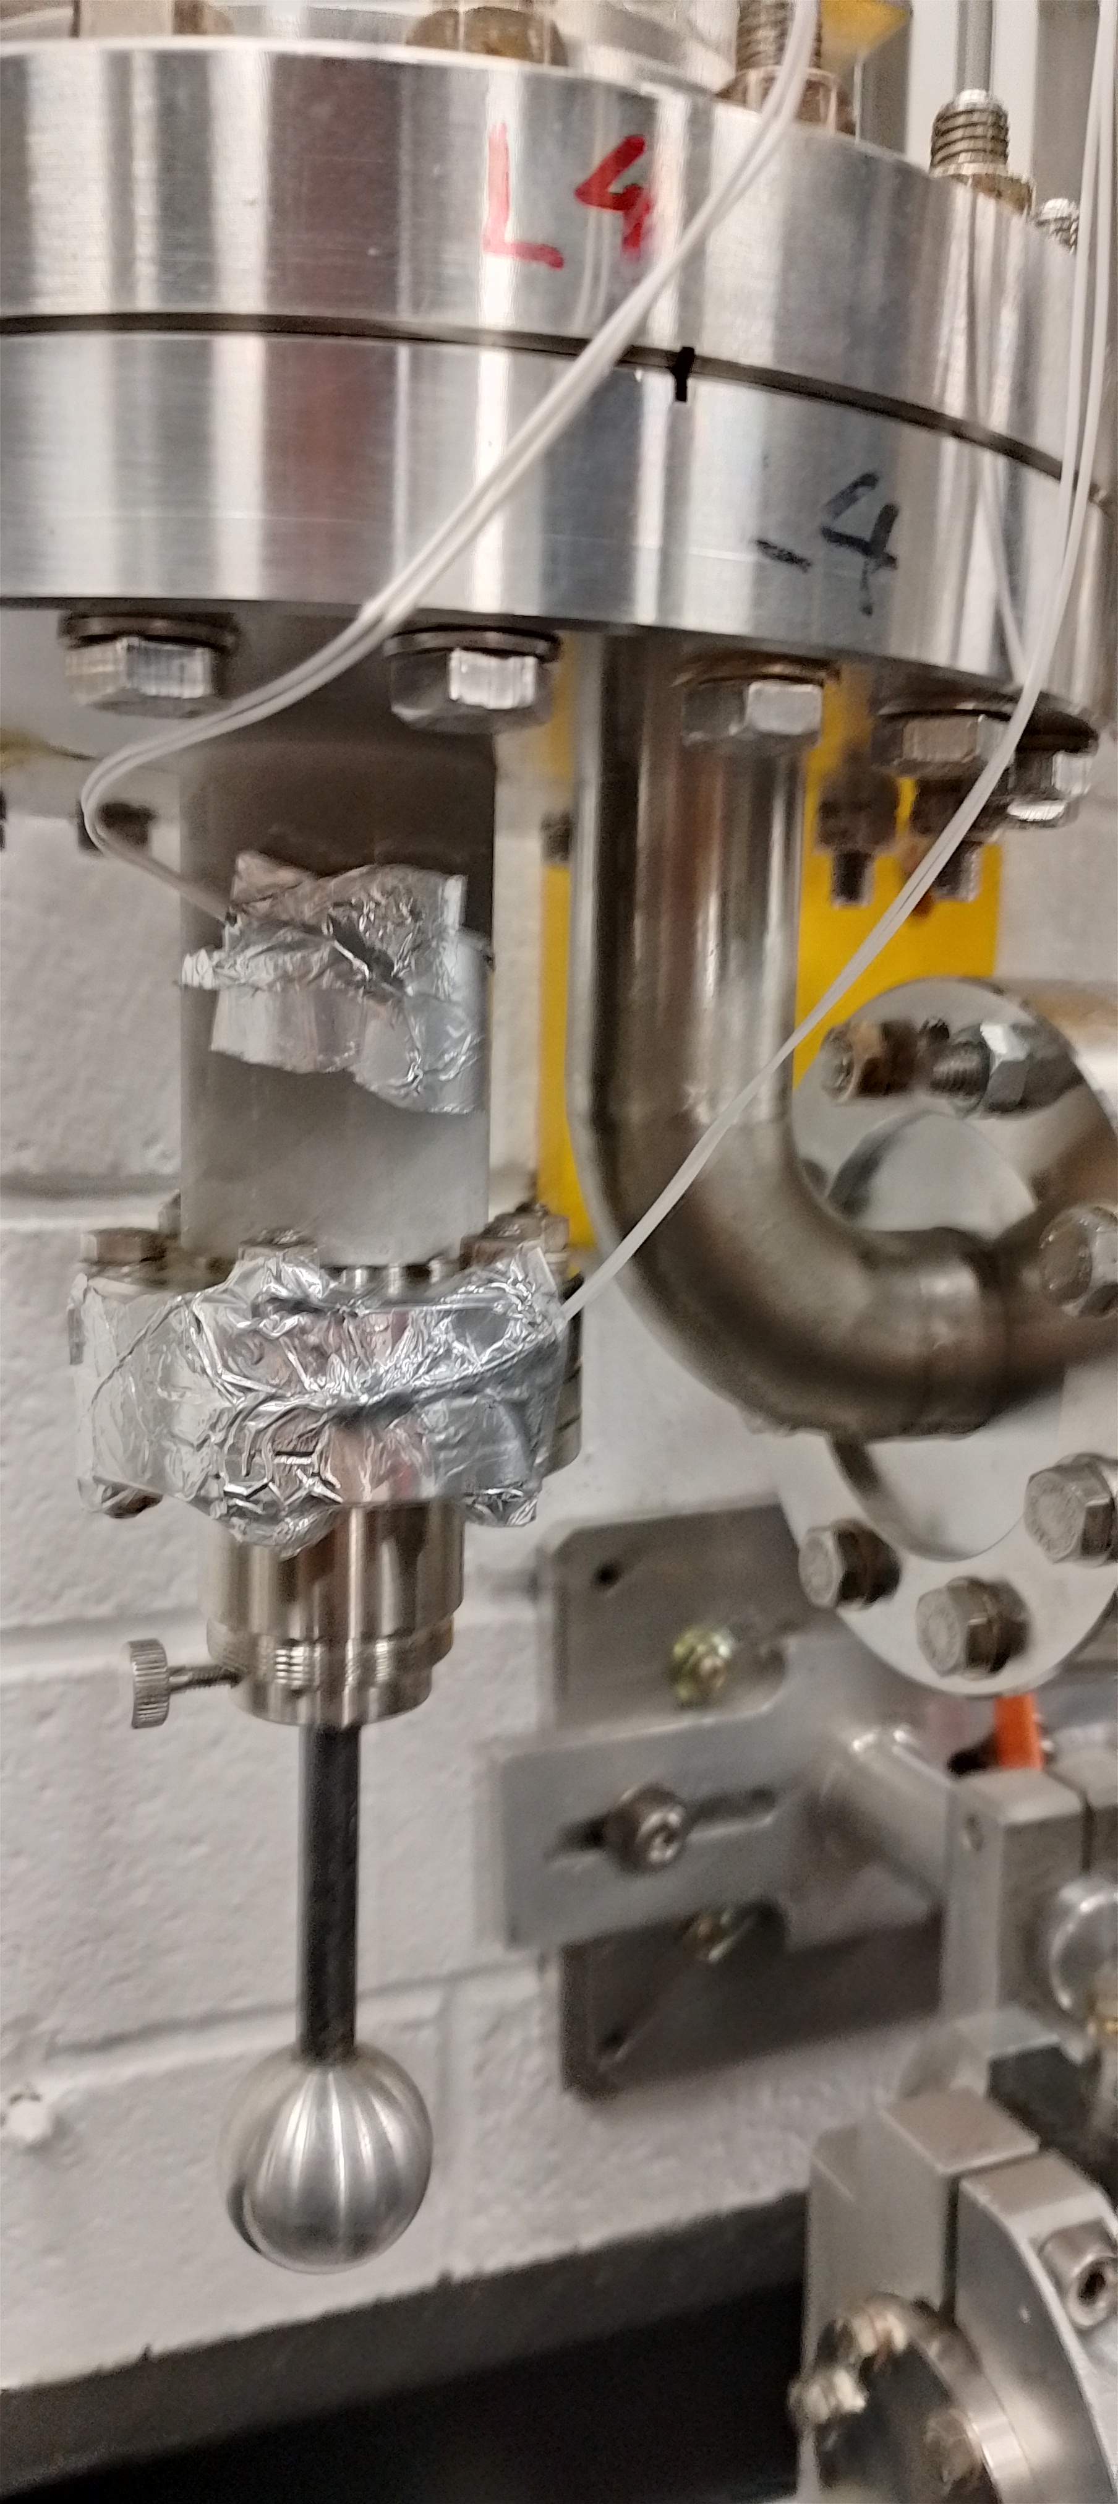
Had a temp. probe to the flange
We observe different temperature on the left and right plunger; the hottest point isn’t at the cup level but on the plunger flange of the left cavity
Right Cavity (R) NOT Calibrated should be -5C
Left (L) Cavity ~ Calibrated
~40C @ L Flange
Note: If change the plunge position, we have vacuum spike even a low power.

Slide 7
Possible reason of temperature difference
The 3 dB hybrid doesn’t split the klystron power equally.
Cavity frequency detuning
Coupling imbalance (β mismatch)
Outgassing and vacuum differences
If one cavity has slightly worse vacuum (e.g. 10⁻⁷ mbar instead of 10⁻⁸ mbar):
There are more residual gas molecules inside.
These molecules absorb part of the RF energy through ionization or dielectric loss, especially near the field maxima.
The absorbed energy appears as additional heating on the cavity wall (mostly at the iris or coupling port, where fields are strongest).
There might be a leak at the gasket, which also doesn’t look perfectly aligned when touched.

Slide 8
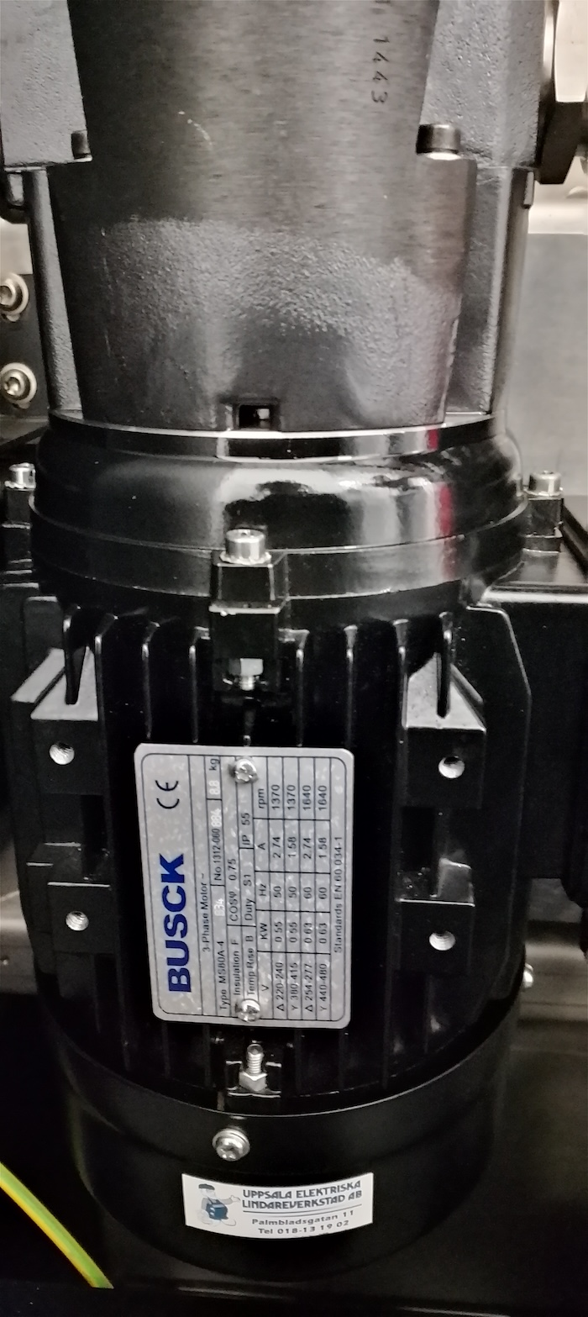
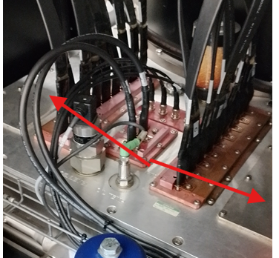
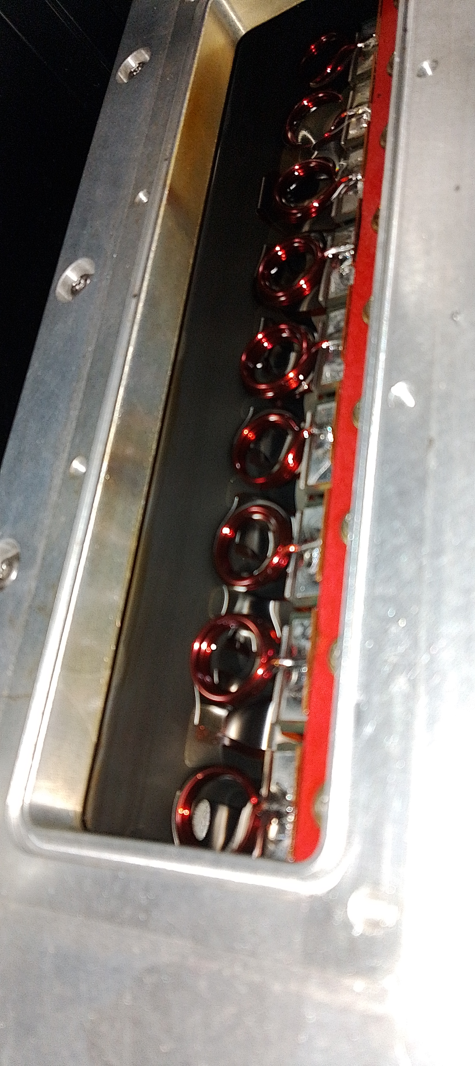
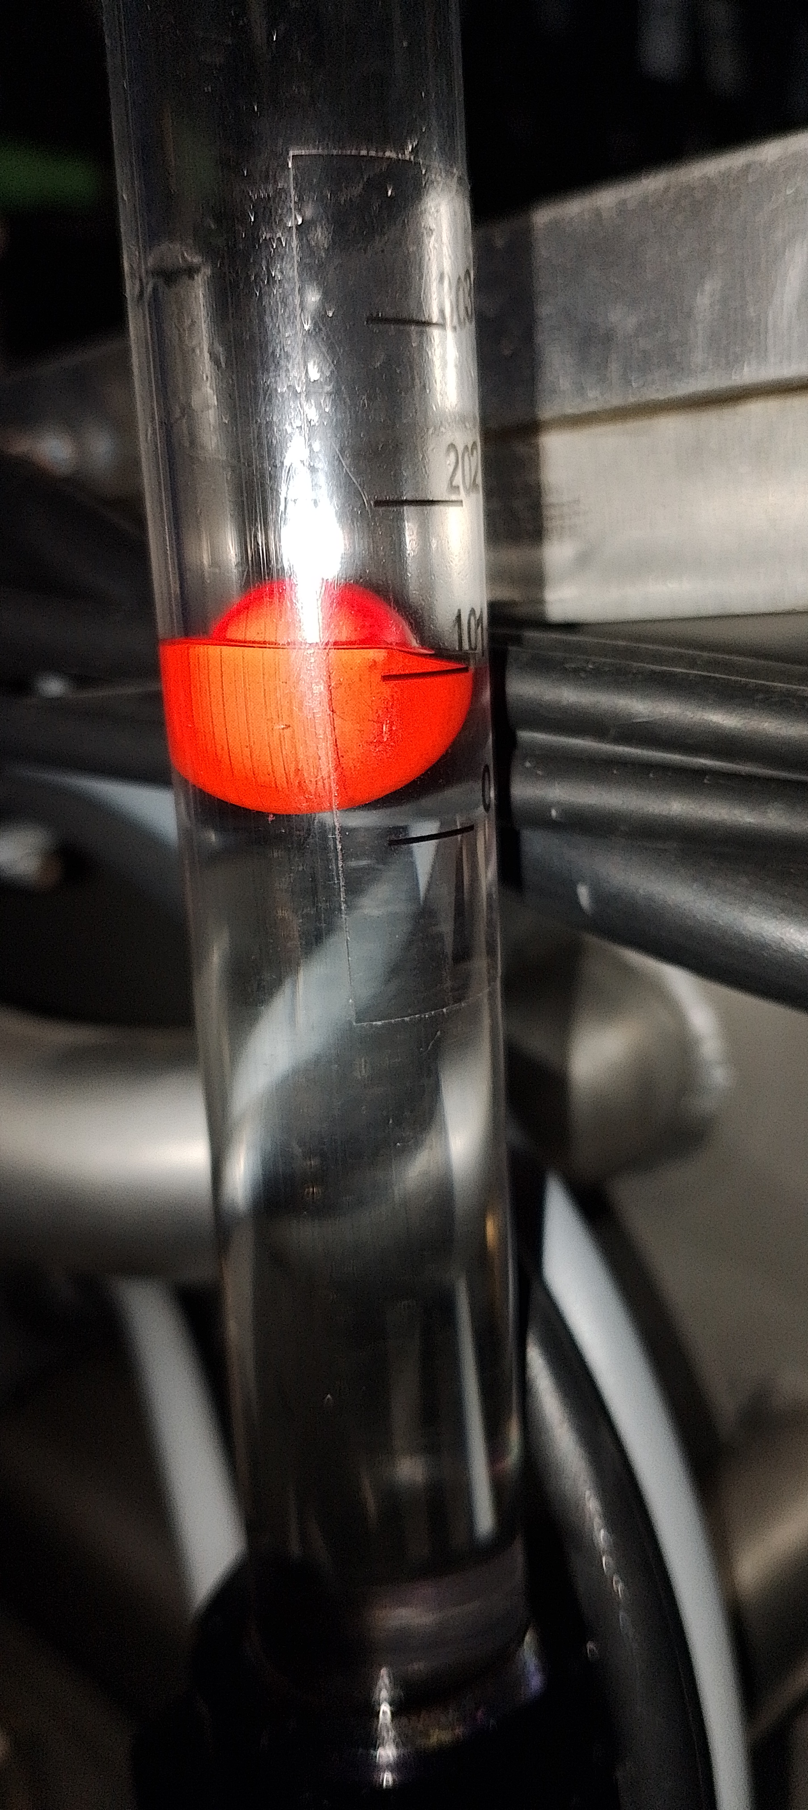
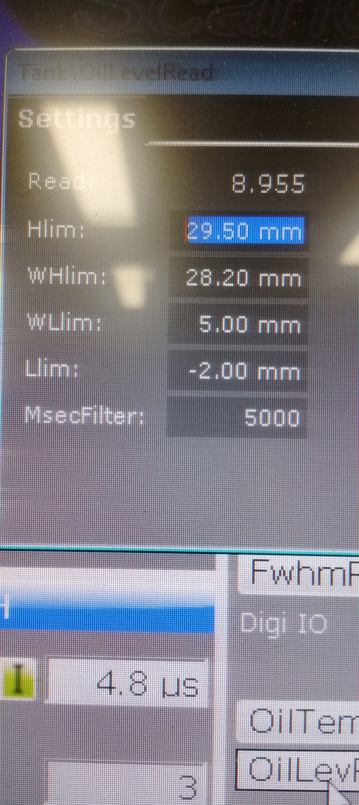
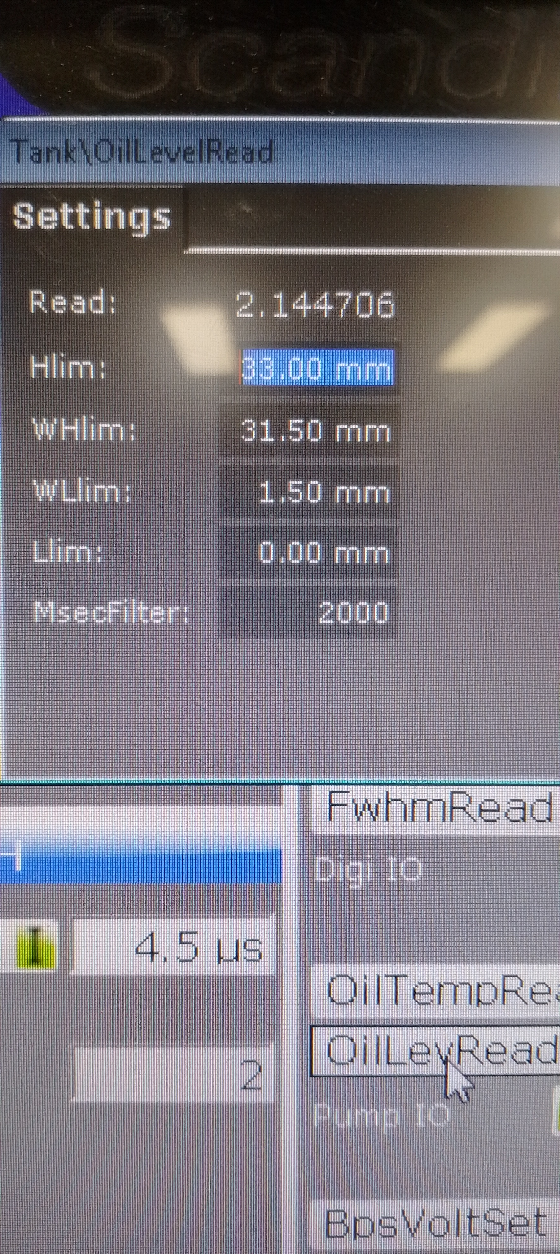
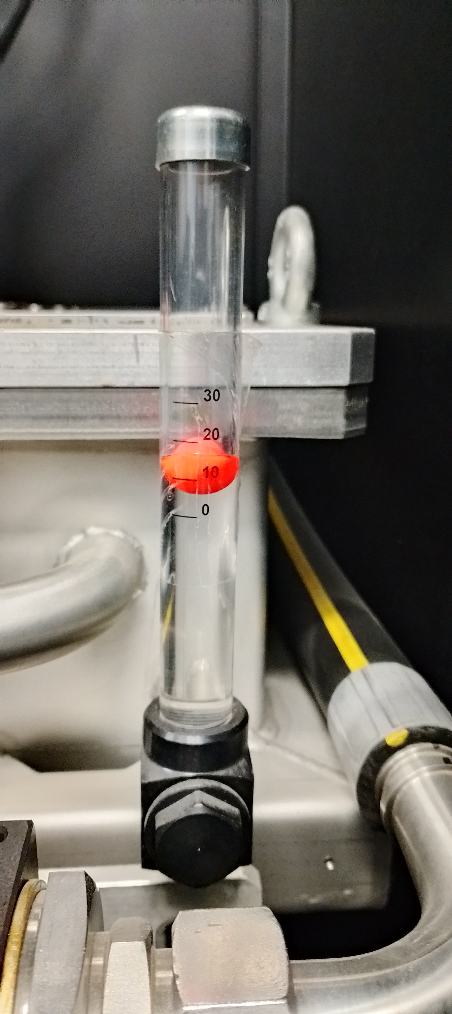
Modulator D - Oil leak
oil just so that the level is just above the screwheads that fastens the tunings,
Problem should be just the gasket
Contacted Scandinova for more details
Modulator C Oil level 8mm
Modulator D Oil level 2mm
Oil level should be just above the screwheads that fastens the tunings.
Leak
D
C
C
D

Slide 9
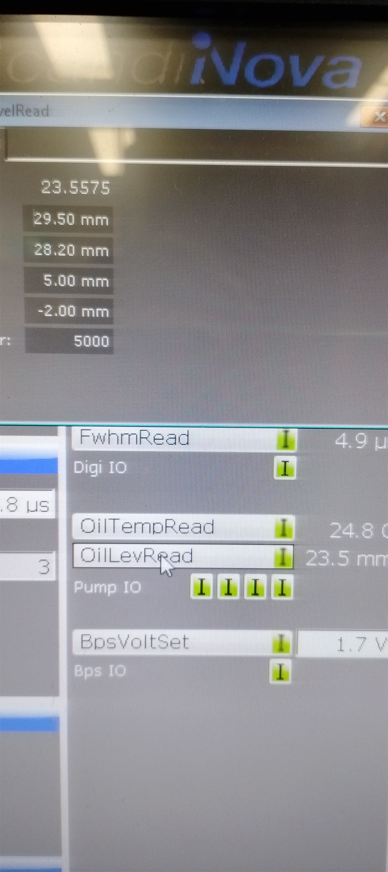
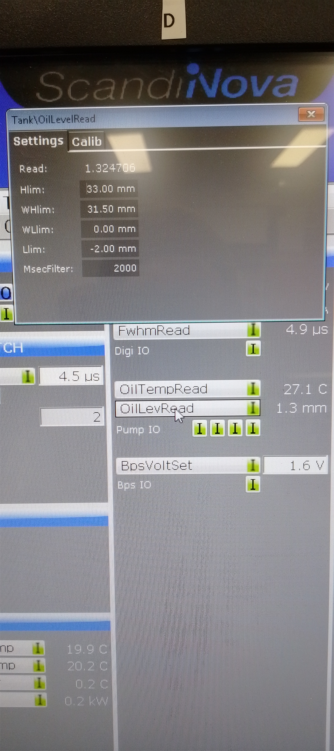
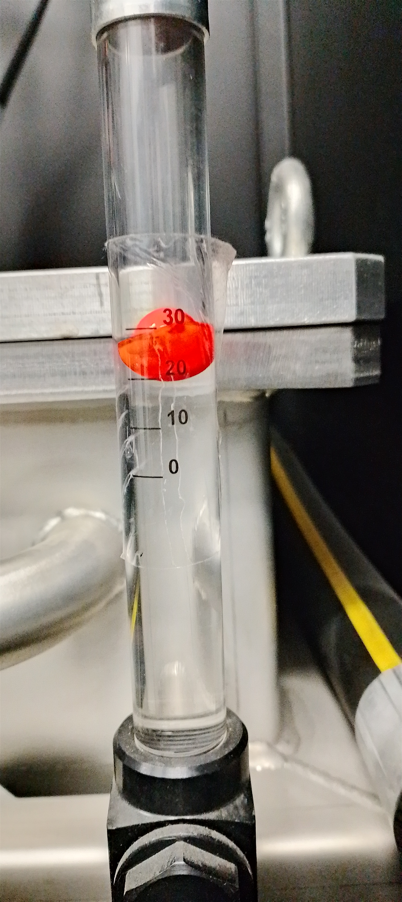
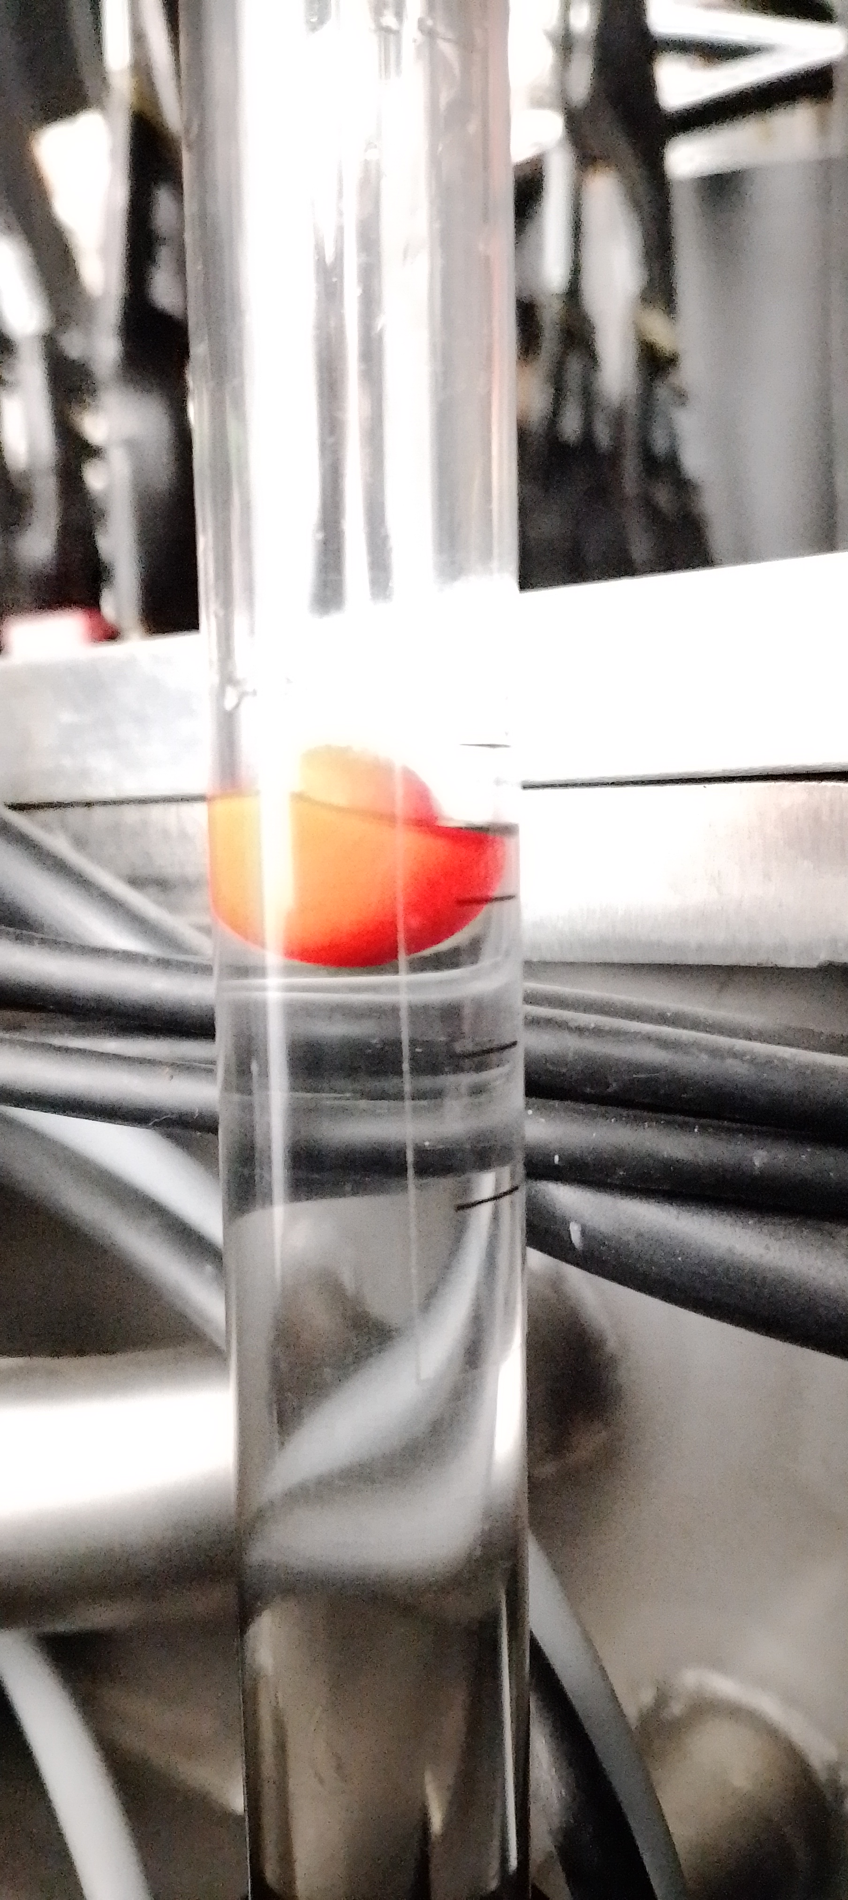
The oil level is decreasing! It shouldn’t be just a calibration issue. By the way, with the refill we’re safe to pulse. Just check the oil level on the lids regularly.
After fill ~1cm of the oil in both KLYs.
oil just so that the level is just above the screwheads that fastens the tunings,
C
D
C
D
D
C
D oil level decrease!!! Should not be calibration only the problem. BTW with the refill we have safe to pulse.
Just check regularly the oil lavel on the lids

Slide 10
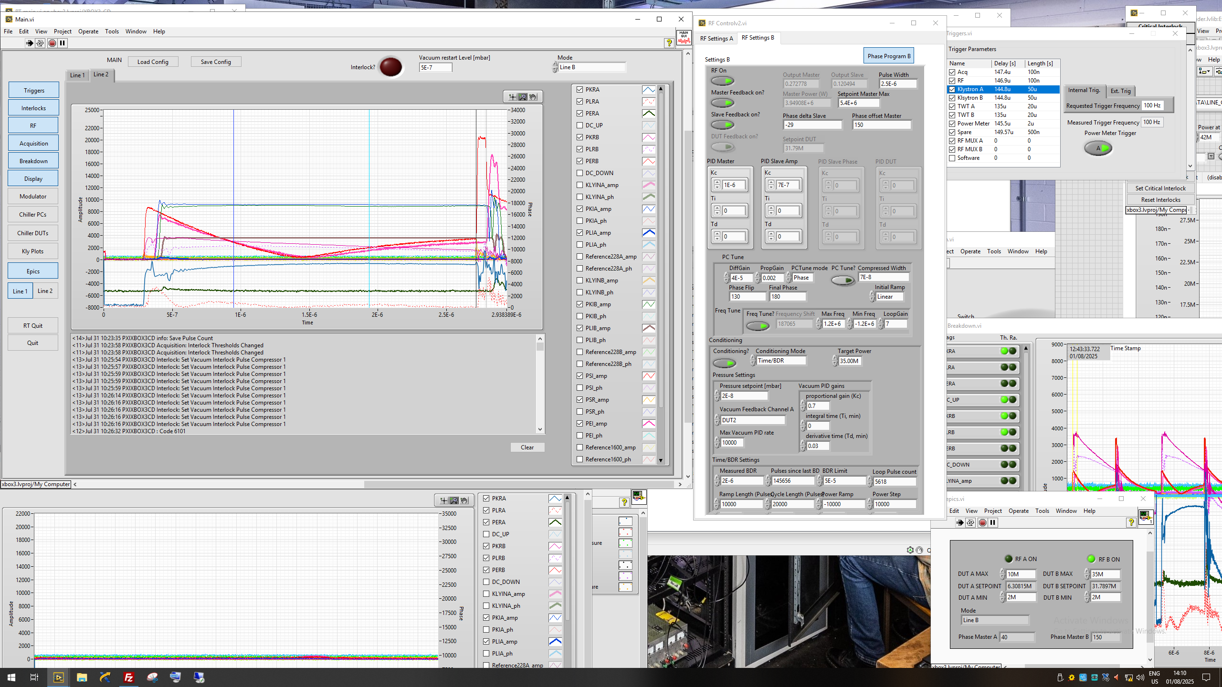
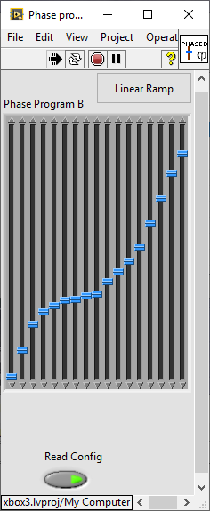
Code updated (Marca)
Choose the line
Reset to zero the SSA values when turned off.
Reload configuration file with fixed phase
Epic INTERFACE
Show both lines
Epic INTERFACE

Slide 11
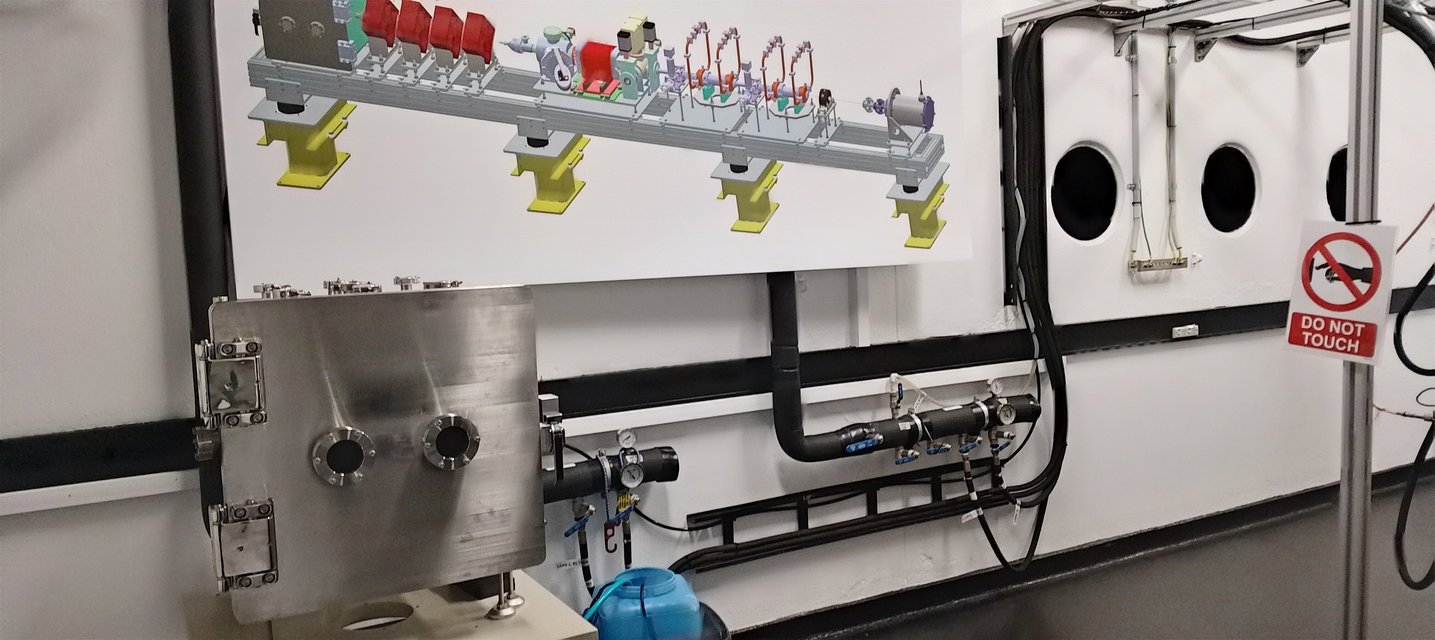
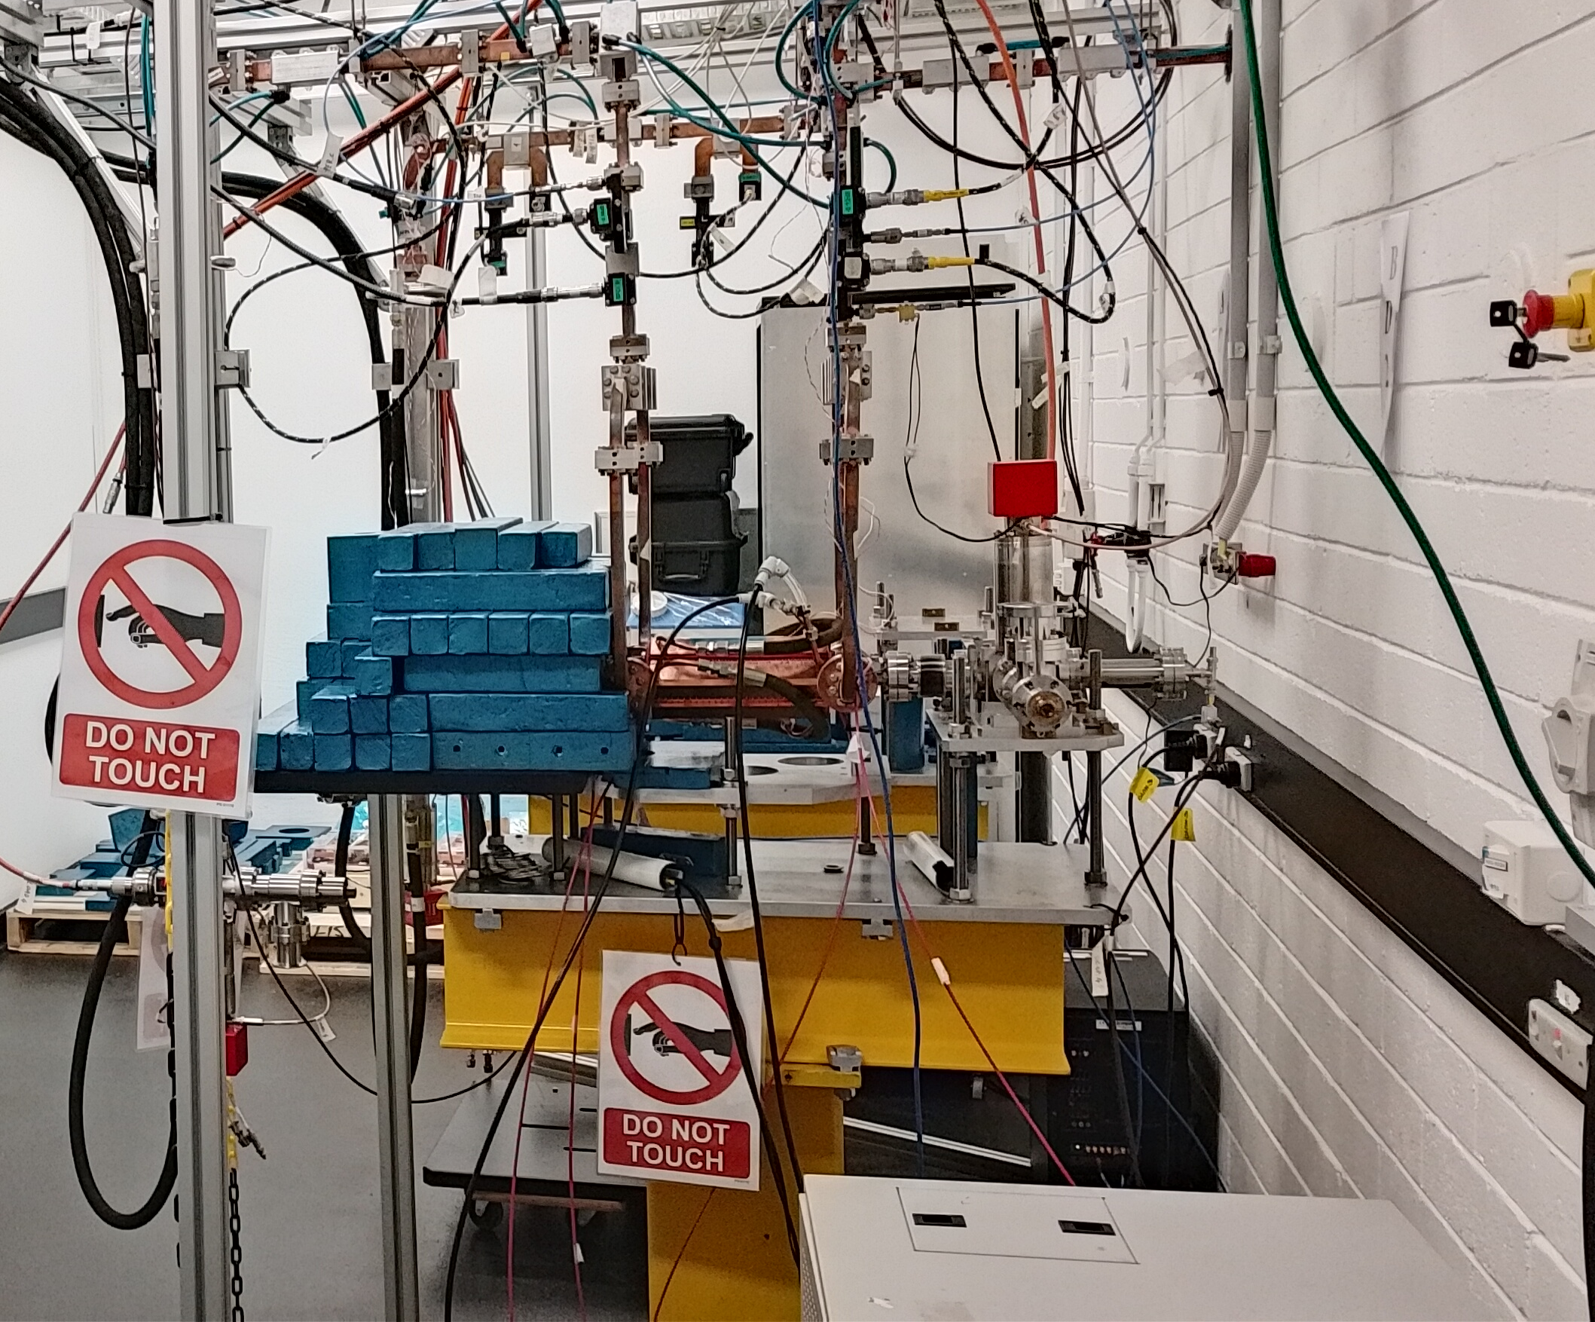
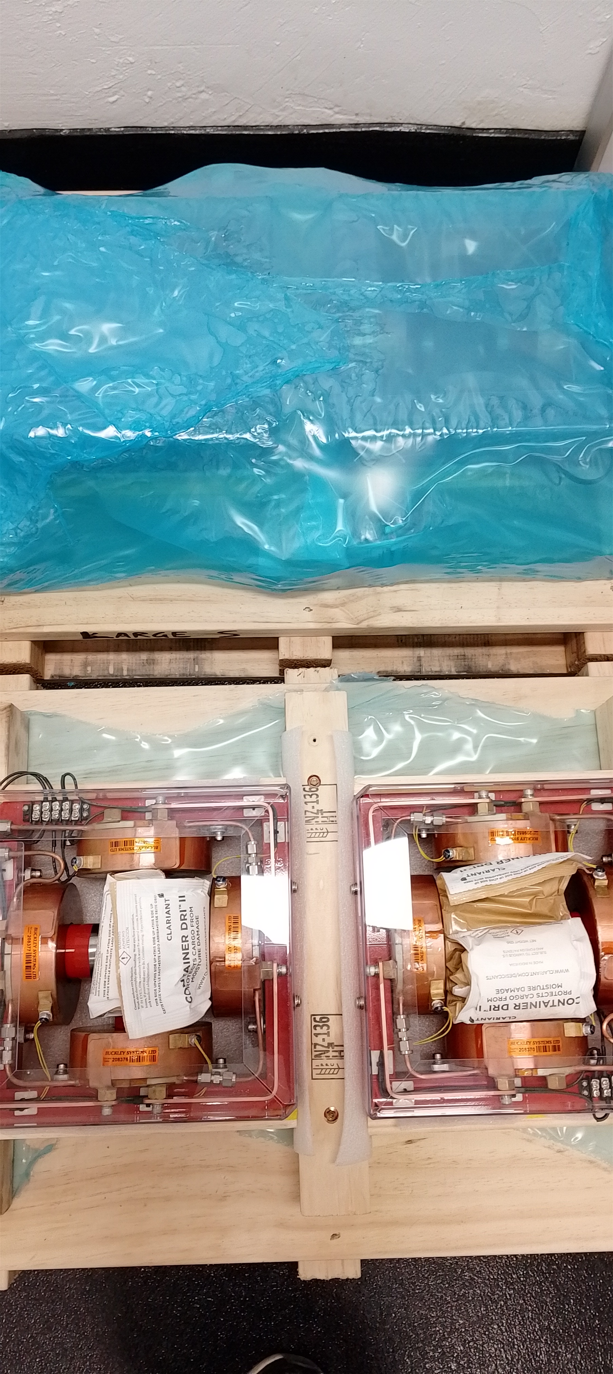
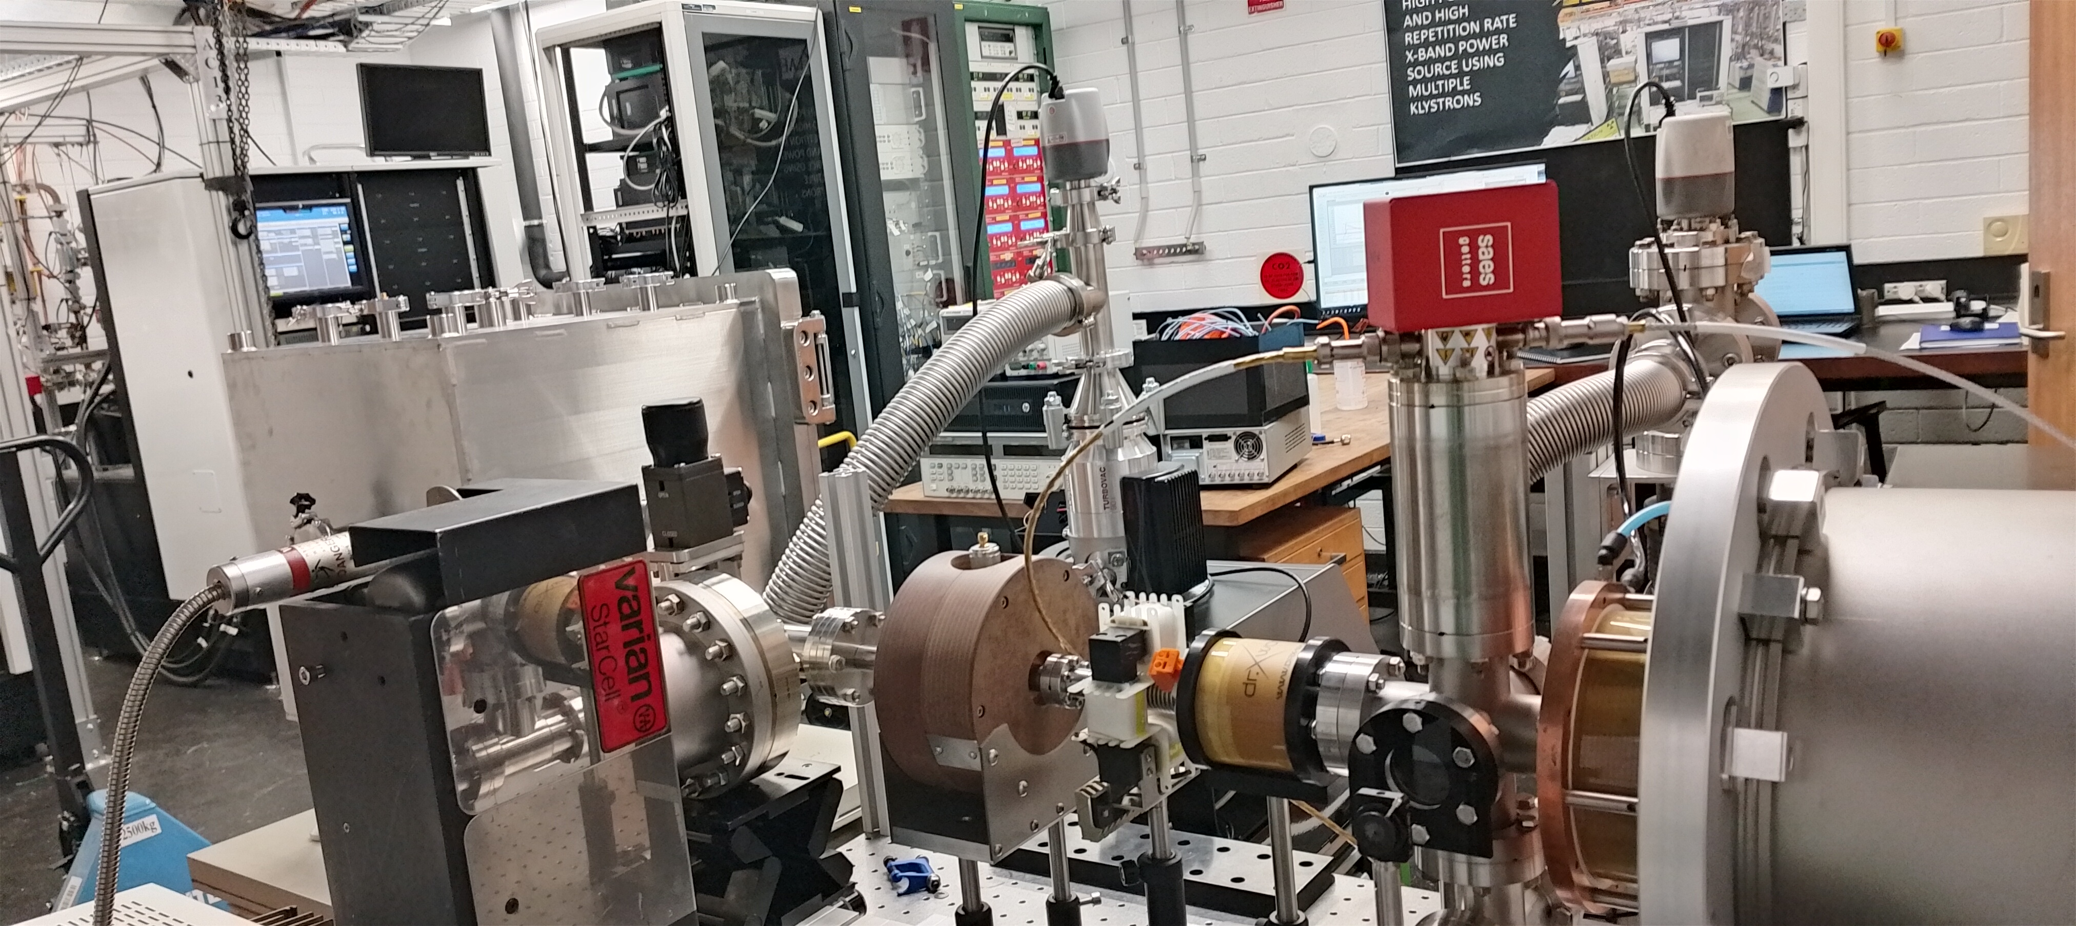
Beam line

