Slide 1
X-Boxes Update
29.10.2025

Slide 2
XBOXES Summary
XBOX2 (Not operative)
XBOX3 (Operative)
No superconductivity (faulty cryocooler)
Changed cryocooler filters, still not working
S. Calatroni provided the contact of the provider. Asked for repair options
Waiting for klystron (in Italy)
Cryocooler is repaired and coming back!!
Started pulsing 13th June
150 Hz in each line
50ns RF pulse, no compression
Setpoint DUT 8MW in both lines
RF pulse 1.58us
Compressed pulse 50ns
Setpoint DUT 3MW (limited by Pulse compressor)

Slide 3
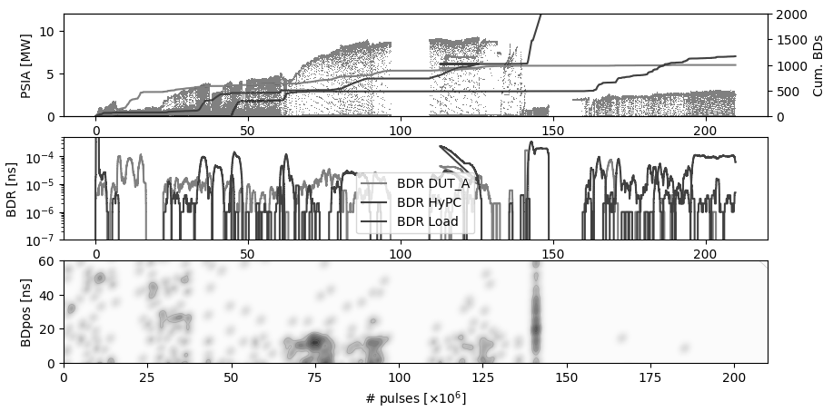
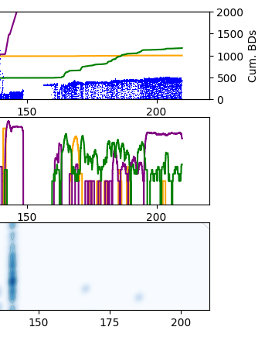
XBOX3 – Power Line 1

Slide 4
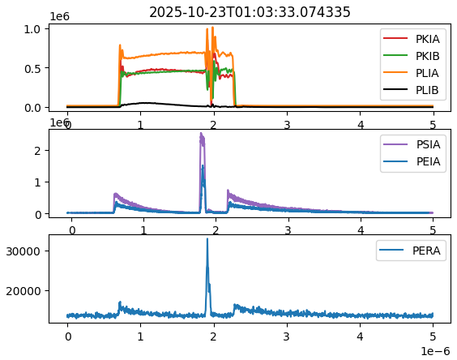
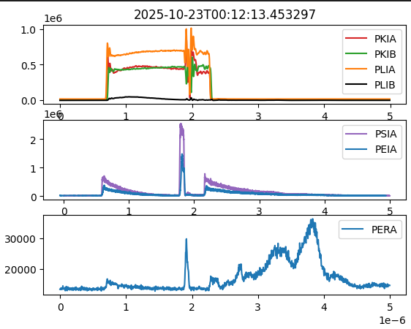
XBOX3 Line1 – BDs in load

Slide 5
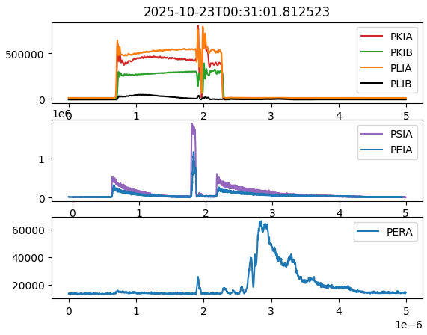
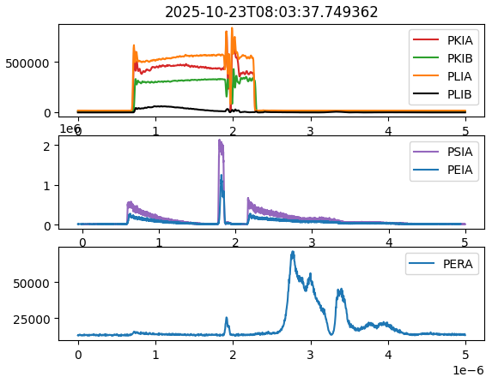
XBOX3 Line1 – BDs in load

Slide 6
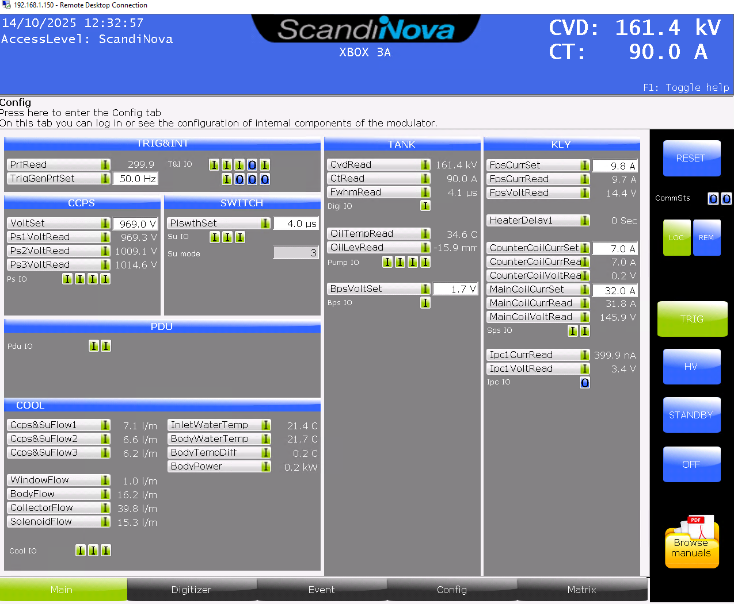
XBOX3 Configuration – HEK klystron
Emission fluctuating while pulsing
Filament current recalibrated
New roll-off curves to set filament heating
Sccandate cathode?
High vacuum levels but stable now
CVD,kV 162.4 162.7 163.2
CT,A 87.4 86.7 86.6
ipc,nA 411 398 429.2
Prfavg,MW 1.8 2.2 2.5

Slide 7
Thank you for these 2 years
and see you soon

Slide 8
XBOX3 Configuration
Bunker
KLY A
PC 1
DUT 1
Load 1
SSA A
KLYINA
PKRA
PKIA
PLRA
PLIA
PSRA
PSIA
PERA
PEIA
HYB
DC
HPDC
HPDC
HPDC
HPDC
Faraday Cups
SSA B
KLYINB
PKRB
PKIB
PLRB
PLIB
PSRB
PSIB
PERB
PEIB
DC
HPDC
HPDC
HPDC
HPDC
PC 2
DUT 2
Load 2
KLY B
DCUP
DCDOWN

Slide 9
XBOX3 Configuration
Bunker
E37117
PC 1
DUT 1
Load 1
SSA A
KLYINA
PKRA
PKIA
PLRA
PLIA
PSRA
PSIA
PERA
PEIA
HYB
DC
HPDC
HPDC
HPDC
HPDC
Faraday Cups
SSA B
KLYINB
PKRB
PKIB
PLRB
PLIB
PSRB
PSIB
PERB
PEIB
DC
HPDC
HPDC
HPDC
HPDC
PC 2
DUT 2
Load 2
E37123
DCUP
DCDOWN

Slide 10
X-Box 2: Reminder on BD classification
BD_Flag_PER_log
BD Load
TRUE
BD_Flag_DC_DOWN
DC Up >=140
DC Down>=100
BD DUT w. BDC
BD_Flag_DC_UP
FALSE
BD_Flag_PSR_log
BD DUT wo. BDC
BD_Flag_PKR_log
BD HyPC
No BD

