Slide 1
Weekly meeting on Xboxes
10.12.2025

Slide 2
XBOXES Summary
XBOX2 (Not operative)
XBOX3 (Operative)
Cryocooler is repaired and coming back !!
Cryocooler is back and installed !!
At the moment:
PT100 probes turned on
Monitoring SC solenoid temperatures
19th November: Started Pulsing
21st November: Abrupt Power Cut
1st December: Dealing with issues
Vacuum pumps off
Soft start interlock
DC power supplies of modulators off (solved by Alan)
3rd December: Started Pulsing
+ Raspberry Pi Bot fixed and running
Away

Slide 3
XBOX3 – Power Lines Recap
Line 1
Line 2
Installed:
New PC w/o tuning plungers
New TD26CIEMAT DUT
New long load (in place of faulty spiral)
Installed:
Conditioned TD31N2 DUT
Conditioned long load
150 Hz rep. rate:
RF pulse 1.58us
Compressed 50ns pulse
150 Hz rep. rate:
RF pulse 1.58us
Compressed 50ns pulse
Setpoint DUT 1.5 MW
(limited vacuum spikes in load and DUT)
Setpoint DUT 8 MW

Slide 4
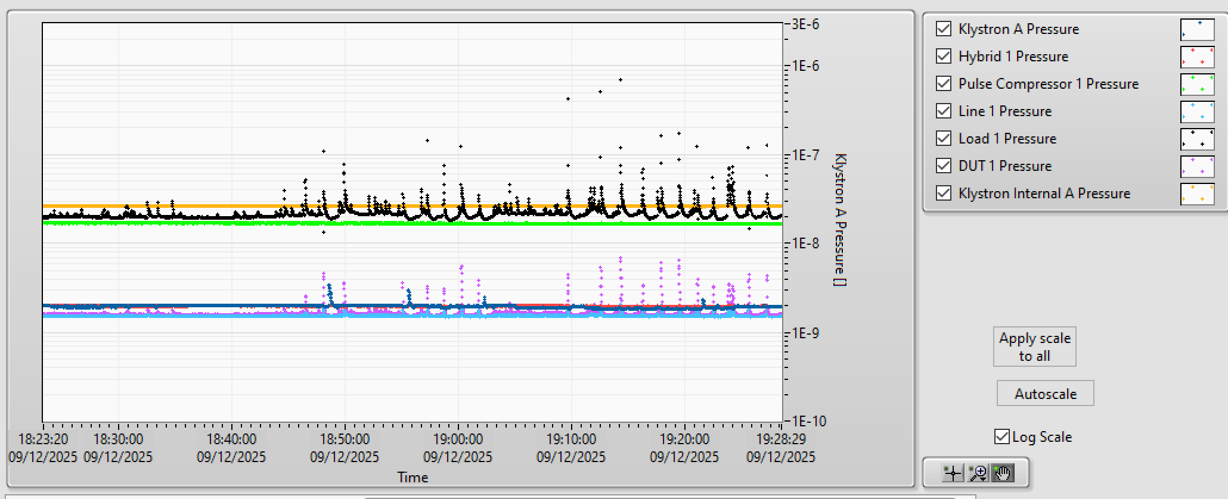
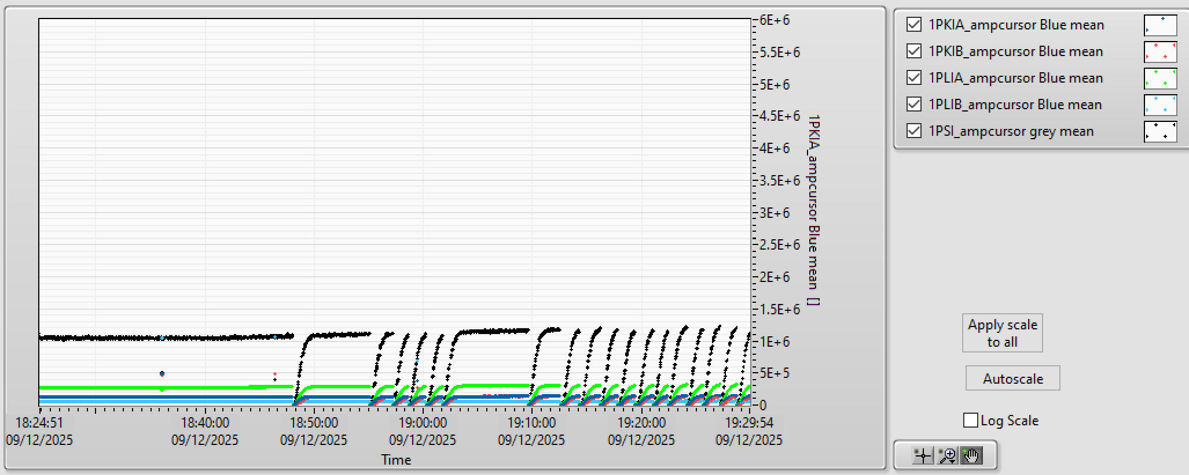
XBOX3 – Power Line 1 – Vacuum Activity

Slide 5
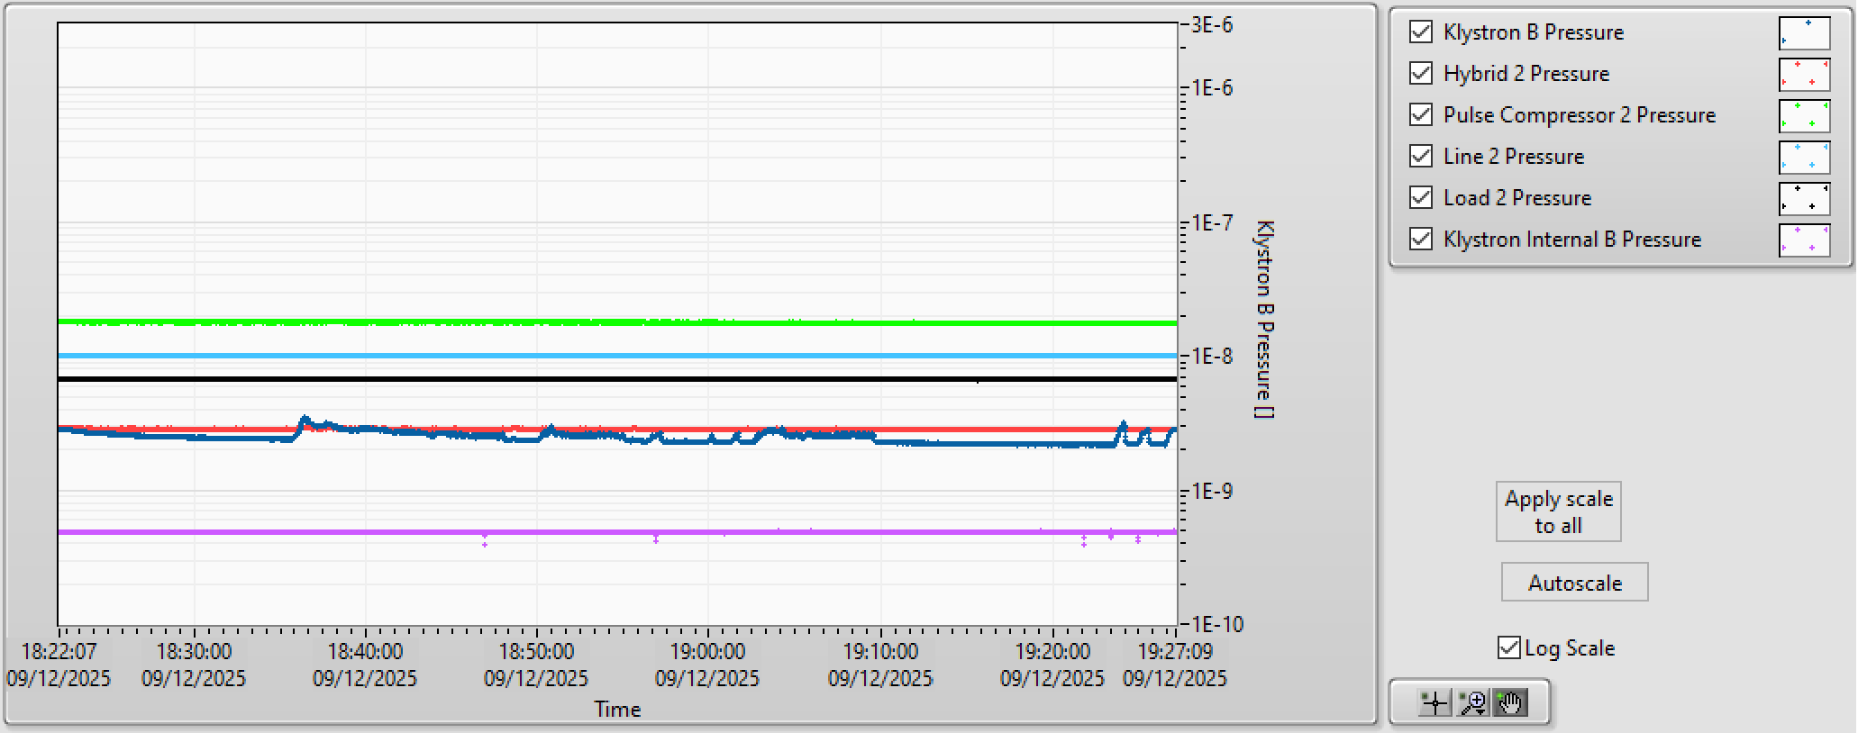
XBOX3 – Power Line 1 – Vacuum Activity
Power Line 2

Slide 6
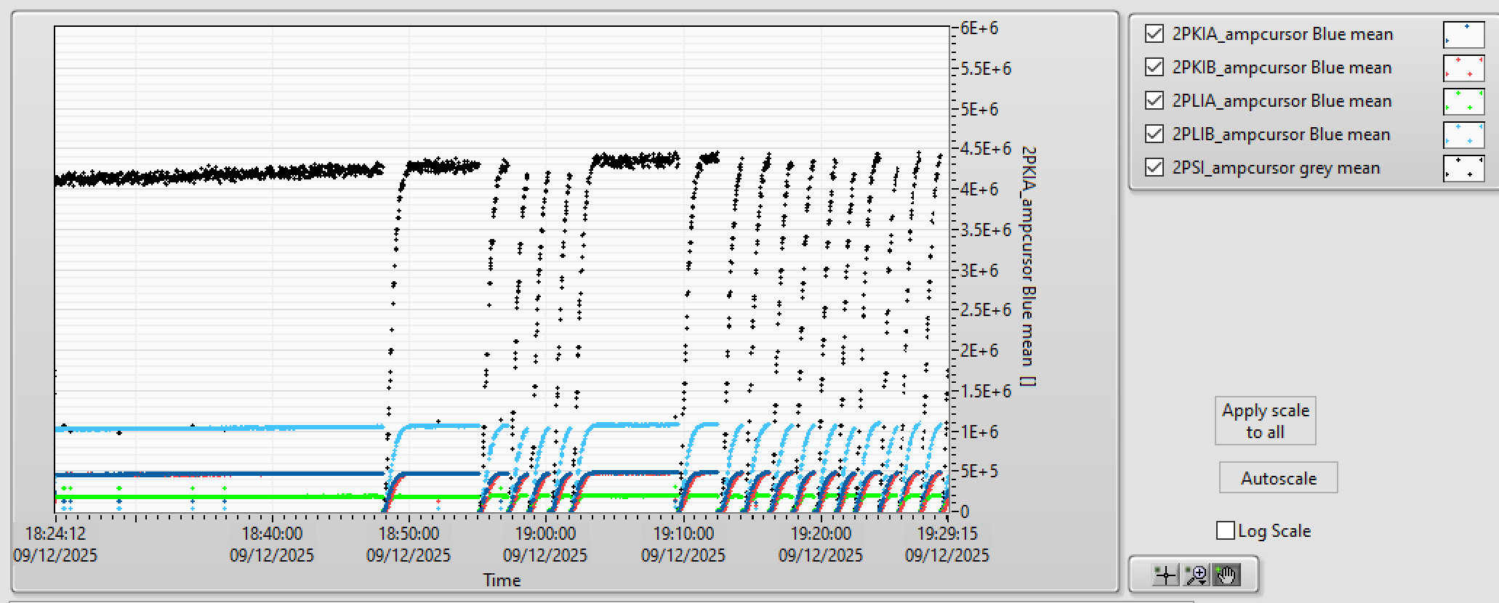
XBOX3 – Power Line 2 – Vacuum Activity

Slide 7
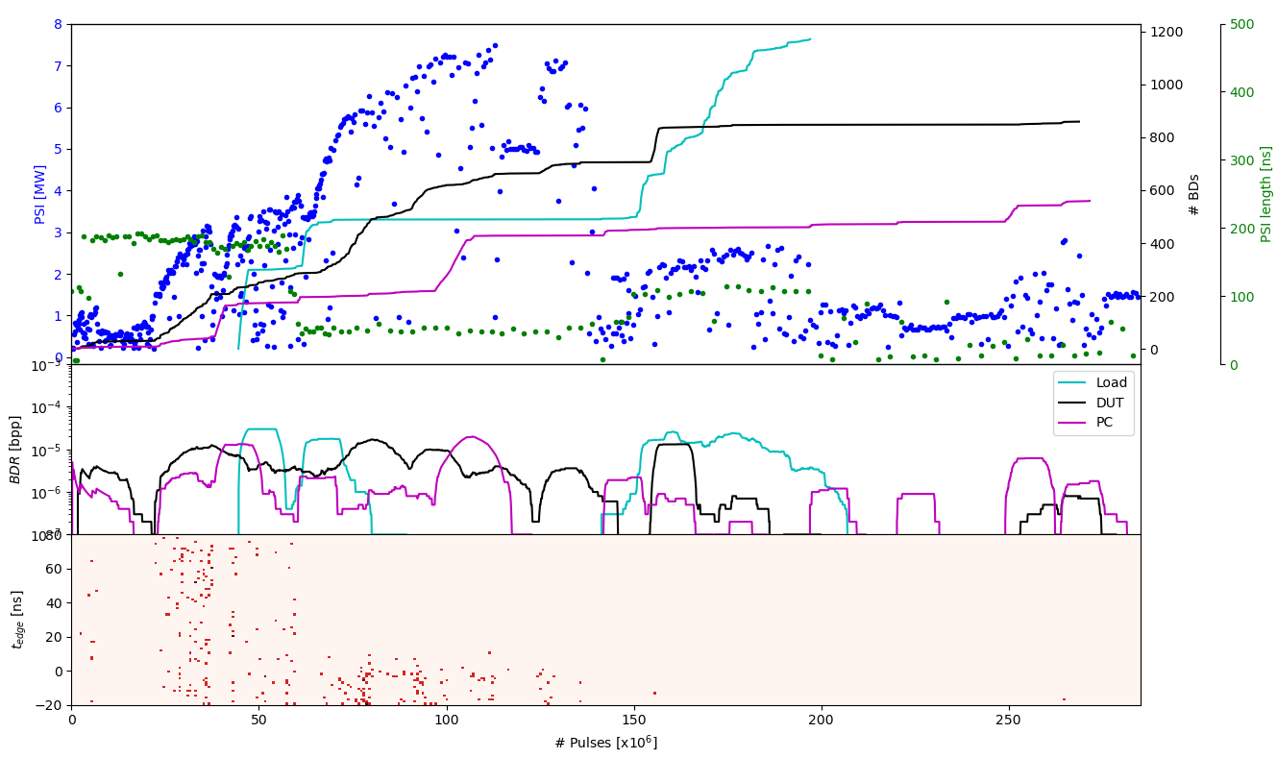
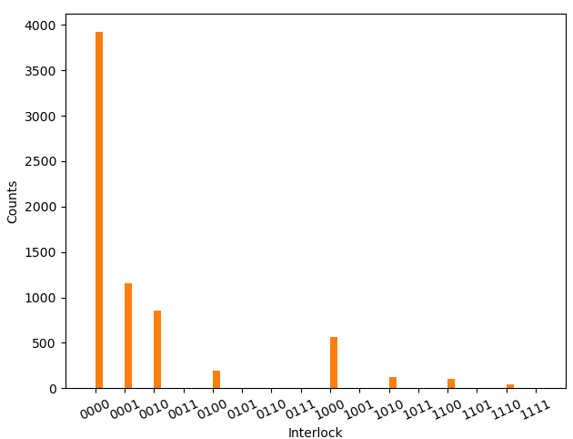
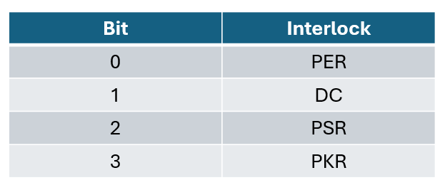
XBOX3 – Power Line 1 – TD26CIEMAT
Data analysis by Pablo

Slide 8
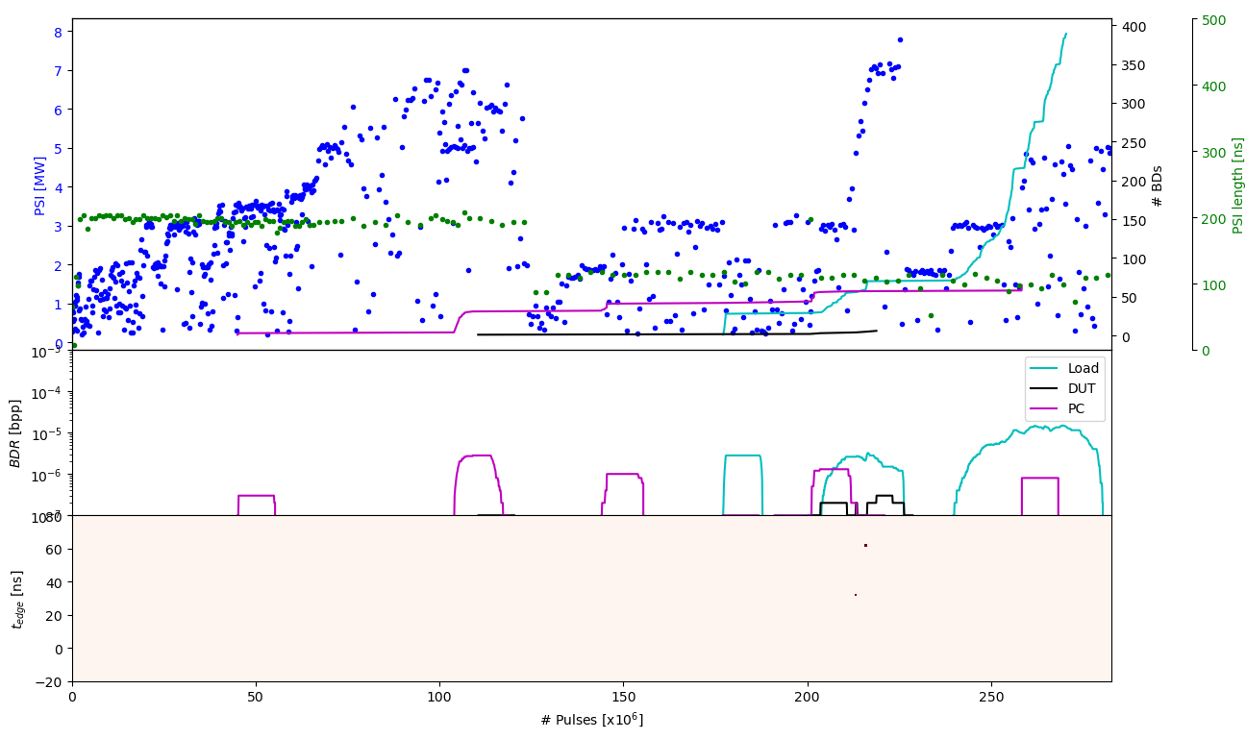
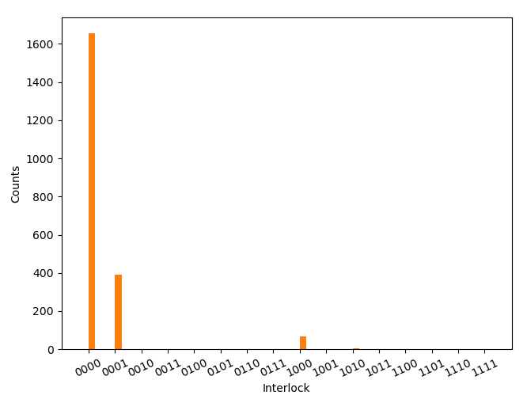
XBOX3 – Power Line 2 – TD31N2
Data analysis by Pablo

Slide 9
XBOX3 – Last comments
Leaving on the 12th December (shutting down)
Controlled Power cut on the 16th December

Slide 10
Thank you!

Slide 11
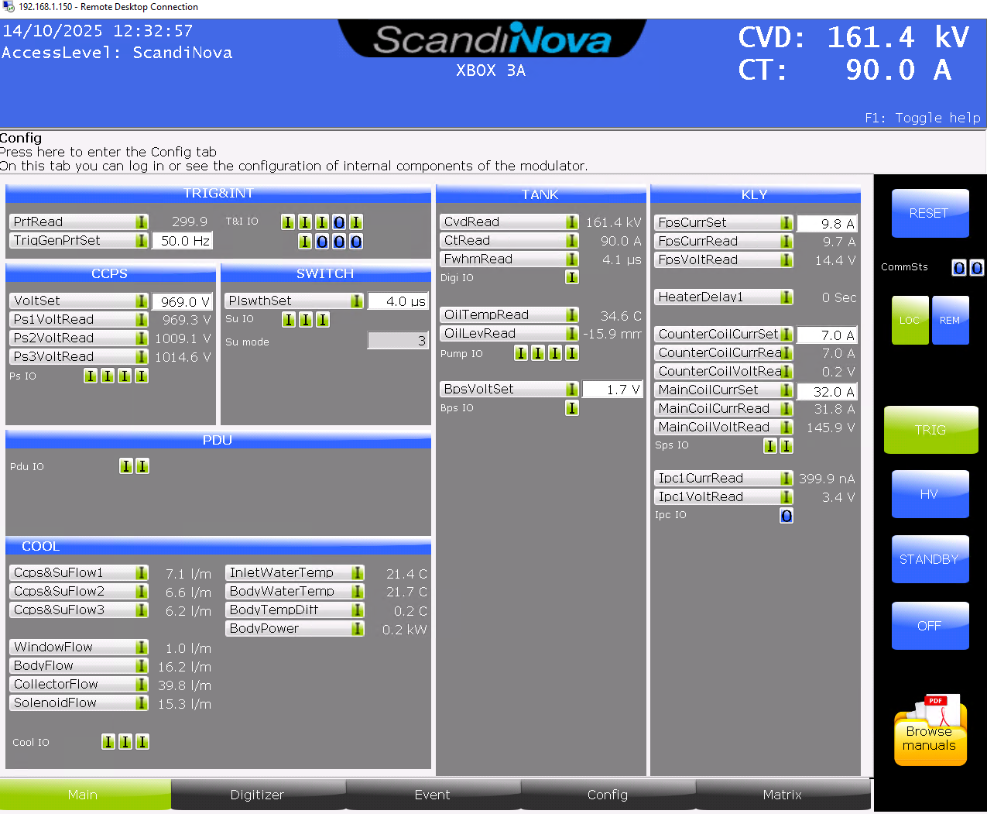
XBOX3 Configuration – HEK klystron
Emission fluctuating while pulsing
Filament current recalibrated
New roll-off curves to set filament heating
Sccandate cathode?
High vacuum levels but stable now
CVD,kV 162.4 162.7 163.2
CT,A 87.4 86.7 86.6
ipc,nA 411 398 429.2
Prfavg,MW 1.8 2.2 2.5

Slide 12
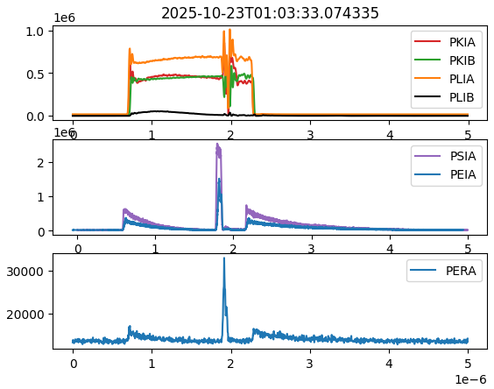
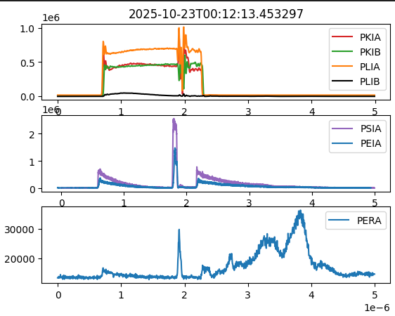
XBOX3 Line1 – BDs in load

Slide 13
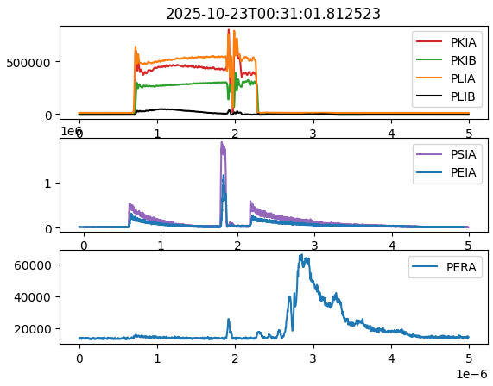
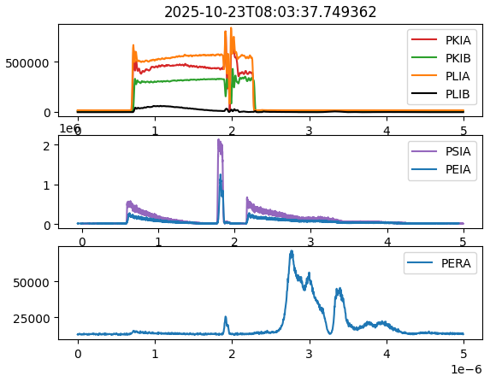
XBOX3 Line1 – BDs in load

Slide 14
XBOX3 Configuration
Bunker
KLY A
PC 1
DUT 1
Load 1
SSA A
KLYINA
PKRA
PKIA
PLRA
PLIA
PSRA
PSIA
PERA
PEIA
HYB
DC
HPDC
HPDC
HPDC
HPDC
Faraday Cups
SSA B
KLYINB
PKRB
PKIB
PLRB
PLIB
PSRB
PSIB
PERB
PEIB
DC
HPDC
HPDC
HPDC
HPDC
PC 2
DUT 2
Load 2
KLY B
DCUP
DCDOWN

Slide 15
XBOX3 Configuration
Bunker
E37117
PC 1
DUT 1
Load 1
SSA A
KLYINA
PKRA
PKIA
PLRA
PLIA
PSRA
PSIA
PERA
PEIA
HYB
DC
HPDC
HPDC
HPDC
HPDC
Faraday Cups
SSA B
KLYINB
PKRB
PKIB
PLRB
PLIB
PSRB
PSIB
PERB
PEIB
DC
HPDC
HPDC
HPDC
HPDC
PC 2
DUT 2
Load 2
E37123
DCUP
DCDOWN

Slide 16
X-Box 2: Reminder on BD classification
BD_Flag_PER_log
BD Load
TRUE
BD_Flag_DC_DOWN
DC Up >=140
DC Down>=100
BD DUT w. BDC
BD_Flag_DC_UP
FALSE
BD_Flag_PSR_log
BD DUT wo. BDC
BD_Flag_PKR_log
BD HyPC
No BD

