Slide 1
Task 7.2.2 - Shower development in SDHCAL
Final Summary
G.Grenier & M.C Fouz
UE participants
Belgium: Ghent → Vrije Universiteit Brussel
France: CNRS-IP2I, CNRS-LPC, CNRS-OMEGA
Spain: CIEMAT
Non-UE participants
China: SJTU - Shanghai Jiao Tong University
South Korea: GWNU - Gangneung–Wonju National University
& SNUBH- Seoul National University Bundang Hospital
AIDAinnova Annual meeting. WP7 May 2025

Slide 2
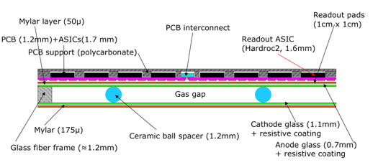
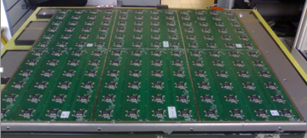

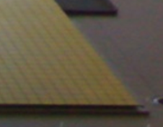
Introduction – The SDHCAL concept
SDHCAL - Semi-Digital Hadronic CALorimeter
A sampling hadronic calorimeter under development at CALICE Collaboration intended to be used with PFA reconstruction techniques. ( ➔ High Granularity is a must)
One of the proposed options for the ILD (International Large Detector) at the ILC (International Linear Collider) and for and CEPC (Circular Electron Positron Collider) detectors
Sampling calorimeter: Absorber: Stainless Steel + Detector: Glass Resistive plate Chambers
Detector: GRPC (Glass Resistive Plate Chambers) operating in avalanche mode
GRPC Sketch
1x1 cm² pads. Semi-Digital Readout, 2bits - 3 thresholds
➔ It counts how many and which pads have a signal larger than one of the 3 thresholds
Embedded electronics:
PCB separated from the GRPC by a mylar layer (50μm).
➔ Bottom: 1x1cm2 pads
➔ Top: HARDROC (HAdronic Rpc ReadOut Chip) & related connections
Power-pulsed electronics: In stand-by during dead time in between ILC Collisions or spills in beam tests
1 pad= 1cm² ,
interpad 0.5 mm
144 ASICs= 9216 channels/1m²

Slide 3
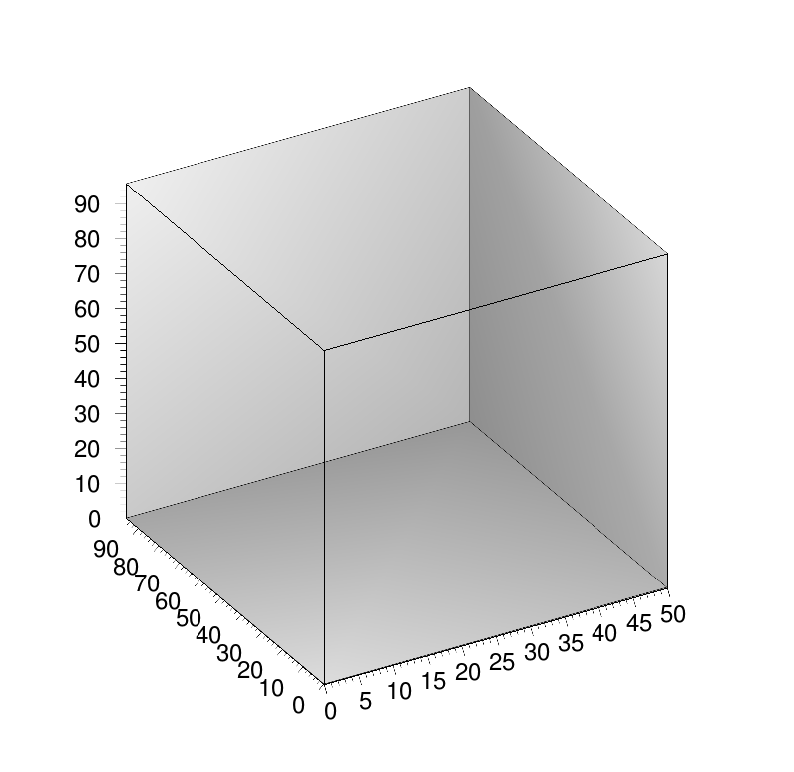
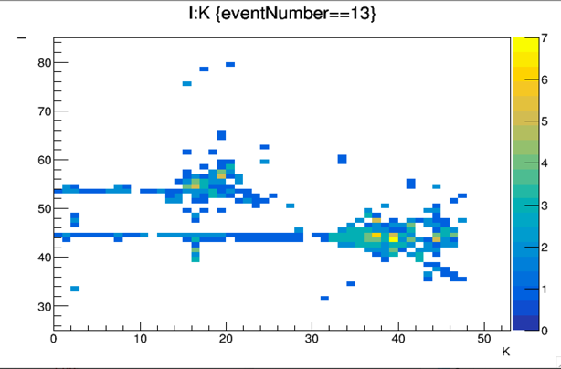
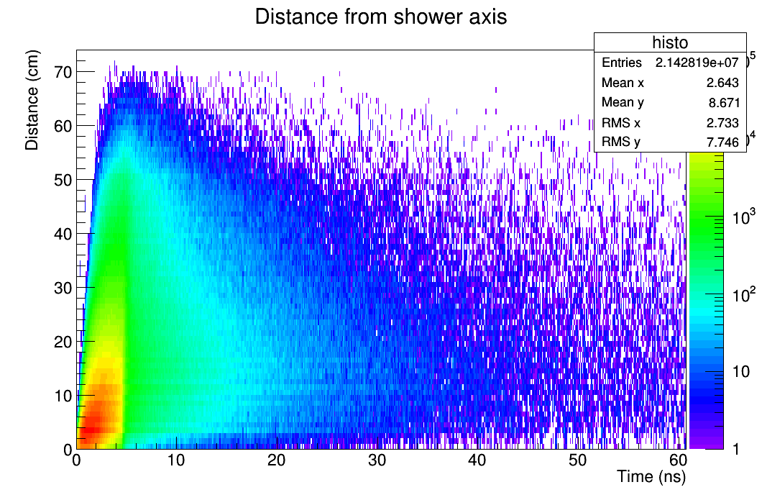
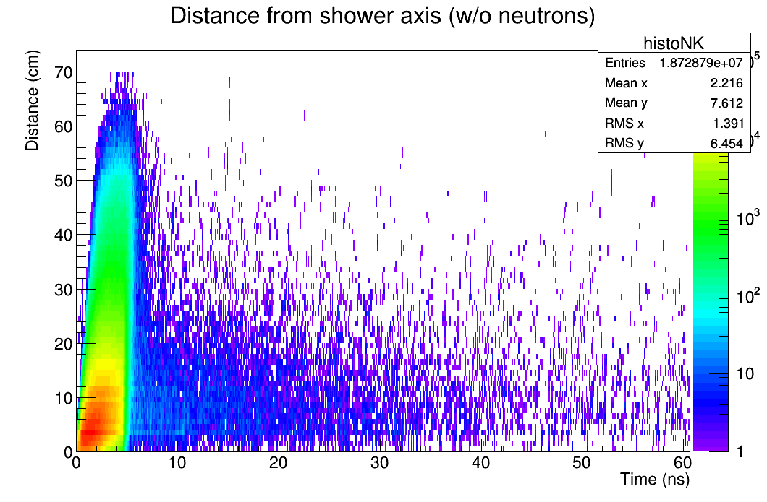
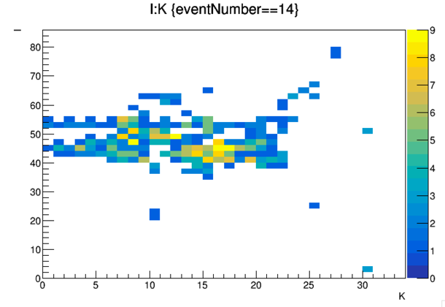
Motivation of including timing readout
Timing could be an important factor to identify delayed neutrons and better reconstruct their energy
Time information can help to separate close by showers and reduce the confusion for a better PFA application.
Example: pi-(20 GeV), K-(10 GeV) separated by 8 cm.
Easy case
Depth
Difficult case
Time
Time
Depth

Slide 4
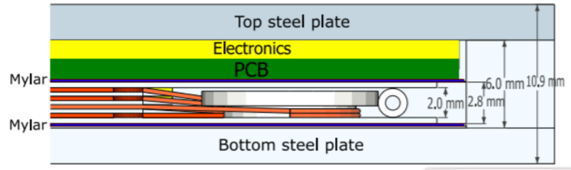
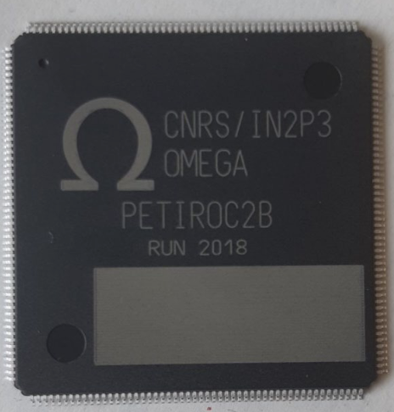
SDHCAL at AIDAInnova – Task 7.2.2
General goal: Extending the Semi-Digital Hadronic CALorimeter (SDHCAL) to include timing information (100 -200ps resolution) for a 5D-calorimetry (space, amplitude & timing)
Implementation: Build small multi-gap RPC (MRPC) and developed a new version of electronics with timing capabilities
The use of MRPC will improve the intrinsic timing of the detector
but electronic on the previous SDHCAL 1m3 prototype has not
high resolution timing capabilities.
➔ Readout Chip HARDROC3. Time Stamping=200ns
PETIROC2
For AIDAInnova developments
Using PETIROC (~50ps) as first step before a future new ASIC
Also some chamber tests using NINO

Slide 5
Chamber developments
Multiple prototype chambers have been built by different institutes
  Sizes from 20x20 cm2 up to 1x1m2
  Single or double stacks
  4 or 5 gas gaps per stack
  Different Glass plates types with
resistivity from ~ 10¹⁰ 𝛀cm to ~ 10¹³ 𝛀cm
(standard glass: 10¹²-10¹³ 𝛀cm )
thickness from 280 μm to 550 μm
  Gas gaps achieved with:
standard fishing lines
ceramic fishing lines (Expecting less charge going to the fishing line)
mylar cone spacers (Ø6mm, 250μm thick) (Minimize dead spaces)

Slide 6
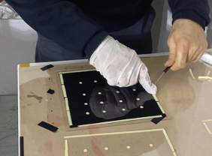
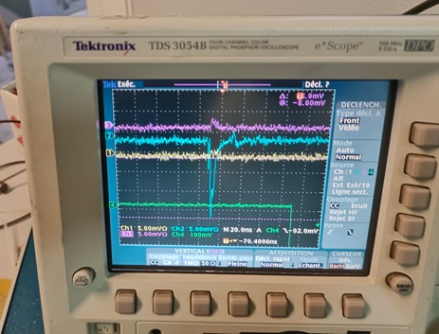
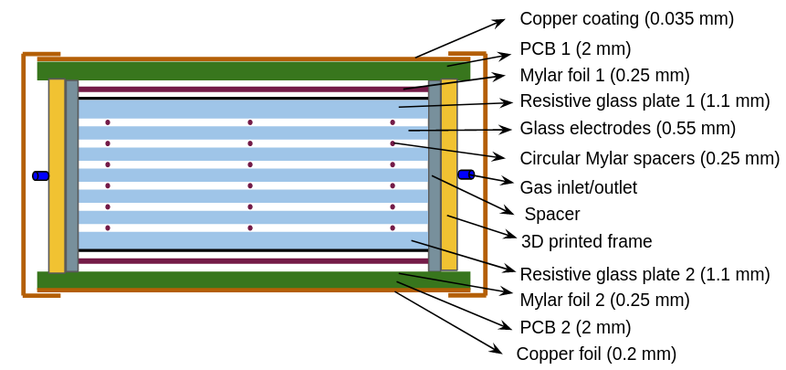
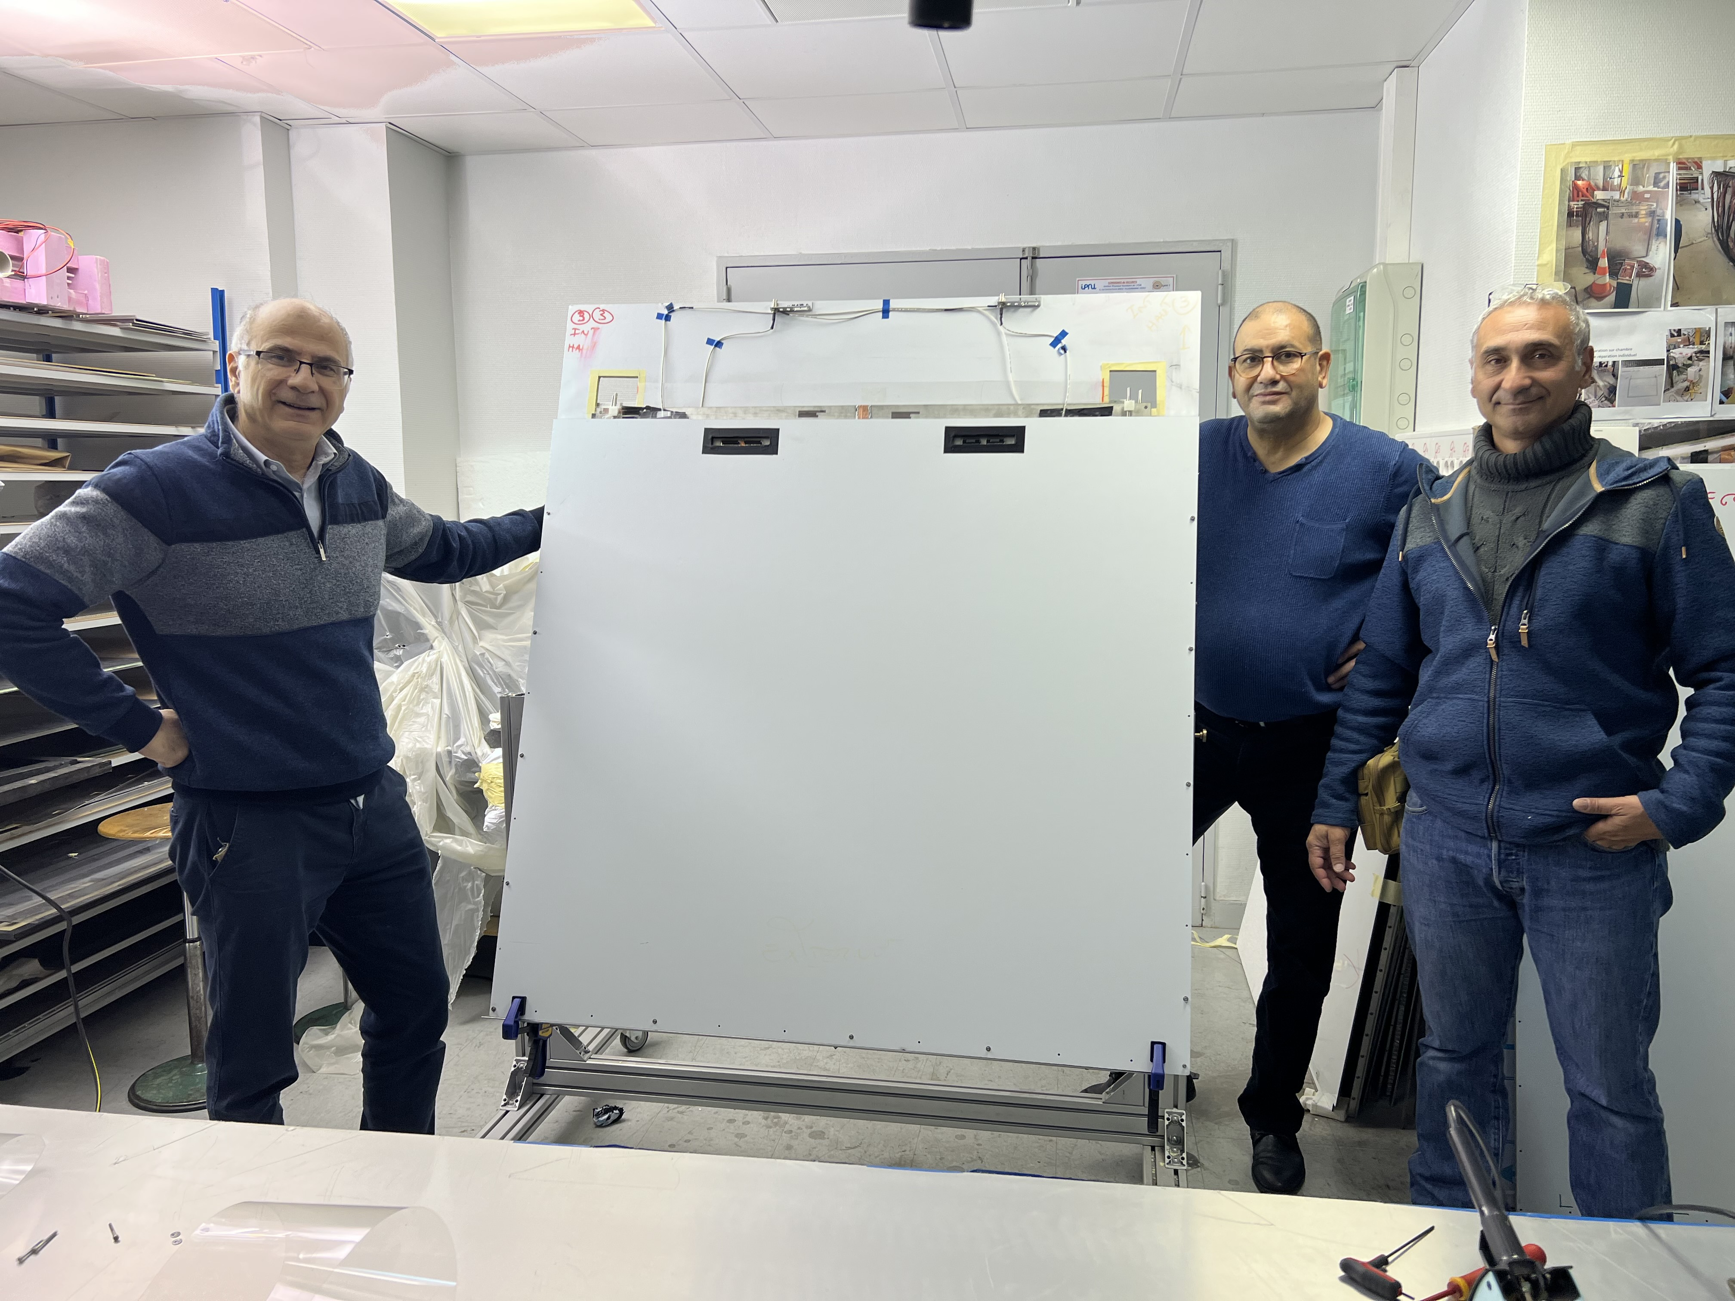
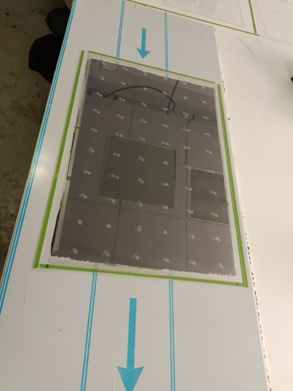
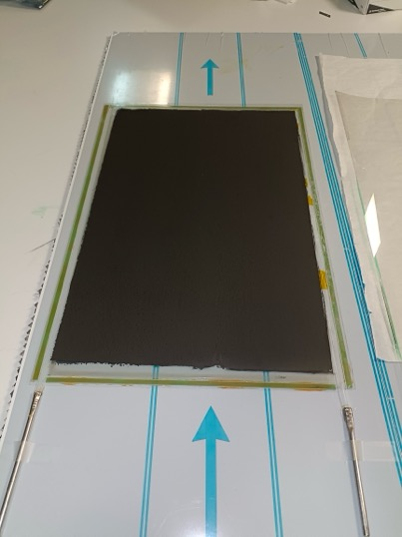
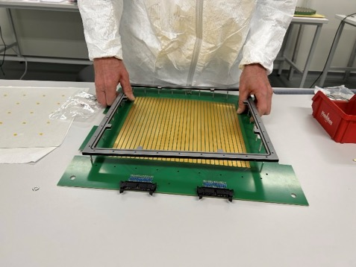
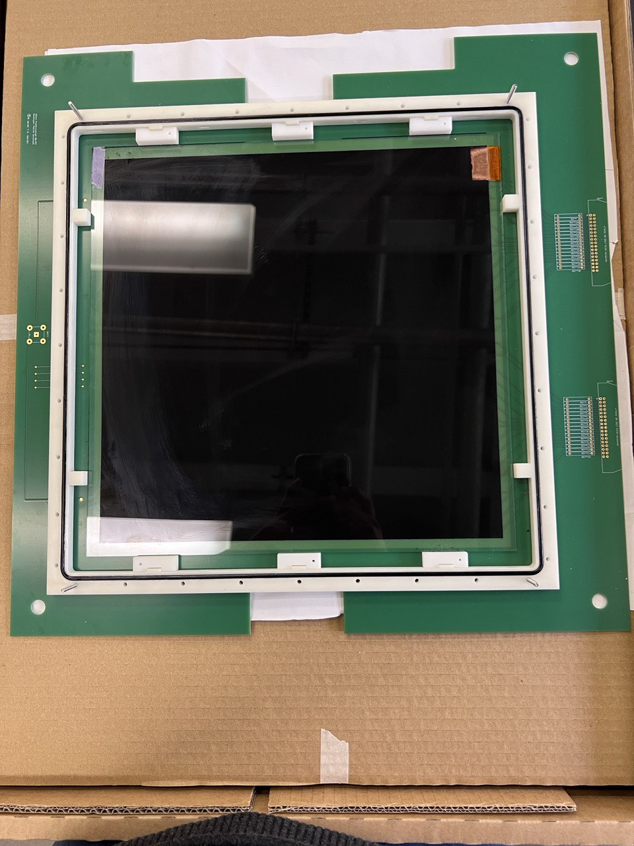
Examples of prototypes with standard glass
Mylar spacers
Ø6mm cones
→ Gas volume contained inside gas-tight metallic frame, sandwiched between 2 Printed Circuit Boards containing strip pattern, connection to readout electronics and services (HV, T-H sensors)
two times 3-gap
1x1 m2
Two times 4-gap (Mylar spacers)
with PCB inserted in between
64 1cm strips
33x50 cm²
Strips 2cm width
30x30cm²
Mylar spacers

Slide 7

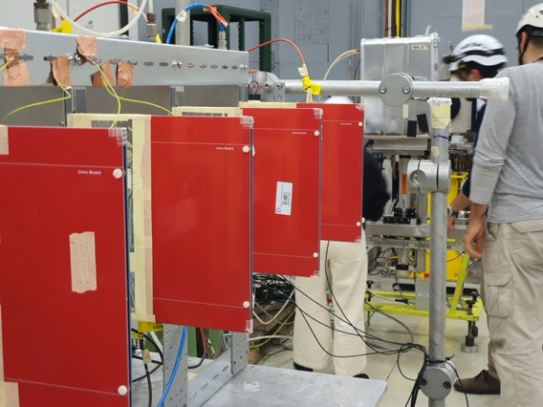
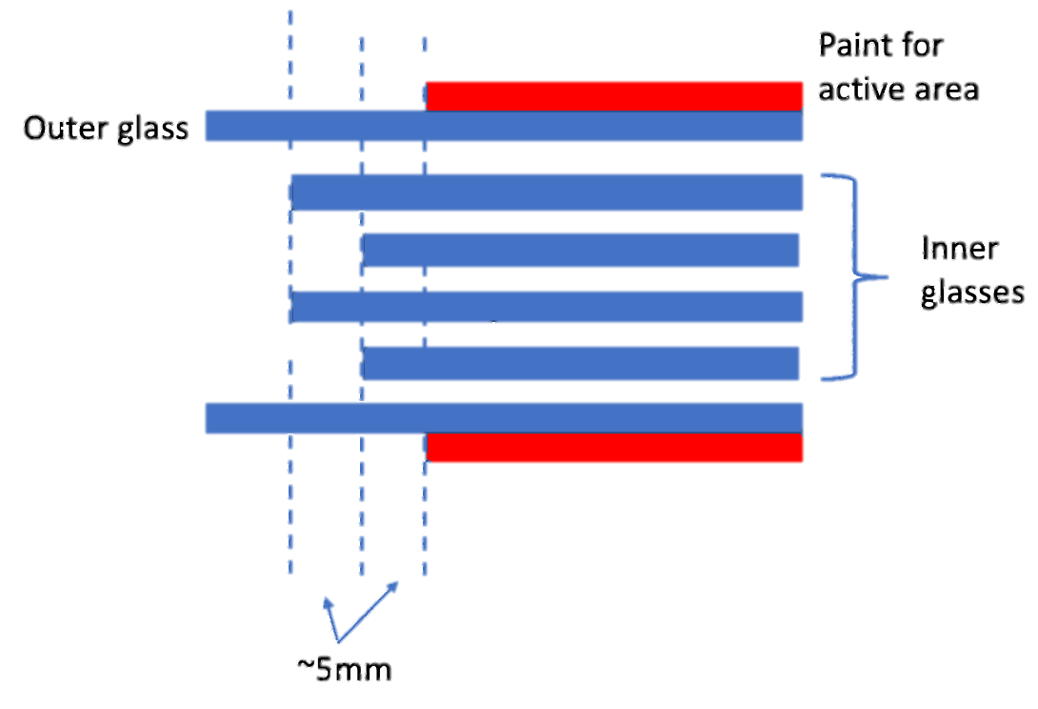
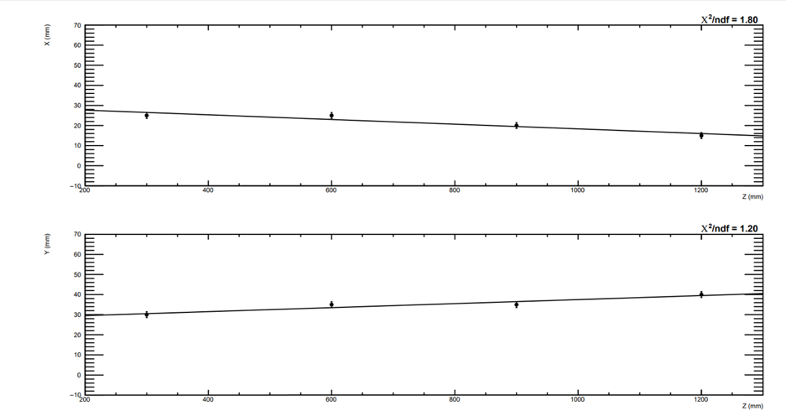
“Low resistivity” glass for high rates
Glass resistivity ~ 10¹⁰ 𝛀cm
Glass thickness : 500 µm
View for one stack
New design of chambers with perpendicular strips on both sides of the chamber
Inner glass arranged in two rows: avoid jumping charges between edges of glasses
Gas gap with fishing lines
Overlaps with Task 7.2.1

Slide 8
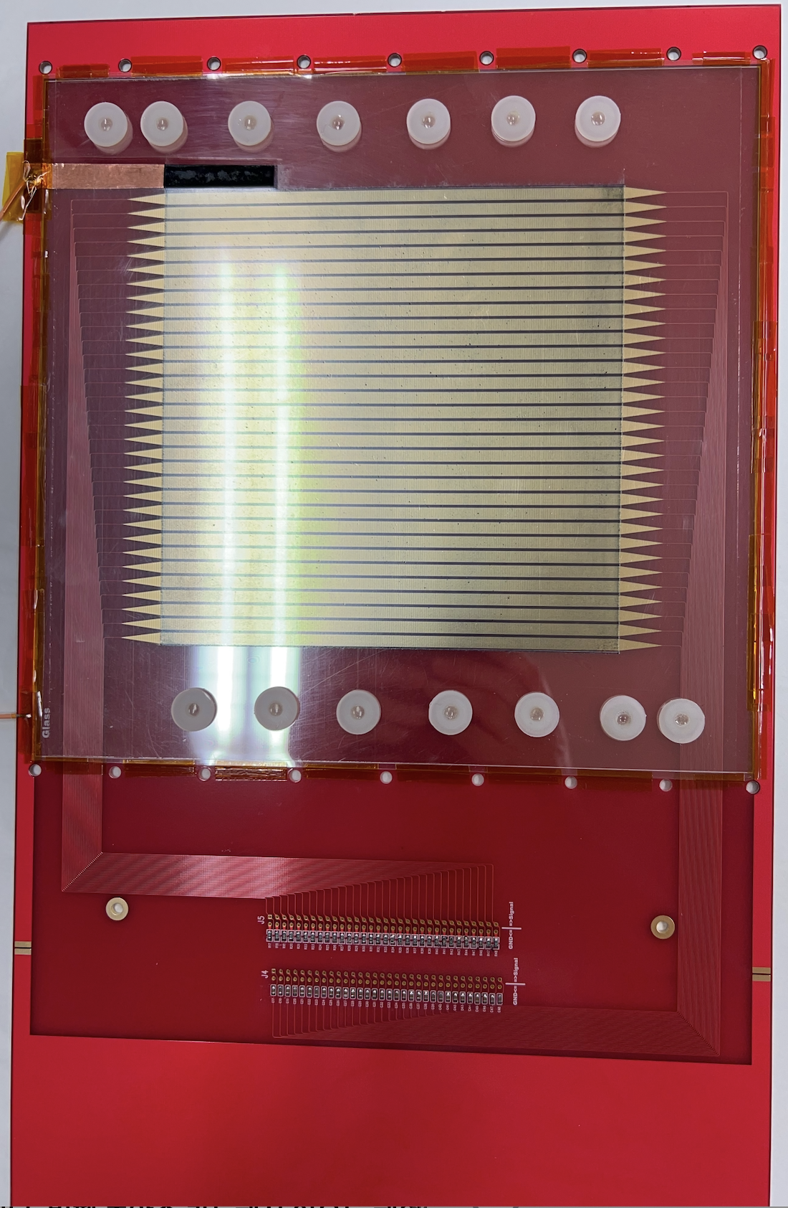
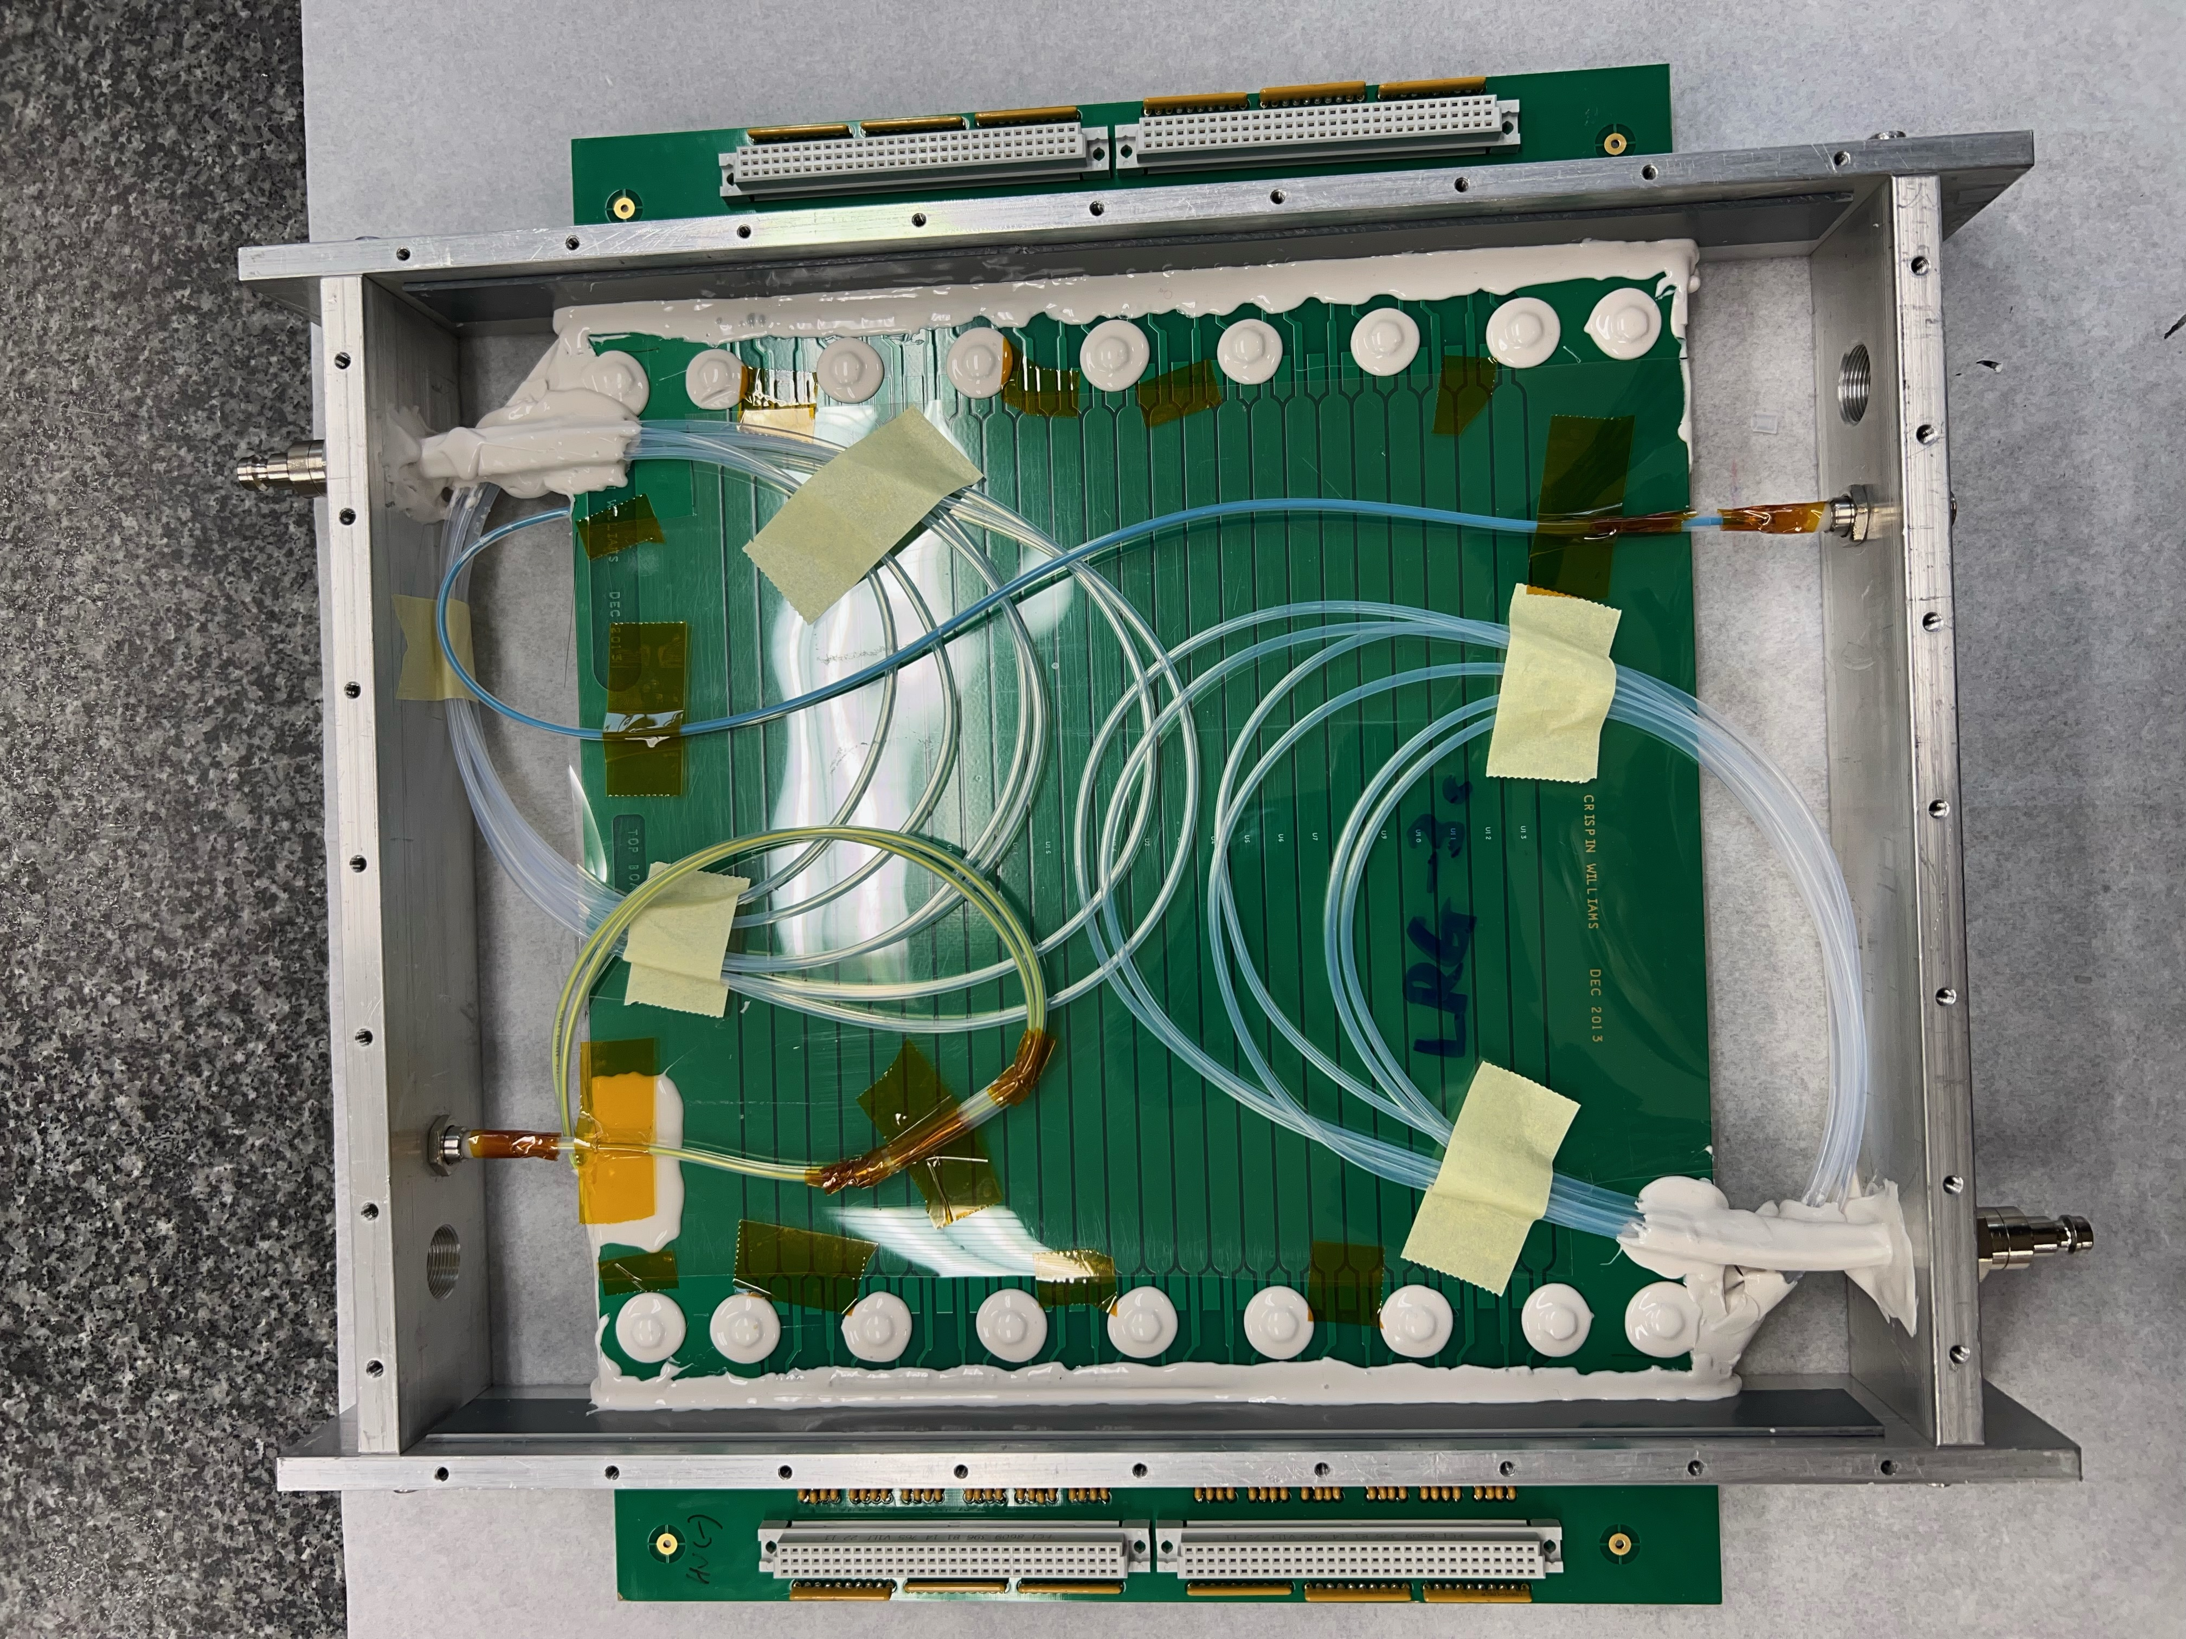
“Low resistivity” glass for high rates
Glass resistivity ~ 5x10¹² 𝛀cm
Glass thickness : 330 µm
Single stack 5 gaps
Glass Thickness : 500 µm
X-Y strip type MRPC
Strip: 5mm pitch(4mm width)
Gas gap with fishing lines
Sealed gas gap
Teflon tubes to make uniform gas flow
Active area: 20 x 20 cm²

Slide 9
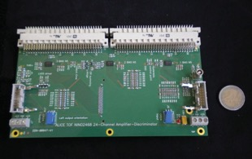
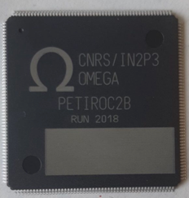

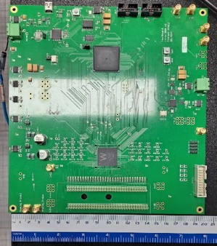
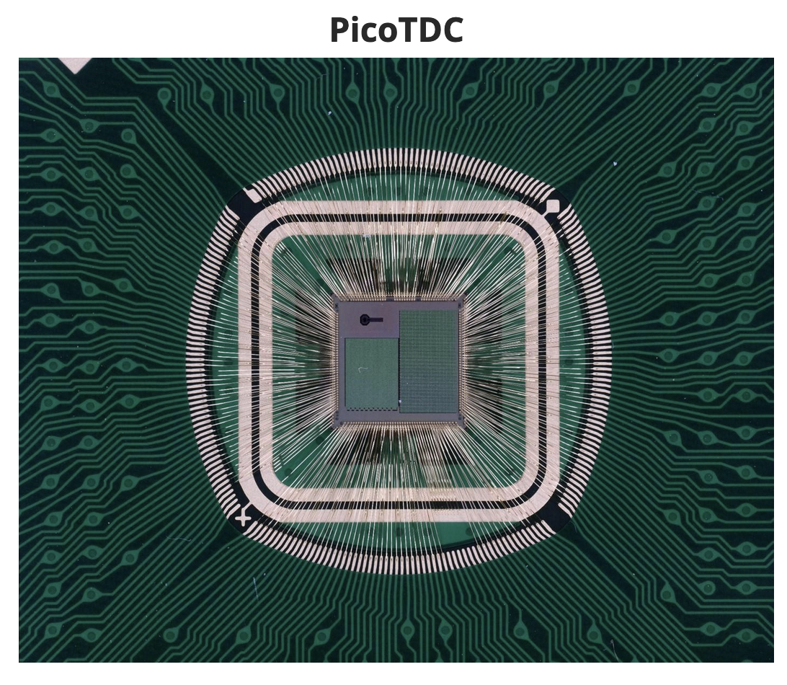
Electronics for SDHCAL
Baseline ASIC
Other ASICS being or to be used
Petiroc2A/B
NINO
It is not the ASIC for the long term,
only for exploring the capabilities.
Some limitations as: difficult to chain,
limited digital logic, deadtime
ASIC designed for the ALICE MRPC (TOF array)
- 8 channels
- Time resoltion ~50 ps
LiROC+picoTDC
- 32 channels
- on-chip TDC
- Time resolution
below 40ps
PETIROC2
ASIC
Board is under development by the WEEROC company
Based on LiROC + picoTDC
64-channel ASIC
64 channel TDC ASIC
Time resolution <12 ps
Developed at CNRS-OMEGA partially thanks to AIDA2020 for CMS-muon upgrade
95.5mm
32mm

Slide 10
Active Sensitive Unit (ASU)
Two different Active Sensitive Unit (ASU) developed
A small ASU , hosting 2 Petiroc ASICs to readout 64 1cm x 1cm pads for 16x16 cm² detector
A larger ASU hosting 8 Petiroc ASICS to readout a 50 cm x 30 cm detector with 2cm x 2 cm pads

Slide 11
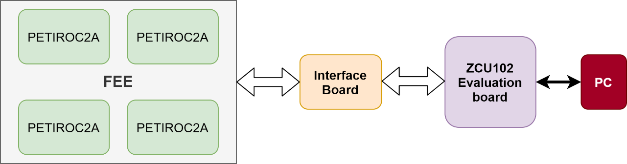
First prototype of Timing Electronics
The FEE prototype includes four PETIROC chips, 128 readout pads on the PCB bottom side for MRPC induction signals.
Detector Interface(DIF) card was designed to connect FEE and FPGA board
  Data transmission, power rail and clock source.
DAQ system to transfer data between FEE and PC.
Block diagram of timing electronics prototype

Slide 12
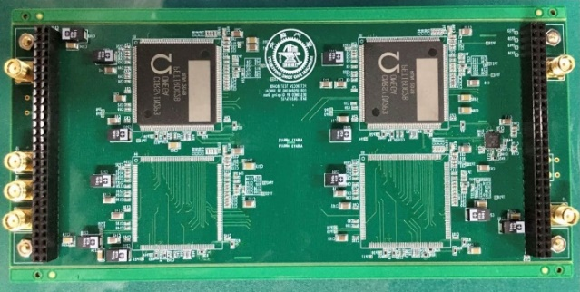
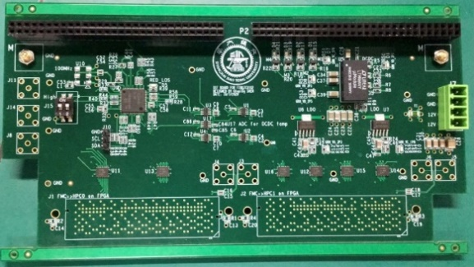
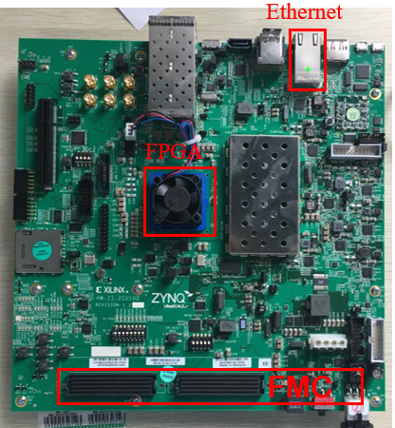
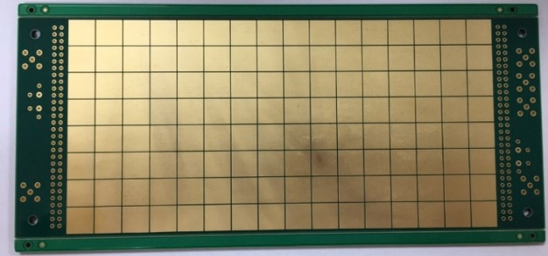
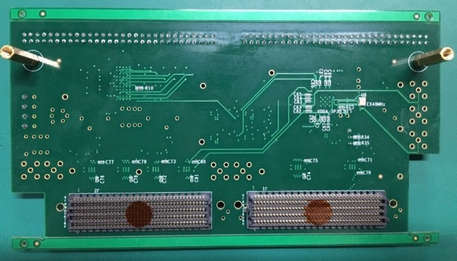

Hardware of Timing Electronics First Prototype
PETIROC
16cm
8 cm
ZCU102
128 pads with the cell size 1cm × 1cm
FE Board
DIF Card

Slide 13
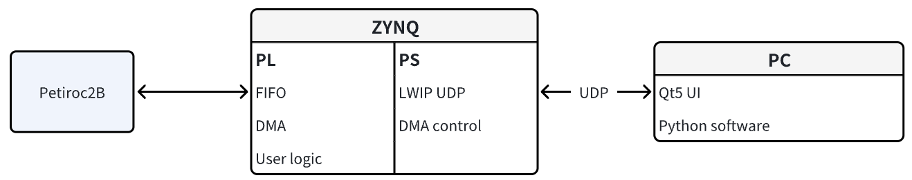

DAQ diagram based on ZYNQ
(to be used with small – 16 x 16 cm² - GRPC prototypes)
(*) PL = Programmable logic (FPGA part)
(*) PS = Processor system (Process part)
(*) DMA= Direct memory access
(*) LWIP UDP -> data transmission protocols
FEB
user logic
AXI-Stream
FIFO
user logic
AXI-Lite
FEB
PS
Data Flow
SC (slow control) Flow
Ethernet
AXI-Stream
PC
Ethernet
PS
AXI-Full
PC
DMA

Slide 14
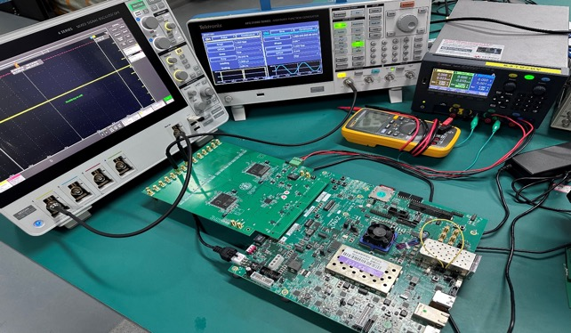
DAQ Tests Setup with FEB v2
Hosting 2 Petiroc ASICs
to readout 64 1cm x 1cm pads for 16x16 cm² detector
Prototype of high-resolution timing system
Layout
PC
Board (version2)
FEB
ZCU102
PC Software
Petirocs
Main settings
  Control masks, thresholds, etc.
EN/PP
  Control other binary configurations (ON/OFF)
Calibration
  Control individual DACs and offer S-curve drawing and calibration function
Slow Control
  For slow controls in user logic in FPGA
Data Transmission
  For sending, receiving and ethernet connecting
Pads
Board Test Setup
Top
Bottom
Using ZCU102 evaluation board

Slide 15
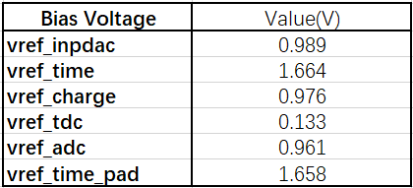
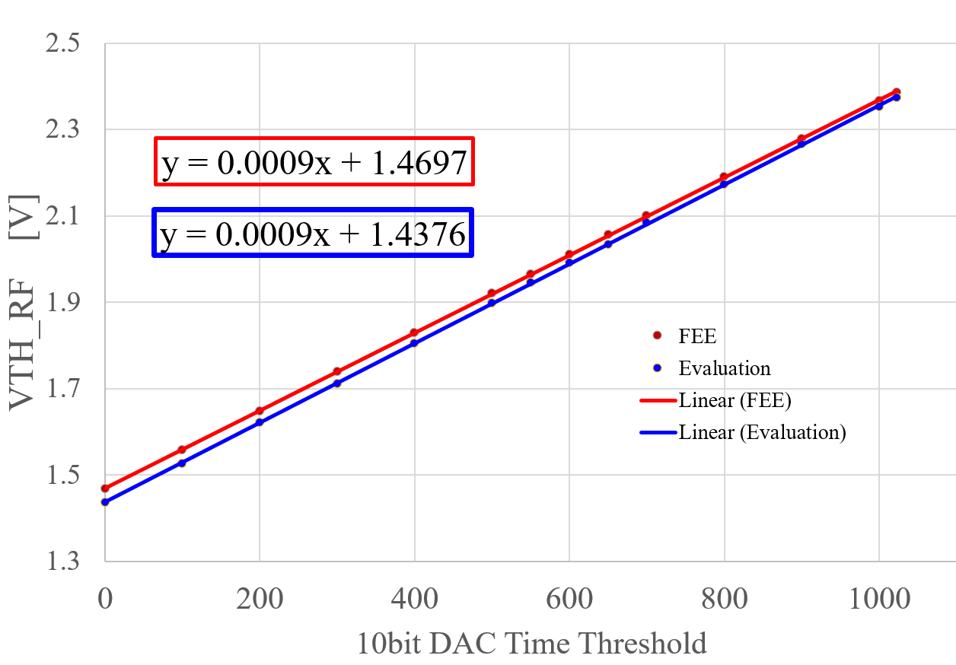
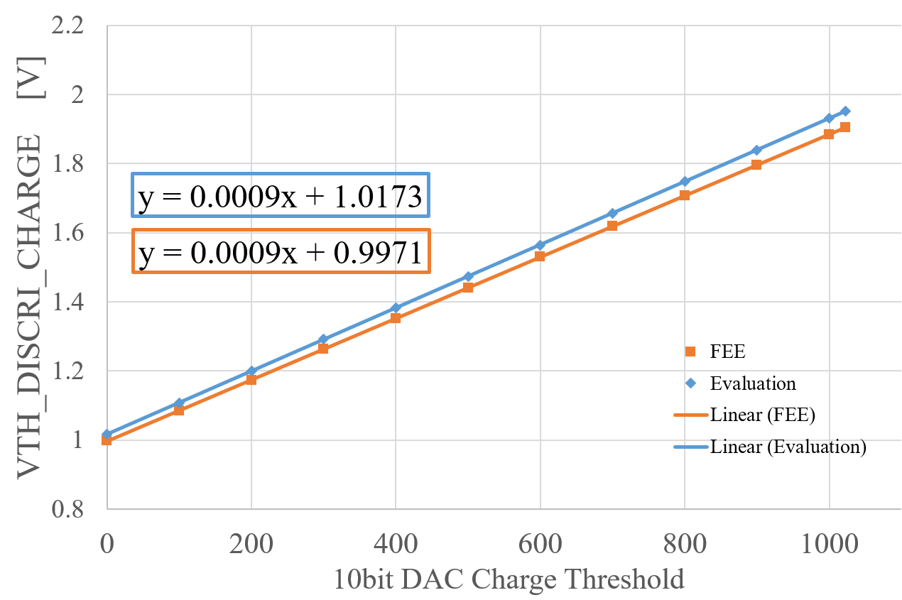
Time and Charge Threshold Voltage Test
All of bias voltage values are correct.
Output data has been checked, after sending trigger signals.
Time threshold is correct according to the voltage value with 10bit DAC.
Time and Charge threshold can be well controlled.

Slide 16

Single injection tests
inject channel
Single injection tests to evaluate if the last version of FEB has clean signals without crosstalk,
    Inject the signal to one of the 32 channels of one of the Petiroc2B chips.
    readout the 960-bit data.
    check ‘if_hit’ data to see if any hits are recorded except for the injected channel.
All the masks are disabled during the tests.
chip1 | chn0 | chn4 | chn8 | chn12 | chn16 | chn29 | chip2 | chn0 | chn4
chn0 | 1 | 0 | 0 | 0 | 0 | 0 | chn0 | 1 | 0
chn1 | 0 | 0 | 0 | 0 | 0 | 0 | chn1 | 0 | 0
chn2 | 0 | 0 | 0 | 0 | 0 | 0 | chn2 | 0 | 0
chn3 | 0 | 0 | 0 | 0 | 0 | 0 | chn3 | 0 | 0
chn4 | 0 | 1 | 0 | 0 | 0 | 0 | chn4 | 0 | 1
chn5 | 0 | 0 | 0 | 0 | 0 | 0 | chn5 | 0 | 0
chn6 | 0 | 0 | 0 | 0 | 0 | 0 | chn6 | 0 | 0
chn7 | 0 | 0 | 0 | 0 | 0 | 0 | chn7 | 0 | 0
chn8 | 0 | 0 | 1 | 0 | 0 | 0 | chn8 | 0 | 0
chn9 | 0 | 0 | 0 | 0 | 0 | 0 | chn9 | 0 | 0
chn10 | 0 | 0 | 0 | 0 | 0 | 0 | chn10 | 0 | 0
chn11 | 0 | 0 | 0 | 0 | 0 | 0 | chn11 | 0 | 0
chn12 | 0 | 0 | 0 | 1 | 0 | 0 | chn12 | 0 | 0
chn13 | 0 | 0 | 0 | 0 | 0 | 0 | chn13 | 0 | 0
chn14 | 0 | 0 | 0 | 0 | 0 | 0 | chn14 | 0 | 0
chn15 | 0 | 0 | 0 | 0 | 0 | 0 | chn15 | 0 | 0
chn16 | 0 | 0 | 0 | 0 | 1 | 0 | chn16 | 0 | 0
chn17 | 0 | 0 | 0 | 0 | 0 | 0 | chn17 | 0 | 0
chn18 | 0 | 0 | 0 | 0 | 0 | 0 | chn18 | 0 | 0
chn19 | 0 | 0 | 0 | 0 | 0 | 0 | chn19 | 0 | 0
chn20 | 0 | 0 | 0 | 0 | 0 | 0 | chn20 | 0 | 0
chn21 | 0 | 0 | 0 | 0 | 0 | 0 | chn21 | 0 | 0
chn22 | 0 | 0 | 0 | 0 | 0 | 0 | chn22 | 0 | 0
chn23 | 0 | 0 | 0 | 0 | 0 | 0 | chn23 | 0 | 0
chn24 | 0 | 0 | 0 | 0 | 0 | 0 | chn24 | 0 | 0
chn25 | 0 | 0 | 0 | 0 | 0 | 0 | chn25 | 0 | 0
chn26 | 0 | 0 | 0 | 0 | 0 | 0 | chn26 | 0 | 0
chn27 | 0 | 0 | 0 | 0 | 0 | 0 | chn27 | 0 | 0
chn28 | 0 | 0 | 0 | 0 | 0 | 0 | chn28 | 0 | 0
chn29 | 0 | 0 | 0 | 0 | 0 | 1 | chn29 | 0 | 0
chn30 | 0 | 0 | 0 | 0 | 0 | 0 | chn30 | 0 | 0
chn31 | 0 | 0 | 0 | 0 | 0 | 0 | chn31 | 0 | 0
if_hit data
No crosstalk in the FEB

Slide 17
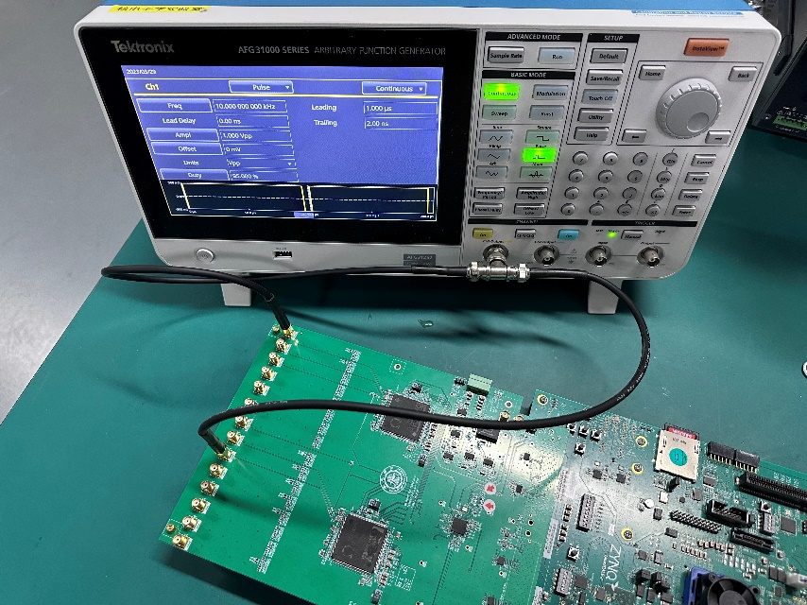
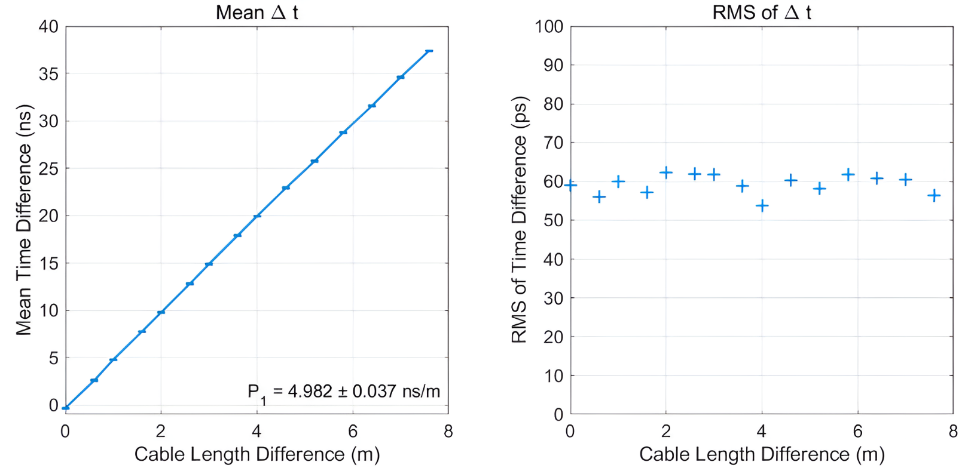
Two chips timing
Inject the signal into different channels
Delay line method
  Control the time difference of signal arrival through different line lengths
  Analyze and measure the obtained time difference
  Obtain time performance

Slide 18
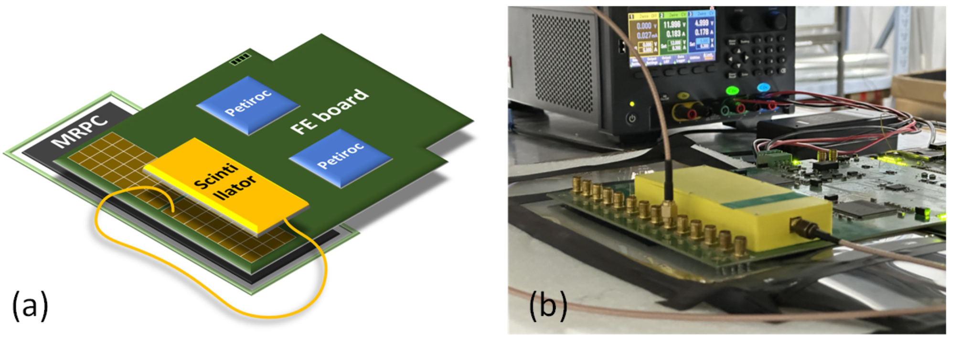
MGRPC cosmic tests - Setup
FEB is placed between the scintillator and the MRPC
Scintillator covers most channels of ASIC1 and few of ASIC2
The system successfully detects cosmic rays,
validating that the FEB operates effectively with the mRPC detector
Test also done with 2 FEBs and 2 MRPC

Slide 19
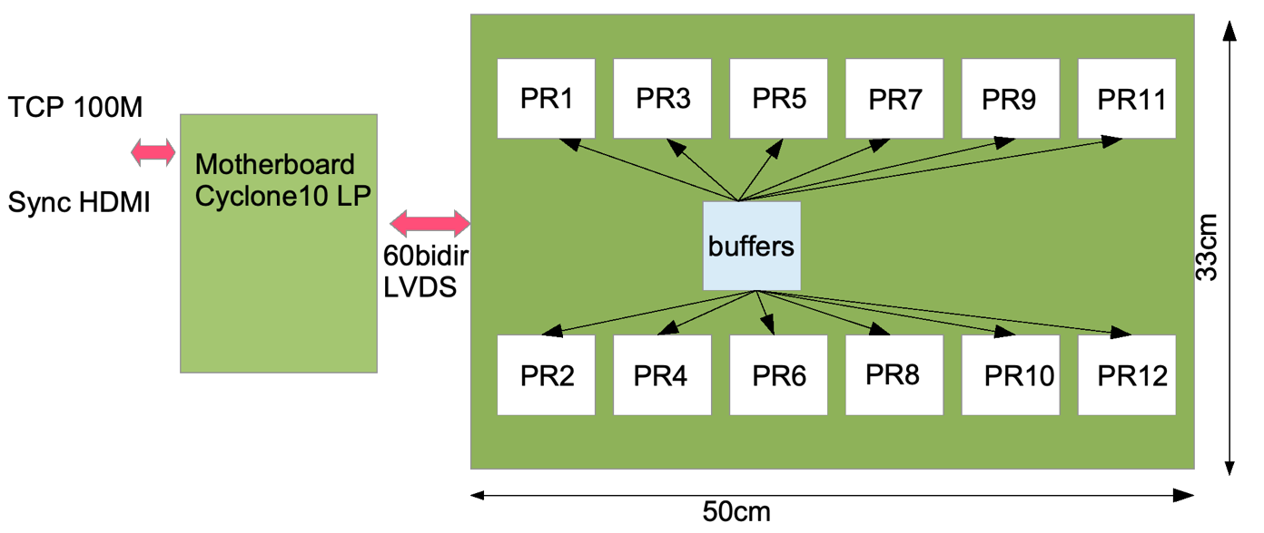
Toward Larger prototypes – Petiroc2B ASU v2
Board with 12 Petiroc2B ASICs, 384 channels
Pads 2cm x 2cm
No local embedded FPGA
Board is connected to the Synchro motherboard (initially developped to replace DCC boards)

Slide 20
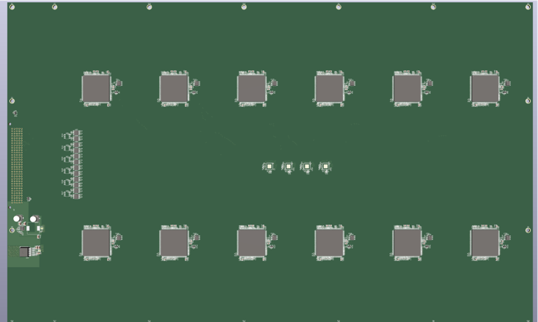
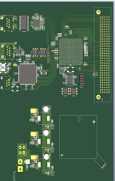
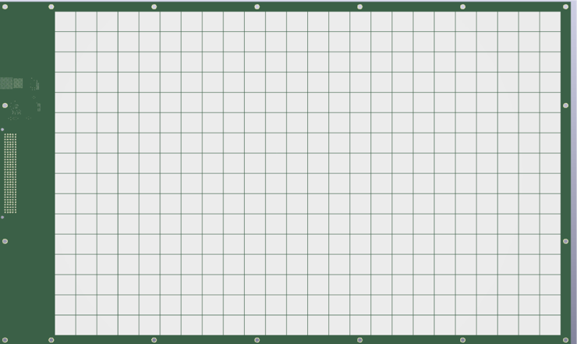
Toward Larger prototypes – Petiroc2B ASU v2 (II)
ASU 12 PR2B (top)
Motherboard Cy10LP
Design to evaluate possibility to measure timing on a 50x30 cm2 RPC chamber with PETIROCB chips.
NOT intended to be chained,
NOT intended to be put on large detectors
ASU 12 PR2B (bottom)

Slide 21
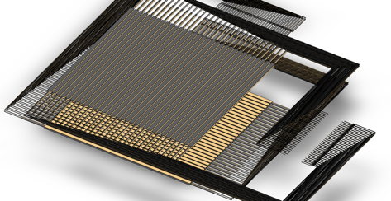

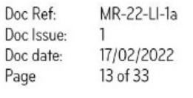

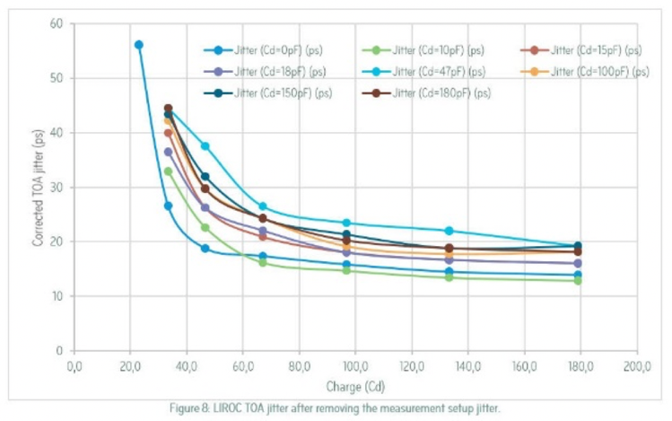
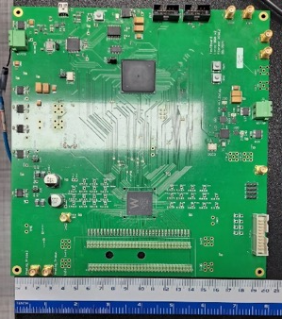
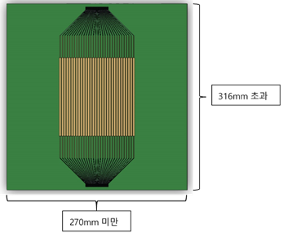

Developments using LiROC chip
MRPC for timing-SDHCAL (& Muon tomography & TOF-PET)
Classic :
Using NINO (CERN, 2003) : differential, 3 x 8 ch.
New :
Using LiROC (Weeroc, 2022) : single-ended, 64 ch.
Designing the signal electrode, and also the ground plane
Time resolution 12 ps
95.5mm
32mm
LIROC jitter after removing the measurement setup jitter
Progress has been made at GWNU on the development of the LVDS-to-sub-LVDS interface card, which is required to connect the output of the NINO FEE boards to the picoTDC board developed by INFN-Bologna

