Slide 1
A Trigger/Timing Logic Unit (TLU) for AIDA-Innova
David Cussans
AIDAinnova Collaboration Meeting, Prague, May 2025

Slide 2







Why a New TLU?
From AIDAinnova grant agreement, part A:
  “To provide a O (100) ps timing for particle hits, a dedicated timing layer as well as a trigger logic unit (TLU) with picosecond-timing support need to be developed, integrated and installed at both CERN and DESY. The precision timing layer will be provided by a TimePix4 plane, which will be fully integrated into the telescope hardware and the EUDAQ2 framework. We foresee having such planes available at all beam lines. To provide an ultimate timing resolution of 30 ps, an LGAD plane based on current developments for the HL-LHC will be included in the EUDET-style pixel telescopes. In order to benefit from this exquisite timing, the TLU needs to provide a stable clock with a 10 ps or better stable edge, which will be part of the AIDA TLU upgrade.”
NWO-I/Nikhef, UNIVBRIS, CSIC-IFCA, DESY,UCL, USC
7 May 2025
2

Slide 3
Why a TLU?
EUDET, AIDA, AIDA-2020 and AIDAInnova programs aimed to provide a common interface (hardware, software) to beam-lines and beam-telescopes.
→ EUDET/AIDA(-2020/Innova) Trigger(Timing) Logic units developed
New detectors need improved timing precision
  →AIDAinnova TLU developed

Slide 4
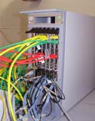
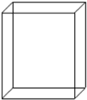
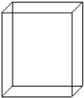

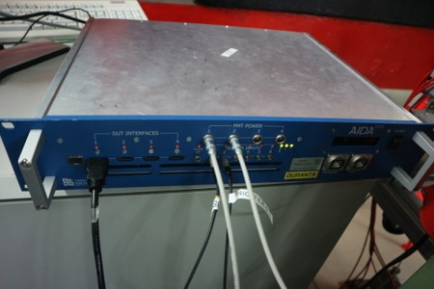

Why?
As part of EUDET/AIDA(-2020/Innova) beam telescopes provided for beamlines at DESY and CERN
Hardware synchronization using TLU
Pixel Sensors
AUX
board
DUT
e
-
TelescopeReadout
Adapted from: Infrastructure for Detector Research and Development towards the International Linear Collider. https://arxiv.org/abs/1201.4657
GBit ETH
LVDS
Trigger
Logic
Unit
EUDAQ PC
USB
ETH
Run Control PC

Slide 5
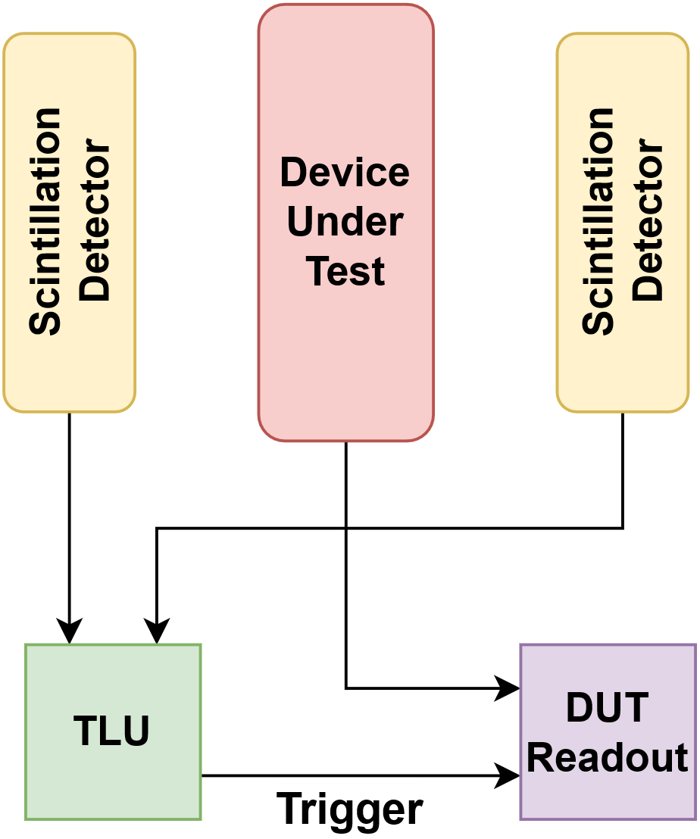
What Does it Do?
Sensors in beam to detect passage of particles.
   Electrical signals conditioningbinary signal
Combine signals from one or more beam sensors to produce a “trigger”
Implementation: Box with signal conditioning and an FPGA inside
Beam
Particle

Slide 6
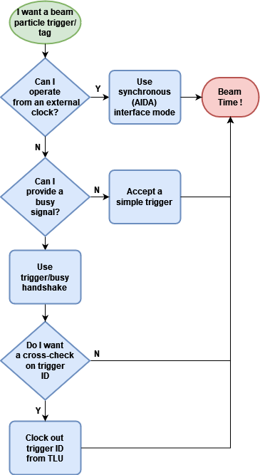
AIDA-2020 TLU
DUT Interfaces: Sync
Can the Device Under Test accept (or provide) a clock?
  Nominally 40MHz, can be adjusted.
→ Use synchronous ( “AIDA mode”) interface.

Slide 7
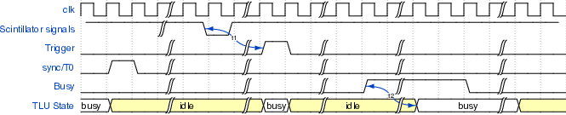
AIDA-2020 TLU
Synchronous Interface
Common clock
Permits higher trigger rate than asynchronous mode (no event-by-event handshake)
Cross-check by matching trigger count and trigger time-stamp in both TLU and DUT.
  Sync/T0 signal sent to DUT at start of run to reset timestamp

Slide 8
AIDA-2020 TLU
DUT Interfaces: Async
Does the Device Under Test have to run on its own clock?
→ Use asynchronous (“EUDET mode”) interface.
  Beam-tests can be electrically noisy.
    Spurious triggers
    Missed triggers
    Can use a trigger busy handshake for increased reliability
  DUT can clock out trigger ID to provide cross-check

Slide 9
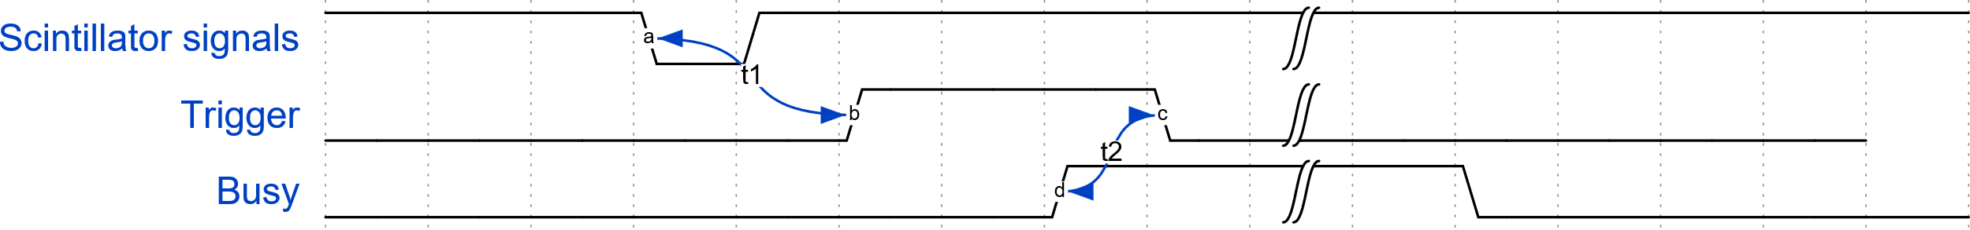
AIDA-2020 TLU
Asynchronous Interface
    Asynchronous “EUDET mode”
          No common clock between TLU and DUT.
          Trigger/Busy handshake
            (Trigger is only released when DUT acknowledges)

Slide 10
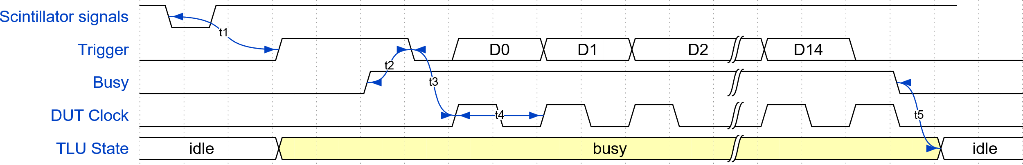
AIDA-2020 TLU
Asynchronous Interface
    Asynchronous “EUDET mode”
          No common clock between TLU and DUT.
          Trigger/Busy handshake (configurable)
          DUT can clock out trigger number from TLU
            Output on trigger line
            Provides event-by-event cross-check

Slide 11
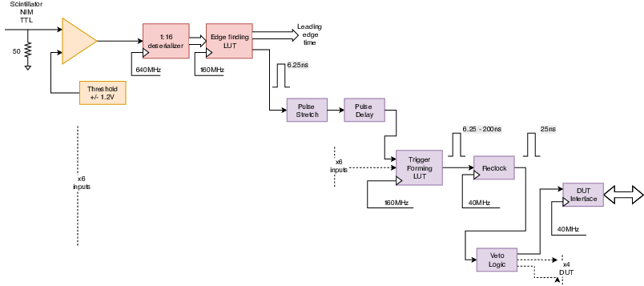
Trigger Logic
Inputs clocked at 160MHz (aiming to move to 320MHz to reduce min latency)
Input signals can be delayed/stretched in units of 1/160MHz (1/320MHz)
Signals from the 10 inputs into look-up table
Trigger output synchronized to clock fed to DUT (40MHz nominal)
State of all inputs recorded at point that trigger “fires”
  Can be used to tag events – e.g. Cherenkov information.
N.B. Triggers synchronized with internal clock → Variable latency in EUDET mode.
  May change to fixed latency , O(10ns) in new TLU

Slide 12
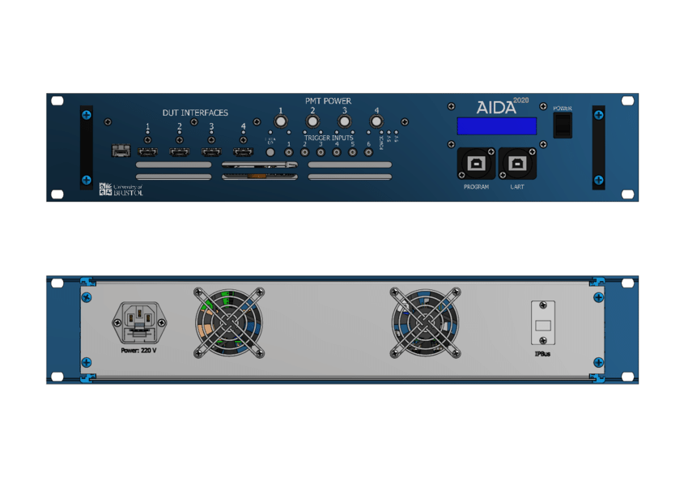
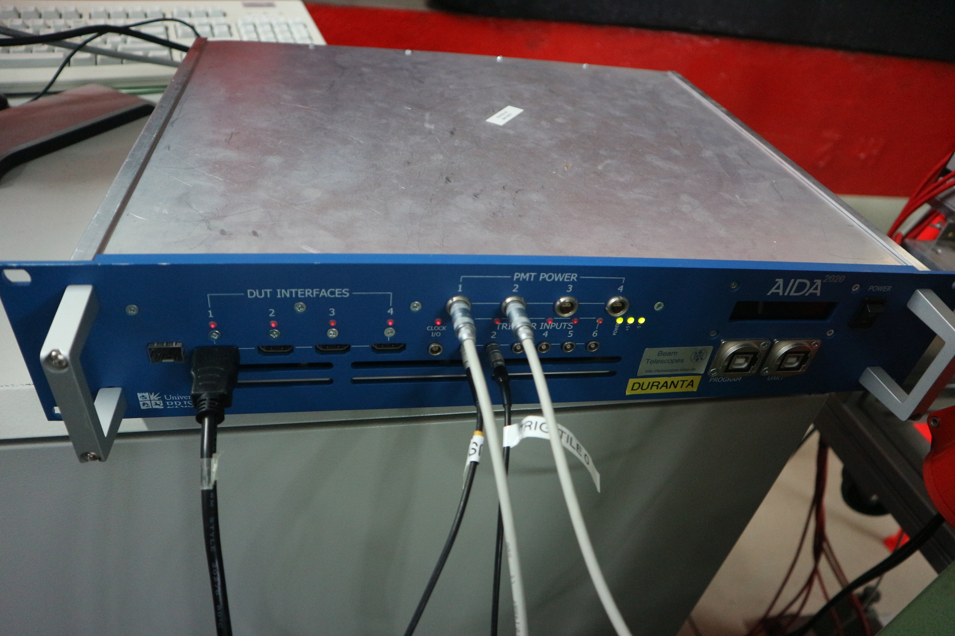
Existing - AIDA-2020
AIDA(-2020) production version
6 trigger inputs
4 DUT connections
  LVDS on HDMI
    But direction of each line can be swapped in hardware to allow different firmware mapping
Low jitter clock
Hardware permits optical distribution of clock/trigger
rack-mount case

Slide 13
Why a New TLU?
Increasing need for more precise timing
      (AIDA-2020 TLU has ~ 1ns time-stamping accuracy)
User requests for more trigger inputs
      (Number of DUT interfaces can be increased in common clock mode using external fanout – up to 30 DUTs)

Slide 14
Picosecond TLU
Timing specification:
  Clock jitter < 10ps RMS
  Timing-stamping of input signals O(100ps) RMS
Backwards compatible with AIDA-2020 TLU
  Same signals on DUT connections
AIDA-2020 TLU connected to beam telescope
EUDET mode | AIDA mode
Trigger | Trigger
Busy | Busy
DUT Clock (DUT->TLU) | Shutter (TLU->DUT)
Reset | T0
Not used | Global clock

Slide 15
Picosecond TLU - I/O
Trigger inputs
  10 (cf. 6 on AIDA TLU)
    Six simple threshold (same as AIDA-2020 TLU)
    Four Fast Analogue Inputs (FAI)
      Designed for short pulses ( > 100ps )
      Output to ADC for time-walk correction ( 9 bits, 800MSample/s, ADC12QJ800 )
  TDC with O(10ps) bins
    Implemented in FPGA as delay-line TDC
    Also, connection to external PicoTDC (3ps bins)
  Aim to contribute less to timing uncertainly than detector.

Slide 16
Picosecond TLU - I/O
Device Under Test (DUT) connectors
  Compatible signal definitions as AIDA-2020 (also LVDS)
  Increase number from 4 to 6
  Move to “Display Port” from HDMI
    Mechanically more robust.
    Five differential pairs (c.f. 4 in HDMI)
    Passive adaptor to HDMI if needed
Run internal logic faster →reduce latency (currently O(100ns))

Slide 17
PicosecondTLU -
Rate Capability
Same goal for rate capability as AIDA-2020 TLU:
      Instantaneous rate ~ 10MHz:
  Sustained rate ~ 1MHz
    Internal buffer in current AIDA-2020 TLU only 4k events.
      Aiming to expand to O(100k events)
        Moved to newer FPGA – more memory

Slide 18
Picosecond TLU -
Optical Interface
Retain optical interface introduced in AIDA-2020 TLU
  Can distribute timing information over fibre
  Used for ProtoDUNE-SP
    https://doi.org/10.1016/j.nima.2019.04.097
  fibre bandwidth much larger than copper cable.
    Possibility of more precise timing over longer distances
      Clock jitter (endpoint w.r.t. master) of ~ 2ps (sigma) measured

Slide 19
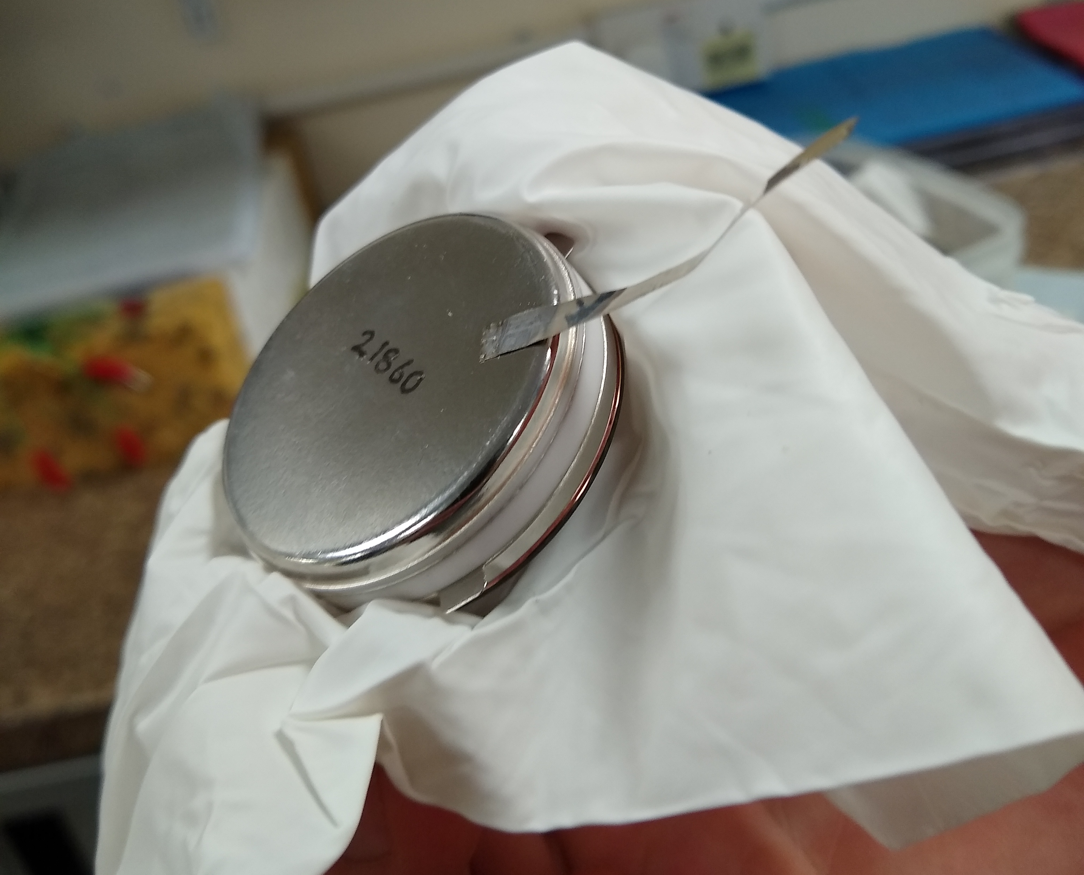
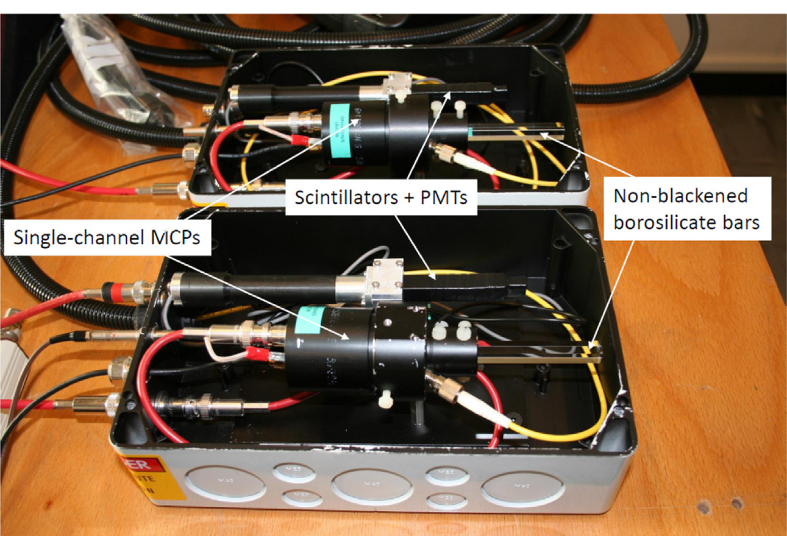
Picosecond TLU - Timing reference
Testing pico-second detectors requires pico-second time reference
  TLU timing only as good as reference
Beam-line may bring their own time reference detectors. Others want to benefit from precise time reference at beam-line.
Use, e.g. Cherenkov light and high-speed photo-detector
  Used for “TORCH” LHCb upgrade beam-tests
  MCP-PMT single photon jitter 66ps FWHM http://www.photek.co.uk/pdf/datasheets/detectors/DS006%20Photomultiplier%20Tube%20Datasheet%20issue%202.pdf
  With many photons, timing precision ~ 10ps
  Pulse width < 1ns FWHM → circuit outside FPGA to capture short pulses.
Bare MCP-PMT module
(photo-cathode facing down)
Taken from http://dx.doi.org/10.1016/j.nima.2016.06.087
Photo: Didier Piedigrossi, TORCH

Slide 20
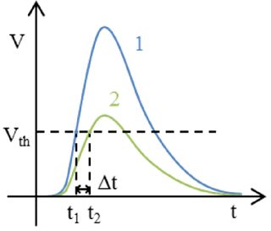
Fast Trigger Inputs
Combine threshold comparator with 9-bit 800MSample/s ADC for time-walk correction
Pulse catcher/stretcher outside FPGA
CERN PicoTDC ASIC for time-stamping – in design
Optimizing for small amplitude fast rise signals.
Use case: single-anode MCP-PMT used as a timing detector

Slide 21
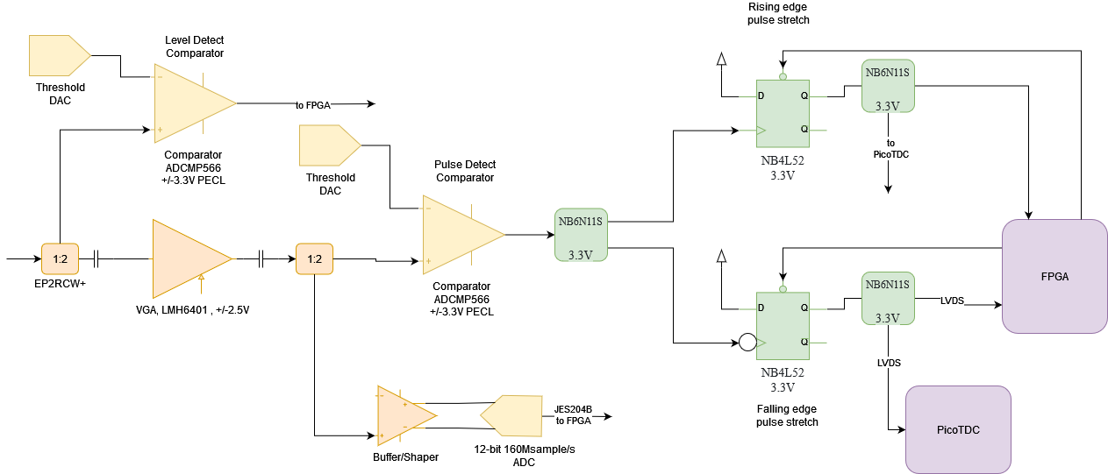
Fast Trigger Inputs

Slide 22
Trigger Inputs
Level
Comparator
(same as AIDA TLU)

Slide 23
Trigger Inputs
Variable
Gain

Slide 24
Trigger Inputs
Pulse
Comparator

Slide 25
Trigger Inputs
ADC for
Time-Walk
Correction

Slide 26
Trigger Inputs
Rising Edge
Pulse Stretching

Slide 27
Trigger Inputs
Falling Edge
Pulse Stretching

Slide 28
Trigger Inputs
TDC

Slide 29
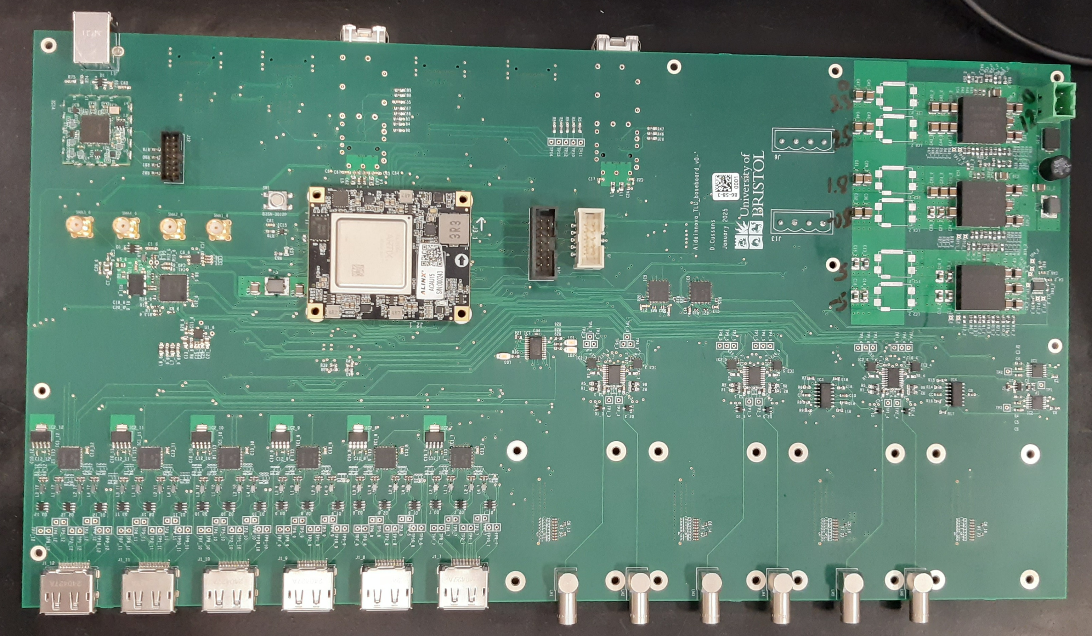
Base Board
Ethernet connection ,1Gbit/s
Serial timing/trigger link
USB forFPGA programming and setting IP address
Artix Ultrascale+
FPGA module
Six DUT connections
Six trigger inputs
(threshold only)

Slide 30
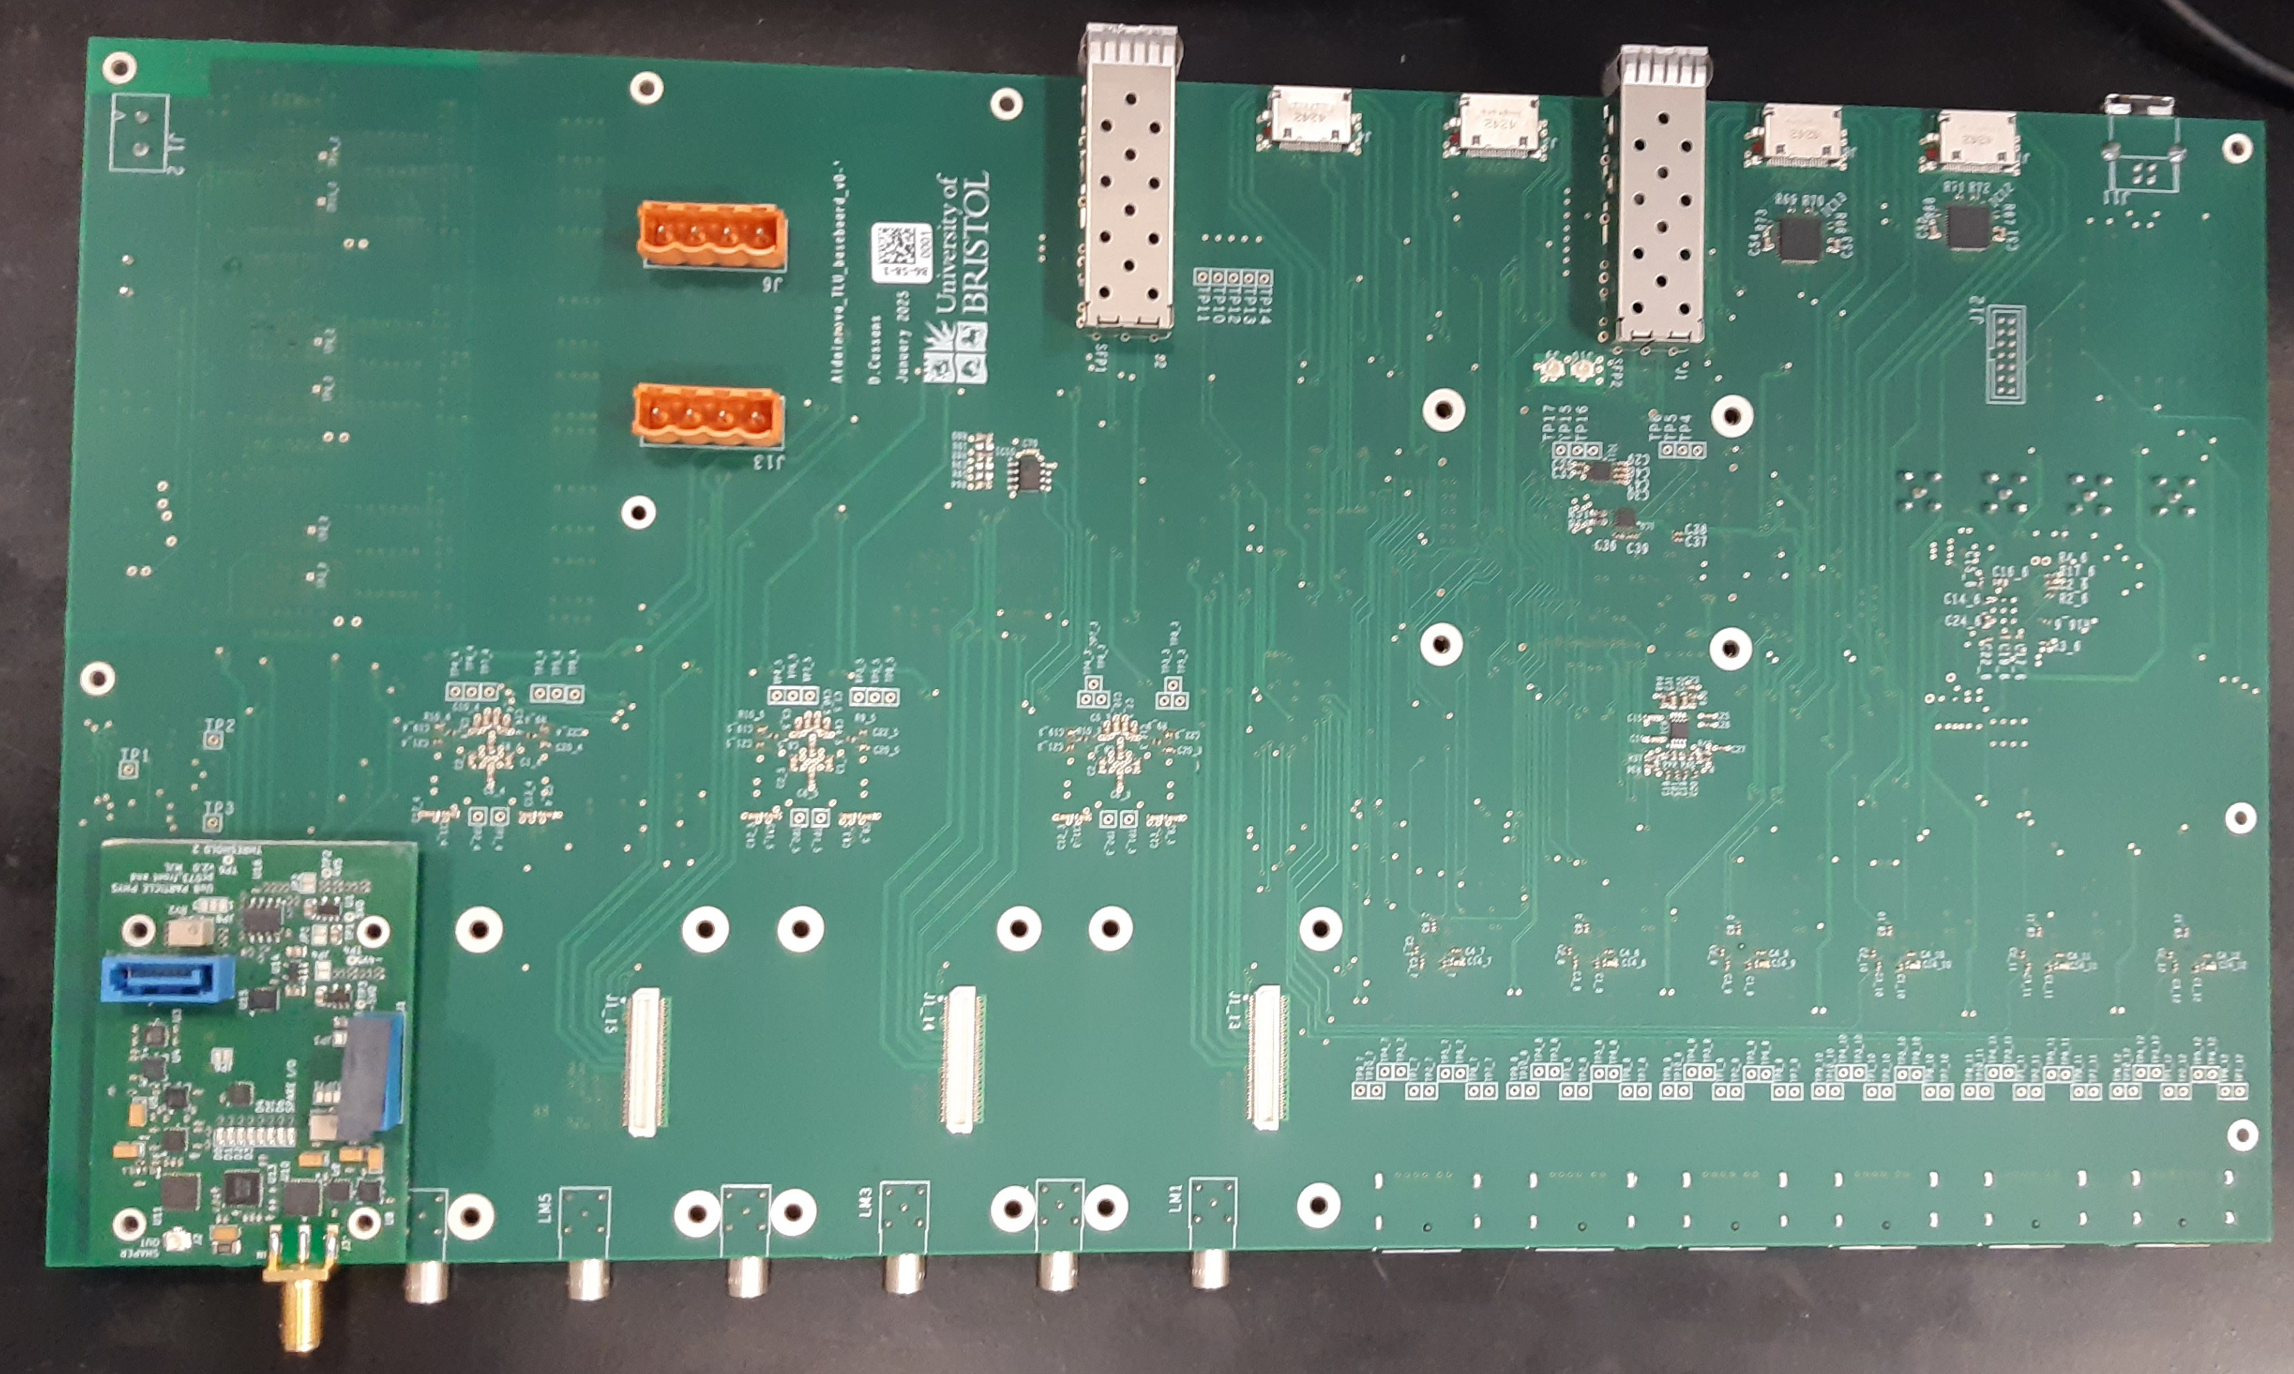
Base Board - bottom
Serial timing/trigger link
Ethernet connection ,1Gbit/s
Connection to TDC
Connection to ADC
Four fast analogue input
(only one shown)
Six trigger inputs
(threshold only)
top

Slide 31
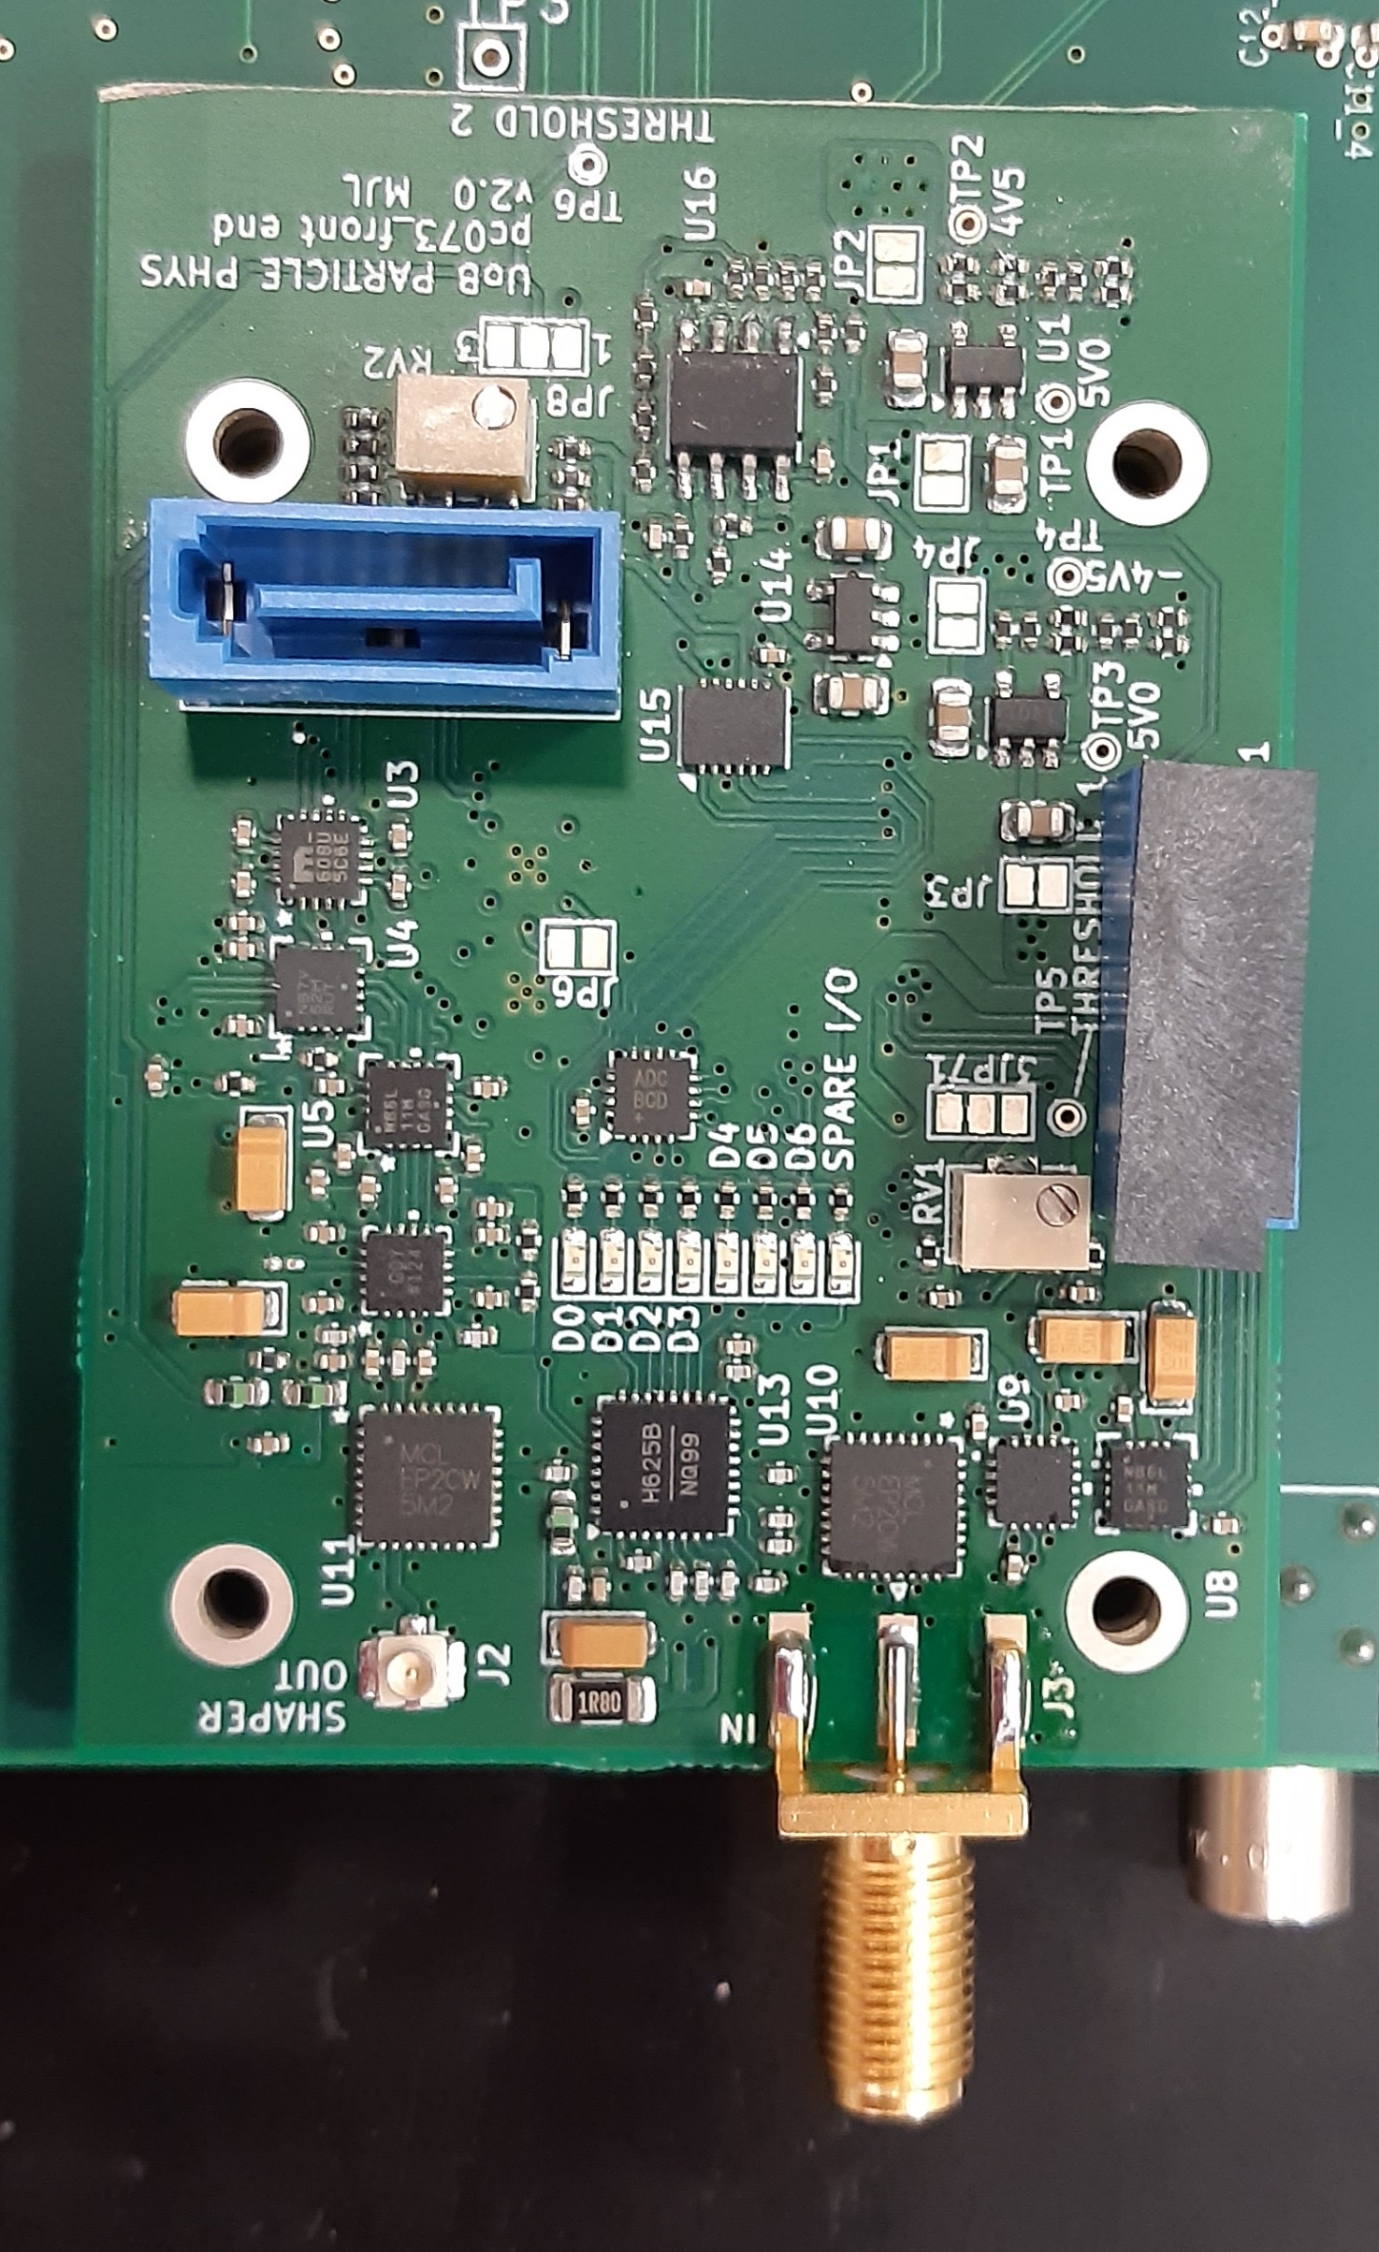
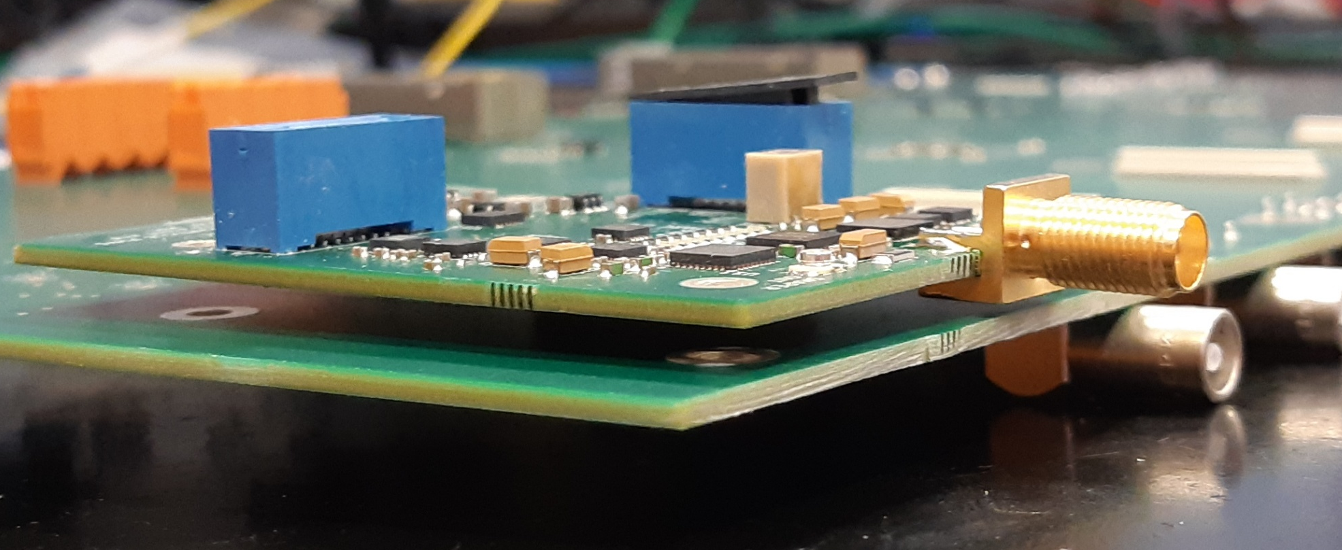
Fast Analogue Input
Digital outputs
to TDC board
Analogue output
to ADC
Analogue
Input

Slide 32
Documentation
Open Hardware project “AIDAinnova TLU”
  https://gitlab.com/ohwr/cussans/aidainnova_tlu
User manual under development
  Will inherit much from AIDA(-2020) TLU since backwards compatible

Slide 33
Firmware
Firmware(gateware) source code
  OHWR Gitlab https://gitlab.com/ohwr/cussans/aidainnova_tlu-gw
  Introduced VHDL-2019 features for better maintainability
Control and readout of time-stamps with UDP/IP 1 Gbit/s Ethernet
  IPBus: https://ipbus.web.cern.ch/ (from CMS)
  Possible increase to 2.5Gbit/s
  Move to DHCP for setting IP address
Ipbb build system
  Scriptable build.

Slide 34
Software
Will be integrated with EUDAQ DAQ software.
  (Like other TLU versions)
  Run control
    Configuration
    Monitoring
  Readout of trigger timestamps
  https://eudaq.github.io/

Slide 35
AIDA-Innova TLU Schedule
Significantly delayed by lack of effort
  Engineer allocated at start of project diverted to another project. Hardware work started Q2/24
FAI prototype produced and tested.
Base board produced. Being tested.
FAI produced.
  Being tested.
  Will be tested with MCP-PMT
Basic firmware/software under development
Full firmware under development
Draft deliverable report (D3.2) ready
  Leaving submission as late as possible to add plots.

Slide 36
Summary
The AIDAinnova TLU provides a common hardware and software interface to beamlines
Backwards compatible at the hardware signal level with EUDET / AIDA-2020 / AIDA TLU
      Data format different
Pico-second detectors need pico-second infrastructure
      Aiming for < 100ps timing

Slide 37
Backup

Slide 38
Outline
What is a TLU?
  (Why do I need one?)
What exists now
  (What are all those blue boxes?)
Why it needs to be improved
  (Why do I need a new blue box)
Implementation
  (Front end , back end).

Slide 39
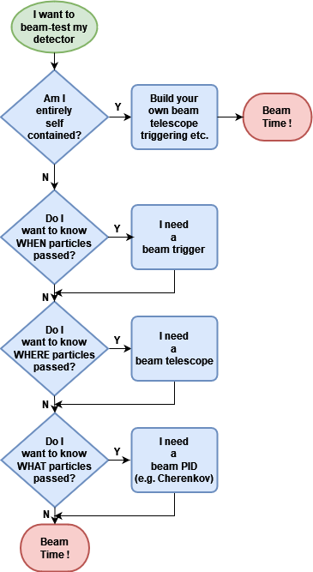
Why a TLU?
May have entirely self-contained system.
  In which case all you need is the beam.
But often want to use existing beamline infrastructure.

Slide 40
Why a TLU?
May want a signal to trigger read-out of detector
  In which case you need a beam trigger
  Can be helpful to have pre-installed scintillators etc.
  And trigger logic (AND, OR, VETO, etc.)

Slide 41
Why a TLU?
May want to know where each particle hit your detector
  In which case you need a beam telescope
  Need a way of matching tracks in telescope with hits in your detector
    → Hardware correlation through TLU

Slide 42
Why a TLU?
May want particle ID
  In which case you need beam instrumentation (e.g. Cherenkov detector)
  Want to tag events with PID information (e.g. p/pi/K from threshold Cherenkov)
    → Hardware correlation through TLU

Slide 43
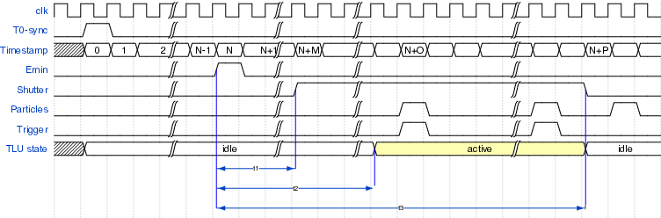
AIDA-2020 TLU
DUT “Shutter”
Some detectors can only capture data with a low duty cycle
In many beam-lines particle are only present a certain times
  DESY – 50Hz cycle
  CERN – SPS cycle
Detectors active period should occur when particles are present
→ Signal from accelerator can be used to generate a “shutter” signal sent to DUT

