Slide 1




Integration Aspects of Highly Granular Calorimeters
WP8 T2.1
Vincent Boudry
LLR, Institut Polytechnique de Paris
for
CERN, CNRS-IJCLab, CNRS-LLR, CNRS-LPNHE,
DESY-HH, FZU, JGU, TAU
materials from Y. Benhammou, A. Irles, K. Kruger, J. Maalmi, E. Sicking, X, Xia, Y. Shi and others
AIDAinnova Final meeting
FZU, Prague, 06/05/2025
This project has received funding from the European Union’s
Horizon 2020 research and innovation programme
under grant agreement No 101004761.
The measurements leading to these results have been performed at the Test Beam Facility at DESY Hamburg (Germany), a member of the Helmholtz Association (HGF)".

Slide 2
WP8 Task 8.2/1

Slide 3
Task 8.2.1 Towards next generation highly granular calorimeters
Task 8.2.1
  Development of a common electromagnetic and hadronic calorimeter data concentration interface for minimised space and power consumption
  Demonstrator with functional active detector elements and full read-out chain (D8.1)
Integration aspects of highly granular calorimeters
  Highly granular electromagnetic and hadronic calorimeters at future colliders will have up to 10⁸ readout cells, calling for common solutions for services such as data concentrators interfacing the embedded front–end electronics and the data acquisition outside the detector.
  This subtask will develop compact and innovative data concentrator and power distribution units, serving more than 10⁶ cells and satisfying the tightest space and power constraints.
  The technical solutions will be embedded in a demonstrator that will be applicable to particle physics detectors at future e+e− colliders such as ILC, CLIC, CEPC, FCC-ee.
  For this demonstrator, mechanical structures and silicon and scintillator based active elements will also be provided

Slide 4

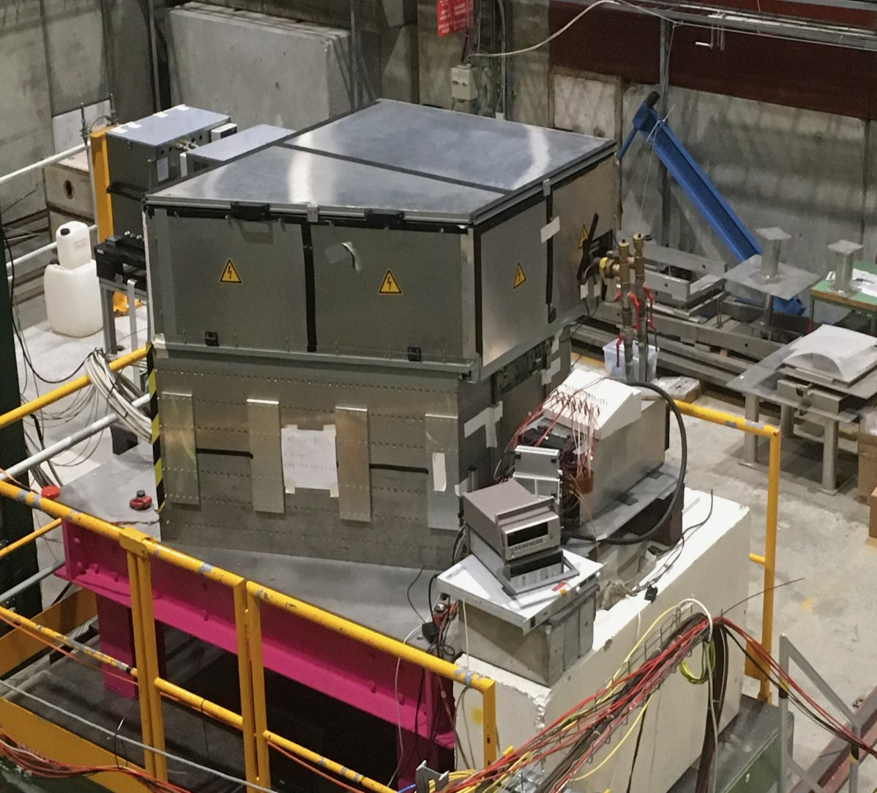
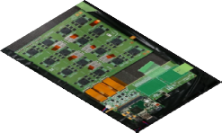
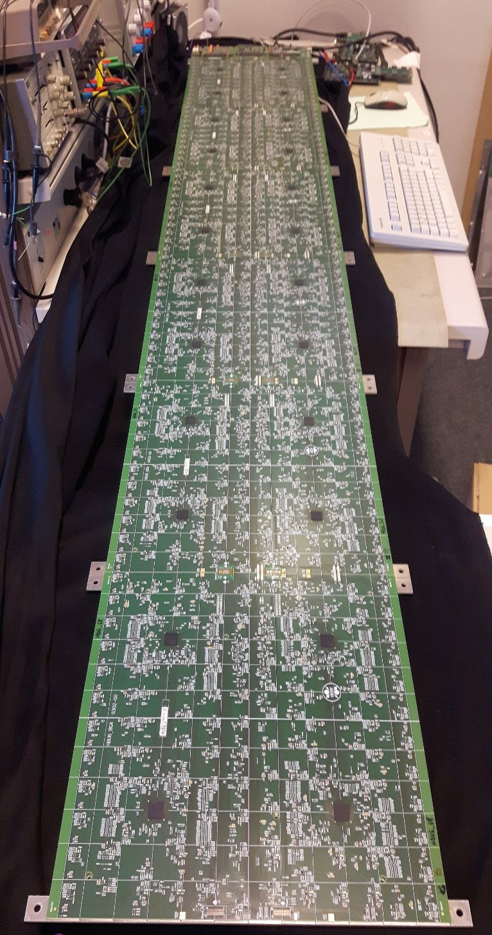
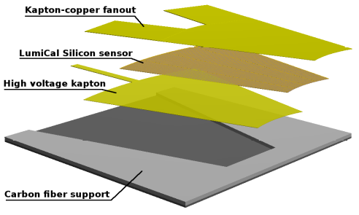
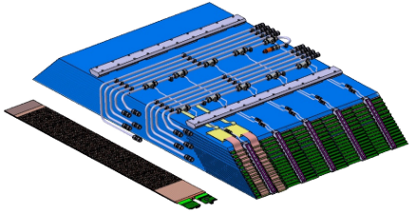
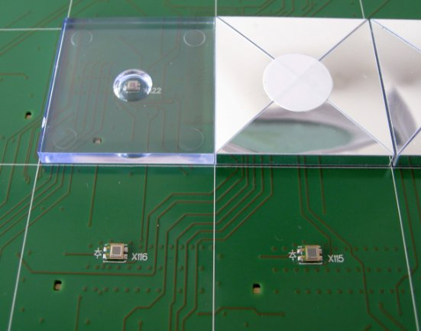
A Map to High-Granularity
Calorimeter Prototypes
FCAL for ILD, LUXE SiW-ECAL for ILD, LUXE AHCAL for ILD
Si 5×5 mm²
For Higgs Factories
HCAL
× 4
ECAL
beam
Common DAQ
HBU
Scint 3×3 cm²
Non-linear QED

Slide 5
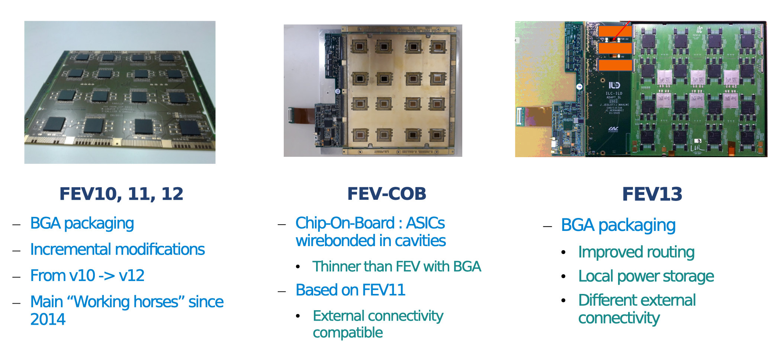
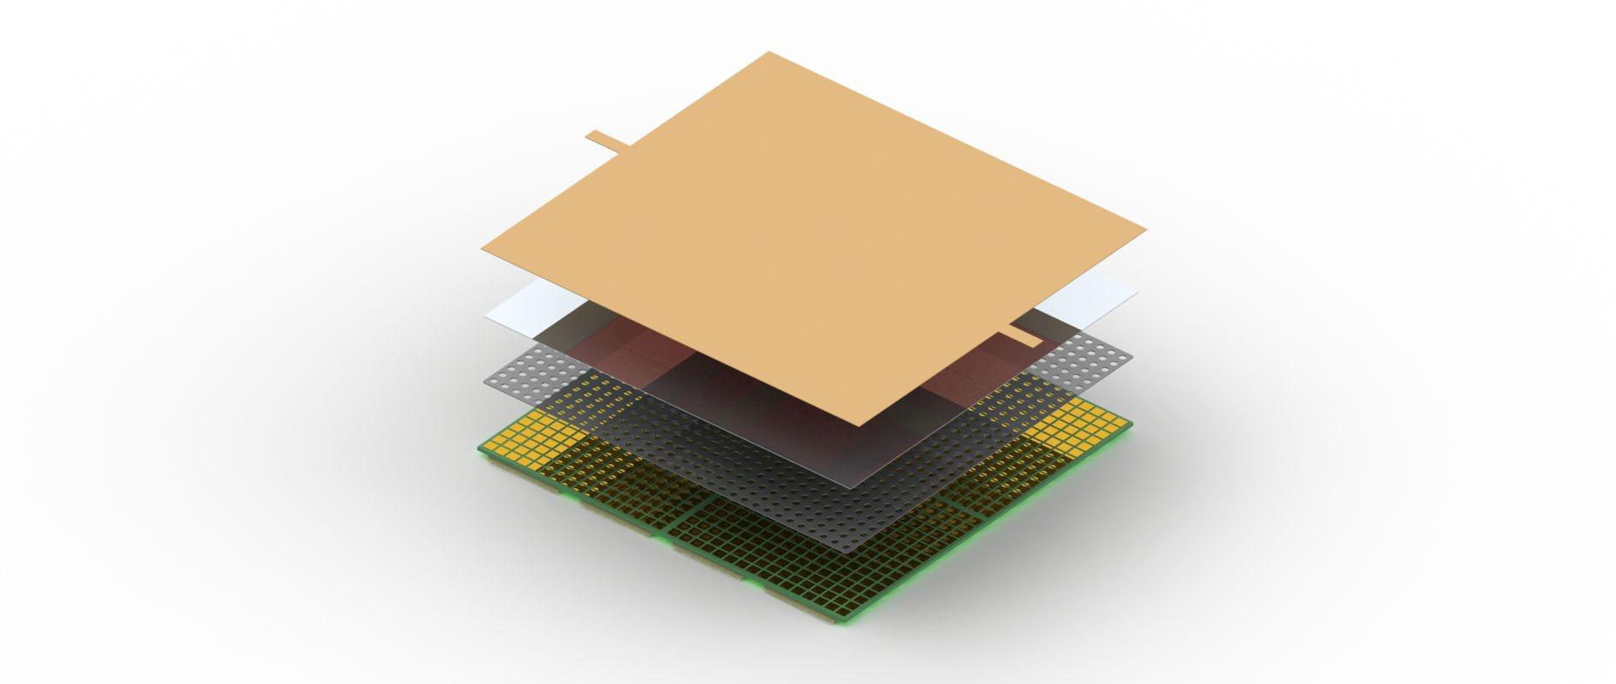
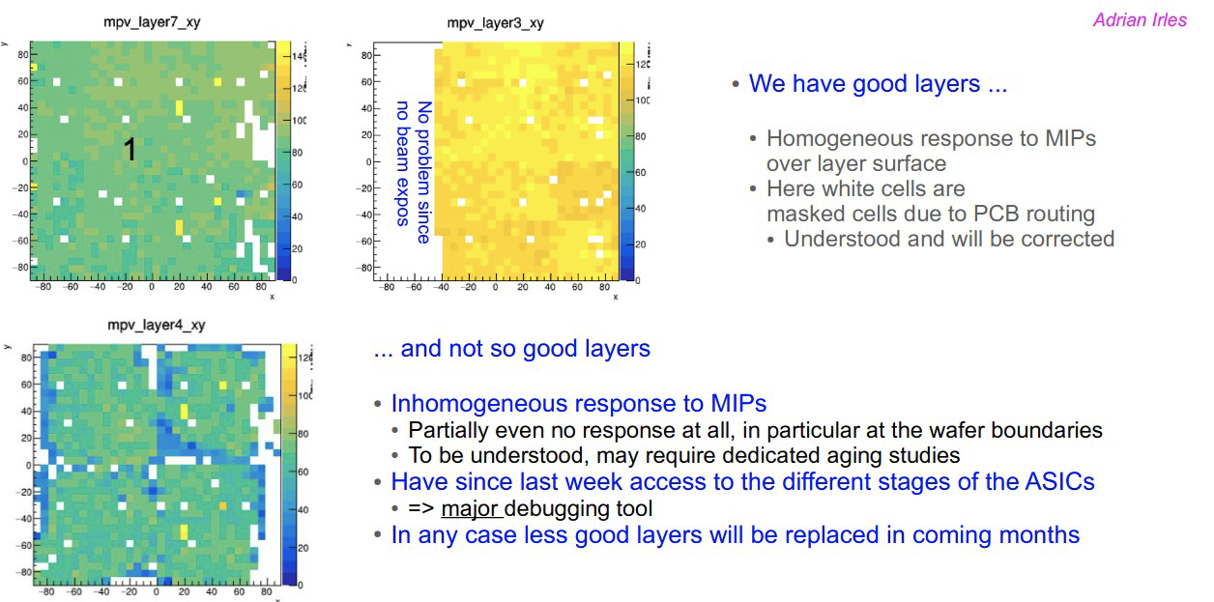
SiW-ECAL Active Elements
2022 DESY & CERN BT
Base element of SiW-ECAL
  Continuous design improvements
    Noisy-cell fraction ➘
  Delamination issues in 2022
    New hybridization process
    needed
See R. Poeschl’s presentation at the AIDAi meeting, March 2024 for more details

Slide 6
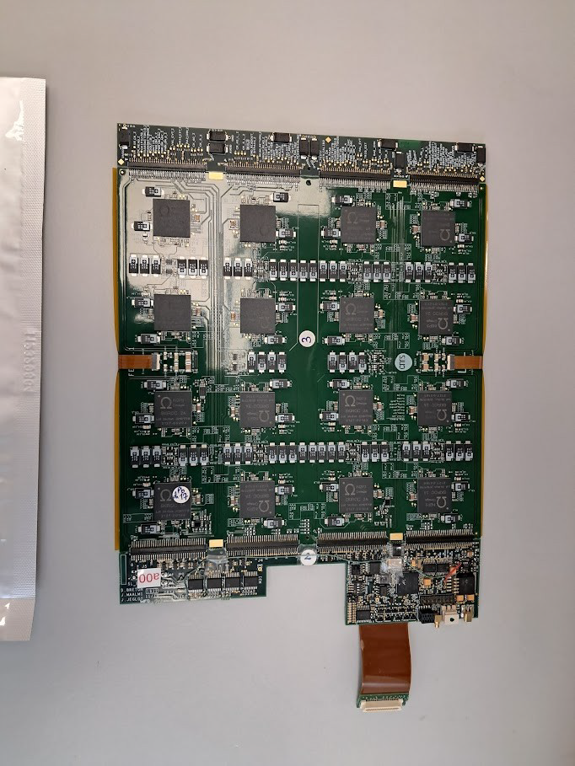
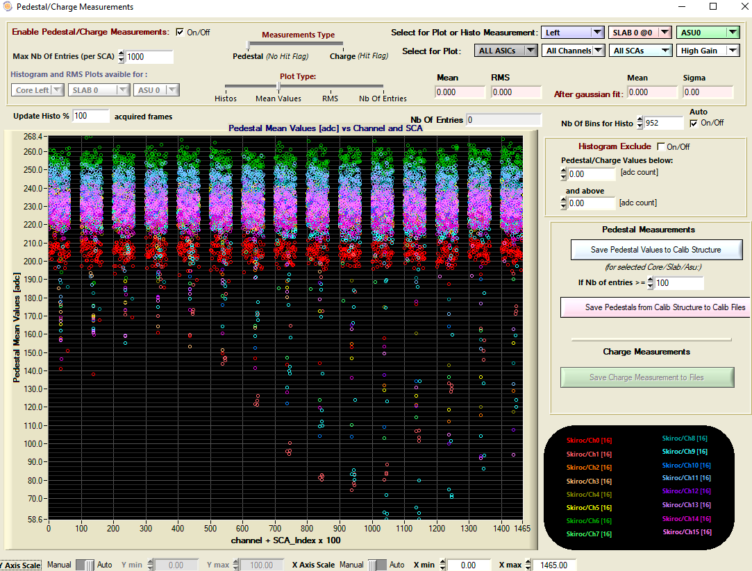
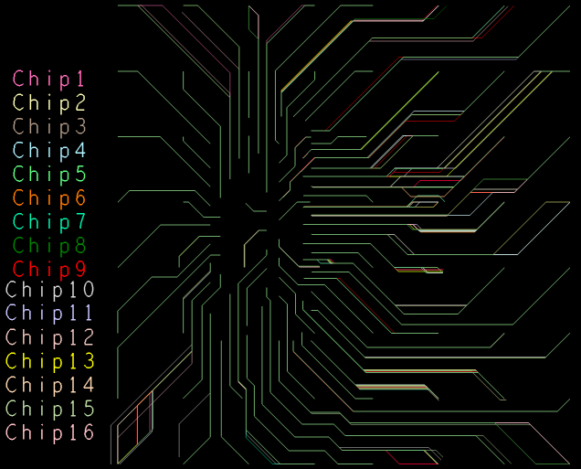
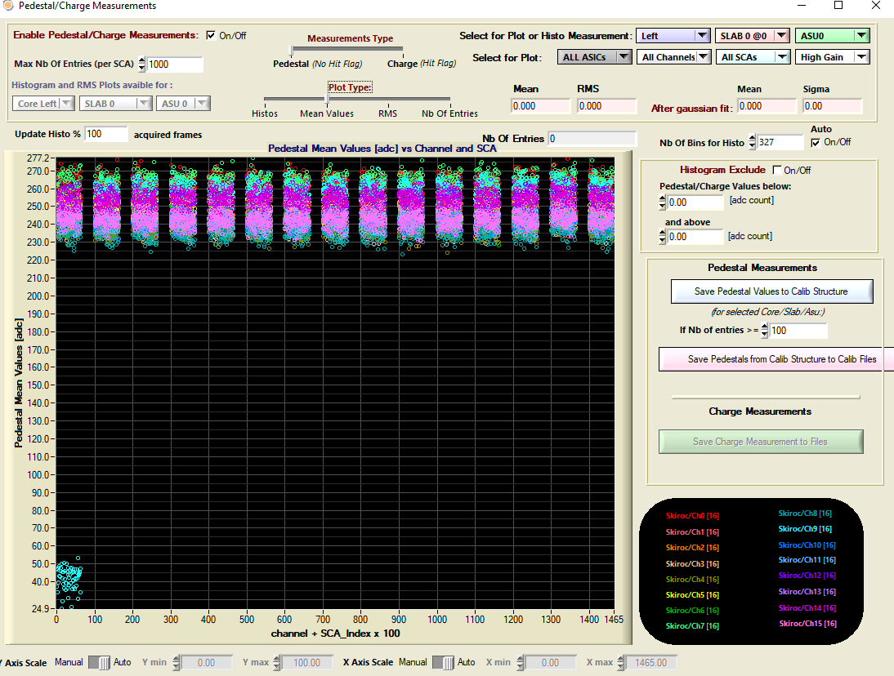
New FE boards
Improvements:
  Power distributions
    Local LV power regulation: LDO’s
    Local HV filtering & Supply
  Signal distribution (buffering), data paths
  Monitoring (single ID, temp, probe analogue line)
  ASIC shielding/routing
Status:
  Noise uniformity dramatically improved (ex: outliers in thr. / 20)
  version 2.1 produced
    4 cabled, 2nd metrology, 2 equipped with sensors (Fev’25)
FEV11
Pedestal measurements vs. Ch# + Mem#×100)
SIngle channel ➞ the fault on the ASIC/packaging
FEV2.0

Slide 7
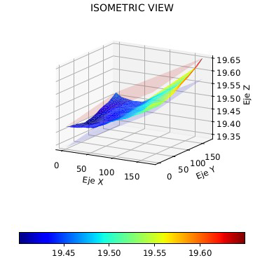
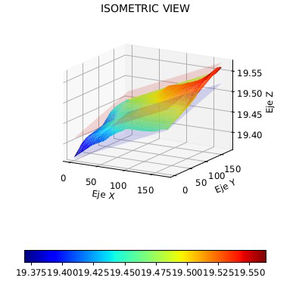
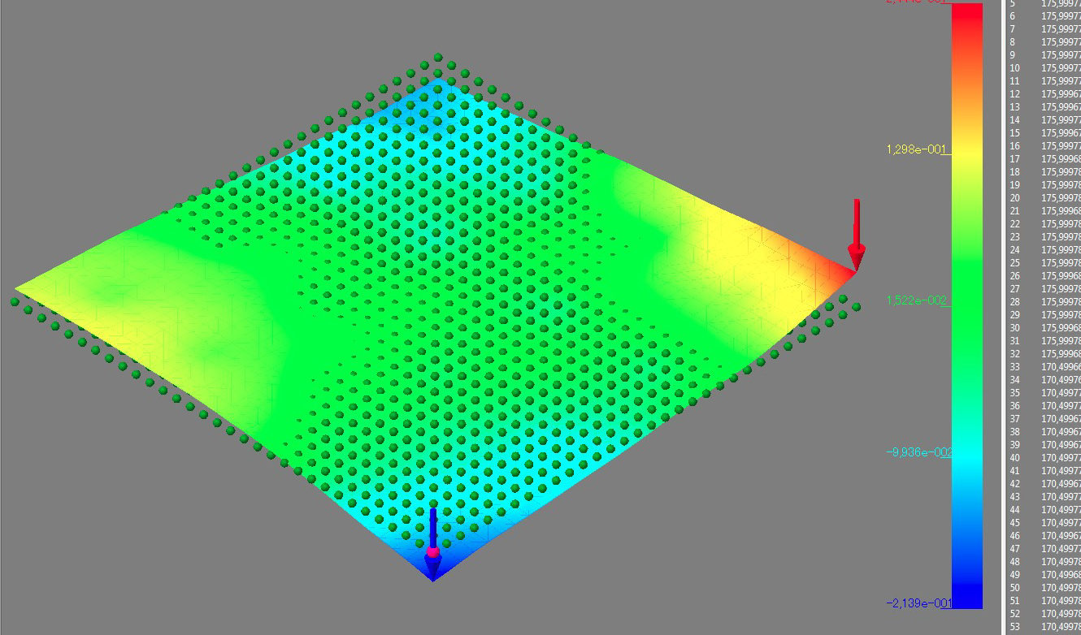
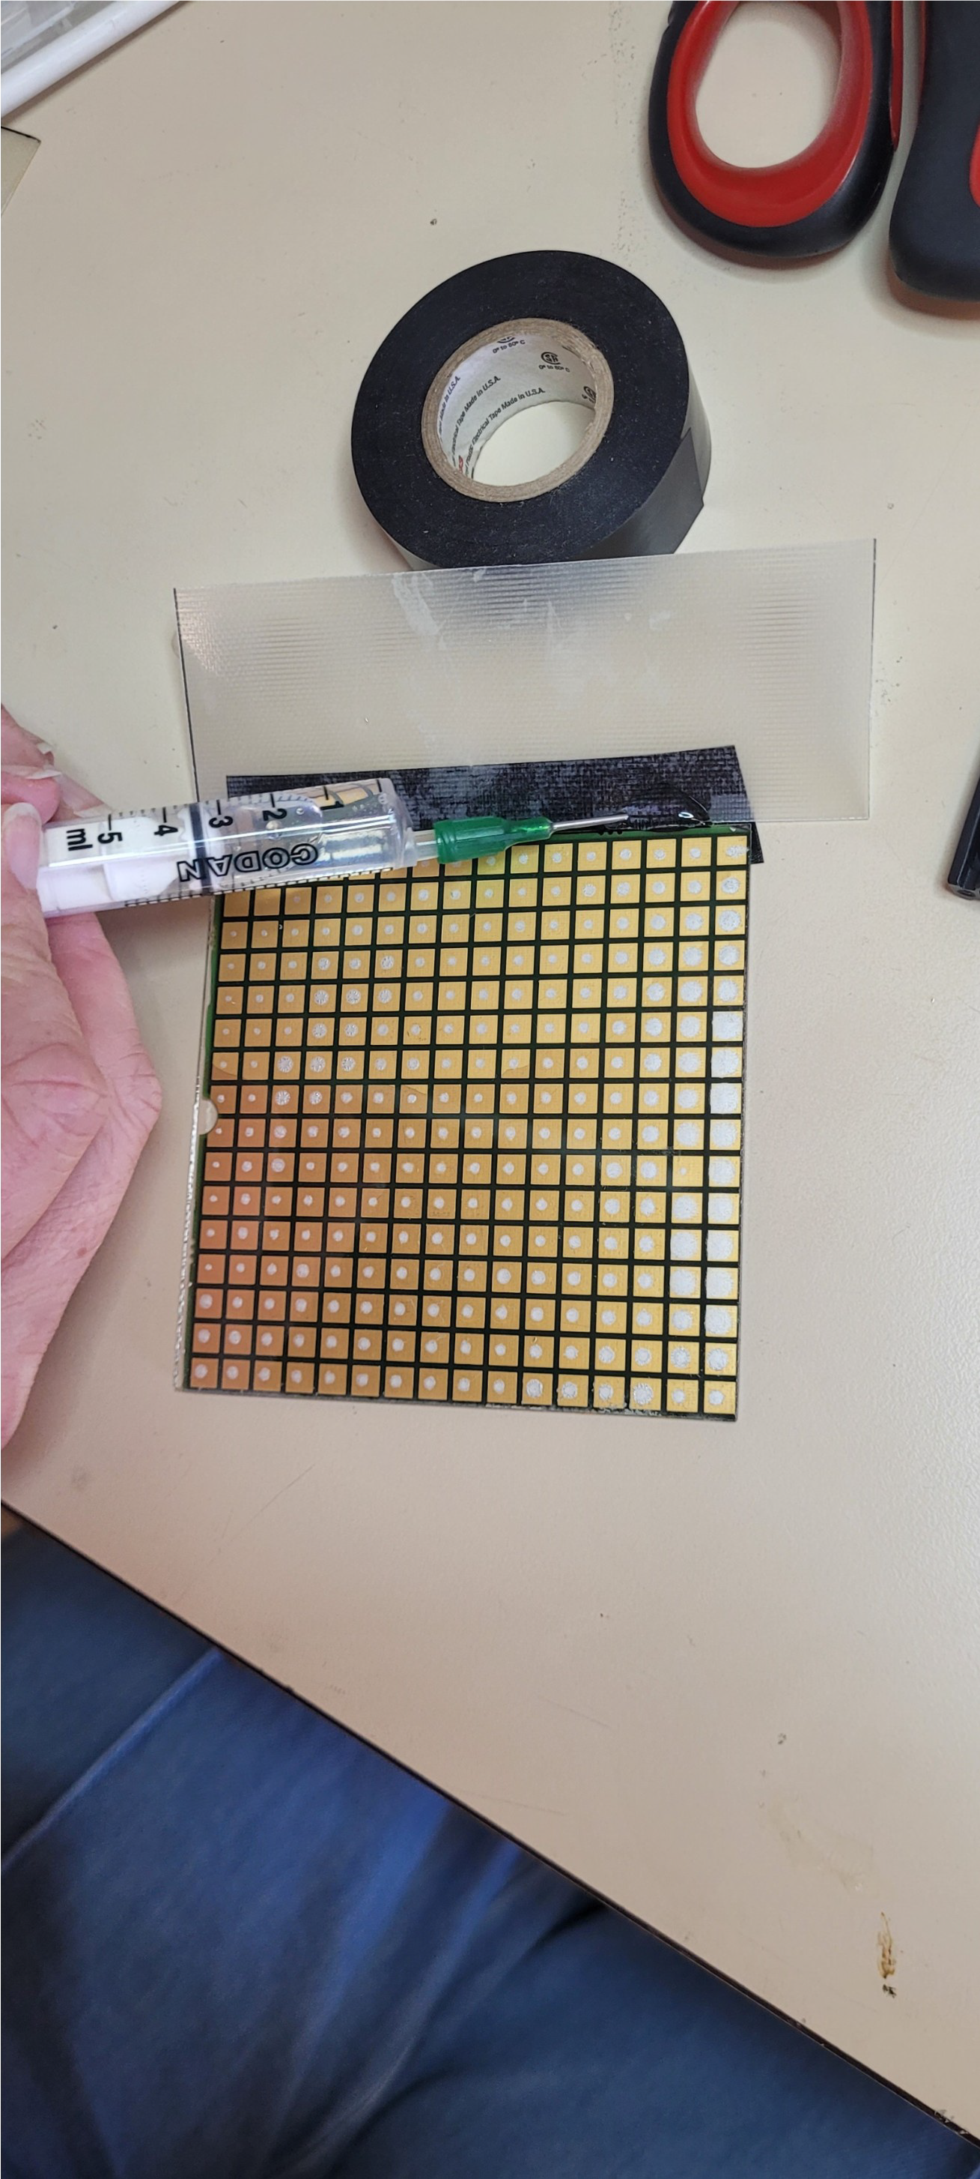
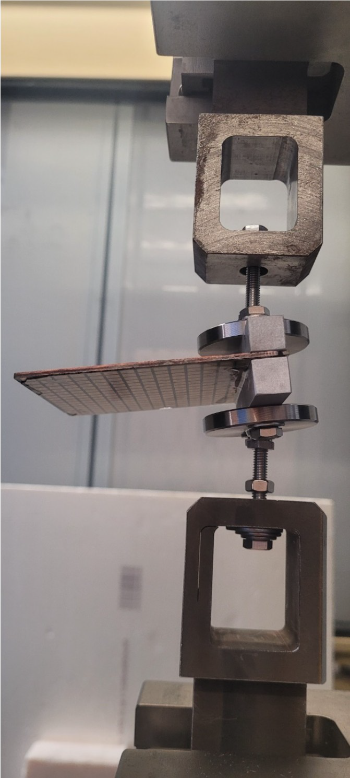
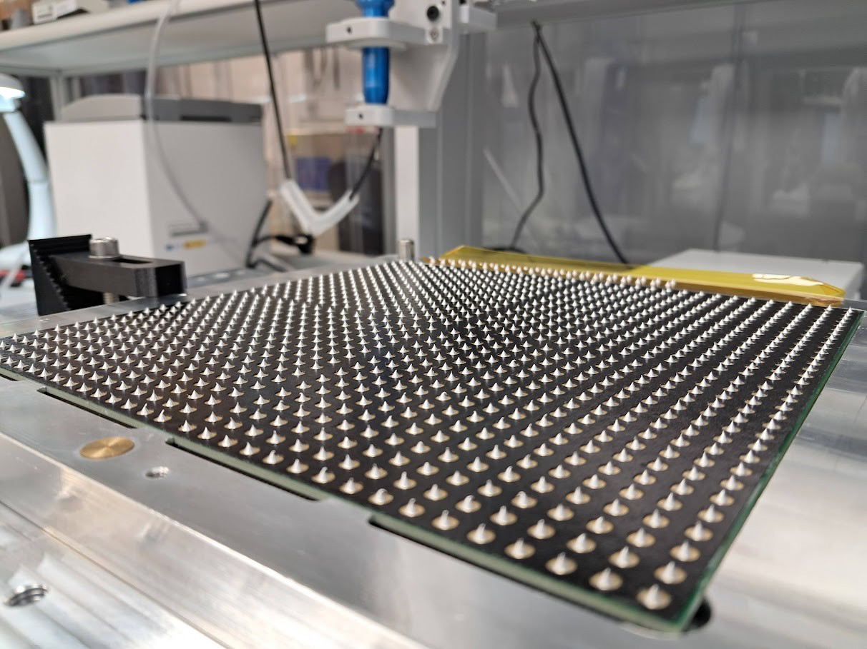
Hybridization studies (2024):
How to glue silicon sensors & PCB ?
Revisiting gluing (IFIC, IJClab, DMLAB)
  PCB metrology
    Bef. & After
    curing &
    soldering
  Glue formula &
  preparation
  Gluing methods
    Robot
    Stencil
  Reenforcement
    Filling glue
    Adhesive films
Flatness of PCB
IJClab (méca)
IFIC (optical)
Conductive glue + filling
(~invisible) on a glass plate
Same PCB before / after 10-day dry storage
Measurements by C. Orero, IFIC
Puncturated
adhesive film (DMLab)
+
conductive glue dots

Slide 8
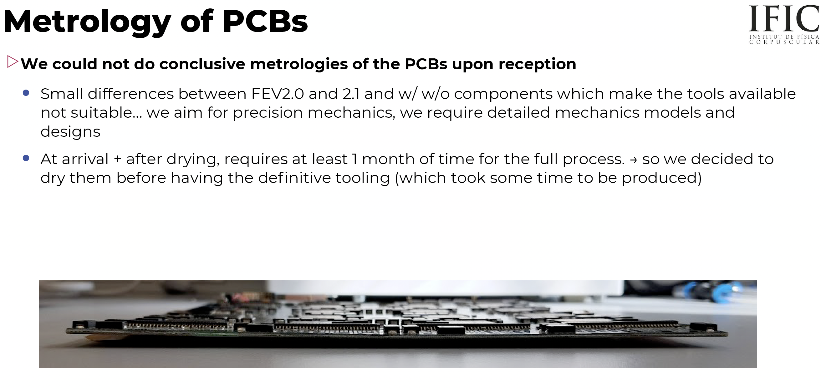

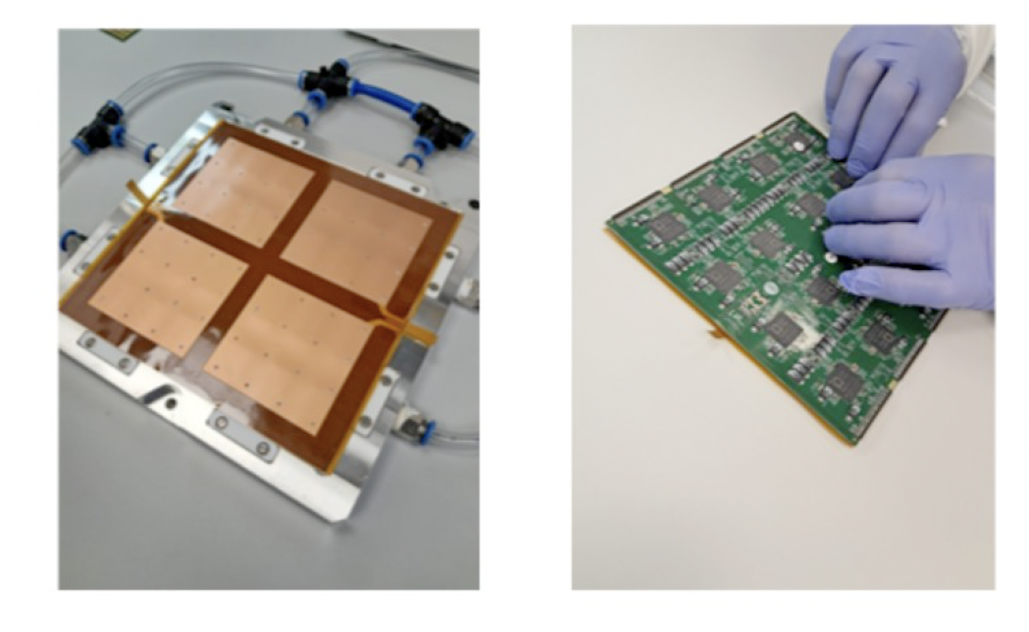
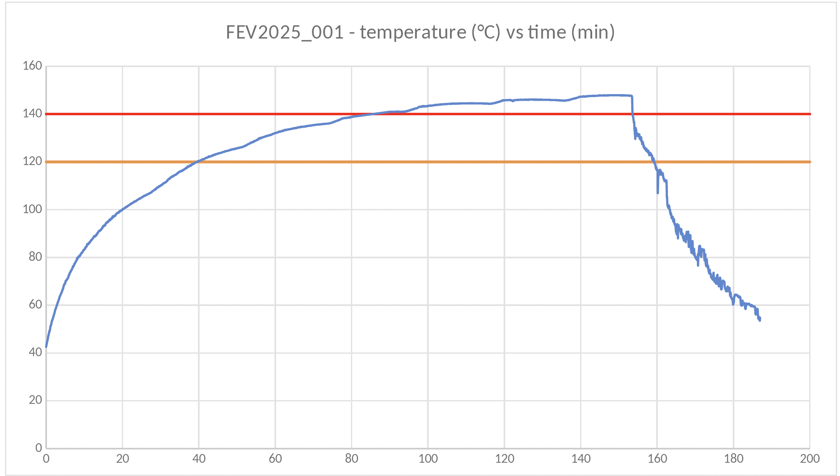

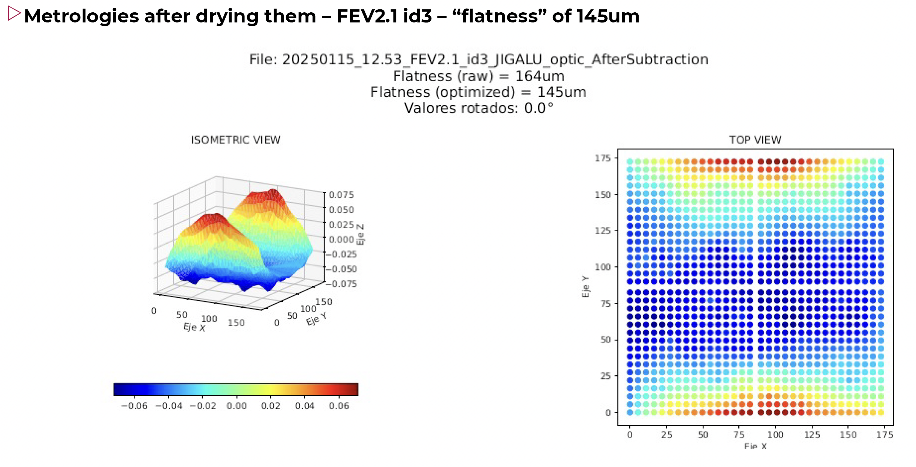

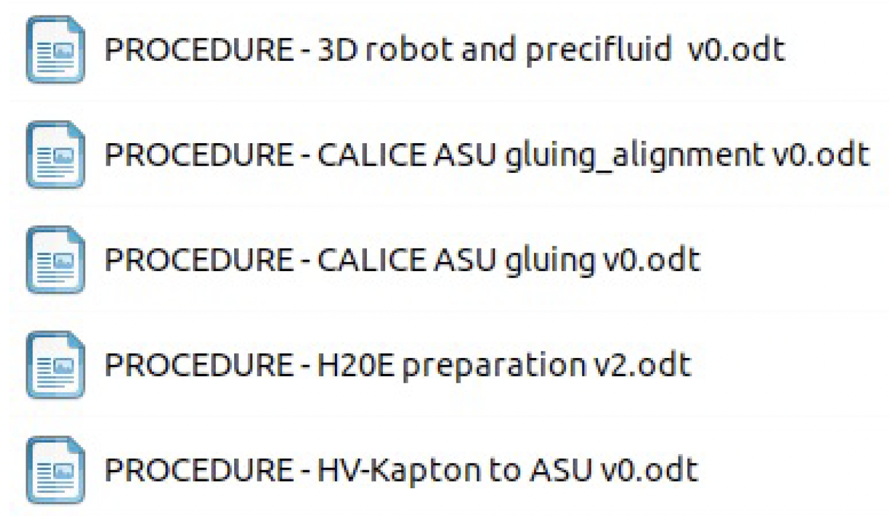
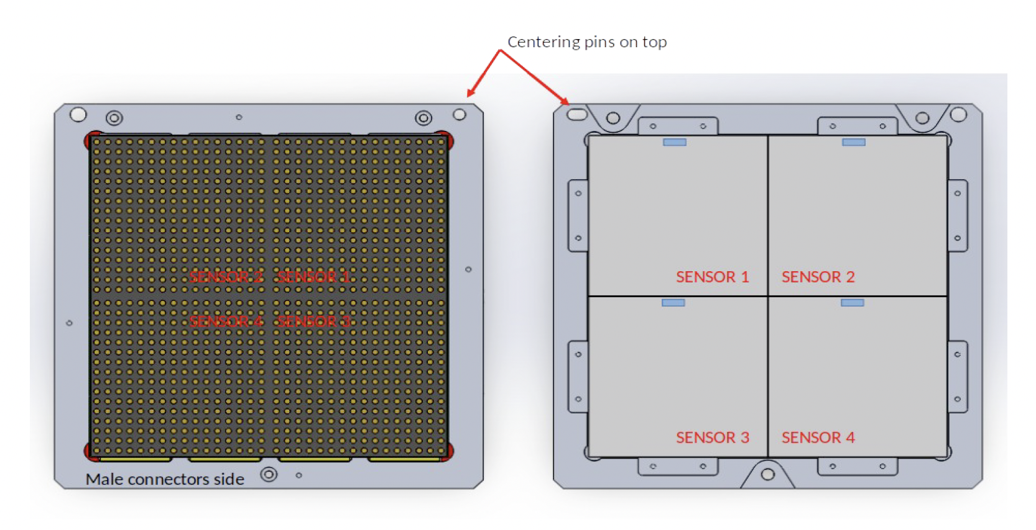
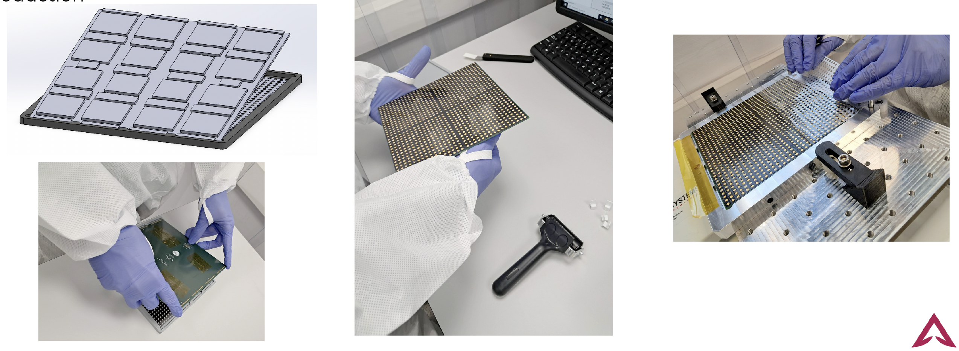
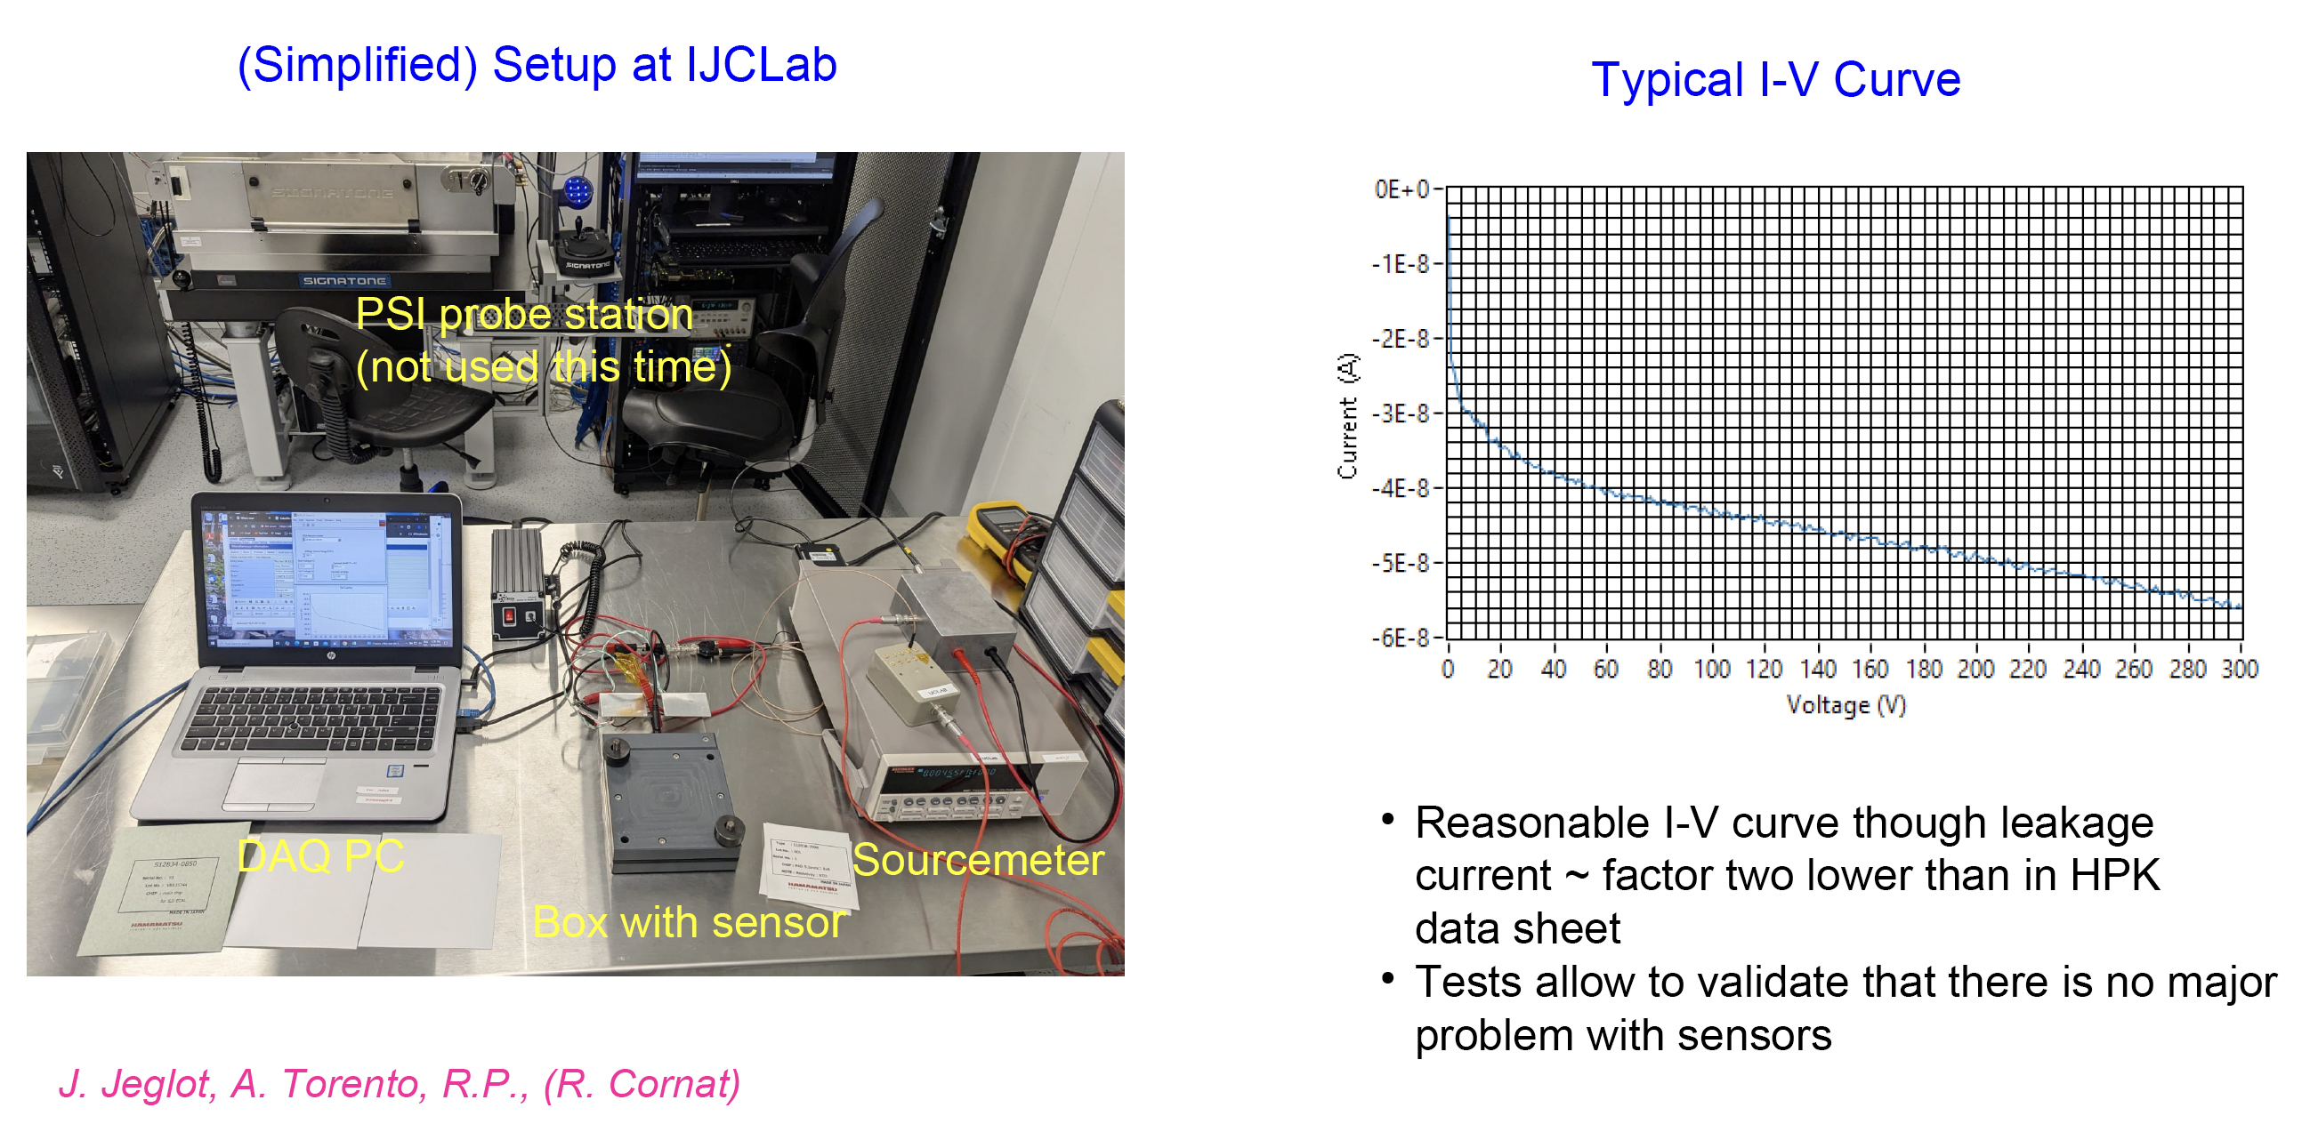

ASU2025_001
+ 002 (2025)

Slide 9
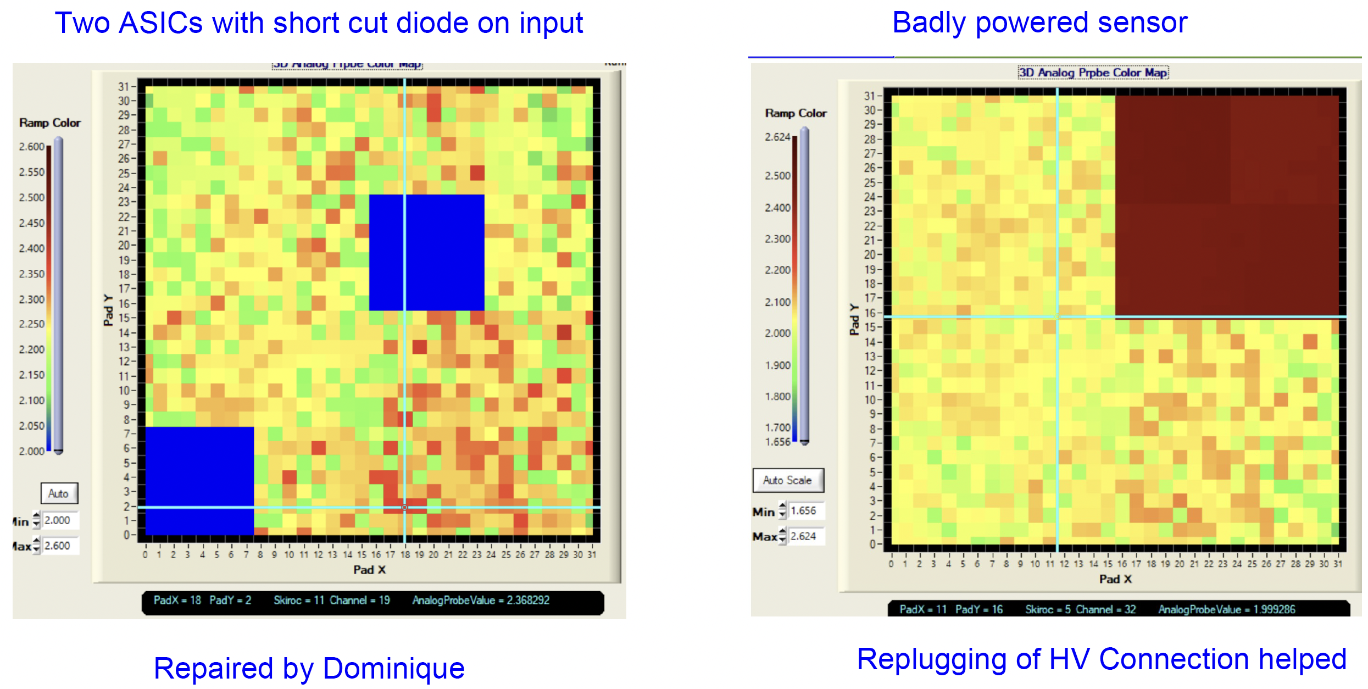
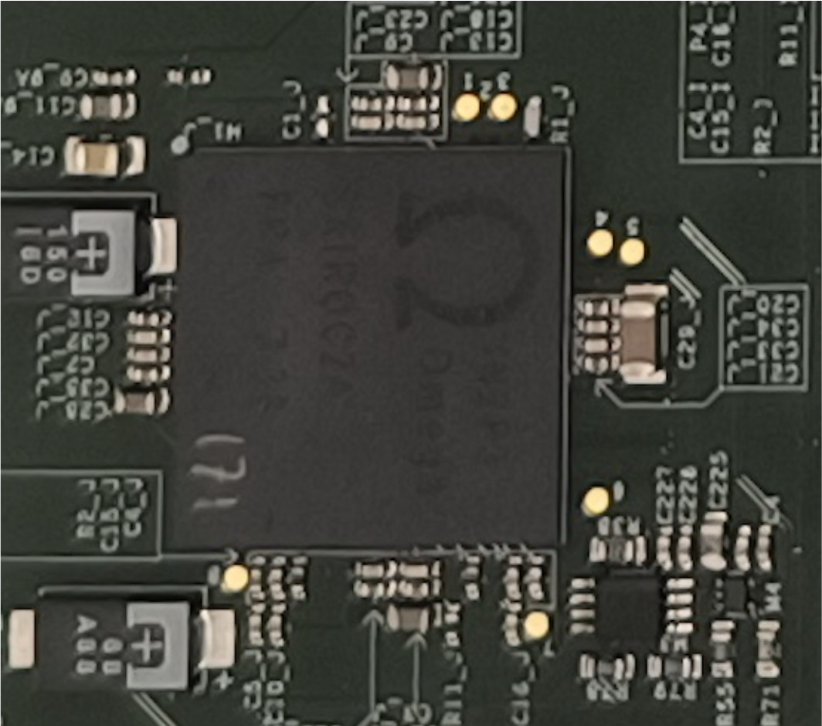
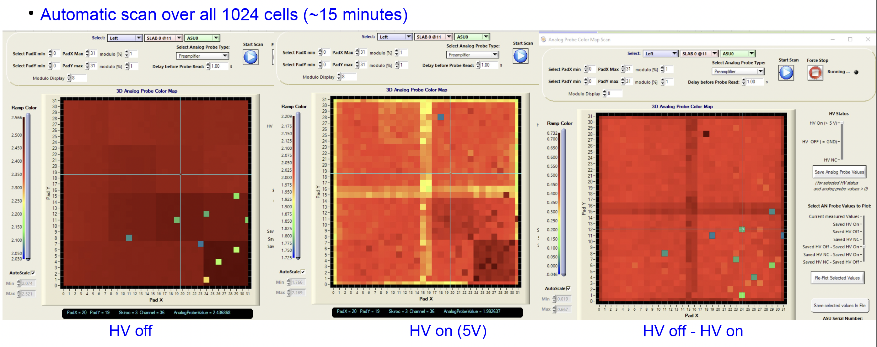
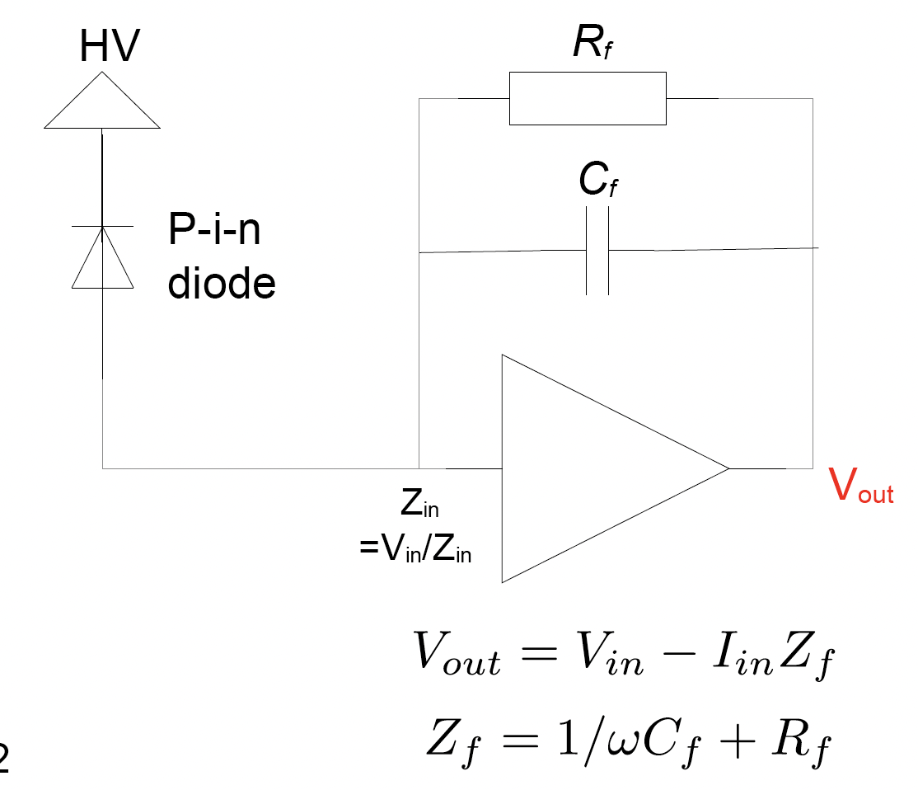
Analogue Probes
Analogue Probes
1 value (LV, Channel, …)
➞ common line

Slide 10
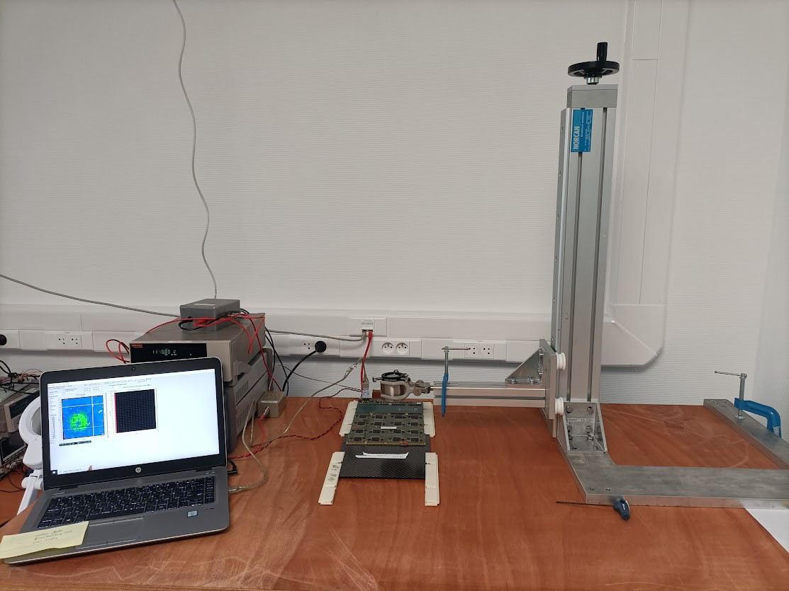
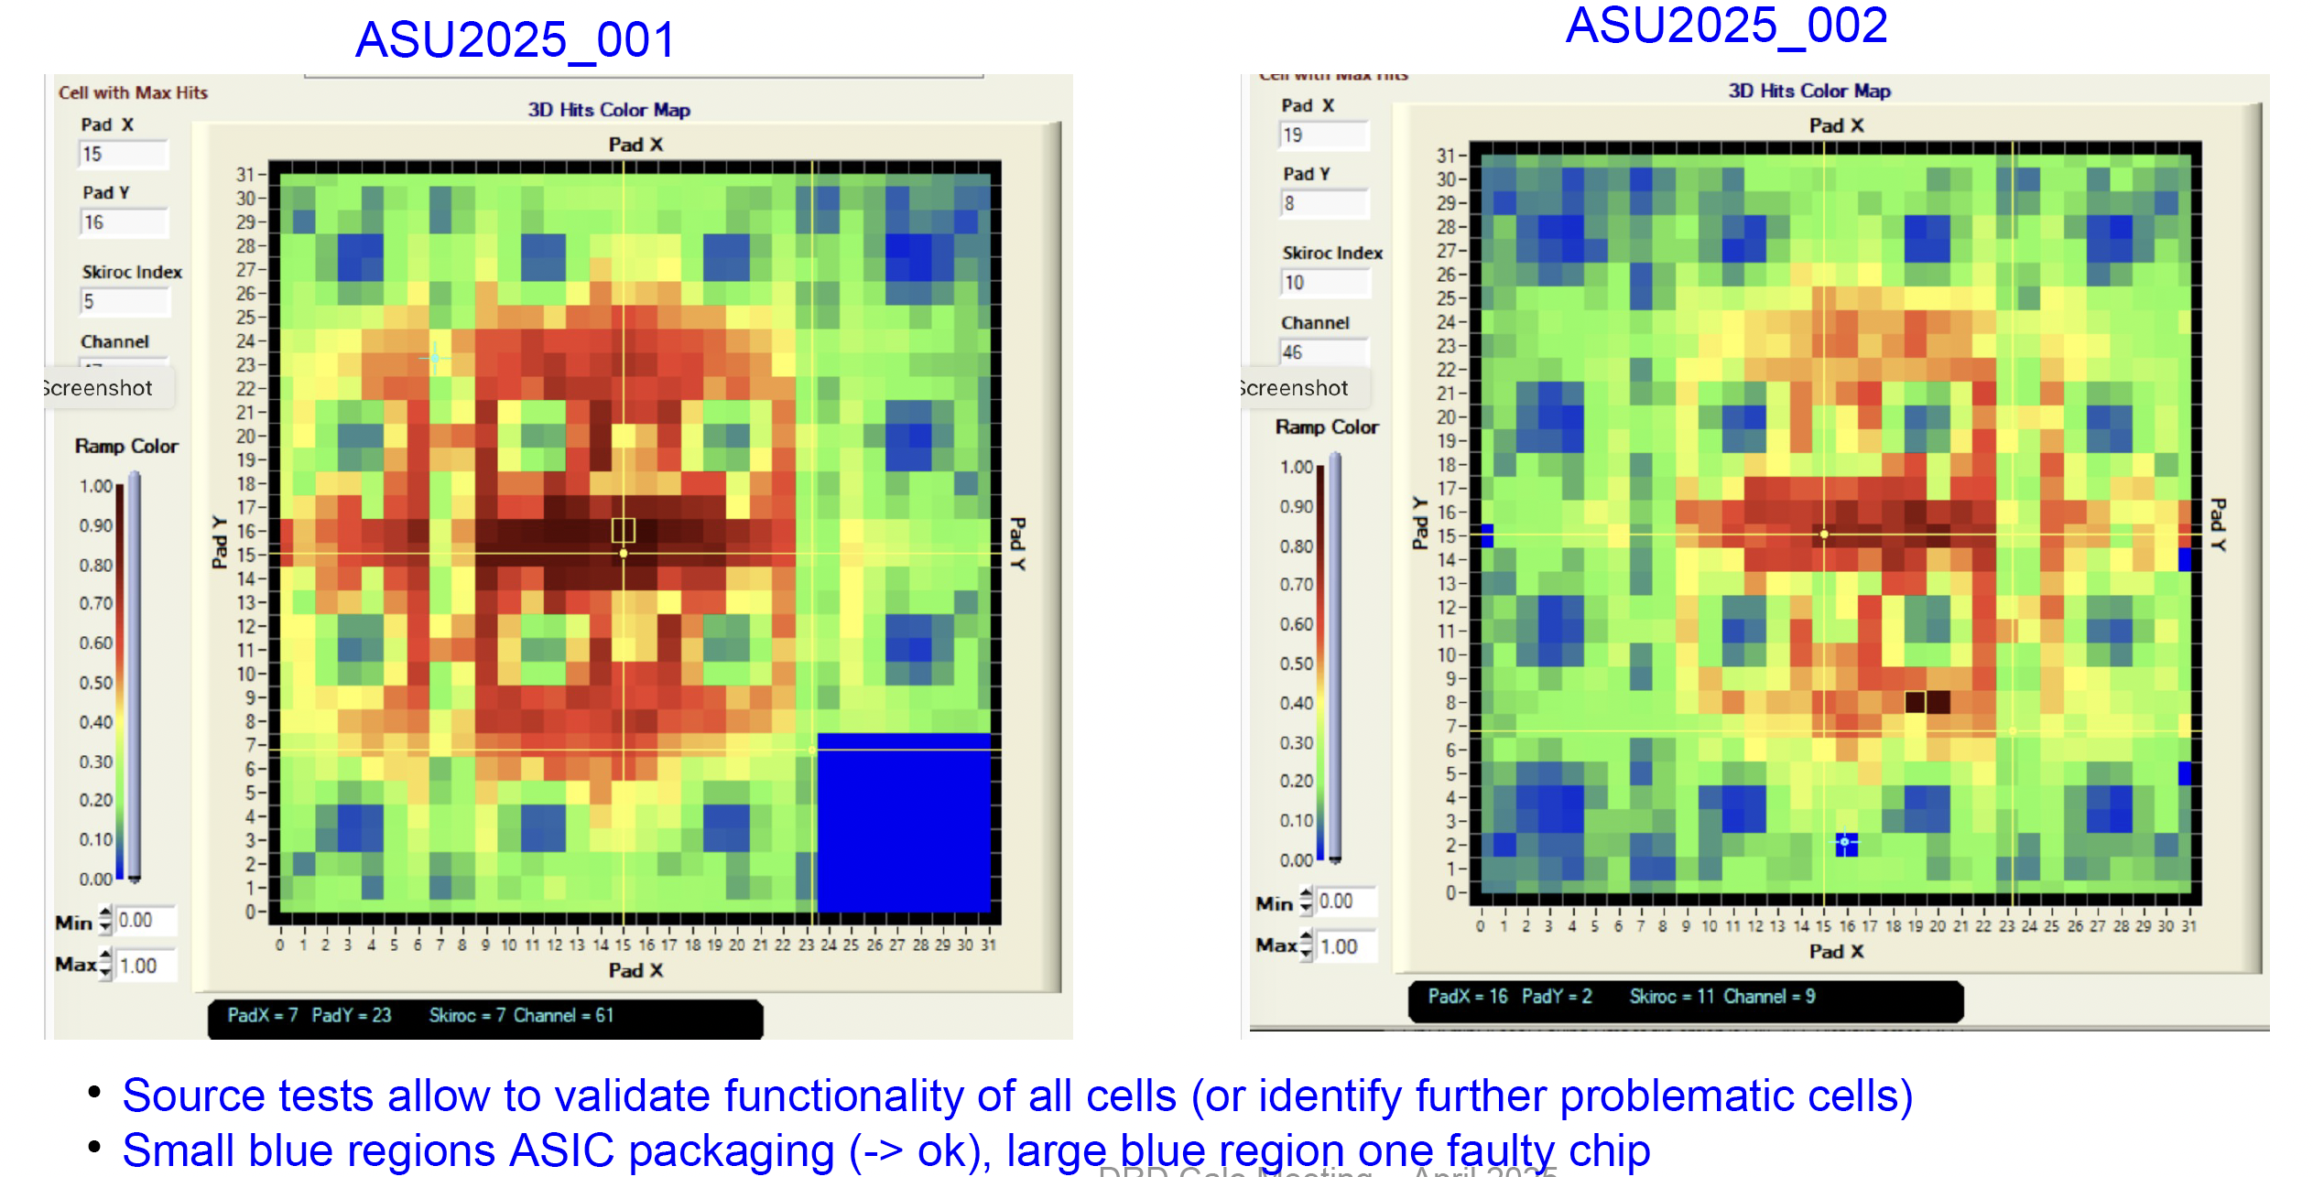
Commissioning: ⁹⁰Sr
Tests made one week before BT at DESY
  1 faulty ASICs AUS01
  Very few noisy channels

Slide 11
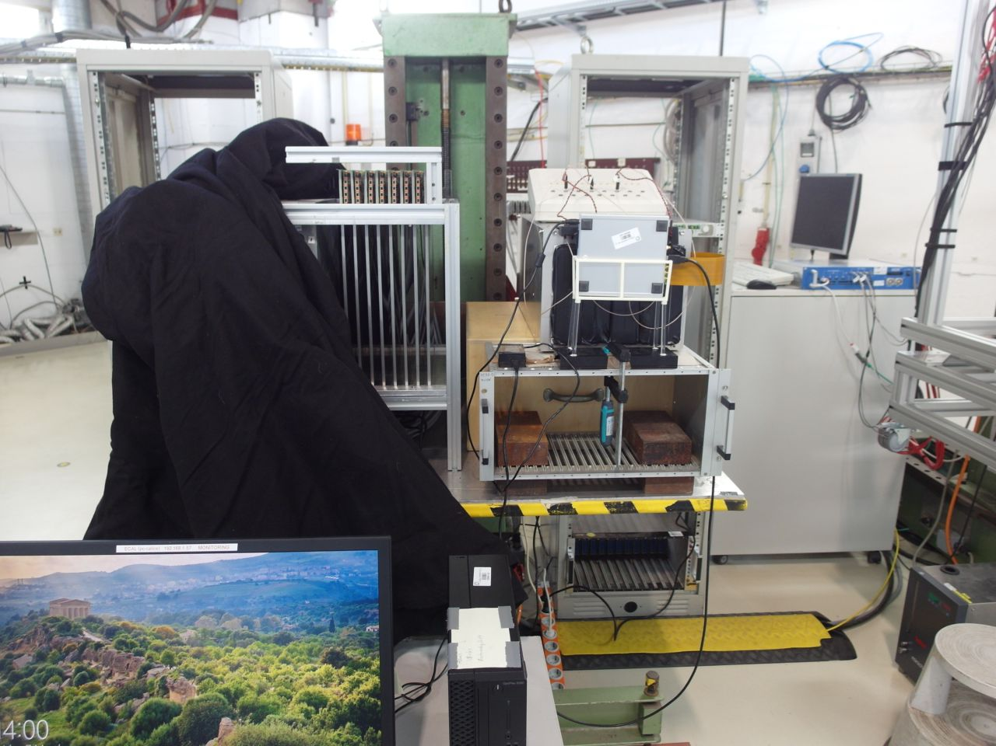
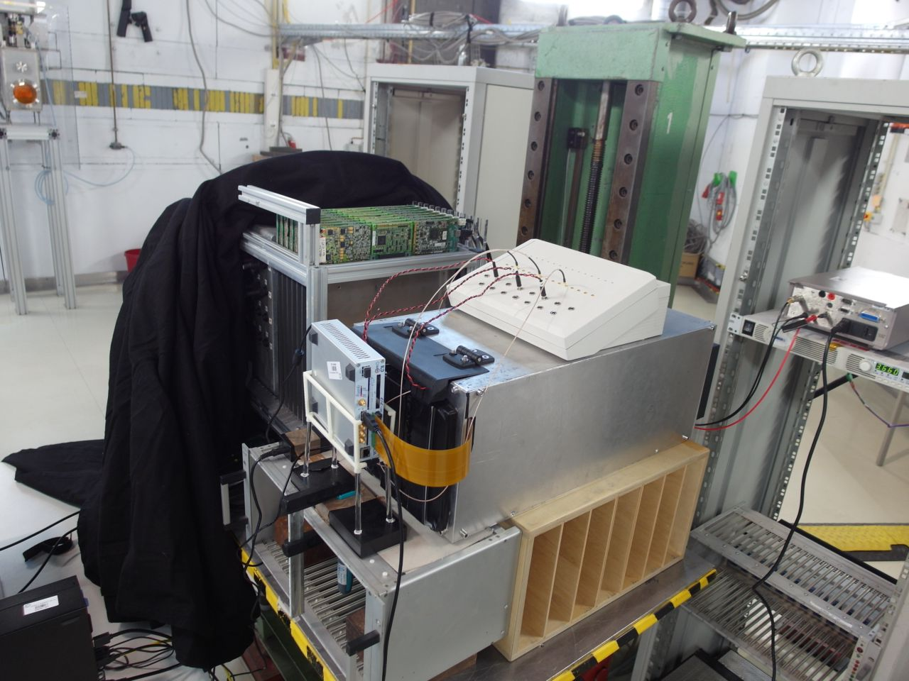

DESY Beam Tests 2025/03
1 week 3–10/03/2025
SiW-ECAL:
  2 new ASU FEv2.1
  1 ASU COB
  No Tungtens
AHCAL:
  “Airstack” with 7 short layers
Running:
  3 days ECAL Stand alone
    ½ d. install + commissioning
    Positions scans : uniformity & mip/noise resp.
  4 days AHCAL
    ½ d install + repair
    Scans & TDC runs
AHCAL
beam
ECAL
beam
The measurements leading to these results have been performed at the Test Beam Facility at DESY Hamburg (Germany), a member of the Helmholtz Association (HGF)".
"Toshiko Yuasa"
France Japan
Particle Physics Network
(TYL-FJPPN)

Slide 12
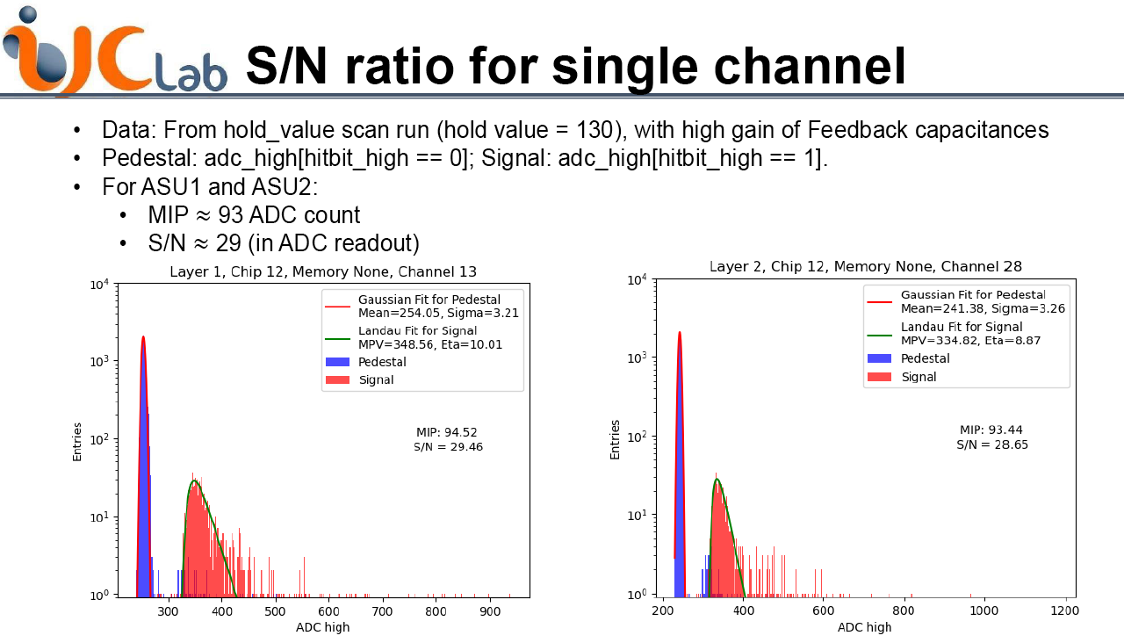
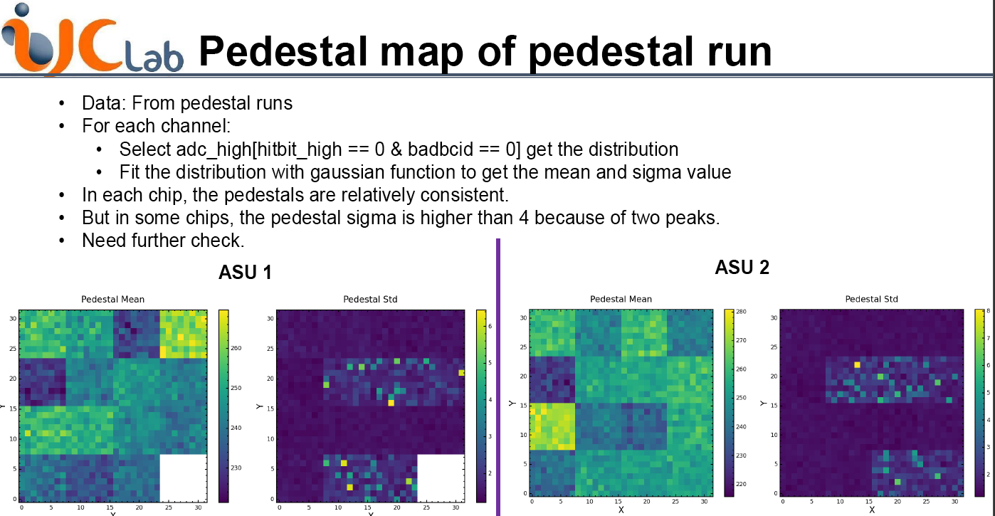
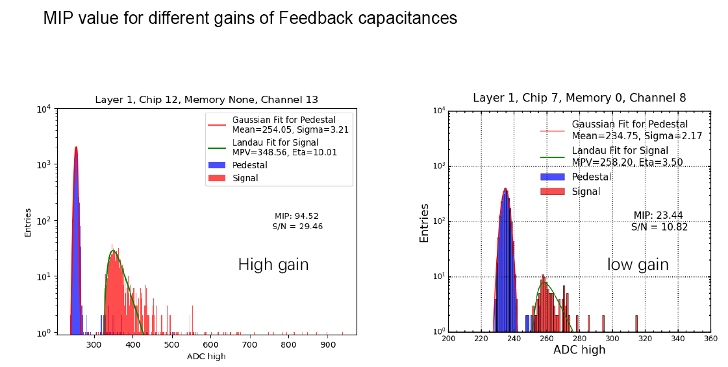
Some results on the SiW-ECAL
Xin XIA (IJCLab)
New FEV2.1 preliminary results:
  High S/N ration (MIP MPV/Noise StdDev) ~ 30
  in readout branch
  Run in lower gain mode possible
  Very few cells masked

Slide 13
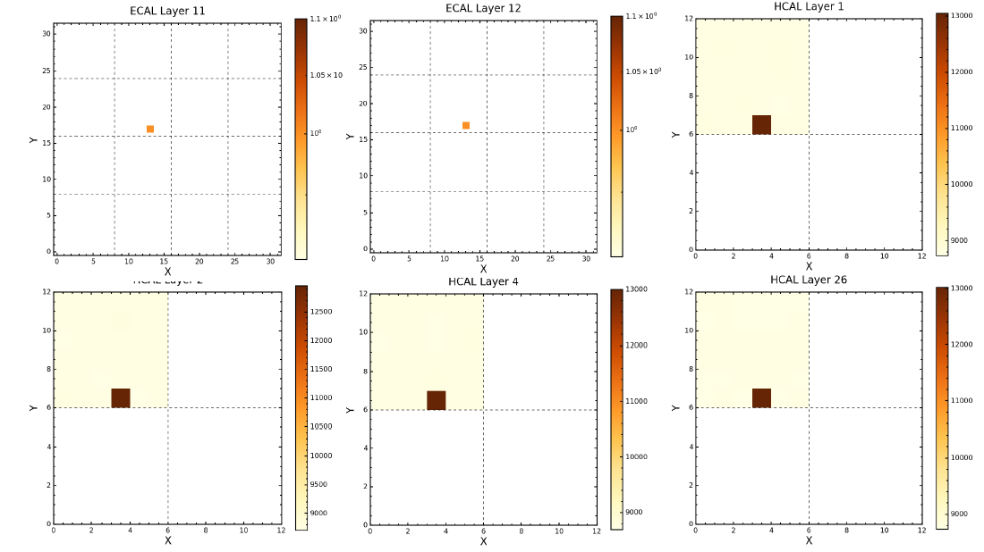
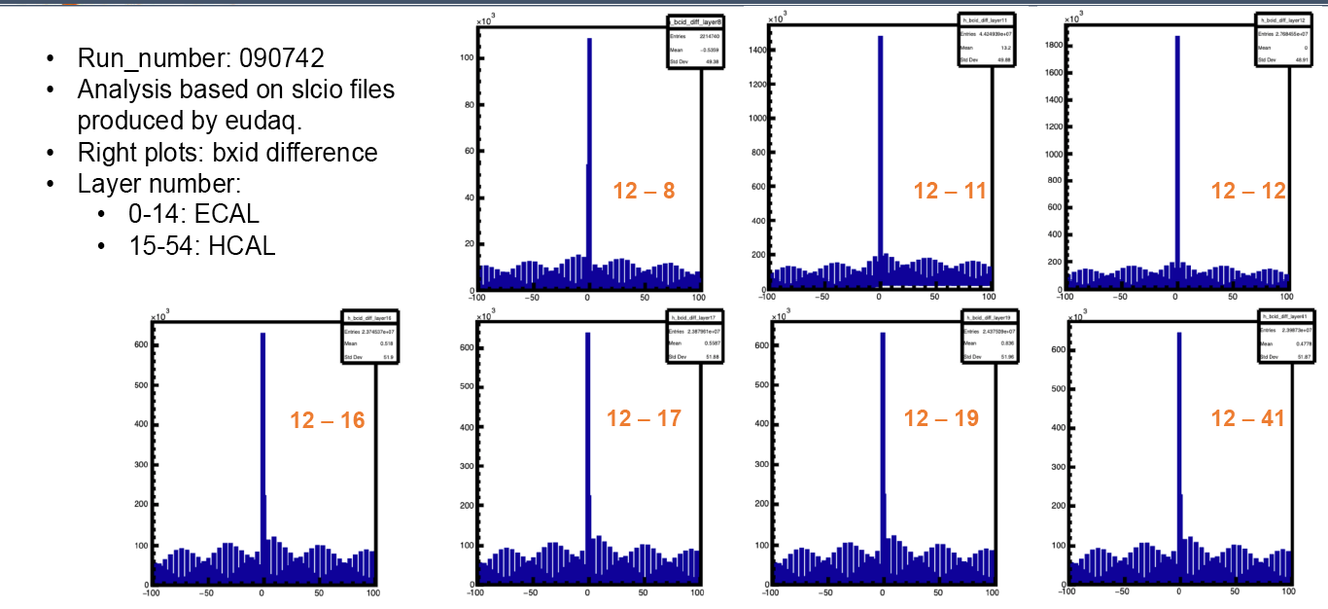
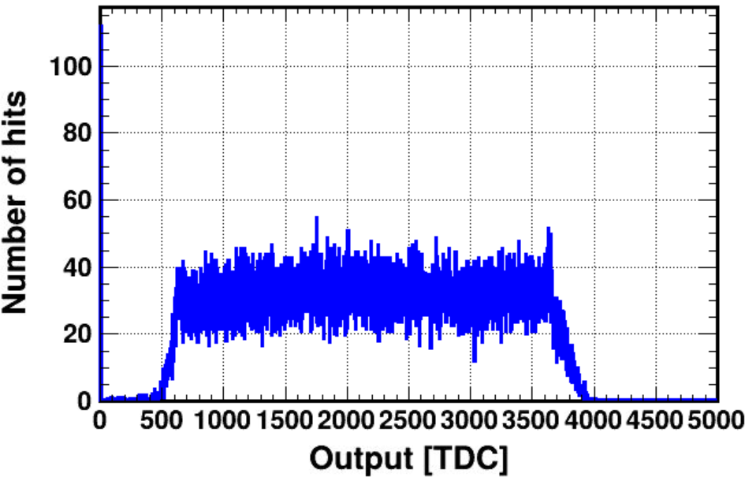
Synchronization ECAL–HCAL
Set-up identical to 2022
  Same setting as in 2022
    Bunch Clock cycle offsets (BCID’s)
    Reconstructed ∆BCID’s OK
    TDC information being analysed
Main BCID
lay. 12 − lay. 11
Coincidental events
following beam time
structure
« Event display » of 1 BCID
TDC raw distribution

Slide 14
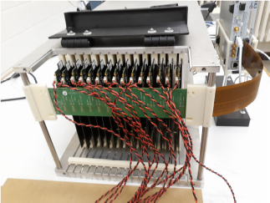
Building of a uniform
SiW-ECAL prototype
Rationale:
  Current prototype
    4(5) types of PCBs ⊗ 3 sensor thicknesses (320, 500, 625 μm)
    (un)gluing issues
  Material for 15 ASUs available ➞ full single tower
    FEV2.1 boards, wafers, components
  Application cases :
  LUXE@XFEL, EBES@KEK, Lohengrin@ELSA
    Extreme QED & Dark γ searches
    low energy, rates, …
    LUXE: FCAL prototypes ➞ common DAQ Application.
    Could be built from same cards in 2×12
      Needs: sensors (€), (Mech. structure), W
1 tower × 15
2 towers × 12
3 towers × 15

Slide 15
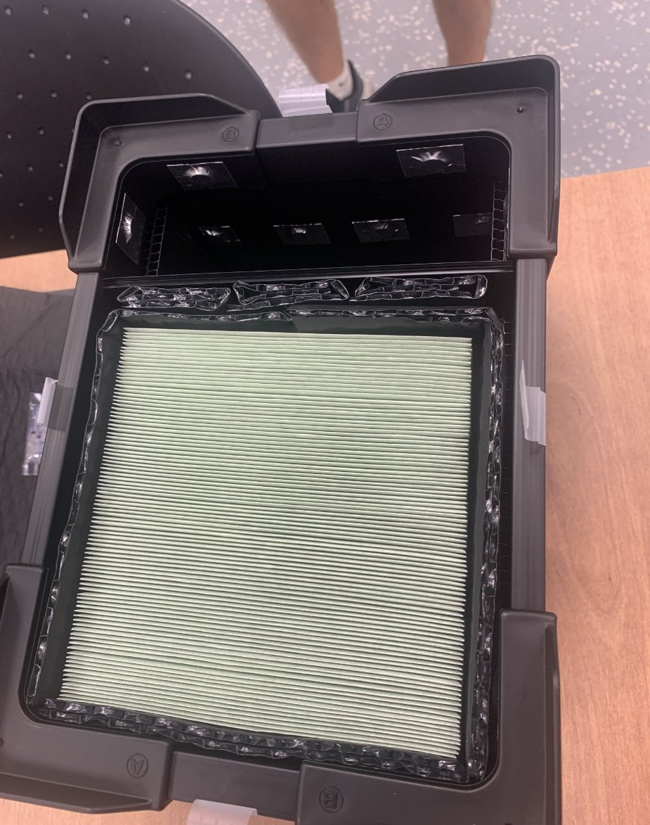
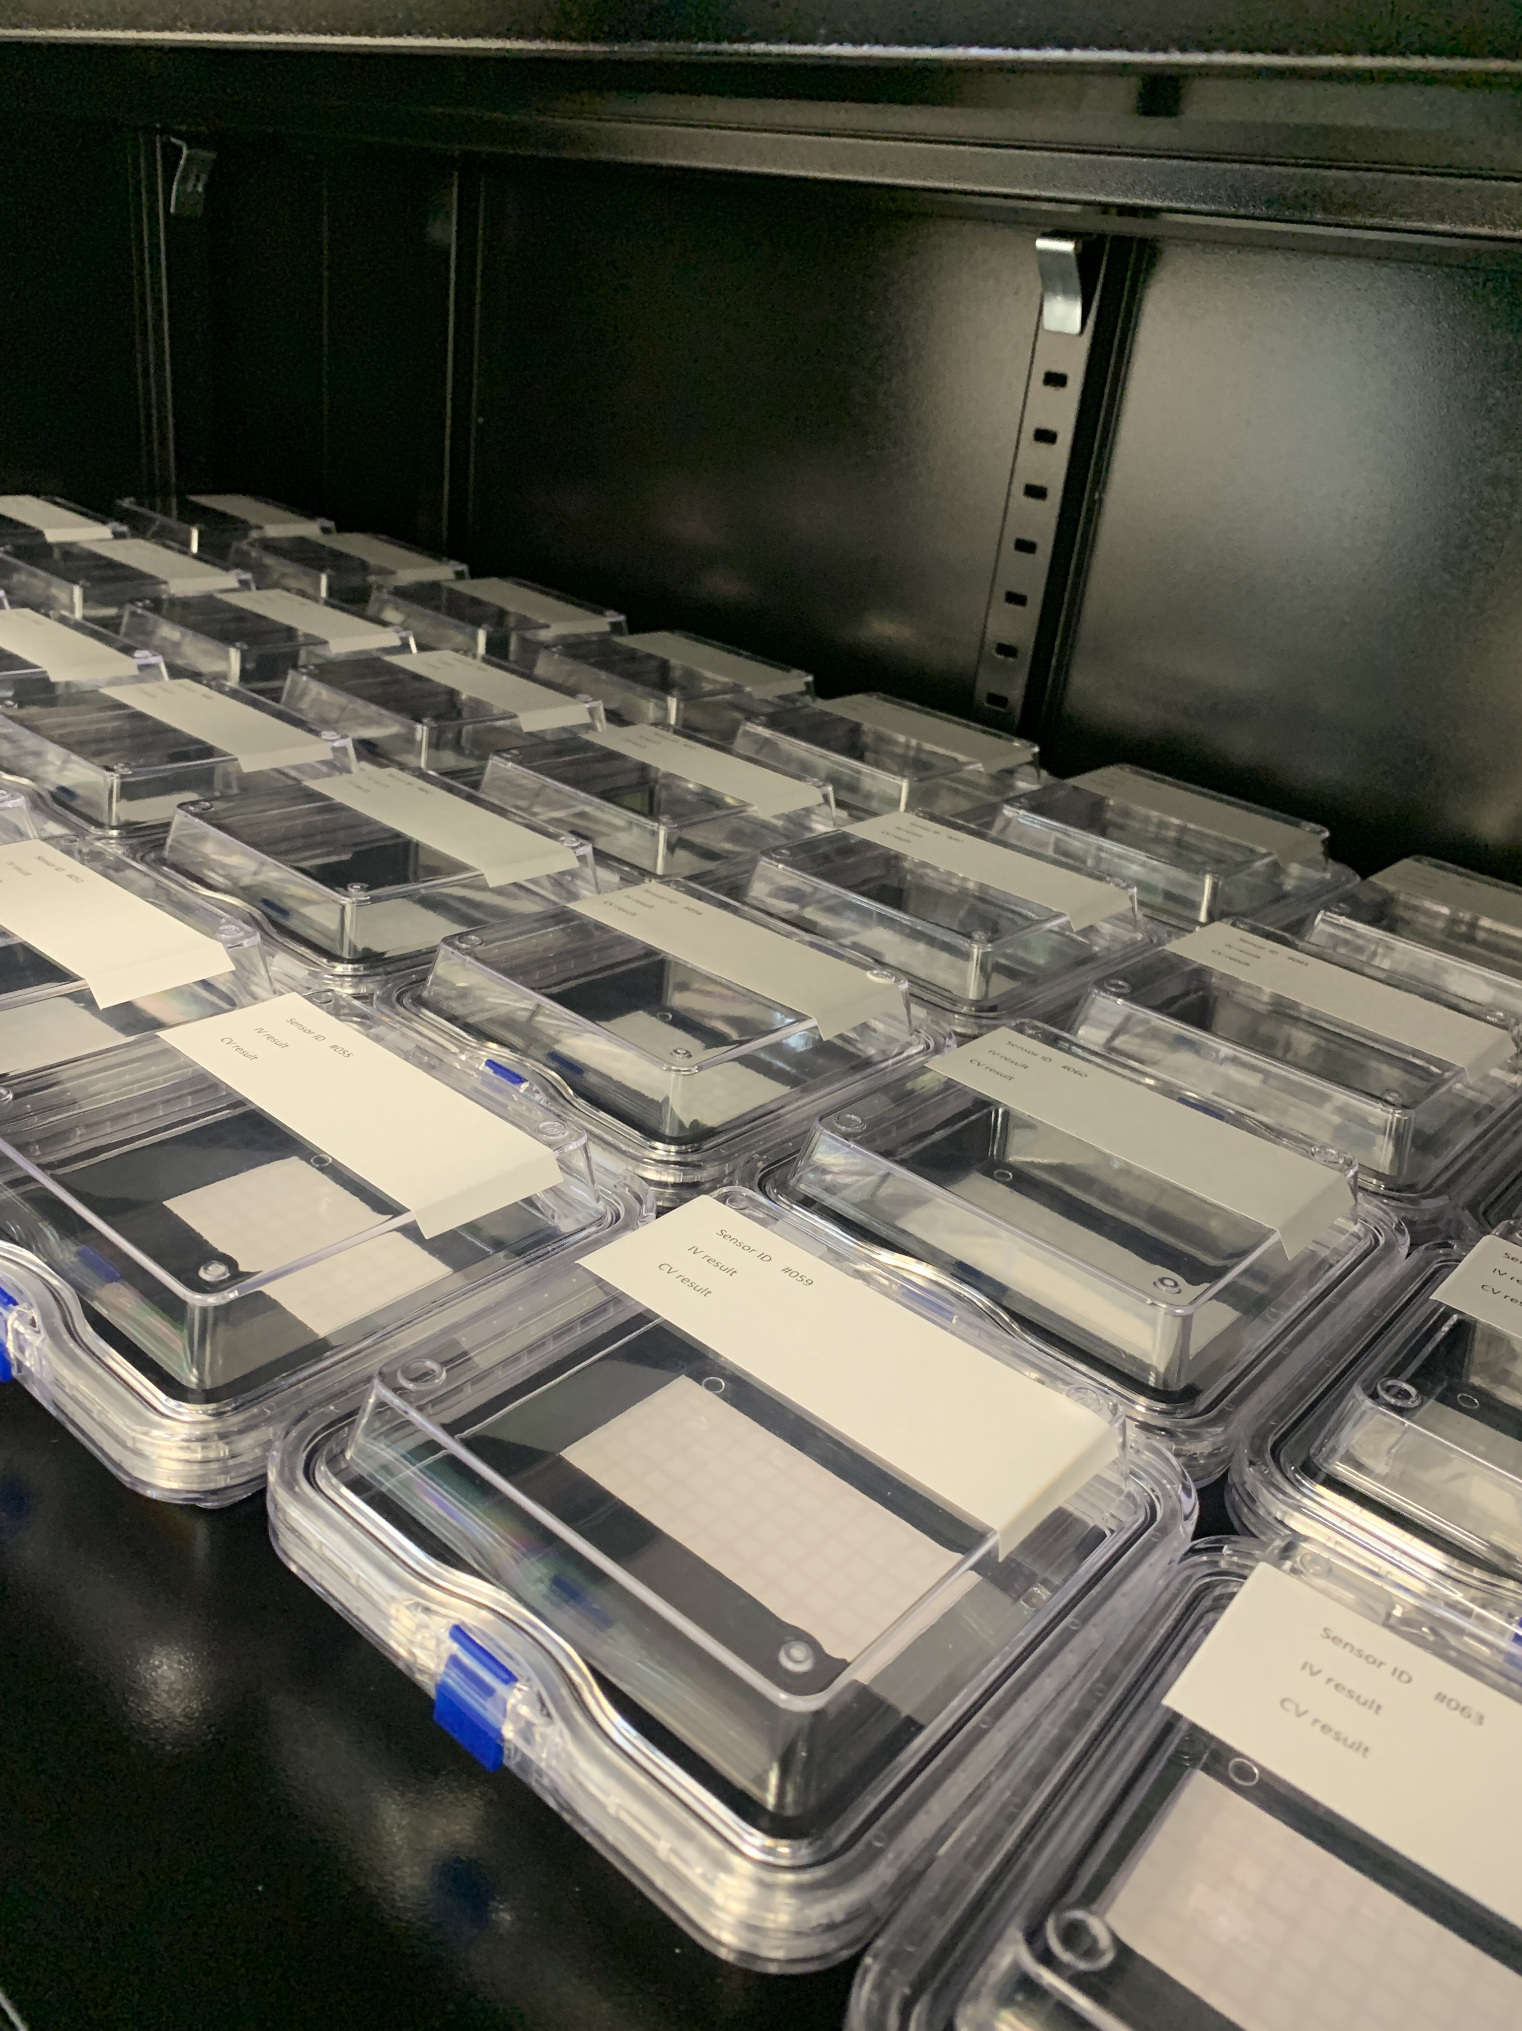
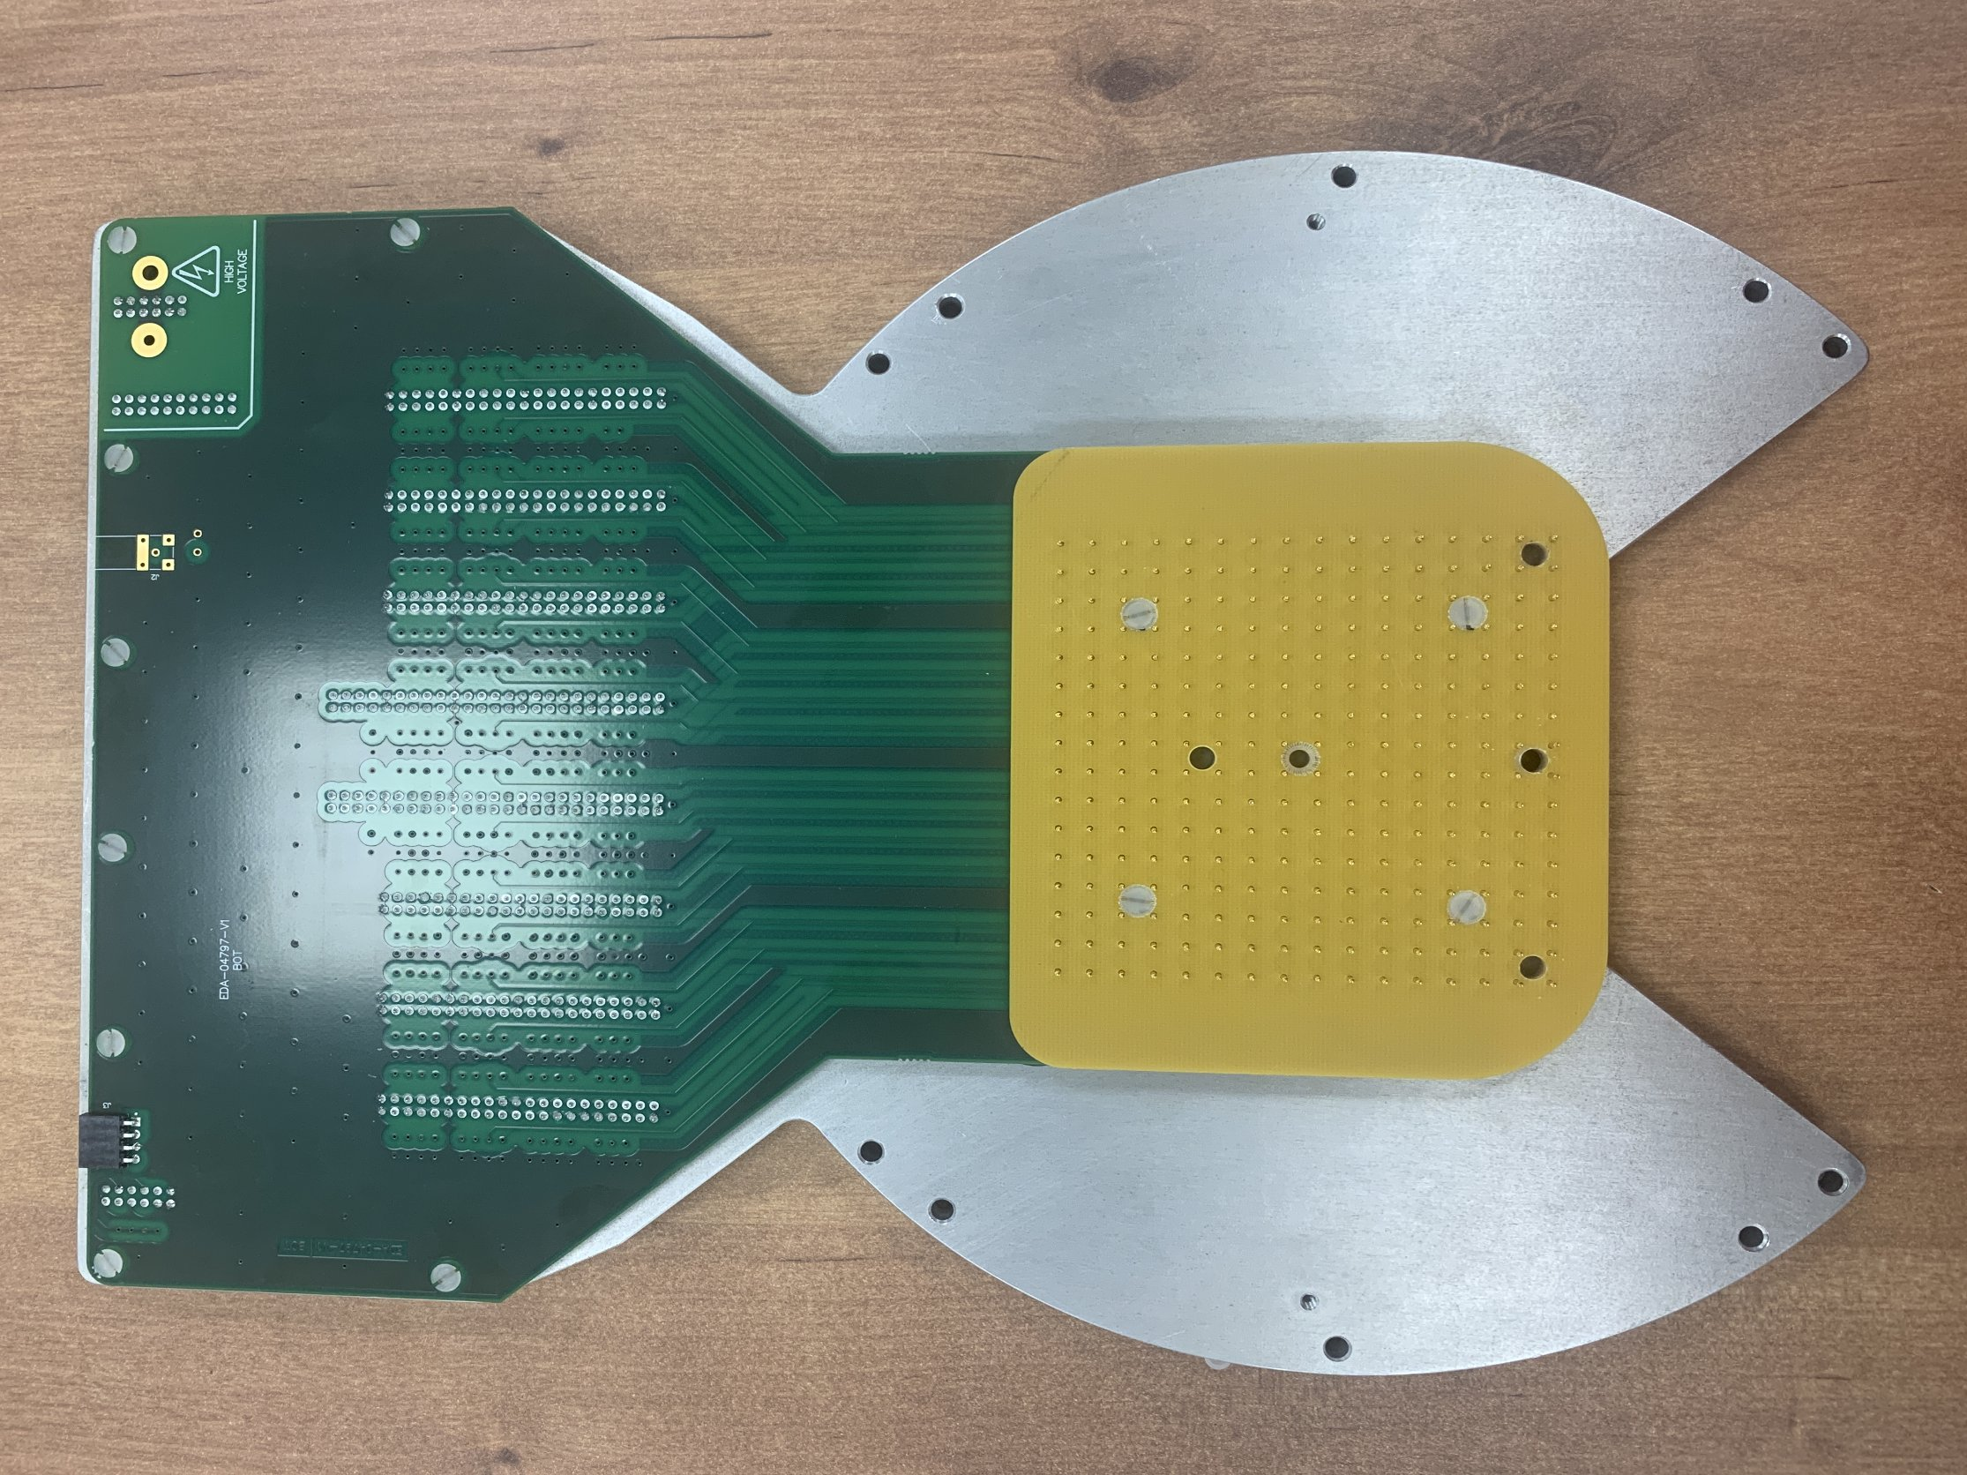
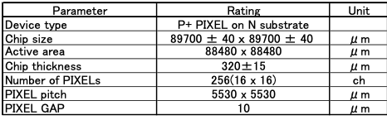
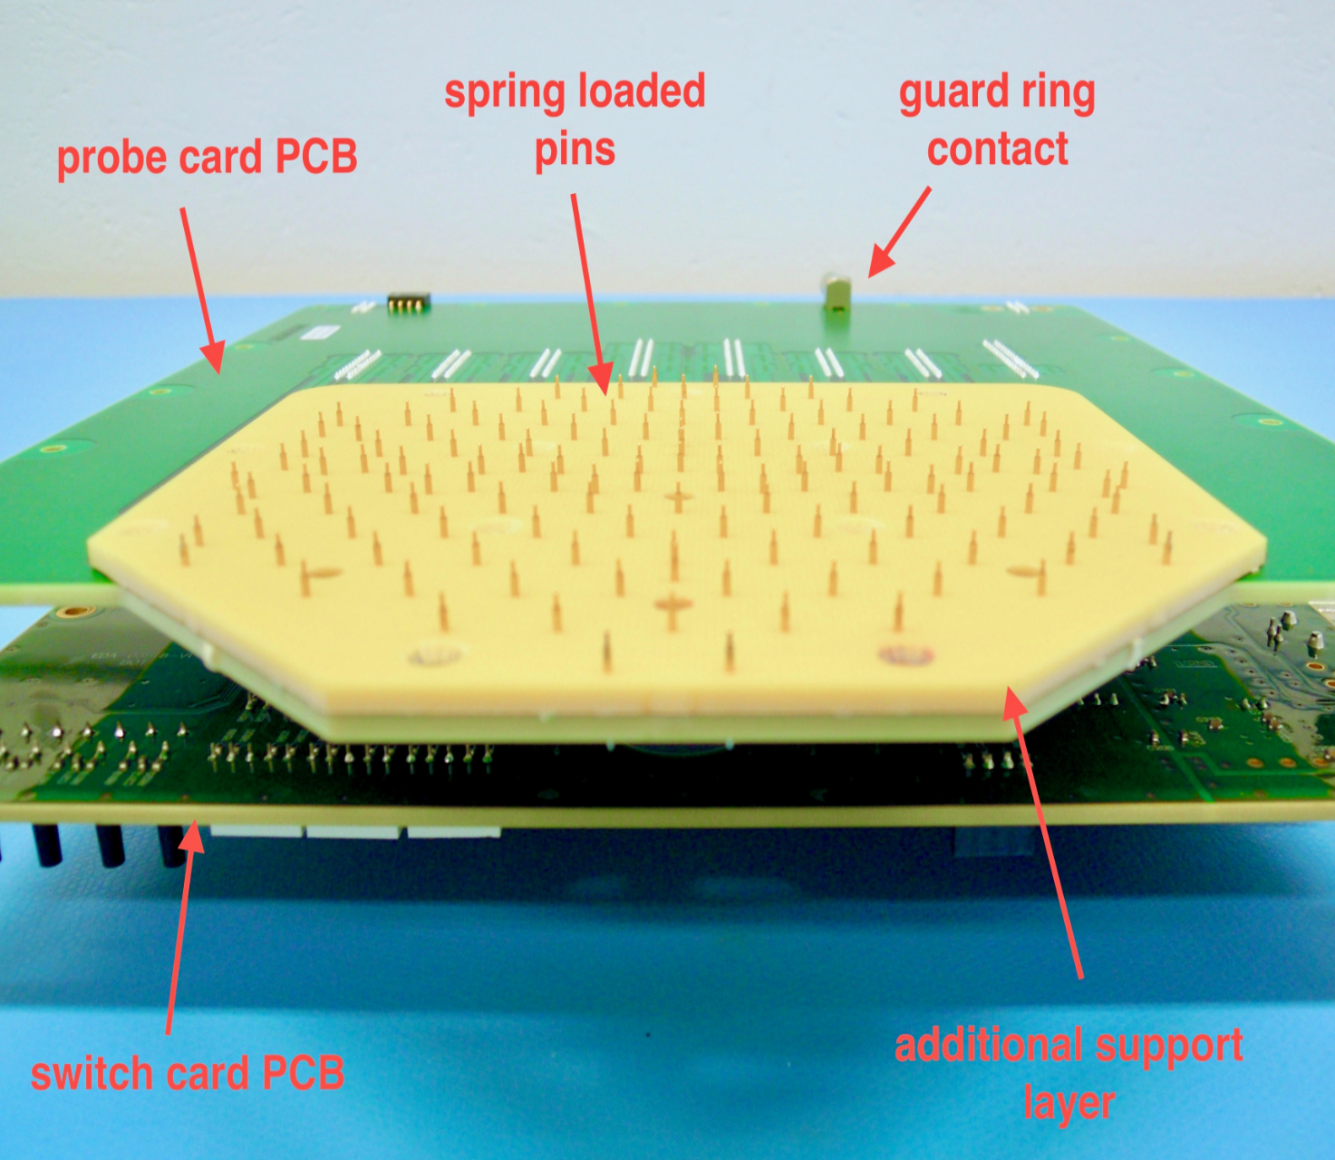
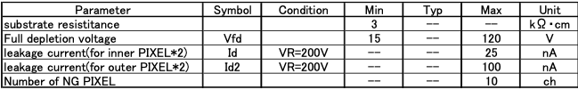
Calice TAU sensors for LUXE
90 CALICE sensors received mid November 2023
A probe card was designed and received in November from CERN
(paid by TAU and IFIC).
System needed for electrical sensor characterisation
in prototyping phase and for
quality control in mass production (IV, CV, VBD, VFD, CFD)
HGCAL
Hex
CALICE
Square

Slide 16
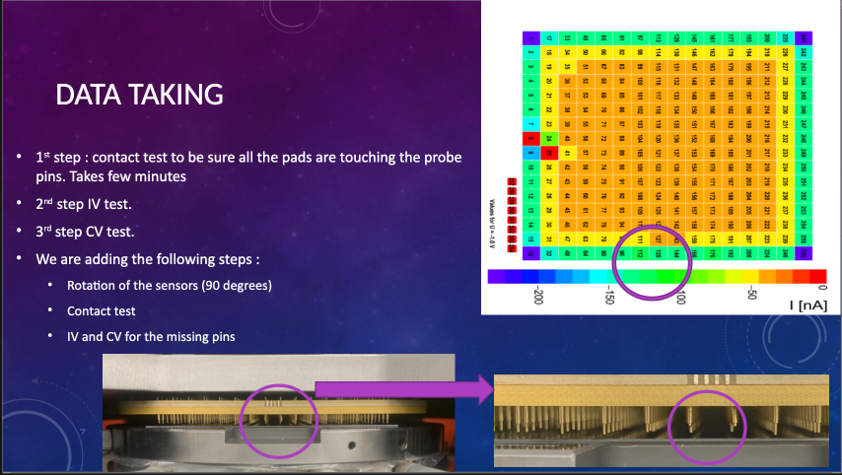
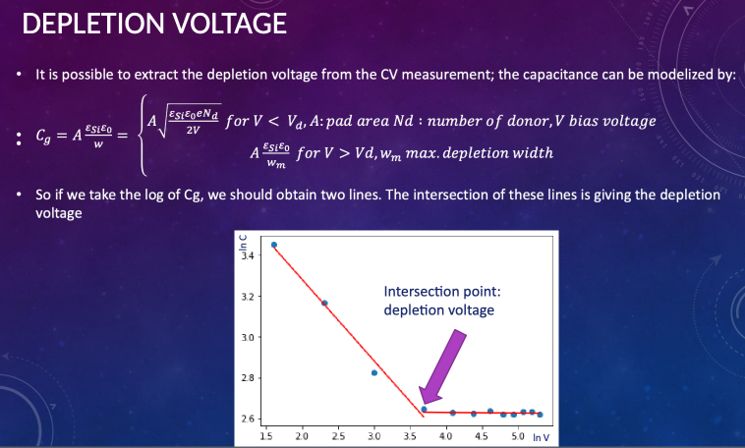


Sensor Tests
Depletion V
Leakage current
Donor’s density
C vs V
I vs V
For details, see Yan benhammou’s presentation at the 3rd AIDAi meeting

Slide 17
Conclusions & Outlooks
Conclusions:
  WP8 fostered the collaboration on the LUXE / SiW-ECAL on Sensor’s testing
  Recent progress on the SiW-ECAL layers with new layers
  Common Beam Test SiW-ECAL+AHCAL finaly took place in March 2025 (M47), with delays due to:
    SiW-ECAL wafer-PCB delamination problem; needed to be solved before any further test can be made; it was raised as the highest priority on the path to the production of new ASUs, on limited manpower (outside AIDAi)
    The DESY AHCAL team is responsible for the production of the board for the CMS HGCAL HCAL part;
    the unexpected observation of the freezing of radiation damage annealing at −35 °C in scintillators forced an urgent change of design, especially of the electronics boards, which had the priority.
  D8.1 has been fulfilled, not with fully integrated HW, as expected, but with a robust setup
    Report to be produced

Slide 18
Conclusions & Outlooks
Some gathered outlooks for AIDAinnova++
  The new version of the DRD6 FE ASICs (CALOROC1A/B/C), with improved timing,
  will require a complete redesign of the FE PCBs and DAQ,
  useful for all calorimeters types (linked to ASICs in WP11)
    This might require adapted local concentrator elements (low-power FPGA/ASICs with optical output ?)
    Go wireless?
  Additional Integration Aspects for FCC-ee: cooling (local & global)
  Extension to integration other types of sensors (MAPS, LGAD, Crystals, Fibrous, Gaseous, …)
  R&D on Hybridization (novel techniques, glues, ACFs, ?)
  novel PCB-flex ideas (integrated sensors in flex PCBs?)
    novel sensors with embedded traces?
  Highly compact calos with high fluence

Slide 19







AHCAL LabView
SiW-ECAL LabWindows
Clocks, Busy
LDA
CCC
CORE
Configs

