Slide 1
WP12: Software for Future Detectors
Frank Gaede (DESY) and Graeme Stewart (CERN)
WP12 Session at the final annual meeting, 2025-05-05

Slide 2
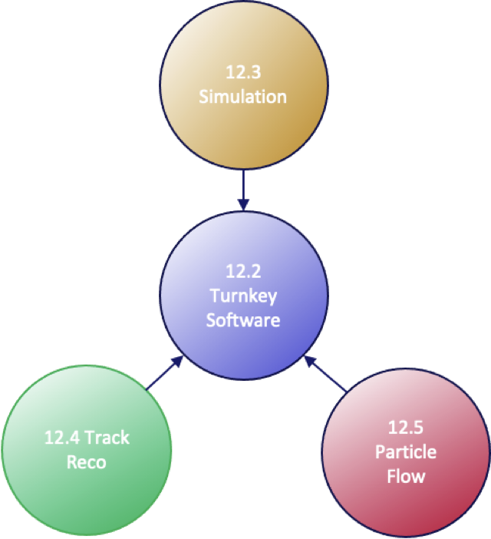
Welcome
Welcome to the Final AIDAinnova Annual Meeting, Software for Future Detectors session
We will have a round up today of what we achieved during AIDAinnova

Slide 3

Final Deliverables
Our final deliverables fell at the end of 2024, start of 2025
All of them were achieved on time
  Many thanks to everyone in the work package for their inputs
Deliverable | Title | Objective | Due
D12.1 | Turnkey software stack (Key4hep) | Fully functional turnkey software stack (Key4hep) with simulation, track reconstruction and particle flow algorithms running for the linear colliders and the FCC, using the common event data model (EDM4hep), with documentation and examples | M46 Jan 2025
D12.2 | Fast shower simulation in Geant4 | Fast shower simulation based on parameterisations and based on machine learning techniques fully integrated in Geant4, released with documentation and examples | M45 Dec 2024
D12.3 | Acts tracking algorithms | Track reconstruction algorithms incorporated into Acts, and fully documented, that manage the full tracking chain on CPU and non-CPU devices, with optional machine learning based algorithms available, also supporting MPGD detectors | M43 Oct 2024
D12.4 | PFA reconstruction algorithms | Improved and documented particle flow algorithms, including machine learning based algorithms, available in the PandoraPFA toolkit, suitable for detectors using new readout technology | M45 Dec 2024

Slide 4
Next AIDA
AIDA does not end with Innova!
There will be a follow-up project proposal
This will include a work package on software
  Frank Gaede and Anna Zaborowska have been involved in the preparation

Slide 5
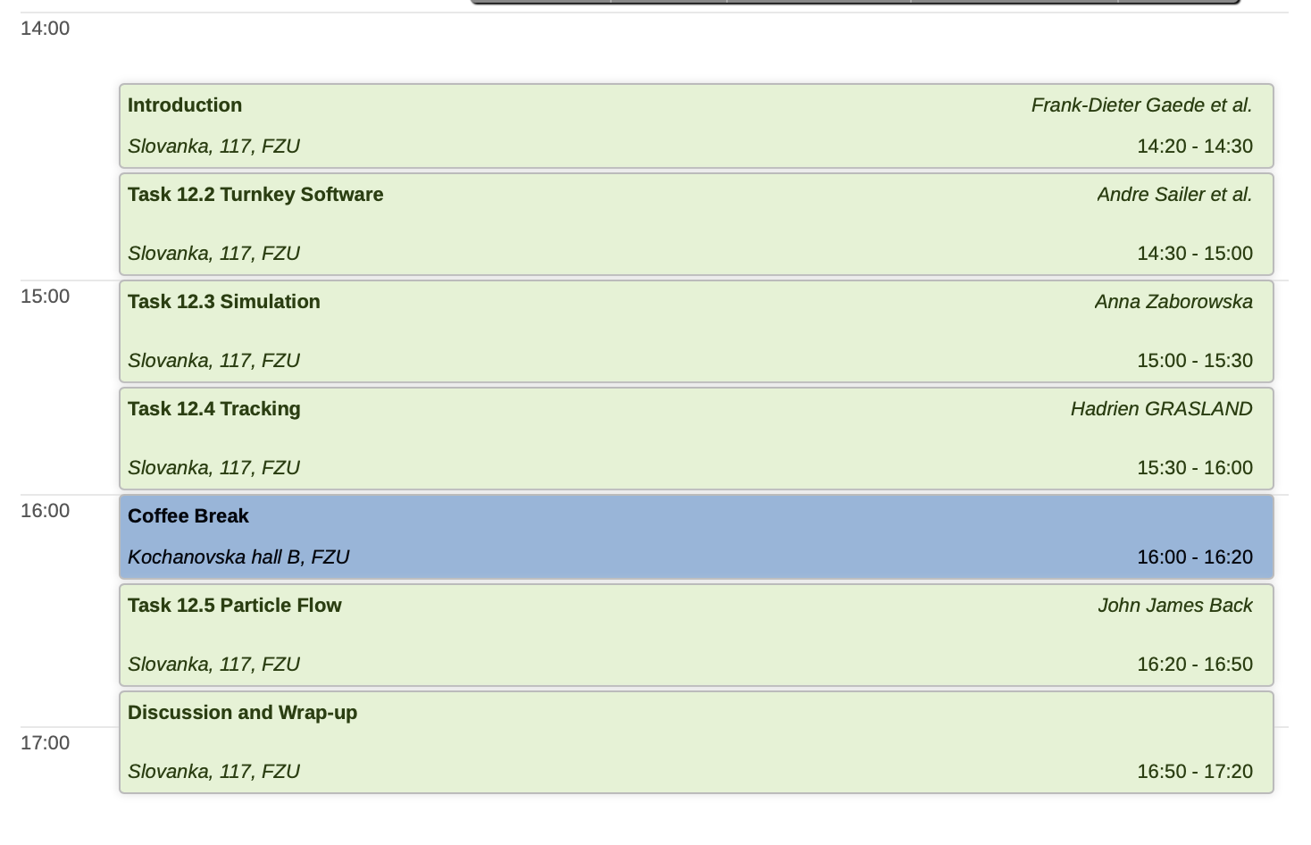
Today’s Meeting
Plenary summary will be on Thursday morning
Thomas Madlener will give this

Slide 6
Final WP12 Hackathon
We won’t have a hackathon at this annual meeting
There is a hackathon arranged at CERN from 3-5 June
  https://indico.cern.ch/event/1545029/
So we also hope to see many of you there!

