Slide 1
AIDAinnova WP10
3D printed ceramics
Martin Schwentenwein

Slide 2
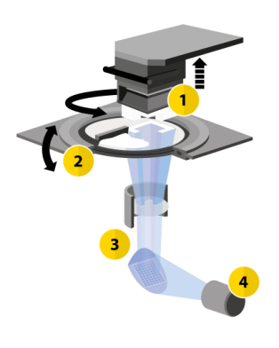
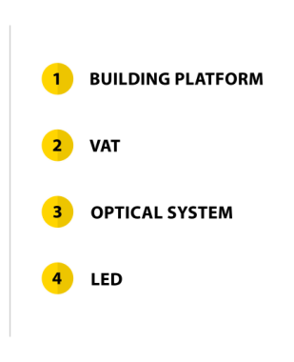

A closer look at our LCM Technology
Blue light cures the photosensitive formulation
Click to watch a video about the LCM technology

Slide 3


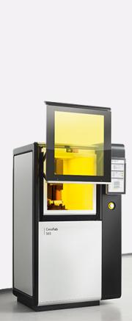
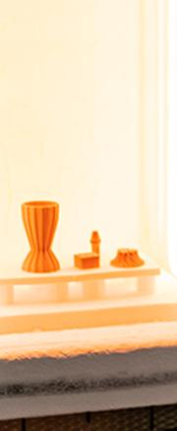

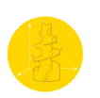

Process Chain
3D PRINT
DEBIND, SINTER
FINAL PRODUCT
CAD DESIGN

Slide 4
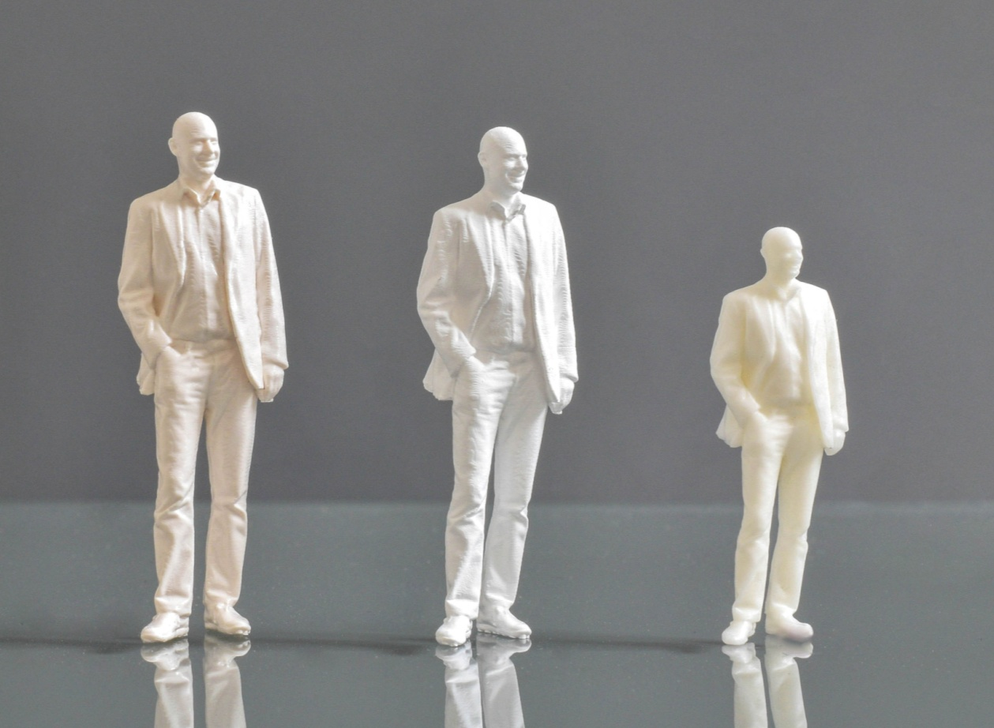
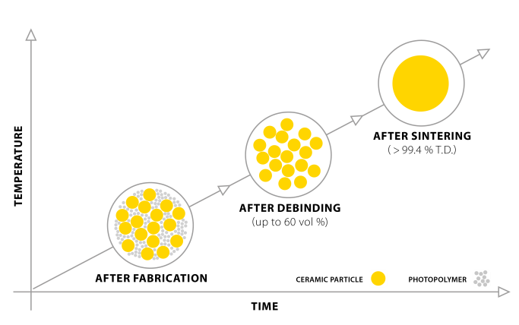
Debind and Sinter Process

Slide 5

Aluminum nitride

Slide 6

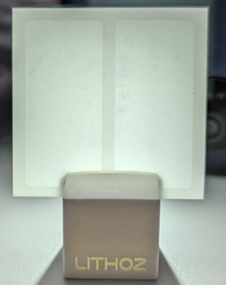
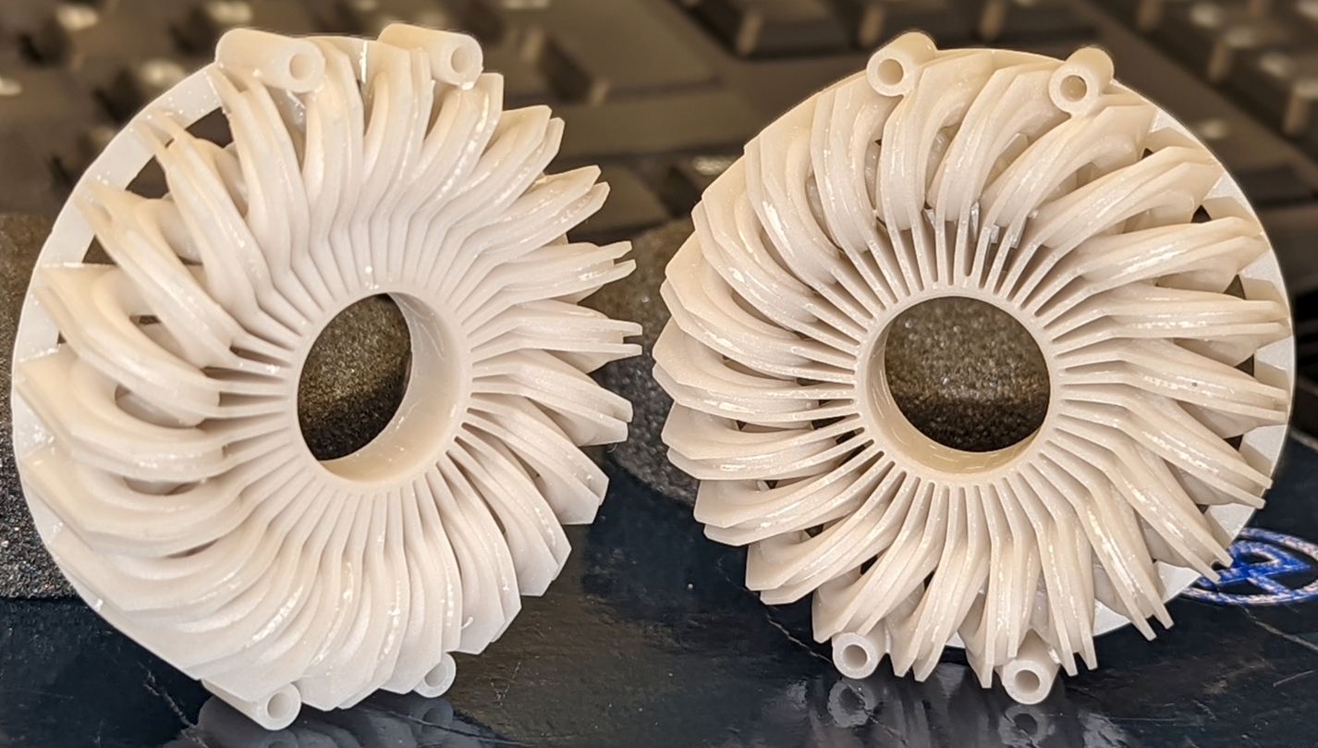
Aluminium Nitride
200µm thick plate
density of 3.26 gm/cm³
Thermal conductivity: 212W/m.K
Maximum wall thickness: 4mm
Minimum wall thickness: 0.2mm
Maximum Aspect ratio: 10
Bending strength: 292.2 (+/-) 40MPa
Heat Exchanger

Slide 7
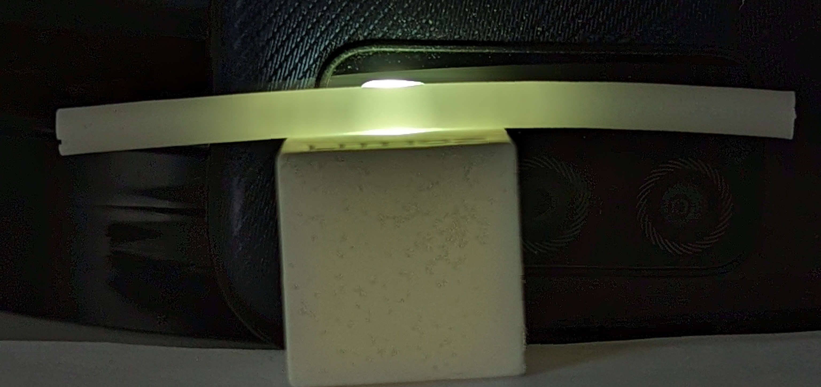
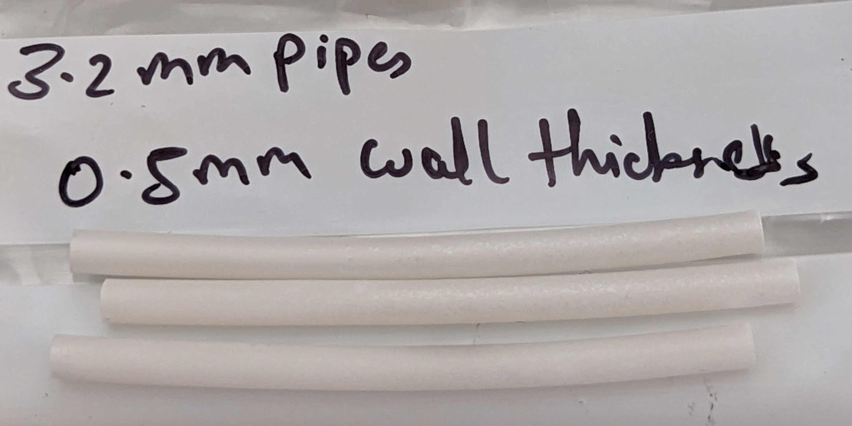
Aluminium Nitride
Parts with extreme aspect ratios tend to warp with the current slurry after different stages of thermal post processing
Current Slurry
  Medium stiff binder
  Easy to debind
  45vol% solids loading => large material movement leading to formation of residual stresses and deformation to reduce/release these stress
  28% shrinkage in XY plane and 29% shrinkage in Z direction
  Large shrinkage and relative low stiffness of green body leads to warping of parts with extreme aspect ratios (>10)

Slide 8
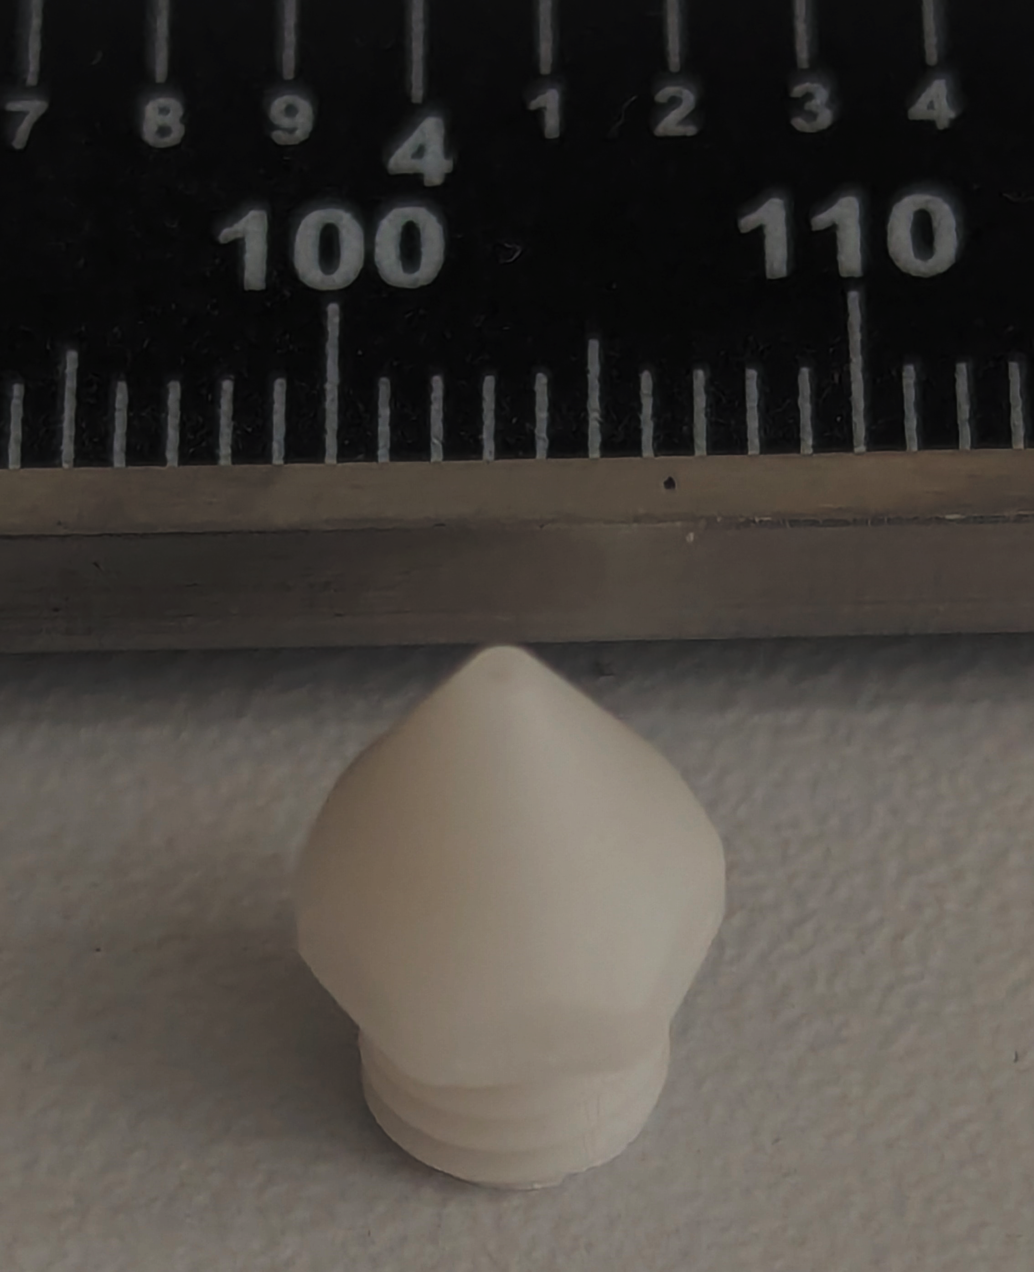
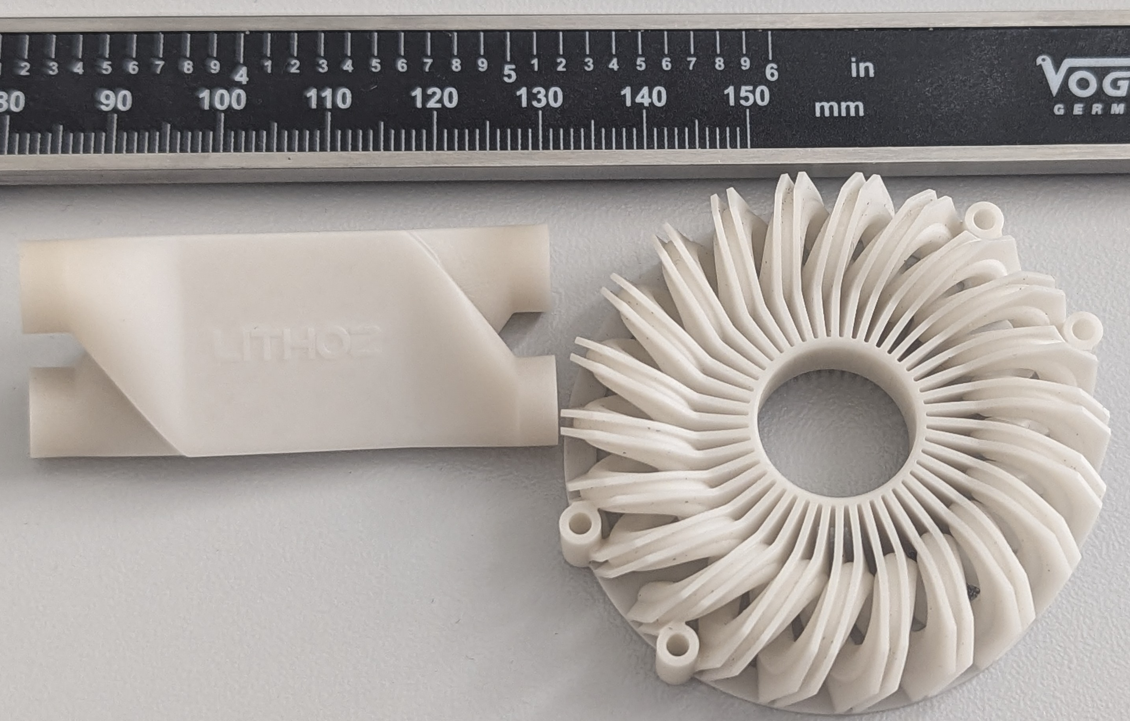
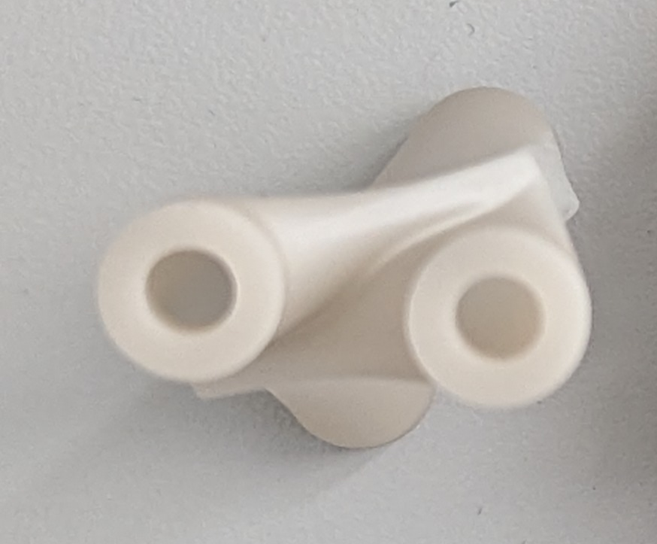
Aluminium Nitride
Exemplary applications
  FDM Nozzles
  Liquid mixers and cooling loops

Slide 9
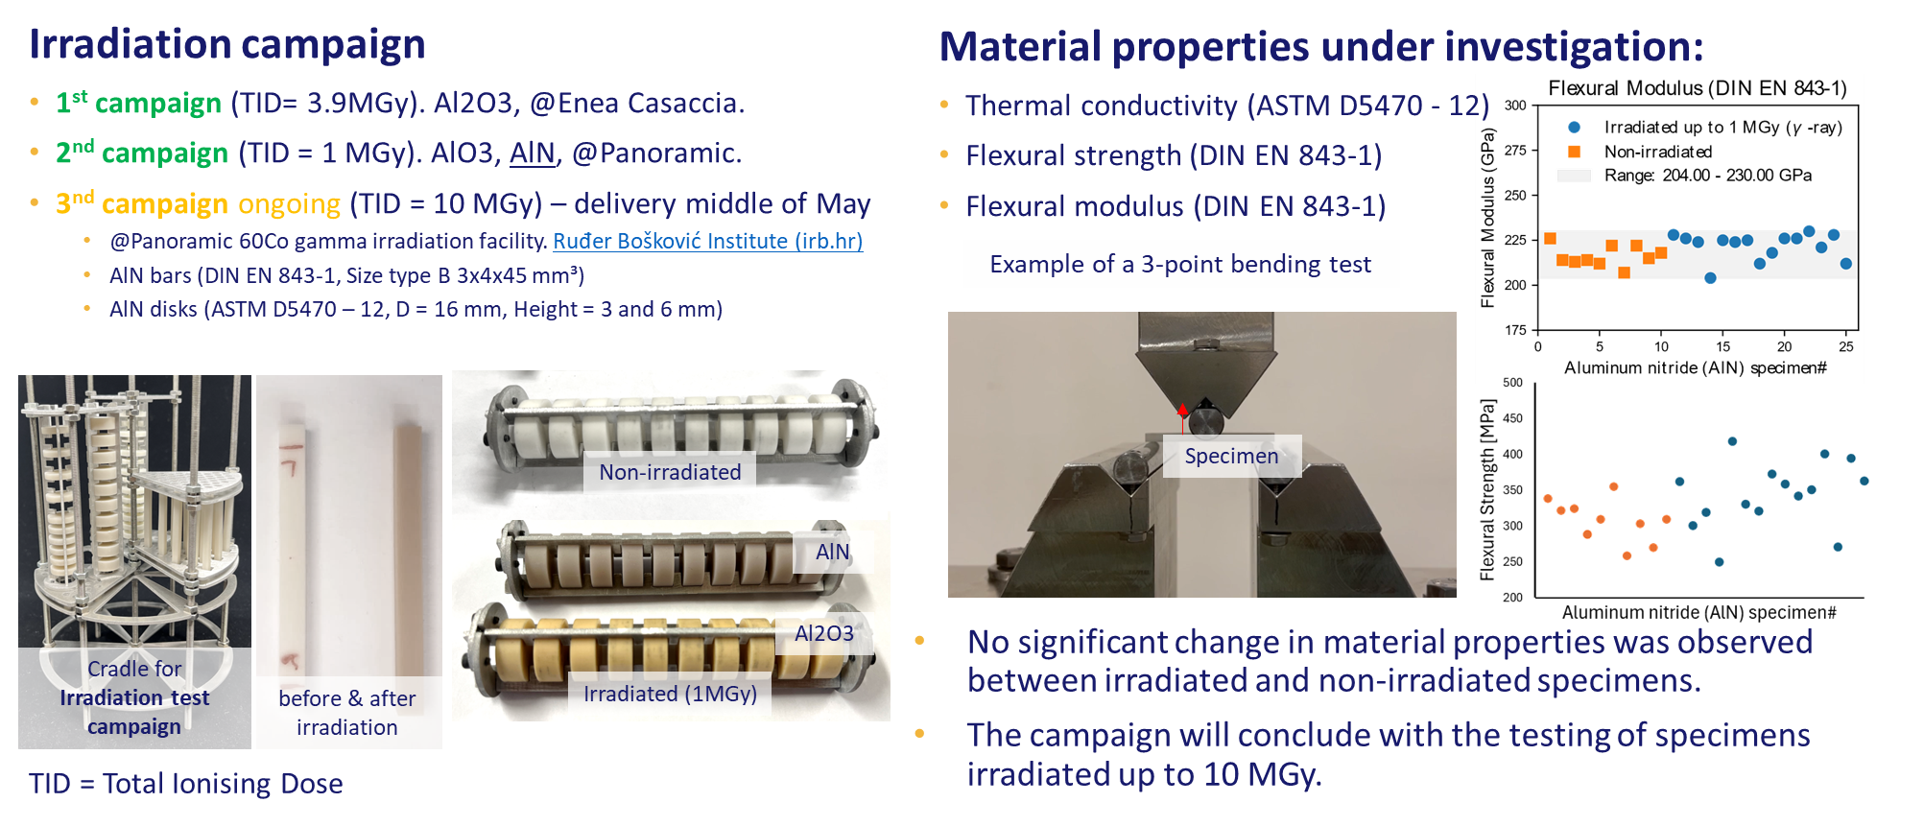
Irradiation tests

Slide 10

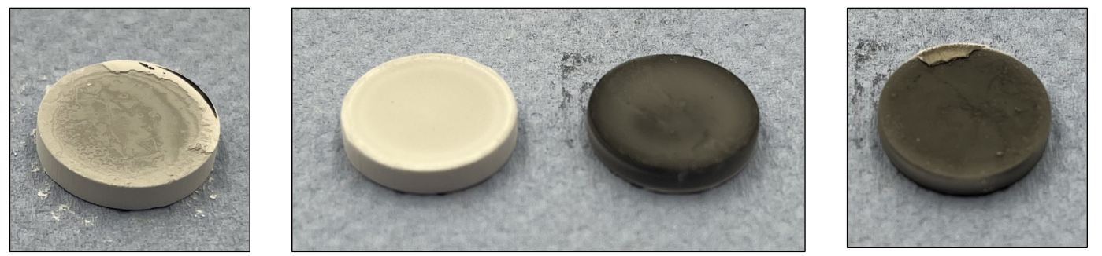
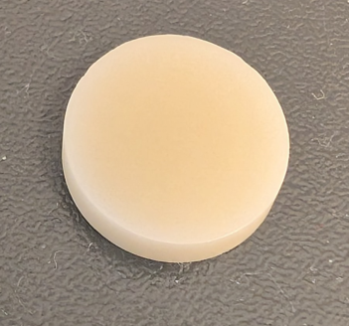
Adaption of sintering method
Sintering trials with service provider (FGK from Germany) successful
Excellent densification accomplished (>99% rel density)
Iteration I
Iteration II
Iteration V

Slide 11
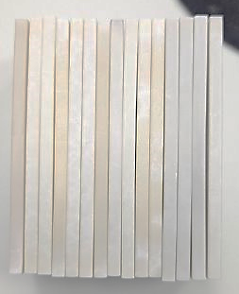
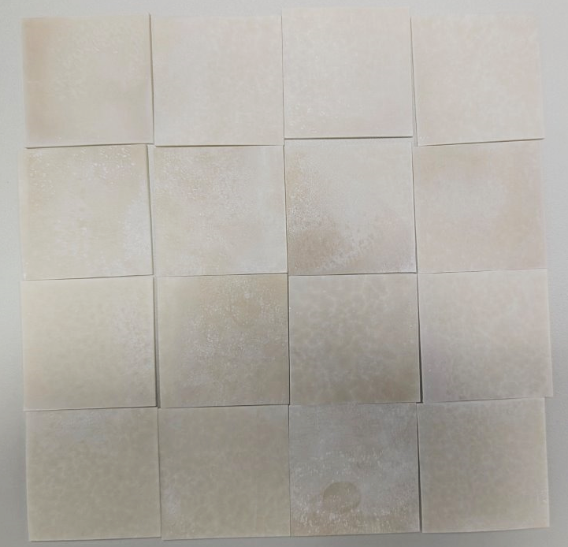
Aluminium Nitride
Sintered cooling channels dimensions – 80*40*4 mm
Sintered cold plates dimensions – 35*35*2 mm
Crack free but not flat
Highly dense parts, relative density >99.3%
High degree of tolerance match with stl

Slide 12
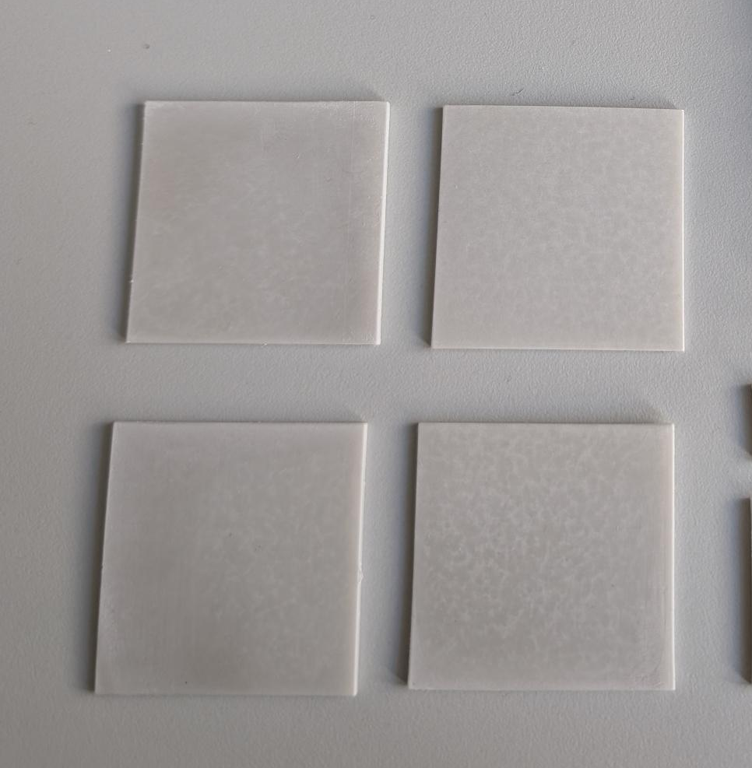
Upcoming print trials
Crack free and flat
New Slurry
  Improved green stiffness
  55vol% solids loading => lower material movement and lower stresses in the part
  Reduced shrinkages to 21% in XY and 23% in Z direction
  Significant improvement in part flatness after thermal post processing
  Ability to print and process part with extreme aspect ratios
  Good for upcoming cold plate parts required in detector at CERN

Slide 13
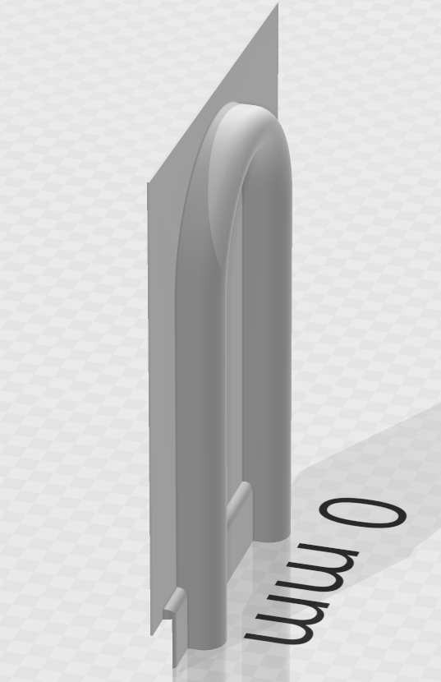
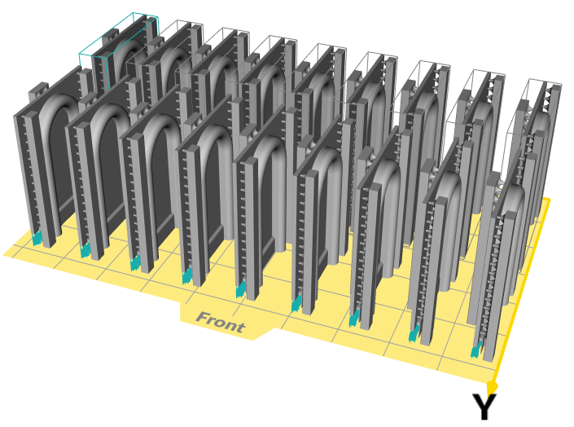
Upcoming print trials
Increased plate thickness to 0.6mm (sintered state)
Print supports added to design to counteract wobbling

Slide 14
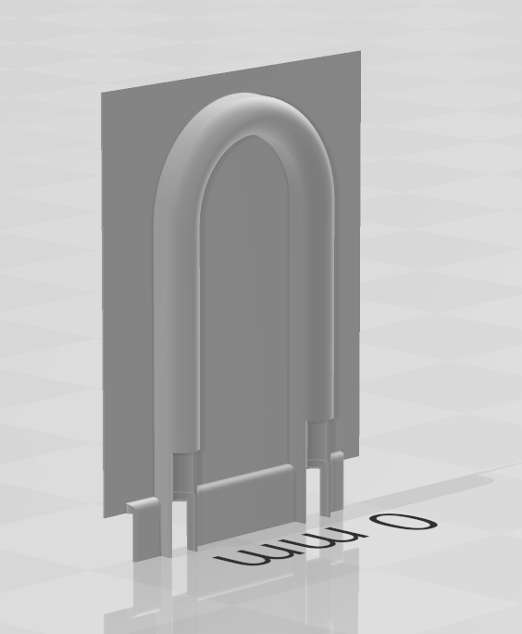
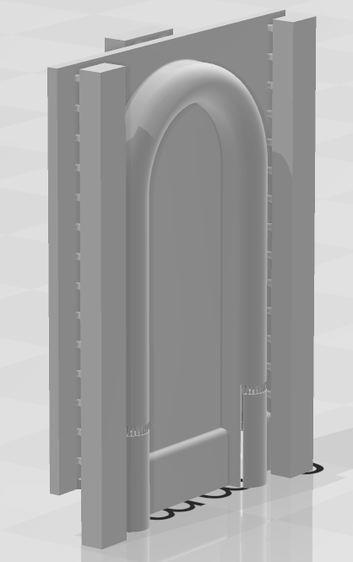
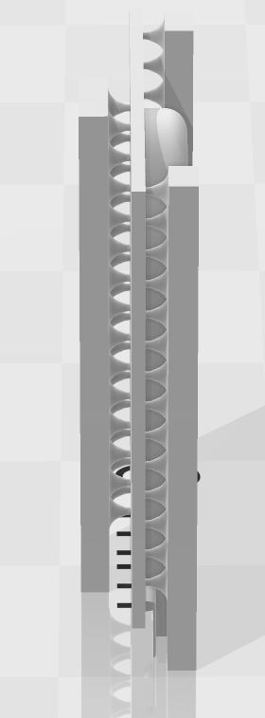
Upcoming print trials
Increased plate thickness to 0.6mm (sintered state)
Print supports added to design to counteract wobbling

Slide 15

Grinding/Polishing
Grinding trials with Fraunhofer IKTS from Germany ongoing (flatness)

Slide 16
Conclusion
A stable sintering process for AlN could be established better reproducibility
An improved feedstock (suspension) could be developed less shrinkage
3D printing and sintering of complex AlN shapes possible more dimensional freedom
Dimensional trueness (deformation) is still challenging for certain designs - warping/deformation occurs particularly with parts with high aspect ratio such as thin plates. Measures taken so far in AIDAinnova helped to significantly reduce this behavior but it did not completely eliminate it

Slide 17
Outlook I
Printing novel designs
Printing and sintering of larger components (>15cm)
Grinding of sintered parts to improve flatness

Slide 18
Outlook II
Further adaptions of feedstock
Further optimization of sintering method
Compensation by design (modelling/simulation)
Using composite materials
?

Slide 19
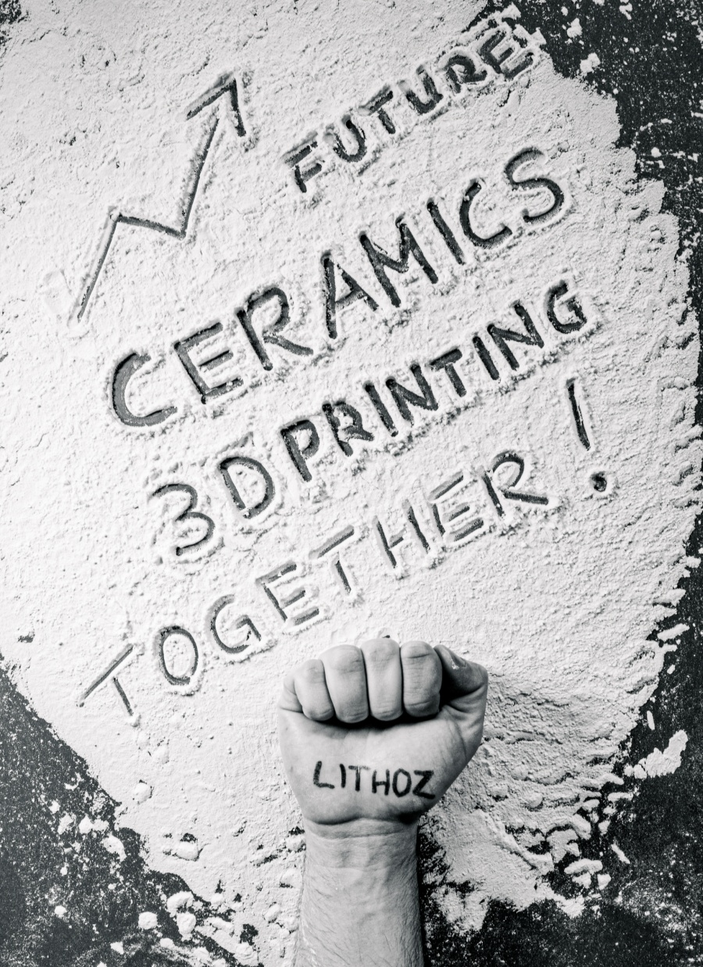

Manufacture the Future.
LITHOZ GmbH
Mollardgasse 85a/2/64-69
1060 Vienna/AUSTRIA
Phone: +43 1 9346612-204
mschwentenwein@lithoz.com
WWW.LITHOZ.COM

