Slide 1
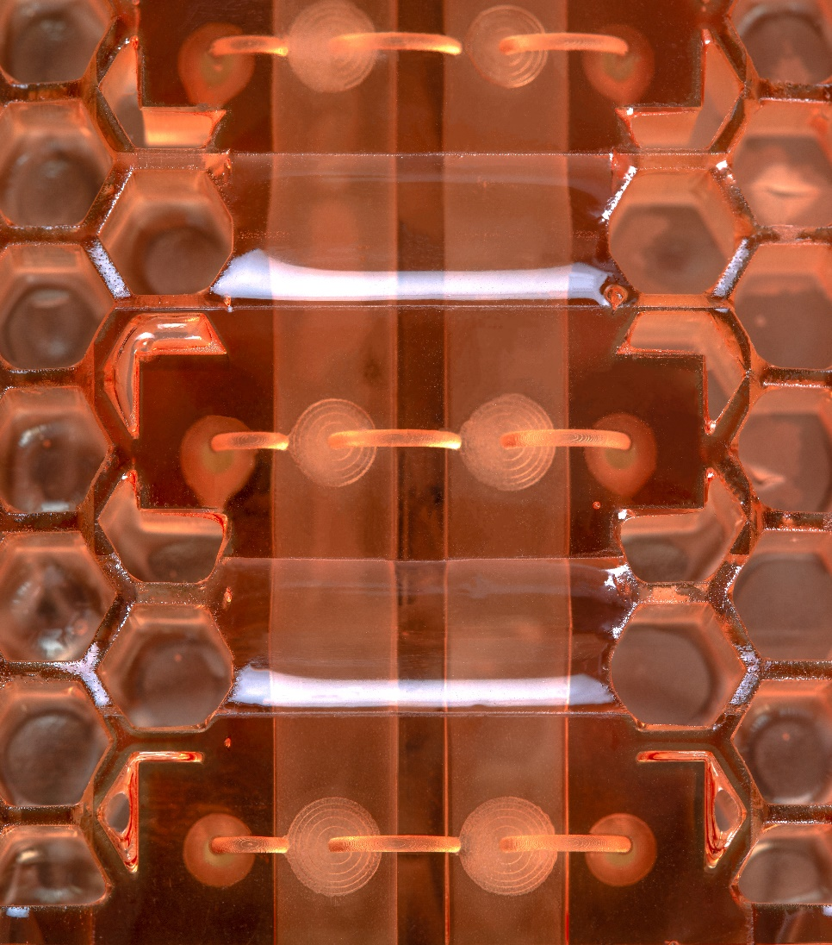
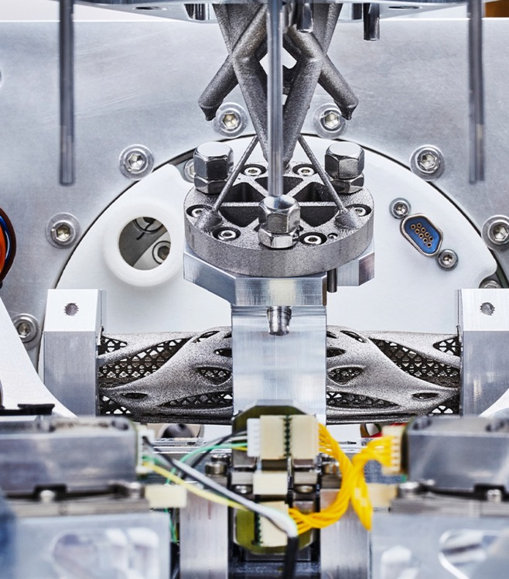
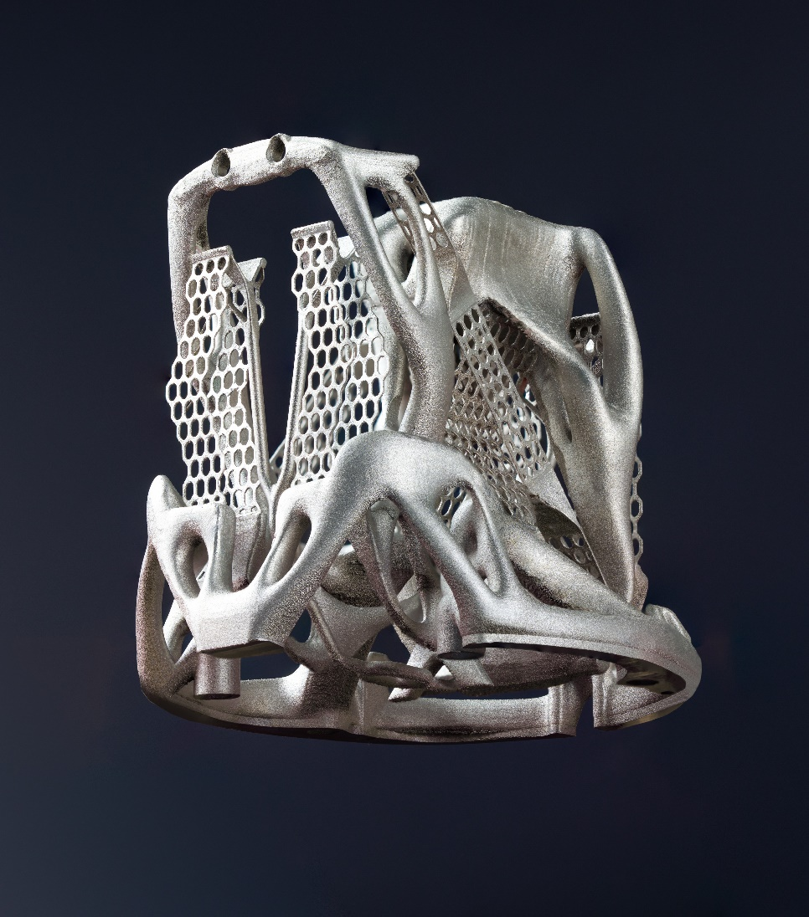
AIDAINNOVA
WP10
Samuel Unterhofer
R&D engineer

Slide 2
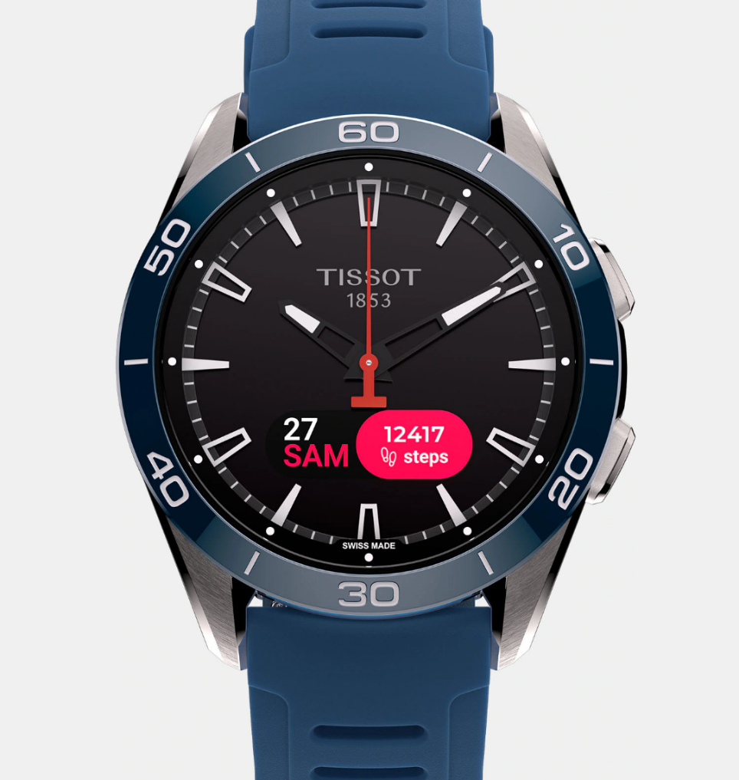
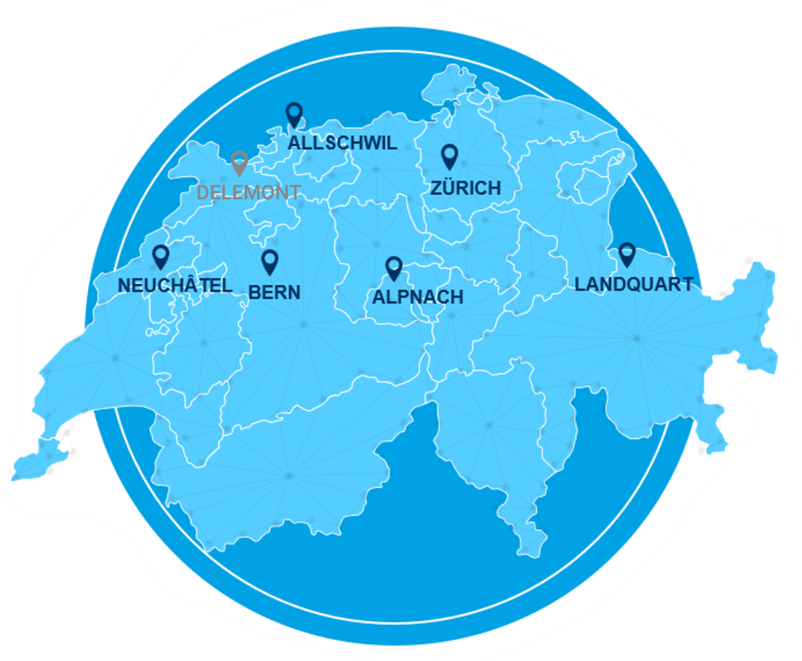


Csem at a glance
We are a public-private, non-profit Swiss technology innovation center
We enable competitiveness by developing and transferring world-class technologies to the industrial sector
We fuel the innovation of more than 200 industrial partners every year.
Tissot T-Touch Connect Sport
630
SPECIALISTS
177
PATENT
FAMILIES
1984
FOUNDED
115.4
M TURNOVER
in 2024
> 50
VENTURES
since 1984

Slide 3
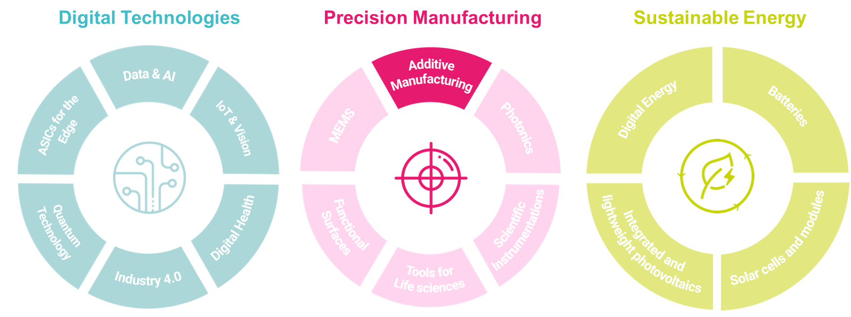
We focus on three research priorities

Slide 4
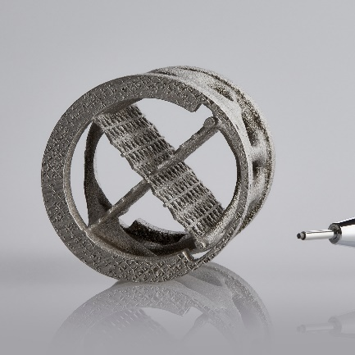
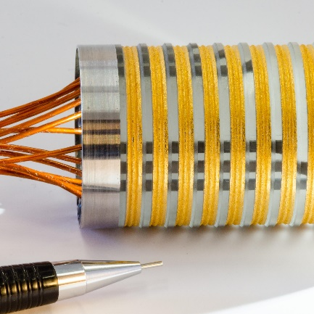
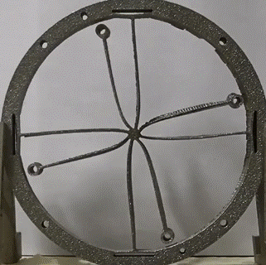

OUR MAIN RESEARCH TOPICS
HIGH-PRECISION AM
INTEGRATED FUNCTIONS
ENABLING MATERIALS & PREDICTIVE QUALITY

Slide 5
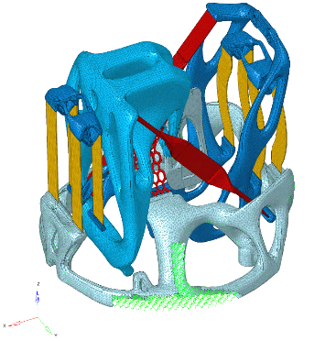
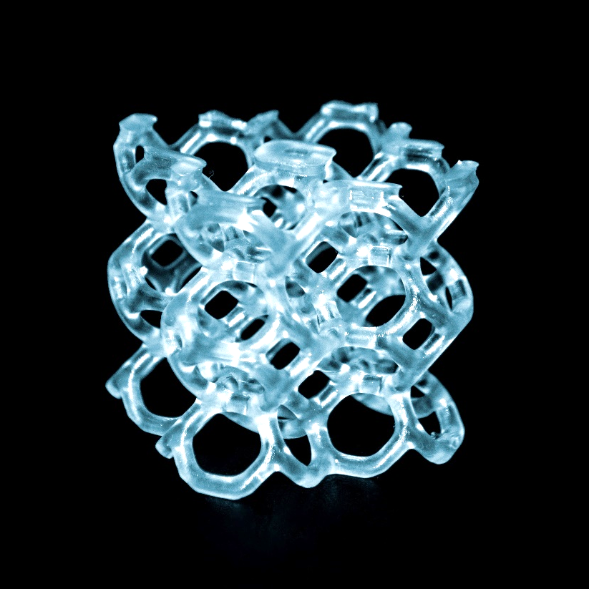
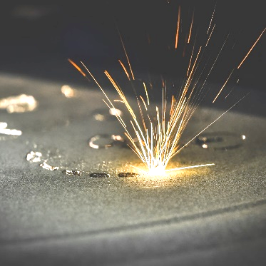
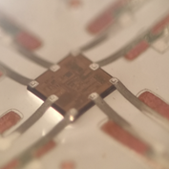
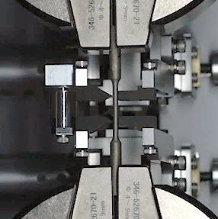
OUR CORE COMPETENCIES IN AM
DESIGN FOR AM
LITHOGRAPHY BASED AM
LASER POWDER BED FUSION
AEROSOL JET PRINTING
MATERIAL CHARACTERIZATION

Slide 6

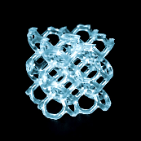
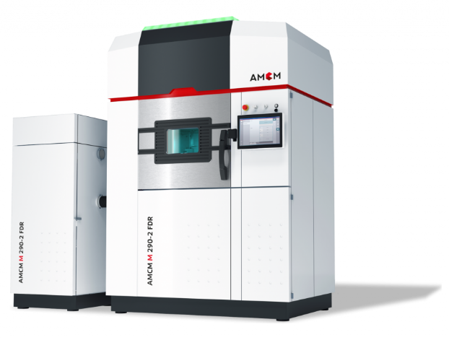
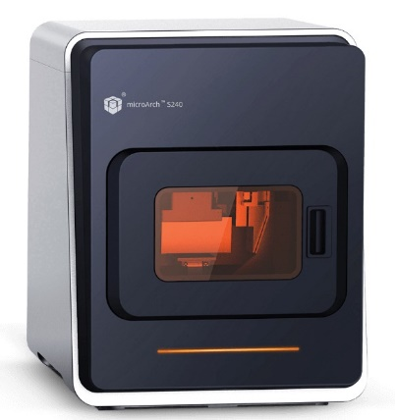
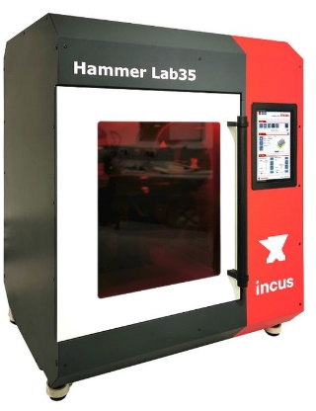
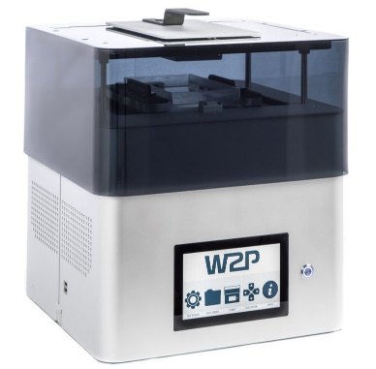

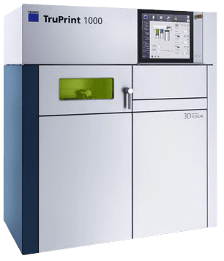
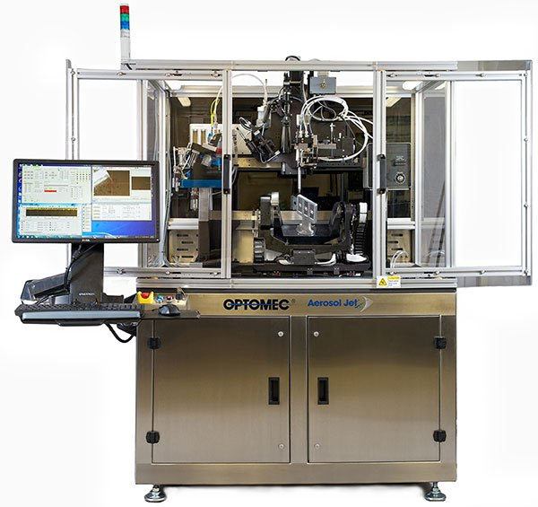
Additive Manufacturing Infrastructure
LASER POWDER BED FUSION
LITHOGRAPHY BASED AM (polymer, metal, ceramic)
EOS-M290 FDR
(40 µm laser spot)
Build volume:
(250 x 250 x 300 mm³)
Materials: Al, Ti alloys, Inconel, Tungsten, Copper
BMF MicroArch S240
(10 µm pixel)
Build volume:
(100 x 100 x 75 mm³)
Materials: Acrylates, Alumina, Zirconia
Incus Hammer Lab35
(35 µm pixel)
Build volume:
(56 x 90 x 120 mm³)
Materials: 316L, Ti6Al4V, Copper
Solflex 635UHD
(35 µm pixel)
Build volume:
(130 x 110 x 130 mm³)
Materials: Acrylates
Trumpf TruPrint 1000
(30 µm laser spot)
Build volume:
(Ø100 x 100 mm³)
Materials: Al, Ti alloys, NiTi, Composites, Multimaterials, High entropy alloys, etc.
AEROSOL JET PRINTING
Optomec AJ300
(10 - 2000 µm line)
Build area:
(300 x 300 mm²)
Materials: Ag, Au, Pt, Cu, Carbon black, Epotek, Polyimide

Slide 7
CSEM aim for AIDAinnova WP10
Define the optimal geometrical features attainable for 3D printed ultra-thin cold plates in metal alloys

Slide 8
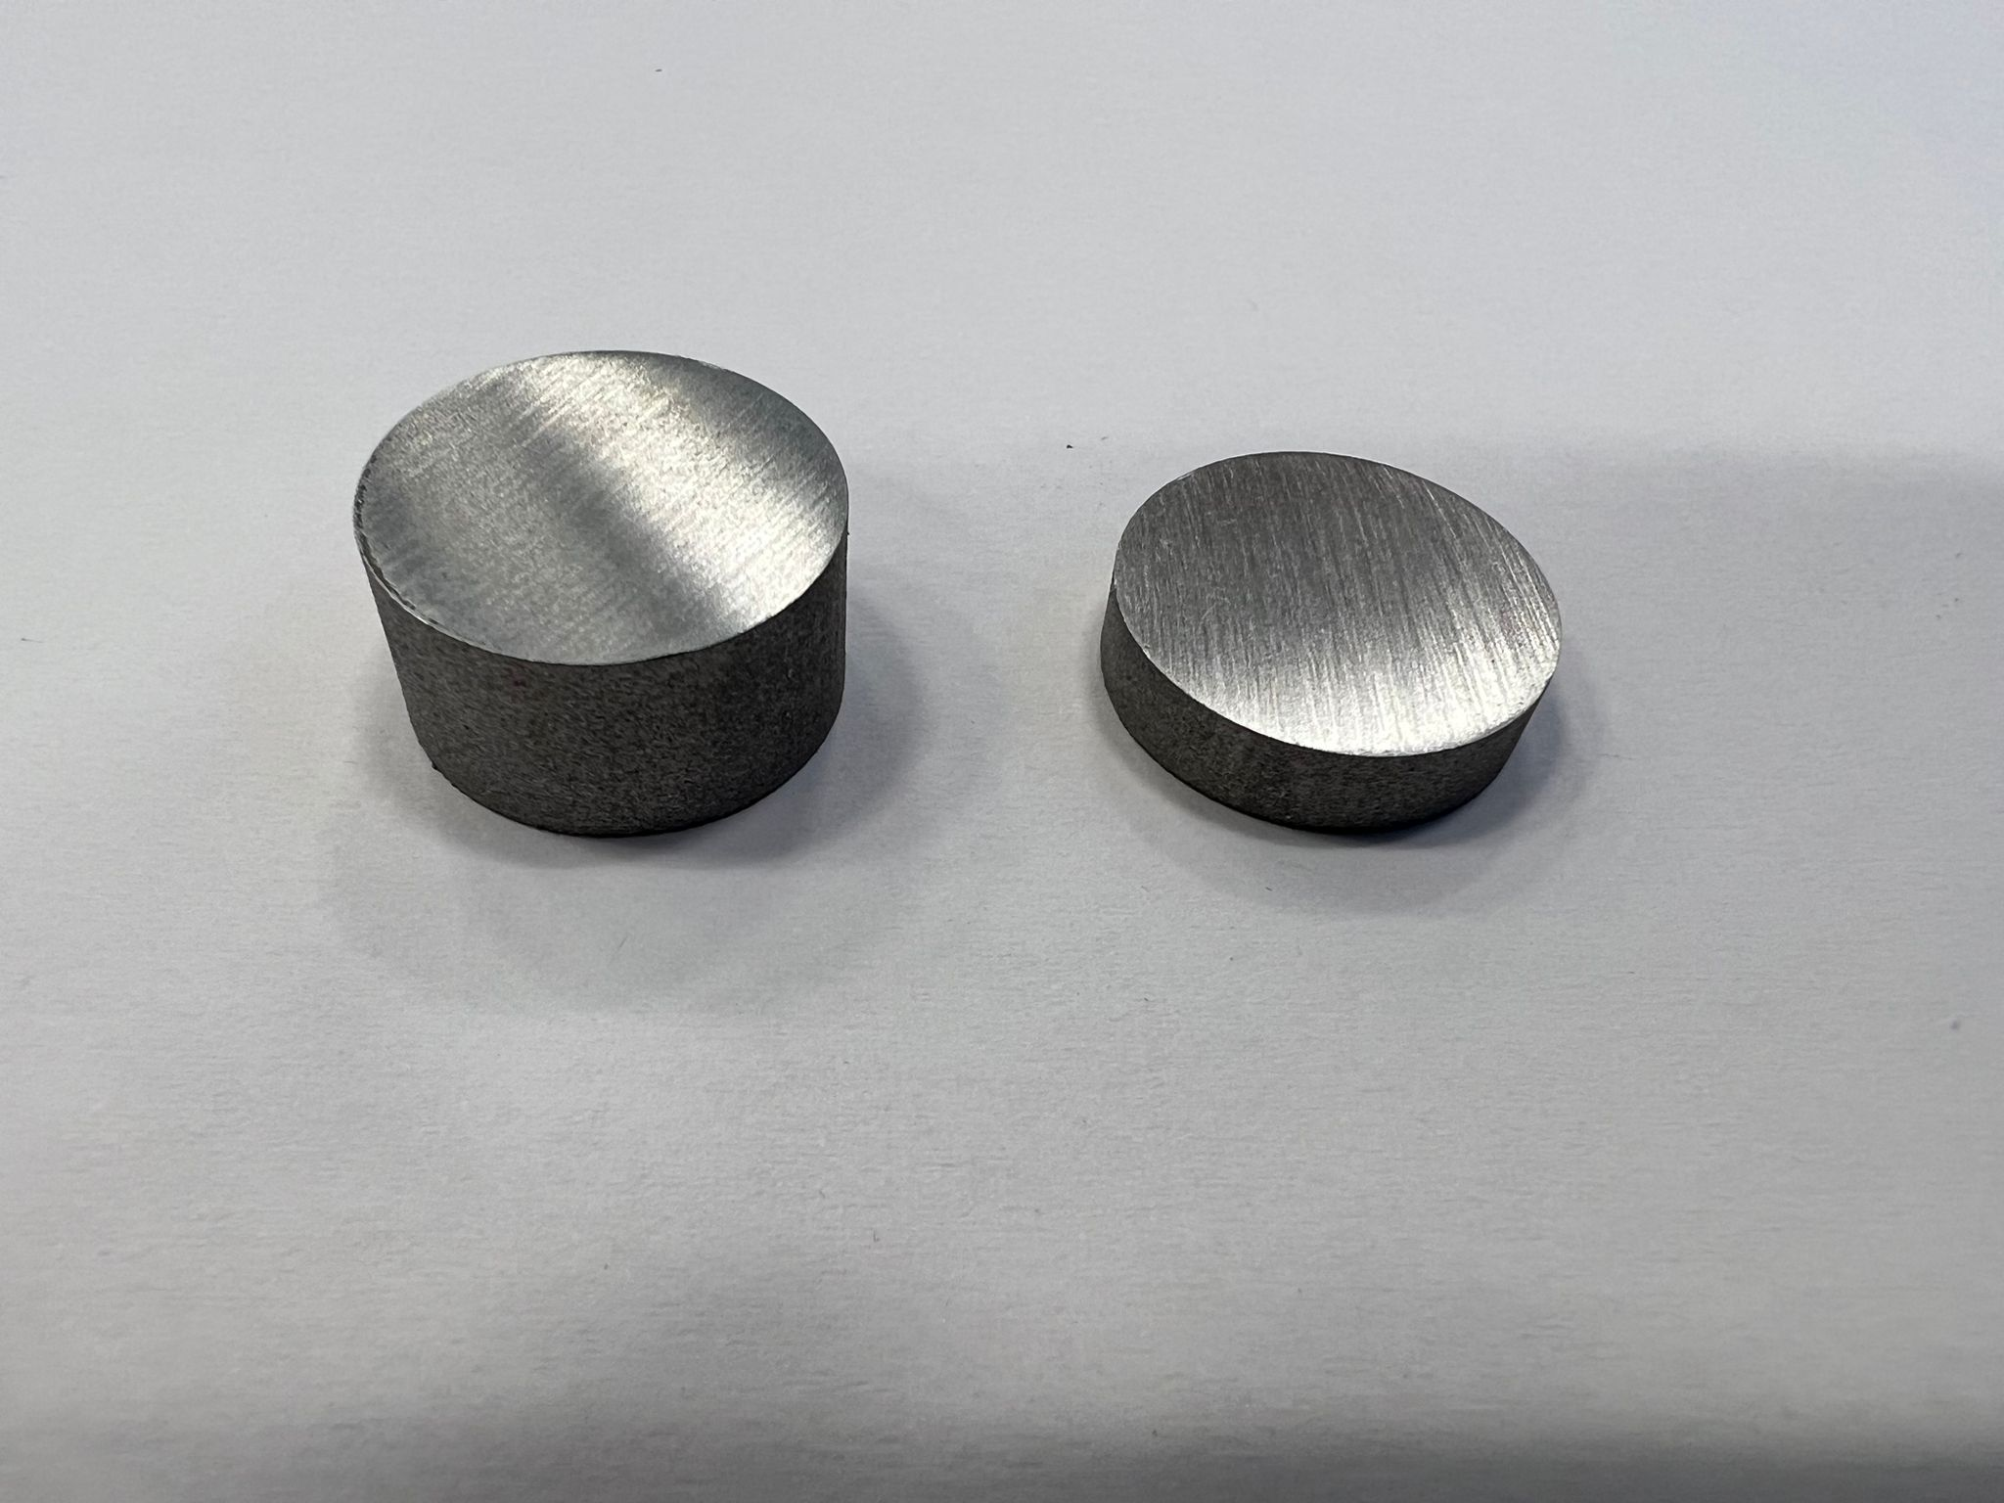
CSEM objectives for AIDAinnova WP10
Test samples
  Thermal conductivity
  Long cavity test
  Pipe roughness
  Flatness (multi-microchannel)
Minimal wall thickness
  Minimum leak-tight wall thickness
Powder removal
  Minimum ratio (D/L) for single straight pipes
  Design feature for 180° bent pipes
  Minimum ratio (D/L) for multi-microchannel
Smart pipe
  Printing parameters
  Aluminium: Al-12-Si
Two disk dimensions
With and without heat treatment (350°C, air, 1h)
Result: 130-160 W/mK

Slide 9
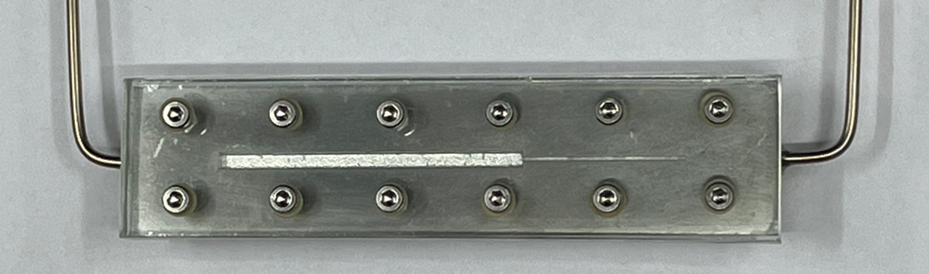


CSEM objectives for AIDAinnova WP10
Test samples
  Thermal conductivity
  Long cavity test
  Pipe roughness
  Flatness (multi-microchannel)
Minimal wall thickness
  Minimum leak-tight wall thickness
Powder removal
  Minimum ratio (D/L) for single straight pipes
  Design feature for 180° bent pipes
  Minimum ratio (D/L) for multi-microchannel
Smart pipe
  Printing parameters
  Aluminium: Al-12-Si
Prototype with one evaporative channel
Glass cover
O-ring
Metal plate
Result: no leached particles observed

Slide 10
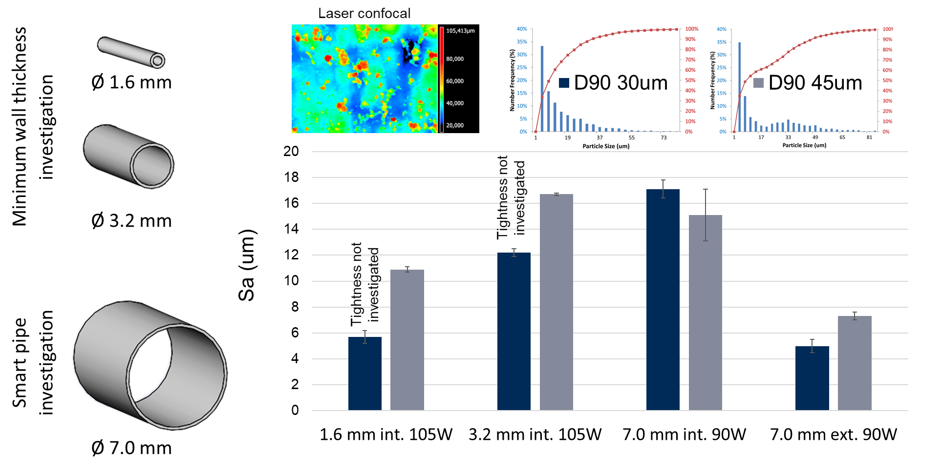
CSEM objectives for AIDAinnova WP10
Test samples
  Thermal conductivity
  Long cavity test
  Pipe roughness
  Flatness (multi-microchannel)
Minimal wall thickness
  Minimum leak-tight wall thickness
Powder removal
  Minimum ratio (D/L) for single straight pipes
  Design feature for 180° bent pipes
  Minimum ratio (D/L) for multi-microchannel
Smart pipe
  Printing parameters
  Aluminium: Al-12-Si

Slide 11
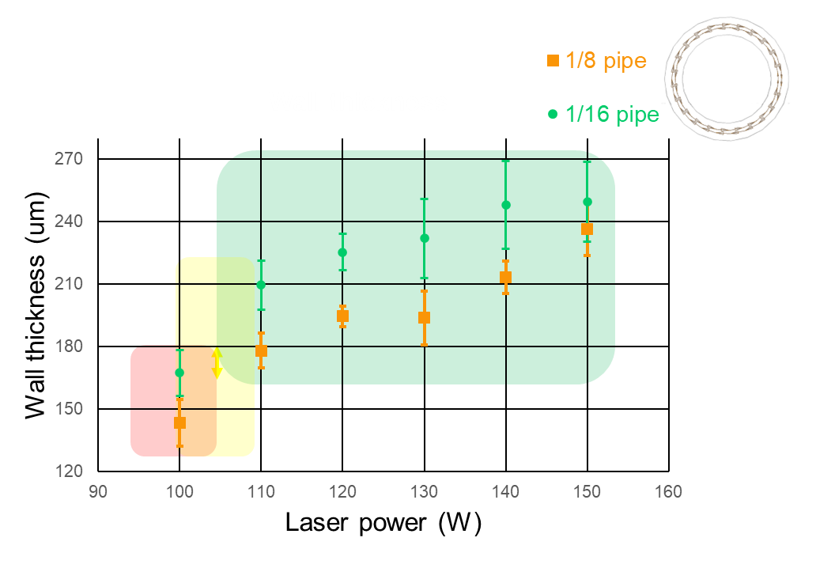
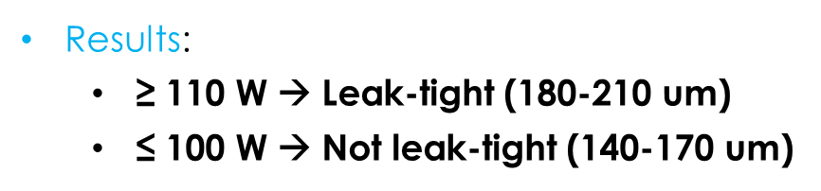
CSEM objectives for AIDAinnova WP10
Test samples
  Thermal conductivity
  Long cavity test
  Pipe roughness
  Flatness (multi-microchannel)
Minimal wall thickness
  Minimum leak-tight wall thickness
Powder removal
  Minimum ratio (D/L) for single straight pipes
  Design feature for 180° bent pipes
  Minimum ratio (D/L) for multi-microchannel
Smart pipe
  Printing parameters
  Aluminium: Al-12-Si
Method tested:
He leaking rate + Water burst up to 80 bars

Slide 12
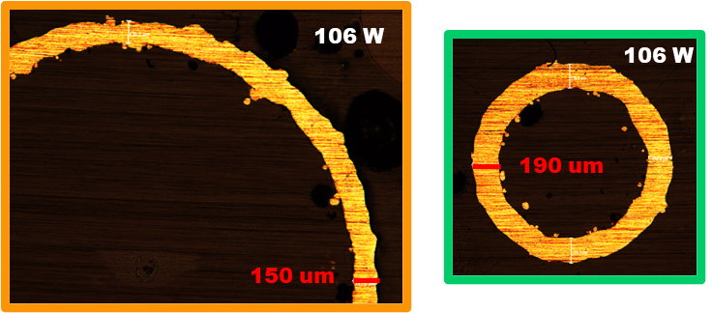
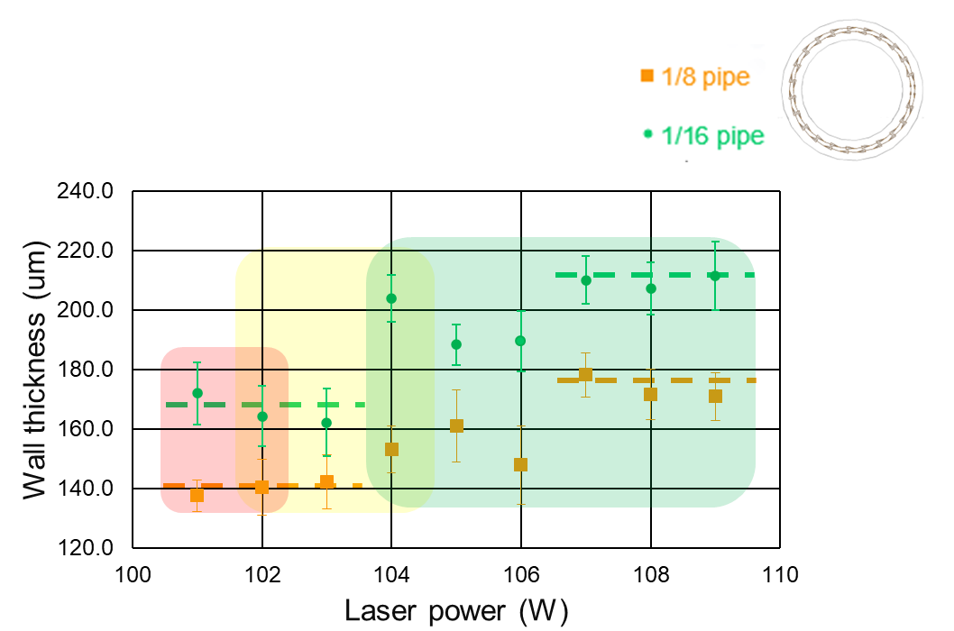
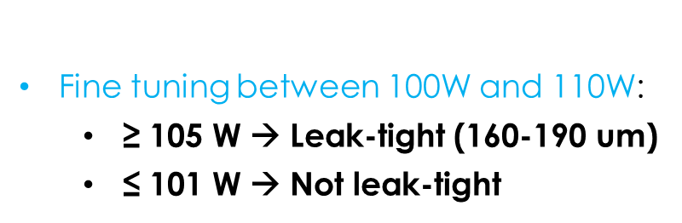
CSEM objectives for AIDAinnova WP10
Test samples
  Thermal conductivity
  Long cavity test
  Pipe roughness
  Flatness (multi-microchannel)
Minimal wall thickness
  Minimum leak-tight wall thickness
Powder removal
  Minimum ratio (D/L) for single straight pipes
  Design feature for 180° bent pipes
  Minimum ratio (D/L) for multi-microchannel
Smart pipe
  Printing parameters
  Aluminium: Al-12-Si

Slide 13
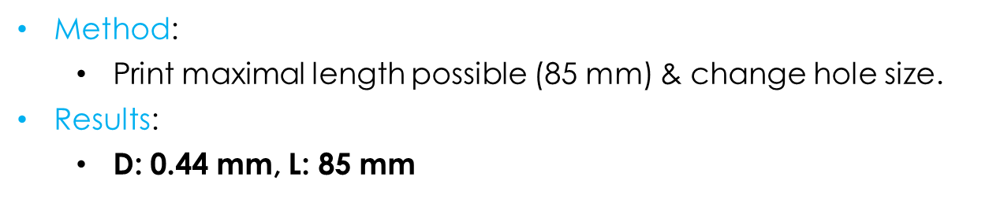
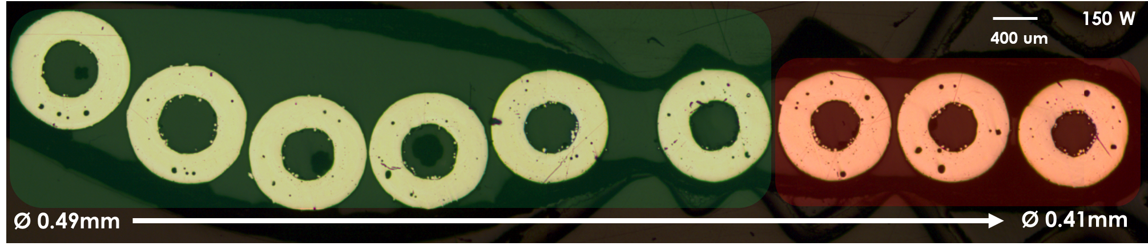
CSEM objectives for AIDAinnova WP10
Test samples
  Thermal conductivity
  Long cavity test
  Pipe roughness
  Flatness (multi-microchannel)
Minimal wall thickness
  Minimum leak-tight wall thickness
Powder removal
  Minimum ratio (D/L) for single straight pipes
  Design feature for 180° bent pipes
  Minimum ratio (D/L) for multi-microchannel
Smart pipe
  Printing parameters
  Aluminium: Al-12-Si

Slide 14
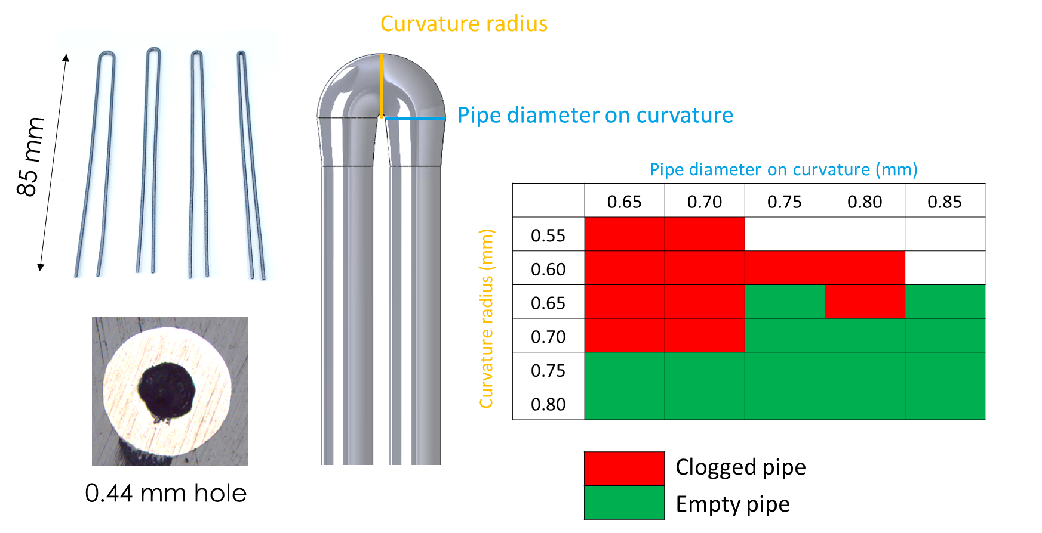
CSEM objectives for AIDAinnova WP10
Test samples
  Thermal conductivity
  Long cavity test
  Pipe roughness
  Flatness (multi-microchannel)
Minimal wall thickness
  Minimum leak-tight wall thickness
Powder removal
  Minimum ratio (D/L) for single straight pipes
  Design feature for 180° bent pipes
  Minimum ratio (D/L) for multi-microchannel
Smart pipe
  Printing parameters
  Aluminium: Al-12-Si

Slide 15
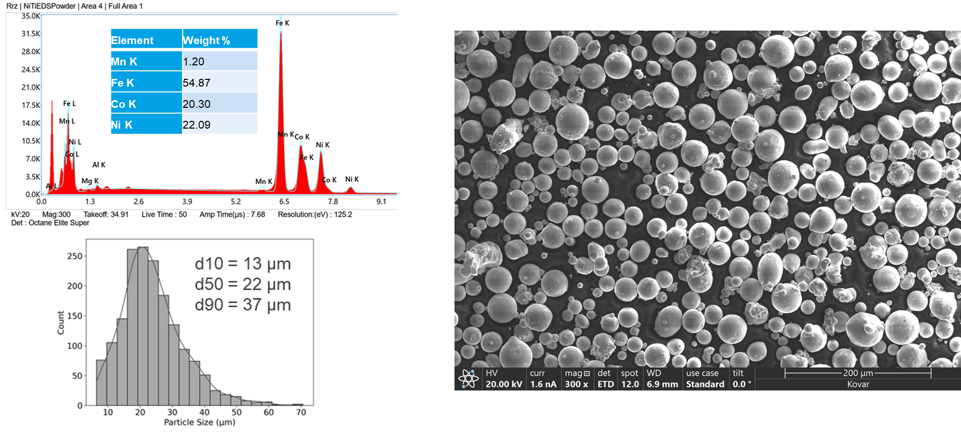
CSEM objectives for AIDAinnova WP10
Phase 1
  Benchmarking for AM grade powder
  Development of process parameters
Phase 2
  Same investigation as Al-12-Si but on a limited number of samples
  KOVAR: Fe-29-Ni-17-Co

Slide 16
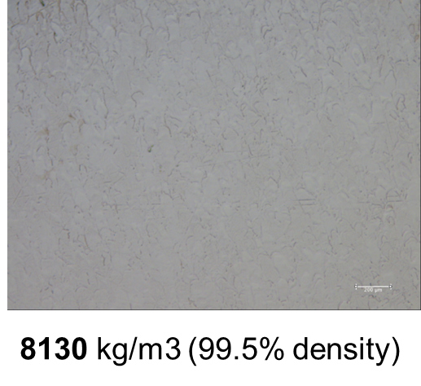
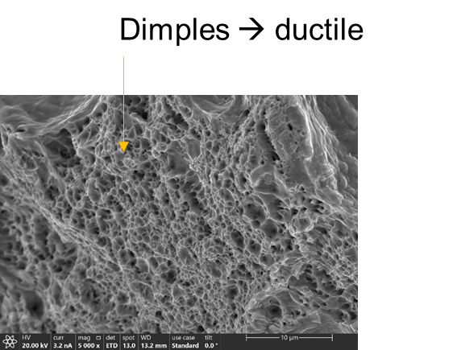
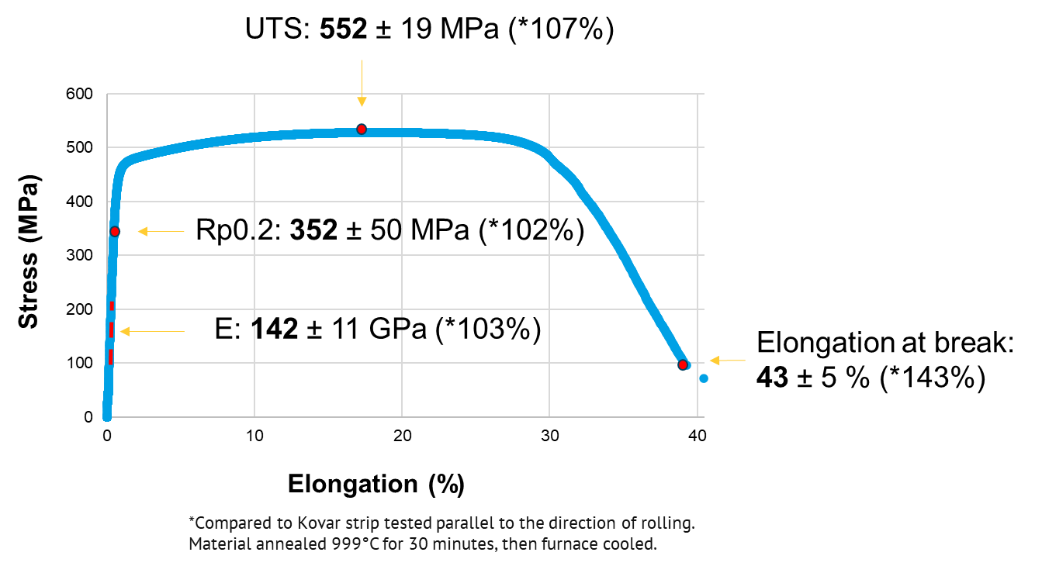
CSEM objectives for AIDAinnova WP10
Phase 1
  Benchmarking for AM grade powder
  Development of process parameters
Phase 2
  Same investigation as Al-12-Si but on a limited number of samples
  KOVAR: Fe-29-Ni-17-Co

Slide 17
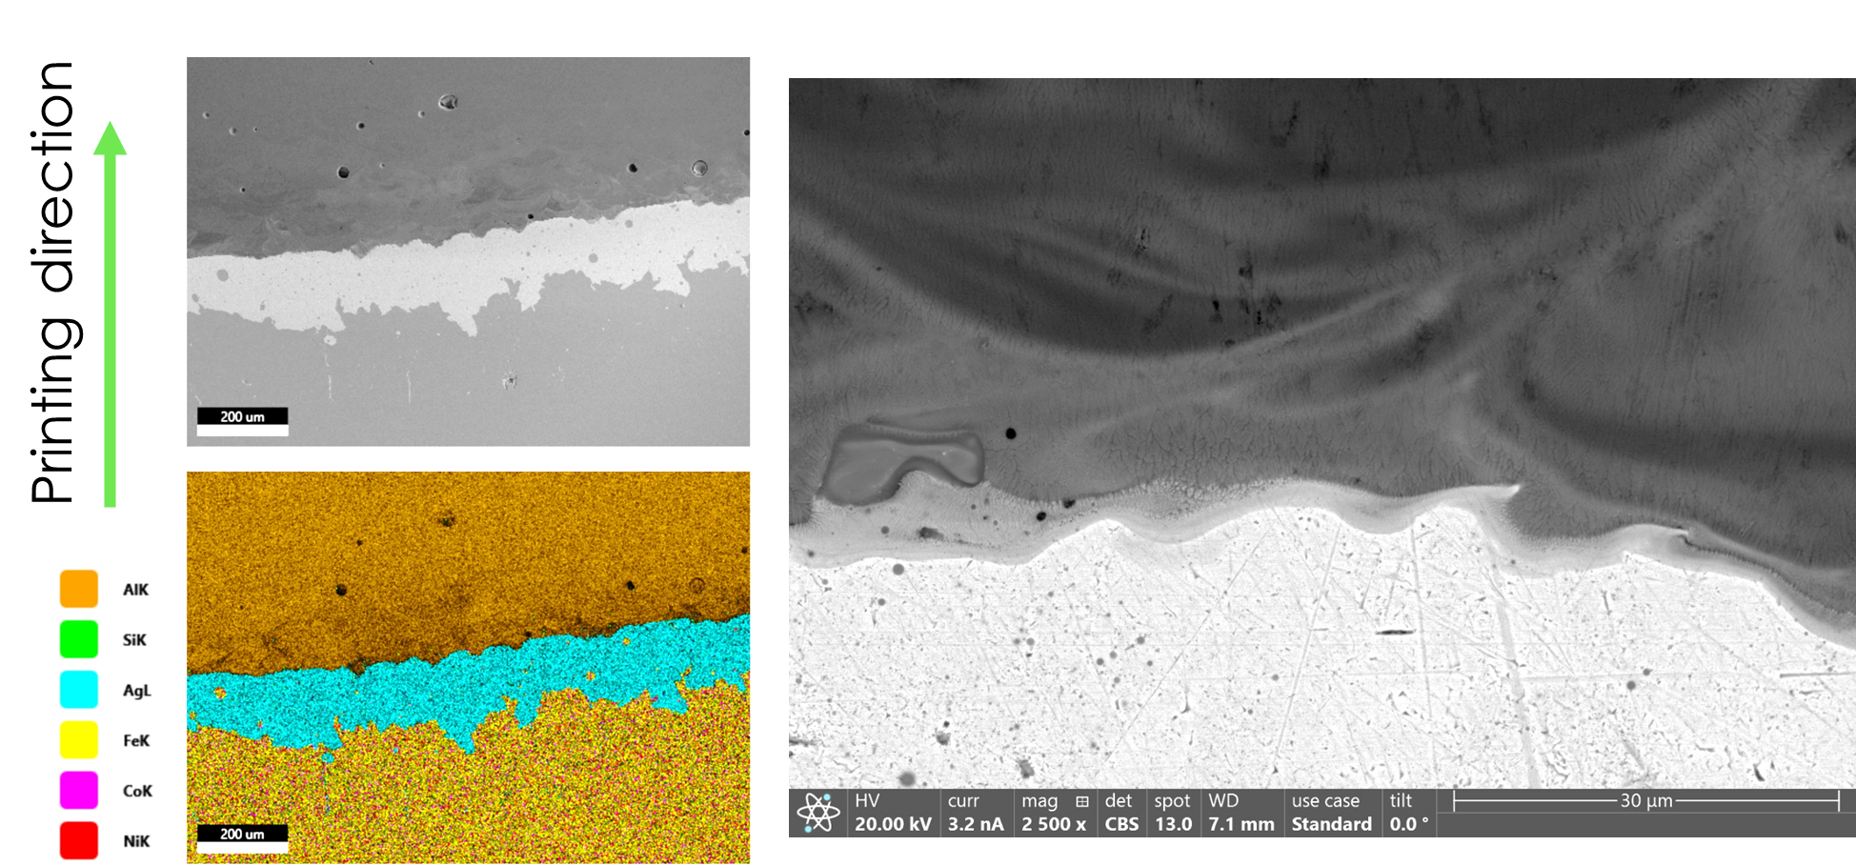
CSEM objectives for AIDAinnova WP10
Phase 1
  Benchmarking for AM grade powder
  Development of process parameters
Phase 2
  Same investigation as Al-12-Si but on a limited number of samples
  Joint feasibility between aluminium and kovar
  µCT scan + Thermal cycling
  KOVAR: Fe-29-Ni-17-Co

Slide 18
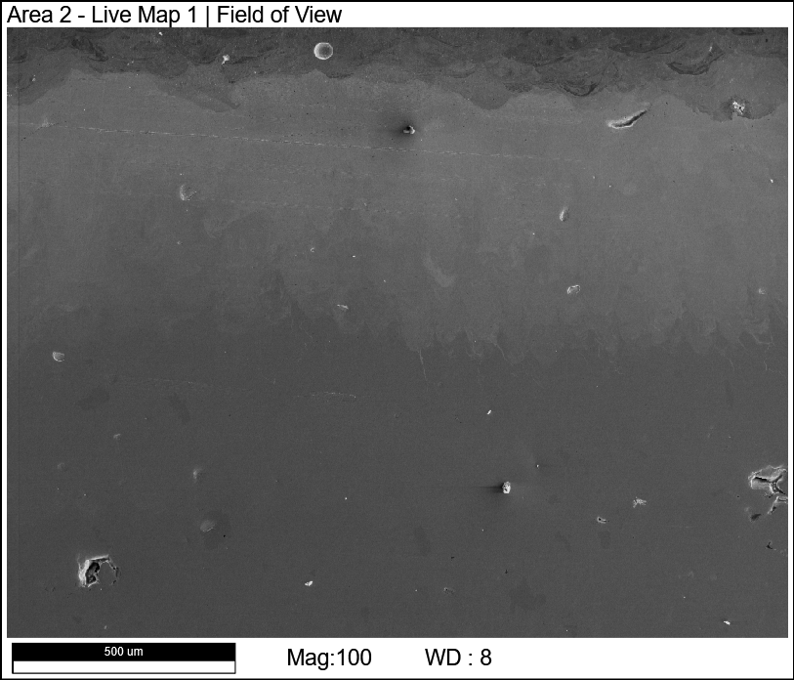
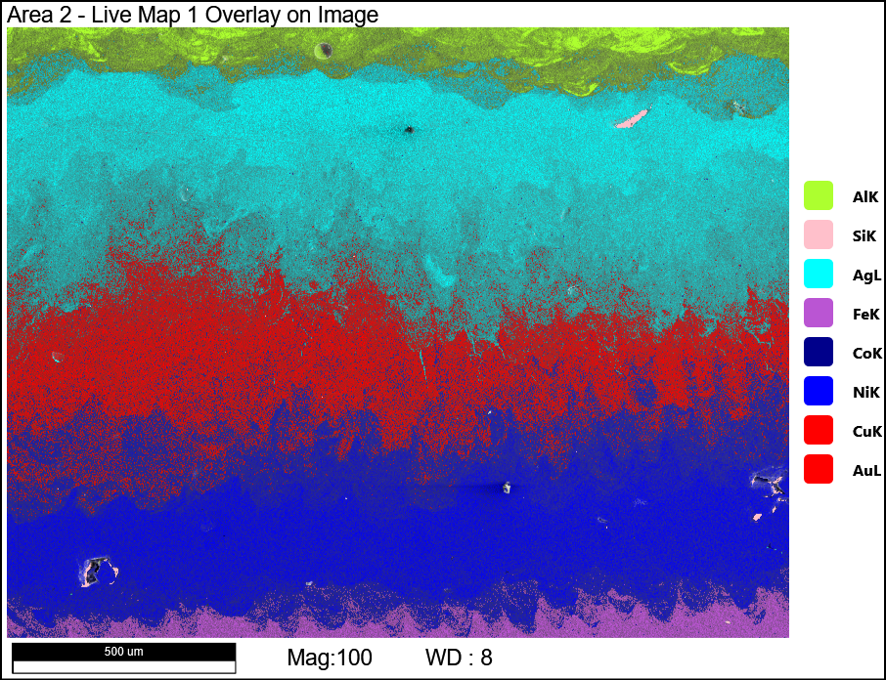
Multimaterial printing to join kovar & alu
Printing direction
SEM
EDX Mapping

Slide 19
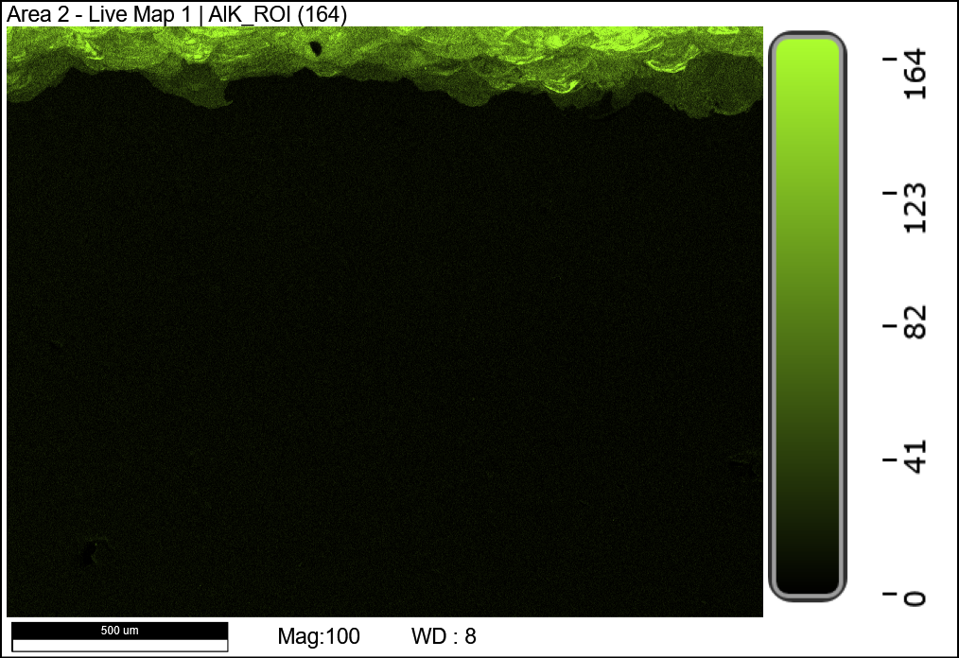
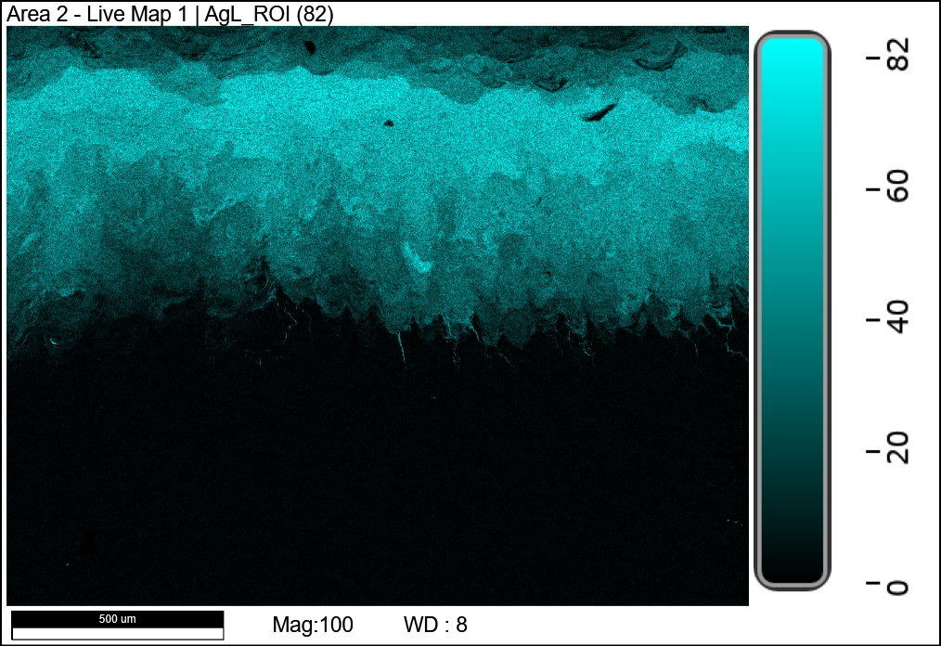
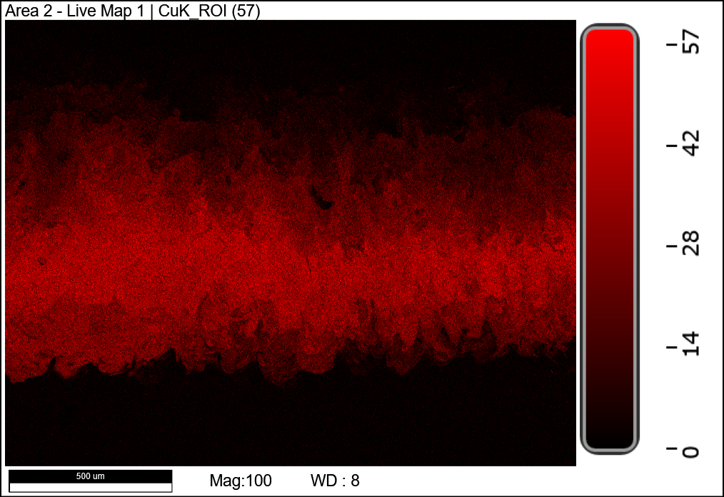
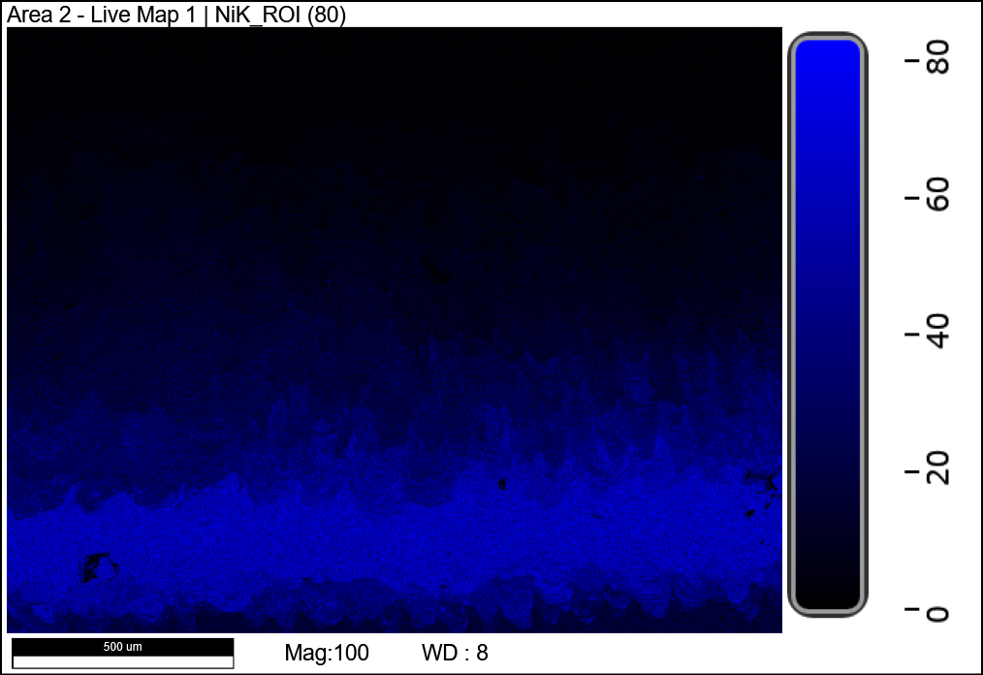
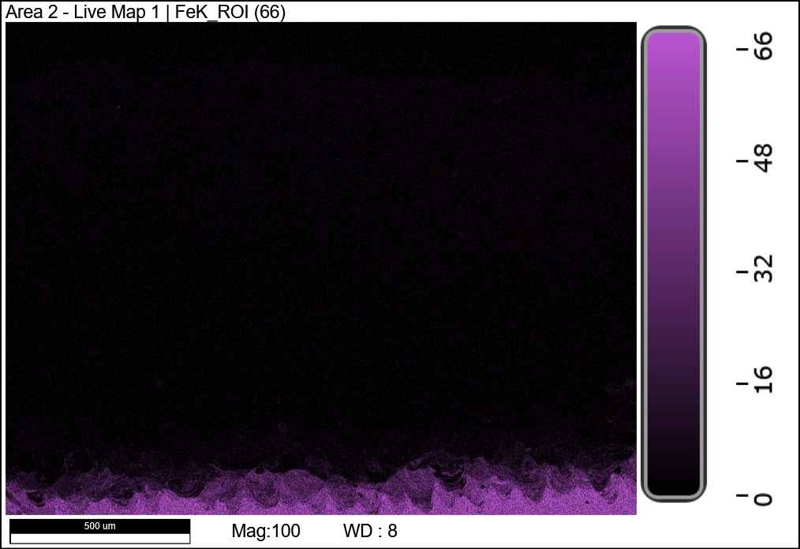
Multimaterial printing to join kovar-alu
Al
250 µm
CTE increasing
Printing direction
Kovar (Fe)

Slide 20
Conclusion
Al-12-Si
  Material properties has been characterized
  Minimum leak-tight wall thickness has been discovered
  Minimum ratio (D/L) for powder removal on straight pipes & 180 degree-bent pipes has been discovered
Kovar
  Benchmarking for AM grade powder has been done
  Process parameters has been developped
  Joint feasibility between aluminium and kovar has been demonstrated
  Joint reliability under investigation

