Slide 1


Development of integrated silicon micro-channel technologies for sensor cooling at CNM-Barcelona
Miguel Ullán, Javier Fernández-Tejero, André Dias
Marta Duch, Roser Mas
…and the invaluable contribution of the personnel of IMB-CNM’s Micro-Fabrication Facility.
In collaboration with:

Slide 2
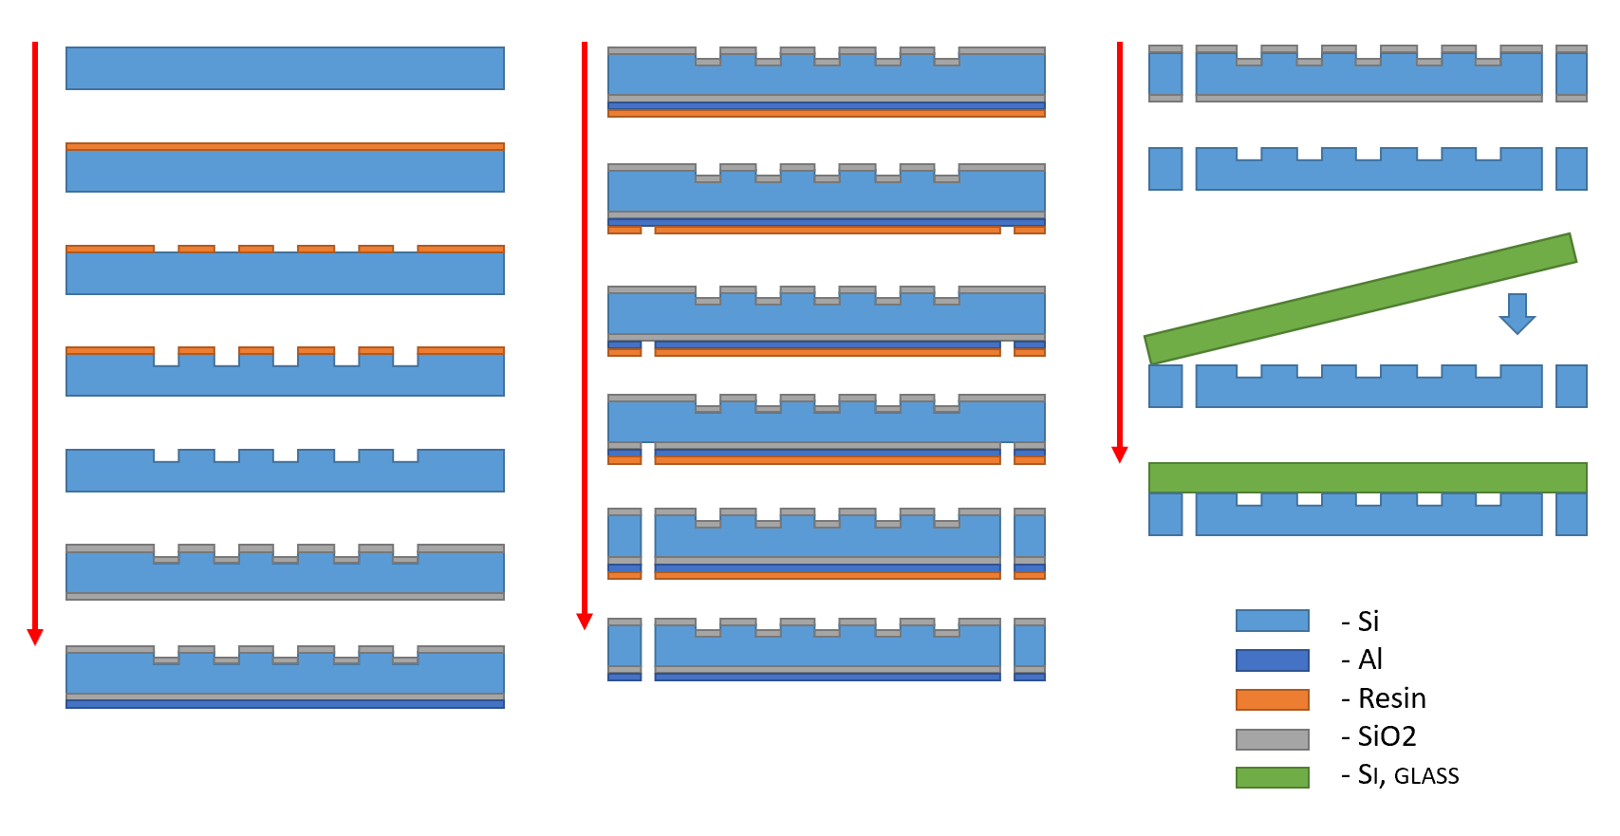
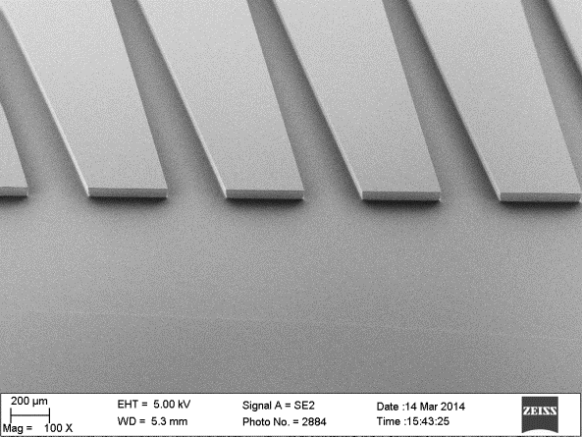
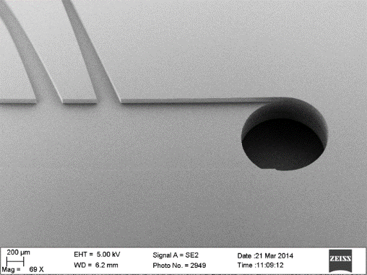
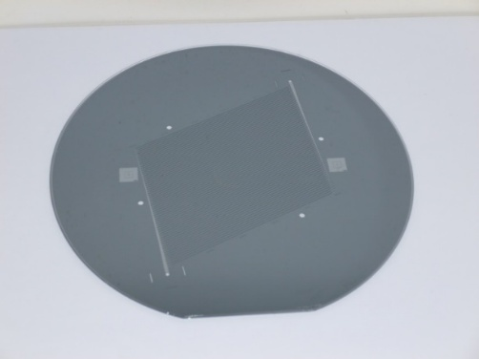
Initial Microch. Technology
Technological steps for embedded micro-channels at CNM

Slide 3
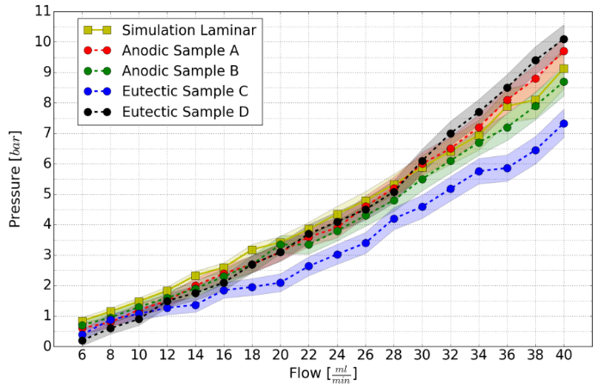
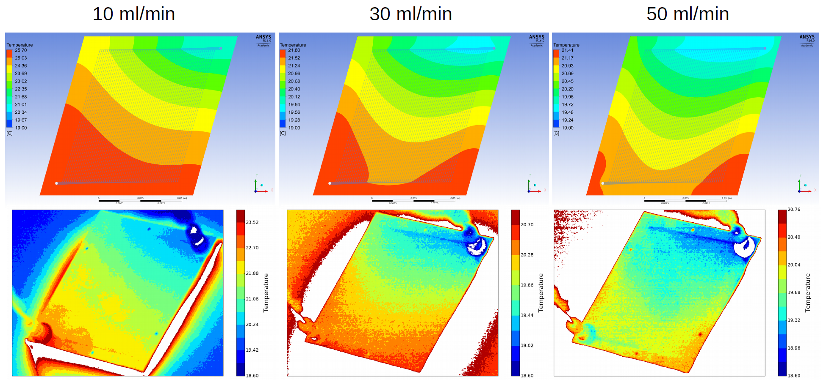
Fluidic & Thermal Assessment
Previous results on fluidic and thermal tests
  Laminar flow
  Thermal homogeneity across the sample (6x5 cm²)
  < ±1 ºC (for lowest flow rate)

Slide 4
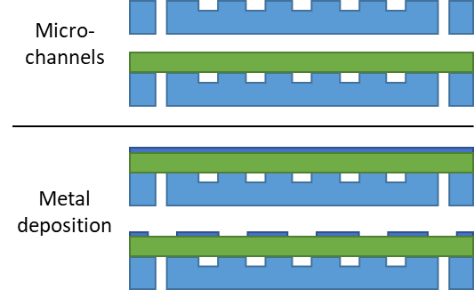
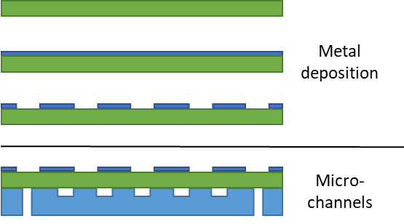
Objectives
Integration of microchannels in silicon plates with integrated signal and power routing (RDL)
Wafer-level post-processing to incorporate micro-channels in CMOS sensors
“Pre-Processing”
“Post-Processing”

Slide 5
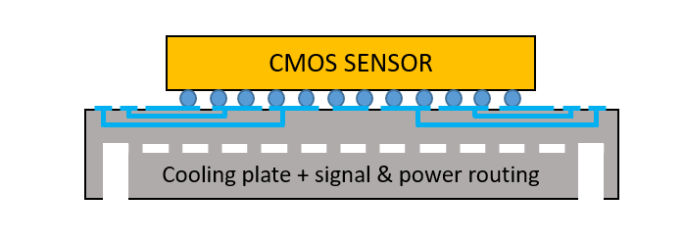
Objective 1 Achieved
Integration of microchannels in silicon plates with integrated signal and power routing
  Combining the cooling capabilities with the electrical connection of the CMOS detector
    For signal and power routing
  Also as mechanical support “All-silicon” ladder

Slide 6
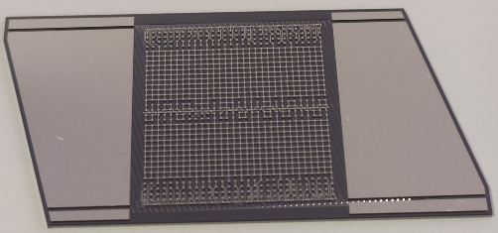
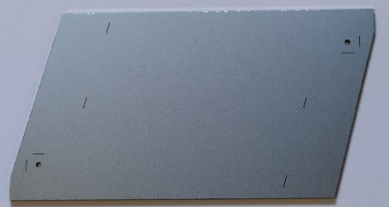
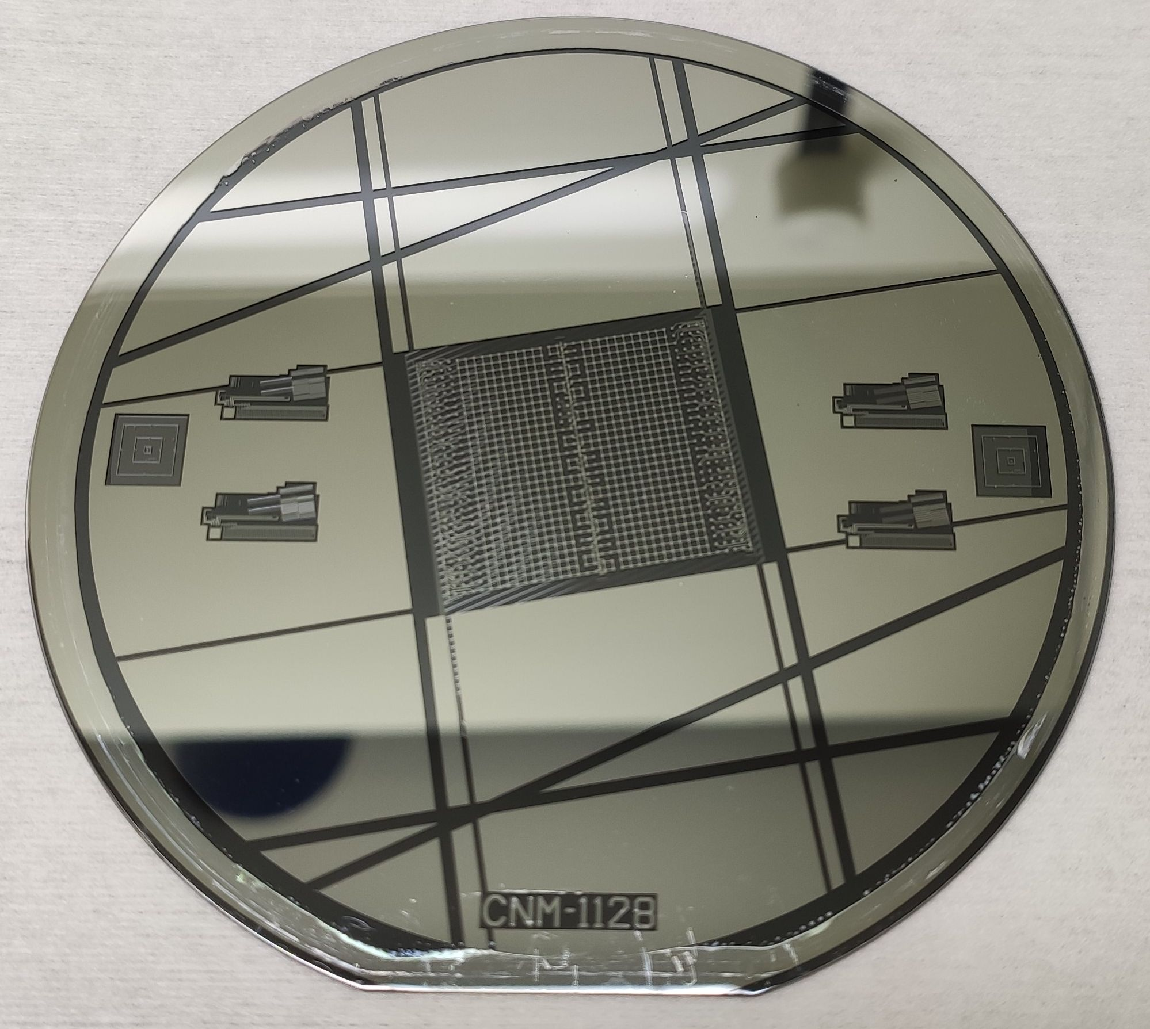
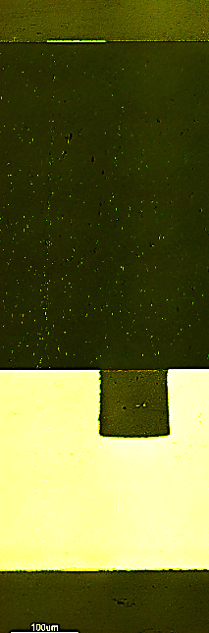
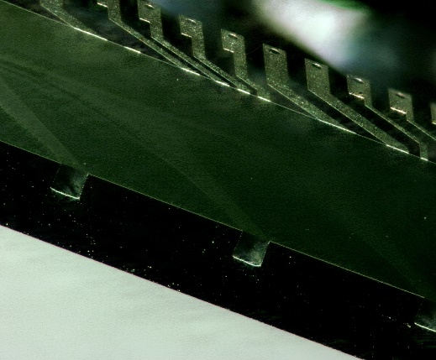
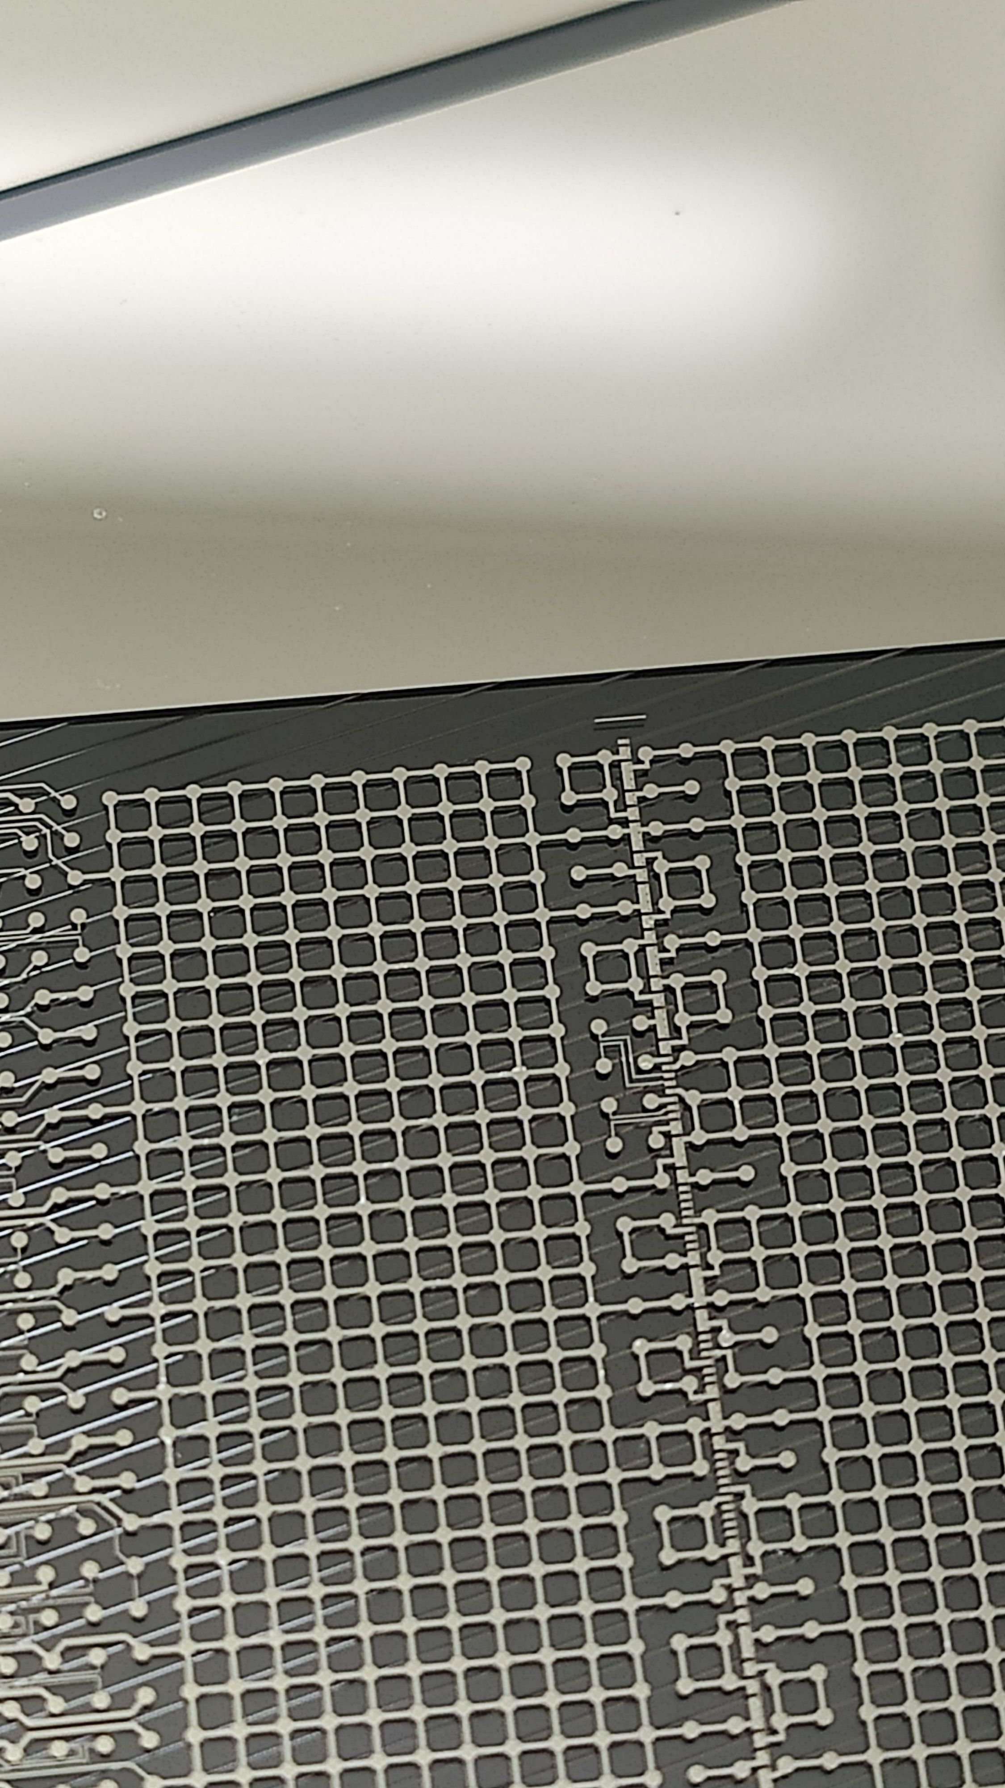
Active Silicon Interposers
Successful integration of microchannels in silicon plates with integrated signal and power routing by “Pre-processing”
  M. Ullán, et al. NIMA, 169490, 2024. https://doi.org/10.1016/j.nima.2024.169490
Front
Silicon plate
Back
Metal tracks
Microchannels

Slide 7
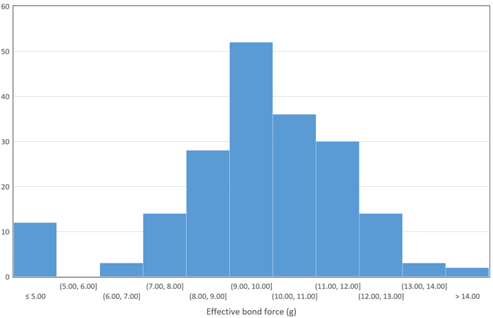
Quality of metal w/ microch.
Bondability tests
  Hundreds of wire-bonds made and pulled on full assemblies
    25 µm Aluminum wire.
    Measure the force at which bond is broken
  Test performed on Pre-processing sample
    Average bond force obtained: 9.5 ± 1.3 g


Slide 8

Adding Eutectic Bonding
Successfull “blanket” eutectic bonding
  Technological adjustments to reach quality eutectic wafer bonding (Au/Si)
  Scanning Acoustic Microscopy (SAM) results;

Slide 9
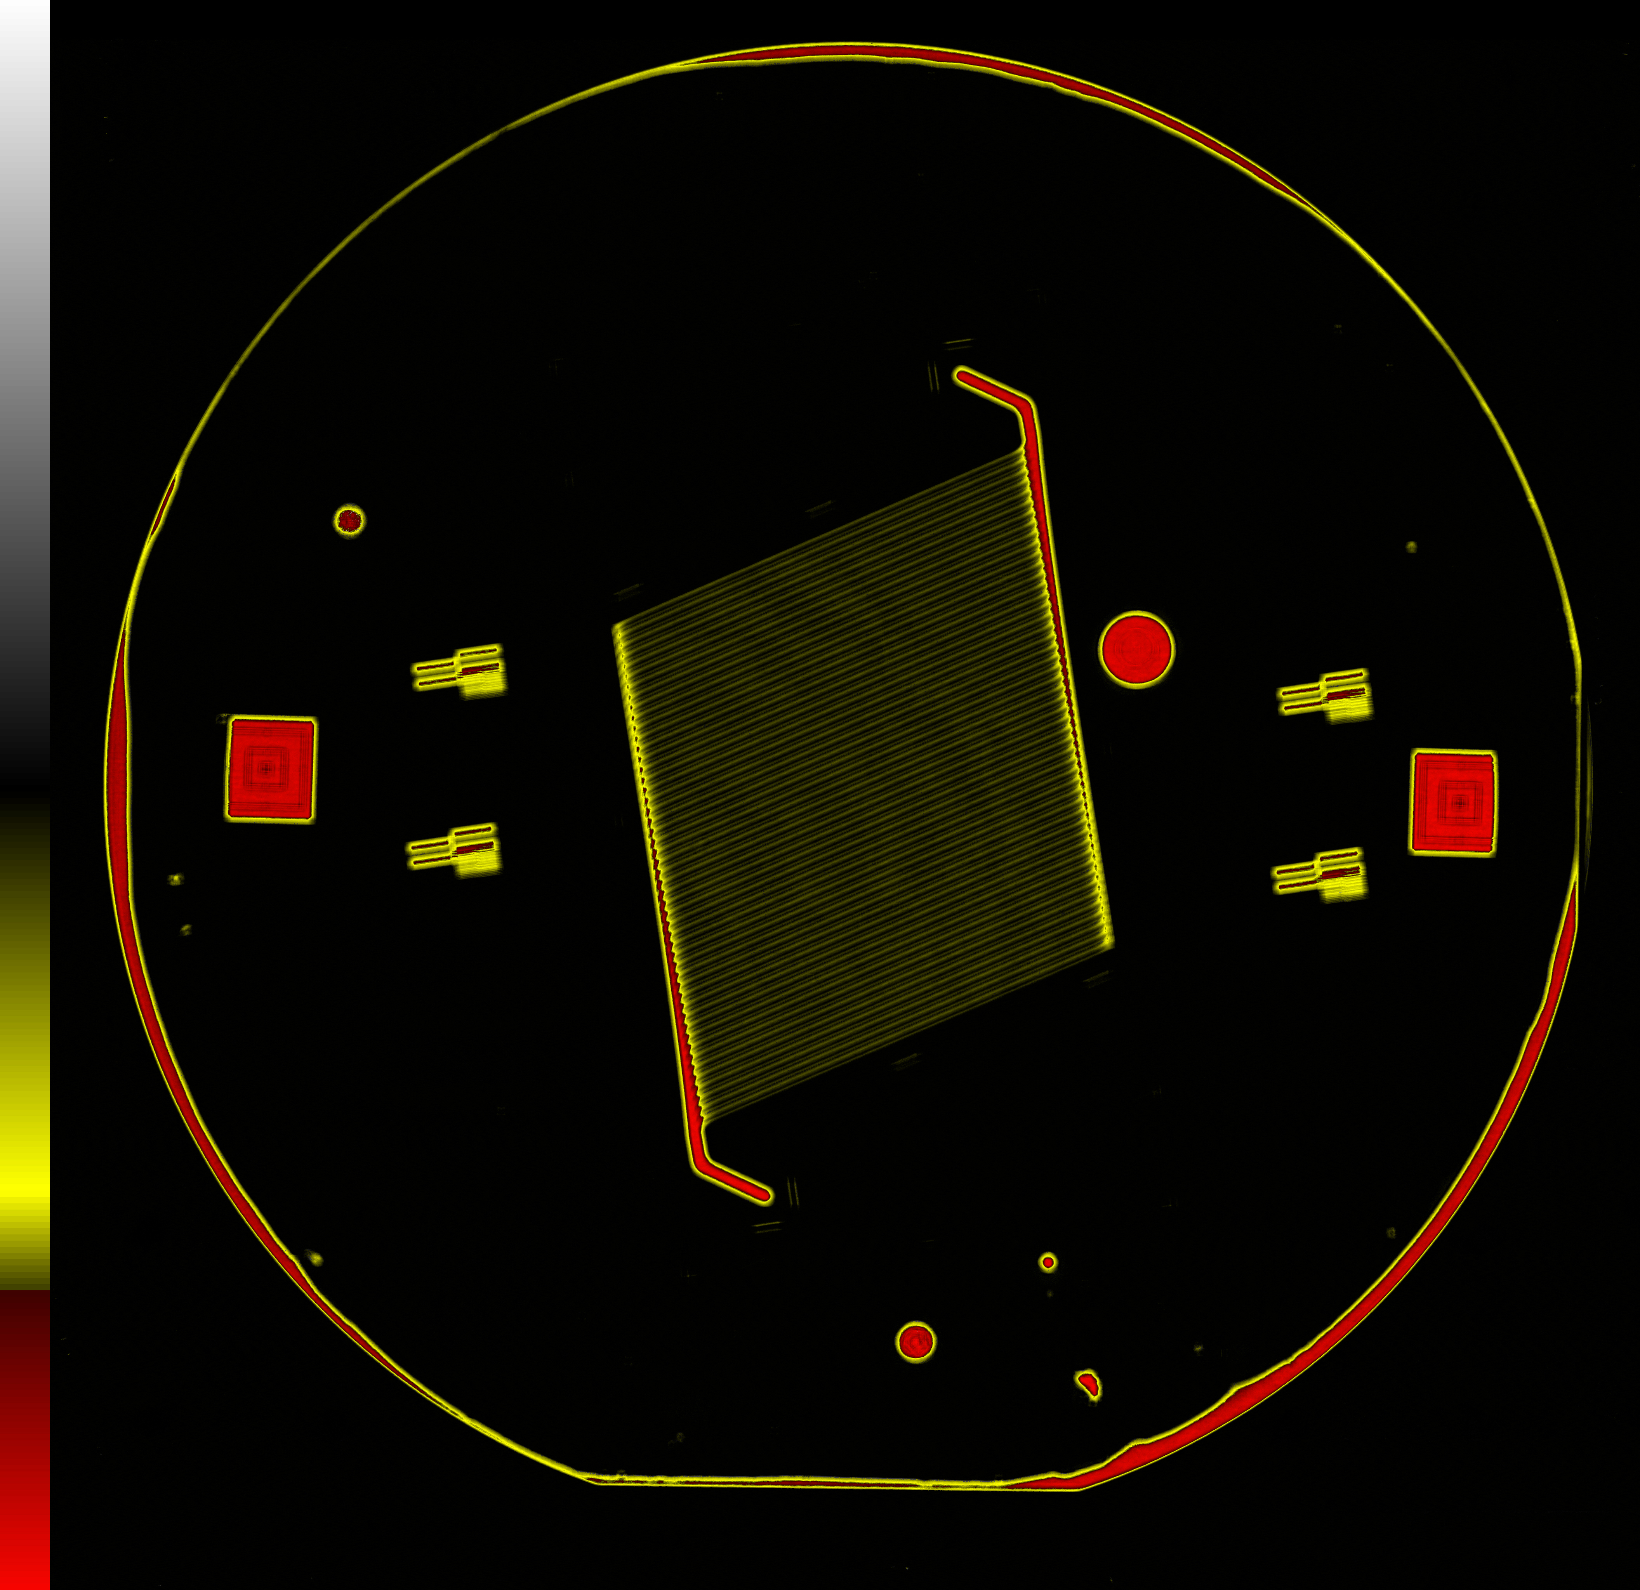
Microch. w/ eutectic bonding
Creation of microchannels using eutectic bonding
  Succesful embedded microchannel creation
  Scanning Acoustic Microscopy (SAM) results

Slide 10
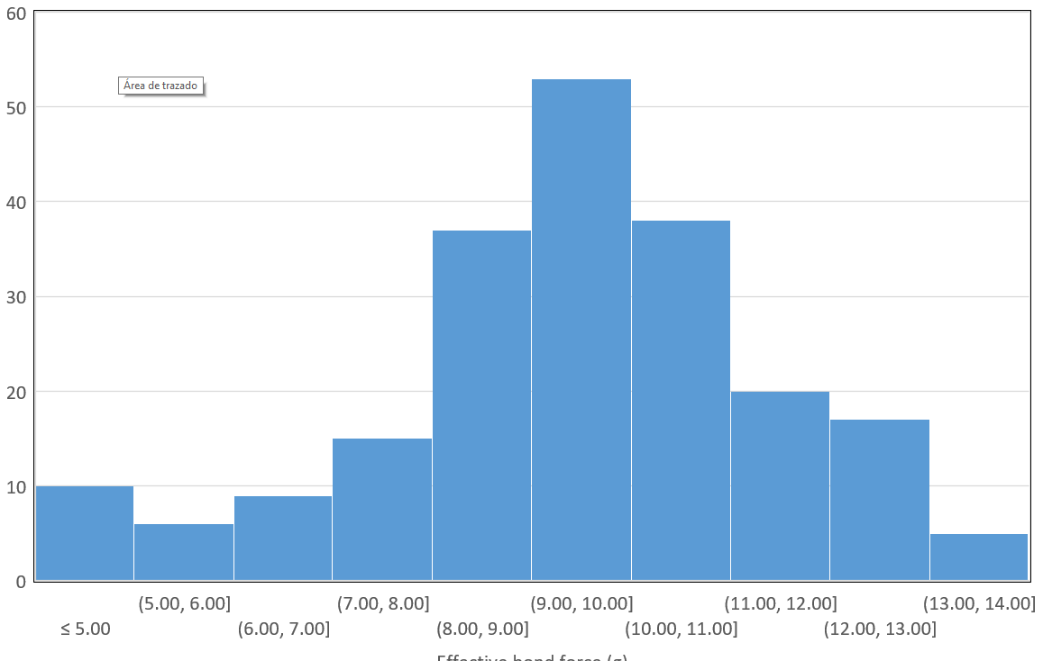
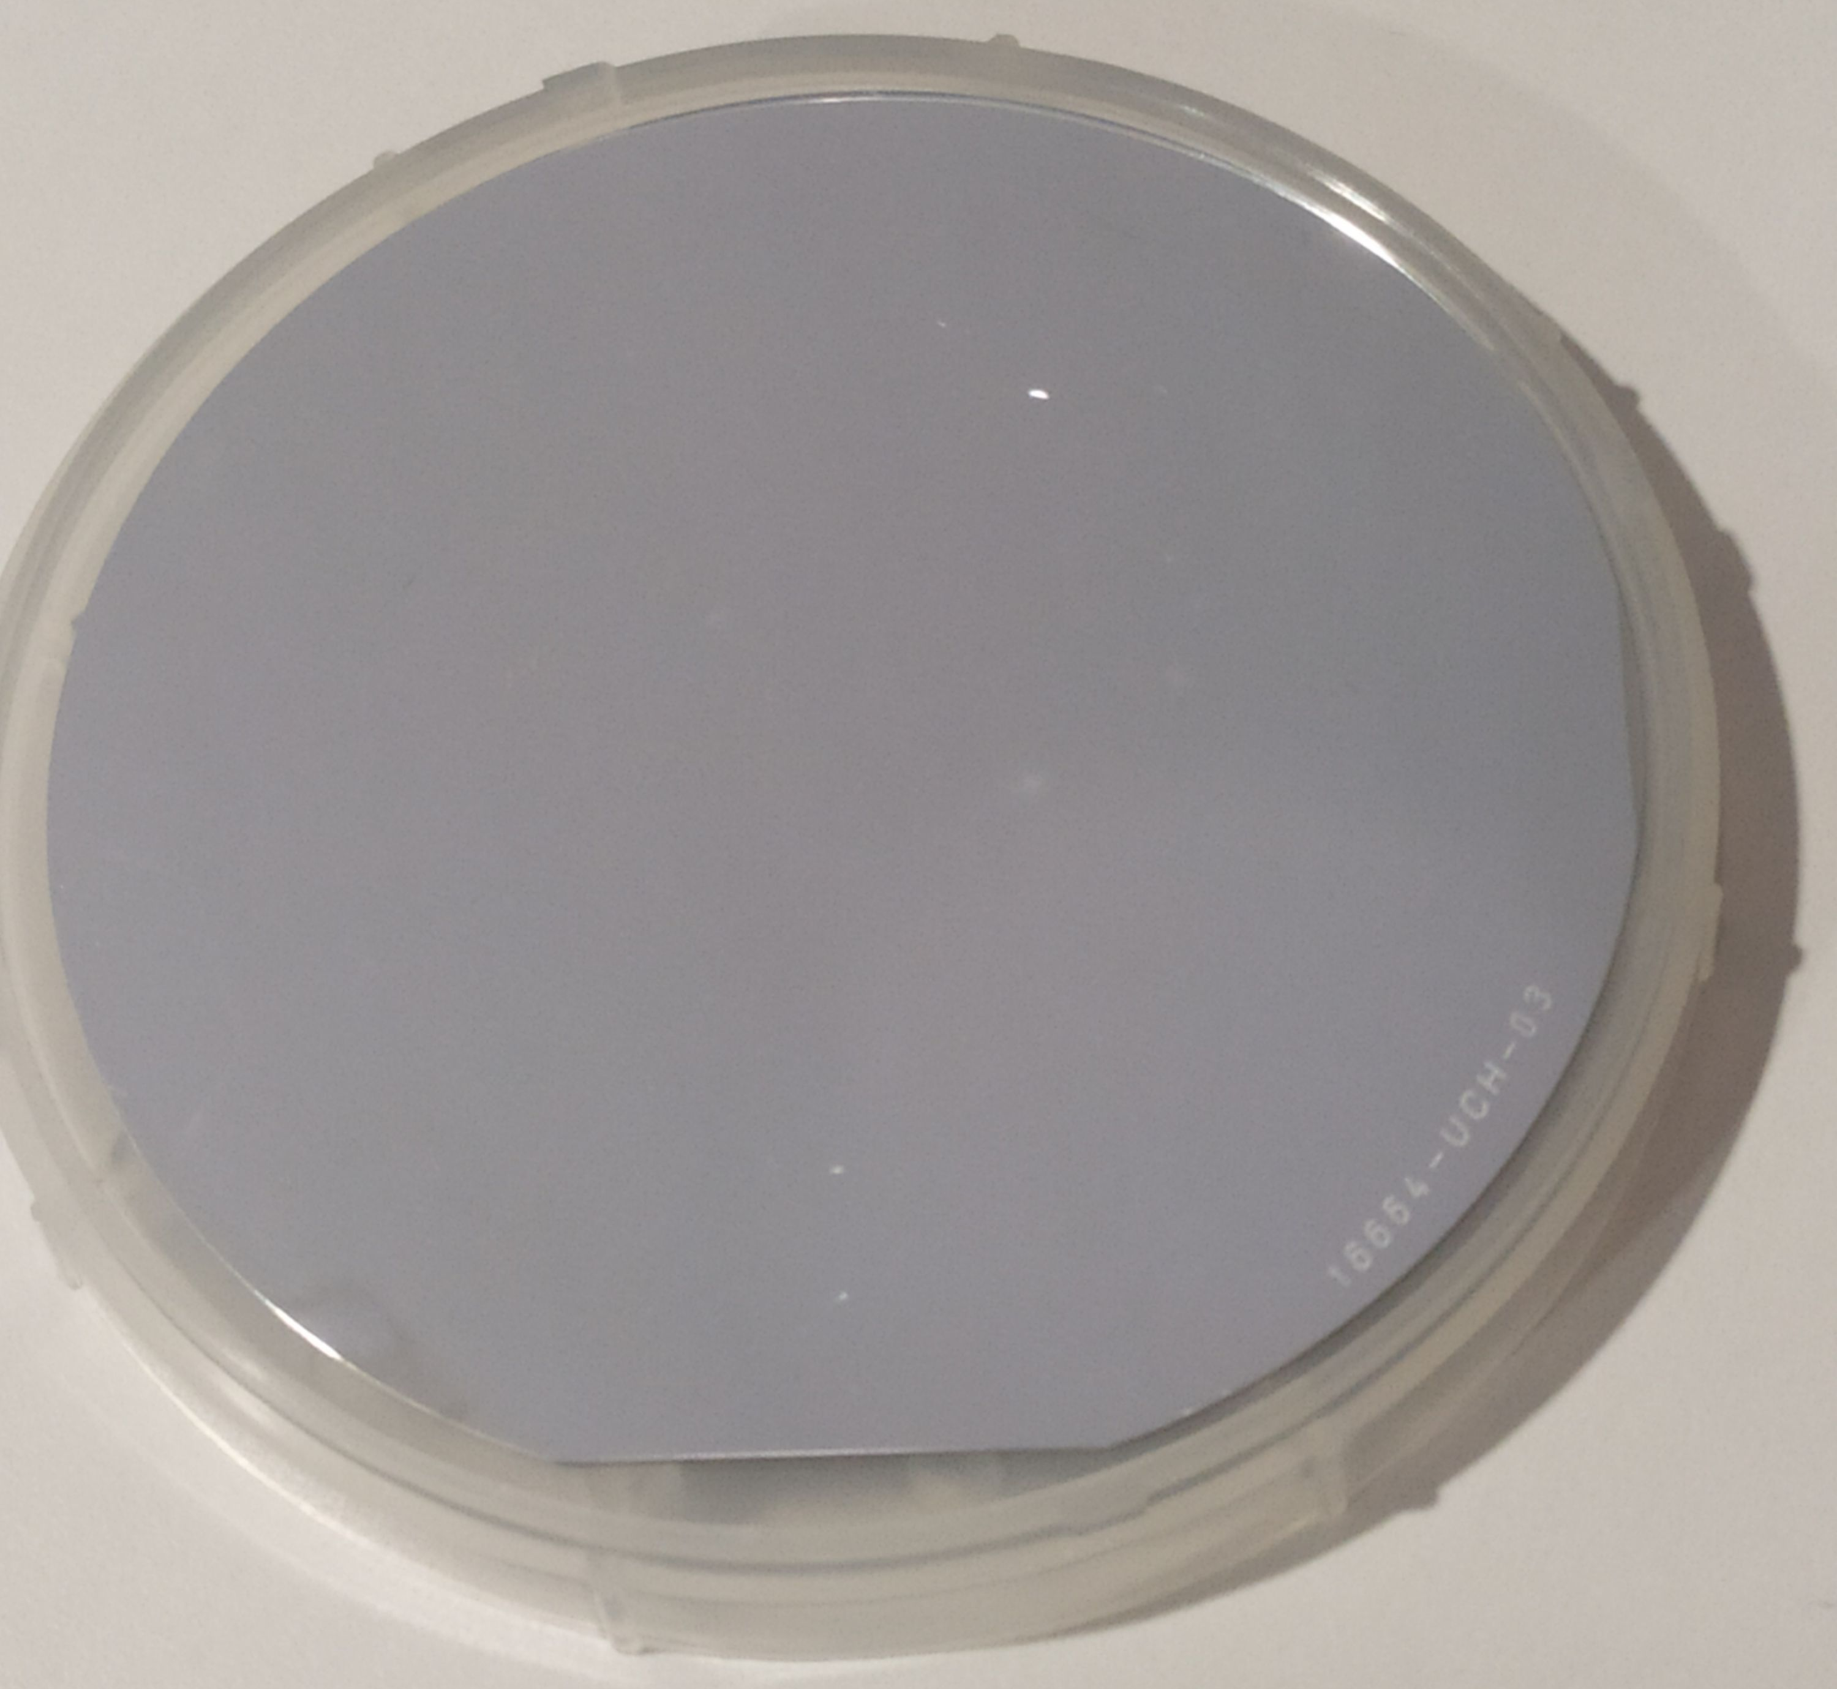
Wafer-level post-processing
Post-processing:
Optimization of metal deposition process
  Sputtering deposition of the metal at high temperature (350 ºC) so the metal is not degraded during the bonding process
    Better metal test results on blanket wafers
  Previous localized problems observed in the metal layer
    Derived from the ion displacement within the glass wafer, inherent to the anodic bonding process
Bondability tests
  Test performed on Post-processed
  blanket assembled sample
    Metal on the silicon wafer
    Average bond force obtained: 9.6 ± 1.8 g


Slide 11
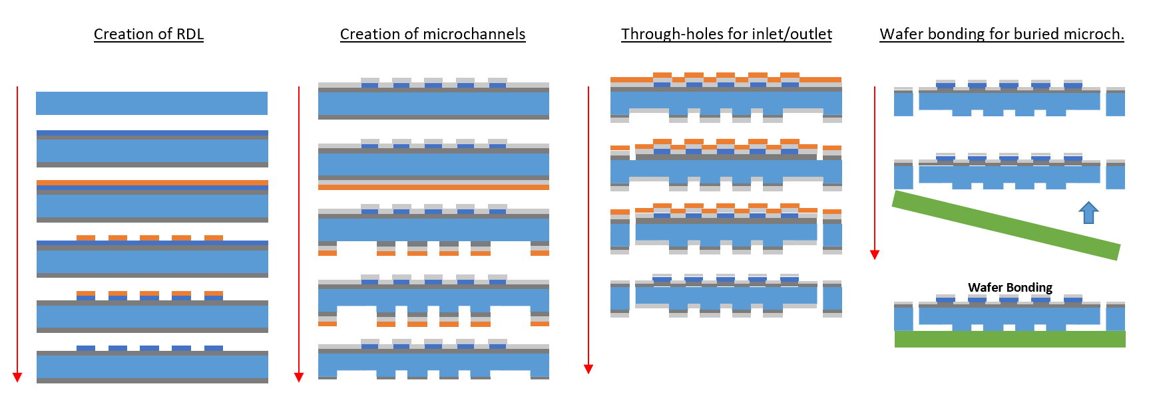
Post-processing Technology
Process modification to deposit the metal on the Silicon side.
  Good metal results in blanket wafers
  Final full assemblies with structured metal (signal and power tracks) on-going
  Demostrator for CMOS integration process → Objective 2
Technological process for CMOS-compatible post-processing

Slide 12
Summary
An initial technology for fabrication of embedded micro-channels in Silicon for cooling has been developed at IMB-CNM
  Anodic bonding
  Eutectic bonding
Successful fabrication of ‘pre-processing’ active interposers with microchannel cooling and integrated signal and power routing (→ paper)
Demonstrated wafer-level ‘post-processing’ to incorporate micro-channels in CMOS sensors
A fruitful collaboration established with DESY and IFIC for these developments with productive complementarity among the institutes
On-going work:
Full silicon interposers to be fabricated with post-processing
Eutectic bonding apraisal
Working on further integration of microchannel cooling for a full system
  Post-processing with Aluminum layer as a key step
  Full monolithic integration with CMOS sensors
    Anodic or eutectic wafer bonding

Slide 13
Thank you

