Slide 1
4th Annual Meeting
Thursday, 8 May 2025
Prague
WP7: Gaseous Detectors
Silvia Dalla Tore (INFN-Trieste), Burkhard Schmidt (CERN)

Slide 2
Objectives
The Goal of WP7, Gaseous Detectors:
The aim of the activities of WP7 is to advance gaseous detectors for instrumenting large areas and volumes to match the challenging requirements of future experiments in terms of resolution, timing, rate capability and radiation hardness.
The pursued technologies are RPCs, MPGDs for muon systems or hadron calorimeters, drift chambers, high-pressure TPCs for long-baseline neutrino experiments and Ring Imaging Cerenkov detectors for particle identification.
The work includes the construction, with industrial partners, of small prototypes and their test, the study of new materials such as diamond-like carbon and the search for eco-friendly gas mixtures.

Slide 3
Task Overview
Task 7.1: Coordination and Communication (S. Dalla Torre, BS)
Task 7.2: RPC sector 3 tasks
                - 7.2.1: Multi-gap RPCs (MRPCs) for fast timing (C. Williams)
                - 7.2.2: Shower development in SDHCAL (Mary-Cruz Fouz)
                - 7.2.3: Eco-friendly gas mixtures for RPCs (B. Mandelli, D. Piccolo)
                Task 7.3: MPGD sector, Technology and engineering 2 tasks
                - 7.3.1: Development of resistive electrodes for MPGDs (P. Verwilligen)
                - 7.3.2: Industrial engineering of high-rate μ-RWELLs (G. Bencivenni)
                Task 7.4: Large volume gaseous detectors 2 tasks
                - 7.4.1: A 4-channel electronic board for cluster counting (F. Grancagnolo)
                - 7.4.2: High pressure gas TPC for neutrino physics (X. Lu, D. Gonzalez Diaz)
Task 7.5: PID sector 1 task
- Photon detectors for hadron Particle ID at high momenta (S. Dalla Torre)

Slide 4
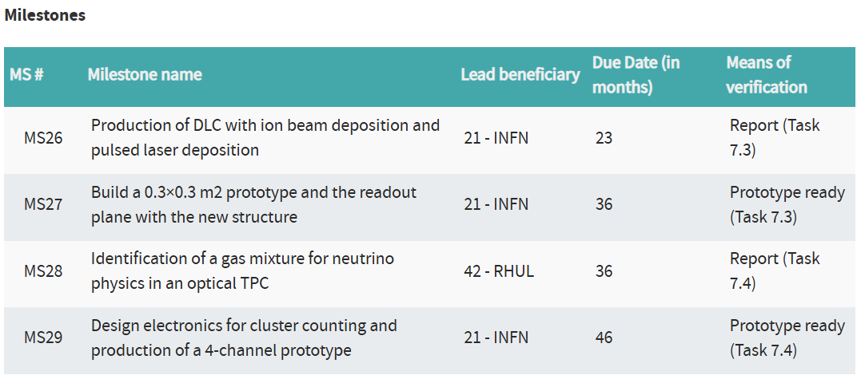
Milestones & Deliverables
M48
All Milestones have been achieved !
8 May 2025
4

Slide 5
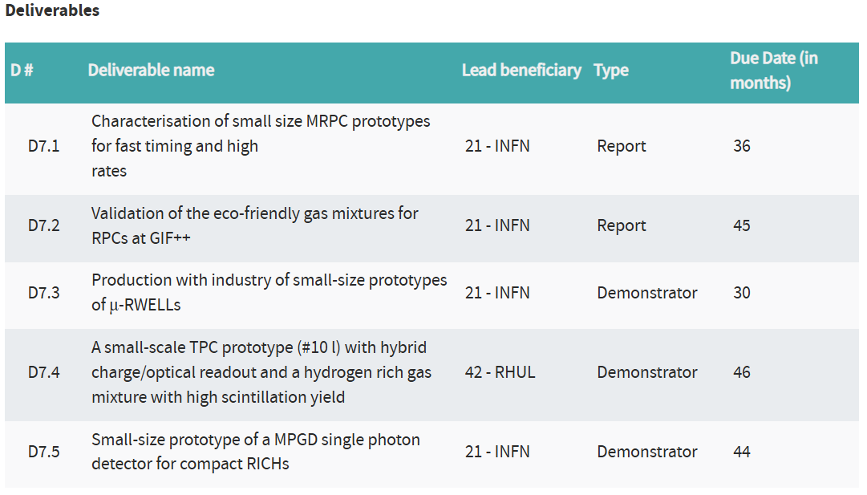
Milestones & Deliverables
M33
M48
All Deliverables have been achieved !
8 May 2025
4

Slide 6
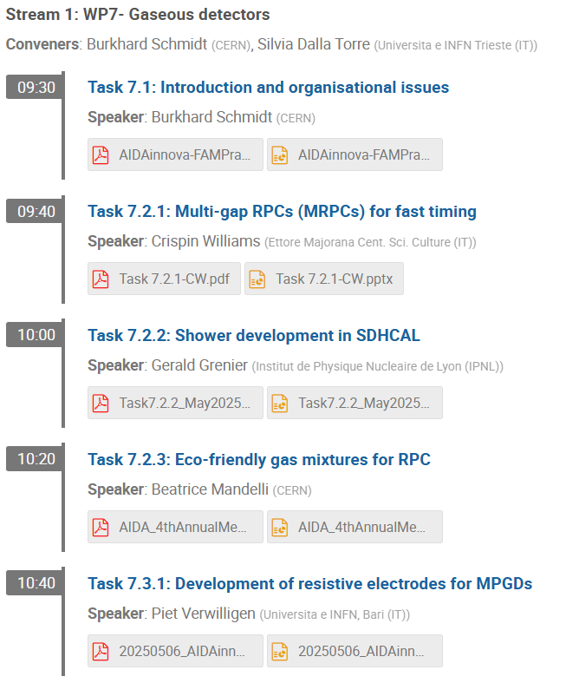
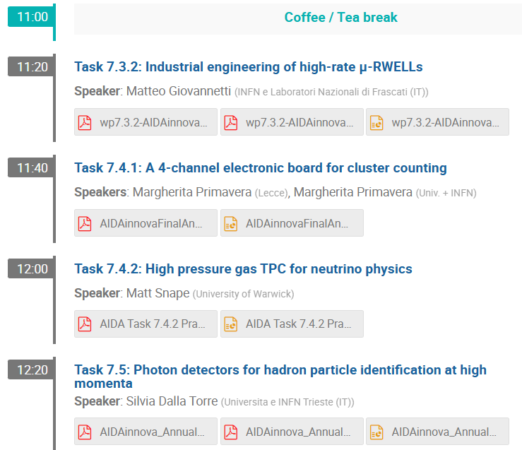
For details, see the presentations in the
parallel session of Tuesday morning
8 May 2025

Slide 7
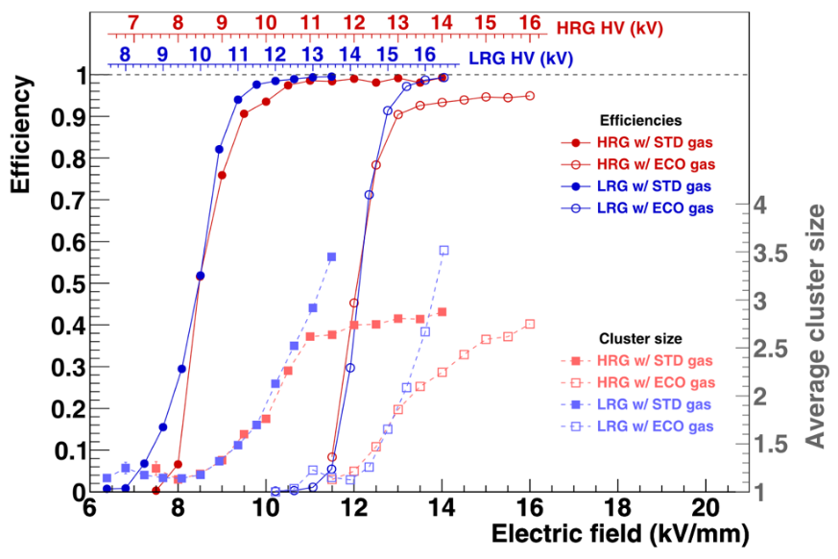
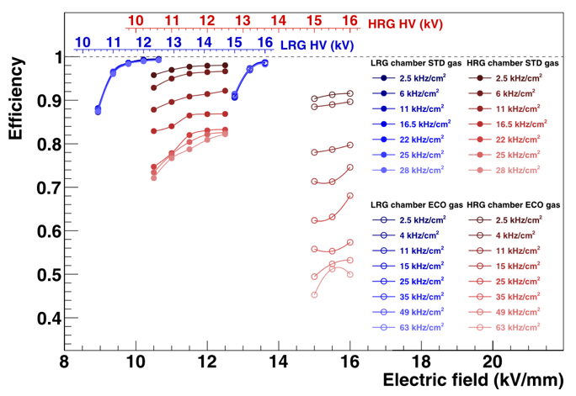
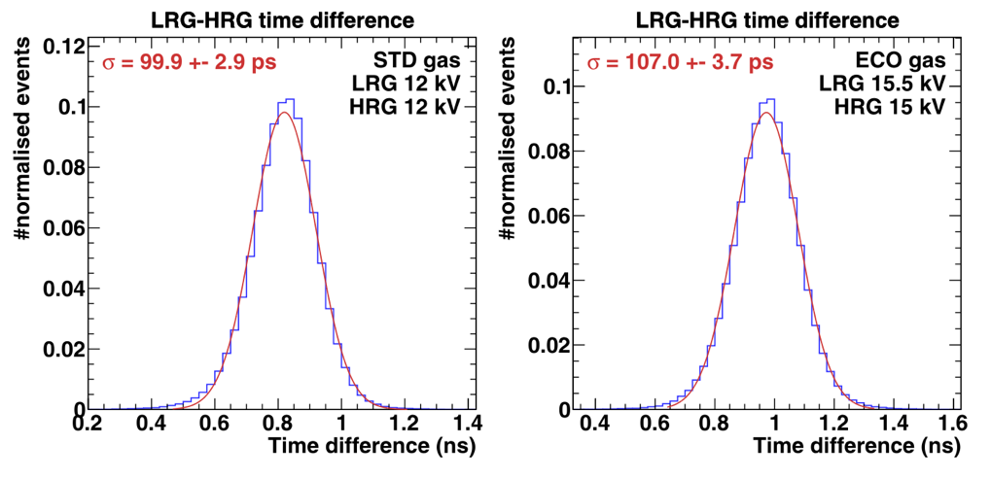
Task 7.2.1: MRPCs for fast timing
MRPC developments for fast timing:
- MRPC with 10 layers and 230μm gaps.
- Glass sheets with low-resistivity (LRG ~10⁹ Ωcm),
and high-resistivity glass (HRG ~10¹² Ωcm) used.
- Standard (98% C₂H₂F₄ 2% SF₆ GWP 2040) and ECO
(100% HFO1234ze GWP 6) gas mixtures were used.
Good performance of LRG, even with ECO gas, but
at much higher voltage (+4kV).
Rate performance with beam spot of 4 cm²
Time resolutions measure: ~100ps

Slide 8




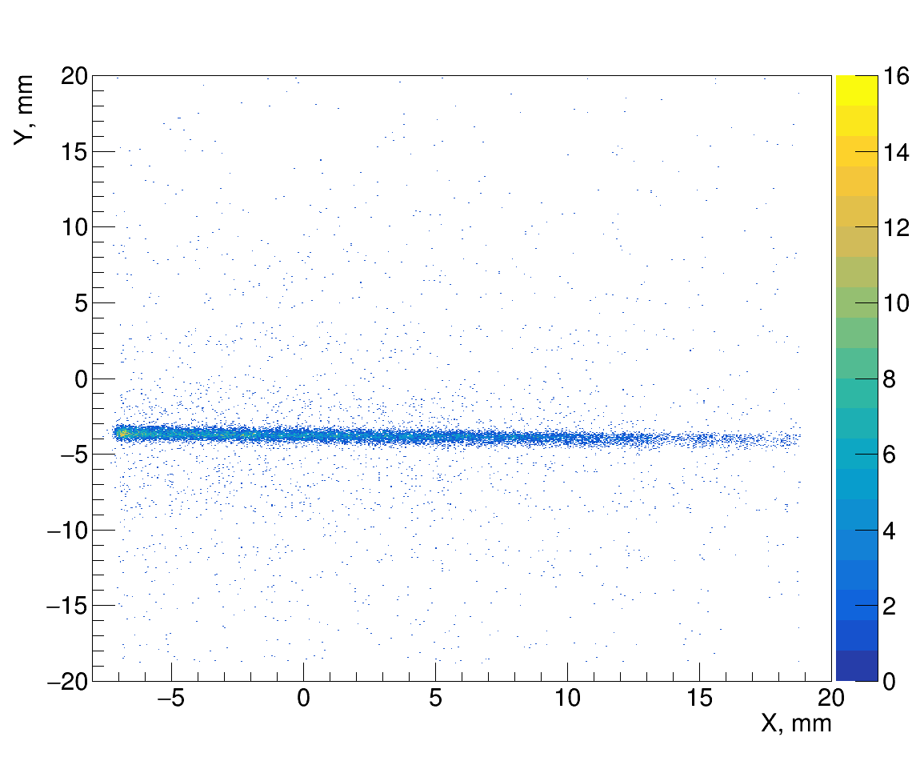
Task 7.2.1: MRPCs for fast timing
Beam collimated by a Cd-Slit & Neutron flux adjusted with plexiglass attenuators
Reconstructed Image
(XY)-2D Map
Detector Collimator

Slide 9
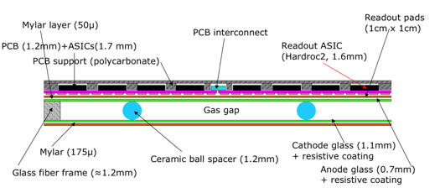
Task 7.2.2: MRPCs for SDHCAL
Task 7.2.2: Shower development in Semi-Digital HCALs
- Detector: GRPC (Glass Resistive Plate Chambers) operating in avalanche mode
GRPC Sketch
- 1x1 cm² pads, Semi-Digital Readout:
2bits - 3 thresholds, counting how many/which pads
have a signal larger than one of the 3 thresholds
- Embedded electronics:
PCB separated from the GRPC by a mylar layer (50μm).
HARDROC (HAdronic Rpc ReadOut Chip) & related connections
General goal: Extend SDHCAL to include timing information (100 - 200ps resolution)
for 5D-calorimetry (space, amplitude & timing)
Implementation: Build small multi-gap RPC (MRPC) equipped with a new version of
electronics with timing capabilities to prove the final performance

Slide 10
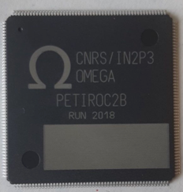
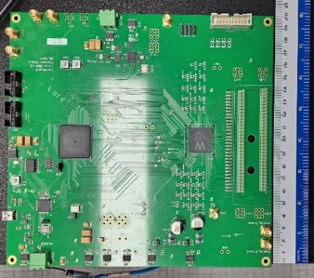
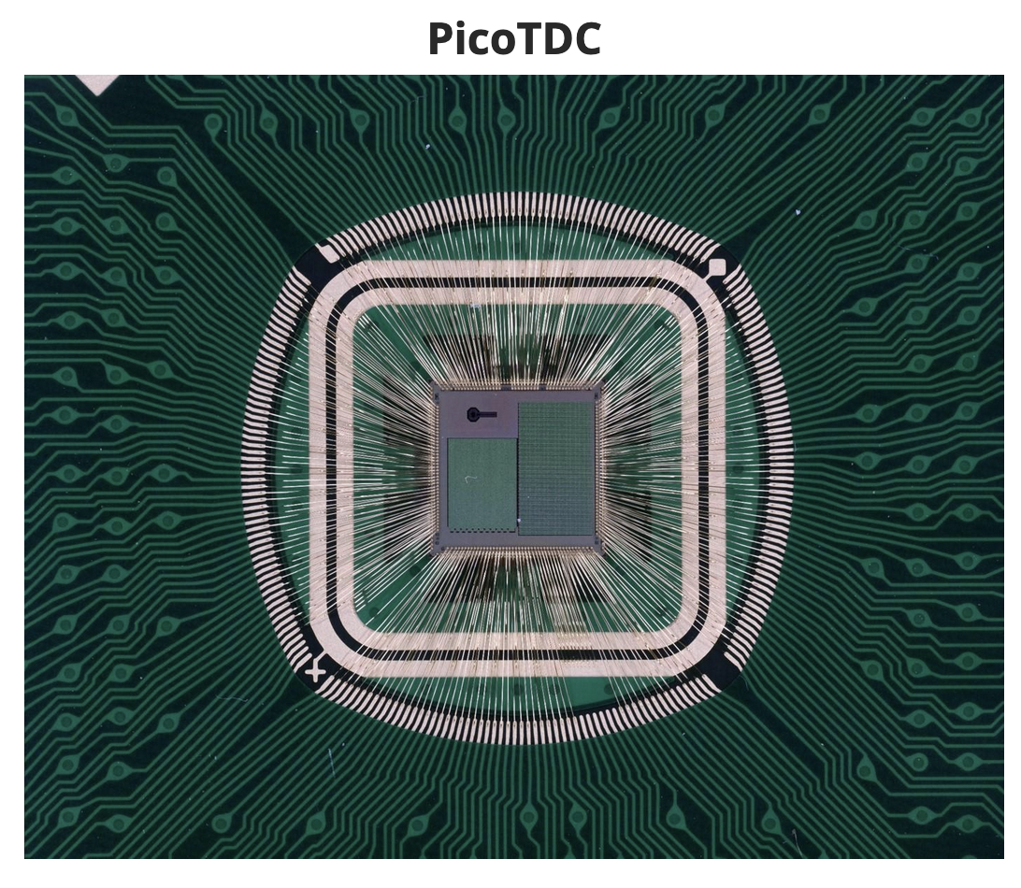
Task 7.2.2: MRPCs for SDHCAL
Task 7.2.2: Electronics for SDHCAL
Baseline ASIC
Other ASICS being or to be used
Petiroc2A/B
NINO
Has some limitations:
difficult to chain, limited digital logic, dead-time
Only for exploring the capabilities.
- ASIC designed for the ALICE MRPC (TOF array)
- 8 channels, Time resoltion ~50 ps
- 32 channels
- on-chip TDC
- Time resolution
below 40ps
LiROC+picoTDC
PETIROC2
ASIC
Board is under development by the WEEROC company
Based on LiROC + picoTDC
64-channel ASIC
64 channel TDC ASIC
Time resolution <12 ps
Developed at CNRS-OMEGA partially thanks to AIDA2020 for CMS-muon upgrade
95.5mm
32mm

Slide 11
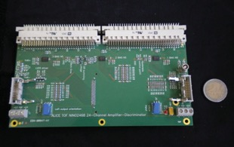

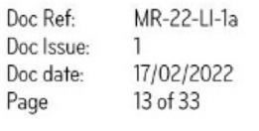

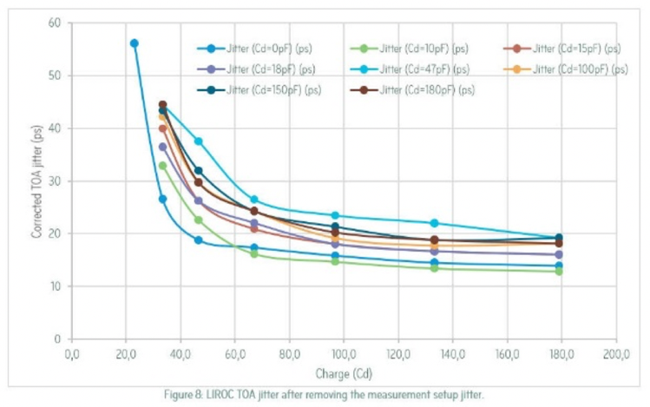
Task 7.2.2: MRPCs for SDHCAL
NINO chip
Time resolution ~50 ps
LIROC chip
Time resolution 12 ps
95.5mm
32mm
LIROC jitter after removing the measurement setup jitter
Progress has been made at GWNU on the development of the LVDS-to-sub-LVDS interface card, which is required to connect the output of the NINO FEE boards to the picoTDC board developed by INFN-Bologna.

Slide 12
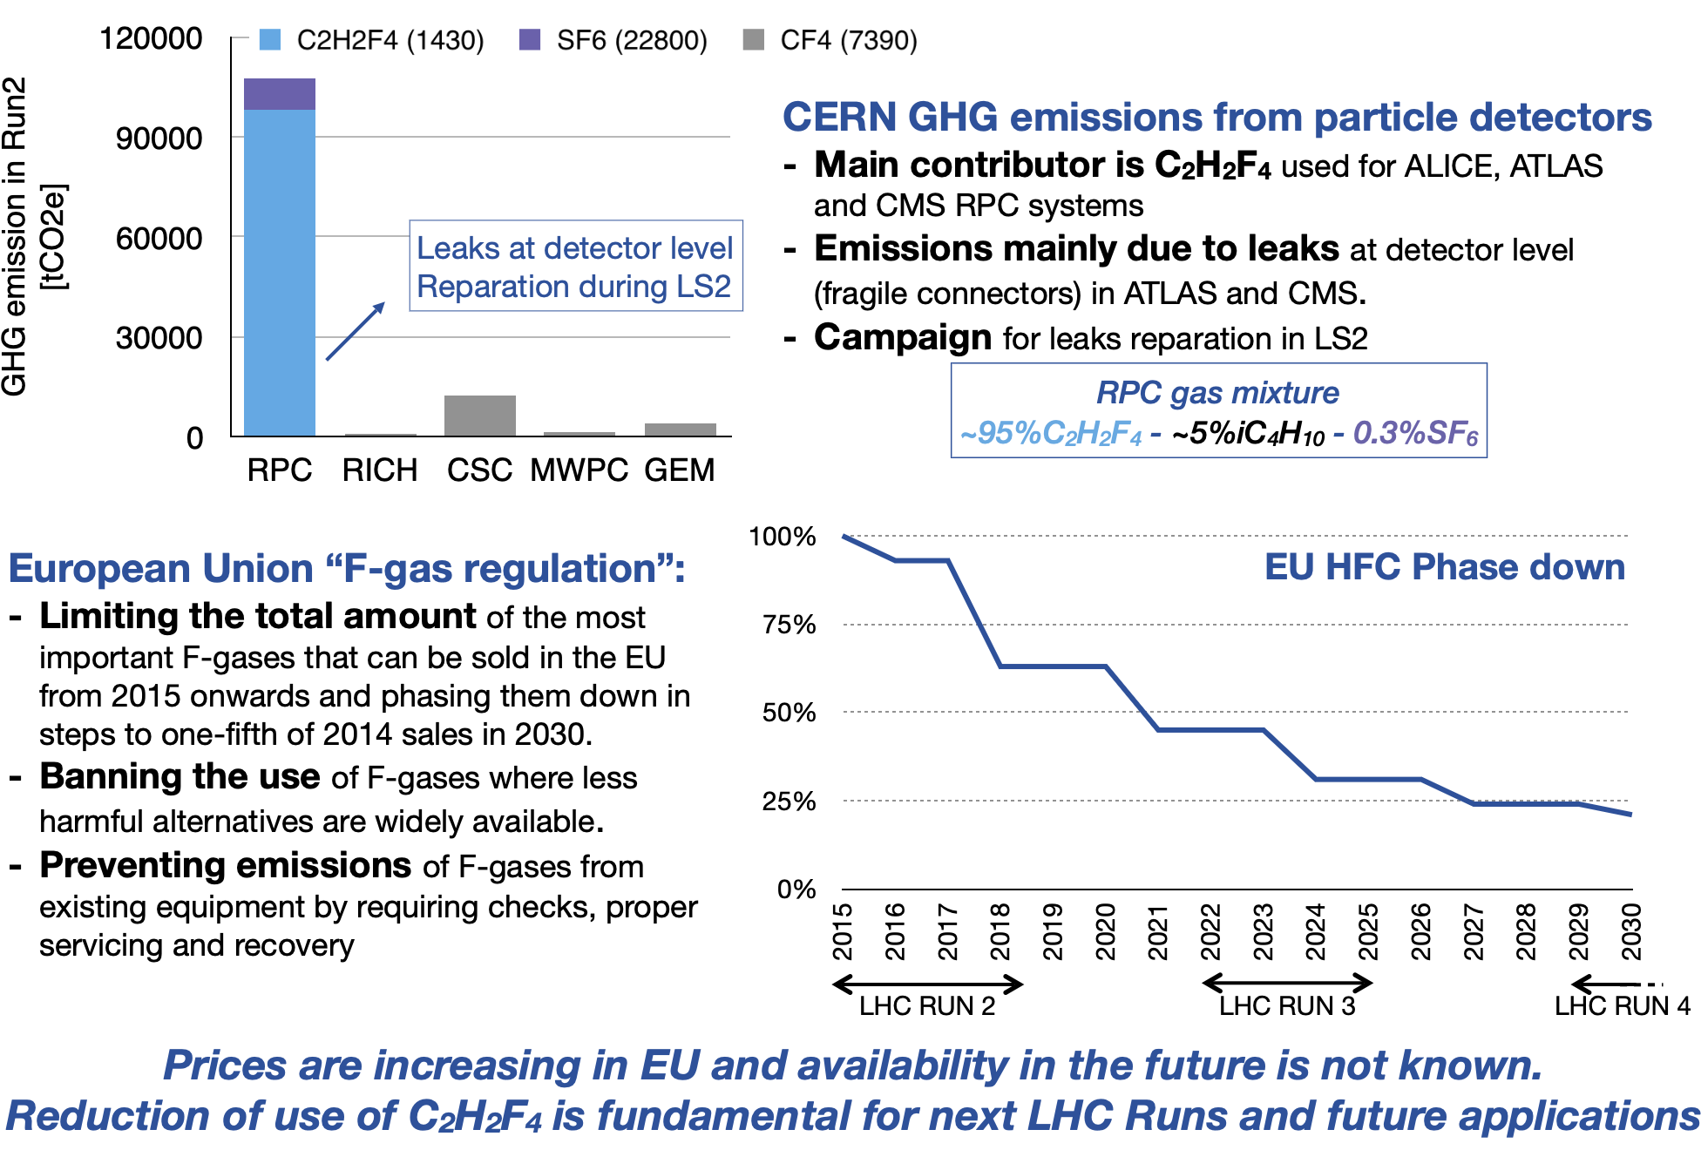
Task 7.2.3:
Eco-friendly RPC Gas Mixtures
EU F-gas 2015
EU-2023 revision

Slide 13
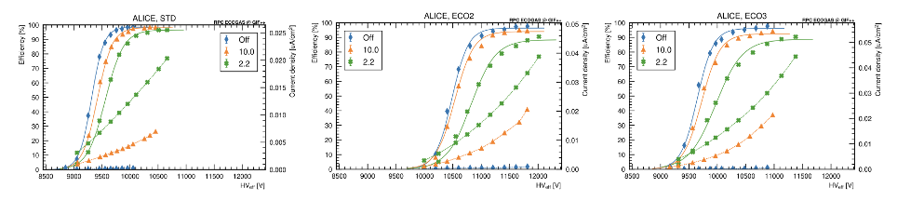
Task 7.2.3:
Eco-friendly RPC Gas Mixtures
Set-up installed at GIF++ facility
  12 TBq ¹³⁷Cs source → Long-term aging test
  H4 Muon beam in some periods of the year → Test-beam to study detector performance
RPCs from ALICE, ATLAS, CMS, EP-DT and SHiP tested
Two eco-friendly gas mixtures tested:
  STD (GWP 1482): 95.2% R134A, 4.5% iC₄H₁₀, 0.3% SF₆
  ECO2 (GWP 485): 60% CO₂, 35% HFO, 4% iC₄H₁₀, 1% SF₆
  ECO3 (GWP 529): 69% CO₂, 25% HFO, 5% iC₄H₁₀, 1% SF₆

Slide 14
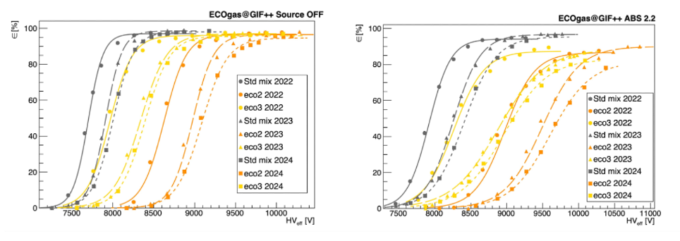
Task 7.2.3:
Eco-friendly RPC Gas Mixtures
Comparison RPC performance after ageing tests
Dedicated test-beam campaigns every year
    Evaluation of detector performance with and without irradiation and with different gas mixtures
Shift of efficiency curves towards higher HV values
    Plateau efficiency remains approximately stable
    Shift visible at different irradiation rates and for the three gas mixtures (smaller for STD gas mixture)
HFO-based gas mixtures are not performing as well as standard RPC gas mixture

Slide 15
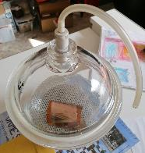
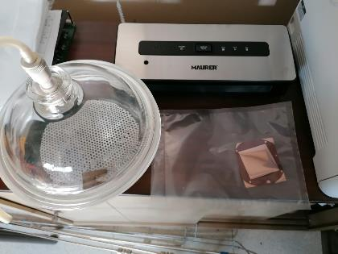
Task 7.3.1: Resistive electrodes
Task 7:3.1: Development of resistive electrodes for MPGDs
High-Resistive GEM with DLC
(Diamond-Like-Carbon) electrodes
Pulsed-Laser-Deposition (PLD) foils of up to 5x5 cm² produced
Ion-Beam-Deposition (IBD) mask for 10x10 cm² are waiting for etching result on 7x7 cm² foil
Latest foils kept under vacuum and put in vacuum sealed bag for transport to CERN.
Etching tests were done at CERN
This activity is related to Milestone M23
PLD 5x5
IBD 7x7
Vacuum sealer
IBD 7x7 foil

Slide 16
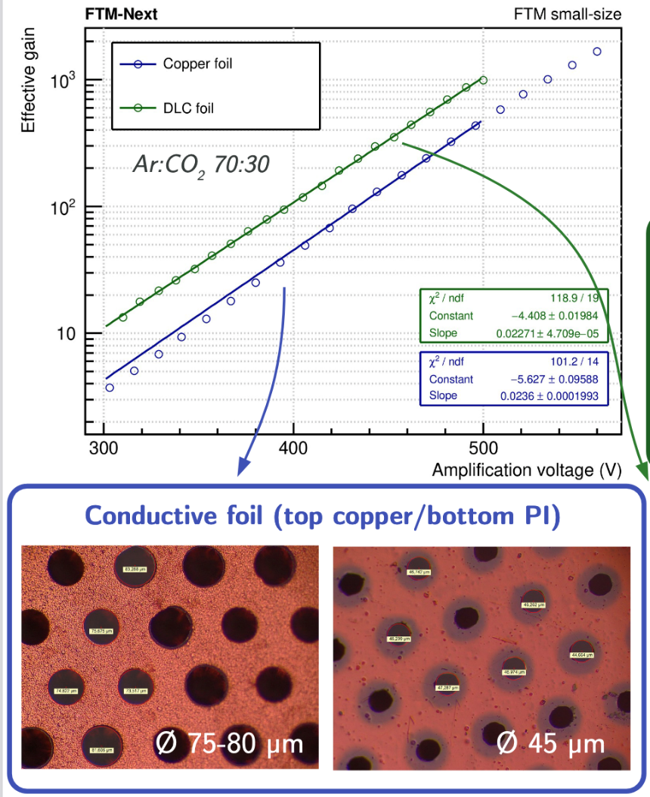
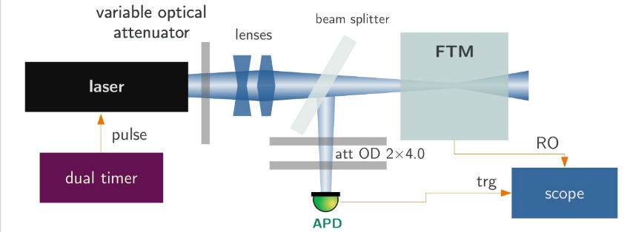
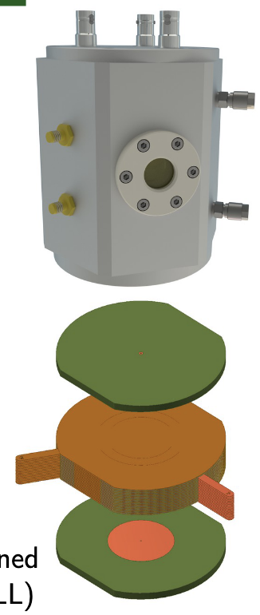
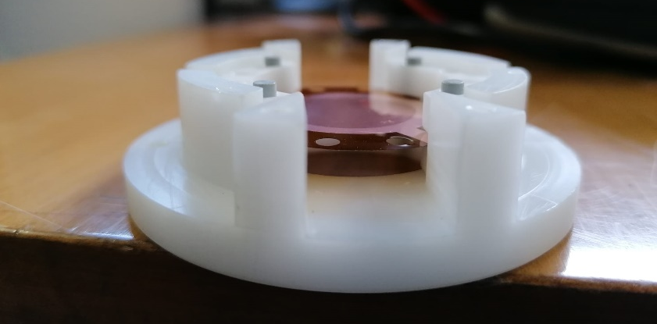
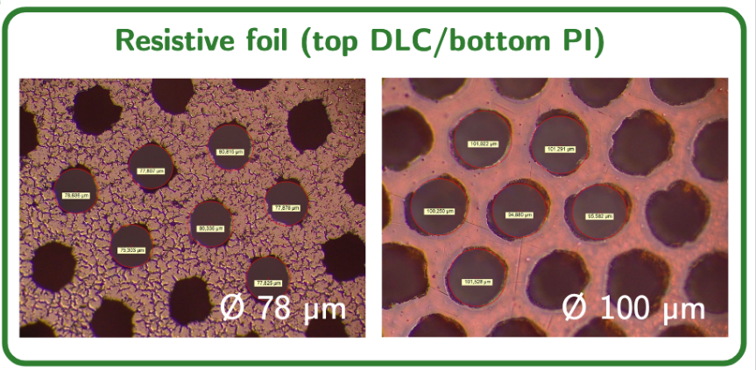
R&D on DLC Electrodes
First Task: High-Resistive GEM with DLC electrodes
Test chamber ready (with Magnetron Sputter DLC test foil inside)
Test setup with UV-laser ready and intesively tested in 2021

Slide 17
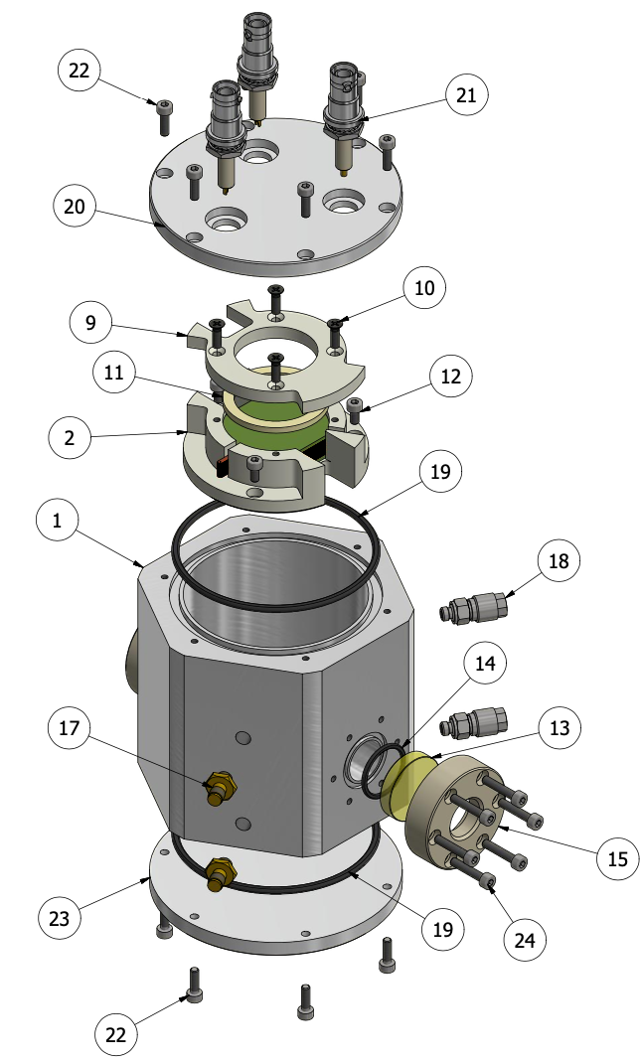

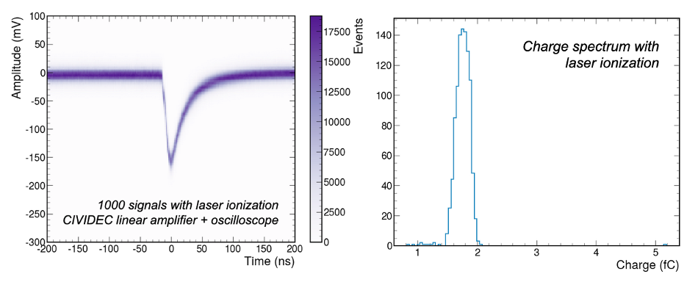
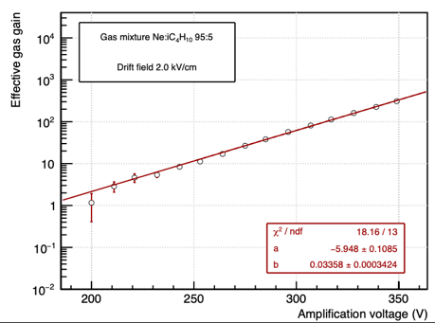
Test of the DLC foil
Test of the DLC foil inside the small-size detector
Setup has both quartz (UV-laser) as mylar (⁵⁵Fe) window
    - Stable operation under 450V in Ar:CO₂:iC₄H₁₀ 93:5:2
    - Signals clearly visible (150mV) and 1.75fC
    - Gain up to 500 measured – not bad for a first production foil

Slide 18

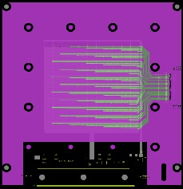
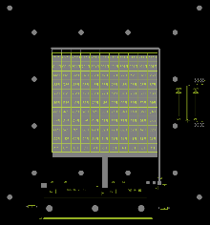

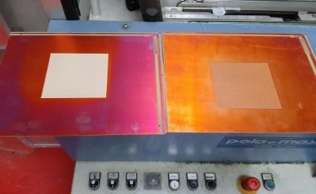
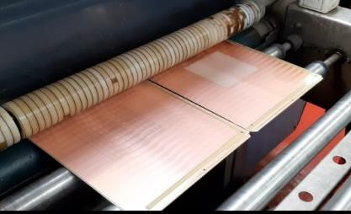
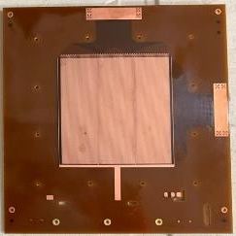

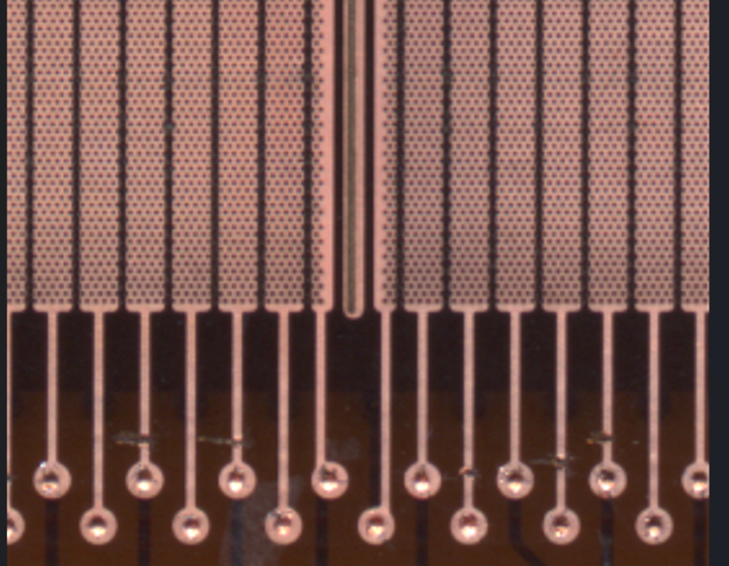
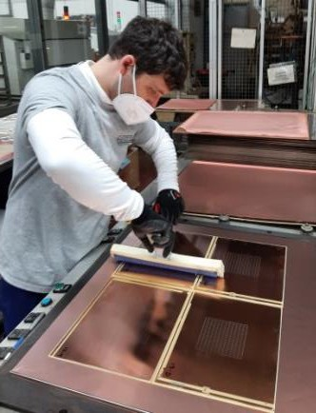
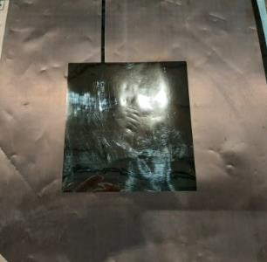
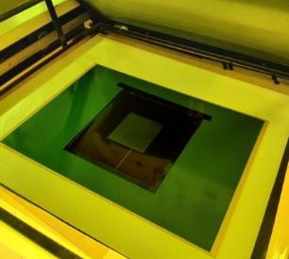
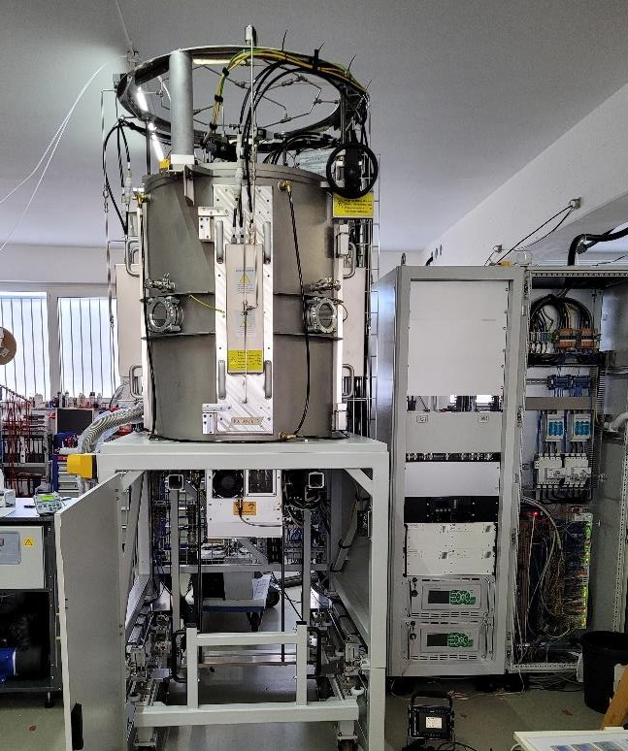

Task 7.3.2: Industrial
Engineering of μ-RWELL
μ-RWELL technology transfer loop (LNF – CERN – ELTOS)
LAYOUT design
Feedback from tests
PCB production
Final detector
manufacturing
DLC foil production (*)
*DLC Magnetron Sputtering machine co-funded by CERN and INFN

Slide 19
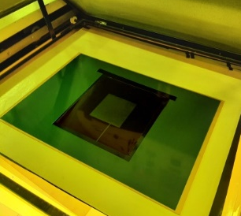
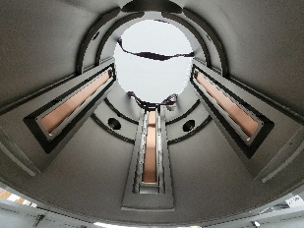
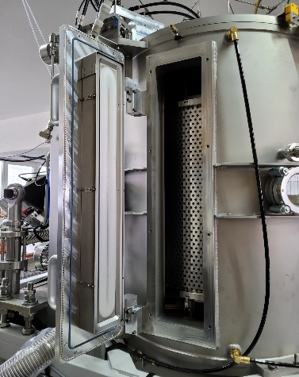

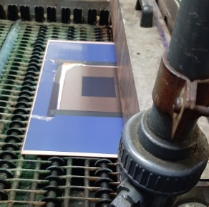
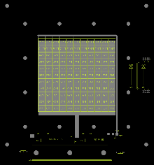
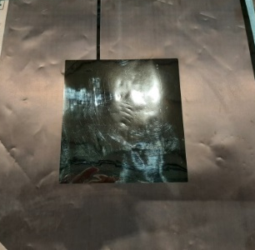
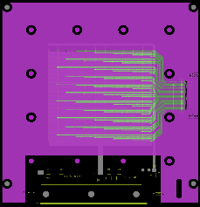

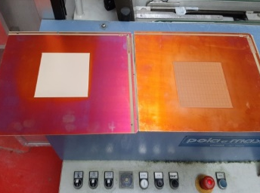
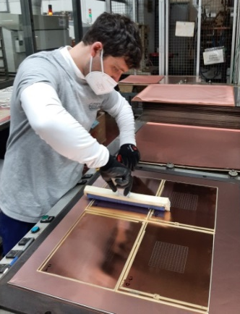
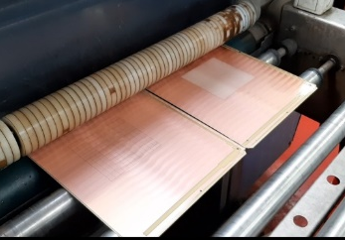
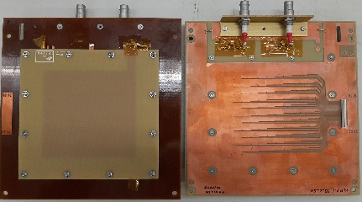
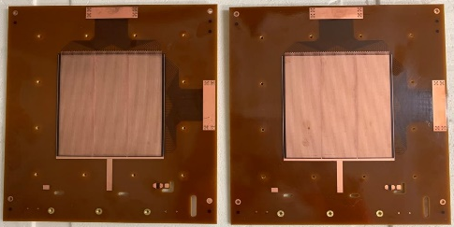
Task 7.3.2: Industrial
Engineering of μ-RWELL
Task 7:3.2: Knowledge Transfer, achievements during the past years
1
Step 0 - Detector PCB design @ LNF
Step 1 - CERN_INFN DLC sputtering machine @ CERN (+INFN)
  delivery foreseen by the end of Oct. 2022
  INFN crew tbd & trained
Step 2- Producing readout PCB by ELTOS
  pad/strip readout
Step 3 - DLC patterning by CERN
  photo-resist → patterning with BRUSHING-machine
Step 4 - DLC foil gluing on PCB by CERN
  double 106-prepreg → 2x50μm thick
  PCB planarizing w/ screen printed epoxy → single 106-prepreg
Step 5 - Top copper patterning by CERN (in future by ELTOS)
  Holes image and HV connections by Cu etching
Step 6 - Amplification stage patterning by CERN
    PI etching → plating → ampl-holes
Step 7 – Electrical cleaning and detector closing @ CERN
3
0
4
5- 6
7

Slide 20




Task 7.3.2: Industrial
Engineering of μ-RWELL
Two high-rate configurations with grounding networks realized and tested:
PEP-Grove layout PEP-DOT layout (2-3% less dead zone)
Results from small test chamber
Notes:
For large-area devices, the path of current-to-ground may become long and highly dependent on the point of particle incidence. To mitigate this effect, the solution is to minimize the average path towards the ground connection by introducing a high-density grounding network on the resistive stage. During our R&D, various high-rate (HR) layouts with dense grounding schemes have been implemented [15]: the Double-Resistive Layer (DRL), the Silver-Grid (SG), and the Pattern-Etching-Plating (PEP). Here we focus on the two most recent PEP layouts: PEP-Groove and PEP-DOT,

Slide 21


Task 7.3.2: Industrial
Engineering of μ-RWELL
0.6% of LHCb U2
Large size detectors are under test
30x25cm² active area
952 R/O pads (9x9mm²)
AIDAinnova strengthened the link between
INFN, CERN and ELTOS, paving the way towards
future new challenges.
Notes:
For large-area devices, the path of current-to-ground may become long and highly dependent on the point of particle incidence. To mitigate this effect, the solution is to minimize the average path towards the ground connection by introducing a high-density grounding network on the resistive stage. During our R&D, various high-rate (HR) layouts with dense grounding schemes have been implemented [15]: the Double-Resistive Layer (DRL), the Silver-Grid (SG), and the Pattern-Etching-Plating (PEP). Here we focus on the two most recent PEP layouts: PEP-Groove and PEP-DOT,

Slide 22






Task 7.4.1: Cluster Counting
Cluster counting in gaseous detectors is mainly a matter of the read-out electronic chain
Several hardware and software approaches are pursued
ADC32RF45 or LMH6522) + FPGA KCU105
NaluScientific
- 4ch ASoCv3
- 32ch HDSoCv1
CAEN VX2751
  Peak finding algorithms
DERIV is based on the 1st and 2nd derivative
of the digitized signal function
RTA is based on a bin-by-bin matching of the signal
waveform with a normalized search template
Notes:
Three different approaches to the CC/T algorithms:
• DERIV, based on the first and second derivative of the digitized signal function.
• RTA, based on a bin-by-bin matching of the signal waveform with a normalized search template.
• ML techniques based on RNN, GNN and Domain Adaptation with Optimal Transport.
different hardware configurations:
• (ADC32RF45 or LMH6522) + FPGA KCU105
• CAEN digitizer VX2751
• NALU Scientific ASoCv3 and HDSoCv1
• PYNQ based solution for ML algorithms

Slide 23

Task 7.4.2: Hybrid readout for a high-pressure gas TPC
Two main goals:
  Optical read-out of photoluminescence, combined with charge read-out for 3-D images
  Innovative gas mixtures with scattering off different nuclei
The team demonstrated the possibility of doing time-tagging and accurate particle tracking simultaneously using an Ar-based TPCs at 10 bar with the addition of 1% CF₄ (which acts as WLS)
It can be used in next-generation
neutrino experiments.
Scintillation light time profile for
α-tracks
Cosmic rays detected from luminescence by a CCD camera in Ar/CF₄ (99%/1%)

Slide 24







Pure Argon (1231 mbar)
98% Ar + 2% CH4 (1233 mbar)
96% Ar + 4% CH4 (1265 mbar)
Measurements with different Methane fractions
between 1.2 and 1.3 bar
94% Ar + 6% CH4 (1288 mbar)
92% Ar +8% CH4 (1306 mbar)
90% Ar +10% CH4 (1335 mbar)
Integrated light images:
  Recorded at each methane fraction
  Clearer when calculating ToT integral
Charge readout:
  Observed events (blue) at each fraction
  Significant amount of noise (yellow) in channels and difficult to build pulse-height spectrum

Slide 25
Task 7.5: Photon Detectors
for hadron Particle ID
Task 7.5. Photon detectors for hadron particle identification at high momenta
A bridge between gaseous detectors and PID, with focus of the detection of single photoelectrons
The R&D activity is dedicated to developments for the detection of single photoelectrons → 3 R&D lines :
  MPGD-based PDs (INFN-TS, Charles U., USTC)
      Optimize the detector construction protocol
      Qualify for this application a novel low-noise FE electronics: VMM3
      Explore novel photoconverter materials (deliverable, month 44)
  2. Visible light PDs insensitive to magnetic field (INFN-BA, INFN-BO, INFN-TS, USTC, INCOM)
  Qualify Si PMs for single photoelectron detection in imaging devices
  Qualify LAPPDs for single photoelectron detection in imaging devices
  Comparative assessment by simulations using as input the photosensor
  performance as from R&D lines 1. and 2. (INFN-BA, INFN-TS)

Slide 26


Task 7.5: Photon Detectors for hadron Particle ID
Task 7.5. Photon detectors for hadron particle identification at high momenta
Visible-light Photo Detectors insensitive to magnetic fields
LAPPDs: Time resolution assessment completed and published (NIM A 1058 (2024) 168937)
  Cherenkov photons generated in a quartz lens radiator at the CERN PS test beam Response from two different LAPPD pads, detecting single photons (black) or with a probability for more than 1 photon (red)
      SPE time resolution
      : ~75ps
SiPMs: recovery of radiation damage by thermal annealing
proven, also iterating cycles; current measured at – 30ºC Annealing cycles in oven at 175ºC – 30 min Irradiation at each cycle: 10⁹ n_{eq}/cm²
      The sustainable integrated dose for SIPMs is made substantially longer

Slide 27

Task 7.5: Photon Detectors for hadron Particle ID
Nanodiamond based photocathodes for MPGD based Single Photon Detectors

Slide 28
Overall conclusion for WP7
The goals for the different tasks in WP7 have been (largely) achieved, and all reports related to the Milestones and Deliverables have been provided, (more of less) in time.
More work is needed by the community on a usable gas mixture for RPC detectors in the Muon Systems of the LHC detectors.
Some Tasks had early Milestones or Deliverables, which had the side effect that the activities slowed down ones the Milestone resp. the Deliverable had been achieved.
What remains to be done is to summarize our achievements as good and clear as possible in the final report, to be prepared in the coming months.
For the follow-up programme of AIDAinnova, the WP on gaseous detectors has to be more focused (less tasks) and less beneficiaries.

