Slide 1
WP4 Session
Upgrade of Irradiation and Characterization Facilities
Fernando Arteche (ITAINNOVA), Federico Ravotti (CERN)
AIDAinnova Final Meeting – Prague (CZ), 5 May 2025

Slide 2
WP4 Goal
Irradiation and characterization tests required for the next generation of particle detectors demand more accurate and reliable procedures, as well as a higher efficiency in their execution
The main goal of WP4 is to develop & standardize common tools for testing infrastructure to better support the next detector generation
  Improve facilities and systems
The activities are covered by different partners:
  Academia
  Industry
  Research and Technology Organizations (RTO)
This good combination of partners aims to ensure the readiness of the detector support infrastructure for high TRL levels

Slide 3
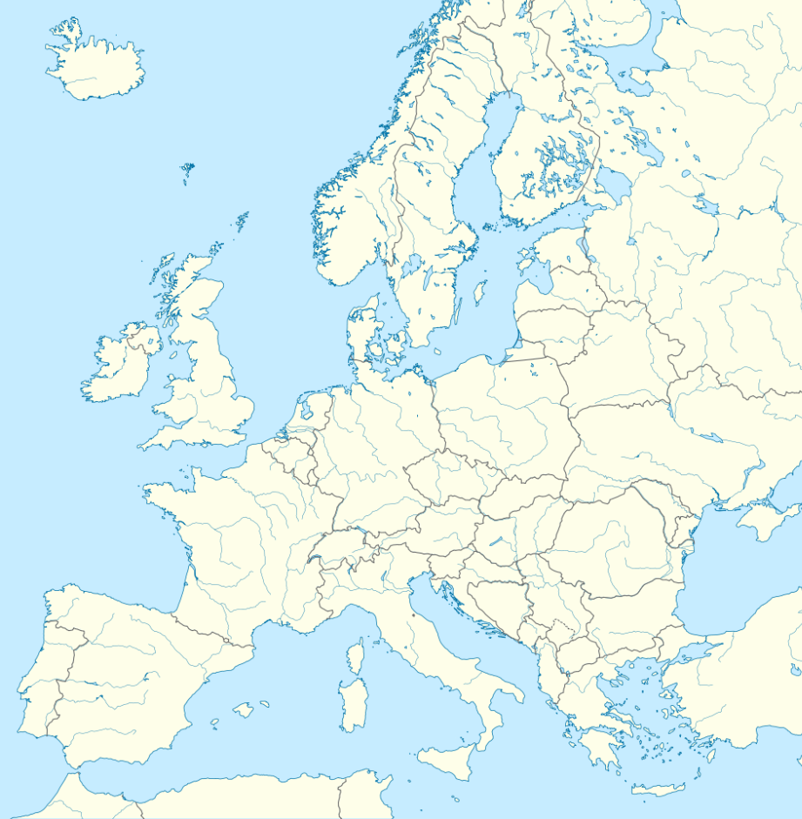


WP4 Structure & Partners
Task 4.1: Task Coordination (CERN, ITAINNOVA)
Task 4.2: Micro-beam Upgrade at RBI Accelerator Facility (RBI)
Task 4.3: Common Tools for Irradiation Facilities QC: Data Management, Traceability, Dosimetry and Activation Measurements (CERN, MINES^{(*)}, INFN, ENEA^{(*)}, CAEN)
Task 4.4: Design & Development of a New Sensor Characterization System based on TPA-TCT Technique (CERN, CSIC-IFCA, FYLA)
Task 4.5: Design & Development of a New Electronics Characterization System for EMC Control (ITAINNOVA⁽⁺⁾, CNRS-IPHC)
IRRAD/GIF⁺⁺
CERN Switzerland
Partner
Company Facility
MINES
Paris (PSL)
France
CNRS-IPHC
France
CSIC-IFCA
Spain
CAEN
Italy
RBI-AF
Croatia
ENEA-FNG
(INFN)
Italy
FYLA
Spain
ITAINNOVA
Spain
^{(*)} Collaborating Institute
⁽⁺⁾ RTO

Slide 4
WP4 Deliverables/Milestones
6 Milestones (MS): M18 – M42
  all achieved (last one, MS15 in Sep. 2024)
5 Deliverables (D): M40 – M46
  D4.1 achieved in M40 (Jul. 24)
  D4.2: M42 (Sep. 24), postponed to M45 (Dec. 24) → M52 (Jul. 25) [draft report exists]
  D4.3: M45 (Dec. 24), extended to M52 (Jul. 25)
  D4.4: M46 (Jan. 25), achieved in M48 (Mar. 25) [report submitted]
  D4.5: M44 (Nov. 24), postponed to M51 (Jun. 25) but already achieved [report submitted]

Slide 5
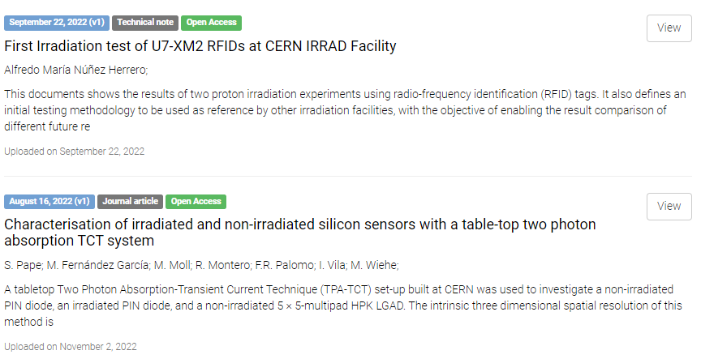
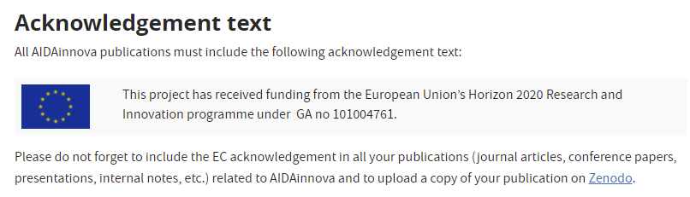
Task 4.1: WP Coordination
https://aidainnova.web.cern.ch/publications
16 publication records for WP4 in Zenodo
  9 other than MS reports (articles, notes, presentations, etc.)
  +1 to be recorded for task 4.3, other tasks ?
INDICO category to host WP- and Task-related meetings:
  https://indico.cern.ch/category/13502/
This afternoon WP4 session agenda:
  https://indico.cern.ch/event/1492202/sessions/581433/#20250505

Slide 6
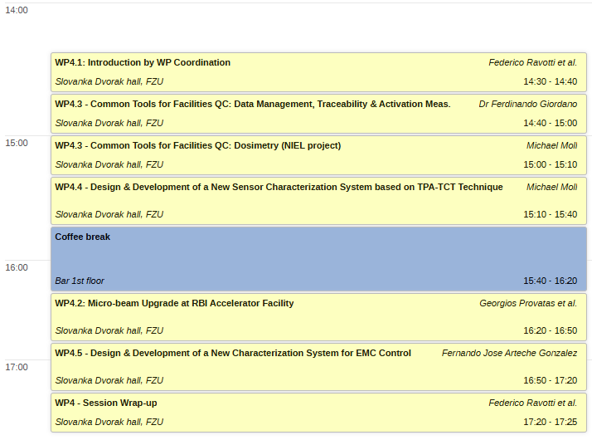



WP4 Session Agenda
WP4 Session:
  One report per task (max. 25min + 5min discussion)
  Coffee break for further discussions
WP4 Plenary Talk:
  Thursday Morning

