Slide 1
AIDAinnova (7.2)
MRPCs for fast timing at high incident flux of charged particles
Muon tomography: Low power, minimal gas use, excellent time resolution
Name of the legal entity | Type | Country | Main contact person
INFN, Bologna | Institute | Italy | Gilda Scioli
Picotech SAS | Company | France | Crispin Williams
LIP-Coimbra | Institute | Portugal | Alberto Blanco
University of Clermont Ferrand | University | France | Cristina Carloganu
EUROPEAN MEMBERS
Tsinghua University | University | China | Yi Wang
Shenzhen Institute of Advanced Technology, Chinese Academy of Sciences | Institute | China | Zheng Liu
Seoul National University Bundang Hospital | Institute | South Korea | Do-Won Kim
Gangneung-Wonju National University | University | South Korea | Yongwook Baek
Benemérita Universidad Autónoma de Puebla | University | Mexico | Cecilia Uribe Estrada
EXTERNAL MEMBERS

Slide 2

AIDAinnova (7.2)
MRPCs for fast timing at high incident flux of charged particles
Muon tomography: Low power, minimal gas use, excellent time resolution
Highlights
  Gas: Need ‘streamer-free’ plateau
  Ecological
  Aging
  Low resistivity glass
  Excellent time resolution: picoTDC
  Muon tomography : minimum channels with excellent position and time resolution
AidaInnova 06/05/2025 slide 2

Slide 3
Grant Agreement No: 101004761
AIDAinnova
Advancement and Innovation for Detectors at Accelerators
Horizon 2020 Research Infrastructures project AIDAINNOVA
deliverable report
Characterisation of small size MRPC prototypes for fast timing and high rates
Deliverable: D7.2
Many thanks to Yongwook Baek and Jinsook Kim for this report
AidaInnova 06/05/2025 slide 3

Slide 4
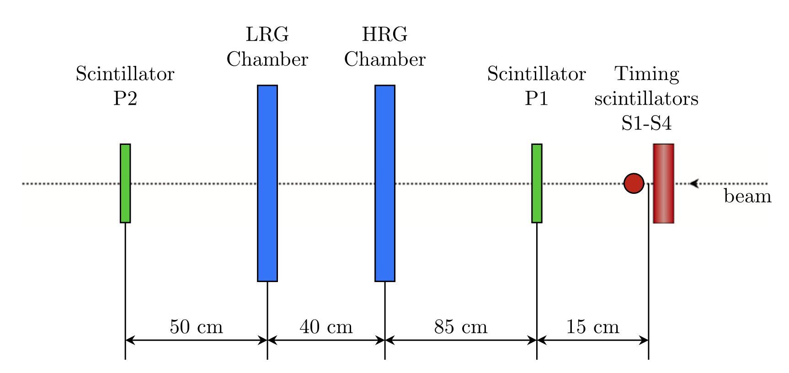
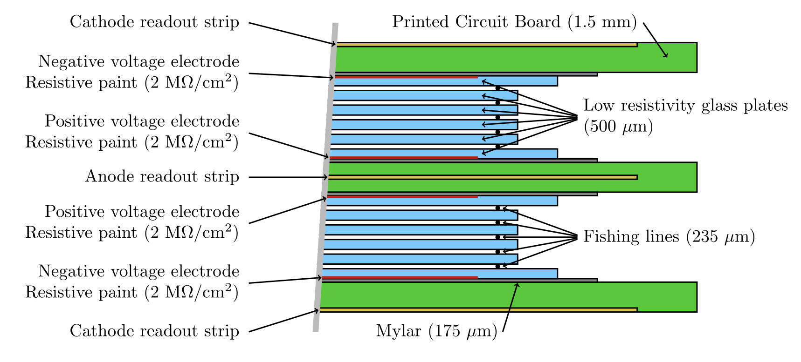
Beam test :
  T10 line at PS CERN
  Two MRPC tested :
    8-gap (2 stacks of 4-gaps) chamber (HRG)
      standard float glass, thickness 400μm
      gap size 250 μm
      nylon fishing lines as spacers
    10-gap (2 stacks of 5 gaps) chamber (LRG)
      Low resistive glass (10⁹ Ωcm), thickness 500μm
      gap size 235 μm
      ceramic coated fishing lines as spacers
  Two mixtures of gas tested :
    98% C₂F₄H₂ and 2% SF₆
    100% HFO-1234ze
AidaInnova 06/05/2025 slide 4

Slide 5
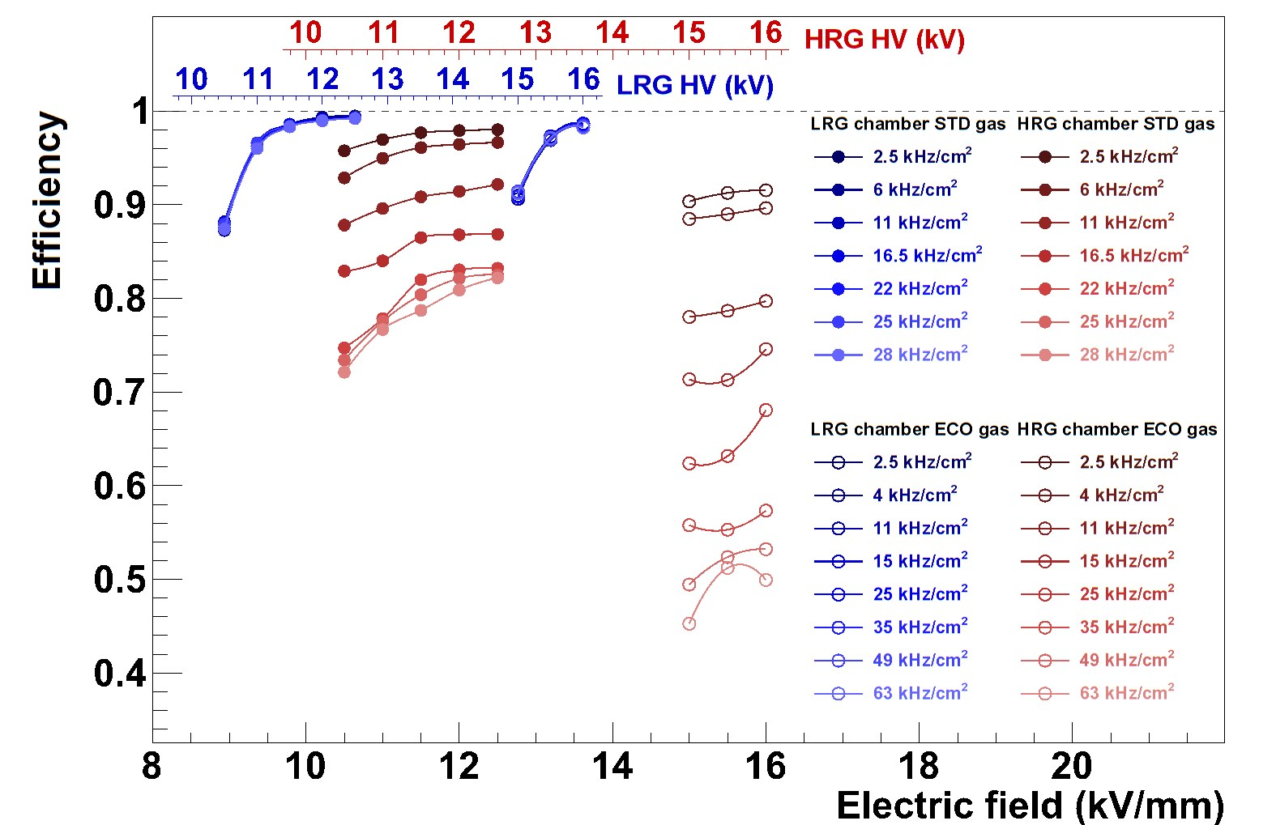
Efficiency vs. Rate
Beam: 7 GeV pions
Beam profile : 1.3 cm FWHM
Rates :
  up to 28 kHz/cm2 for standard gas
  up to 63 kHz/cm2 for eco gas
difference between low resistivity and soda lime glass
Rate has no effect on LRG chamber (as expected)
AidaInnova 06/05/2025 slide 5

Slide 6
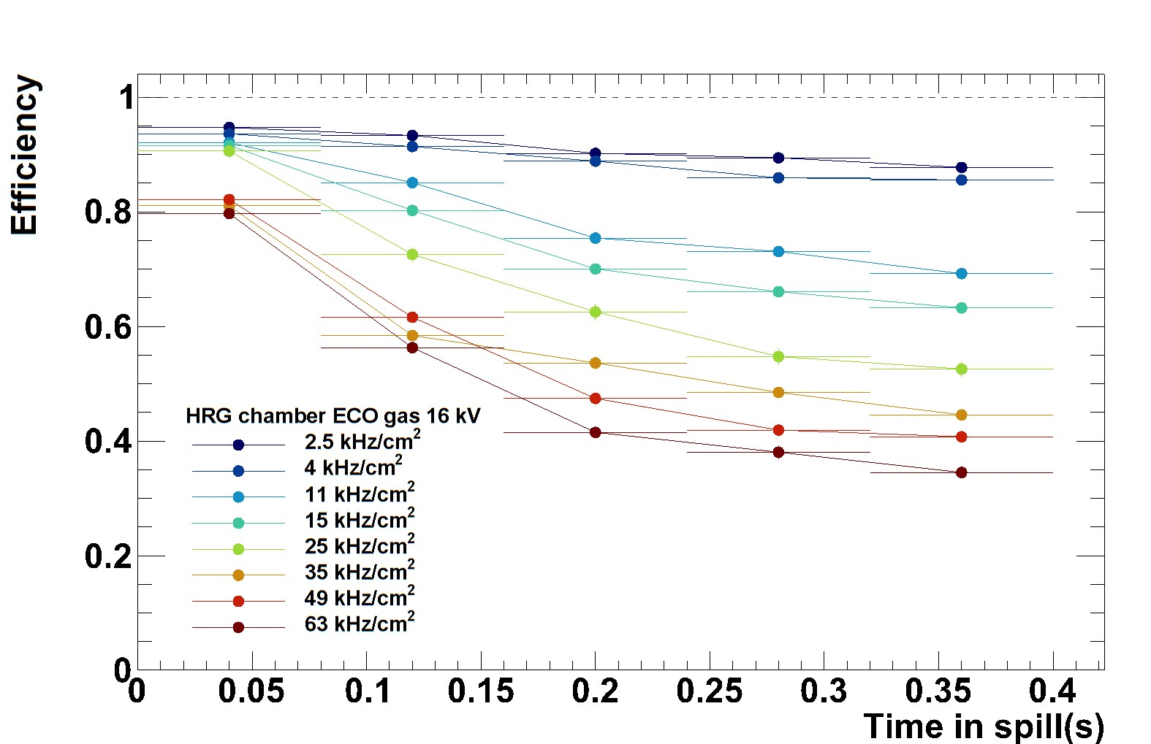
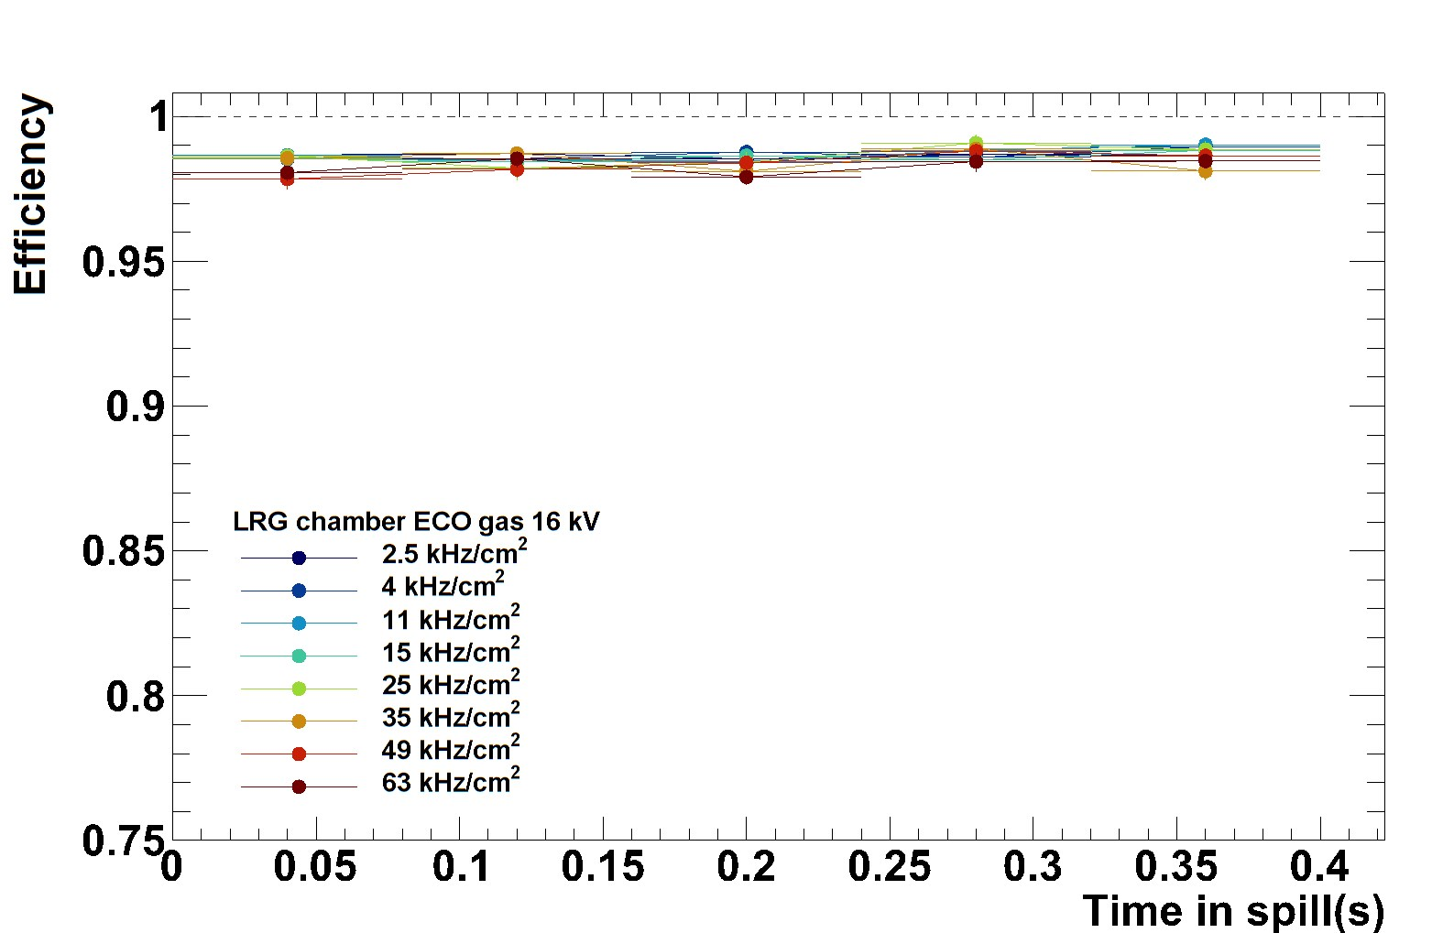
Efficiency in a beam spill (ps spill 400 ms long)
HRG
LRG
AidaInnova 06/05/2025 slide 6

Slide 7
HRG vs. LRG
  A distinct difference in the rate capability at high rate flux
Ecological gas vs. Standard gas
  No conspicuous difference in efficiency and timing performance (but significant increase of voltage)
A realistic test on the rate capability needs to be carried out in the further test by irradiating the larger detector area instead of a focused beam on a small spot.
AidaInnova 06/05/2025 slide 7

Slide 8

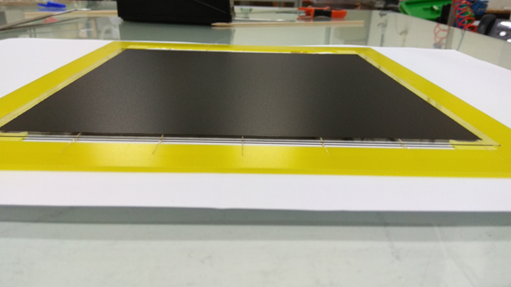
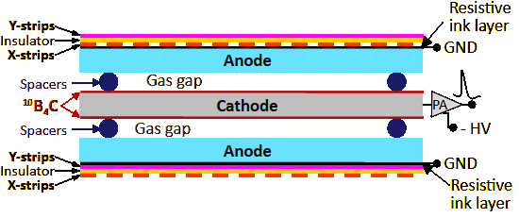
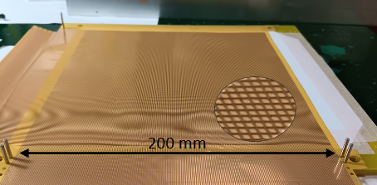
neutron RPCs
n
n
200 mm
200 mm
XY-coordinates readout
Cu-strips mutually orthogonal on 25μm thick FLEX-PCB
0.3mm strip width, 1mm Pitch
Cathode: 0.3mm thick aluminium plate with both sides
coated with ¹⁰B₄C @ ESS Detector coatings workshop
Anodes: 0.3mm thick Float Glass plates
OR 0.4mm thick Low Resistivity Glass
Spacers: 0.28mm diameter PEEK monofilament
¹⁰B₄C layers thickness: 0.6 - 2.2μm
AidaInnova 06/05/2025 slide 8

Slide 9
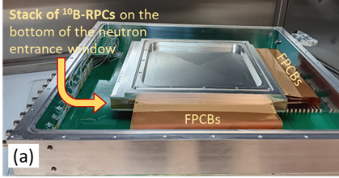




Detector on CT2 neutron beamline (λn=2.5 Å) at ILL
nRPC Detector - stack of 10 nRPCs
9 x nRPC units made with float glass
1 x nRPC unit made with Low Resistivity Glass
AidaInnova 06/05/2025 slide 9

Slide 10
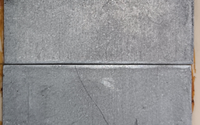
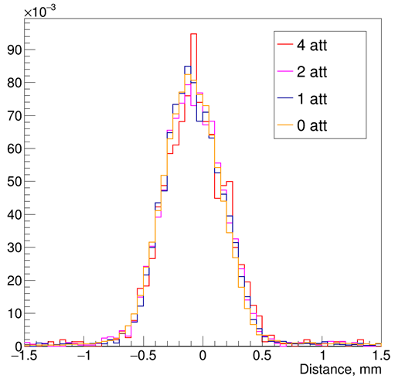
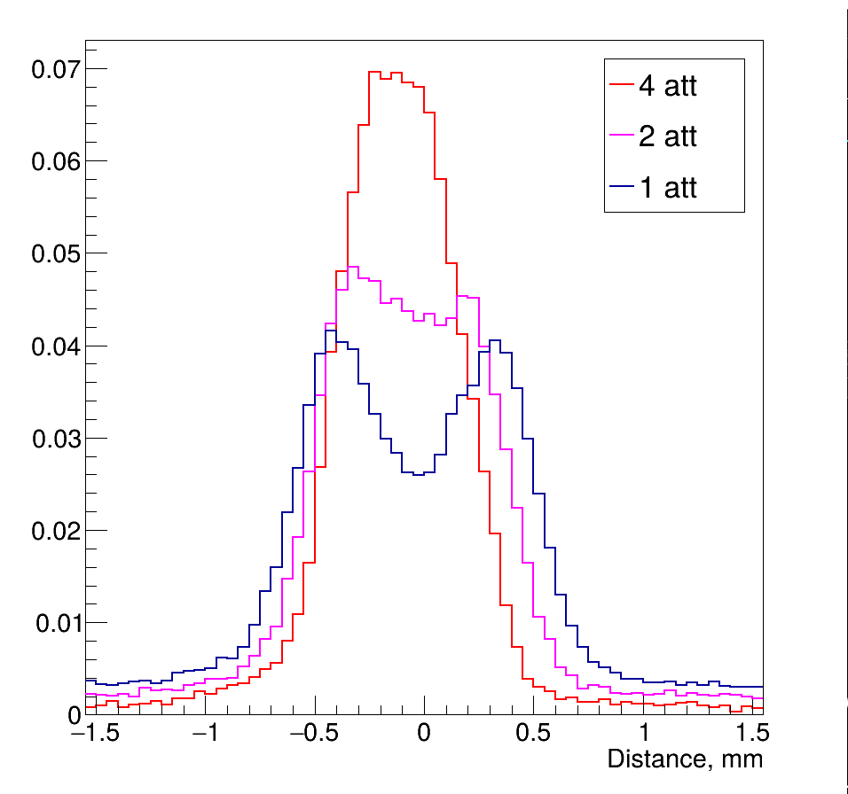
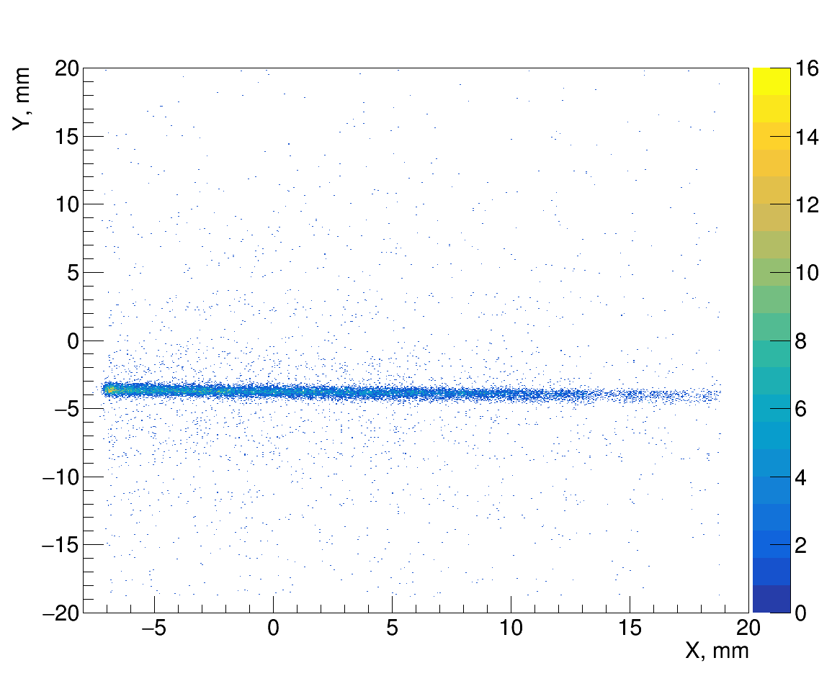
Count rate: LR-Glass vs Float Glass nRPCs
Beam collimated by a Cd-Slit & Neutron flux adjusted with plexiglass attenuators
Cd slit
0.5 mm width
Float-Glass (9 x nRPCs)
Integral of histograms normalized to unity
Reconstructed Image
(XY)-2D Map
For the LR-Glass the slit image profile remains unchanged by decreasing
the number of attenuator (Increasing the neutron flux):
Capable to sustain count rates > 40 kHz/cm² (0 attenuators)
AidaInnova 06/05/2025 slide 10

Slide 11
Multilayer nRPC Detector
The detector's active area increased 4-fold compared to
the first prototype, with spatial resolution remaining
unaffected by scaling (staying < 0.3 mm FWHM)
Total detection efficiency (~42 %, λn=2.5 Å) agrees well
with the simulation prediction.
The LR-Glass nRPC is shown to sustain
máx. count rates > 40 kHz/cm²
  Suggests potential for count rates in the
  hundreds of kHz/cm² with multilayer nRPC detectors
Note that each neutron detection affects only a
single gas gap at a time
AidaInnova 06/05/2025 slide 11

Slide 12
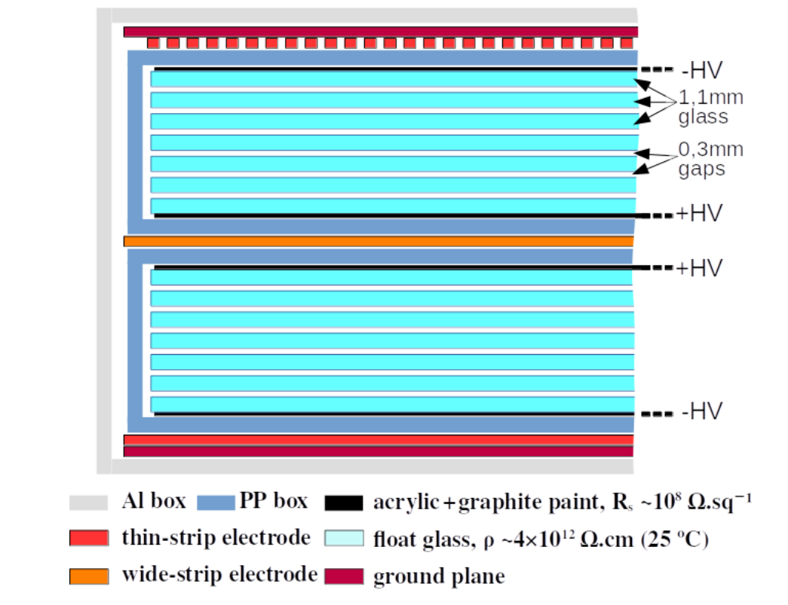
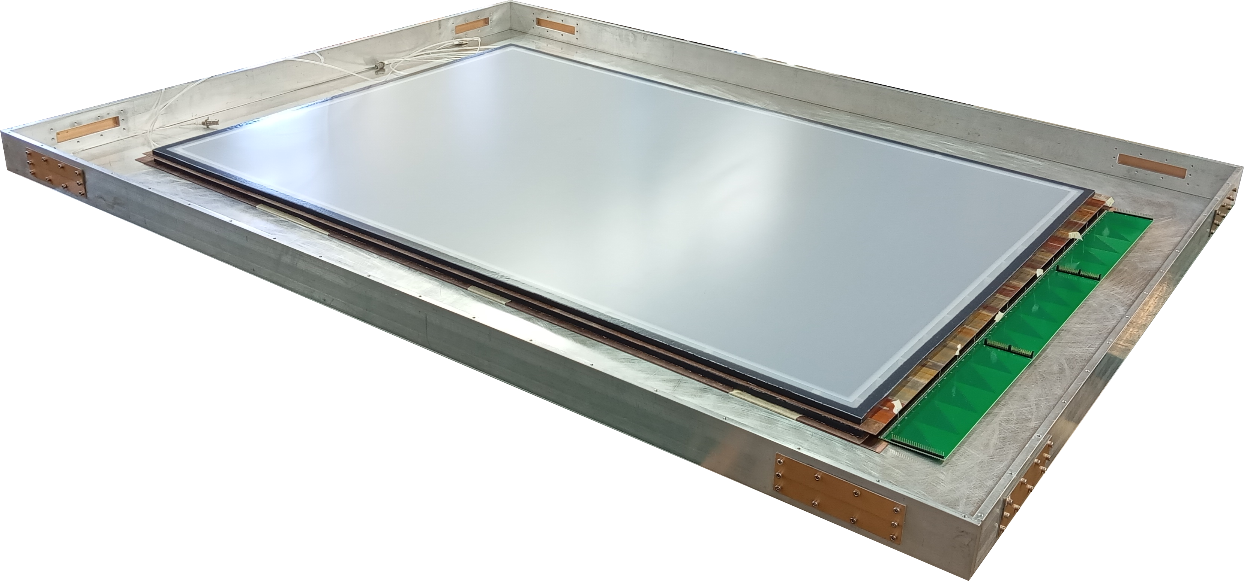
Detector scheme 2x 6 gaps (0.3mm).
98% C2H2F4 and 2 % SF6
Large area Muon detectors
Detector Concept
24 X channels + 24Y + 10 timing.
X, Y readout in parallel sub-groups,
group disentanglement via raw position from time Raw (X,Y).
Q amplifiers, Y
Q amplifiers, X
130x90 cm² detector
T amplifiers
Raw (X,Y)
illustration (partial) of readout
AidaInnova 06/05/2025 slide 12
10.1016/j.nima.2025.170466

Slide 13
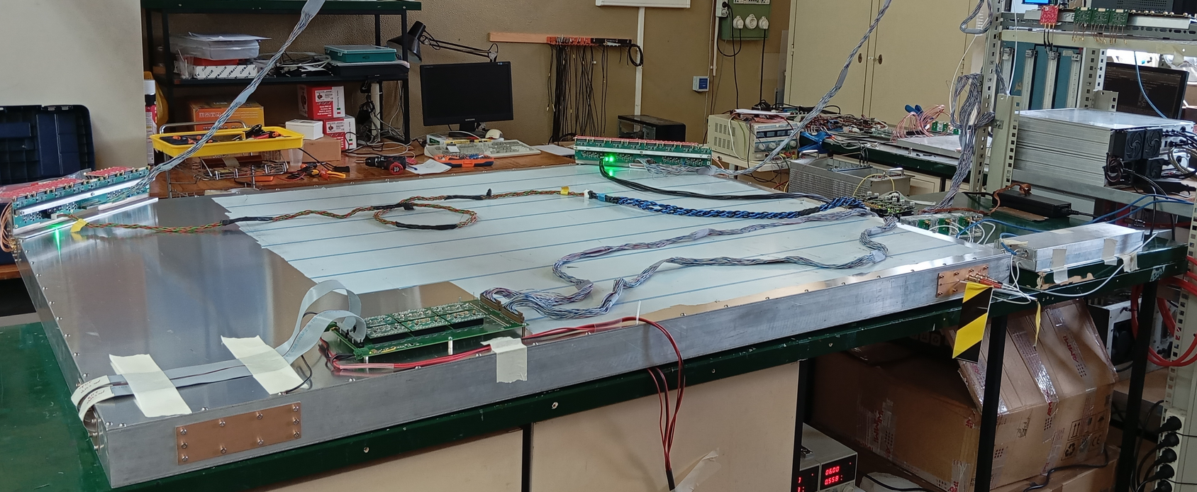

Slide 14
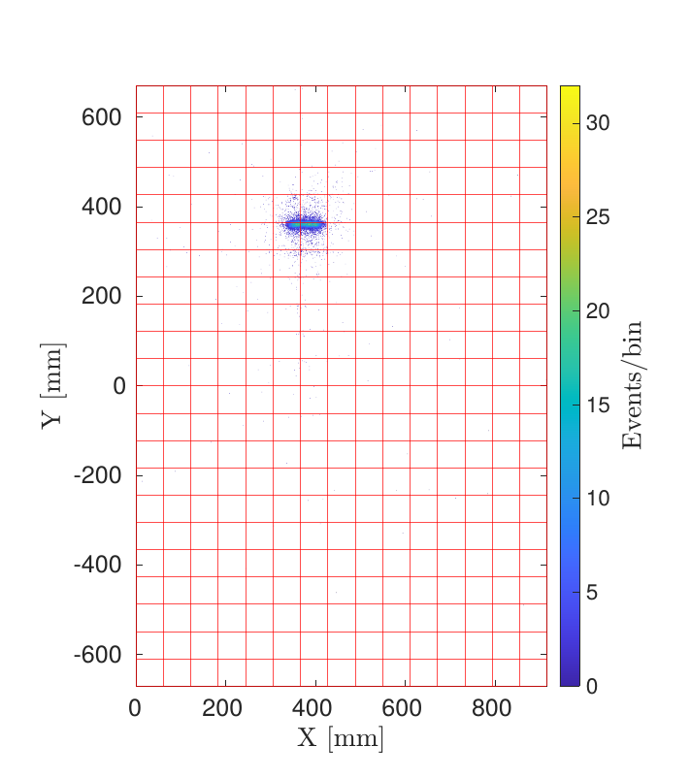
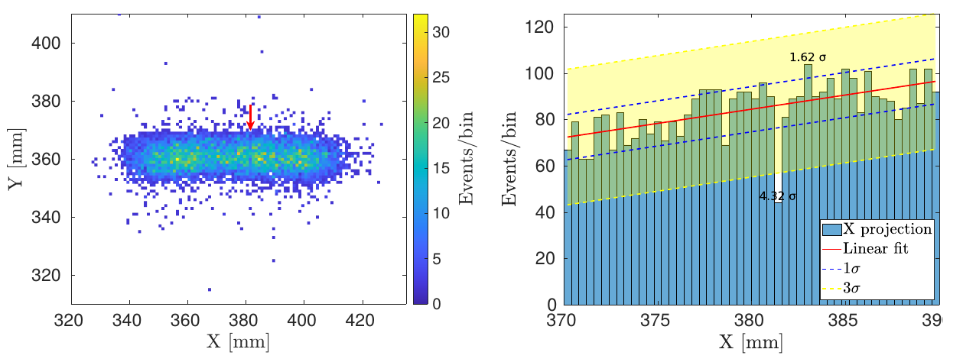
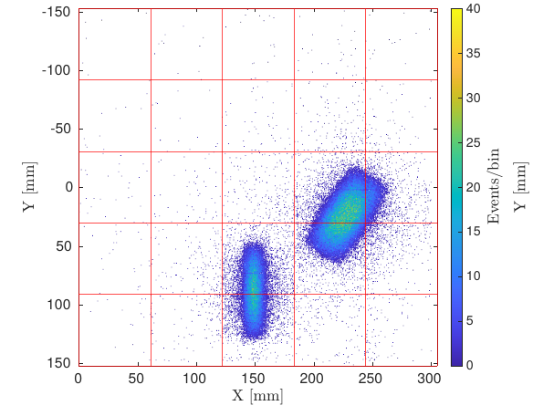
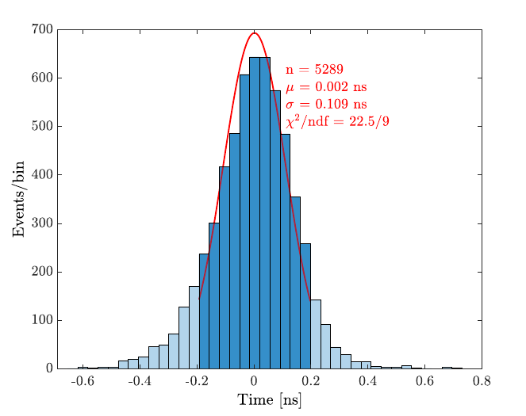
2D Spatial resolution
Timing precision
(a) 2D position map of the 8×3×2 cm³ scintillators. The red arrow identifies the location of the spacer. (b) Projection of the 2D event map onto the X-axis, showing a clear reduction in the number of events at the location of the 300-μm gas gap spacers.
89 ps
2D position map of the 8×3×2 cm3 scintillators over the full
detector area, created with a 1.0 mm bin size in both dimensions.
2D position map of the 8×3×2 cm³ and 8×4×1 cm³ scintillators
Distribution of time differences
MRPC and scintillators
AidaInnova 06/05/2025 slide 14

Slide 15
Some words on the picoTDC development
INFN Bologna
AidaInnova 06/05/2025 slide 15

Slide 16

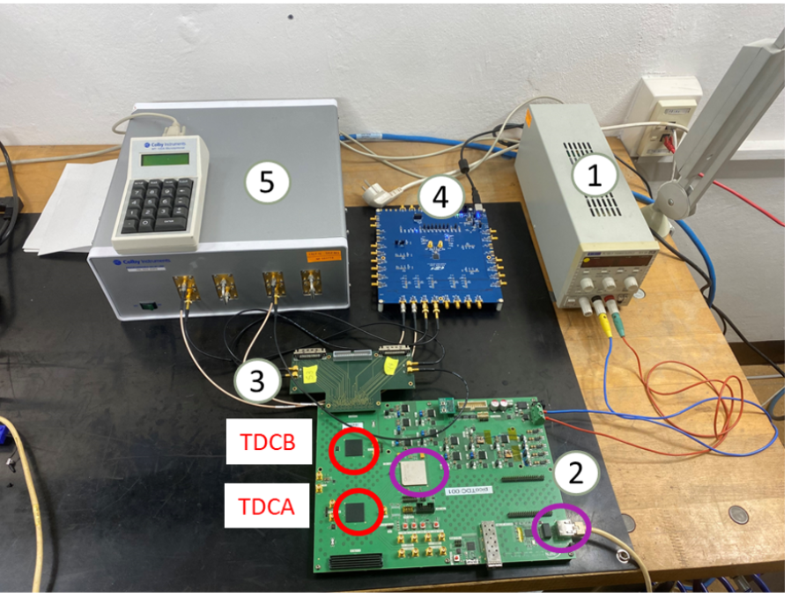
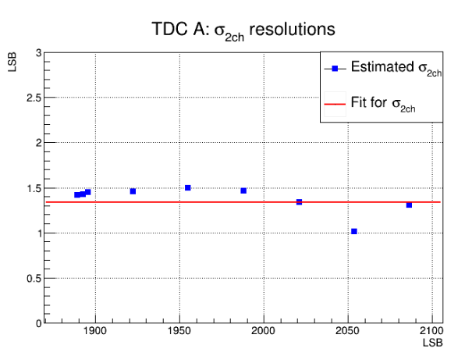
Update on picoTDC card (128 channels)
Firmware suite fully developed for PolarFire FPGA
I2C programming of picoTDC
Data acquisition via Ethernet (IPBUS)
Resolution tests using calibrated delayed line (EM) (0 – 600 ps)
s_{2ch} ≅ 1.34 LSB
s_{1ch} ≅ 0.95 LSB
Note :
LSB is 3 ps
s_{2ch} (TDC bins)
1. power supply (12 V)
2. picoTDC board with 2 picoTDC
3. FMC adapter card (includes VHDCI connectors getting inputs from ALICE TOF FEA cards)
4. SiLab low-jitter clock (used to pulse at 30 KHz)
5. Electromagnetic trombone (Colby XT-200)
Delay (TDC bins)
AidaInnova 06/05/2025 slide 16

Slide 17
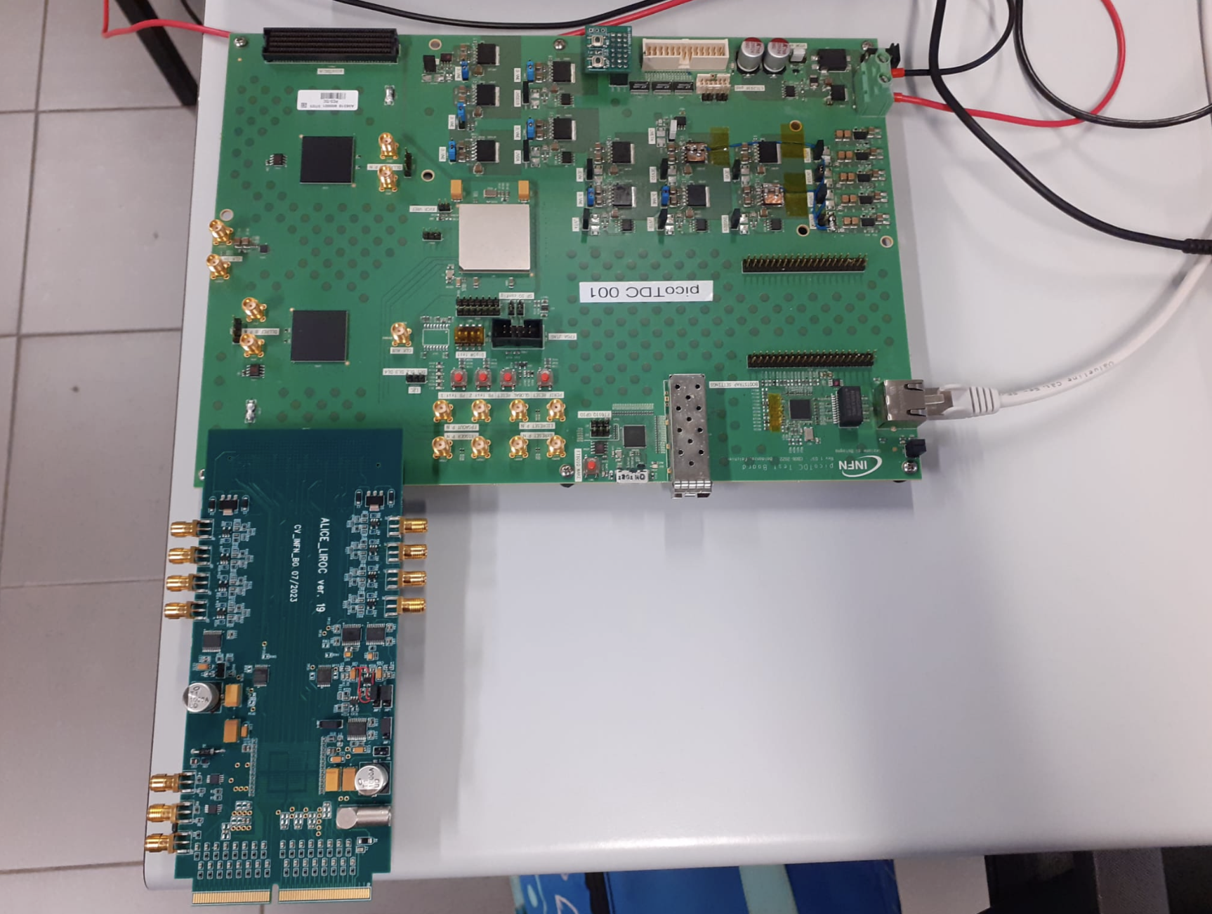
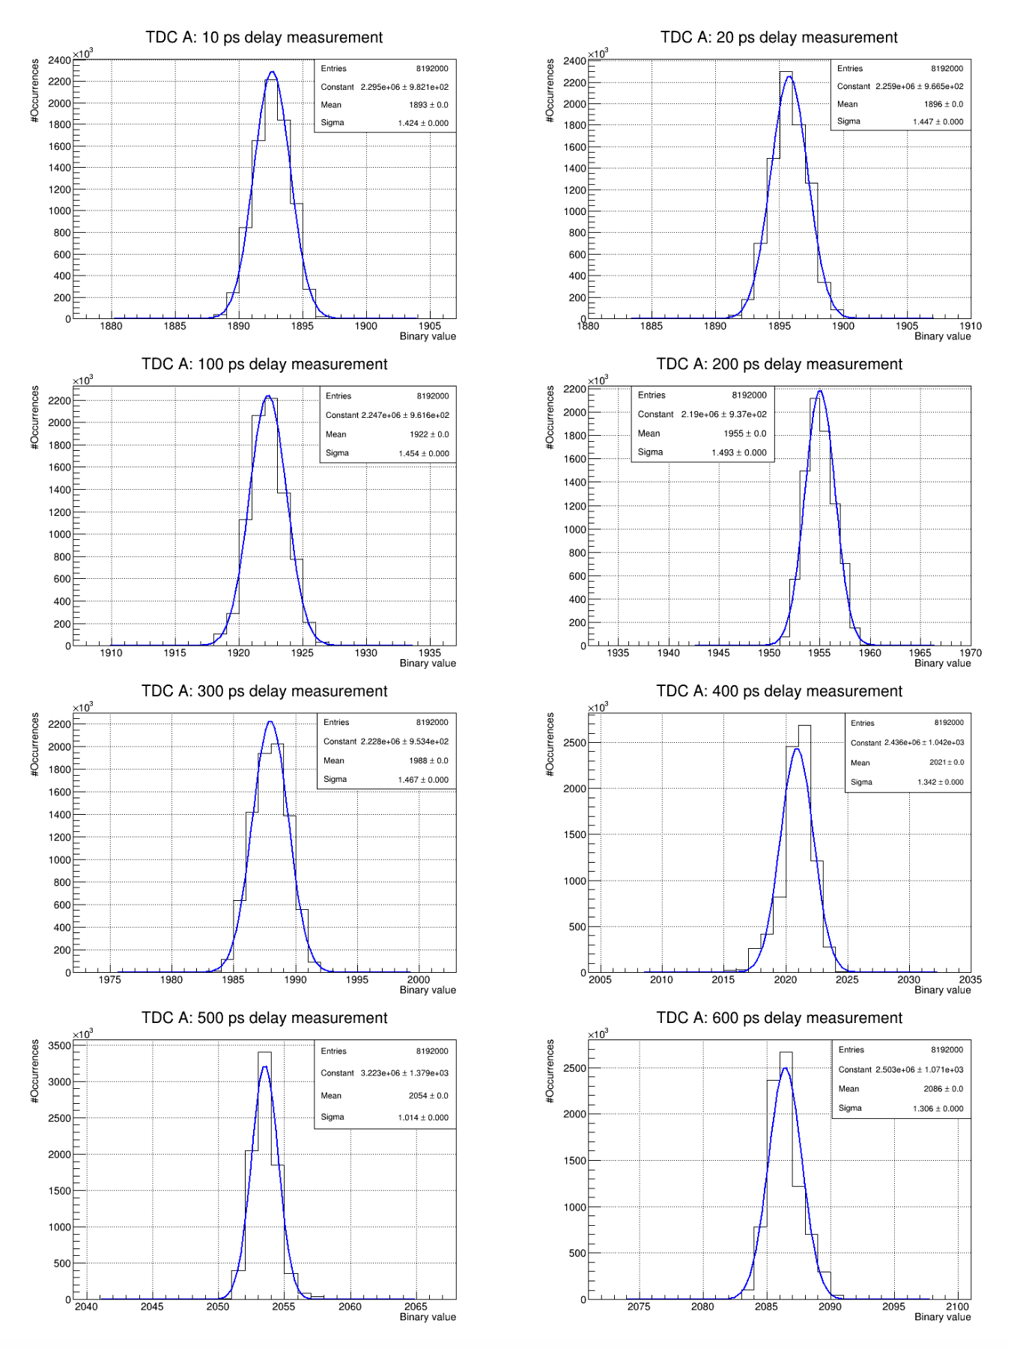
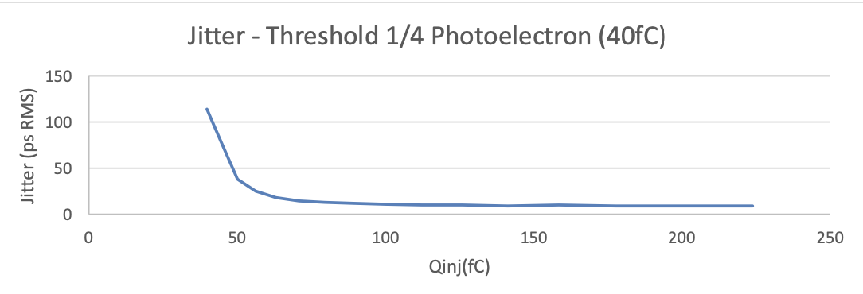
Delay line measurements with picoTDC Board
Additional custom card: FMC adapter for Weeroc LIROC
LIROC is an ASIC (preamp+disc) optimized for SiPM
64 channels naturally “coupled” with picoTDC
8 discriminated output available on ext. connectors
I2C programming of LIROC via picoTDC Board
The cards will be used for test beams at CERN both on MRPC
(from NINO FEA) and SiPM (from LIROC)
AidaInnova 06/05/2025 slide 17

Slide 18
Main highlights
Suitable eco gas tested (needs higher voltage)
Low resisitivity glass – works well for charged particle + neutron detector
Intelligent readout of Muon detectors allows small number of channels for readout of large area with exceptional position and time resolution
PicoTDC - excellent time resolution
AidaInnova 06/05/2025 slide 18

Slide 19
Thank you for your attention

