Slide 1
Development of Resistive Electrodes for MPGDs
Task 7.3a
Piet Verwilligen
INFN Bari

Slide 2
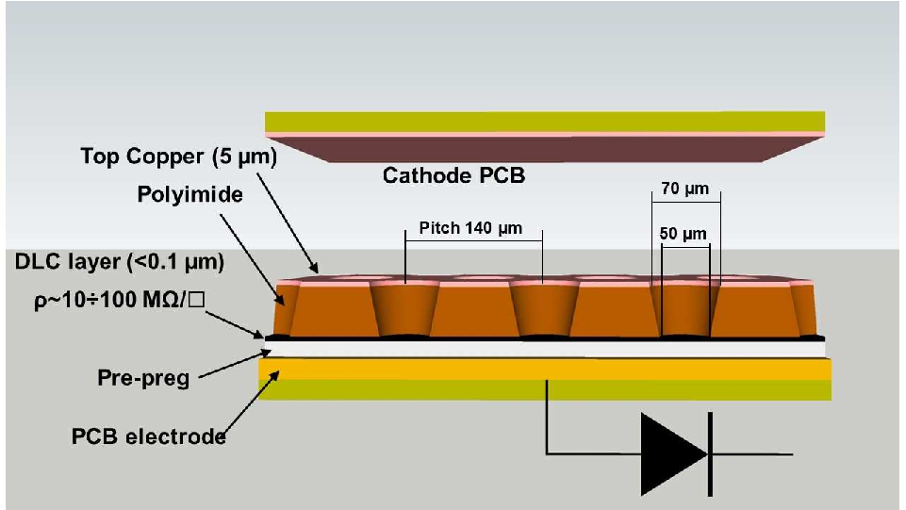
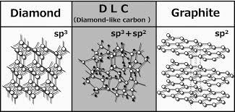
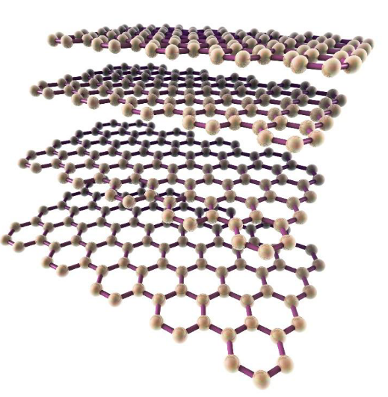
Introduction
  Resistive electrodes improve detector stability of single amplification stage MPGDs (micromegas, μRWELL) and might be the bridge to higher gains (reach wire-chambers gain of ~10⁵) and stable operation
  Resistive electrodes can be used for:
  Discharge quenching: well established
  Signal charge smearing: being studied
  Creation amplification structures: hard, R&D ongoing
  Diamond Like Carbon (DLC) coating techniques are currently explored by several groups to develop new structures and new detectors profiting from coating properties (e.g. robustness, resistivity,…) and on the possibility of controlling them.
  Explore innovative resistive coatings such as
  Multi-Layer Graphene (ML-Graphene) that are very strong, have high conductance and low material budget

Slide 3
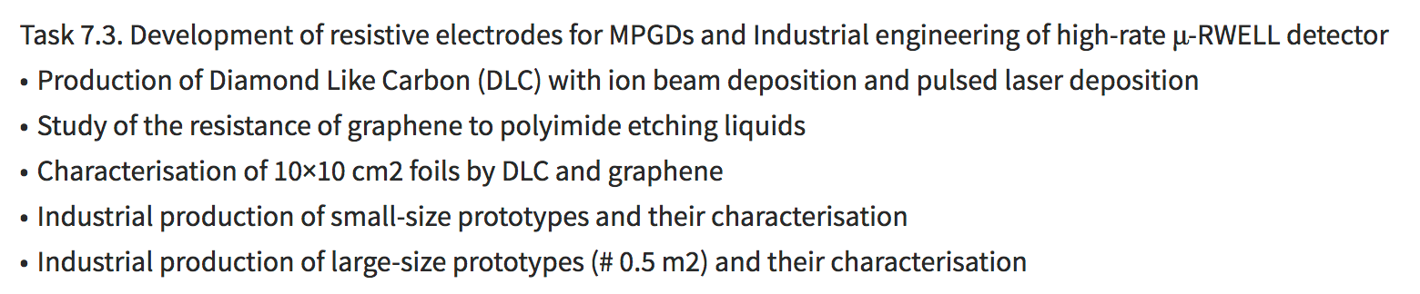
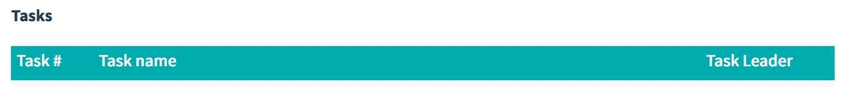
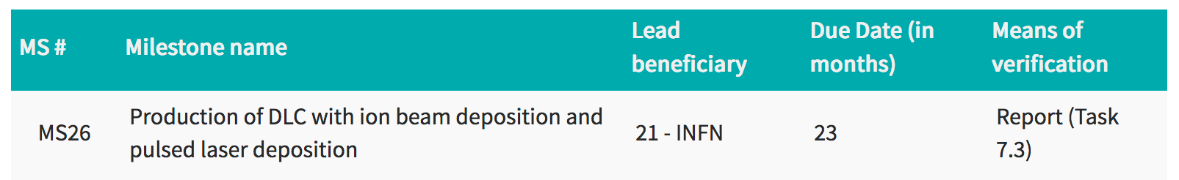
Work within AIDAinnova

Slide 4
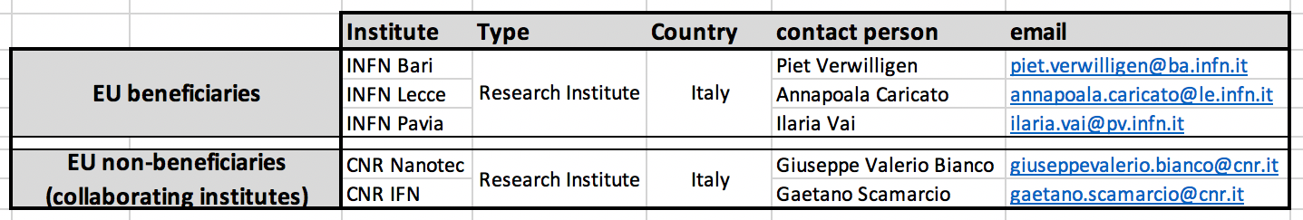
Partners
Benificiaries:
INFN Bari: Ion Beam Deposition DLC, Detector Design & Testing, Task Leader
INFN Lecce: Pulsed Laser Deposition DLC
INFN Pavia: Detector Testing
AIDA innova collaborators (not included in Proposal, but essential contributors):
CERN: Micro-Pattern Technology (MPT) Workshop: Rui De Oliveira
Collaborating Institutes:
CNR Nanotec (Bari) ML-Graphene Deposition, ML-Graphene Etching
CNR IFN (Bari) Photo-Lithography, Patterning
Futher possibilities (already ongoing collaboration within INFN R&D activities)
CNR Nanotec (Lecce) Photo-Lithography, Patterning, DLC Etching
Non-EU close contacts: USTC (Hefei, CN) – Magnetron Sputtering - Resistive DLC collab RD51

Slide 5
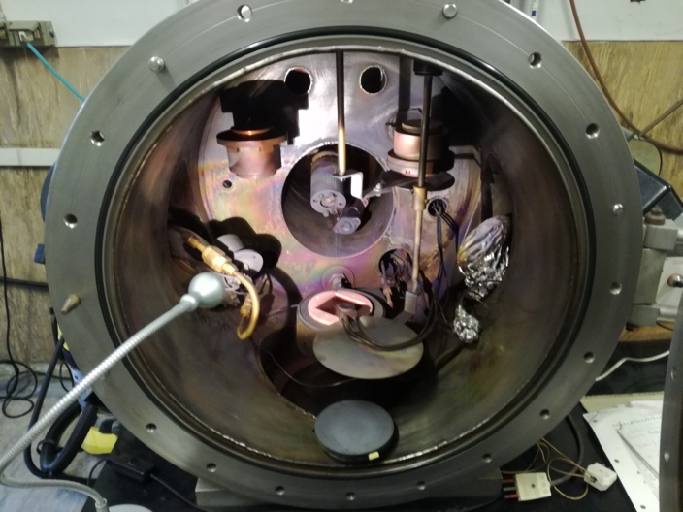
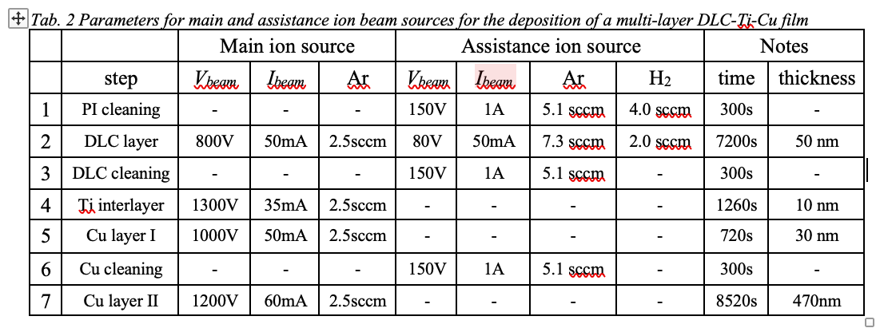
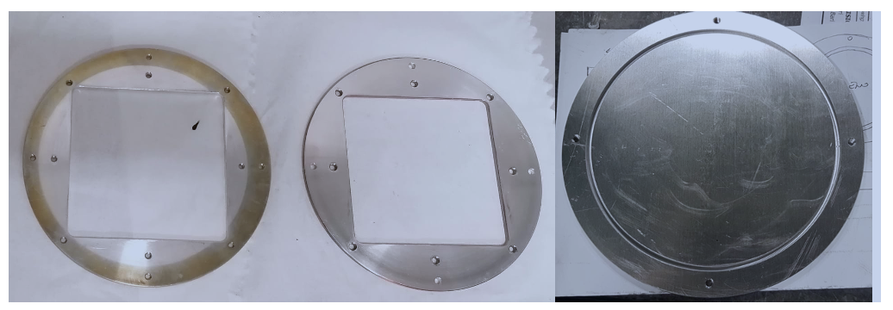
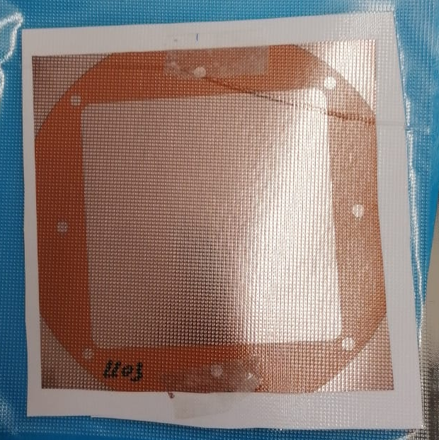
Ion Beam Sputter Deposition
Obtained correct recipe for 100MOhm/sq DLC covered by 500nm Cu layer
Scaled up production to 10x10 cm²
Version I and Version II 10 x 10 cm² substrate holders
10x10 cm²

Slide 6
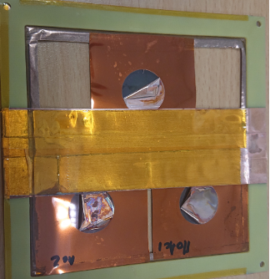
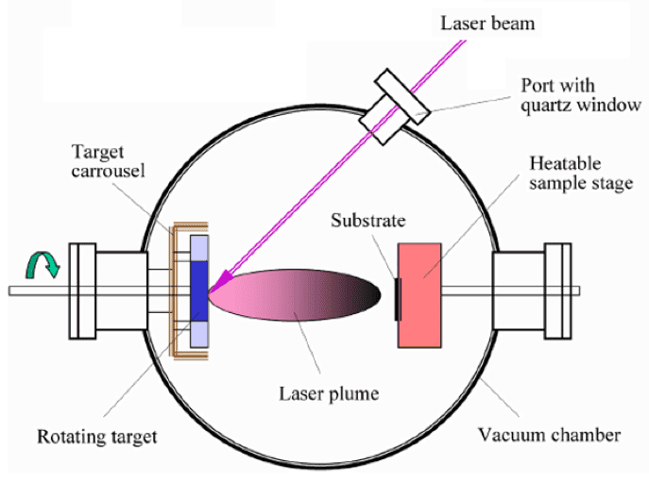
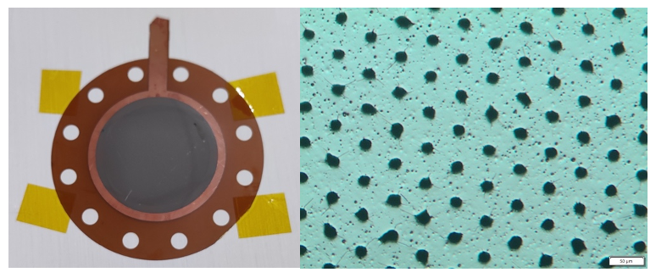
Pulsed Laser Deposition
Obtained correct recipe for 100MOhm/sq DLC covered by 500nm Cu layer
Scaled up production to 5x5 cm²
Several failed Etching tests
  Understood due to delamination of final 7um Cu
  layer made through electroplating on top of original
  100nm of Cu made through PLD
  Solution
    increase to 500nm Cu thickness through PLD
  shipment under vacuum
  Finally good detector-grade DLC foil produced
  Many thanks to CERN MPT workshop

Slide 7
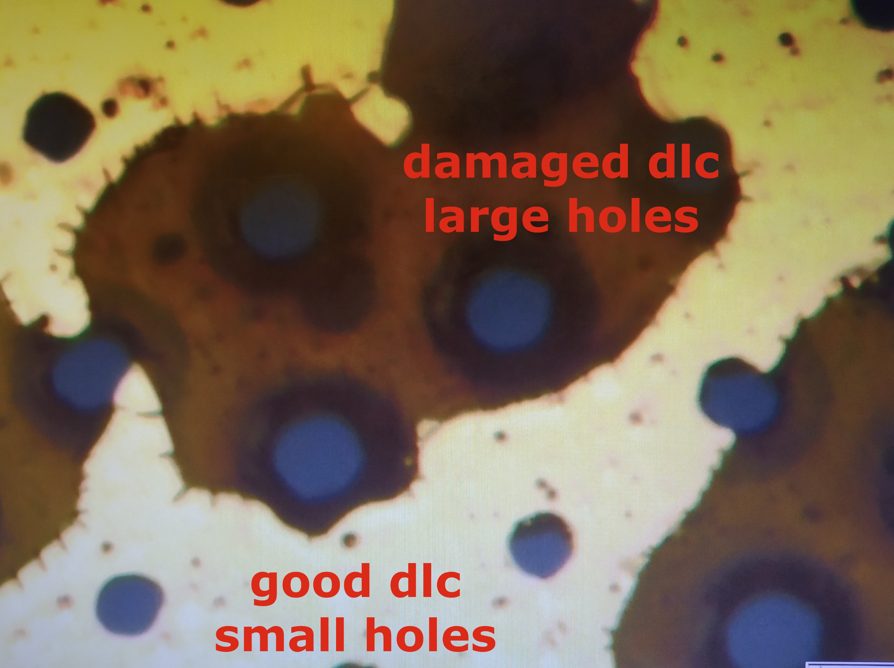
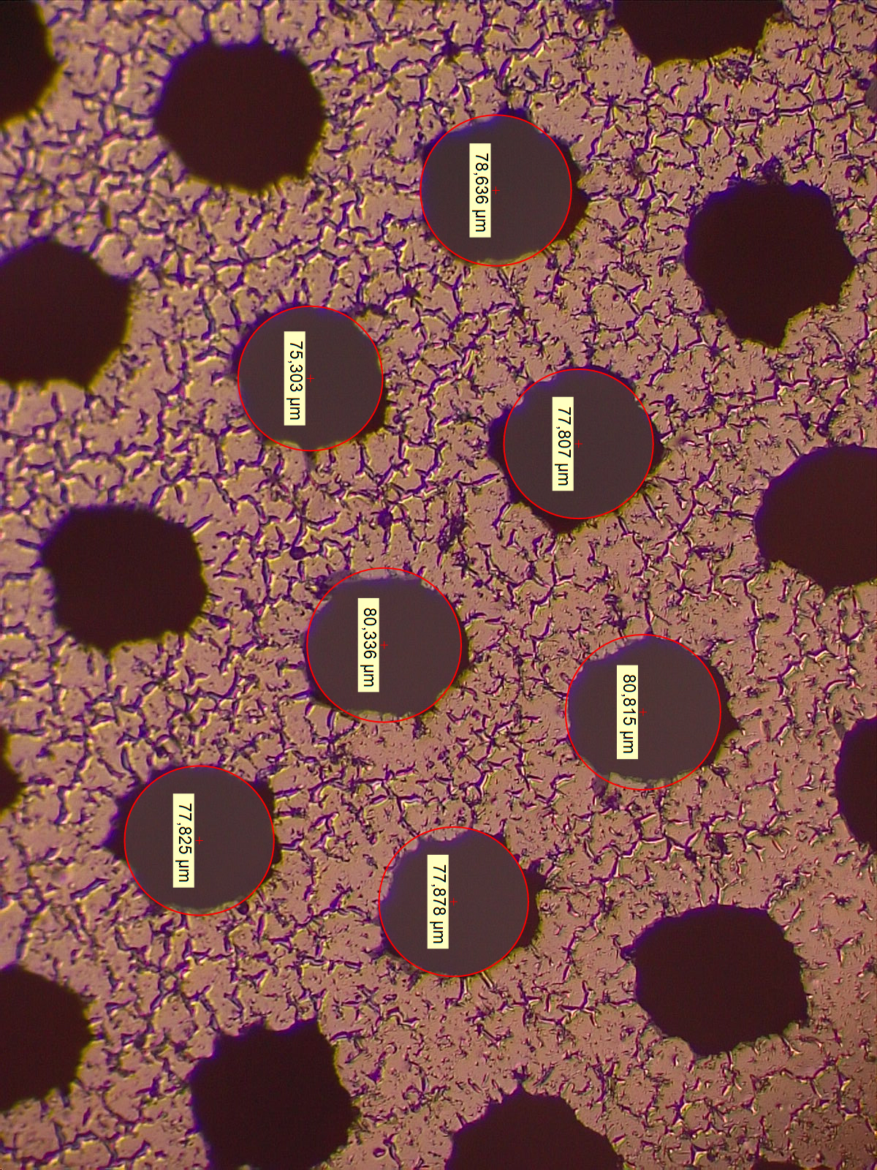
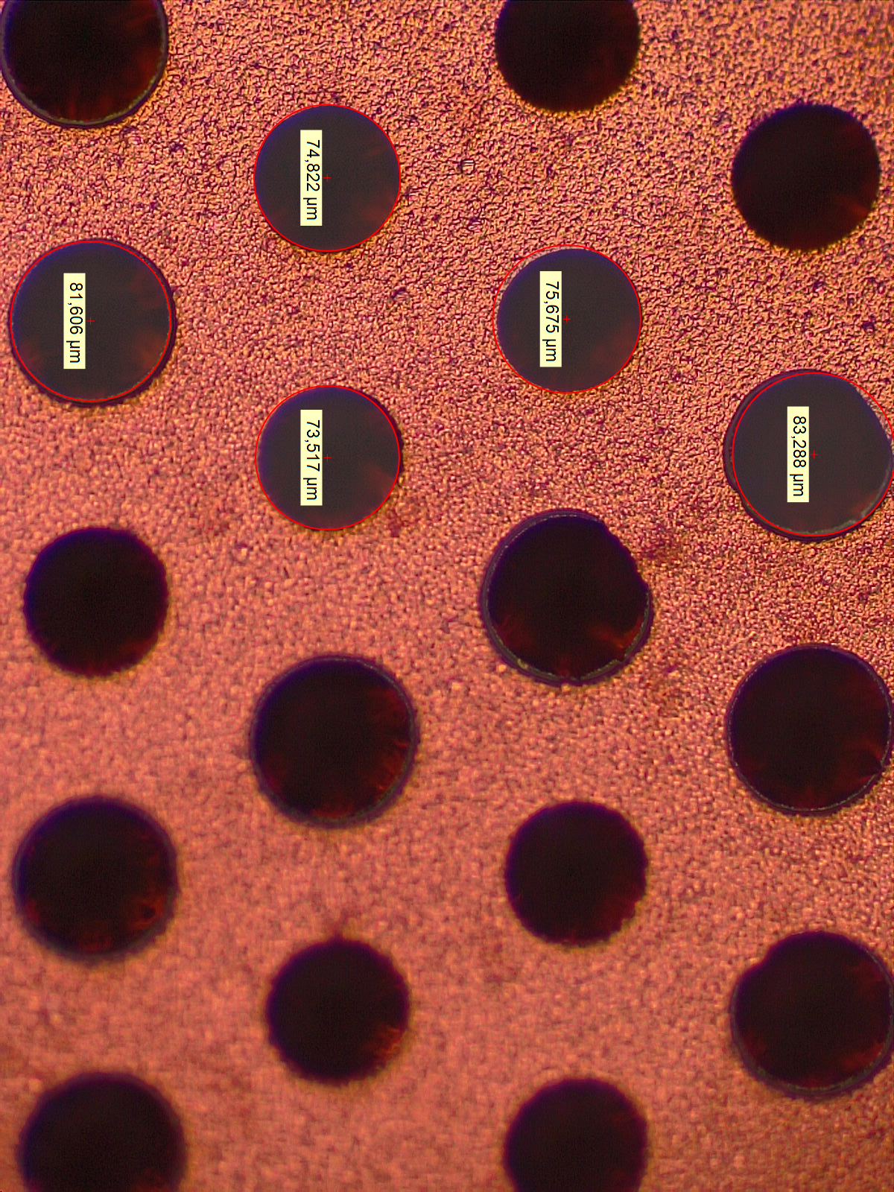
Resistive Challenges
Challenging to make good Amplification structures out of Flexible Cu Clad Laminates (FCCLs) with DLC coating
  Standard Production: Magnetron sputter
  First problem: DLC delaminates
  Solved: Good adhesion found with Ion Beam & Pulsed Laser Deposition
  Solved: for Magnetron: Plasma treatment
  Second problem: Cu delaminates
  Solved: 10nm Cr / Ti layer glues Cu to DLC
  Third problem: DLC (magnetron sputter)
  is not smooth around holes, limits Gain
  Future Research: “DLC-breaking” methods
  Future Reserarch: alt. production schemes
Latest-gen DLC GEM
Regular
Cu GEM

Slide 8
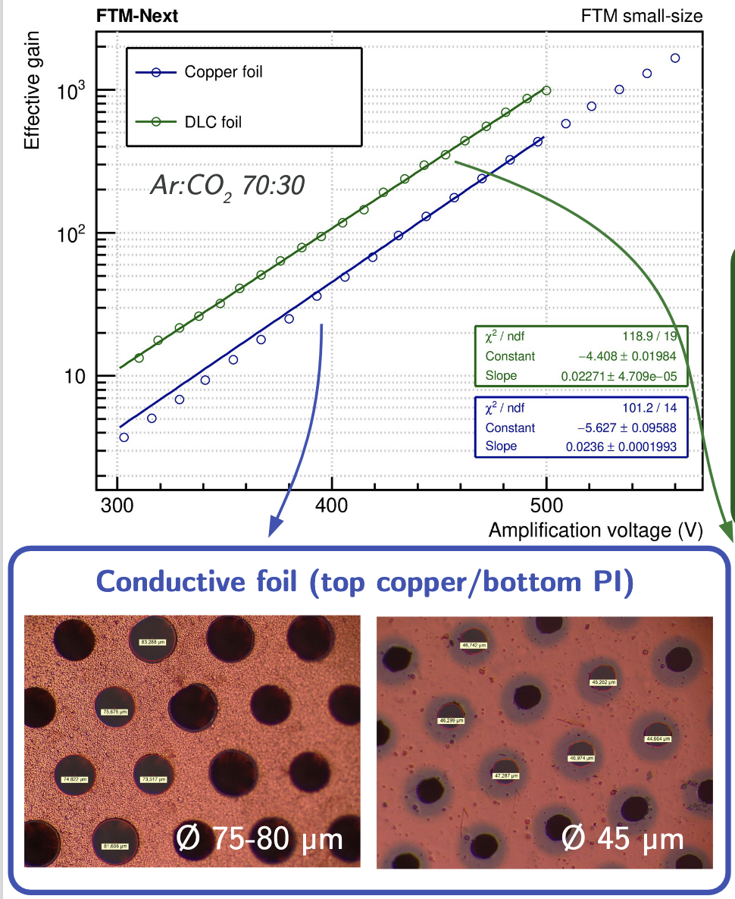
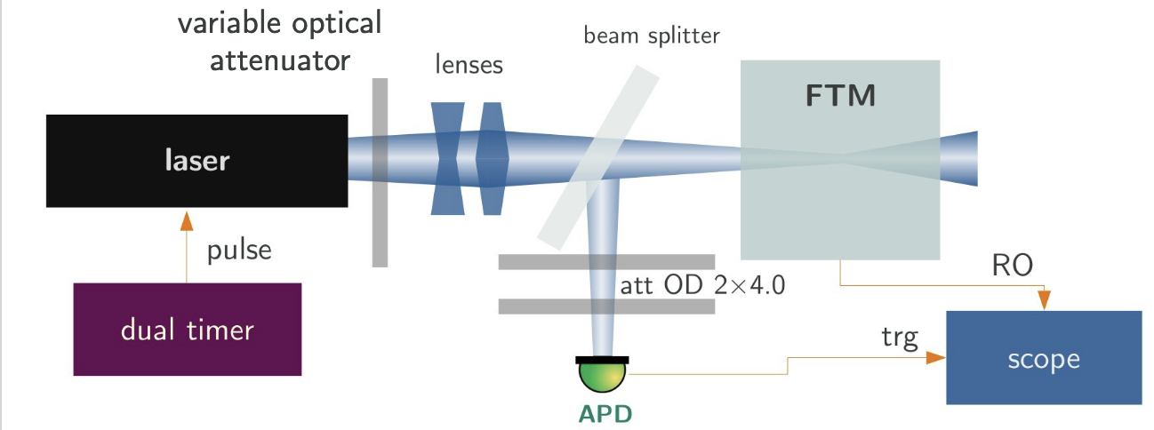
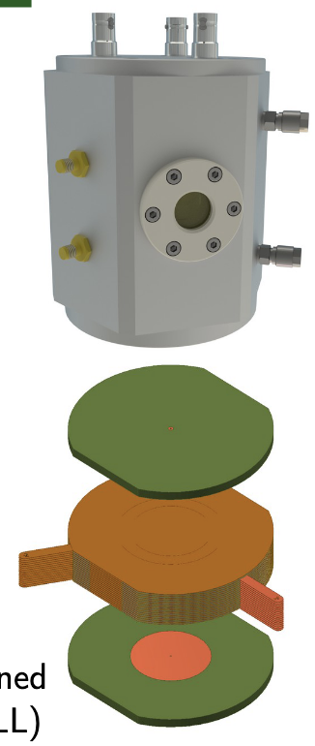
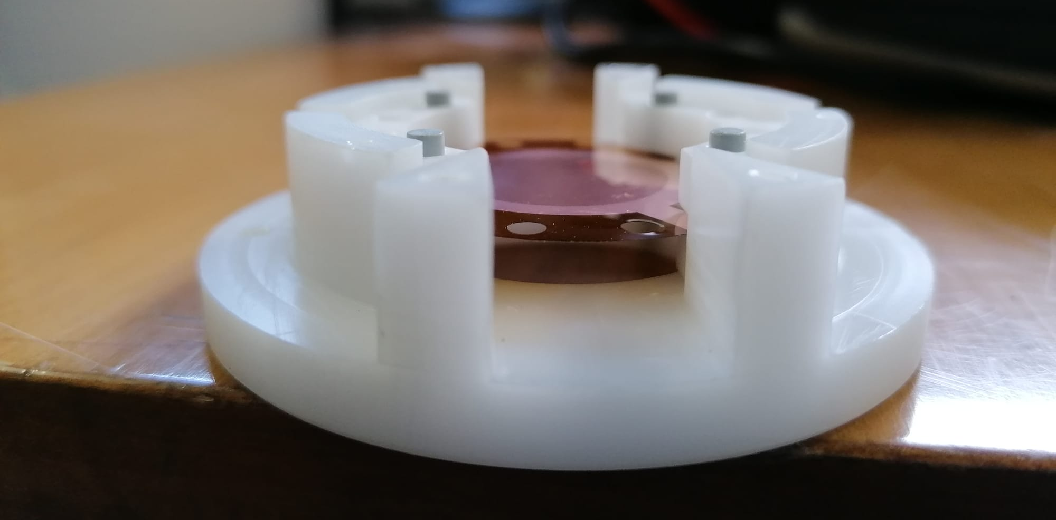
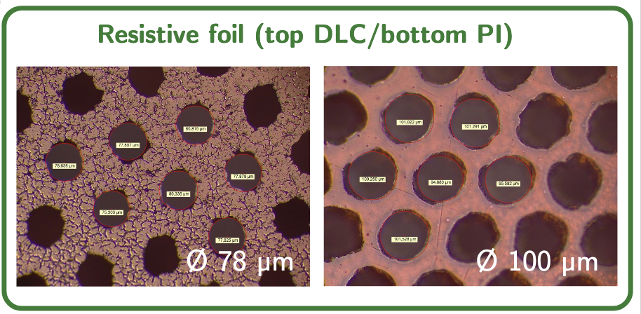
R&D on DLC Electrodes
First Task: High-Resistive GEM with DLC electrodes
Test chamber ready (with Magnetron Sputter DLC test foil inside)
Test setup with UV-laser ready and intesively tested in 2021

Slide 9
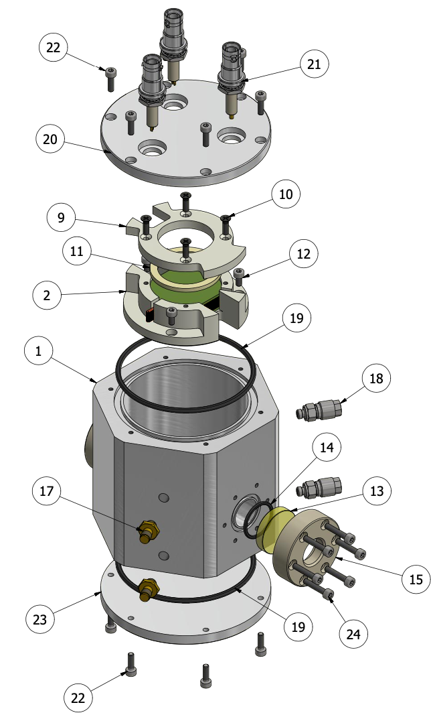
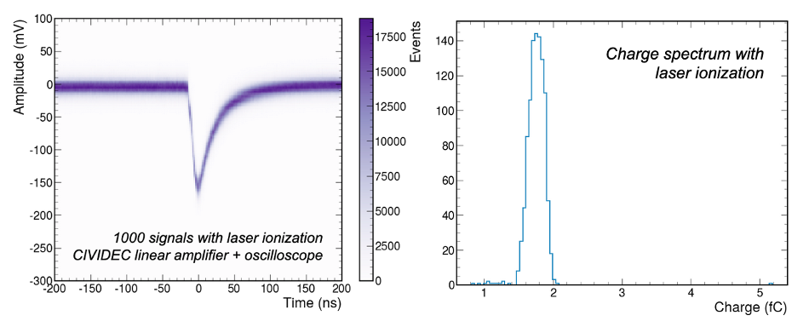
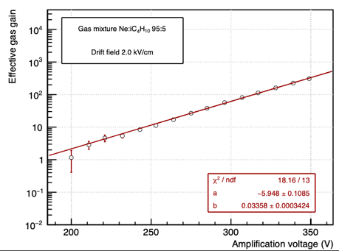
Test of the DLC foil
Test of the DLC foil inside the small-size detector
- has both quartz (UV-laser) as mylar (⁵⁵Fe) window
    Stable operation under 450V in Ar:CO₂:iC₄H₁₀ 93:5:2
    Signals clearly visible (150mV) and 1.75fC
    Gain up to 500 measured – not bad for a first production foil

Slide 10
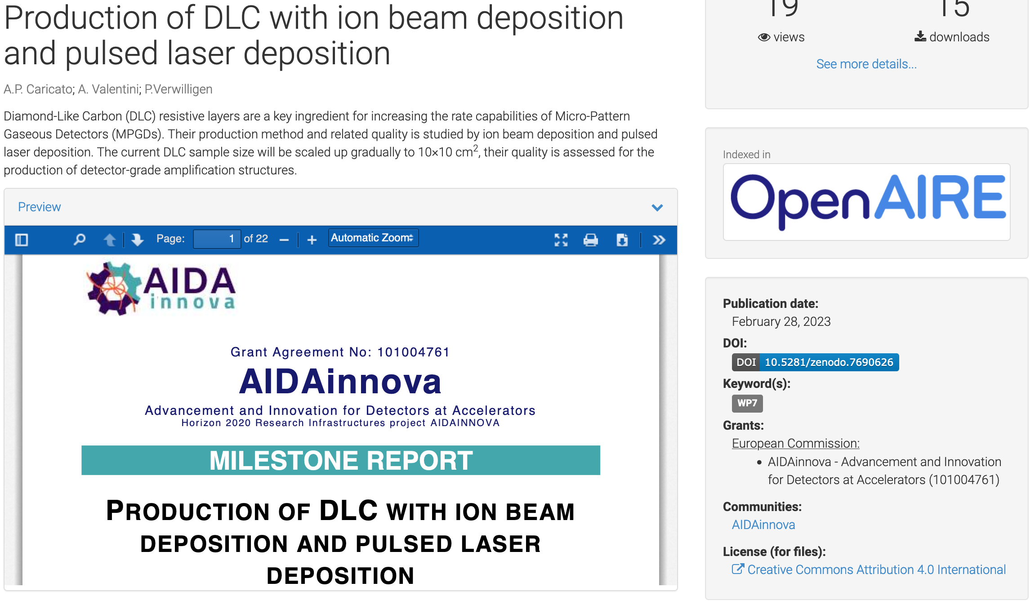
Milestone Report
22 pages – 15 figures – Introduction to various PVD techniques for DLC

Slide 11
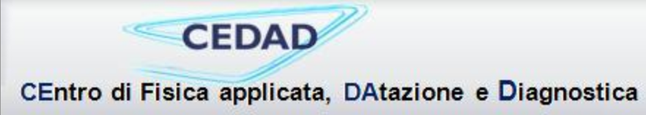
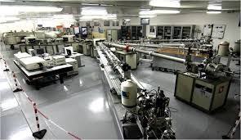
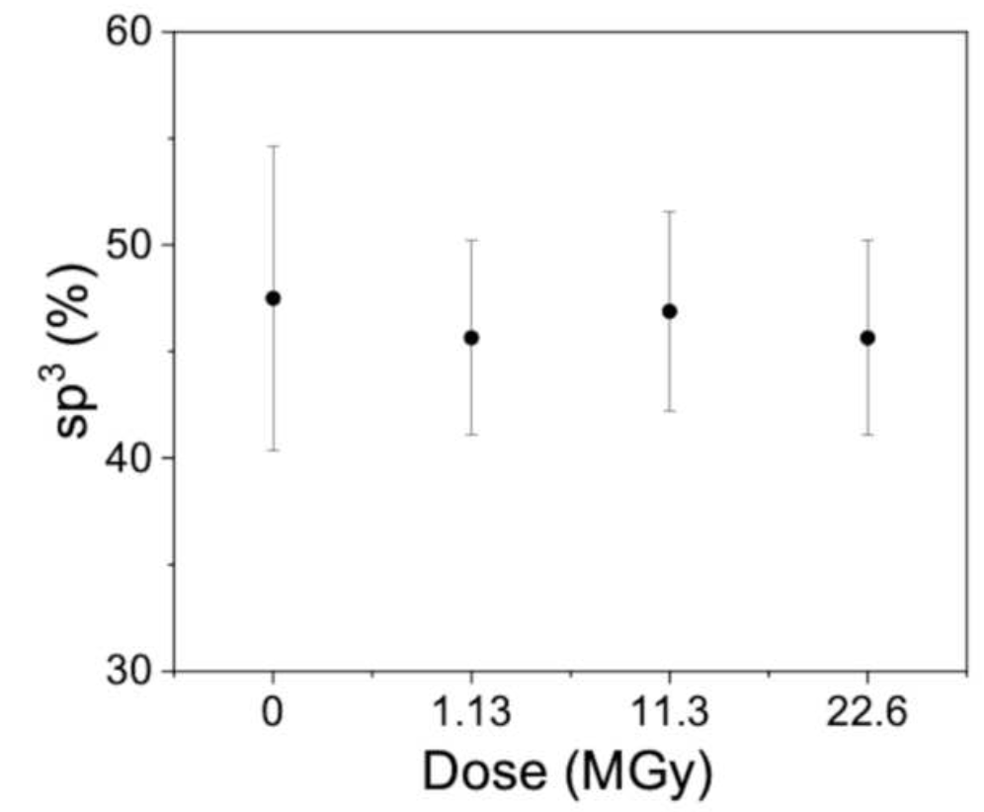
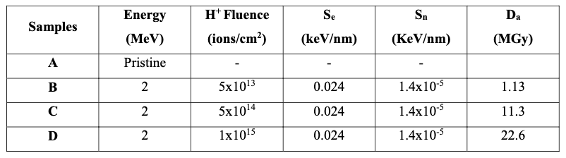
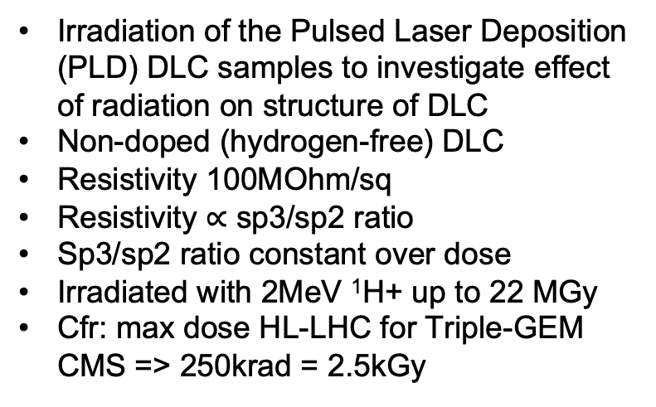
Irradiation of Pulsed Laser Depositioned DLC
Irradiation of the Pulsed Laser Deposition (PLD) DLC samples to investigate effect of radiation on structure of DLC
Non-doped (hydrogen-free) DLC
Resistivity 100MOhm/sq
Resistivity $∝$ sp3/sp2 ratio
Sp3/sp2 ratio constant over dose
Irradiated with 2MeV ¹H+ up to 22 MGy
  Cfr: max dose HL-LHC for Triple-GEM CMS => 250krad = 2.5kGy
3 MV Tandetron Accelerator
¹H+ 3-4MeV – 1um beam
ion species ¹H, ⁴He, ¹²C, ²⁸Si
0.2-10 MeV beam energy

Slide 12
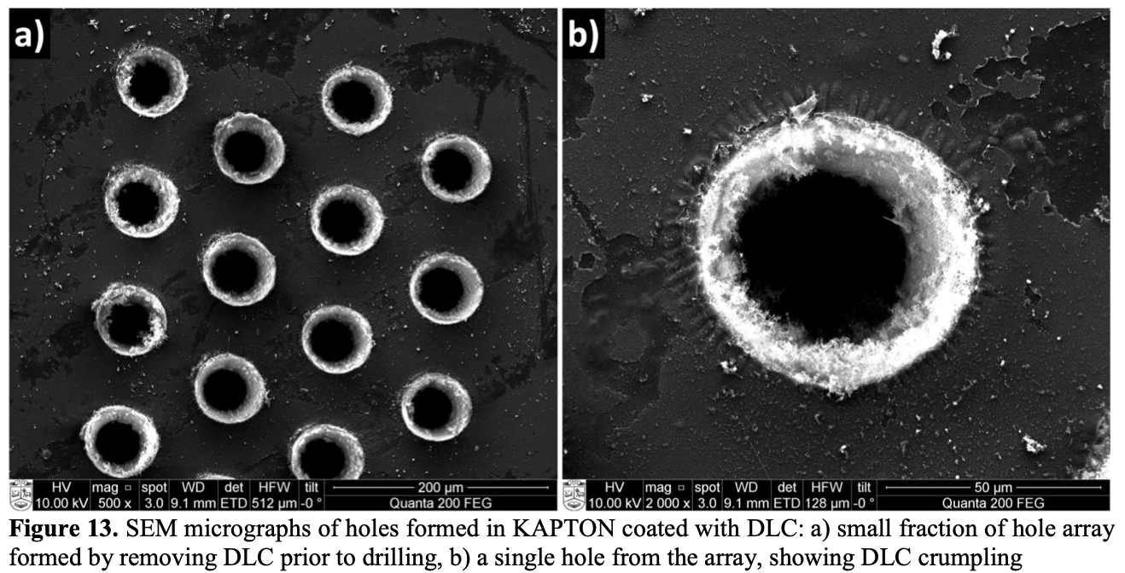
Extra: Kaunas University of Technology collaboration
In 2022 I was contacted by the Kaunas university of Technology (Lithuania)
  They have capabilities and expertise in:
      thin film deposition with Magnetron sputtering
      Micro-etching with Laser
    Wrote a project together for their national funding agency
      Were funded in 2023 and started working on DLC and laser etching
      Entering DRD1 collaboration
first DLC coated Kapton foil that was laser ablated
More samples are being produced to be evaluated on their electrical properties (resistance between two electrodes, capacity to keep high-voltage) and on the cleanliness of the samples
Figure Courtesey:
S. Tamulevicius, B. Abakeviciene

Slide 13
Summary
Pulsed Laser Deposition setup
  Irradiation of Pulsed Laser Deposition created DLC Foils at CEDAD (Mesagne)
  Electrical and structural properties of DLC unchanged under 22MGy irradiation
Ion Beam Deposition setup
  Mostly out of use in 2023-24:
    Maintenance of the setup
    Discussions on future of the setup (new location)
    Started Skill transfer to operate the setup (new PhD student)
Outlook / Future work: Magnetron Sputtering
  Collaboration / knowledge transfer with CERN MPT workshop Magnetron Sputtering Setup
    Currently dedicated at R&D for LHCb high-rate uRWELLs
    Thereafter will be possible to concentrate on double-DLC foils
    Involvement of new PhD student to work / evaluate quality of foils
    Student on leave due to pregnancy and this program has not started
Extra: collaboration with Kaunas University of Technology
  They have found their way into DRD1 now and are starting new collaborations

