Slide 1


Task 7.4.1
A 4-channel electronics board for Cluster Counting
F. Grancagnolo, M. Primavera (Collaborators: A. Corvaglia, E. Gorini, M. Panareo, A. Ventura, C. Veri with contributions of G. Chiarello, G.F. Tassielli)
Beneficiary: INFN-Lecce (and CAEN)
AIDAinnova Final Annual Meeting - FZU, Prague, Czech Republic 5-8 May, 2025

Slide 2

Outline
Main purpose of the Task → strategy to define an optimized configuration of software and hardware necessary to design a multi-channel electronics board for cluster counting (CC)/timing (T) → decrease the cost and complexity of the data acquisition system of a large drift chamber (DC), to reduce the data transfer rate and to provide, with data coming from contiguous channels, the ability to correlate hits to form track segments in real time.
Two different algorithms → for identifying ionization electron peaks in the waveforms generated by a drift signal. Both algorithms converted for use with FPGA.
Three different hardware solutions proposed → among which the final choice for the 4-channel prototype of the readout electronics for CC/T is indicated.

Slide 3
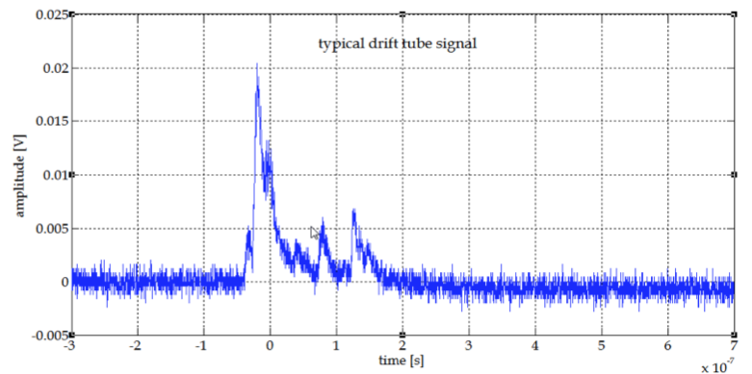
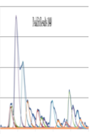
Cluster Counting: the signal
Typical drift tube signal
1 cm diameter,
20 𝜇m sense wire,
90% He – 10% iC₄H₁₀,
2×10⁵ gas gain,
2 Gsa/s – 12 bit
digitization,
No pre-amplifier.
Goal: Single out, in every recorded detector signal, the isolated structures related to the arrival on the anode wire of the electrons belonging to a single ionization act.

Slide 4
Cluster Counting: the technique
Cluster Counting technique: particle identification
Empirical parametrization
^{Poisson}
from Poisson distribution
dN_{cl} /dx
𝛿_{cl} = 12.5/cm for He/iC₄H₁₀ = 90/10,
80% counting efficiency and 2m track
Based on the steps:
for the IDEA
Drift Chamber
2.3%
Determine the time ordered sequence of the electron arrival:
Define the probability function, that the j^{th} electron belongs to the i^{th} cluster, based on the average time separation between consecutive clusters and on the time spread due to diffusion as a function of the drift time :
Cluster Timing technique: spatial resolution
For any given first cluster (FC) drift time, the cluster timing technique exploits the time distribution of all successive clusters to determine hit by hit, the most probable impact parameter, by using statistical (MPS) or ML techniques, thus reducing the bias and improving the average spatial resolution with respect to that obtainable with the FC method alone:
over a 1 cm drift cell, spatial resolution may improve by ≳ 20%
down to ≲ 80 μm.
N_{cl}
Derive the total number of clusters: , the cluster population:
and the most probable time ordered sequence of the ionization clusters:
N_{cl}
n_{el} /N_{cl}
N_{cl}

Slide 5
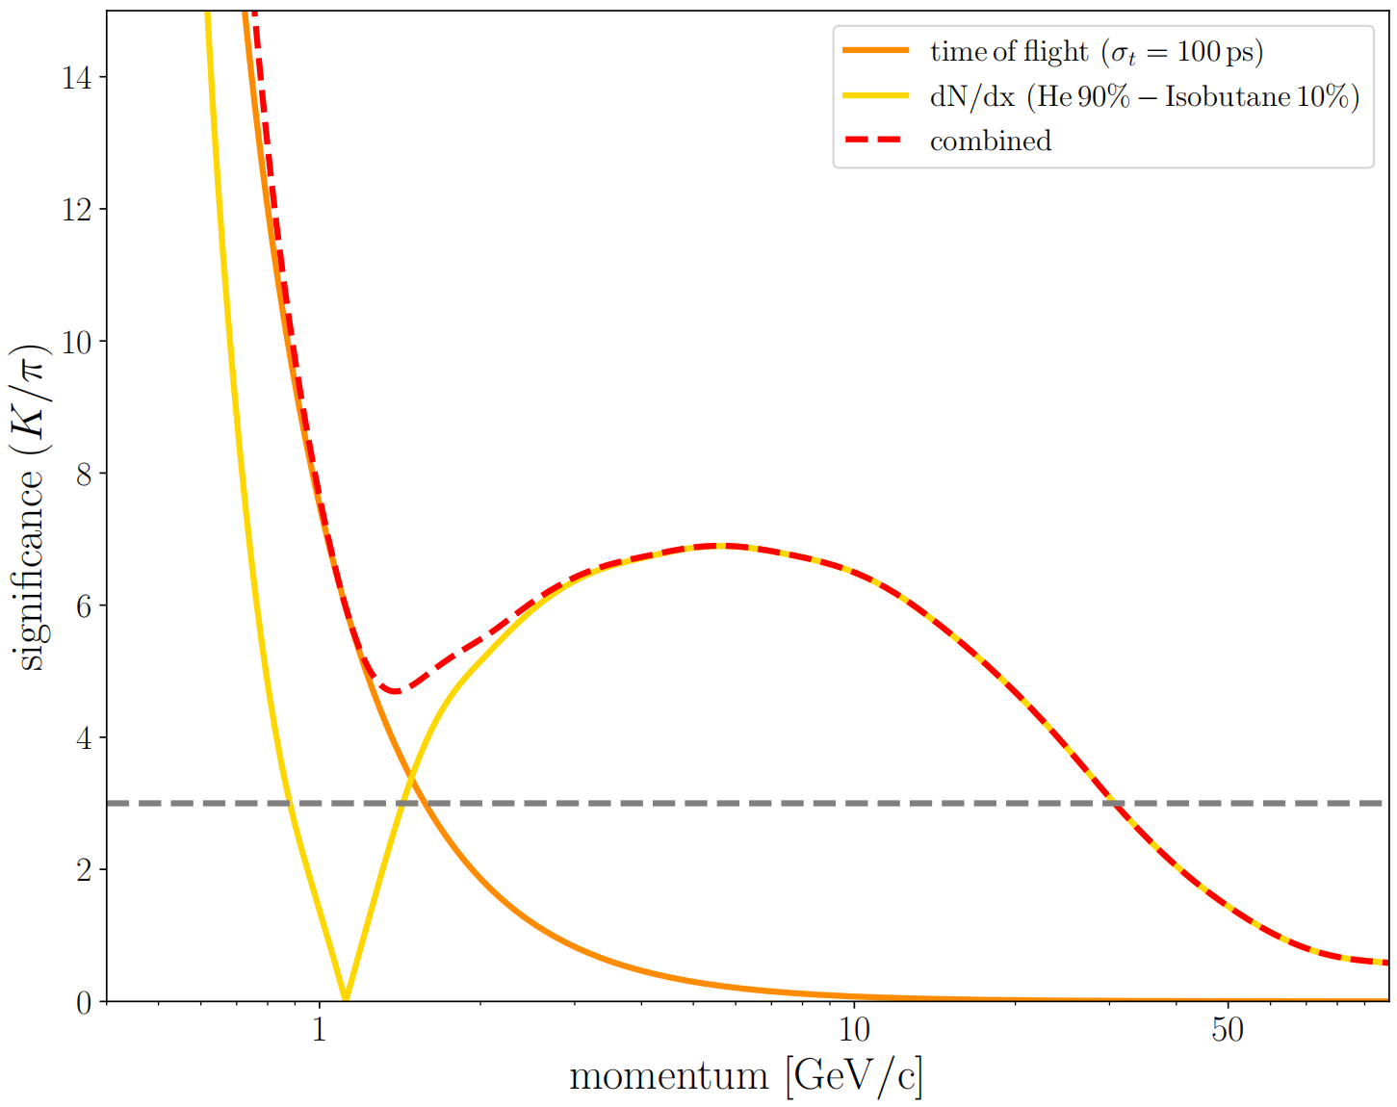
Motivations for the Task 7.4.1 - 1
IDEA DC
expected 𝝅/K separation
(DELPHES simulation)
PROBLEM
SOLUTION
For the IDEA DC, however, given:
> 56,000 drift cells, readout at both ends;
~1.5 cm drift length, max drift time: ～500 ns;
Z decays: ～100 KHz;
charged tracks multiplicity: 20 tracks/hadronic event;
average of 130 hit cells/track;
Digitization: 12 bits at 2 Gsa/s:
20 track/event × 130 cell/track/side × 2 side
× 10⁵ event/s × 5×10⁻⁷ s/cell × 2×10⁹ byte/s =
= 0.5 TB/s
plus 𝛾𝛾, Bhabha, beam background, noise, …
⟹ Transfer rate at Z-pole ≳ 1 TB/s!
some data reduction is mandatory!
A possible solution→ transfer for each hit drift cell the minimal information, i.e.:
amplitude and arrival time of each peak associated with each individual ionization electron, instead of the full digitized signal waveform:
20 track/event × 130 cell/track/side × 2 side
× 10⁵ event/s × 30 peaks/cell × 2 byte/peak =
= 30 GB/s
This can be accomplished → use of simple algorithms on a FPGA for the real time pre-processing of the drift chamber digitized data.
Background and noise can be filtered out by the same algorithm.
CC recipe:
high front-end bandwidth (～ 1 GHz)
～ 1V dynamical range
S/N ratio ≳ 10
high sampling rate (≳ 2 GSa/s)
and ≳ 12 bit
digitization over ∼1 μs

Slide 6
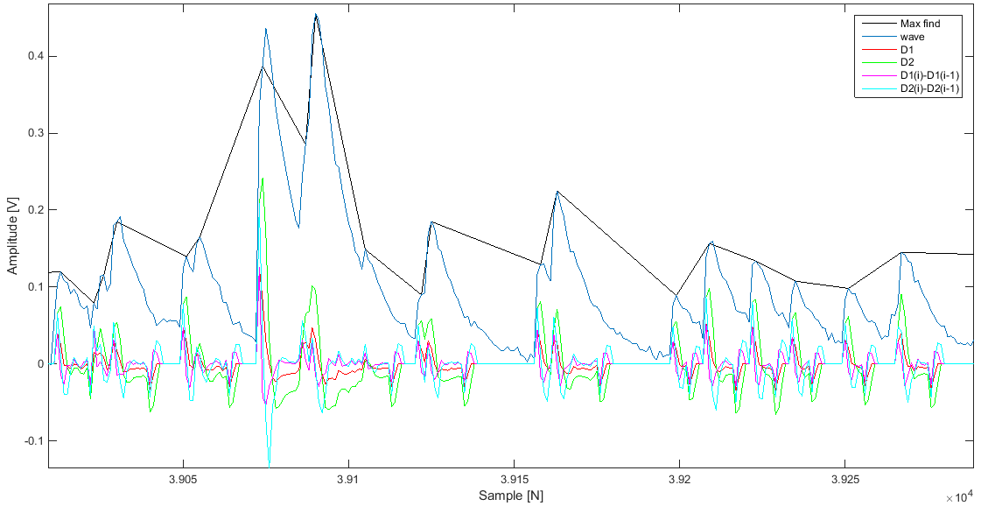
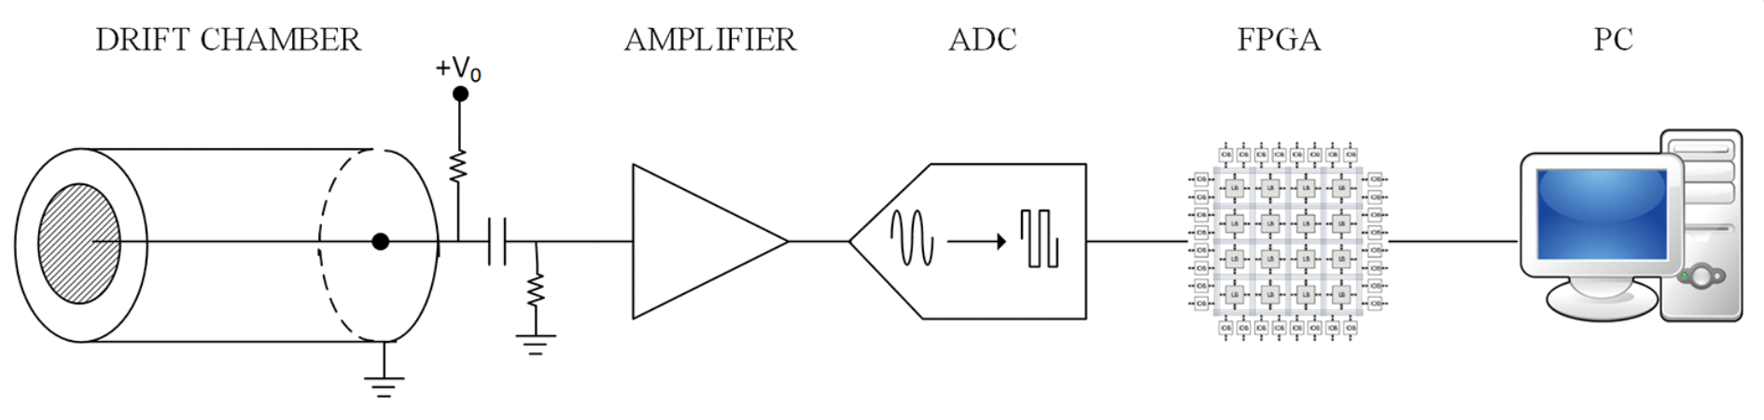
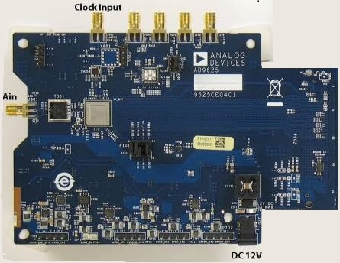
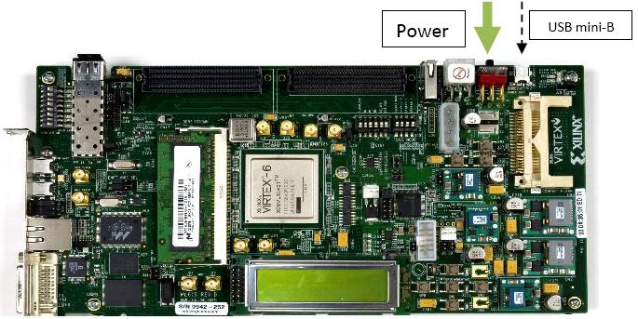
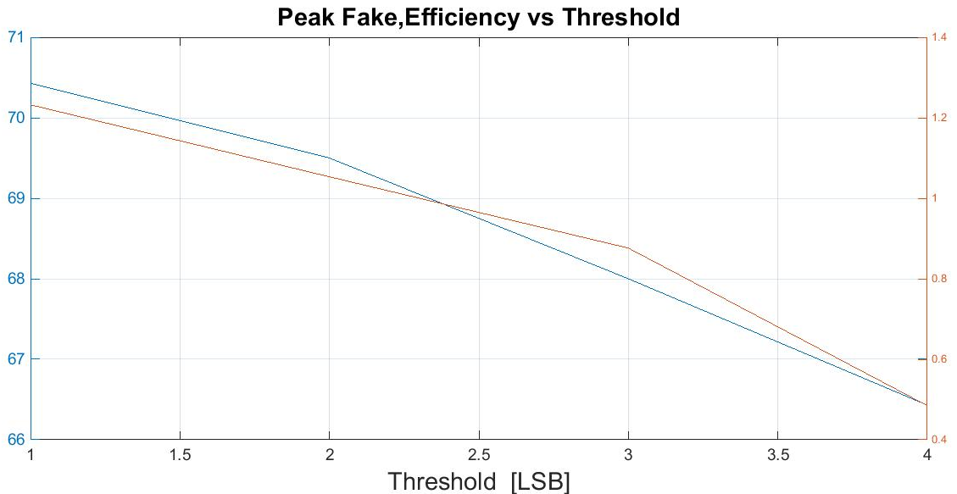
Motivations for the Task 7.4.1 - 2
Single channel implemented solution
The CluTim algorithm*
A peak at the i-th bin is defined by relating its amplitude to those of a number n of preceding and successive bins, with n function of the rise and fall times of the single electron signal.
The amplitude and time of a found peak are then sent to a pipeline memory.
A trigger signal occurs at time t₀, →the reading procedure is enabled and the data relative to the found peaks in t_{0,} t₀ + t_{max}] (t_{max} is the maximum drift time), are transferred to an external device
50 samples
25 ns
Portion of the input signal, values of the auxiliary functions and found peaks.
A fast readout algorithm (CluTim) for identifying, in the digitized DC signals, the individual ionization peaks and recording their time and amplitude was developed as a VHDL/Verilog code implemented on a Virtex 6 FPGA, allowing for a maximum input/output clock switching frequency of 710 MHz.
The hardware setup included also a 12-bit monolithic pipeline sampling ADC at conversion rates of up to 2.0 GSPS.
At 1.5 LSB threshold
70% efficiency with
1.1 average fake peak/total
* G. Chiarello, C. Chiri, G. Cocciolo, A. Corvaglia, F. Grancagnolo, M. Panareo, A. Pepino and G. Tassielli
The Use of FPGA in Drift Chambers for High Energy Physics Experiments, ISBN 978-953-51-3208-0, 2017 JINST 12 C03056

Slide 7
Objectives of the Task 7.4.1
The objective of this task was the implementation, on a single FPGA, of CC/T algorithms (with high peak finding efficiency) for the parallel preprocessing of as many channels as possible (4, at this stage)
This information, besides providing a precise (order of a ns) event time stamping, can be used to exploit the possibility of defining a first-level trigger based on track multiplicity, with latency compatible with the maximum drift time.
This strategy has been accomplished with FPGAs for the real time analysis of the data generated by the DC and successively digitized by an ADC.
Two different approaches to the CC/T algorithms:
  DERIV, based on the first and second derivative of the digitized signal function.
  RTA, based on a bin-by-bin matching of the signal waveform with a normalized search template.
  have been implemented on different hardware configurations:
  ADC32RF45 + FPGA KCU105
  CAEN digitizer VX2751
  NALU Scientific ASoCv3 and HDSoCv1
Test-bed for all hardware configurations with the different algorithms is a beam test campaign aimed at establishing the performance of the CC/T technique.

Slide 8
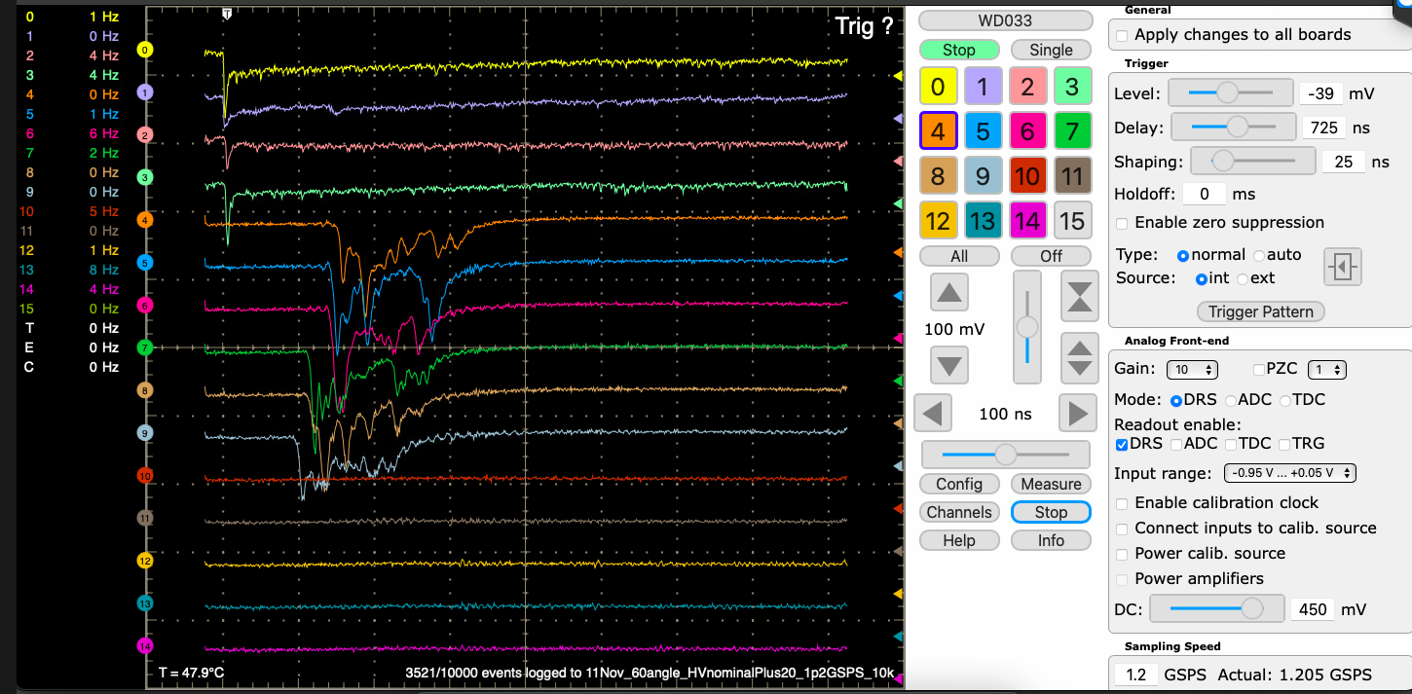
Beam test campaign
Muon beam test campaign
Test setup at CERN
The hearth of the acquisition system
2023-24 CERN PS-T10
The explored βγ values extend over the region of interest for PID at the future lepton colliders.
Wave Dream Board (courtesy of MEG2)
Single electron pulse height
Trigger
1.0 cm
2.0 cm
3.0 cm
Landau fit

Slide 9
Software Implementations

Slide 10
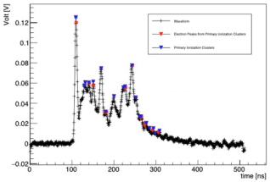

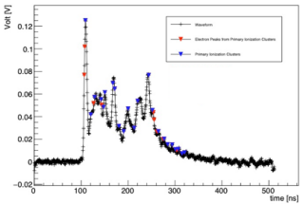
Peak finding algorithms
DERIV algorithm
Both algorithms are executed in real time, while the signal waveform is being digitized, lagging just by the a priori defined single pulse search window, t_{w}. Their full execution, therefore, occurs after a time interval t_{algo}, typically a few clock steps, added to the maximum drift time, t_{max}.
In addition to a C++ version used for the analysis of beam test data, both algorithms, limited to the identification in the digitized DC signal waveform of the individual ionization electron peaks and to recording their time and amplitude, have been developed as VHDL/Verilog hardware description languages for FPGA programming.
The DERIV algorithm acts in strict analogy with the single channel CluTim algorithm previously described. Results of the application of the VHDL version of the CluTim algorithm, implemented on a Virtex 6 FPGA have been published.
For each event, the list of found peaks, with their relative time and amplitude, is stored in a pipeline memory, which is transferred to the data acquisition system in case of a trigger signal, or, alternatively, overwritten by the new list of peaks found in the subsequent event.
Small differences in the found peaks observed between DERIV and RTA algorithms (and expected, due to their peculiarities).
The peaks are detected by imposing thresholds on the local amplitude of the signal waveform and on its first derivatives.
A threshold criterion is also imposed on the sign of the second derivative (thresholds in units of the r.m.s. value of the detected signal noise).
The algorithm has been successfully implemented on FPGAs, reaching satisfactory results in terms of peak-finding efficiency and purity.
electron peak
primary cluster
RTA algorithm
electron peak
primary cluster
Based on a bin-by-bin matching of the signal waveform with a normalized single-electron-pulse template
Raising and falling exponential empirically inferred from the experimental data, digitized according to the data sampling rate, normalized to the amplitude in the search window.
Agreement assessment quantity established by an empirical cut-off value.

Slide 11
Hardware Implementations

Slide 12
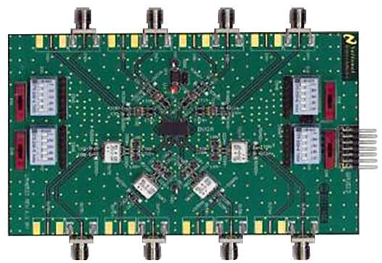
V-sensitive pre-amplifier LMH6522 from TI
To drive a high-performance digitizer a voltage-sensitive preamplifier (Texas Instruments LMH6522) has been chosen, with a maximum high voltage gain of 20 and a high bandwidth (1.5 GHz).
It contains four digitally controlled variable gain amplifiers (DVGA), each one with an independent, digitally controlled, attenuator and a high linearity, differential output amplifier, optimized for low distortion and maximum system design flexibility.

Slide 13
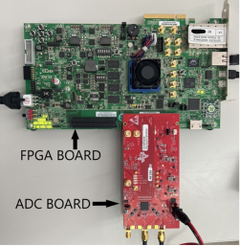
ADC32RF45 + AMD Kintex UltraScale FPGA KCU105
This approach (only one of the two dual-channel ADC is shown) provides the best performance in terms of the CC → used as a test bed to compare the performance of different algorithms and of alternative hw implementations.
The ADC32RF45 is a 14-bit, 3.0 GSa/s, dual-channel ADC that supports waveform sampling with input frequencies up to 4 GHz and beyond. It is designed for high signal-to-noise ratio (SNR), and channel isolation over a large input frequency range. It supports the JESD204B serial interface, a system-level software providing a performance optimized framework to integrate the ADC with various FPGA platforms.
The Xilinx's KCU105 evaluation board is a powerful FPGA development platform specifically designed to provide high-performance computing, enabling wide-band data acquisition over JESD204B high-speed serial connectivity. It utilizes the Xilinx Vivado development environment and it is equipped with 64-bit DDR4 component memory, offering robust storage and memory management, efficient data handling, and supporting faster processing speeds.

Slide 14
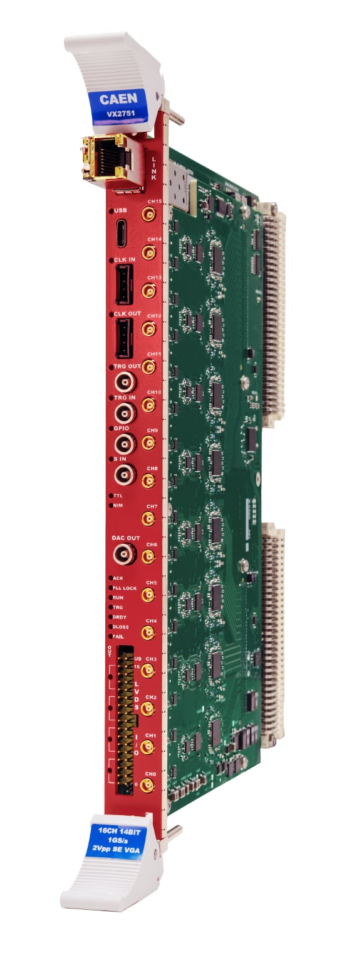
CAEN digitizer VX2751
The CAEN VX2751 is a 16-channel digital signal processor offering, independently for each of the 16 channels, waveform digitization and recording. It can manage the full acquisition chain, from the input signal sampling in the ADC to the processing of the signal and readout. At the end of January 2025, CAEN has commercially released the first version of the VX2751.
The analog single-ended input channels, with software selectable input gain up to x100 and 500 MHz bandwidth, are digitized with a 14 bit, 1 GSa/s ADC, compatible with the minimal requirements for CC. The sampled data are used to initiate the digital pulse processing sequence, managed in the FPGA at the firmware level, where different firmware types, including custom algorithms, like DERIV and RTA, can be selected via software. Besides VHDL programming language, the available Sci-Compiler software, a block-diagram-based graphic tool, offers a very flexible and user-friendly way to build up more complex algorithms.
The CC algorithms are currently being implemented, the test of the whole procedure will shortly follow and the results of a direct comparison between the CAEN VX2751 and the ADC32RF45 + KCU105 with experimental drift tube waveforms will be shown.

Slide 15
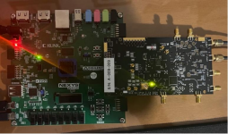
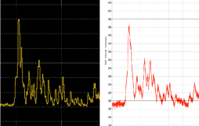
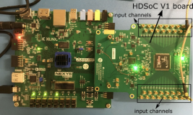
NALU Scientific ASoCv3 and HDSoC
The ASoCv3 board, shown with a Digilent Nexys FPGA board with a serial communication interface, has been tested on the bench by injecting an AWG signal simulating a drift tube signal. The comparison of the AWG signal (at left) with the signal seen by the ASoCv3 (at right) shows bandwidths limitations, concealing structures with close peaks, and a significant worsening of the signal to noise ratio.
ASoCv3 board
Nalu Scientific has also developed a new high-density chip, HDSoC, with 64 channels, > 600 MHz analog bandwidth and up to 2 GSa/s sampling rate. A 32 channels evaluation board of this chip has been procured (thanks to CAEN Technologies, US branch of CAEN, distributor for Nalu Scientific), together with a Digilent Nexys FPGA board with a serial communication interface. The electronic setup, is currently under testing.
HDSoC board

Slide 16
CONCLUSIONS for Task 7.4.1 - 1
Concentrating on the three alternative hardware implementations previously listed, equipped with the described DERIV and RTA algorithms:
  • NALU SCIENTIFIC ASoCv3 and HDSoC
It is evident that the quoted bandwidth of the ASoCv3 chip, 850 MHz, is marginal for an efficient application of the cluster counting technique. We expect an even inferior performance from the test of the HDSoCv1 chip, since its analogue bandwidth is quoted to be even lower, 600 MHz. We are confident that future versions of these chips will provide better performance in terms of bandwidth, and we will pay attention to new releases.
  • CAEN digitizer VX2751
Although the performance of the very recently (January 2025) released VX2751 digitizer have not yet been fully evaluated, according to the experience gained with the Nalu ASoCv3 tests, the CAEN quoted 500 MHz bandwidth sounds even more marginal. However, the high input gain and the larger number of bits, 14, may moderate the bandwidth limitations. It is important to complete the tests and evaluate the performances of the VX2751. Both peak finding algorithms are being optimized by taking advantage of the available Sci-Compiler software.
  • TEXAS INSTRUMENT ADC32RF45 coupled to AMD Kintex UltraScale FPGA KCU105
We propose this configuration as the final choice, as it represents the best solution in terms of performance, satisfying the requirements of the cluster counting/timing technique.

Slide 17
CONCLUSIONS for Task 7.4.1 - 2
Therefore, the 4-channels prototype electronics chain for cluster counting, shown below, made of a sequence of the following blocks:
  • Texas Instruments LMH6522 as a first stage of a 4-channels voltage sensitive preamplifier, directly connected to the terminated outputs of the drift tubes.
  • Texas Instruments ADC32RF45, two dual channel analog-to-digital converter chips on an interface card, accepting at the input the four differential outputs of the preamplifier, and sending the digitized outputs through the serial interface JESD2048 to the FPGA.
  • AMD Kintex UltraScale FPGA KCU105, with the DERIV and RTA algorithms implemented on, as described.

