Slide 1


WP7 Task 4.2 Final Report: High pressure gas TPC for neutrino physics
Gary Barker, Alan Burton, Alexander Deisting,
Philip Hamacher-Baumann,
Xianguo Lu, Matthew Snape
University of Warwick
On behalf of the Task Group

Slide 2
A reminder
Task 7.4. A 4-channel electronic board prototype for cluster counting and Hybrid readout for high pressure gas TPC for neutrino physics
• Design electronics and realise a 4-channel prototype for cluster counting in ultra-light drift chambers
• Identification and characterisation of adequate gasses
• Construction of a small-scale TPC prototype (#10 l) with a hybrid charge and optical readout
(https://aidainnova.web.cern.ch/wp7)

Slide 3
Collaborators
INFN and Politecnico di Bari, IT
  Gabriella Catanesi, Lorenzo Magaletti
University of Oxford, UK
  Jocelyn Monroe, Morgan Wascko
Royal Holloway, University of London, UK
  Asher Kaboth
University of Santiago, ES
  Diego Gonzalez Diaz
CSIC & Univ. de Valencia, ES
  Justo Martín-Albo
University of Warwick, UK
  Gary Barker, Alan Burton, Alexander Deisting, Philip Hamacher-Baumann, Matthew Snape, Xianguo Lu

Slide 4
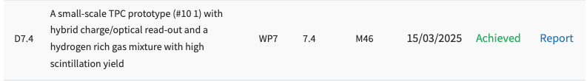
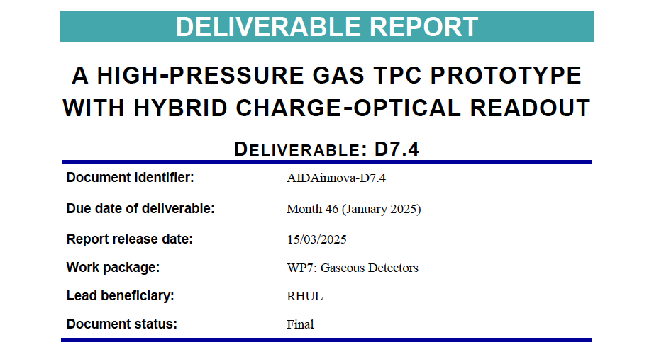
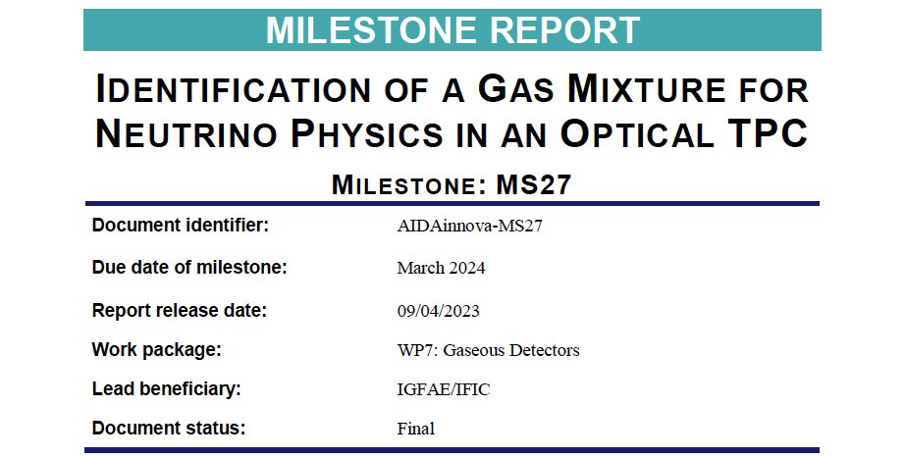
Milestone report https://aidainnova.web.cern.ch/milestones
Deliverable report https://aidainnova.web.cern.ch/deliverables
https://zenodo.org/records/10952386
https://zenodo.org/records/15188304

Slide 5
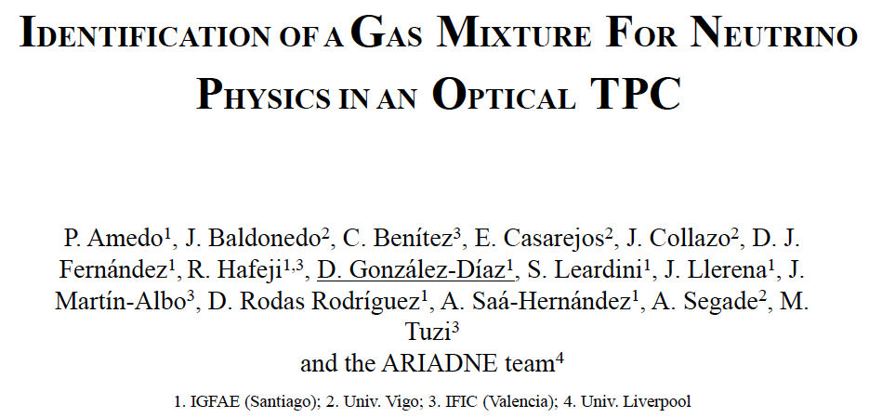
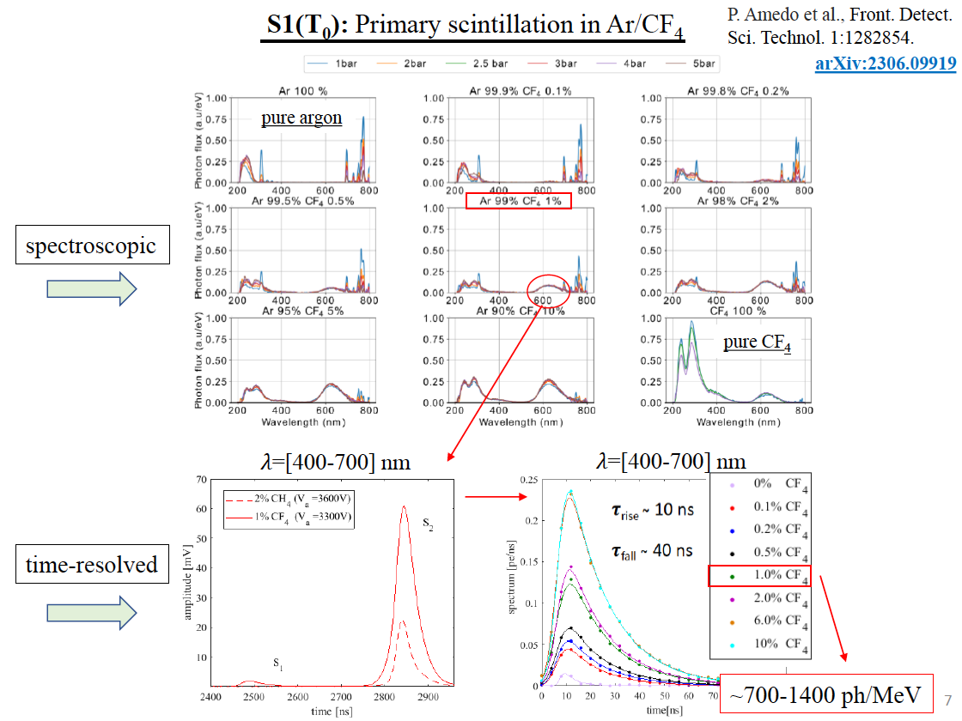
Conclusion with Milestone Report
An argon–CF₄ gas mixture (with CF₄ at the percent level) scintillates in the visible spectrum sufficiently to allow detection thresholds of a few MeV
https://indico.cern.ch/event/1307202/contributions/5498811/

Slide 6
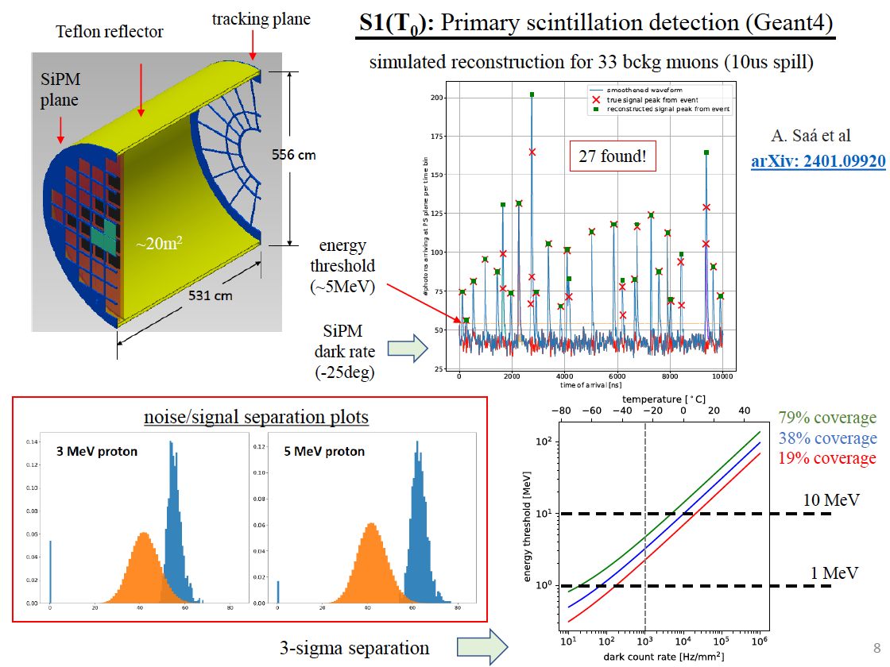
Conclusion with Milestone Report
An argon–CF₄ gas mixture (with CF₄ at the percent level) scintillates in the visible spectrum sufficiently to allow detection thresholds of a few MeV
https://indico.cern.ch/event/1307202/contributions/5498811/

Slide 7
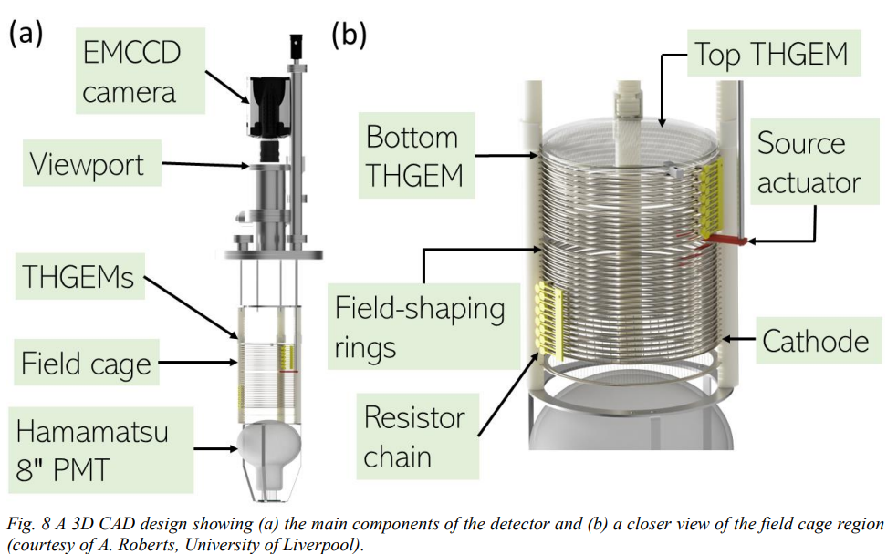
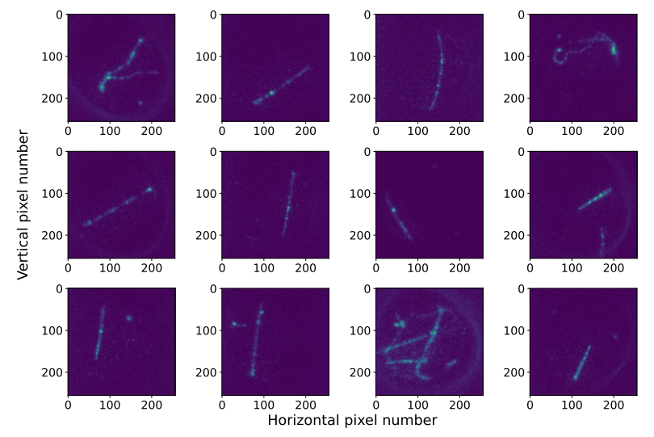
Muon tracks have been reconstructed with a double-thGEM up
to 1.5bar, for 1% CF4
The optical gain is around 2 x 10^4 (final analysis ongoing).
Milestone MS27 report

Slide 8
Introduction
Aims and Motivations
WarTPC Introduction
  Gas System
  Drift Components
  THGEMs
  Photonis Cricket Intensifier
  Optical Readout
  Charge Readout
Measurements
  Different Methane Fractions Results
  High-Pressure Pure Argon Results
Conclusion & Outlook

Slide 9
WarTPC Aims and Motivations
Develop optical readout TPC
  Optical readout provides scalable and cost-effective readout with highly granular data for analysis.
  Aim for high-pressure operating conditions.
Gas Studies
  Investigate hydrogen-rich gas mixtures which have the potential for event-by-event detection of neutrino-hydrogen interaction (Lu et al. Phys.Rev.D 92, 051302 (2015); Hamacher-Baumann, Lu, Martín-Albo, Phys.Rev.D 102, 033005 (2020))
  Achieve high scintillation yield for optical readout.
TPC R&D platform:
  Create a platform for UK researchers to develop next generation TPC technologies

Slide 10
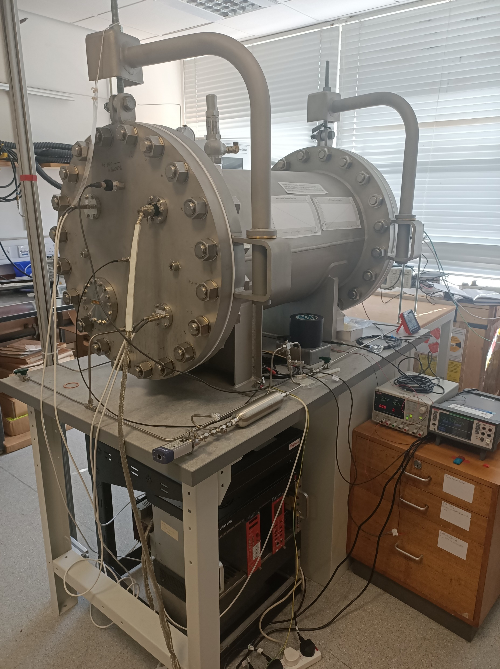
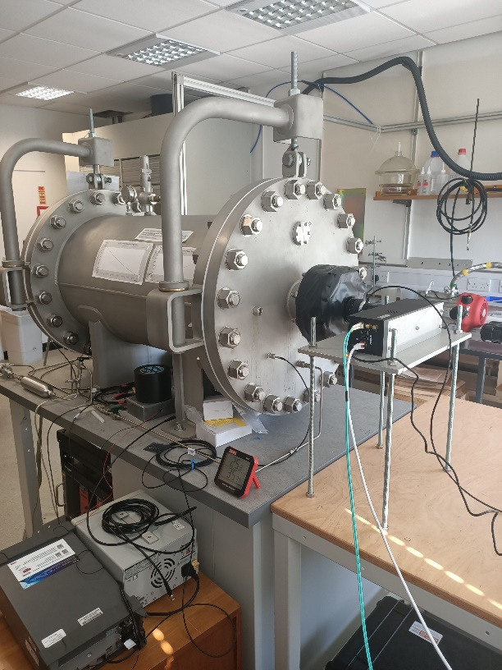
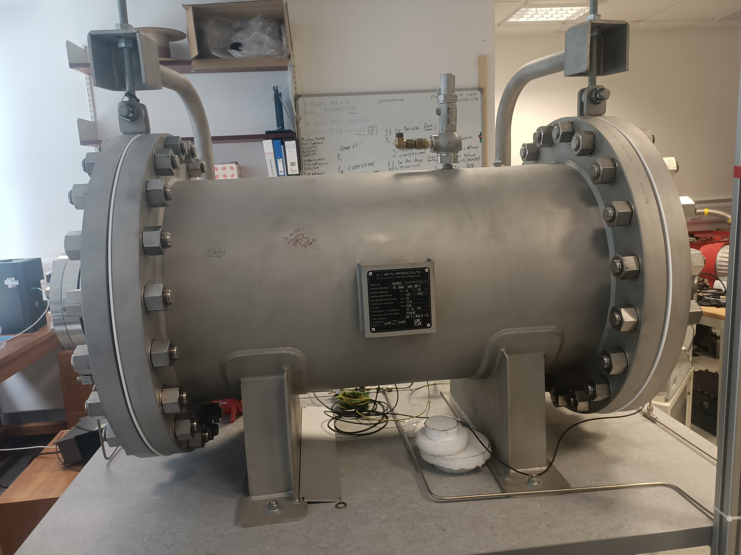
WarTPC Introduction
Hybrid optical/charge readout TPC
195 L 10 bar maximum pressure vessel:
  1 meter long, 50 cm diameter
Am-241 for ionisation source
Has own in-house gas system
Fig. 2. The closed pressure vessel seen from the cathode side (left) and the camera side (right).
Fig. 1. The closed pressure vessel seen from the side.

Slide 11
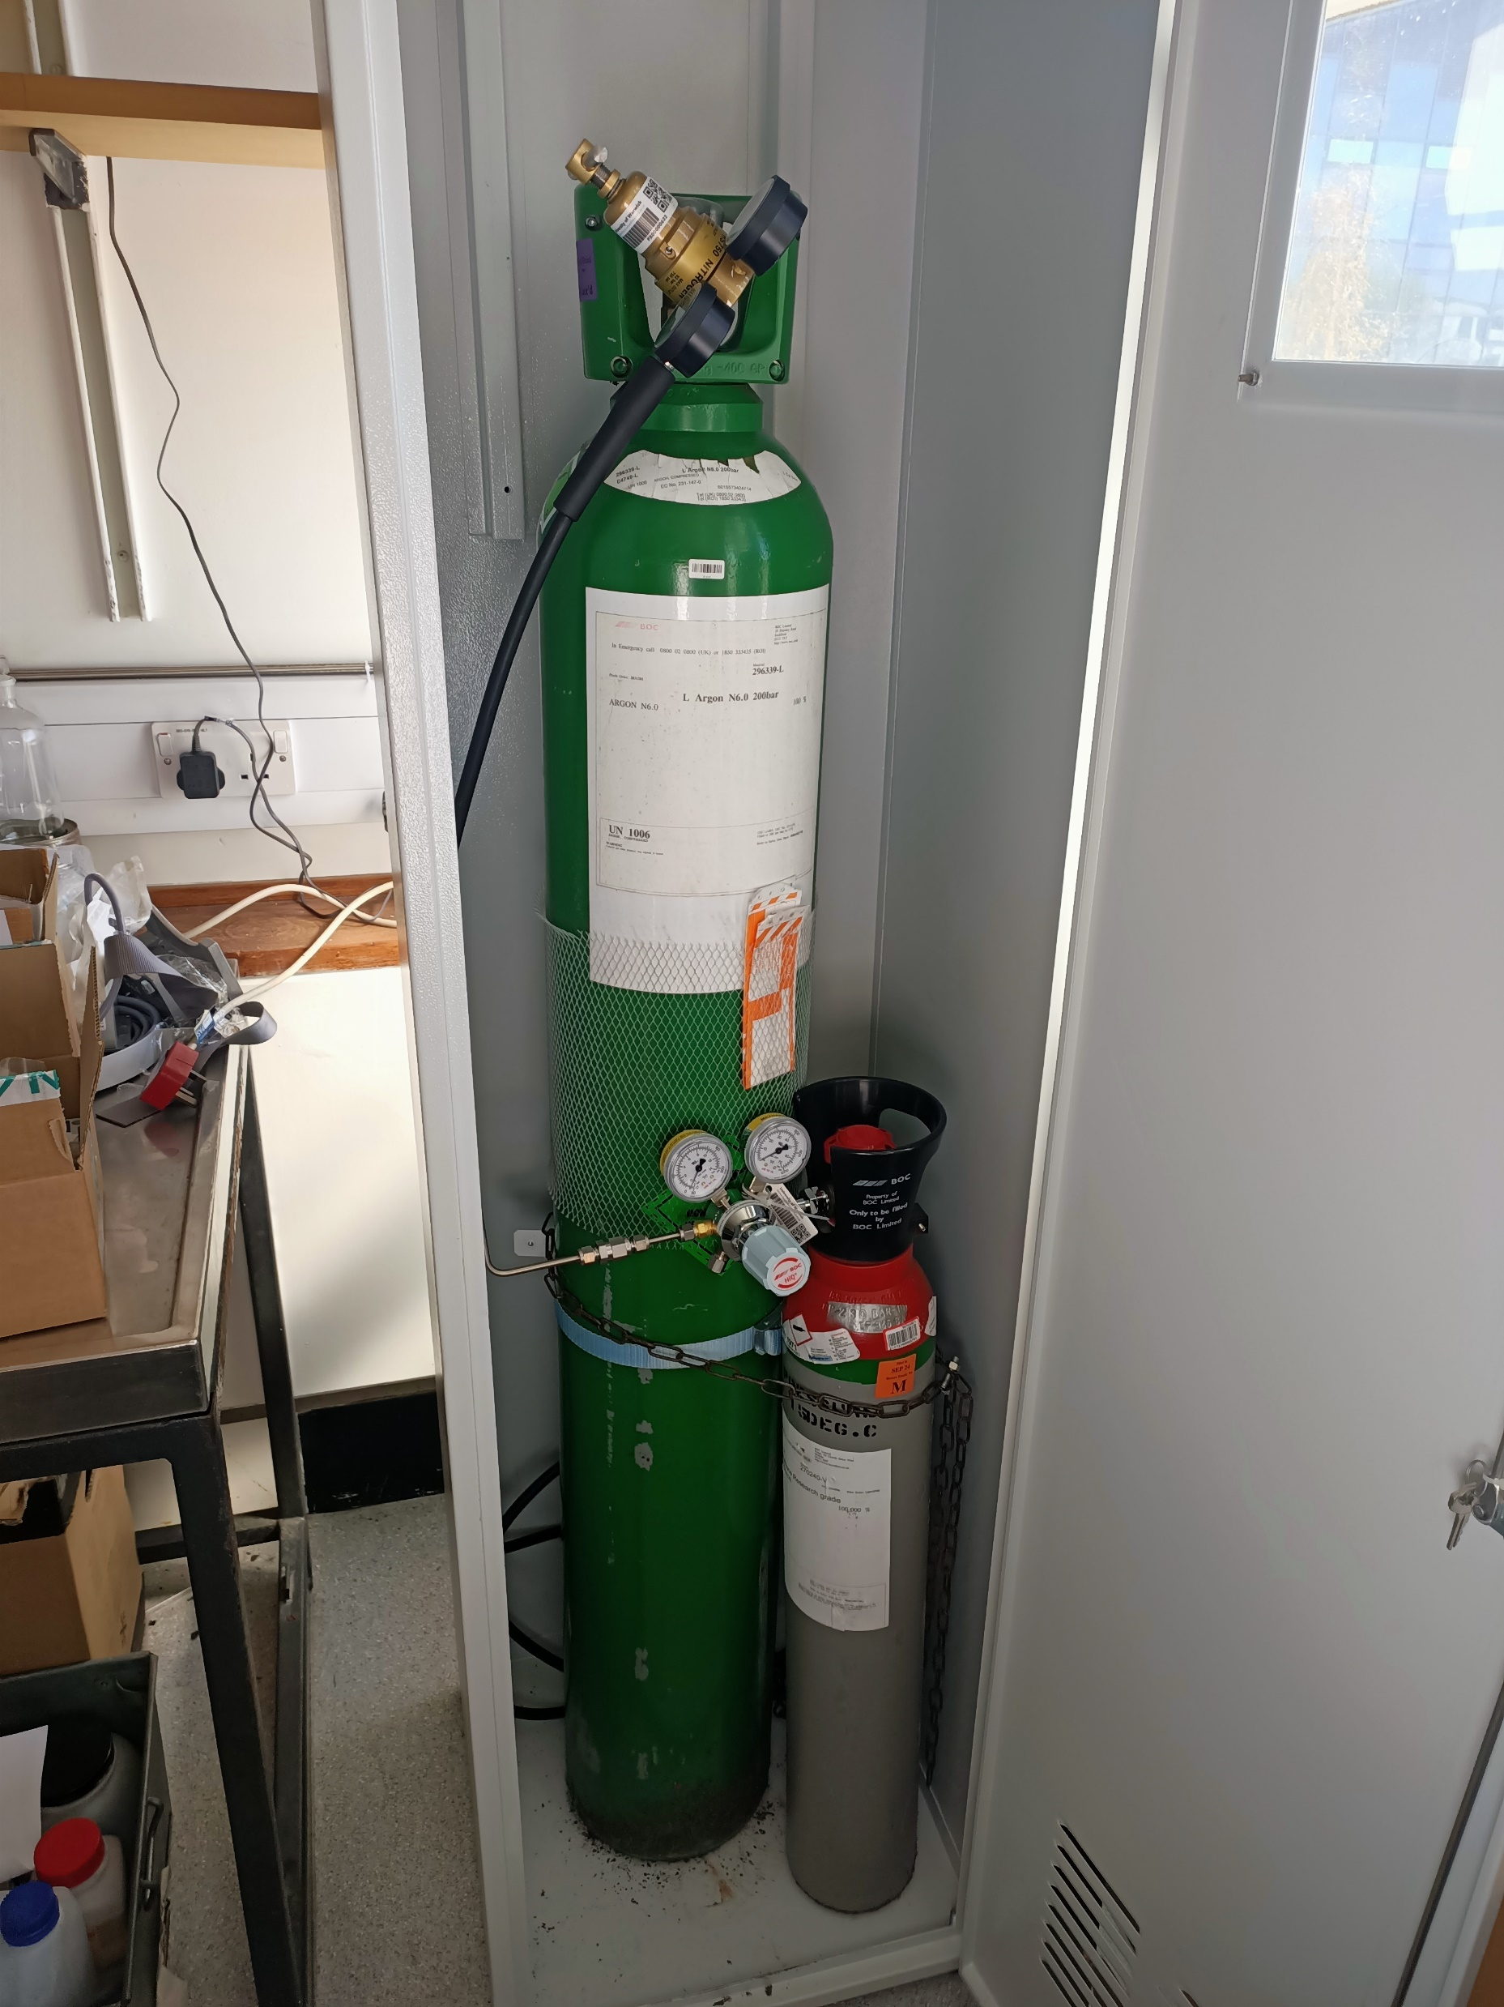
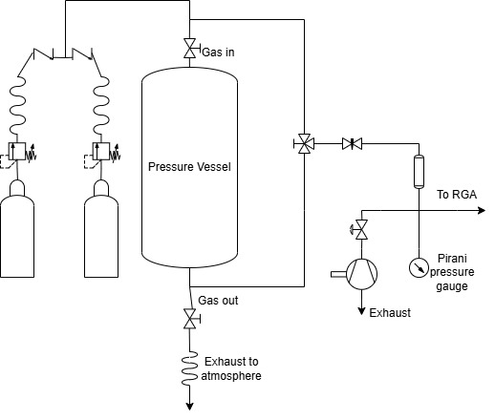
Gas System
Capable of connecting two cylinders to vessel:
  Argon + one other gas type
Dedicated sampling system:
  Capable of sampling vessel or cylinder gas
  Connects to Residual Gas Analyser (RGA) to measure gas purity
Fig. 3. Schematic for the WarTPC gas system.
Fig.4. The argon and methane cylinders connected to the gas system

Slide 12
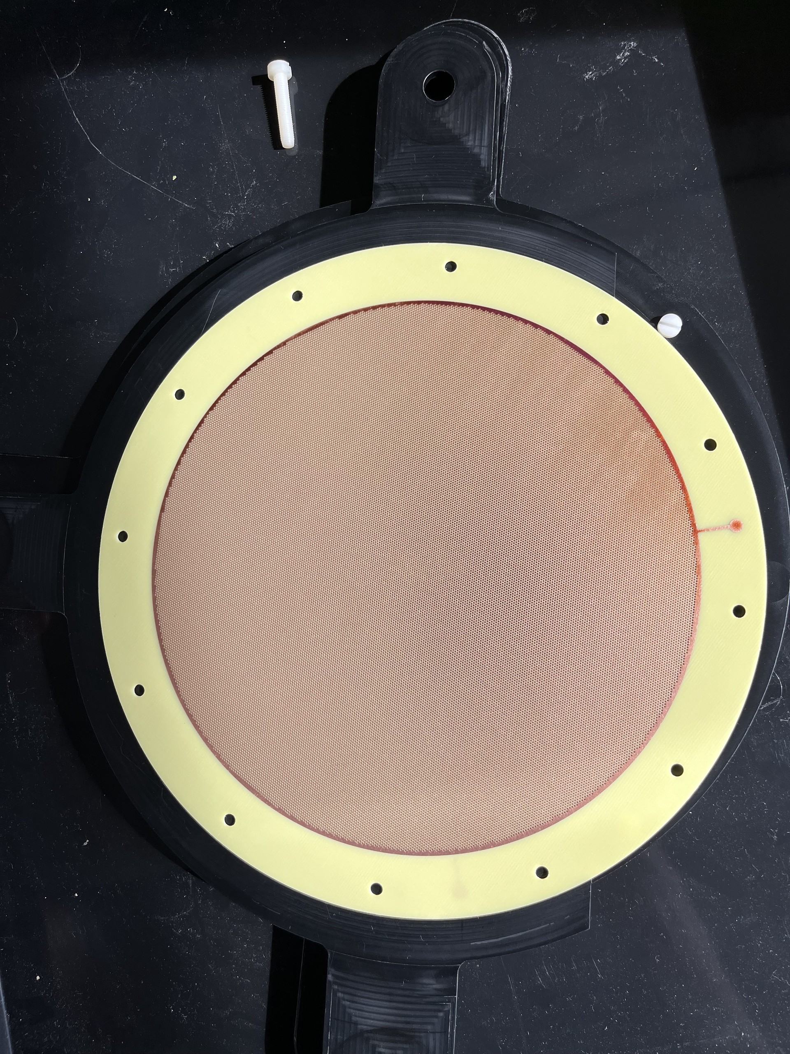
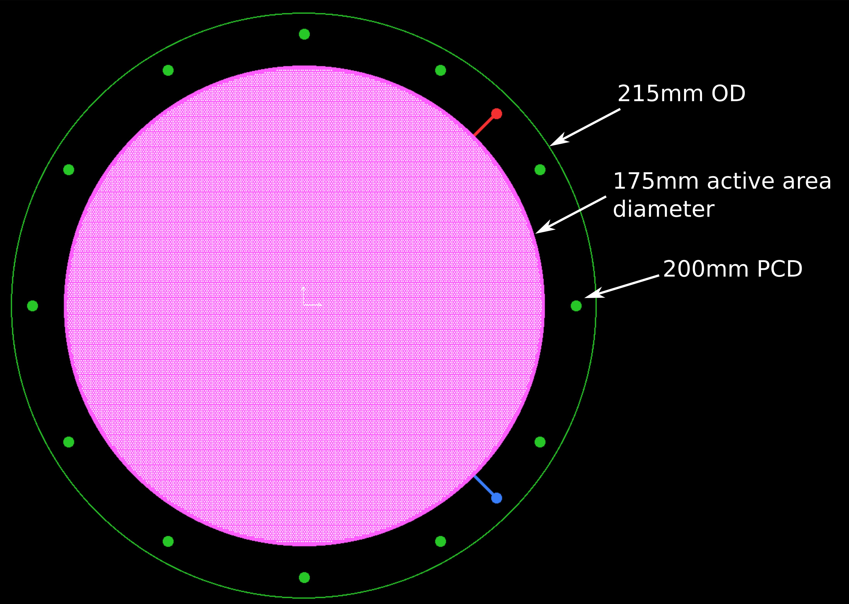
THGEMs
FR4 dielectric with passivated copper electrodes
175 mm diameter active area
0.5 mm holes, with 0.8 mm pitch and 50 µm rims around the holes
Produced by CERN
Fig.5. The original CAD model of the THGEMs
Fig.6. One of the THGEMs resting in the holder

Slide 13
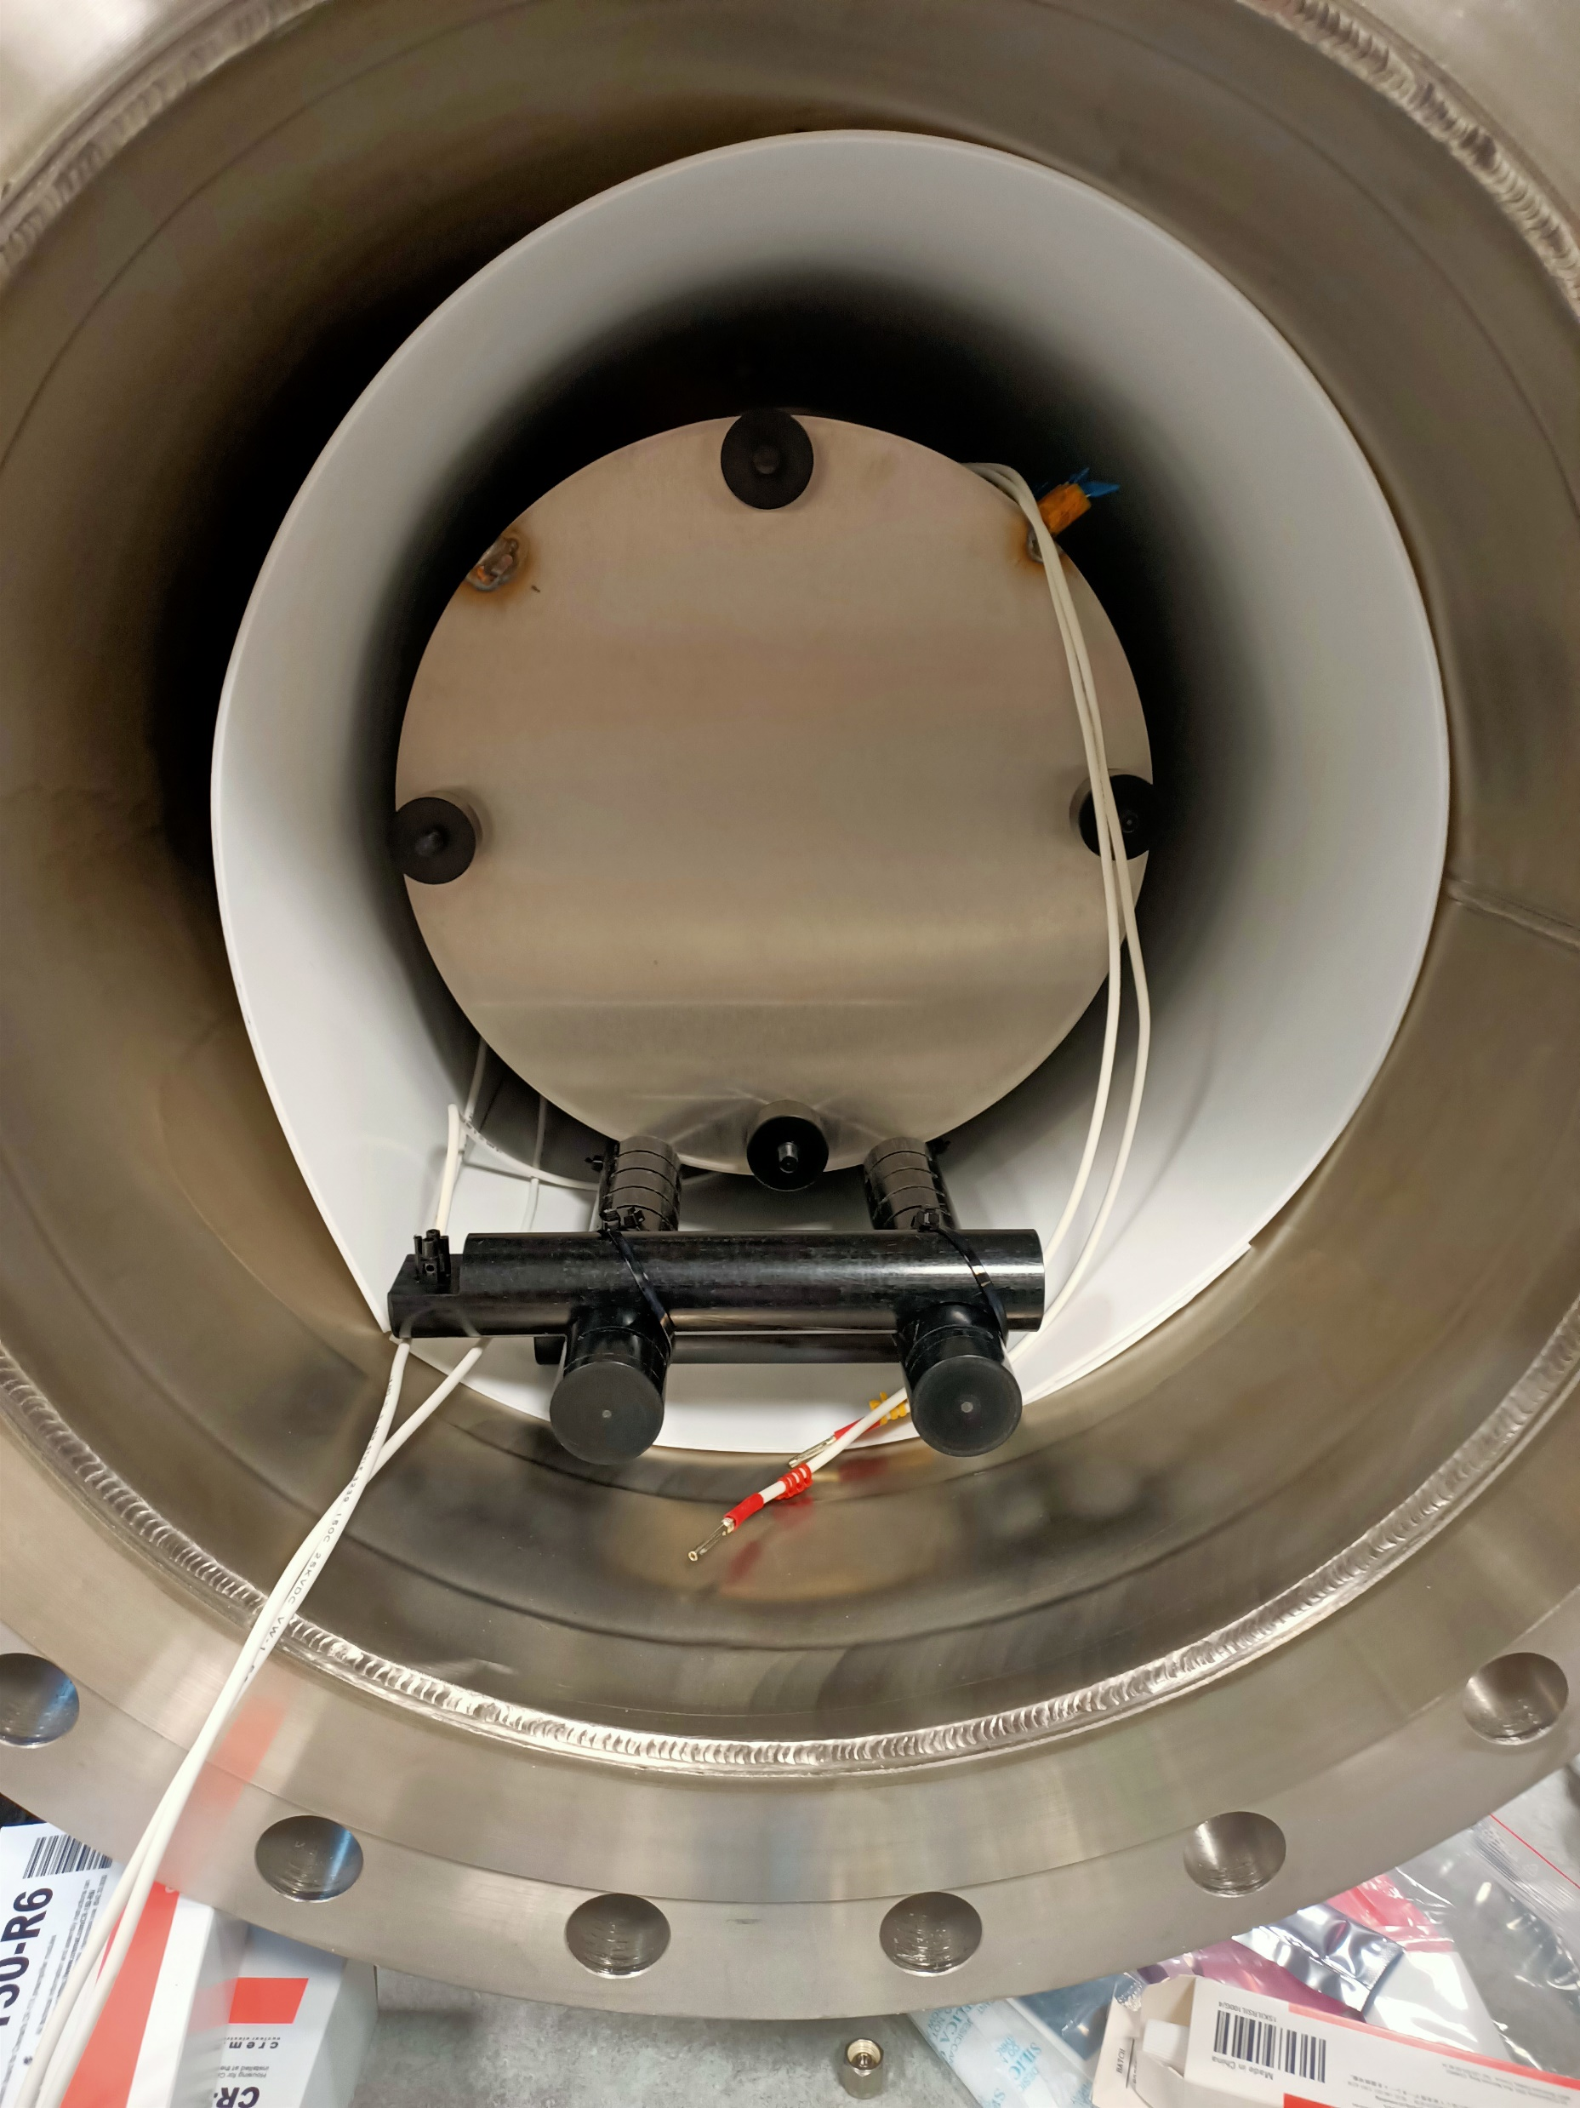
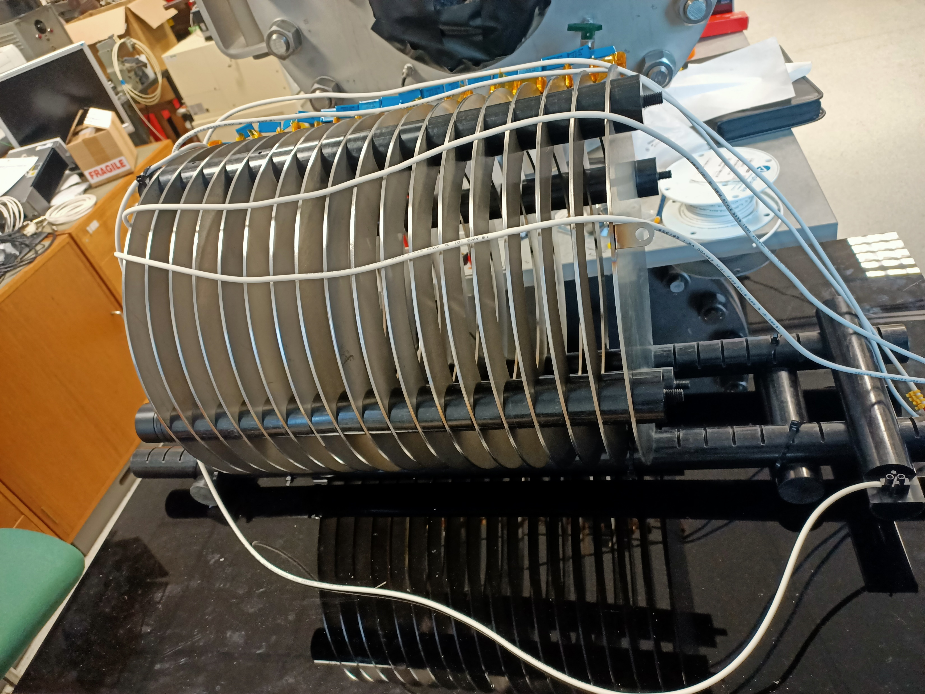
Drift components
Field cage mounted on Delrin holders:
  17 steel rings (ID 280mm), and a cathode (OD 360mm)
Drift length of ~42 cm
Delrin spacers maintain distance between rings and provide stability
Resistor chain connected via terminal connector
Fig.7. The field cage seen from the side (left).
Fig.8. The TPC mounted inside of the pressure vessel

Slide 14
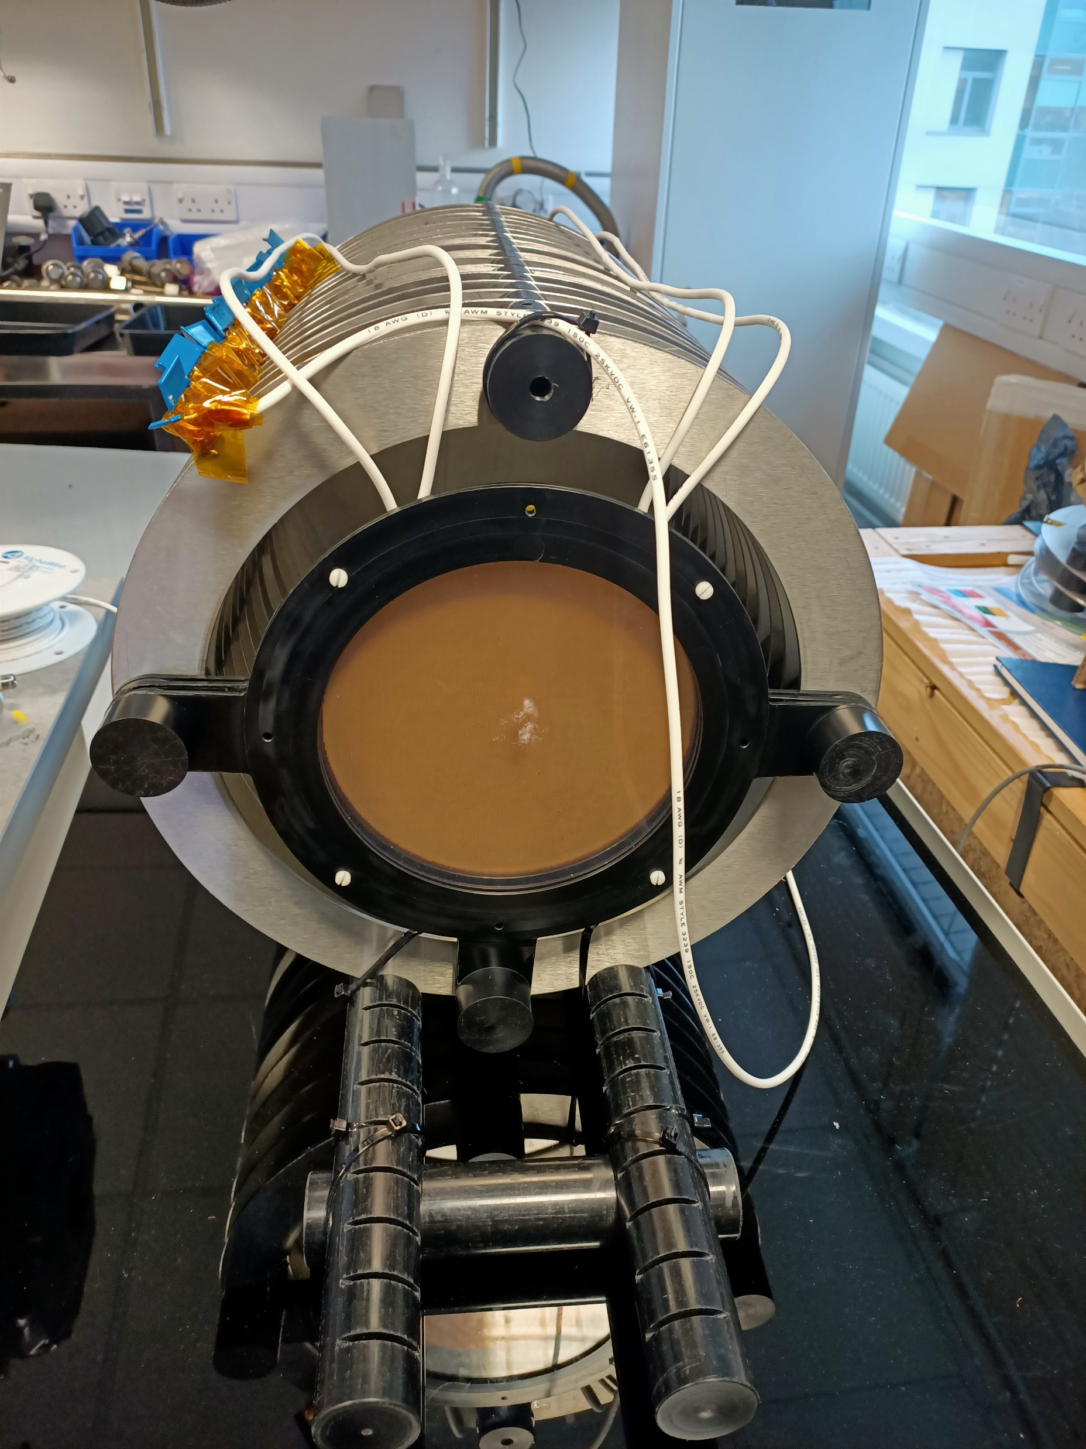
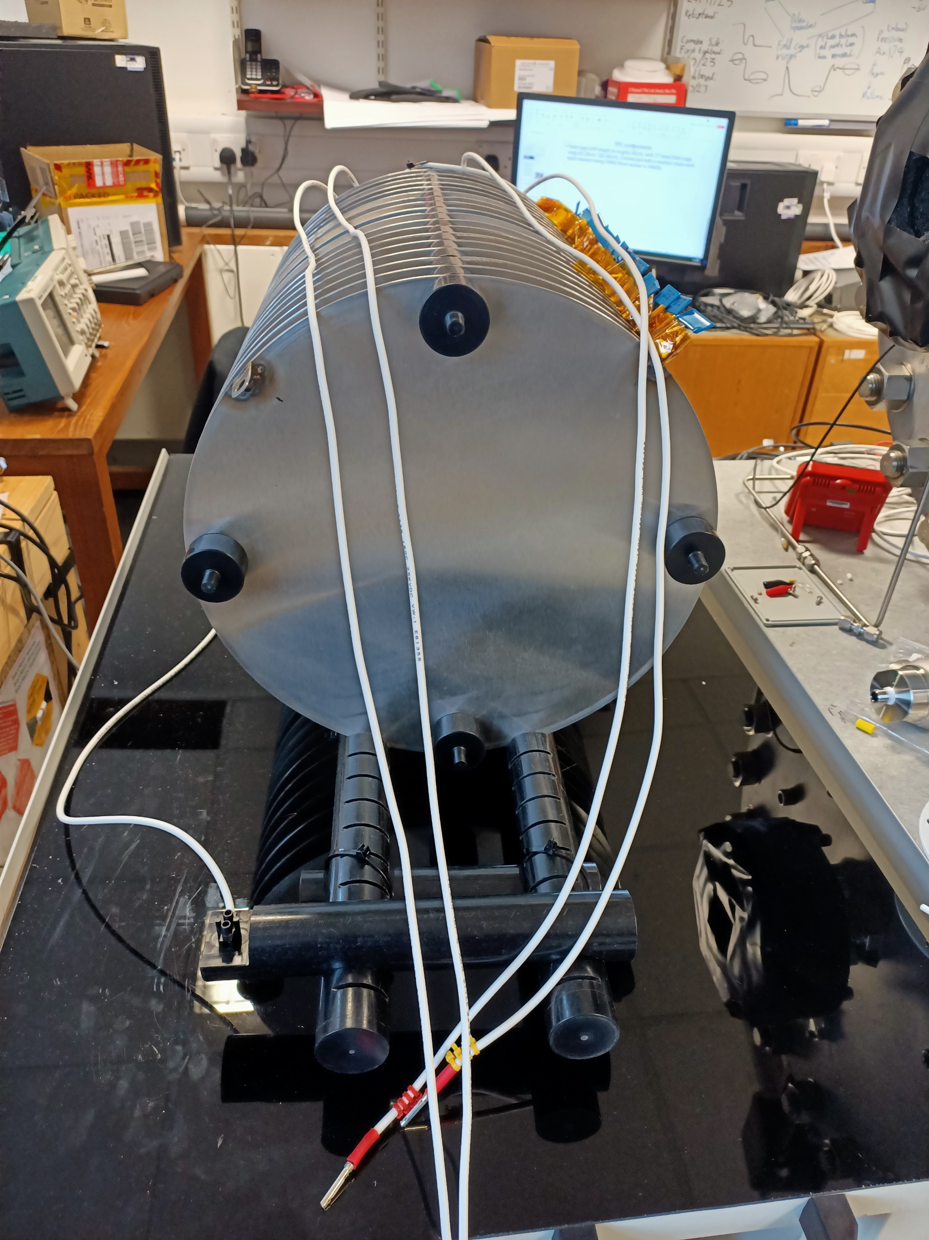
Drift components (continued)
THGEMs and wavelength shifter mounted to end of field cage
Double THGEM configuration for amplification:
PEN foil wavelength shifter:
  Epoxy glue with good optical properties
Further amplification by Photonis Cricket intensifier
Fig.9. The field cage seen from the THGEM side (left), and from the cathode side (right).

Slide 15
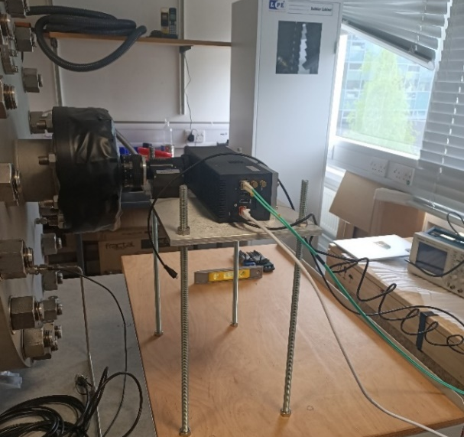
TimePIX3 camera readout
  256x256 pixel array (14x14mm sensor size)
  Imaging plane of ~120x120mm
  Measures Time-over-Threshold (ToT), Time-of-Arrival (ToA), pixel coordinates
  ToA resolution of ~1.6ns
  Natively 3D data
  Zero-supressed readout
Fig. 10. TPX3 in mounted onto the camera mount.

Slide 16
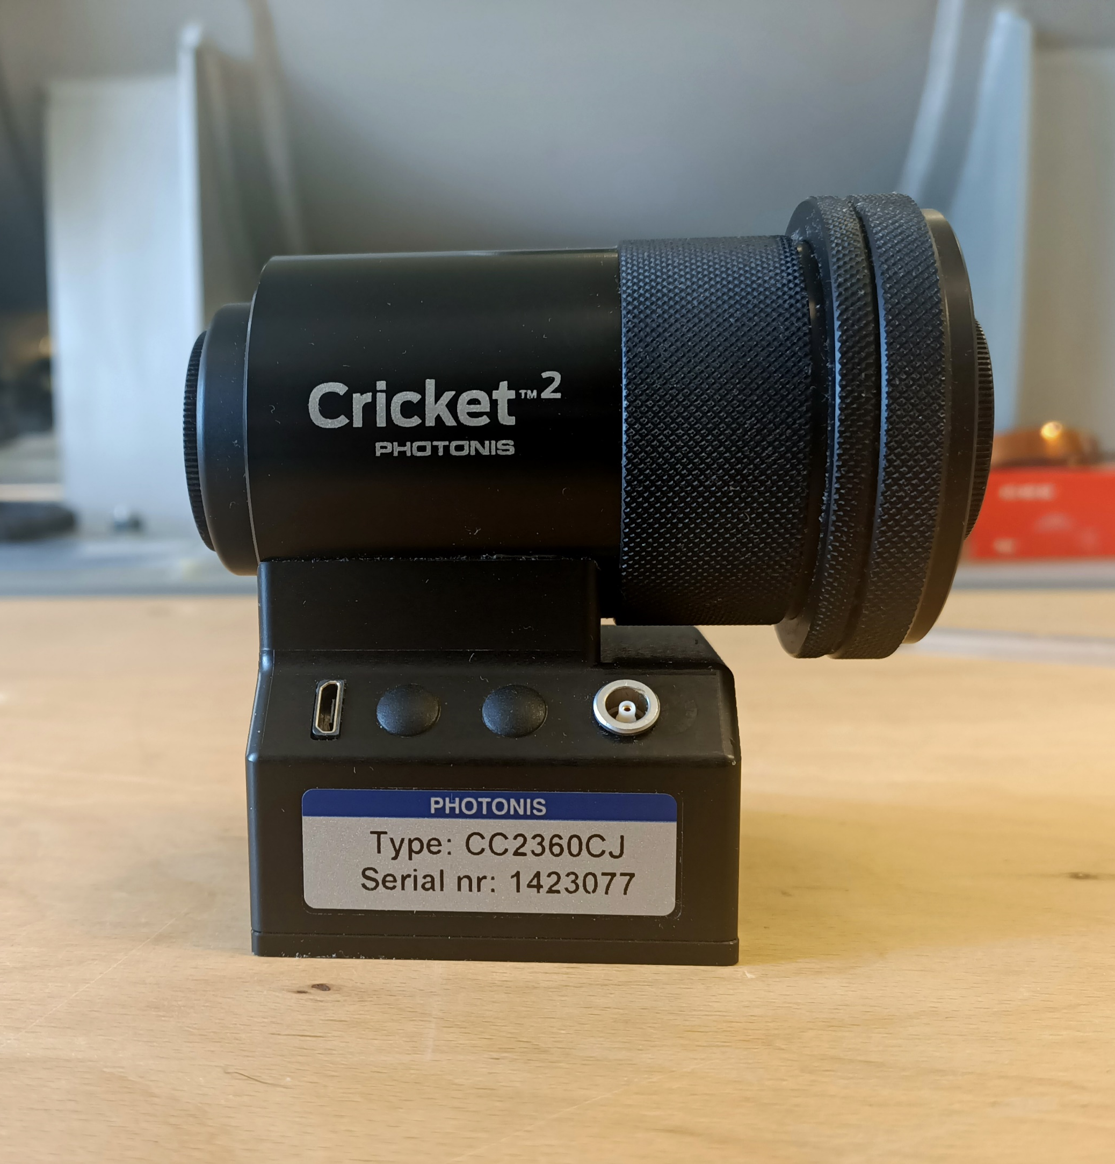
Photonis Cricket Intensifier
Light impinges on photocathode, emitting electrons
Electrons are amplified through double chevron-shaped MCPs
Electrons strike scintillation pad, producing light
This light is then imaged by the TimePIX3 camera
Fig.11. The Photonis Cricket image intensifier

Slide 17
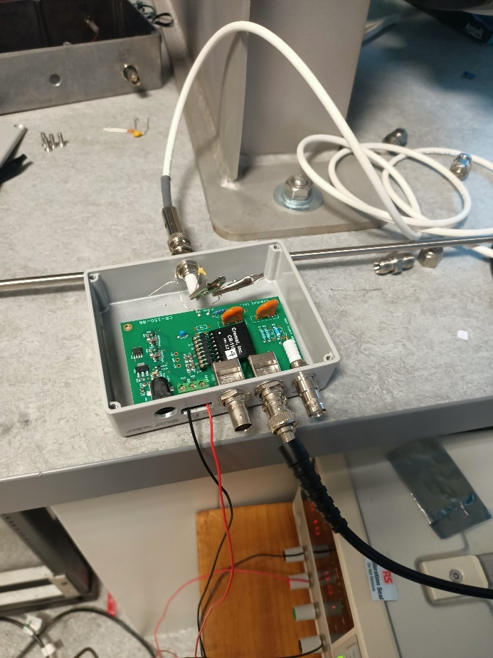
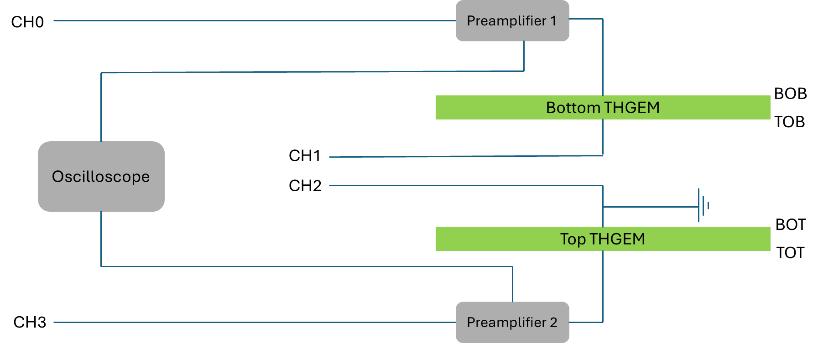
Charge Readout
Two channel readout:
  Preamps connected to electrodes
  Convert charge into measurable voltage
Connected to oscilloscope for readout
Can measure output pulse height
Fig. 13. The two high voltage power supplies (left), and the preamplifier and evaluation board (right).
Fig. 12. Circuit diagram for the THGEMs and charge readout.

Slide 18
Measurements
Measuring effect on light output
Integration test of charge readout
  Looking for signal indication from coincident events
Electrical Fields:
  Field Cage: 0.1 kV/cm
  Bottom THGEM: 10 kV/cm
  Top THGEM: 9 kV/cm
Measurements performed in two different settings
 | Measurement 1 | Measurement 2
Pressure | 1 to 6 bar | 1.2 to 1.3 bar
Gas mixture | Pure argon | Argon-methane ratio: 100%:0% to 90%:10%

Slide 19
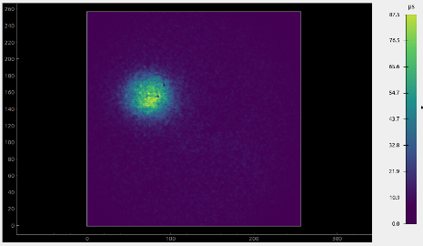
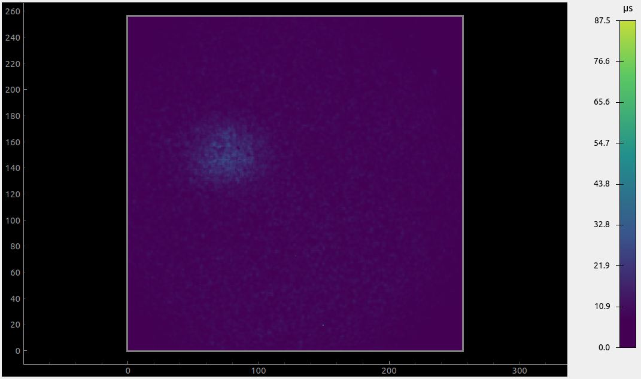

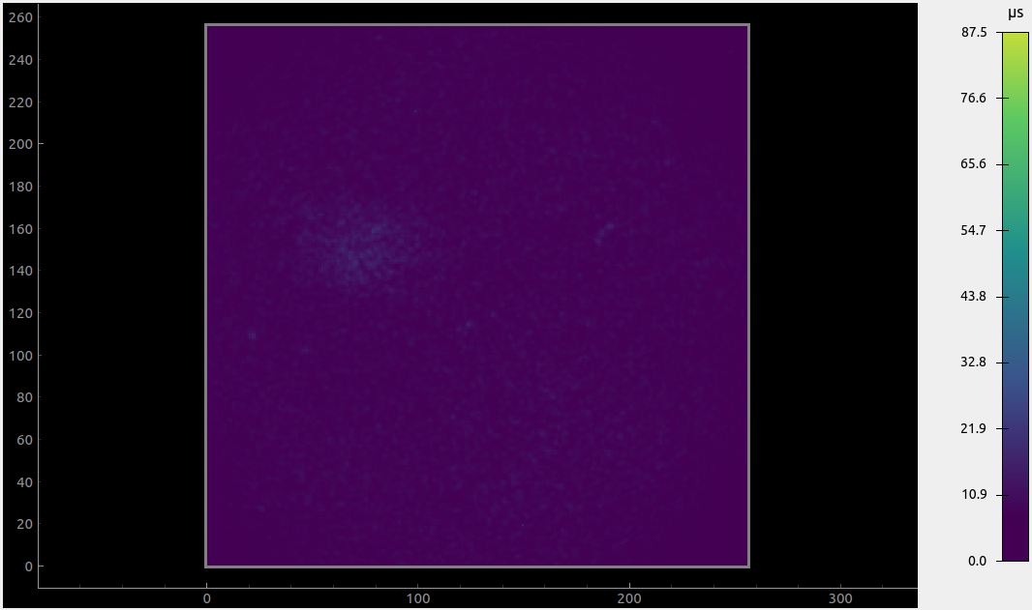
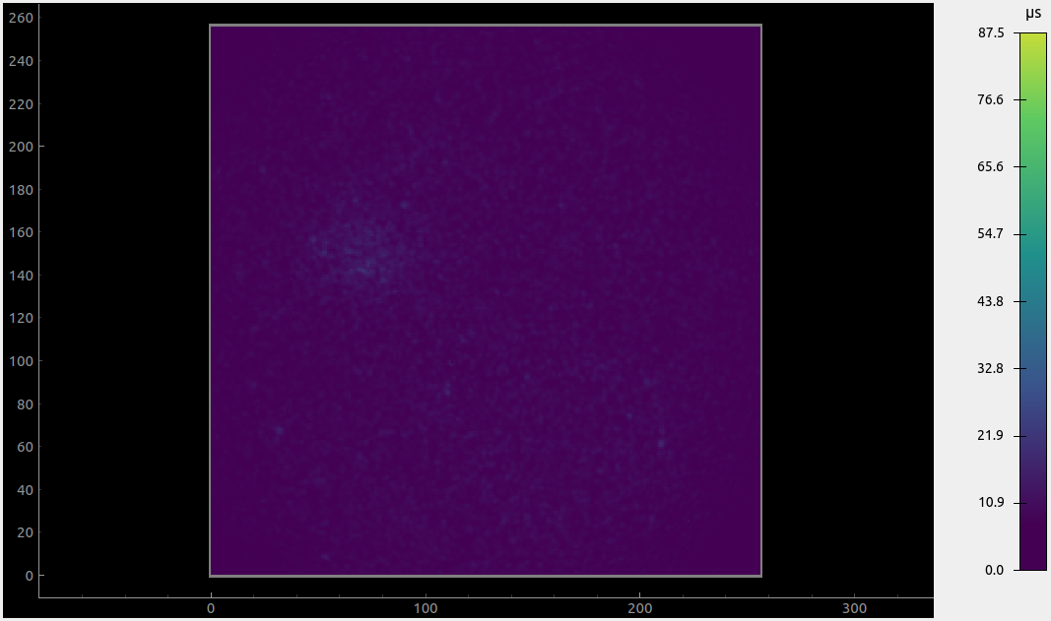

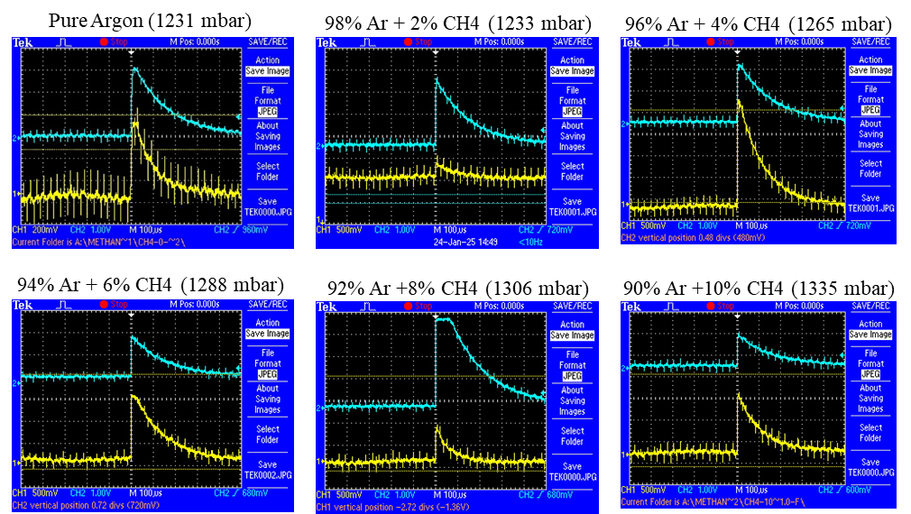
Measurements at Different Methane Fractions Between 1.2 and 1.3 bar
Pure Argon (1231 mbar)
98% Ar + 2% CH4 (1233 mbar)
96% Ar + 4% CH4 (1265 mbar)
94% Ar + 6% CH4 (1288 mbar)
92% Ar +8% CH4 (1306 mbar)
90% Ar +10% CH4 (1335 mbar)
Integrated light images:
  Recorded at each methane fraction
  Clearer when calculating ToT integral (See next slide)
Charge readout:
  Observed events at each fraction
  Significant amount of noise in channels and difficult to build pulse-height spectrum
Fig. 13. Integrated ToT images at various methane fractions.
Fig. 14. Coincident events recorded at various methane fractions.

Slide 20
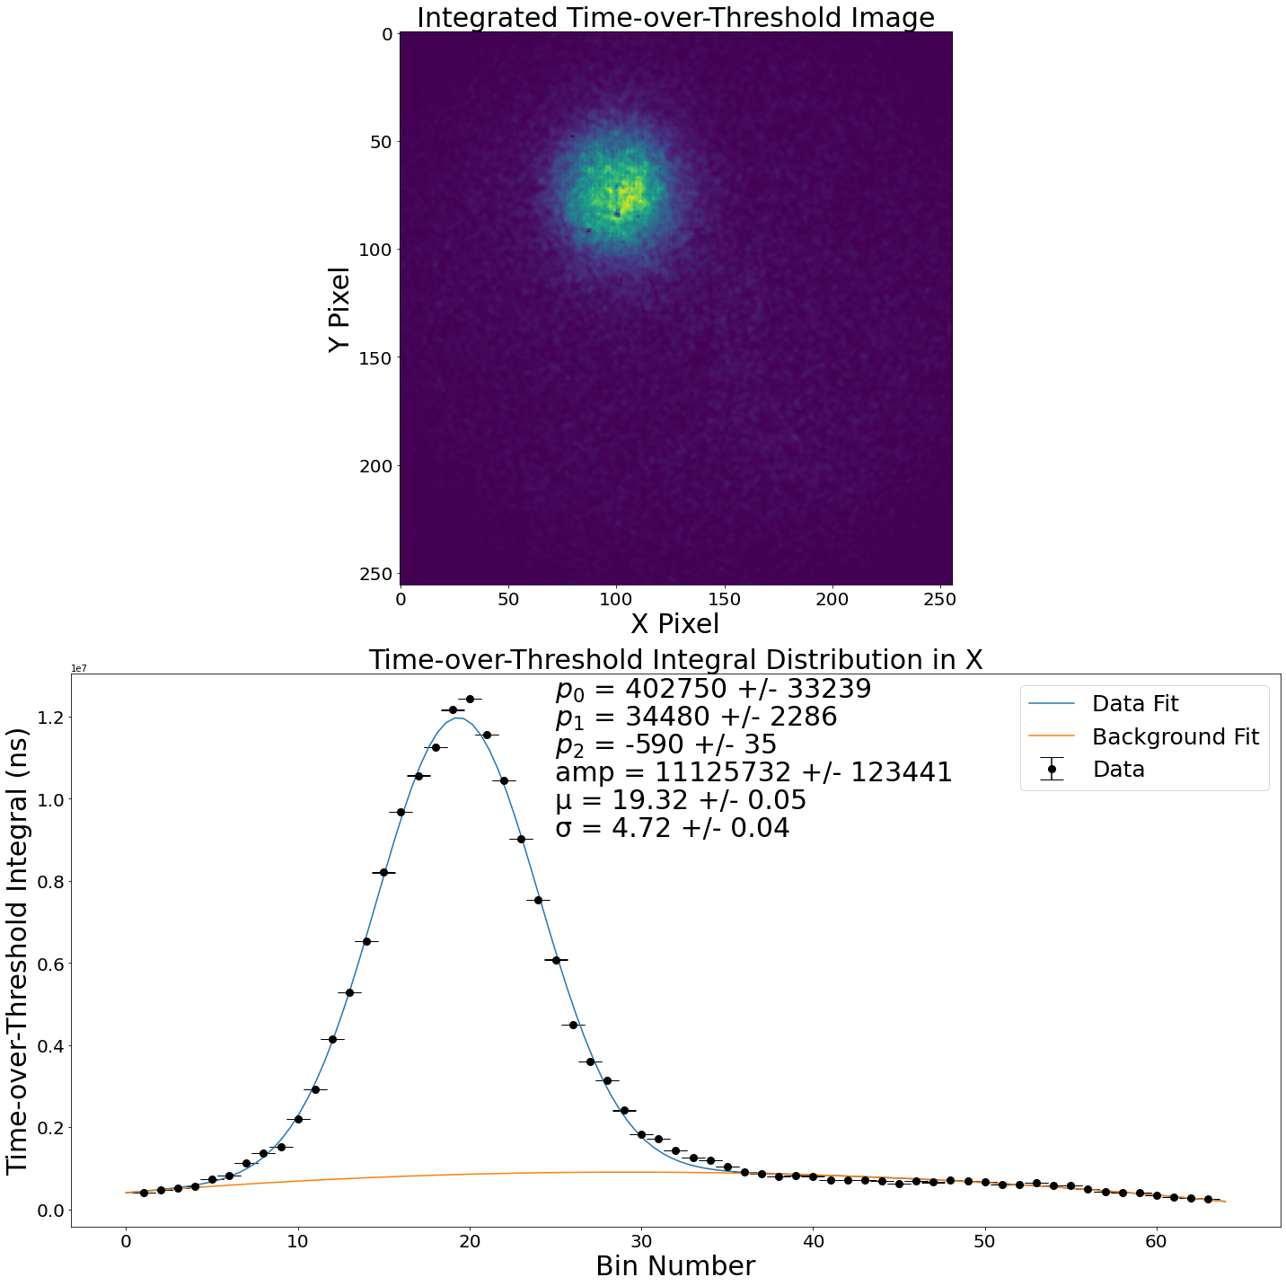
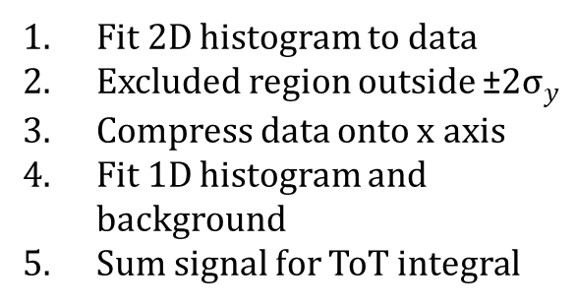
ToT Integral
Fit 2D histogram to data
Excluded region outside ±2$σ_{y}$
Compress data onto x axis
Fit 1D histogram and background
Sum signal for ToT integral
Fig.15. The Integrated Time-over-Threshold image (top), and the cut 1D compressed data with a histogram plus background fit (bottom)

Slide 21
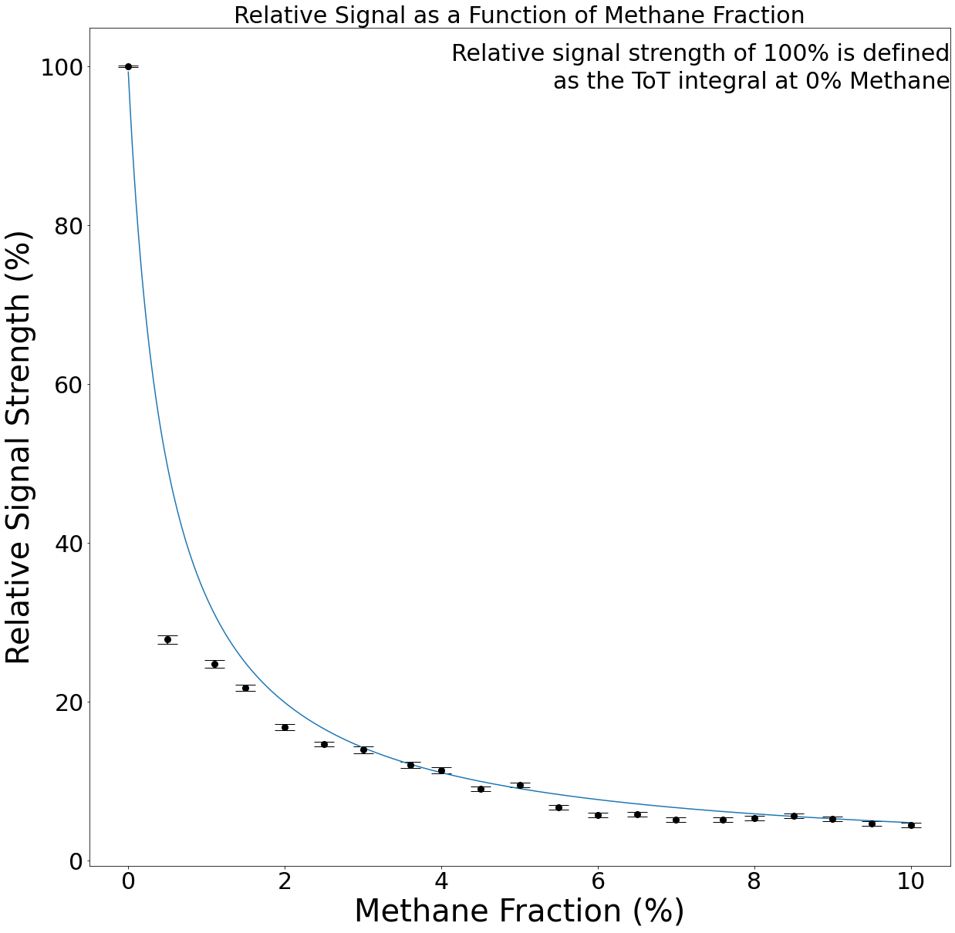
Measurements at Different Methane Fractions Between 1.2 and 1.3 bar – integrated Signal
ToT integral:
  Calculated for every methane fraction
  0% methane fraction set baseline
At 1.5% methane fraction, light yield falls to 21%
10% Light yield at 4% methane
10% methane mixture yields 4% of baseline light
A y=a/x curve has been added to guide the eyes.
Fig. 16. Calculated relative optical signal strength as a function of the CH₄ fraction.

Slide 22
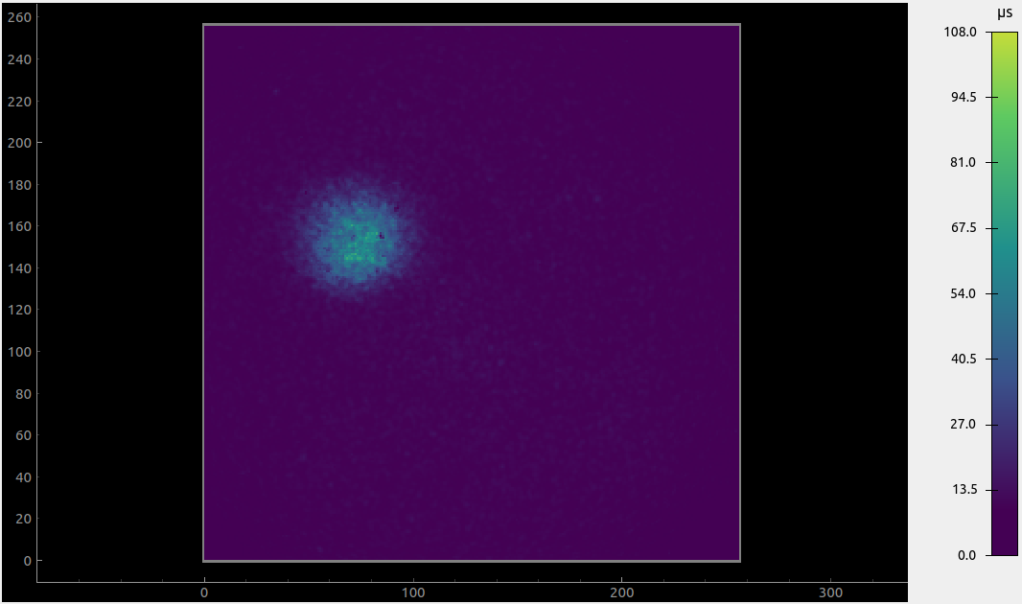
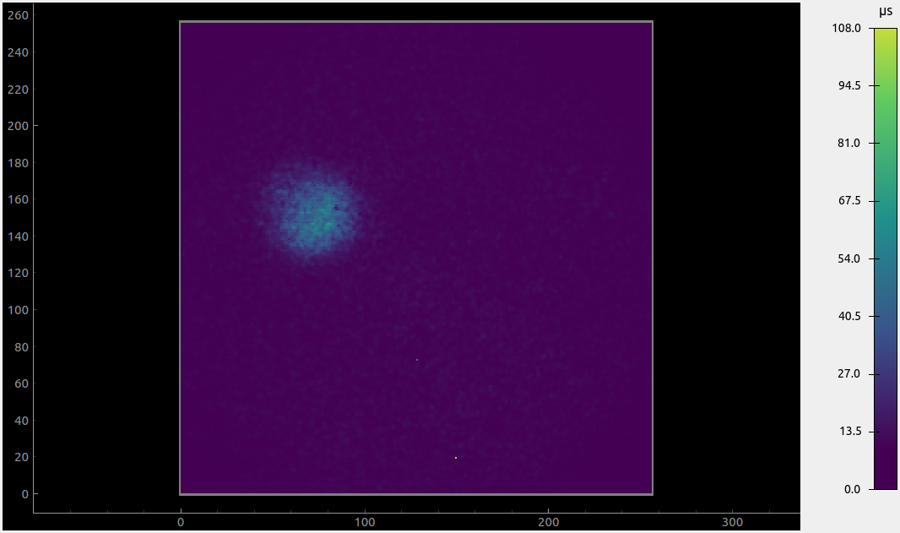
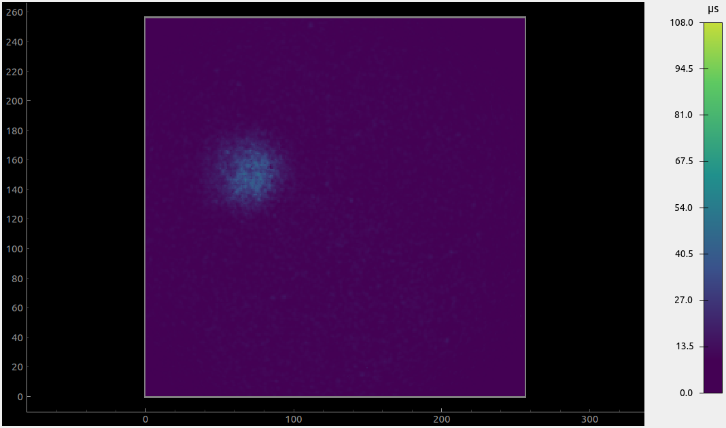


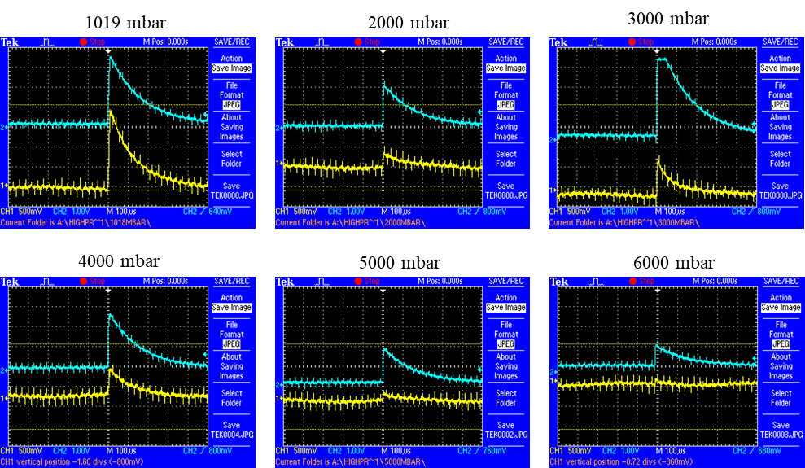
Measurements at High-Pressure Pure Argon
1019mbar
2000mbar
3000mbar
4000mbar
5000mbar
6000mbar
Data taken in pure (>99.5%) argon:
  Integrated images at constant THGEM and field cage bias
Decreasing light with increasing pressure (decreasing E/P, see outlook)
Charge readout:
  Observed events at each fraction
Fig. 15. The integrated ToT images at different pressures of argon.
Fig. 17. Coincident events observed at different argon pressures.

Slide 23
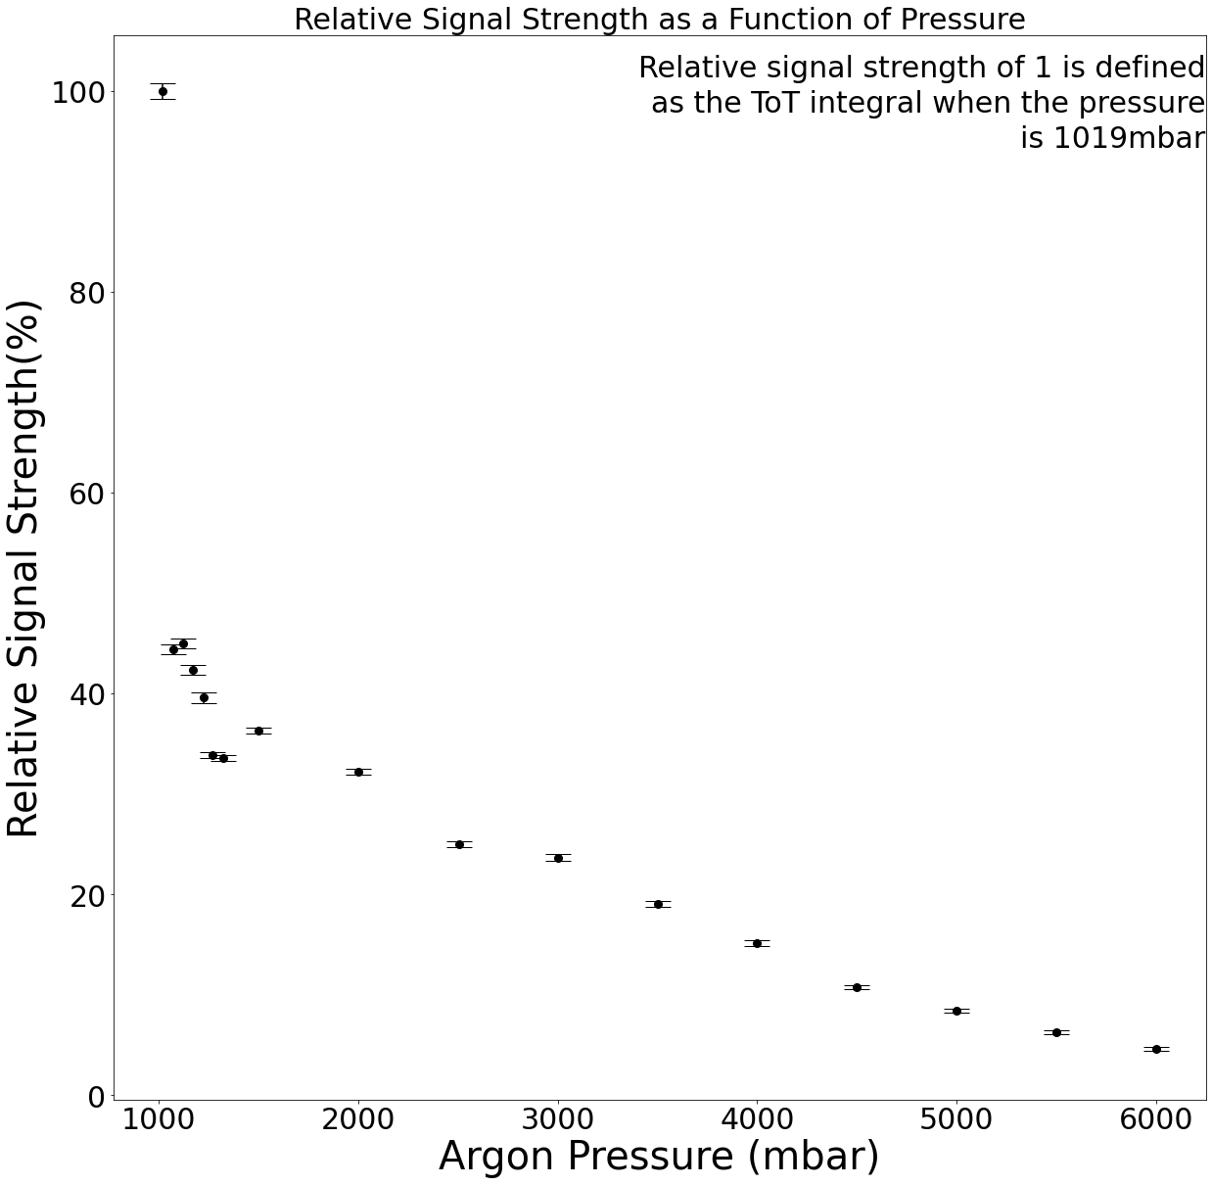
High-Pressure Pure Argon Results
Expected ToT integral response
Sharp initial drop, followed by slower drop
Additional fluctuations due to inconsistent timing
Fig. 18. (right) Calculated relative optical signal strength as a function of the argon pressure.

Slide 24
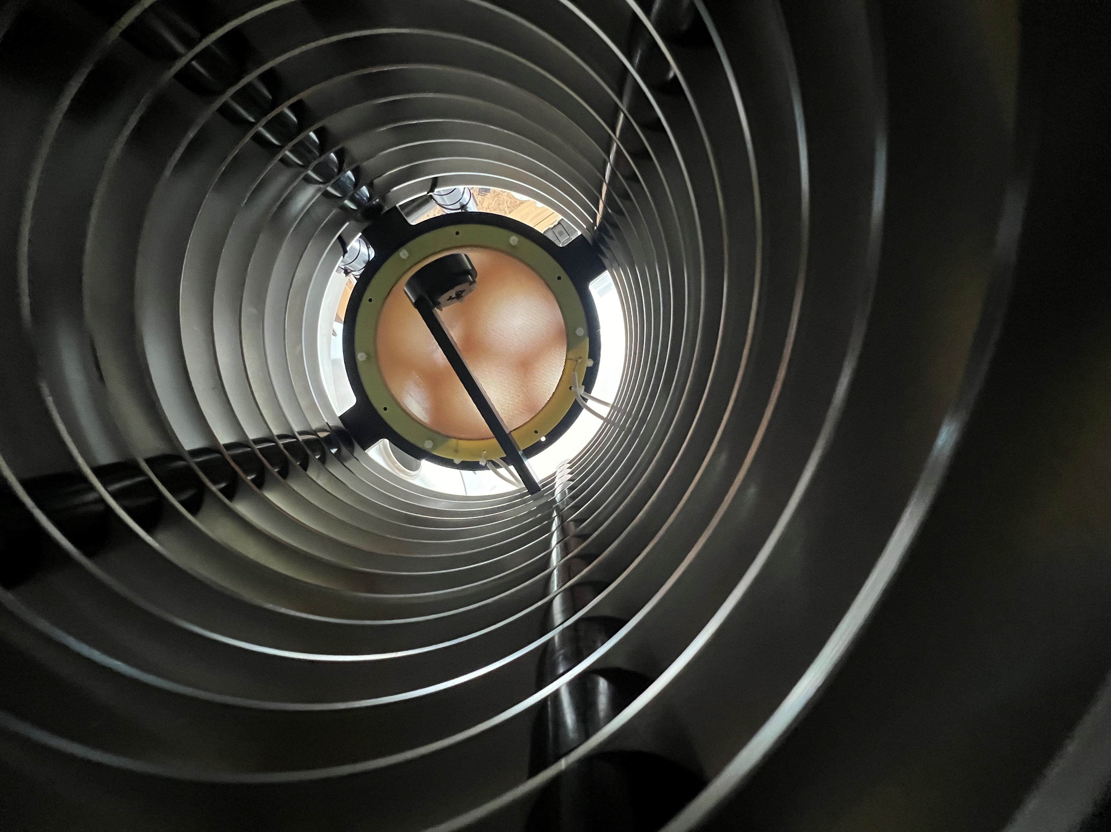
Conclusion
WarTPC commissioning:
  First measurements with hydrogen rich gas mixture
  Optical ToT response as expected
  Promising first integration test for charge readout
Outlook
Charge Readout (important for hydrogen-rich gas measurement):
  Digitise readout for pulse-height spectra
  Use filters to reduce noise
  Use of lower gain preamplifiers to prevent readout saturation
  New evaluation boards to prevent limiting THGEM bias
Constant E/P measurements at high pressure to test light yield
Fig.19. Source holder mounted on field cage before alpha source run

Slide 25
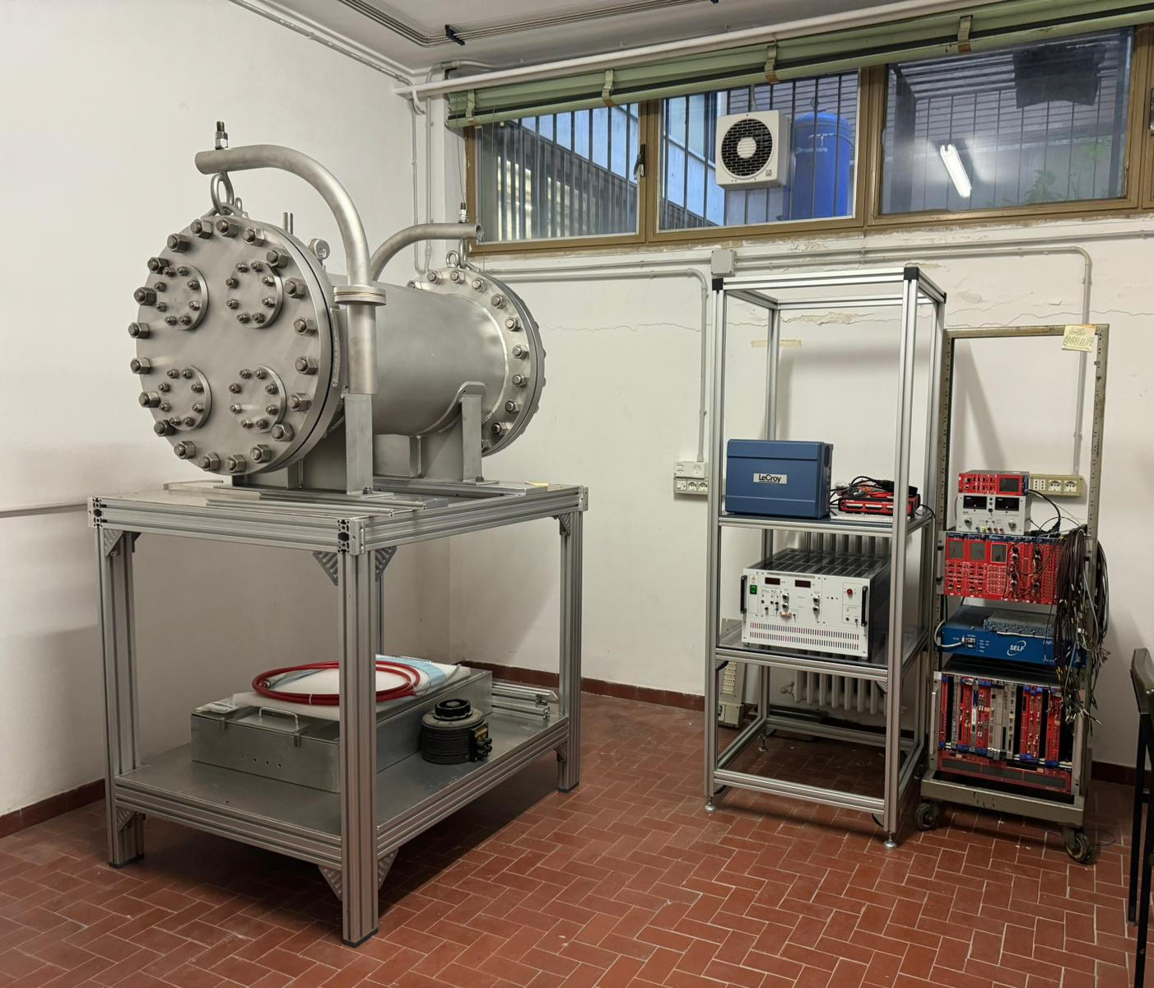
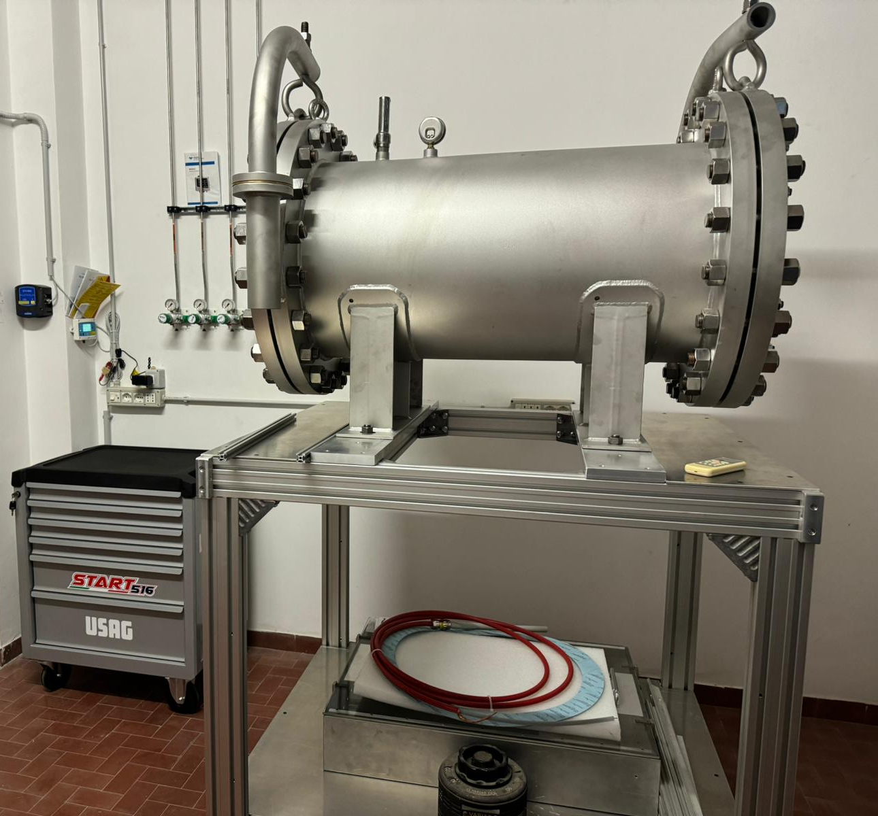
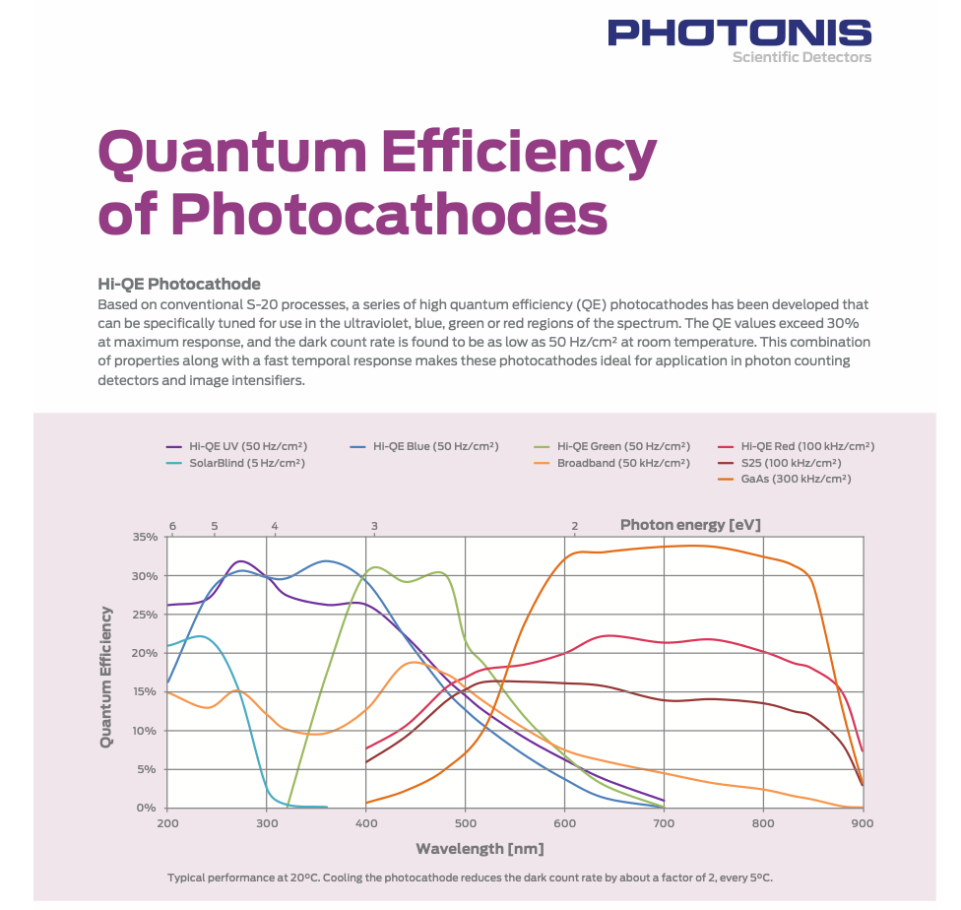
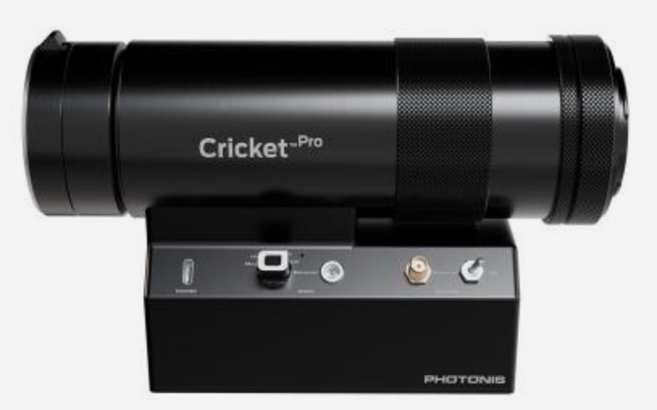
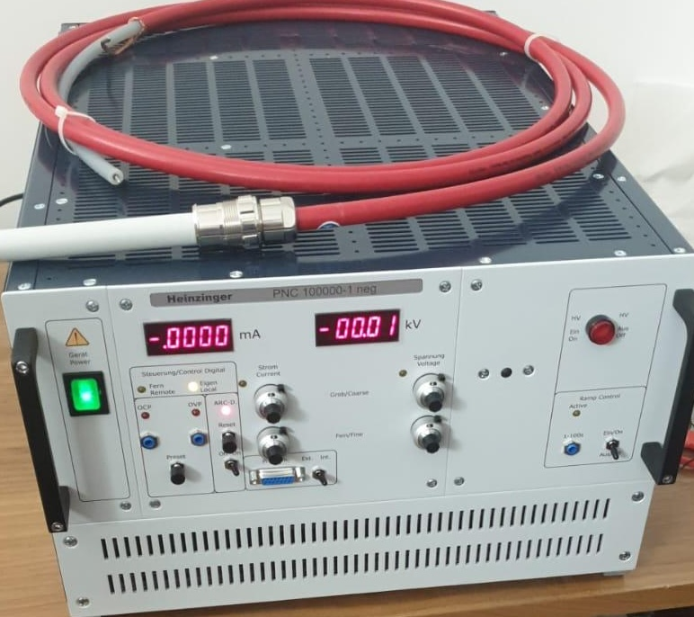
Outlook (continued)
Status & Prospect at INFN-Bari (Gabriella Catanesi, Lorenzo Magaletti)
Basic idea of the project:
Development of an experimental setup similar in size to the UK one, enabling complementary measurements.
Vessel modified at the flanges to allow flexibility in inputs and tightness in the range from 100–200 mbar up to 10 bar.
Flexible gas system that allows the use of various gases (including light ones such as Helium) and the creation of ternary mixtures, as well as gas and impurity analysis.
Image intensifier also sensitive to infrared photons.
Status of the project
Vessel , tables and support: realized & installed
HV , LV electronics : procured
Gas system:
  procurement completed , items tested
  in construction (ready in June 2025)
Image intensifier : procured
Thick gems : in procurement (summer 2025)
FieldCage : designed
TimePIX3: borrowed
Goal: have the set-up assembled and ready by the end of the year

Slide 26
Back Up Slides

Slide 27
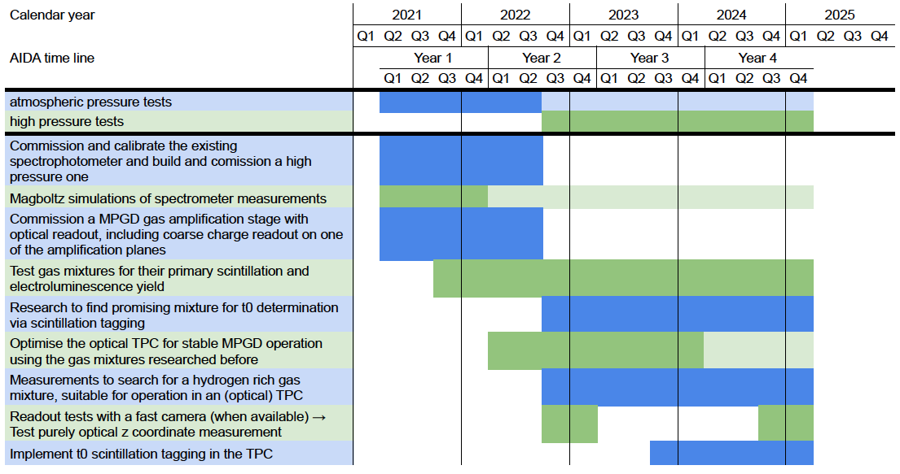

Slide 28
https://aidainnova.web.cern.ch/wp7
MS # | Milestone name | Lead beneficiary | Due Date (in months) | Means of verification
MS26 | Production of DLC with ion beam deposition and pulsed laser deposition | 21 - INFN | 23 | Report (Task 7.3)
MS27 | Build a 0.3×0.3 m2 prototype and the readout plane with the new structure | 21 - INFN | 36 | Prototype ready (Task 7.3)
MS28 | Identification of a gas mixture for neutrino physics in an optical TPC | 42 - RHUL | 36 | Report (Task 7.4)
MS29 | Design electronics for cluster counting and production of a 4-channel prototype | 21 - INFN | 46 | Prototype ready (Task 7.4)
D # | Deliverable name | Lead beneficiary | Type | Due Date (in months)
D7.1 | Characterisation of small size MRPC prototypes for fast timing and high rates | 21 - INFN | Report | 36
D7.2 | Validation of the eco-friendly gas mixtures for RPCs at GIF++ | 21 - INFN | Report | 45
D7.3 | Production with industry of small-size prototypes of μ-RWELLs | 21 - INFN | Demonstrator | 30
D7.4 | A small-scale TPC prototype (#10 l) with hybrid charge/optical readout and a hydrogen rich gas mixture with high scintillation yield | 42 - RHUL | Demonstrator | 46
D7.5 | Small-size prototype of a MPGD single photon detector for compact RICHs | 21 - INFN | Demonstrator | 44

Slide 29
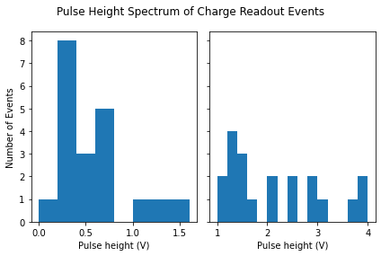
Pulse-Height Spectrum
Aimed to build pulse-height spectrum
Significant noise in readout channels
No digitiser, so done manually
Only built spectrum for 0% methane
Fig. 20. Example Pulse heigh spectrum of channel 1 (left), and channel 2 (right) taken in an Ar-100, CH₄-0 gas mixture.

Slide 30
S1(T₀): Primary scintillation in Ar/CF₄
P. Amedo et al., Front. Detect. Sci. Technol. 1:1282854.
arXiv:2306.09919
pure argon
From Diego Gonzalez Diaz talk at AIDAinnova 3rd annual meeting (19/03/2024)
spectroscopic
pure CF₄
𝜆=[400-700] nm
𝜆=[400-700] nm
time-resolved
~700-1400 ph/MeV

