Slide 1


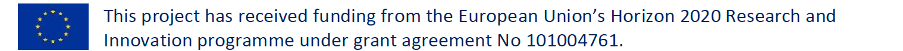
Task 12.5: Particle Flow Reconstruction
John Back
on behalf of the Task 12.5 institutes
5th May 2025

Slide 2
Overview
Particle Flow Algorithms (PFAs)
State-of-the-art reconstruction for HEP calorimeters and neutrino detectors
Research Groups (main contacts)
Dual Readout Calorimeters:
  I. Vivarelli (Sussex), B. Di Micco (INFN Roma-3), S. Vallecorsa (CERN)
APRIL, Algorithm for Particle Reconstruction @ ILC:
  G. Grenier (CNRS-IP2I), V. Boudry (CNRS-LLR)
DUNE Near Detector reconstruction & WP12.5 conveners:
  J. Marshall & J. Back (Warwick)

Slide 3
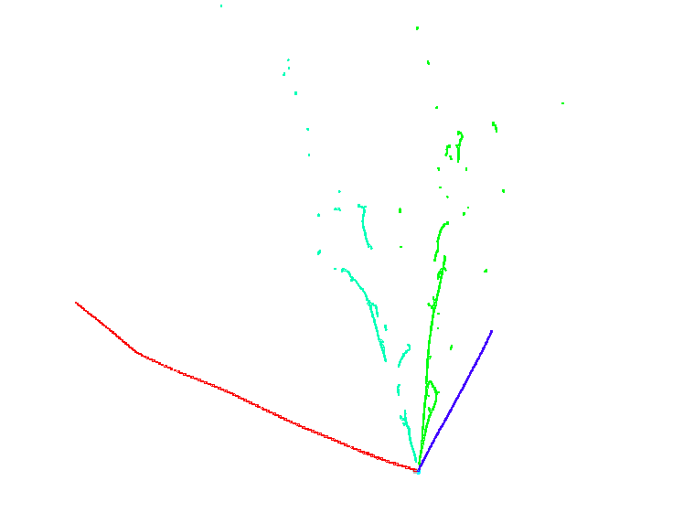
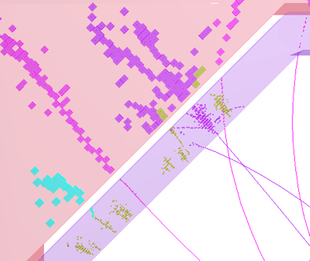
Pandora Software Development Kit
https://github.com/PandoraPFA
A single clustering approach is unlikely to work for complex event topologies:
  Mix of track-like & shower-like clusters
  Use multi-algorithm approach using the Pandora SDK to build up events gradually:
  Each step is incremental - aim not to make mistakes (undoing mistakes is hard)
  Deploy more sophisticated algorithms as picture of event develops
  Algorithms: can use machine-learning methods & detector physics knowledge
LArTPC
3x2D inputs
HCAL
𝜸1
𝝅⁺
ECAL
𝜸2
TPC
p
n
𝜸
wire
𝝁
ILC/CLIC
3D inputs
time

Slide 4
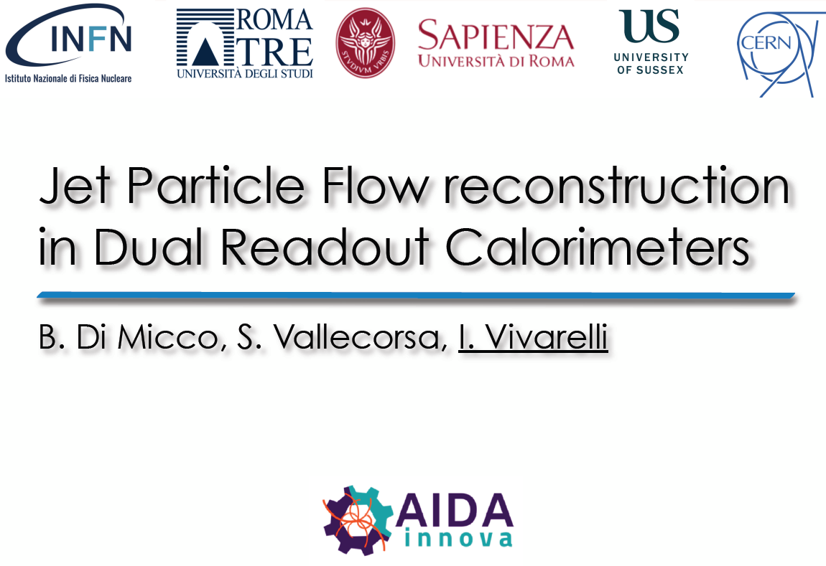
M. Biglietti, A. Farilla, R. Di Nardo, A. D’Onofrio

Slide 5
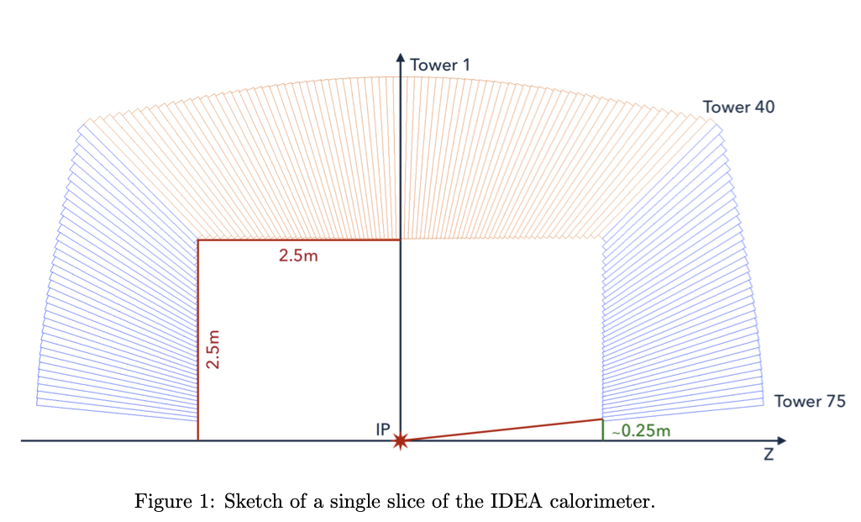
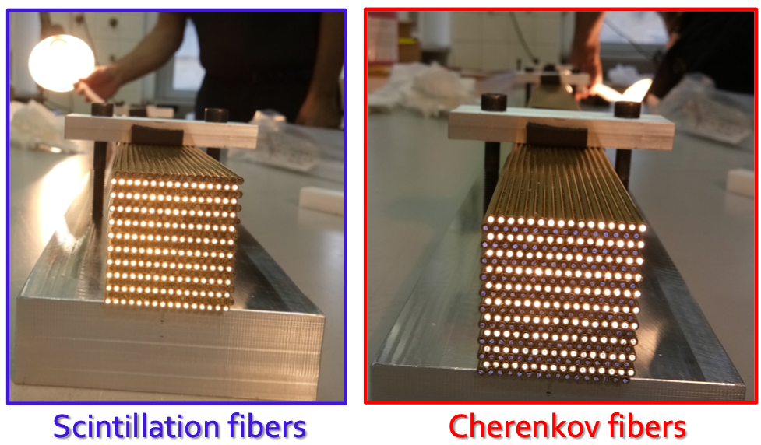
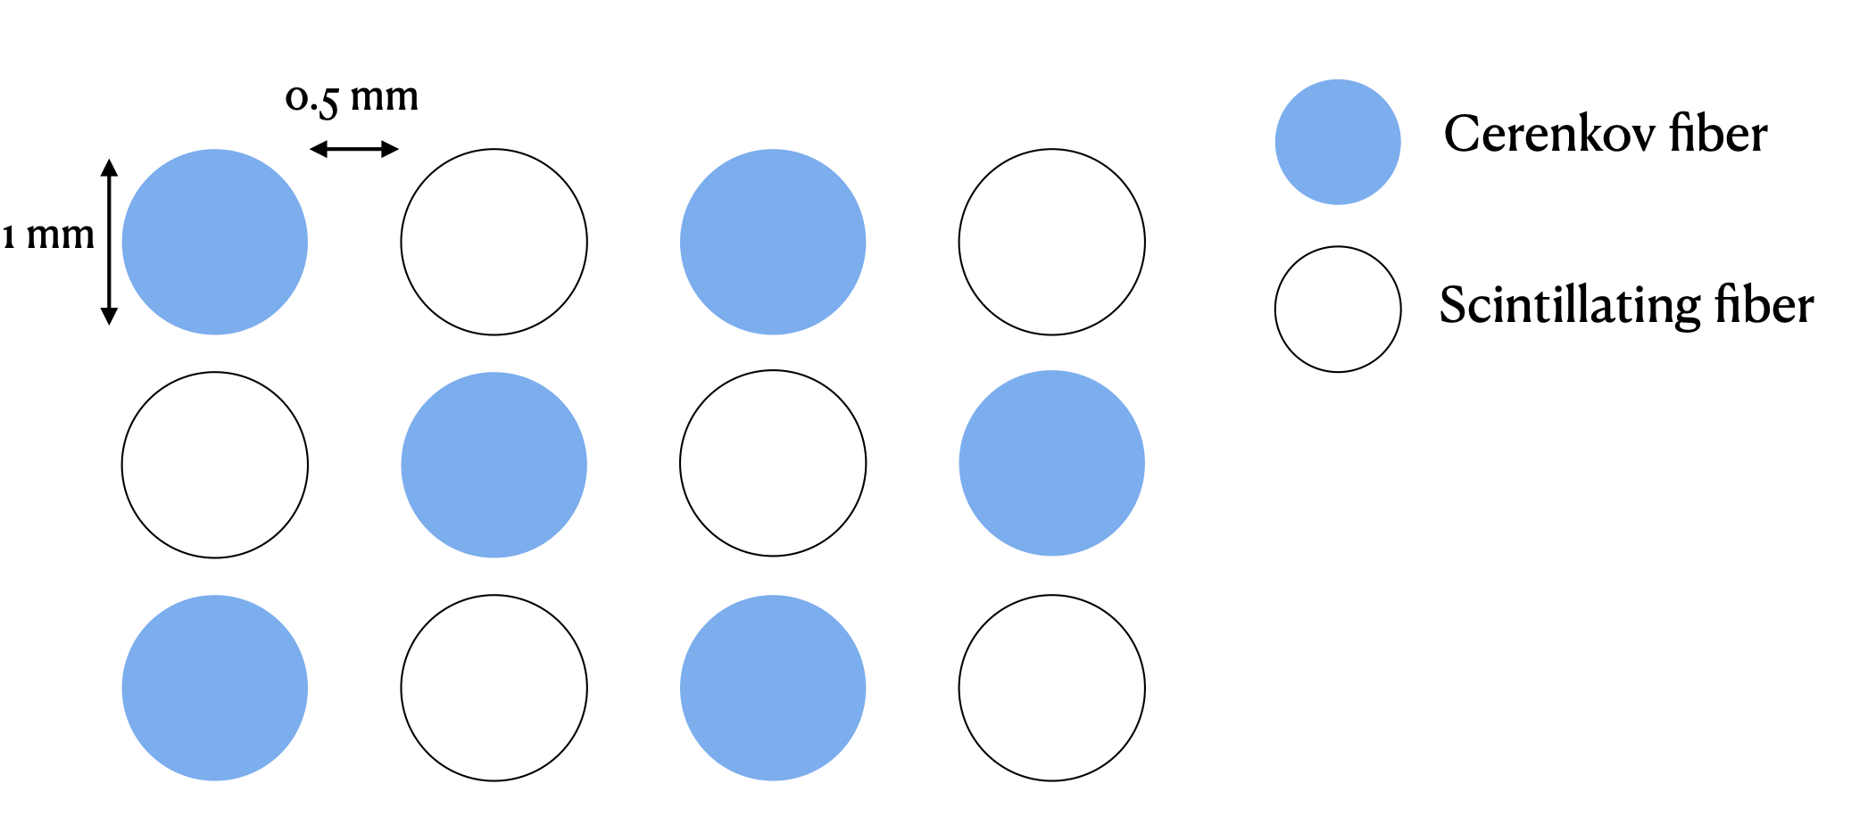
Dual Readout Calorimeter
Improve energy resolution of hadronic calorimeters: measuring the EM fraction using scintillating & Cerenkov fibre readout
Calorimeter layout simulated with GEANT-4 for the IDEA detector (Innovative Detector for future e+e- Accelerators)
Scintillating fibers: polystyrene
Cherenkov fibers: PMMA (PolyMethyl MethAcrylate)
Passive material: copper

Slide 6
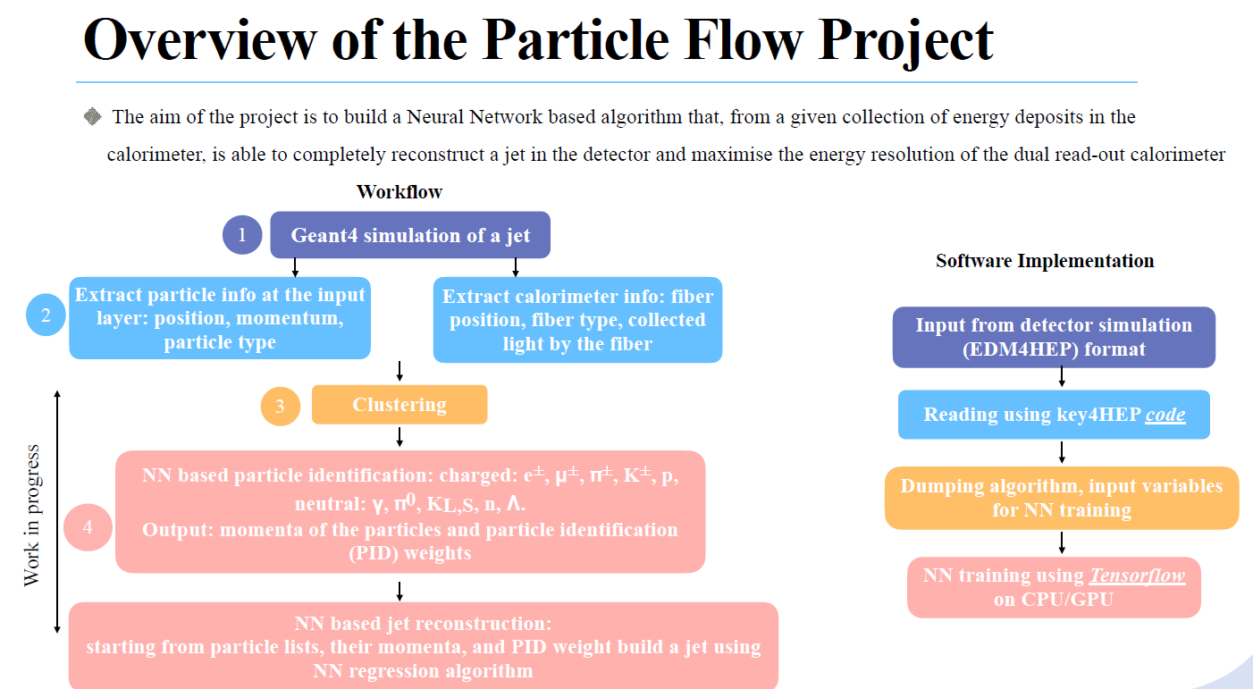
✓
✓
Use Pandora as algorithm collector
Interface via KEY4HEP & EDM4HEP

Slide 7
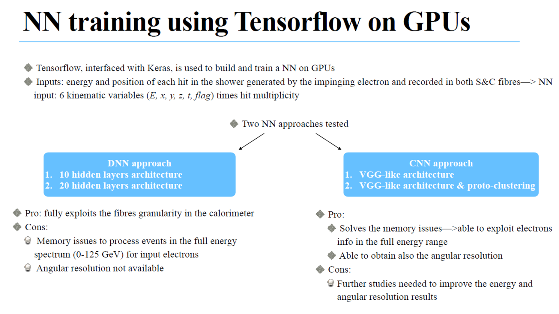

Slide 8
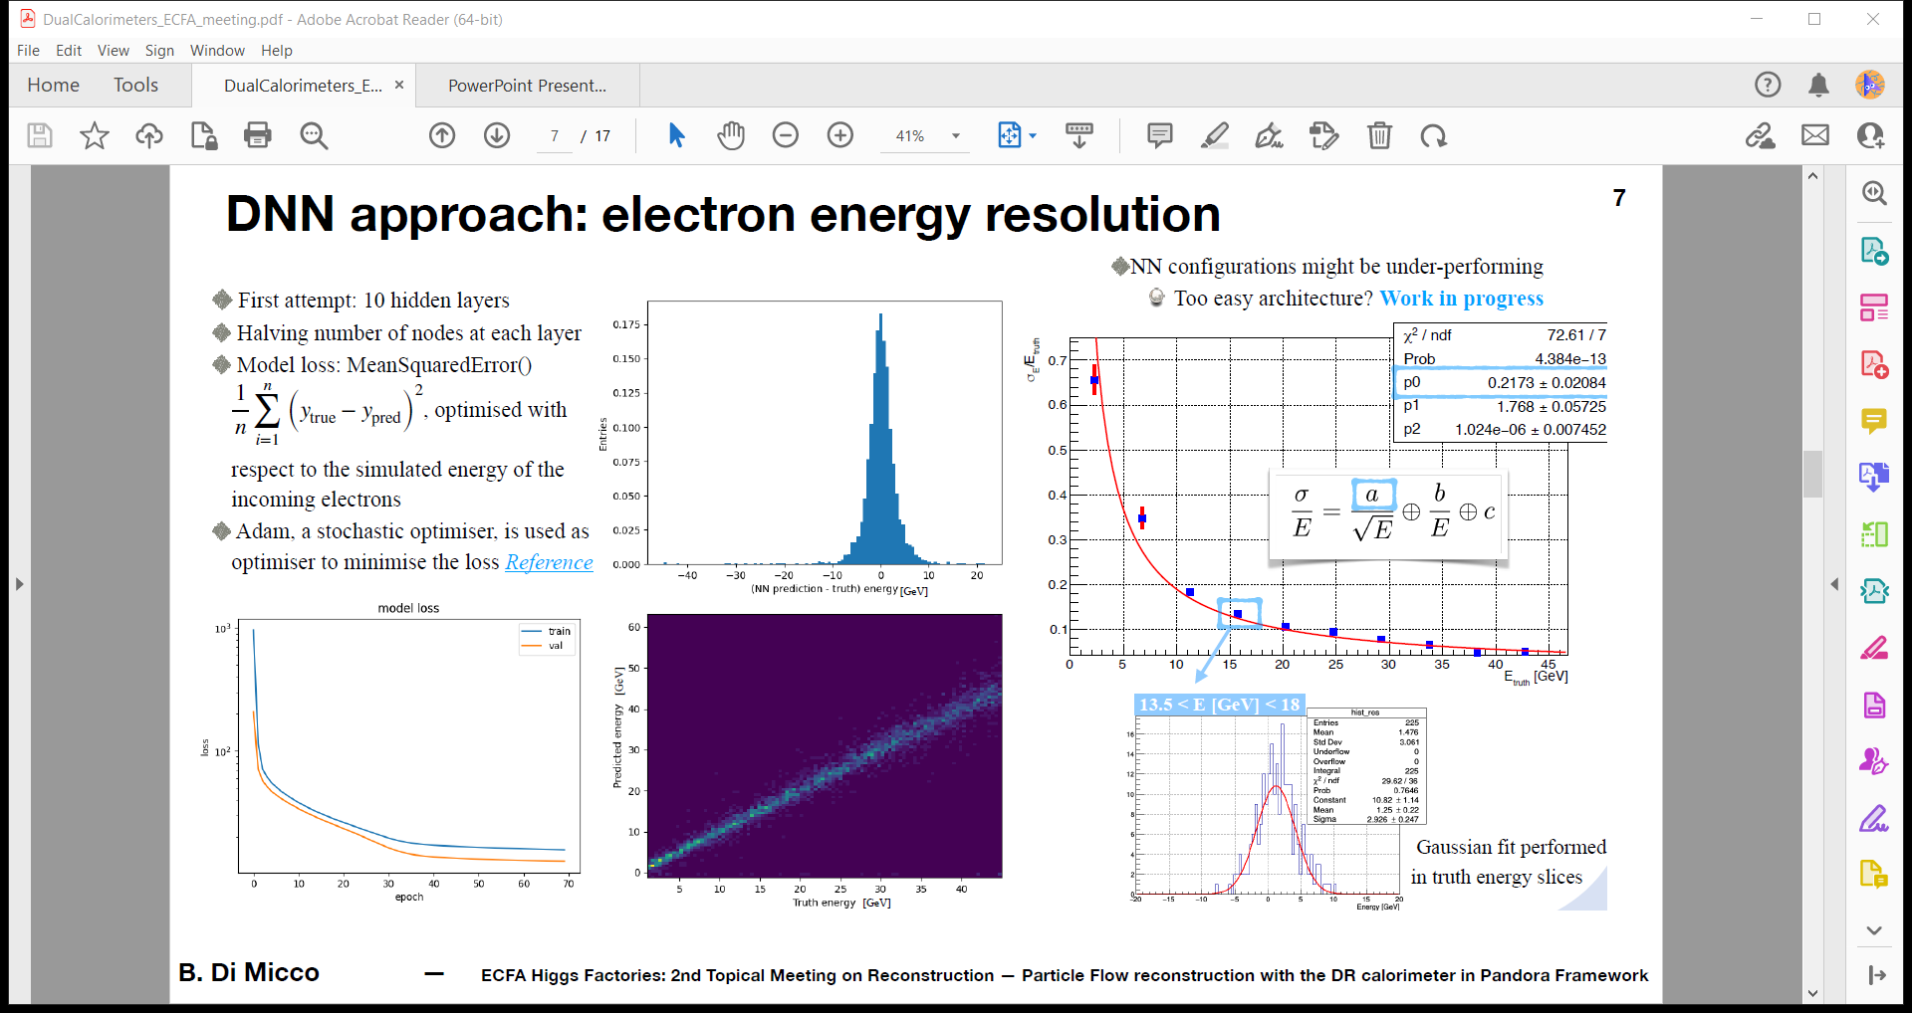
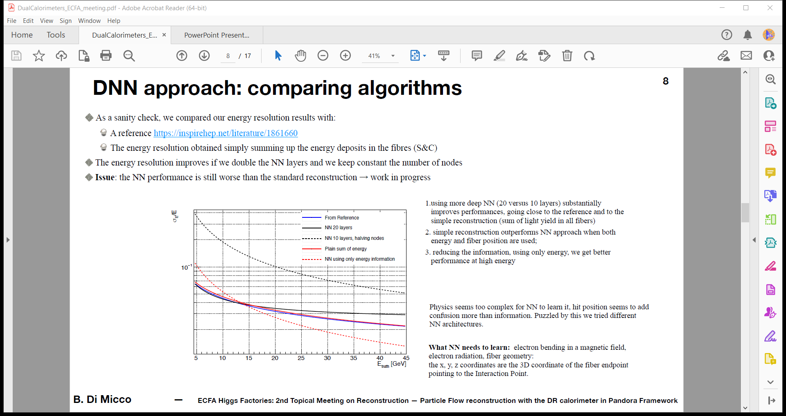
TensorFlow & Keras (CPU & GPUs)
Fit Gaussian: σ_{E}
10 → 20 layers
Prediction vs Truth E

Slide 9
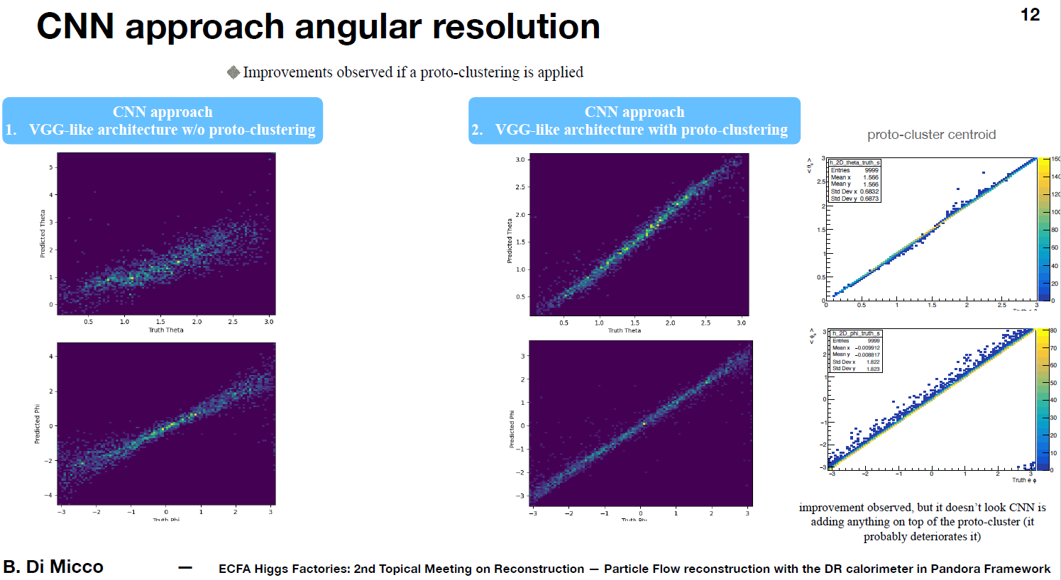
θ_{CNN}
<θ_{CNN}>
θ_{CNN}
Proto clustering
θ_{True}
θ_{True}
θ_{True}
<φ_{CNN}>
φ_{CNN}
φ_{CNN}
φ_{True}
φ_{True}
φ_{True}

Slide 10
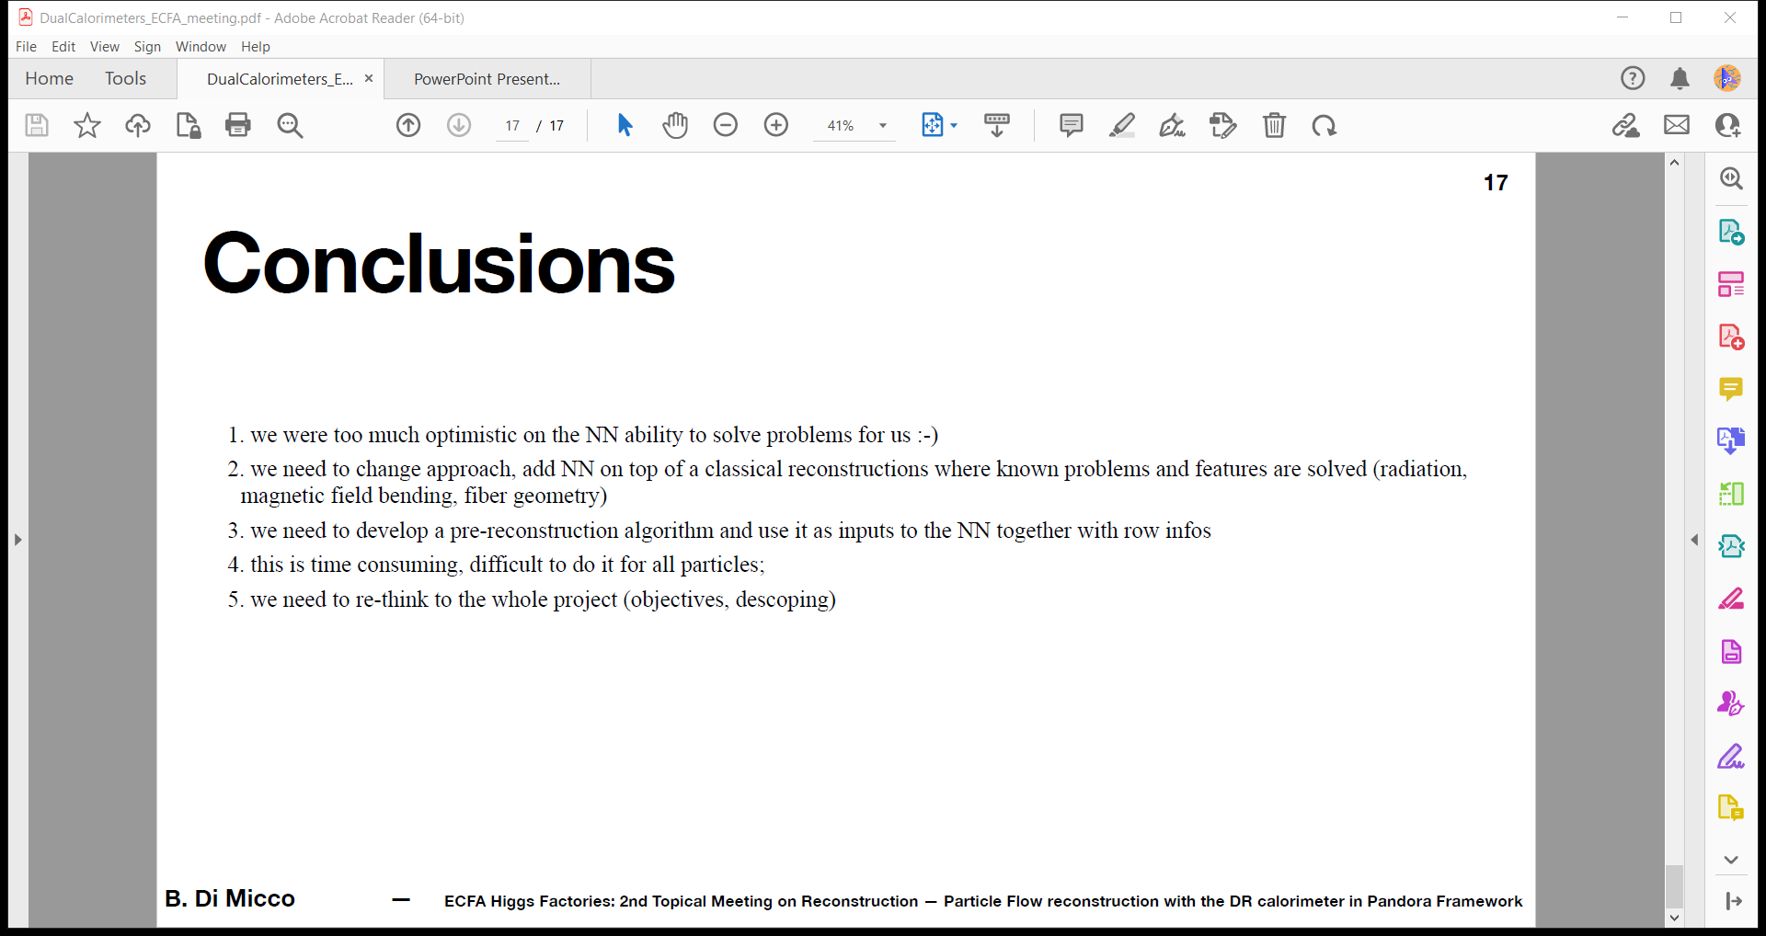
Outcomes for Dual Readout Calorimeter Pandora work

Slide 11

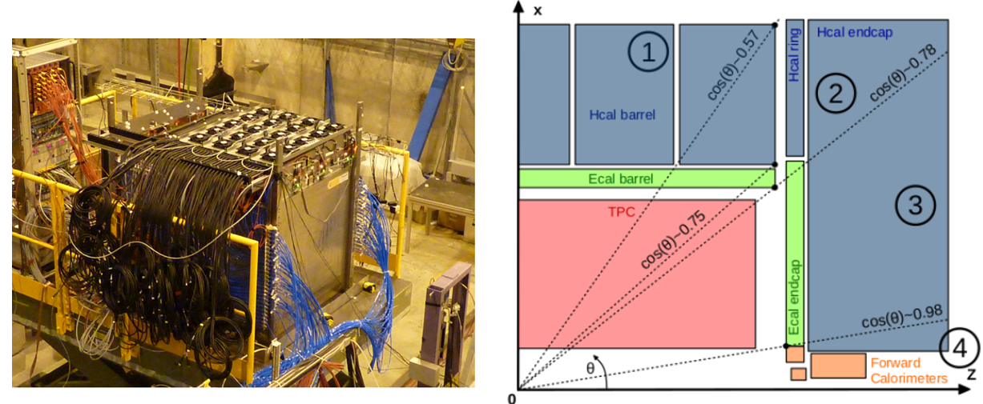
Prototype of Semi Digital Hadronic CALorimeter
International Large Detector layout

Slide 12
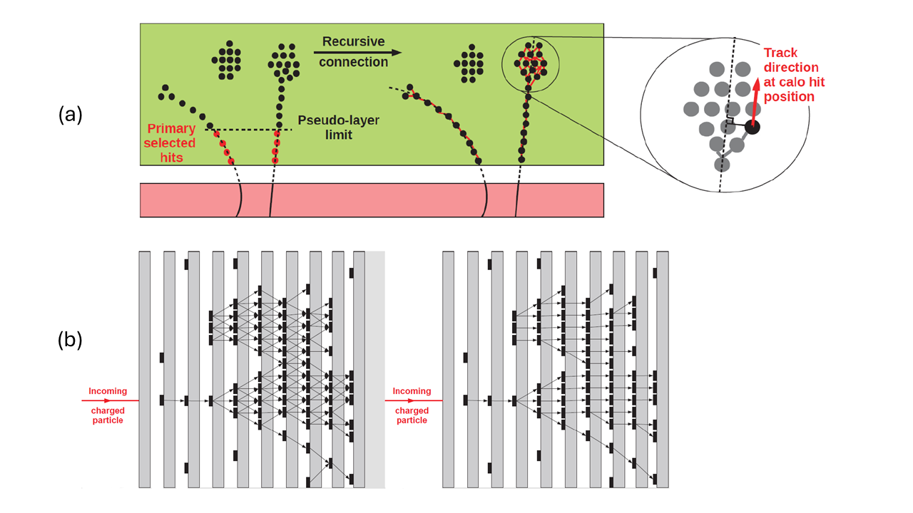
Algorithm for Particle Reconstruction for the ILC
Clustering
Cleanup of connecting
hits inside clusters

Slide 13
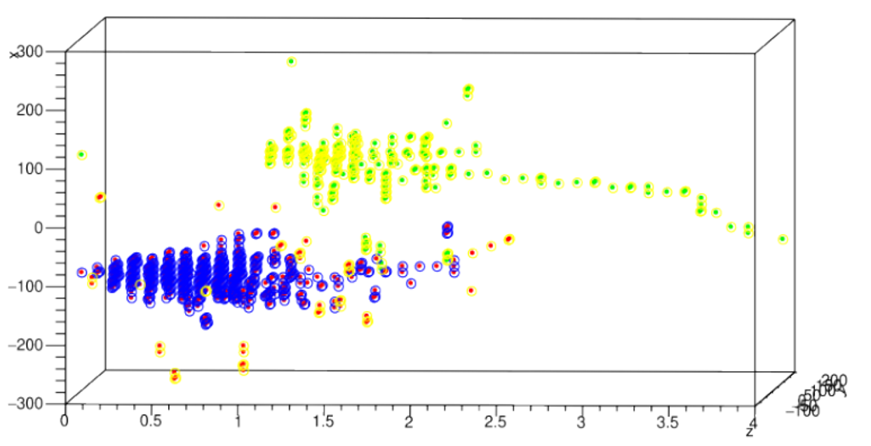
APRIL: 30 GeV π & 10 GeV K⁰_{L} inside SDHCAL
10 GeV K⁰_{L}
(green sim, yellow reco)
30 GeV π (red sim, blue reco)

Slide 14
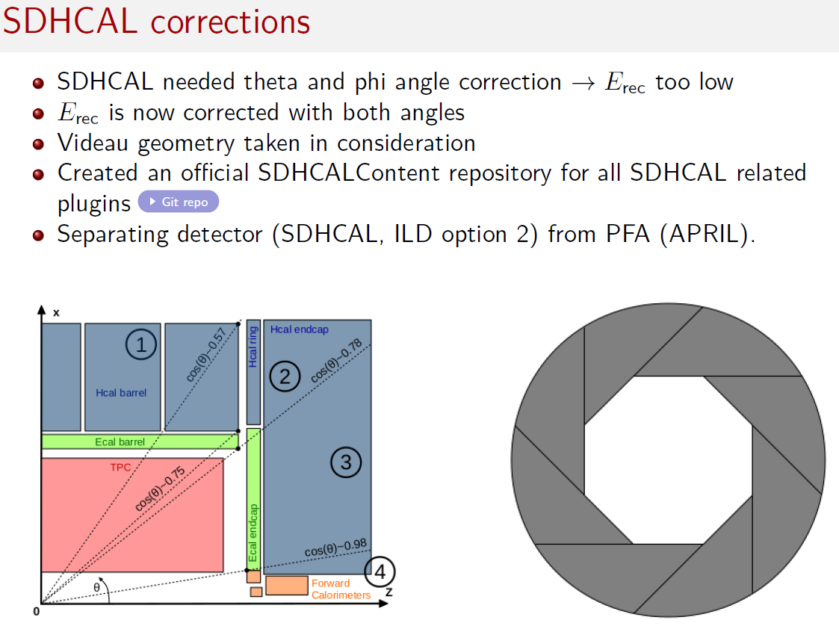
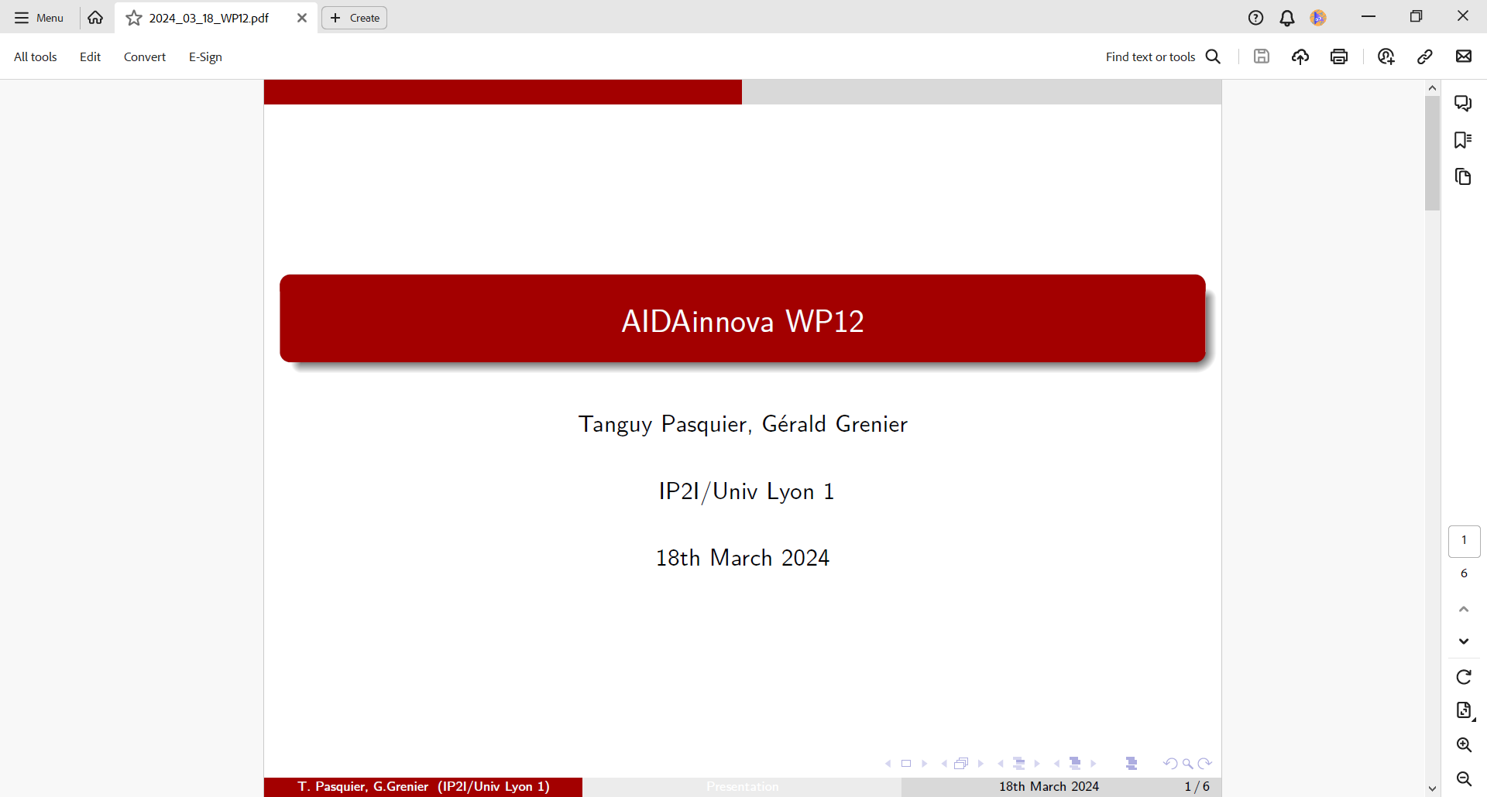
https://github.com/SDHCAL/SDHCALContent

Slide 15
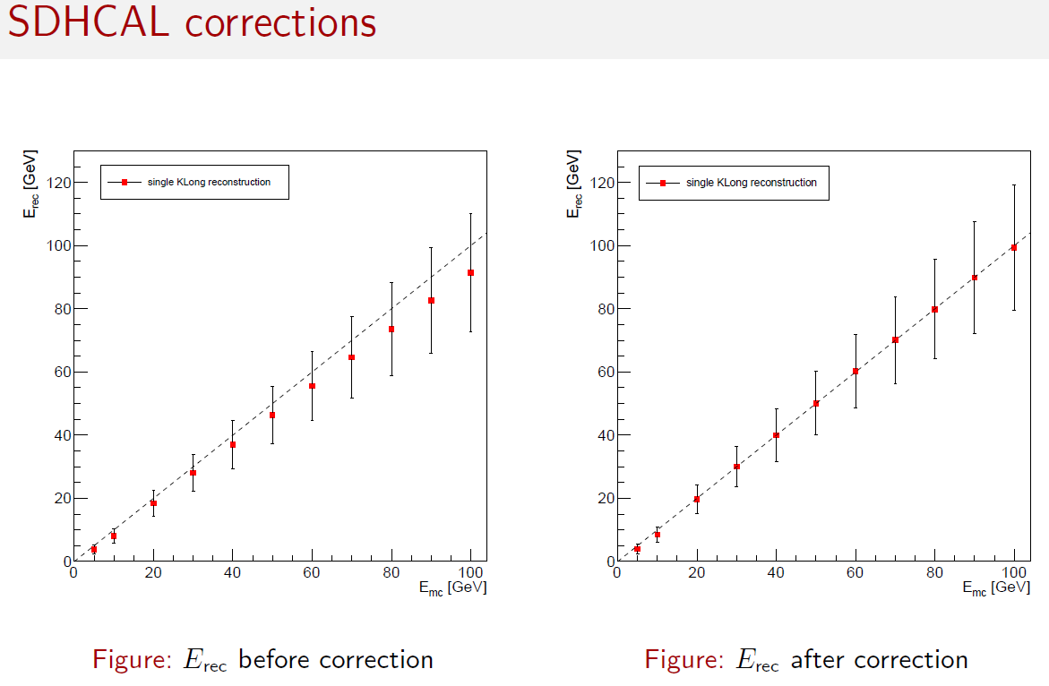

Slide 16
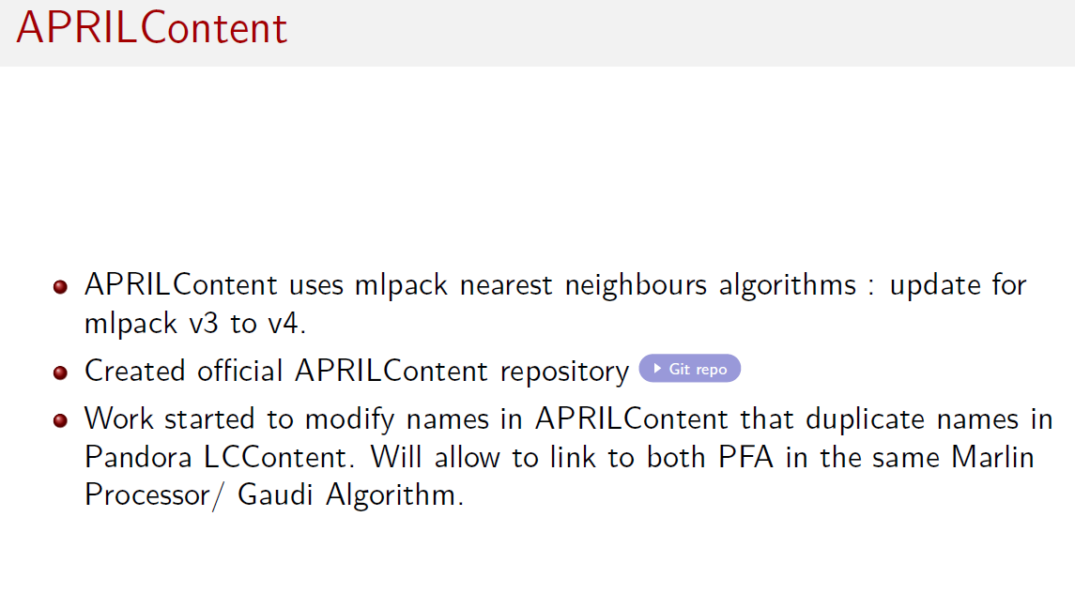
https://github.com/SDHCAL/APRILContent

Slide 17
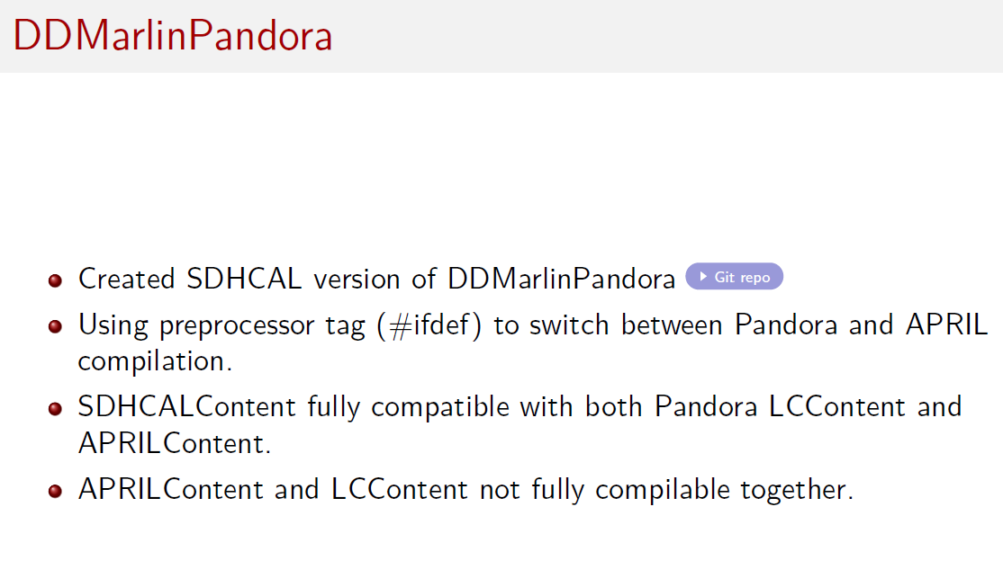
https://github.com/SDHCAL/DDMarlinPandora

Slide 18
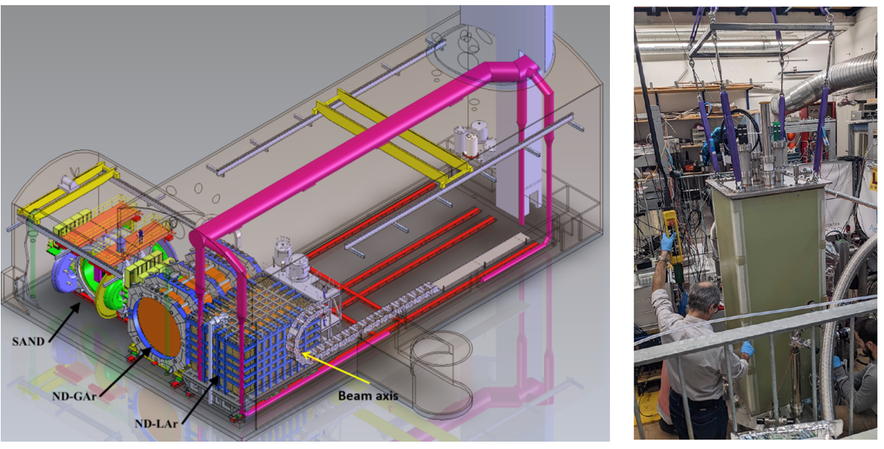
Reconstruction for the DUNE Near Detector (ND)
John Back & John Marshall (Warwick) & various DUNE collaboration members
Conceptual layout of ND complex
Prototype ND-LAr module
ND-LAr = 7x5 array of 1x1x3 m³ modules, optically segmented LAr TPCs, 3D pixel readout

Slide 19
LArRecoND package
Runs Pandora reconstruction for DUNE ND-LAr
3D clustering, with LArContent neutrino & cosmic ray algorithms
  Steered by xml parameter files
Integrated into DUNE ND simulation & data production jobs
  Creates Common Analysis Files (CAFs) for neutrino physics analyses
Used for 2x2 prototype reconstruction as well as 7x5 ND-LAr

Slide 20
Pandora 3D ND reco developments (Leigh Whitehead, Cambridge)
Initial energy hits clustering performed using 3D coords
Cluster merging and refinement
  Apply existing 2D algorithms to the 3D hit clusters
  Currently does not use y information (to be addressed)
Clusters projected into 2D
  Use neutrino reco algorithms based on 2D projections (e.g. MicroBooNE)
Create Particle Flow Objects
  Match 2D hits back to 3D
  Build final tracks and showers

Slide 21
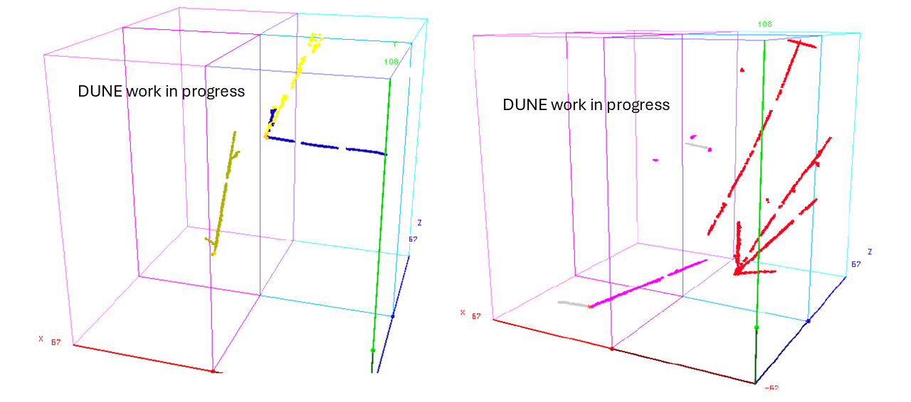
Pandora reco of 2x2 LArTPC simulated events
Clusters overlap
along y projection
Vertical y coord not currently used for 3D clustering

Slide 22
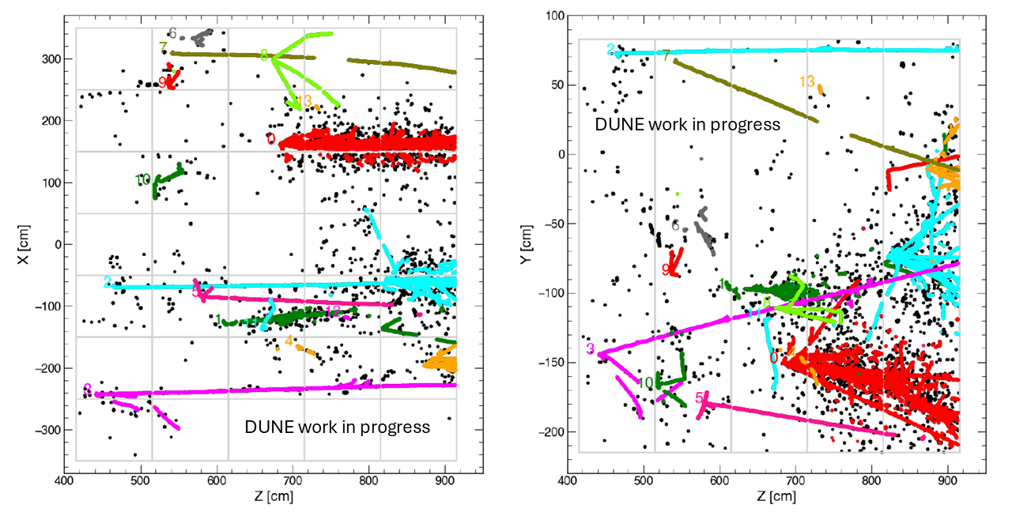
Slicing: reconstructing simulated ν pileup in 7x5 ND-LAr
(Bruce Howard, FNAL & York University, Canada)
1 reconstructed colour slice ≅ 1 ν interaction

Slide 23
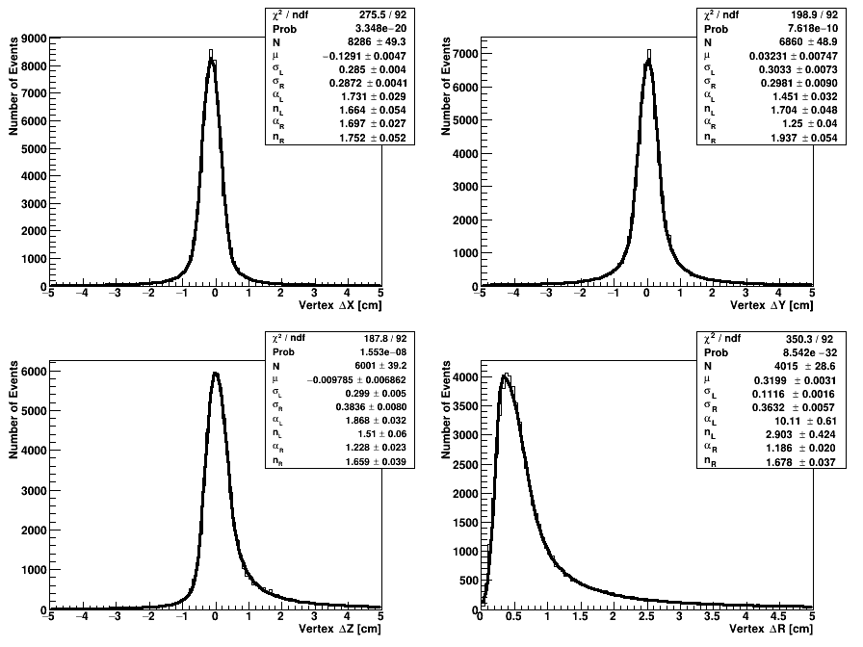
Single ν_{μ} Deep Learning Vertexing: reco – true MC residuals (cm)
<ΔX> = -1 mm
σ_{L} = 3 mm
σ_{R} = 3 mm
<ΔY> = 0 mm
σ_{L} = 3 mm
σ_{R} = 3 mm
DUNE
preliminary
DUNE
preliminary
Gaussian fits
with μ, σ_{L}, σ_{R}
& power law tails
<ΔZ> = 0 mm
σ_{L} = 3 mm
σ_{R} = 4 mm
<ΔR> = 3 mm
σ_{L} = 1 mm
σ_{R} = 4 mm
DUNE
preliminary
DUNE
preliminary

Slide 24
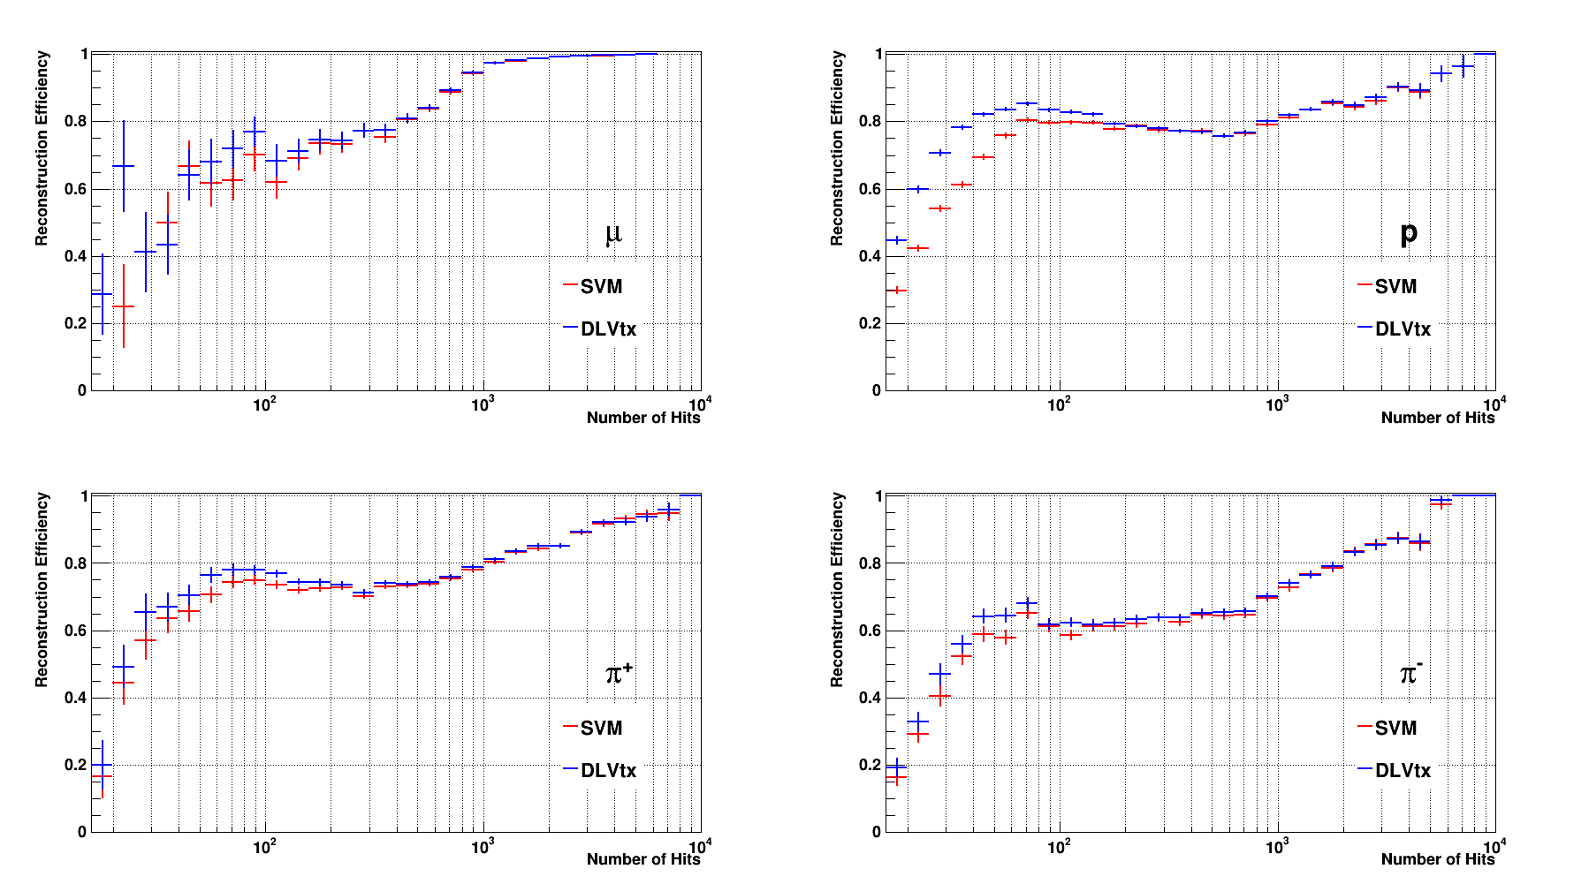
Pandora hit reconstruction efficiencies: single ν_{μ} events
Eff gain
DUNE
preliminary
DUNE
preliminary
DUNE
preliminary
DUNE
preliminary
SVM: MicroBooNE support vector machine, DLVtx: pytorch ND deep learning vertexing

Slide 25
Summary
Dual readout calorimeters
  NN (TensorFlow) jet reconstruction & PID studies
  Need to use traditional physics-based reco methods 1st, then improve using NN
APRIL
  Hadronic shower reconstruction algorithm for SDHCAL
  Energy calibration studies
  SDHCALContent, APRILContent & SDHCAL/DDMarlinPandora git repositories
DUNE Near Detector
  Pandora reconstruction: LArRecoND package
  2x2 LArTPC prototype data analysis underway, using CAFs
  Several DUNE institutes continuing work on LArRecoND for 2x2 & ND-LAr

