Slide 1
AIDAinnova
4th Annual Meeting
7th May 2025
CERN
WP2
Communication, Outreach and Knowledge Transfer
Ana Rita Pinho (CERN), Ana Dorda (CERN), Anne Dabrowski (CERN), Beatrice Mandelli (CERN),
Thomas Brent (CERN), Antoine Laudrain (DESY)

Slide 2
Task 2.1 Work Package Coordination
Rita Pinho (CERN)

Slide 3
Deliverables & Milestones
 | Deliverable | Due date | Status
D2.1 | Presentation video | M3 | Achieved
D2.2 | Final report on career actions for young scientists | M47+6 | In preparation
D2.3 | Report on Communication, Dissemination and Outreach | M48+6 | In preparation
D2.4 | Impact Analysis | M48+6 | In preparation
Milestones |  |  | Status
MS4 | Launching of project website | M1 | Achieved
MS6 | Young Scientist Publication Committee | M15 | Achieved
MS7 | Analysis of innovations needed in markets and technologies | M12 | Achieved
MS5 | Academia Meets Industry Symposium | M24 | Achieved
AIDAinnova Annual Meeting Prague- WP2

Slide 4
Objectives
Task 2.1. Work Package coordination
  Coordinate the WP.
  Create a network of Knowledge Transfer Officers (KTOs) within the AIDAinnova beneficiaries and coordinate their work and liaise with KTOs in other Innovation Pilots
Task 2.2. Communication, dissemination and outreach
  Define and implement a communication strategy to address key stakeholders in particle physics.
  Ensure the flow of information within the project (internal).
  Report the results of the project to a wider audience (external).
  Engage the detector community and industry to enhance societal impact of fundamental research.
Task 2.3. Careers of young detector scientists
  Enhance recognition, training and career opportunities for detector scientists.
Task 2.4. Industrial relations and Knowledge Transfer
  Promote co-innovation with industry to demonstrate societal impact of fundamental research.
  Impact analysis of innovation aligned with UN Sustainable Development Goals.

Slide 5


Synergies with Innovation Pilots
  Contribute to the RI Innovation Coordination Group:
    Frequent Meetings (approx. 4 per year)
  Strength interaction with other innovation pilots:
      Invited talks at LEAPS industry meeting
      Participation in ALBA event on Industry opportunities in light source
      TIPP23 conference, talk on behalf of:
        AIDAinnova, I.FAST, LEAPS-innov, EURO-LABS and EASI-STRESS projects
      Cryogenics Industry meeting
      BSBF 2024

Slide 6
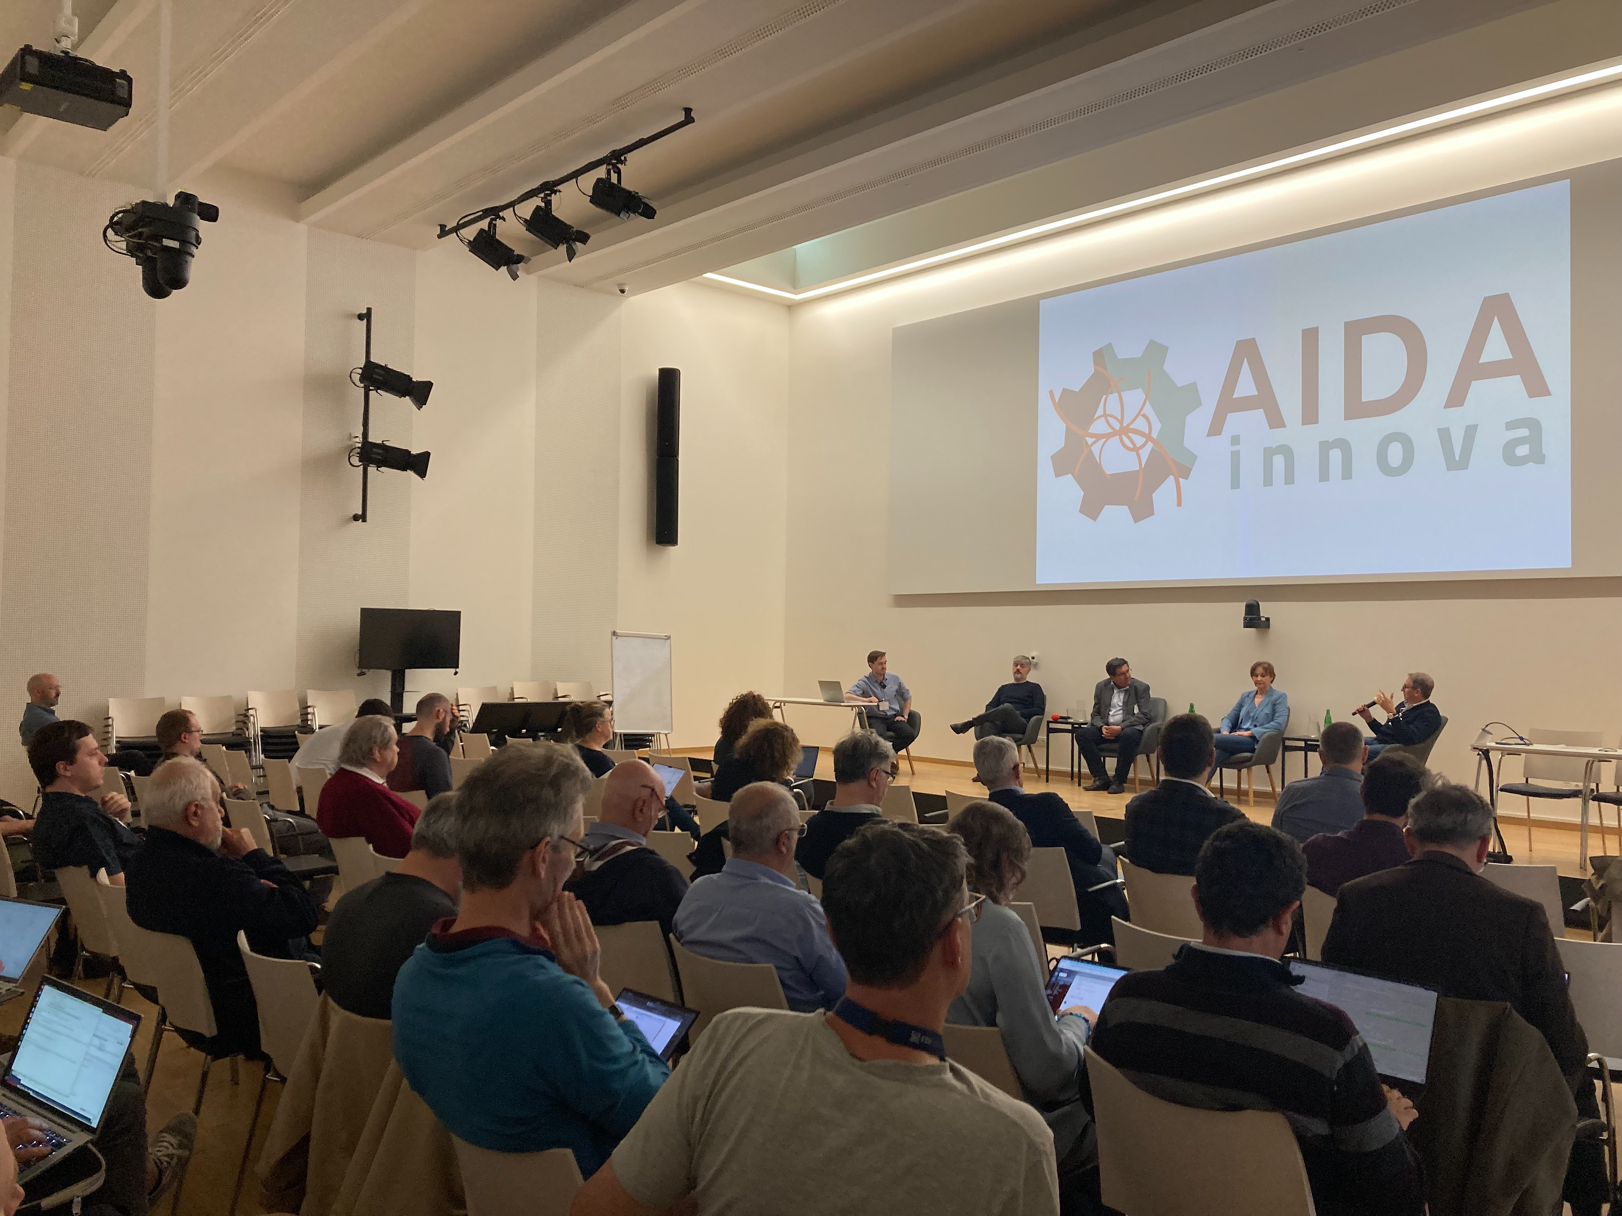
Knowledge Transfer Network
Roundtable “AIDAInnova Meets Industry” & Industry Exhibition
Network of KT/TT Offices
  46 beneficiaries, 35 academics;
Next:
  Workshop with KT/TTO network
    Present results of the survey
    Discuss challenges

Slide 7
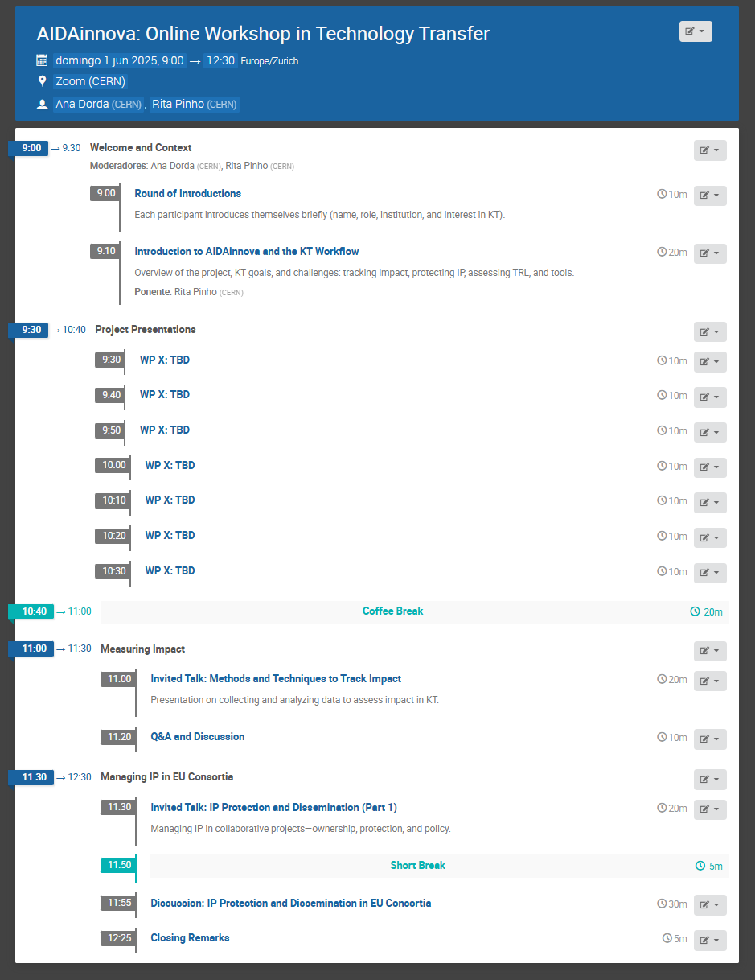

KT/TTO Workshop
Half-day online event focused on strategies, tools & experiences in:
Knowledge transfer (KT)
IP management
Impact assessment
When:
Date to be scheduled
Doodle poll coming soon
Target: before summer
Why Attend:
Learn about AIDAinnova developments with KT potential
Get practical guidance on tracking impact & protecting IP in EU projects
Share challenges & solutions across the consortium
Strengthen collaboration between technical and KT teams

Slide 8








Help Us Spread the Word!
If you're a technical expert, please inform your KT office and encourage them to join.
Your help is key to ensuring representation from all partner institutes!

Slide 9
Task 2.2 Communication
Thomas Brent (CERN), Antoine Laudrain (DESY)

Slide 10
Objectives
Task 2.1. Work Package coordination
  Coordinate the WP.
  Create a network of Knowledge Transfer Officers (KTOs) within the AIDAinnova beneficiaries and coordinate their work and liaise with KTOs in other Innovation Pilots
Task 2.2. Communication, dissemination and outreach
  Define and implement a communication strategy to address key stakeholders in particle physics.
  Ensure the flow of information within the project (internal).
  Report the results of the project to a wider audience (external).
  Engage the detector community and industry to enhance societal impact of fundamental research.
Task 2.3. Careers of young detector scientists
  Enhance recognition, training and career opportunities for detector scientists.
Task 2.4. Industrial relations and Knowledge Transfer
  Promote co-innovation with industry to demonstrate societal impact of fundamental research.
  Impact analysis of innovation aligned with UN Sustainable Development Goals.

Slide 11





Communication channels
Project website
aidainnova.web.cern.ch
Mailing lists,
including internal newsletter
External newsletter
On Track (quarterly).
Participants channels,
including social media
Events
Workshop, conference, nights
We are here to help. Come to us to make the community more visible!

Slide 12
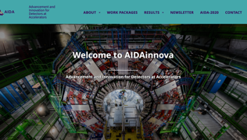
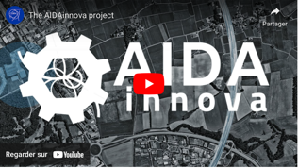
Results/highlights
Task 2.2: Output
Logo and branding
Website
>5600 unique visitors
36 articles
Newsletter
>400 subscribers
7 issues
Introduction video
On CERN YouTube
>5500 views
MS4
D2.1
Publication targets (data from Zenodo -> Please contact us!)
Objectives | AIDAinnova targets | Currently
Scientific dissemination | 180 publications including 60 journal publications and 50 conference contributions | 134 publications including 40 journal publications and 9 conference contributions
General communication and news | 10 articles in newsletters and other communication channels | 48 articles in newsletters and other communication channels (including 29 on the main website)
Other communication | N/A | >20 presentations at international physics workshops, 1 technical report, 4 posters

Slide 13

What can AIDAInnova do
to build a more effective, engaging communication

Slide 14
A more effective, engaging comms
How can we help:
Provide a service Website updates, creation (flyer, poster, video, photo).
Build a story
Disseminate for recognition and funding.
How can you help:
Explain your activity & find nice stories
Coordinate your communication with us
Involve your institute and the beneficiaries you work with

Slide 15
Benefits of communicating your work
Convince funders and policy makers – Draw attention to your work and demonstrate its impact, it could mean more money or support
Inspire young scientists and engineers – help bring new, motivated people into your field
Find new collaborators – if you promote your work, you may get fellow scientists reach out to share their ideas and experience
Help avoid duplication – Showcase your work so others don’t spend time trying to do the same
Boost your career (or the career of your PhDs / Post-docs) – Media attention looks great on the CV, especially for early-career scientists and engineers
We promise, it takes only a few hours to help put together an article showcasing your work!

Slide 16
Next:
Two new edition of On Track to cover results from the AIDAInnova project.
Report on Communication, Dissemination and Outreach

Slide 17
Task 2.3 Careers of young detector scientists
Anne Dabrowski (CERN) ,
Beatrice Mandelli (CERN), Antoine Laudrain (DESY)

Slide 18
Objectives
Task 2.1. Work Package coordination
  Coordinate the WP.
  Create a network of Knowledge Transfer Officers (KTOs) within the AIDAinnova beneficiaries and coordinate their work and liaise with KTOs in other Innovation Pilots
Task 2.2. Communication, dissemination and outreach
  Define and implement a communication strategy to address key stakeholders in particle physics.
  Ensure the flow of information within the project (internal).
  Report the results of the project to a wider audience (external).
  Engage the detector community and industry to enhance societal impact of fundamental research.
Task 2.3. Careers of young detector scientists
  Enhance recognition, training and career opportunities for detector scientists.
Task 2.4. Industrial relations and Knowledge Transfer
  Promote co-innovation with industry to demonstrate societal impact of fundamental research.
  Impact analysis of innovation aligned with UN Sustainable Development Goals.

Slide 19
Task 2.3 since previous annual meeting
Collaboration with EP R&D at CERN,
  EP R&D Days, poster session for young researches, June 2024
  22 Poster presentations with awards for young scientists
Training on Quantum applications at CERN, Jan 2025
  Target audience: non-expert young scientists & engineers
  > 100 participants
  Collaborative organisation effort
Opportunity for poster session at 2024 & 2025 annual meetings

Slide 20
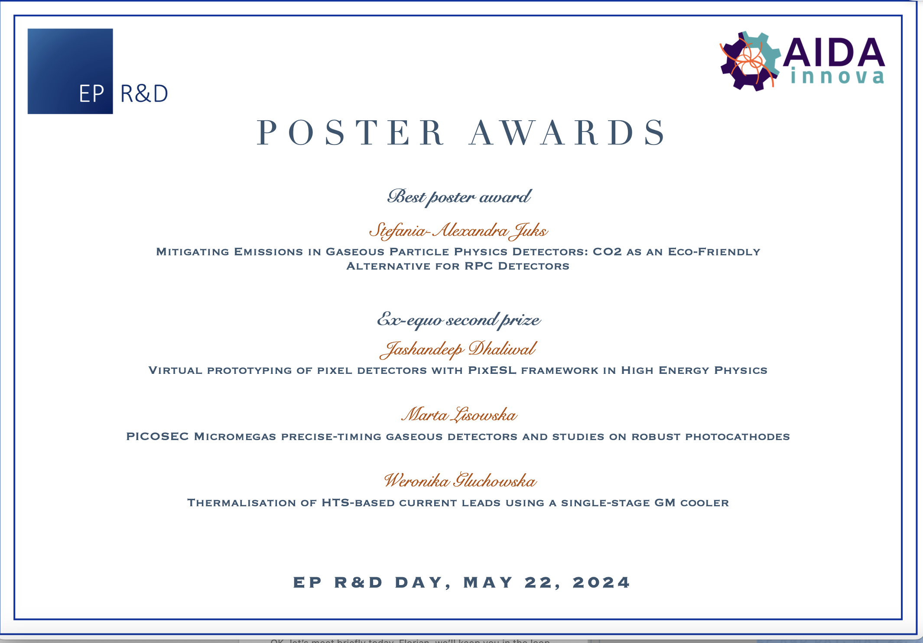
Collaboration EP R&D
Poster session for young researchers
  22 posters at the "EP R&D Days"
    very good contribution from AIDAinnova young collaborators.
    Indico event 1395929 ; Book of abstracts
  Prize winners, with the first place poster being awarded a scholarship by AIDAinnova WP2 to attend a School on Particle Detectors
    https://agenda.infn.it/event/41033/ annual Bonaudi-Chiavassa International School on Particle Detectors

Slide 21
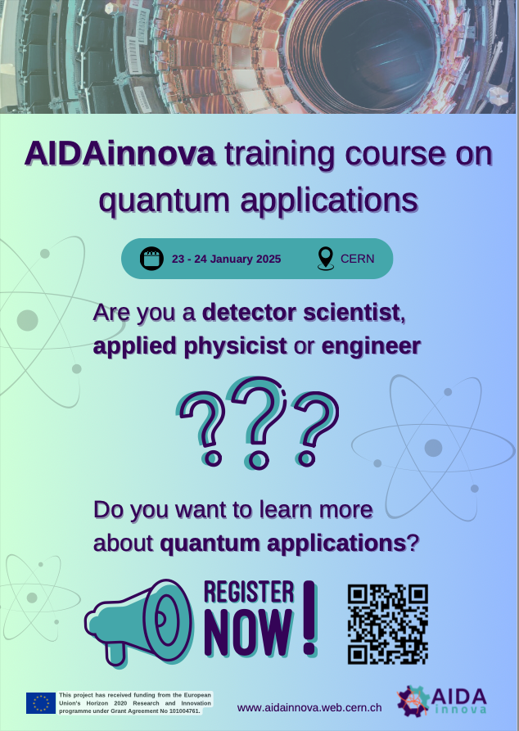
Quantum Training
Quantum Applications Training Course
with an emphasis on Particle Detection Technologies for Applied Physicists and Engineers
Goals:
Provide an overview of quantum sensing technologies & applications to HEP detectors
Facilitate contacts with the industry & Enable networking among participants/lecturers
Lecturers: mix of academia, RTO and industry
(Hamamatsu, Amsterdam Scientific Instruments, IDQuantique, IBM, STMicroelectronics, Random Power FBK, ICFO)
~100 participants (room capacity limit), priority given to AIDAinnova
  ~25 <PhD, ~30 PhD, ~40 >PhD, mostly from academia
  33% in active in AIDAinnova projects
  5 student grants
  Poster session with ~15 posters (various topics, incl. Quantum)
Notes:
Organising Team: Rafael Ballabriga (CERN), Thomas Brent (CERN), Anne Dabrowski (CERN), Amanda Diez Fernandez (CERN), Ana Dorda (CERN), Sabrina El Yacoubi (CERN), Georgy Kornakov (U. Tech Warsaw), Antoine Laudrain (DESY), Lucie Linssen (CERN), Beatrice Mandelli (CERN), Rita Pinho (CERN)
Lectures recorded and available
https://indico.cern.ch/event/1441944/timetable/?view=standard

Slide 22
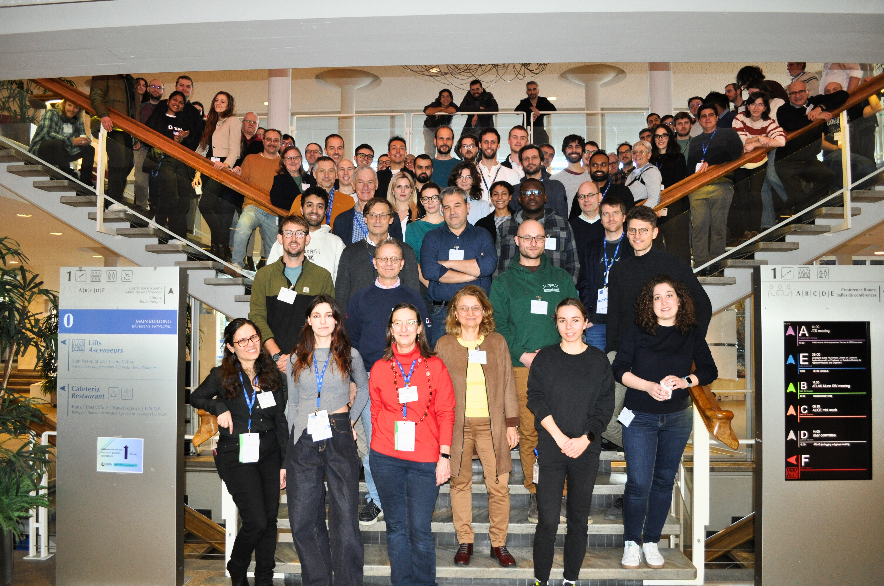
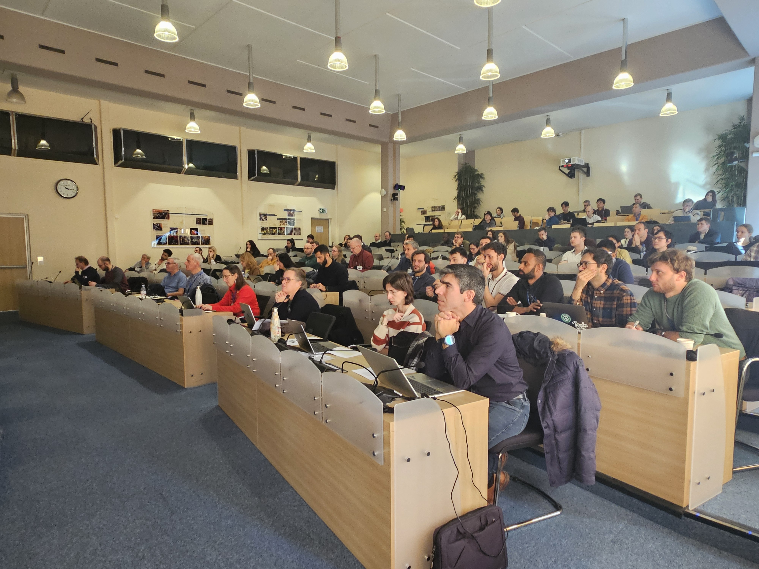
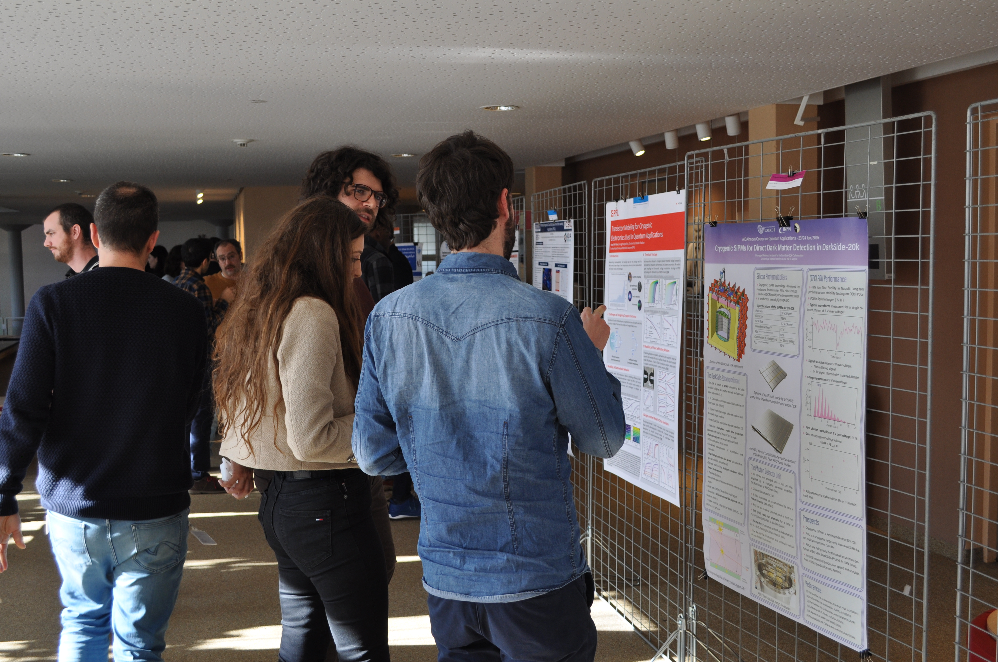
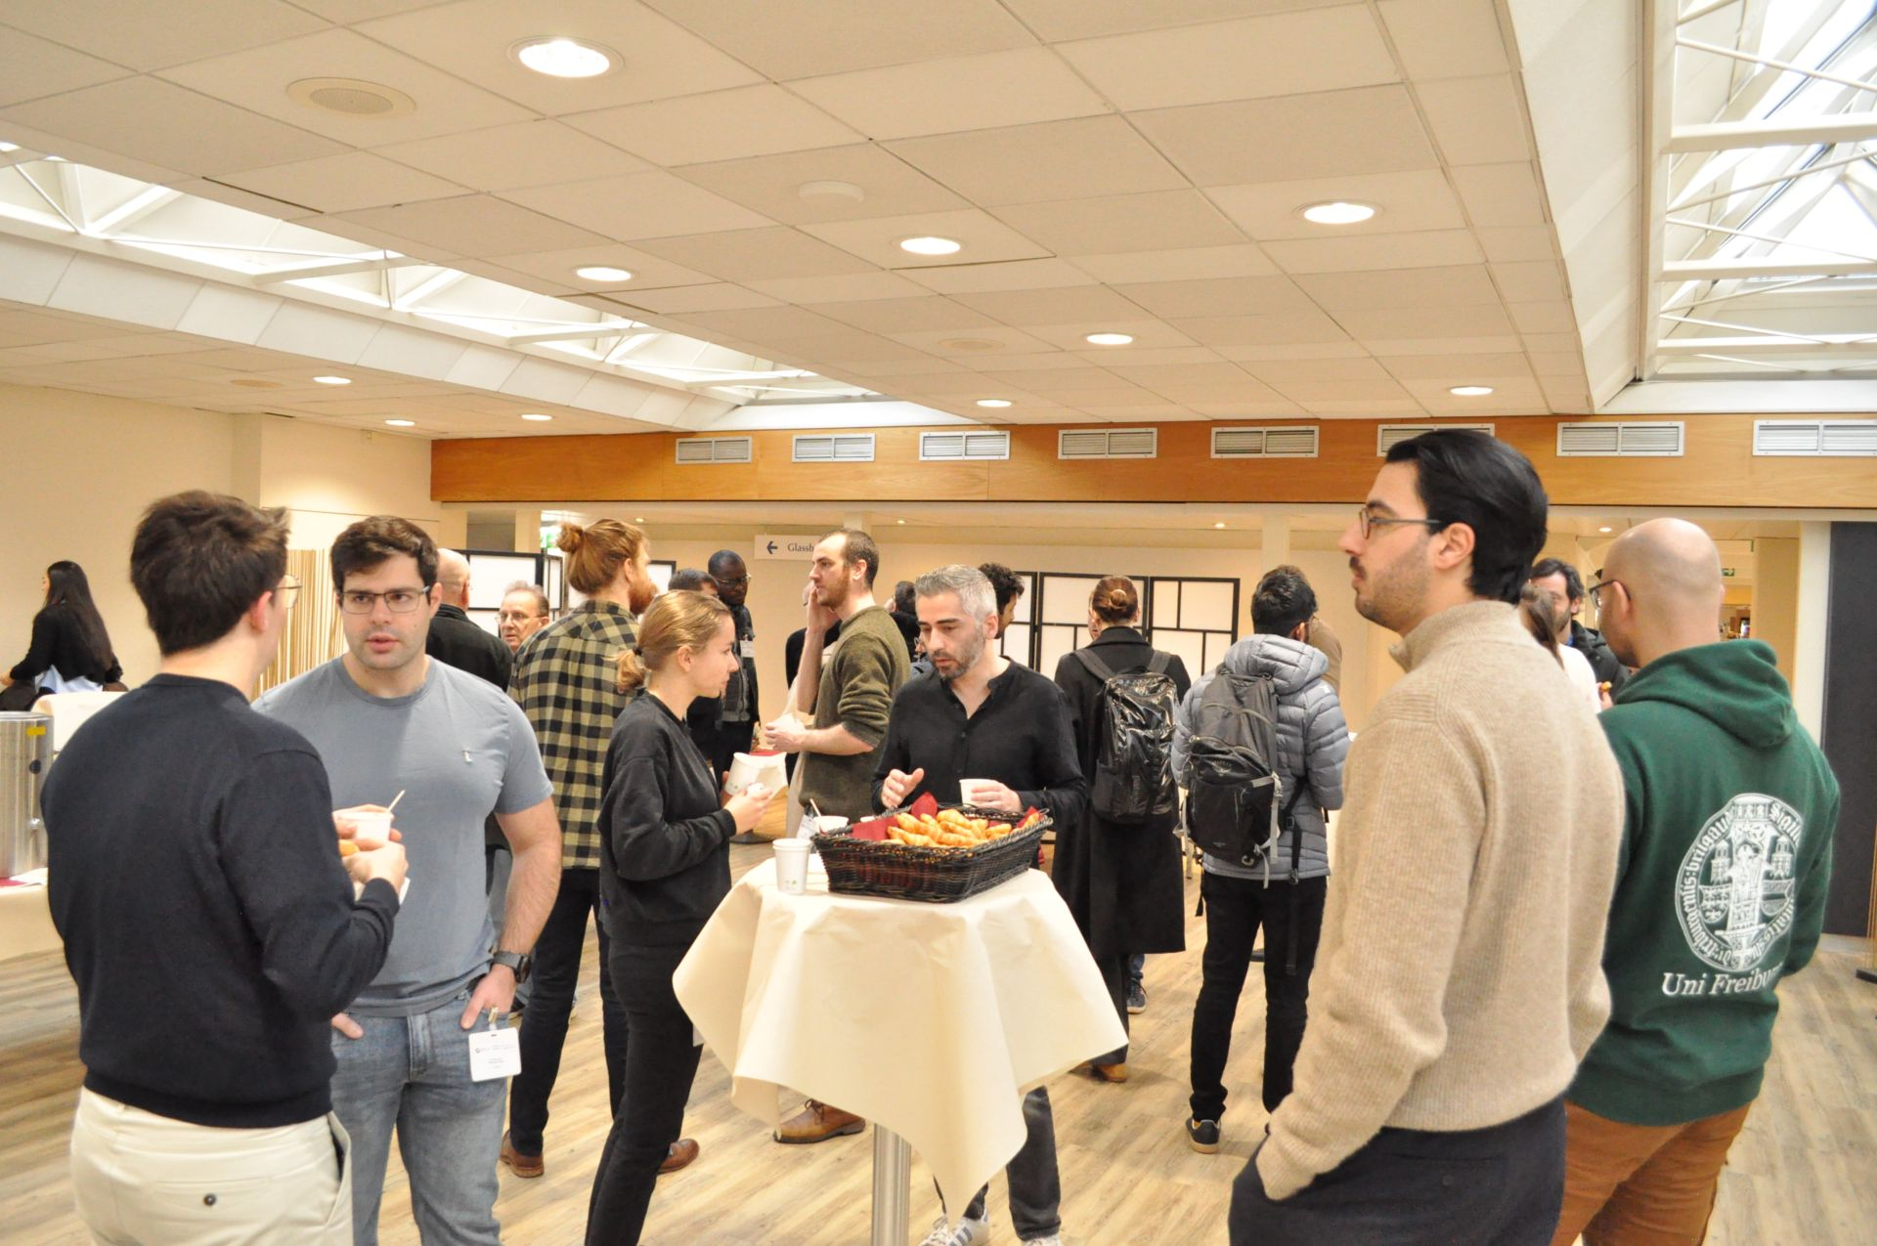
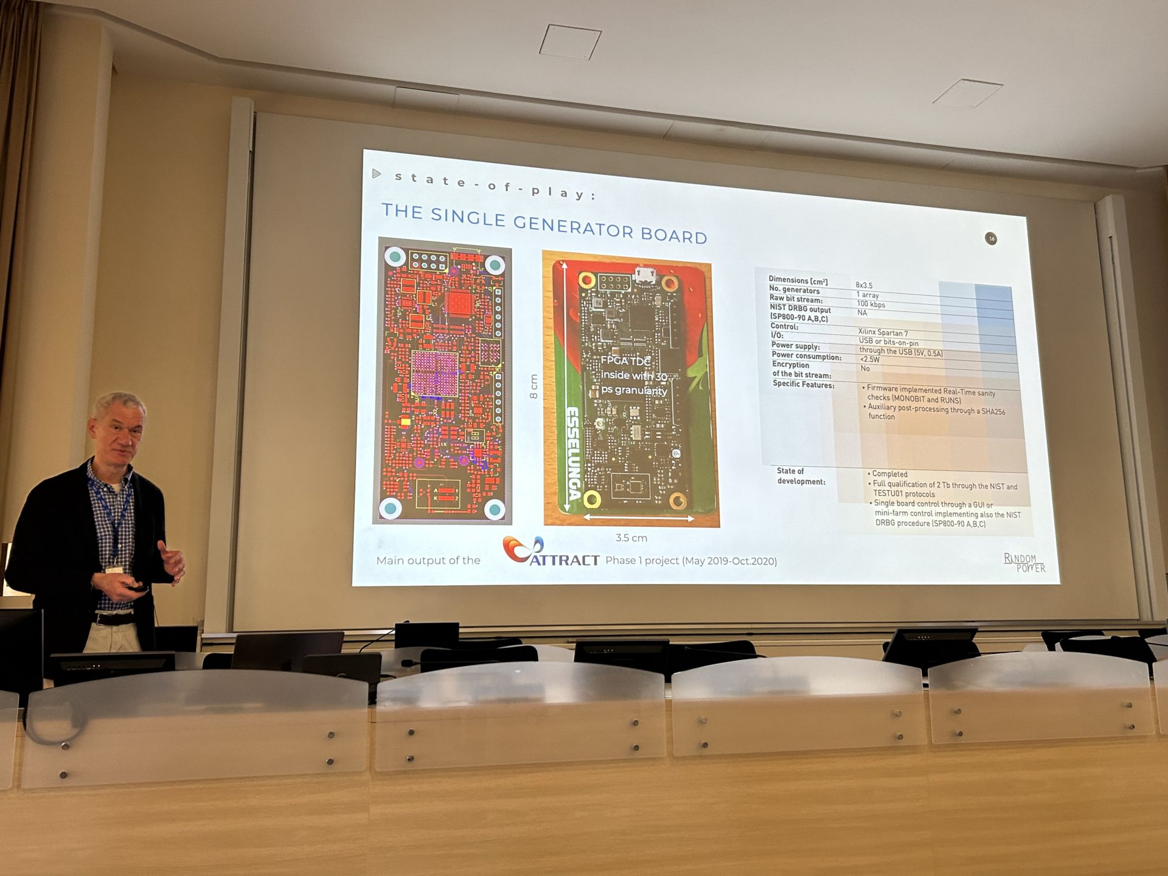
Great success!
Very interesting talks
Many connections made
Very positive feedback from participants and lecturers
Recordings available on indico:
  https://indico.cern.ch/event/1441944/

Slide 23
Towards D2.3 - M47
D2.3 Final report on career actions of young scientists WP2 2.3 M47 (end February, extended to include this annual meeting)
Report will include:
  Establishment and infrastructure for publication committee, noting that it has not been used
  AIDAinnova annual meeting lecture ('23) – Ivan and Sune
  EP R&D days poster session, incl. Prize for best poster awarded to AIDAinnova student – grant to attend detector school
  AIDAinnova Course on Quantum Applications with an emphasis on Particle Detection Technologies for Applied Physicists and Engineers
  Poster session and networking opportunities at annual meetings
Next: Drafting of the report has started

Slide 24
Task 2.4 Industrial relations and Knowledge Transfer
Rita Pinho (CERN), Ana Dorda (CERN)
AIDAinnova Annual Meeting Prague- WP2

Slide 25
Objectives
Task 2.1. Work Package coordination
  Coordinate the WP.
  Create a network of Knowledge Transfer Officers (KTOs) within the AIDAinnova beneficiaries and coordinate their work and liaise with KTOs in other Innovation Pilots
Task 2.2. Communication, dissemination and outreach
  Define and implement a communication strategy to address key stakeholders in particle physics.
  Ensure the flow of information within the project (internal).
  Report the results of the project to a wider audience (external).
  Engage the detector community and industry to enhance societal impact of fundamental research.
Task 2.3. Careers of young detector scientists
  Enhance recognition, training and career opportunities for detector scientists.
Task 2.4. Industrial relations and Knowledge Transfer
  Promote co-innovation with industry to demonstrate societal impact of fundamental research.
  Impact analysis of innovation aligned with UN Sustainable Development Goals.
AIDAinnova Annual Meeting Prague- WP2

Slide 26
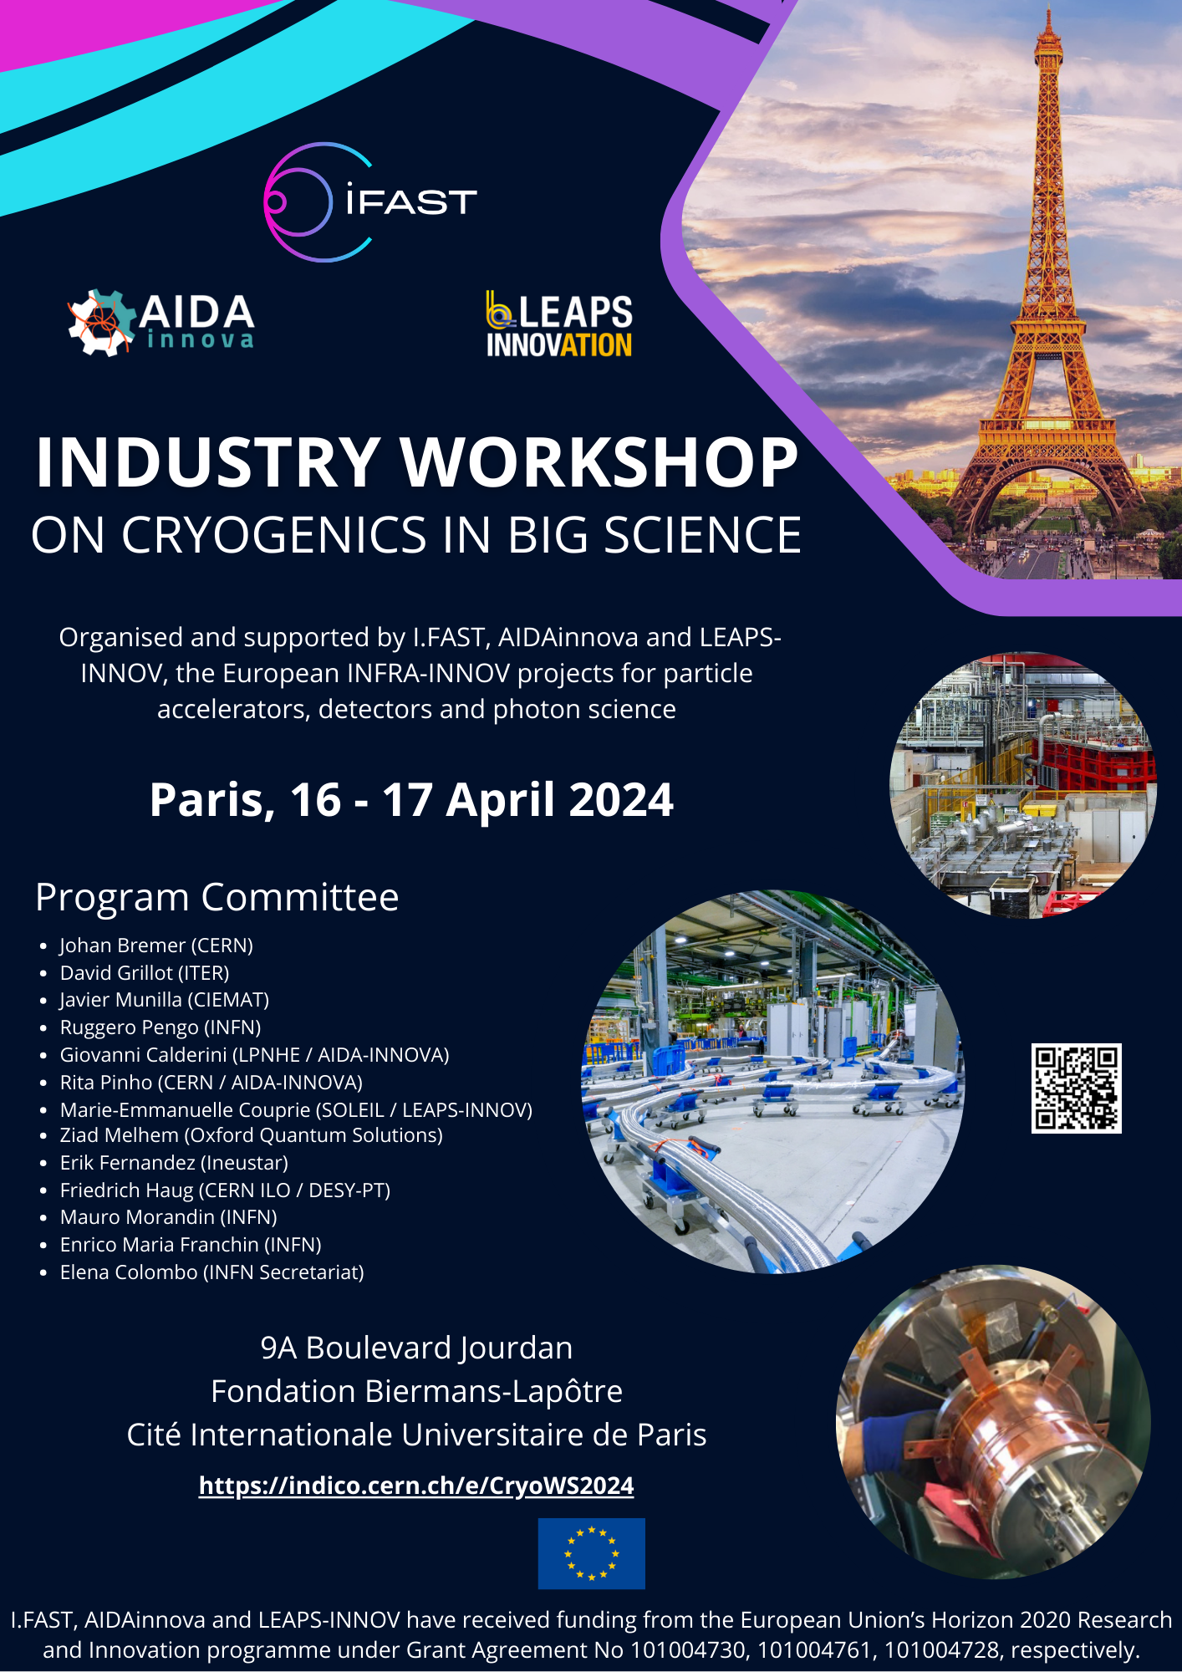
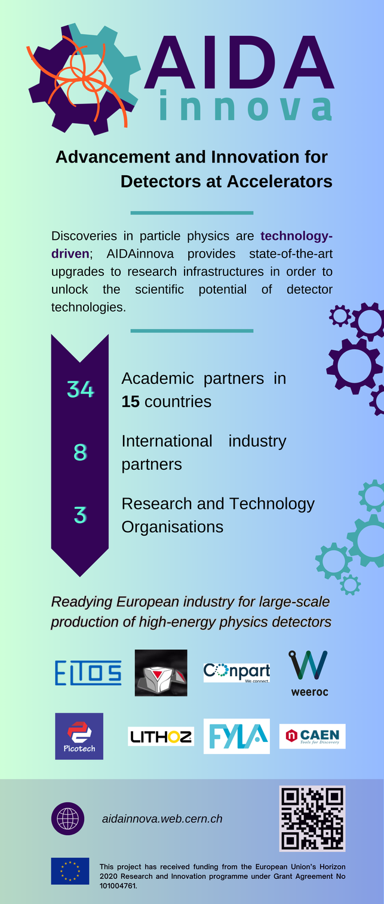
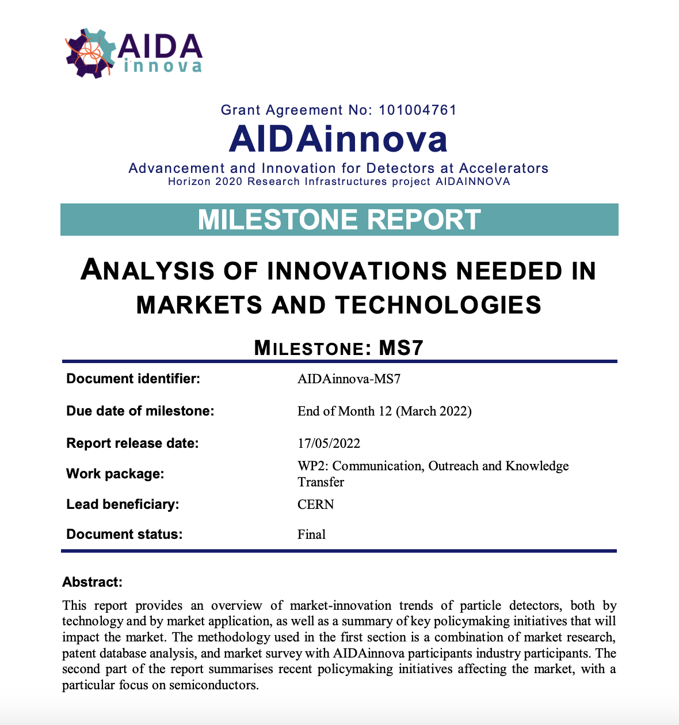
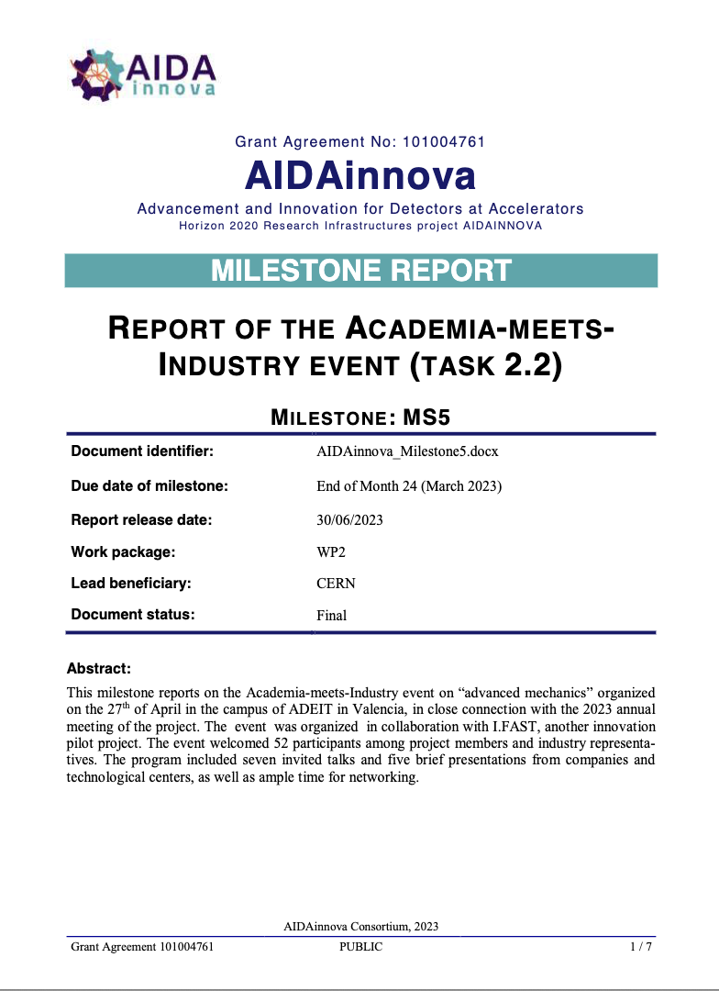
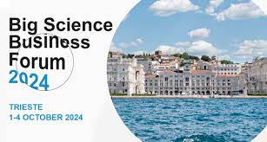
Results/highlights

Slide 27

What we promised
Knowledge Exchange Workshops with Industry and other scientific communities:
  1 “Academia Meets Industry” Advanced Mechanics event – April 2023
  1 “Industry Workshop on Cryogenics in Big Science” - April 2024
  Joint booth at BSBF 2024 – Oct 2024
  Quantum Training (w/industry talks)– Jan 2025
  1 workshop with other TT offices – tbc (online)
Technology Disclosures (target was 5 → we have 10 so far)
  Description of the technology, the problem that it addresses, potential applications outside HEP, how it compare to the state of the art, maturity, etc
  Value propositions of the main results per WP?
    Description of key technological advancements
    Applications beyond HEP
    Target markets and costumers
AIDAinnova Annual Meeting Prague- WP2

Slide 28

Impact analysis
  Developments Survey
  Interview WP leaders on AIDAinnova developments:
    exploitable foreground;
    lessons learned from industry partnerships;
    link to UN SDGs;
  Report mapping the economic and commercial impact, as well as technological, environmental, social and cultural impacts following UN SDGs (D2.4)

Slide 29
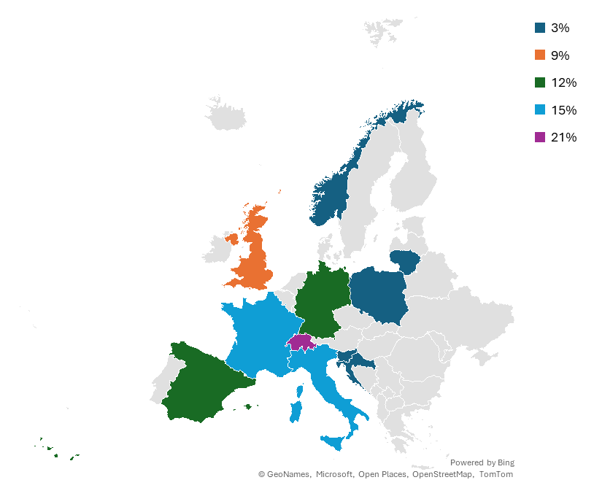

Impact analysis
Input for Impact Analysis
  Report mapping the economic and commercial impact, as well as technological, environmental, social and cultural impacts following UN SDGs (D2.4)
AIDAinnova network 45 beneficiaries:
    3 RTO
    8 industrial companies
    34 research institutes from 15 countries
37 responses received from:
  26 research institutes
  2 industrial partners
  12 different countries
AIDAinnova Annual Meeting Prague- WP2

Slide 30
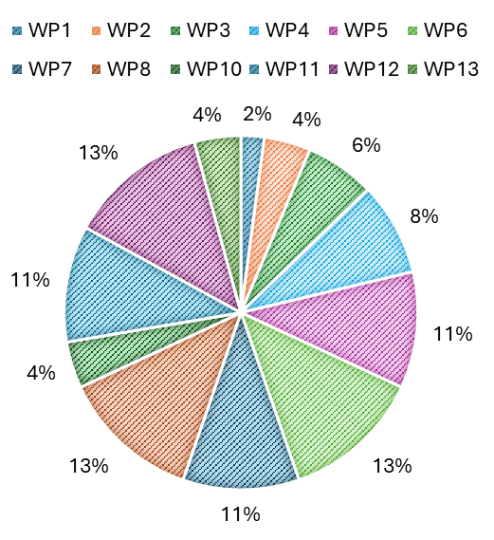
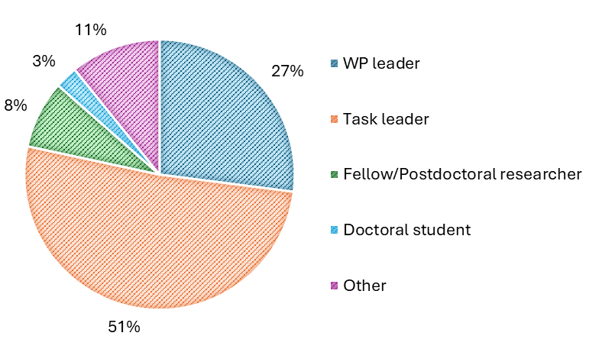
Answers per WP
50% of the answers were from Task Leaders
The WPs with the highest percentage of responses (13%) were WP6, WP8, and WP12.
No responses were received from WP9.
AIDAinnova Annual Meeting Prague- WP2

Slide 31
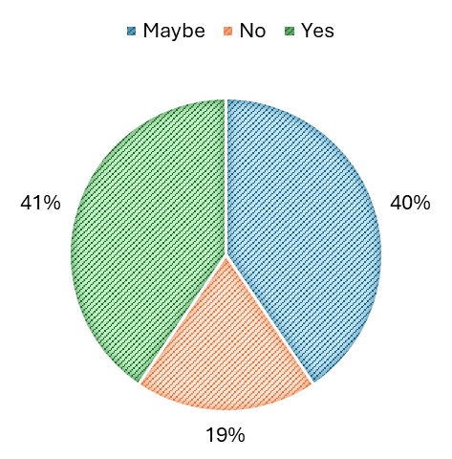
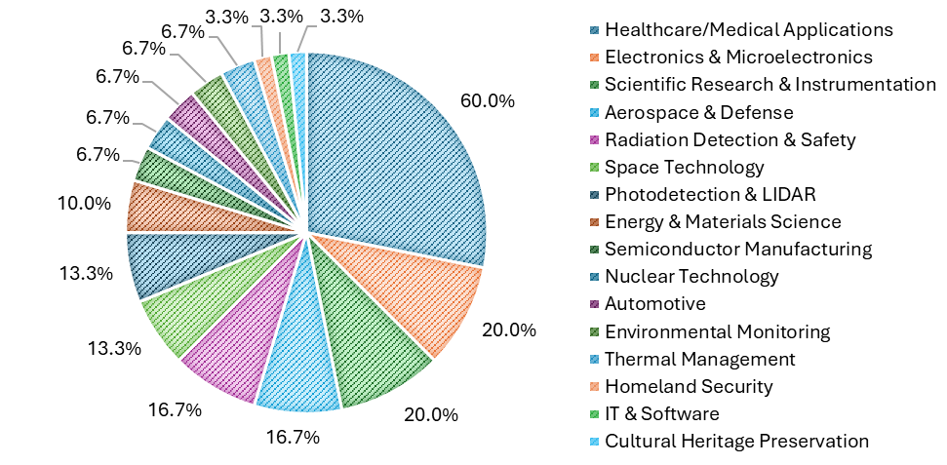
Impact analysis
One objective of the survey was to gather insights on potential exploitable foreground, focusing on key developments and achievements within the project.
When asked about applicability outside High Energy Physics (HEP), 41% answered 'Yes,' 40% 'Maybe,' and 19% 'No.’
60% of the positive answers mention “Healthcare/Medical Applications”.
Are any of these technologies applicable to industries outside the field of HEP?"
AIDAinnova Annual Meeting Prague- WP2

Slide 32
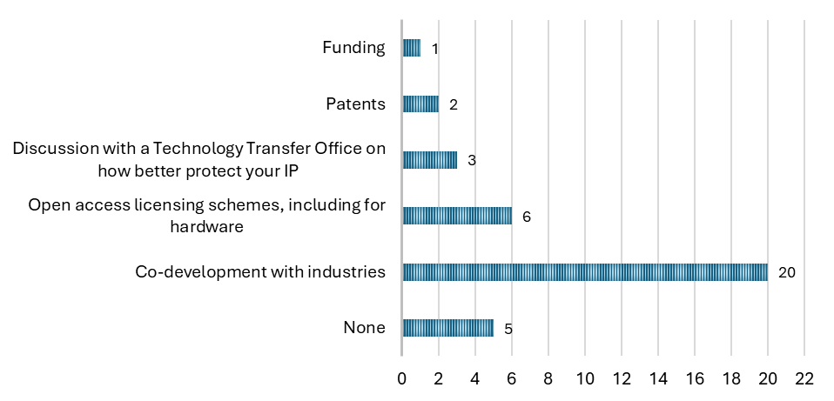
Impact analysis
The same respondents were asked how their Work Package could generate beneficial results.
20 selected 'Co-development with industries.
The next most popular option was 'Open access licensing schemes, including for hardware.’
Only a 35% acknowledged to collaborate win industry on their developments
"Do you think that your WP will generate any results that would benefit from:" highlighting areas where respondents indicated they might need assistance, such as funding, IP protection, and other forms of support.
AIDAinnova Annual Meeting Prague- WP2

Slide 33
Impact analysis
“Are you currently collaborating with any industrial companies as part of this WP?"
“Are there stakeholders (e.g., companies or research institutions) currently interested in your WP’s innovations?”
AIDAinnova Annual Meeting Prague- WP2

Slide 34

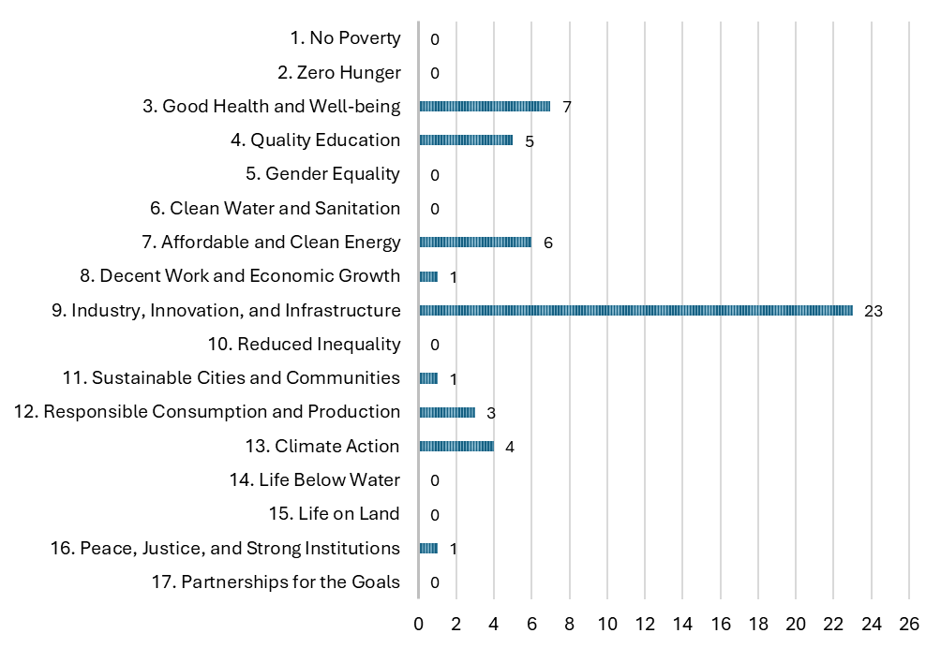
Impact analysis
The last section of the survey focused on the United Nations Sustainable Development Goals (UN SDGs).
These are a set of 17 interconnected global objectives designed to create a more equitable, sustainable, and prosperous world by 2030.
23 respondents chose SDG number 9, related to Industry, Innovation, and Infrastructure
AIDAinnova Annual Meeting Prague- WP2

Slide 35
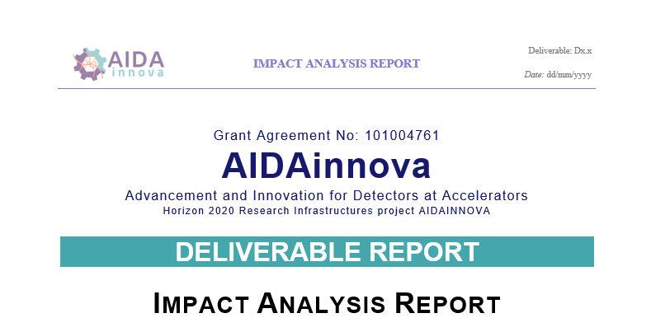
Impact analysis
The study was conducted as follows:
Online survey
Target follow-up interviews to explore in detail the potential of the developments:
  Eleven follow-up interviews with technical experts from WP1, 2, 3, 4, 5, 6, 7, 8, 10, 11, 12 and 13.
  So far 10 technologies have been scouted.
A report, presenting conclusions from the survey on the economic, technological, environmental, and social impacts.
AIDAinnova Annual Meeting Prague- WP2

Slide 36
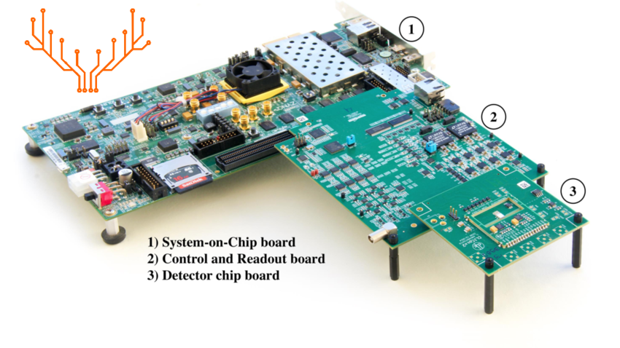
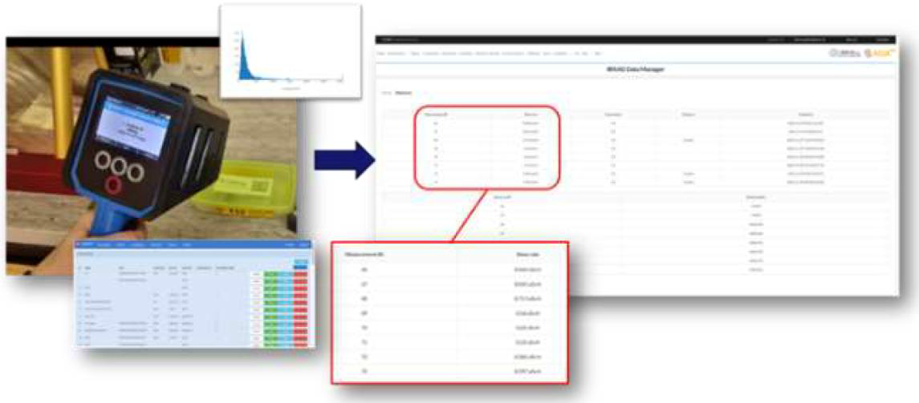
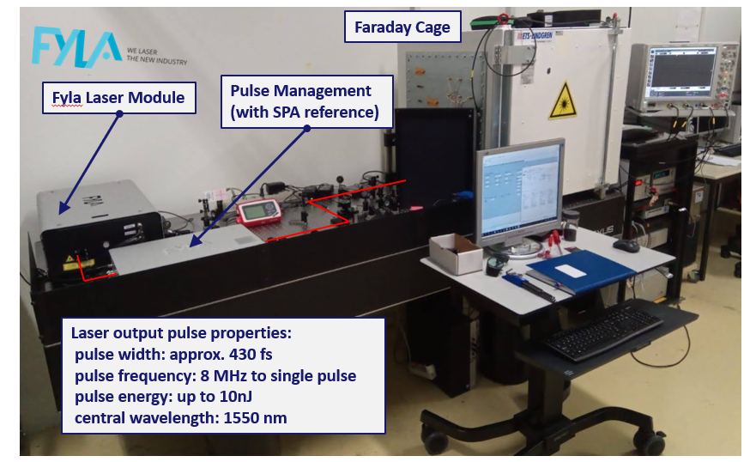
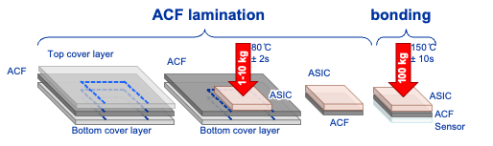
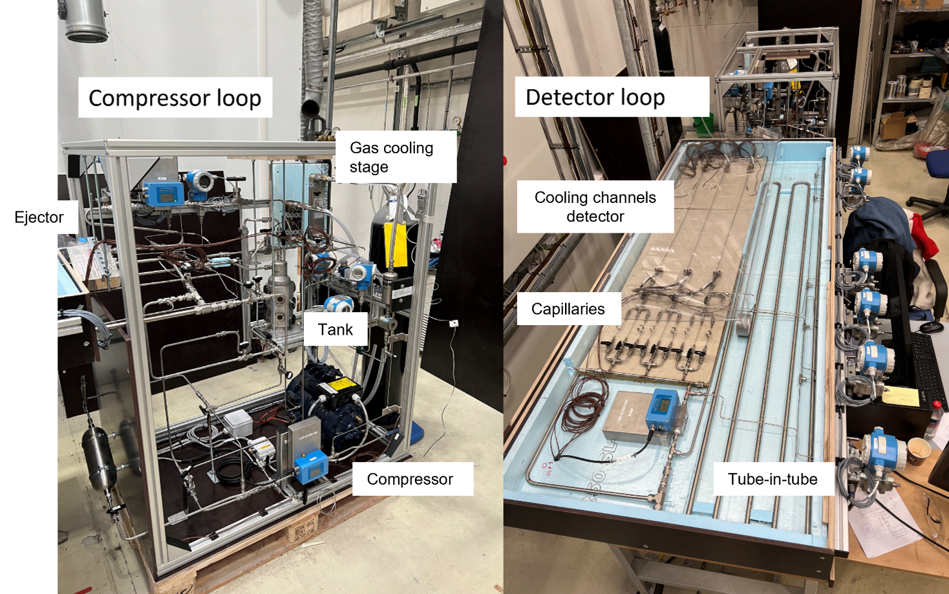
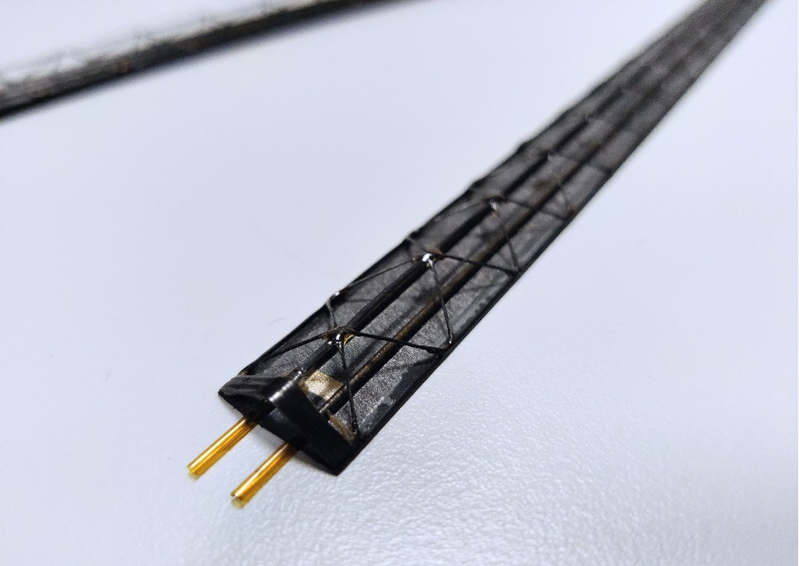
Impact analysis
WP3 Caribou
WP4 TPA-TCT
WP4 DIGIWASTE & IRRAD
WP6 Anisotropic Conductive Films
WP10 Krypton cooling
WP10 Ultralight Cold Plate (UCP)

Slide 37
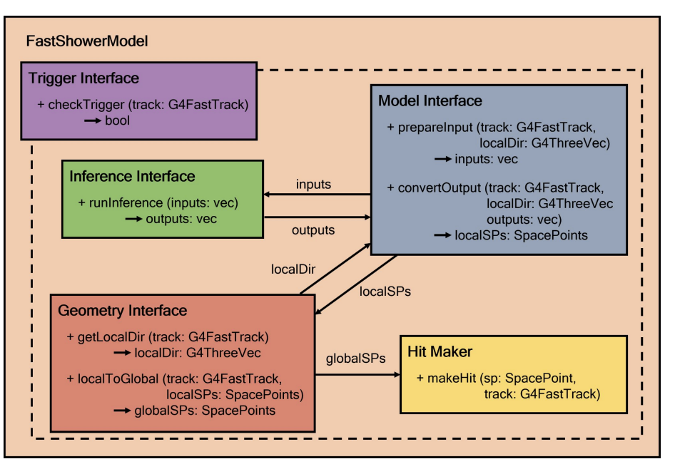
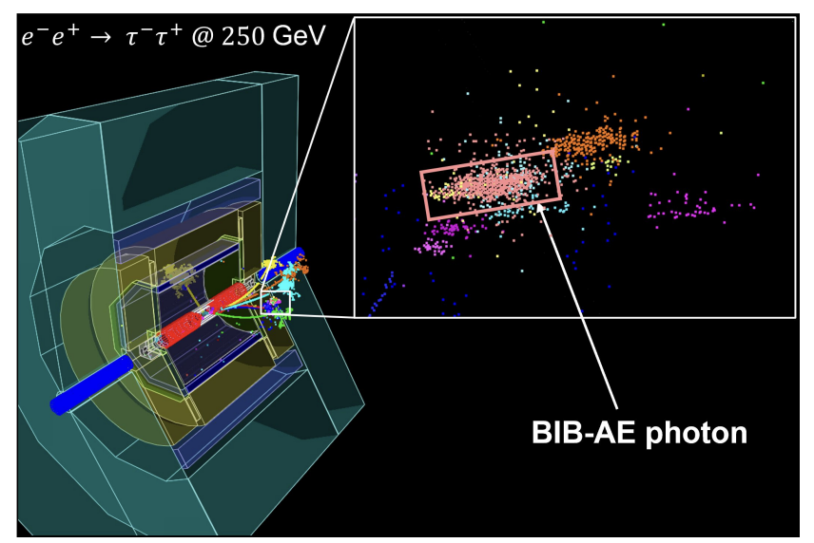
Impact analysis
WP10 Tubes with sensor / Annular flow
WP11 HKROC & LIROC
WP12 ML for particle showers simulation

Slide 38
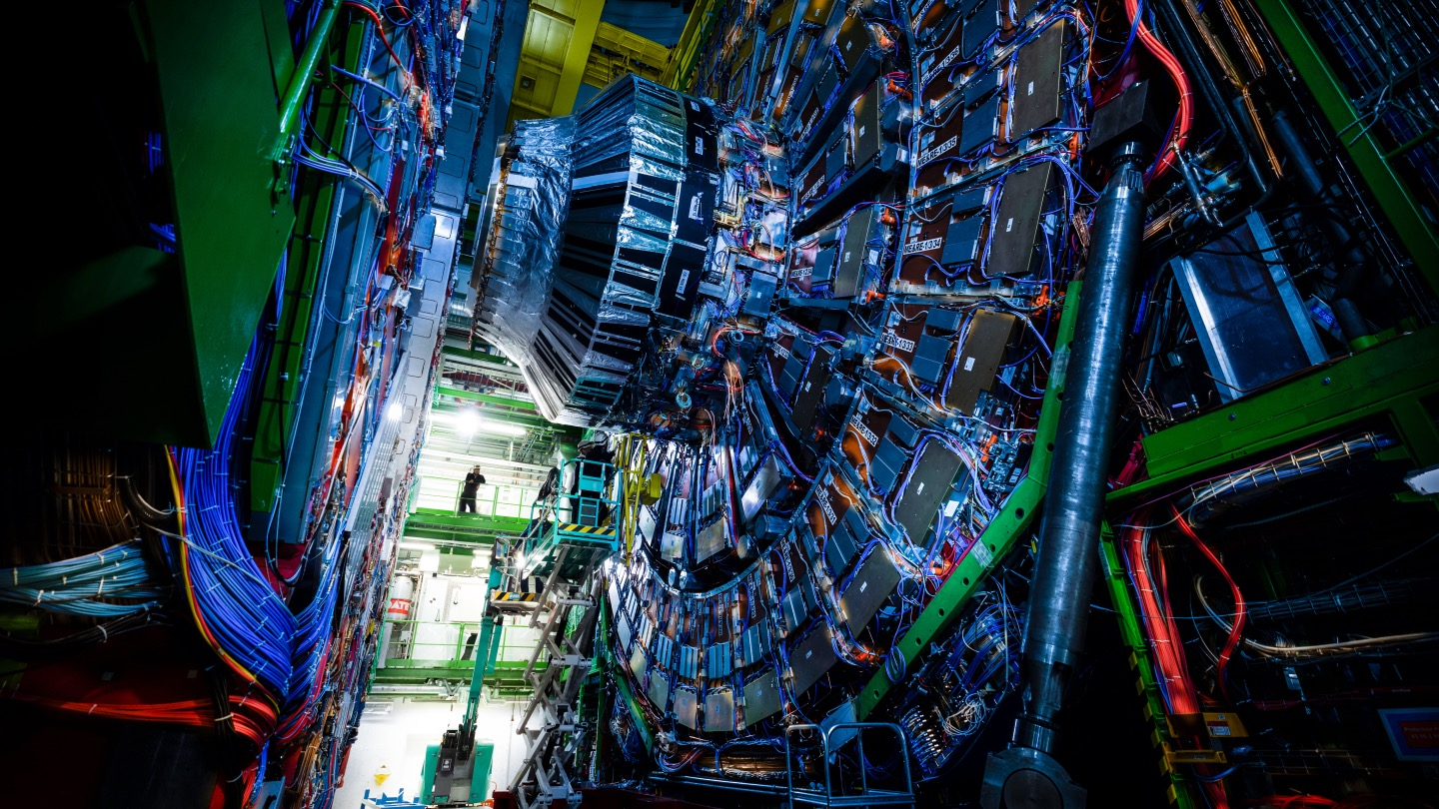
Thanks!
Questions?

