Slide 1
WP6- Hybrid pixels sensors for 4D tracking and interconnection technologies
Hybrid Pixel Sensors for 4D Tracking and Interconnection Technologies
Anna Macchiolo, Claudia Gemme
AIDAinnova Final Annual Meeting 2025

Slide 2
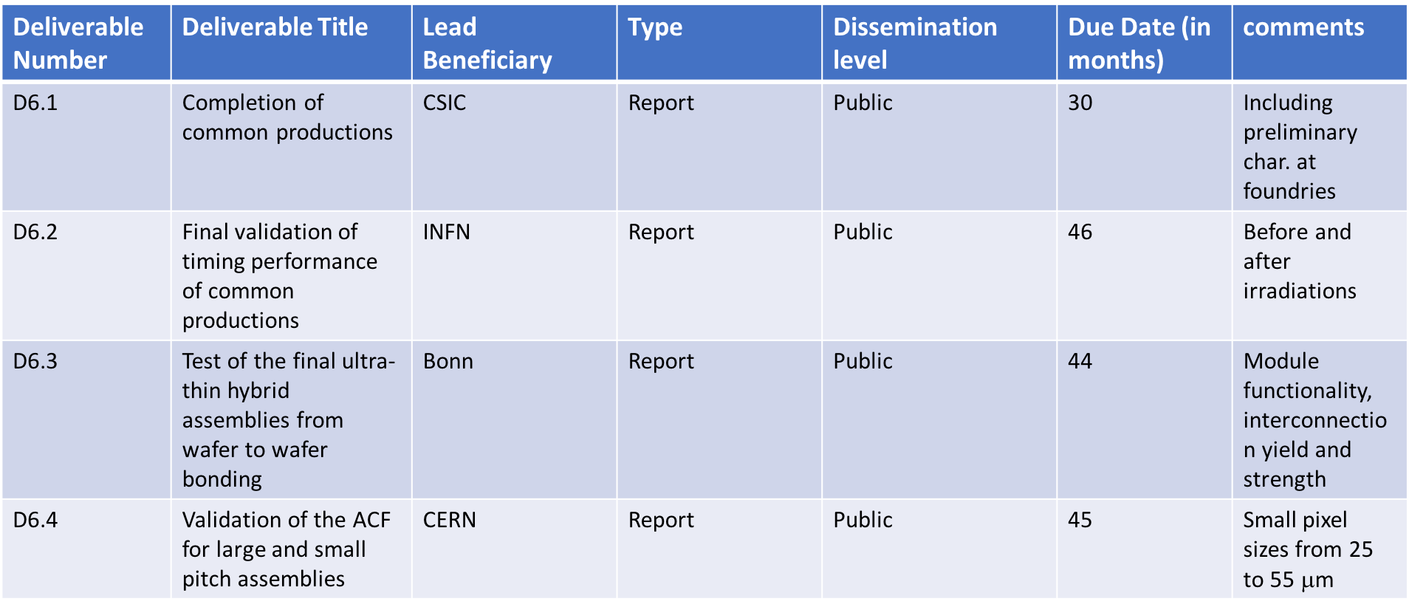
WP6 Deliverables
Delayed to September 2025
Oct 2023
Delayed to July 2025
Delayed to August 2025
Achieved
Many late deliverables have been delayed using the 6 months of prolongation of the AIDAinnova project (end in September 2025)
Final report to be delivered within November 2025 but the Deliverables have to be achieved within the dates specified in the table above
2
2
2

Slide 3

Task 6.2
Report from FBK
MS 22: M18 completed - wafer layouts
D6.1: due by Oct 2025 – completion of common production
Maurizio Boscardin
AIDAinnova Final Annual Meeting
6th May 2025
3

Slide 4
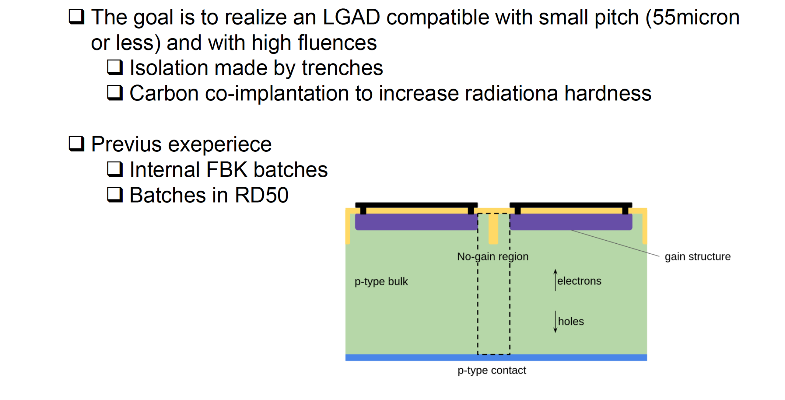
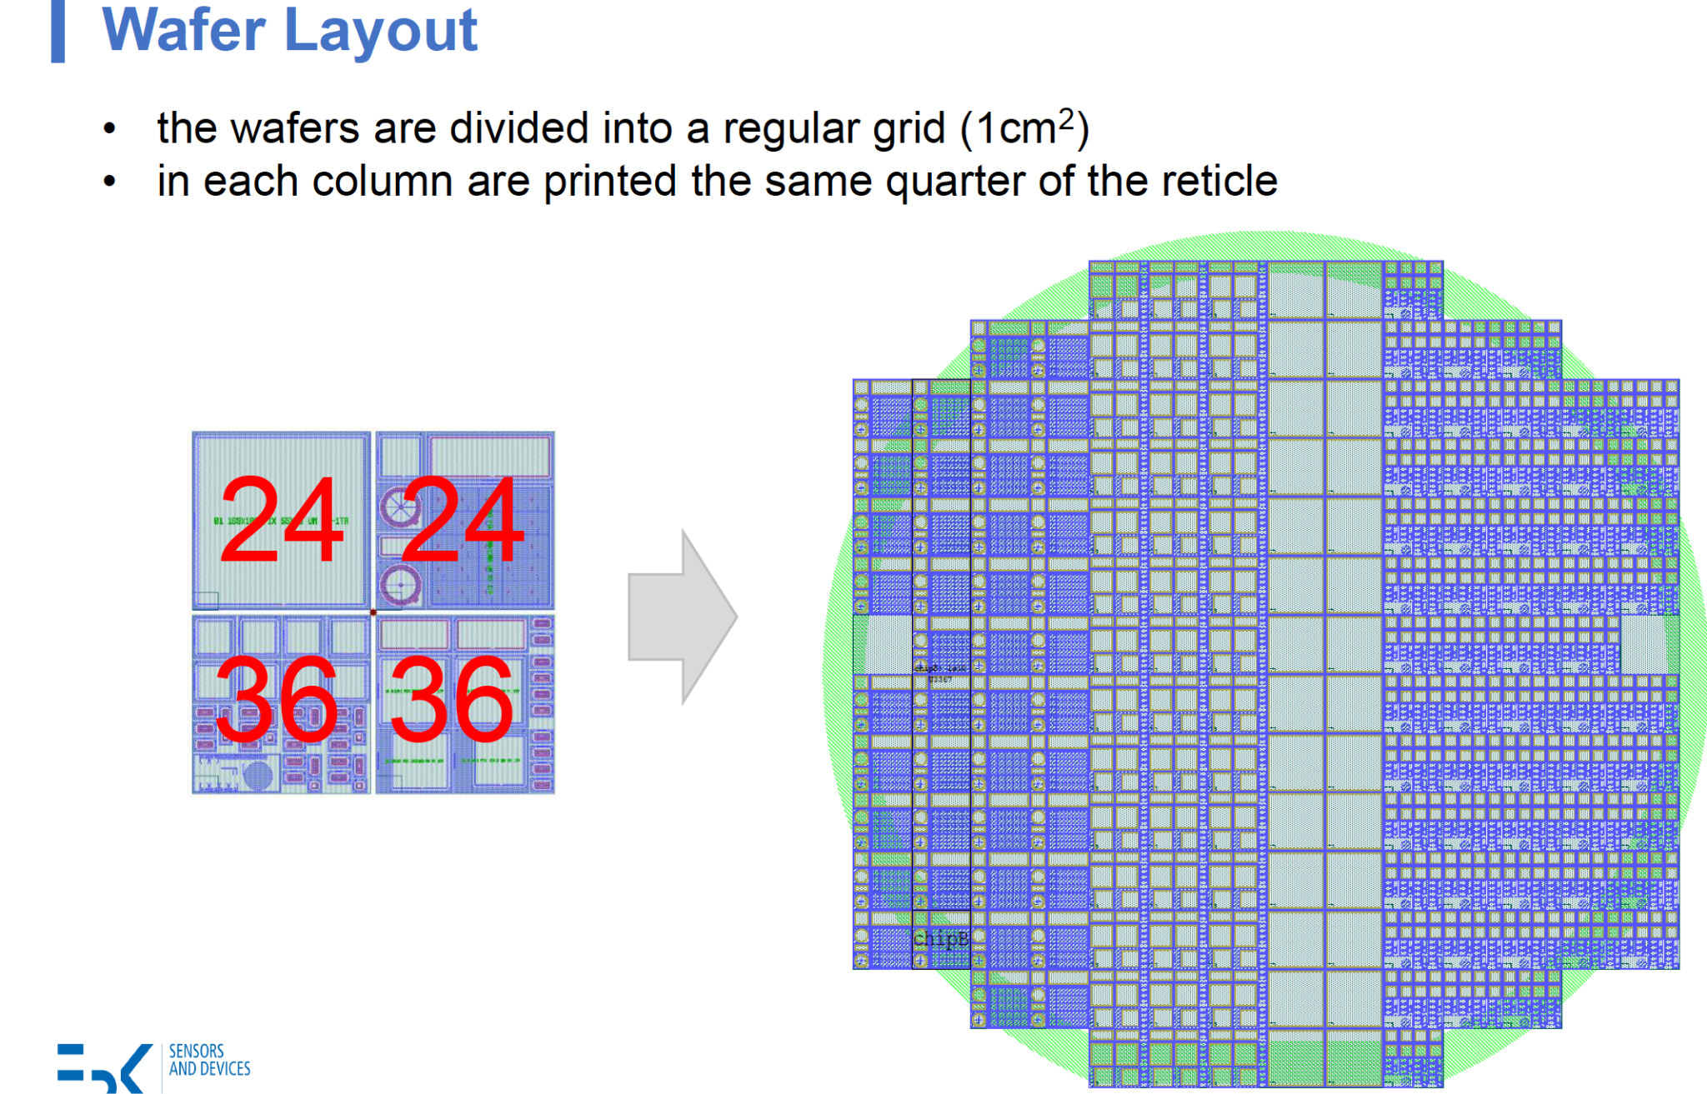
TI-LGAds in FBK
Reminder
One full reticle (about 2x2 cm)
4 quarter (about 1x1cm)
• Pixel & strip
• PCM FBK
• 2x1 Test devices
In order to explore:
• Pitch: 42,55,1300
• Border: 4 version
• Number of trenches : 1 or 2
AIDAinnova Final Annual Meeting
6th May 2025
4

Slide 5
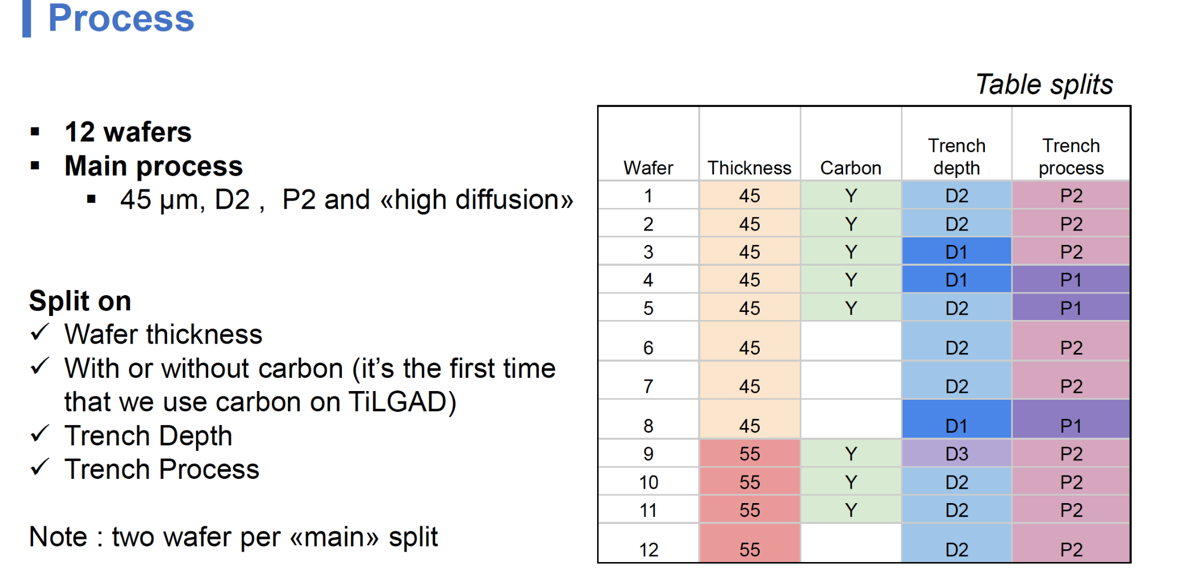
TI-LGAds in FBK
Reminder
Irradiations and test-beams carried out with these structures → see next slides
AIDAinnova Final Annual Meeting
6th May 2025
5

Slide 6
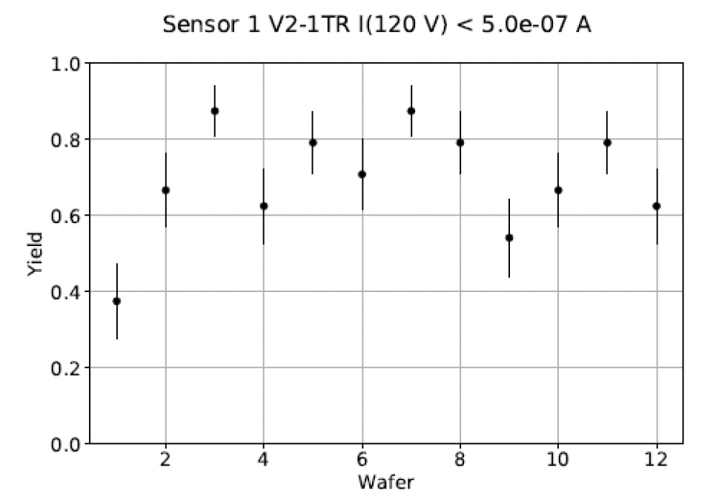
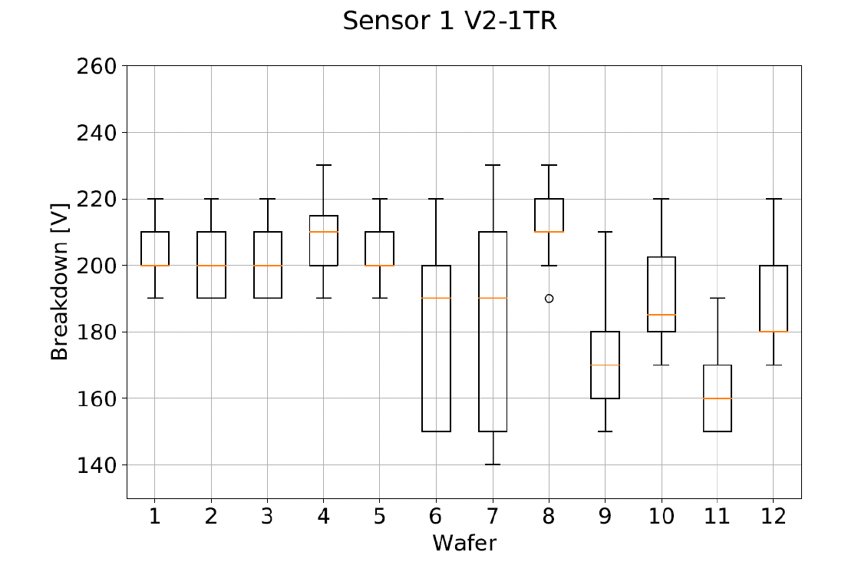
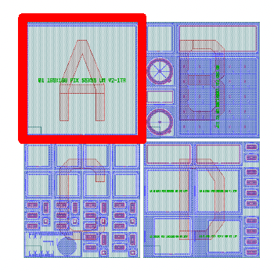
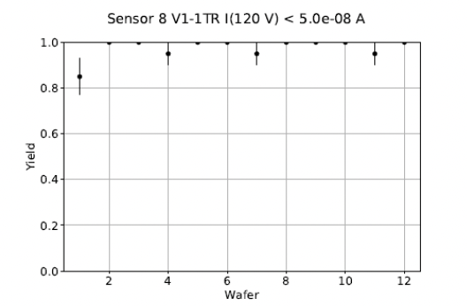
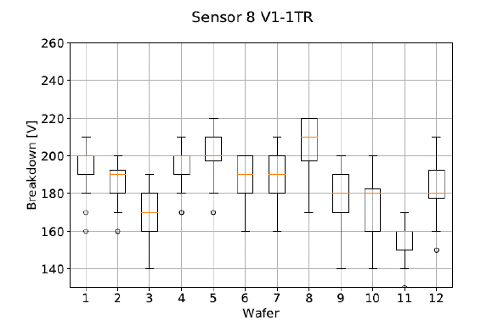
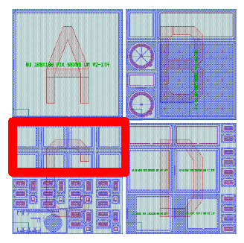
TI-LGAds in FBK
Results: examples
Current Yield
Breakdown
Large Structures
Small Structures
AIDAinnova Final Annual Meeting
6th May 2025
6

Slide 7
TI-LGAds in FBK
Conclusions
Fabrication of Ti-LGAD with carbon co-implantation with encouraging yield
Parts are available for testing:
  9 wafers UBM deposited @ IZM, back to FBK for dicing
  1 wafer with UBM available already at CERN for distribution
  2 Wafers diced @ FBK w/o UBM
Sensors are being measured in different institutes and flip-chipped to Timepix3/Timepix4 chips while waiting for more pixelated timing chips to become available
Two batches are planned within the DRD3 project in the next 3 years to further optimize process and design, and include structures compatible with the new timing chips
AIDAinnova Final Annual Meeting
6th May 2025
7

Slide 8
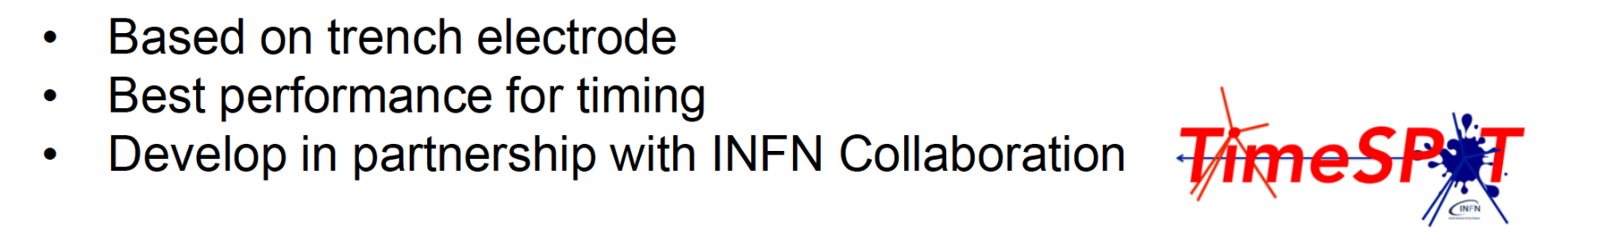
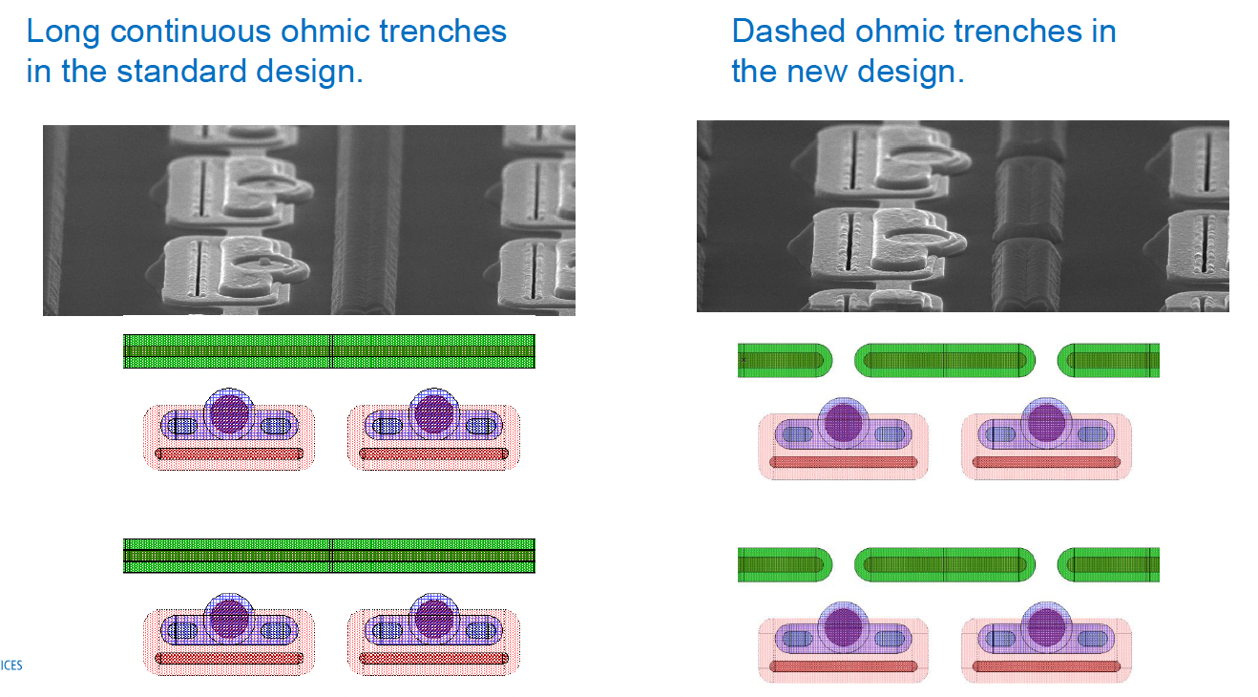
3D in FBK
Reminder
Lessons learnt by TimeSPOT project:
Two types of trenches implemented.
Process split: trench filling
    Trench filling ( two poly thickness 2 or 3 μm)
Planarization (BPSG doped oxide)
AIDAinnova Final Annual Meeting
6th May 2025
8

Slide 9
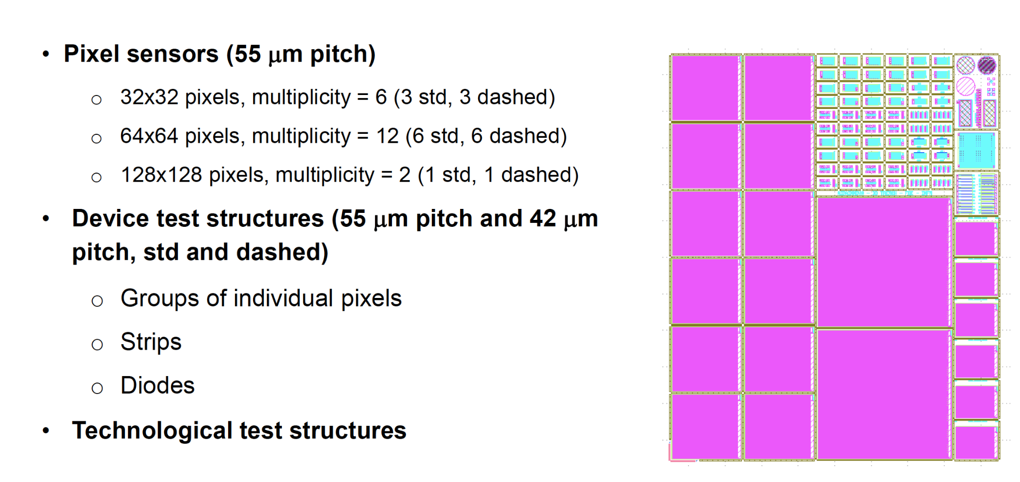
3D in FBK
Reminder
Layout
Wafer Layout Sparse
18 shots per wafer
Wafer Layout Full
29 shots per wafer
AIDAinnova Final Annual Meeting
6th May 2025
9

Slide 10
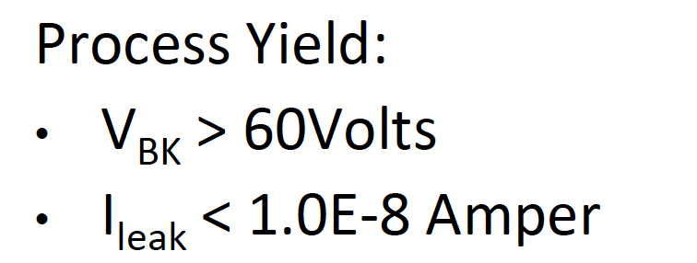
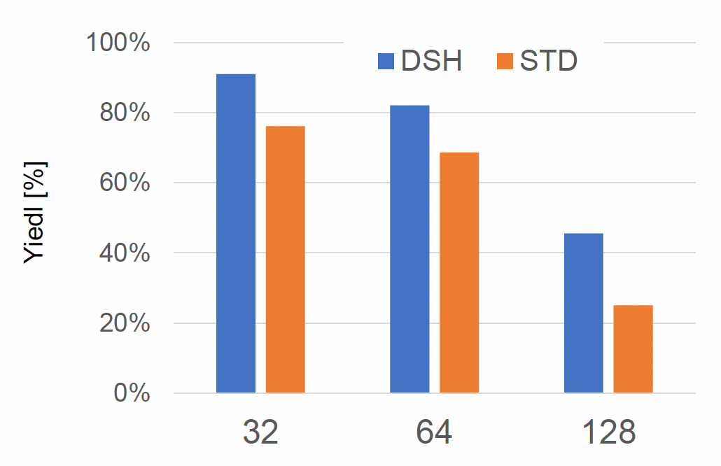
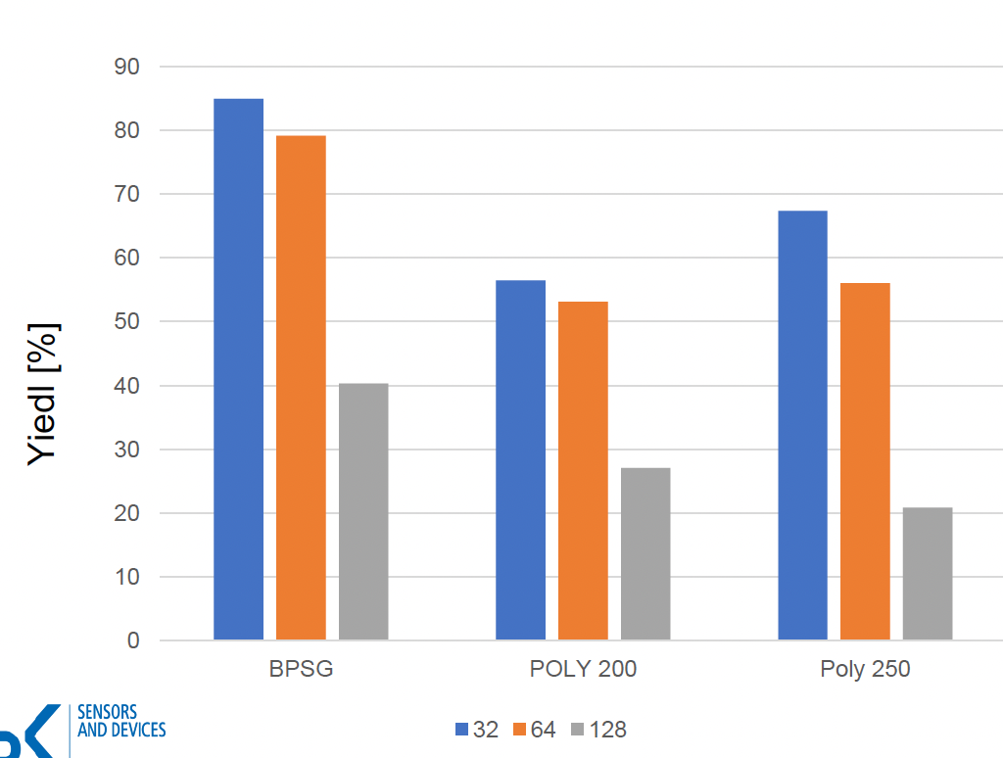
3D in FBK
Results
Bow is under control, below 20um in final step.
As a function of trench type
Initial
Poly removal
Final
P-hole fill
N poly
metal
As a function of fill split
AIDAinnova Final Annual Meeting
6th May 2025
10

Slide 11
3D in FBK
Conclusions
A 3D process based on trenches was developed with a full layout and acceptable bow
Parts are available for testing:
  6 wafers sent to IZM for post-processing, The wafers with UBM are now back at FBK, dicing
  one wafer diced without UBM and distributed
  Structures ready to be distributed
The manufacturing yield remains highly dependent on the physical dimensions of the devices.
AIDAinnova Final Annual Meeting
6th May 2025
11

Slide 12
Task 6.2
Report from CNM
MS 22: M18 completed - wafer layouts
D6.1: due by Oct 2025 – completion of common production
Neil Moffat
AIDAinnova Final Annual Meeting
6th May 2025
12

Slide 13
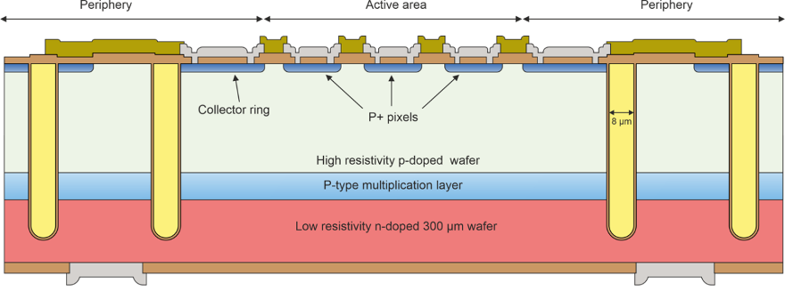
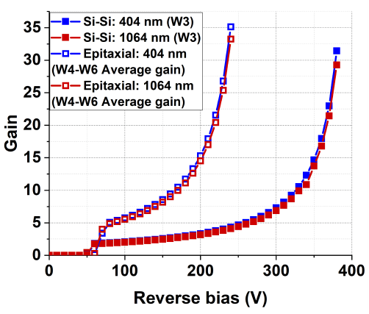
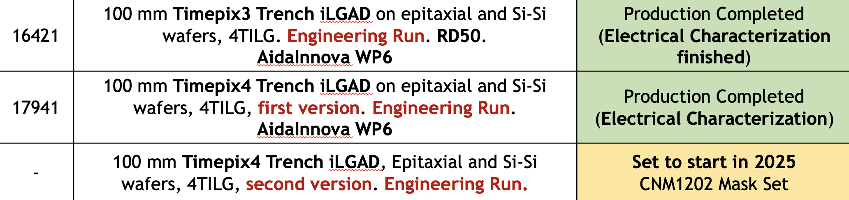
Summary of Trench iLGAD sensors at CNM production at CNM
Expected performance
TI-LGAD concept
AIDAinnova Final Annual Meeting
6th May 2025
13

Slide 14
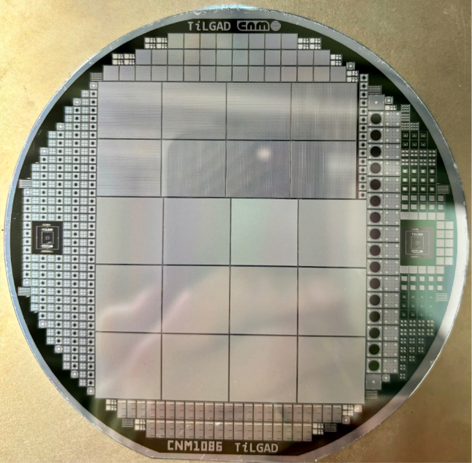
Summary of iLGAD sensors at CNM production at CNM
  First CNM TiLGAD Run: TimePix3
  3 Epitaxial wafers
    Doping resulted very high → Devices performed like APDs
    Annealing tried (1175ºC, 180min) to reduce doping of the multiplication region (still APD)
  3 Si-Si wafers (each with different boron dose for the multiplication region)
    2 doses performed like PiN (no gain)
    1 dose performed like APD
    Issue during passivation: degradation of the IV’s
Conclusions from 1st Run:
Need to reduce doping concentration of the multiplication layer
Trench isolation seems to work (ok for PiN-like devices)
AIDAinnova Final Annual Meeting
6th May 2025
14

Slide 15
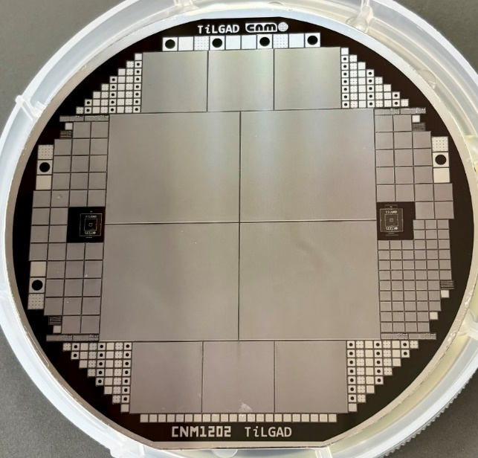
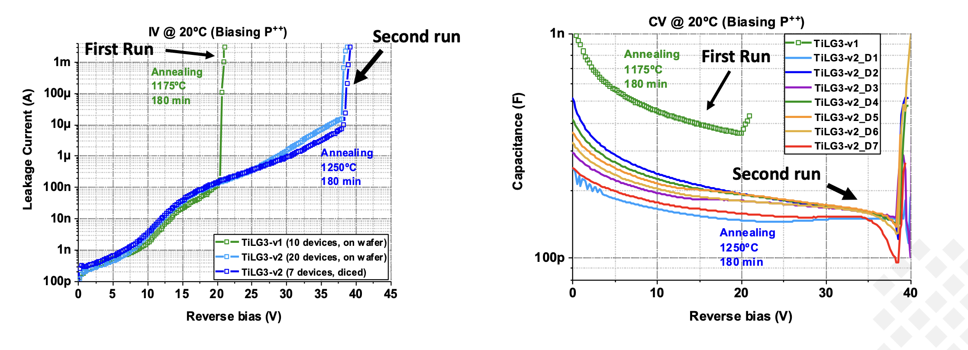
Summary of iLGAD sensors production at CNM
  Second CNM TiLGAD Run: TimePix4
  Focused on optimizing the thermal budget to obtain LGAD performance
  3 Epitaxial wafers
    Pre-conditioning thermal step: 1250ºC – 3h
    2 Si-Si wafers (each with different boron dose for the multiplication region)
  Pre-conditioning step: 1000 ºC – 0.5 h
Example for Epitaxial
Pre-conditioning thermal step improves performance (higher BDV and lower capacitance)
Still, as for the Si-Si, breakdown is lower than expected and capacitance higher
AIDAinnova Final Annual Meeting
6th May 2025
15

Slide 16
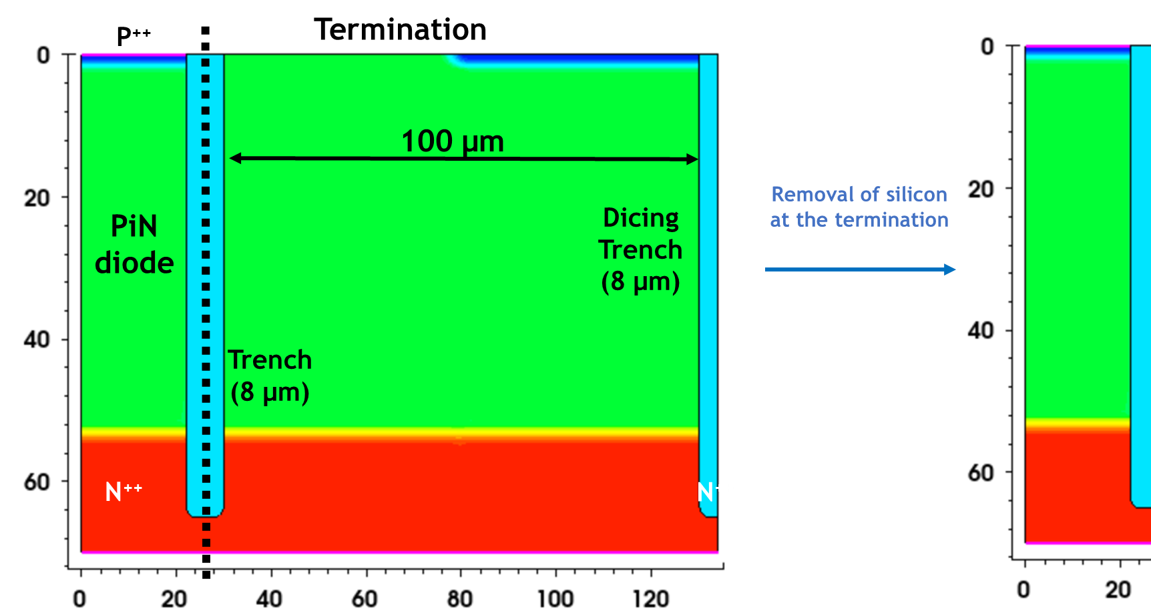
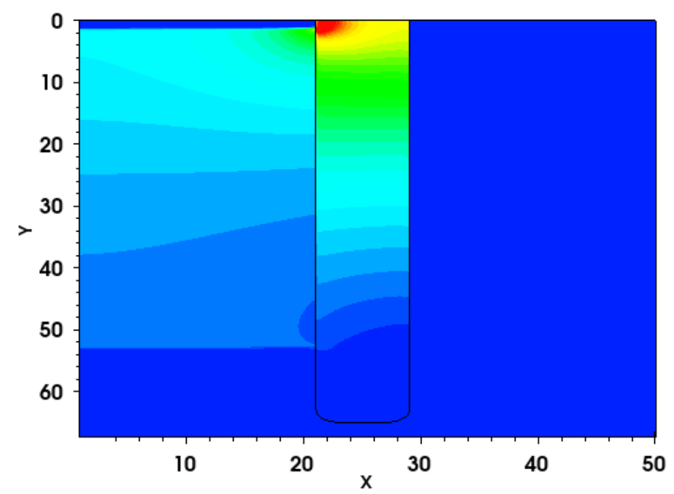
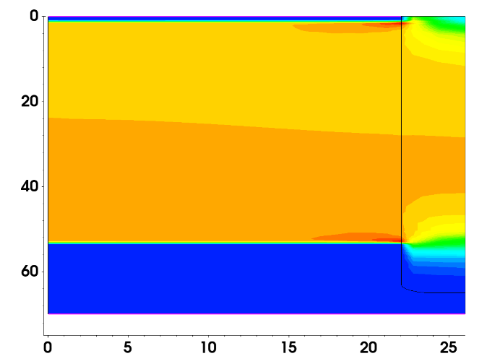
Summary of iLGAD sensors at CNM production at CNM
Silicon at the termination seems to degrade the breakdown as seen in simulations
Design proposal → remove the termination silicon
To prove the concept, tried polishing a diced device → not successful
Laser dicing planned
Electric Field (with silicon) @ 350V
Electric Field (removing termination) @ 950V
AIDAinnova Final Annual Meeting
6th May 2025
16

Slide 17
iLGAD in CNM
Conclusions- so far
iLGAD trench detectors show promise but have issues with the termination and the doping concentration of the multiplication layer. New substrate providers will be used in the future.
A laser dicing method will be utilised to fix the termination issues.
  Run 2: Samples from wafer 4 (Si-Si) to be diced with laser:
    Already in contact with a European vendor
    Once diced and tested, samples would be available for distribution
New run in the queue:
  Mask set designed, only pending on the success of the laser dicing
  If laser dicing does not help, we can modify the process to perform a general etching of the peripheral region at the end of the run.
  Not funded by AIDAInnova, but still the samples will be available
AIDAinnova Final Annual Meeting
6th May 2025
17

Slide 18
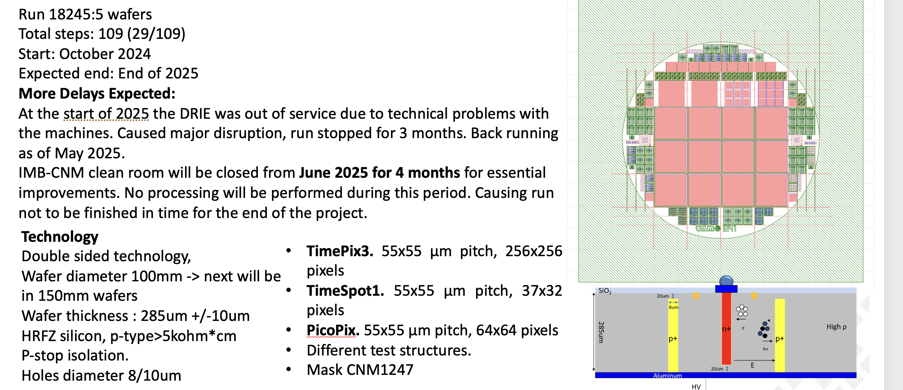
Status of 3D sensor production at CNM
AIDAinnova Final Annual Meeting
6th May 2025
18

Slide 19
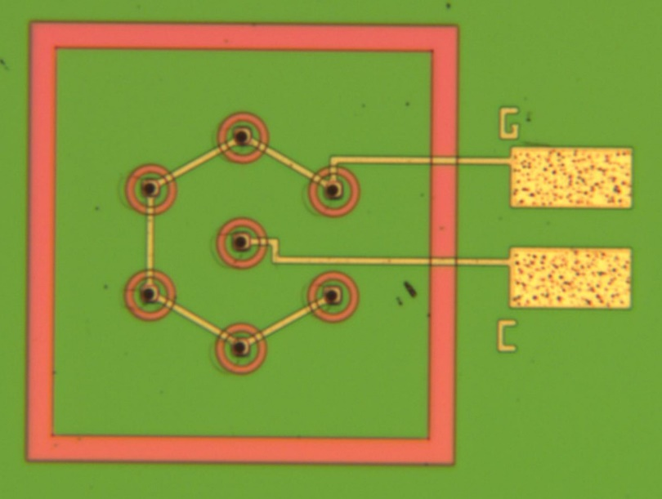
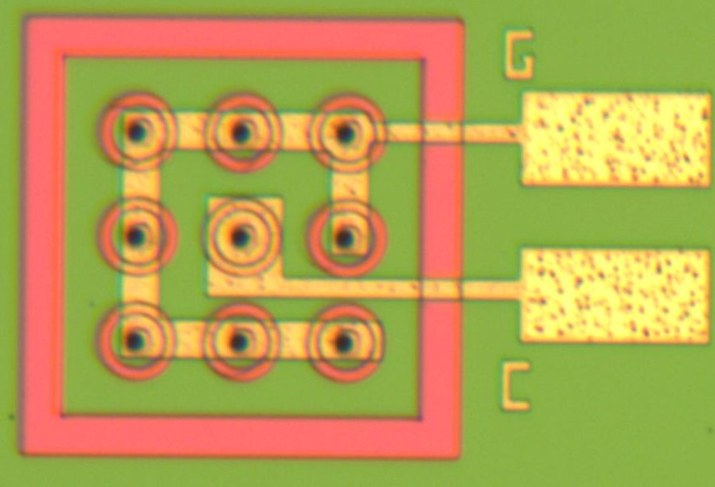
Characterization of RD50 3D production
Plan for 3D detectors, irradiation and timing resolution campaign.
Samples have been irradiated in collaboration with Gregor Kramberger (Ljubliana) and Victor Coco(CERN).
Gregor to study timing performance as a function of fluence in testbeams and using the TCT (Neutron Irradiation).
Victor to study timing performance as a function of fluence in testbeams. (Proton and Neutron Irradiation).
Neil Moffat to study timing performance as a function of laser position at ELI (Non Irradiated). Will obtain a 2D map and show position dependence on timing performance.
Measurements have been performed by IFCA using the TPA to map the timing response to compare different 3D design on unirradiated detectors.
AIDAinnova Final Annual Meeting
6th May 2025
19

Slide 20
Task 6.4
Interconnections: ACF
Talk by Ahmet Lale
20
20

Slide 21
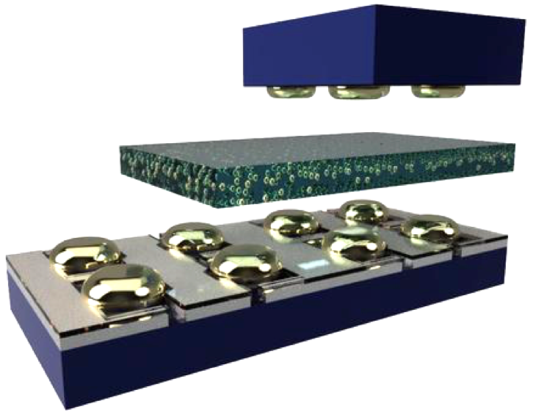
ACF:
Introduction
Development of an in-house module hybridization technique in two main steps:
  Bumping: creation of bumps on the pads of Sensor and ASIC with ENIG plating, gold studs…
  Flip-chip assembly with an anisotropic conductive layer or non-conductive layer between the chips
  Advantages:
    Single die processing
    Adaptable to the application
    Low temperature process
    Maskless
    In-house (short turnaround time, quick adjustments)
Sensor
Bumps
Adhesive layer
With/without µparticles
Bumps
ASIC
  ENIG: Electroless Nickel Immersion Gold
  ACF: Anisotropic Conductive Film
  ACP: Anisotropic Conductive Paste
  NCP: Non-Conductive Paste
Deliverable 6.4: validation of ACF for large and small pitch assemblies → Achieved
Notes:
I will present our work on the development of an innovative interconnection technique. This technique consists of two main steps: the creation of bumps on the pads, followed by the assembly of chips using the flip-chip technique. The main advantages of our approach are: the possibility of processing single dies, it’s easily adaptable to the application, it’s a maskless technique and we can do it in-house, that means short turnaround time and quick adjustments.
Description of the pictures and definitions
The first part of my presetation will focus on the creation of ENIG bumps, the second will focus on the flipchip hybridisartion

Slide 22
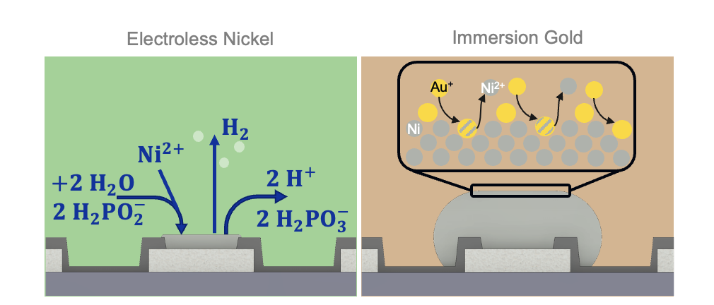
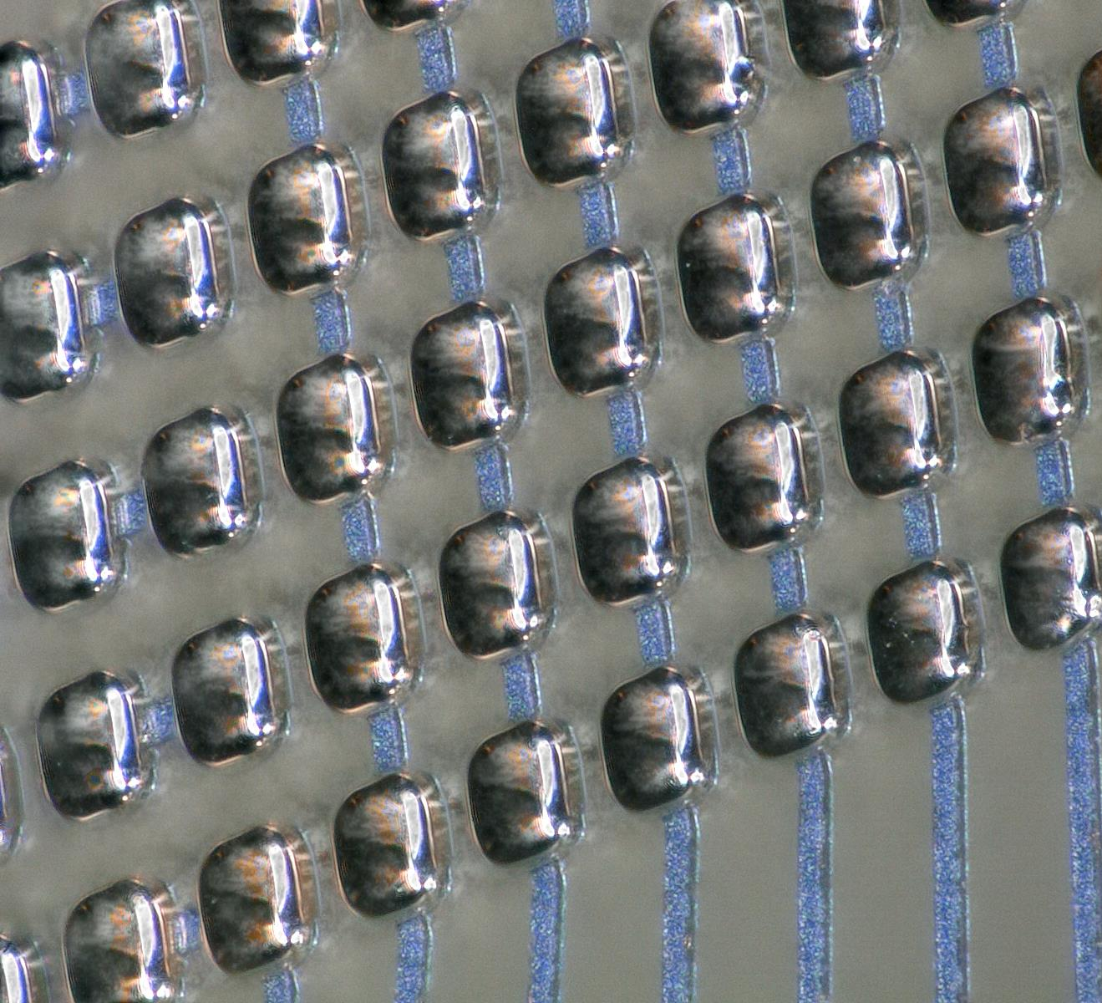
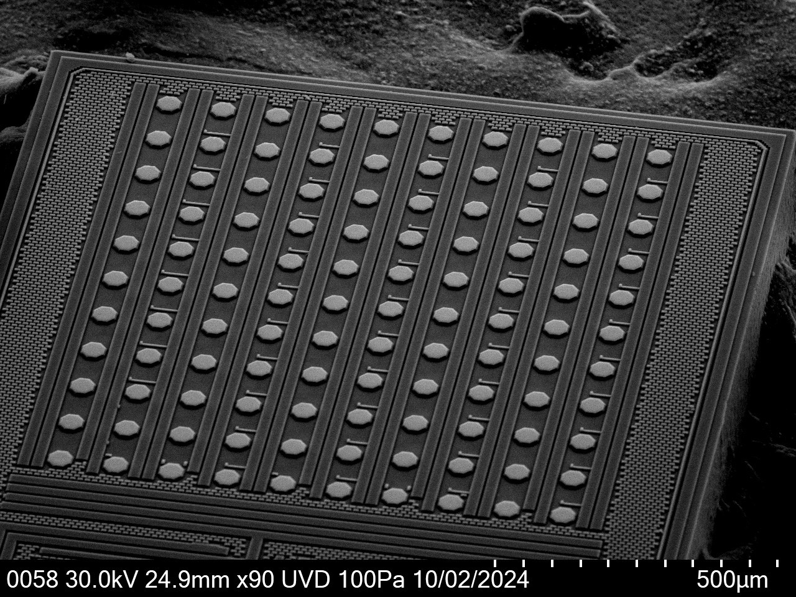
ACF:
ENIG plating
ENIG plating process optimized and tested on different configurations:
High pad density (20 µm pitch) and small pads (10 µm)
Low pad density (1.3 mm pitch) and large pads (90 µm)
Successful plating of functional chips
Test structures
Chip name | Pad diameter | Pitch | ENIG bump height | Chip size
“Timepix3” daisy-chain test structures | 12-22 µm | 55 µm | 10 µm ± 0.5 μm | 14x14 mm²
“Small pitch” daisy-chain test structures | 10x8 µm² (rectangular) | 20 µm | 4.5 µm ± 0.2 μm | 3.2x3.2 mm²
TimeSpot1 ASIC | 19 µm | 55 µm | 10 µm ± 0.5 μm | 2.4x2.7 mm²
SPHIRD silicon sensor | 40 µm | 100 µm | 5-6 µm | 1.6x3.2 mm²
ATLAS HGTD LGAD sensors | 90 µm | 1.3 mm | 8.5 µm 0.7 μm | 20x22 mm²
SiGe ASIC and KEK AC-LGAD sensors | 40 µm | 100 µm | 8.5 µm ± 0.6 μm | ASIC 1.3x2.9 mm² Sensor 1.9x1.9 mm²
ColorPix2 | 40 µm | 70 µm | 11 µm ± 0.5 μm | 3x4.9 mm²
ASIC
Notes:
I will present our work on the development of an innovative interconnection technique. This technique consists of two main steps: the creation of bumps on the pads, followed by the assembly of chips using the flip-chip technique. The main advantages of our approach are: the possibility of processing single dies, it’s easily adaptable to the application, it’s a maskless technique and we can do it in-house, that means short turnaround time and quick adjustments.
Description of the pictures and definitions
The first part of my presetation will focus on the creation of ENIG bumps, the second will focus on the flipchip hybridisartion

Slide 23
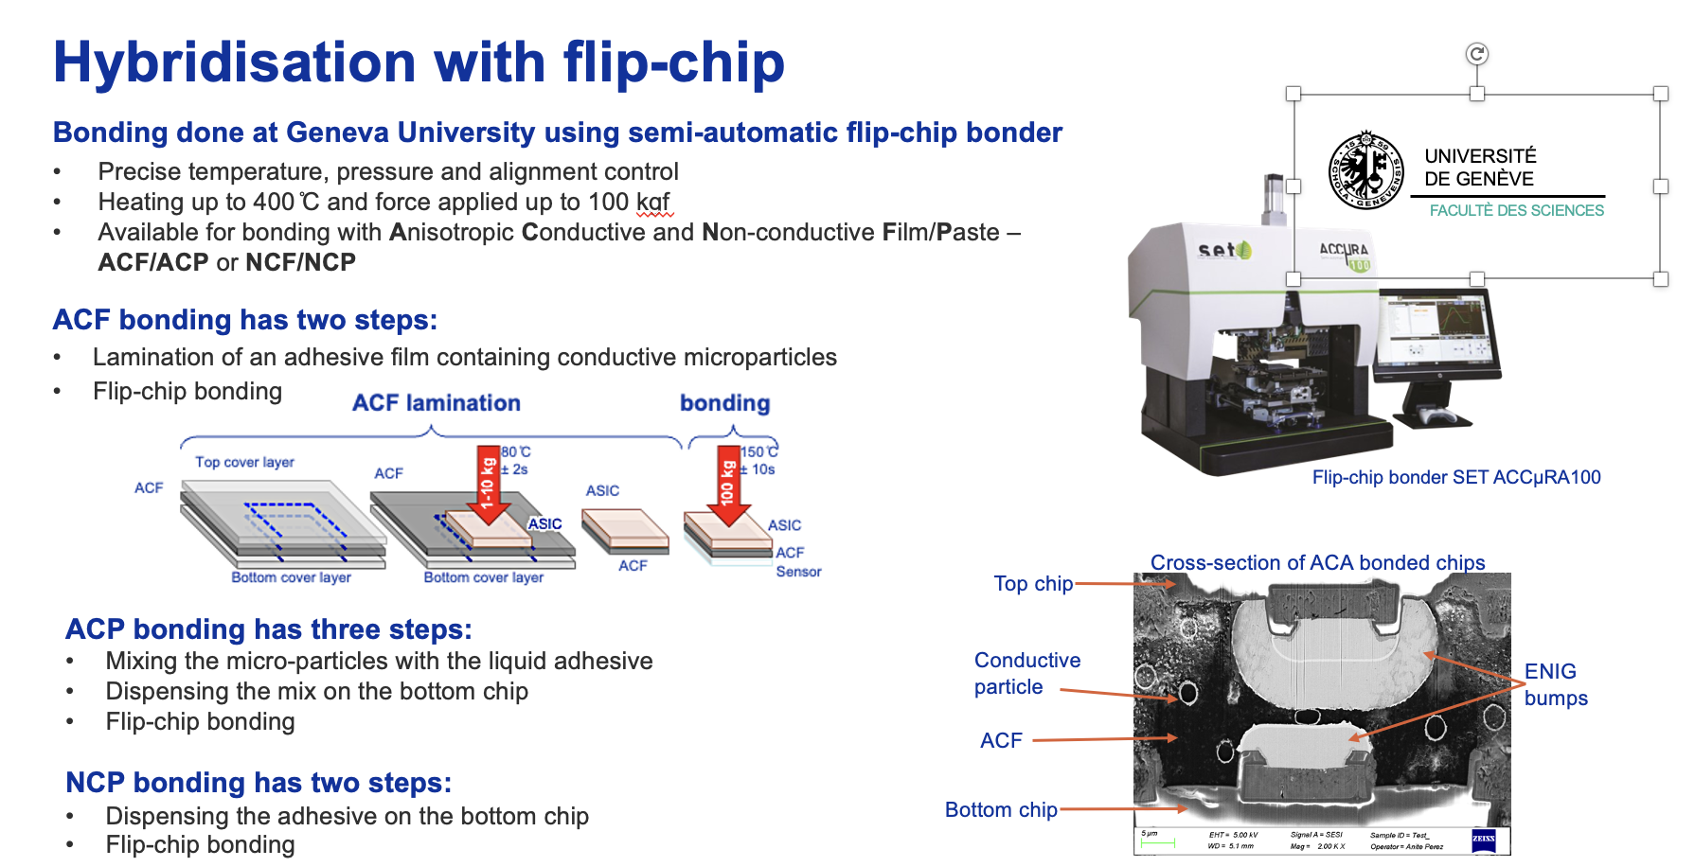
ACF:
Flip-Chip
Optimization initially done with daisy chains structures of different pitches and sizes
AIDAinnova Final Annual Meeting
6th May 2025
23
Notes:
I will present our work on the development of an innovative interconnection technique. This technique consists of two main steps: the creation of bumps on the pads, followed by the assembly of chips using the flip-chip technique. The main advantages of our approach are: the possibility of processing single dies, it’s easily adaptable to the application, it’s a maskless technique and we can do it in-house, that means short turnaround time and quick adjustments.
Description of the pictures and definitions
The first part of my presetation will focus on the creation of ENIG bumps, the second will focus on the flipchip hybridisartion

Slide 24
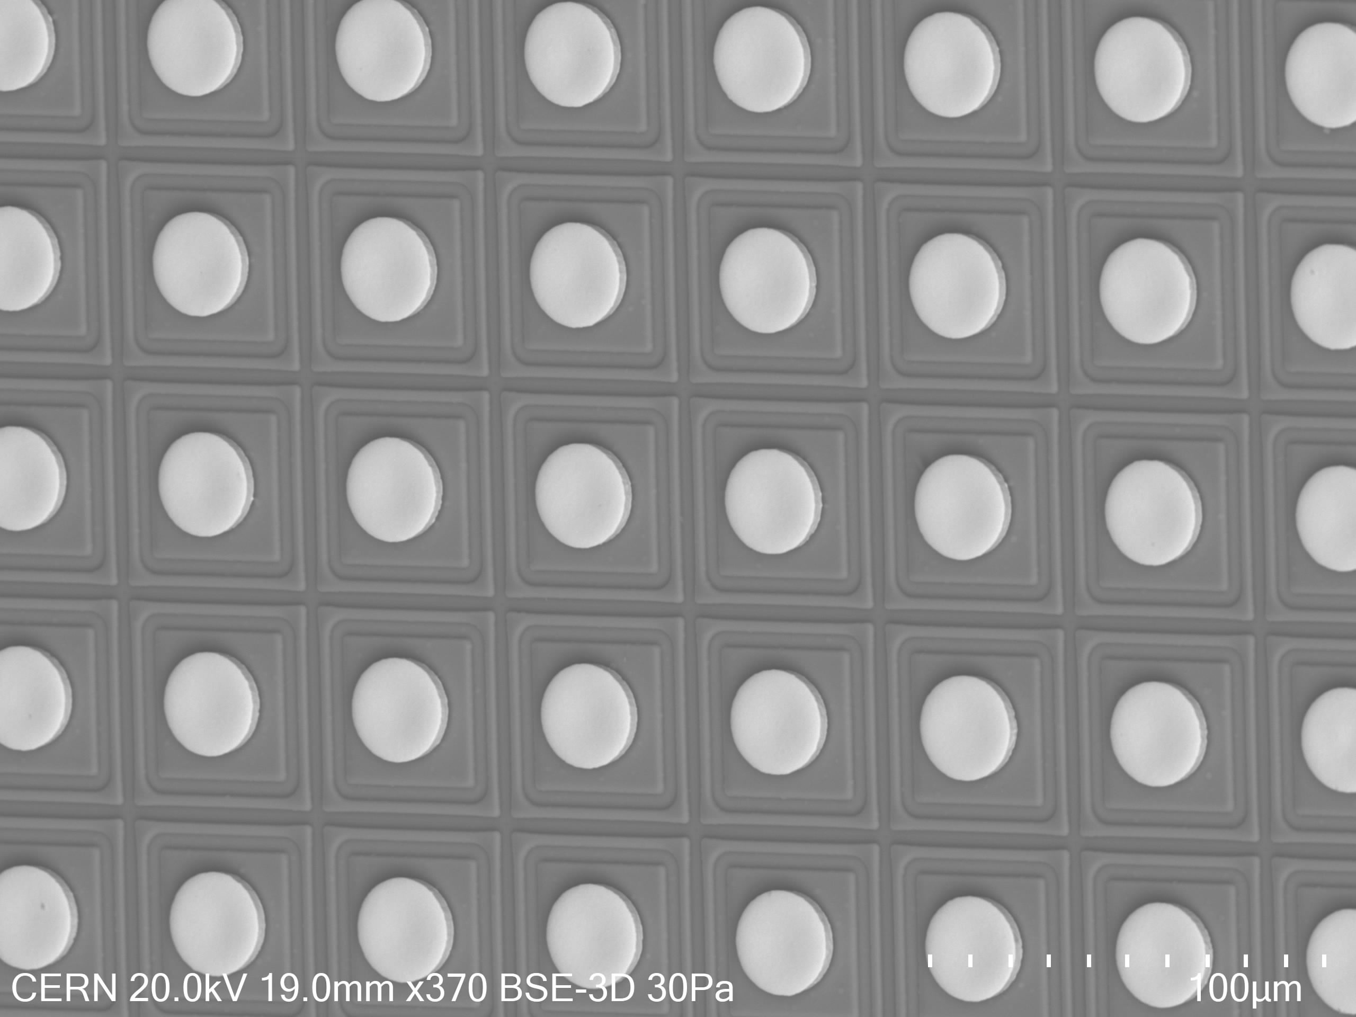
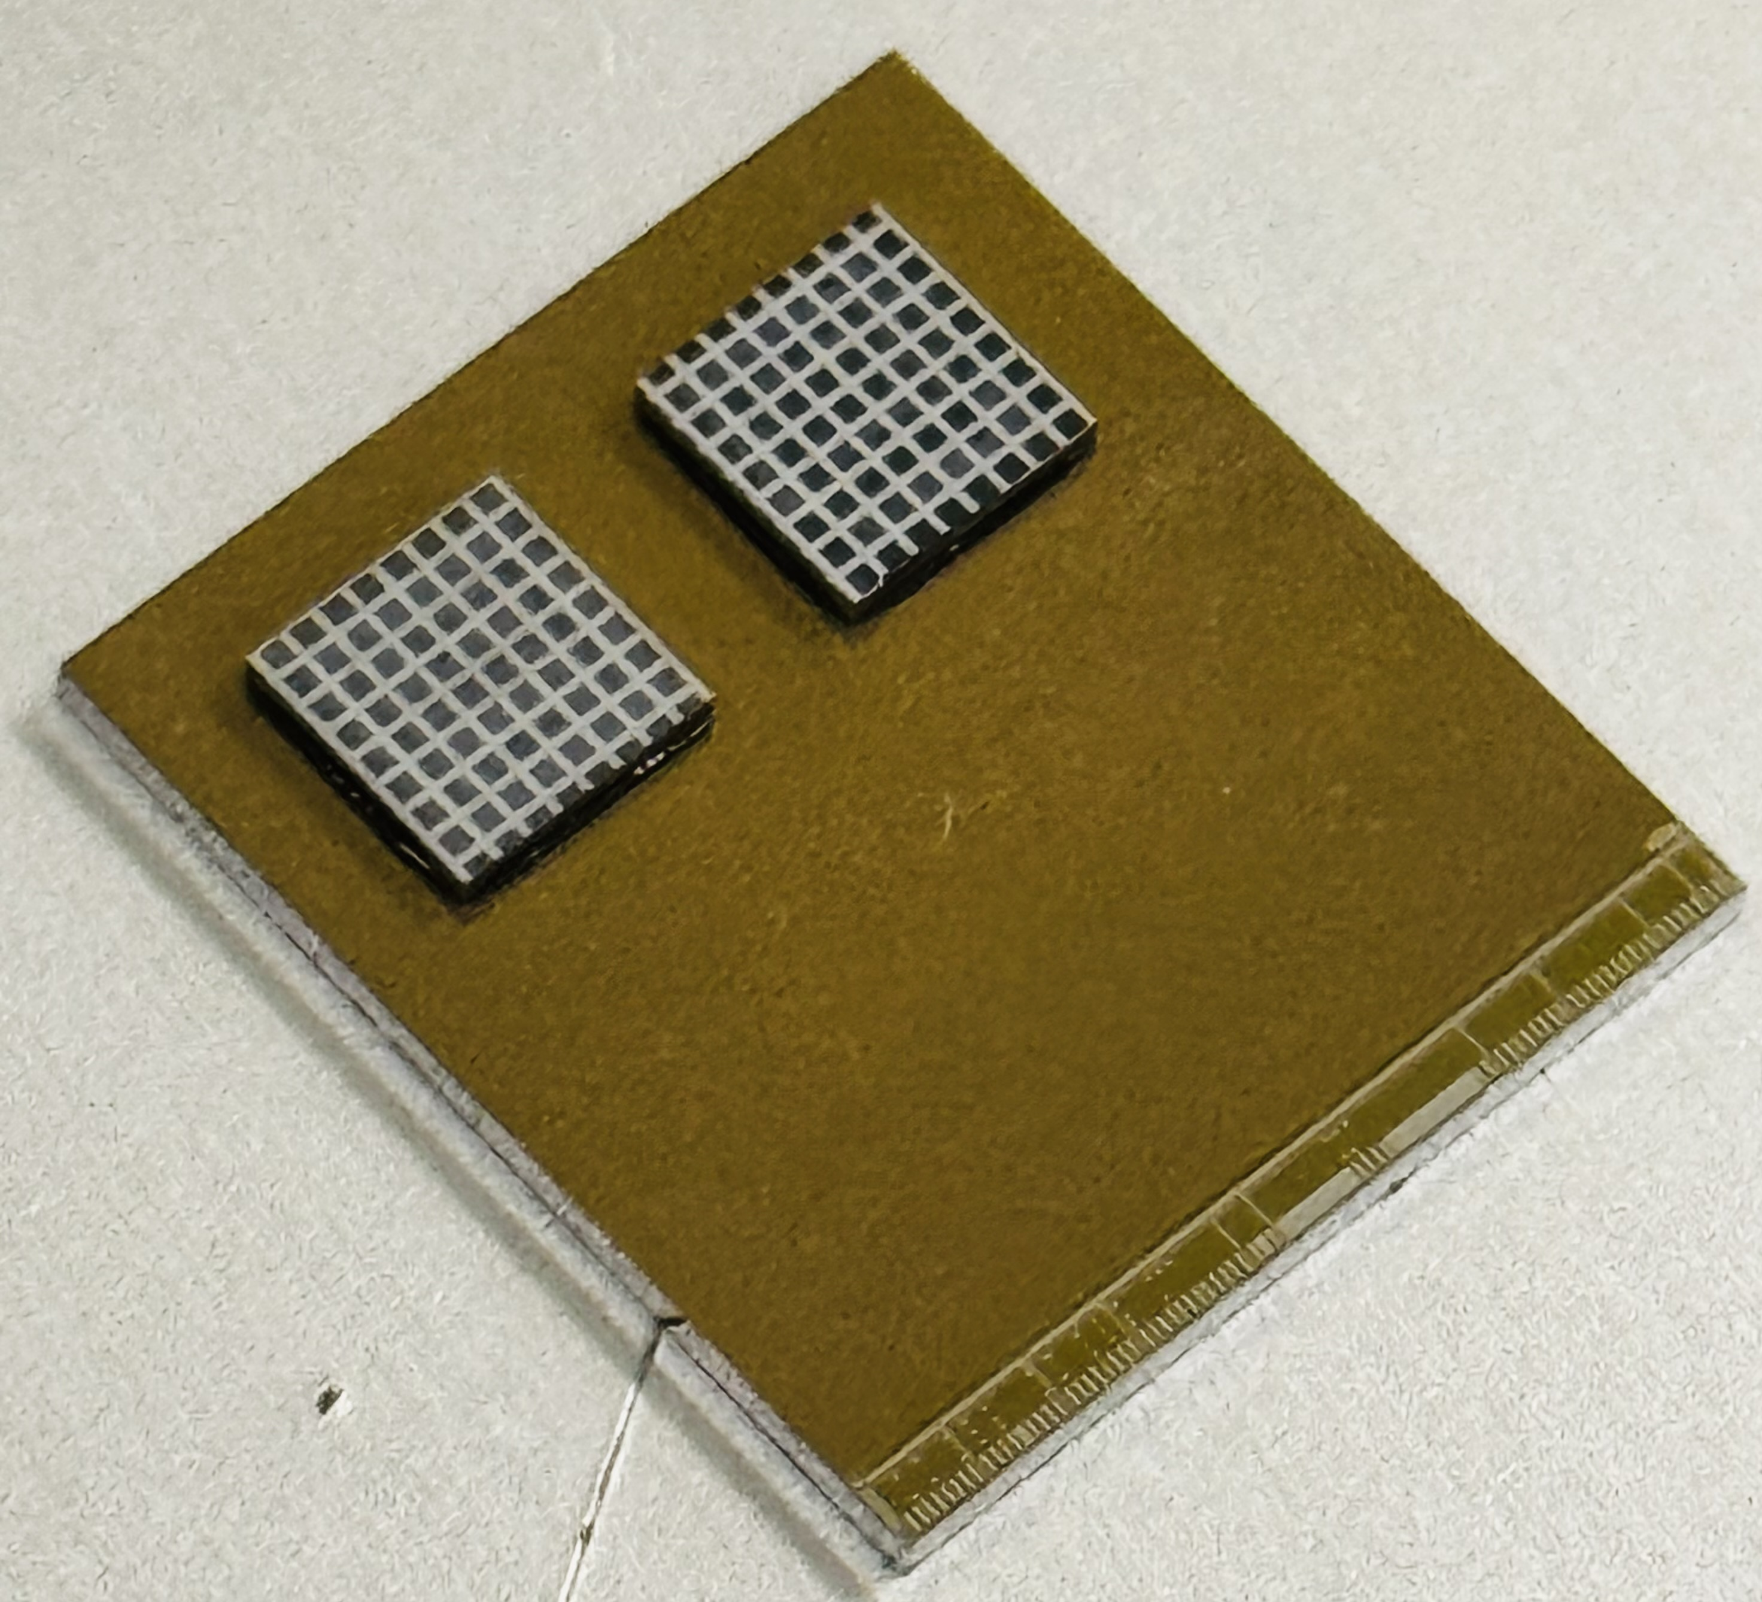
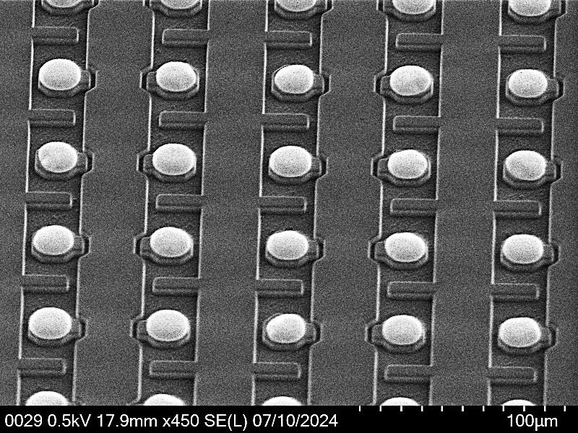
ACF:
Flip-Chip of AidaInnova FBK TI-LGAD
5 µm UBM (by IZM) on Ti-LGAD sensor
ACF laminated on Ti-LGAD
Two Ti-LGAD 64x64 pixel matrix FBK-AIDAinnova production connected to a Timepix3 ASIC
Pitch: 55 µm
Pad diameter: 25 µm
In-house ENIG plating on Timepix3 ASICs ~6 µm height bumps
Pitch: 55 µm
Bump diameter: 19 µm
AIDAinnova Final Annual Meeting
6th May 2025
24
Notes:
I will present our work on the development of an innovative interconnection technique. This technique consists of two main steps: the creation of bumps on the pads, followed by the assembly of chips using the flip-chip technique. The main advantages of our approach are: the possibility of processing single dies, it’s easily adaptable to the application, it’s a maskless technique and we can do it in-house, that means short turnaround time and quick adjustments.
Description of the pictures and definitions
The first part of my presetation will focus on the creation of ENIG bumps, the second will focus on the flipchip hybridisartion

Slide 25
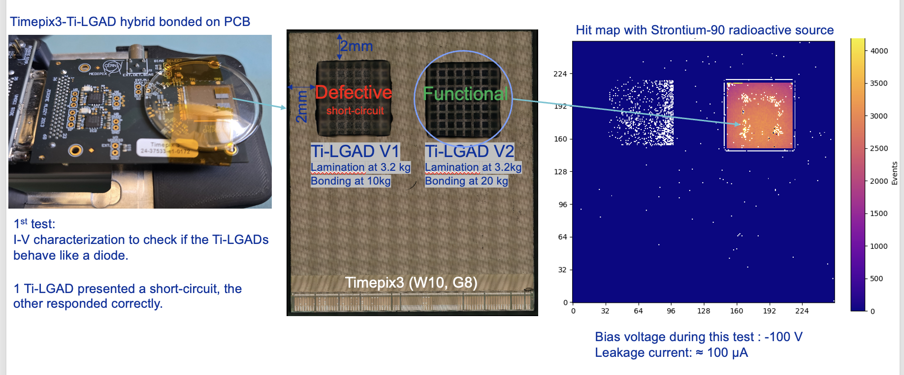
ACF:
Flip-Chip of AidaInnova FBKTI-LGAD
One device is not working (but was not tested before): for future assemblies all the other still available have been tested, and an average yield of ~85% have been observed
For the functional one, ACF lamination defect was observed, correlated with bonding tool. Otherwise, excellent connection (0.51% bad of 4096 pixels)
  Issue identified: will be solved using a different bonding tool already available
  Test beam planned in June
AIDAinnova Final Annual Meeting
6th May 2025
25
Notes:
I will present our work on the development of an innovative interconnection technique. This technique consists of two main steps: the creation of bumps on the pads, followed by the assembly of chips using the flip-chip technique. The main advantages of our approach are: the possibility of processing single dies, it’s easily adaptable to the application, it’s a maskless technique and we can do it in-house, that means short turnaround time and quick adjustments.
Description of the pictures and definitions
The first part of my presetation will focus on the creation of ENIG bumps, the second will focus on the flipchip hybridisartion

Slide 26
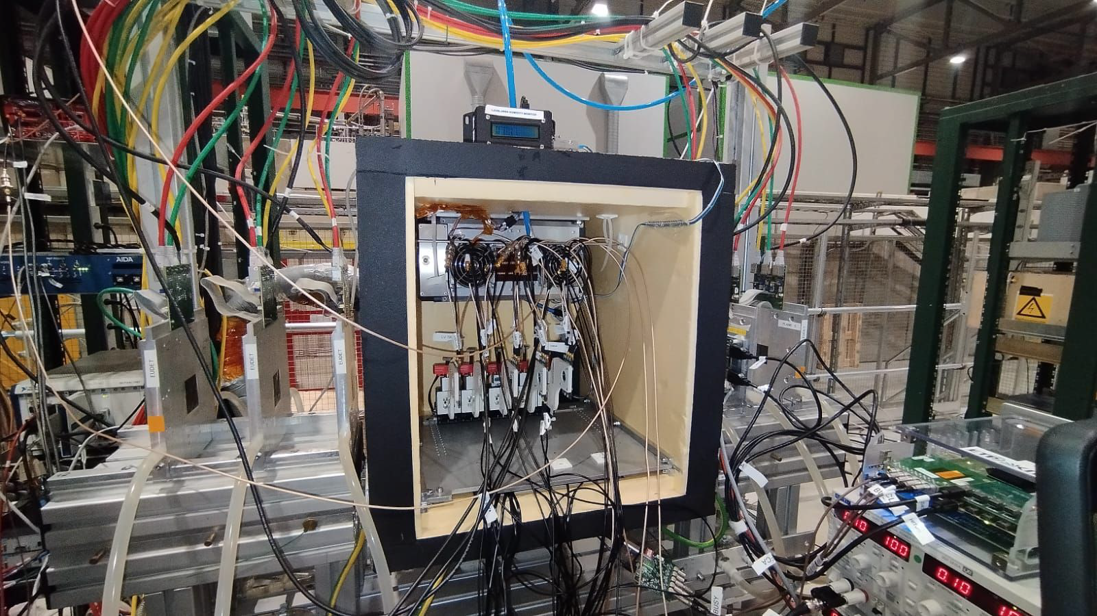
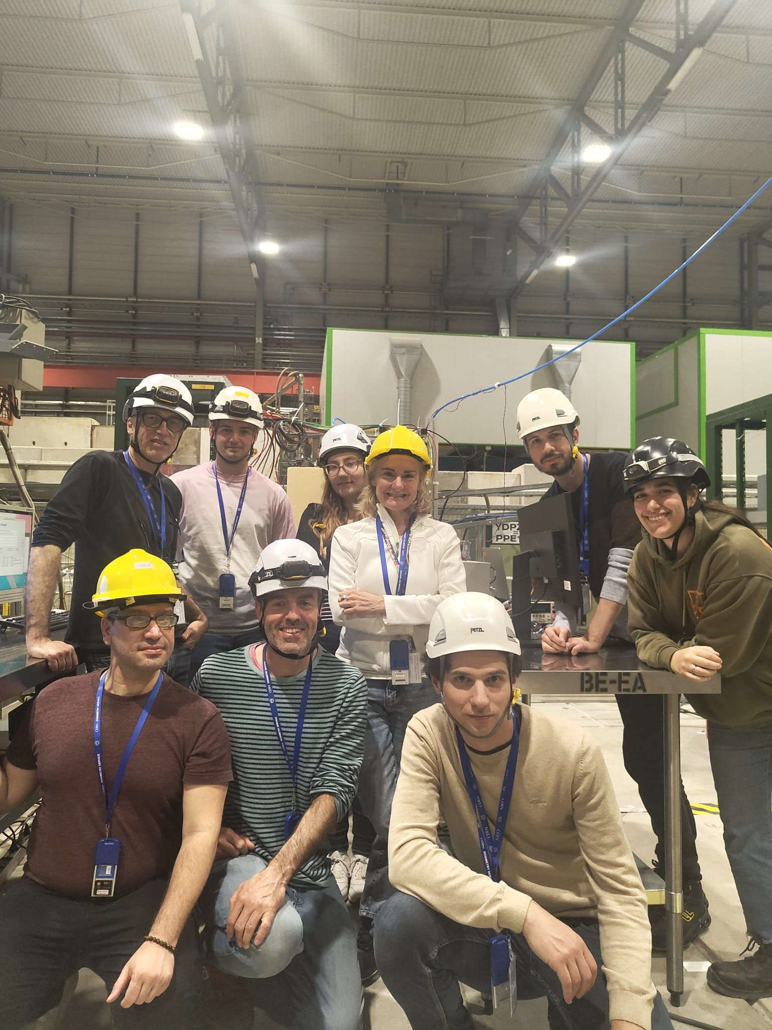
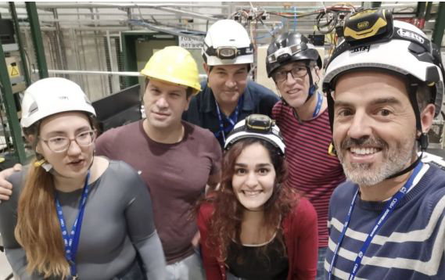
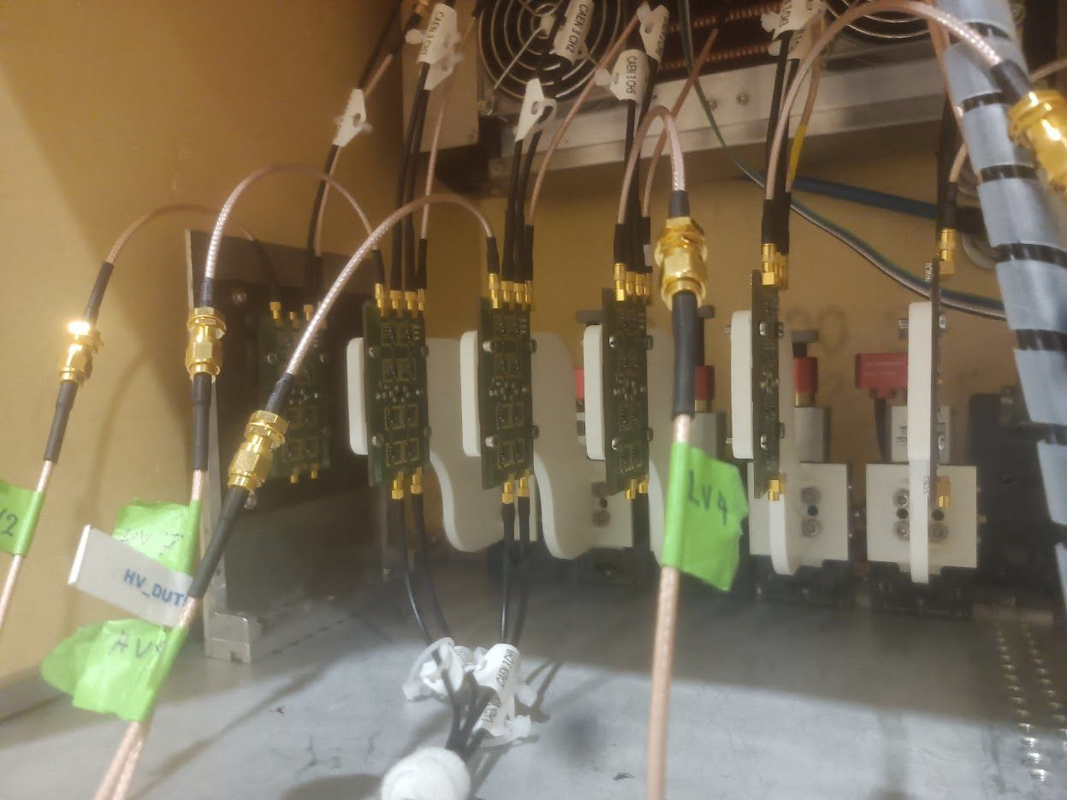
Task 6.3
Validation and
Test beam organization
26
26
26
26
AIDAinnova Final Annual Meeting
6th May 2025
26

Slide 27
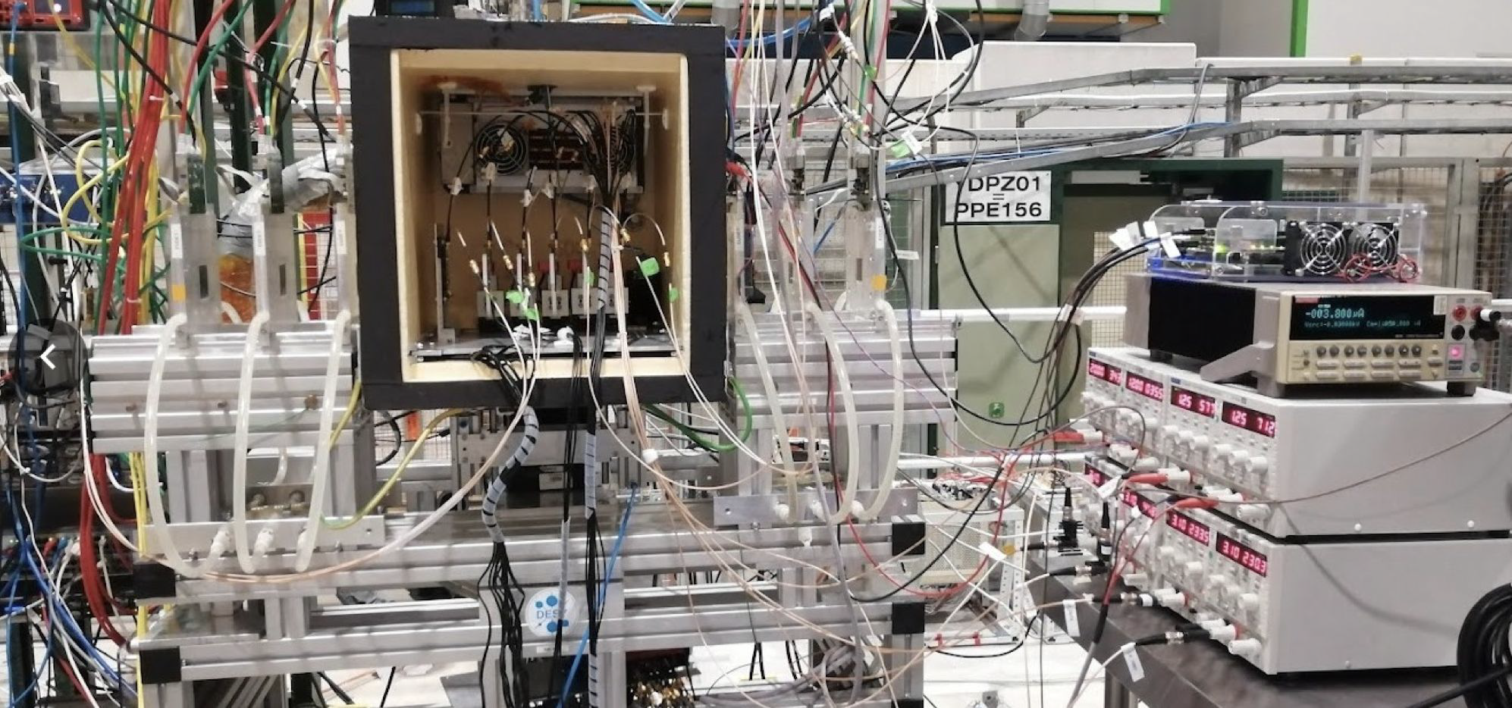
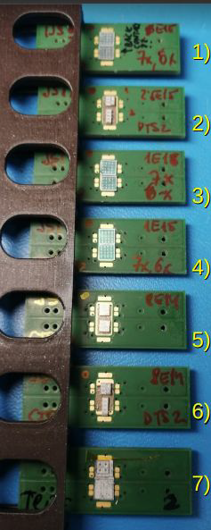
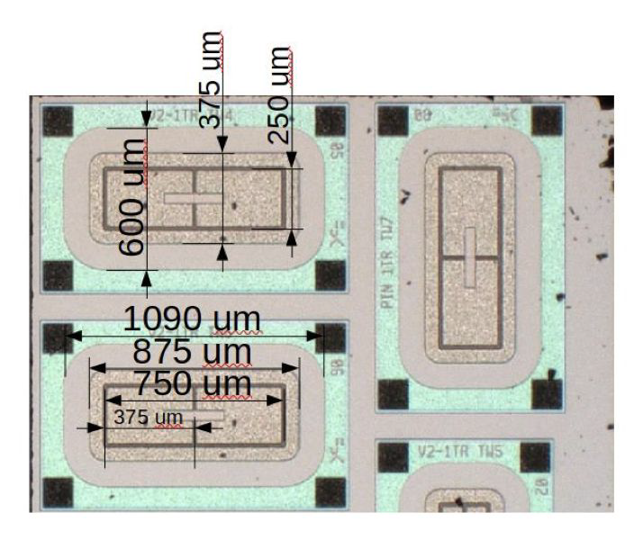
WP6 Test-beam campaigns (I)
Coordinators: G. Kramberger and I. Vila
10 weeks of beam test time obtained between 2023-2025
8 weeks at CERN SPS and 2 at DESY
Bare test structures with different layouts
● Structures wire-bonded to passive carrier boards and connected to an active read board with amplification
and power delivery circuitry: Chubut-2 board
→ 4 channel low-noise discrete readout board specifically developed for LGAD testing (Matias Senger’s design open-source project).
Main focus: FBK TI-LGAD sensors before and after irradiations up to 2.5e15
27
27
AIDAinnova Final Annual Meeting
6th May 2025
27

Slide 28
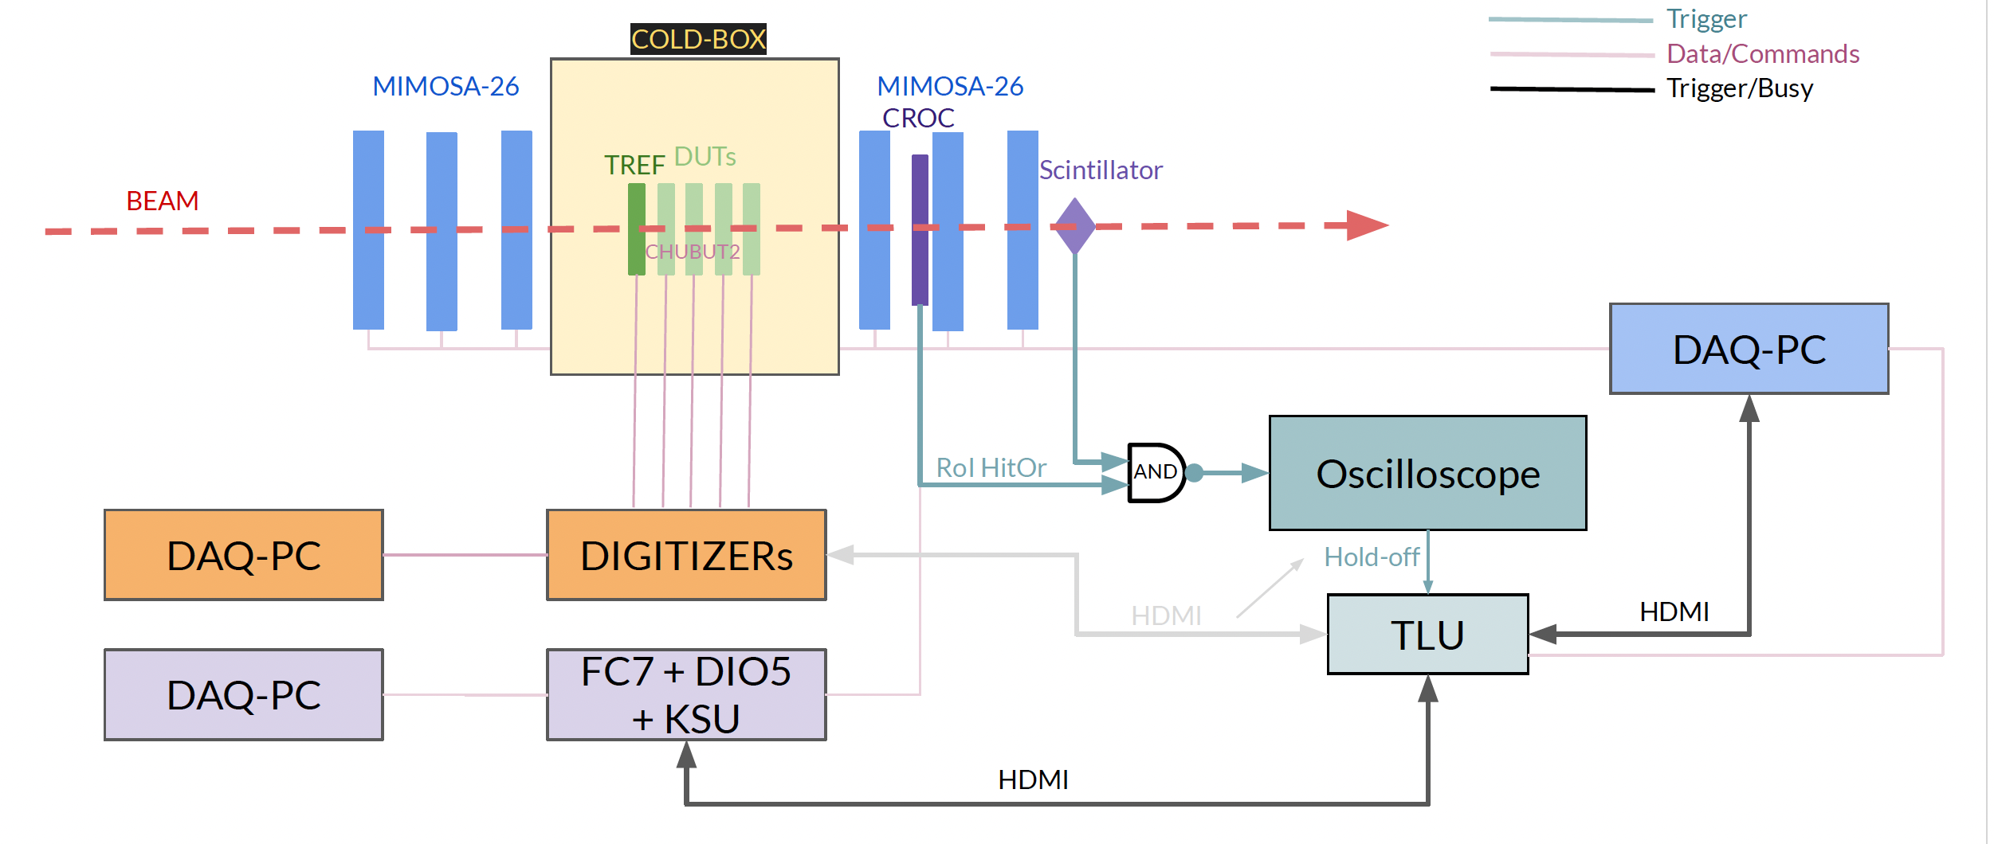
WP6 Test-beam campaigns (II)
● Data acquired with CAEN DT5742 16 channel (+ 1) digitizer
Analog bandwidth of 0.5 Ghz at 5 GS/s rate
Up to 4 Chubut-2 boards per digitizer
● Tracks reconstructed with AIDA telescope
Rolling shutter readout → track pile-up during full-frame readout (~ 115us x 2)
● Trigger RoI and track pile-up resolution with a CMS inner tracker phase-2 module
○ CROC + 3D 25x100 pixel sensor (216 x 672 pixels)
○ Triggered, 25 ns time-sliced buffers → resolves pile-up unambiguously .
● HPK-LGAD σ_{t} ~ 30 ps as time reference plane
● Trigger and synchronization: Oscilloscope and TLU
● EUDAQ2 for data taking
28
28
AIDAinnova Final Annual Meeting
6th May 2025
28

Slide 29
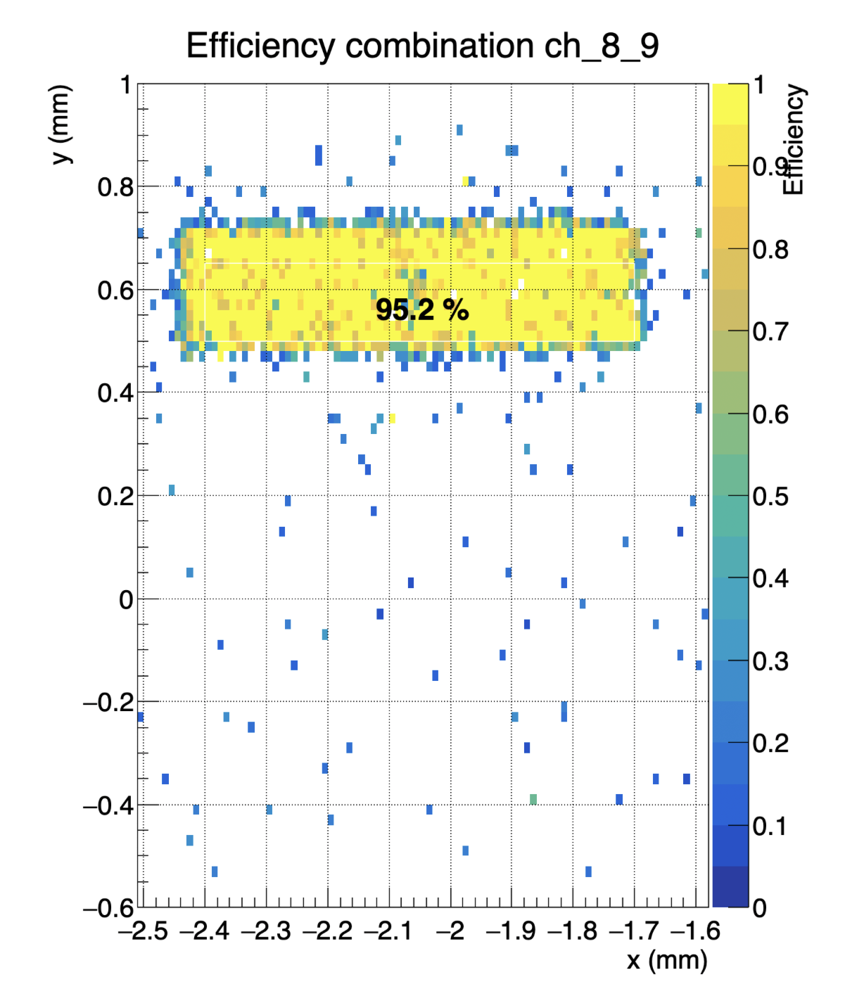
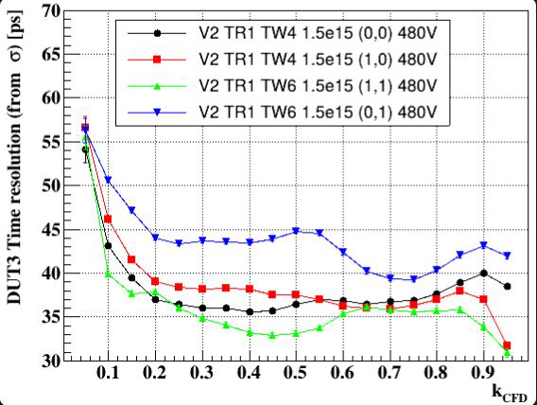
Preliminary results from latest TBs
Time resolution of TI-LGADs irradiated at 1.5e15
Hit-efficiency of TI-LGADs irradiated at 1.5e15
V_bias=530V
Analysis of the 2024-2025 data for TI-LGADs on-going
Set-up and methodology will be transferred to the future common test-beam campaigns organized by DRD3 WG5
Plan to characterize test-structures from the FBK production of trenched 3D sensors in upcoming DRD3 TBs
29
29
6th May 2025
29
AIDAinnova Final Annual Meeting
6th May 2025
29

Slide 30
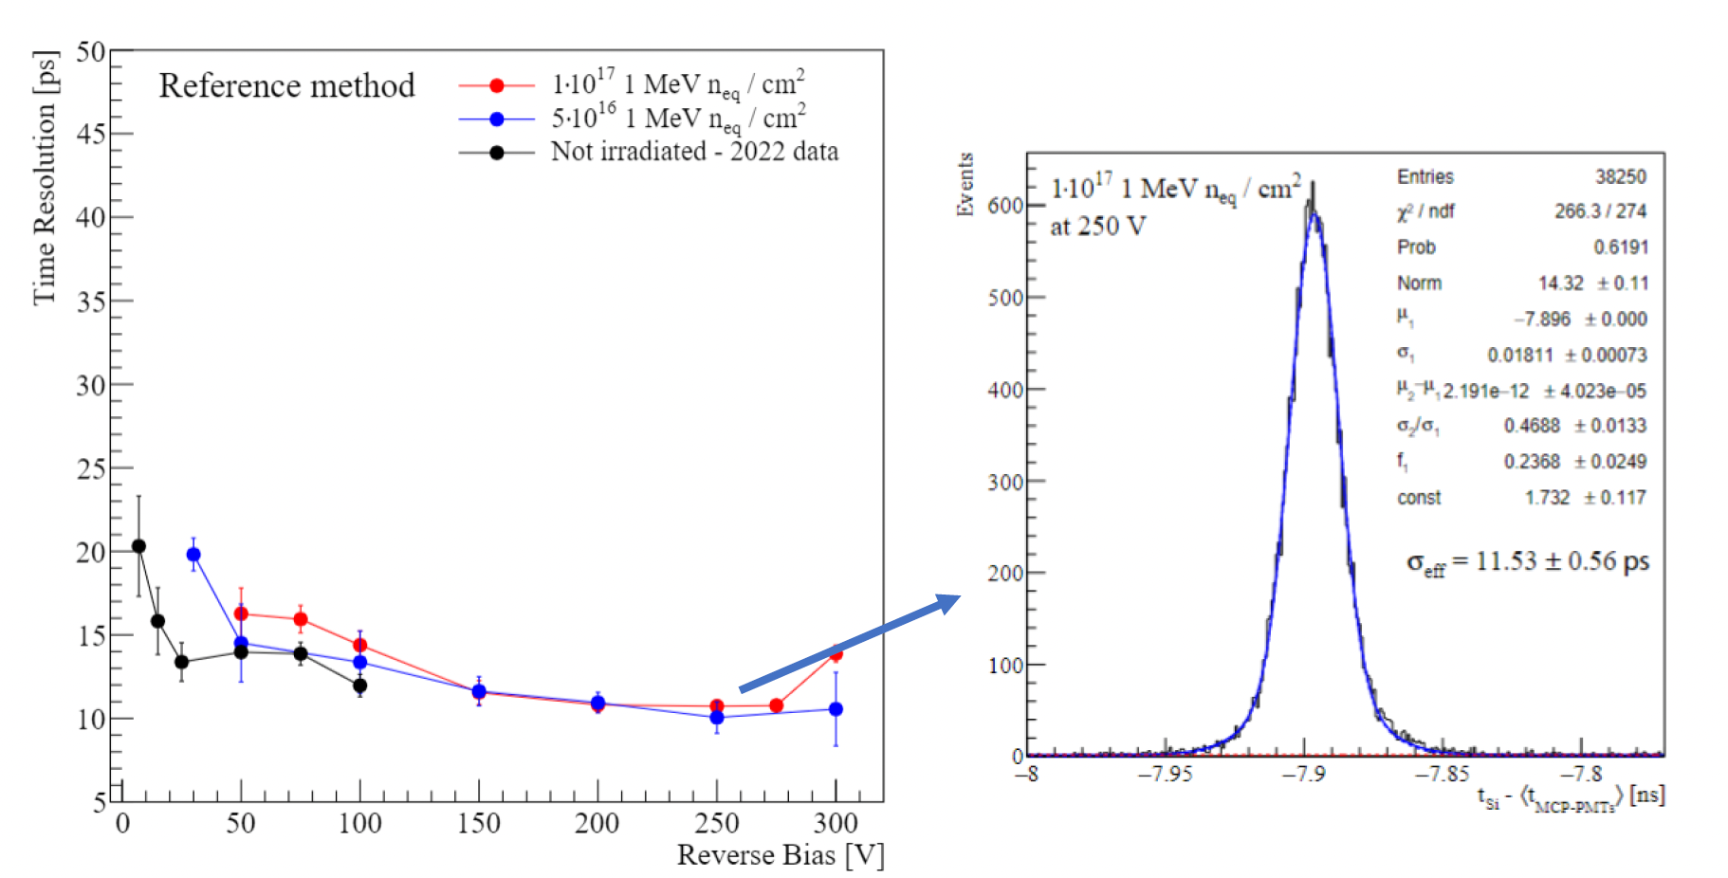
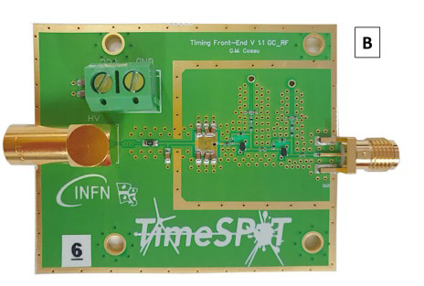
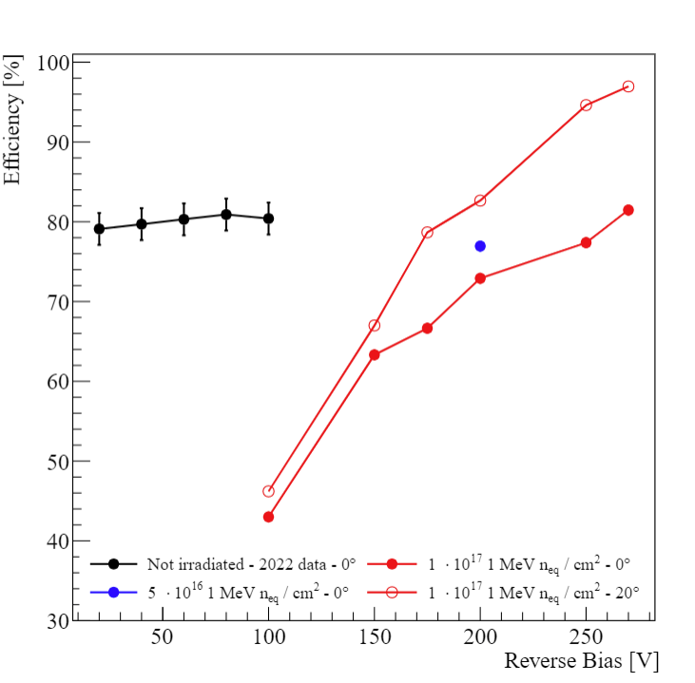
Characterization of the FBK trenched 3D sensors
Characterization mainly performed on previous productions of trenched 3D sensors carried out within the Timespot project (2019 and 2021)
Irradiated 3D trench sensors maintain excellent timing performance even after irradiation
Custom-made front-end electronics boards featuring a two-stage transimpedence amplifier made with fast SiGe BJTs
The test-beam confirmed that trenched 3D sensors maintain the performance up to fluence of 10¹⁷ n_{eq} : hit efficiency of 96.8% at 20º angle
AIDAinnova Final Annual Meeting
30
30
30
30
6th May 2025
30

Slide 31

Characterization of the FBK trenched 3D sensors - Outlook
Characterize 3D trench matrices from AIDAInnovabatch with the newly developed Ignite ASICs
AIDAinnova Final Annual Meeting
31
31
31
31
6th May 2025
31

Slide 32

Simulations of LGAD and 3D sensors
Recent upgrade of the Perugia radiation damage model → “PerugiaModDoping”
  Traps parameterization (“New University of Perugia” TCAD model)
  Torino analytical parameterizations : Gain Layer and Bulk effective doping evolution with Φ
32
32
32
32

Slide 33

LGAD: comparison of simulations and measurements
The new model has been verified for LGAD devices, by comparing TCAD simulations w/ measurements
  UFSD2 production (FBK): static (DC), small-signal (AC) and gain behavior well reproduced
  HPK2 production (HPK): DC, AC and gain behavior well reproduced
AIDAinnova Final Annual Meeting
33
33
33
33
33
33
33
33
33
33
6th May 2025
33

Slide 34

3D sensors: comparison of simulations and measurements
Measurements and Simulation of 3D detectors (in collaboration with Trento group for 3D detectors modelling)
  The original CERN model needs some changes/modification to be able to proper reproduce/predict the IV and CV measurements of 3Ds → New measurements in Perugia on 3D detectors and test structures in the range 1-2.5×10¹⁶ n/cm² to drive simulations
34
34
34
34

Slide 35


Wafer to wafer interconnection (I)
Goal of the project: W2W bonding of passive CMOS sensors and Timepix3 chip wafers
Fabrication of sensor wafers done in 2024 at Lfoundry with an engineering run
Wafers are now at IZM for postprocessing
2 wafers have been processed with backside metallization and front side handling wafer removal → test results available → sensors are functional!
The Cu/Sn bond will be supported by spin coated, photo-structured polymer layer which is joined simultaneously (polymer hybrid wafer bonding)
Process evaluation with different wafer stacks:
Polymer layer height and planarity → Planarization process for the polymer developed and evaluated
Planarization process developed for the Cu/Sn pillars
AIDAinnova Final Annual Meeting
35
35
35
35
6th May 2025
35

Slide 36

Final W2W process evaluation with daisy chains and outlook
Batch 2 - Bonding process with planarized pillar bumps using daisy chain wafer:
Fabrication of new mask with adapted alignment marks
Polymer bonding layer deposition and patterning
Pillar formation by electroplating
Pillar planarization (ongoing)
W2W bonding
Backside thinning (target thickness 50μm)
Si-etch probe pad access window
Electrical daisy chain and resistance measurements
After process validation: Start of W2W processing with real sensor and FE wafers
AIDAinnova Final Annual Meeting
36
36
36
6th May 2025
36

