Slide 1
WP4.4 - Design & Development of a
Sensor Characterization System based on the TPA-TCT Technique
AIDAinnova final annual meeting, 5-8. May 2025, FZU, Prague
Michael Moll (CERN)
on behalf of WP4.4.

Slide 2
Outline
Introduction to TCT and TPA-TCT
TPA-TCT project & project partners
  Status of TPA-TCT systems in AIDAinnova-community
  A new – more compact - laser system with fiber output
  Examples of advances in TPA-TCT methodology, analyses and simulation
  Examples of recent TPA-TCT applications
Dissemination: First AIDAinnova and DRD3 TCT School
Status: Milestones and Deliverables
Summary and Outlook
Annex
  Publications and additional slides
  The deliverable report, as submitted on 31.3.25, is attached to the agenda

Slide 3
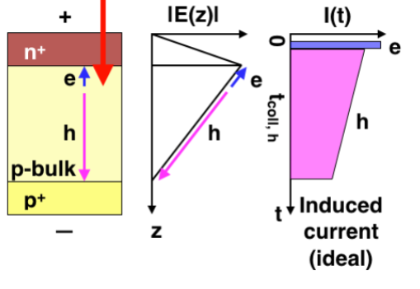
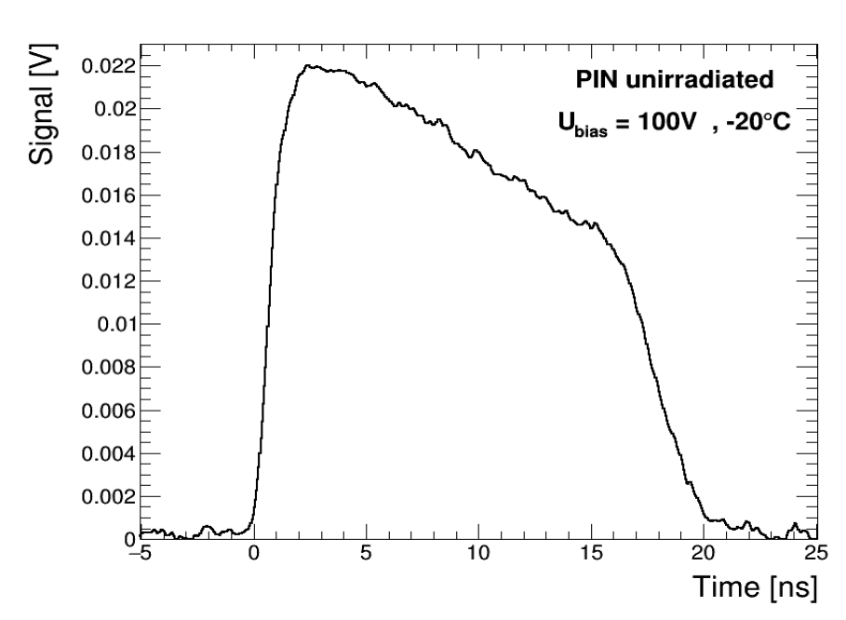
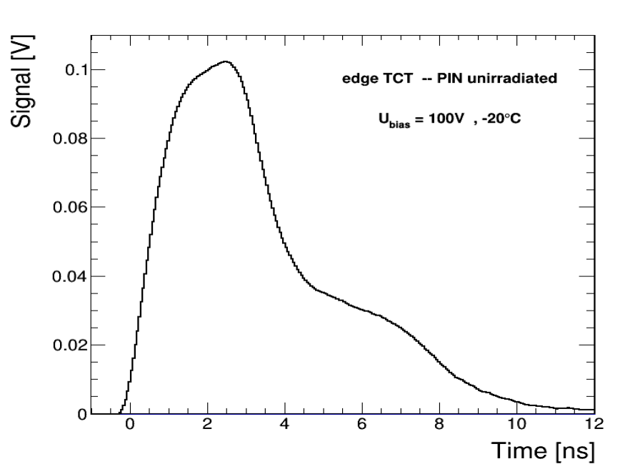
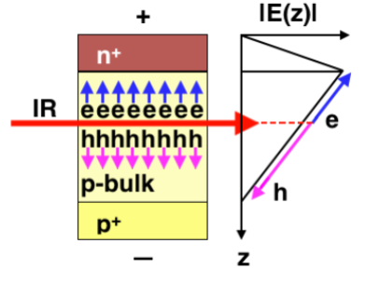
Transient Current Technique
Transient Current Technique (TCT) for characterization of semiconductor sensors
  Principle: Illumination with laser light pulse (<1ns) followed by recording of the resulting current transient
Example 1:
mode: “top TCT”
red laser
(e.g. 660 nm)
hole signal
Example 2:
mode: “edge TCT”
infrared laser
(e.g. 1060 nm)
electron signal
hole signal

Slide 4



TCT: Transient Current Technique
TCT “invented”: 1996
TCT: Pulsed laser induced generation of charge carriers inside detector
    Study of E-field in sensor, charge collection efficiency, homogeneity, ..
    Benchmark simulation tools, e.g. signal formation,
    Measure physics parameters e.g. mobility, impact ionization, ..
edge-TCT invented within RD50: 2010
TCT commercialized: 2013
TCT (red laser)
  short penetration length (650nm = 1.9 eV)
  carriers deposited in a few μm from surface
  front & back TCT: study electron & hole drift separately
  2D spatial resolution (5-10μm)
TCT (infrared laser)
  long penetration (1064nm = 1.17 eV)
  similar to MIPs (though different dE/dx)
  top and edge-TCT
  2D spatial resolution (5-10μm)
TPA-TCT (far infrared)
  No single photon absorption in silicon (1550nm = 0.8 eV)
  2 photons produce one electron-hole pair
  Point-like energy deposition in focal point
  3D spatial resolution (1.5 x 1.5 x 15 μm³)
TPA-TCT: Proof of concept presented by RD50 in 2015
Table-top TPA-TCT laser
commercialized: 2020/21
Table-top
TPA-TCT system
All fiber based table-top TPA-TCT laser - 2025

Slide 5
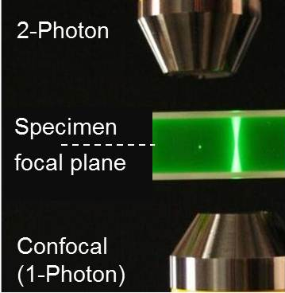
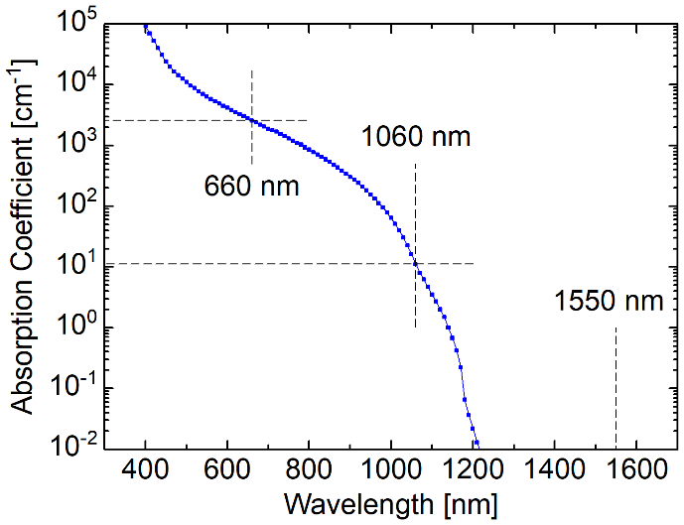
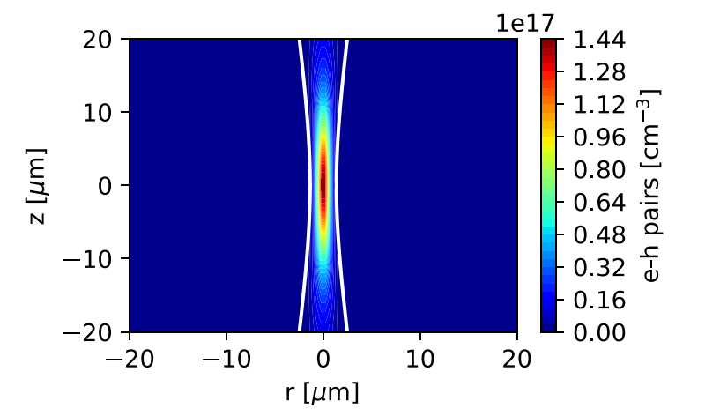
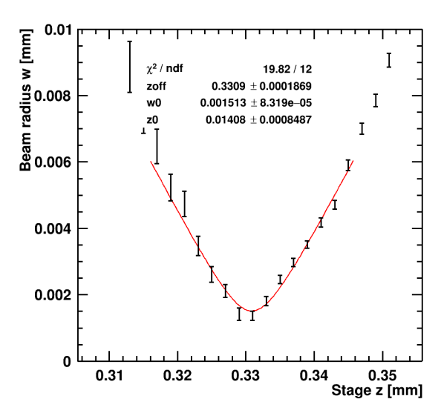
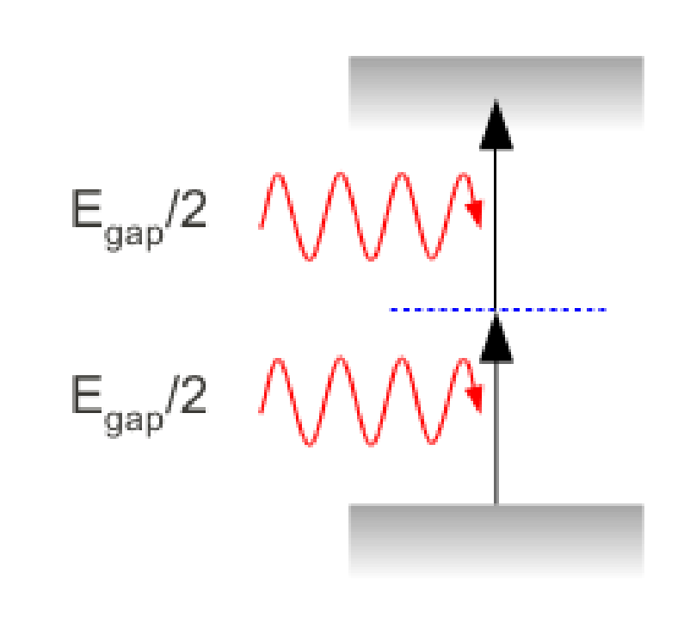






TPA: Two Photon Absorption
Example: Fluorescence
TPA in silicon
Si: SPA - Single Photon absorption
charge carrier density
simulation
$$λ=1550 nm$$
$$ω_{0}=1.4 μm$$
$$z_{R}=13 μm$$
[Photo: C.Yanez, Uni of Central Florida]
1550nm: no absorption unless two photons are absorbed at same time (i.e. within fs)
Measurement
$$ω_{0}≈1.5 μm$$
$$z_{R}≈14 μm$$
TPA – Two Photon Absorption
Absorption only in focal point
SPA – Single Photon Absorption
Continuous absorption along beam
$$\frac{dI(r,z)}{dt}=− αI−βI^{2}(r,z)$$
SPA
TPA

Slide 6





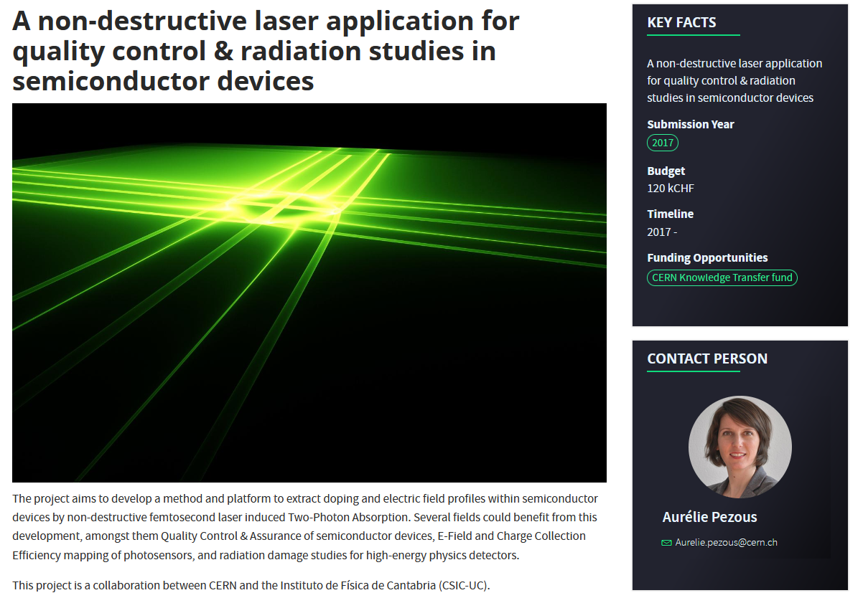
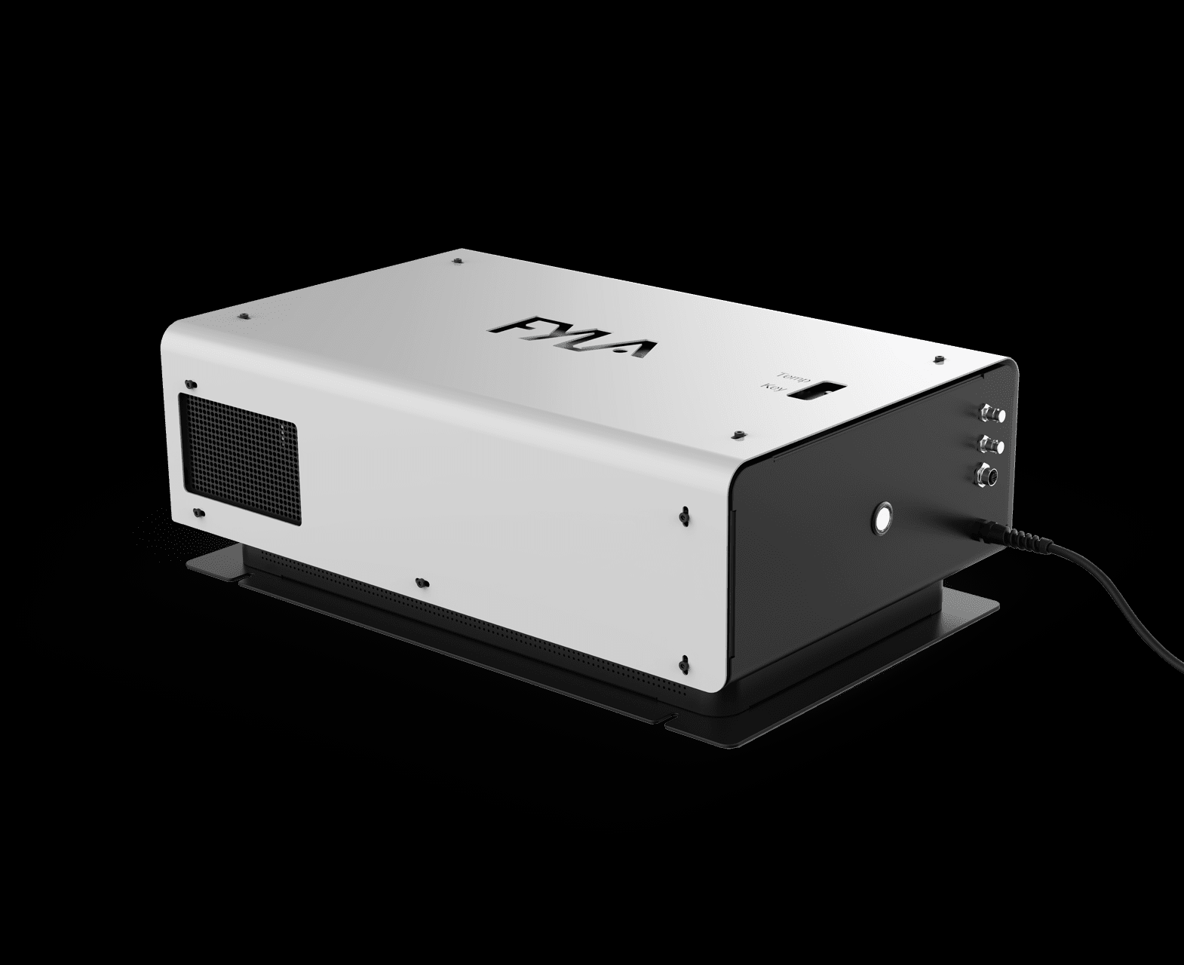

TPA-TCT development history
Since 2015: TPA-TCT measurements performed at laser facility in Bilbao
  Proof of concept, demonstration of 3D resolution and feasibility to study irradiated sensors
2017: CERN KT-fund approves & funds a project to develop a table-top TPA-TCT system
2017-18: development of specs, discussions with laser experts, market survey, …..
03/2018 Call for Tender
06/2018 Order to Fyla
04/2019 1st prototype arrived at CERN,
installation problem & transport damage
07/2019 2nd delivery; installation successful, commissioning, system debugging..
10/2019 power cut damages laser, repair
12/2019 replacement of components
07/2020 power stability issues detected,
laser returned to FYLA, upgraded
01/2021 new generation prototype delivered to CERN; since then: data taking
selection of company
laser development
Fyla LFC1500X
AIDAinnova WP4.4
further improvements & user community
system development & all fiber laser system

Slide 7
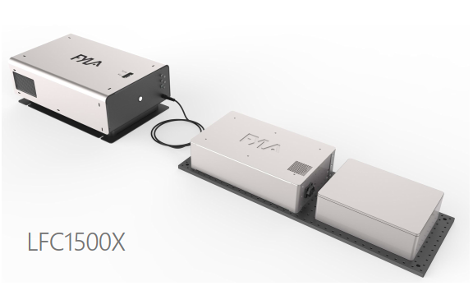
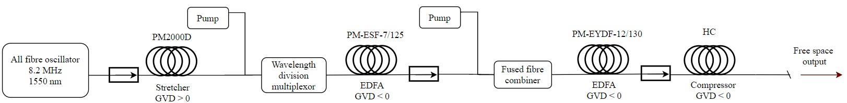
Laser system schematics
LS
Modular femtosecond laser system
  Laser Source (LS)
    10 MHz, 1550 nm, < 300 fs
  Laser Pulse Management (LPM)
    10 pJ to 10 nJ, 10 MHz to single shot
  Dispersion management (DM)
    300 – 600 fs, pulse characterization
LPM
DM
Fiber Laser System of 1550 nm Femtosecond Pulses with Configurable Properties for the Two-Photon Excitation of Transient Currents in Semiconductor Detectors; Azahara Almagro-Ruiz, Sebastian Pape, Hector Muñoz, Moritz Wiehe, Esteban Curras Rivera, Marcos Fernández-García, Michael Moll, Raúl Montero Santos, Rogelio Palomo, Cristian Quintana, Iván Vila Álvarez, Pere Pérez-Millán; Applied Optics 61, 9386-9397 (2022); https://doi.org/10.1364/AO.470780
Details:

Slide 8

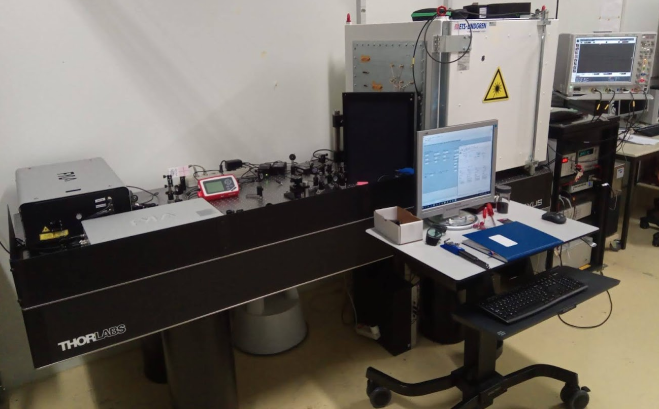

TPA-TCT at CERN SSD (EP-DT)
CERN: TPA-TCT at the Solid State Detectors (SSD) lab of the EP-DT group
  Laser laboratory with interlocked access and personal protection equipment
Faraday Cage
Fyla Laser Module
Pulse Management
(with SPA reference)
[M.Wiehe et al.: Development of a Tabletop Setup for the Transient
Current Technique using Two-Photon Absorption in Silicon Particle Detectors, IEEE TNS, Vol.68, Issue.2, Feb.2021, pages 220-228]
Laser output pulse properties:
pulse width: approx. 430 fs
pulse frequency: 8 MHz to single pulse
pulse energy: up to 10nJ
central wavelength: 1550 nm

Slide 9
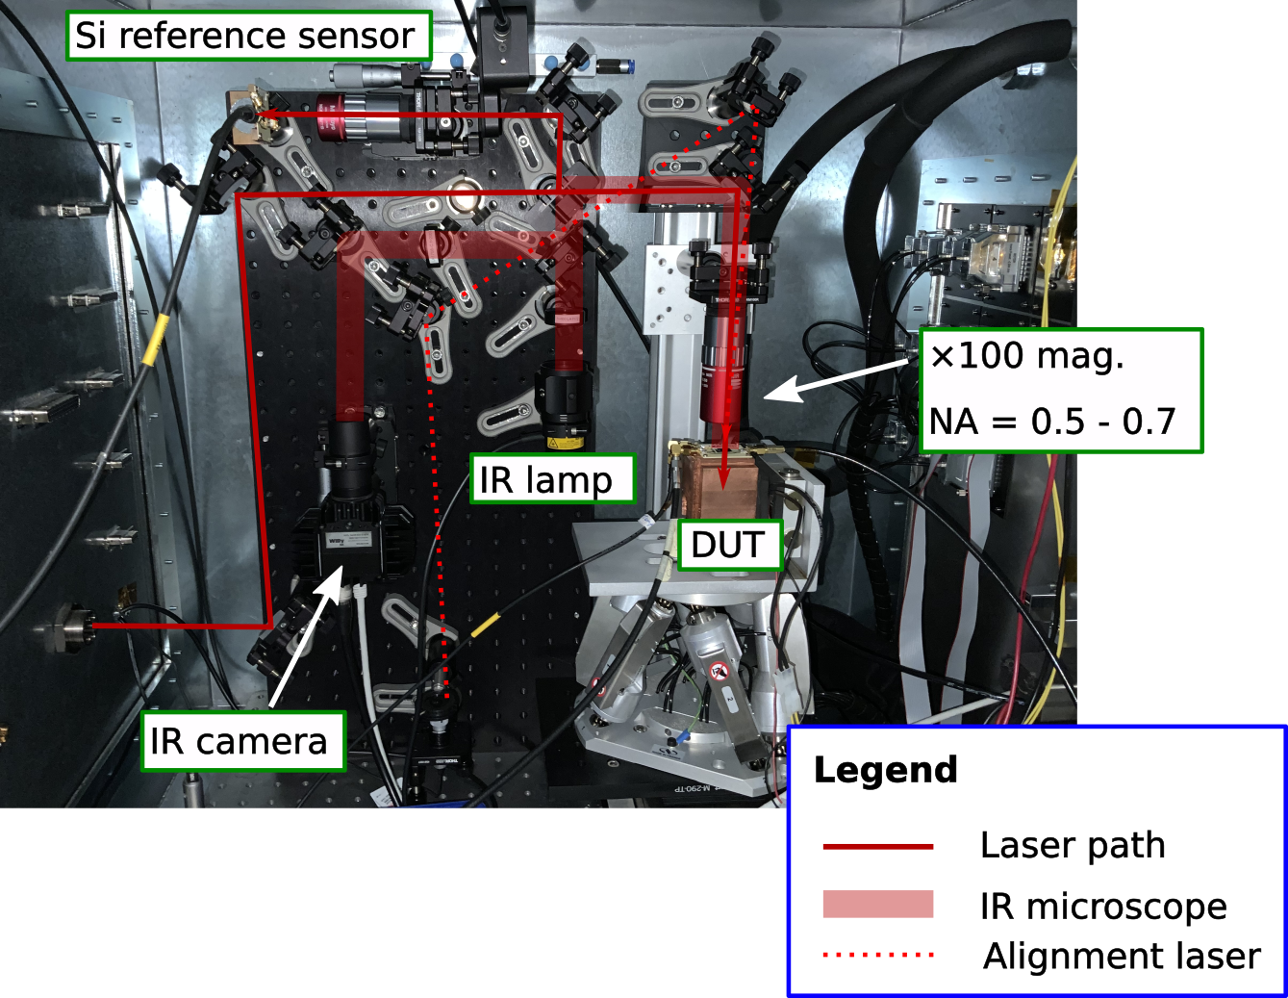
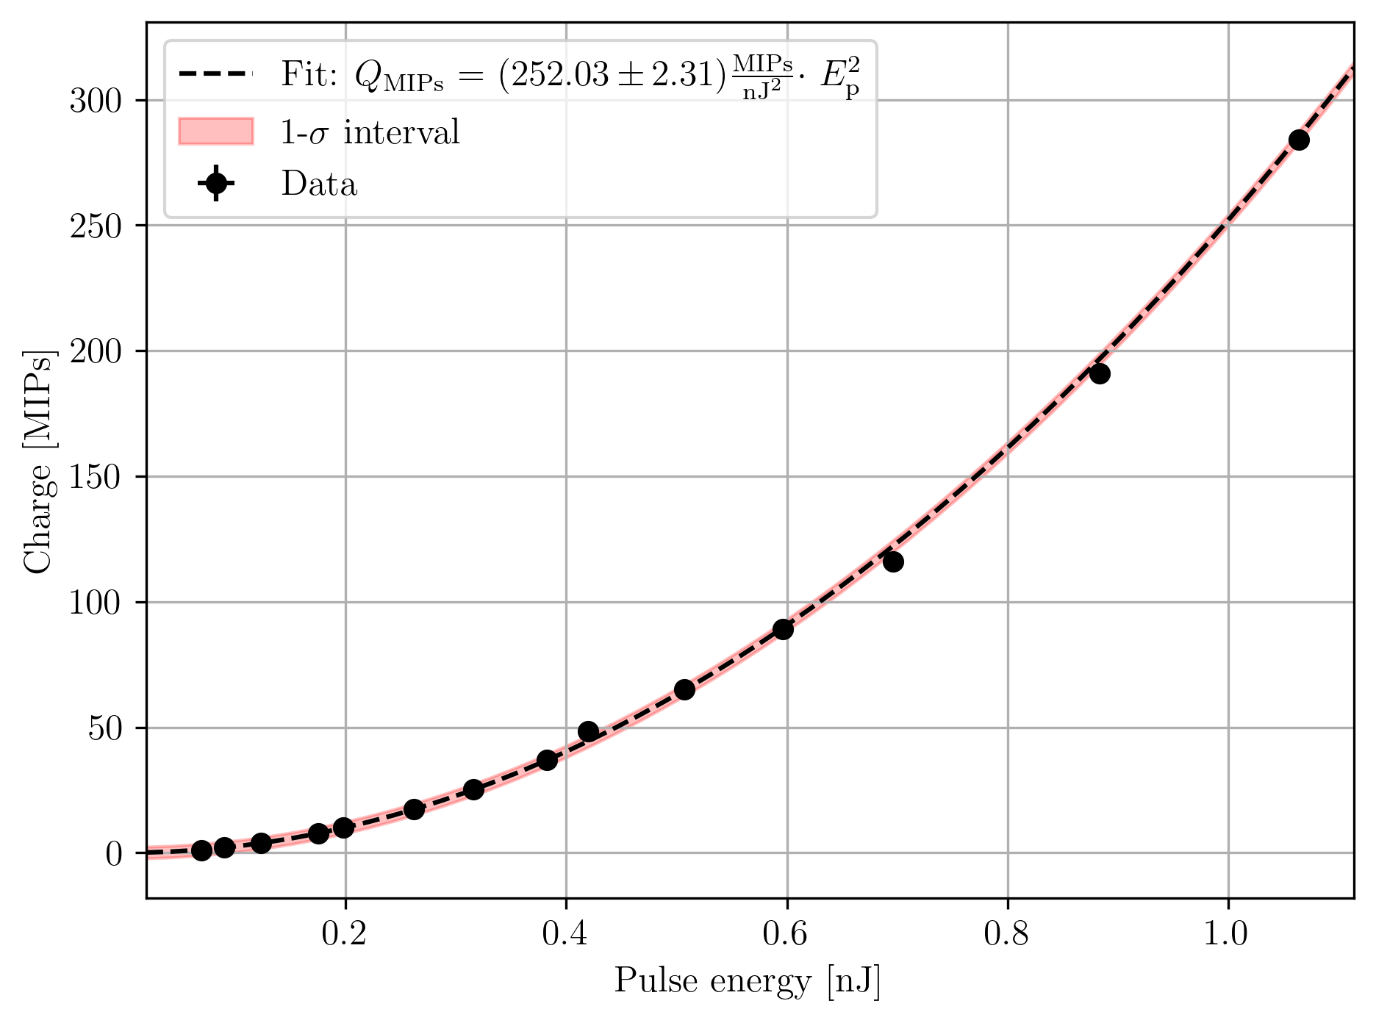
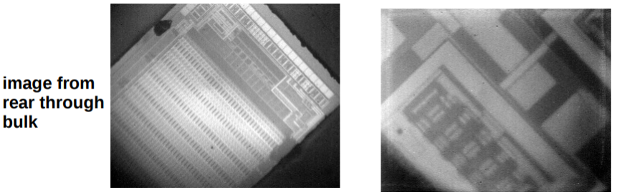
Setup & Calibration (CERN)
Inside the Faraday cage
Calibration against MIP (⁹⁰Sr)
Pulse energy against generated charge
(285 µm PIN; NA = 0.5 at 20°C and 0% humidity)
Si reference sensor
x100 mag.
NA = 0.5, 0.7
IR camera
The pulse energy is measured with a S401C thermal power sensor from Thorlabs.
$$\frac{dI(r,z)}{dt}=− αI−βI^{2}(r,z)$$

Slide 10
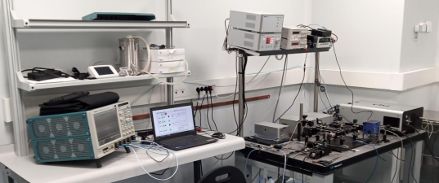

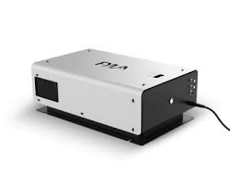
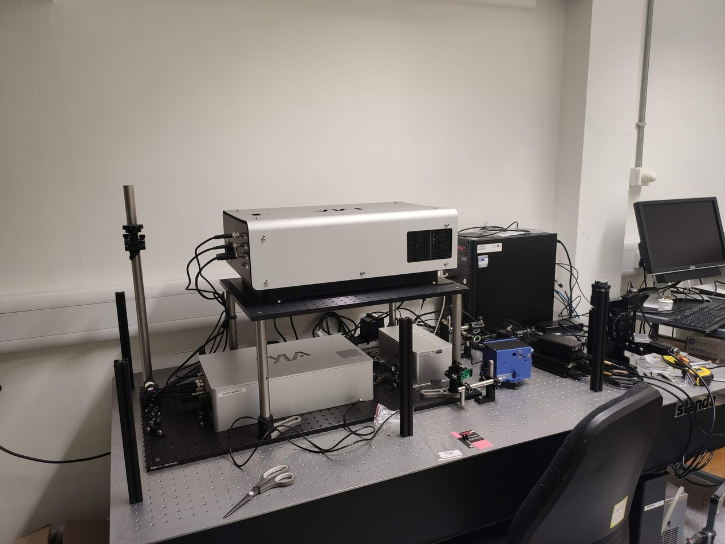
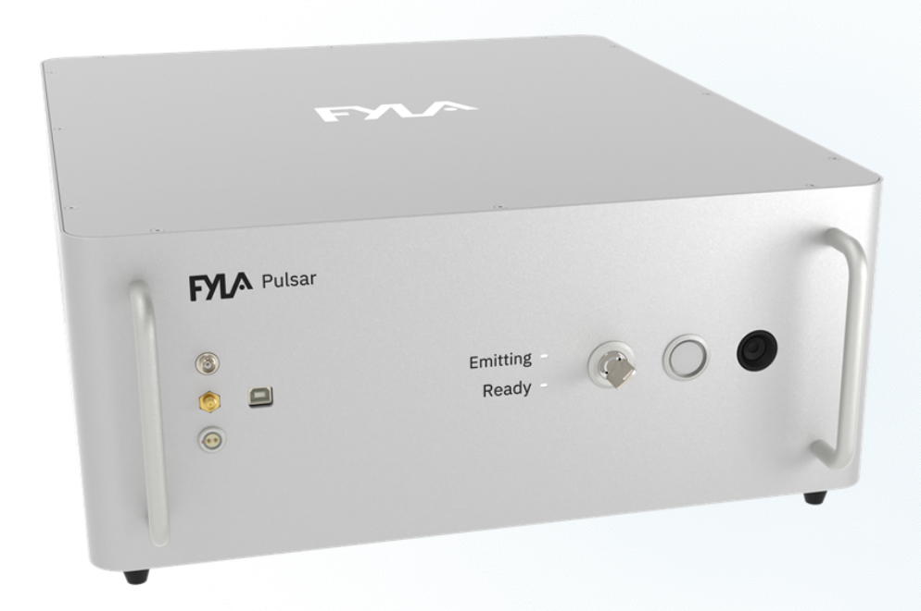

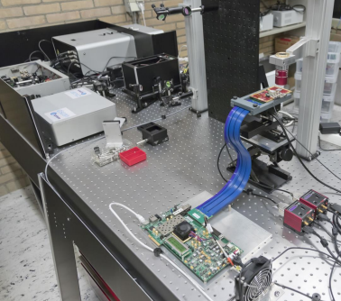
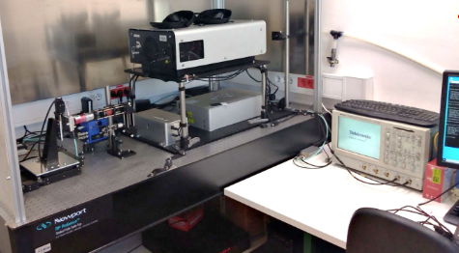



TPA-TCT systems
TPA-TCT systems have been set up at several institutes
The new AIDAinnova TPA-TCT laser (see following slides)
has been distributed as well
LFC1500X
Pulsar

Slide 11
A new TPA-TCT laser
- developed in the AIDAinnova Task 4.4. framework -

Slide 12
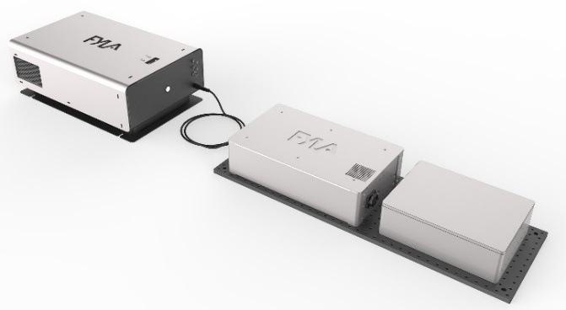
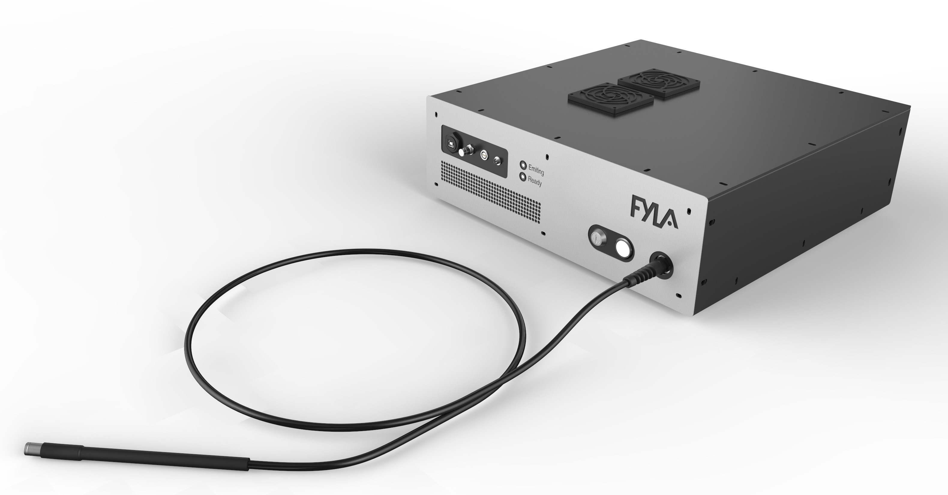
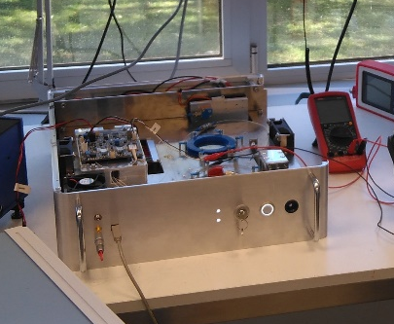
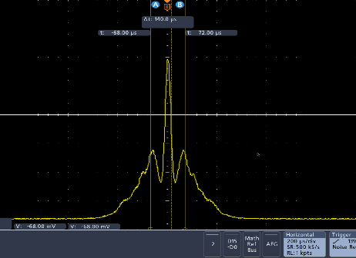
Fiber based TPA-TCT System
CURRENT
LFC1500X commercial model
AIDA INNOVA
Single box fully all-fiber
CERN SSD
Collimated
Output
Fiber delivery
Current TPA-TCT system
LPS: Laser Pulse Source
  All-fiber CPA femtosecond pulses generation
  Pulse rep rate selection. Single shot to 8 MHz
LPM: Laser Pulse Management module
  Pulse energy modulation: <10 pJ to > 10 nJ
  Synchronized shutter. rise/fall time < 1 us
Δτ = 200 fs
Prototype January 2022
Details on the new design: A.Almagro-Ruiz, Fyla “Towards an All-Fiber Femtosecond Laser System as Excitation Source in the TPA – TCT”, presented on 39th RD50 Workshop, November 2021, Valencia
LPS + LPM + D-SCAN in single box fully all-fiber
  Pulse duration goal < 100 fs
  Fiber-based tunable dispersion compensation: < 100 fs to 1 ps
  Fiber-pigtailed AOM functionalites:
    Energy modulation; Pulse rep rate selection; Sync shutter
    Dispersion-less fiber output

Slide 13
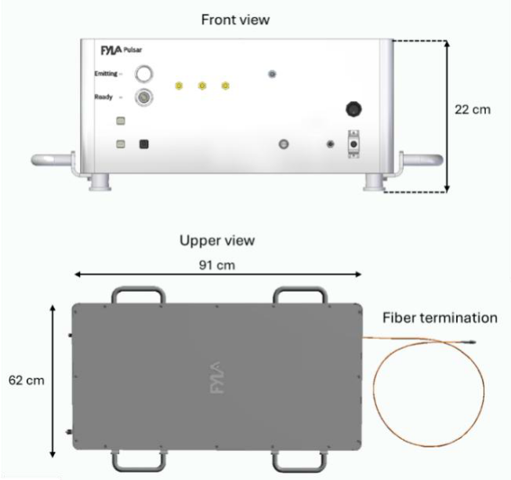
The new laser system: Pulsar
Status 2025
The new “Pulsar” laser system is commercially available at Fyla
  The system fully integrates the laser pulse source (LPS), the pulse management module (LPM) and the dispersion compensation module (D-scan) in a single box component
  The system presents better robustness and stability
  in optical and temporal properties compared to
  the previous laser system.
  It provides beam delivery through several meter
  of hollow core optical fibers (Kagome fibers)
  preserving the pulse shape during propagation.
  The coupling efficiency into the fiber is ~70%.
“Pulsar” system specifications
LPS: Laser Pulse Source
  All-fiber CPA femtosecond pulses generation
  Pulse rep rate selection. 1 Hz to 10 MHz
LPM: Laser Pulse Management module
  Pulse energy modulation: 10pJ to 10nJ
  Synchronized shutter, rise/fall time < 1μs
D-SCAN: Dispersion scanning
  Pulse duration tuning: 300fs to 600fs
  Pulse temporal properties characterization
Pulsar laser system

Slide 14
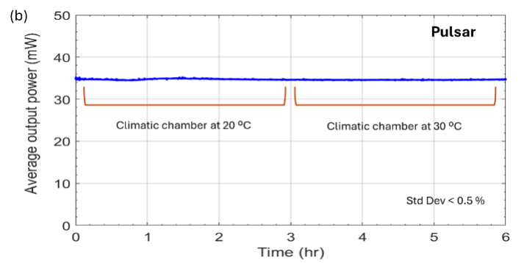
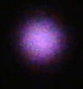

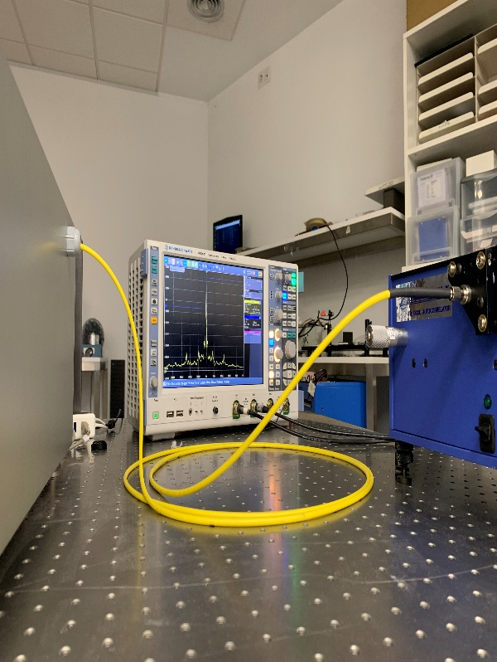
Pulsar laser system
Performance testing
  Power stability over time factor two better than previous system
  Beam delivery through hollow optical fiber
    Good preservation of pulse shape
    Coupling efficiency of ~ 70% to Kagome fiber
Power Stability
Evaluation of pulse shape with/without fiber
Fiber coupling test

Slide 15
Measurement technique improvements
&
Application examples

Slide 16
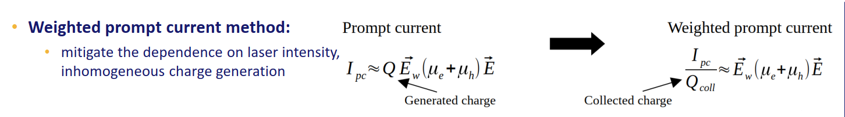
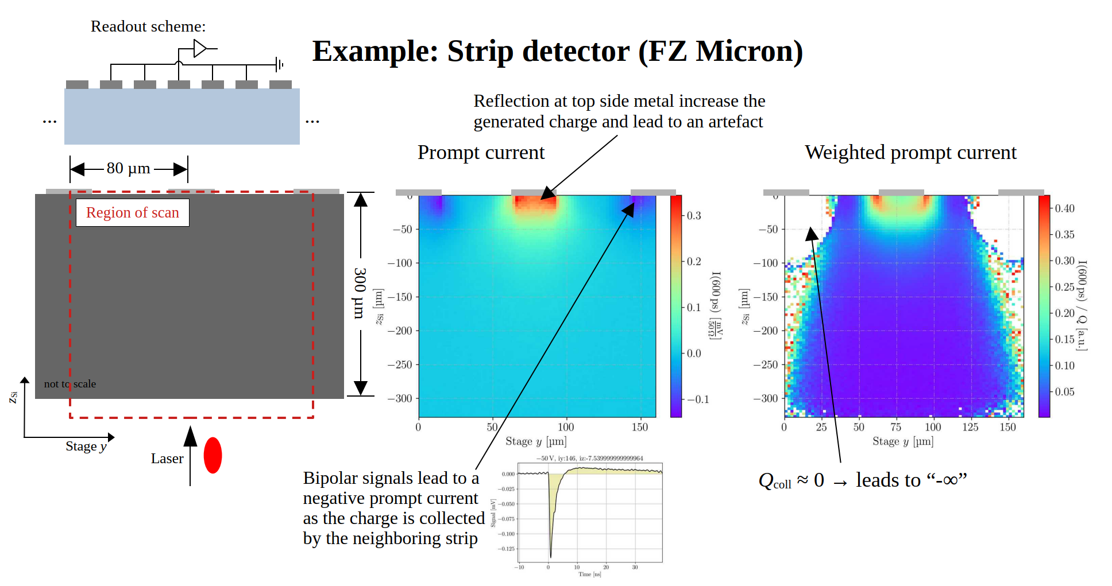
“The weighted prompt current method”
S.Pape et al. Sensors 2023, 23(2), 962; https://doi.org/10.3390/s23020962 , January 2023

Slide 17
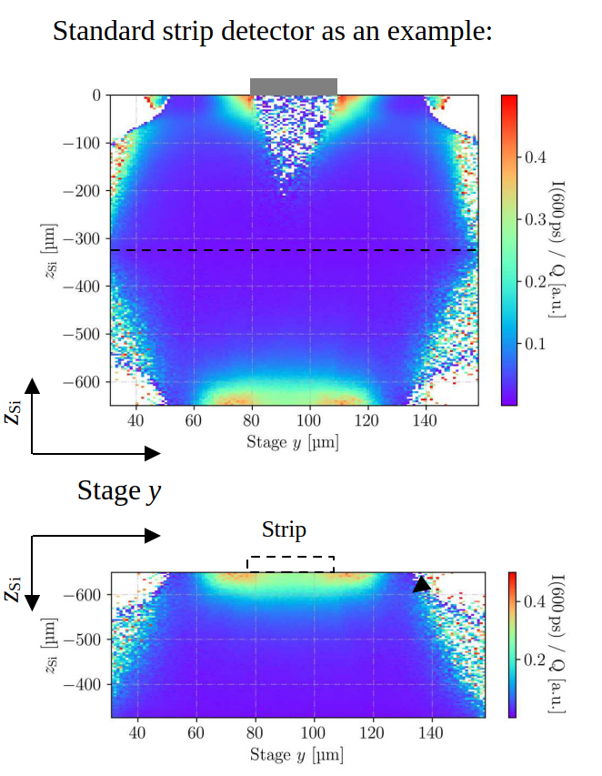
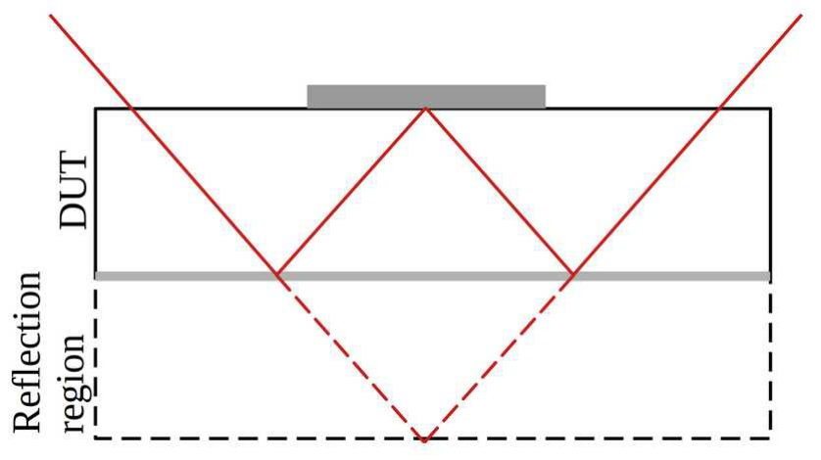
“The Mirror Technique”
The mirror technique
  Reflection at a metallized back side can be exploited to probe below the top side metallisation with illumination from the top
  All intensity independent quantities can be probed in this way.
  Requires a metallized back side
  Enables a measurement below the top side metals
  Note that beam clipping can reduce the numerical aperture and hence the special resolution.
This technique is only feasible with TPA-TCT as it requires 3D resolution!
Image flipped
Details: S.Pape et al.: “Techniques Techniques for the Investigation of Segmented Sensors Using the Two Photon Absorption-Transient Current Technique”,
Sensors 2023, 23(2), 962; https://doi.org/10.3390/s23020962 , January 2023

Slide 18
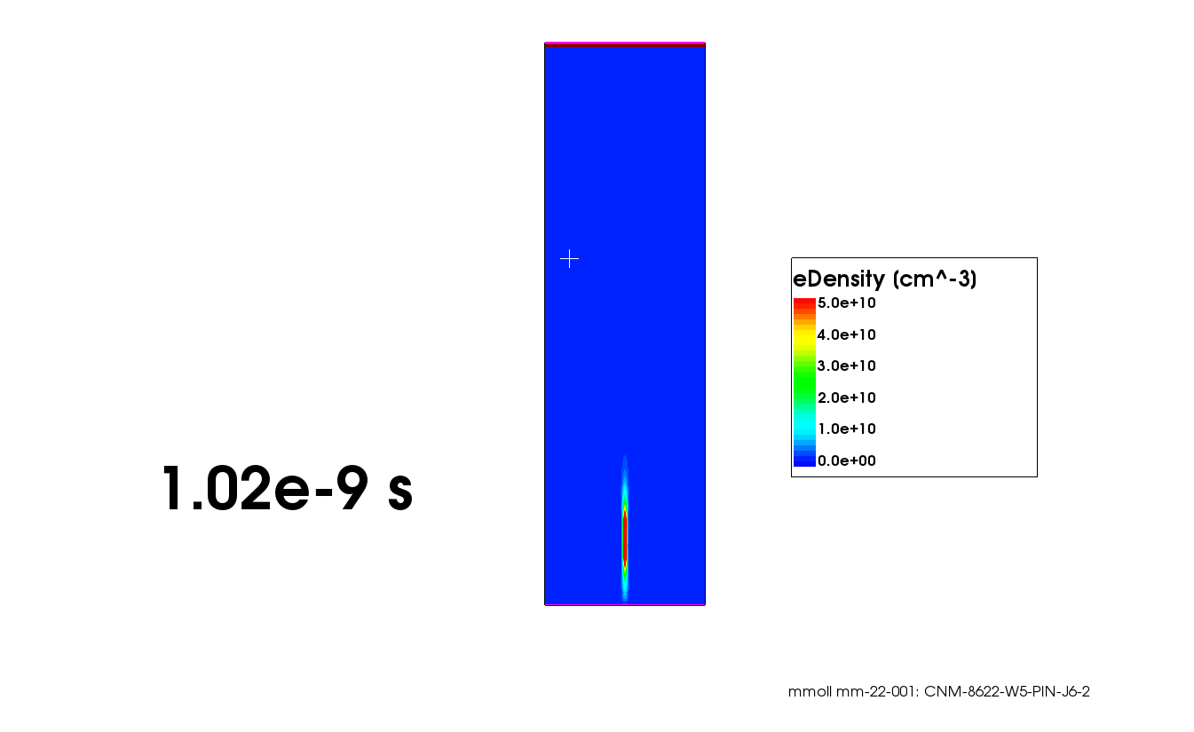

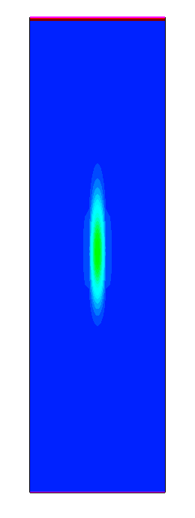
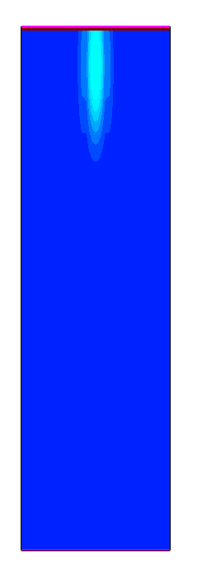
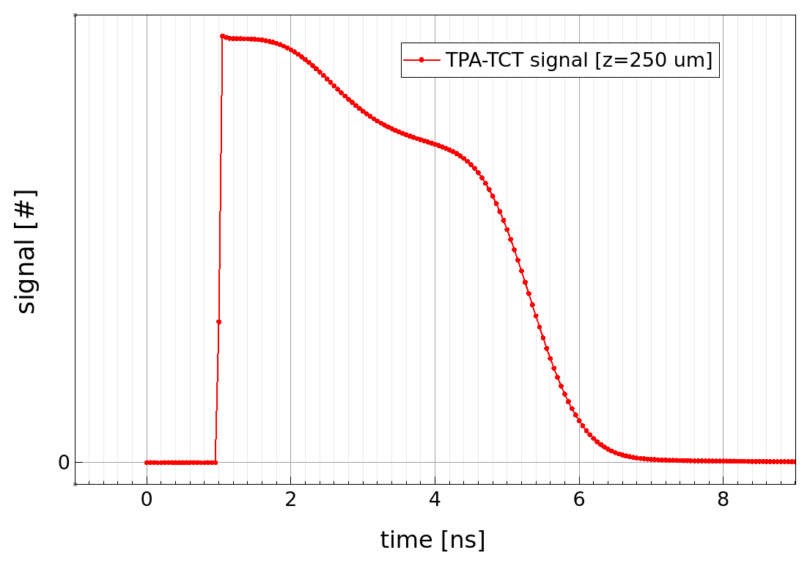
TCAD simulations of TPA-TCT
Simulation of TPA-TCT (in Synopsys TCAD)
  Example: Charge cloud generated around focal depth of 250 μm (at t=1.0 ns)
  Visualisation of electron cloud moving through a PIN detector (holes not shown)
frontside (n⁺)
p-type sensor
Transient Current (TC)
induced by electrons and holes
1.0 ns
3.0 ns
5.0 ns
backside (p⁺)
p-type sensor
1.0 ns charge
cloud generated
at z = 250 μm
Note:
This example is calculated
in 2D for better visibility, all shown
transients calculated from 3D simulations.
The shown transient still has to be folded with a transfer function for taking into account the electronic shaping (dominated by the sensor capacitance)
3.0 ns
5.0 ns

Slide 19
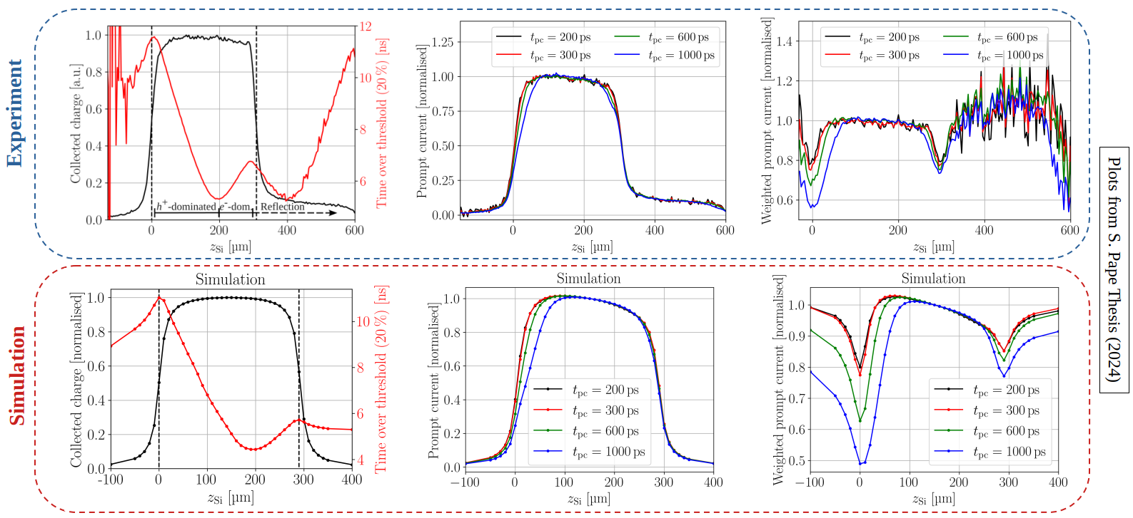
Advances in TCAD simulations
Comparison of data extracted from experimental current transients versus data extracted from simulated transients taken on a 300µm thick PIN sensor

Slide 20
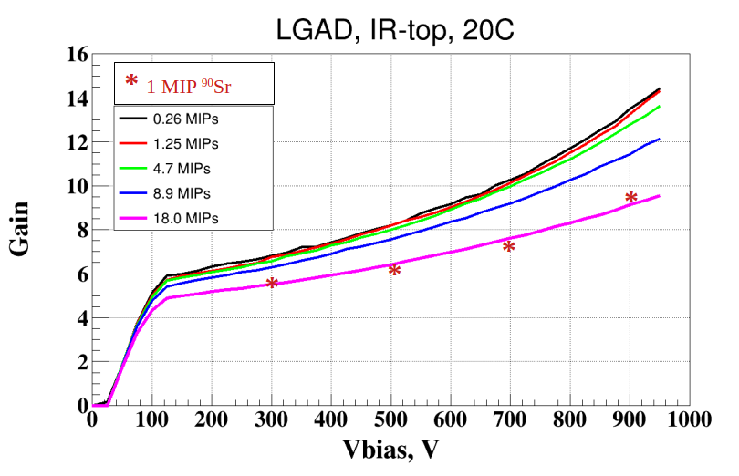
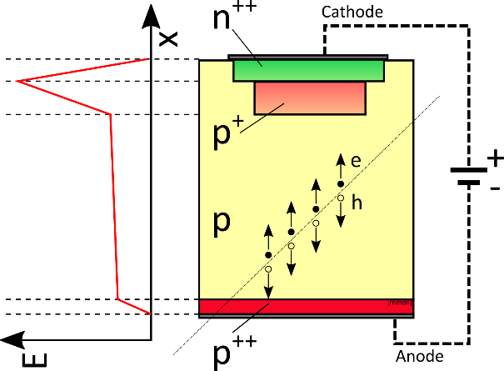
Application: Gain suppression in LGADs
- as studied with TPA-TCT -
Gain suppression in LGADs:
  The gain in Low Gain Avalanche Diodes (LGADs) depends on the charge density entering the gain layer
  Effect relevant for characterization and operation of LGADs for the HL-LHC ATLAS/CMS timing experiments
Example of a study employing standard TCT and ⁹⁰Sr source induced signals
  Sensors: LGAD and PIN from CNM 8622 batch (285 μm thick devices with/without a gain layer)
TCT 1060nm top
gain reduction
with
increasing
ionization
density
  LGAD schematics
  PIN (no p⁺ , i.e. no gain layer)
  Gain = Signal LGAD / Signal PIN

Slide 21
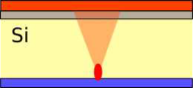
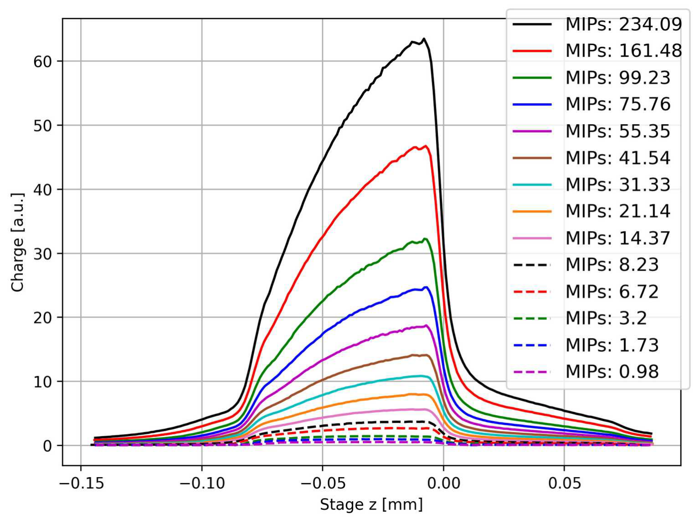
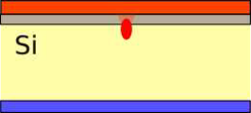

LGAD gain suppression in TPA-TCT
focus close
to backside
Experiment: LGAD
  1 MIP ≈ 3.6 fC
lower charge density
at gain layer
= less gain suppression
charge injected
250μm depth
+2.0 ns
+4.0 ns
focus close
to frontside
high charge density
at gain layer
= high gain suppression
More details on experimental results:
  S.Pape, PhD thesis 2024
  List of publications in Annex
“Shark fin effect”

Slide 22
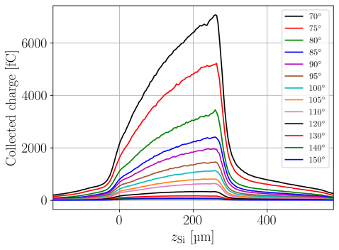
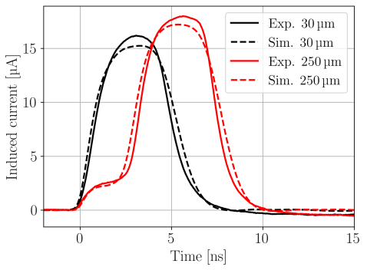
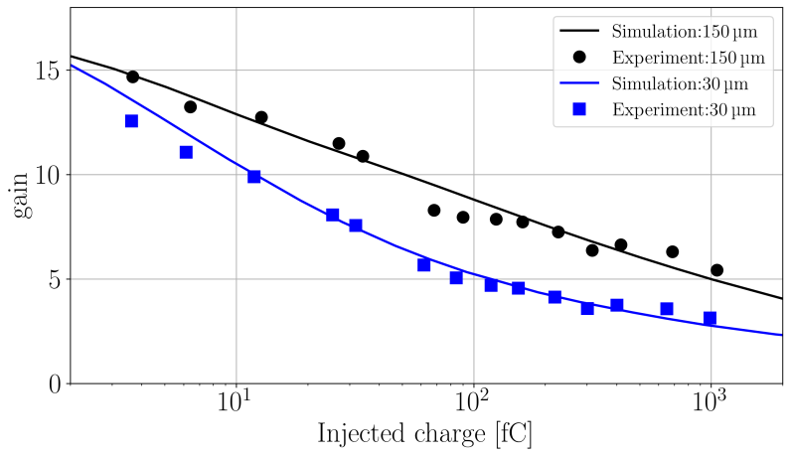
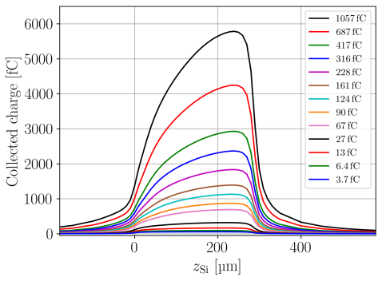
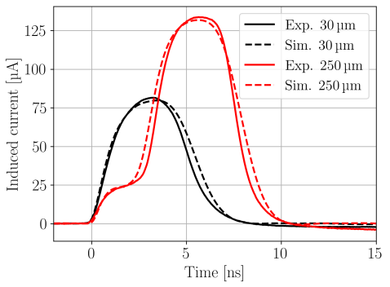
LGAD gain suppression in TPA-TCT
Comparison: measurements versus data
Gain suppression as function of injected charge and injection depth.
Transients
Charge collection profiles
6.5fC (NDF140°)
Experiment
68fC (NDF110°)
Simulation
Good agreement:
  LGAD gain suppression can be well reproduced in TCAD simulations
  A local impact ionization model as used in this TCAD simulation is sufficient to explain the effect.
  No hidden physics.
S. Pape et al., TCAD Simulation of Two Photon Absorption—Transient Current Technique Measurements on Silicon Detectors and LGADs; Sensors 2024, 24(24), 8032; https://doi.org/10.3390/s24248032

Slide 23






TPA-TCT as high precision scanning tool
The examples show the probing of the top side metals of monolithic detectors. Regions with metal have an increased charge collection due to reflection.
Features in the μm scale are well resolved (~60 x 60μm pixels)!
Reference PicoAD:
M. Milanesio et al. 2023
R.Cardella et al. 2022
Reference MPW2:
E. Vilella 2022

Slide 24
TPA-Testing for the community
AIDAinnova Task 4.4. team involvement in TPA-TCT testing for the community
(beyond our own research on semiconductor sensors)
TPA-TCT tests were performed at CERN for:
  Silicon devices:
  LHCb - University of Bonn (CMOS sensors), FBK (Space LGAD development), CMS IFCA team (3D pixel), ATLAS – TU Dortmund (passive CMOS strip sensors), University Geneva (monolith, picoAD projects), RD50 (MPW productions), INFN – TimeSPOT project, CERN R2E (SRAM memories)
  Other devices:
  CERN EP-ESE (optical link team), University of TelAviv (MCT sensors)
  …strong support to efforts at Manchester University for TPA-TCT on Diamond
Intensive studies at SGIKER laser facility in Bilbao:
  Deepen understanding of TPA-TCT with a more flexible laser
  Study of TPA-TCT in 4H-SiC sensors (irradiated/non-irradiated)

Slide 25

AIDAinnova TCT-School
THE FIRST DRD3 AND AIDAINNOVA TCT SCHOOL [web-site]
  Venue: CERN, Geneva from 4-6 March 2025; Solid State Detectors (SSD) laboratory of the EP-DT group
  Commonly organized by:
    AIDAinnova Task 4.4. (CERN, IFCA) & JSI Ljubljana
    DRD3 WG5 (DRD3 WG on Characterization Techniques and Facilities)
  Subjects covered:
    Transient Current Technique (Single Photon & Two Photon)
    Signal formation, lasers, simulations…
  Participants:
    Targeted PhD students and postdocs
3-day program:
  Day 1
    Morning: Lectures
    Afternoon: Hands-on session 1
    Evening: Dinner
  Day 2
    Morning: Hands-on session 2
    Afternoon: Hands-on session 3
  Day 3
    Morning
      Participant presentations
      Data analyses presentation
    Afternoon
      Visit to the ATLAS experiment
Photos available on CERN CDS: http://cds.cern.ch/record/2925863

Slide 26




AIDAinnova TCT-School
THE FIRST DRD3 AND AIDAINNOVA TCT SCHOOL [web-site]
  Participants:
    12 lecturers, tutors, organizers
    18 participants (selected out of >50 applications)
      ….from 13 different countries
  Hands-on training
    6 groups of 3 students worked hands-on
    guided by tutors on different laser-setups
photos available on CERN CDS: http://cds.cern.ch/record/2925863

Slide 27


AIDAinnova TCT-School
…very positive feedback received and requests to repeat the school soon
We are planning to repeat the school in the DRD3 framework (date not fixed)
before school
after school

Slide 28
Task 4.4.: Milestone/Deliverable
WP4.4 - Design & Development of a TPA-TCT Sensor Characterization System
  Scope: Development of a customizable and user friendly Two Photon Absorption – Transient Current Technique (TPA-TCT) system for the characterization and testing of silicon devices
  Beneficiaries: CERN (task leader); CSIC-IFCA (Santander, ES); Fyla (Valencia, ES)
Deliverables/Milestones:
  MS16 (M23–February 2023) – “Commissioning of complete TPA-TCT system”; Milestone Document report: https://zenodo.org/records/8027093 [achieved]
  D4.4. (M46–January 2025) “Offer support towards the implementation of TPA-TCT systems and contribute to the evaluation of newly developed sensor technologies”
    Delayed by 2 months to M48 (31.3.2025) to include a report on the First AIDAinnova & DRD3 TCT school into the report.
    Deliverable Report submitted on 31.3.2025 (submitted version attached to agenda).
    [report submitted]

Slide 29

Task 4.4.: Summary/Outlook
WP4.4 - Design & Development of a TPA-TCT Sensor Characterization System
    Scope: Development of a customizable and user friendly Two Photon Absorption – Transient Current Technique (TPA-TCT) system for the characterization and testing of silicon devices; promotion and development of the TPA-TCT technique
    Beneficiaries: CERN (task leader); CSIC-IFCA (Santander, ES); Fyla (Valencia, ES)
    Deliverables/Milestones: D4.4./MS16 achieved/report submitted
Achievements:
  TPA-TCT technology
    Advancements in methodology, analyses and simulation; documented in publications and deliverable report
    Wide range of use-cases demonstrates the usefulness of this new-technology
    Extension towards other than silicon devices (SiC, Diamond, …)
  Laser system development:
    New, more compact and stable, “Pulsar” laser commercially available (including all-fiber up to objective)
  User community:
    TPA-TCT lasers delivered by Fyla: “LFC1500X” at CERN, IFCA (ES), JSI Ljubljana (SI), NIKHEF (NL), Lancaster (UK); “Pulsar” at Oxford (UK); Support provided for setting up systems at the institutes
    Established a school on TCT that will be continued in framework of DRD3 collaboration
Outlook:
  TPA-TCT common effort presented as example for collaborative efforts for new R&D collaboration (DRD3) in ECFA Detector R&D roadmap implementation plan.
  Consortium will continue work on the technology (if possible, in the framework of follow-up EU-project)
    Extension towards other than silicon semiconductors
    Full-system commercialization (not only laser system)
    Extension towards low-temperature operation

Slide 30
ANNEX

Slide 31
Publications – Task 4.4.
7 scientific publications in peer-reviewed open-access journals:
  A. Almagro-Ruiz et al., Fiber laser system of 1550 nm femtosecond pulses with configurable properties for the two-photon excitation of transient currents in semiconductor detectors, Appl. Opt. 61, 9386-9397 (2022); https://doi.org/10.1364/AO.470780
  S. Pape et. al., First observation of the charge carrier density related gain reduction mechanism in LGADs with the Two Photon Absorption-Transient Current Technique, Nuclear Instruments and Methods in Physics Research Section A: Accelerators, Spectrometers, Detectors and Associated Equipment, Volume 1040, 2022, 167190, https://doi.org/10.1016/j.nima.2022.167190
  S. Pape et al., Characterisation of irradiated and non-irradiated silicon sensors with a table-top Two Photon Absorption TCT system; S. Pape, M. Fernández García, M. Moll, R. Montero, F.R. Palomo, I. Vila and M. Wiehe; Journal of Instrumentation, C08011, 2022, volume 17, number 08; https://doi.org/10.1088/1748-0221/17/08/c08011
  S. Pape et al., Technique for the investigation of segmented sensors using the Two Photon Absorption – Transient Current Technique; Sensors 2023, 23(2), 962; https://doi.org/10.3390/s23020962
  S. Pape et al., Influence of temperature on measurements of the Two Photon Absorption – Transient Current Technique in silicon planar detectors using a 1550 nm femtosecond fibre laser; Nuclear Instruments and Methods in Physics Research Section A: Accelerators Spectrometers Detectors and Associated Equipment, Volume 1053, August 2023, 168387; https://doi.org/10.1016/j.nima.2023.168387
  S. Pape et al., TCAD Simulation of Two Photon Absorption—Transient Current Technique Measurements on Silicon Detectors and LGADs; Sensors 2024, 24(24), 8032; https://doi.org/10.3390/s24248032
  S. Pape et al., Study of Neutron-, Proton-, and Gamma-Irradiated Silicon Detectors Using the Two-Photon Absorption–Transient Current Technique; Sensors 2024, 24(16), 5443; https://doi.org/10.3390/s24165443

Slide 32



AIDAinnova proposal: WP4.4.
Objectives:
Description of work:
1 Milestone:
1 Deliverable:

