Slide 1



Status of LGAD and 3D Productions at CNM

Slide 2
Current Status of the CNM AidaInnova Runs
Run | Description | Clean Room Step
15543 | 150 mm Timepix4 PiN, Si (300 µm), 6PN1. AidaInnova WP3 | Production Completed (Characterization at Nikhef)
16020 | 150 mm AC-LGAD, Si (300 µm) and Si-Si (50/350 µm), 6LG4. RD50, AidaInnova WP6 | Production Completed (Electrical Characterization)
16069 | 100 mm 3D-DS Timing, Si (285 µm), 240 µm depth columns, 10 µm columns diameter. RD50, AidaInnova WP6 | Production Completed (Electrical Characterization)
16421 | 100 mm Timepix3 Trench iLGAD on epitaxial and Si-Si wafers, 4TILG. Engineering Run. RD50. AidaInnova WP6 | Production Completed (Electrical Characterization finished)
17941 | 100 mm Timepix4 Trench iLGAD on epitaxial and Si-Si wafers, 4TILG, first version. Engineering Run. AidaInnova WP6 | Production Completed (Electrical Characterization)
18245 | 100 mm 3D timing 285um thick wafers AidaInnova WP6 | Production at step 29/109 (Production delayed until end of 2025)
- | 100 mm Timepix4 Trench iLGAD, Epitaxial and Si-Si wafers, 4TILG, second version. Engineering Run. | Set to start in 2025 CNM1202 Mask Set

Slide 3
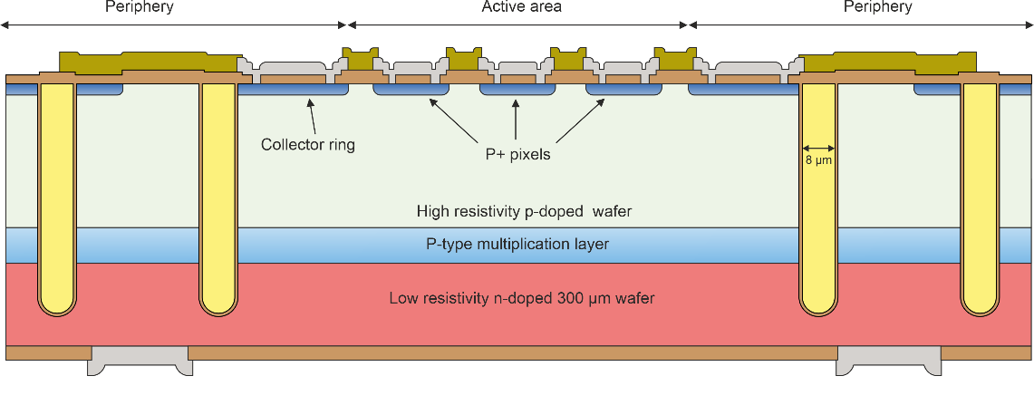
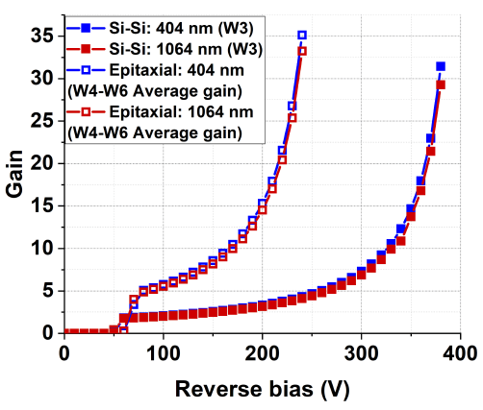
Trench Isolated inverse LGAD (TiLGAD)
Concept: Inverse LGAD (pixels on the P+ electrode) + isolation of active area with trenches
  Multiplication region is fully isolated.
  Nominally 100% fill factor
  Simpler single-side and 50% less fabrication steps than iLGADs with planar termination
  Devices are able to sustain higher voltages.
  Slim-edge technology.
  Optimization of the multiplication layer is independent of charge collection and cross-talk at the electrodes
  Good performance for both high and low penetrating particles
Simulated performance
J. Villegas. PhD Thesis. p 182

Slide 4
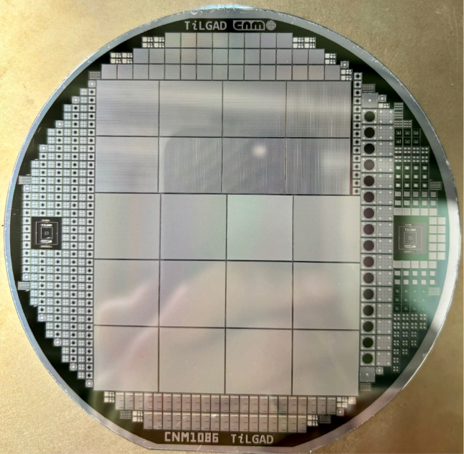
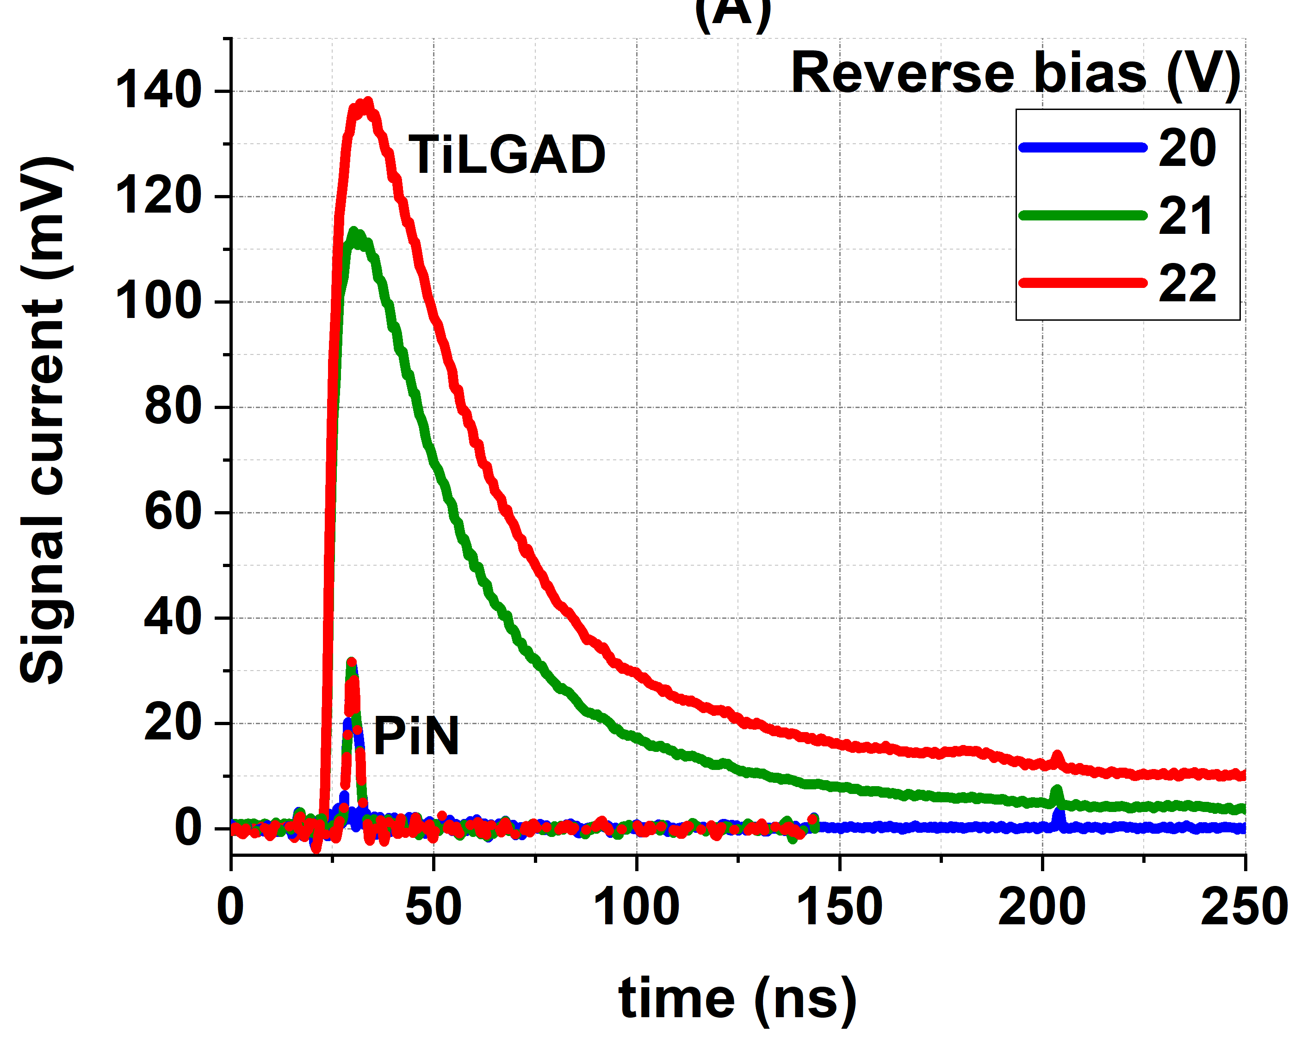
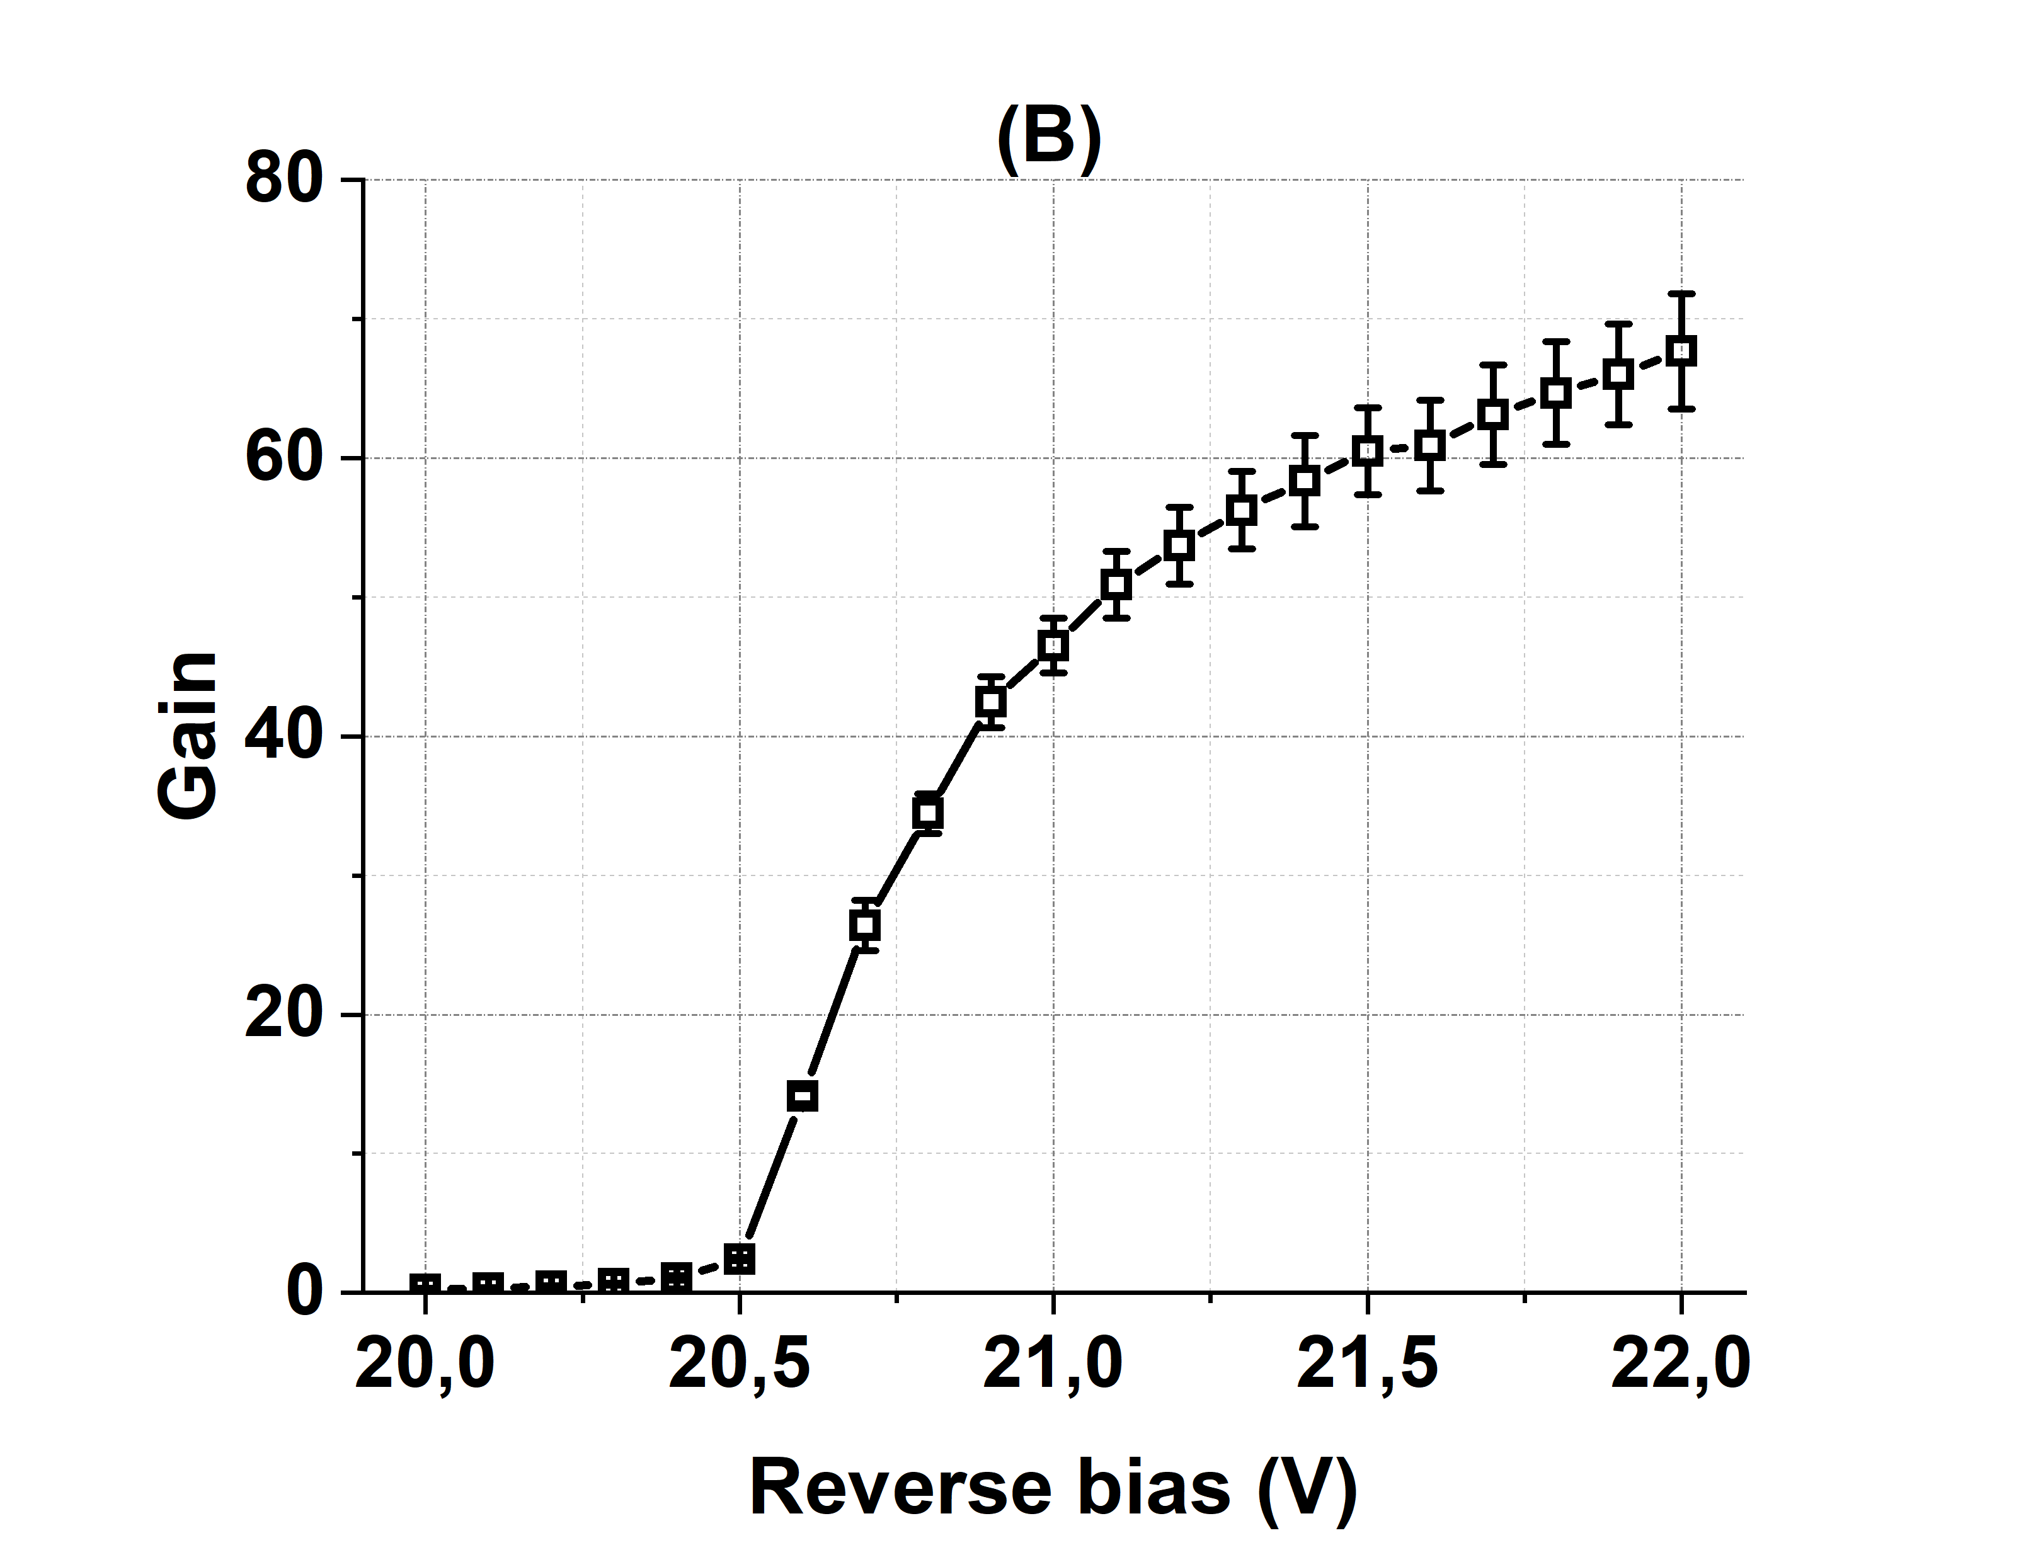
First CNM TiLGAD Run: TimePix3
  3 Epitaxial wafers
    Doping resulted very high → Devices performed like APDs
    Annealing tried (1175ºC, 180min) to reduce doping of the multiplication region (still APD)
  3 Si-Si wafers (each with different boron dose for the multiplication region)
    2 doses performed like PiN (no gain)
    1 dose performed like APD
    Issue during passivation: degradation of the IV’s
TCT measurements, 20 ºC, IR light
APD performance
Conclusions from 1st Run:
Need to reduce doping conc.
Trench isolation seems to work (ok for PiN-like devices)

Slide 5
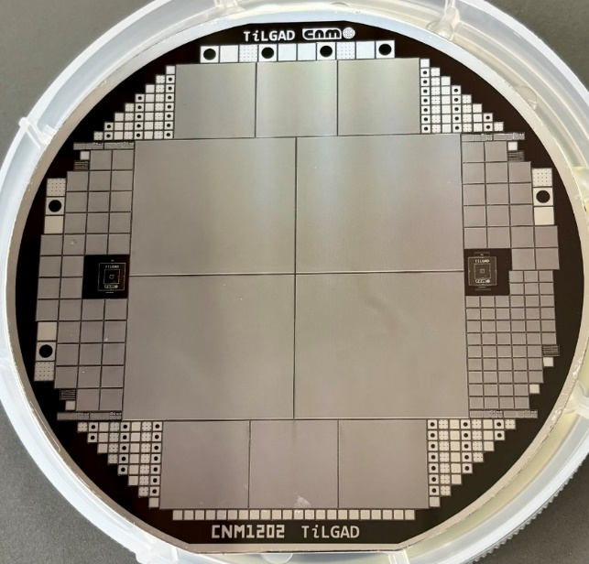
Second CNM TiLGAD Run: TimePix4
Focused on optimizing the thermal budget to obtain LGAD performance
3 Epitaxial wafers
  Pre-conditioning thermal step: 1250ºC – 3h
2 Si-Si wafers (each with different boron dose for the multiplication region)
  Pre-conditioning step: 1000 ºC – 0.5 h
Wafer | Type | Multiplication layer | Boron dose/energy (Mult layer) | Pre-conditioning thermal step | Behavior on single-pad devices | Thermal reprocess
1 | Epitaxial | Epitaxially grown thickness 3.0±0.3 µm doping Concentration 3.75±0.75e16 at/cm³ | N/A | 1250ºC – 3h | APD V_{BD} = 30-40 V V_{gl} > V_{BD} | No
2
3
4 | Si-Si | Implanted | 3.7e14 at/cm² 150 keV | 1000ºC – 0.5h
4 | Si-Si | Implanted | 3.7e14 at/cm² 150 keV | 1000ºC – 0.5h (1175ºC – 3h In version 1) |  | Yes 1100ºC - 1h
5 |  |  | 3.9e14 at/cm² 150 keV
5 |  |  | 3.9e14 at/cm² 150 keV |  |  | No

Slide 6
Second CNM TiLGAD Run: TimePix4
Si-Si wafers (W4)
Pre-conditioning annealing + post-fabrication annealing to achieve LGAD performance (measurements on pad diodes)
Low V_{gl} (5-10 V), but saturation capacitance is higher than expected (200 pF instead of few pF)

Slide 7
Second CNM TiLGAD Run: TimePix4
Epitaxial wafers (W2)
Pre-conditioning thermal step improves performance (higher BDV and lower capacitance)
Still, as for the Si-Si, breakdown is lower than expected and capacitance higher
Second run
First Run
First Run
Second run

Slide 8
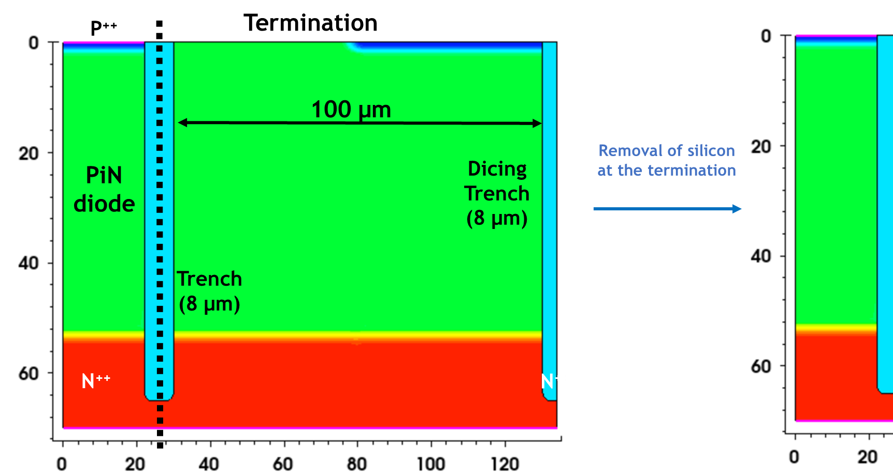
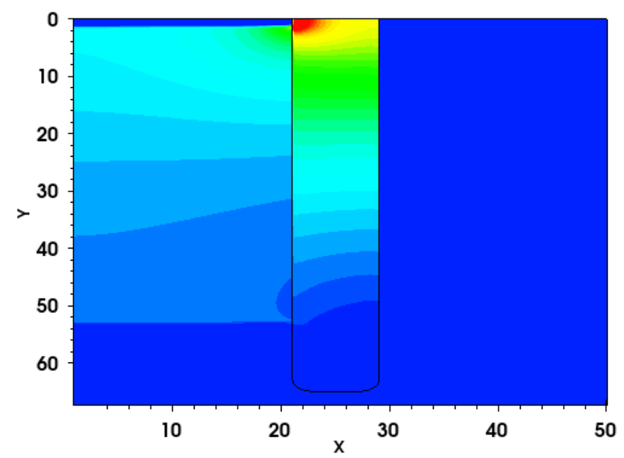
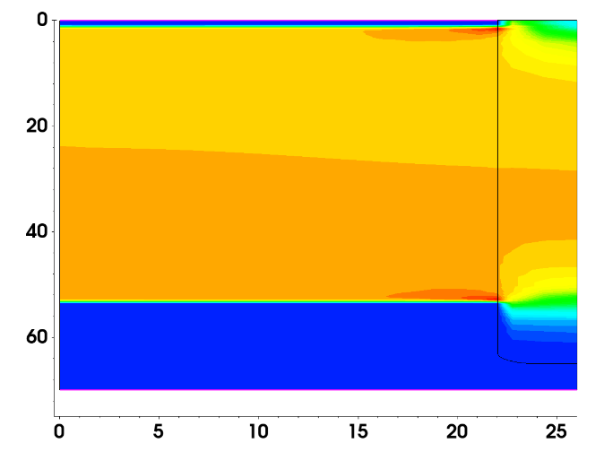
Simulation: PiN isolated with trenches
Silicon at the termination seems to degrade the breakdown
Design proposal → remove the termination silicon
Electric Field (with silicon) @ 350V
Electric Field (removing termination) @ 950V

Slide 9
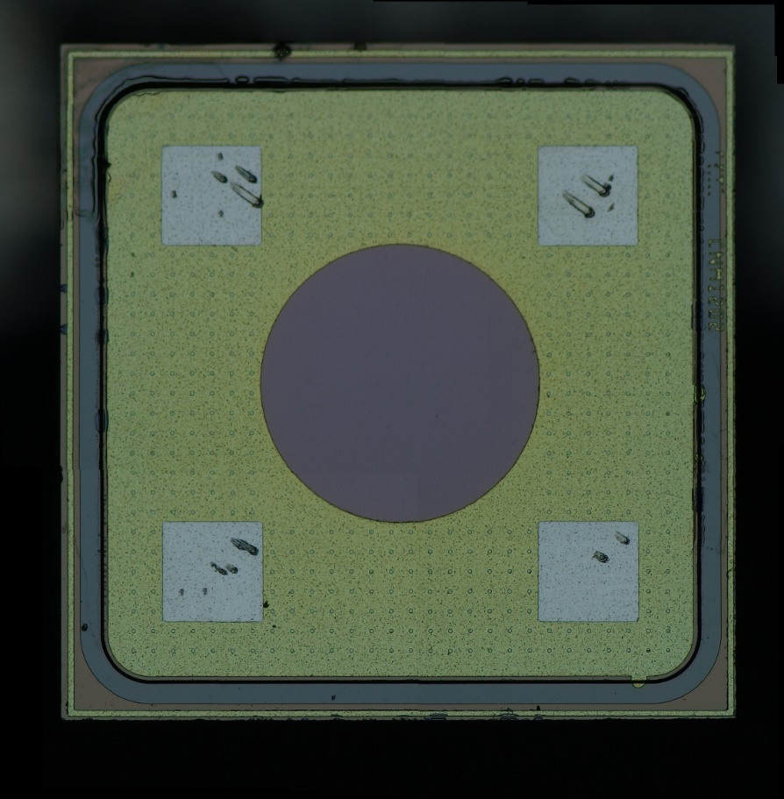
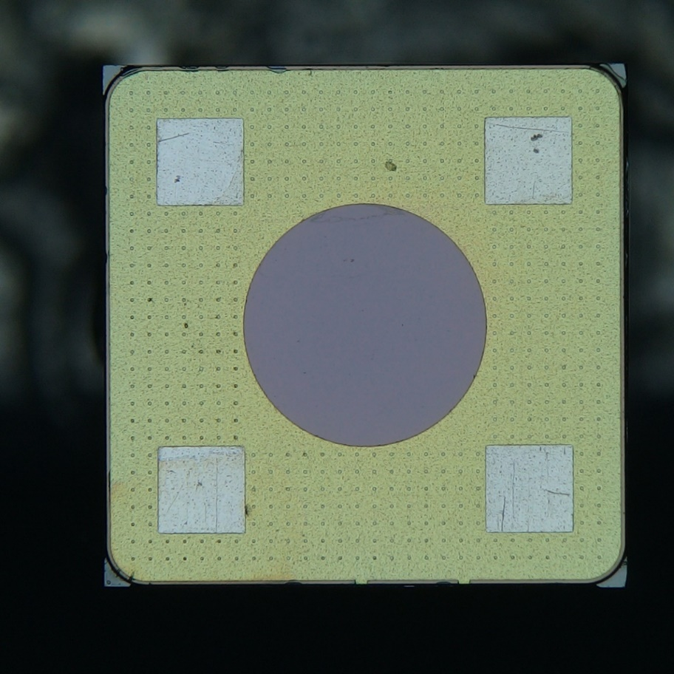
Engineering the termination: Wafer 2
To proof the concept, tried by polishing on a diced device
  Not ideal (silicon remains at the corners)
  Very aggressive and non-repeatable (only 1 sample survived)
Not polished device (W2_D4)
Polished device (W2_D3)

Slide 10
Engineering the termination: Wafer 2
Polishing does not seem effective: Silicon in the corners might be still enough to induce early breakdown
I-V Before and after polishing
C-V Before and after polishing

Slide 11
TCT measurements on single-pad detectors
Gain estimated with a 50 µm PiN measured under the same illumination conditions
Not polished device (W2_D4)
Polished device (W2_D3)
10% Max Laser Power
Gain > 1 obtained only for V ≥ 38.5 V (V_{FD}?)
  In run 1: Gain > 60 at 20V
Gain suppression observed when increasing laser power
Similar performance in the polished device

Slide 12
TiLGAD: next steps
Run 2: Samples from wafer 4 (Si-Si) to be diced with laser:
  Already in contact with a European vendor
  Once diced and tested, samples would be available for distribution
New run in the queue:
  Mask set designed, only pending on the success of the laser dicing
  If laser dicing does not help, we can modify the process to perform a general etching of the peripheral region at the end of the run.
  Not funded by AIDAInnova, but still the samples will be available

Slide 13
3D Detectors

Slide 14
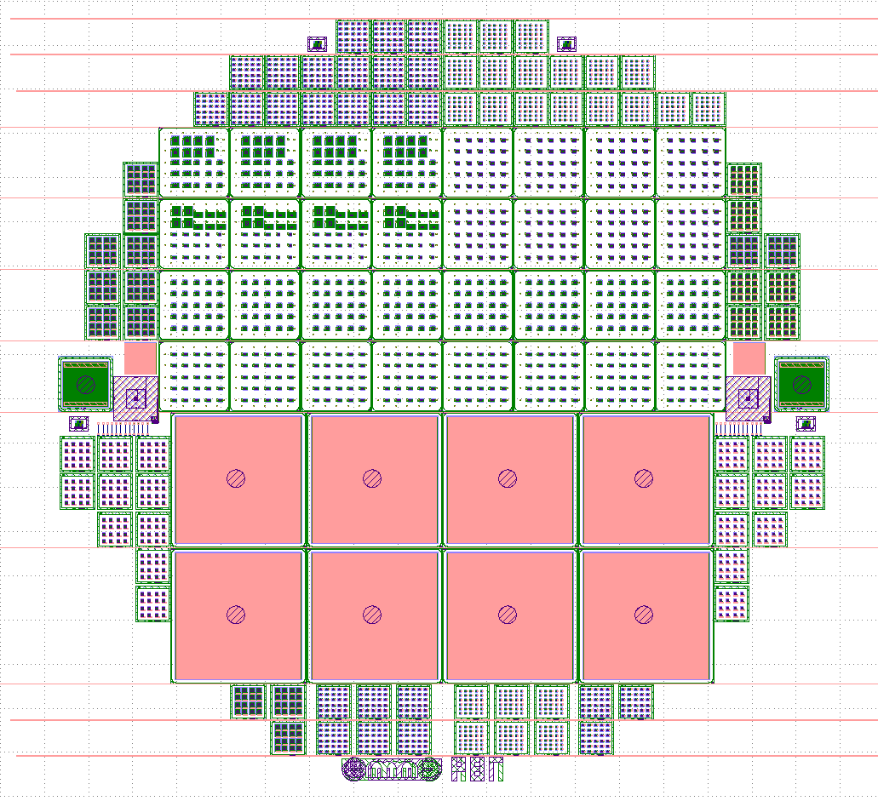
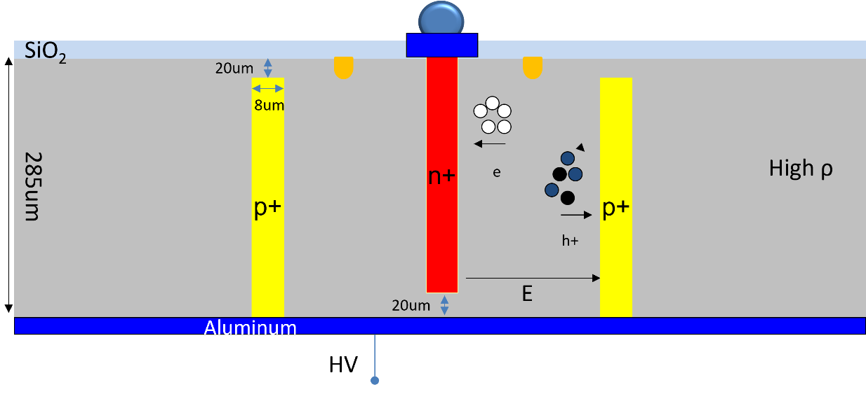
3D – DS Timing – Run 16069
Double sided technology improves fabrication reliability and simplifies the processing,
Wafer thickness : 285um +/-10um
HRFZ silicon, p-type>5kohm*cm
P-stop isolation.
Holes diameter 8/10um
Metal opening on the back

Slide 15
3D – DS Timing – Run 16069
Run16069: 3 Wafers, 100 mm, CNM987 Mask Set
MediPix3. 55x55 µm pitch, 256x256 pixels: 8 devices.
Altiroc 1. 300x300 µm pitch, 40x45 pixels: 24 devices.

Slide 16
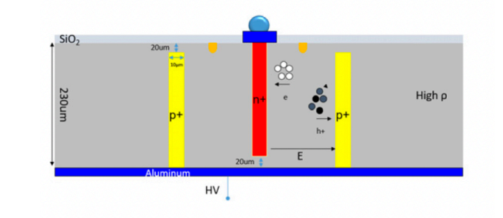
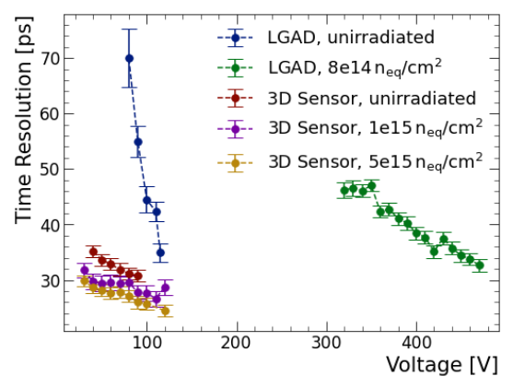
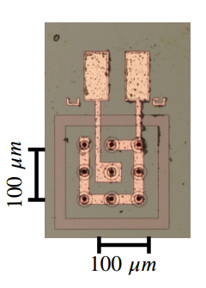
3D – DS Timing – Non Timing Run
Insertable B-layer production:
Double Side
230µm active thickness
50 x 50µm² unit cell size
100 x 100µm² active area
Depletion voltage 5-10V
https://indico.cern.ch/event/1402825/contributions/5998053/attachments/2879629/5044461/DRD3-Timing.pdf

Slide 17
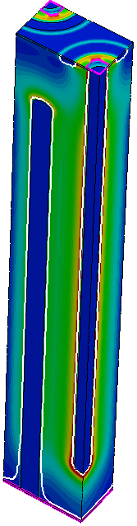
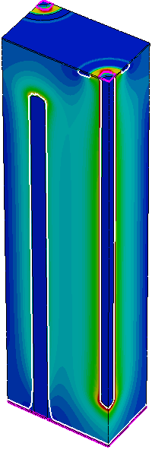
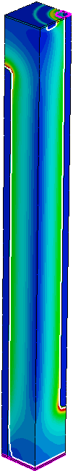
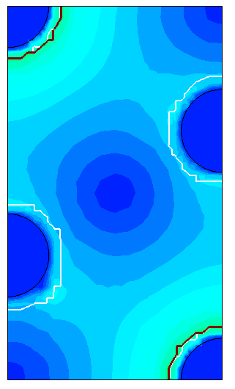
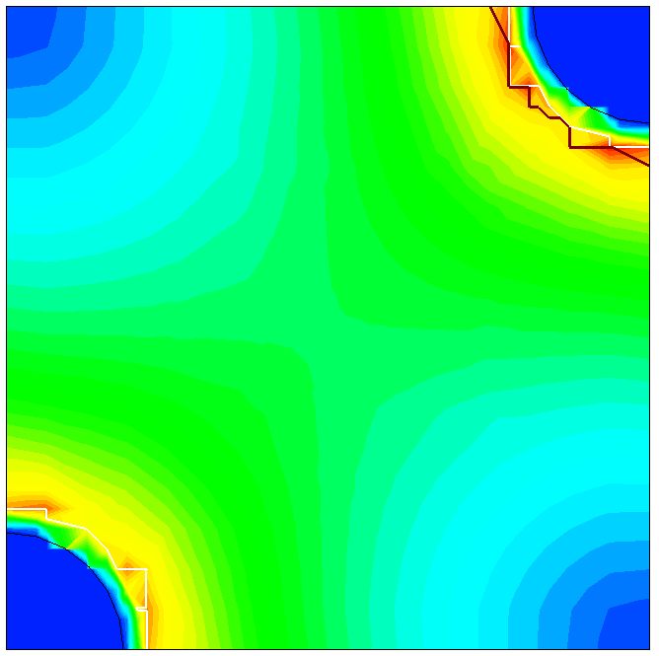
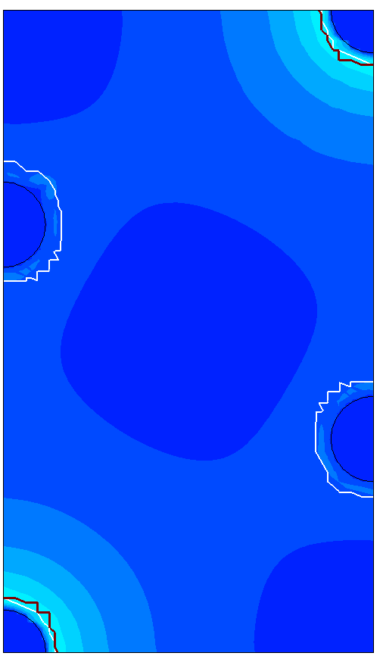
3D – DS Timing – Simulation TCAD – Electric field Uniformity
Hexagonal 30µm
Hexagonal 50µm
Orthogonal
Important: hexagonal structures feature 2 pixels, orthogonal only one
Strong electric fields near n-columns, lower values between pixels

Slide 18
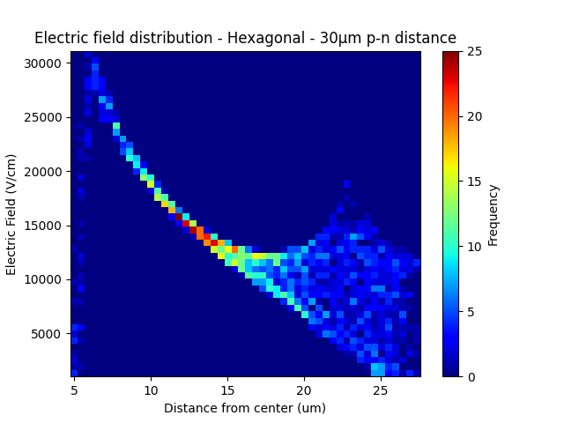
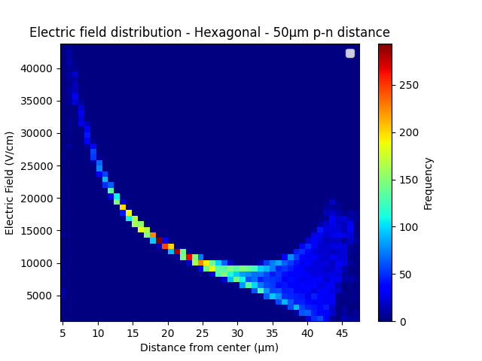
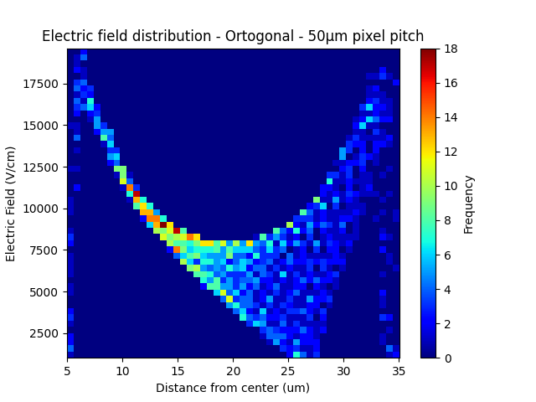
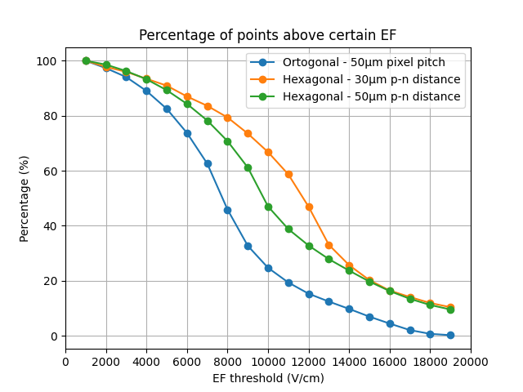
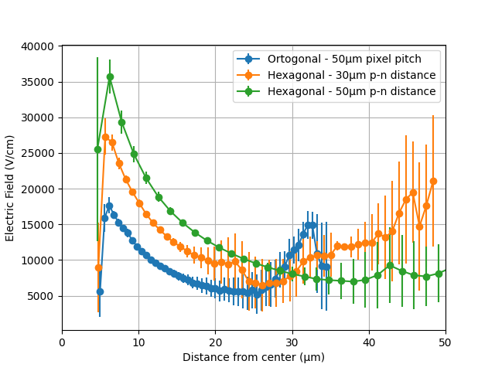
3D – DS Timing – Run 16069 – TCAD Simulation
Electric field distribution slightly more uniform for hexagonal
Stronger electric field for hexagonal geometries throughout the sensor
Need to improve simulations
Oscar Ferrer PhD thesis.

Slide 19
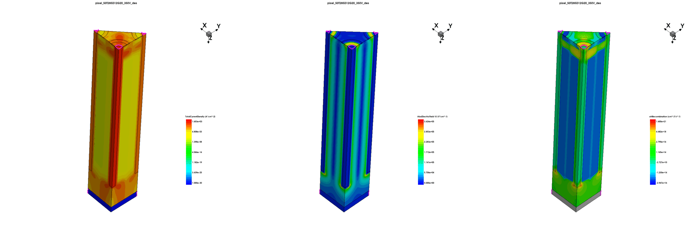
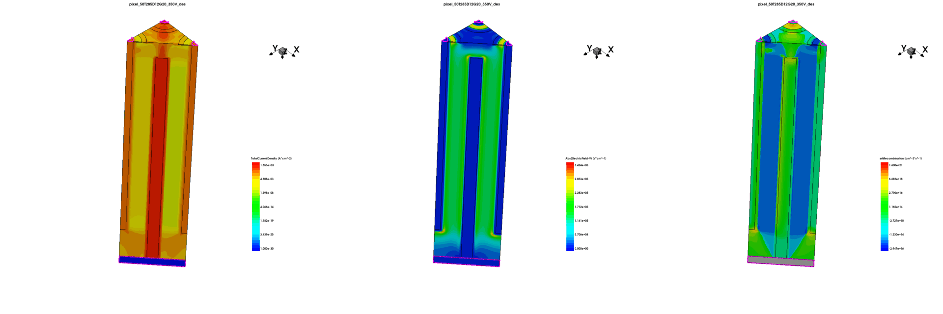


3D – DS Timing – TCAD Optimisation
Geometry specifications:
  Pitch = 50 um
  N col. gap = 20, 35, 50 um
  P col. gap = 20 um
  Thickness = 285um
  Col. Diameter = 12 um
Observations:
  Smaller n col. gaps (e.g., 20um), stronger electric field coupling than larger gaps (e.g., 50um) which reduce the overlap and coupling between electrodes.
Current
Electric Field
Plots taken from Alfonso Puicercus.

Slide 20
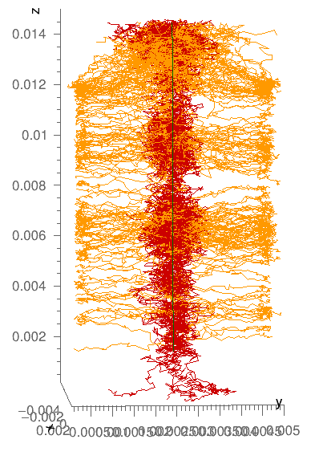
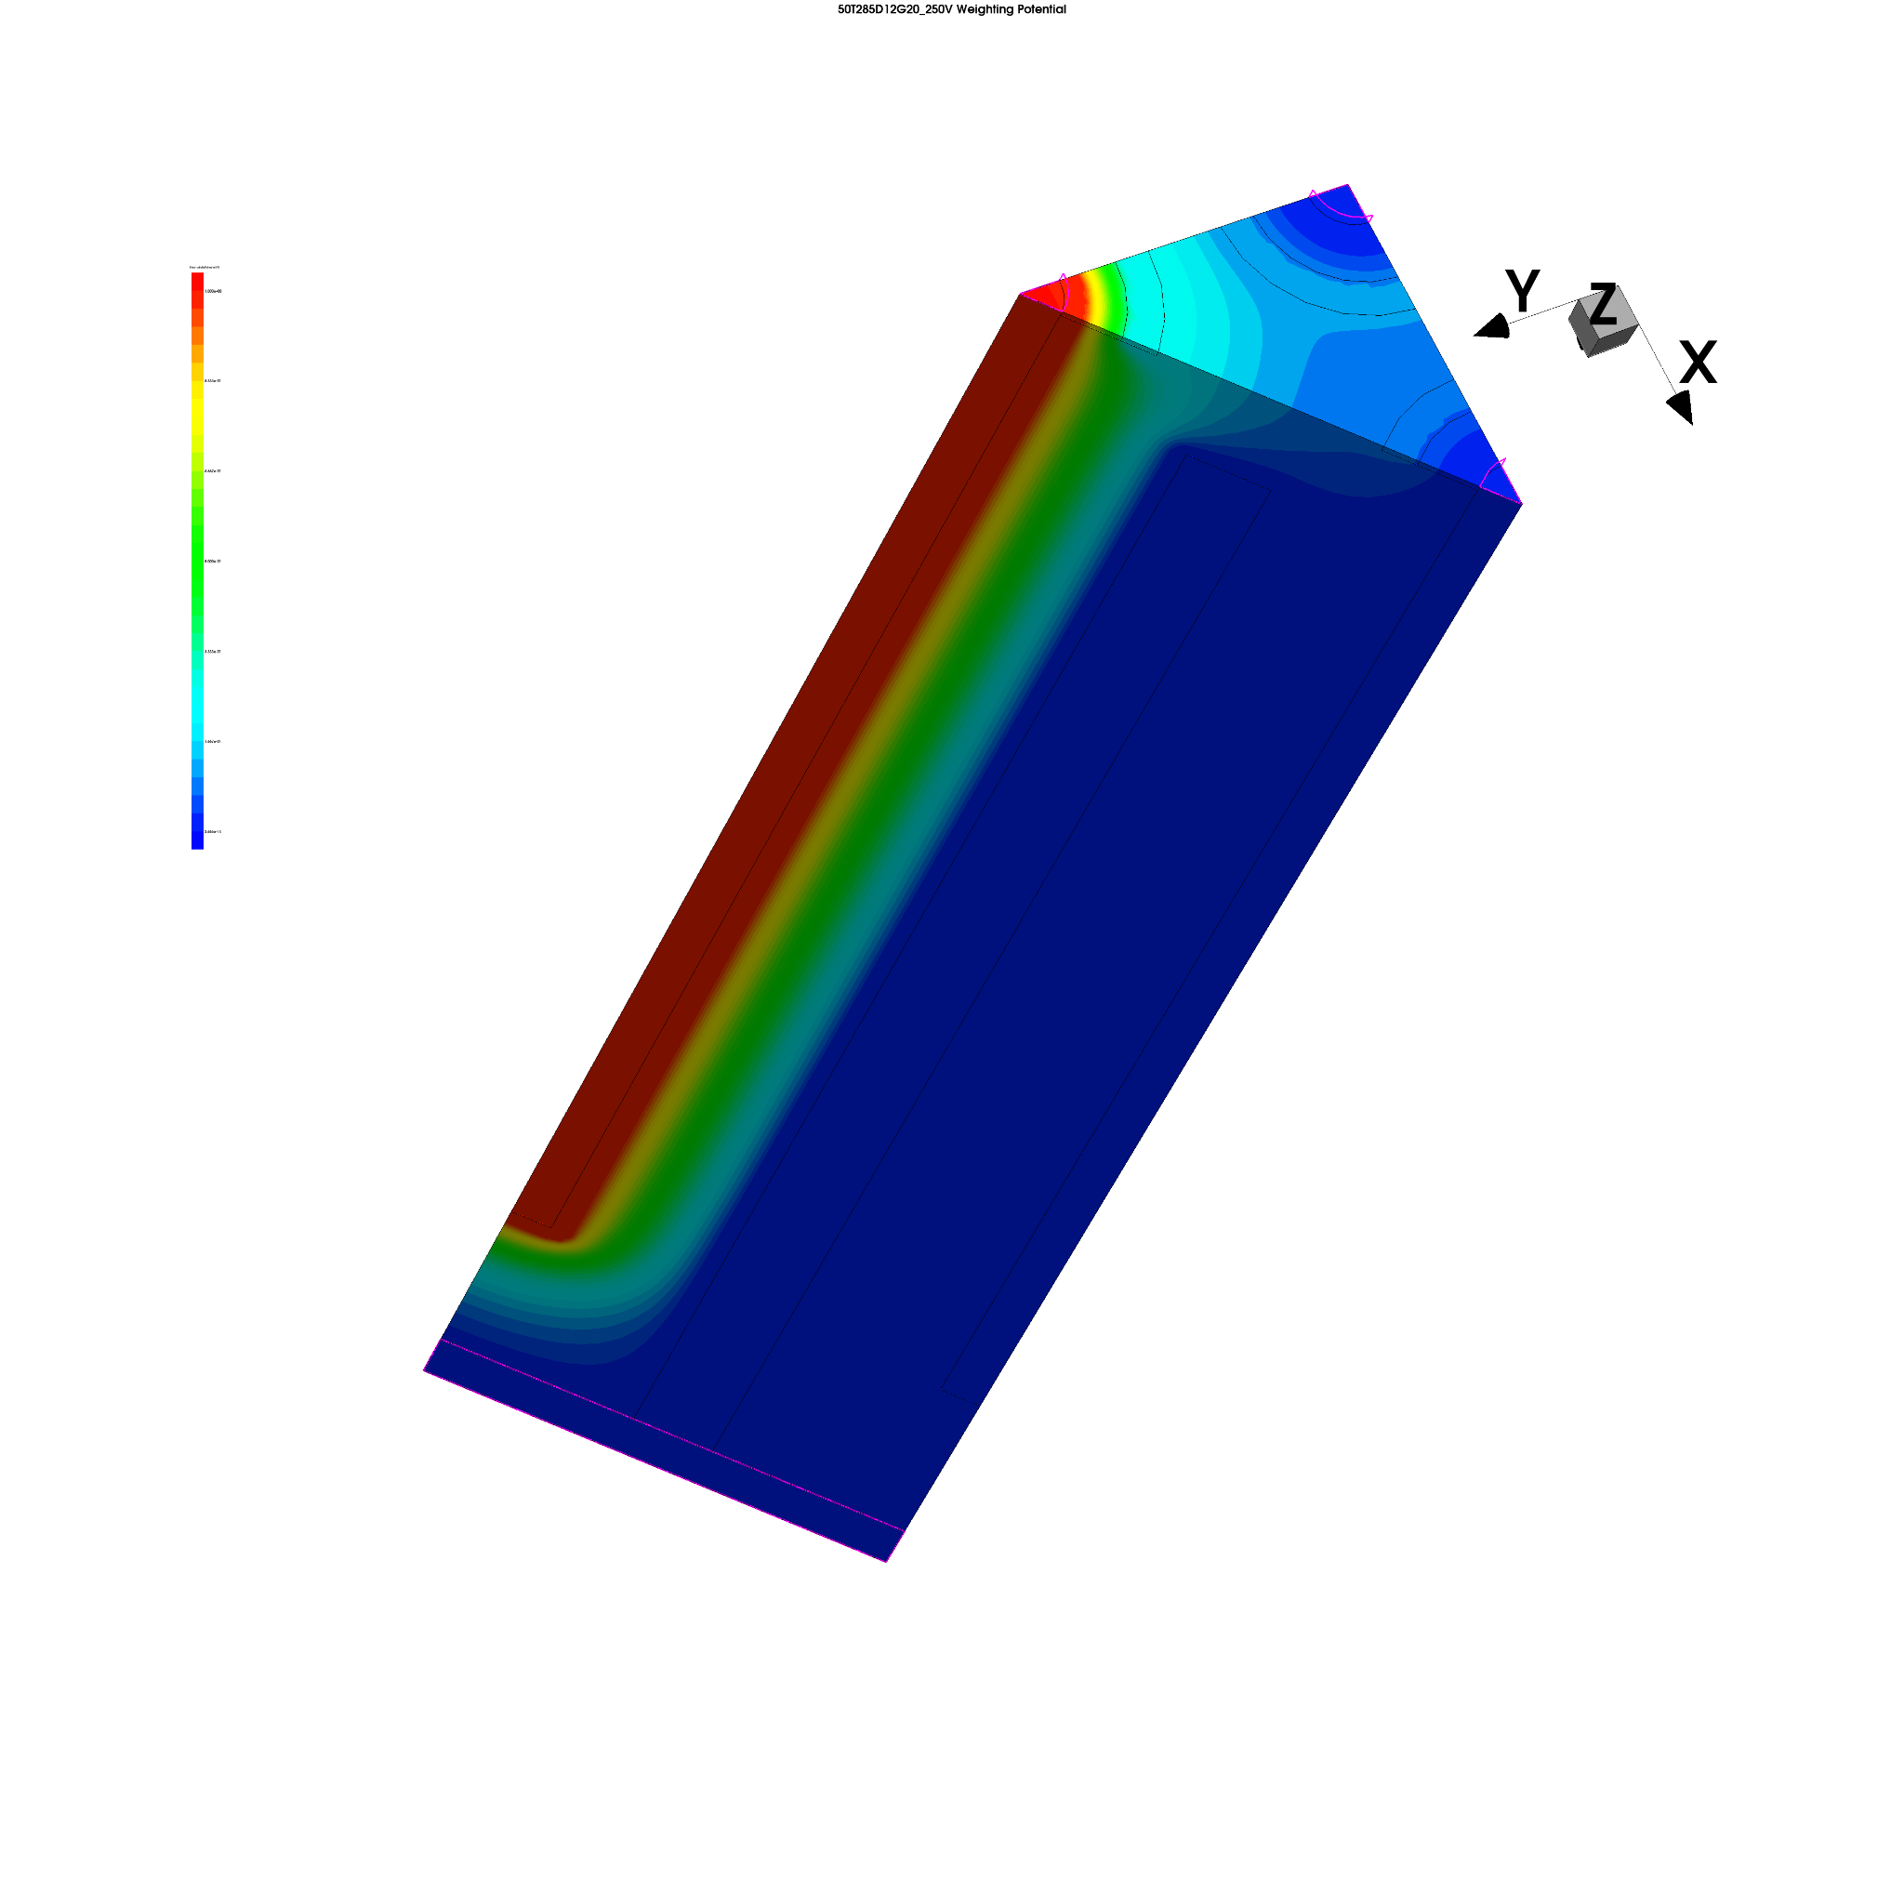
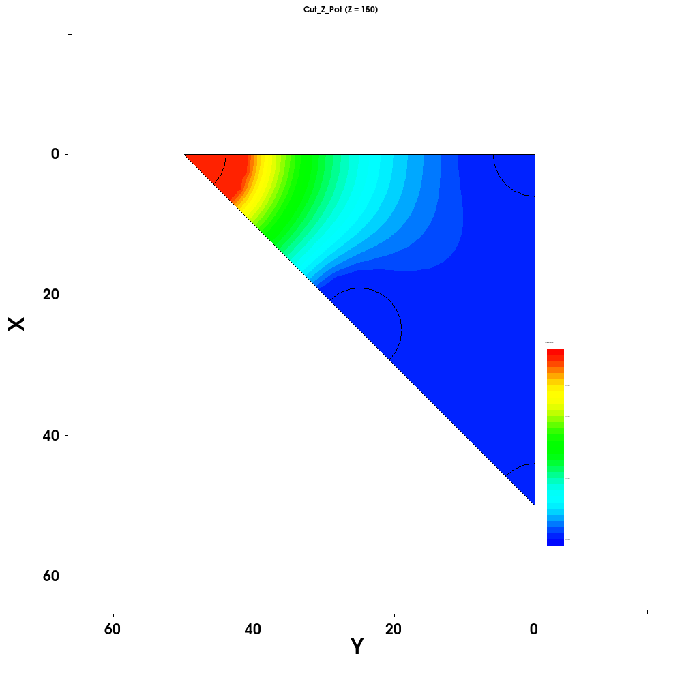
3D – DS Timing – TCAD to Garfield
Weighting field:
  Determines EM coupling of a charge to an arrangement of conducting electrodes
Last TCAD step
Then into Garfield ++
Plots taken from Alfonso Puicercus.

Slide 21
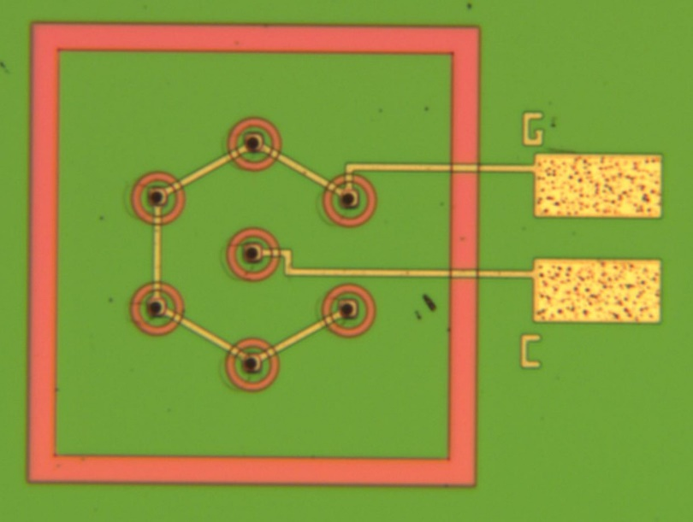
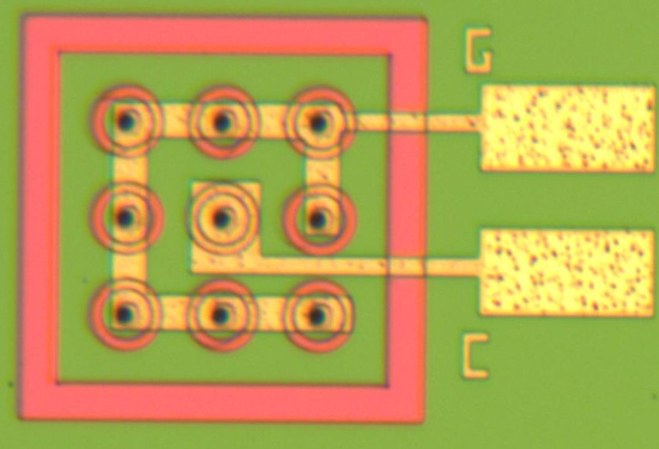

3D – DS Timing – Run 16069
Plan for 3D detectors, irradiation and timing resolution campaign.
86µm
Samples have been irradiated in collaboration with Gregor Kramberger (Ljubliana) and Victor Coco(CERN).
Gregor to study timing performance as a function of fluence in testbeams and using the TCT (Neutron Irradiation).
Victor to study timing performance as a function of fluence in testbeams. (Proton and Neutron Irradiation).
Neil Moffat to study timing performance as a function of laser position at ELI (Non Irradiated). Will obtain a 2D map and show position dependence on timing performance.
Measurements have been performed by IFCA using the TPA to map the timing response to compare different 3D design on unirradiated detectors.
55µm

Slide 22

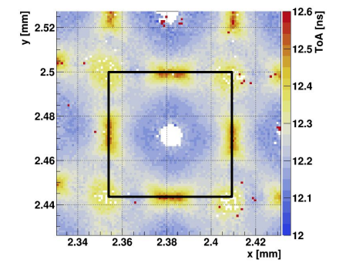
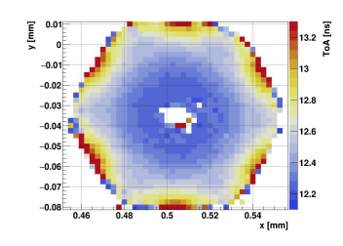
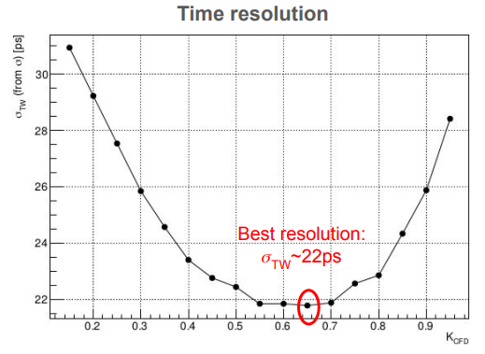
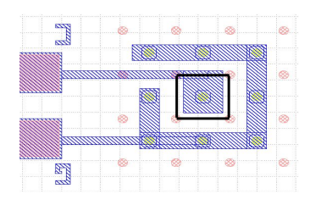
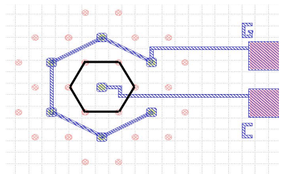
3D – DS Timing – Run 16069 – IFCA TPA
TOA Maps
Hexagonal sensor
Excellent 3D spatial resolution using TPA-TCT allows for the characterization of 3D columnar-electrode pixel sensors throughout their bulk.
The non-homogeneity of the electric field can be inferred from the ToA maps.
More uniform response for the square pixel sample. The spread in ToA at -20 V is 75 ps across the square cell and 175 ps across the hexagonal cell.
https://indico.cern.ch/event/1455346/contributions/6323191/attachments/3010069/5306865/TREDI25_CLG_20250206.pdf

Slide 23
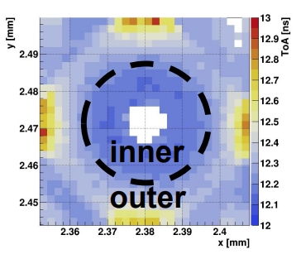
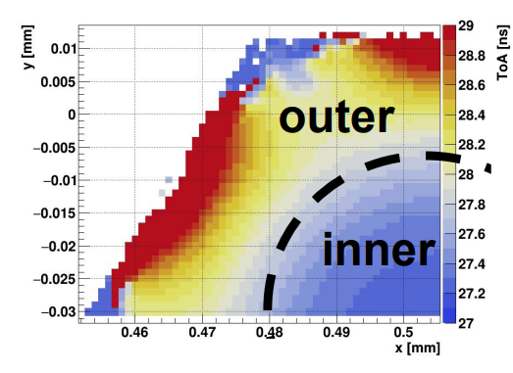
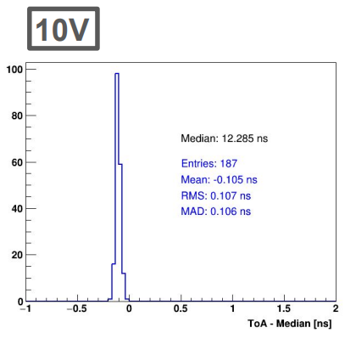
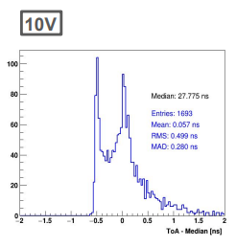
3D – DS Timing – Run 16069 – IFCA TPA
TOA Maps
Hexagonal sensor
Excellent 3D spatial resolution using TPA-TCT allows for the characterization of 3D columnar-electrode pixel sensors throughout their bulk.
The non-homogeneity of the electric field can be inferred from the ToA maps.
More uniform response for the square pixel sample. The spread in ToA at -20 V is 75 ps across the square cell and 175 ps across the hexagonal cell.
https://indico.cern.ch/event/1455346/contributions/6323191/attachments/3010069/5306865/TREDI25_CLG_20250206.pdf

Slide 24
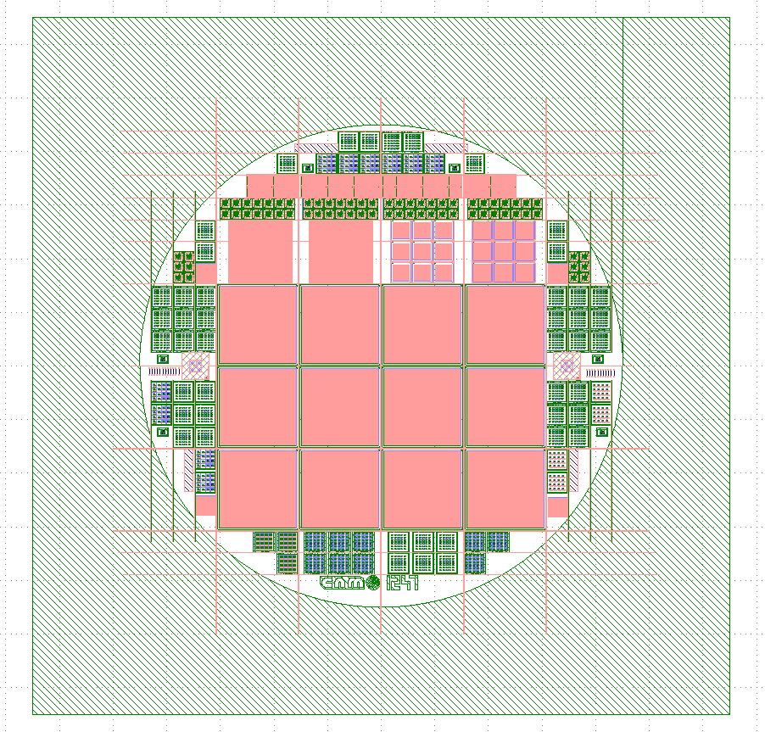

3D-DS Timing, AidaInnova Timing Run
Run 18245:5 wafers
Total steps: 109 (29/109)
Start: October 2024
Expected end: End of 2025
More Delays Expected:
At the start of 2025 the DRIE was out of service due to technical problems with the machines. Caused major disruption, run stopped for 3 months. Back running as of May 2025.
IMB-CNM clean room will be closed from June 2025 for 4 months for essential improvements. No processing will be performed during this period. Causing run not to be finished in time for the end of the project.
Technology
Double sided technology,
Wafer diameter 100mm -> next will be in 150mm wafers
Wafer thickness : 285um +/-10um
HRFZ silicon, p-type>5kohm*cm
P-stop isolation.
Holes diameter 8/10um
TimePix3. 55x55 µm pitch, 256x256 pixels
TimeSpot1. 55x55 µm pitch, 37x32 pixels
PicoPix. 55x55 µm pitch, 64x64 pixels
Different test structures.
Mask CNM1247

Slide 25
Summary and Future Outlook
Summary:
iLGAD trench detectors show promise but have issues with the termination and the doping concentration of the substrates. New substrate providers will be used in the future.
A laser dicing method will be utilised to aid in the design of a new run to fix the termination issues.
The 3D detectors show a good timing performance with hexagonal sensors reaching a time resolution of 22ps. The TPA showed how one can study the TOA to better understand the uniformity of the response.
Future Endeavours:
Future 3D detectors will be optimised with the use of Garfield simulations in parallel with TCAD simulations in collaboration with the EP R&D group at CERN.
We are developing the LGAD technology in Silicon Carbide substrates in collaboration with HEPHY Vienna (OEAW). We foresee this as a strategy line for the future of radiation detectors.
The future is bright the future is now…

Slide 26

Acknowledgement
This work has been financed by the Spanish Ministry of Science and Innovation (MCIN/AEI/10.13039/501100011033/)
Project references: PID2020113705RB-C32 and PID2021-124660OB-C22
This project has received funding from the European Union’s Horizon 2020 Research and Innovation program under Grant Agreement No 101004761.
This work has received funding from the Programa Ramón y Cajal of the Agencia Estatal de investigación under grant RYC2022-037296-I

