Slide 1
Measurements and Simulations of LGAD and 3D detectors
F. Moscatelli^{(2,1)}, K. Aouadj⁽¹⁾, T. Croci⁽¹⁾, D. Passeri^{(3,1)}, A. Morozzi⁽¹⁾,
A. Fondacci⁽³⁾, M. Menichelli ⁽¹⁾, G.M. Bilei⁽¹⁾,
V. Sola^{(5,4)}, M. Ferrero⁽⁴⁾, F. Siviero⁽⁵⁾, L. Lanteri⁽⁵⁾,
J. Ye⁽⁶⁾, A. Boughedda⁽⁶⁾, G.-F. Dalla Betta⁽⁶⁾
(1) INFN Perugia, Perugia, Italy
(2) IOM-CNR Perugia, Perugia, Italy
(3) DI, University of Perugia, Perugia, Italy
(4) INFN Torino, Torino, Italy
(5) University of Torino, Torino, Italy
(6) University of Trento, Trento, Italy
Notes:
1

Slide 2
AIDAinnova - Motivations
INFN and University of Perugia are involved in WP6 Task 6.2
  Simulations of surface and bulk radiation damage for 4D (tracking+timing) detectors toward more radiation tolerant solutions
Calibration/extension of the previously developed simulation models
Calibration/extension of the previously developed models (“New University of Perugia” TCAD model, and its recent upgrade) by comparing the simulation findings with measurements carried out on dedicated test structures as well as on different classes of 3D and LGAD detectors.
Study the effect of surface and bulk radiation damage with reference to 4D (tracking+timing) detectors toward more radiation resistance solutions.
The proposed activity will focus specifically on disentangling the effects of the two main radiation damage mechanisms, e.g., the surface damage due to ionizing effect and the bulk damage due to atomic displacement, with reference to 4D detectors toward more radiation resistance solutions.

Slide 3
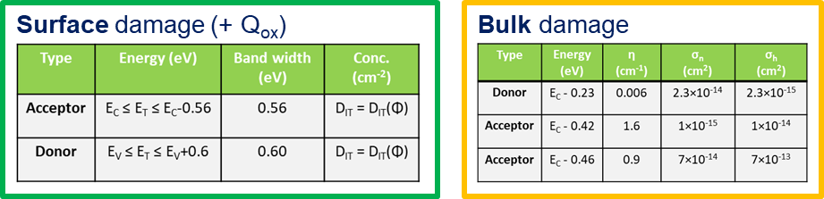
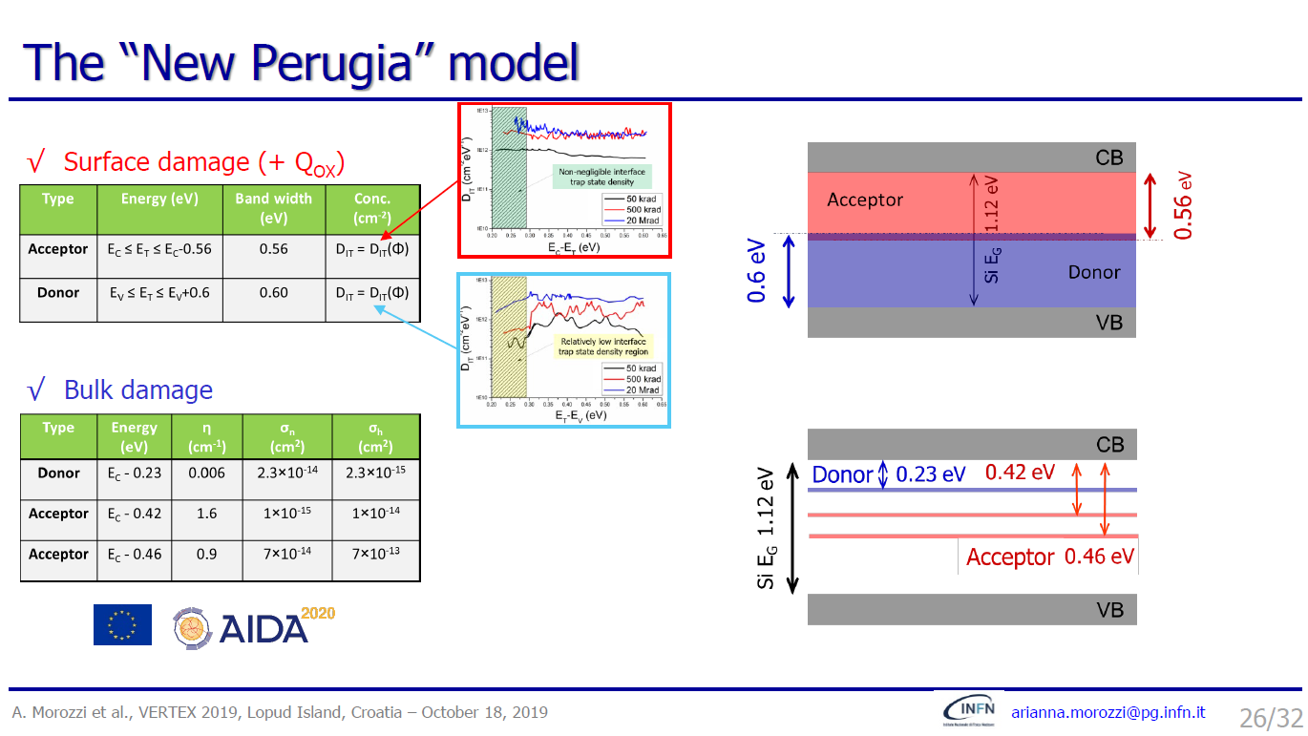
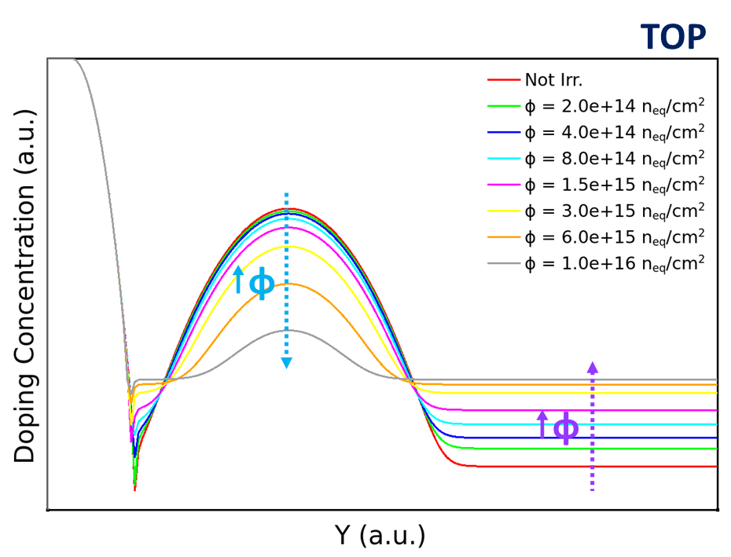

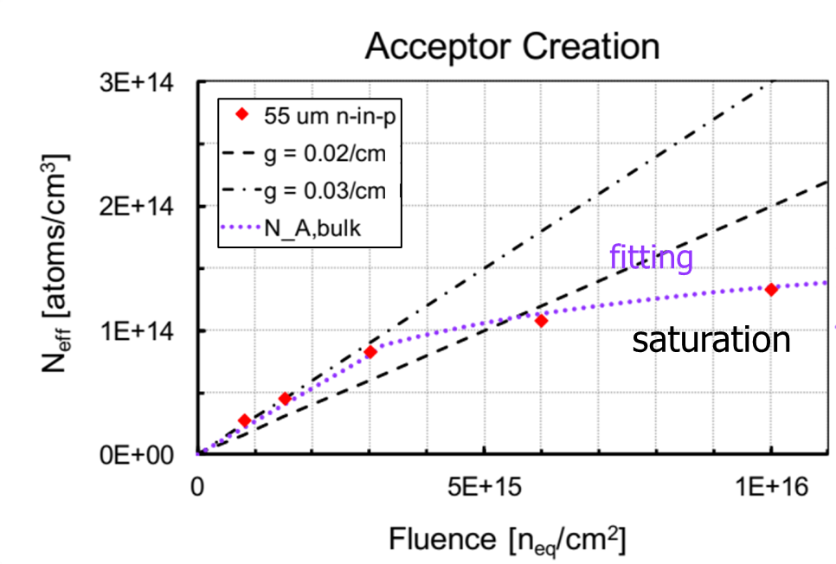
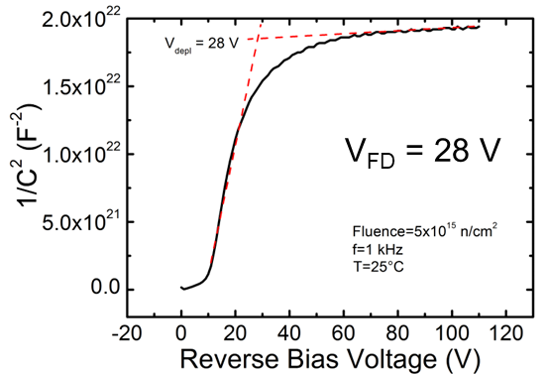
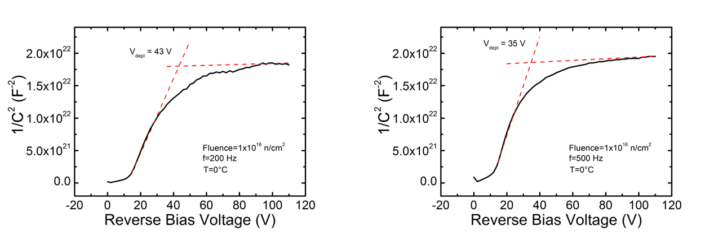
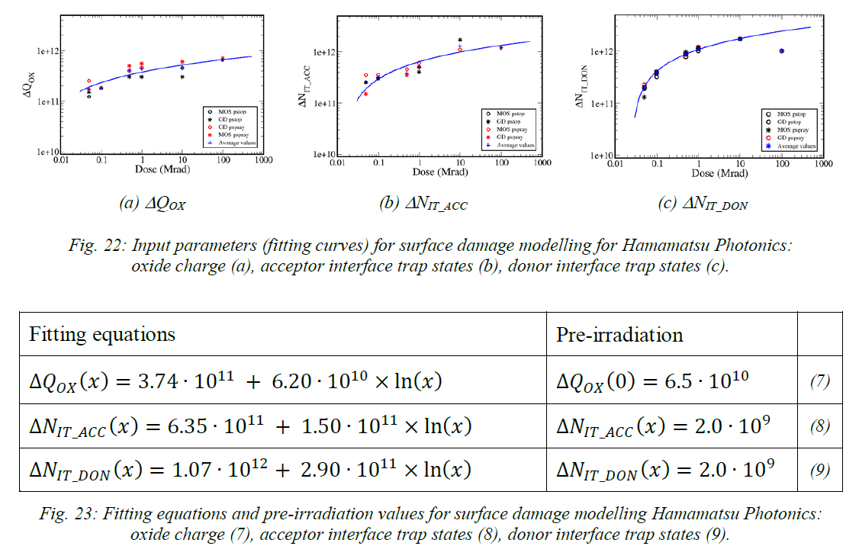
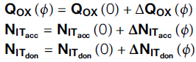


Extension of the Radiation Damage Model
‘‘PerugiaModDoping’’
    ^{[1]}
“New University of Perugia” Radiation Damage Model
Torino analytical parameterizations
Gain Layer (Acceptor Removal)
  N^{peak}_{A,GL}(Φ) = N_{A,GL}(0) ∙ e^{-c ∙ Φ}
Bulk (Acceptor Creation)
if 0 < Φ ≤ 3e15 n_{eq}/cm²
N_{A,bulk}(Φ) = N_{A,bulk}(0) + g_{c} ∙ Φ
if Φ > 3e15 n_{eq}/cm²
N_{A,bulk}(Φ) = 4,17e13 ∙ ln(Φ) – 1,41e15
    ^{[2]}
    ^{[3]}
Bulk damage → Traps concentrations dependence upon the
introduction rate η (defects concentration) and the fluence (~ η×Φ)
Surface damage → Traps (N_{IT} interface trap density) and oxide charge (Q_{OX}) concentrations dependence upon the fluence as follow:
3E15 n_{eq}/cm²
5E15 n_{eq}/cm²
1E16 n_{eq}/cm²
fitting
fitting
fitting
[1] P. Asenov et. al, NIM. A 1040 (2022) 167180; [2] A. Morozzi et. al, PoS (Vertex2019) 050; [3] M. Ferrero et. al, CRC Press (2021).
Notes:
Coupling the Torino analytical Bulk and Gain Layer parameterizations with the “New University of Perugia” Radiation Damage modelling scheme, we defined a new version of the model, named “Perugia Modified Doping”.
“New University of Perugia” Radiation Damage modelling scheme -> modelling the effects of the radiation damage
Bulk damage
Traps (
(Acceptor Conc=@ConcAcc1@ Level EnergyMid=0.42 fromCondBand eXsection=1e-15 hXsection=1e-14 Add2TotalDoping)
(Acceptor Conc=@ConcAcc2@ Level EnergyMid=0.46 fromCondBand eXsection=7.00e-14 hXsection=7.00e-13 Add2TotalDoping)
(Donor Conc=@ConcDon@ Level EnergyMid=0.23 fromCondBand eXsection=2.3e-14 hXsection=2.3e-15 Add2TotalDoping)
)
where
#set ConcAcc1 [format %.2e @<1.6*Flu>@]
#set ConcAcc2 [format %.2e @<0.9*Flu>@]
#set ConcDon [format %.2e @<0.006*Flu>@]
Surface damage
Traps (
(Acceptor Conc=@Dit_acc@ Uniform EnergyMid=0.84 EnergySig=0.56 fromValBand eXsection=1e-16 hXsection=1e-15 Add2TotalDoping)
(Donor Conc=@Dit_don@ Uniform EnergyMid=0.30 EnergySig=0.60 fromValBand eXsection=1e-15 hXsection=1e-16 Add2TotalDoping)
(FixedCharge Conc=@Qox@)
)
where
#set Dit_acc [format %.2e @<(DeltaNitacc+Nitaccpre)/0.56>@]
#set Dit_don [format %.2e @<(DeltaNitdon+Nitdonpre)/0.3>@]
#set Qox [format %.2e @<Qoxpre+DeltaQox>@]
and
#set DeltaNitacc [format %.2e [expr @<1.58e+12+3.76e+11*log(Dose)>@]]
#set DeltaNitdon [format %.2e [expr @<6.28e+11+1.98e+11*log(Dose)>@]]
#set DeltaQox [format %.2e [expr @<5.86e+11+1.24e+11*log(Dose)>@]]
Torino analytical parameterizations
gain layer and bulk effective acceptor doping evolution with fluence, which have been obtained via C-V measurements.
Saturation of radiation effects observed @ Φ > 5E15 n_{eq}/cm² (onset of acceptor creation saturation above fluence of 3E15 n_{eq}/cm²)

Slide 4
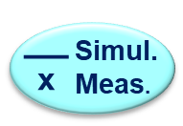
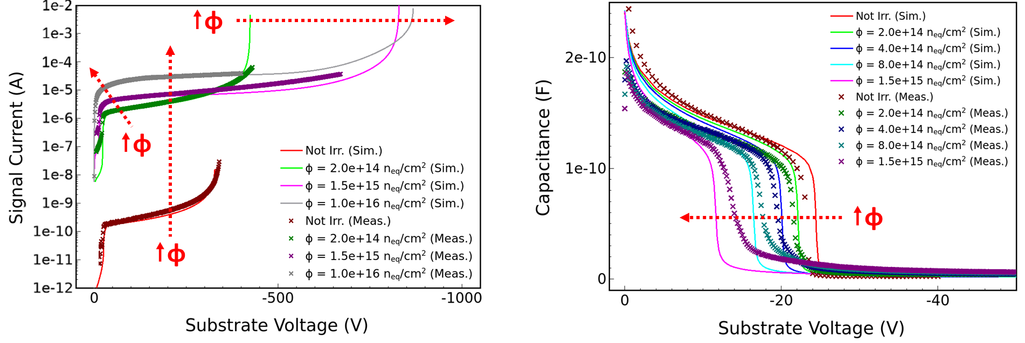
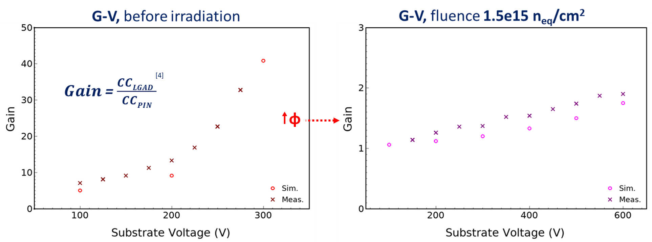
TCAD simulation of LGAD device - FBK
In collaboration with INFN Torino: calibration/extension of the previously developed models by comparing the simulation findings with measurements carried out on different classes of LGAD detectors.
Comparison with experimental data, before and after irradiation (UFSD2 production run, by FBK)
I-V, pre- & post-irr @ 300 K
C-V, pre- & post-irr @ 300 K, 1 kHz
‘‘PerugiaModDoping’’
Torino analytical parameterizations
  Gain Layer (Acceptor Removal)
  Bulk (Acceptor Creation/Damage Saturation)
“New UNIPG” TCAD Radiation Damage Model
Current (A)
Reverse
Reverse
G-V, pre-irr @ 300 K
G-V, post-irr @ 300 K, 1.5E15 n_{eq}/cm²
    ^{[4]}
[4] V. Sola et al., First FBK production of 50 µm ultra-fast silicon detectors, Nucl. Instrum. Methods Phys. Res. A, 2019.
[5] A. Chilingarov, Temperature dependence of the current generated in si bulk, JINST 8 P10003, 2013.
Reverse
Reverse
Massey avalanche model. Temperature 300 K ^{[5]}. Electrical contact area 1 x 1 mm²
Notes:
Than we have validated this model with Low-Gain Avalanche Diode measurements data.
The layout of the simulated device has been designed in a quasi-mono dimensional domain, since this helps to focus the study on the main performances of such a complex structure.
A Gaussian analytical profile has been used for both the highly doped n-type electrode and for the moderately doped p-type region implanted below, which define the multiplication region.
The peak doping concentration and the implantation depth of the p-type region have been carefully tuned since these parameters strongly influence the gain properties of the device.
Moreover, the peak dose of the multiplication layer has been properly reduced for increasing values of fluence, in order to consider the acceptor-removal mechanism for the irradiated structures.
ONLY IF TIME ALLOWS!
Indeed, neglecting the edge of the multiplication implant, the breakdown voltage is only due to the high electric field in the core region of the device.
Fully 2D or 3D structures would be needed to investigate the breakdown voltage of the device due to the field distribution at the edge of the implants.
The p-type epitaxial layer has been described by a uniform doping concentration, whereas an error function analytical profile has been considered for the backside highly doped p-type contact.
Regarding the radiation damage model, the “New University of Perugia TCAD model” scheme has been implemented in the simulation framework.
This model allows to consider the comprehensive surface and bulk radiation damage effects in silicon by means of a limited set of physically meaningful deep-level radiation-induced traps.
Surface => two trapped states: one acceptor and one donor type
Bulk => three trapped states: 2 acceptors, 1 donor
The surface recombination velocity parameter is self-consistently defined with the traps.
In the «New University of Perugia TCAD Model», bulk and surface radiation damage effects have been modelled by means of a limited set of physically meaningful deep-level radiation-induced traps (which act as recombination centres) whose parameterization is based on experimental evidences. This parameterization allows a realistic device-level modeling and electrical behavior description in terms of space-charge, electric field profile and charge collection properties. The trapping mechanism can be described within the TCAD environment by the SRH statistics which calculate the effect of a single defect once its type (acceptor or donor), concentration, energy distribution and capture cross sections for both electrons and holes. This modeling scheme has been extensively validated by the comparison between TCAD simulations and experimental data in terms of current-voltage (I-V) and capacitance-voltage (C-V) analyses of dedicated test structures exposed to irradiation. The extensively reported good agreement between the two ensures the use of the model for the analysis and prediction of the radiation damage effects of different classes of devices.

Slide 5
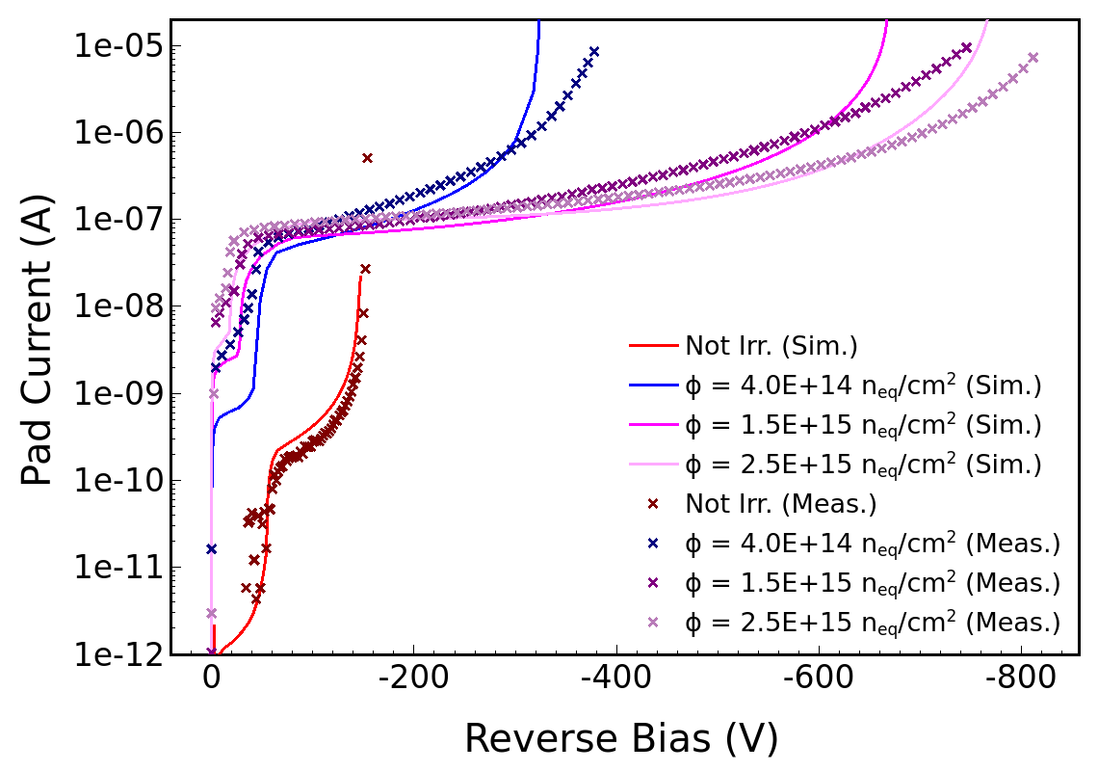
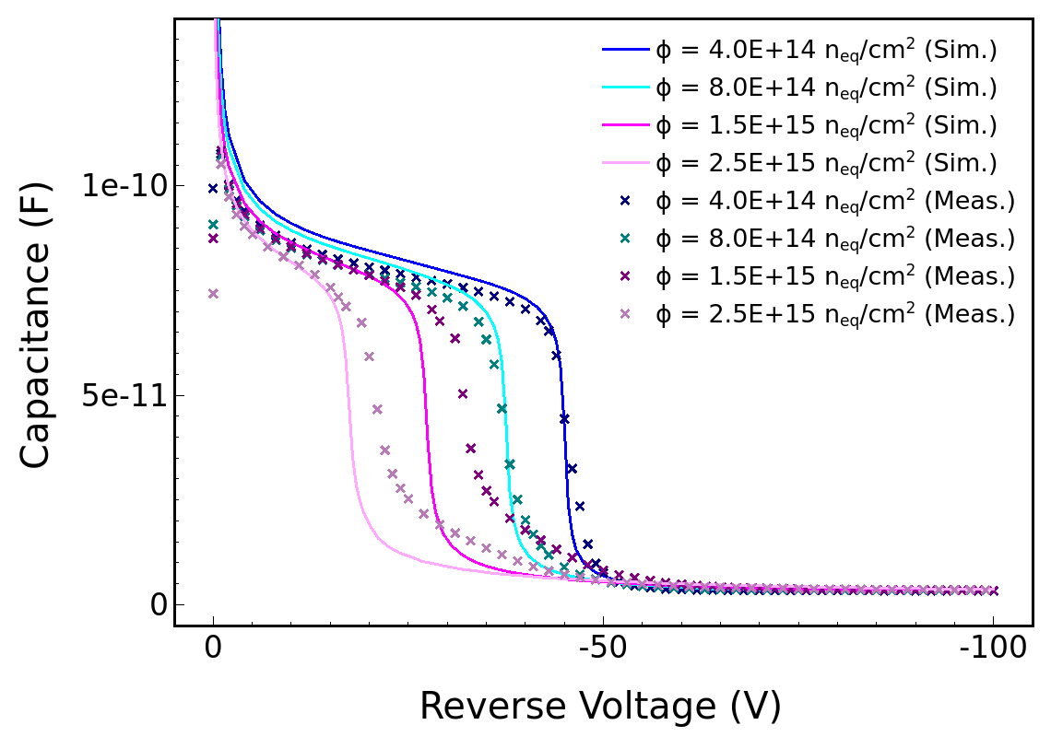
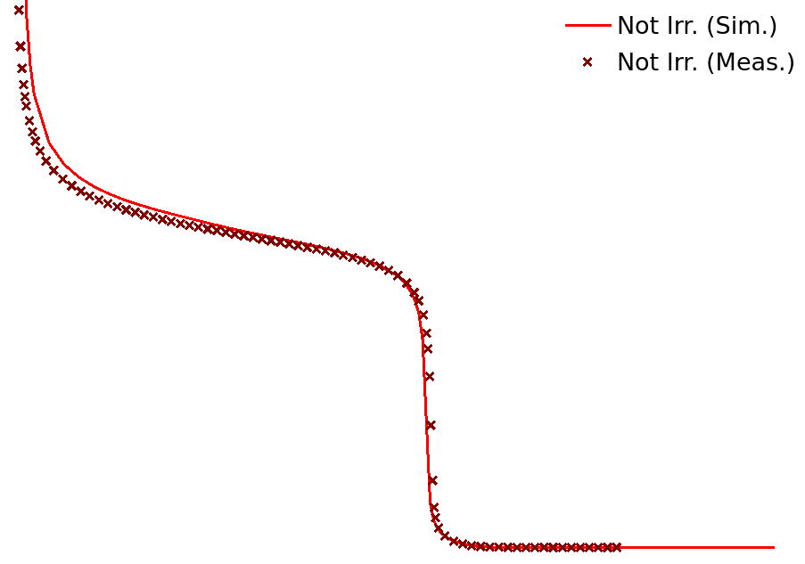
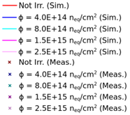
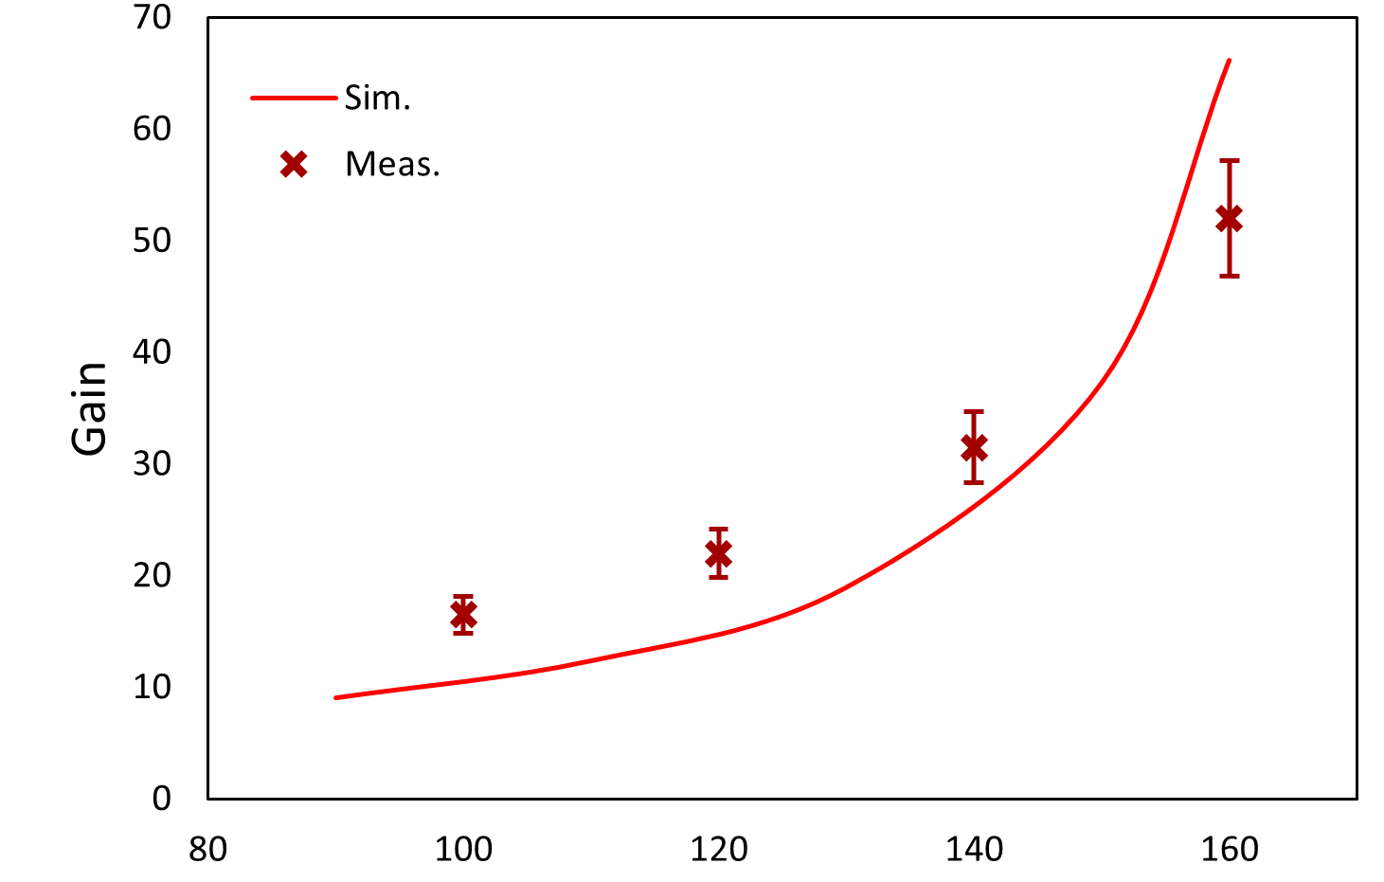
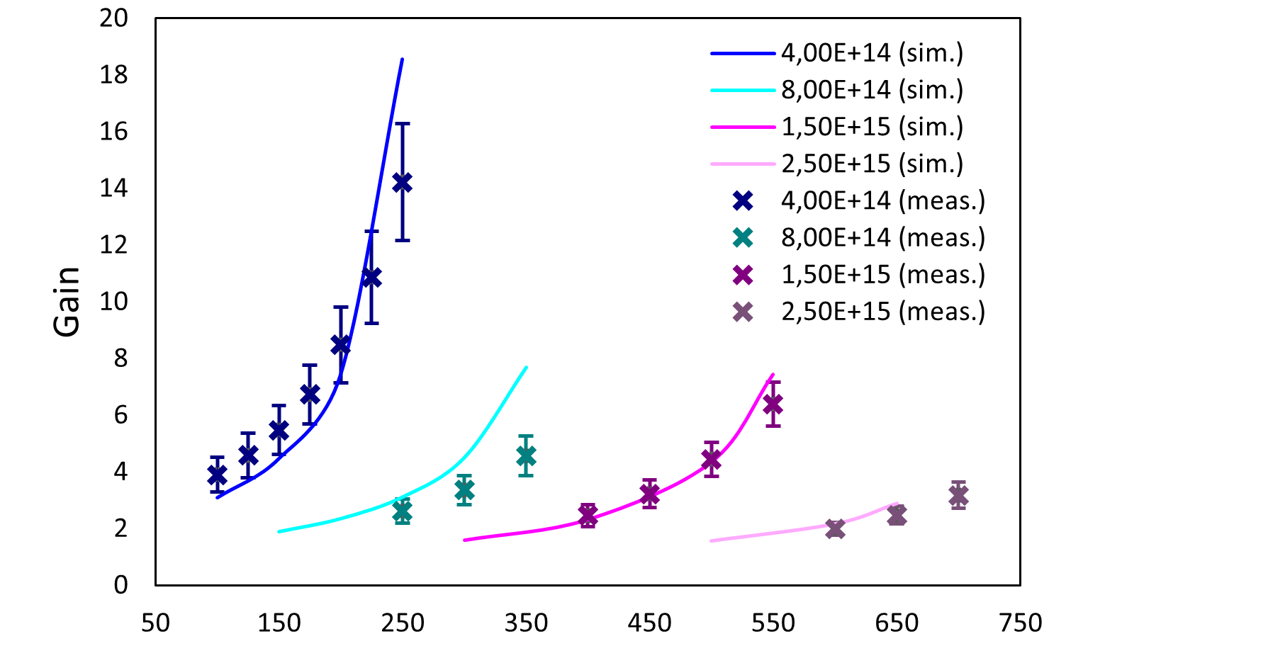
TCAD simulation of LGAD device - HPK
In collaboration with INFN Torino: calibration/extension of the previously developed models by comparing the simulation findings with measurements carried out on different classes of LGAD detectors.
Comparison with experimental data, before and after irradiation (HPK2 production run, by HPK)
I-V, pre-irr @ 290 K, post-irr @ 248 K
C-V, pre- & post-irr @ 298 K, 2 kHz
‘‘PerugiaModDoping’’
φ
Torino analytical parameterizations
  Gain Layer (Acceptor Removal)
  Bulk (Acceptor Creation/Damage Saturation)
“New UNIPG” TCAD Radiation Damage Model
Current (A)
φ
φ
Reverse Voltage (V)
Reverse Voltage (V)
G-V, pre-irr @ 290 K
G-V, post-irr @ 248 K
φ
[6] R. V. Overstraeten et al., Measurement of the ionization rates in diffused silicon p-n junctions, SSE. 13, 1970.
[7] E. C. Rivera, Study of Impact Ionization Coefficients in Silicon With Low Gain Avalanche Diodes, IEEE TED 70, 2023.
Reverse Voltage (V)
Reverse Voltage (V)
vOv ^{[6]} & Opt. vOv ^{[7]} avalanche models. Electrical contact area 1,25 x 1,25 mm²
Notes:
Than we have validated this model with Low-Gain Avalanche Diode measurements data.
The layout of the simulated device has been designed in a quasi-mono dimensional domain, since this helps to focus the study on the main performances of such a complex structure.
A Gaussian analytical profile has been used for both the highly doped n-type electrode and for the moderately doped p-type region implanted below, which define the multiplication region.
The peak doping concentration and the implantation depth of the p-type region have been carefully tuned since these parameters strongly influence the gain properties of the device.
Moreover, the peak dose of the multiplication layer has been properly reduced for increasing values of fluence, in order to consider the acceptor-removal mechanism for the irradiated structures.
ONLY IF TIME ALLOWS!
Indeed, neglecting the edge of the multiplication implant, the breakdown voltage is only due to the high electric field in the core region of the device.
Fully 2D or 3D structures would be needed to investigate the breakdown voltage of the device due to the field distribution at the edge of the implants.
The p-type epitaxial layer has been described by a uniform doping concentration, whereas an error function analytical profile has been considered for the backside highly doped p-type contact.
Regarding the radiation damage model, the “New University of Perugia TCAD model” scheme has been implemented in the simulation framework.
This model allows to consider the comprehensive surface and bulk radiation damage effects in silicon by means of a limited set of physically meaningful deep-level radiation-induced traps.
Surface => two trapped states: one acceptor and one donor type
Bulk => three trapped states: 2 acceptors, 1 donor
The surface recombination velocity parameter is self-consistently defined with the traps.
In the «New University of Perugia TCAD Model», bulk and surface radiation damage effects have been modelled by means of a limited set of physically meaningful deep-level radiation-induced traps (which act as recombination centres) whose parameterization is based on experimental evidences. This parameterization allows a realistic device-level modeling and electrical behavior description in terms of space-charge, electric field profile and charge collection properties. The trapping mechanism can be described within the TCAD environment by the SRH statistics which calculate the effect of a single defect once its type (acceptor or donor), concentration, energy distribution and capture cross sections for both electrons and holes. This modeling scheme has been extensively validated by the comparison between TCAD simulations and experimental data in terms of current-voltage (I-V) and capacitance-voltage (C-V) analyses of dedicated test structures exposed to irradiation. The extensively reported good agreement between the two ensures the use of the model for the analysis and prediction of the radiation damage effects of different classes of devices.

Slide 6
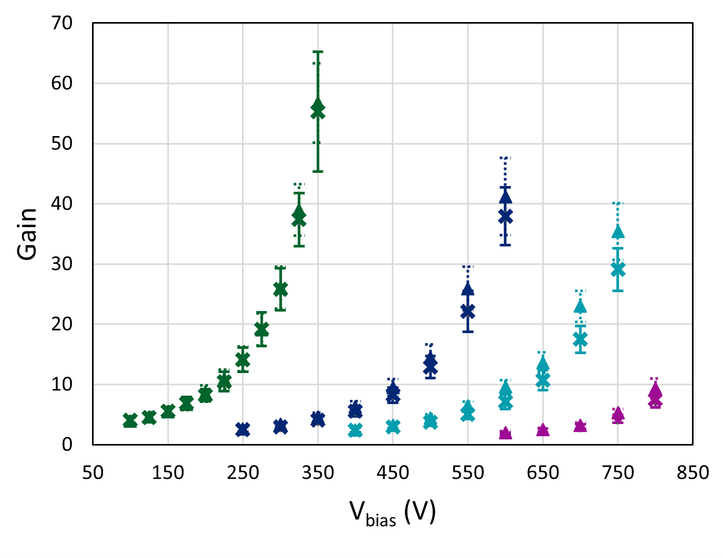
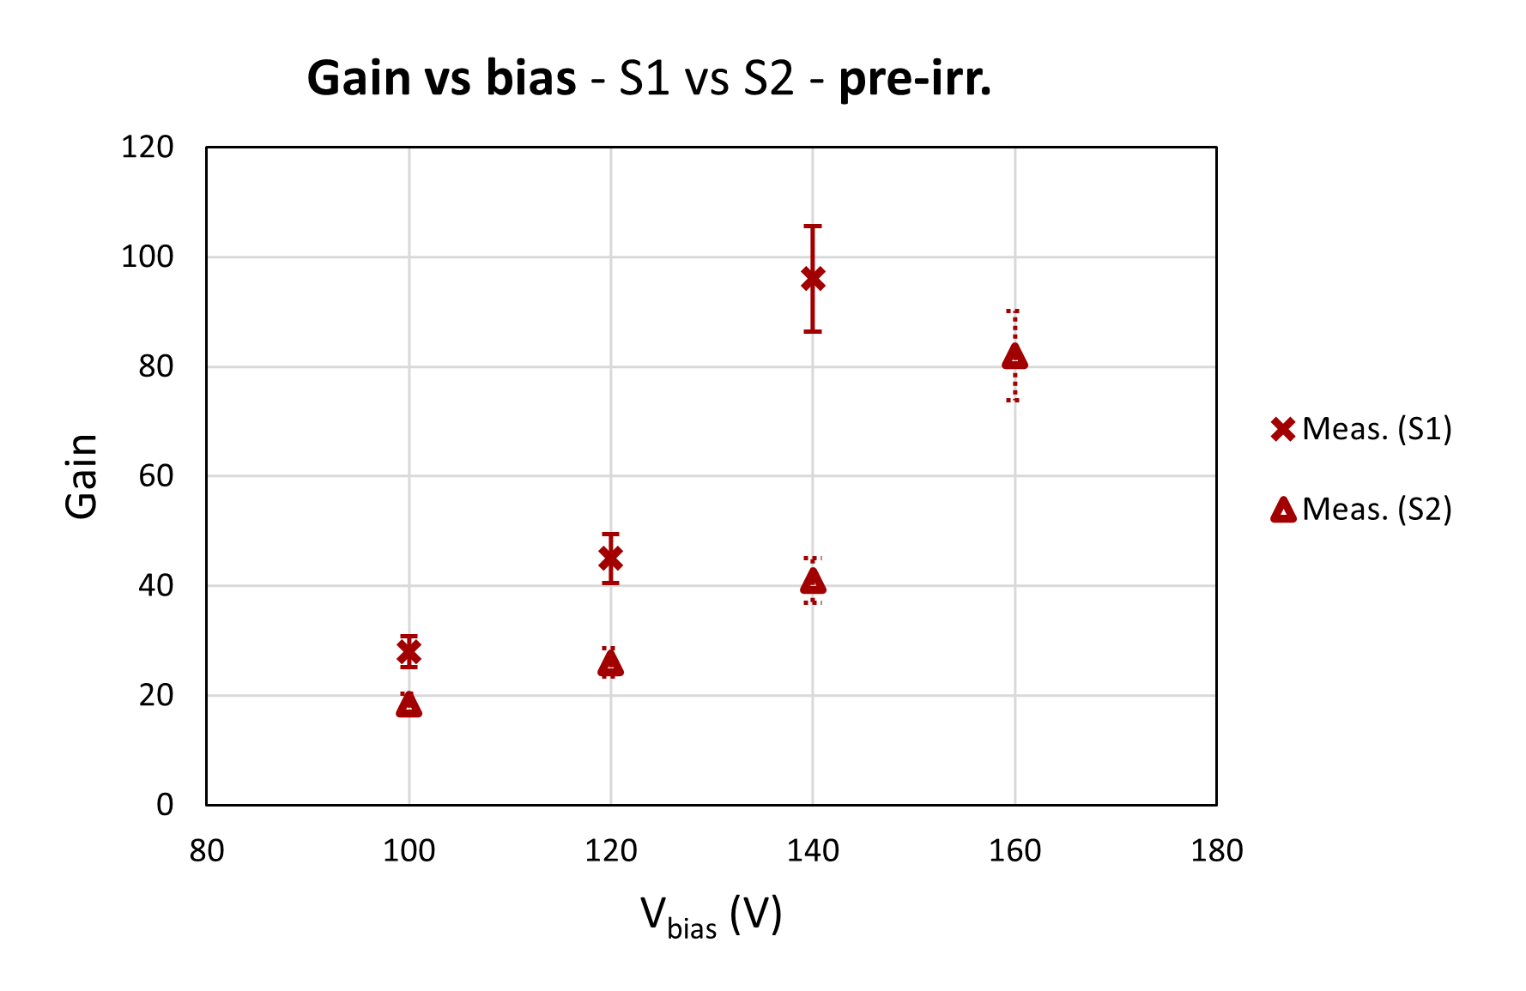
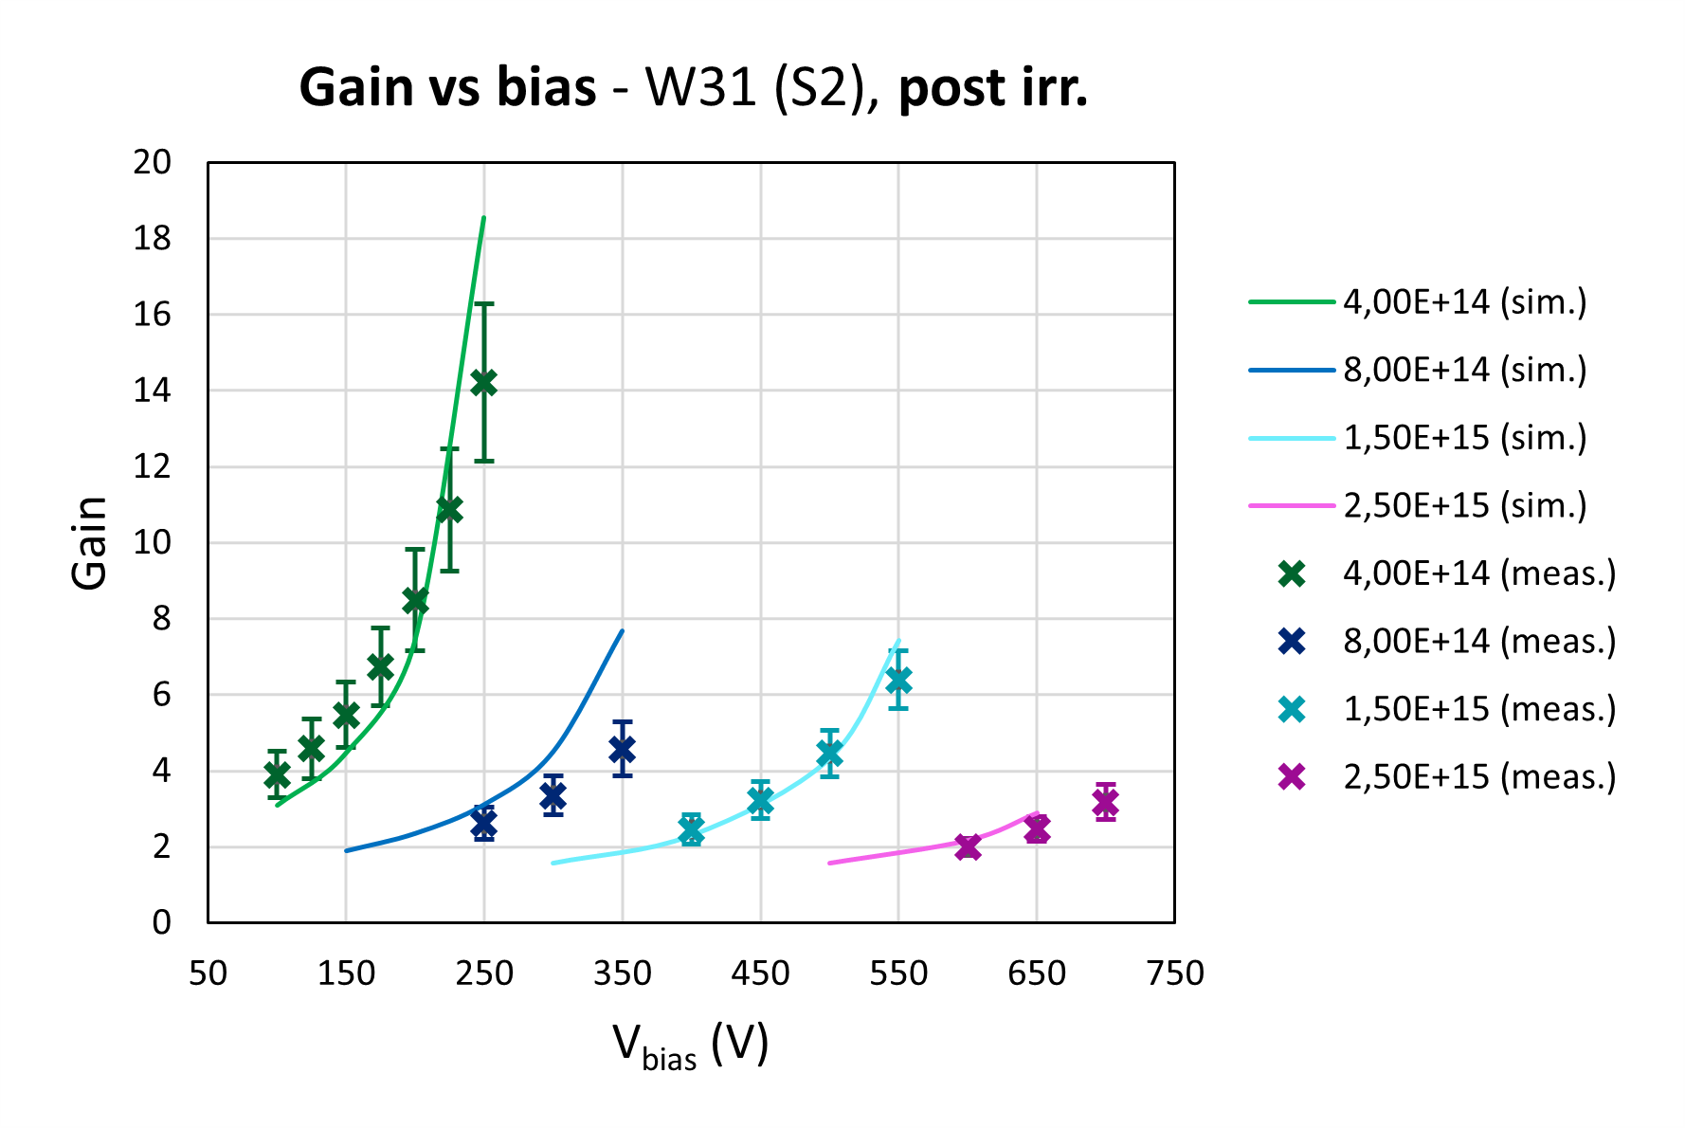
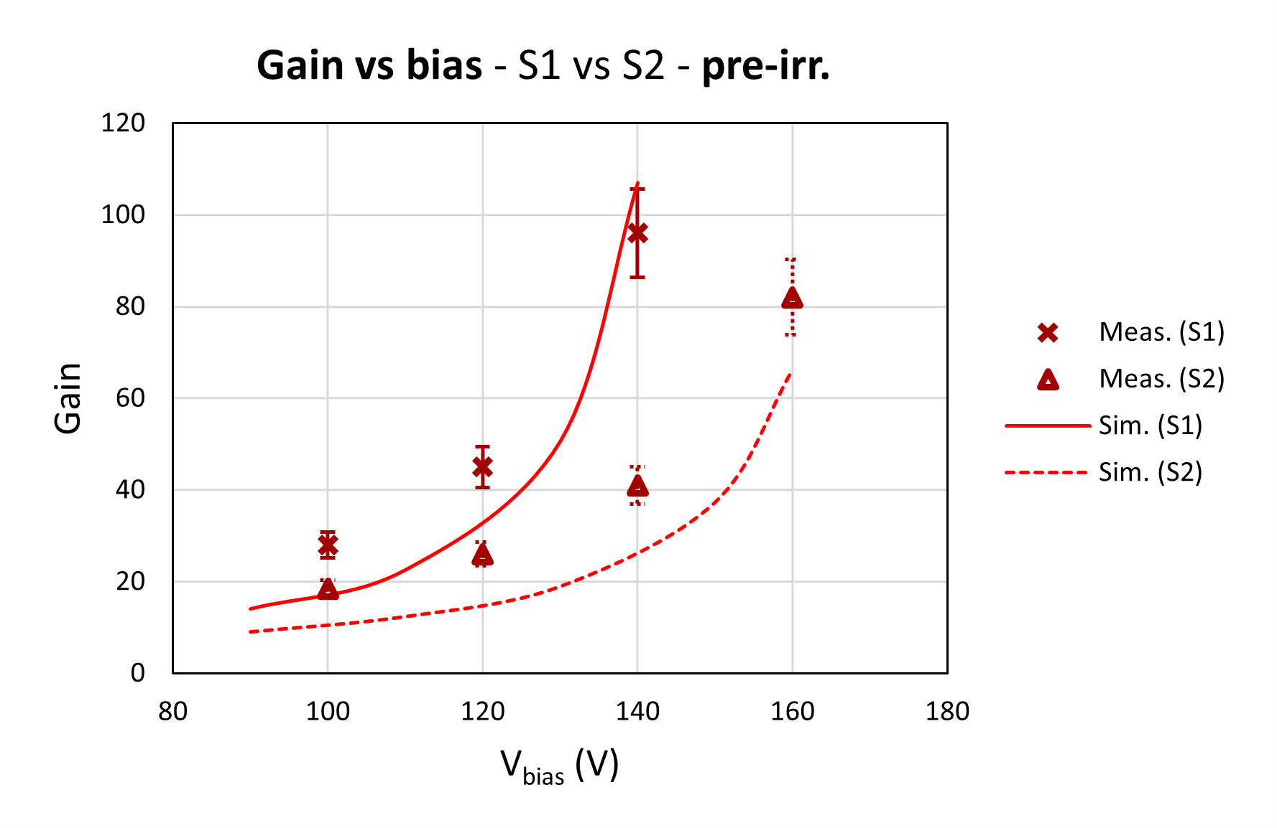
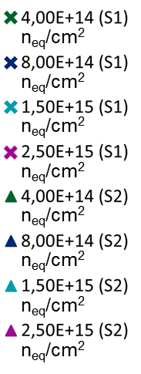
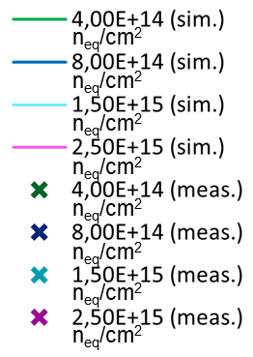
SIM. vs. MEAS. G-V – HPK2, Split 1 vs. Split 2
Pre-irradiation (TCT setup @ Torino)
Post-irradiation (β-source setup @ Torino)
Gain-Voltage @ 290 K, 1 MIP
Gain-Voltage @ 248 K, 1 MIP
Split 2
φ
Gain_{S1} > Gain_{S2}
Gain_{S1} ≈ Gain_{S2}
vOv ^{[6]} avalanche model. Electrical contact area 1,25 x 1,25 mm²

Slide 7
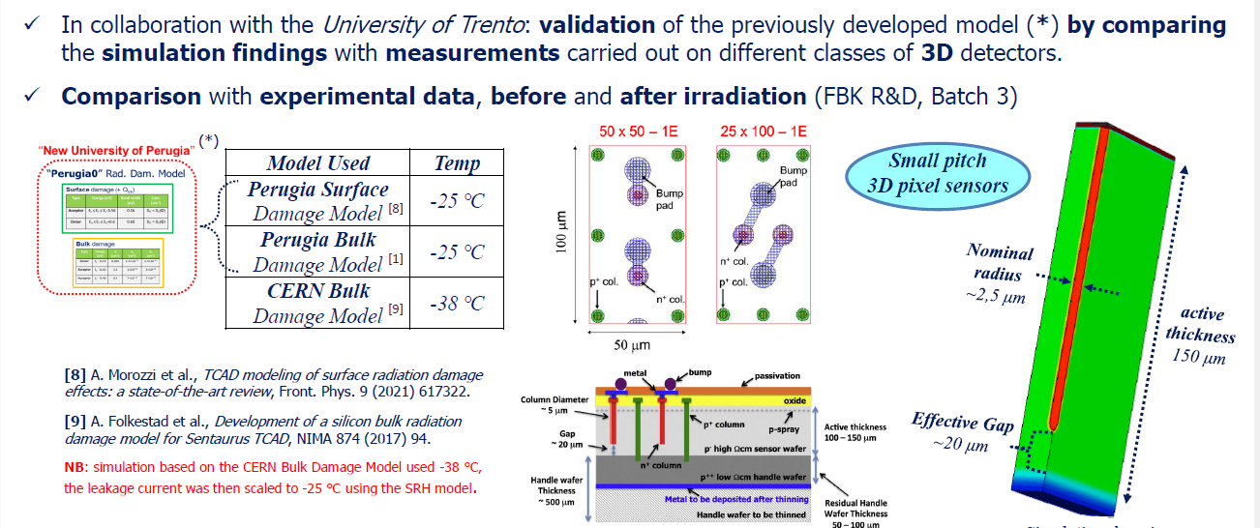
Simulation of 3D devices

Slide 8
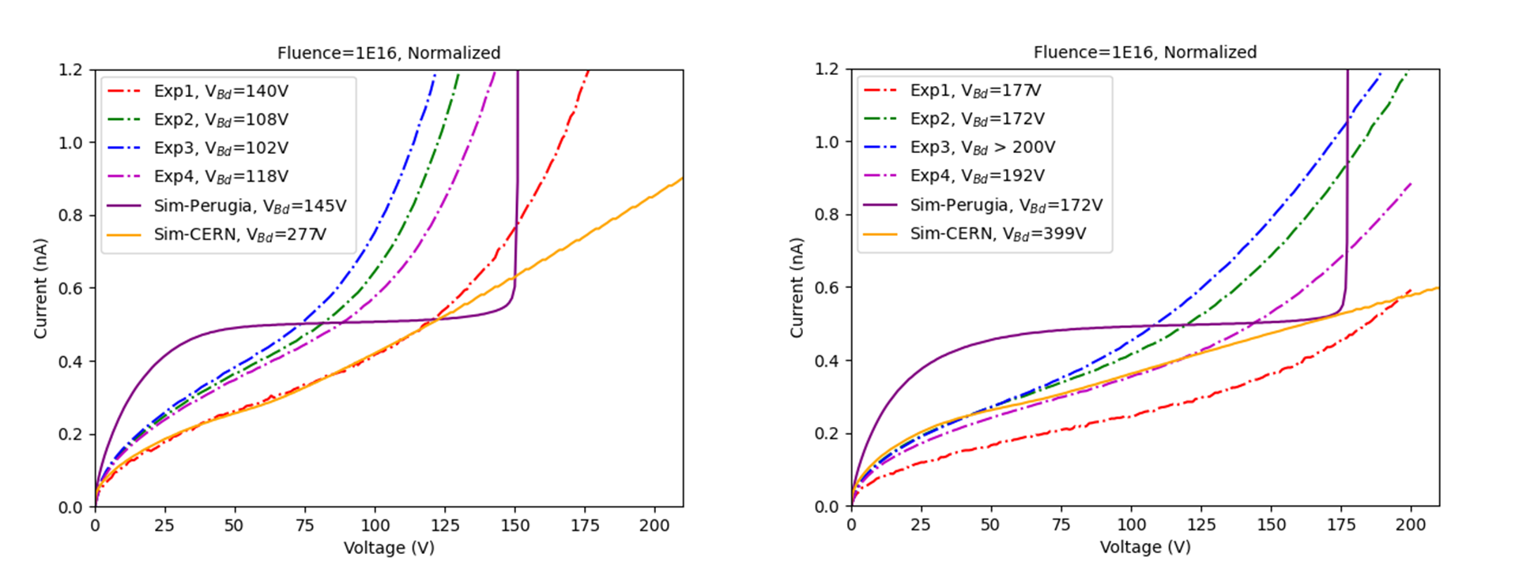
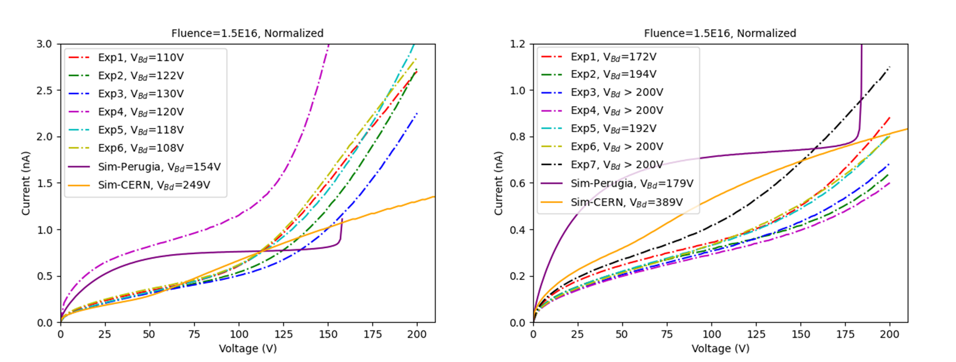
SIMULATED I-V – Bulk Damage Model
I-V, 50x50-1E
I-V, 25x100-1E
Post-irr.
1,0E16
n_{eq}/cm²
Calculated Damage Rate at V_{b}=100V, T=20℃
Structure | α* Experiment (10⁻¹⁷A/cm) | α* Perugia Model (10⁻¹⁷A/cm) | α* CERN Model (10⁻¹⁷A/cm)
50×50-1E | 6.92±1.14 | 5.92 | 4.90
25×100-1E | 4.25±0.91 | 5.74 | 4.22
1,5E16
n_{eq}/cm²
Structure | α* Experiment (10⁻¹⁷A/cm) | α* Perugia Model (10⁻¹⁷A/cm) | α* CERN Model (10⁻¹⁷A/cm)
50×50-1E | 4.41± 0.36 | 5.91 | 5.14
25×100-1E | 3.87±0.43 | 5.54 | 4.09
van Overstraeten - de Man model. Temperature 248 K
Notes:
Analysis of leakage and breakdown voltage (irr. w/ neutrons)
Perugia Model:
predicted breakdown voltage of both layouts before and after surface damage;
the prediction of breakdown voltage is still in good agreement with experiment after bulk damage;
the shape of the leakage current is different from the measured I-V curve.
CERN Model:
leakage current well predicted at low reverse bias when the fluence is low;
leakage current starts to deviate from measured results at high fluence;
over-estimates the breakdown voltage for all simulated scenarios, including different layouts and fluences.

Slide 9
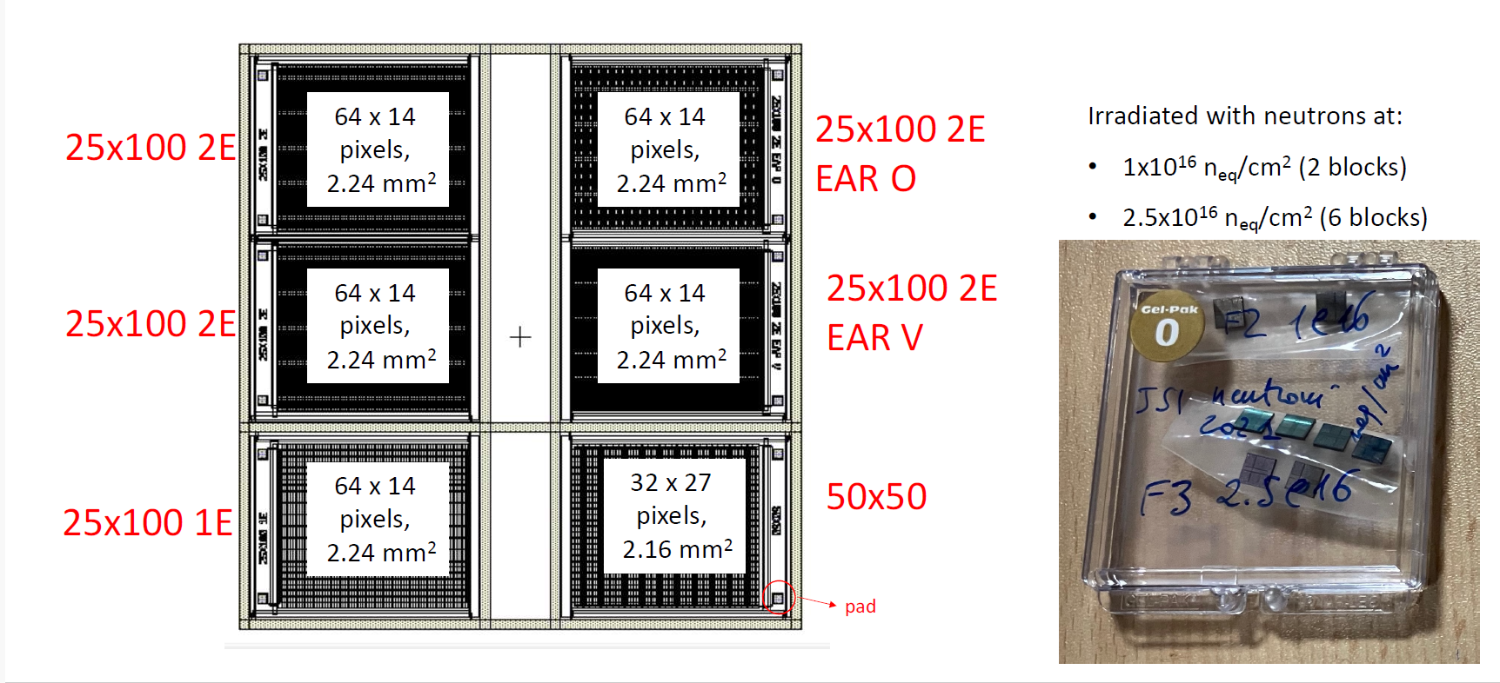
3D diodes from Trento

Slide 10
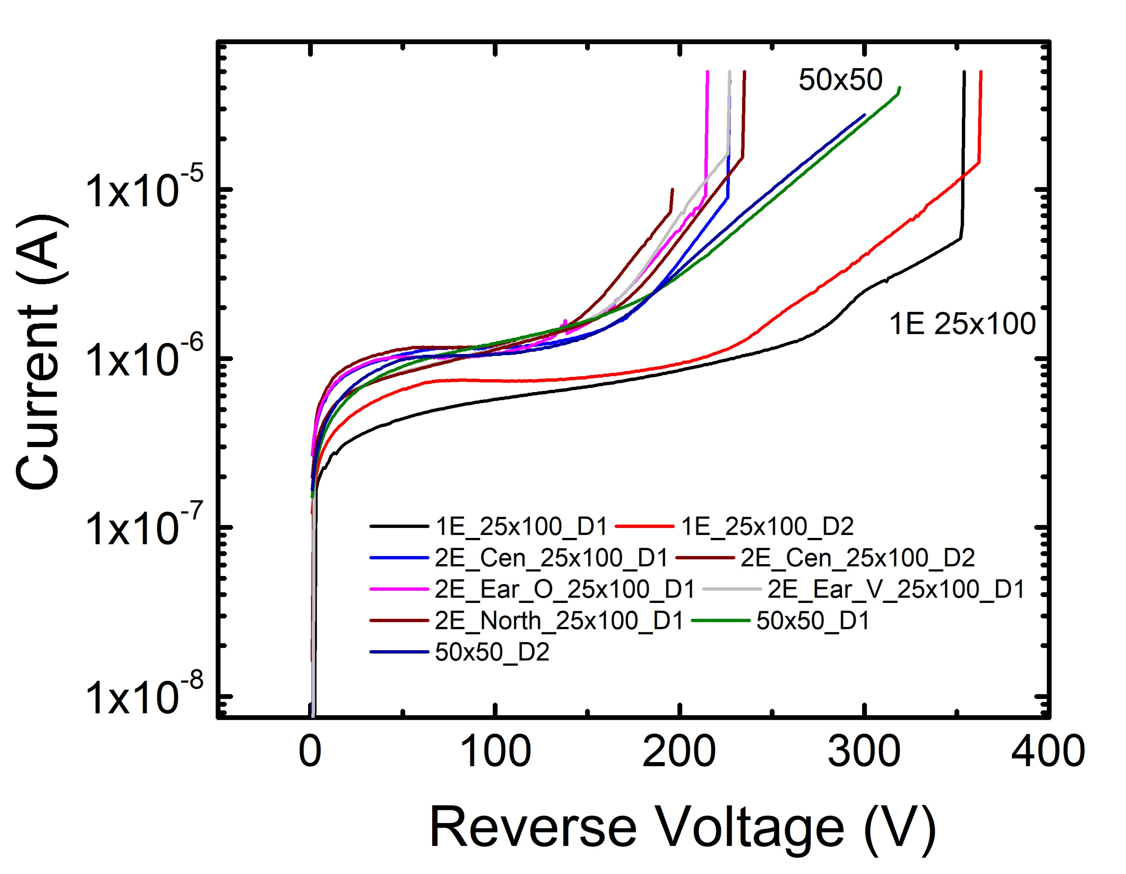
IV: 50x50 and 1 E 25x100 3D diodes
V_{BD} for 50x50 structures is over 300 V
V_{BD} for 1 E 25x100 structures is near 350 V.
Φ=1×10¹⁶ n/cm²

Slide 11
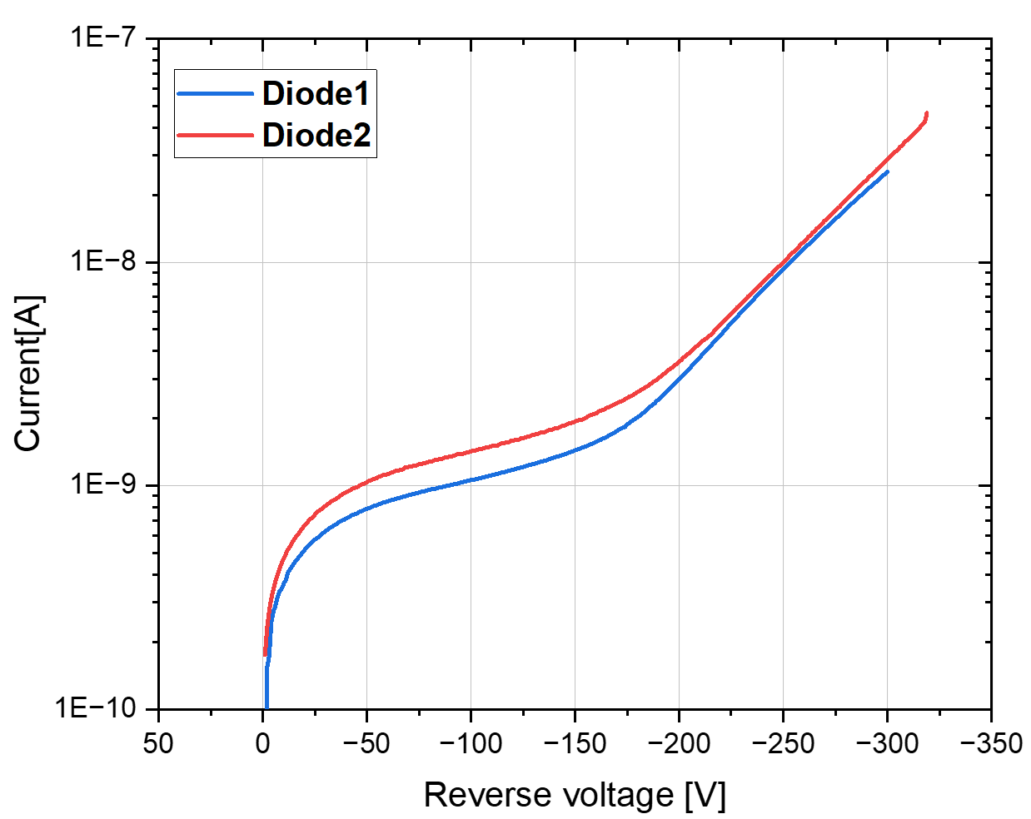
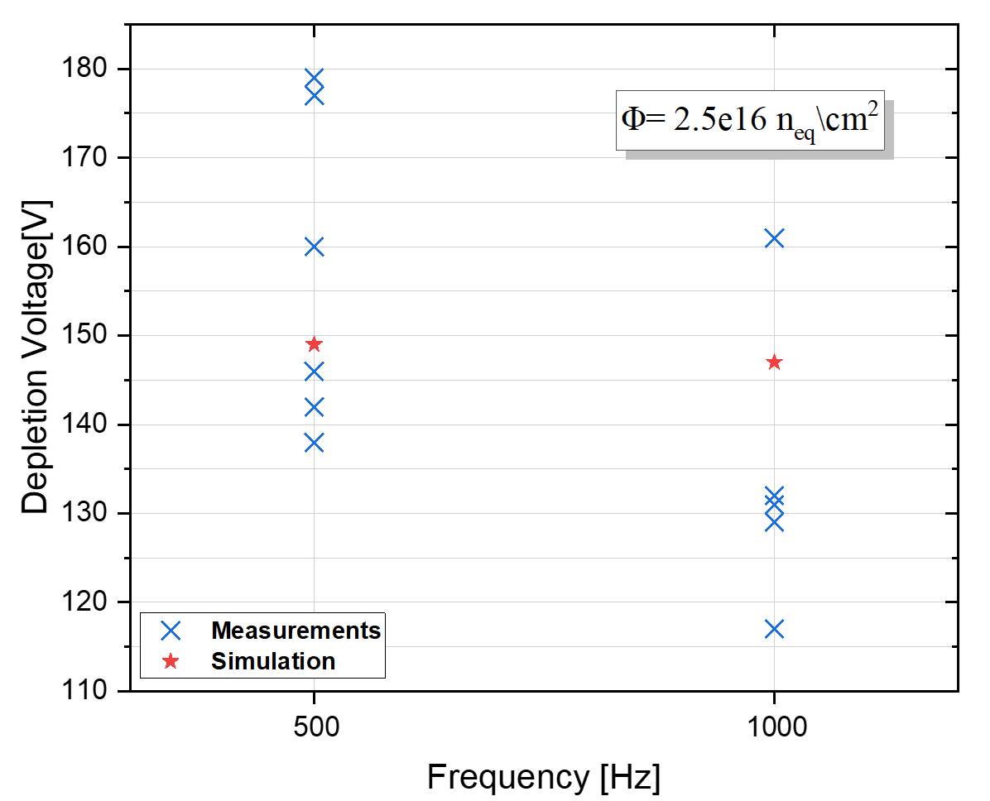
3D diodes: I-V measurements
50x50-1E
T=248 K

Slide 12
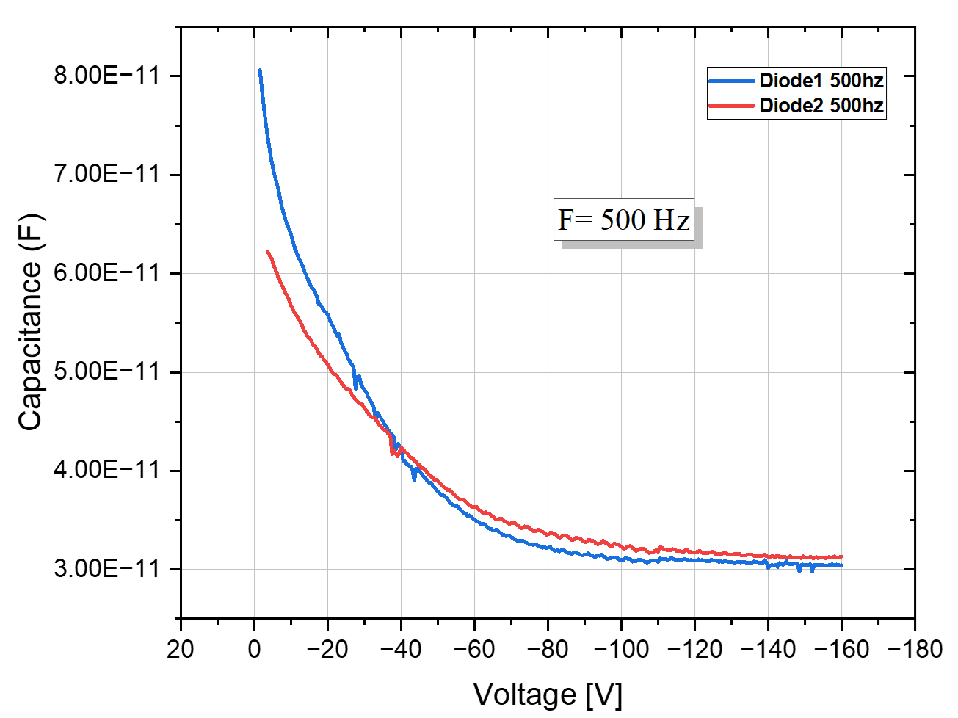
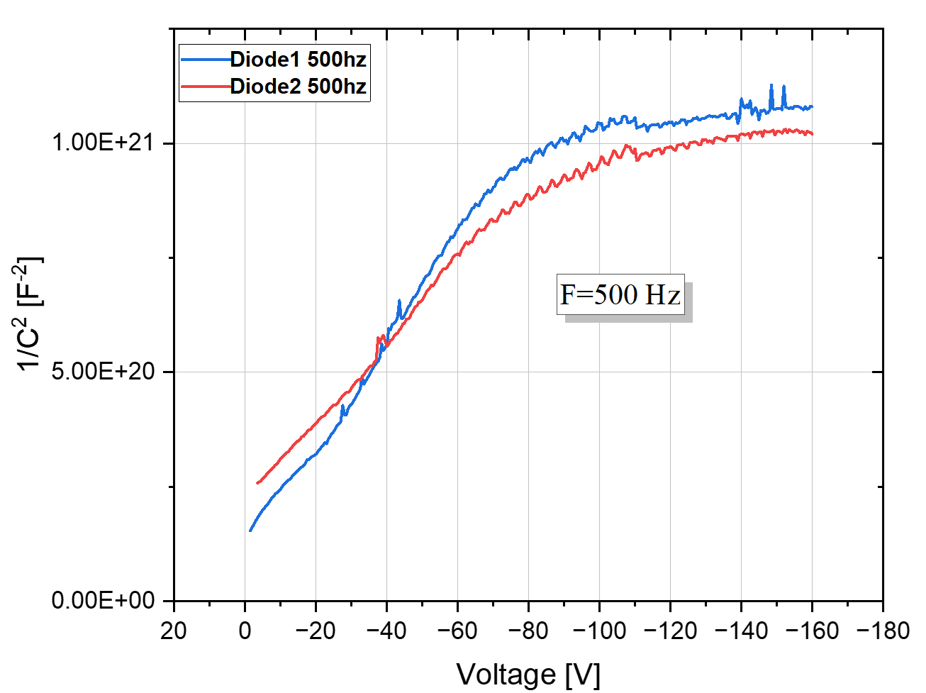
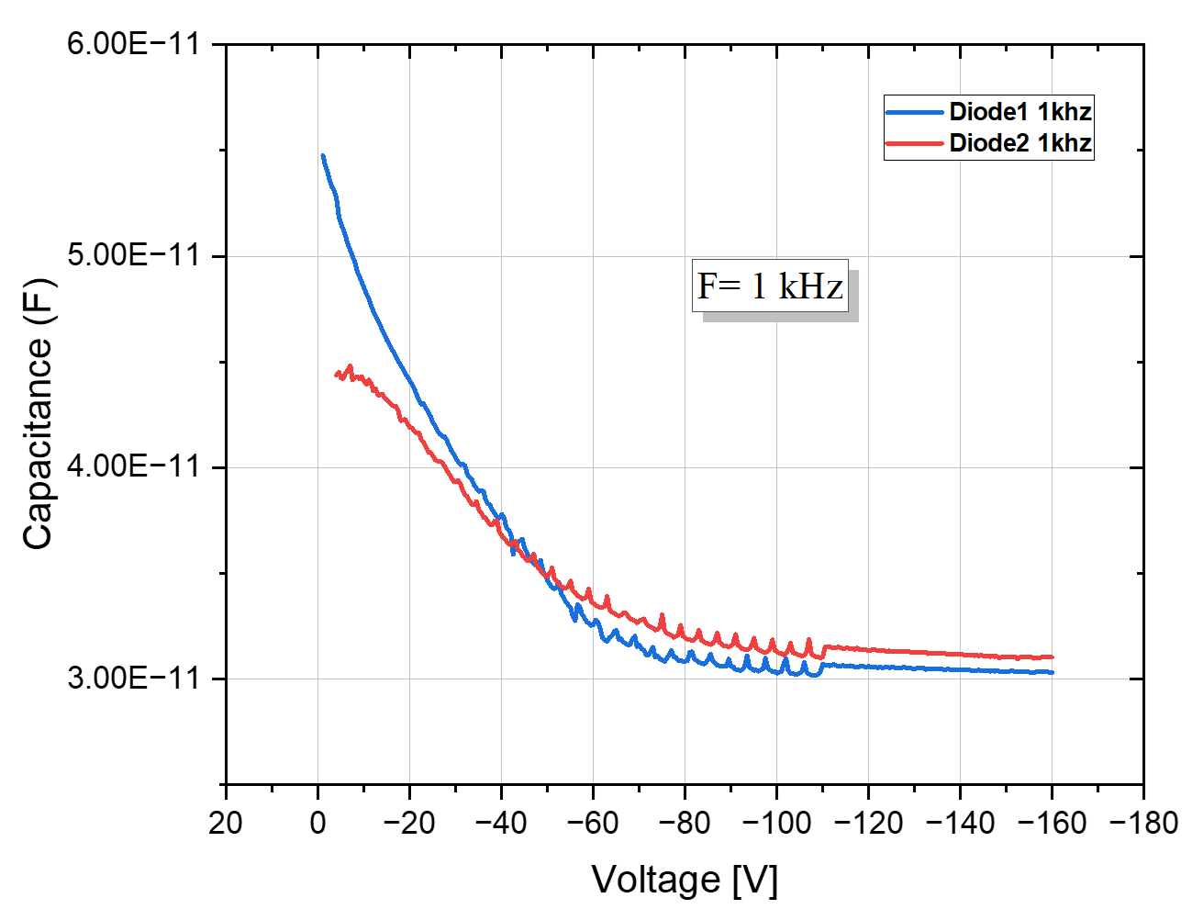
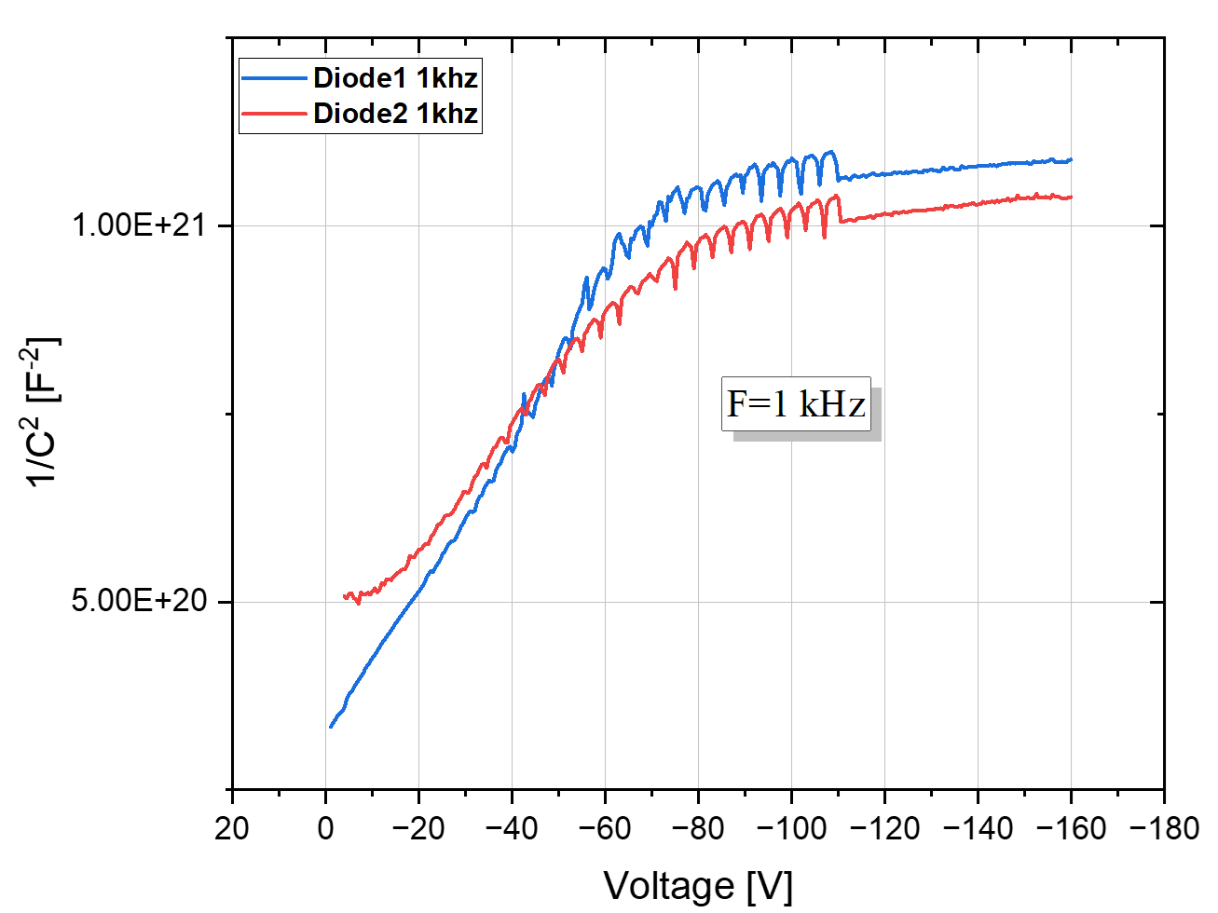
3D diodes C-V measurements: 1e16 n_{eq}\cm²
Table: Depletion Voltage values
 | 500Hz | 1kHz
Diode 1 | 84 | 70
Diode 2 | 94 | 84
50x50-1E
T=248 K

Slide 13
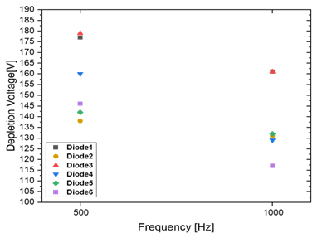
3D diodes C-V measurements: 2.5e16 n_{eq}\cm²
T=248 K
50x50-1E
Table: Depletion Voltage values
 | 500Hz | 1kHz
Diode 1 | 177 | 161
Diode 2 | 138 | 131
Diode 3 | 179 | 161
Diode 4 | 160 | 129
Diode 5 | 142 | 132
Diode 6 | 146 | 117

Slide 14
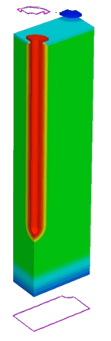
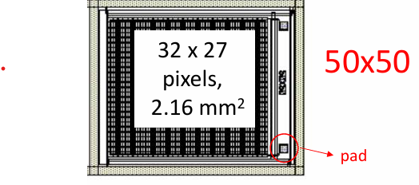
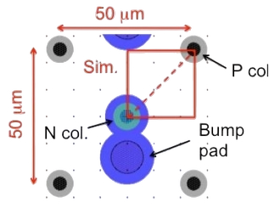
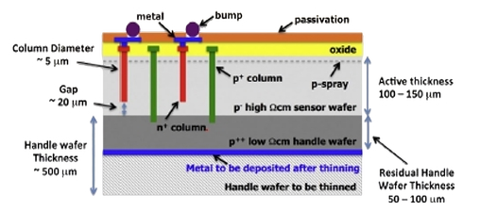
Simulation Setup: Sensor Layout & Models
Van Overstraeten- de Man model
Heavy ion model for mip (80 e-/µm)
CERN Bulk Damage Model * @ -38 ℃
(50x50-1E)
Defect number | Type | Energy level | 𝜎_{e}[cm⁻²] | 𝜎_{h}[cm⁻²] | η[cm⁻¹]
1 | Donor | Ev+0.48 | 2x10⁻¹⁴ | 1x10⁻¹⁴ | 4
2 | Acceptor | EC-0.525 | 5x10⁻¹⁵ | 1x10⁻¹⁴ | 0.75
3 | Acceptor | Ev+0.90 | 1x10⁻¹⁶ | 1x10⁻¹⁶ | 36
Simulated domain : ¼ of pixel layout
Geometrical parameters:
Active thickness : 150 μm
Nominal radius : ~2.5 μm
Effective gap : ~20 μm
Simulation used Temp=-38 ℃, the leakage current was then scaled to-25 ℃ using Chilingarov’s formula
* Folkestad, Å. et al, "Development of a silicon bulk radiation damage model for Sentaurus TCAD," NIMA874 (2017)

Slide 15
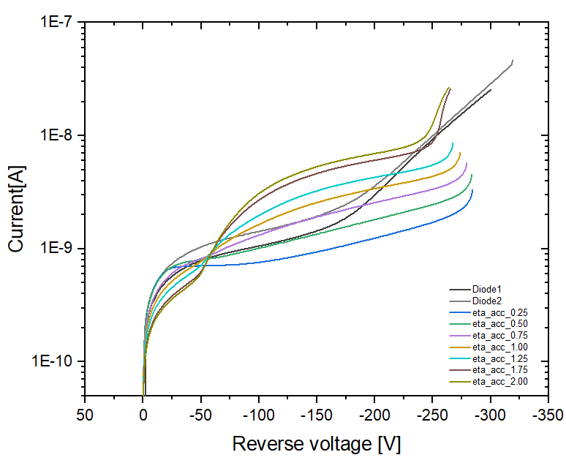
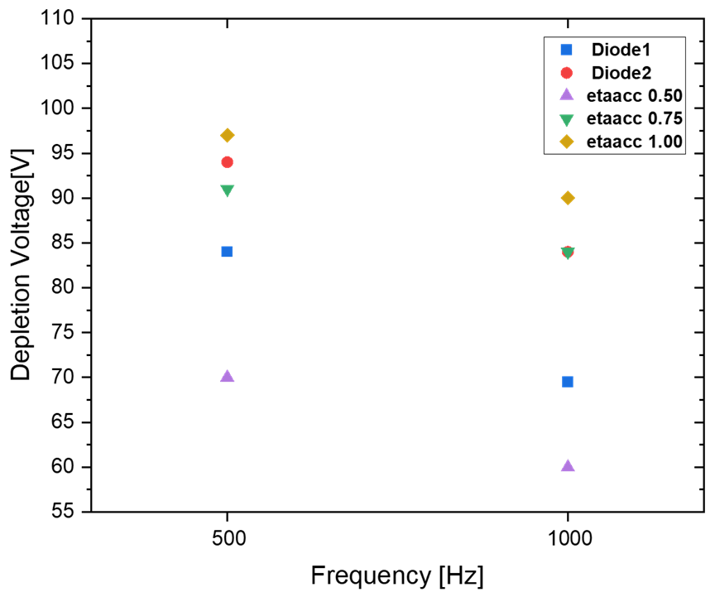
Simulation Results: Effect of the η _{acc}
Φ= 1e16 n_{eq}\cm²
T=248 K
Van Overstraeten- de Man model
Defect number | Type | Energy level | 𝜎_{e}[cm⁻²] | 𝜎_{h}[cm⁻²] | η[cm⁻¹]
1 | Donor | Ev+0.48 | 2x10⁻¹⁴ | 1x10⁻¹⁴ | 4
2 | Acceptor | EC-0.525 | 5x10⁻¹⁵ | 1x10⁻¹⁴ | ↓↑
3 | Acceptor | Ev+0.90 | 1x10⁻¹⁶ | 1x10⁻¹⁶ | 36
η _{acc}
Vbd
I leak
V_{dep}

Slide 16
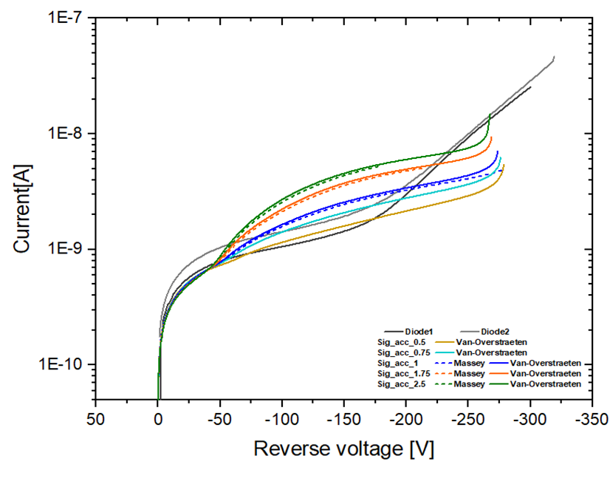
Simulation Results: Effect of the σ _{acc}
Φ= 1e16 n_{eq}\cm²
T=248 K
Van Overstraeten- de Man model
Defect number | Type | Energy level | 𝜎_{e}[cm⁻²] | 𝜎_{h}[cm⁻²] | η[cm⁻¹]
1 | Donor | Ev+0.48 | 2x10⁻¹⁴ | 1x10⁻¹⁴ | 4
2 | Acceptor | EC-0.525 | 5x10⁻¹⁵ | ↓↑ | 0.75
3 | Acceptor | Ev+0.90 | 1x10⁻¹⁶ | 1x10⁻¹⁶ | 36
σ _{acc}
Vbd
I leak

Slide 17
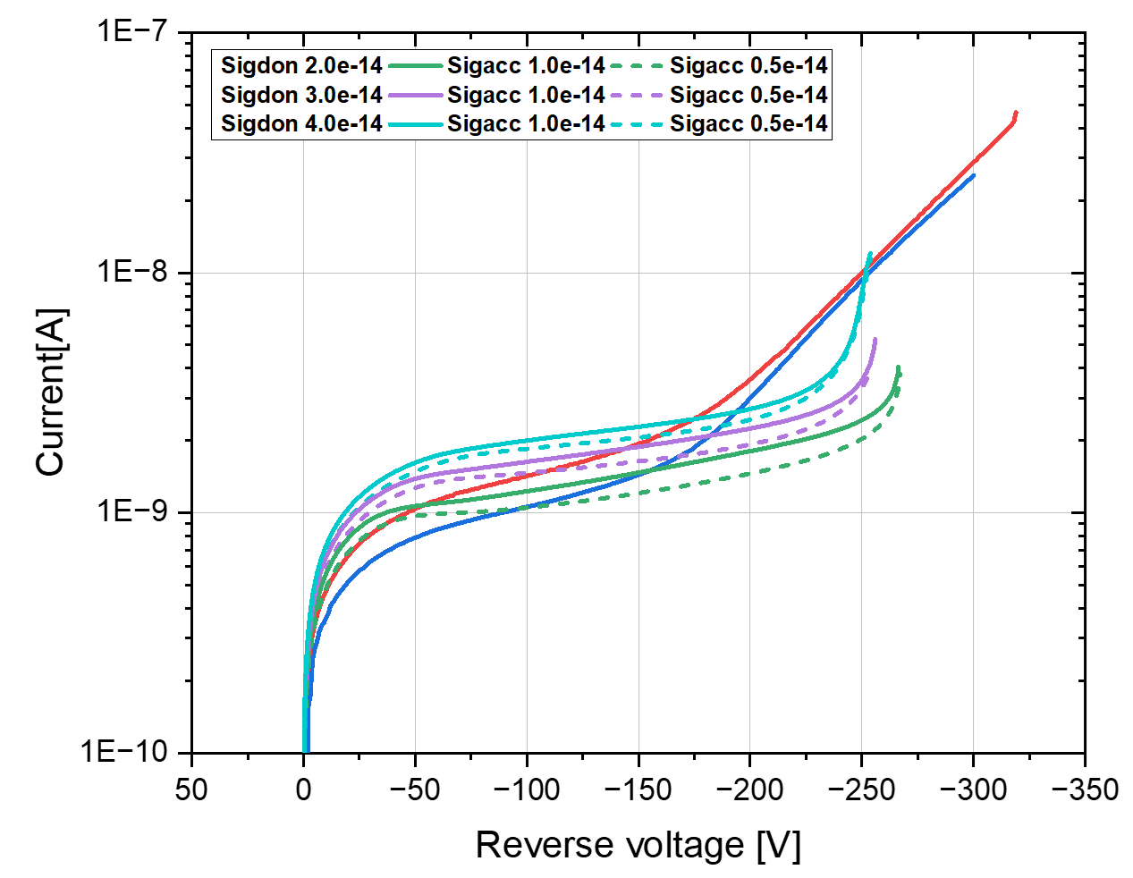
Simulation Results: Effect of the σ _{acc}
Φ= 1e16 n_{eq}\cm²
T=248 K
Van Overstraeten- de Man model
Defect number | Type | Energy level | 𝜎_{e}[cm⁻²] | 𝜎_{h}[cm⁻²] | η[cm⁻¹]
1 | Donor | Ev+0.48 | 3x10⁻¹⁴ | 1x10⁻¹⁴ | 6
2 | Acceptor | EC-0.525 | 5x10⁻¹⁵ | ↓↑ | 0.75
3 | Acceptor | Ev+0.90 | 1x10⁻¹⁶ | 1x10⁻¹⁶ | 36
σ _{acc}
Vbd
Vbd CST
I leak
Flat Current

Slide 18
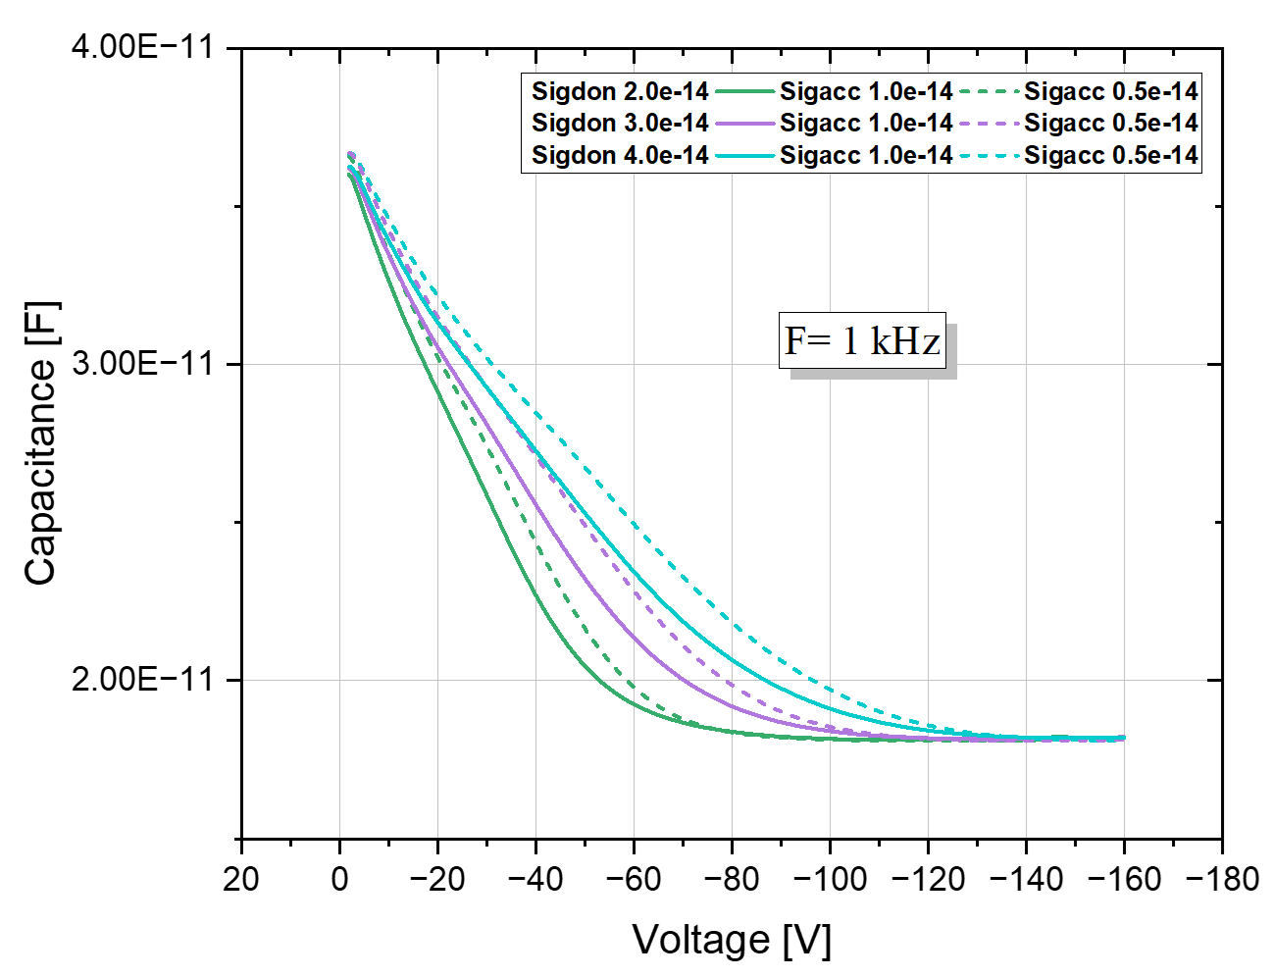
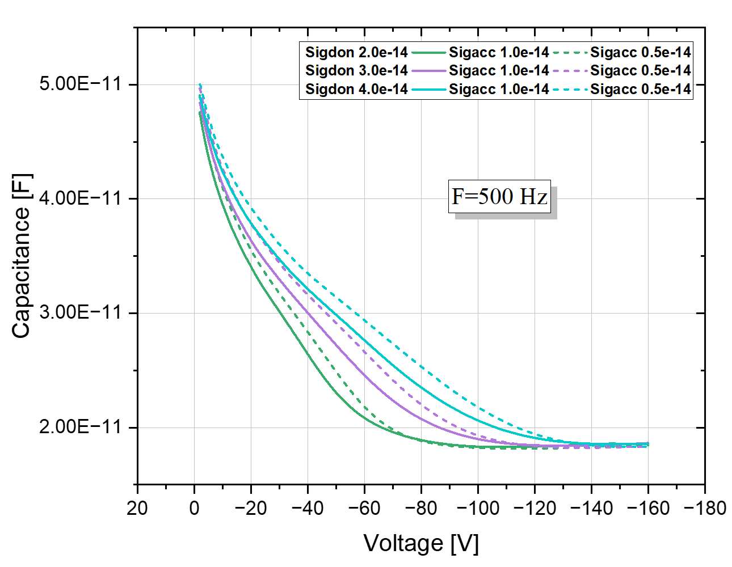
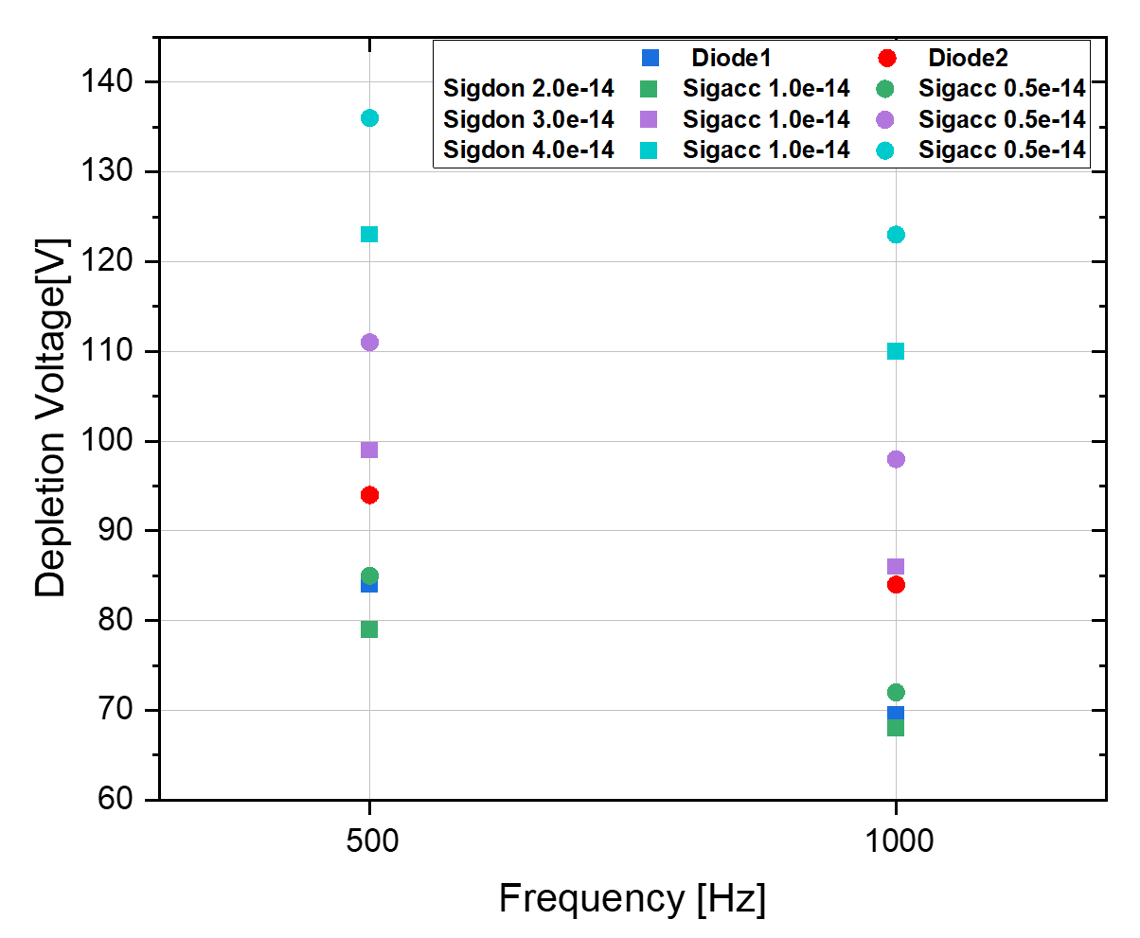
Simulation Results: Effect of the σ _{acc}
Φ= 1e16 n_{eq}\cm²
T=248 K
Van Overstraeten- de Man model
Defect number | Type | Energy level | 𝜎_{e}[cm⁻²] | 𝜎_{h}[cm⁻²] | η[cm⁻¹]
1 | Donor | Ev+0.48 | 3x10⁻¹⁴ | 1x10⁻¹⁴ | 6
2 | Acceptor | EC-0.525 | 5x10⁻¹⁵ | ↓↑ | 0.75
3 | Acceptor | Ev+0.90 | 1x10⁻¹⁶ | 1x10⁻¹⁶ | 36
σ _{acc}
V_{dep}

Slide 19
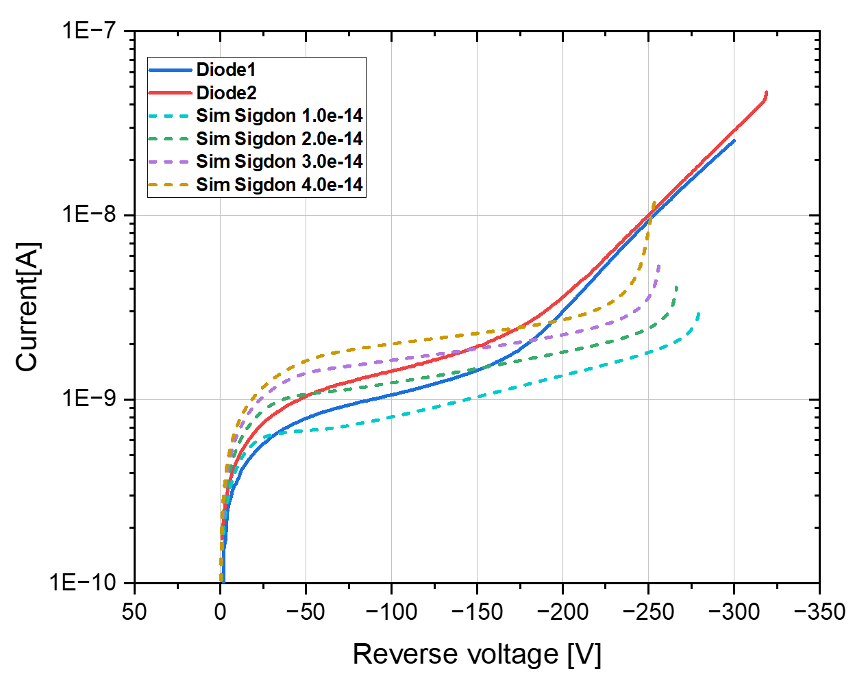
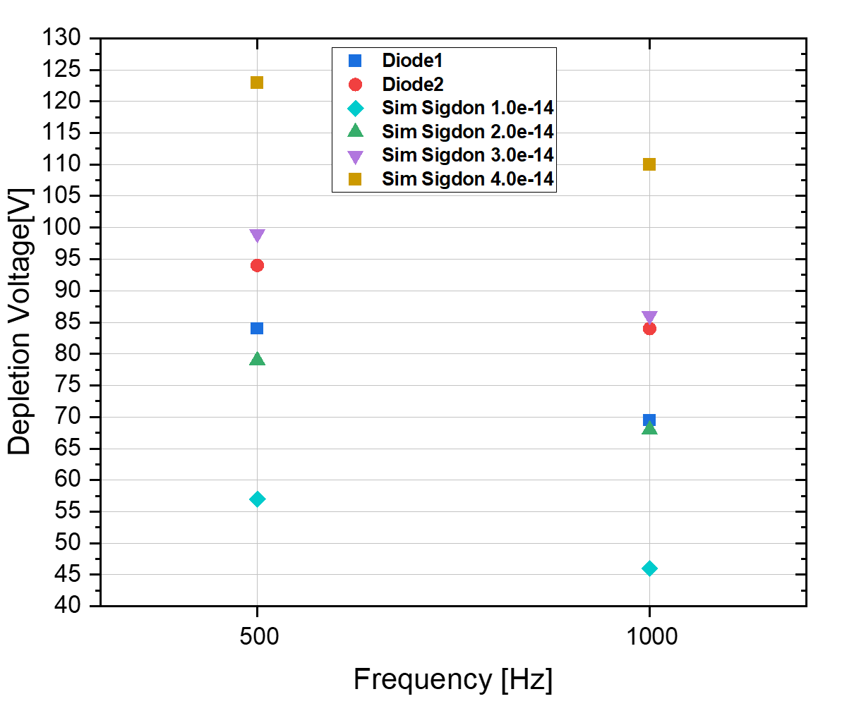
Simulation Results: Effect of the σ _{don}
Φ= 1e16 n_{eq}\cm²
T=248 K
Van Overstraeten- de Man model
Defect number | Type | Energy level | 𝜎_{e}[cm⁻²] | 𝜎_{h}[cm⁻²] | η[cm⁻¹]
1 | Donor | Ev+0.48 | ↓↑ | 1x10⁻¹⁴ | 6
2 | Acceptor | EC-0.525 | 5x10⁻¹⁵ | 1x10⁻¹⁴ | 0.5
3 | Acceptor | Ev+0.90 | 1x10⁻¹⁶ | 1x10⁻¹⁶ | 36
Vbd
σ _{don}
I leak
V_{dep}

Slide 20
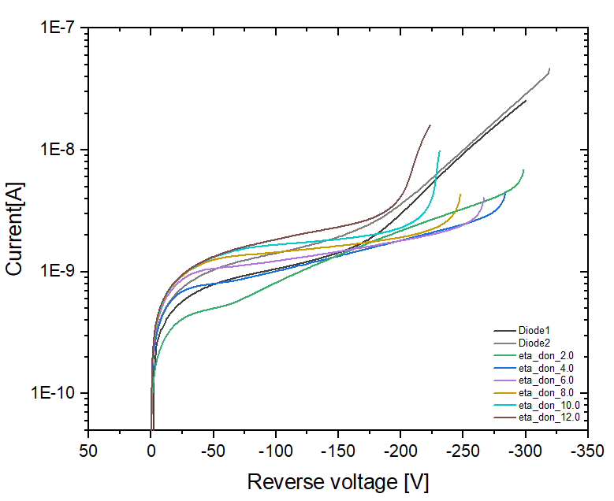
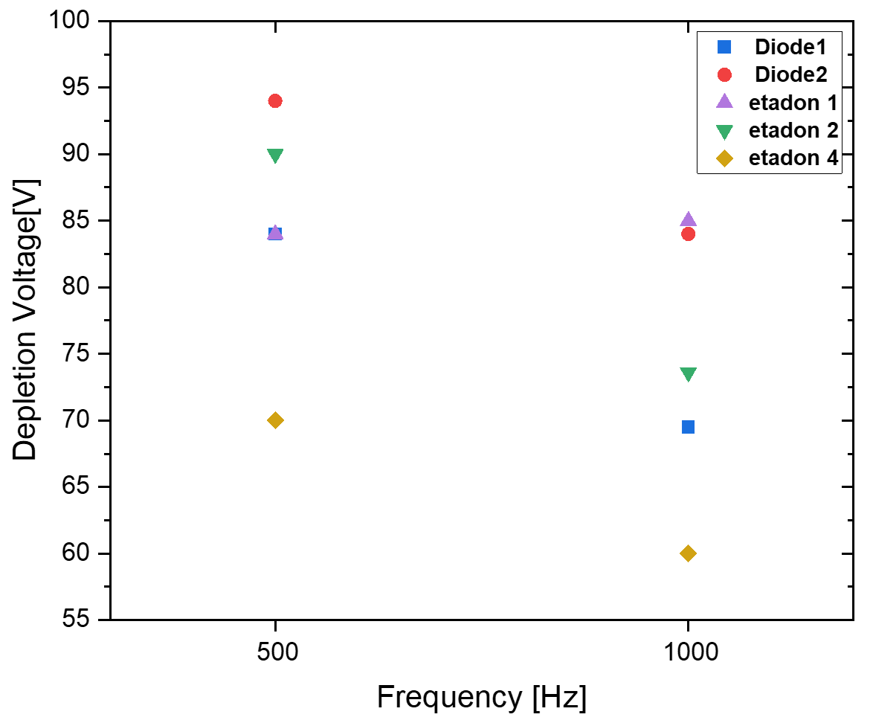

Simulation Results: Effect of the η_{don}
Φ= 1e16 n_{eq}\cm²
T=248 K
Van Overstraeten- de Man model
Defect number | Type | Energy level | 𝜎_{e}[cm⁻²] | 𝜎_{h}[cm⁻²] | η[cm⁻¹]
1 | Donor | Ev+0.48 | 2x10⁻¹⁴ | 1x10⁻¹⁴ | ↓↑
2 | Acceptor | EC-0.525 | 5x10⁻¹⁵ | 1x10⁻¹⁴ | 0.5
3 | Acceptor | Ev+0.90 | 1x10⁻¹⁶ | 1x10⁻¹⁶ | 36
I leak
η _{don}
Vbd
V_{dep}

Slide 21


Next step: CCE measurements and simulations
Measurements
in collaboration with INFN Torino
CCE measurements will be carried out at Torino laboratories with β source
β Setup
Oscilloscope: LeCroy 9254M (2.5GHz - 40Gs/s)
HV Power supply: CAEN DT1471ET
UCSC Board+Cividec Broadband Amplifier (20dB)
Time reference: Photonis MCP-PMT – s_{t} ~ 15 ps
β source: Sr90 – activity ~ 37 kBq
T = -25ºC
Simulations
Performed in Perugia
CERN Model has been modified to enhance the applicability
3D Simulated layout. A,B,C,D are MIP hit points
Average signal efficiency vs. reverse voltage for all pixel geometries irradiated at
2 × 10¹⁶ n_{eq} cm⁻²
21
From A. Boughedda et al 2021 JINST 16 C10006

Slide 22

Measurements at highest fluences
I-V and C-V measurements to carry out in Perugia on different test structures (3D diode, 3D strip, 3D array)

Slide 23

I-V 1 - 2.5 and 5x10¹⁶ n/cm²
Current damage factor α at 20°C scaled using Chilingarov’s formula:
Average current for a single cell
Fluence (n/cm²) | α (A/cm)
1×10¹⁶ | 4.7×10⁻¹⁷
2.5×10¹⁶ | 5.7×10⁻¹⁷
5×10¹⁶ | 6.1×10⁻¹⁷

Slide 24
Conclusions & Next steps
Recent upgrade of the Perugia radiation damage model → “PerugiaModDoping”
  Traps parameterization (“New University of Perugia” TCAD model)
  Gain Layer and Bulk effective doping evolution with Φ (Torino analytical parameterizations)
The new model has been verified for LGAD devices, by comparing TCAD simulations w/ measurements
  UFSD2 production (FBK): static (DC), small-signal (AC) and gain behavior well reproduced
  HPK2 production (HPK): DC, AC and gain behavior well reproduced (but pay attention to the impact ionization model)
Measurements and Simulation of 3D detectors (in collaboration with Trento group for 3D detectors modelling)
  The original CERN model needs some changes/modification to be able to proper reproduce/predict the IV and CV measurements of 3Ds
  New measurements in Perugia on 3D detectors and test structures in the range 1-2.5×10¹⁶ n/cm².
  Next steps CCE measurements with beta setup of 3D detectors, before and after irradiation
  (up to the fluence of 2.5E16 n_{eq}/cm²) in Torino in collaboration with INFN Torino and CCE simulations using the modified model
Notes:
We are waiting for the measurements of irradiated samples, in order to start a new batch of simulations for the model validation purpose.

Slide 25

Simulation Results: Effect of the η_{don}
Φ= 2.5e16 n_{eq}\cm²
T=248 K
Van Overstraeten- de Man model
Defect number | Type | Energy level | 𝜎_{e}[cm⁻²] | 𝜎_{h}[cm⁻²] | η[cm⁻¹]
1 | Donor | Ev+0.48 | 5x10⁻¹⁴ | 1x10⁻¹⁴ | ↓↑
2 | Acceptor | EC-0.525 | 5x10⁻¹⁵ | 1x10⁻¹⁴ | 0.5
3 | Acceptor | Ev+0.90 | 1x10⁻¹⁶ | 1x10⁻¹⁶ | 36
Vbd
I leak
η _{don}

