Slide 1
Updates on reflectorless FSI
Armin Reichold, Georg Viehhauser
University of Oxford

Slide 2
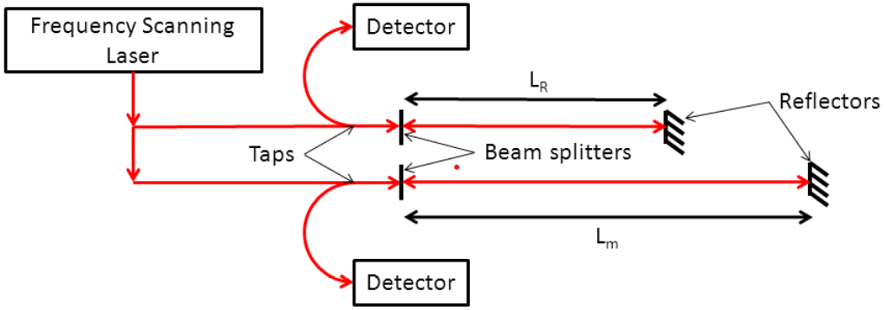
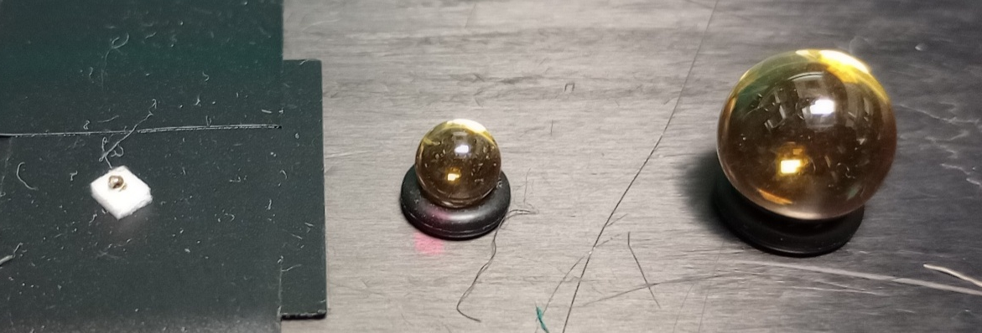
Introduction
Our FSI system is a commercial system from Etalon
  As the development of FSI originated at Oxford, we have a (not too close) relationship with them
  Originally, we wanted to include Etalon in AIDAinnova, but shortly before submission of the proposal they bulked
  This system has been designed for distance measurements with sub-µm precision
We have been routinely using the system with reflectors
  Our reflectors are n = 2 glass spheres with an Au coating on one hemisphere
    Have used 10 mm, 5 mm and 1 mm diameter spheres
    While the 1mm glass sphere is indeed small (1.5 mg), and thus would not affect even very lightweight structures, reflectorless operation would remove any need to interfere with the object
Real system has collimators here
Simplified scheme
Real system has 2 lasers
1 mm
5 mm
10 mm

Slide 3
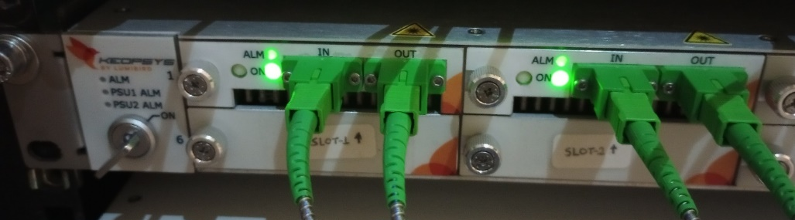
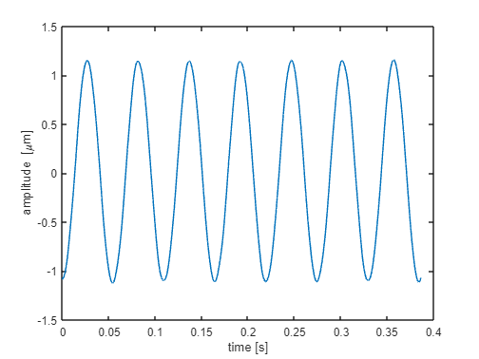
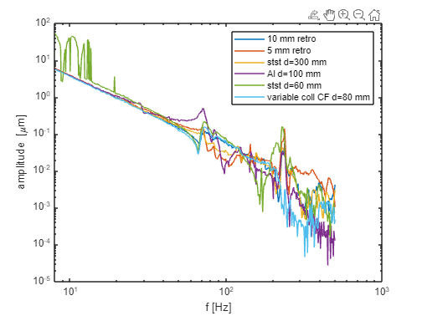
Reflectorless operation
The reflectorless operation is the deliverable for AIDAinnova
The major addition to the system for the reflectorless operation was the addition of an optical amplifier
  This brings the optical power from 60 µW to 900 µW
  At the same time we upgraded from 4 optical lines to 16
The good news: We have observed reflectorless operation for a variety of surfaces (carbon fibre, Cu (also Kapton-clad), Al, brass, steel) with various surface qualities
The criterion for verification of the operation was the correct observation of vibrations of our low-intensity shaker table
  Driven by our application of the system
  Covering a range of table excitation frequencies from 8 to 500 Hz, range of amplitudes from 10⁻⁶ m to 10⁻⁹ m
  Failure manifests itself not in an error on the displacement, but a completely arbitrary result (the FSI algorithm gets confused by noise signals)
3 other lines failed
Differences caused by deformations of the table

Slide 4
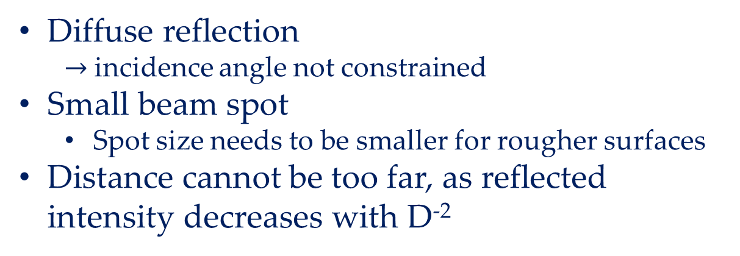
What we learned
Unfortunately, for a long time we were not consistently successful in getting good data from reflectorless operation
We do understand this now as an interplay of
  Surface quality (specular vs diffuse reflection)
  Beam spot size on the object
  Distance of the collimator to the object
  For specular reflection: angle of incidence
The ideal case
Diffuse reflection
  $→$ incidence angle not constrained
Small beam spot
  Spot size needs to be smaller for rougher surfaces
Distance cannot be too far, as reflected intensity decreases with D⁻²

Slide 5
Why it often failed
Failed because of large spot size
  Collimators had different focal lengths, and the focal length was fixed
  We did not adjust the distance, but placed collimators where the support frame was
  This led to different spot sizes on the object
Interference of different areas in spot (speckle pattern) cancels intensity
  This can even happen at very short distances
Surprisingly, sometimes we got good results with large beam spot (~10 mm) on reflective surface at large distance (~300 mm), when the beam hit the surface perpendicularly
  We now think that this is because most of the light is undergoing specular reflection, with the interfering light paths from the large spot size missing the collimator
Once we realised this we made a dedicated collimator, which was modified to allow variation of the distance to the fibre end, so that the beam spot could be focused for each distance
  This works repeatably
  We verified that this is indeed working with diffuse reflection by varying the impact angle

Slide 6
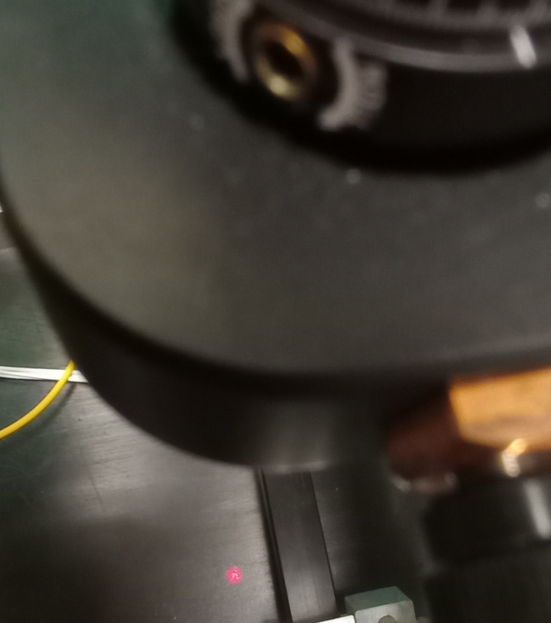
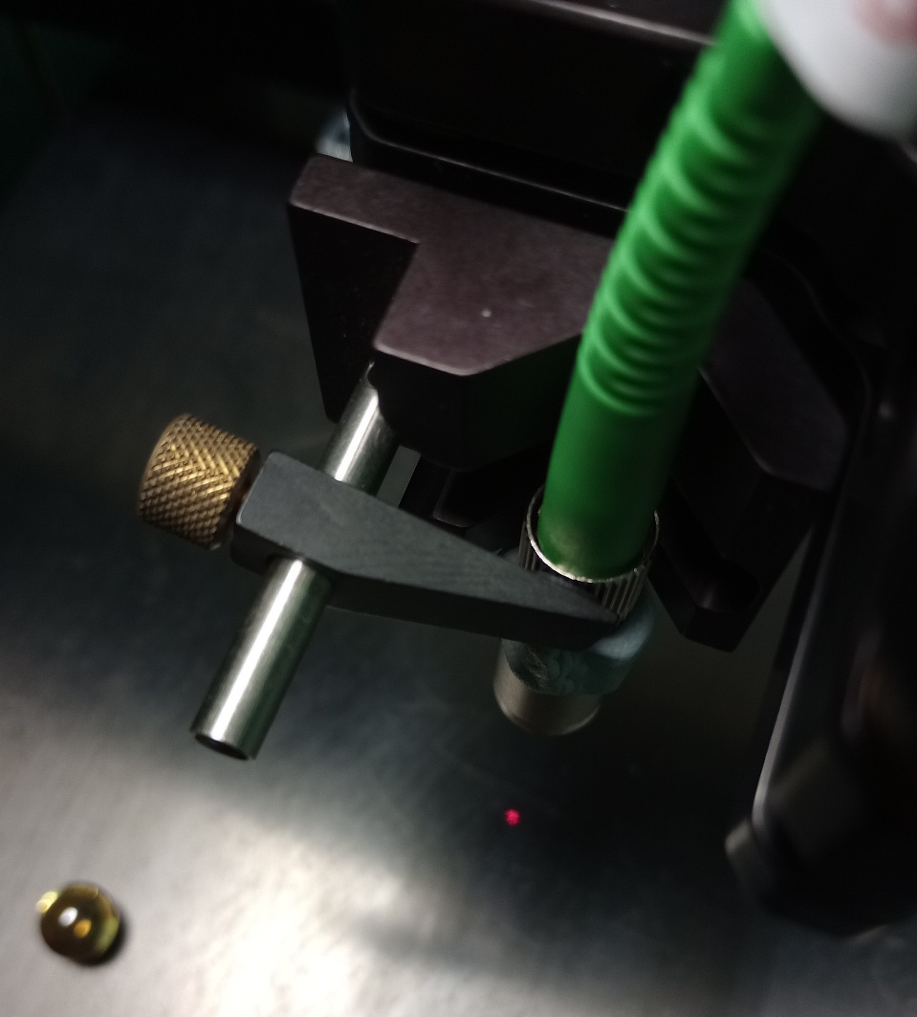
Spot size pictures
Wide beam spot
Focussed collimator
Red laser used for alignment
Spot diameter ~10 mm
5 mm sphere
Collimator-surface distance 250 mm
Collimator-surface distance 160 mm

Slide 7
Conclusion & plans
We have achieved reflectorless FSI operation
We are now understanding better the conditions required
  For optically rough surfaces (diffuse scattering) need focussed beam spot and closer is better
  For reflective surfaces (specular scattering) large beam spot is allowable, but need perpendicular incidence and further away is better
We have to finish our report by the end of the month
  We have started writing this
In parallel we would like to get through a few more measurements to confirm our correct understanding of what is required for successful operation
  Different surfaces
  Scan distances

