Slide 1
AIDAinnova Final Annual Meeting
Summary of the work accomplished on new natural refrigerants and of the D10.3 report
L. Contiero^{(1,2)}, A. Hafner⁽²⁾, C. Pedano^{(1,3,4)}, P. Petagna⁽¹⁾, B. Verlaat⁽¹⁾
07-05-2025
CERN
NTNU
Technical University Offenburg
Karlsruhe Institute of Technology
Notes:
Supercritical fluids are characterized by low values of density and viscosity while exhibiting high thermal capacity without phase change. This makes them interesting candidates as refrigerants for the thermal management of future High Energy Physics detectors. However, in compliancy with the recently updated European Strategy, general interest developments for future detectors should ideally target both ultra-light detectors operated at temperatures above 0 °C and detectors operating in extreme radiation environments requiring very low temperatures, below those attained for the forthcoming LHC detector upgrades.
In this context, thanks to synergies with the CERN-funded EP-RDET programme and leveraging on the recently signed collaboration frame agreement between CERN and the Norwegian Institute of Technology (NTNU), it has been possible to launch two parallel programmes targeting both directions of investigation.

Slide 2
Natural fluids considered
Low radiation
“Ambient” temperature
Detector environment
High radiation
Significantly cold temperature
(lower than the CO₂ limit)
Provide precision measurements of thermal-fluidic properties of sCO₂ in the range of temperatures of interest for possible ultra-light future detectors operating in environments with low radiation levels.
Design a completely new cycle and provide a precise strategy to move from the warm to the cold area without any thermal shocks on the detector
Aim
sCO₂
Fluid
Kr
Notes:
In this context, thanks to synergies with the CERN-funded EP-RDET programme and leveraging on the recently signed collaboration frame agreement between CERN and the Norwegian Institute of Technology (NTNU), it has been possible to launch two parallel programmes targeting both directions of investigation.

Slide 3
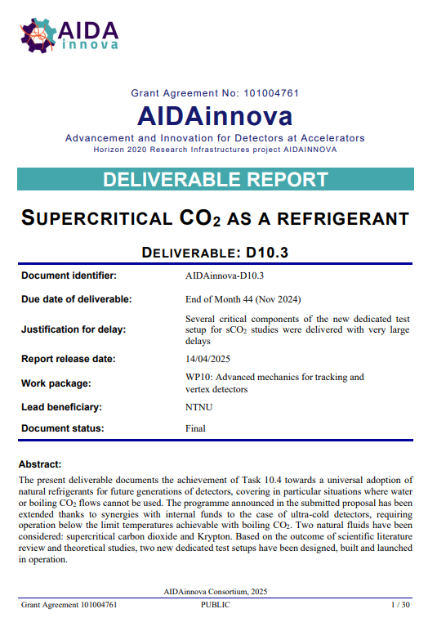
D10.3 (final report) delivered
30 Pages
35 References
Nice summary of the state of the art and of the work accomplished until now (waiting for the two PhD theses to be out).
Will be completed by an addendum before the end of the project with the latest experimental results.
Additional journal publications will follow

Slide 4
The Kr cycle for detector cooling
The superheated gas at the compressor suction (1) is compressed up to the required discharge pressure (2). The warm gas at the compressor outlet goes through two cooling stages. The high-pressure cold stream (5) enters the ejector where its pressure is reduced (6) creating locally a depressurization zone (9) that enables some flow to be entrained from the low-pressure stage. The two stream are then mixed in the mixing chamber (7) and then the flow is pre-compressed (8) via a divergent section called diffuser and discharge into the tank in the form of liquid-vapor mixture. At the detector level, flow circulation is promoted by the ejector recovering part of the expansion work available (5-6). In supercritical operation (T ≥ -60 °C) the fluid is directly circulated in single phase in the detector. In subcritical operation (T < -60 °C) The saturated liquid is vaporized inside the detector (14-15) to low vapor qualities, to prevent any risk of inception of dry-out. The exhaust two-phase flow (15) is further vaporized in the return line (15-16) before being sucked by ejector.

Slide 5
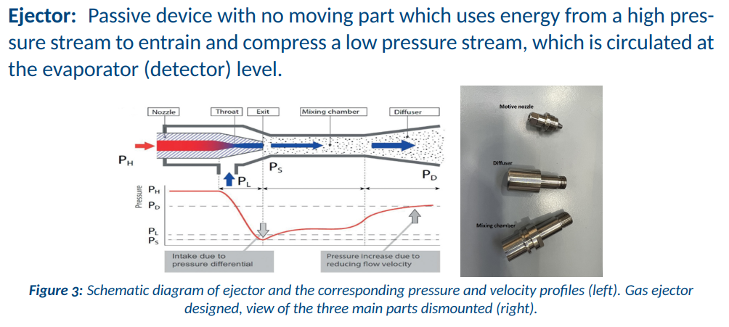
The ejector (the “pumping” element)

Slide 6
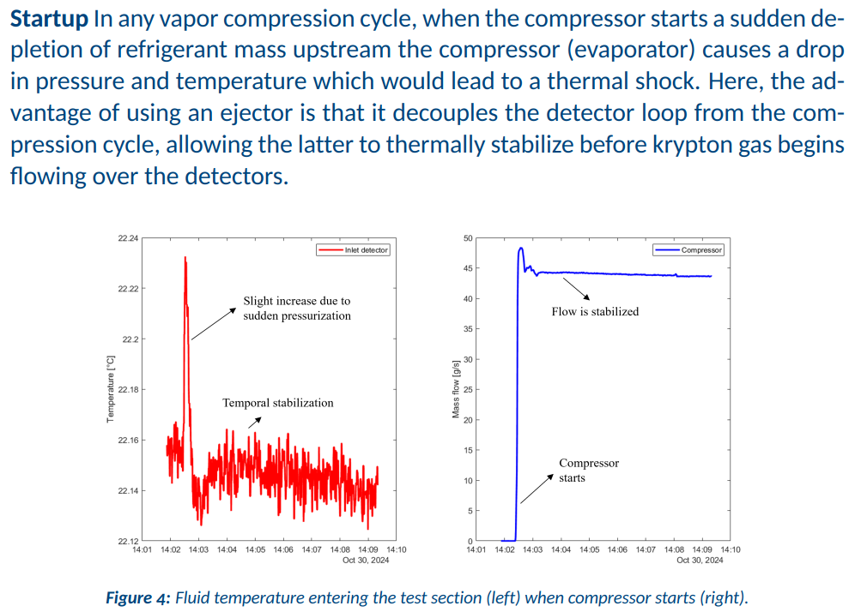
Krypton cooling: system demonstration (1)

Slide 7
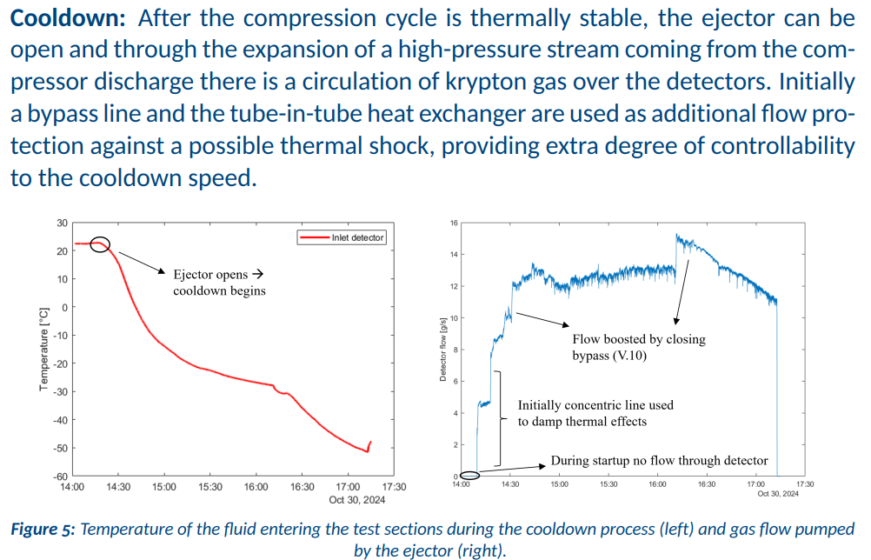
Krypton cooling: system demonstration (2)

Slide 8
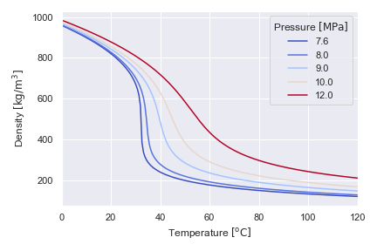
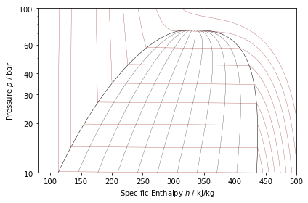
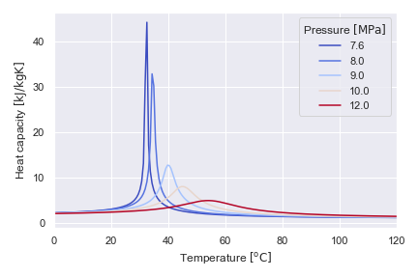
The supercritical condition
The supercritical condition of CO₂
At subcritical: discontinuities
Above critical value: change is continuous
  T<Tc liquid-like fluid
  T>Tc vapor-like fluid
Temperature of interest for room temperature detector cooling (+31 to +45 °C)
Tm = Pseudo-critical temperature
Critical point of carbon dioxide: 74 bar, 31 °C
Notes:
Just to make a clear point of what we are talking about when we say supercritical fluids:
At temperatures below the critical value, the variation of pressure with enthalpy along an isotherm exhibits discontinuities where it intersects the saturation line: where phase change takes place. The horizontal constant pressure segments represent the presence of two distinct phases. Above the critical point, these discontinuities are not found. Macroscopically speaking, there is a continuous variation from a liquid-like condition to a vapor-like one. This means, above the critical pressure, at temperatures lower than the critical the liquid-like fluid (with higher density) is found. At temperatures higher than that, the gas-like fluid is present.
In this region, standard techniques of correlating data fail: Dittus-Boelter equation does not correlate near-critical forced convection phenomena, boiling equations exhibit discontinuities and oscillations are commonplace. The similarities in heat transfer, pressure drop, wall temperatures and pressure oscillation between subcritical and near-critical regimes are significant.
The supercritical point of carbon dioxide corresponds to pressures above 7.4 MPa. Its corresponding critical temperature is 31 °C. In the supercritical region, the thermophysical properties of CO2 change dramatically with temperature and pressure.
For a given pressure, thermal conductivity, dynamic viscosity and density (seen in figure on the right top) strongly decrease with an increase in temperature. At the same time, the specific heat capacity reaches a sharp peak which is reduced as the pressure increases, as seen on the right bottom. This temperature, at which the heat capacity reaches its maximum value, is defined as the pseudo-critical temperature.
As can be seen from both figures, these changes are less steep when increasing the operating pressure. However, these sharp variations make its heat transfer performance different from conventional fluids, especially in the determination of the convective heat transfer coefficient from a heat transfer surface.
Finally, coming back to the point in the slide shown before, the temperature of interest for room temperature detector cooling is shown in the plots on the right. (+31 to +45 °C)

Slide 9
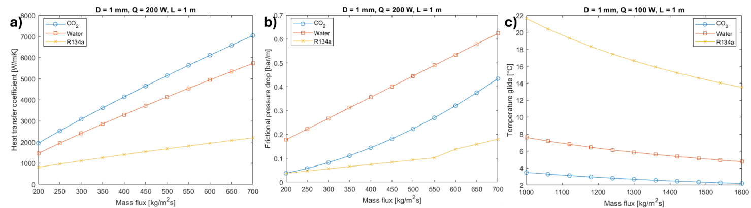
sCO₂ is better than water (theoretical results)
Variation of several important thermophysical and transport properties of sCO2 with mass flux and pressure: a) heat capacity; b) density; c) thermal conductivity; d) dynamic viscosity (simulation at T = 33 °C, p = 80 bar)

Slide 10
First experimental results
Geometry
1mm ID pipe SS304L
Heated length is 940 mm (L/D=50 for flow development left at the inlet)
10 Thermocouples evenly spaced throughout the heated section (distance between each TC = 85mm)
Condition | Liquid CO2 | Supercritical CO2 | Water
Inlet pressure (bar) | 81 | 77.3 | 12
Inlet temperature (°C) | 20.3 | 20.5 | 20.3
Mass flow (g/s) | 1.8 | 1 | 1/1.28
Power (W) | 29.6 | 152.7 | 29.6/65.7
Leaks from and to environment were not accounted for
Very preliminary results, no correction on sensors on liquid phase yet
Heat transfer coefficient calculated for water and compared with experimental value for CO2
Pressure drop calculated for water and compared with experimental value obtained for CO2
Experimental pressure drop compared to the one obtained theoretically (frictional)

Slide 11
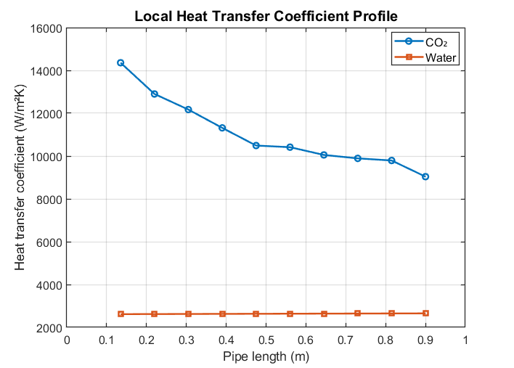
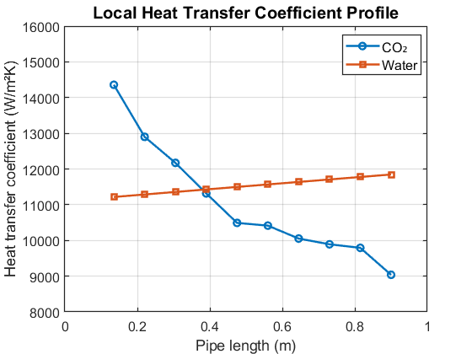
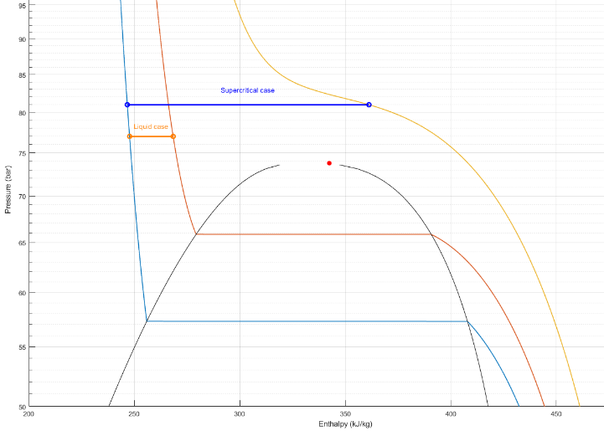
First experimental results: liquid CO₂
Condition | Liquid CO2 | Water
Inlet pressure (bar) | 77.34 | 12
Inlet temperature (°C) | 20.3 | 20.3
Mass flow (g/s) | 1.8 | 1.28
Power (W) | 29.6 | 29.6
Inlet-Outlet ΔT (K) | 5.5 | 5.5
Pressure drop (bar) | 0.7 | 0.49/1.1
Re | 3-3.5 x 10⁴ | 1600-1890
Water in laminar flow (natural)
Water in turbulent flow (forced)
20 °C
26 °C
36 °C

Slide 12
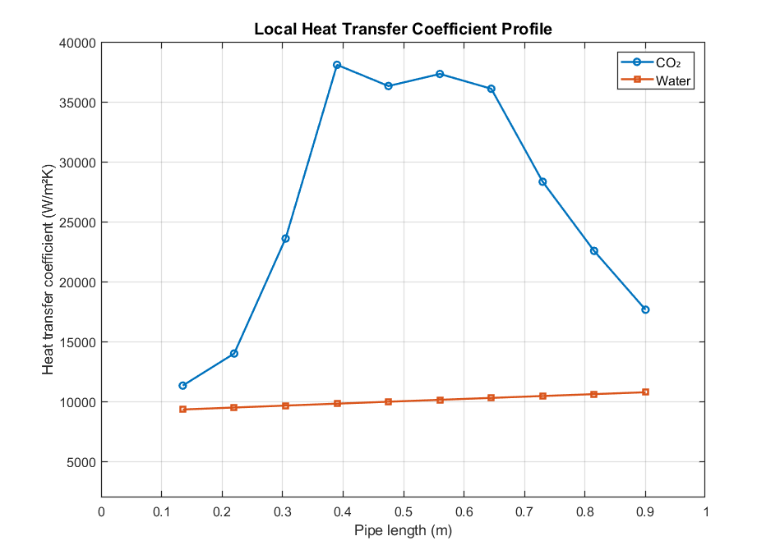
First experimental results: supercrtitical CO₂
Condition | Liquid CO2 | Water
Inlet pressure (bar) | 81 | 12
Inlet temperature (°C) | 20.44 | 20.3
Mass flow (g/s) | 1 | 1
Power (W) | 152.7 | 65.7
Inlet-Outlet ΔT (K) | 15 | 15
Pressure drop (bar) | 0.34 | 0.41
Re | 1.7-6.5 x 10⁴ | 1200-1890
20 °C
26 °C
36 °C
Water in turbulent flow (forced)

Slide 13
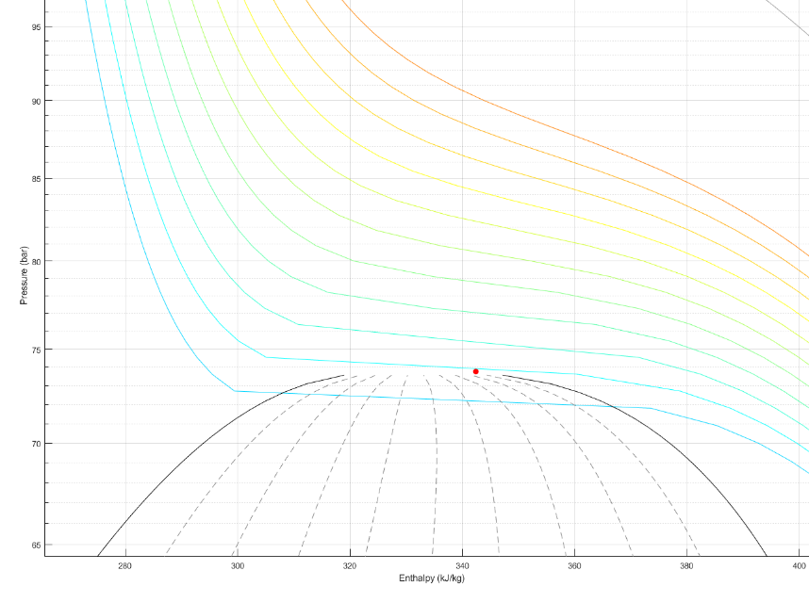
sCO₂: single phase isothermal cooling?
If designed for a controlled pressure drop, one could flow sCO2 almost isothermally and get a very good cooling capacity
For instance, if you consider a pipe designed to accept sCO₂ at 32 °C and 77 bars with a quite standard pressure drop of 3 bars (outlet pressure of 74 bars), you can see that you can absorb ~75 kJ/kg (in detector cooling language: 75 W/(g/s) ) exiting the pipe at the same 32 °C of the inlet.
To be noted that for a CO₂ boiling flow at 20 °C (saturation pressure of ~57.3 bars) this is exactly the available latent heat before reaching a vapour quality of 0.5 (you certainly do not want to go further to stay safely away from dry out).

Slide 14
D10.3 Addendum
At the end of AIDAinnova we will issue an addendum to D10.3 containing:
New results from the Kr set-up now completed in all components at CERN and connected to a powerful primary CO2 source at -53 °C
New results from the sCO₂ test rig now fully operational at CERN exploring the details of the wide operational envelope

