Slide 1
AIDAinnova Annual Meeting
6th May 2025
CERN
WP2
Communication, Outreach and Knowledge Transfer
Ana Rita Pinho (CERN), Ana Dorda (CERN), Anne Dabrowski (CERN), Beatrice Mandelli (CERN),
Thomas Brent (CERN), Antoine Laudrain (DESY)

Slide 2
Task 2.1 Work Package Coordination
Rita Pinho (CERN)

Slide 3
Objectives
Task 2.1. Work Package coordination
  Coordinate the WP.
  Create a network of Knowledge Transfer Officers (KTOs) within the AIDAinnova beneficiaries and coordinate their work and liaise with KTOs in other Innovation Pilots
Task 2.2. Communication, dissemination and outreach
  Define and implement a communication strategy to address key stakeholders in particle physics.
  Ensure the flow of information within the project (internal).
  Report the results of the project to a wider audience (external).
  Engage the detector community and industry to enhance societal impact of fundamental research.
Task 2.3. Careers of young detector scientists
  Enhance recognition, training and career opportunities for detector scientists.
Task 2.4. Industrial relations and Knowledge Transfer
  Promote co-innovation with industry to demonstrate societal impact of fundamental research.
  Impact analysis of innovation aligned with UN Sustainable Development Goals.

Slide 4

Knowledge Transfer Network
Create a network of Knowledge Transfer Officers
  46 beneficiaries, 35 academics;
Next:
  RoundTable & Industry Exhibition (today)
  Online workshop with KT/TTO network
    Present results of the survey
    Discuss challenges

Slide 5
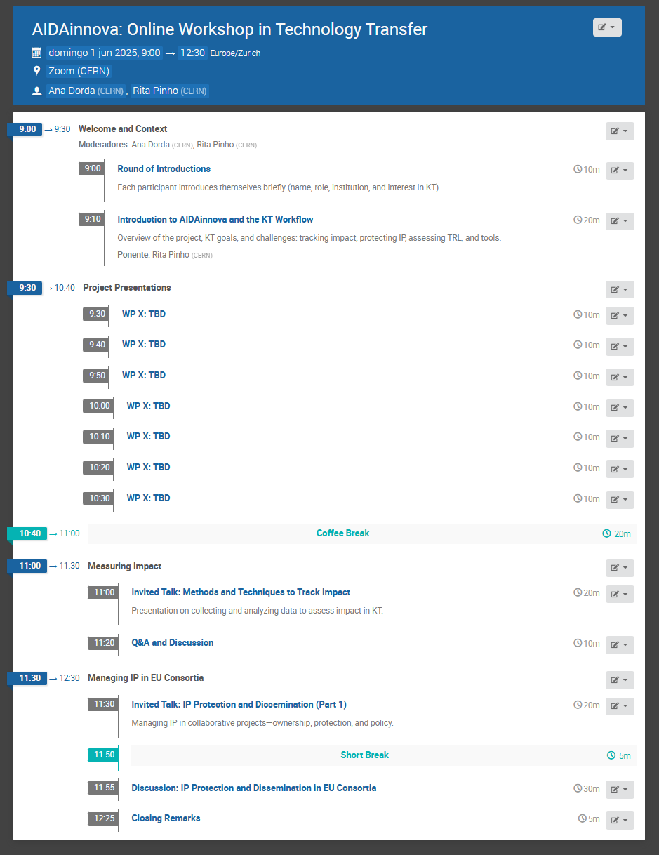
Technology Transfer Workshop
A half-day online event focused on sharing strategies, tools, and experiences in knowledge transfer, IP management, and impact assessment within the AIDAinnova consortium.
When:
To be scheduled – Doodle poll coming soon
We aim to hold the workshop before the summer.
Why attend:
Learn about AIDAinnova developments with KT potential
Get practical guidance on tracking impact and protecting IP in EU projects
Share challenges and approaches across the consortium
Strengthen collaboration between technical and KT teams

Slide 6








Help Us Spread the Word!
If you're a technical expert, please inform your KT office and encourage them to join.
Your help is key to ensuring representation from all partner institutes!

Slide 7


Synergies with Innovation Pilots
  Contribute to the RI Innovation Coordination Group:
    Frequent Meetings (approx. 4 per year)
  Strength interaction with other innovation pilots:
      Invited talks at LEAPS industry meeting
      Participation in ALBA event on Industry opportunities in light source
      TIPP23 conference, talk on behalf of:
        AIDAinnova, I.FAST, LEAPS-innov, EURO-LABS and EASI-STRESS projects
      Cryogenics Industry meeting
      BSBF 2024

Slide 8
Task 2.2 Communication
Thomas Brent (CERN), Antoine Laudrain (DESY)

Slide 9
Objectives
Task 2.1. Work Package coordination
  Coordinate the WP.
  Create a network of Knowledge Transfer Officers (KTOs) within the AIDAinnova beneficiaries and coordinate their work and liaise with KTOs in other Innovation Pilots
Task 2.2. Communication, dissemination and outreach
  Define and implement a communication strategy to address key stakeholders in particle physics.
  Ensure the flow of information within the project (internal).
  Report the results of the project to a wider audience (external).
  Engage the detector community and industry to enhance societal impact of fundamental research.
Task 2.3. Careers of young detector scientists
  Enhance recognition, training and career opportunities for detector scientists.
Task 2.4. Industrial relations and Knowledge Transfer
  Promote co-innovation with industry to demonstrate societal impact of fundamental research.
  Impact analysis of innovation aligned with UN Sustainable Development Goals.

Slide 10
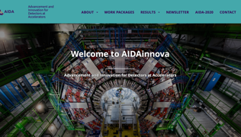
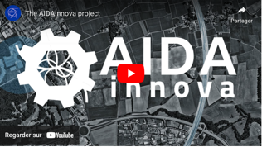
Results/highlights
Task 2.2: Output
Logo and branding
Website
>5600 unique visitors
36 articles
Newsletter
>400 subscribers
7 issues
Introduction video
On CERN YouTube
>5500 views
MS4
D2.1
Publication targets (data from Zenodo -> Please contact us!)
Objectives | AIDAinnova targets | Currently
Scientific dissemination | 180 publications including 60 journal publications and 50 conference contributions | 134 publications including 40 journal publications and 9 conference contributions
General communication and news | 10 articles in newsletters and other communication channels | 48 articles in newsletters and other communication channels (including 29 on the main website)
Other communication | N/A | >20 presentations at international physics workshops, 1 technical report, 4 posters

Slide 11
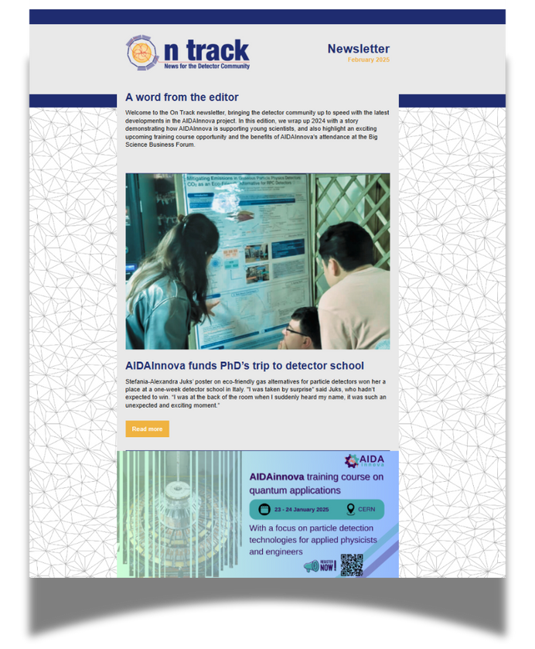
On Track newsletter
Sent on 12 December, 2024
Featuring five stories
Sent to 405 recipients
170 unique opens

Slide 12
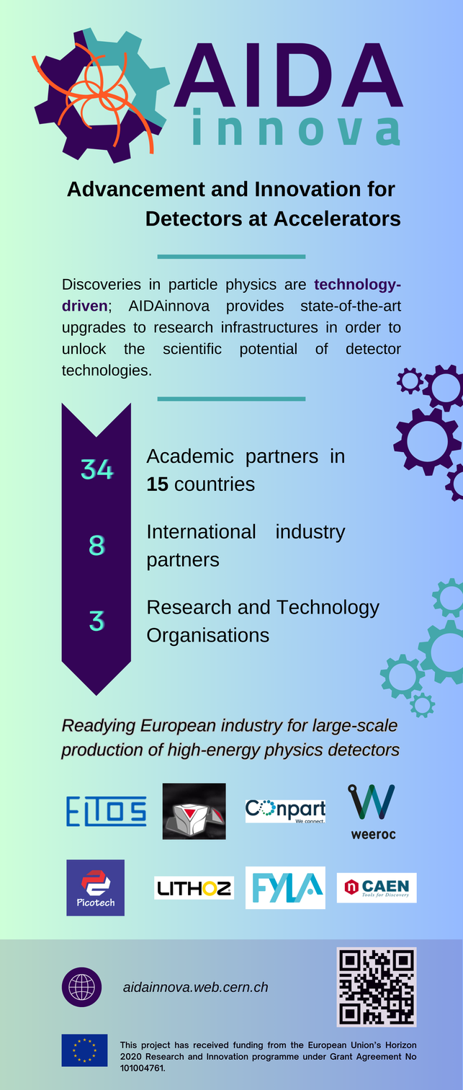
Big Science Business Forum
BSBF is one of Europe’s most important events for bringing together science and business
In total, more than 1,300 attendees from 500 different organisations were present
Published an article on AIDAInnova attendance: https://aidainnova.web.cern.ch/aidainnova-connects-industry-big-science-business-forum

Slide 13
Article on quantum training course for: AidaInnova website, CERN EU Projects newsletter, CERN KT newsletter
Future plans
Two new edition of On Track to cover results from the AidaInnova project.
Report on Communication, Dissemination and Outreach

Slide 14
Task 2.3 Careers of young detector scientists
Anne Dabrowski (CERN) ,
Beatrice Mandelli (CERN), Antoine Laudrain (DESY)

Slide 15
Objectives
Task 2.1. Work Package coordination
  Coordinate the WP.
  Create a network of Knowledge Transfer Officers (KTOs) within the AIDAinnova beneficiaries and coordinate their work and liaise with KTOs in other Innovation Pilots
Task 2.2. Communication, dissemination and outreach
  Define and implement a communication strategy to address key stakeholders in particle physics.
  Ensure the flow of information within the project (internal).
  Report the results of the project to a wider audience (external).
  Engage the detector community and industry to enhance societal impact of fundamental research.
Task 2.3. Careers of young detector scientists
  Enhance recognition, training and career opportunities for detector scientists.
Task 2.4. Industrial relations and Knowledge Transfer
  Promote co-innovation with industry to demonstrate societal impact of fundamental research.
  Impact analysis of innovation aligned with UN Sustainable Development Goals.

Slide 16
Task 2.3 since previous annual meeting
Opportunity for poster session at 2024 meeting in Catania
Collaboration with EP R&D at CERN,
  EP R&D Days, poster session for young researches, June 2024
  22 Poster presentations with awards
Training on Quantum applications at CERN, Jan 2025
  Large, collaborative effort in organization
  > 100 participants
Opportunity for poster session at 2025 annual meeting

Slide 17
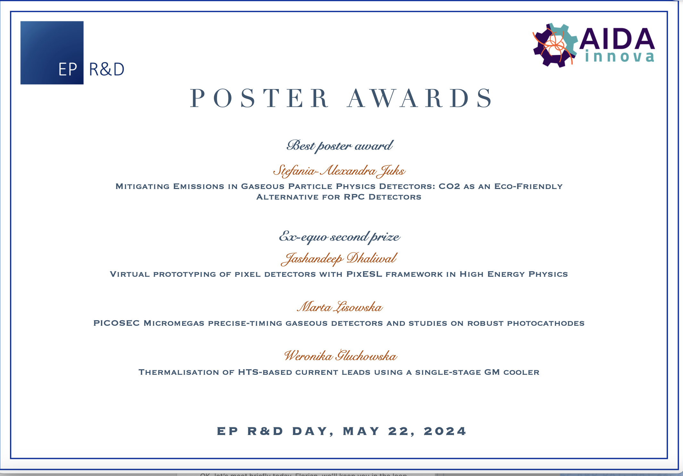
Collaboration EP R&D
Collaboration with EP R&D, poster session for young researches
  22 posters at the EP R&D days and a very good contribution from AIDAinnova collaborators.
  4 Prize winners - with the first place poster being awarded a scholarship by AIDAinnova WP2 for attendance to the https://agenda.infn.it/event/41033/ annual Bonaudi-Chiavassa International School on Particle Detectors

Slide 18
Quantum Applications
Training Course with an emphasis on Particle Detection Technologies for Applied Physicists and Engineers
23/24 January 2025, CERN
Organising Team: Rafael Ballabriga (CERN), Thomas Brent (CERN), Anne Dabrowski (CERN), Amanda Diez Fernandez (CERN), Ana Dorda (CERN), Sabrina El Yacoubi (CERN), Georgy Kornakov (U. Tech Warsaw), Antoine Laudrain (DESY), Lucie Linssen (CERN), Beatrice Mandelli (CERN), Rita Pinho (CERN)
AIDAinnova Annual Meeting Prague- WP2

Slide 19

Objectives of the training
2-day Training Course on Quantum Applications for detectors in HEP
Target audience: non-expert young scientists & engineers, starting work or with an interest in QT or would just like to expand their horizons in terms of state-of-the art detector applications
Goals:
  Provide an overview of quantum sensing technologies & applications to HEP detectors
  => Introductory talks on a broad range of technologies and topics, leaving ample time for questions & discussions
  Facilitate contacts with the industry
  Enable networking among participants and lecturers

Slide 20
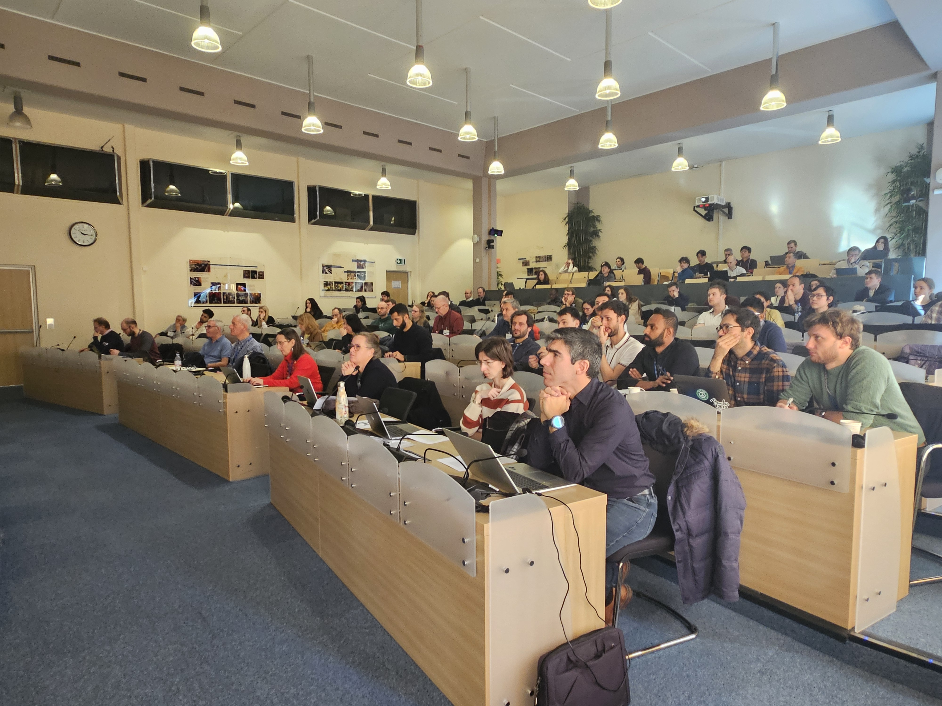
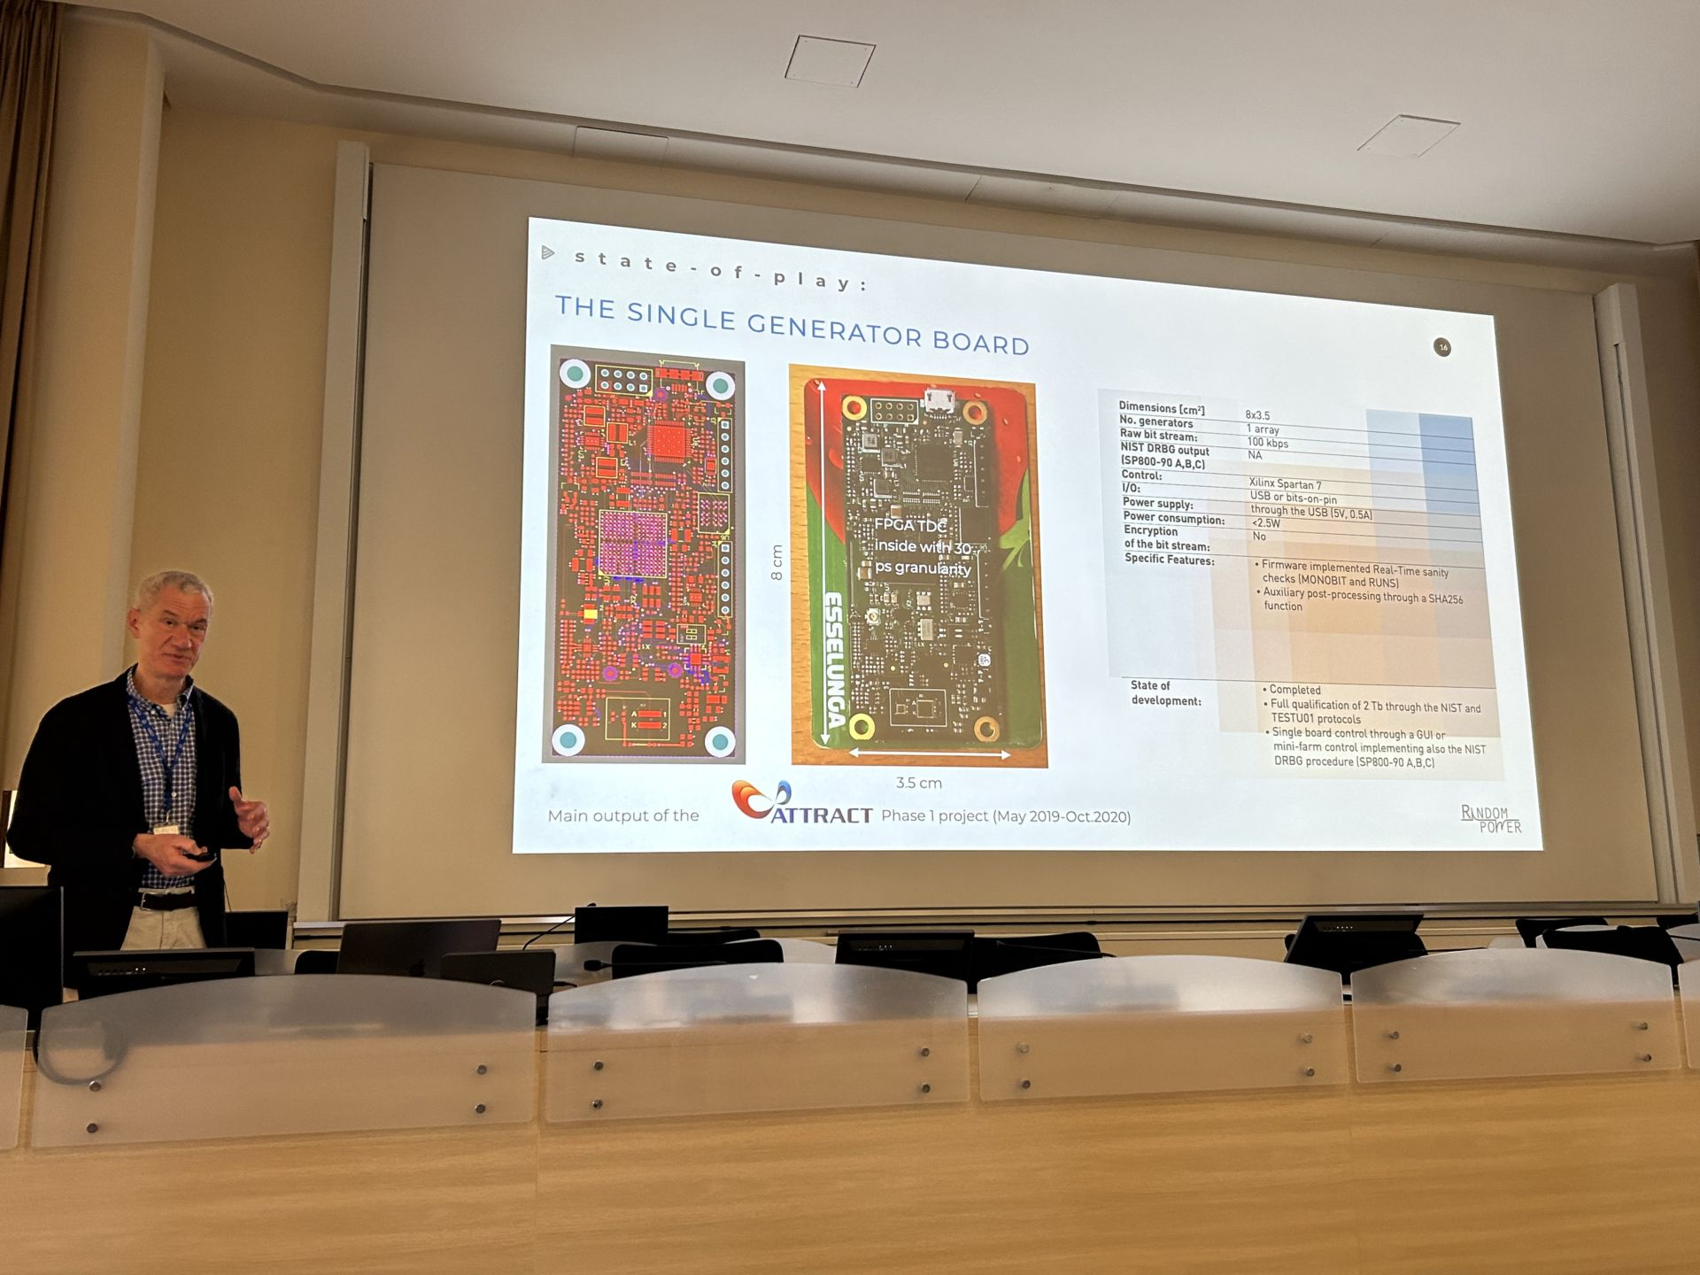
Overview
Date decided on 23-24 January
same week as QT4HEP conference at CERN: presence of many experts already on-site.
Lecturers: mix of academia, RTO and industry
(Hamamatsu, Amsterdam Scientific Instruments, IDQuantique, IBM, STM)
~100 participants (room capacity limit), priority given to AIDAinnova
  ~25 <PhD, ~30 PhD, ~40 >PhD, mostly from academia
  33% in active in AIDAinnova projects
  5 student grants (see next slide)
Poster session with ~15 posters (various topics, incl. Quantum)
Organised cocktail and breakfast for networking
Lectures recorded and available
  https://indico.cern.ch/event/1441944/timetable/?view=standard

Slide 21
Student grants
We financed 5 PhD students to attend the training:
  3 male, 2 female
  Institutes: CNRS, RBI, Université de Kinshasa
  Nationality: Croatia, France, Kongo, Vietnam
Financial support (Total expenses 710 CHF) consisted of:
  Rooms in CERN hostel (single or shared)
  Meal vouchers for the duration of the training
One of the student will be interviewed for the AIDAinnova newsletter
None of students who asked financial support is in an AIDAinnova task
All presented a poster during the training

Slide 22
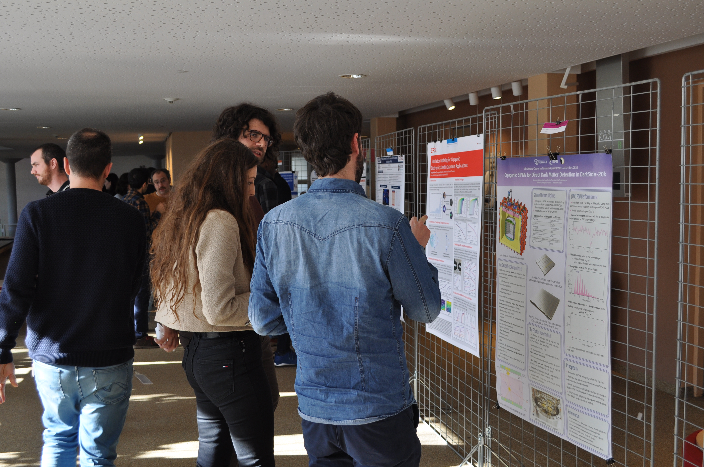
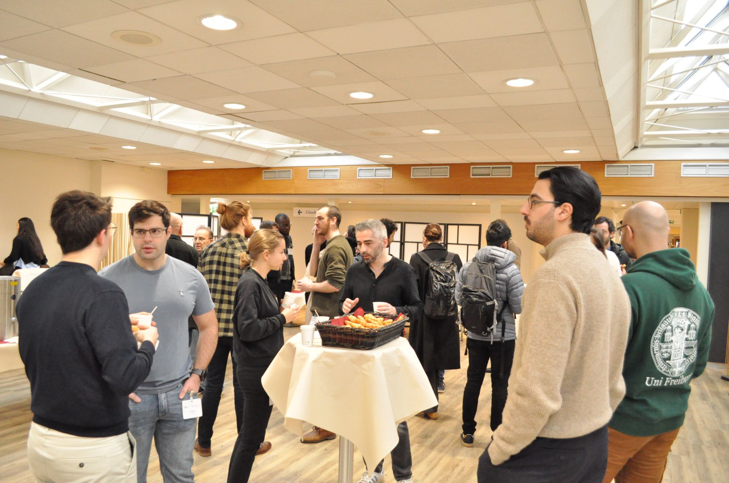
Pictures
Poster session
Networking breakfast

Slide 23
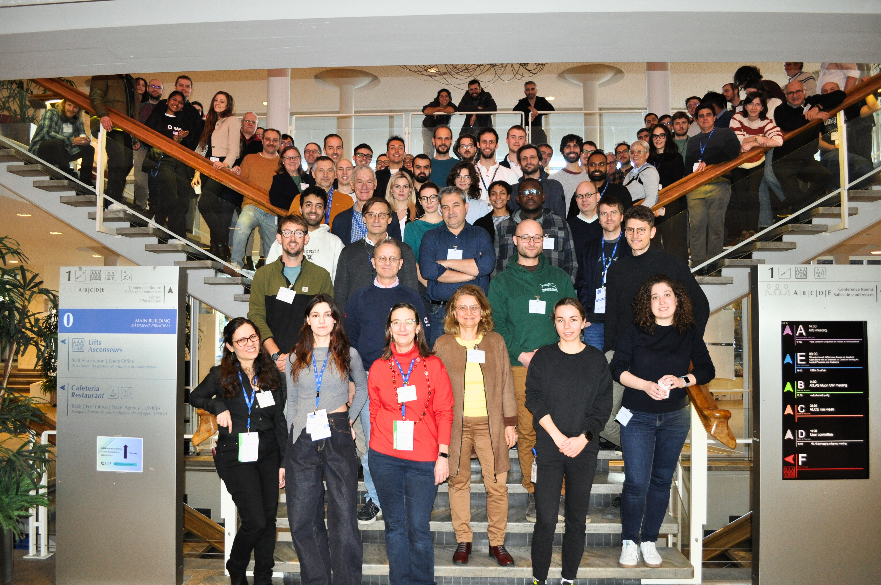
Great success!
Very interesting talks
Many connections made
All appreciated
Great feedback from participants and lecturers
https://indico.cern.ch/event/1441944/

Slide 24
Quantum training - Thank you
Thank you so much for all the preparations and the execution!
Antonine – for taking ownership of the school and being an excellent sounding board for the team – flexible to take on and close any loose ends
Lucie – all the registrations and also the academic program and follow up with the lecturers
Beatrice, thank you for the work behind the scenes for the students, grants, accommodation, meals, posters and the follow up with the certificates
  Putting the students first at every step
Thomas – excellent support for the advertising and documenting the event
Sabrina – amazingly reliable with many logistics from catering, rooms to lecture travel etc etc
Ana – thank you for stepping up and being a very reliable partner …
Rafa - for the academic program steering
Rita and Amanda for the insight into industry participation and sharing of your contacts

Slide 25
Towards D2.3 - M47
D2.3 Final report on career actions of young scientists WP2 2.3 M47 (end February, extended to include this annual meeting)
Report will include:
  Establishment and infrastructure for publication committee, noting that it has not been used
  AIDAinnova annual meeting lecture ('23) – Ivan and Sune
  EP R&D days poster session, incl. Prize for best poster awarded to AIDAinnova student – grant to attend detector school
  AIDAinnova Course on Quantum Applications with an emphasis on Particle Detection Technologies for Applied Physicists and Engineers
  Poster session and networking opportunities at annual meetings
Drafting of the report has started

Slide 26
Towards D2.3 - M47
Considerations – Annual meeting:
Small budget of ~2k chf has been kept aside to support the '25 annual meeting with
  Poster session - 3 Poster submitted

Slide 27
Task 2.4 Industrial relations and Knowledge Transfer
Rita Pinho (CERN), Ana Dorda (CERN)
AIDAinnova Annual Meeting Prague- WP2

Slide 28
Objectives
Task 2.1. Work Package coordination
  Coordinate the WP.
  Create a network of Knowledge Transfer Officers (KTOs) within the AIDAinnova beneficiaries and coordinate their work and liaise with KTOs in other Innovation Pilots
Task 2.2. Communication, dissemination and outreach
  Define and implement a communication strategy to address key stakeholders in particle physics.
  Ensure the flow of information within the project (internal).
  Report the results of the project to a wider audience (external).
  Engage the detector community and industry to enhance societal impact of fundamental research.
Task 2.3. Careers of young detector scientists
  Enhance recognition, training and career opportunities for detector scientists.
Task 2.4. Industrial relations and Knowledge Transfer
  Promote co-innovation with industry to demonstrate societal impact of fundamental research.
  Impact analysis of innovation aligned with UN Sustainable Development Goals.
AIDAinnova Annual Meeting Prague- WP2

Slide 29


What we promised
Knowledge Exchange Workshops with Industry and other scientific communities:
  1 “Academia Meets Industry” Advanced Mechanics event – April 2023
  1 “Industry Workshop on Cryogenics in Big Science” - April 2024
  Joint booth at BSBF 2024 – Oct 2024
  Quantum Training (w/industry talks)– Jan 2025
  1 workshop with other TT offices – tbc (online)
Technology Disclosures (target was 5 → we have 10 so far)
  Description of the technology, the problem that it addresses, potential applications outside HEP, how it compare to the state of the art, maturity, etc
  Value propositions of the main results per WP?
    Description of key technological advancements
    Applications beyond HEP
    Target markets and costumers
AIDAinnova Annual Meeting Prague- WP2

Slide 30

AIDAinnova Developments Survey
This survey seeks insights from WP leaders and collaborators on key developments, industry partnerships, and contributions to the UN Sustainable Development Goals (UN SDGs) within the framework of AIDAinnova.
Input for Impact Analysis
  Report mapping the economic and commercial impact, as well as technological, environmental, social and cultural impacts following
  UN SDGs (D2.4)
AIDAinnova Annual Meeting Prague- WP2

Slide 31
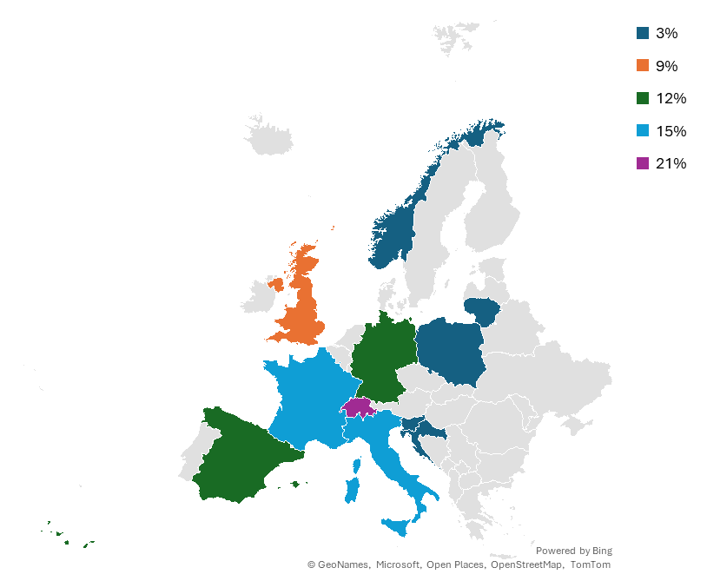

Profile of the respondents
AIDAinnova network
  45 beneficiaries:
    3 RTO
    8 industrial companies
    34 research institutes from 15 countries
We got 37 responses from
  26 research institutes
  2 industrial partners
  12 different countries
AIDAinnova Annual Meeting Prague- WP2

Slide 32
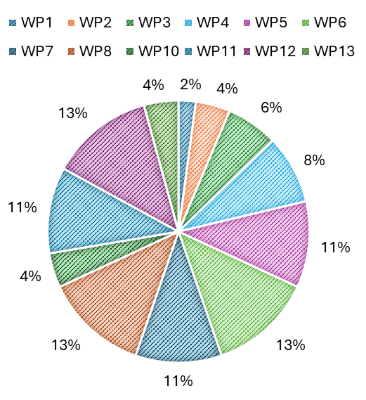
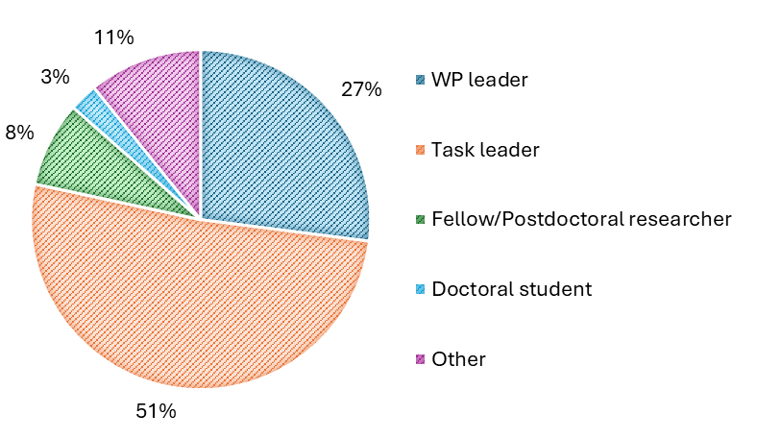
Answers per WP
50% of the answers were from Task Leaders
The WPs with the highest percentage of responses (13%) were WP6, WP8, and WP12.
No responses were received from WP9.
AIDAinnova Annual Meeting Prague- WP2

Slide 33
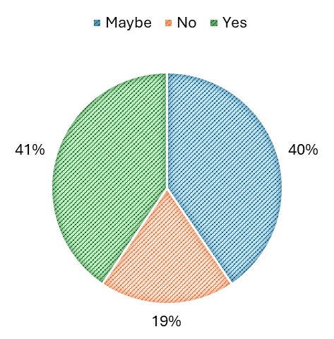
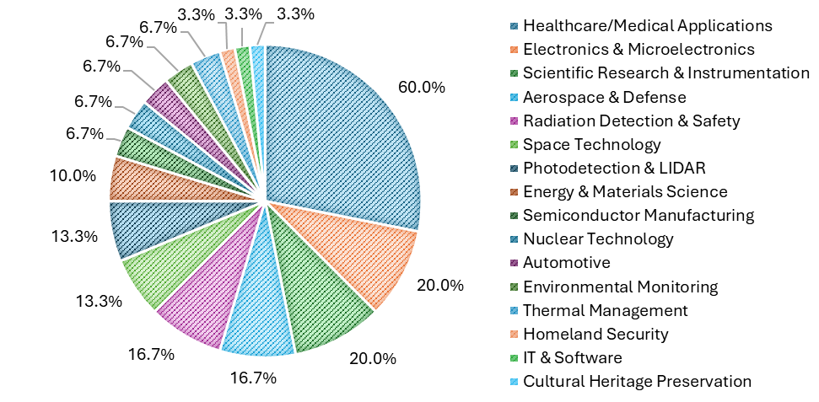
Exploitable foreground I
One objective of the survey was to gather insights on potential exploitable foreground, focusing on key developments and achievements within the project.
When asked about applicability outside High Energy Physics (HEP), 41% answered 'Yes,' 40% 'Maybe,' and 19% 'No.’
60% of the positive answers mention “Healthcare/Medical Applications”.
Are any of these technologies applicable to industries outside the field of HEP?"
AIDAinnova Annual Meeting Prague- WP2

Slide 34
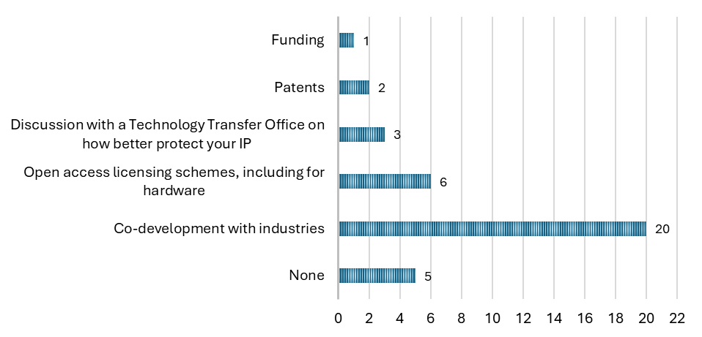
Exploitable foreground and Industry Partnerships
The same respondents were asked how their Work Package could generate beneficial results.
20 selected 'Co-development with industries.
The next most popular option was 'Open access licensing schemes, including for hardware.’
Only a 35% acknowledged to collaborate win industry on their developments
"Do you think that your WP will generate any results that would benefit from:" highlighting areas where respondents indicated they might need assistance, such as funding, IP protection, and other forms of support.
AIDAinnova Annual Meeting Prague- WP2

Slide 35
Exploitable foreground and Industry Partnerships
“Are you currently collaborating with any industrial companies as part of this WP?"
“Are there stakeholders (e.g., companies or research institutions) currently interested in your WP’s innovations?”
AIDAinnova Annual Meeting Prague- WP2

Slide 36

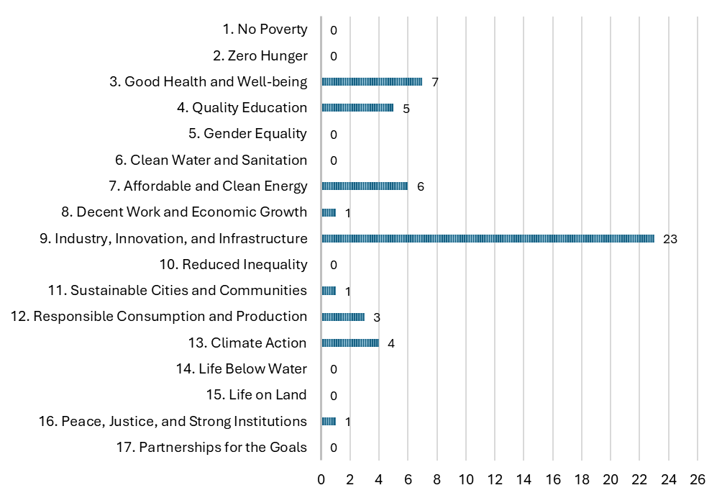
UN SDGs &Impact analysis
The last section of the survey focused on the United Nations Sustainable Development Goals (UN SDGs).
These are a set of 17 interconnected global objectives designed to create a more equitable, sustainable, and prosperous world by 2030.
23 respondents chose SDG number 9, related to Industry, Innovation, and Infrastructure
AIDAinnova Annual Meeting Prague- WP2

Slide 37
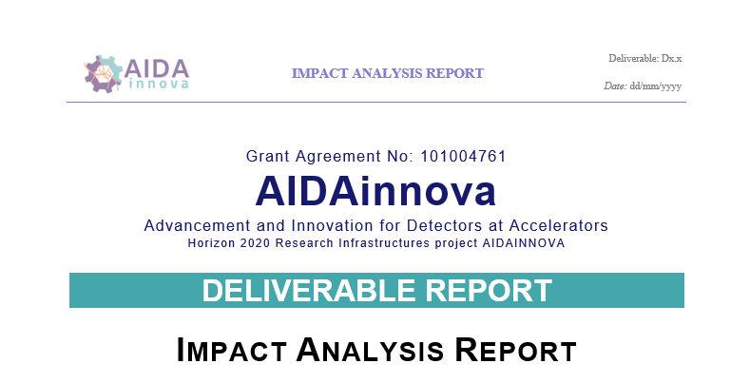
Impact analysis
The study was conducted as follows:
Online survey
Target follow-up interviews to explore in detail the potential of the developments:
  Eleven follow-up interviews with technical experts from WP1, 2, 3, 4, 5, 6, 7, 10, 11, 12 and 13.
  So far 10 technologies have been scouted.
A report, presenting conclusions from the survey on the economic, technological, environmental, and social impacts.
AIDAinnova Annual Meeting Prague- WP2

Slide 38
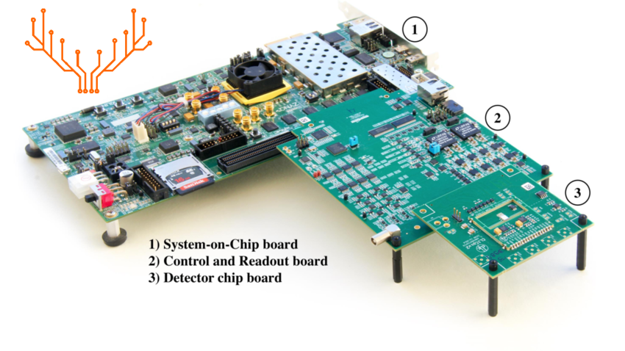
Impact analysis
WP3 Caribou
        Key Differentiating Features
Provides a flexible, open-source, and reusable hardware, firmware, and software for prototyping of silicon detectors and IP blocks.
Ensures high-throughput data acquisition, real-time signal processing, and low-latency data handling.
The CARboard is fully designed by BNL, allowing users to design their own chip carrier boards and work with the SoC board at the software level.
The user-friendly software requires minimal commands for operation, hosted on GitLab with a common branch to facilitate collaboration.
Successfully integrated into test-beam environments at DESY and CERN SPS, capable of supporting multiple detector prototypes.
Features an FPGA-based Time-to-Digital Converter (TDC) with picosecond timing precision.

Slide 39
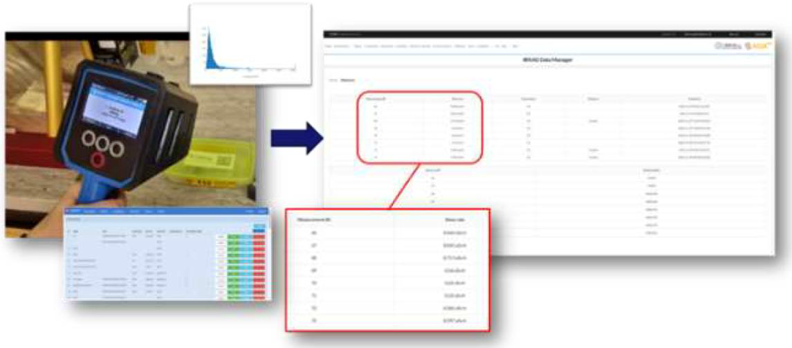
Impact analysis
WP4 DIGIWASTE & IRRAD
        Key Differentiating Features
Evolving into a versatile tool for irradiation facilities worldwide, enhancing data management
and operational efficiency.
Automates radiation sample tracking with RFID tagging, improving safety and traceability.
Successfully deployed at CERN, PSI, JSI, Fermilab, and more, demonstrating flexibility
across international infrastructures.
Direct integration with radiation measurement tools (CAEN RadHAND, CANBERRA
APEX-Gamma) for improved accuracy.
Manages ~800 irradiated objects annually, ensuring regulatory adherence, reducing errors,
and streamlining sample tracking.

Slide 40
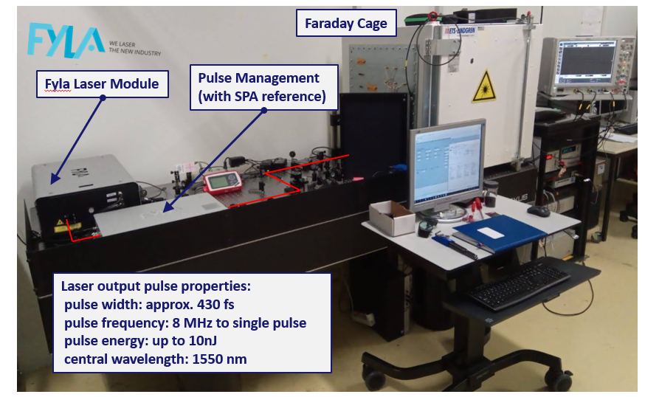
Impact analysis
WP4 TPA-TCT
        Key Differentiating Features
Achieves lateral resolution of ~2 µm and depth resolution of ~10 µm, surpassing standard TCT techniques.
Enables precise charge injection without requiring physical contact with the device under test.
Applicable to a wide range of semiconductor technologies, including radiation-hard sensors for HL-LHC upgrades.
Enhances predictive modeling through validation with TCAD simulations.
Ensures accessibility for a broad research community, accelerating detector development.
Notes:
Maybe we can get a better pic

Slide 41
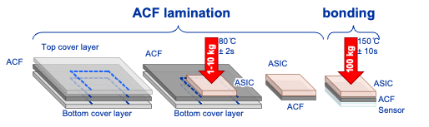
Impact analysis
WP6 Anisotropic Conductive Films
        Key Differentiating Features
The ACF process enables in-house single-die hybridization, reducing dependence on external facilities and expensive bump-bonding processes.
Achieved up to 97% for pixel pitches down to 55 µm, making it suitable for fine-pitch applications. Preliminary tests indicate reliability for long-term use in extreme environments.
Validated with a variety of ASICs and sensors, enabling broad applications in hybrid pixel detector R&D.
Ongoing optimization efforts focus on improving bonding force limitations for large-area fine-pitch devices.

Slide 42
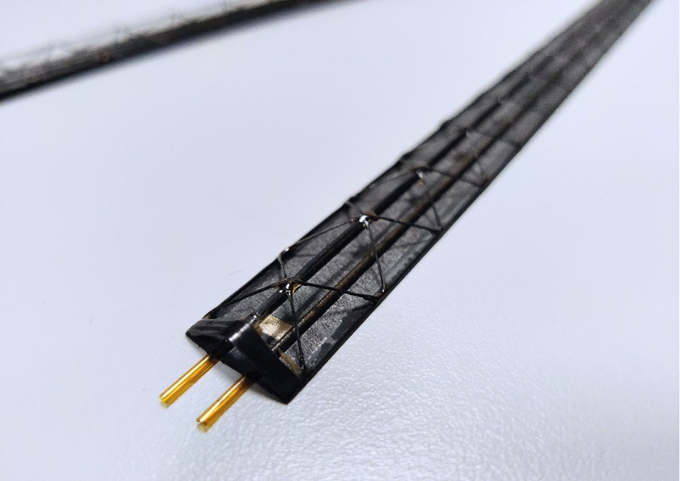
Impact analysis
WP10 Ultralight Cold Plate (UCP)
        Key Differentiating Features
Carbon fiber structures significantly reduce the overall material budget, making them ideal for applications where weight is a constraint.
Embedded boiling CO₂ cooling channels enable superior heat dissipation, crucial for low-temperature environments (-25°C to room temperature).
Designed to withstand pressures up to 150 bar, ensuring compatibility with high-efficiency cooling systems.
The modular design allows for varied geometries, making it adaptable to different detector configurations and industrial applications.
Manufacturing partners like Workshape and Lithoz have contributed to the development of advanced 3D-printed composite and ceramic cooling structures.

Slide 43
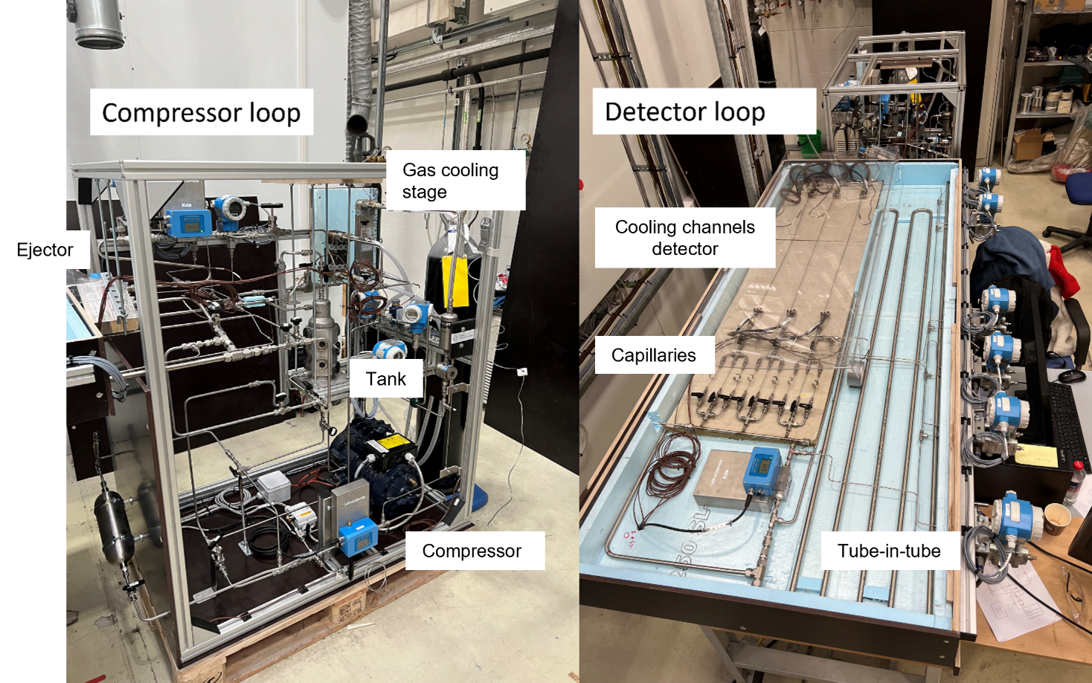
Impact analysis
WP10 Krypton cooling
        Key Differentiating Features
Krypton is a natural noble gas with a negligible environmental impact: 0.335 GWP and no PFAS components
In that range of temperatures, Krypton works at high pressure which allows for reduced dimensions
Compared to C02, Krypton stays liquid at much lower temperature, allowing cooling from -80°C to possibly -150°C
There is already interest in the detector community with clear potential in environment and the pharmaceutical industry

Slide 44
Still to be drafted…
WP10 Tubes with sensor / Anular flow
WP11 HKROC & LIROC

Slide 45
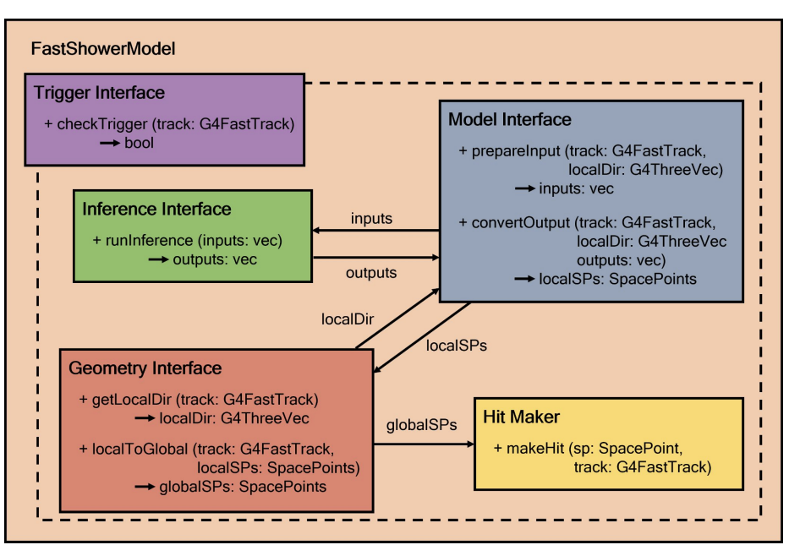
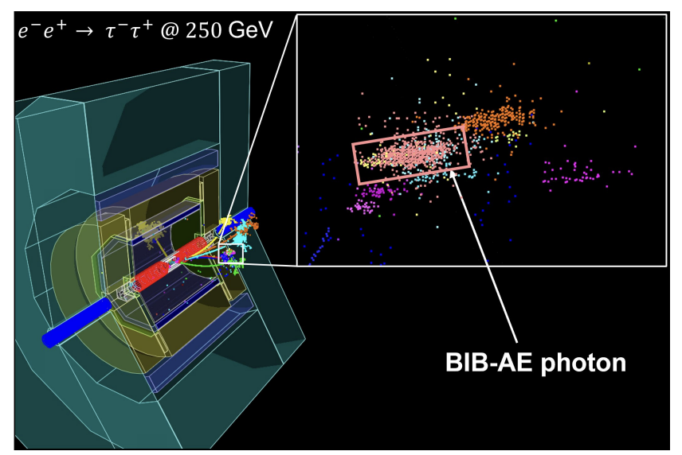
Impact analysis
WP12 ML for particle showers simulation
        Key Differentiating Features
ML-based simulation drastically reduces computation time compared to traditional methods.
The ML-based fast simulation is embedded within the Geant4 framework, enabling direct comparison with detailed simulations.
Users can choose from different inference libraries to optimize performance for their specific use case.
The code and pre-trained models are distributed, allowing further research and customization.
Fast simulation results are benchmarked against detailed Geant4 simulations to ensure accuracy.

Slide 46
Deliverables & Milestones
 | Deliverable | Due date | Status
D2.1 | Presentation video | M3 | Achieved
D2.2 | Final report on career actions for young scientists | M47 | In preparation
D2.3 | Report on Communication, Dissemination and Outreach | M48 | In preparation
D2.4 | Impact Analysis | M48 | In preparation
Milestones |  |  | Status
MS4 | Launching of project website | M1 | Achieved
MS6 | Young Scientist Publication Committee | M15 | Achieved
MS7 | Analysis of innovations needed in markets and technologies | M12 | Achieved
MS5 | Academia Meets Industry Symposium | M24 | Achieved
AIDAinnova Annual Meeting Prague- WP2

Slide 47
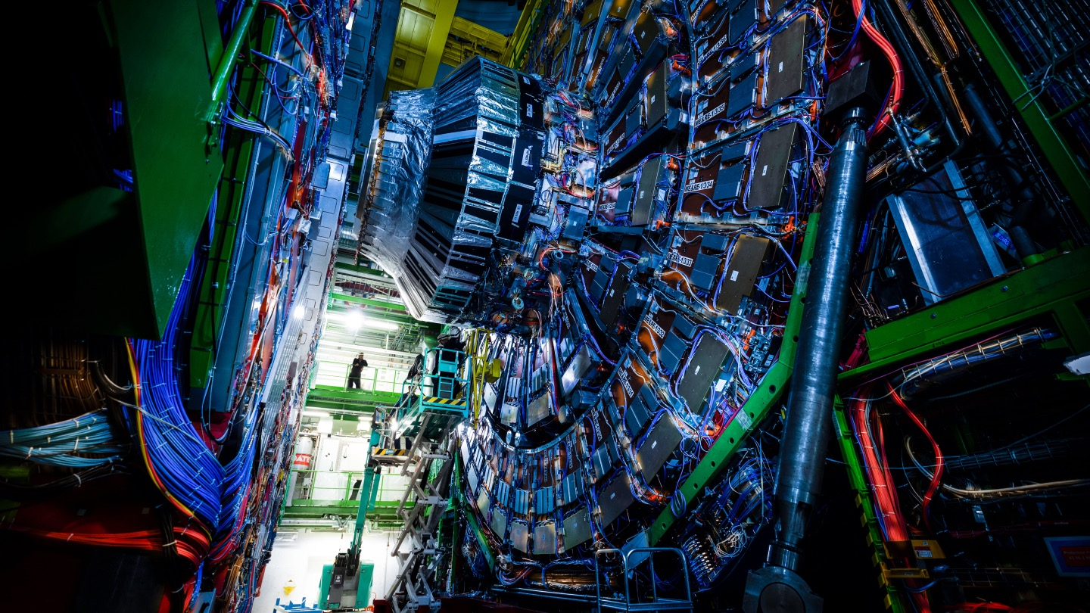
Thanks!
Questions?

