Slide 1
Report from WP13
Prospective and Technology-driven Detector R&D
AIDAinnova Annual Meeting, FZU Prague, May 7, 2025
Peter Križan
J. Stefan Institute and University of Ljubljana

Slide 2
Projects
Thin Silicon Sensors for Extreme Fluences
Make Si sensors radiation tolerant by using a thin bulk, internal amplification and using a gain implant that would withstand a factor of 50 higher fluences than what is presently available.
The Silicon Electron Multiplier, a new approach to charge multiplication in solid state detectors
Make Si sensors radiation tolerant by a novel biasing method – electrodes embedded in silicon.
Development of fine-sampling calorimeters with nanocomposite scintillating materials
Develop a new generation of fine-sampling calorimeters that use innovative scintillating materials based on perovskite nanocrystals dispersed in a plastic matrix to form fast (~100ps) and radiation resistant (~1 MGy) scintillators.
Wireless Data Transfer for High-Energy Physics Applications
Develop mm-wave-based wireless communication as an alternative to optical and wired links in a HEP-like environment to reduce the material and optimize the read-out.

Slide 3
Project: eXFlu-innova
Thin Silicon Sensors for Extreme Fluences
Make Si sensors radiation tolerant by using a thin bulk, internal amplification and using a gain implant that would withstand a factor of 50 higher fluences than what is presently available.
The Silicon Electron Multiplier, a new approach to charge multiplication in solid state detectors
Make Si sensors radiation tolerant by a novel biasing method – electrodes embedded in silicon.
Development of fine-sampling calorimeters with nanocomposite scintillating materials
Develop a new generation of fine-sampling calorimeters that use innovative scintillating materials based on perovskite nanocrystals dispersed in a plastic matrix to form fast (~100ps) and radiation resistant (~1 MGy) scintillators.
Wireless Data Transfer for High-Energy Physics Applications
Develop mm-wave-based wireless communication as an alternative to optical and wired links in a HEP-like environment to reduce the material and optimize the read-out.

Slide 4
eXFlu-innova Target
Goal: Design planar silicon sensors able to work in the fluence range 10¹⁶ – 10¹⁷ n_{eq}/cm²
Difficult to operate silicon sensors above 10¹⁶ n_{eq}/cm² due to:
– defects in the silicon lattice structure → increase of the dark current
– trapping of the charge carriers → decrease of the charge collection efficiency
– change in the bulk effective doping → impossible to fully deplete the sensors
The ingredients to overcome the present limits above 10¹⁶ n_{eq}/cm² are:
1. saturation of the radiation damage effects above 5∙10¹⁵ n_{eq}/cm²
2. the use of thin active substrates (15 – 45 μm) with internal gain
3. extension of the charge carrier multiplication up to 10¹⁷ n_{eq}/cm² → Compensated LGADs

Slide 5
The principle: compensation with two dopants
Doping Profile – Standard LGAD
Doping Profile – Compensated LGAD
–– Boron × 1 Φ = 0
Effective doping
–– Boron × 5 Φ = 0
–– Phosp × 4 Φ = 0
–– Comp Φ = 0
Doping Density [a.u.]
Doping Density [a.u.]
Compensated LGAD
Use the interplay between acceptor and donor removal to keep a constant gain layer active doping density
Depth [a.u.]
Irradiation
Φ = 1×10¹⁶/cm²
Depth [a.u.]
–– Boron × 1 Φ = 1E16
- - Boron × 1 Φ = 0
–– Boron × 5 Φ = 1E16
–– Phosp × 4 Φ = 1E16
–– Comp Φ = 1E16
- - Comp Φ = 0
Many unknowns:
▻ donor removal coefficient,
from n⁺(Φ) = n⁺(0)⋅e^{-cDΦ}
▻ interplay between donor and acceptor
removal (c_{D} vs c_{A})
▻ effects of substrate impurities on the
removal coefficients
Doping Density [a.u.]
Doping Density [a.u.]
Effective doping
Depth [a.u.]
Depth [a.u.]

Slide 6
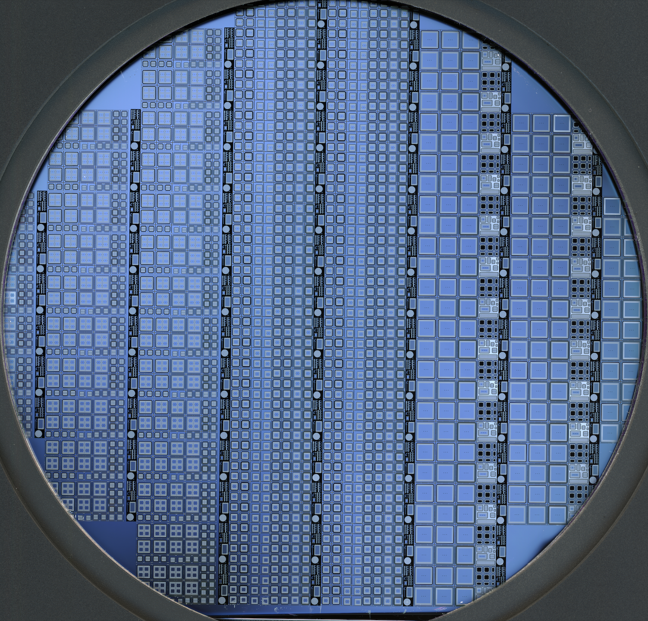
Compensated Gain Layer Design – Split Table
Active
thickness
30 μm
[ a < b < c ]
3 different combinations of p⁺ – n⁺ doping: 2 – 1, 3 – 2, 5 – 4

Slide 7
Compensated LGAD – State-of-the-Art
W13
3–2+C
Φ = 2.5E15
Lesson from the first batch of compensated LGAD sensors:
▻ Difficult to control the shape and the peak concentration of two different elements
→ Necessary to carefully tune all the process parameters
▻ After irradiation, possible to successfully operate compensated LGAD sensors
→ Good gain and timing performances after irradiation
▻ Co-implantation of Carbon in the same volume of Boron and Phosphorus
→ Same effect as in standard LGAD, a reduction of a factor of ~ 3 of the Acceptor removal
▻ Simulation to replicate I-V, C-V, and VdP behaviour after irradiation
→ Possible to extract Acceptor and Donor removal by comparing data and simulations
We are now ready to design the next batch of Compensated LGADs
→ COMPLEX1 will start the processing by Summer 2025

Slide 8
An NLGAD Batch to Extract Donor Removal
Several open questions:
▻ Is donor removal faster than acceptor removal?
▻ How can we extract the donor removal over a
wide range of doping densities?
▻ Should donor removal follow the same
parametrisation as acceptor removal?
▻ Can we mitigate it by co-implanting other
dopants, e.g., Oxygen?
c_{D}
?
?
?
?
?
NO Carbon
CHBL / CHBH (0.4, 2, 3, 5)
CHBL / CHBH (0.8 – 1)
CBL / CBH (0.6 –1)
1 10 100
p⁺⁺
n⁺
n
n⁺⁺
→ The NLGAD batch will be used to precisely investigate the donor removal coefficient, c_{D}
p-in-n LGAD or NLGAD

Slide 9
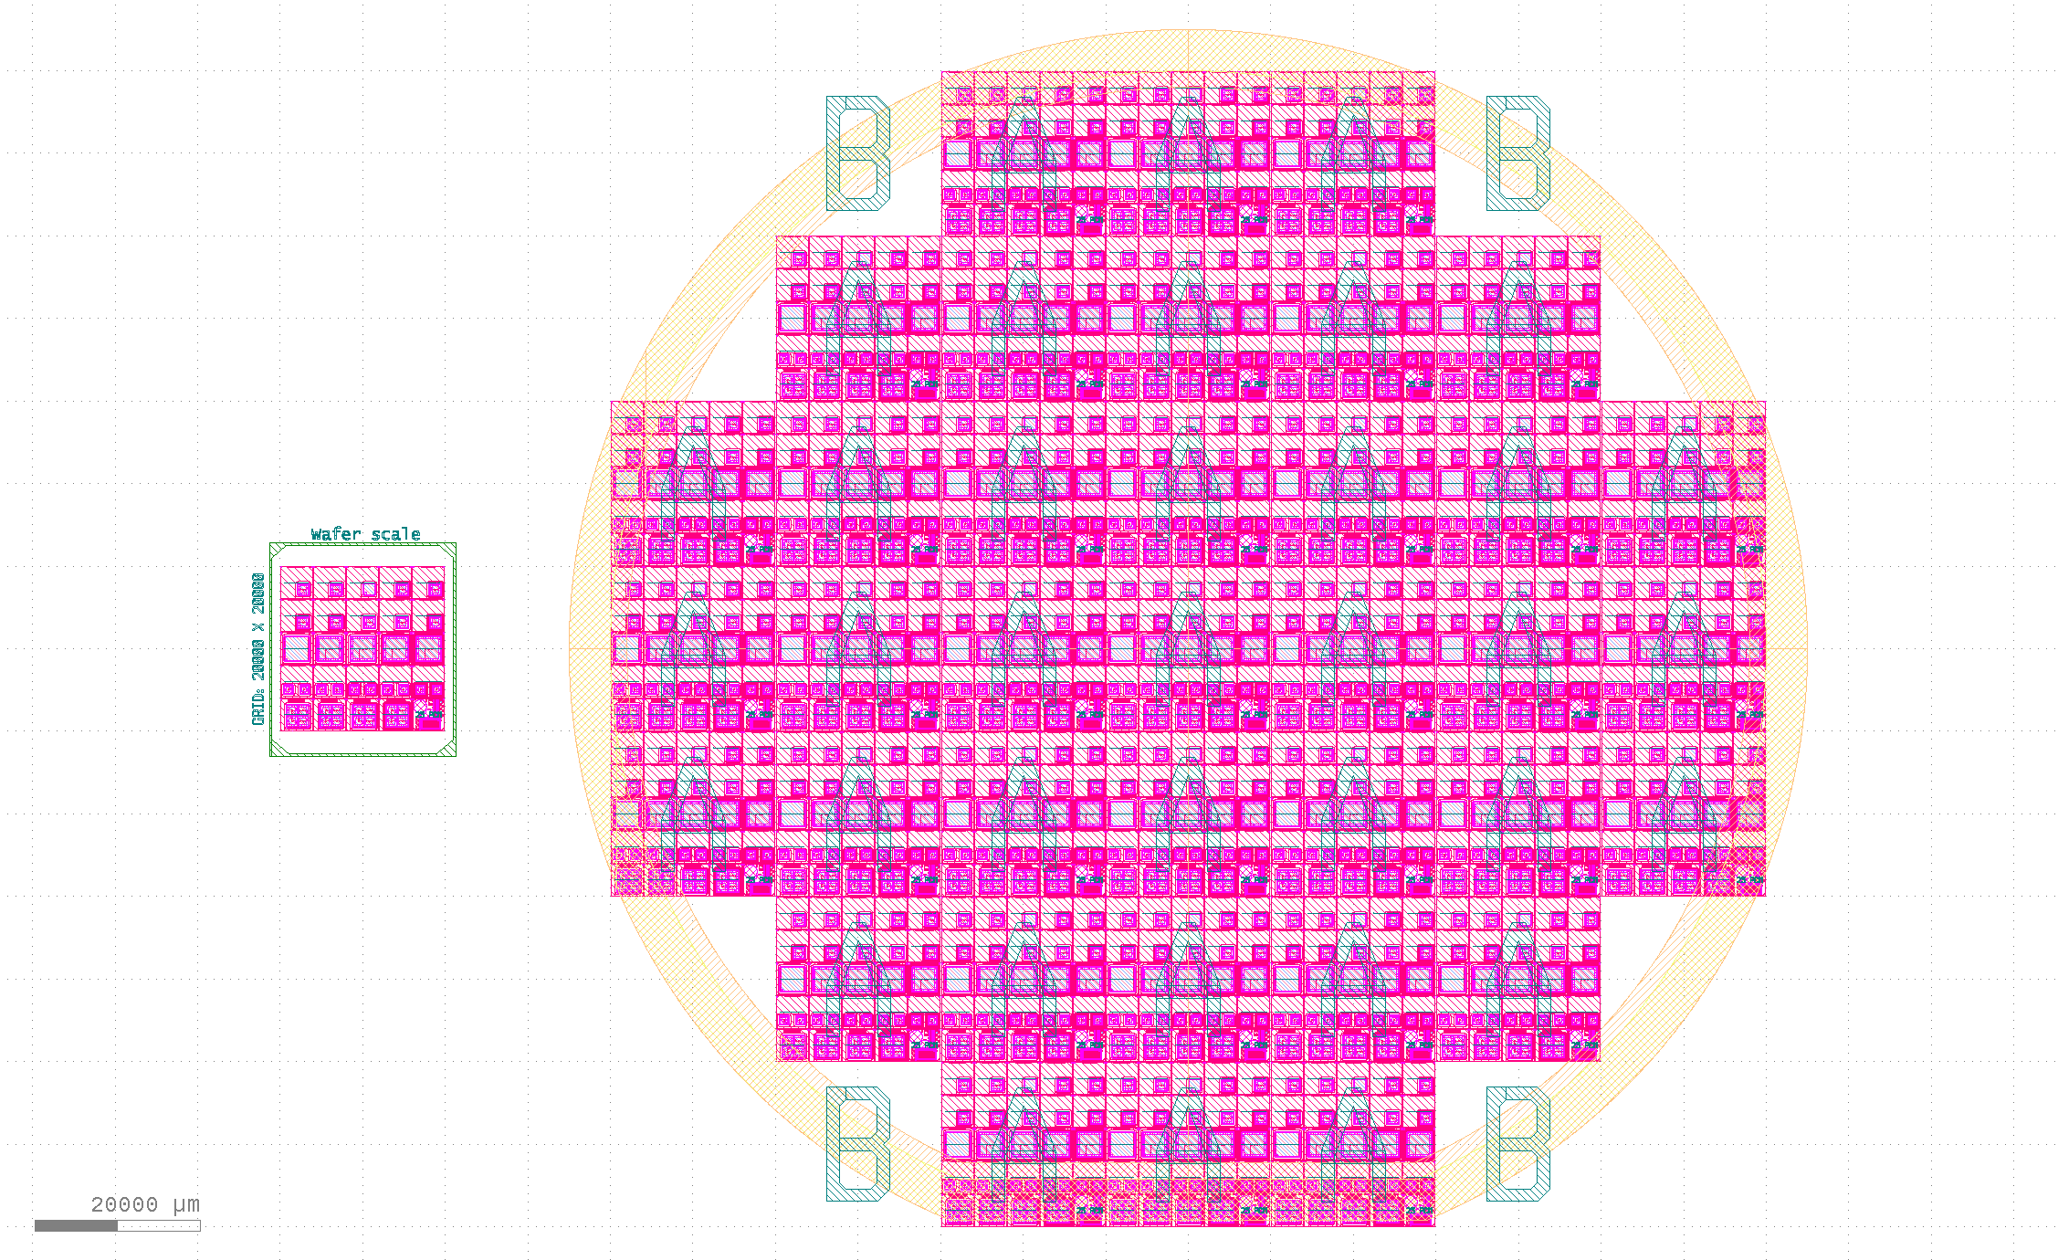
The NLGAD Batch at FBK
p⁺⁺
n⁺
n
n⁺⁺
The NLGAD batch will be used to study the donor removal coefficient, c_{D}
14 epitaxial substrates with active thickness of 55 μm
+ 3 substrates with active thickness of 450 μm
p-in-n LGAD or NLGAD

Slide 10

The eXFlu-innova Outlook
The eXFlu-innova activities are ongoing
▻ The p⁺–n⁺ design has been completed – Deliverable 1 🎯
▻ The p⁺–n⁺ production batch has been completed – Part of Deliverable 2 🎯
▻ The characterisation and testing on the p⁺–n⁺ sensors is complete 🎯
▻ The n-doped LGAD batch is in progress (part of D2) – expected delivery by mid August ⏳
→ Moderate delay in the eXFlu-innova activities
An ERC Consolidator Grant awarded to further develop compensated LGAD sensors
Doping Compensation in Thin Silicon Sensors:
the pathway to Extreme Radiation Environments
CompleX
→ The best parameters to manufacture compensated LGADs (D3) are about to be implemented in the COMPLEX1 batch

Slide 11
Project: SiEM
Thin Silicon Sensors for Extreme Fluences
Make Si sensors radiation tolerant by using a thin bulk, internal amplification and using a gain implant that would withstand a factor of 50 higher fluences than what is presently available.
The Silicon Electron Multiplier, a new approach to charge multiplication in solid state detectors
Make Si sensors radiation tolerant by a novel biasing method – electrodes embedded in silicon.
Development of fine-sampling calorimeters with nanocomposite scintillating materials
Develop a new generation of fine-sampling calorimeters that use innovative scintillating materials based on perovskite nanocrystals dispersed in a plastic matrix to form fast (~100ps) and radiation resistant (~1 MGy) scintillators.
Wireless Data Transfer for High-Energy Physics Applications
Develop mm-wave-based wireless communication as an alternative to optical and wired links in a HEP-like environment to reduce the material and optimize the read-out.

Slide 12
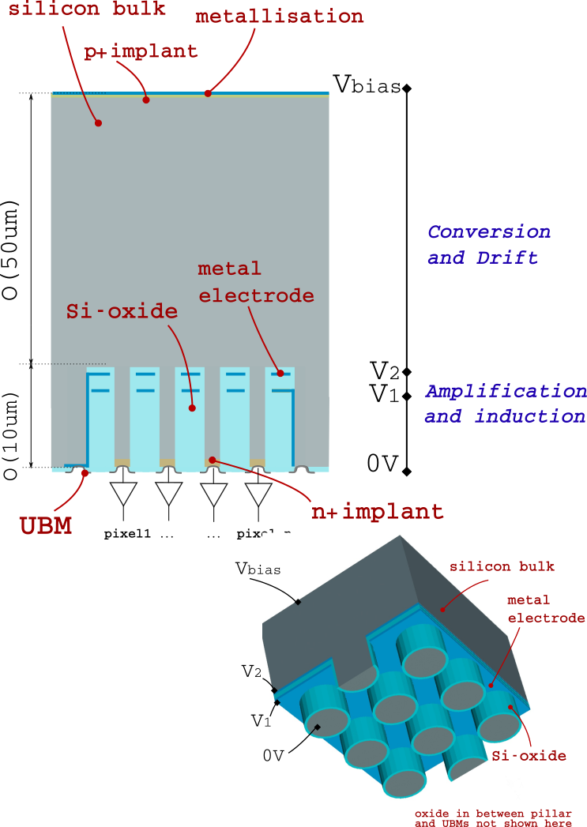
SiEM Detection principle
High field without doping
Silicon Electron Multiplier
(SiEM) principle
NIM A 1041 [2022] 167325
Primary charges generated by ionisation in the Conversion and drift region.
  Silicon, SiC, diamond…
High electric field region generated by applying a difference of potential to a set of electrodes
  GEM-like structure (two grids separated by a dielectric)
  Micromegas like (single grid)
  ...
Electrons drifting in amplification and induction region are multiplied and induce signal on the readout electrode
  can be readout individually (small pitch ~5-10μm)
  can be interconnected (large pitch ~50μm)
“Manufacturability” and gain mechanism to be demonstrated in Silicon

Slide 13
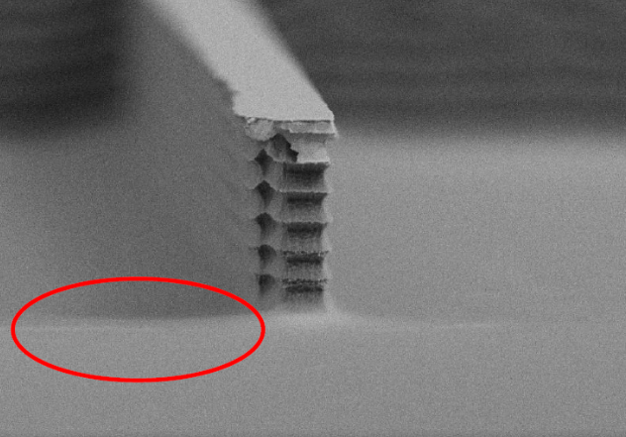

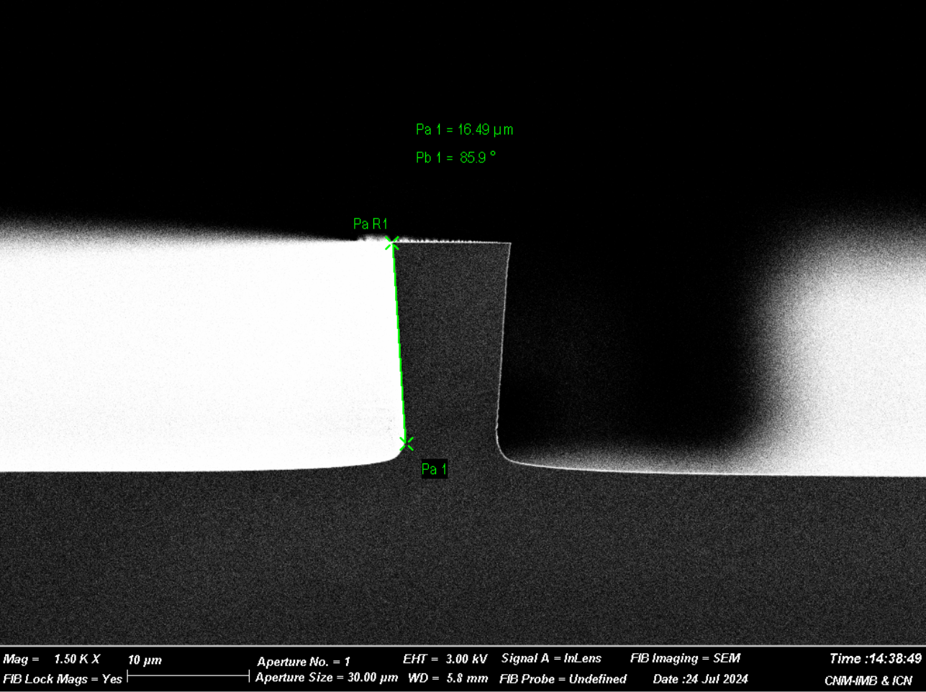
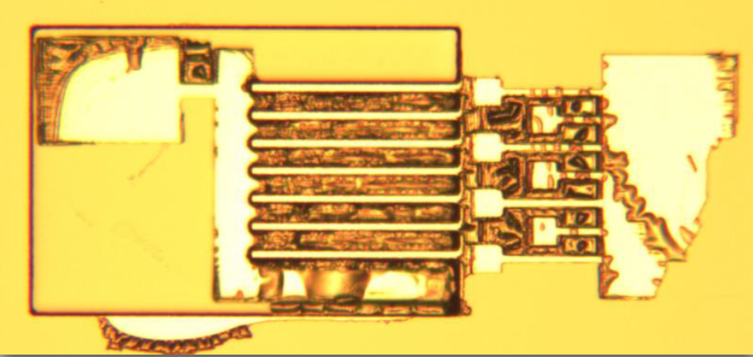
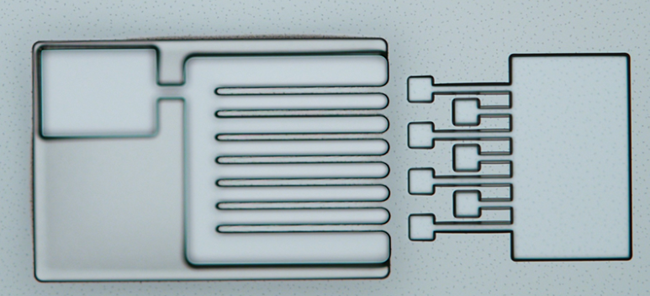
Process Developement
Etching and metalisation tuning
SiEM
Finalised the DRIE (Deep reactive-ion etching) parameters with laser photolithography:
  Good balance found in fall 2024.
  Achieves up to ~5deg slanted walls.
  Variation of the results depending on the pitch.
Improved the metalisation procedure:
  Used to have first a layer of photoresist followed by sputtering
  Non homogeneous lift-off
⇒ needed to change the method
  Uses first metallization, followed by photoresist and RIE to etch the unwanted metal
⇒ metalisation and photoresist OK, RIE to be tested in the coming days
TCAD mesh

Slide 14
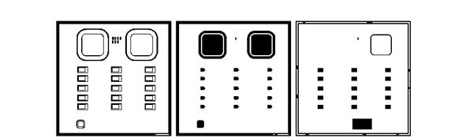

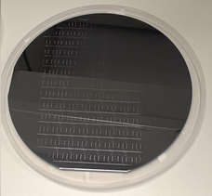
Production Status
Project: SiEM
Last year encountered issues when going for larger scale:
  Limited wafer planarity led to difficulty to keep the laser in focus → manual operations
  Non repeatable results
Moved to the CMOS compatible production line:
  Design of a new reticle mask for the stepper photolithography.
Produced four mechanical wafers in Nov 2024:
  Good etching quality.
  Improved structure reproducibility over the whole wafer compared to laser photolithography.
Doping of the production wafers in Dec 2024:
  Unavailability of the RIE machines until mid-April 25 → just restart the production.
DRIE to happen this week or next, followed by metalisation.
TCAD mesh

Slide 15
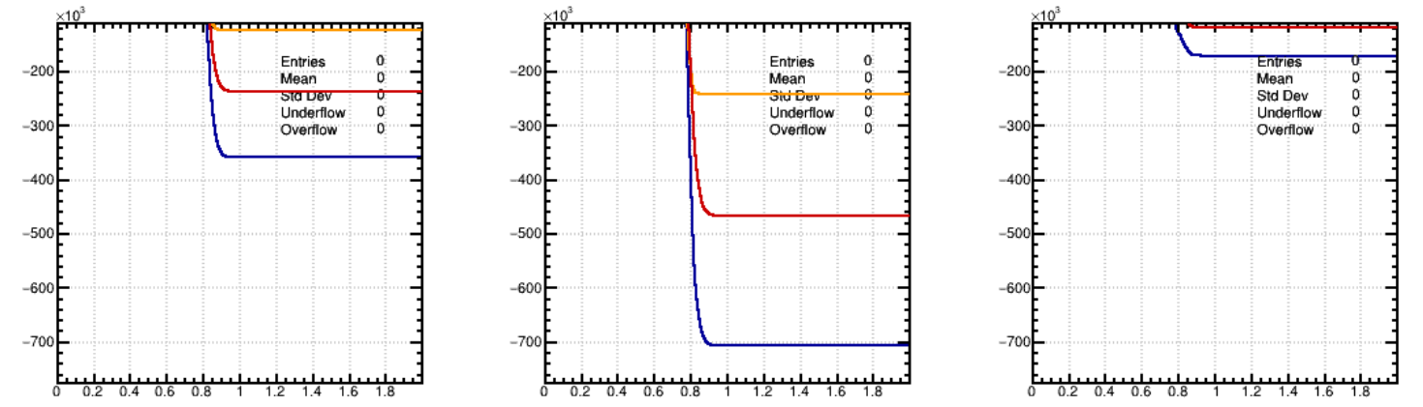
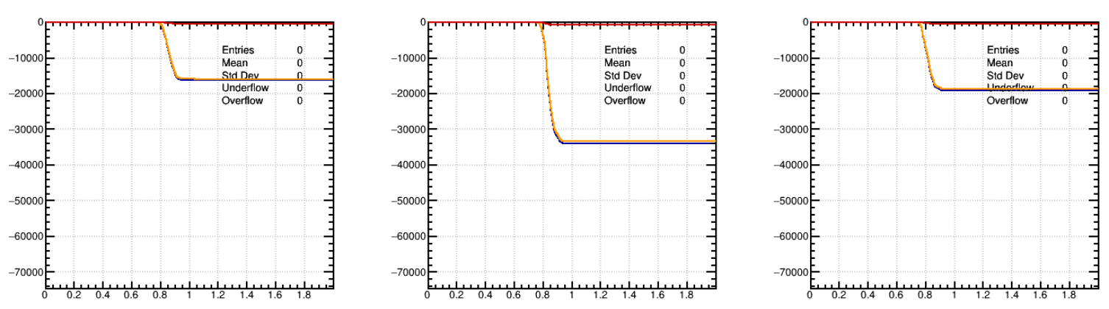
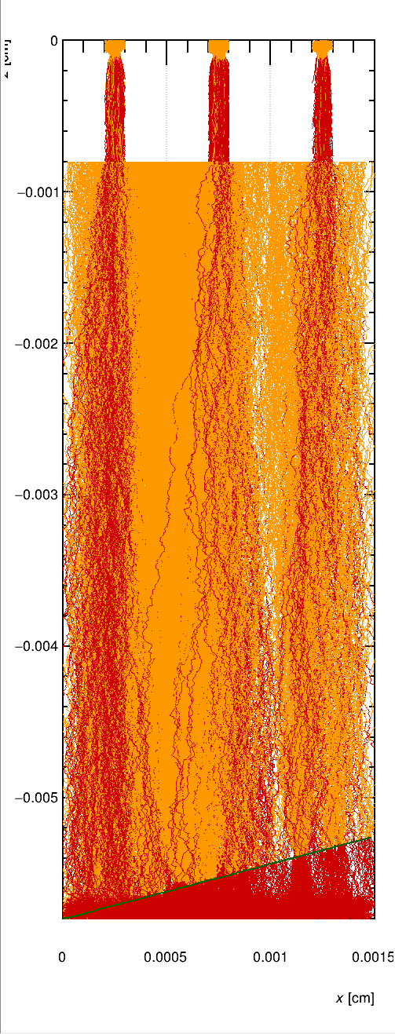
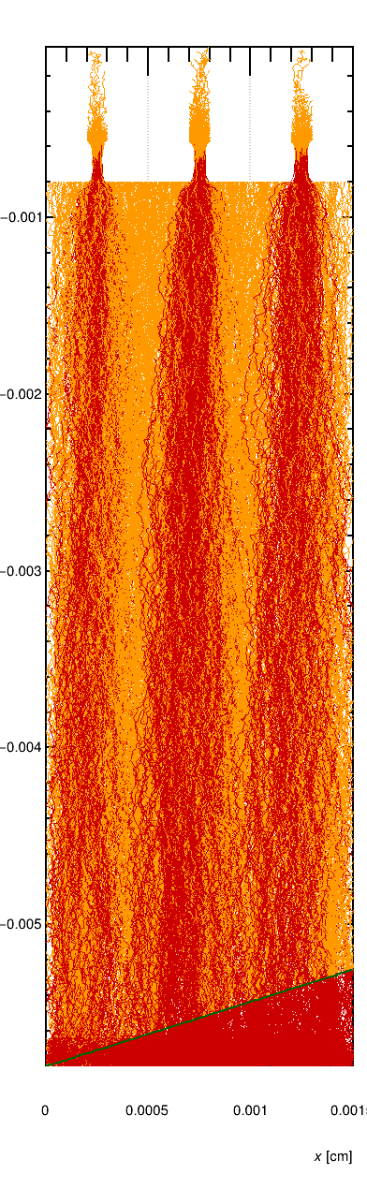
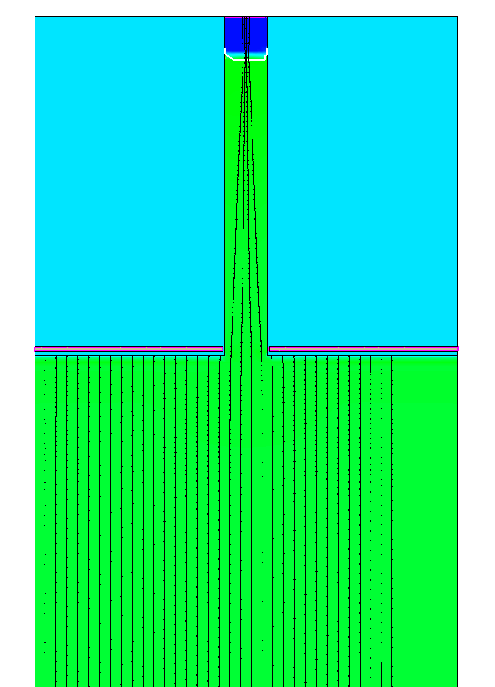
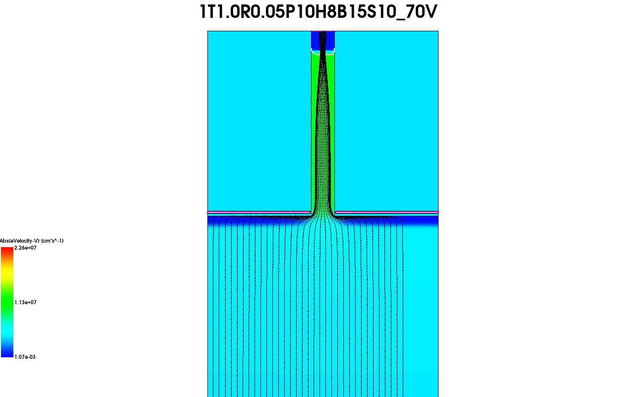

SiEM: Simulations
TCAD used to understand parameter variation
  used to drive the production targets
MC simulation using Garfield++ to understand transient response
Studies of single electrode vs. double electrode configuration:
  In both case the amplification electrodes “shields” the bulk.
  Double electrode: induced signal is dominated by amplified electron drift in the pillar.
  Single electrode: amplification happens at the tip of the sensor so that after a fast prompt of electron component, the holes back drifting in the pillar are dominant.
Effects of too large bulk voltage is visible in the charge collection amplitude for tracks not aligned with a pillar.
Small voltage difference in the pillar can lead the electrons hitting the wall.
Integrated Q
electrons
holes
time [ns]
time [ns]
z
Single electrode
Double electrode
Single electrode, bulk @ 200V
Single electrode, bulk @ 15V
TCAD mesh
x

Slide 16
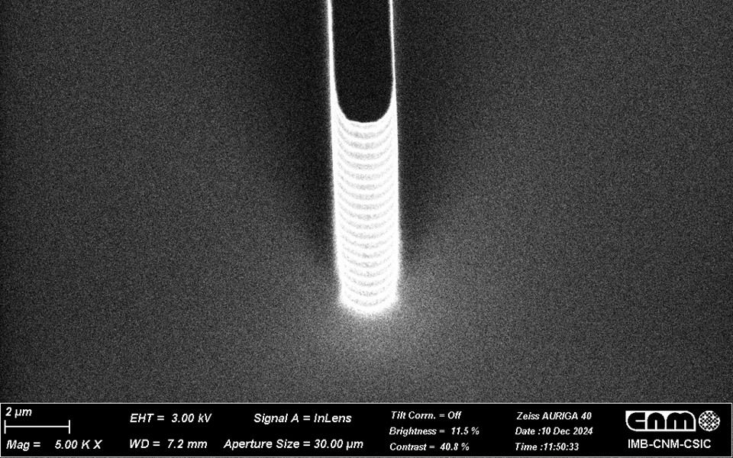
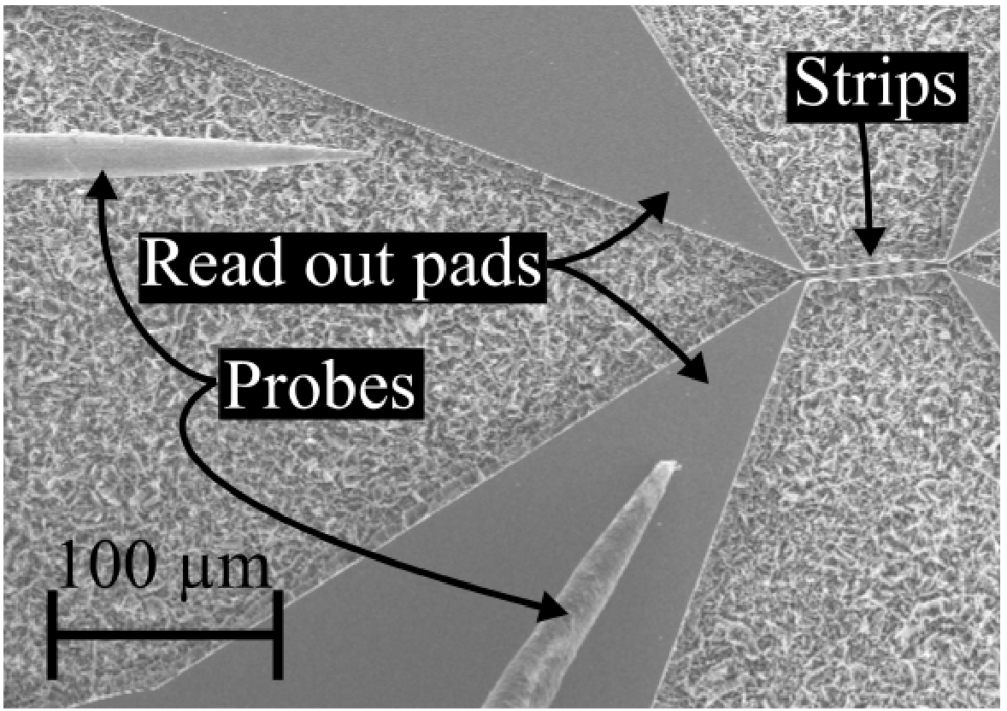
SiEM: Overall project achievement
  Understand the DRIE process constraints D1
  Produce a demonstrator and study performance D2
  Investigate other usage / processes D3
Production method developed:
  parameters of RIE etching well defined
  process in place
  repeatable and scalable results
    metal etching to be checked still
    double electrode version will be done after the end of AIDA innova
Refining simulation and understanding expected behaviour
Characterisation:
  setup ready
  difficulty in production means the characterisation will happen only around summer / fall
Investigation of alternative production methods:
  Studied and produced a first test structures with MacEtch rather than DRIE
    potentially low cost, but need another round to demonstrate its effectiveness
Roadmap document:
  being prepared (summarising the most promising develolpement route). Ideally containing the results of the characterisation but first version could just contain the production related observations.
achieved / not yet achieved
2um
RIE based pillars
TCAD mesh
MacEtch strip structure
[NIM A 1060 (2024) 169046]

Slide 17
Project: NanoCal
Thin Silicon Sensors for Extreme Fluences
Make Si sensors radiation tolerant by using a thin bulk, internal amplification and using a gain implant that would withstand a factor of 50 higher fluences than what is presently available.
The Silicon Electron Multiplier, a new approach to charge multiplication in solid state detectors
Make Si sensors radiation tolerant by a novel biasing method – electrodes embedded in silicon.
Development of fine-sampling calorimeters with nanocomposite scintillating materials
Develop a new generation of fine-sampling calorimeters that use innovative scintillating materials based on perovskite nanocrystals dispersed in a plastic matrix to form fast (~100ps) and radiation resistant (~1 MGy) scintillators.
Wireless Data Transfer for High-Energy Physics Applications
Develop mm-wave-based wireless communication as an alternative to optical and wired links in a HEP-like environment to reduce the material and optimize the read-out.

Slide 18
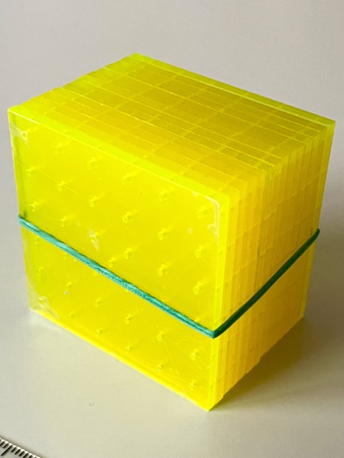
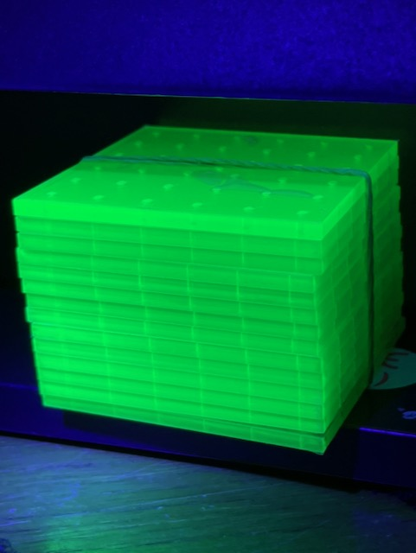
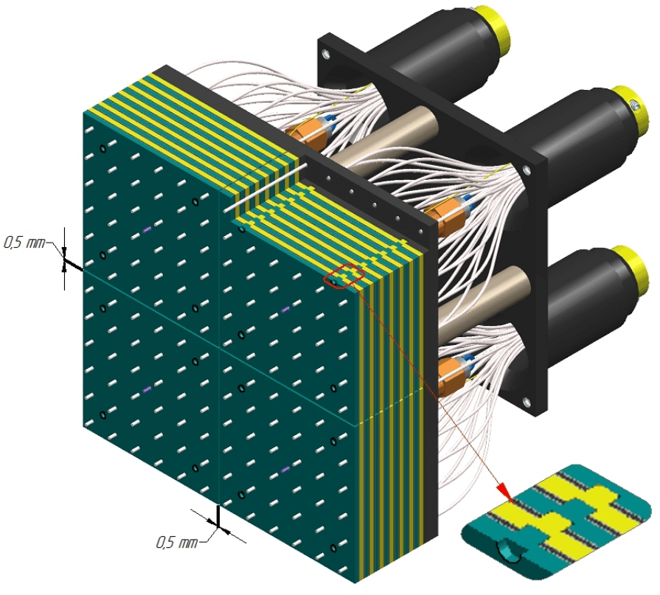
Nanomaterial composites (NCs)
Semiconductor nanostructures can be used as sensitizers/emitters for ultrafast, robust scintillators:
Perovskite (ABX₃) or chalcogenide (oxide, sulfide) nanocrystals
  Cast with polymer or glass matrix
  Decay times down to O(100 ps)
  Radiation hard to O(1 MGy)
Despite promise, applications in HEP have received little attention to date
No attempt yet to build a real calorimeter with NC scintillator and test it with high-energy beams
Shashlyk design naturally ideal as a test platform:
Easy to construct a shashlyk calorimeter with very fine sampling
Primary scintillator and WLS materials required: both can be optimized using NC technology
KOPIO/PANDA design
Fine-sampling shashlyk

Slide 19
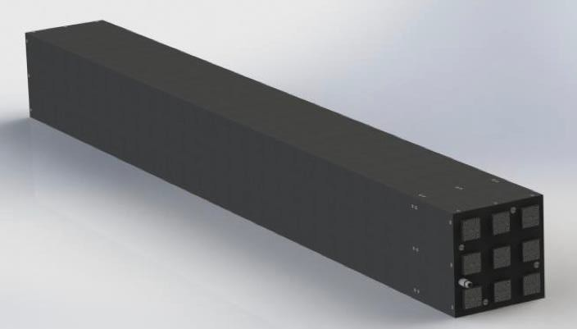
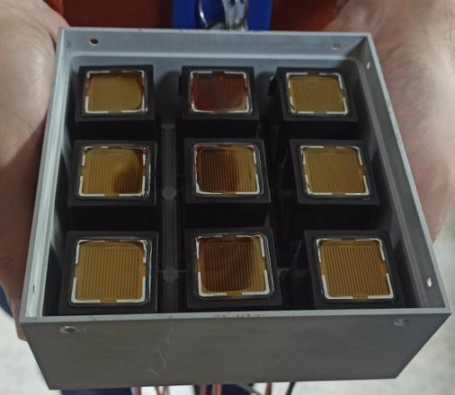
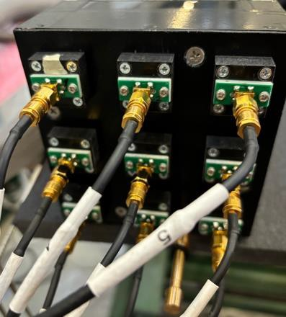
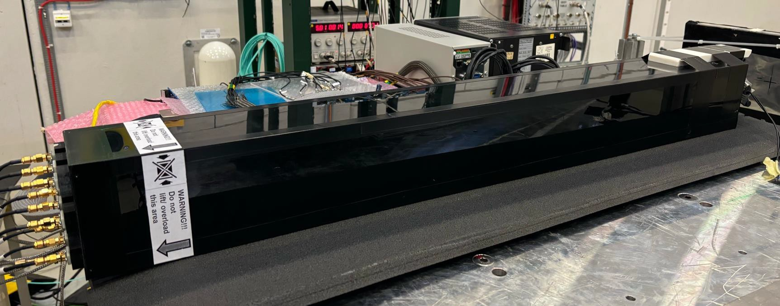

NC scintillators and shashlyk calorimetry
NanoCal shashlyk platform adapted from PANDA forward EM calorimeter:
Very fine sampling
0.3 mm Pb/1.6 mm scintillator
ISMA UPS-923A scintillator 2% PTP + 0.03% POPOP
BCF-92XL WLS, 1.2 mm dia.
500-layer depth = 27X₀ Can be reconfigured
Fine granularity
3x3 cells, 4x4 cm² each
Alternatives for light readout
  SiPM: Hamamatsu S13360-6025
  PMT: R7600-300 (green extended)
Use as platform for studies with innovative scintillator
First perform exploratory tests with 1X₀ shashlyk towers
Prototype developed in synergy with HIKE Parts & main assembly at ISMA Ukraine
19

Slide 20
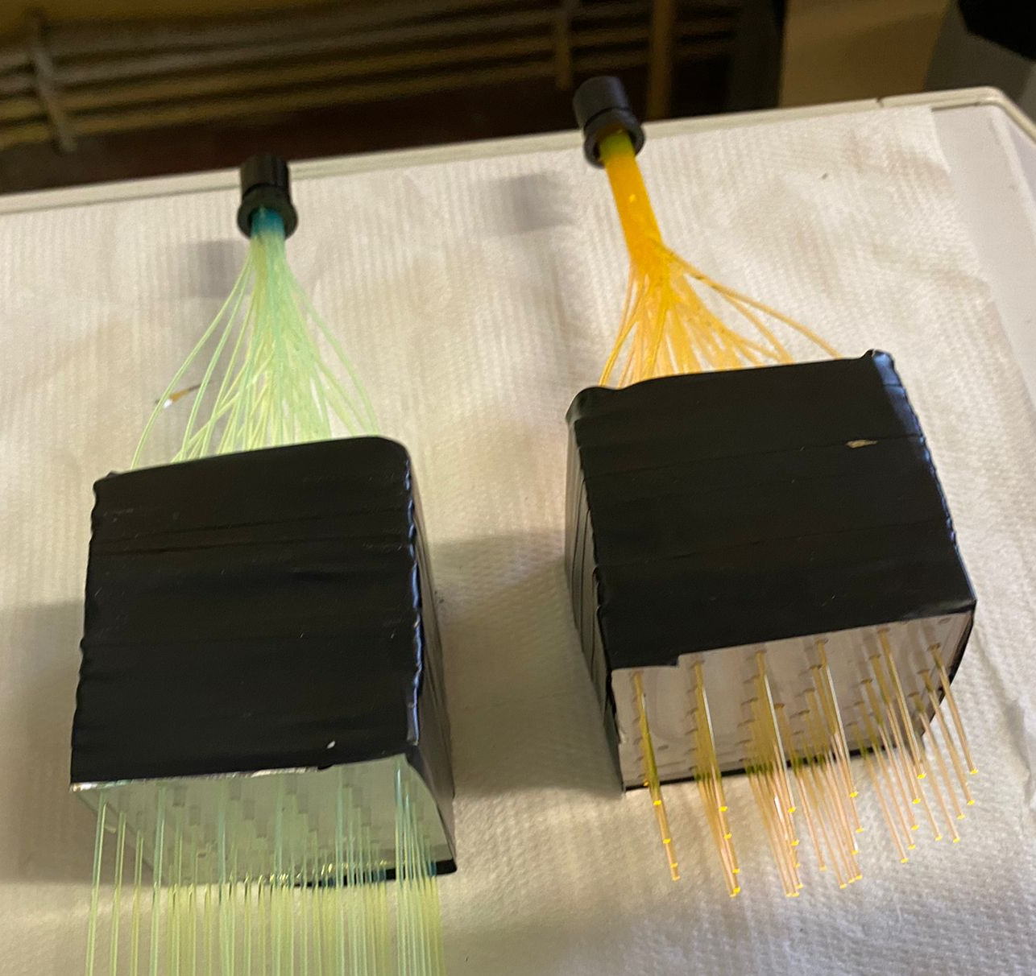
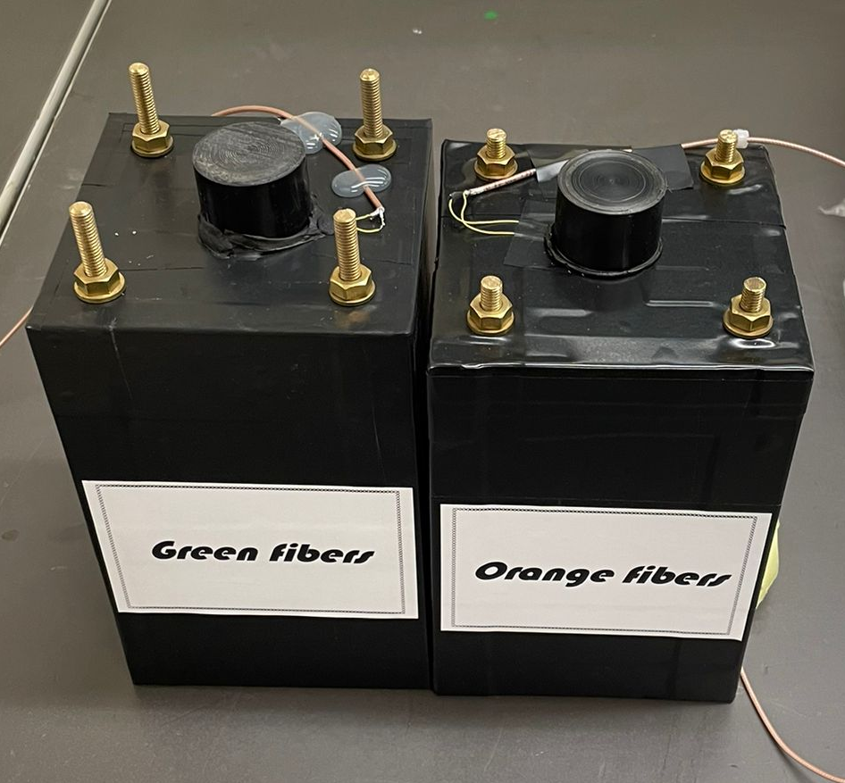
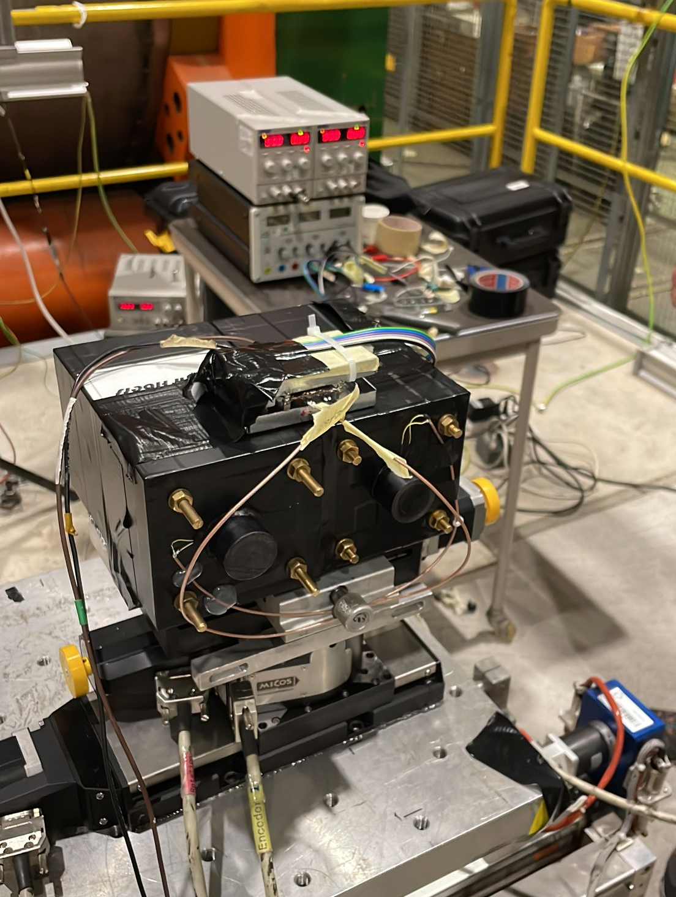
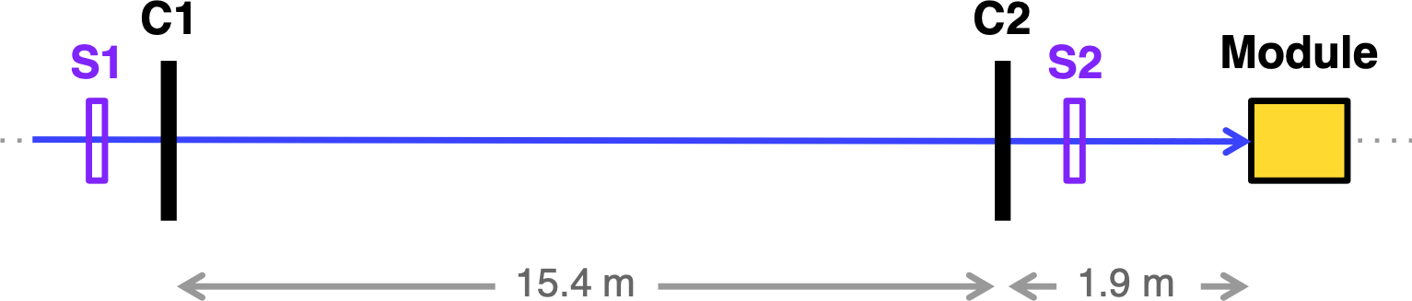
Early tests of NC shashlyk towers
First test of NanoCal prototype, fall 2022
Comparison of light yield from
Protvino shashlyk tower
NanoCal prototype
SPS H2 beamline:
80 GeV e⁻, 150 GeV π⁺
Conventional
Protvino scintillator
Polystyrene
1.5% PTP
0.04% POPOP
Y-11(200) WLS
NanoCal
PMMA
0.2% CsPbBr₃
O-2(100) WLS
LY_{mip}(NanoCal/Protvino) ~ 5%
Possible issues:
NCs have too much self-absorption?
Inefficient excitation of nanoparticles: concentration too low, no energy transfer from matrix?

Slide 21
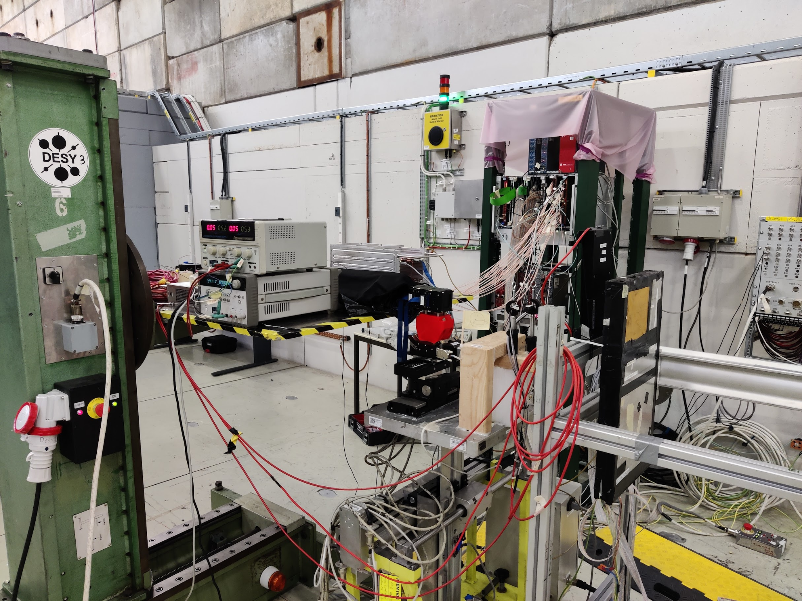
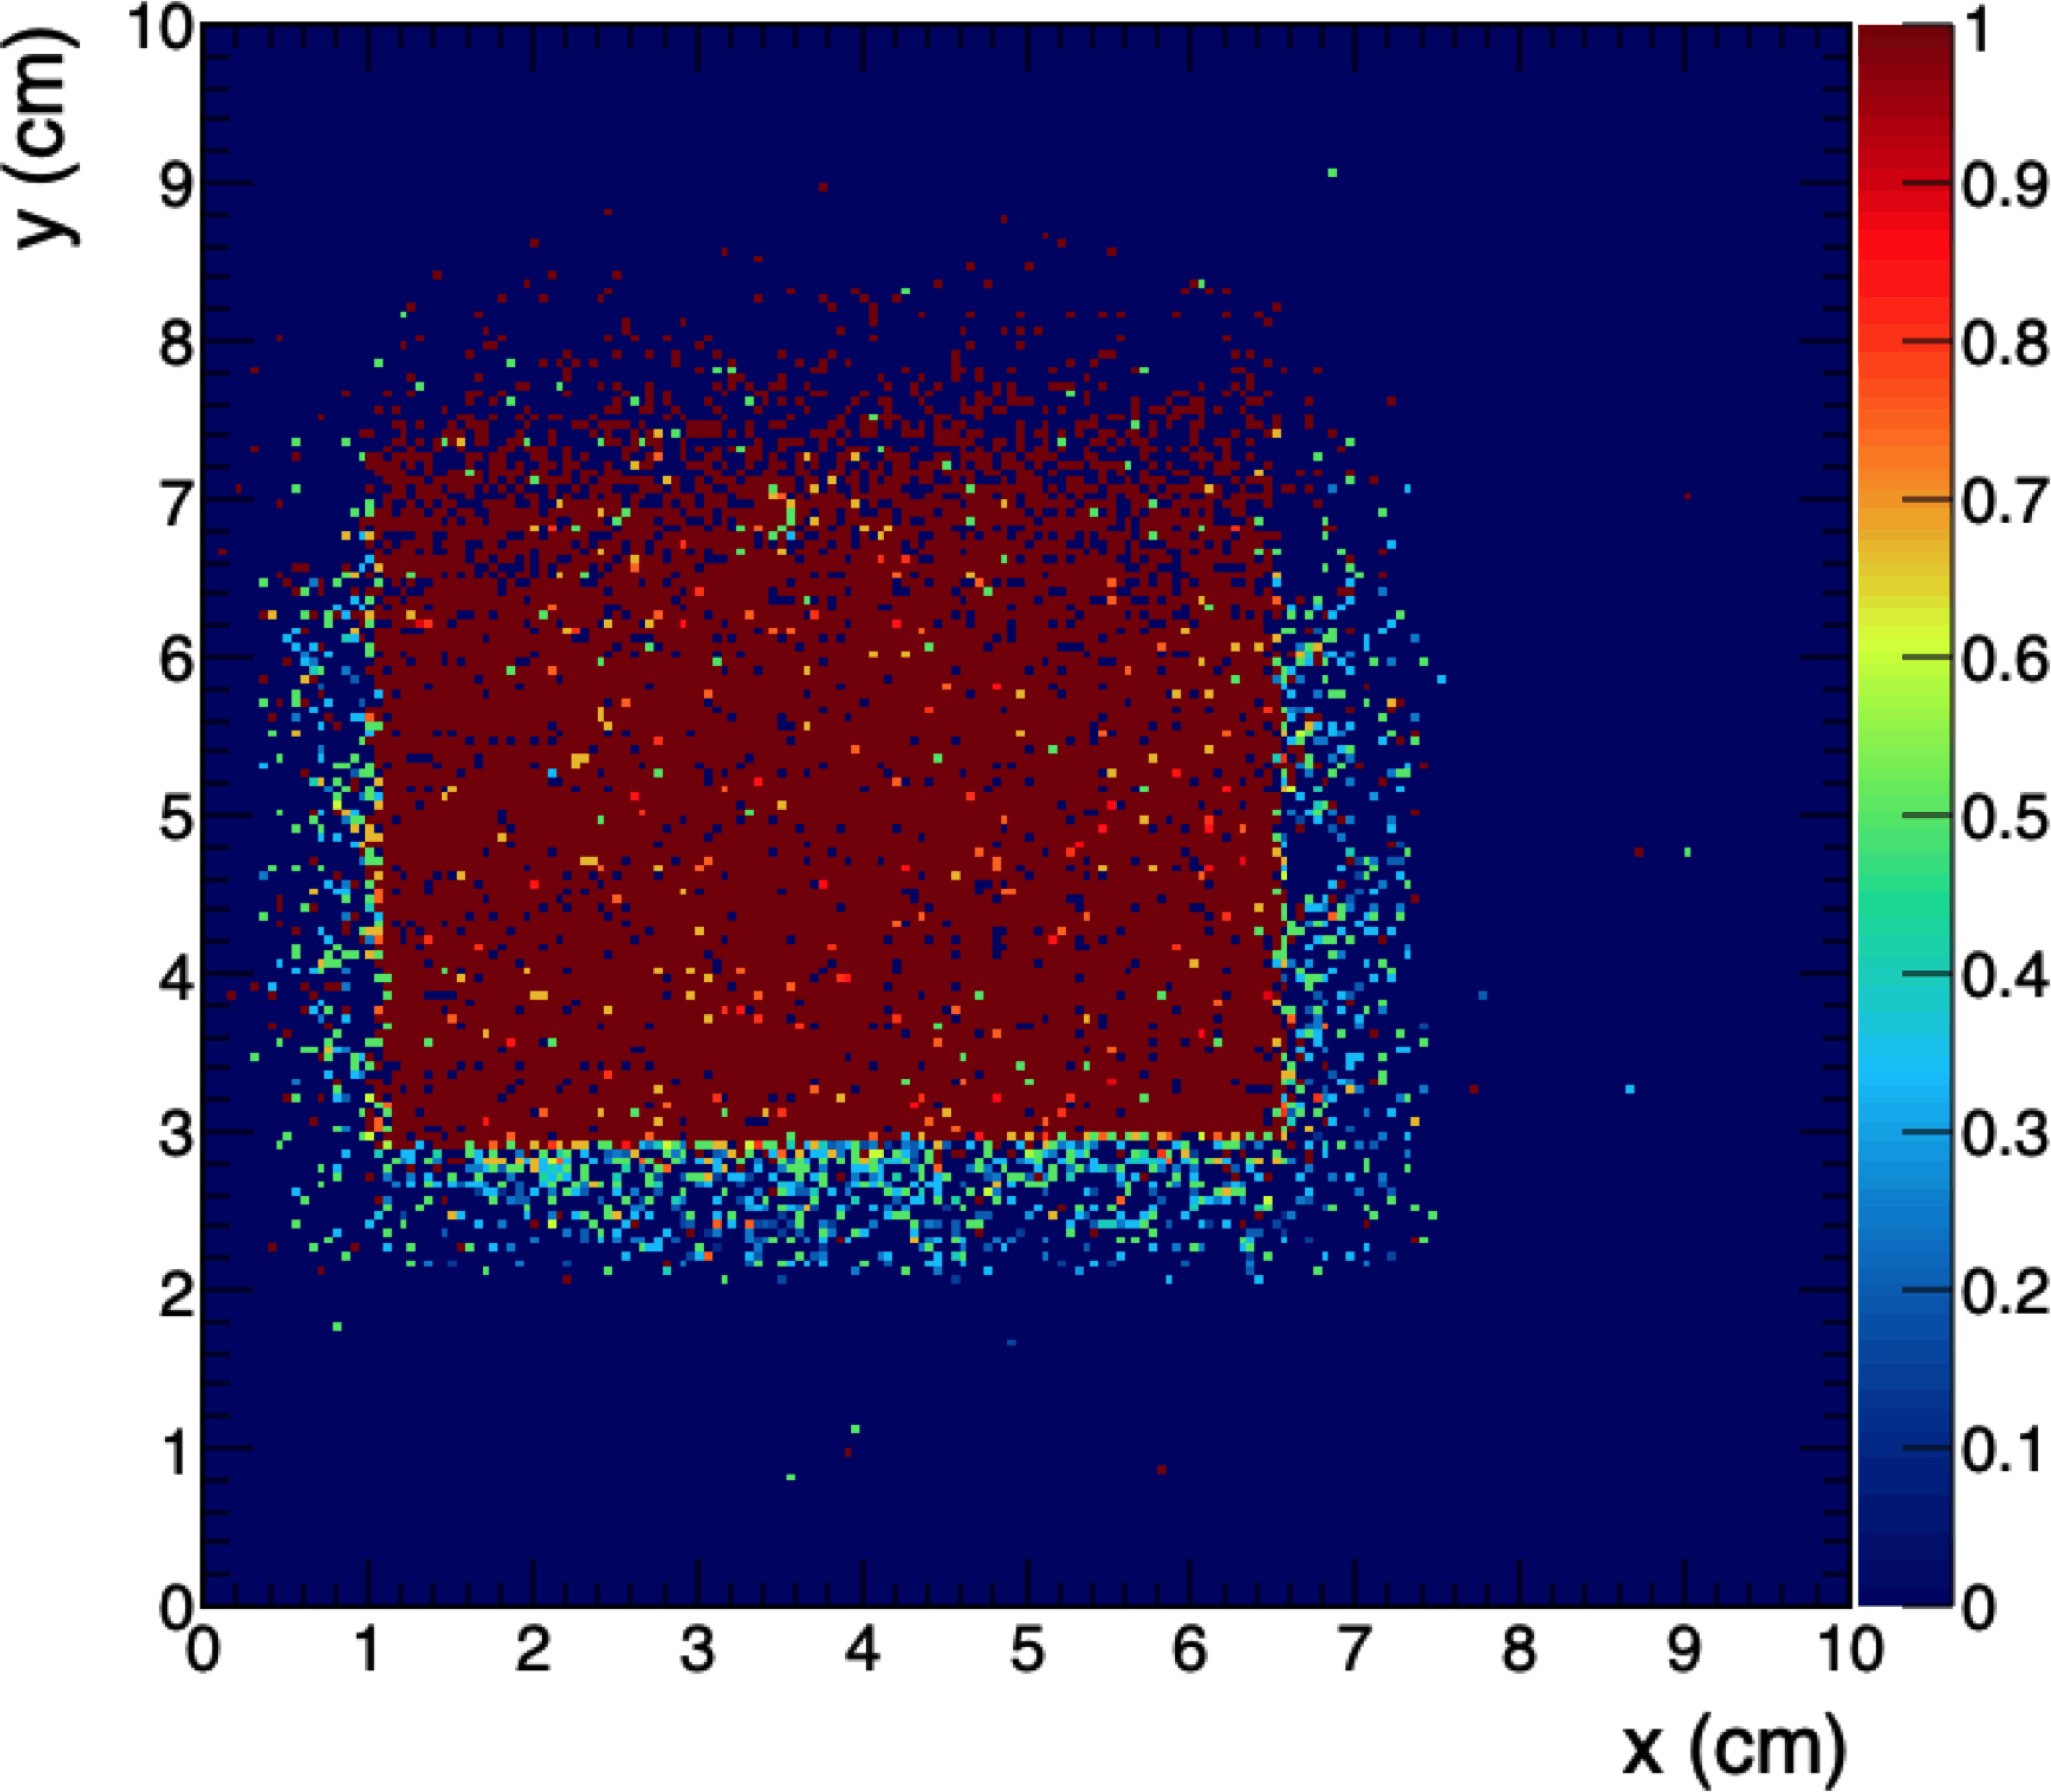
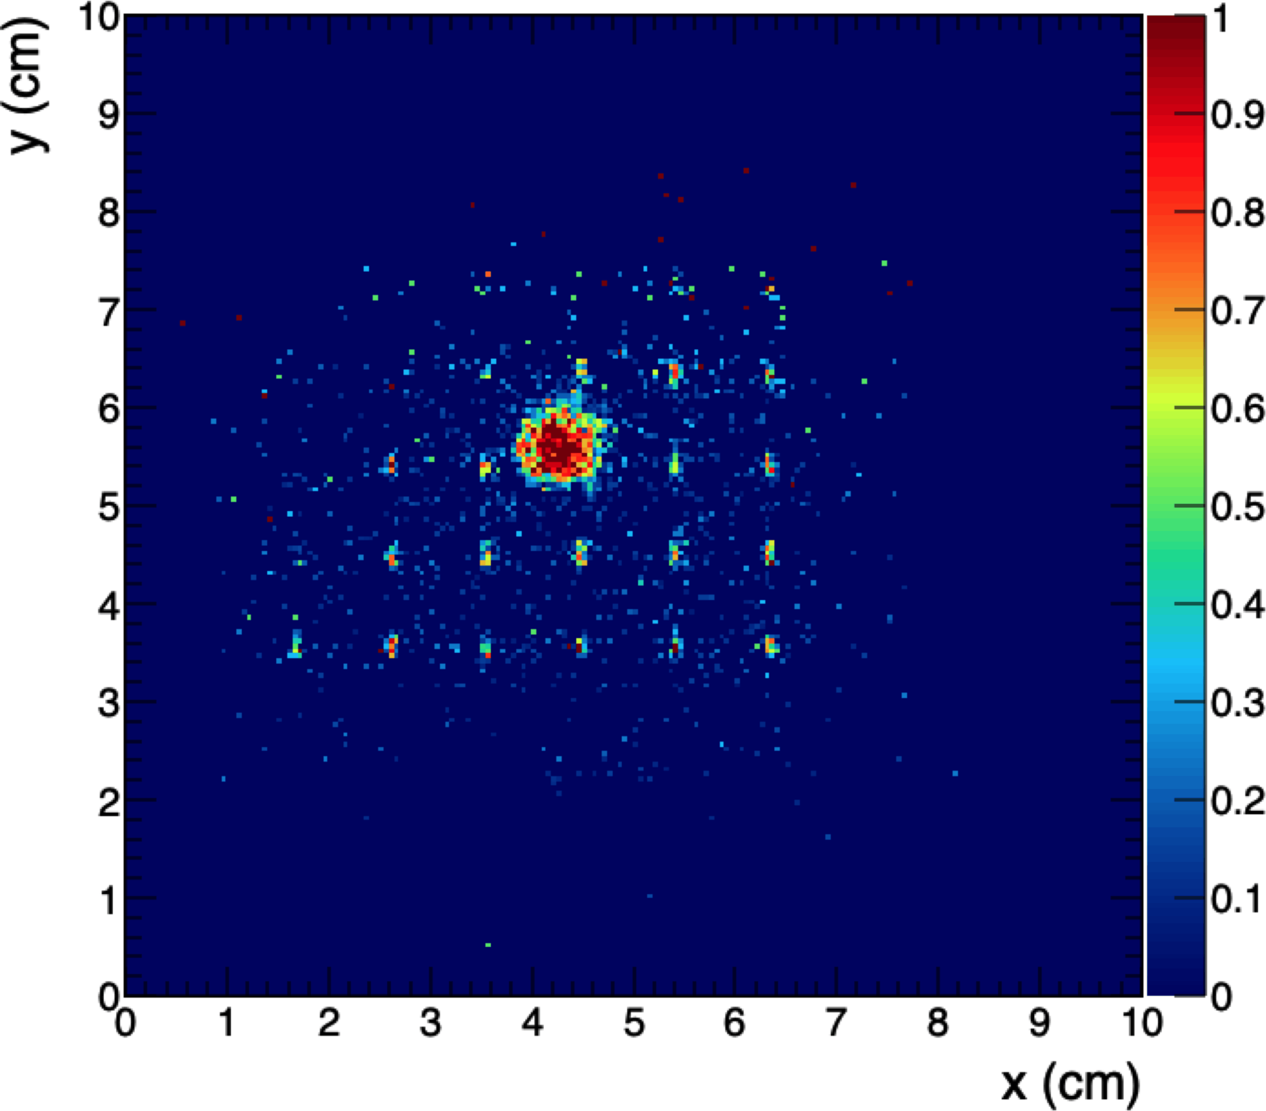
Tests with second-generation modules
Efficiency maps with 10 GeV μ, threshold = 5σ_{noise}
PS T9 beamline, Jun 2023
Electron beam, 1, 2, 4 GeV
MIP beam (μ⁻ or π⁻), 10 GeV
Cerenkov ID for e/μπ/p
For each prototype:
MIP response, efficiency
e⁻ response
Time resolution
Protvino
CsPb(Br,Cl)₃ + WLS
Reliable combination of Protvino scintillator and Y-11 fibers shows good performance
Signal from the NC-based modules entirely from the fibers:
    Reabsorption, in part because WL-shifted NC scintillator not working because of (resolvable) quality problems
    Inefficient nanocrystal excitation: low concentration, inert matrix

Slide 22
One step back: First focus on NC scintillator alone
Explore WL-shifted NC scintillators to overcome self absorption
Direct synthesis of CsPb(Br,Cl)₃ to preserve surface passivation is possible
  Needed for green scintillators (e.g. shahslyk applications)
For direct tests of NC scintillators, can use green-to-orange WLS: makes synthesis easier
Use aromatic matrix materials to transfer energy to nanocrystals
  First formulations use PMMA
    UV polymerized to preserve nanocrystal surface passivation
    Gives no primary scintillation contribution
  New protocol developed to allow use of perovskites in thermally polymerized matrix (e.g. PS, PVT)
  Surface passivation with fluorine allows higher nanocrystal concentrations
Complete set of new samples synthesized and tested:
Beam tests at CERN PS T9 in Oct 2023 and at Frascati BTF in Nov 2023 and Apr 2024
Molecular (organic) scintillators included for comparison and study
Complete set of control samples to isolate contributions from components

Slide 23
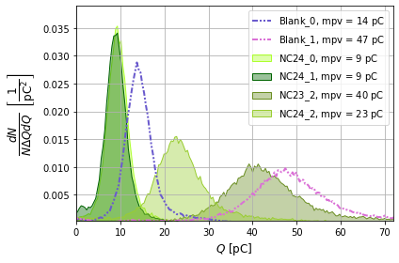
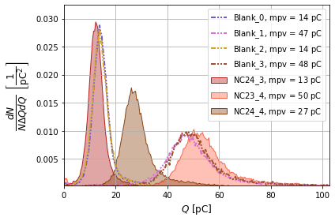
Summary of light yield measurements
Unshifted NC samples: PVT(+PTP)+CsPbBr₃
Shifted NC samples: PVT(+PTP)+CsPbBr₃+perylene
Unshifted samples: With or without intermediate fluor (PTP), adding CsPbBr₃ slightly decreases LY
Shifted samples: With or without PTP, adding CsPbBr₃ slightly increases LY
WLS (perylene) inefficiently coupled to PVT & PTP
Some evidence that WLS mitigates self absorption
Relative to EJ200:
Our molecular samples have 40-50% of LY
Our best NC samples have 20-30% of LY

Slide 24
Summary and outlook
Realization of the promise of perovskite nanocomposites as fast, bright, and radiation-tolerant scintillators for HEP will require efforts to increase the light output, which is currently limited by various factors:
Number concentration of nanocrystals too small for direct excitation by single quanta
Inefficient energy transfer from matrix compared to conventional scintillators
Number concentration of nanocrystals O(10⁵) smaller than for organic dye molecules at same weight concentration
Self-absorption of light emitted by nanocrystals
Energy deposition mechanism in radioluminescence measurements (with excellent response) is very different from the interaction of a mip or shower particle:
Radioluminescence: Many simultaneous low-energy quanta (10 keV x-ray) can directly excite nanoparticles?
MIP: Single quanta depositing 2 MeV/cm in matrix, which has to be transferred to the nanoparticle
Collaboration with the HEP community is essential for NC scintillator development!

Slide 25
NanoCal accomplishments
NanoCal project focus has shifted from rapid prototyping to sample characterization to
drive the development of better NC scintillators for HEP:
NCs with WLS shifting dyes
Thermally polymerized NCs with aromatic matrix materials
NC scintillators with higher concentrations of nanocrystals
Longer term: Possibility to continue studies of novel nanostructures & hybrid materials
NanoCal has also given rise to side projects to evaluate novel compositions for organic scintillators that respond to specific needs in HEP, such as fast, long-wavelength (radiation tolerant) scintillators
NanoCal has developed experience and infrastructure for the experimental qualification of novel scintillators, both organic and nanocomposite
Test beam detectors for reproducible light yield measurements with fast timing detectors and optical band selection
Compton edge LY measurements with radioactive sources
A working shashlyk module as a test platform for future prototyping

Slide 26
Project: Wireless Data Transfer for HEP Applications
Thin Silicon Sensors for Extreme Fluences
Make Si sensors radiation tolerant by using a thin bulk, internal amplification and using a gain implant that would withstand a factor of 50 higher fluences than what is presently available.
The Silicon Electron Multiplier, a new approach to charge multiplication in solid state detectors
Make Si sensors radiation tolerant by a novel biasing method – electrodes embedded in silicon.
Development of fine-sampling calorimeters with nanocomposite scintillating materials
Develop a new generation of fine-sampling calorimeters that use innovative scintillating materials based on perovskite nanocrystals dispersed in a plastic matrix to form fast (~100ps) and radiation resistant (~1 MGy) scintillators.
Wireless Data Transfer for High-Energy Physics Applications
Develop mm-wave-based wireless communication as an alternative to optical and wired links in a HEP-like environment to reduce the material and optimize the read-out.

Slide 27
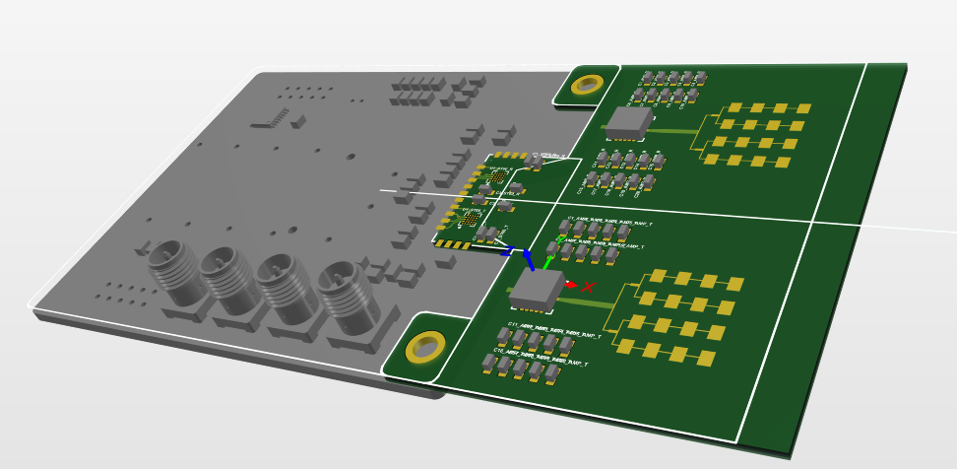
Wireless Data Transfer for HEP Applications
Deliverable 1: First mock-up assembled and tested during the first year, including a study of antenna technologies allowing a seamless integration in such a harsh environment (strong irradiation and magnetic fields); specification of the antennas.
Deliverable 2: Second mock-up assembled and tested during the two next years. Three or four layers of silicon detector with their readout, equipped with low power consumption transceiver and antennas.
Deliverable 3: Published a study of performance in the HEP environment and access to the technology for new user communities. Make packages available with user support.
Deliverable 4: (option, depending on the time left) Study of the cumulative noise in multi-hop data transmission and jitter, development of wireless communications strategies for managing crosstalk
  Debit 1 Gbps per layer cumulative, thus 3 Gbps at the outer enclosure.
Final design.

Slide 28
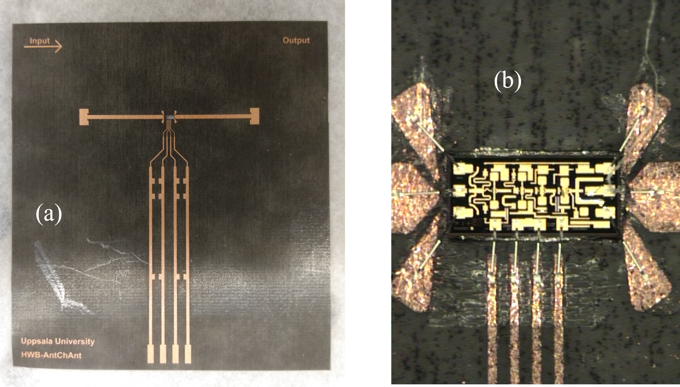
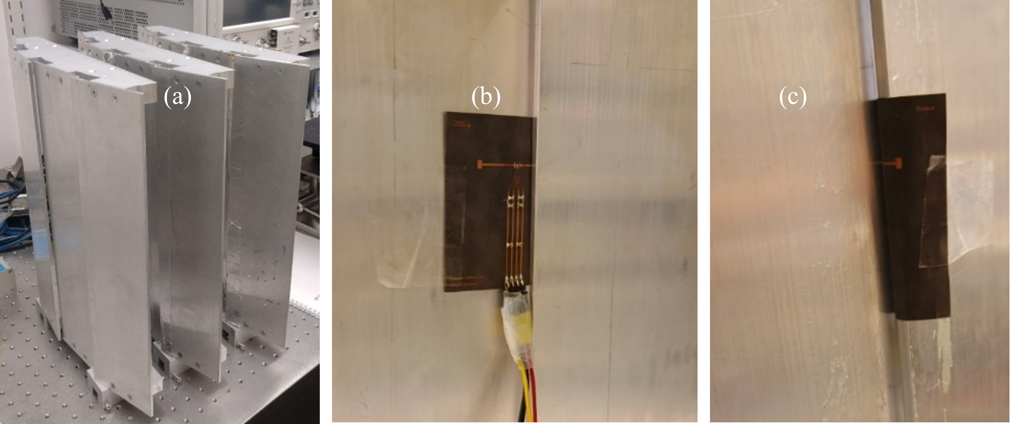
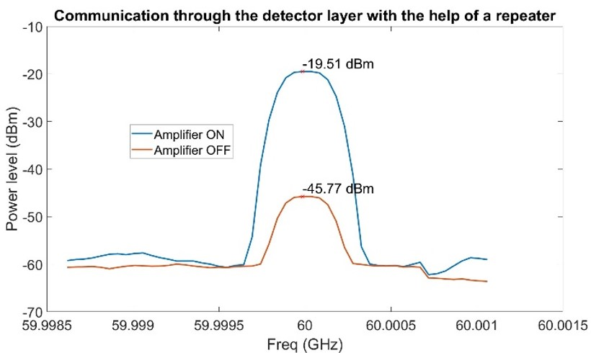
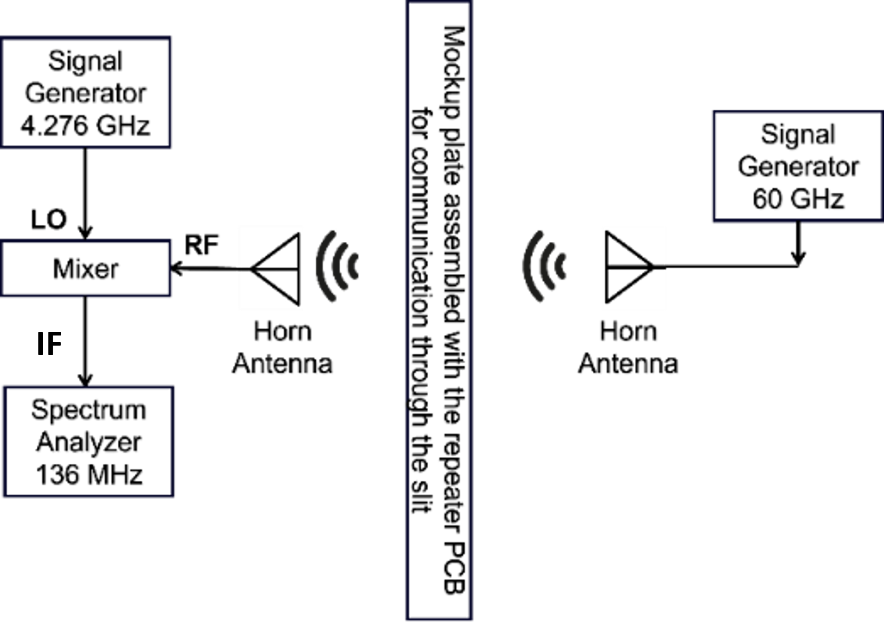
Active repeater mounted on the mockup and demo 20 cm reach
Fig. 1. (a) Fabricated active repeater board (b) amplifier is wire-bonded on the board
Fig. 2. Test setup (a) Mockup (b) Repeater board mounted on the mockup, input antenna can be seen on the left (c) output antenna, transmitting the amplified signal on other side of the layer
Published at EUCAP25
Fig. 3. Measurement setup schematic for propagation through the tracking layer with the help of active repeater board. The RX patch antenna on the repeater board, mounted on the mockup, receives the signals from the horn antenna on the right, and the TX patch antenna re-transmits the signal to the horn antenna on the left.
Fig. 4. Corrected power levels when the amplifier is ON (blue) and when the amplifier is OFF (orange). The distance between the horn antenna and the repeater board is 20cm.

Slide 29
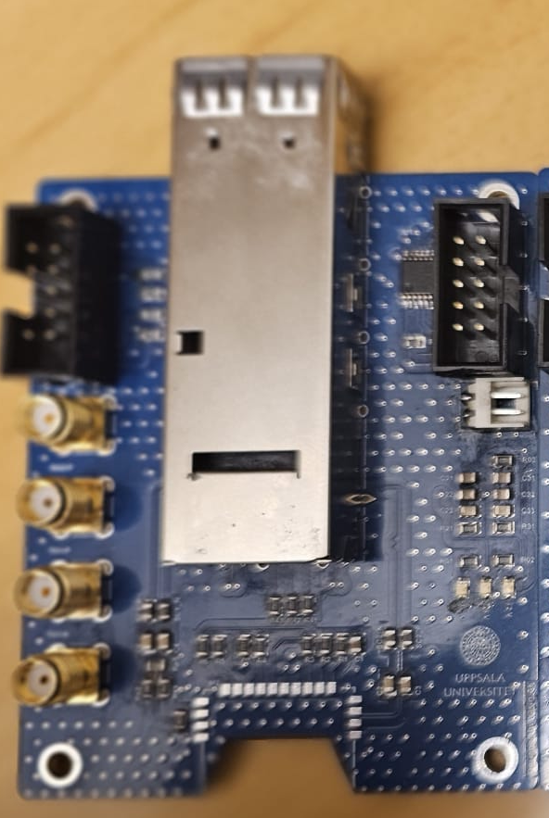
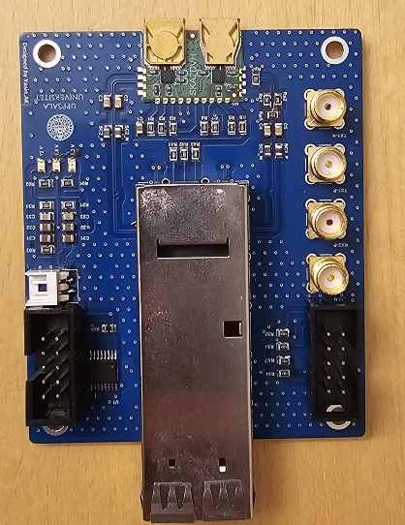
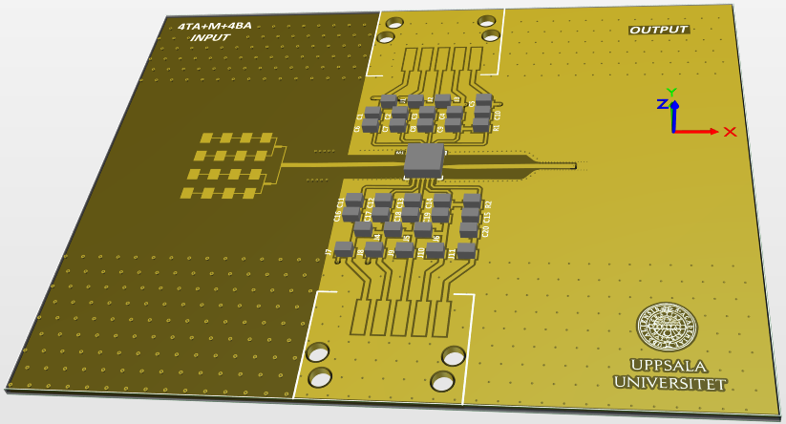
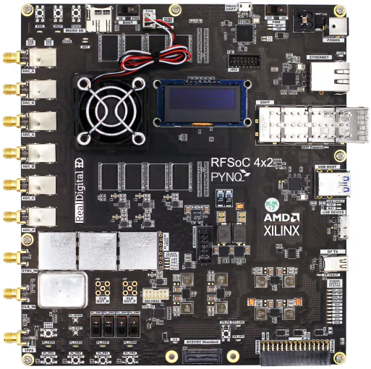

High speed communication boards development and integration with RFSoC (Radio Frequency System-on-Chip)
  QSFP28 board
  with ST chip and horn antennas
  QSFP28 board
  Testing with RF-SoC
  Debugging (now)
  Repetitor amplifier and antenna array
  for QSFP28 board
  and ST chip integration
RF-SoC #1
RF-SoC #2
Final demo
20 cm
New UU boards with ST chip, repetitor amplifier and antenna array

Slide 30
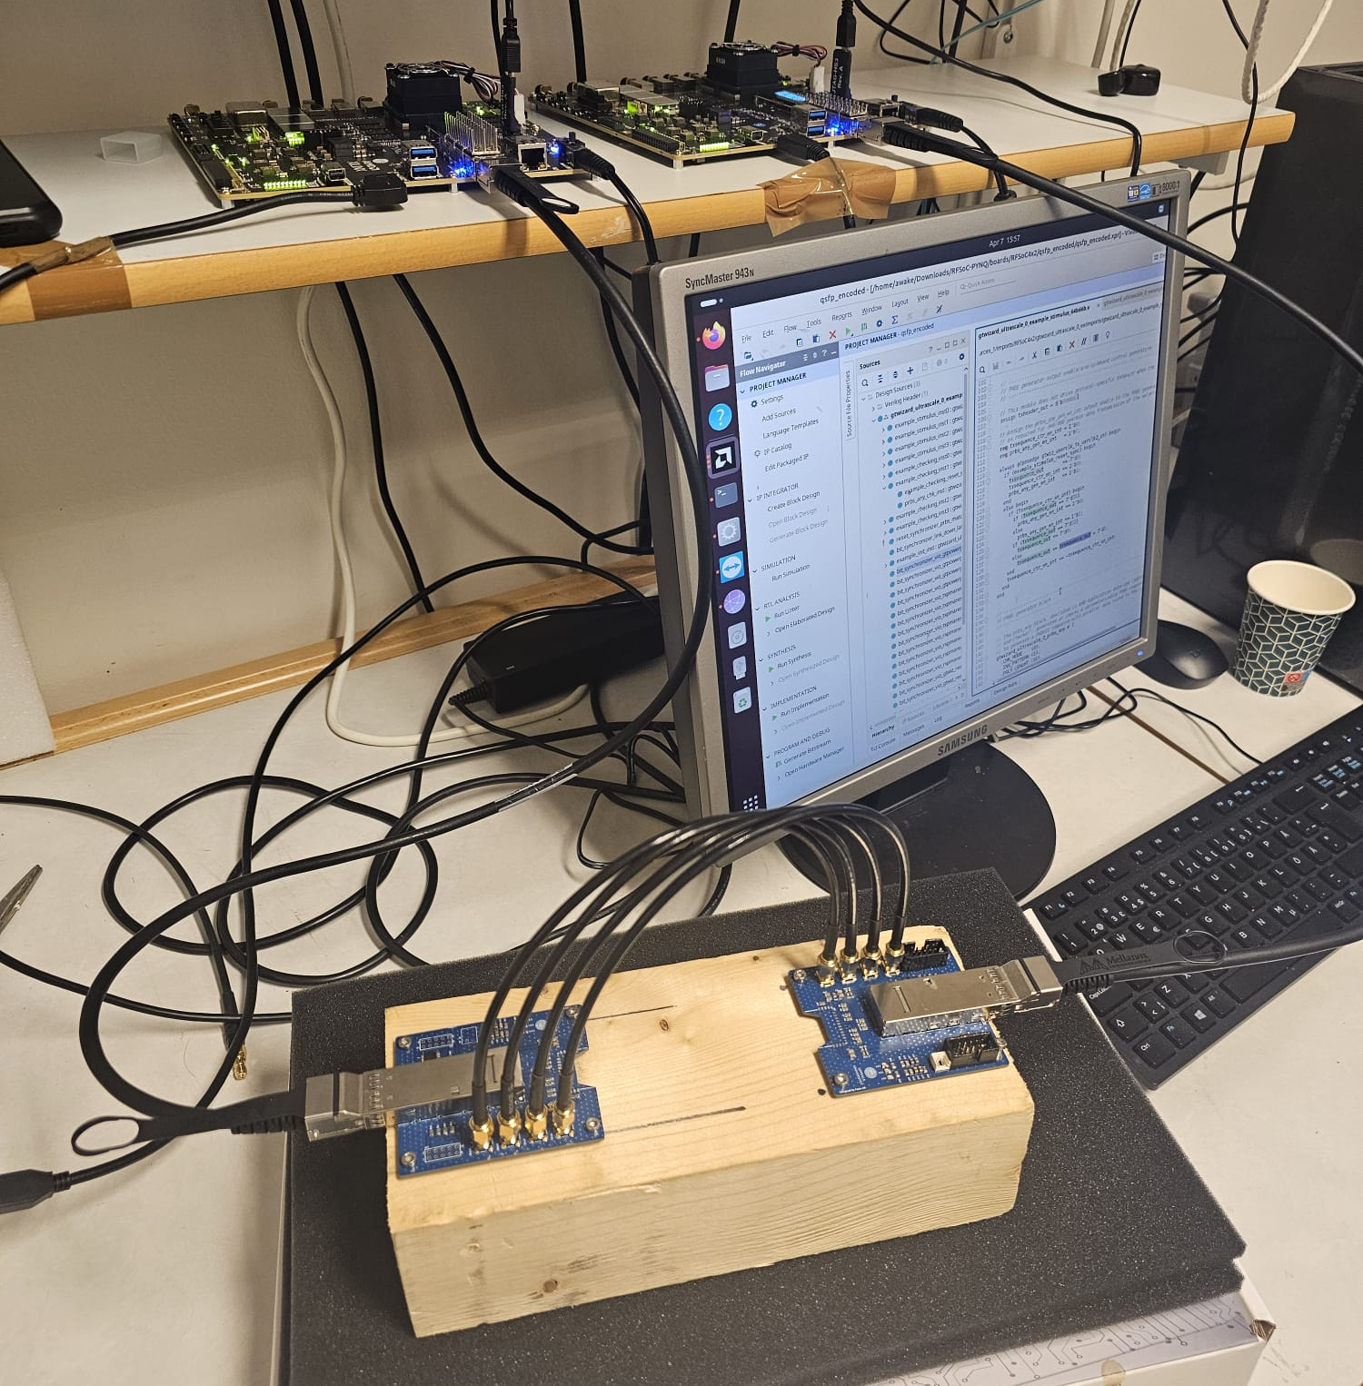
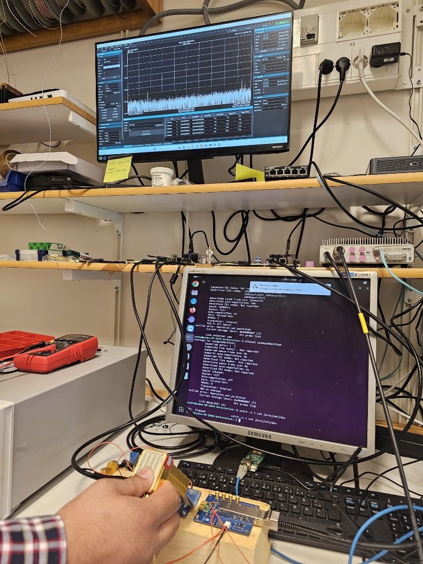
RFSoC development and testing set-up – operational at 60 GHz
Wired data transfer test
QSFP28 + SKA2: 60 GHz signal
60 GHz

Slide 31
Overview of work and deliverables
Wireless Data Transfer for HEP Applications
Deliverable 1: Initial prototype successfully assembled and tested. Comprehensive study on antenna technologies addressing the challenges of integration. Antenna array was finalized.
Deliverable 2: Second prototype assembled and validated integrated low-power transceivers and embedded antennas. Substantial progress has been made toward complete system.
Deliverable 3: Performance evaluation in a HEP environment is not yet completed. However, promising results were presented at EUCAP 2025 conference in Stockholm. Technology is being prepared for dissemination to new users, and possible new collaborations.
Deliverable 4: Initially conceived as optional, could not be fully realized.
  Debit 1 Gbps per layer cumulative, thus 3 Gbps at the outer enclosure.
Final design.

Slide 32
WP13 Prospective and Technology -driven Detector R&D: summary
Summary and outlook
Call for blue-sky projects prepared and carried out in the first year of AIDAinnova
Four blue-sky projects were selected out of 15 excellent proposals
The four projects have explored new territories
They have seen a lot of interesting new findings
All of them have also encountered problems, found ways on how to mitigate them, in many places with success; good ideas on how to proceed
At present, wrapping-up, final reports (D12.2-5) due by May 31, 2025
All of them plan to continue their research beyond the AIDAinnova

