Slide 1


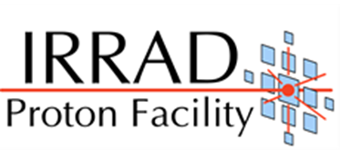


Task 4.3 - Common Tools for Irradiation Facilities QC: Data Management, Traceability, Dosimetry and
Activation Measurements
Objective 3: Common Dosimetry Calibration Set
M.Moll on behalf of Task 4.3 - Objective 3
5 May 2025

Slide 2
Task 4.3 Objectives
Generalize the IRRAD facility Data Manager (IDM) system to include new facilities and improve its features (usability, sharing of irradiation experiment results and operational data, etc.)
Design and develop a prototype for an integrated system to manage induced activation (APEX-gamma, etc.) and traceability data for irradiated objects (CAEN DigiWaste) based on IDM
Covered in previous
presentation by
Ferdinando
Giordano
Produce a common dosimetry calibration set for cross-comparing irradiation facilities by evaluating, with dedicated dosimeter structures, the Non-Ionizing Energy Loss (NIEL) of their particle beam
5 May 2025

Slide 3
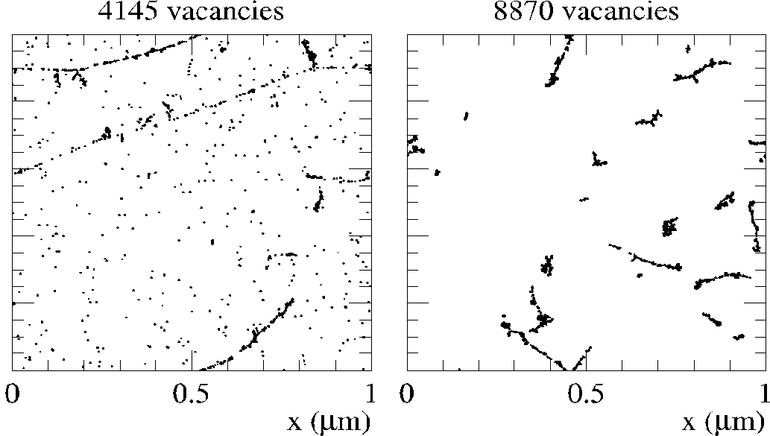
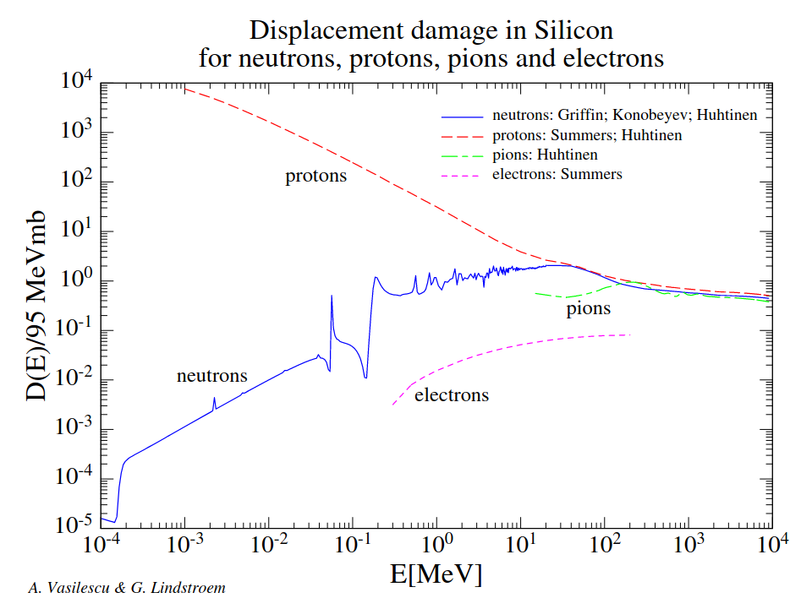
NIEL
(Non-Ionizing Energy Loss)
Objective 3
NIEL is a physical quantity describing the non-ionizing energy loss as the particle travels through the medium
NIEL can be used to predict the radiation damage and therefore to predict the lifetime of the detectors and components necessary for measurements
NIEL is usually expressed as an equivalent to NIEL of 1 MeV neutrons
NIEL is used by most of the LHC experiments
V. Subert
(PhD, synergy with EP-R&D)
NIEL for Silicon was determined from various sources 20 years ago by A. Vasilescu and G. Linström¹⁻⁵ (RD-48 data).
NIEL does not distinguish in point defects/ cluster defects, NIEL violation has been reported. ⁶⁻⁷->need to revisit NIEL
RD-48 data
Data from A. Vasilescu (INPE Bucharest) and G. Lindström (Univ. of Hamburg)
P.J. Griffin et al., SAND92-0094 (Sandia Natl. Lab.93), priv. comm. 1996: E = 1.025E-10 - 1.995E+01 MeV
Konobeyev, Alexander Yu., et al. “Nuclear Data to Study Damage in Materials under Irradiation by Nucleons with Energies up to 25 GeV.” Journal of Nuclear Science and Technology, vol. 39, no. sup2, Aug. 2002, pp. 1236–39. Taylor and Francis+NEJM, https://doi.org/10.1080/00223131.2002.10875327.
Huhtinen, M., and P. A. Aarnio. “Pion Induced Displacement Damage in Silicon Devices.” Nuclear Instruments and Methods in Physics Research Section A: Accelerators, Spectrometers, Detectors and Associated Equipment, vol. 335, no. 3, Nov. 1993, pp. 580–82. ScienceDirect, https://doi.org/10.1016/0168-9002(93)91246-J.
Summers, G. P., E. A. Burke, P. Shapiro, et al. “Damage Correlations in Semiconductors Exposed to Gamma, Electron and Proton Radiations.” IEEE Transactions on Nuclear Science, vol. 40, no. 6, Dec. 1993, pp. 1372–79. IEEE Xplore, https://doi.org/10.1109/23.273529.
Huhtinen, M. “Simulation of Non-Ionising Energy Loss and Defect Formation in Silicon.” Nuclear Instruments and Methods in Physics Research Section A: Accelerators, Spectrometers, Detectors and Associated Equipment, vol. 491, no. 1, Sept. 2002, pp. 194–215. ScienceDirect, https://doi.org/10.1016/S0168-9002(02)01227-5.
Gurimskaya, Yana, et al. “Radiation Damage in P-Type EPI Silicon Pad Diodes Irradiated with Protons and Neutrons.” Nuclear Instruments and Methods in Physics Research Section A: Accelerators, Spectrometers, Detectors and Associated Equipment, vol. 958, Apr. 2020, p. 162221. ScienceDirect,
3

Slide 4
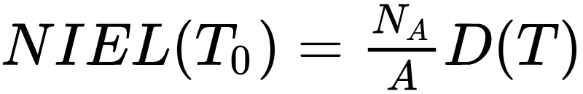
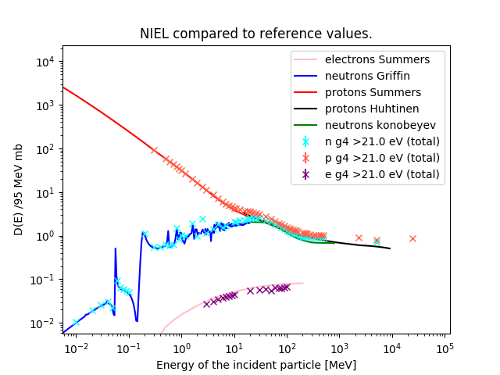
NIEL
(Non-Ionizing Energy Loss)
T₀: energy of incident particle
T: energy transferred to the recoil atom
(dσ/dT): differential partial cross section for a particle with energy T₀ to create a recoil atom with energy T in the i-th reaction
Q(T): partition factor giving the fraction of T that is going into further displacements
N_{A} : Avogadro number
A : atomic mass of target atom
Displacement damage function
MeV cm²/g
MeV mb
NIEL curves in literature with Geant4 and FLUKA simulations successfully reproduced
Algorithm for identifying clustered versus point defect damage implemented
Agreement with qualitative analysis reached
The tuning of the parameters (number of neighbours to be considered cluster, threshold energy for recoil production in Silicon) ongoing: benchmarking with the measurements data
RD-48 data
Geant4
^{1,2,3,4,5}
New Geant4
Simulations vs
RD-48 data

Slide 5
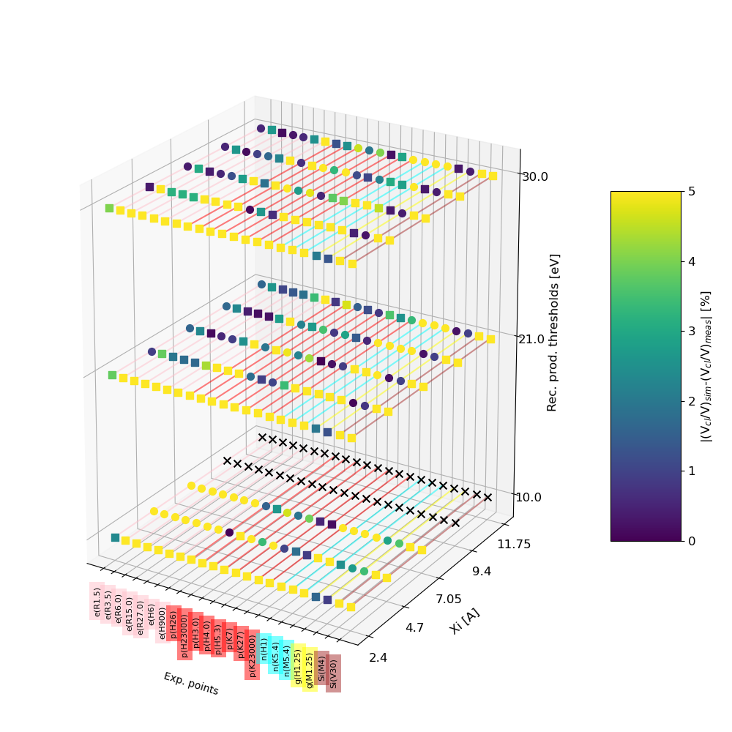
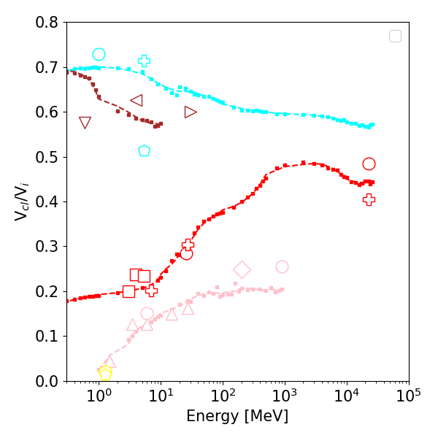
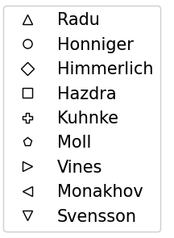
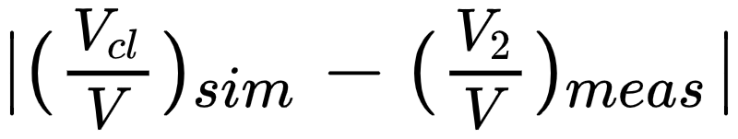
Parameter tuning and meas. benchmarking
X: axis measurement points
Y axis: nearest neighbor parameter in A
Z: recoil threshold production cutoff
Yellow shows the settings for which the simulation and measurements does not agree by > 5 %
We look for a row that is dark along the X-axis: good candidate for parameter tuning.
Cubes: Simulation predict higher fraction of clusters/isolated then measurements
Spheres: Simulation predict lower fraction of clusters/isolated then measurements
Measurements compilation from:
M.Kuhnke et al., Defect generation in crystalline silicon irradiated with high energy particles, https://www.sciencedirect.com/science/article/pii/S0168583X01008862,
L.Vines: Effect of spatial defect distribution on the electrical behavior of prominent vacancy point defects in swift-ion implanted Si, https://journals.aps.org/prb/pdf/10.1103/PhysRevB.79.075206
E.V.Monakhov: Ion mass effect on vacancy-related deep levels in Si induced by ion implantation, https://journals.aps.org/prb/pdf/10.1103/PhysRevB.65.245201
B.G. Svensson: Point defects in MeV ion-implanted silicon studied by deep level transient spectroscopy, https://www.sciencedirect.com/science/article/abs/pii/0168583X95007024
M.Moll: Radiation Damage in Silicon Particle Detectors: microscopic defects and macroscopic properties, PhD thesis
P. Hazdra: Defect distribution in MeV proton irradiated silicon measured by high-voltage current transient spectroscopy, 2002, https://www.sciencedirect.com/science/article/pii/S0168583X01011612
F. Honniger: Radiation Damage in Silicon - Defect Analysis and Detector Properties, 2007, https://inspirehep.net/files/f1ccf3f290d0ec203961dbdcd962701a
R. Radu: Bulk radiation damage in Silicon: from point defects to clusters, PhD thesis 2015
A.Himmerlic, private communication, CERN
More details: V.Subert 1st DRD3 Week 2024

Slide 6
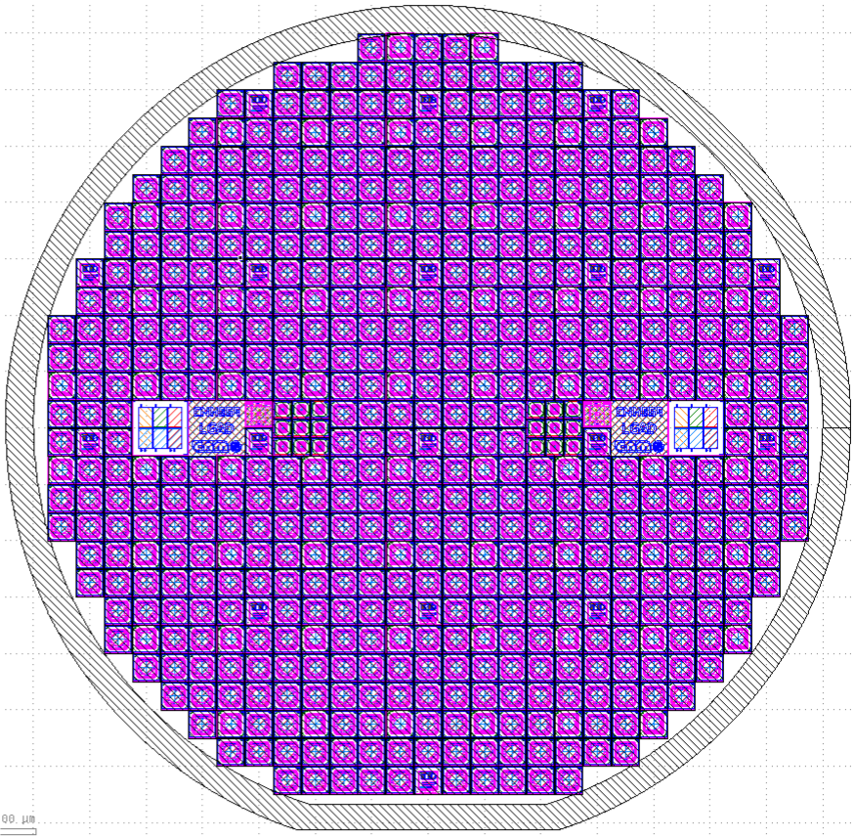
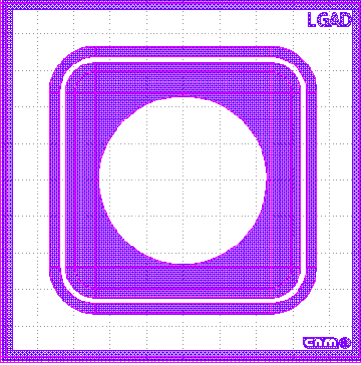

Sensors for NIEL measurements
NIEL sensors
  Produce a set of identical pin sensors that will be used to
    (a) study more profoundly the NIEL Hypothesis in dependence of particle type and energy
      Measurement of damage parameters: Diode (leakage, depletion, E-Field) and material (defect spectroscopy)
    (b) inter-compare radiation facilities in terms of their ‘hardness factors’
      Measurement of leakage current after exposure and specified annealing [alpha-value]
A set of Silicon Sensors (n-in-p) has been produced at CNM, Barcelona
Cost effective production:
  use of existing mask set with one new mask
  simple design: 8 mask levels (150 mm wafer)
536 devices of 3.3x3.3 mm² per wafer
10 wafers ordered (2 broken during production)
  1.5 wafers will go to Ljubljana reactor
  1.5 wafers will go to CERN IRRAD
  5 wafers for in-depth NIEL studies
Status: production finished in early 2025
  Wafers at CERN for testing before distribution
frontside
backside

Slide 7
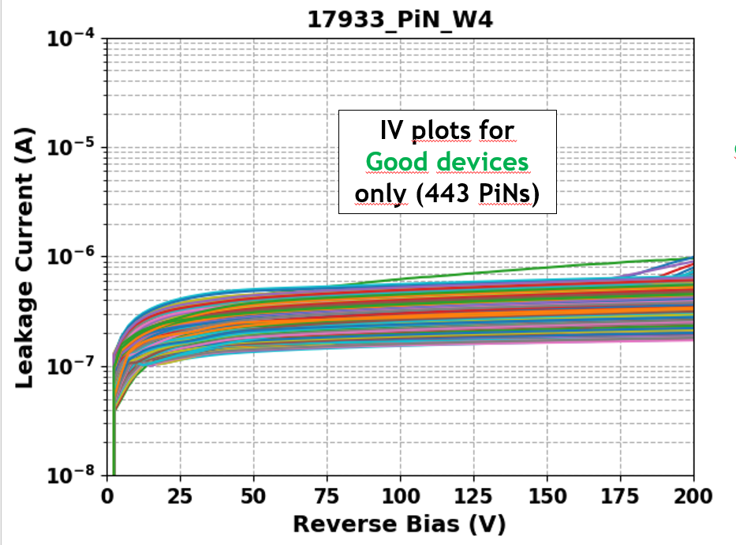
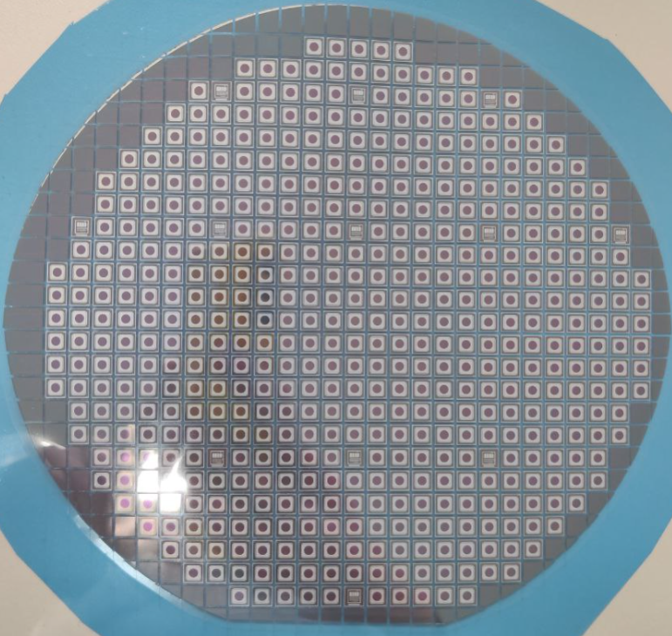
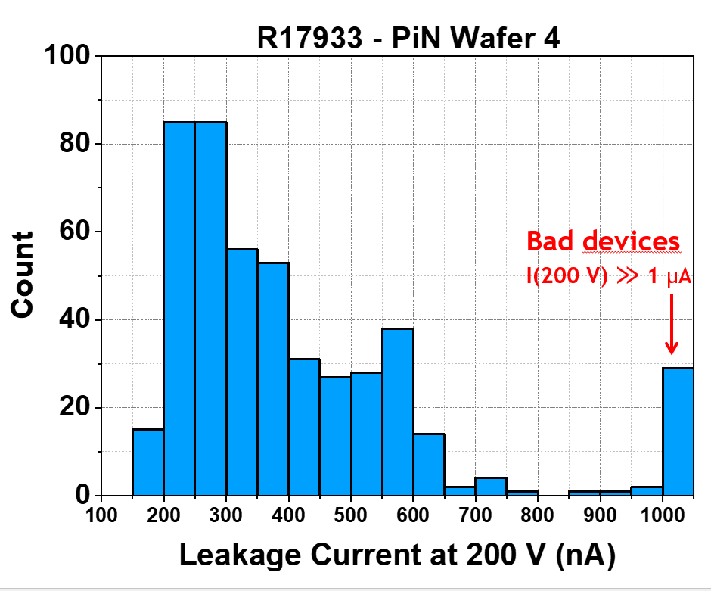
Sensors for NIEL measurements
Sensor characterization
Yield ≈ 90%
Foto of frontside of the wafer (150 mm)
Leakage current as measured on wafer 4 at CNM
  rather high leakage for pin sensors
frontside
backside

Slide 8
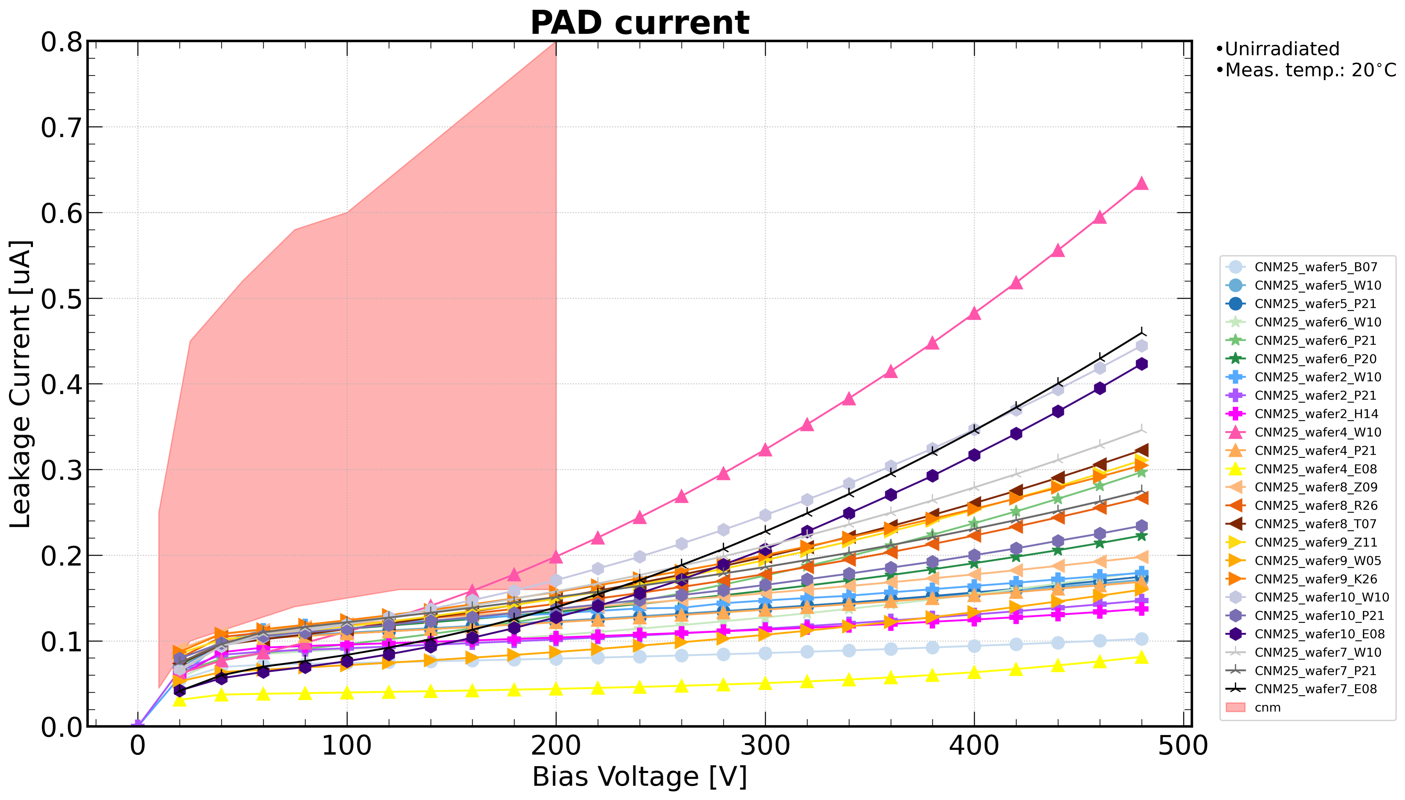
Sensors for NIEL measurements
Sensor characterization
Leakage current as measured on wafer 4 at CNM
Foto of frontside of the wafer (150 mm)
Measurement after dicing at CERN shows lower current when guard ring connected to ground
Sensors can be used as dosimeters (NIEL measurement)
frontside
backside

Slide 9
Conclusion
Task 4.3. Objective 3: Common dosimetry calibration set for cross-comparison of irradiation facilities by NIEL evaluation
  Geant4 and FLUKA simulations for NIEL curves successfully reproduced and algorithm for identifying clustered vs point defect damage implemented
  Benchmarking simulations with measurements data is ongoing and will continue beyond AIDAinnova
  AIDAinnova Deliverable D4.2.
    Deliverable date was postponed from M42 (Sept.24) to M52 (Jul.25) due to delayed sensor production
    Cost effective solution for production of silicon sensors for NIEL measurements was found and production was completed; First measurements confirm that sensors can be used for dosimetry.
    Distribution of sensors in May/June to irradiation facilities (IRRAD, JSI reactor)
    Deliverable report in writing and to be finished before summer break

