Slide 1


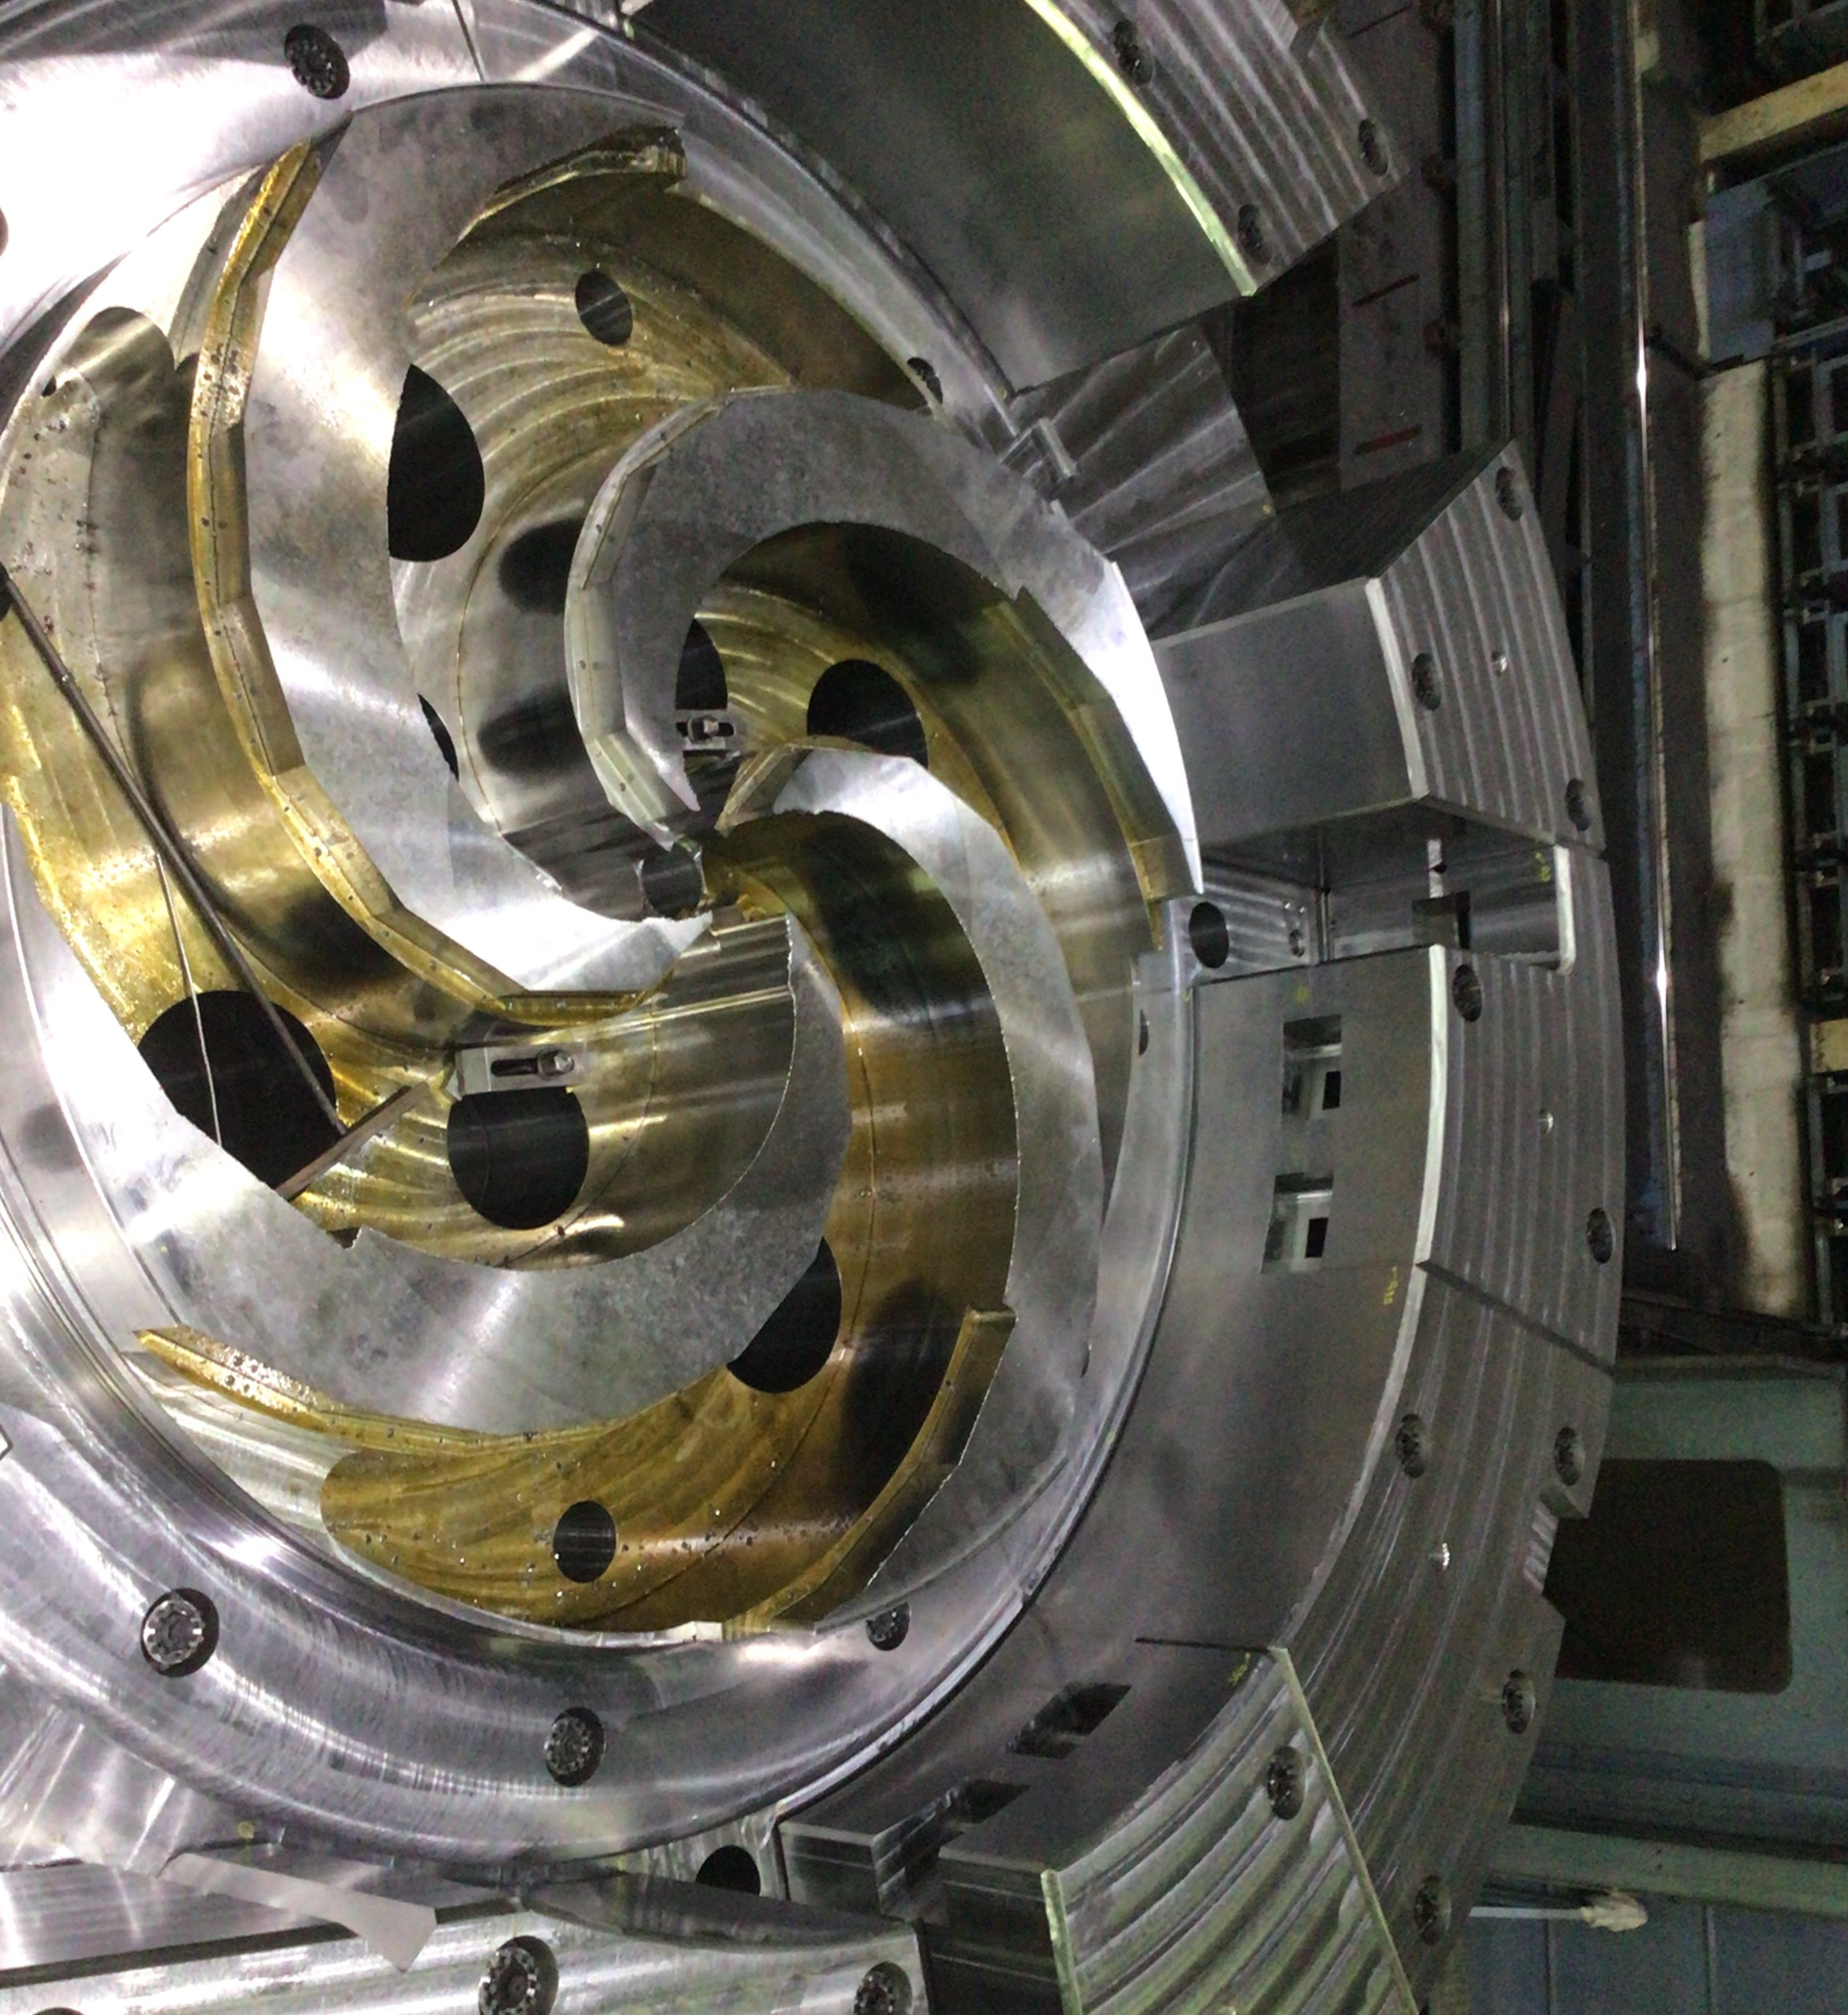

THE FIRST CYCLOTRON-BASED MULTI-ION THERAPY SYSTEM
PROJECT STATUS, PERSPECTIVES AND CHALLENGES
Authors
V. Letellier¹, P. Velten¹, L. Maunoury ¹, O. Cosson ¹,
J. Mandrillon², G. Gérard², M. De Leenheer¹, G. Saive ¹
¹ NHA – Normandy Hadrontherapy – 1 rue Claude Bloch, 14000 Caen - France
² IBA – Ion Beam Applications - 3 chemin du Cyclotron, 1348 Louvain-la-Neuve- Belgium
Philippe Velten
Knowledge Transfer Seminar CERN, 21-23th of January 2025
Notes:
Good morning,everybody. First I would like to thank the organizers for giving me the opportunity to present the status of the C400 IONS project on behalf of Normandy Hadrontherapy, which is the company responsible for marketing and installing this new system.
The achievements and developments I will present here is the result of a collective work from many people, not all of them listed here.

Slide 2

Disclaimer
PROPRIETARY INFORMATION
THE INFORMATION CONTAINED IN THIS DOCUMENT IS CONFIDENTIAL AND IS THE EXCLUSIVE PROPERTY OF IBA S.A. AND NHA. THIS IS SHARED FOR INFORMATION PURPOSES ONLY. THE REPRODUCTION, TRANSMISSION OR USE OF THIS INFORMATION IS FORBIDDEN, UNLESS PRIOR WRITTEN PERMISSION OF IBA AND NHA IS PROVIDED.
This document may contain express or implied forward-looking statements, opinions, expectations or analysis (the “Statements”). The Statements are subject to a variety of risks and uncertainties, many of which are beyond IBA’s or NHa’s control, and some of which could cause actual results that differ materially from those contemplated in the Statements. IBA and Nha assumes no obligation nor makes any warranty or commitment with respect to the Statements.
Due to a continuous research and development program and due to the fact that the Heavy Ion system is under development, IBA and NHa cannot provide a guarantee that every technical specifications given in this document will be in accordance with the developed product. IBA and NHa reserve the right to make changes in design, technical descriptions and specifications of its products without prior notice. The Heavy Ion system is also subject to review by competent authorities (FDA, notified bodies, etc.).
Confidential

Slide 3
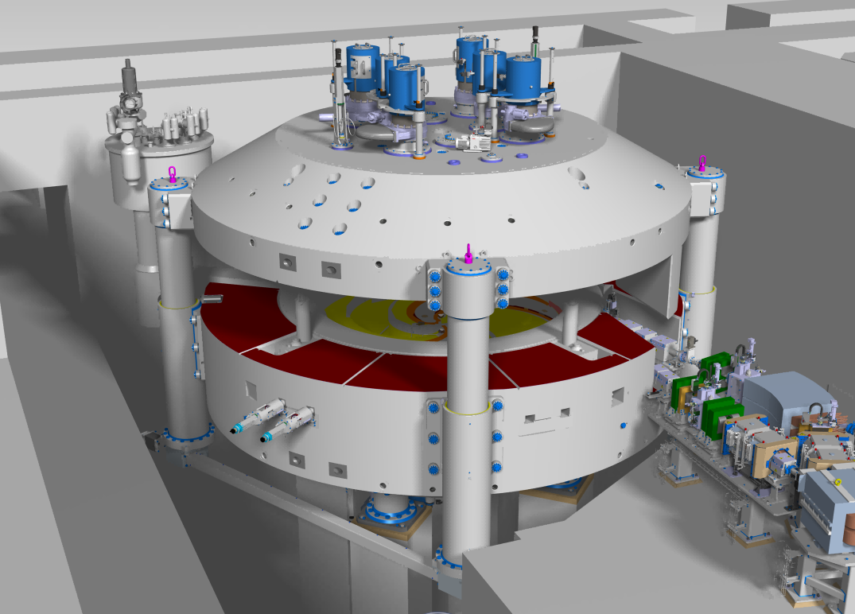
Layout of the presentation
The clinical context
Presentation of the C400IONS
Recent developments: design & production
Installation status
Confidential
Notes:
My talk will be divided into these 4 parts.

Slide 4

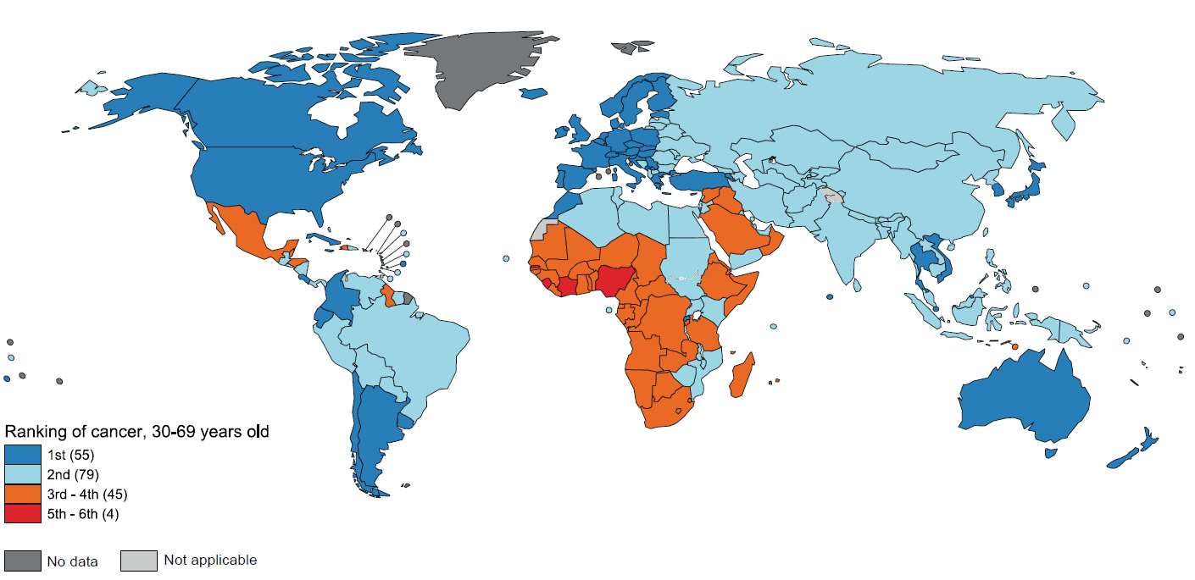
# Let’s bridge the PT gap
Estimated number of patients who may benefit from carbon ion radiation therapy is about 1-4% of new cancer cases ¹
So about 200 000 to 800 000 new patients per year based on the 19M to 28M new cancer incidence worldwide in 2022 and 2040 respectively²
Less than 7 000 patients (0,04%) were treated with carbon in 2023 ³
Source: ¹ SEER database / Ahern et al., 2023
² IARC
³ PTCOG
©2024 Normandy Hadrontherapy – Confidential & Proprietary
Notes:
Pas assez de patient pr la hadonr

Slide 5
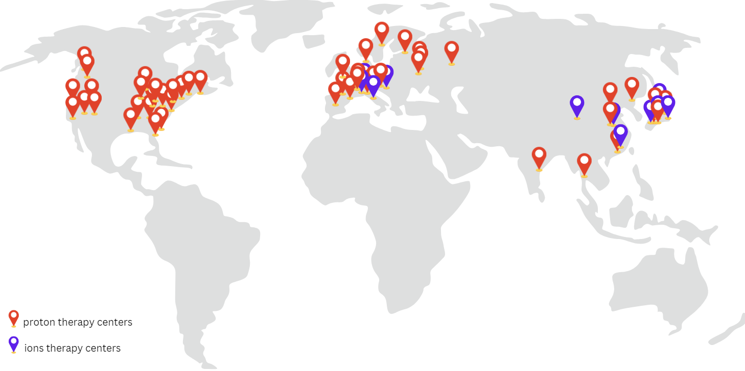


Operational Ion Therapy around the World
1st C400 IONS INSTALLATION
at
100 proton therapy centers
  30 under construction
16 ions therapy centers (about 30 rooms)
  4 under construction
700 centers (roughly 1400 rooms) would be needed to treat 1% of the incidence
  Assumption of 350 patients treated per year per room
©2024 Normandy Hadrontherapy – Confidential & Proprietary
Notes:
Repartition pas homoegene
Principalement à l’Est
Peu en Europe, pas aux US

Slide 6
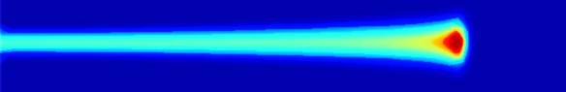
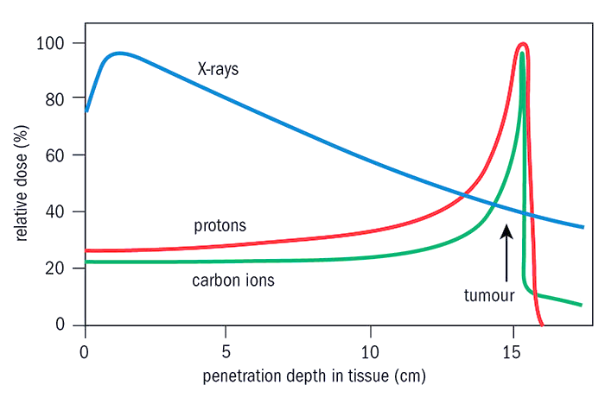
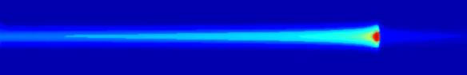
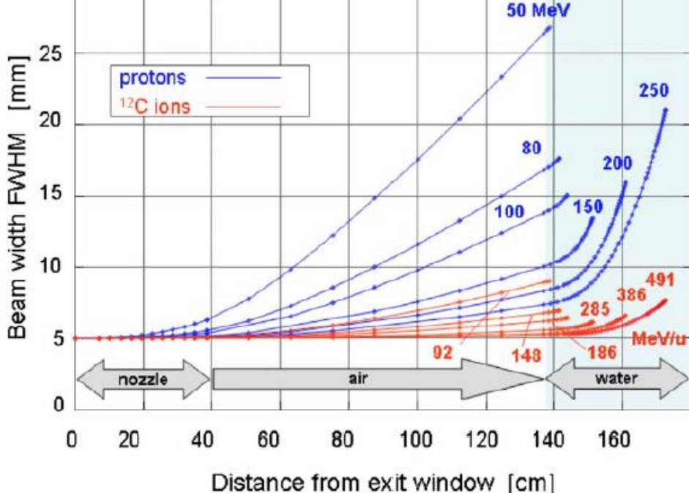
Why Ion Beam Therapy?
Small lateral penumbras | Thin Bragg Peak | Reduced spot size in tissue
Proton 175MeV
140 MeV carbons
70 MeV protons
Carbon 330Mev/u
100
80
Weber and Kraft, Cancer J 2009
60
Relative dose (%)
Relative dose (%)
40
20
-200
-150
-100
-50
0
Lateral distance (mm)
Courtesy of G. Kraft
GSI, Darmstadt
Courtesy of Johannes Gutleber
CERN, Geneva
Sharper dose distribution
©2024 Normandy Hadrontherapy – Confidential & Proprietary
Notes:
What drive us at NHa and IBA is that Carbon has very promising physical and biological characteristics. Compared to photons (and protons), carbons have the potential of:
Much sharper dose distribution - scattering
A much stronger biological effect (RBE) that has the capacity to break the double strand of our DNA, which makes the DNA repair capacity very complicated. Which is not the case with conventional radiation therapies.
Heavy Ion Therapy combined with Immuno-oncology is generating a lot of interest based on the hypothesis the very cell death is more immunogenic, which will eventually lead to a more efficient activation of the immune response and a better elimination of metastases.

Slide 7
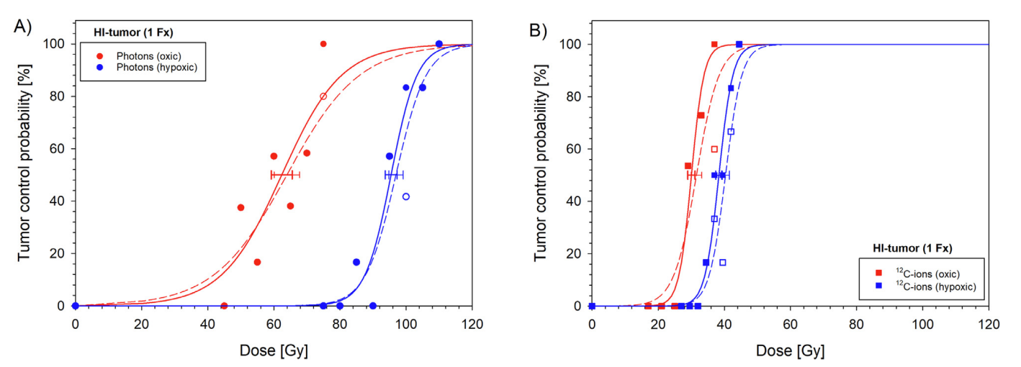
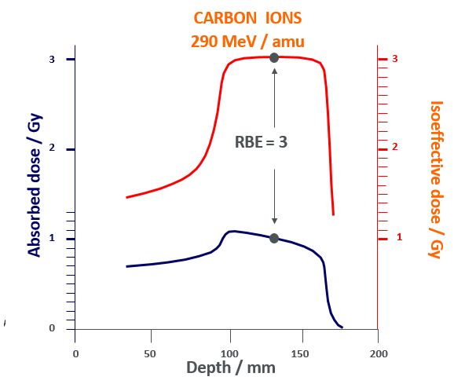
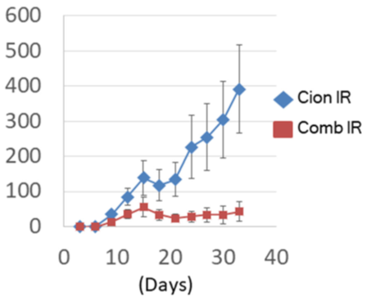
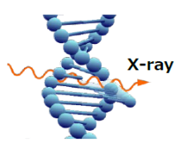
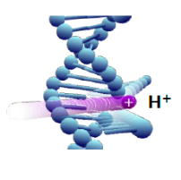
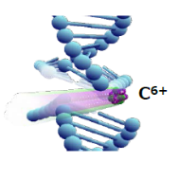
Why Ion Beam Therapy?
Efficient for radioresistant cells | High LET and RBE | Combined with immunotherapy
 |  | Enhanced tumor efficacy with immune checkpoint inhibitors
290 MeV carbons
Isoeffective dose / Gy
Absorbed dose / Gy
Tumor Volume mm3
Takaashi et al Oncotarget 2019,
2024 Glowa et al.
Modified Kraft et al 2000
Hypoxic tumor response
DNA Double strand break
Apoptosis effect activation
©2024 Normandy Hadrontherapy – Confidential & Proprietary
Notes:
What drive us at NHa and IBA is that Carbon has very promising physical and biological characteristics. Compared to photons (and protons), carbons have the potential of:
Much sharper dose distribution - scattering
A much stronger biological effect (RBE) that has the capacity to break the double strand of our DNA, which makes the DNA repair capacity very complicated. Which is not the case with conventional radiation therapies.
Heavy Ion Therapy combined with Immuno-oncology is generating a lot of interest based on the hypothesis the very cell death is more immunogenic, which will eventually lead to a more efficient activation of the immune response and a better elimination of metastases.

Slide 8
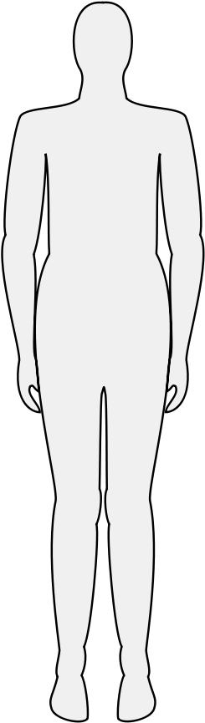
Possible Indications
Brain
Skull Base & Spinal
Head and Neck
(Salivary gland, nasopharyngeal carcinoma)
Breast & Lymphoma
Lung
Upper Gastrointestinal
(oesophagus, pancreas)
Liver
Recurrent rectal cancer
Sarcoma
(Bones, soft tissues)
Prostate
Re-Irradiation
Pediatric Tumors
Source: NIRST/QST Chiba hospital
©2024 Normandy Hadrontherapy – Confidential & Proprietary
Notes:
Radioresistance tumor

Slide 9
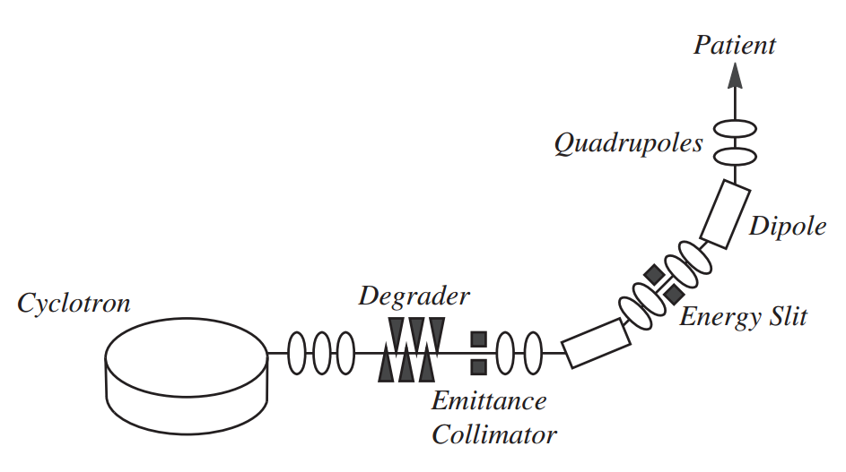
The C400 IONS project
Bring all the advantages of the cyclotron-based PT system to hadrontherapy, starting with Carbon and Helium beams
Strong points of cyclotrons technology relative to existing solutions:
Continuous beam
  Easier beam delivery
Compact layout
  A factor ~3 in footprint layout compared to current synchrotron-based systems
Simple system
  Less equipment, less complex magnet, no injector, etc.
  Fixed B-field, fixed RF
Cost efficient
Easy to maintain
  expect ~15 technicians for site maintenance (3 rooms)
High beam current
  Interesting opportunity for FLASH and minibeams
Technology very well known and mastered
  C400 developed in close collaboration with IBA (>600 accelerators, incl. >70 PT solutions, 120000+ patients treated worldwide)
Confidential
Notes:
If we would summarize the goal of the C400 IONS project, we could say that it is designed to bring all the advantages of the cyclotron-based PT system to the world of heavier ions therapy, starting with carbon and helium.
As a quick reminder, here is a list of the strong points of cyclotron-based technology compared to existing solutions, mainly of course synchrotron:
A continuous beam, which makes beam handling, and therefore delivery easier
A compact layout, where a factor about 3 is saved on the footprint layout compared to existing synchrotron systems
A relatively simple system overall, with less equipment, less magnet in number but also in complexity. No specific accelerator needed for injection
All of the above feature’s logically result in a significantly less expensive solution, easier to maintain – we expect that a pool of only 15 technicians will be needed to operate and maintain the site
The high current that cyclotron can deliver makes it well suited for the hot topic's applications such as FLASH (both for proton and carbon) and minibeams
And finally, an obvious strong advantage of this specific project is the close collaboration with IBA, where the very large experience and knowledge of this company have been adapted and transferred whenever possible to the C400, from the cyclotron inner workings to the beam delivery to the patient.

Slide 10


NHa in few words
Designs and produces its own C400 IONS treatment system
Designs the superconducting cyclotron 400MeV/u
Designs the treatment rooms with fixe beamline / couch / chair
Markets the C400 IONS treatment system
Accelerators technology is IBA’s DNA
Supports design of the C400 heavy ion cyclotron and beamline
Treatment room equipment based on IBA software and hadware
Supports market the new heavy ion system
©2024 Normandy Hadrontherapy – Confidential & Proprietary
Notes:
Private company.
NHa is a subsidiary of IBA.

Slide 11
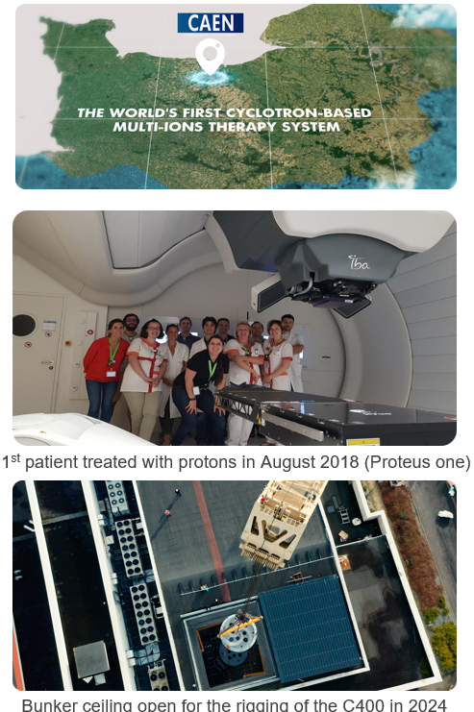
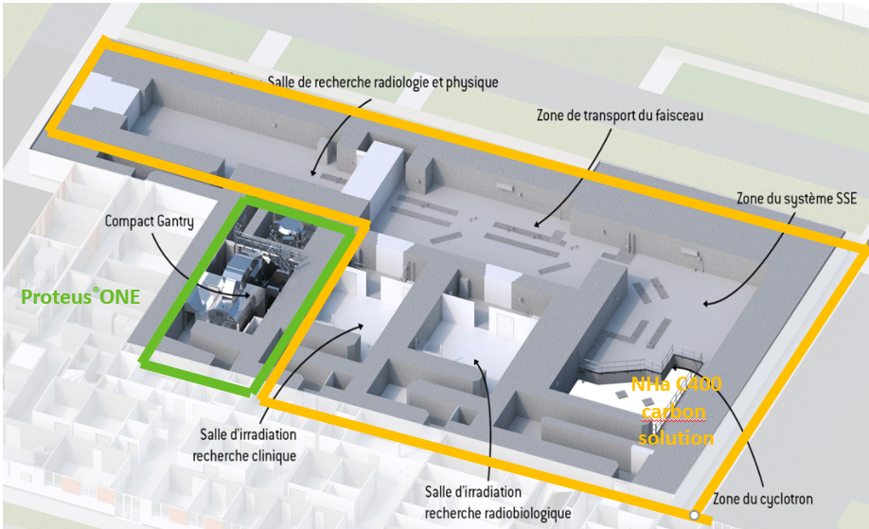
center in Caen - France
Research room for physics
Transfert beamline
ESS system
Proton Gantry
NHa C400
Multi-ions
Solution
Radiobiological
Research room
Multi-ions
Treatment room
C400 Cyclotron
©2024 Normandy Hadrontherapy – Confidential & Proprietary
Notes:
Prof. JL ARCHADE

Slide 12
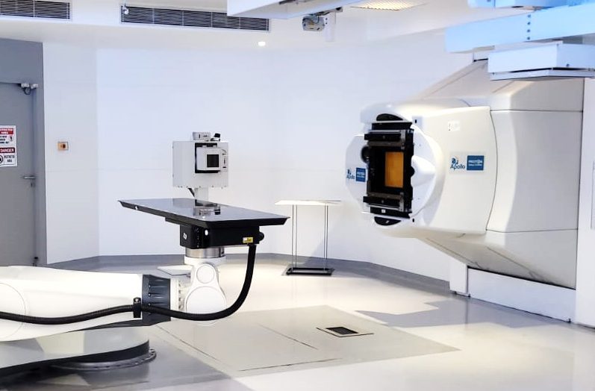
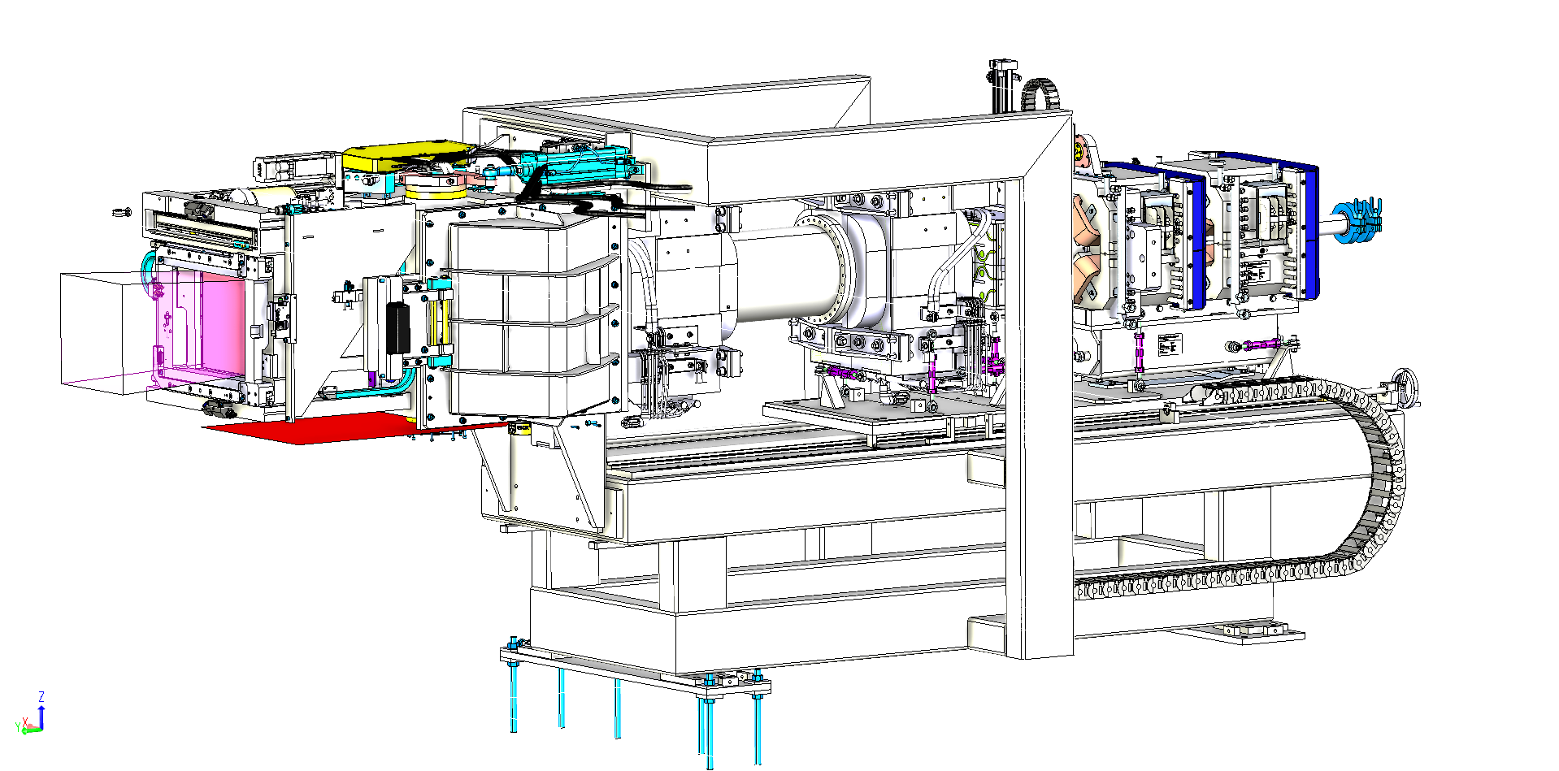
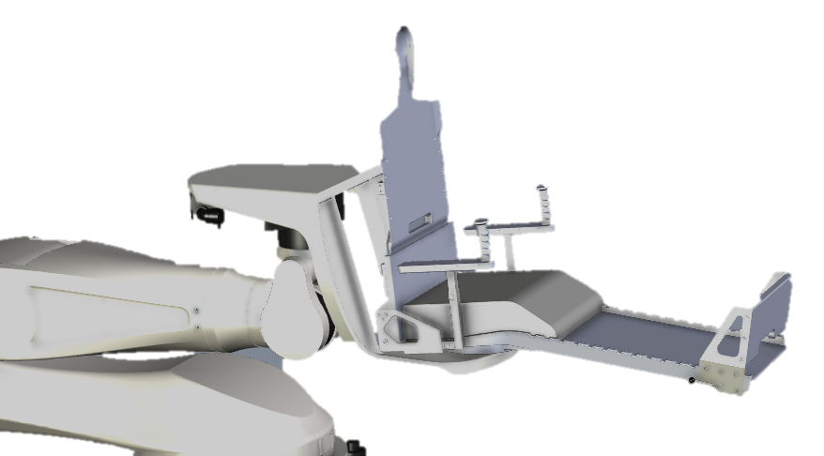
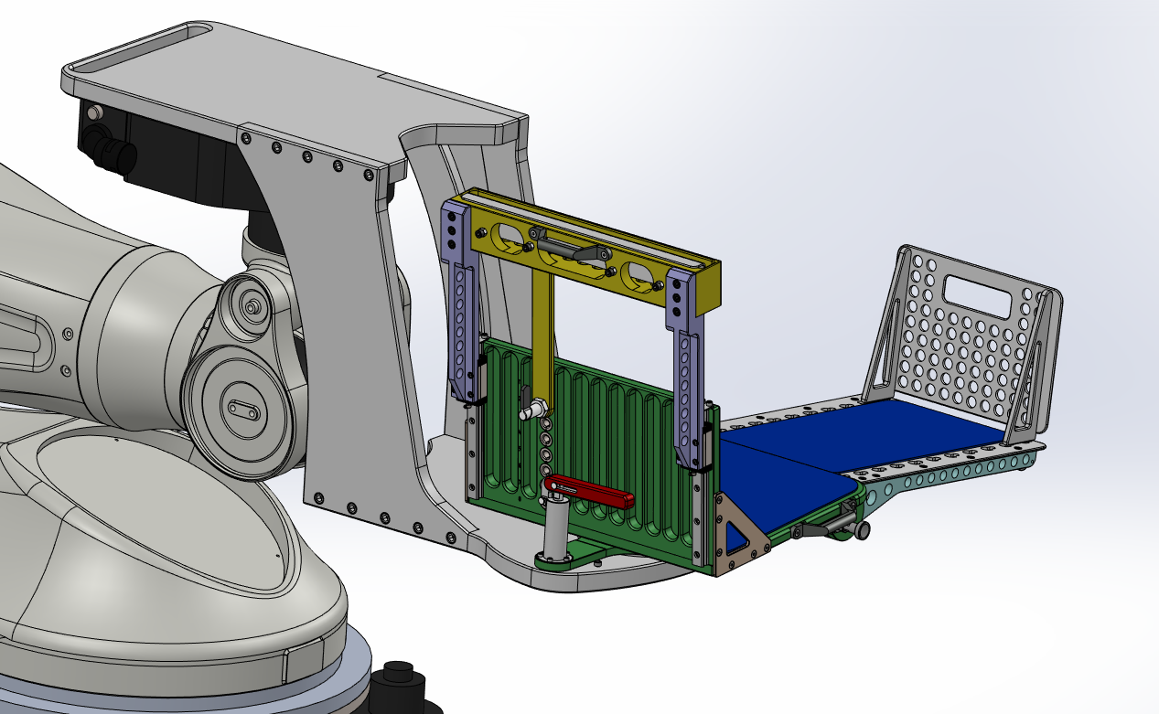
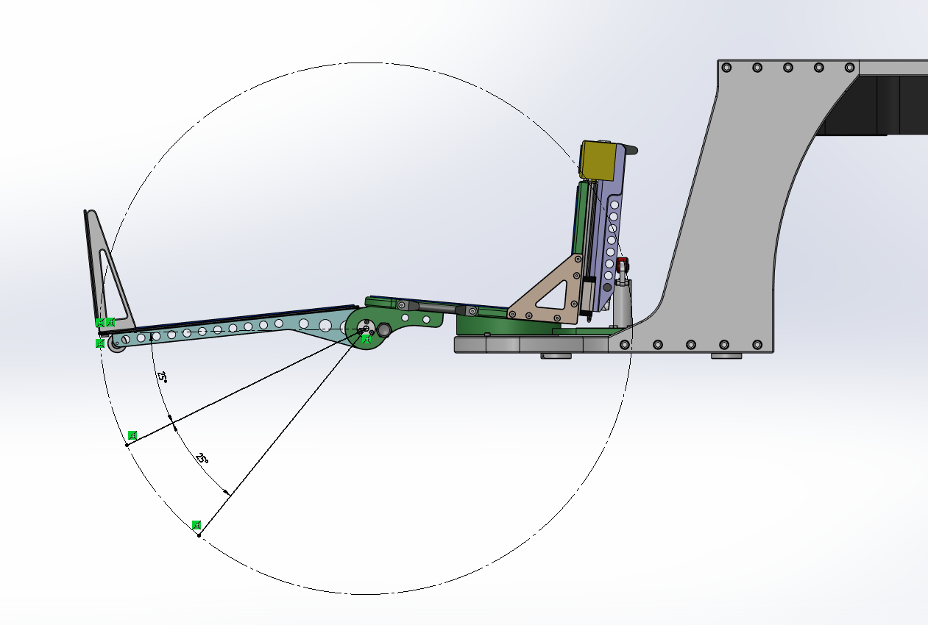
Multi-particles – fixed beam treatment room
Taking advantage of know-how and experience from IBA
High performance beam delivery and dosimetry:
  Pencil beam scanning technology
  6D PPS robotic system
  2D PPVS flat panel with 3 X-ray tubes
  Accessories to optimize irradiation range & treatment
  Nozzle bottom clearance improved for a chair
  Particle Quick switching
Innovative chair currently in development
Courtesy of IBA: Chennai site, India
Courtesy of IBA: Chennai site, India
Confidential
Notes:
Starting from the end, here is a quick slide on the treatment room which will host a fixed beam delivery, equipped both with a couch and a new chair still currently in development.
To equip this treatment room, state-of-the-art technology will be available making use as much as possible to the know how and experence from IBA.
Accessories to optimize irradiation range & treatment time: timeRipple filter to reduce the number of layers

Slide 13
Isocenter performances
Clinical Beam Performance Specifications | Unit | Carbon | Proton | Helium | Helium
Maximum range | g/cm² | ≥ 27 | ≥ 32 |  | 32
Beam position accuracy at isocenter | mm | ≤ 0.5 |  |  | 0.5
Beam spot size @ max range (1σ) | mm | ≤3 | ≤ 3.6 |  | ≤3.6
Beam spot size @ min range (1σ) | mm | ≤ 4 | ≤ 8 |  | ≤ 6
Maximum Field size | cm² | ≥ 20x20 | ≥ 30x30 |  | ≥ 28x28
SAD X/Y | cm | 296 / 330
Average dose rate (homogeneous cube of a 10 cm × 10 cm × 10 cm) | Gy/min | ≥ 2
Patient Positioning and Alignment Specifications | Unit | Couch | Chair
Treatment volume (L x W x H) | cm | 100 x 50 x 40 | 32 x 23 x 55
Yaw rotation for prescription / correction | ° | ± 90 / ± 5 | ± 180 / ± 5
Pitch and roll range for prescription / correction | ° | ± 10 / ± 5
©2024 Normandy Hadrontherapy – Confidential & Proprietary
Notes:
The design parameters of the system will translate to the following beam performances for clinical use.
Concerning the beam delivery performance, values similar to the state-of-the-art of particle therapy will be achieved, for clinical range of course but also for beam position accuracy and spot size at isocenter.

Slide 14



Challenges, perspectives and partnerships
Helium ions PBS ready
Third party CBCT, SGPT compatible
NEXT DEVELOPMENT
Conformal Hadron Flash therapy
ALREADY COMPATIBLE
Carbon Flash research - 2x2x2cm²
Helium imaging
High dose rate treatment
Gantry based technology (Arc, CBCT…)
New ions like Oxygen…
©2024 Normandy Hadrontherapy – Confidential & Proprietary

Slide 15
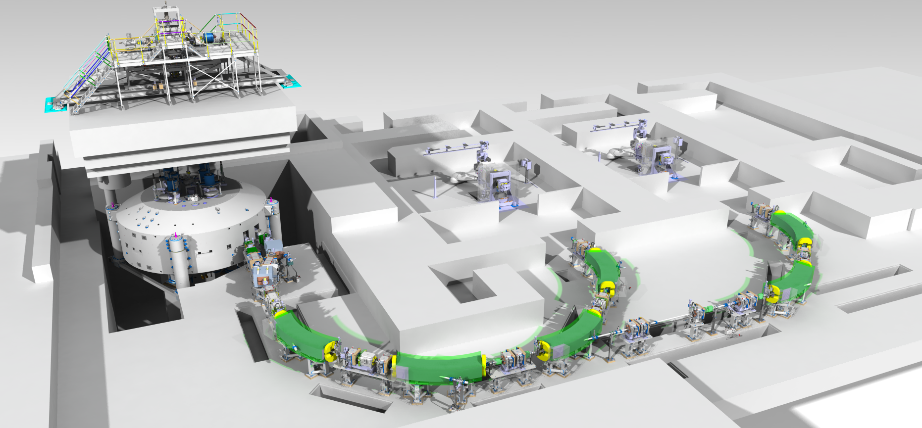

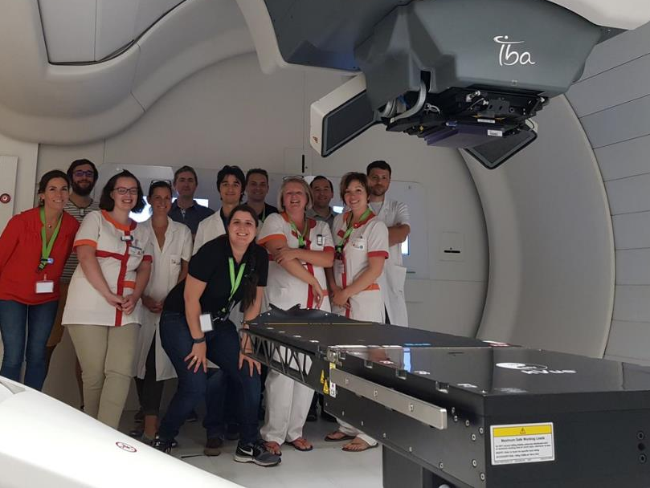


First site: CYCLHAD (Caen, France)
Fixed beam room #1 Treatments
& Clinical research
Fixed beam room #2
Radiobiology research
C400 cyclotron
Confidential
Notes:
The site that will host the first system is CYCLHAD, located in Caen, France. Over there, an active PT site (Proteus One from IBA) is already active and treating patients since 2018.
On the picture, you can see the general layout of the future C400 IONS system with the cyclotron vault, above it the ion source platform and its vertical beam line toward the cyclotron. And downstream the cyclotron the lines transporting the beams toward the 2 clinical rooms, one of them dedicated to treatment and clinical research, the other one dedicated to radiobiology research. Not shown on the picture there is also a straight part beam line leading to Physics research room.

Slide 16
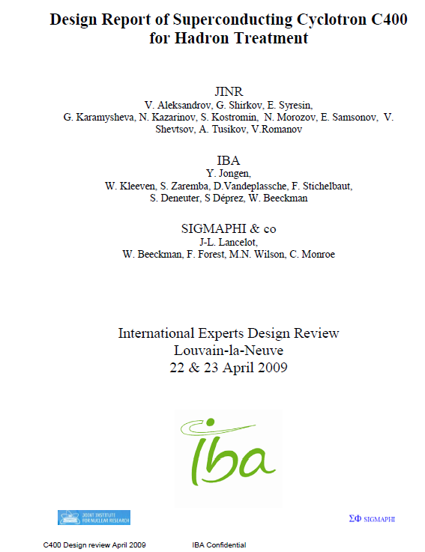
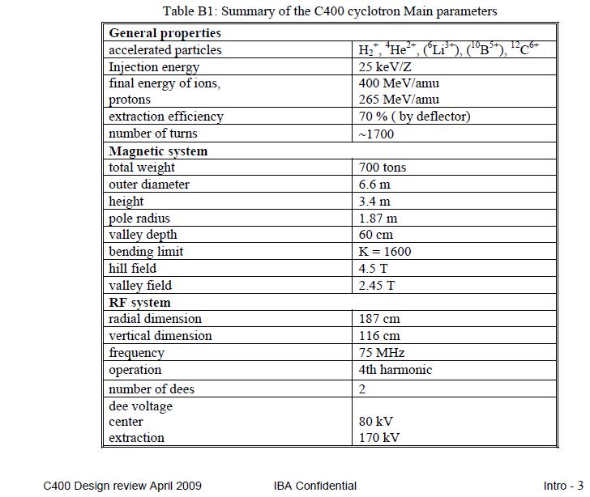


The C400 cyclotron
REMINDER: Initial accelerator design is based on a IBA-JINR collaboration from 2009, reviewed by experts of our community.
26 kV
260<<270
~2100
737 Tons
7m
~60 kV
~150 kV
IBA experts (Jérôme Mandrillon, Vincent Nuttens, Willem Kleeven et al.) did an extra pass on all subsystems with substantial modifications and additions
.
Let’s mention also the mechanical engineering experts: Laurent Koffel, Sebastien Deprez and Yohakim Otu that led the nice developments presented here.
.
Confidential
Notes:
Just as a reminder that the C400 design originates from an IBA-Dubna collaboration from 2009. Since then, during the 4-5 last years, IBA experts did an extra pass on all subsystems with substantial modifications, some of them listed there.
Let’s also mention the mechanical experts that did crucial contributions to the system and whose results will be presented here.

Slide 17
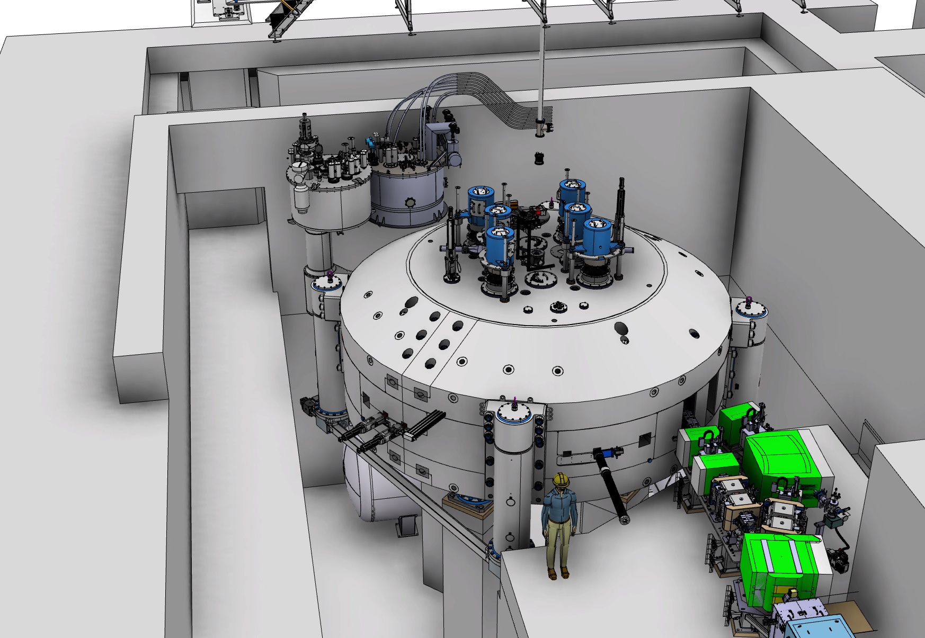
General overview of the C400 cyclotron
Main technical features:
“Compact” magnet
  740 Tons – 7m diameter yoke - pole radius 1.87m
  pole is 4-fold symmetry / Elliptical gap / Spiralized poles
  can accelerate q/m = ½ particles
RF: 75MHz for ¹²C⁶⁺ , 75.6MHz for H₂⁺, Harmonic #4
Cryogenic coils
  max field 4.5T
  coils in liquid He bath
  2 sub-coils/coil to adapt field to particle masses discrepancies.
Injection line
  3 sources: H₂⁺, ⁴He²⁺ & ¹²C⁶⁺
  Beam optics controls, buncher & diagnostics
Dual extraction:
  H₂⁺ @ ~265 MeV/u: protons extracted via stripping
  ⁴He²⁺ & ¹²C⁶⁺ @ 400 MeV/u: via electrostatic deflector
Confidential
Notes:
We will have a look on the main technical feature of this cyclotron, but first let’s have a zoomed in view of the accelerator vault to give an idea of the device scale with the little guy in front of it.

Slide 18
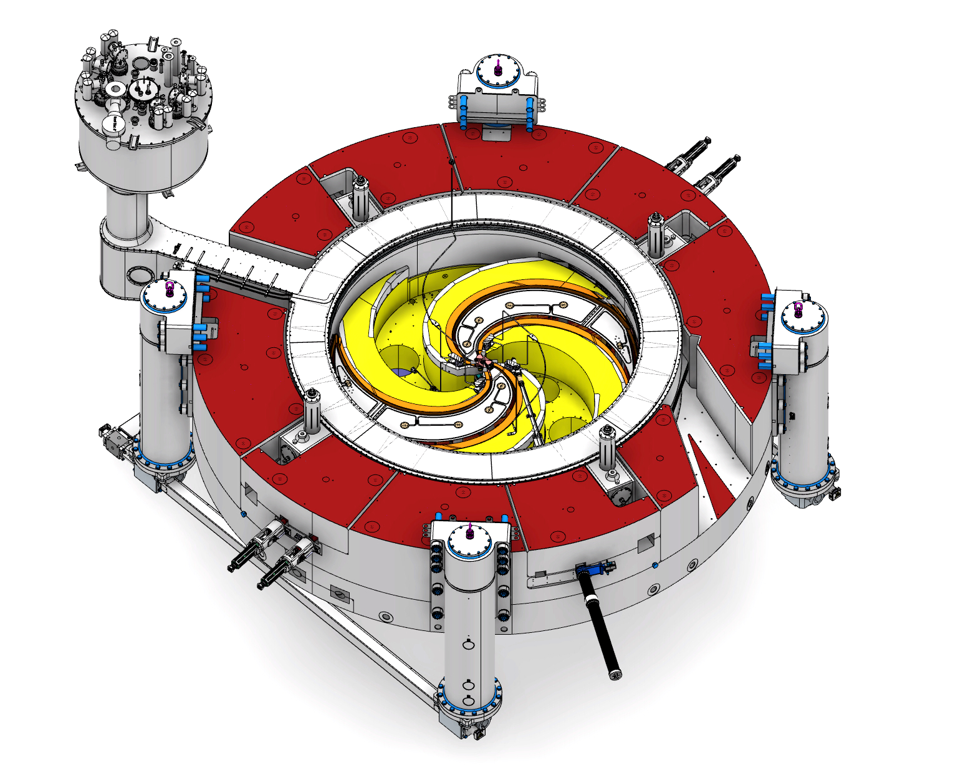
General overview of the C400 cyclotron
Main technical features:
“Compact” magnet
  740 Tons – 7m diameter yoke - pole radius 1.87m
  pole is 4-fold symmetry / Elliptical gap / Spiralized poles
  can accelerate q/m = ½ particles
RF: 75MHz for ¹²C⁶⁺ , 75.6MHz for H₂⁺, Harmonic #4
Cryogenic coils
  max field 4.5T
  coils in liquid He bath
  2 sub-coils/coil to adapt field to particle masses discrepancies.
Injection line
  3 sources: H₂⁺, ⁴He²⁺ & ¹²C⁶⁺
  Beam optics controls, buncher & diagnostics
Dual extraction:
  H₂⁺ @ ~265 MeV/u: protons extracted via stripping
  ⁴He²⁺ & ¹²C⁶⁺ @ 400 MeV/u: via electrostatic deflector
Confidential
Notes:
Every efforts have been made to make the magnet as compact as possible for this multi-particle isochronous cyclotron, the end result being the following: a 7 m diameter yoke. pole radius of 1.87m, all that totaling an iron mass of about 740 tons.
The pole is of 4-fold symmetry with elliptical gap and spiralized poles, as is common on such accelerator. From design, it can in principle accelerates all ions having a charge over mass ratio close to ½.
It works on harmonic #4 and the RF frequency can be adjusted to account for the particle mass discrepancies.

Slide 19
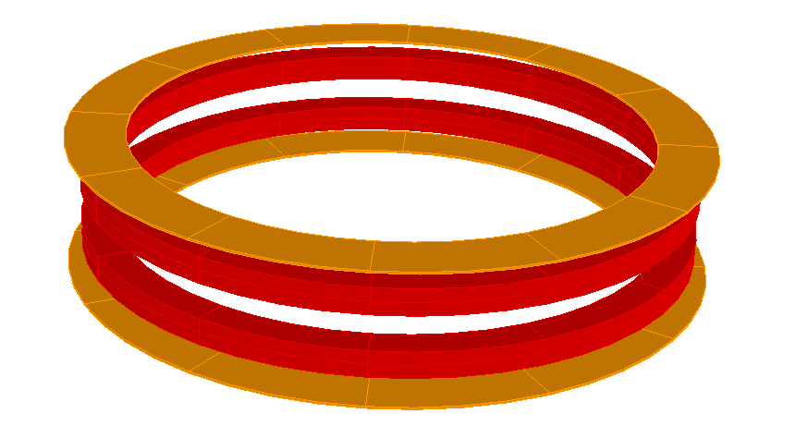
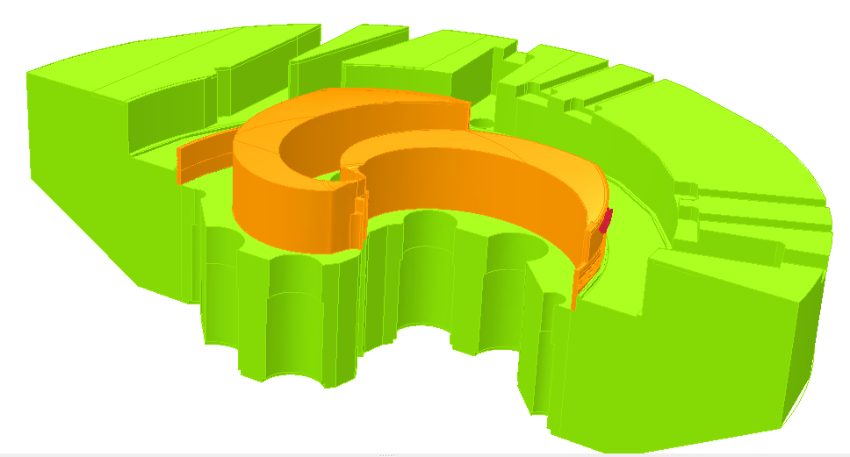
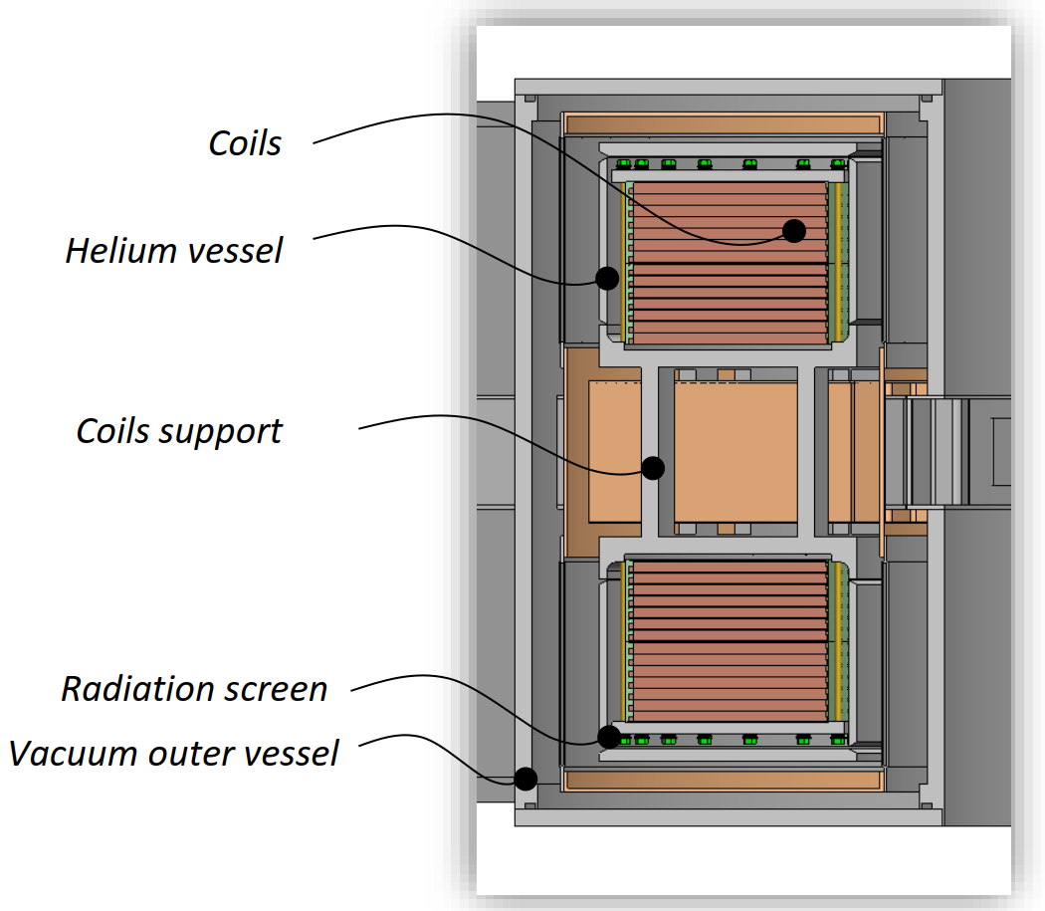
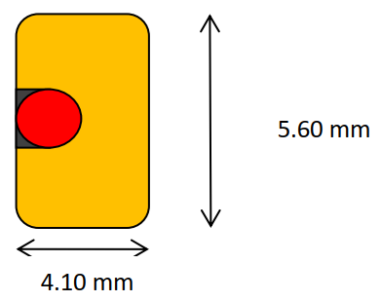
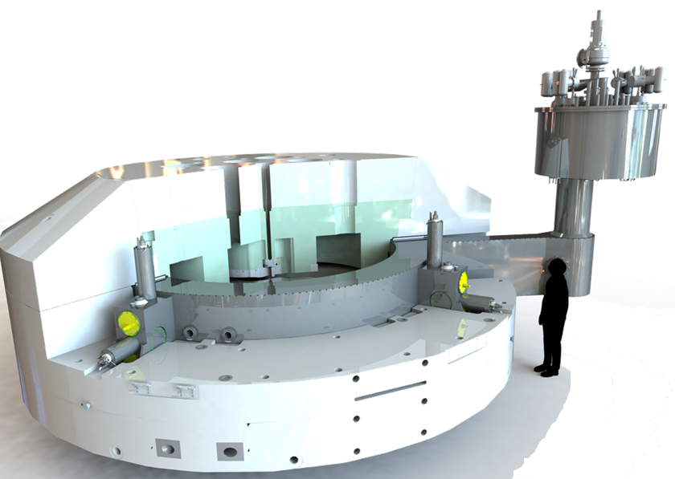
General overview of the C400 cyclotron
Coils
Ramping time : 2 hours
Time to switch between particles : < 15 min
Stored energy: ~55.6 MJ
turns per coil : 1344
Supra material : NbTi
Critical current: 2800 A @ 4,5 T @ 4,2 K
Main technical features:
“Compact” magnet
  740 Tons – 7m diameter yoke - pole radius 1.87m
  pole is 4-fold symmetry / Elliptical gap / Spiralized poles
  can accelerate q/m = ½ particles
RF: 75MHz for ¹²C⁶⁺ , 75.6MHz for H₂⁺, Harmonic #4
Cryogenic coils
  max field 4.5T
  coils in liquid He bath
  2 sub-coils/coil to adapt field to particle masses discrepancies.
Injection line
  3 sources: H₂⁺, ⁴He²⁺ & ¹²C⁶⁺
  Beam optics controls, buncher & diagnostics
Dual extraction:
  H₂⁺ @ ~265 MeV/u: protons extracted via stripping
  ⁴He²⁺ & ¹²C⁶⁺ @ 400 MeV/u: via electrostatic deflector
SC wire
NbTi
Hardened copper
Fiber glass insulation
Encapsulation with Epoxy impregnation
Cryostat
Outer diameter: 4.8m
Liquid helium bath T°: 4.3 K
Confidential
Notes:
The coils are cooled down to superconductive regime thanks to a liquid Helium bath enclosed into a cryostat carefully isolated from the rest of the system. Each upper and lower coils are divided into 2 sub-coils to, also here, adapt the field in order to account for the particle mass discrepancies.
Again let’s speed up this part since it was already presented.
(The cryogenic coil and its cryostat have been designed and manufactured by the SigmaPhi company. The picture on the right shows the cryostat in their hall with the coils already inserted and all the welding completed. This crucial piece of equipment will be delivered and installed on site in the coming months in the so-called ‘phase 2’ of the installation.)

Slide 20
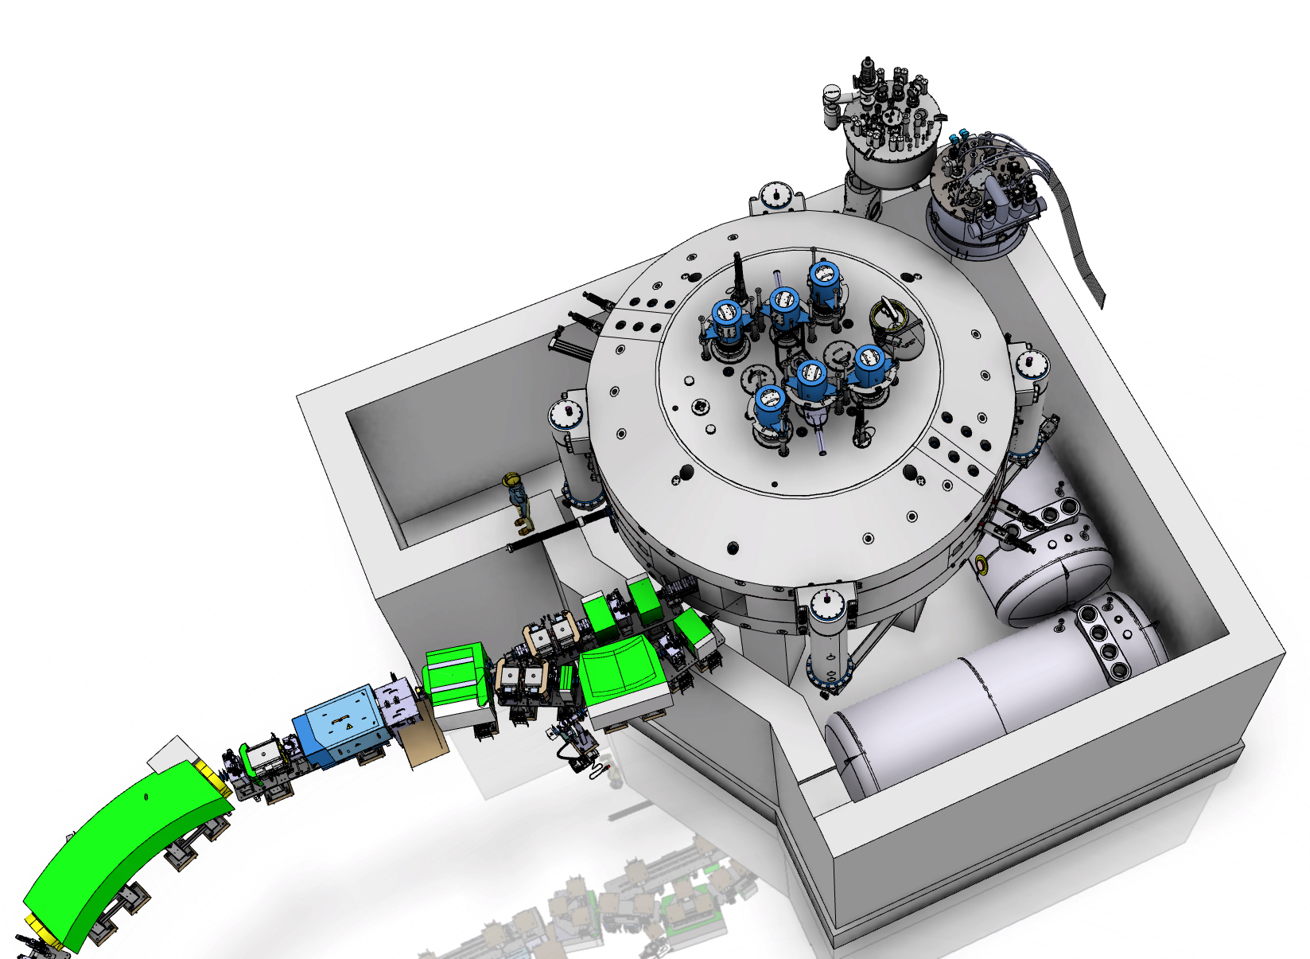
General overview of the C400 cyclotron
‘HMS’ (Helium Management System)
Main technical features:
“Compact” magnet
  740 Tons – 7m diameter yoke - pole radius 1.87m
  pole is 4-fold symmetry / Elliptical gap / Spiralized poles
  can accelerate q/m = ½ particles
RF: 75MHz for ¹²C⁶⁺ , 75.6MHz for H₂⁺, Harmonic #4
Cryogenic coils
  max field 4.5T
  coils in liquid He bath
  2 sub-coils/coil to adapt field to particle masses discrepancies.
Injection line
  3 sources: H₂⁺, ⁴He²⁺ & ¹²C⁶⁺
  Beam optics controls, buncher & diagnostics
Dual extraction:
  H₂⁺ @ ~265 MeV/u: protons extracted via stripping
  ⁴He²⁺ & ¹²C⁶⁺ @ 400 MeV/u: via electrostatic deflector
Cryogenic system
First cooling from GHe to LHe with closed loop liquifaction system
Cooling power : 6 cryocoolers / 14 W cooling power @ 4.3 K
Highly instrumented for quench management
(Temperatures / Voltages / pressures, strain gauges, quench heaters)
2x large tanks for complete He recovery & reliquefication on site
→ Cost saving and environment friendly
Confidential
Notes:
I guess I can skip this part about the cryogenic system since my colleague Laurent presented it in details yesterday.
(The coil cryogenic cooling is managed by an autonomous system designed to minimize operating expense and eliminate the need for a supply logistics of the liquid Helium. I won’t expand further since you already had a detailed presentation of the system by my colleague Laurent yesterday.)

Slide 21
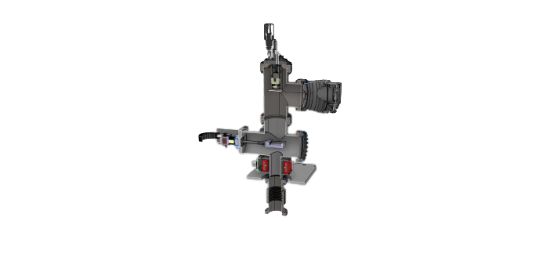
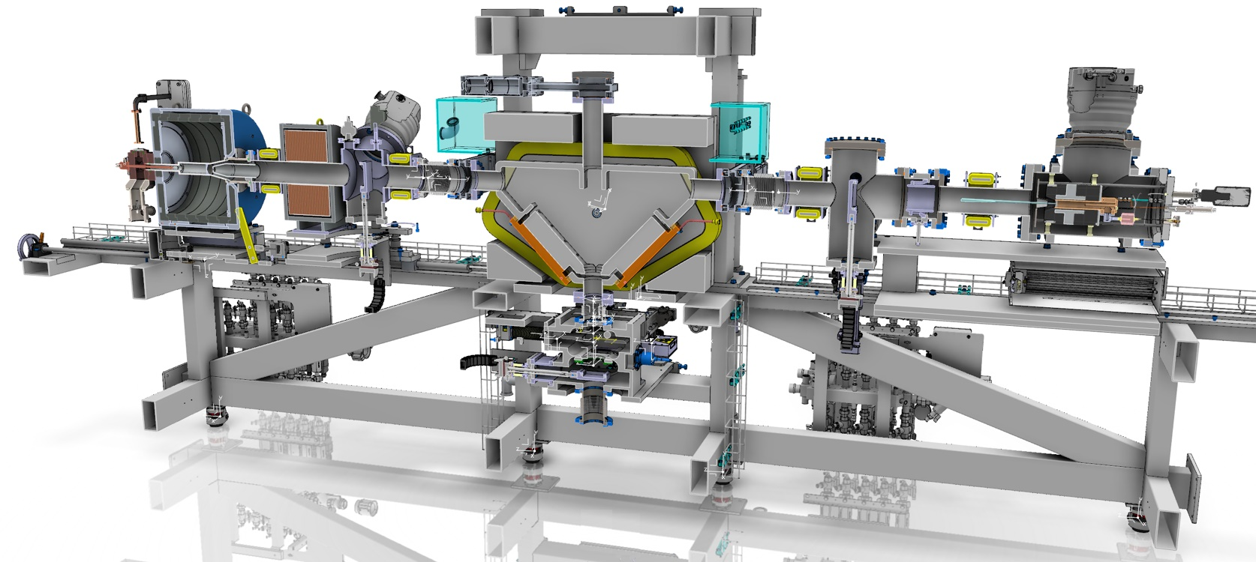
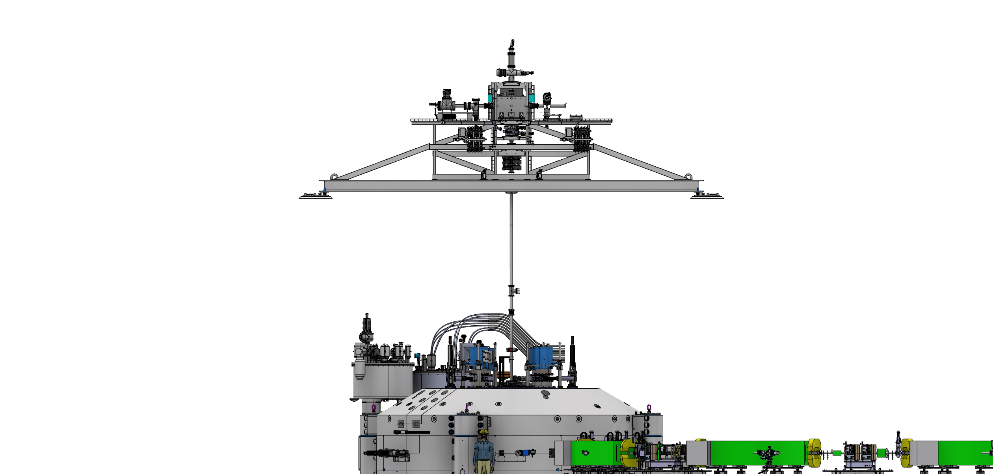
General overview of the C400 cyclotron
H₂⁺ - TES type IS
¹²C⁶⁺ - ECR type IS
⁴He²⁺ - ECR type IS
Main technical features:
“Compact” magnet
  740 Tons – 7m diameter yoke - pole radius 1.87m
  pole is 4-fold symmetry / Elliptical gap / Spiralized poles
  can accelerate q/m = ½ particles
RF: 75MHz for ¹²C⁶⁺ , 75.6MHz for H₂⁺, Harmonic #4
Cryogenic coils
  max field 4.5T
  coils in liquid He bath
  2 sub-coils/coil to adapt field to particle masses discrepancies.
Injection line
  3 sources: H₂⁺, ⁴He²⁺ & ¹²C⁶⁺
  Beam optics controls, buncher & diagnostics
Dual extraction:
  H₂⁺ @ ~265 MeV/u: protons extracted via stripping
  ⁴He²⁺ & ¹²C⁶⁺ @ 400 MeV/u: via electrostatic deflector
Carbon source
^{Tmagnet}
^{Diagnostic}
^{box}
ECR sources
He and H2 sources are commercial items (Polygon Physics) specifically tuned for the C400 IONS injection line
The Carbon source is a novel in-house developments with up-to-date methods and technology
Transport line
layout & equipment designed to maximize transmission and injection into cyclotron
Confidential
Notes:
A quick look on the external ion source platform and transport line, located some 10 m above the cyclotron.
Each ion beam, Carbon 6+. Helium 2+, and molecular hydrogen 1+, has its own dedicated ECR sources for fast switching. Those sources have been specifically designed and optimized to maximize production.
In particular, the ions wil be extracted from the source by a 30 kV HV electrode and therefore won’t require additional pre-acceleration before cyclotron injection, as is necessary on synchrotron-based system.

Slide 22
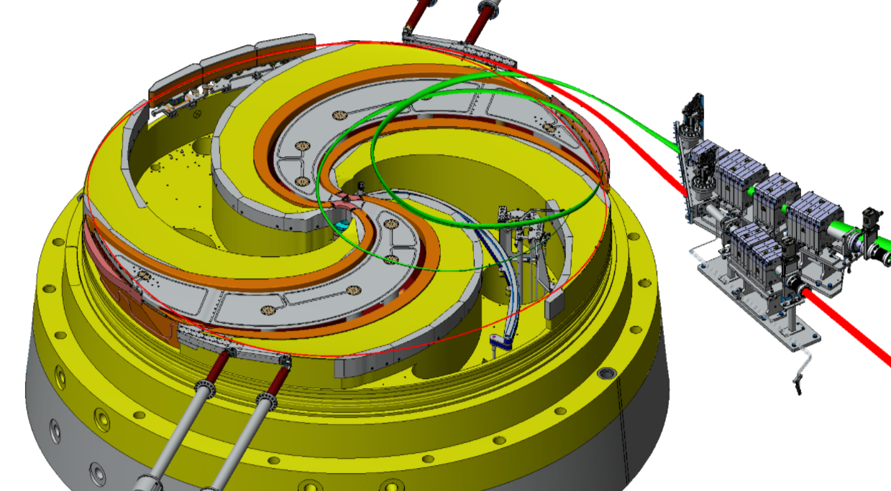
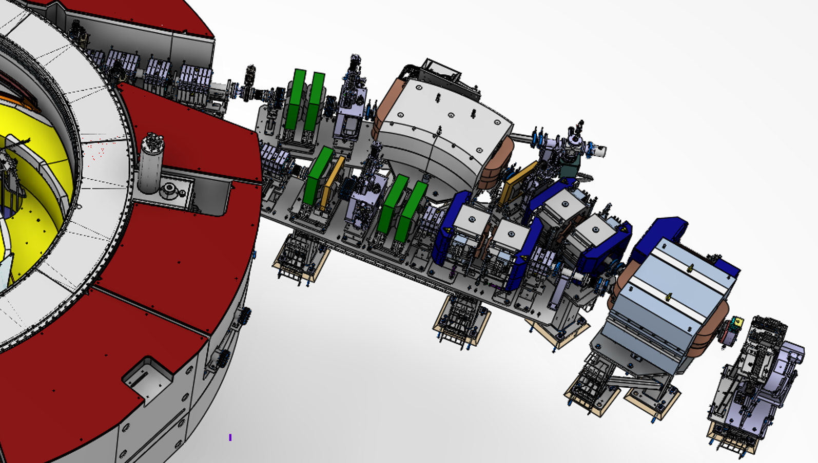
General overview of the C400 cyclotron
Main technical features:
“Compact” magnet
  740 Tons – 7m diameter yoke - pole radius 1.87m
  pole is 4-fold symmetry / Elliptical gap / Spiralized poles
  can accelerate q/m = ½ particles
RF: 75MHz for ¹²C⁶⁺ , 75.6MHz for H₂⁺, Harmonic #4
Cryogenic coils
  max field 4.5T
  coils in liquid He bath
  2 sub-coils/coil to adapt field to particle masses discrepancies.
Injection line
  3 sources: H₂⁺, ⁴He²⁺ & ¹²C⁶⁺
  Beam optics controls, buncher & diagnostics
Dual extraction:
  H₂⁺ @ ~265 MeV/u: protons extracted via stripping
  ⁴He²⁺ & ¹²C⁶⁺ @ 400 MeV/u: via electrostatic deflector
Confidential
Notes:
Coming back to the cyclotron itself, one distinctive feature is the dual extraction system:
The carbon and helium are extracted at max radius and 400 MeV/u with an electrostatic deflector and magnetostatic channel combination. This is the red trajectory on this picture.
Whereas the protons are extracted at 260 MeV thanks to the stripping of the molecular hydrogen followed by a 2-turns trajectory extraction. The green one on the picture.

Slide 23
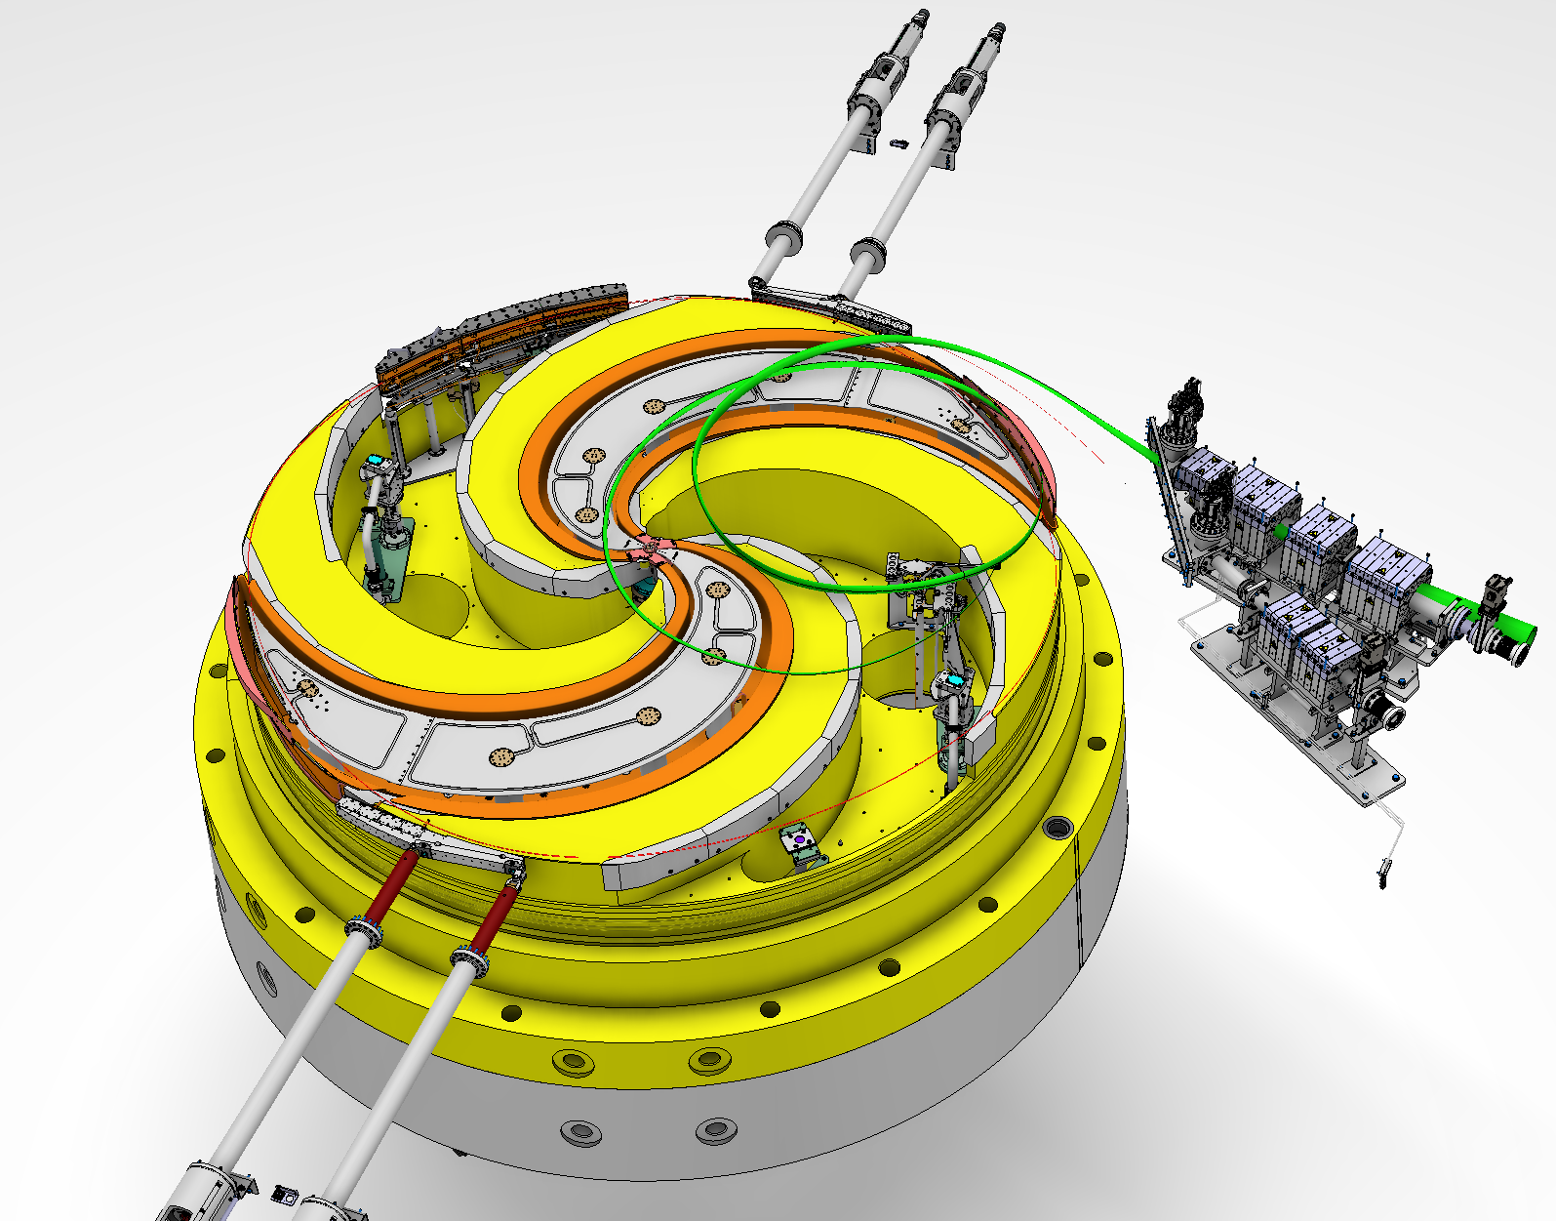
General overview of the C400 cyclotron
“Gradient corrector”
(Magnetostatic channel)
C400 – Inside view
on BOTTOM pole:
Electrostatic deflector
Stripper positioning system
Movable shims
Extraction tables
Permanent magnets quadrupoles assemblies
(still in yoke !)
Cavity and Dee
265 MeV protons
Magnet
Pole = single piece of iron of 3.8m
400 MeV/u
ions
Dummy Gradient corrector
Keep magnetic symmetry
Notes:
All the inner elements typical of isochronous cyclotrons are either in their final stage of design, or already manufactured like for example the RF cavities, which were test fitted in factory like two weeks ago.

Slide 24
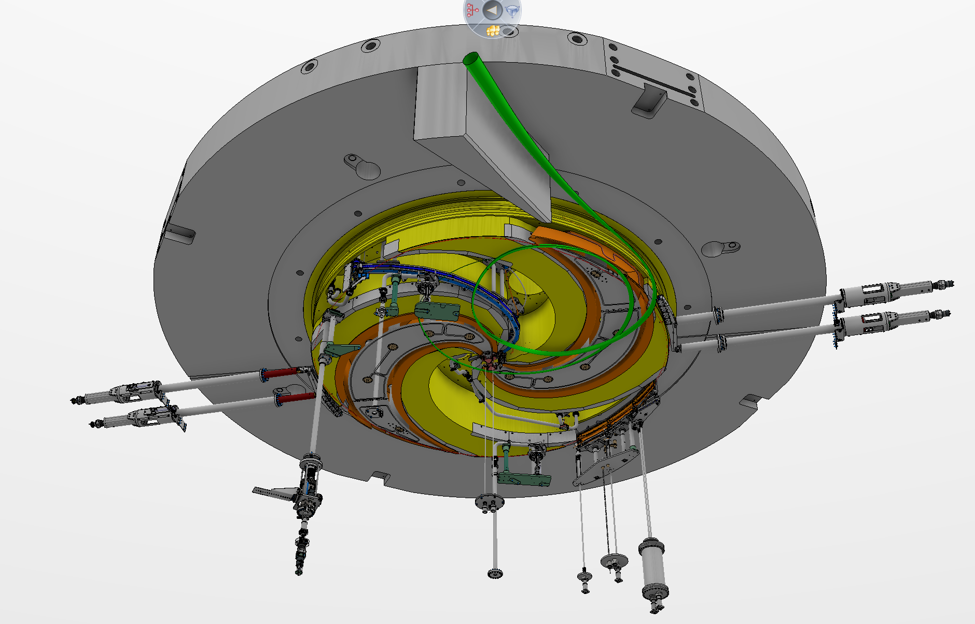
General overview of the C400 cyclotron
C400 – Inside view
on TOP pole:
265 MeV protons
400 MeV/u
ions
“Beam probe”
Current measure + visual
“Periscope”

Slide 25
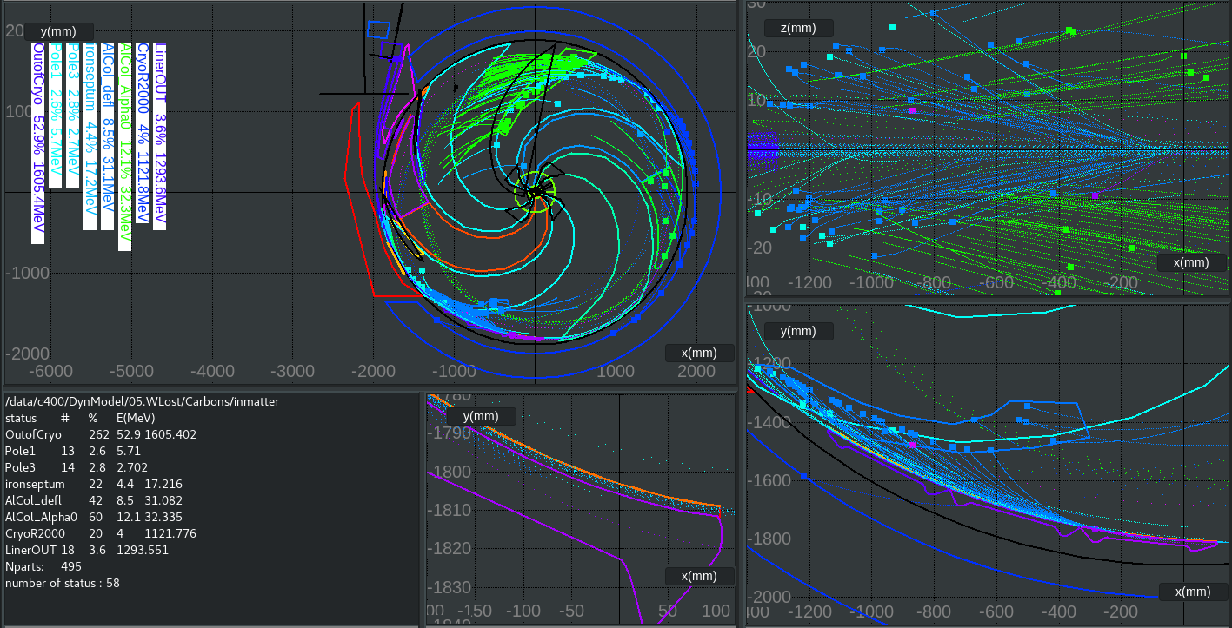
Recent developments: Design progress
Beam losses management
  Why?
    High energy & current large energy deposition spread inside the cyclotron
    Activation Dose received to personnel
    Power transmitted on SCC cryostat Quench risk
  Principles:
    Computation of particle tracking of the lost particles inside matter
  Mitigations:
    1. Optimize injection
    2. Tune beam in the central region
    3. Addition of collimators at high radius
Confidential
Notes:
About beam losses management. This is a specific issue of the C400 linked to the high current and energy of the accelerated ion beams, especially of the Helium beam, that lead to significant activation of critical pieces, which in turn will translate into dose received by the personnel during maintenance.
Another worry is the power transfer from this losses to the cryostat of the superconductive coil which could lead to a risk of quench.
So the principle is to compute the tracking of the lost particles also inside matter to precisely identify their energy deposition and location.
Once their history and trajectories are well known back to the injection point, several mitigations can be employed to prevent them to reach critical locations.
We will quickly go through the three of them.

Slide 26
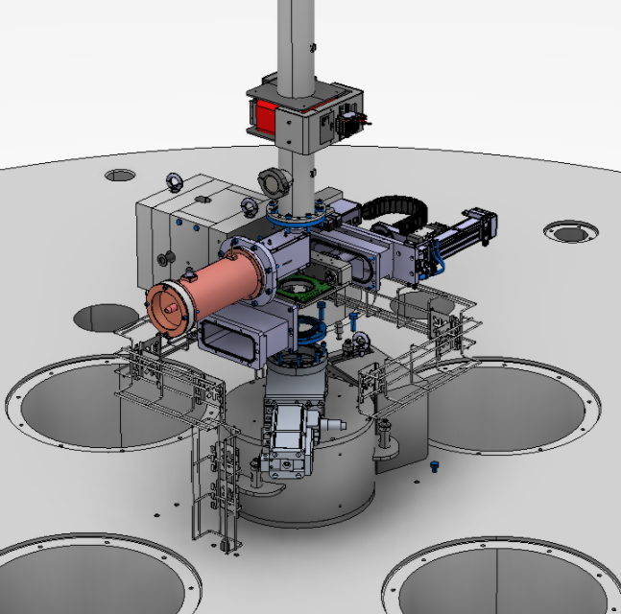
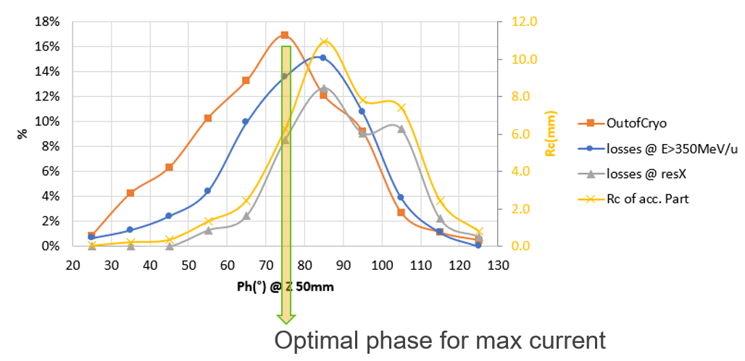
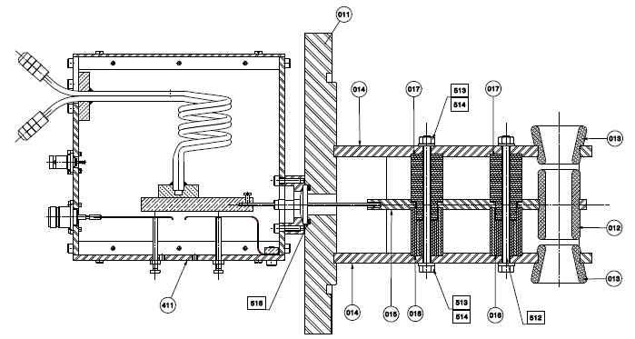
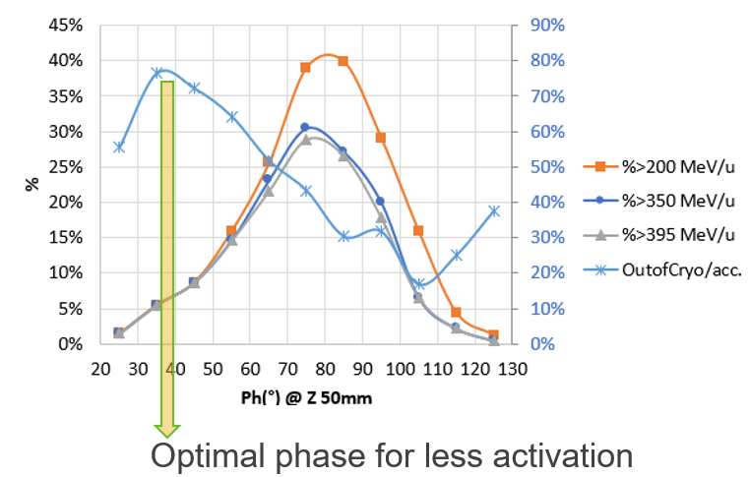
Recent developments: Design progress
Beam losses management
1. Optimize injection: make use of the buncher in the injection line
“outofCryo”: meaning particles reaching cryostat exit port
2 gaps – single harmonic buncher of known design
Transmission
Transmission
Depending on the settings of the buncher, we can get either:
- an activation reduction by a factor ~2
- OR a max current multiplication by a factor ~4
Final settings and use will be defined by tests during commissioning
Confidential
Notes:
A simple 2-gaps single harmonic buncher is installed in the injection line, originally foreseen to increase the max current injected into the cyclotron.
Combining previously shown computation of lost tracks, it was identified that all the major losses (blue grey and yellow curves on the phase selection plot of the buncher) were all peaked at roughly the same value and close to the nominal setting for the max current (OutofCryo – orange plot).
Therefore by purposefully tuning out the buncher phase at a lower value, one can suppress significantly those losses at the cost of max current that the buncher could bring, as shown on the plot below.
These studies give the following order of magnitude: either a factor 4 for the max current, or an activation reduction by a factor 2.

Slide 27
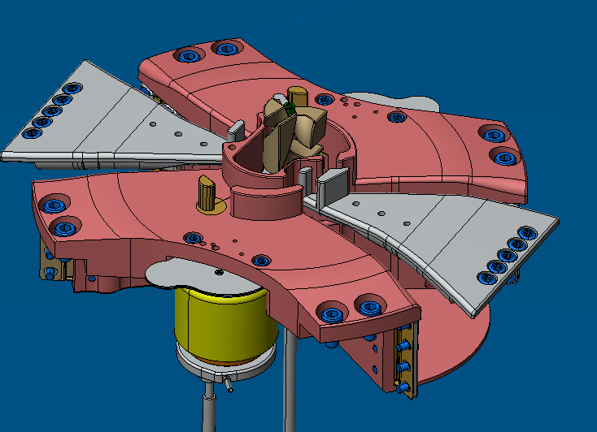
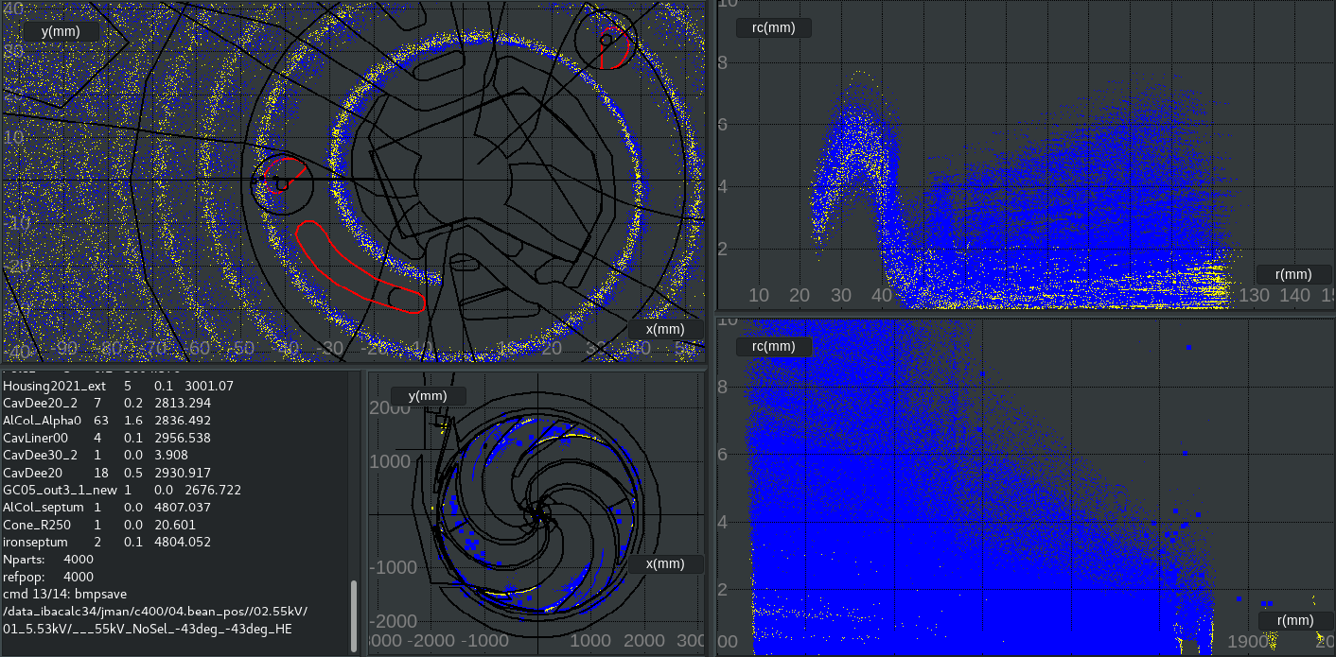
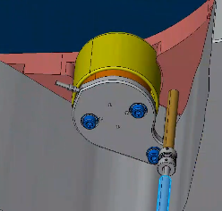

Recent developments: Design progress
Beam losses management
2. Tune beam in the central region: ‘droplet’ shaped phase selector
Droplet phase selectors
Inflector
NO HIT DETECTION ON SELECTOR
Contact with RF cavities
Contact with Dees
Actuated from outside the cyclo
“outofCryo”: meaning particles reaching cryostat exit port
Blue: High energy losses: losses post central region: in resonance & in extraction
Drop axis
Dia. 14mm
Base circle(Ro)
Confidential
Notes:
Second mitigation is located in the central region during the very first turns.
On this picture you can see the final design of the central region with at its center the inflector electrodes that bend the injected beam 90deg and the contacts with the RF system.
The mitigation is actually composed of these 2 little drop shaped phase selectors that can be rotated from outside the cyclo.
As you can see from the particle tracking visualization plot on the right, depending on their angle setting the selectors will cut more or less the low energy beam at those 2 different locations.
To illustrate qualitatively the effects of theses devices, let’s see on this plot the tracks that have been colored depending on their fate: in yellow the particles that reach the exit of the cyclotron in blue the ones that will be lost downstream the acceleration path at higher energy.
At the very right, the same data shown as a function of cyclo radius.
Actually, for the calculation shown here, hit detection on those selectors have been deactivated, which explains the large fraction of lost tracks.
And if we now make the same calculation activating hit detection…

Slide 28

Recent developments: Design progress
Beam losses management
2. Tune beam in the central region: ‘droplet’ shaped phase selector
Droplet phase selectors
Inflector
HIT DETECTION ON SELECTOR (θ = -43°)
Contact with RF cavities
Contact with Dees
Actuated from outside the cyclo
“outofCryo”: meaning particles reaching cryostat exit port
Blue: High energy losses: losses post central region: in resonance & in extraction
Drop axis
Dia. 14mm
Base circle(Ro)
Confidential
Notes:
.. We can see that the ‘lost tracks’ have been significantly reduced, and of course such beam stopping at low energy doesn’t generate significant activation.
This theoretical result is a proof-of=principle, of course the nominal setting will be defined empirically during the beam tests.

Slide 29





Recent developments: Design progress
Beam losses management
3. Addition of collimators at high radius
Added a low Z material (Al) volume to stop the tracks as much as possible
Extraction channel capture parts of several orbit turns
Energy losses in the septum generate a “particle shower” of variable radii downstream
Electrostatic deflector
HV electrode
septum
Confidential
Notes:
Third mitigations is the installation of several collimator volumes, placed at high radius to stop the remaining lost tracks that could not be suppressed before.
Going from left to right, there is a zoomed-in view toward the electrostatic deflector in orange.
The extracted channel is of course the path between the HV electrode and the septum and is constituted from a cocktail of several different turns, so that inevitably, some particles will pass through the 100um thick septum losing some energy and therefore havin a small curvature radius.
To stop them, a volume of low Z material (probably Aluminium) have been drawn to stop them as much as possible and diluting the activation, taking into account the various mechanical and space constraints.

Slide 30



Recent developments: Design progress
Beam losses management
3. Addition of collimators at high radius
Second piece of collimators to stop remaining particles that going to be lost
4th piece deals with proton losses
during the 2-turns extraction
Pre-septum of the gradient corrector to protect it from carbons and heliums
Confidential
Notes:
Other such pieces have been added:
A second one in the opposite valley to stop the ones that couldn’t be dealt with the first piece.
A small piece constitutes a pre-septum in front of the septum of the gradient corrector, in order to protect it from carbons and heliums.
And finally a last piece is located here along the proton extraction channel to protect the cryostat from lost protons.

Slide 31

Recent developments: Design progress
Beam probes
  Design Requirements:
    measure beam current & shape at all orbits, mechanical accuracy (1mm), non magnetic+vacuum compatible
    Cooling, signal extraction, shielding from RF noise
    relatively fast: 2/3 minutes for a full track
“Usual radial probe” used on IBA cyclotron
Not suited for C400
Did not allow for the optimum angle between beam and probe (90°)
Confidential

Slide 32



Recent developments: Design progress
Beam probes
Chosen design:
curvilinear rail system + periscope +pops-ups
Features:
suspended from upper yoke because of space optimization
Curve parameterized to match almost perfect 90° between probe and beam down to R< 430mm
Maximal reach R~100mm
Confidential
Notes:
The chosen design is the following: curvilinear probe where the carrier is moved thanks to a belt motion system. The curve itself has been parameterized in a way to ensure an almost perfect 90deg match between the probe surface and the beam down. This feature works down to 430 mm radius at which point it was necessary to increase the curve to get close to the central region, down to 100mm.

Slide 33

Recent developments: Design progress
Beam probes
Chosen design:
curvilinear rail system + periscope +pops-ups
Beam current measurement:
Confidential

Slide 34





Recent developments: Design progress
Beam probes
Chosen design:
curvilinear rail system + periscope +pops-ups
MEDIAN PLANE
CAMERA
Beam shape measurement:
« visual track »
Confidential
Notes:
On the same carrier, there is also a so-called visual track which consists in an alumina foil mounted on a swing arm actuated by a pneumatic system that enables it to be inserted in and out depending on the needs.
The light generated by the foil is then collected by a mirror, actually two sets of mirror depending on the probe position. This was necessary to ensure complete field of view.
The light is then transmitted down to a camera located far from the median plane to prevent irradiation.
The pictures of the beam are then analyzed in post-process allowing to precisely measure the beam shape and centroid position along radius to detect anomalies, median plane shifts, etc.

Slide 35





Recent developments: Design progress
Proton stripper
1400 mm stroke (with bellow)
Main requirements:
- Accuracy and reliability of stripping foil position (affect beam properties)
- Fast particle switching proton/ions
- Replacement of stripping foil without cyclotron opening
Docking station:
with isolated vacuum volume
automated airlock sequence
Stripping foil in nominal position
Stripper motion for extraction
  System and test bench Design finished, production starts soon
Confidential

Slide 36







Upscaling from C230: in need of new probes and mapping methods
NHa C400
2.26m
3.75m
C230
  40 pole edges with 5 different shapes
  pole edge weights: max 25 kg
  Median plane: dia=2.26m → surface to cover: 4 m2
  Min-max B field: 1 - 2.8 T
C400
  88 multi-part forming the pole edges with 11 different profiles
  Parts weight: 21-44 kg
  Median plane: dia=3.75m → surface to cover: 11 m2
  Min-max B field: 2.5 - 4.5 T
    Higher risk of accident/damages and mixing errors with pole edge handling
    Much larger surface to cover
      Significantly increase mechanical & measurement accuracy challenges
        Position: ± 0.1mm repeatability & accuracy, B field: Aim for 10ppm absolute precision (~5G at B=4.5T max)
      Time challenge: Goal= Keep a full mapping under 24h
    Take into account impact of pressure force on magnetic field → mapping directly under vacuum
  C230 → C400
Confidential

Slide 37



Recent developments: Design progress
Magnetic mapping wheel
Key characterics:
  Full nonmagnetic environment, no induction, no thermal dilatation
    → Use of polymers, composites
  Vacuum compatible: remote electronics
  High speed of the mechanical arm: up to 0.5 m/s radial , >3 m/s azimuthal at max radius
  Multi-probes: Hall probe + NMR + custom-made high precision search coils
Search coil probes advantages:
Measurement signal proportional to field gradient
  Independent of field value: full precision in C400 field 2.5 -> 4.5 T
Dynamic measurement – making use of the high speed of the mechanical arm
Very high measurement accuracy, depends only on the acquisition setup and electronic chain of measurement
small
large
 | model
 | small | large
diameter (mm) | 3,8 | 7,4
wire dia (um) | 13 | 20
coil height (mm) | 2,6 | 5
number of turns | ~10k | ~18k
eff surface (m2) | ~0,045 | ~0,375
Confidential

Slide 38











Search coils commissioning sub-project
Recent developments: Design progress
Magnetic mapping wheel
Steps:
Search coil(s) design:
  Geometry: height, inner/outer diameter
  Sensitivity: wire thickness, number of turns
Modelling of the probe response function
  Analytical simulation
  Determine the acquisition setup
Manufacture the coils
Probe calibration
Data analysis and systematic effect mastering
Mapping strategy
Commissioning tests
L. Maunoury & Ph. Velten et al., poster presented at IPAC23
METROLAB FDI 2056 – top class digital integrator
Manufactured by AUDEMARS (manufacturer of Swiss luxury watches!)
Performed at IBA with C230 mapping probe calibration dipole
+ dedicated rotative & translation setup
In-depth analysis revealed a small but significant impedance mismatch between coils and integrator
-> confirmed by METROLAB expert
On-going works with strong support of IBA experts
Goal: Mapping Wheel ready for deployment mid 2025
Confidential

Slide 39




Recent developments: Design progress
Pole edges handling arm
Design requirements:
- Minimize risks of accident/damage and mixing errors during handling
- Speed-up overall process
- Facilitate pole edge machining iterations
Zero gravity actuated arm (commercial item)
Allows reversal for upper & lower pole edge manipulation
tool head
NHa C400
IBA C230
Pneumatic suction cups,
allow fitting on all types of pole edges
Docking station + transport chassis
Confidential
Notes:
…
All that to optimize the whole machining process between each iteration of mapping.

Slide 40
Recent developments
Design progress:
  Beam losses management
  Beam probes
  Proton stripper
  Magnetic mapping wheel
  Pole edges arm
Production status:
  SCC & cryostat
  RF cavities
  Electrostatic deflector
  Magnetostatic channel (“gradient corrector”)
Magnetostatic channel
Electrostatic deflector
NHa C400
RF cavities
IBA C230
Confidential

Slide 41







Recent developments: Production status
SCC & cryostat
Conception & commissioning outsourced to SigmaPhi company
Last step before delivery: Service turret commissioning (leak tests + functionality)
August 24: Cryostat vacuum (coils volumes) successfully tested at 10-6 mbar
October 24: FAT @100K
Outer vessel: equipped with radiation + N2 active cooldown
Confidential

Slide 42


Recent developments: Production status
RF cavities
Process:
12mm thick pure copper plates, dimensions around 2,5m x 1,5m x 0,6m, around 585 kg
Challenging Sheet metal work (boiler), MIG/TIG welding (Preheating 300°C!), re-machining
Tuner
Tuner
Cooling
Cooling
Cooling
+Coupler
Cooling
+Coupler
Tuner
Tuner
1 cavity set fully finished + FAT, ready for delivery
3 others: production under way
Confidential

Slide 43




Recent developments: Production status
Electrostatic deflector
Magnetostatic channel
Entrance position, exit position, gap are adjustable
Curvature can be adjusted
≈1.20m total length (0,6m on C230)
Foreseen operating voltage: <50 kV
Entrance position, exit position are adjustable
RFQ on-going with suppliers
Production and FAT finished, including motorized movement tests
Not yet installed in the cyclotron
Confidential

Slide 44


Project delivery status
Phase 1 rigging – February 2024
NHa C400
IBA C230
Confidential

Slide 45

Project delivery status
Phase 1 rigging – February 2024
NHa C400
IBA C230
Confidential

Slide 46

Project delivery status
Phase 1 rigging – February 2024
NHa C400
IBA C230
Confidential

Slide 47

Project delivery status
Auxiliaries installation: Mid 2024 - Present
Installation, connection, conditioning, boot-up of various sub-systems…
NHa C400
IBA C230
Confidential

Slide 48





Project delivery status
Next step starting early 2025
NHa C400
SCC Delivery Sigmaphi -> CYCLHAD
IBA C230
SCC Rigging
Upper yoke rigging
Yoke Lifting system validation
Confidential

Slide 49


Project delivery status
Commissioning the cryogenic system
NHa C400
General view
IBA C230
Screen interface
Confidential

Slide 50





Project delivery status
Extraction line
NHa C400
Degrader assembly
External Injection System
IBA C230
ESS and Transport beamlines
Beam delivery and treatment room equipment
Confidential

Slide 51




Project delivery status: Perspectives
Timeline
Important Dates
International Particle Accelerator Conference, Ganil 05/2026 Caen
Particle Therapy Co-Operative Group, François Baclesse 06/2026 Caen
©2024 Normandy Hadrontherapy – Confidential & Proprietary

Slide 52
Challenges, perspectives and partnerships
Helium ions PBS ready
Third party CBCT, SGPT compatible
NEXT DEVELOPMENT
Conformal Hadron Flash therapy
ALREADY COMPATIBLE
Carbon Flash research - 2x2x2cm²
Helium imaging
High dose rate treatment
Gantry based technology (Arc, CBCT…)
New ions like Oxygen…
©2024 Normandy Hadrontherapy – Confidential & Proprietary

Slide 53


Thank you for your attention

Slide 54









Introducing …
Normandy Hadrontherapy (NHa) located in Caen, France
  2 main shareholders: IBA & SAPHYN (Normandy Region).
  Several other industrial and institutional partners joined the project
Owning about 40% of the shares, IBA is:
  (i) the largest equity stakeholder
  (ii) industrial shareholder of NHa.
Colombe Investment
Design, produce and market the ion therapy system

Slide 55

SC coils & cryostat
Cryostat
Outer diameter: 4.8m
Liquid helium bath T°: 4.3 K
Liquid helium thermosyphon circulation system
Cooling power : 6 cryocoolers / 14 W cooling power @ 4.3 K
Highly instrumented for quench management (Temperatures / Voltages / pressures, strain gauges, quench heaters)
Coils
Ramping time : 2 hours
Time to switch between particles : < 15 min
Stored energy: ~55.6 MJ
Cold mass at 4.3K: 14.6 tons
turns per coil : 1344
Supra material : NbTi
Critical current: 2800 A @ 4,5 T @ 4,2 K
Conductor peak field: 3.9T
Current density : ~31 A/mm²
Coils current:
PS1 ~1034 A (on all 4 sub coils)
PS2 (max 120A) (only on 2 sub coils)
Lower subcoil
Gauss/A
Upper subcoil
Radius(m)
Confidential
Notes:
Systeme innovant de cryogenie: permet la liquefaction on site et circulation en circuit fermé + systeme de recuperation en cas de quench – fully automatized

