Slide 1
Update on “Task 2” progress
Ground model and 3D cavern layout

Slide 2
Our task….
Initial review of the geological, geotechnical and civil engineering aspects of the IR cavern layout and design and potential risks and opportunities for the design and construction in the Molasse (Task 2)
Separate review of the design of the experiment foundations (including cavern invert) and transportation mechanism to cater for a maximum load of 15,000tonnes ….(Task 1)

Slide 3
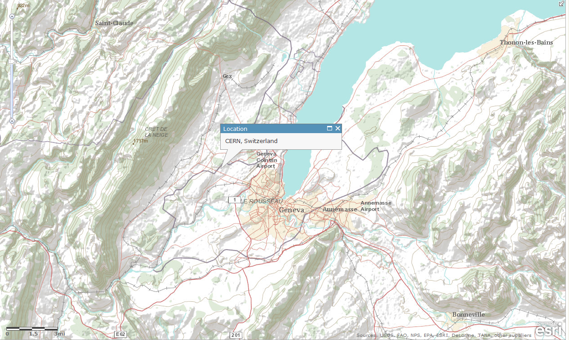
Location

Slide 4
This presentation…
Data used
CERN Molasse Geological model
Molasse rock types and properties
Geotechnical behaviour – stress, strength & stiffness
Engineering behaviour – EDZ, HDZ (URL analogies)
Cavern design – initial studies
Further analysis for presentation in September (Granada)

Slide 5
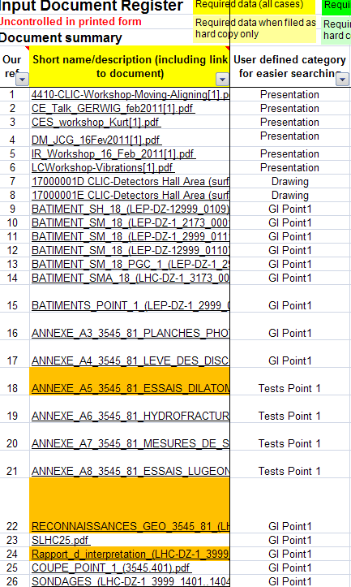
1. Data used
Published geotechnical literature on Mudrocks
Published geological/geotechnical literature on the CERN and NW Greece Molasse
CERN reports for Point 1 and 5 (LEP) including borehole logs, in situ and laboratory testing
Published geotechnical literature for the Underground Research laboratories (URLs) at Bure, Mol and Mont Terri in analogous mudrocks

Slide 6
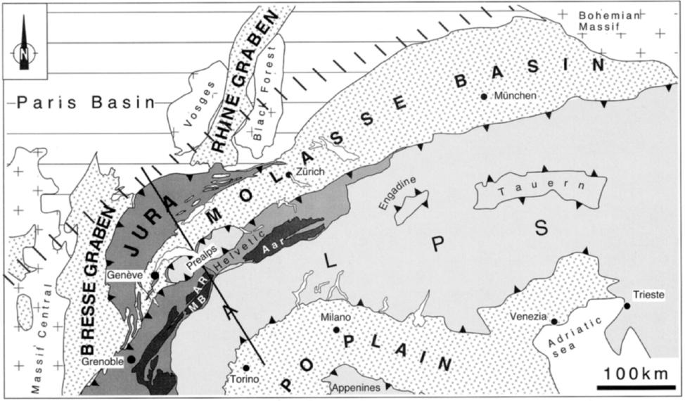
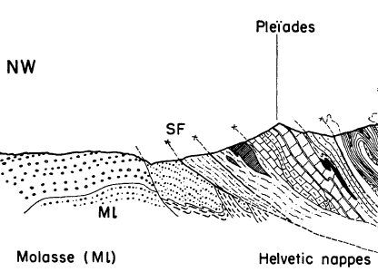
2. Geological model
Late Oligocene to early Miocene epoch rocks (Chattian to Aquitanian Stages approx. 30 – 21Ma ) sediments eroded from the Alps
Lake and river deposits formed in a humid environment
Mainly “marl”, siltstone and sandstone
Up to 2.6km has been eroded: heavily “over-consolidated” and cemented
Relatively unaffected by Alpine Orogeny, but some gentle tilting and minor faults
“bedded” cm to m scale, but largely “unfractured”

Slide 7
3. The molasse rocks
Marls: The fine grained rocks described in the CERN archive reports range from sandy Marls to marly Sandstones and Grumeleuse and Tectonisee Marls. Up to 40 -55% of the marl samples were said to be composed of clay minerals, with the remainder comprising iron oxides, feldspar, quartz and calcite/dolomite. The majority of the clay minerals are composed of illite, whilst the remainder consist of chlorite and mixed layer illite-smectites.
Sandstones: quartz-feldspar sands with mica (chlorite or muscovite), and calcareous cement. The grain size is fine, occasionally medium. Locally, the grain size approaches that of silt (0.002 - 0.06 mm).
Calcareous deposits (Caliche/ Duricrusts): occasionally Strong nodular limestone with marl matrix, marly limestones and marls with intercalations of limestones and gypsum.

Slide 8
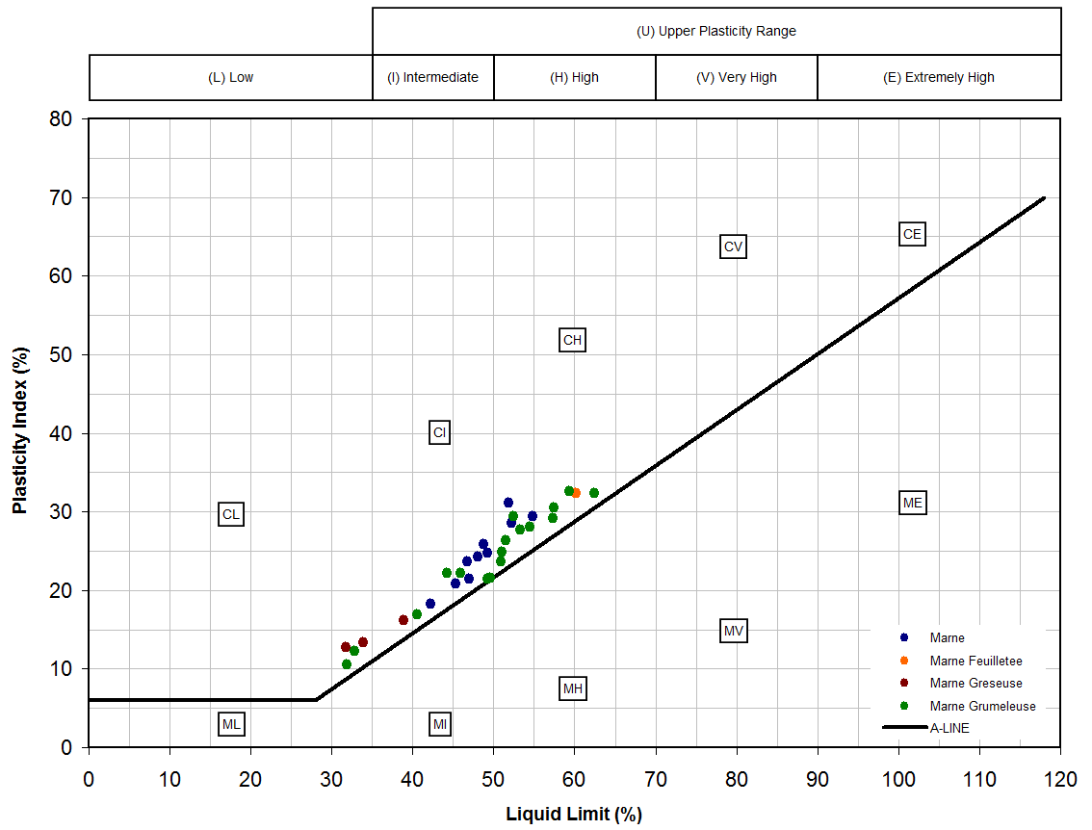
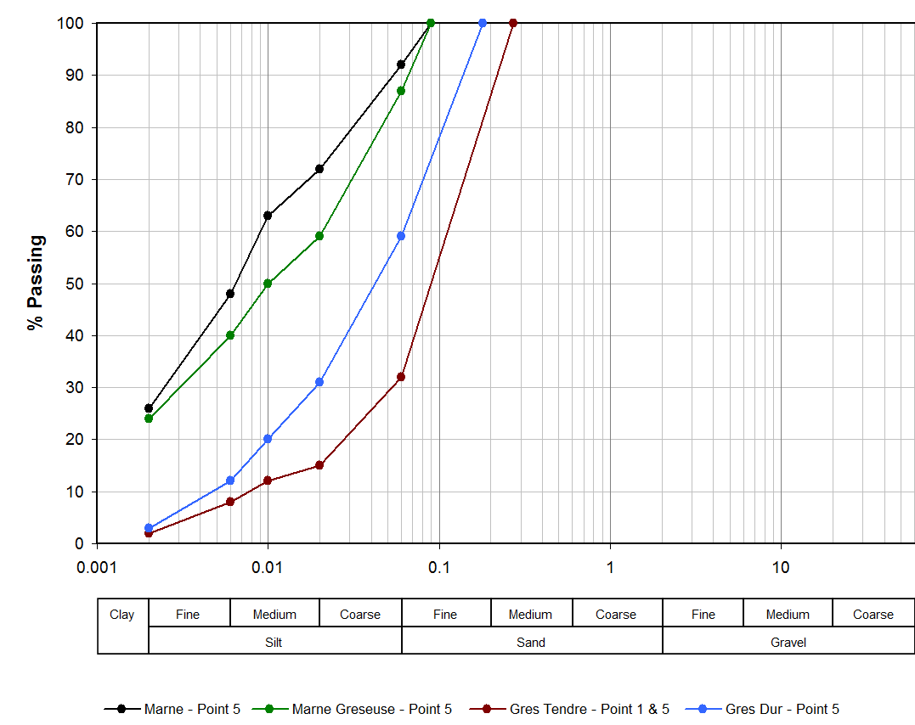
Hawkins & Pinches (1992)
  Siltstone – clay minerals <25%
  Mudstone – clay between 25 and 40%
  Claystone – clay >40%
Void ratio typically 0.11 to 0.29
Porosity between 9 to 22%
Permeability very low (“zero” Lugeon)

Slide 9
Ternary diagrams (few data)
Clay-silt-sand diagram: “marne” actually a siltstone-mudstone
Quartz-clay-carbonate: Wide carbonate range; least carbonate in fissured marls (leaching?)
Illite-smectite-chlorite: tight grouping; consistent clay mineralogy across lithologies

Slide 10
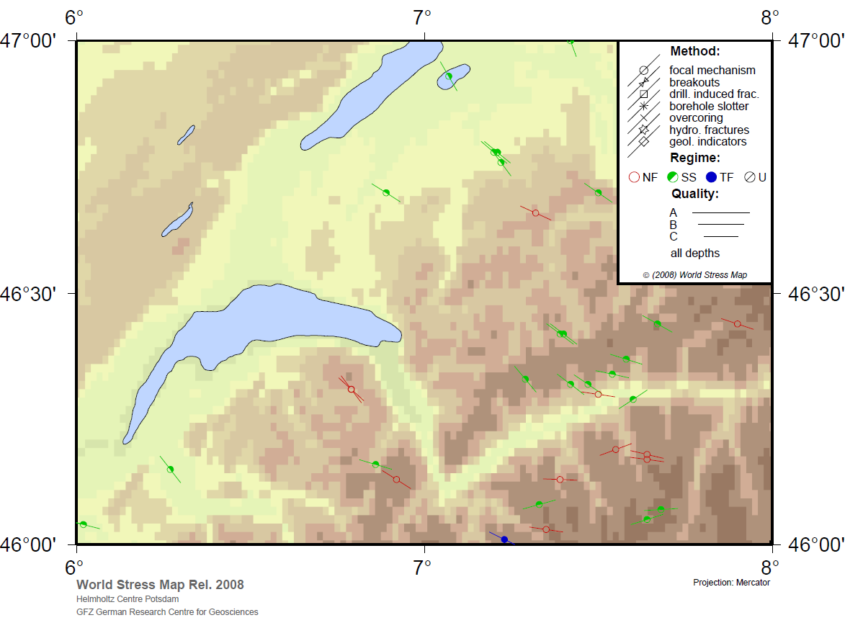
4. Geotechnical
In situ stresses at LHC at 92 to 123m depth have been determined as:
σ_{H, max} = 4.7±0.7MPa to 5.3±0.7MPa (NNE-SSW to ENE-WSW);
σ_{h, min} = 3.44±0.15MPa to 3.95±0.15MPa;
σ_{v} = overburden (mean bulk unit weight taken as 23.75 to 25.10kN/m³.
But contradictory evidence!
σ_{v}
σ_{h, min}
σ_{H, max}
Notes:
Contradictory data available from over-coring and published data – need to refine this

Slide 11
UCS test on “Marne” (at 82.3m depth) by the EPFL. UCS = 8MPa, w = 6.7%. Globally Youngs’ Modulus (E_{P}) = 330MPa and local modulus(E_{J}) =500MPa. Modulus ratios (E/UCS) of around 100 can be estimated for the “marne” and 160 for the “marnogres” (marly sandstone) from the global strain measurement
Uncertainties:
P’ at failure?
Pore pressures?
Rate effects?
Disturbance/slaking?
Fabric?
Notes:
UCS test by the Ecole Polytechnique Federale de Lausanne. Following an initial “bedding in”, the rock shows an initial approximately linear elastic response (E = 500MPa) but increasing anelasticity towards peak strength. Testing was carried out at 0.1mm/min (0.01% strain per minute). UCS sensitive to w% material is slaking.
Undrained strength in rocks such as the weak molasse mudrocks is thus likely to be a function of: mean effective stress (this is unknown in a UCS test), degree of cementation (i.e. “cohesion”), stress path direction (i.e. extension or compression), pore pressure conditions during testing (e.g. suctions) and the effects of geological structure (e.g. fissures and laminations). Thus significant variation in UCS data due to the testing conditions can arise.

Slide 12
CIU_{extension} and CK_{o}D_{ext} triaxial tests with pore pressure measurement – short term undrained strength, long term effective stress strength can be obtained. UCS test limitations reduced.

Slide 13
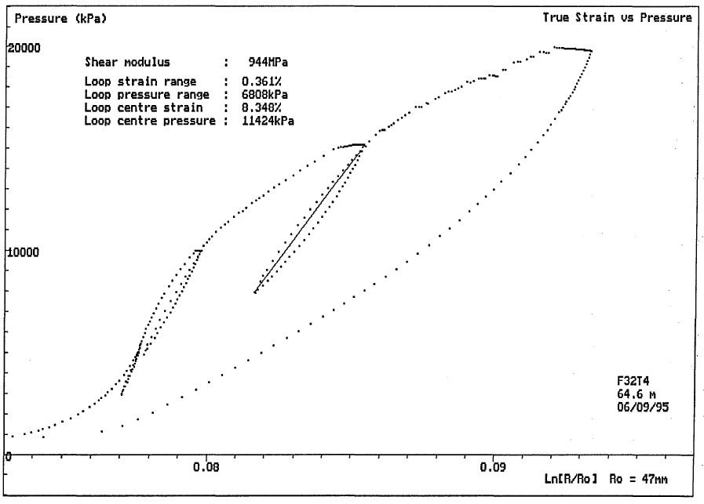
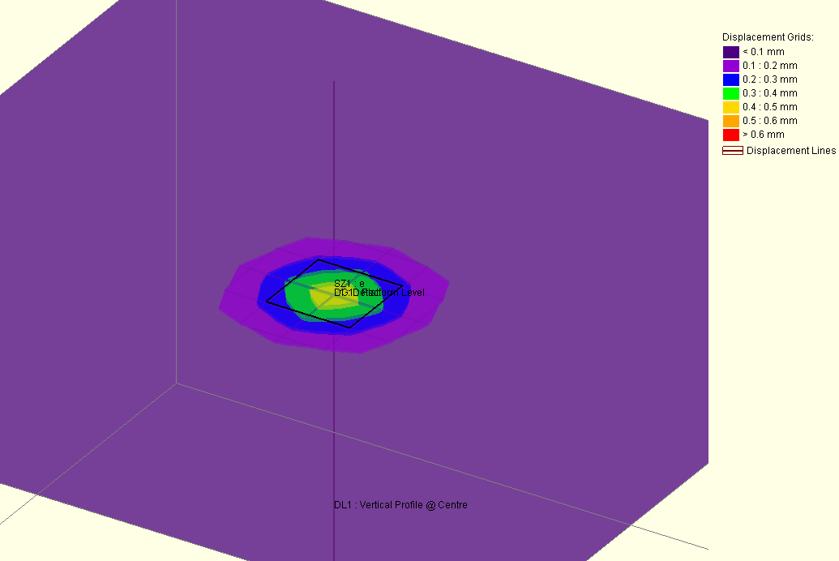
Stiffness:
UCS MR = 100 to 160
Shear modulus from HPD tests shows distinct reduction with increasing strain
Creep & hysteric effects evident….
However!
Transient Load:
Low stress & strain levels
Available test stress and strain levels not relevant?
Require information regarding tests carried out in similar loading conditions + strain levels
Monitoring Data
(MPa) = 740kPa
δ = 0.5mm
=>
G₀ = 6.5GPa
ε(%) = 0.017
Notes:
Note some creep strains at holding tests prior to each loop and permanent strain at end of test – possible hysteresis effects: “…for any particular consolidation history, a critical level of repeated stress existed. Below this critical level, a state of nonfailure equilibrium was reached in which the stress-strain curves followed closed hysteresis loops. Above the critical level of repeated stress, effective stress failure occurred; and each cycle of loading produced cumulative increases in deformation…” (Sangrey et al (1969). Can Geot. J.).

Slide 14
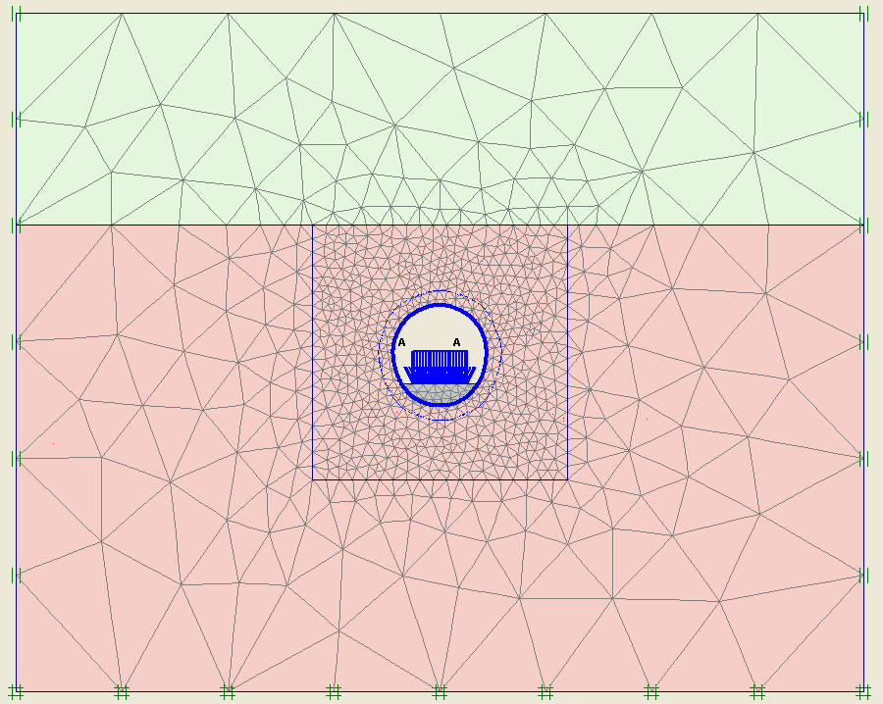
Short term deformation (PLAXIS Linear Elastic)
Morianne
E = 50MPa
K₀ = 2
Molasse
E = 3000MPa
K₀ = 2
300mm Shotcrete
E = 20,000MPa
Detector + 15m x 15m slab = 742kPa
5000mm Mass Concrete Invert
E = 25,000MPa

Slide 15
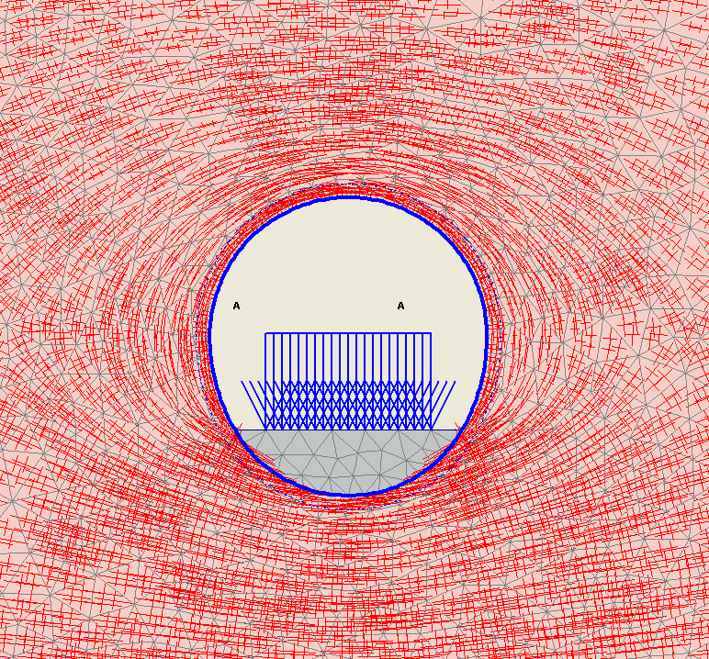
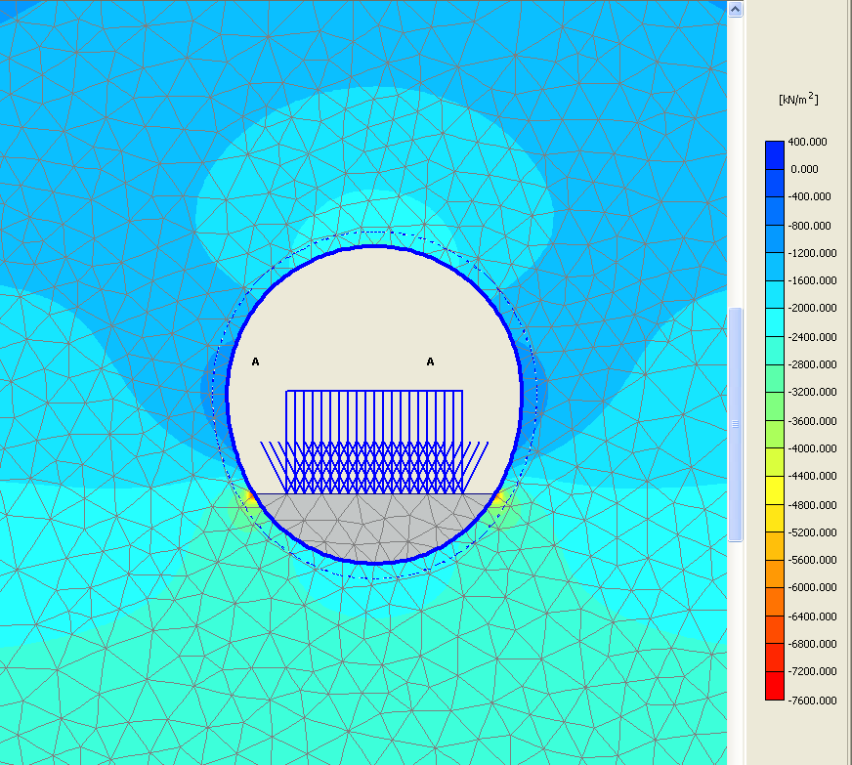
Short term Loading (PLAXIS Linear Elastic)
Principal Stress Trajectories
P’ contours

Slide 16
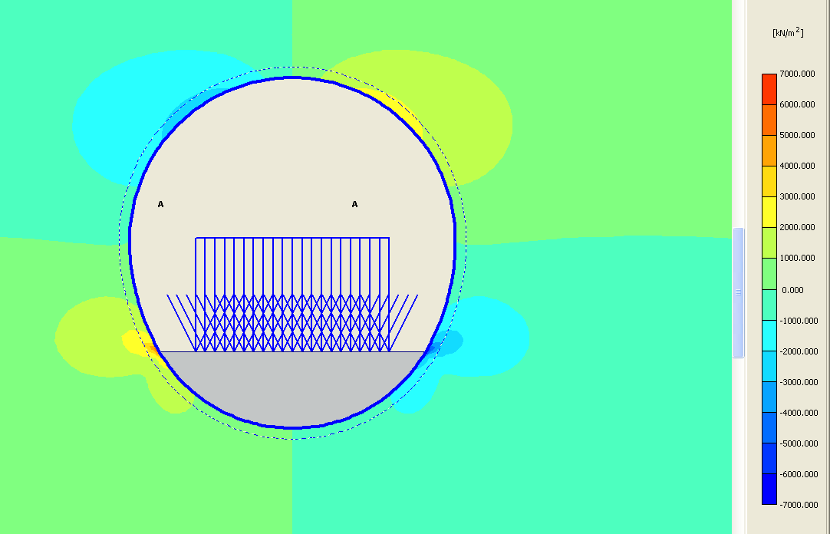
Short term Loading (PLAXIS Linear Elastic)
Shear Stress

Slide 17
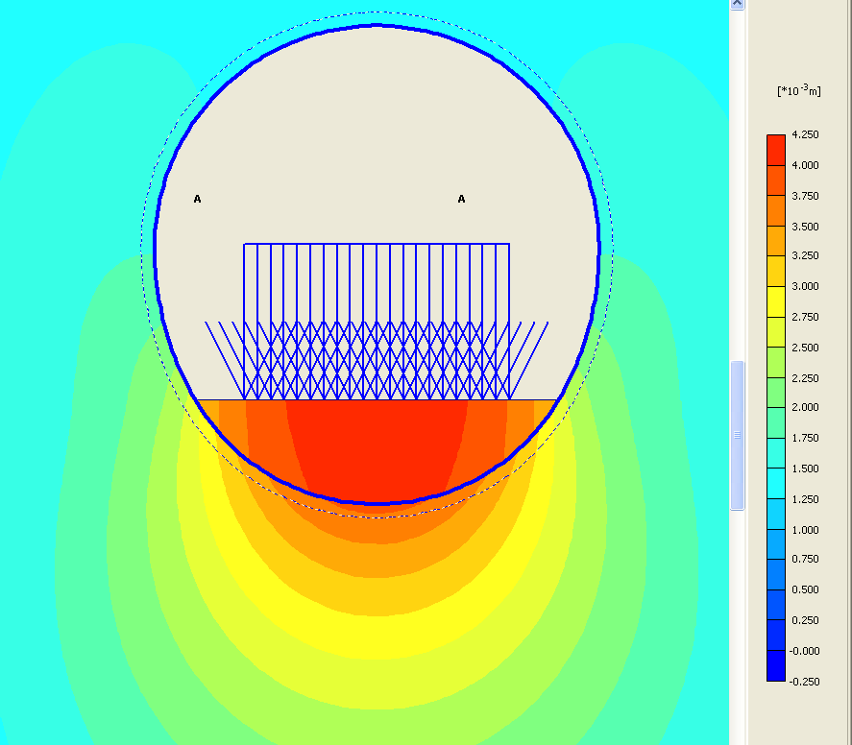
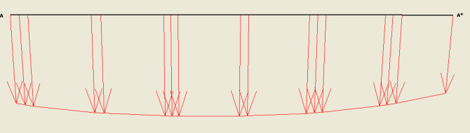
Short term Loading (PLAXIS Linear Elastic)
Deformations
Slab differential settlement
0.6mm per 15m
0.004% strain

Slide 18
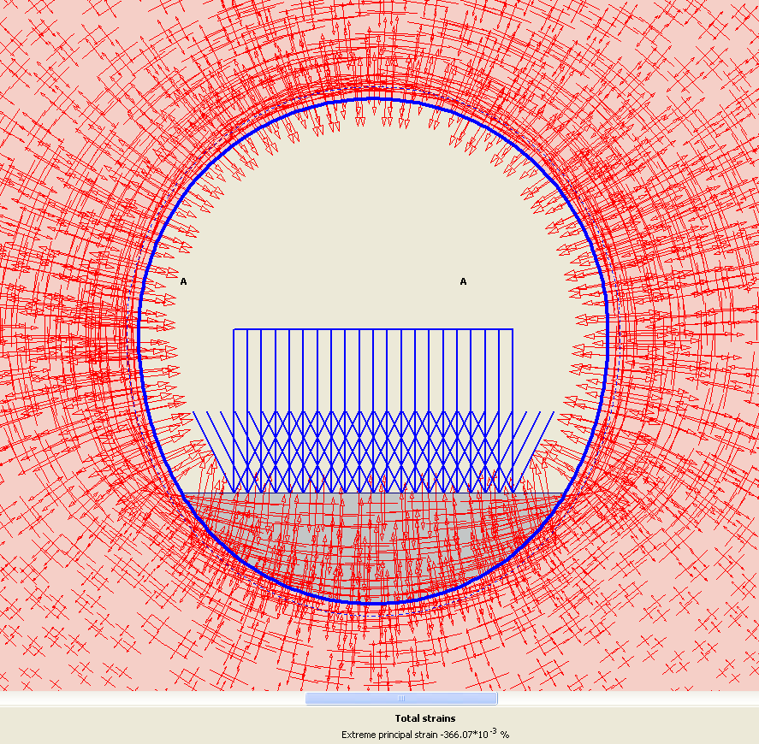
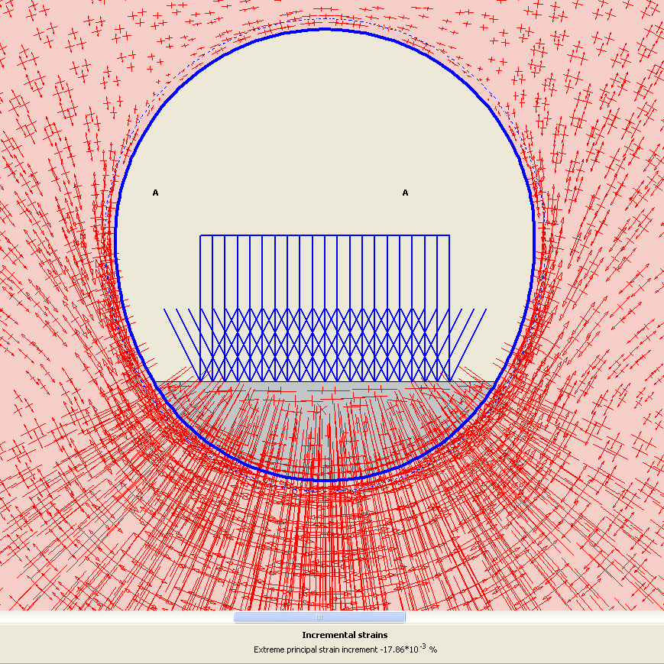
Short term Loading (PLAXIS Linear Elastic)
Total Strains
Incremental Strains

Slide 19
Time dependent behaviour:
  swelling & softening due to smectite
  Large secondary consolidation/creep behaviour (1D compression)
  reductions in modulus of between 20 to 50% (6-months) and 40 to 70% (50-years) were estimated from Triaxial tests
Mixed layer clay-smectite accounts for up to 8 to 15% of the rock. Swelling tests show there is a potential for significant time-dependent swelling strains of up to 25% and swelling pressures of over 2MPa - i.e. > the unconfined tensile strength of the rock.

Slide 20
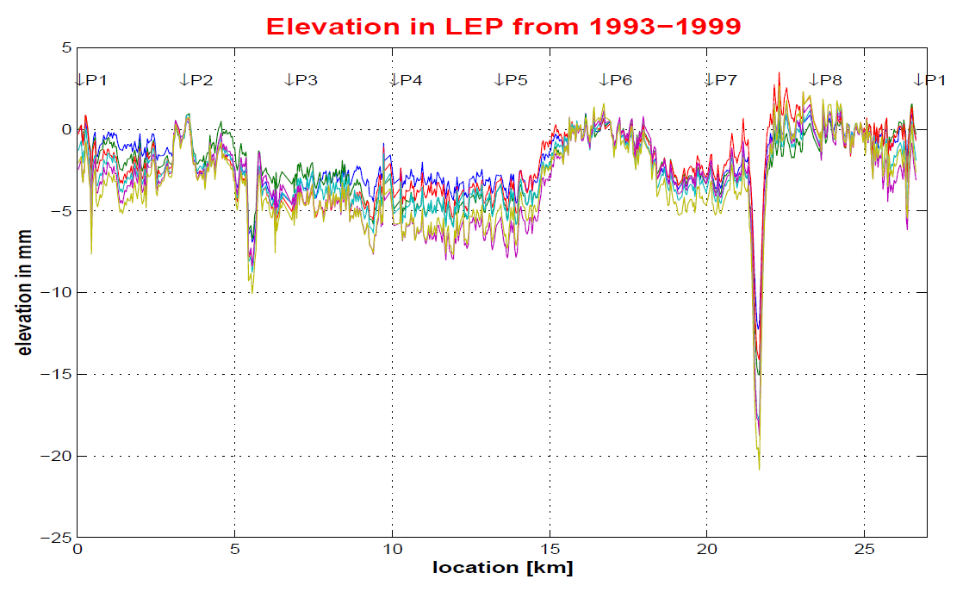
Monitoring Data
Pitthan (1999) -LEP Vertical Tunnel Movements - Lessons for future colliders

Slide 21
Findings….
The Excavation Damaged Zone (EDZ): a very localised zone of fracturing where significant changes in mass permeability, pore pressures and in situ stress occur.
Excavation Disturbed zone (EdZ), or Hydraulic disturbance zone (HDZ): the volume of rock where perturbations in the stress field induce significant changes in pore pressure. This zone extends for 10 radii or more beyond the excavations. This zone also exhibits a change to anelastic behaviour. However no change in permeability occurs in this zone.
Empirical estimates of the extent of the EDZ:
  R_{f}/a = 0.49(±0.1) + 1.25* (σ_{max} / UCS)
Notes:
Model of the EdZ and EDZ developed for the Mon Terri test galleries in the Opalinus Claystone (Corkum & Martin, 2007)
Corkum AG and Martin CD (2007). Rf/a equation from Martin et al (1999).

Slide 22
Different yield criteria approaches available for modelling mudrocks:
Standard Hoek-Brown or Mohr-Coulomb shear strength criterion
Undrained shear strength with stress dependent modulus (Corkum & Martin, 2007)
“Brittle” Hoek-Brown criterion (Martin et al, 1999)
Tensile failure mechanism using Mohr-Coulomb or Hoek-Brown criterion (Hoek et al, 2005)
Notes:
…further investigation required…..

Slide 23
Cavern Stress State
Simple modelling to examine:
Cavern layout and optimisation
Invert stress state as starting point for foundation analysis
Notes:
Youngs Modulus: 2500 Mpa Poisson Ratio: 0.25
Tensile Strength: 0.05 Mpa Cohesion: 0.15 MPa
Phi: 37 Depth: 100m
S1: 5.0 MPa
S2: 3.9 MPa
S3: 2.5 MPa

Slide 24
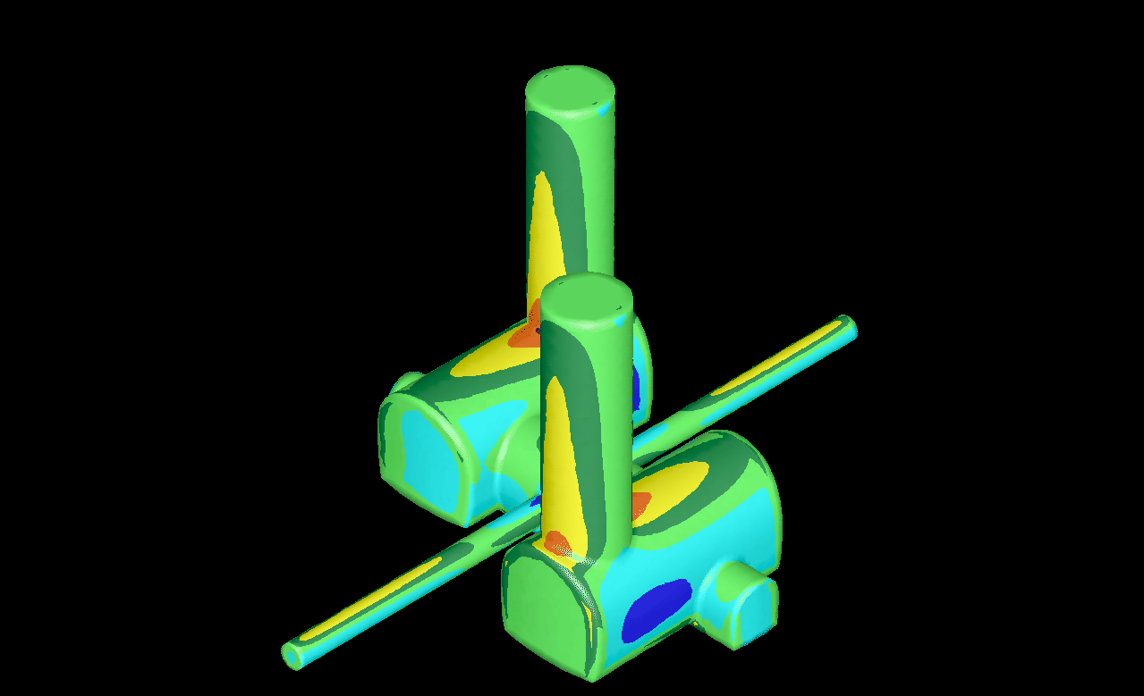
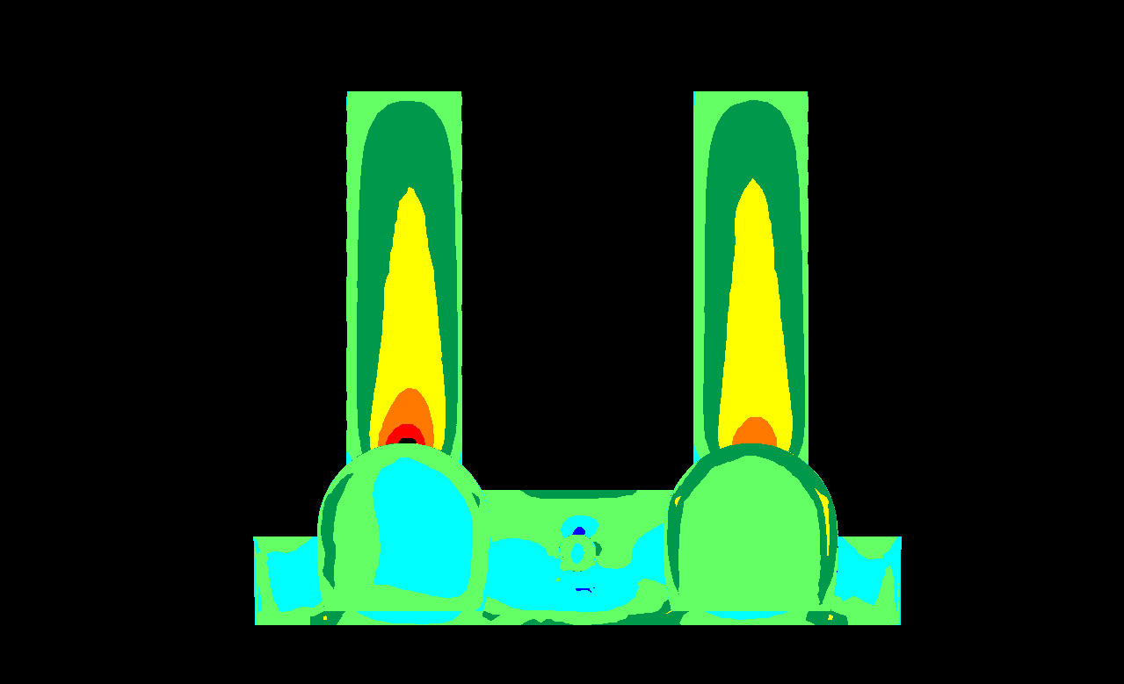
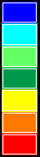
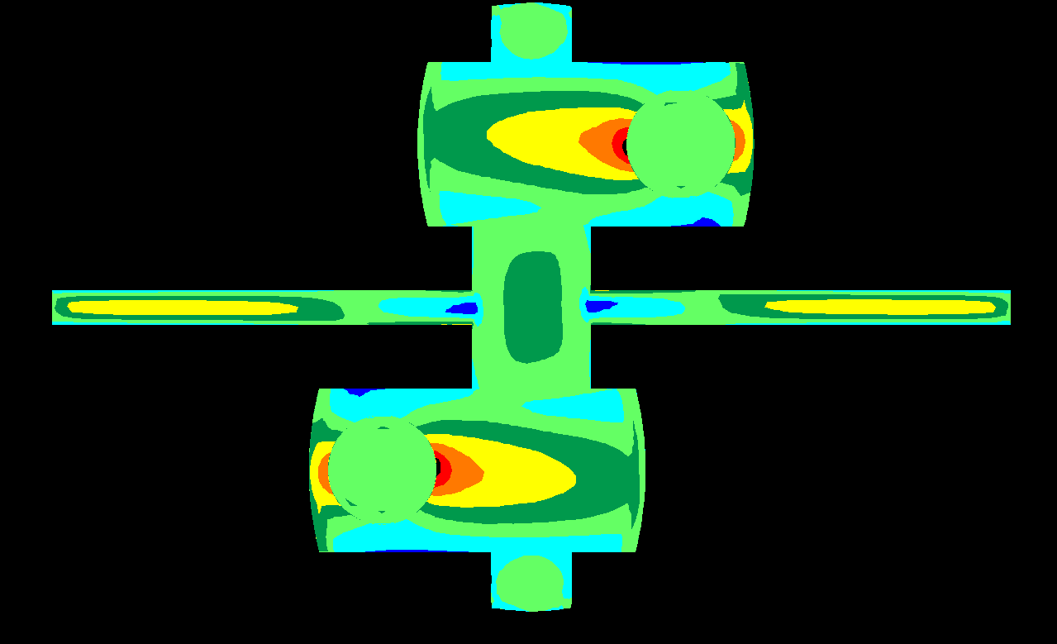
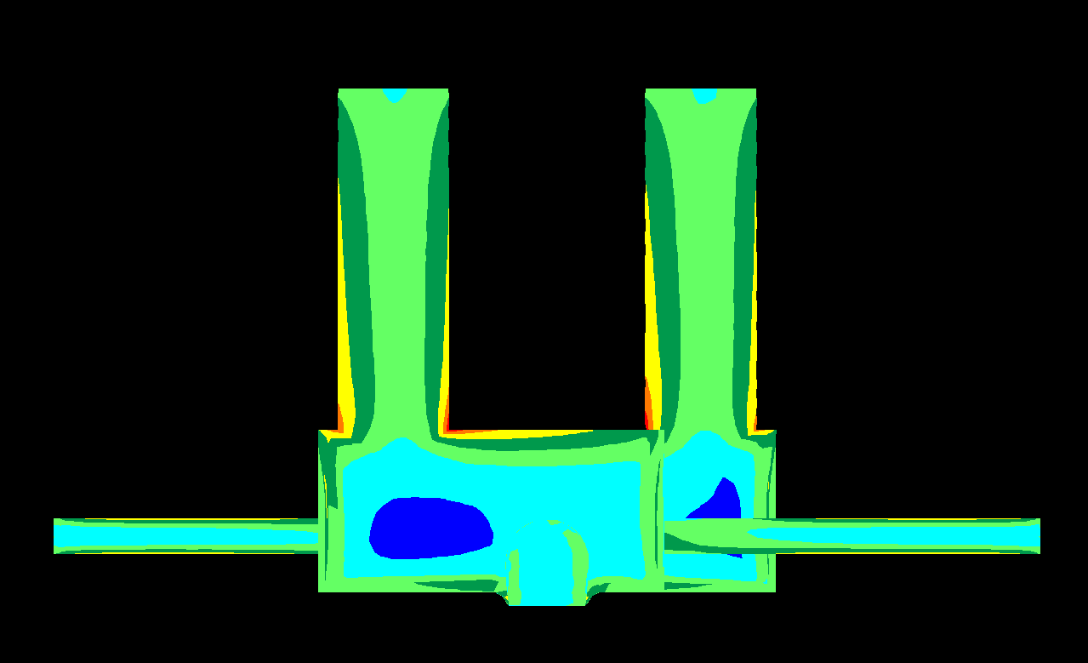
000.0/00
σ₁ (MPa)
0
10
20

Slide 25
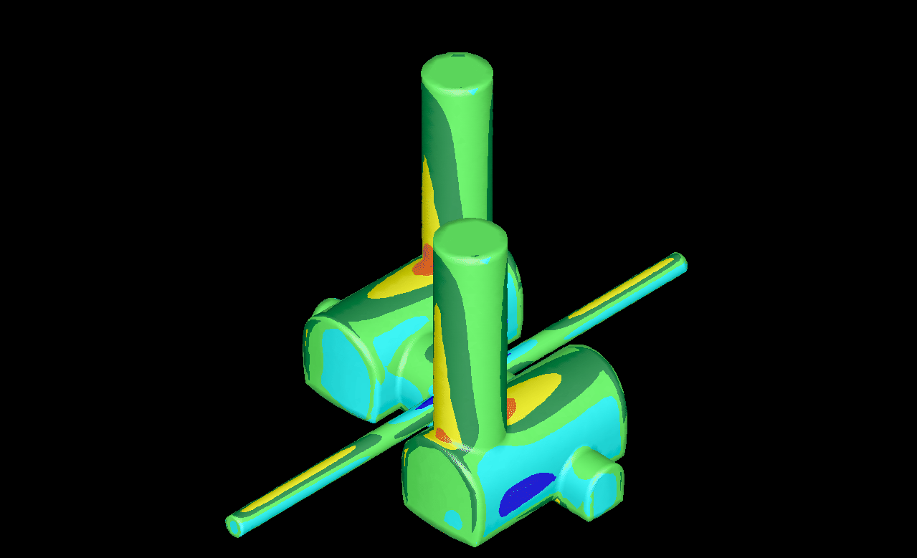
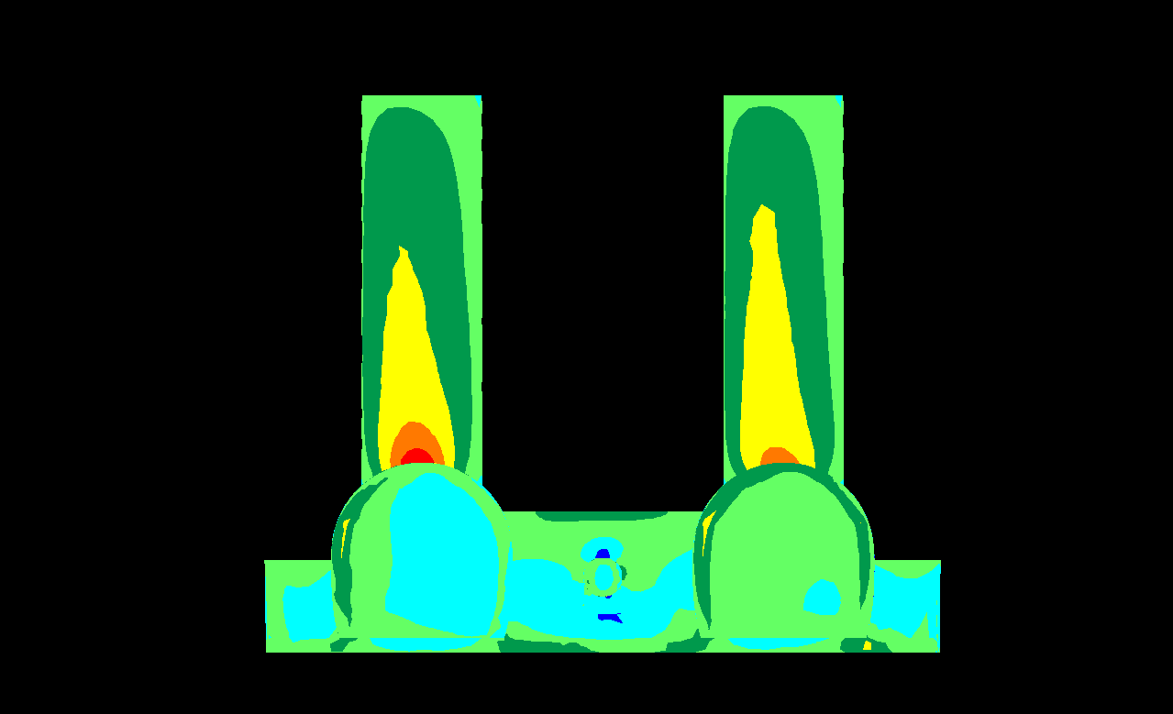
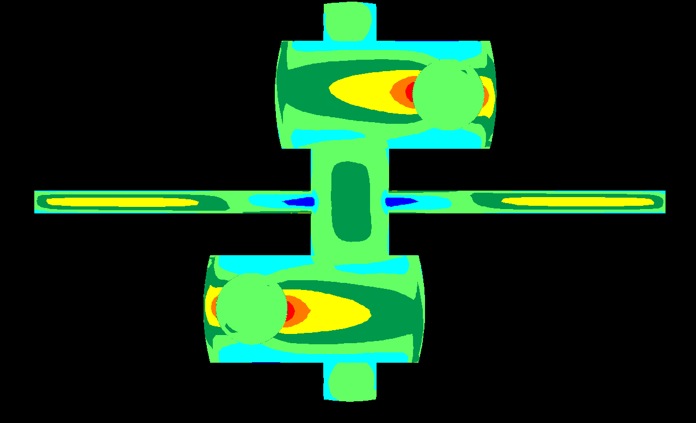
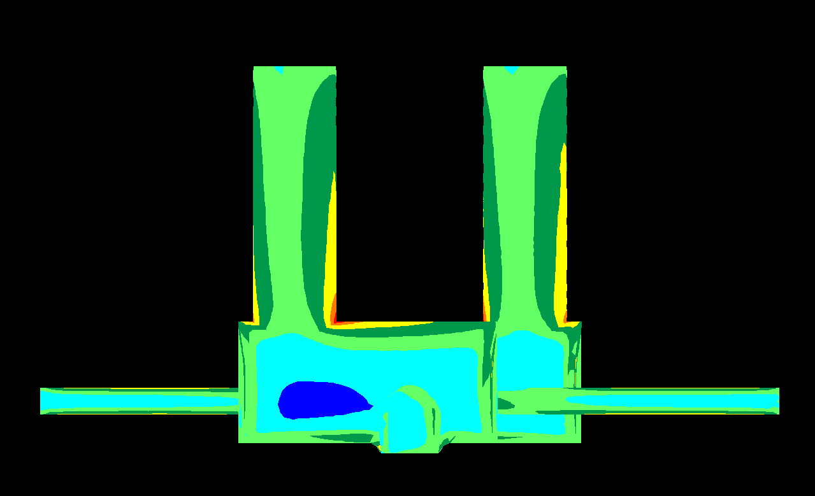
022.5/00
σ₁ (MPa)
0
10
20

Slide 26
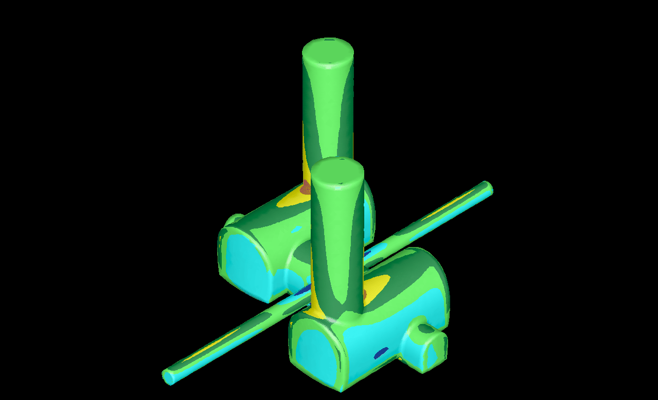
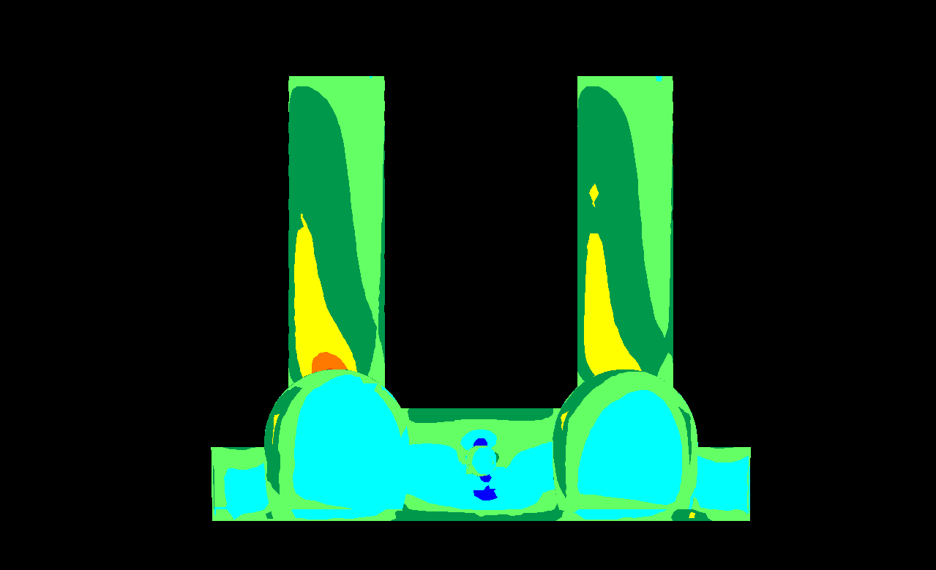
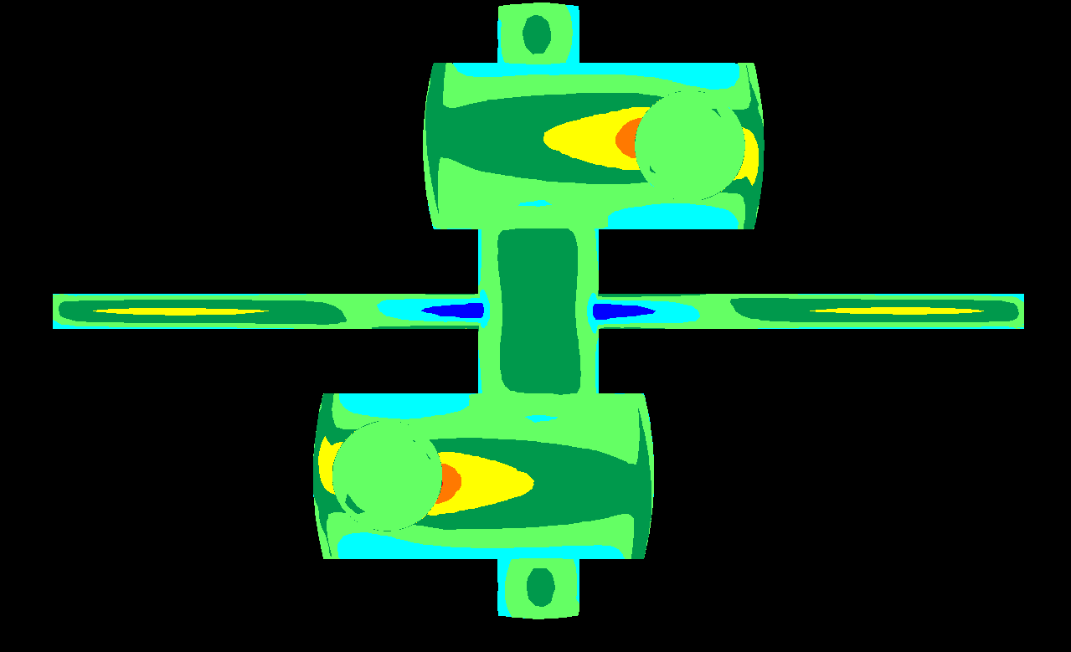
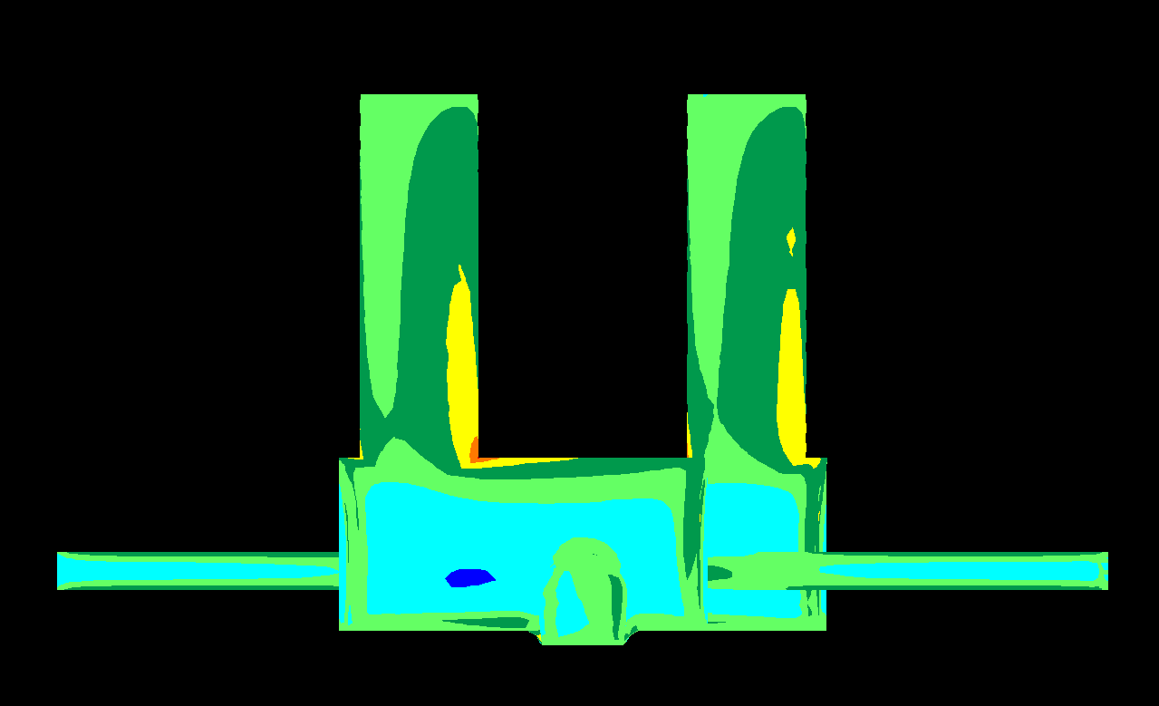
045.0/00
σ₁ (MPa)
0
10
20

Slide 27
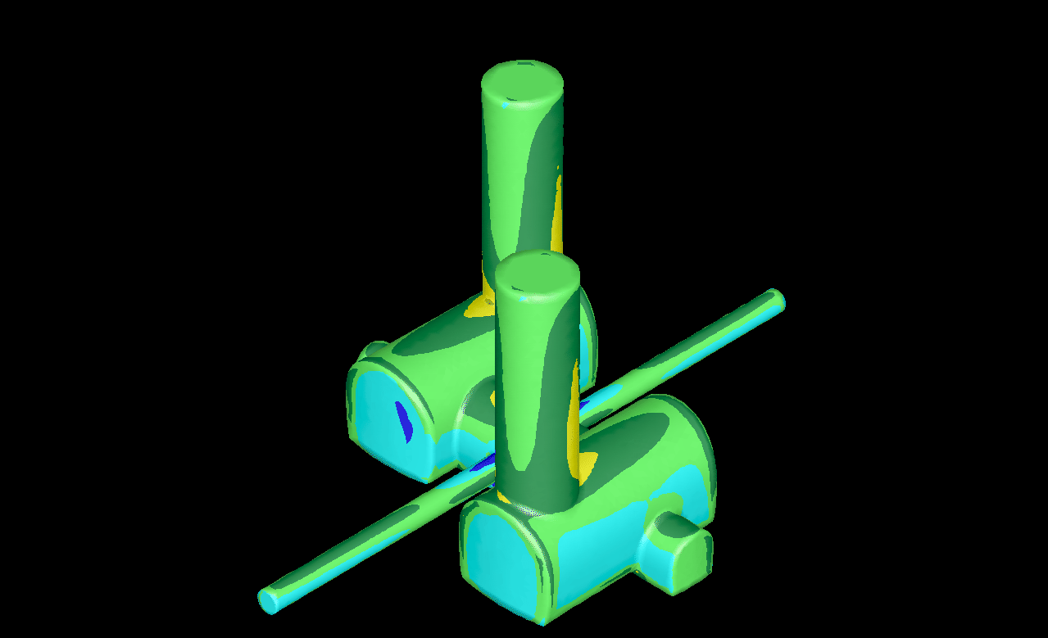
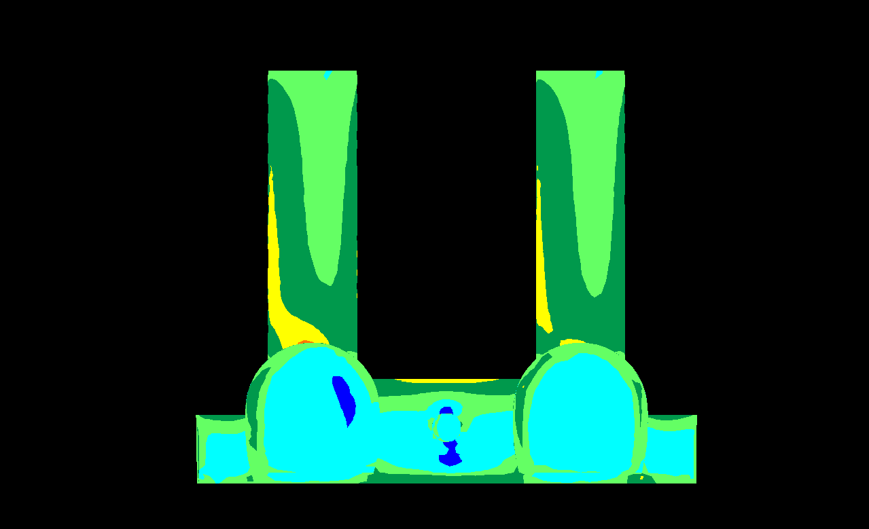

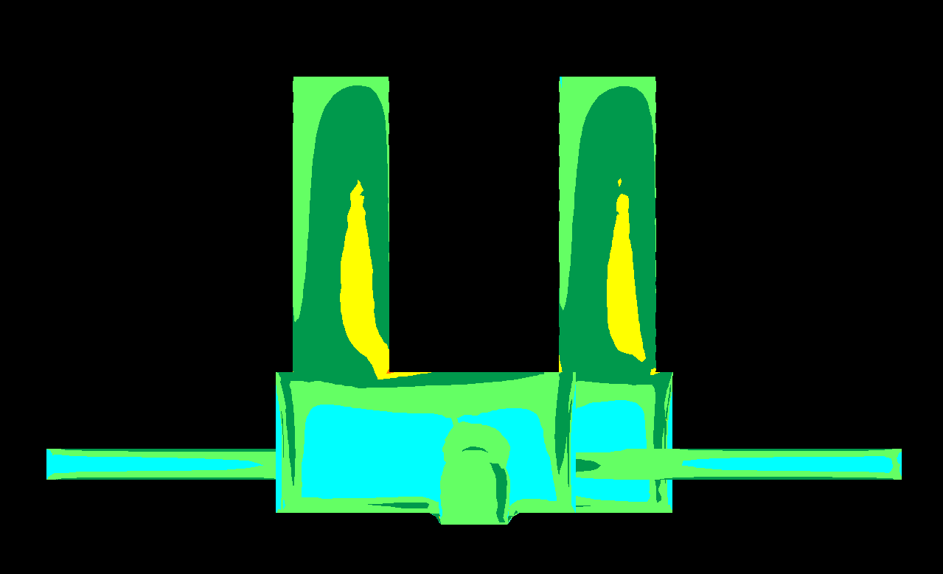
067.5/00
σ₁ (MPa)
0
10
20

Slide 28
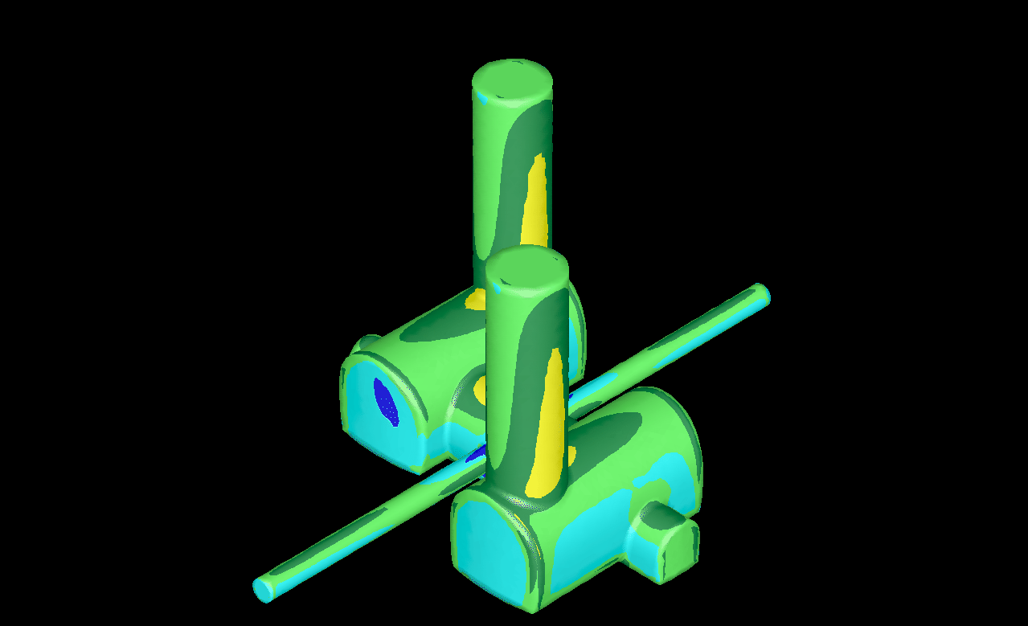
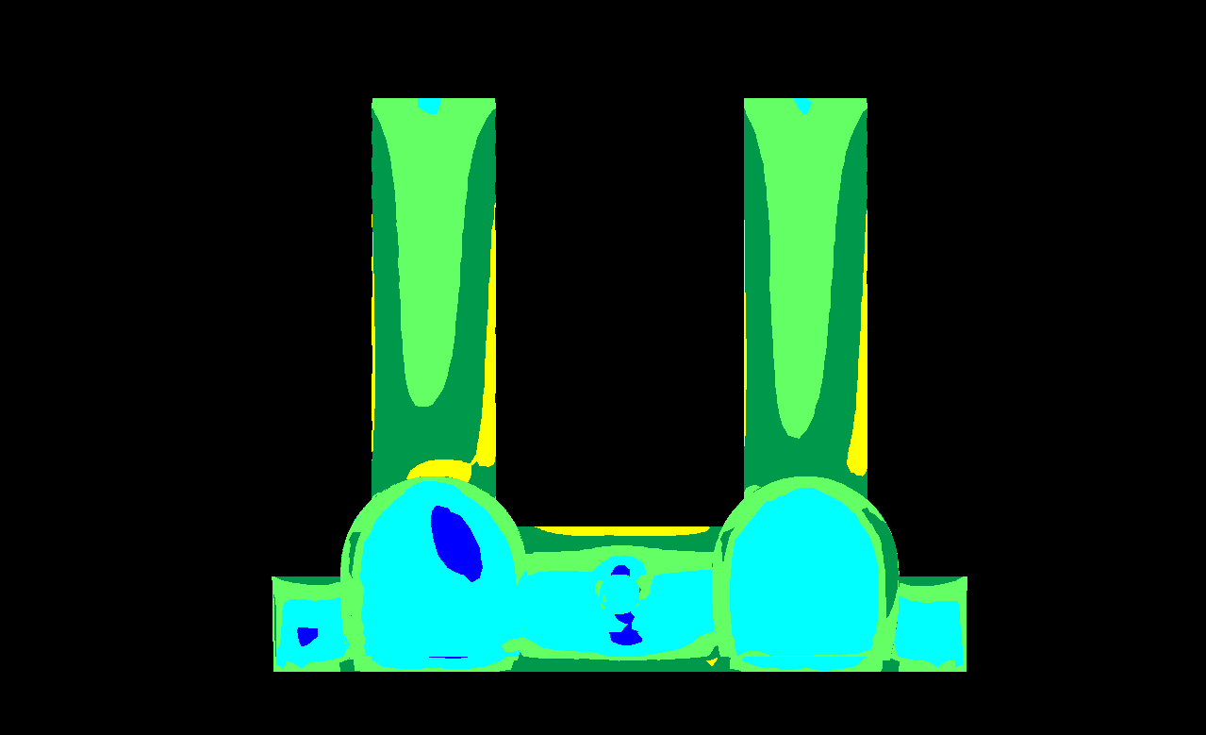

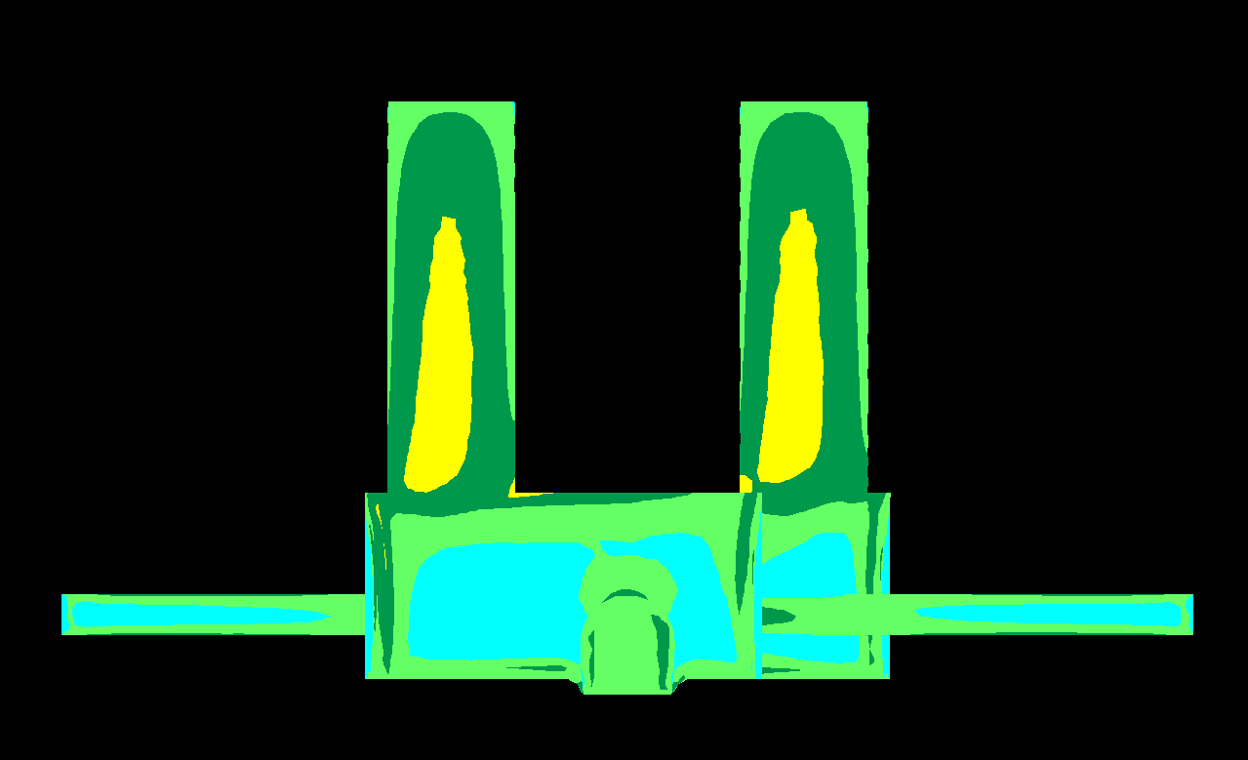
090.0/00
σ₁ (MPa)
0
10
20

Slide 29
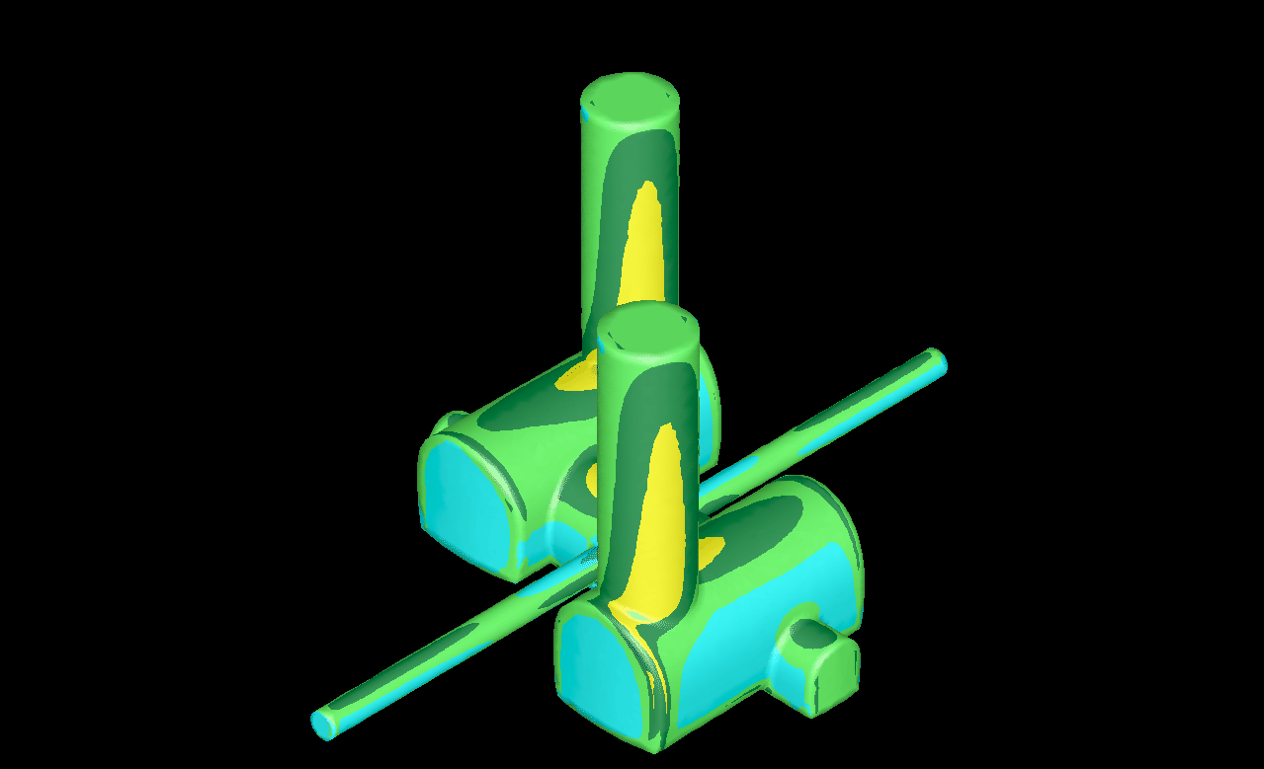
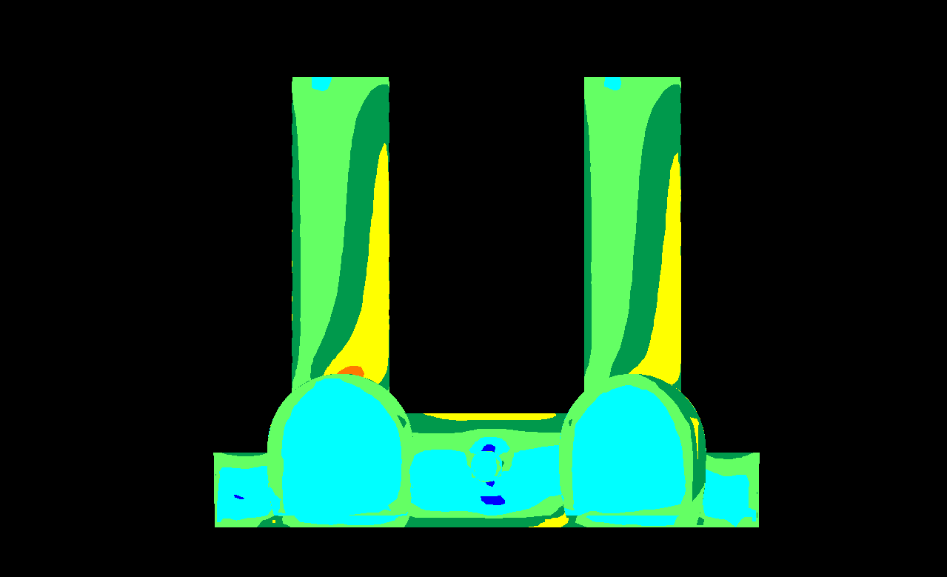
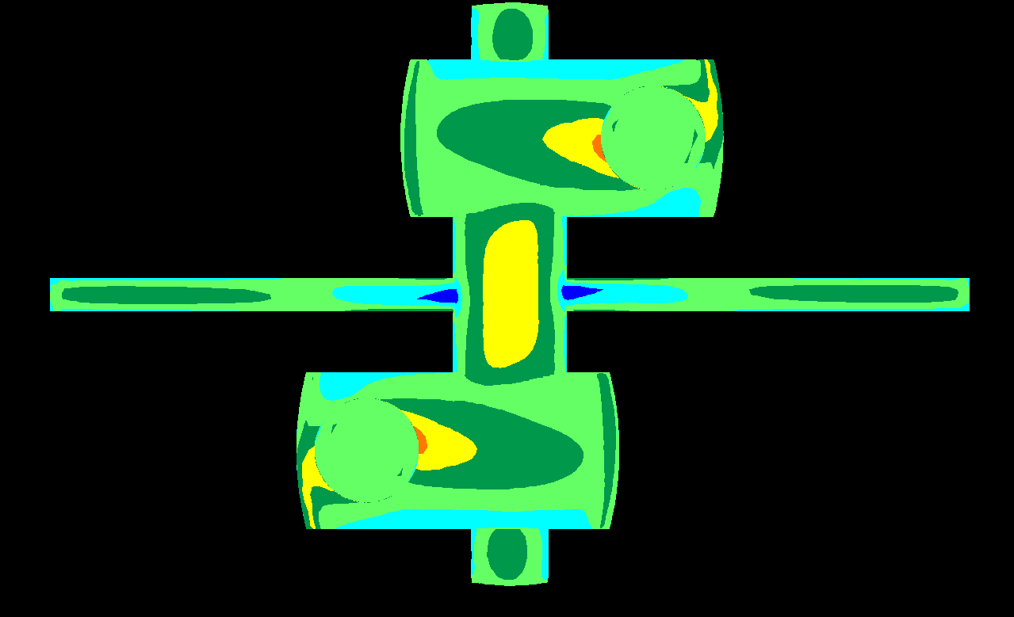
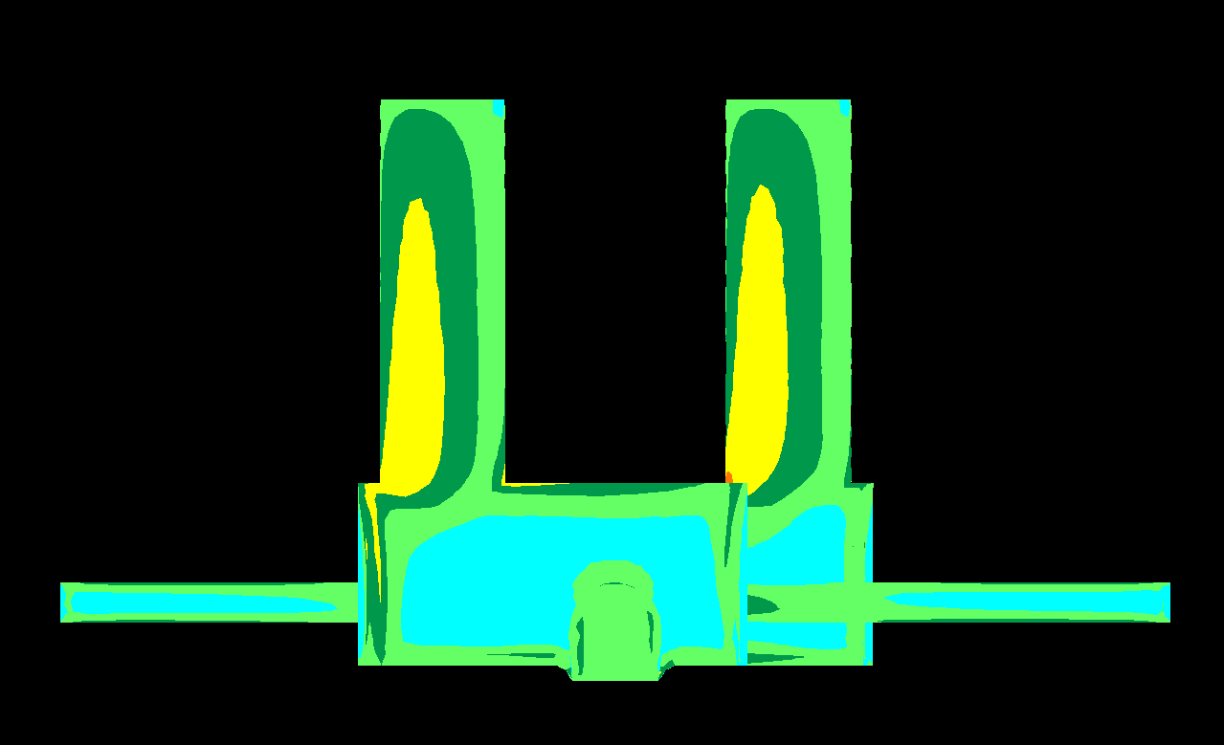
112.5/00
σ₁ (MPa)
0
10
20

Slide 30

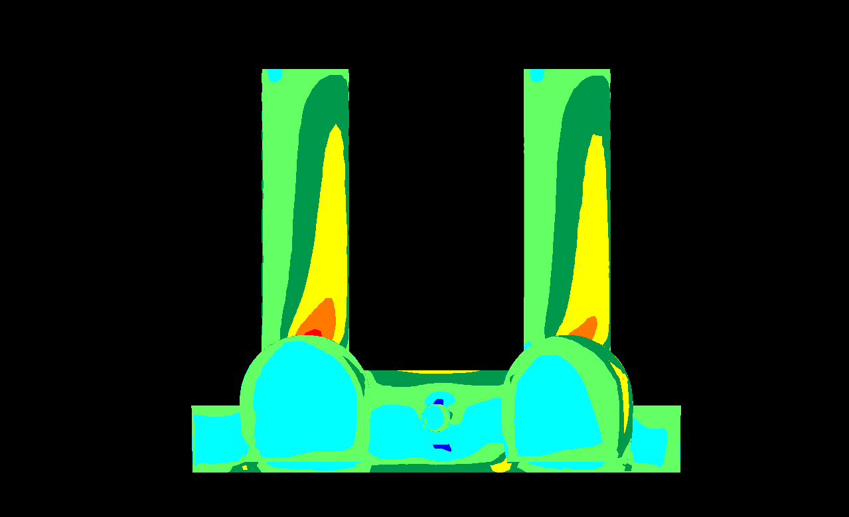
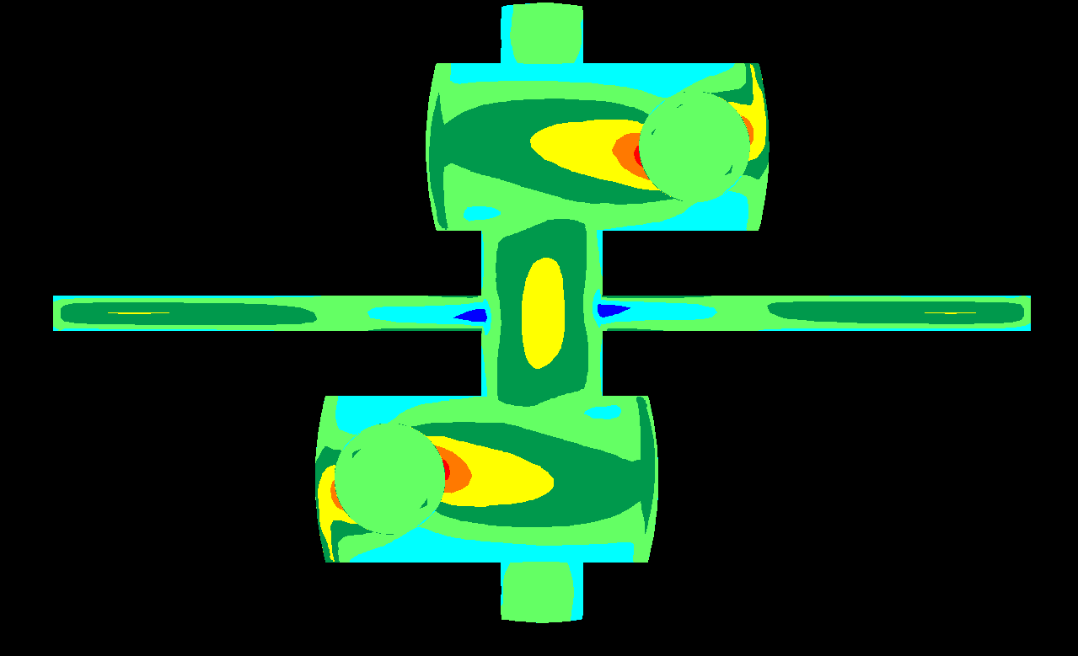
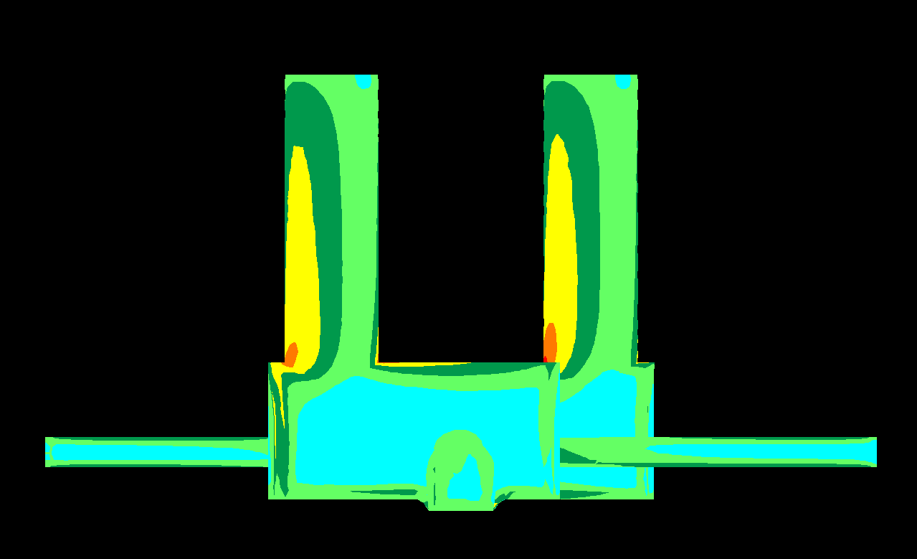
135.0/00
σ₁ (MPa)
0
10
20

Slide 31
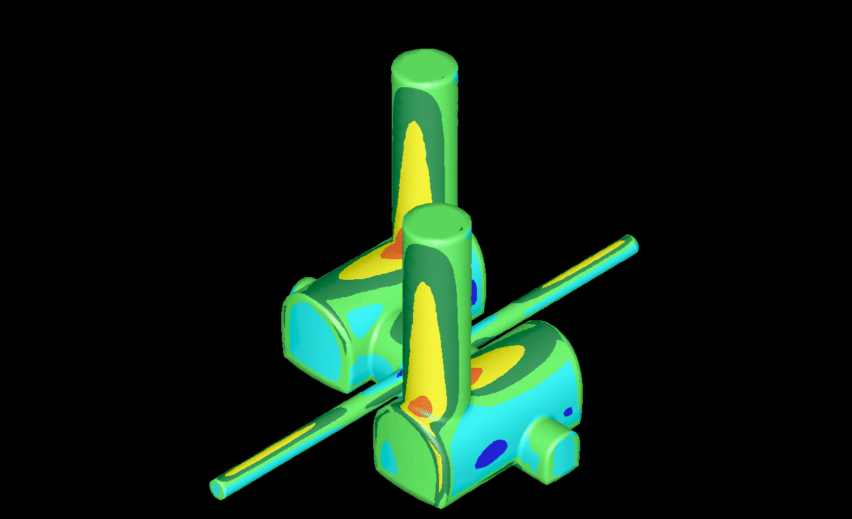
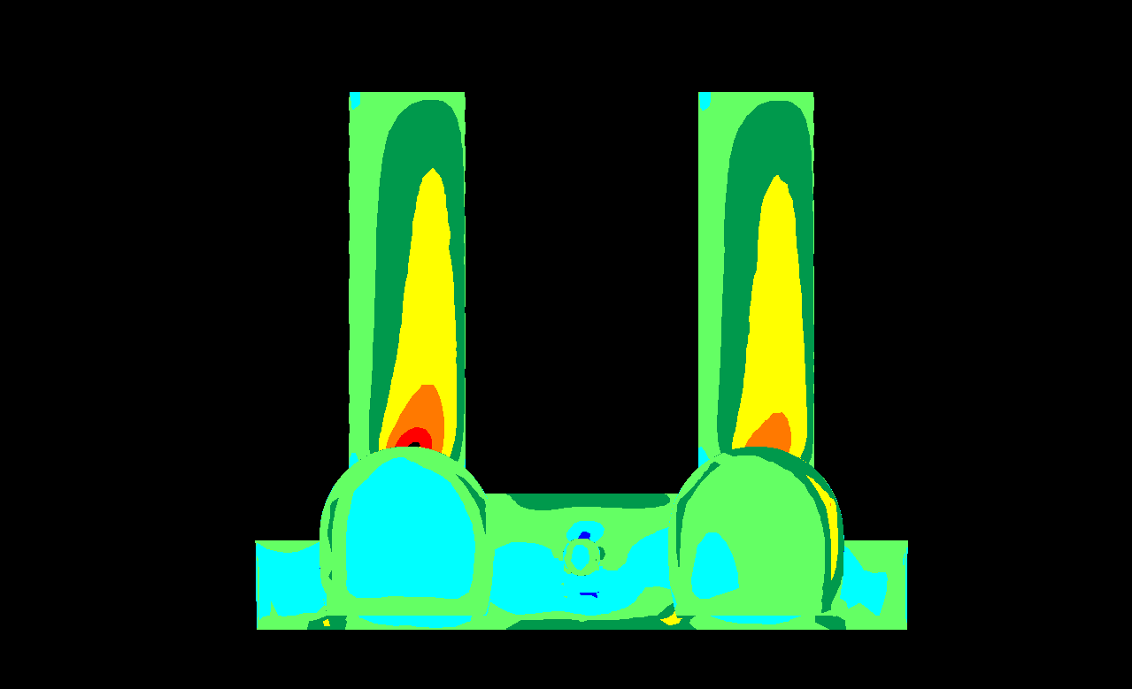
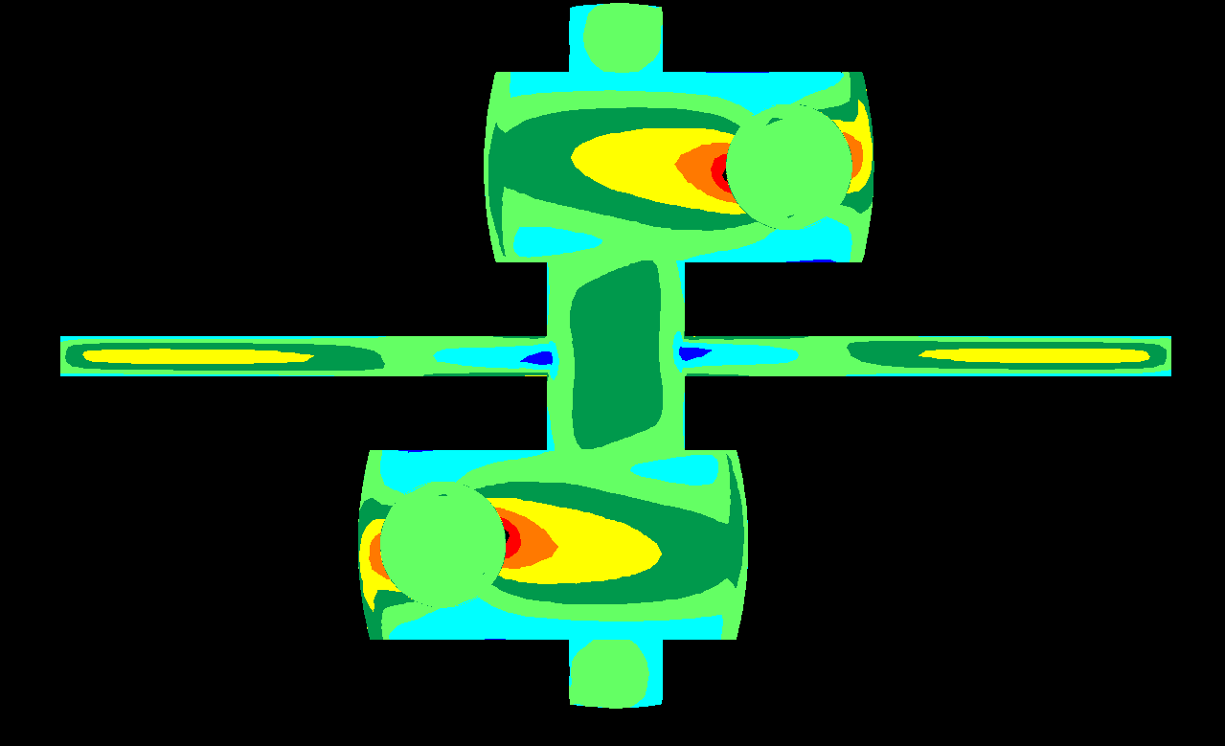
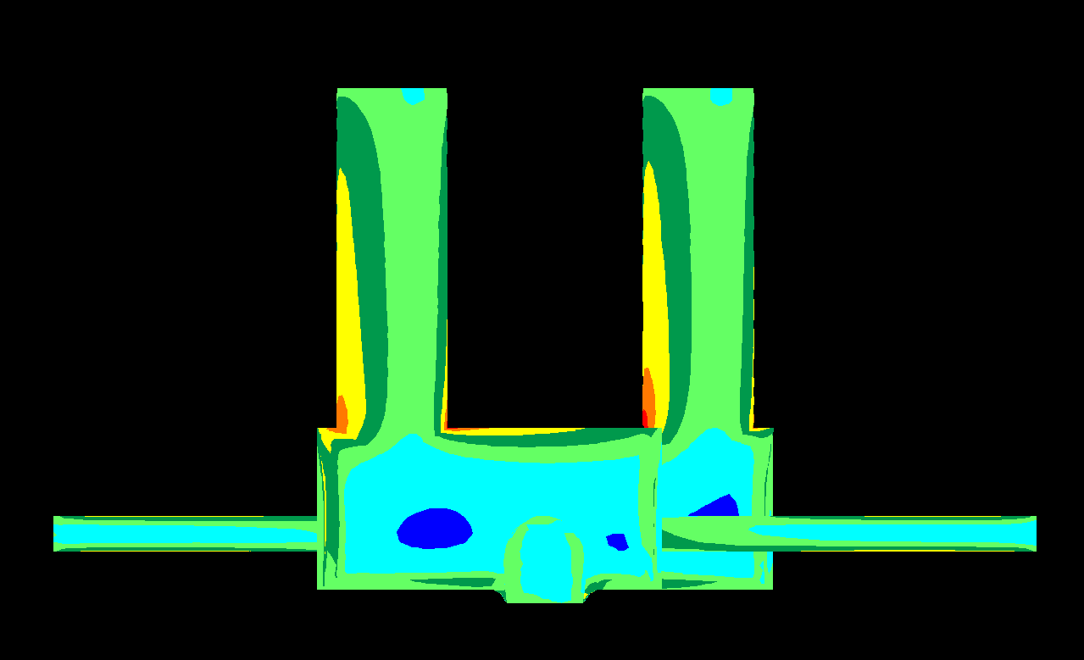
157.5/00
σ₁ (MPa)
0
10
20

Slide 32
180.0/00
σ₁ (MPa)
0
10
20

Slide 33
202.5/00
σ₁ (MPa)
0
10
20

Slide 34
225.0/00
σ₁ (MPa)
0
10
20

Slide 35
247.5.5/00
σ₁ (MPa)
0
10
20

Slide 36
270.0/00
σ₁ (MPa)
0
10
20

Slide 37
292.5/00
σ₁ (MPa)
0
10
20

Slide 38
315.0/00
σ₁ (MPa)
0
10
20

Slide 39
337.5/00
σ₁ (MPa)
0
10
20

Slide 40
360.0/00
σ₁ (MPa)
0
10
20

Slide 41
σ_{H} normal to beam tunnel
σ_{H} parallel to beam tunnel
Notes:
If σ_{H} normal to beam line: Beneficial for IR Cavern, not so good for Shaft/Crown Intersection

Slide 42
σ_{H} normal to beam tunnel
σ_{H} parallel to beam tunnel

Slide 43
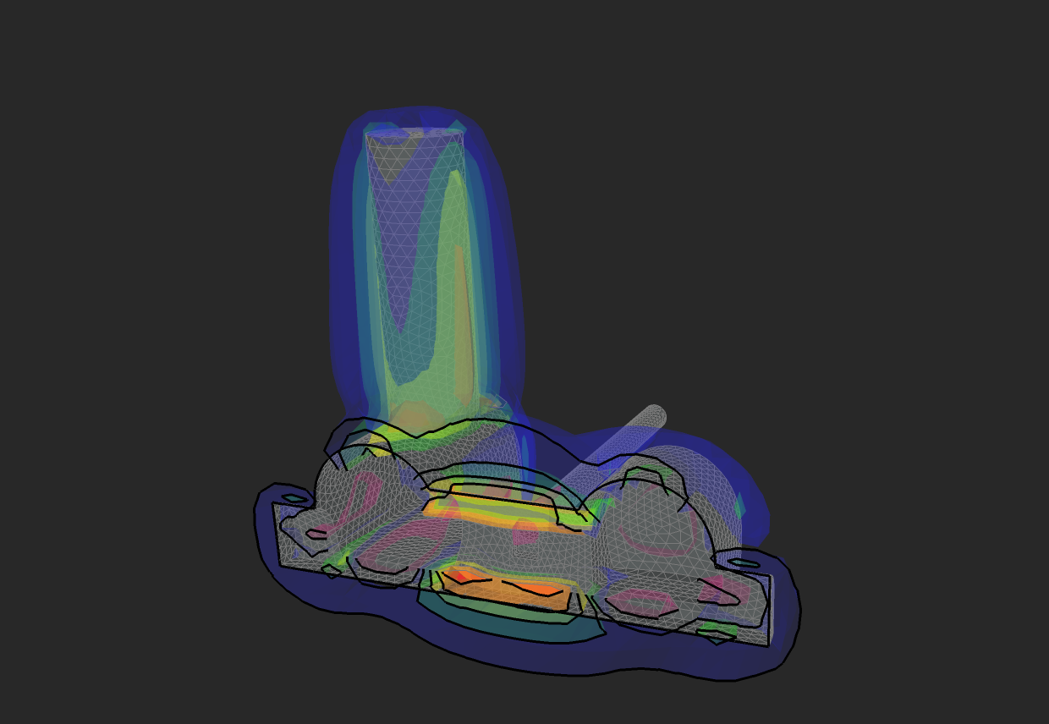
σ_{H} parallel to beam tunnel

Slide 44
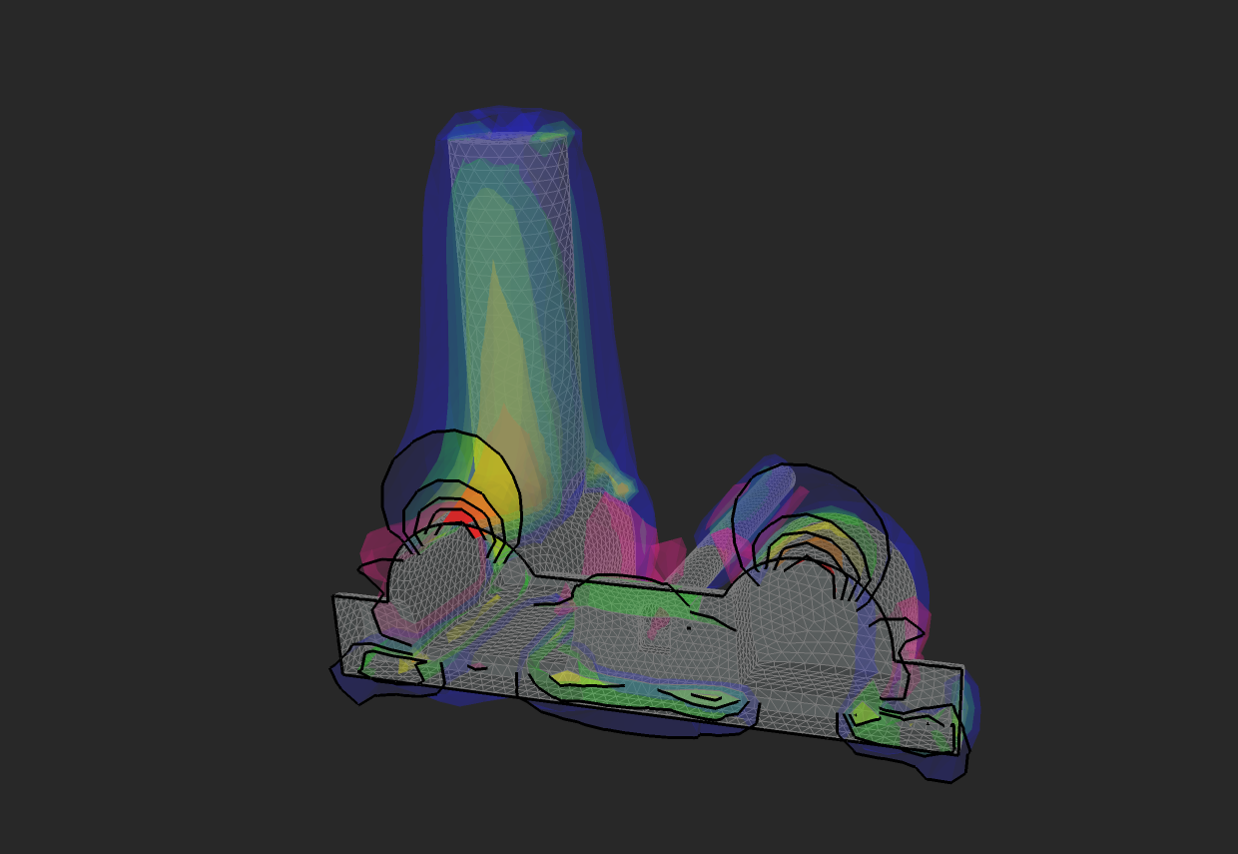
σ_{H} normal to beam tunnel

Slide 45
7. Further work
Collect data regarding small strain @ low stress range
Collect data regarding ground movements in Molasse rocks for similar loading conditions
Complete review and collation of geotechnical index properties
Complete geophysical profiling and stratigraphic interpretation
Detailed interpretation of relevant geotechnical tests
Further consideration of yield criteria for layout cavern design
Complete 3D boundary element analysis of cavern orientation and revised layout and shape
Develop non-linear “BRICK” model for molasse yield – undertake ground-structure interaction analysis for detector-slab-cavern invert foundation “system”.

