Slide 1
CP-prototype cold mass MTF: HCLMCXF001-CR000001
Discussion on flattop quenches
Gerard Willering
Franco Mangiarotti, Gaëlle Ninet, Guillaume Pichon
Many thanks to Raphaël Bouvier
Test plan: EDMS 3177216
Test results: EDMS 3213574

Slide 2
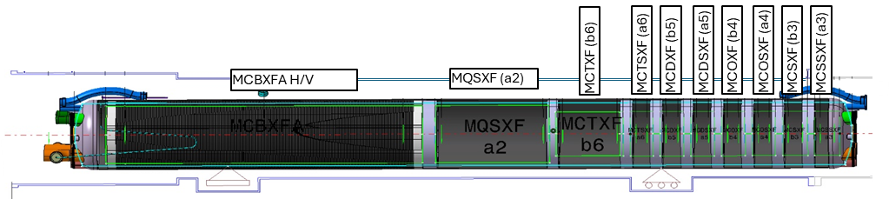
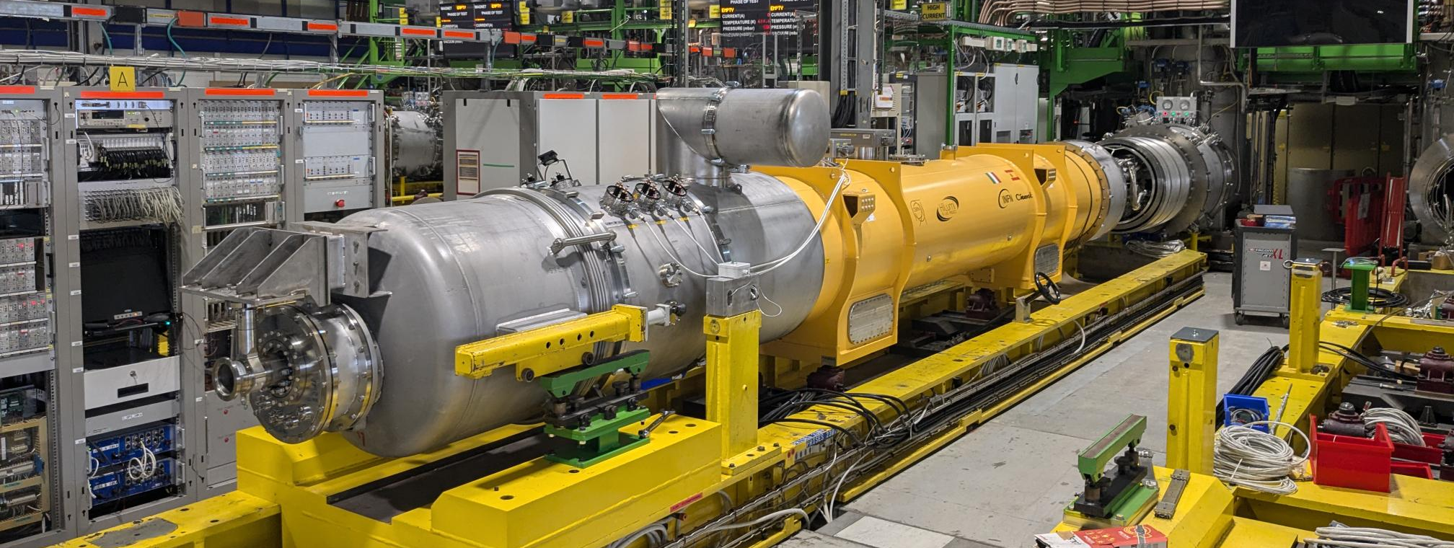
CP-assembly on the SM18 test bench
CFB
MRB
10 magnets are in the cold mass:
MCBXFAP1
MQSXF2
MCDXF01b
MCDXF02b
MCOXF03
MCOXF03b
MCSXF01b
MCSXF02
MCTXF2
MCTXF1
Approximate location of TT821
2 meter from end of cold mass.

Slide 3
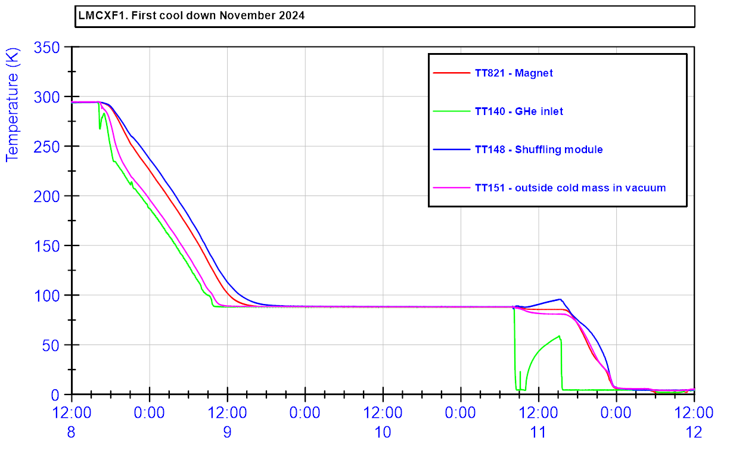
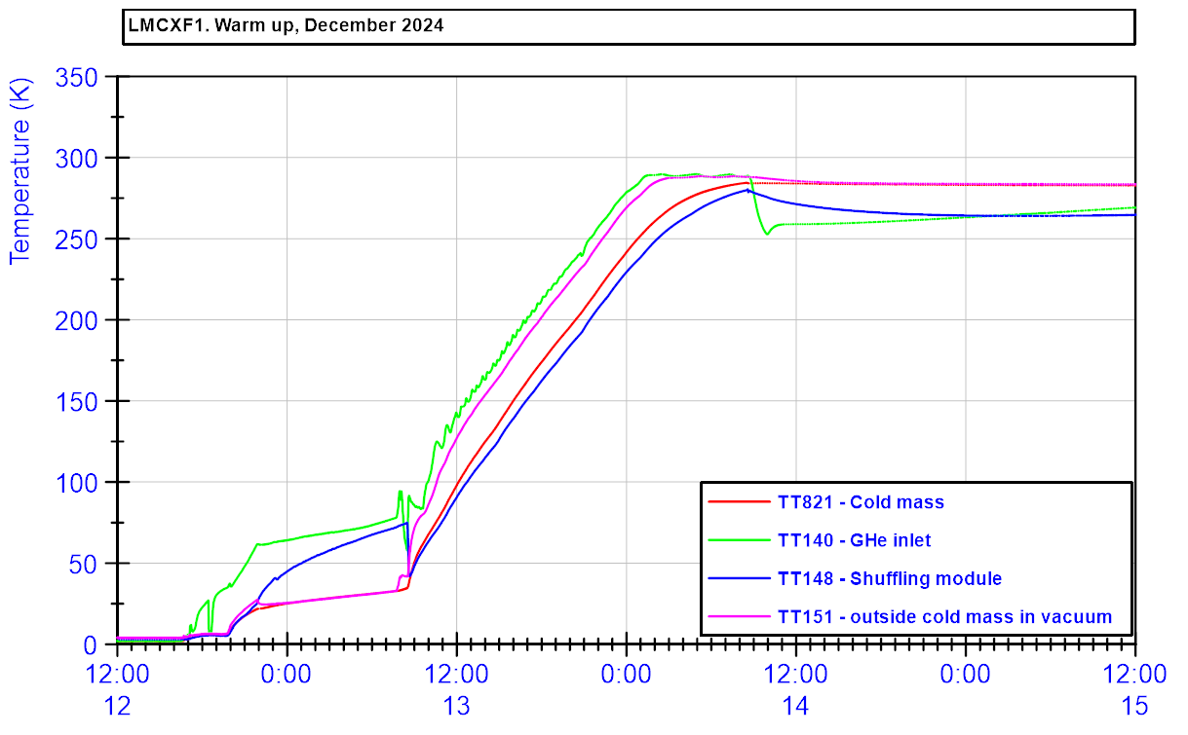
Cool down and warm up.

Slide 5
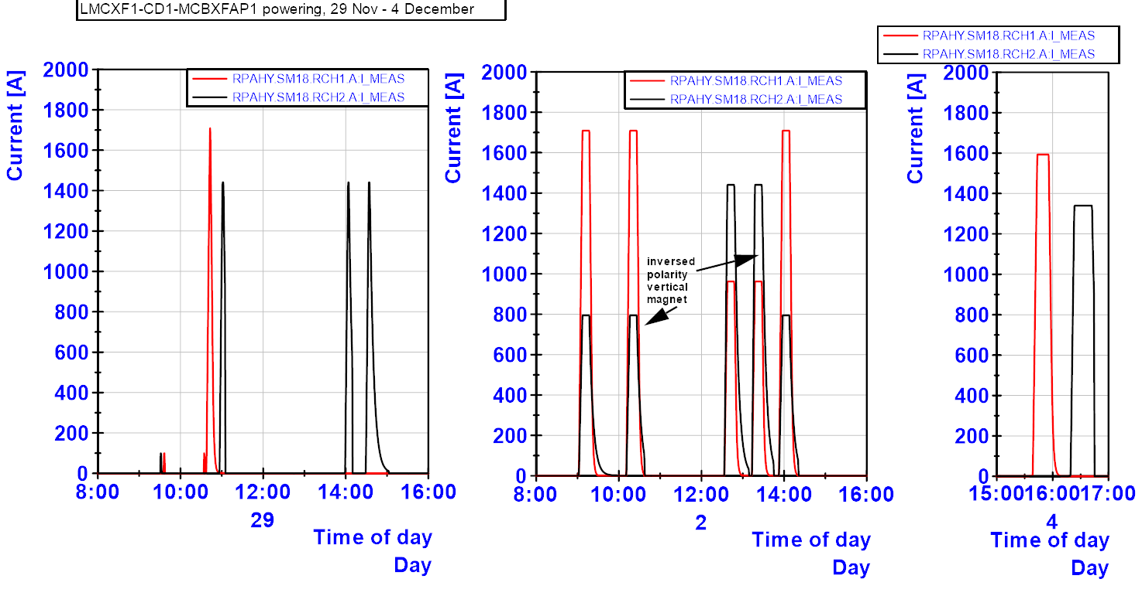
LMCXF1-MCBXFAP1
Training MCBXFAH/V. On the second day polarity inversions were done.

Slide 6
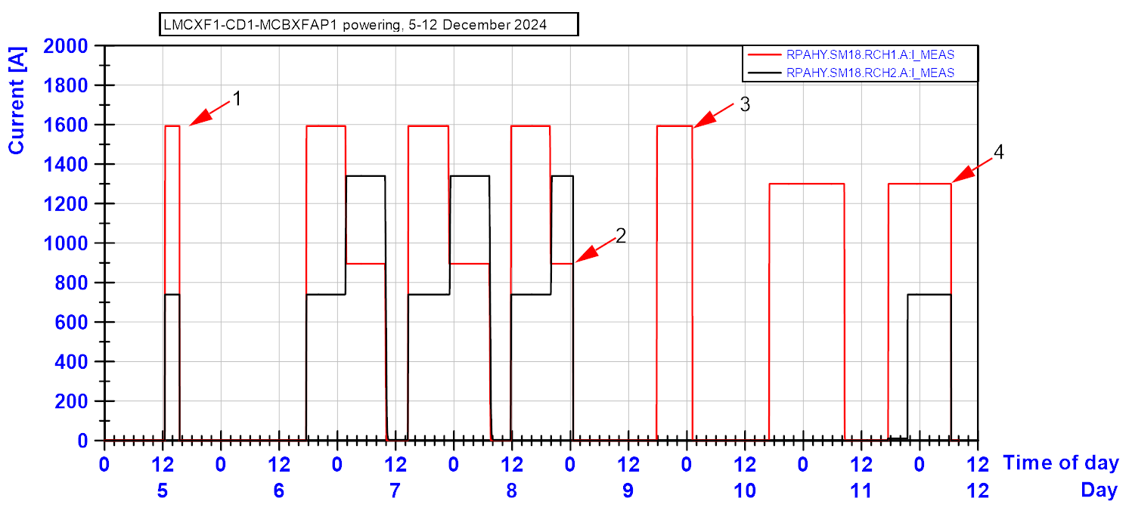
Combined powering – holding currents MCBXFAH/V. All powering in the ++ quadrant.

Slide 7
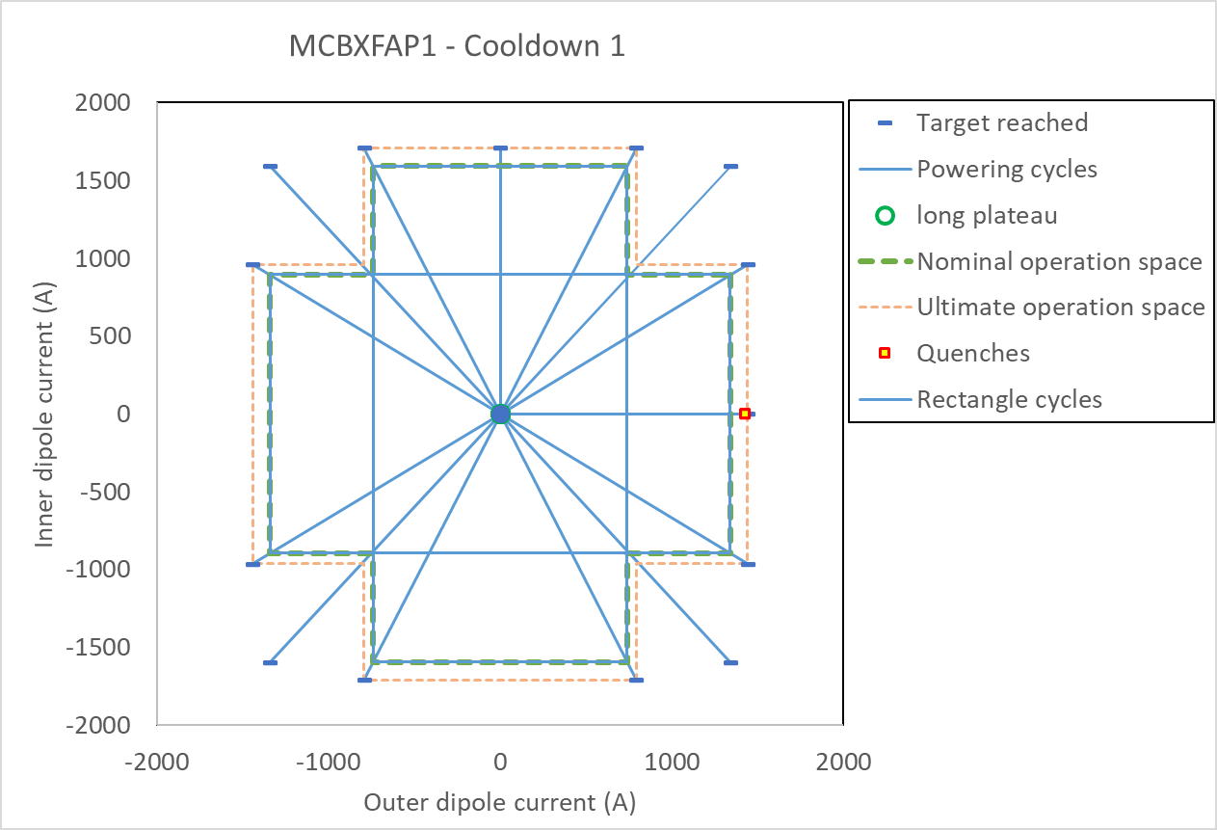
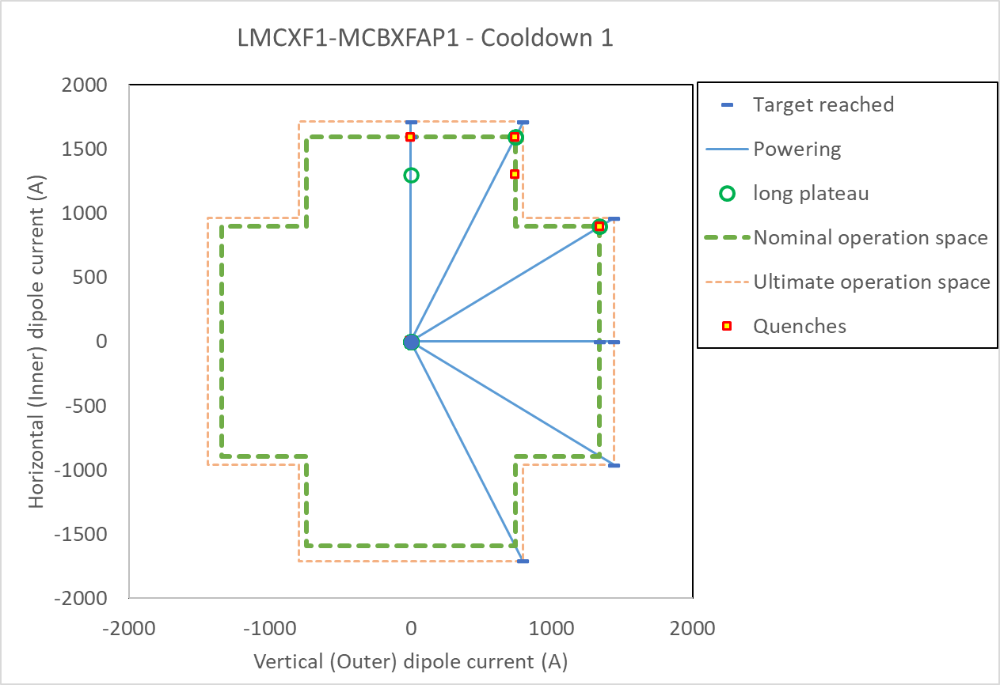
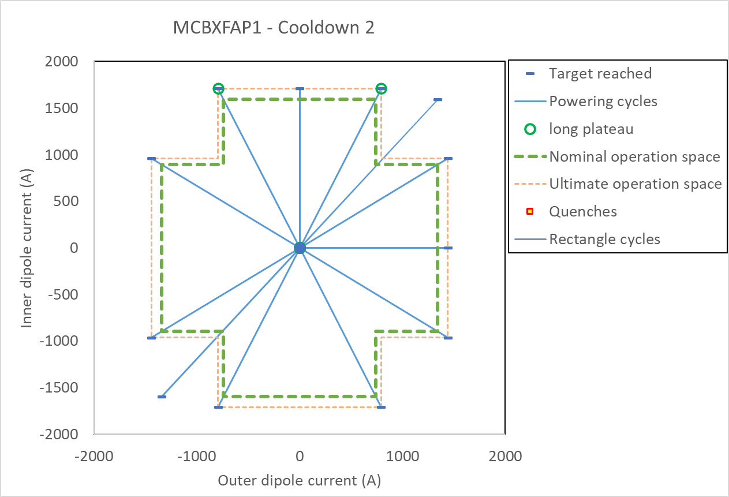
Full powering overview MCBXFAP1, vertical cool down 1 and 2 and in the LMQXF1

Slide 9
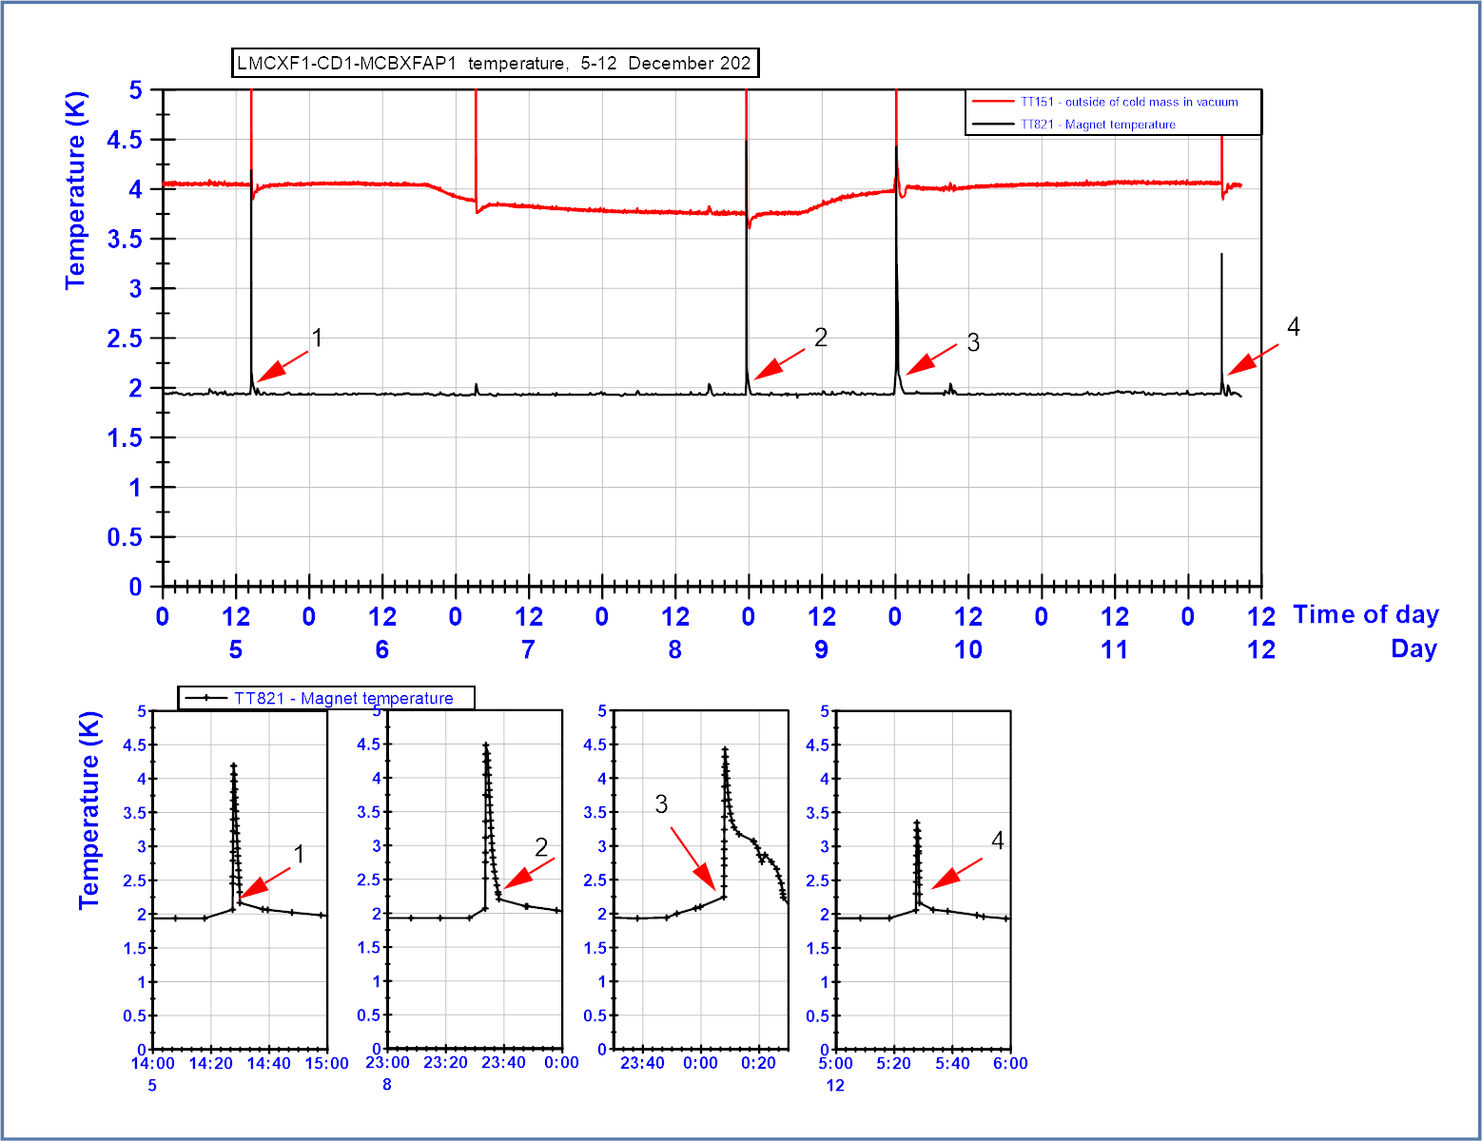

Slide 10
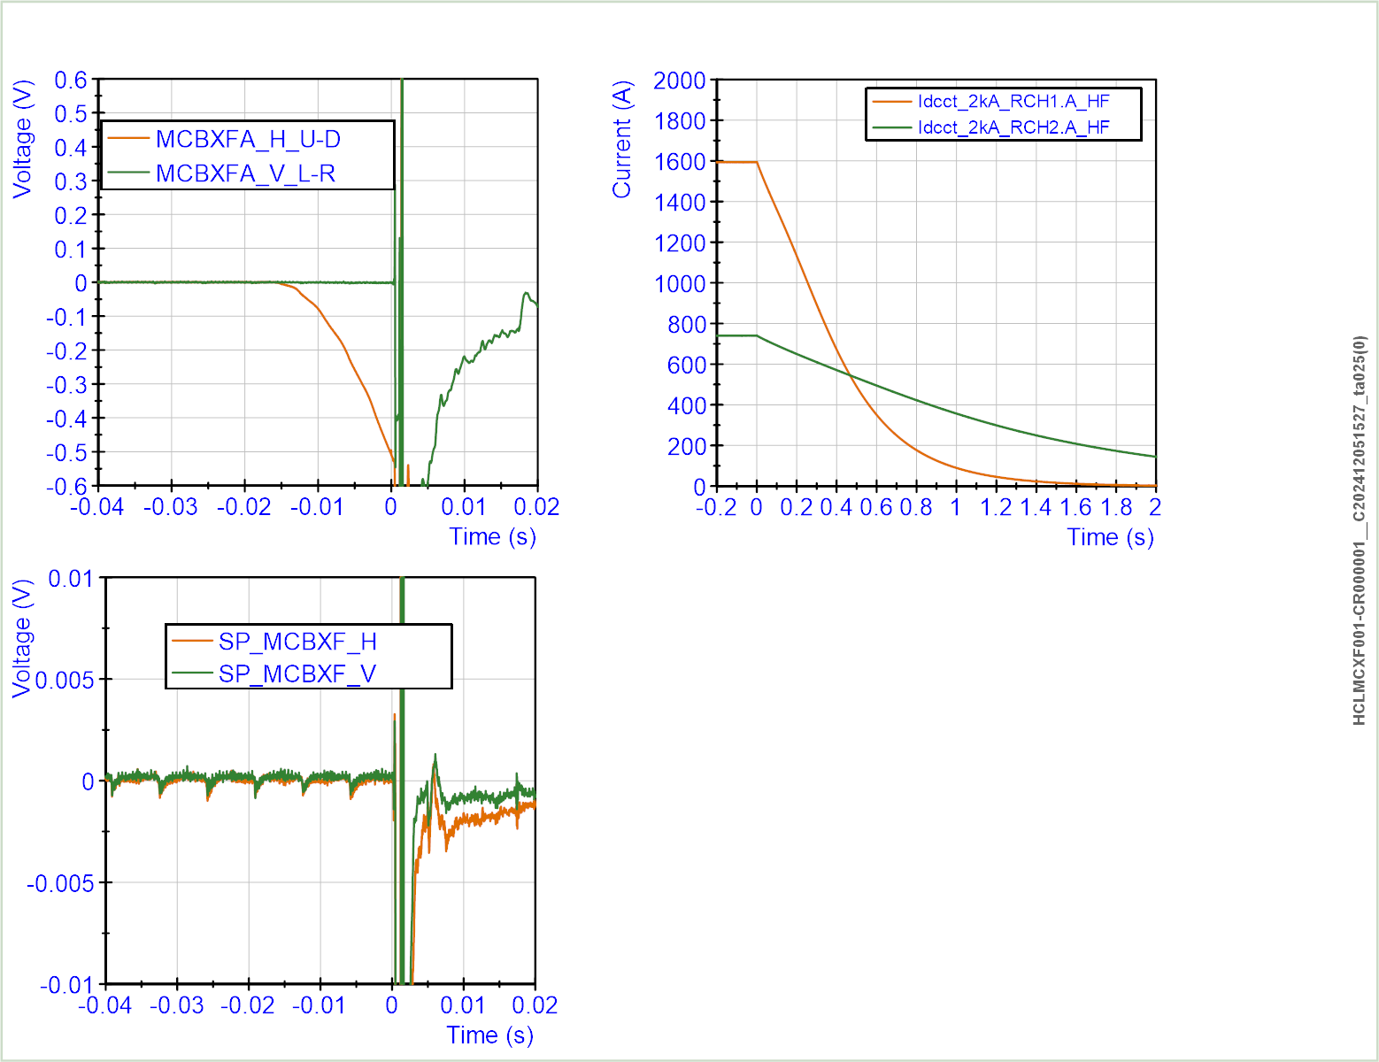
Quench 1

Slide 11
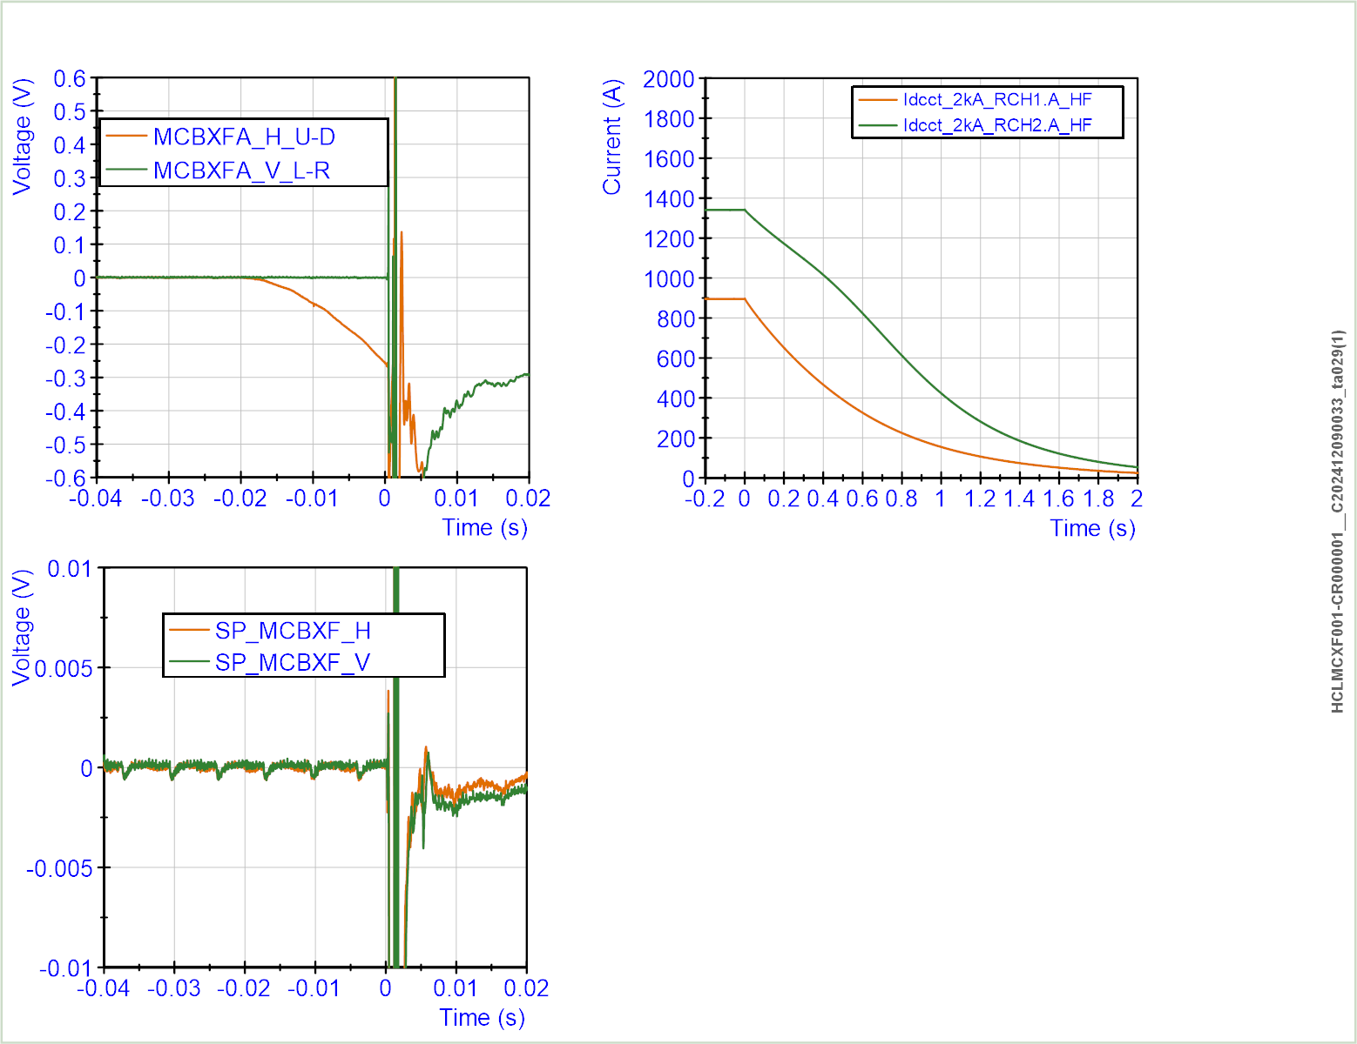
Quench 2

Slide 12
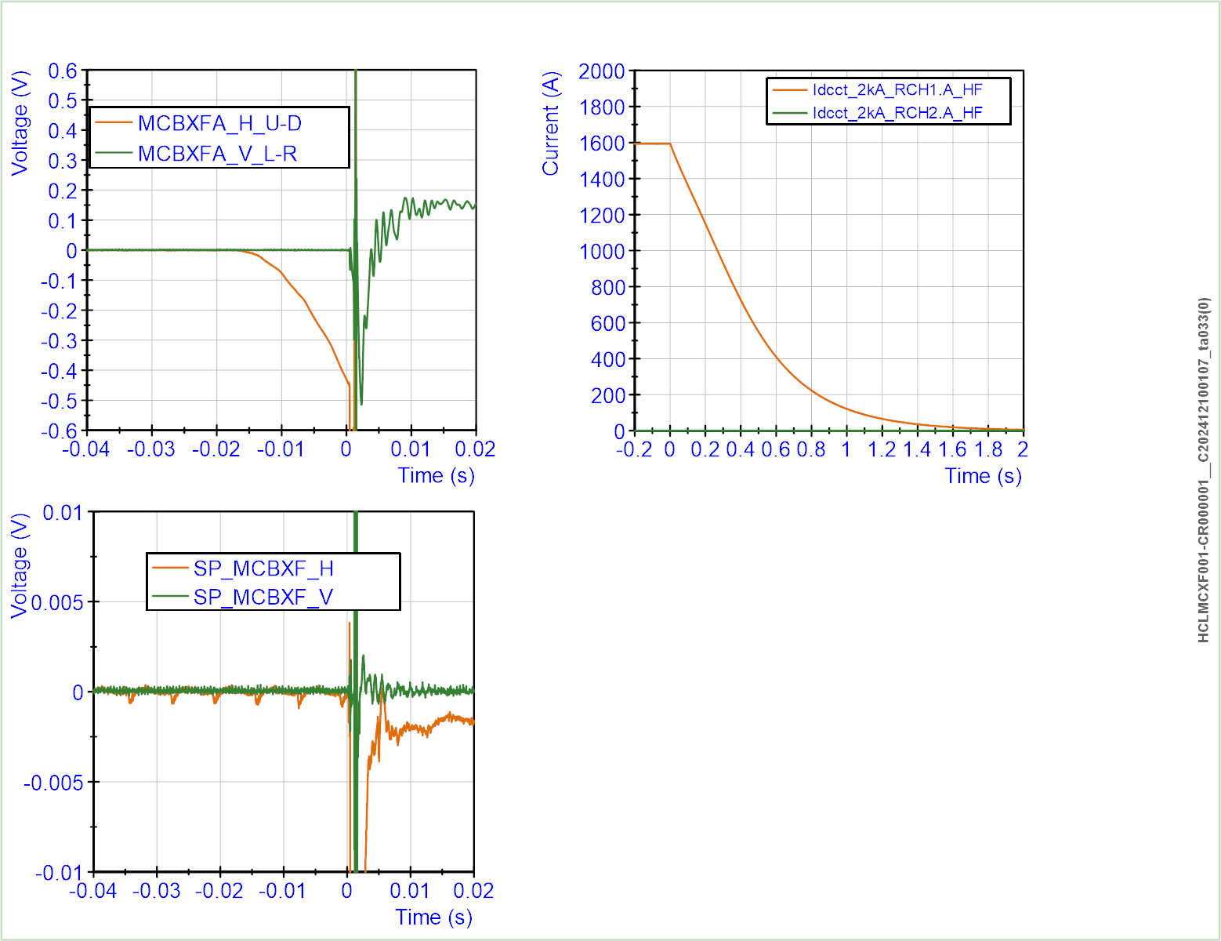
Quench 3

Slide 13
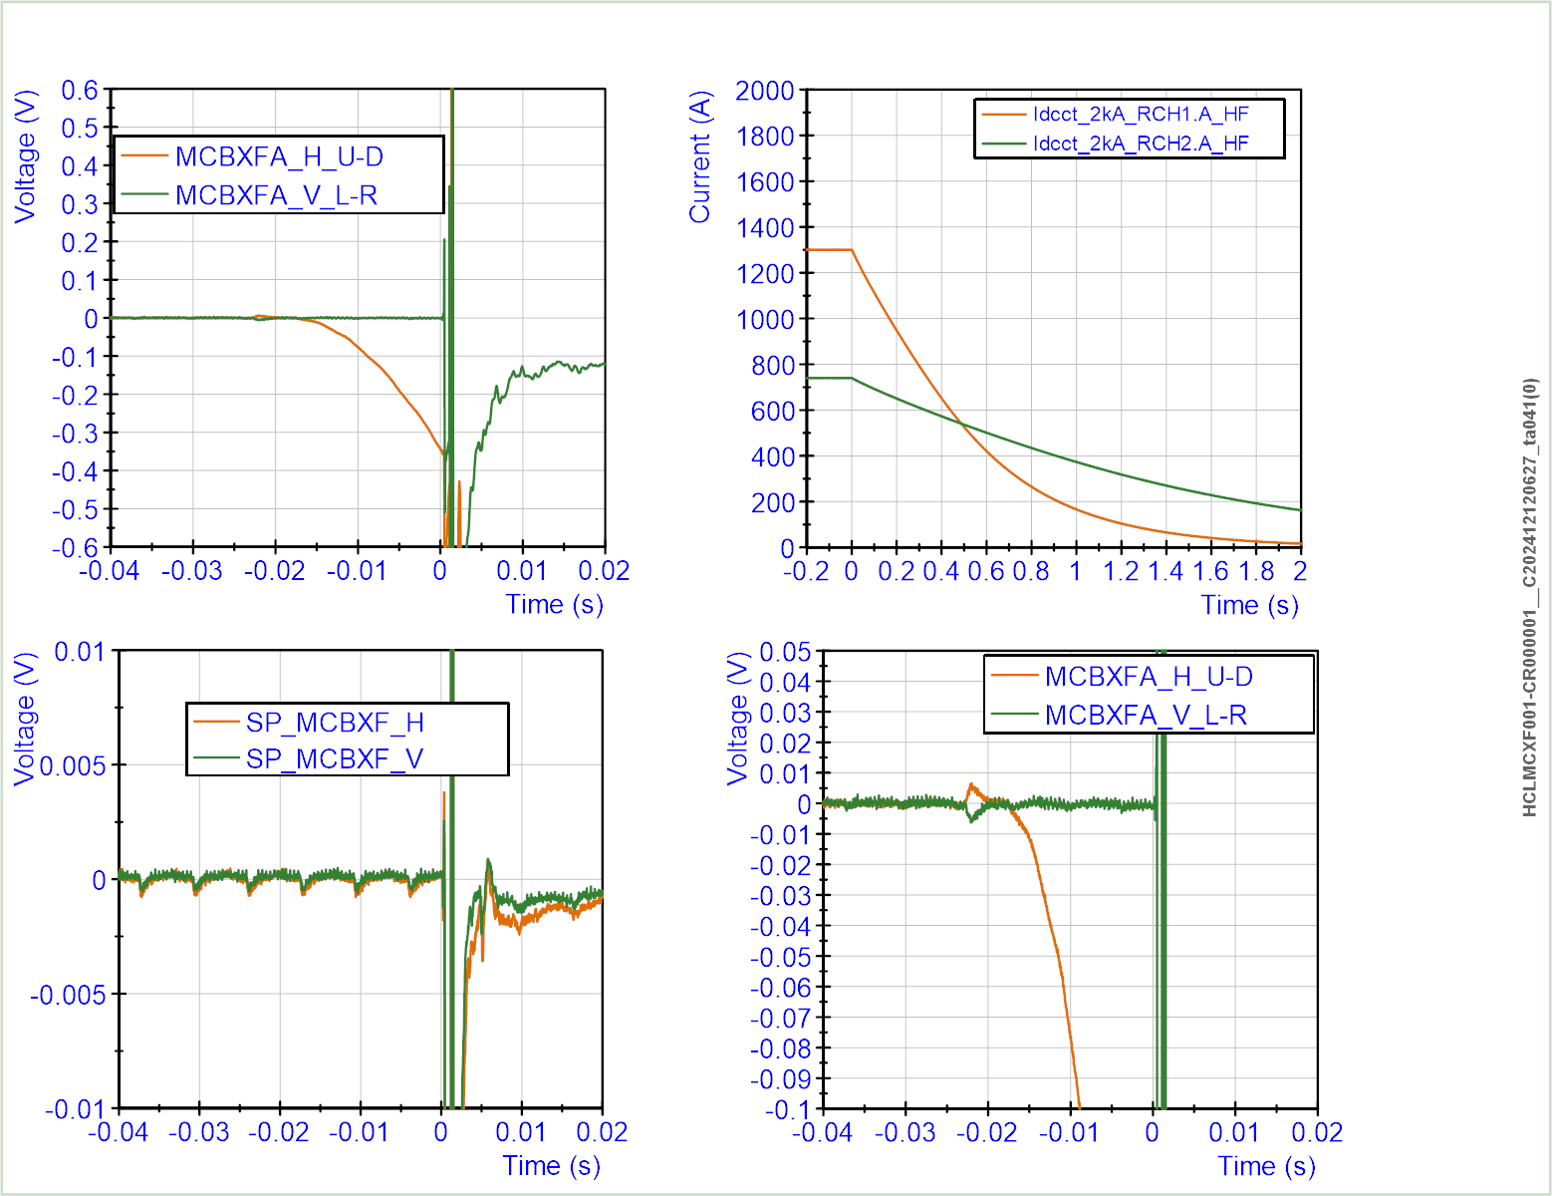
Quench 4

Slide 14
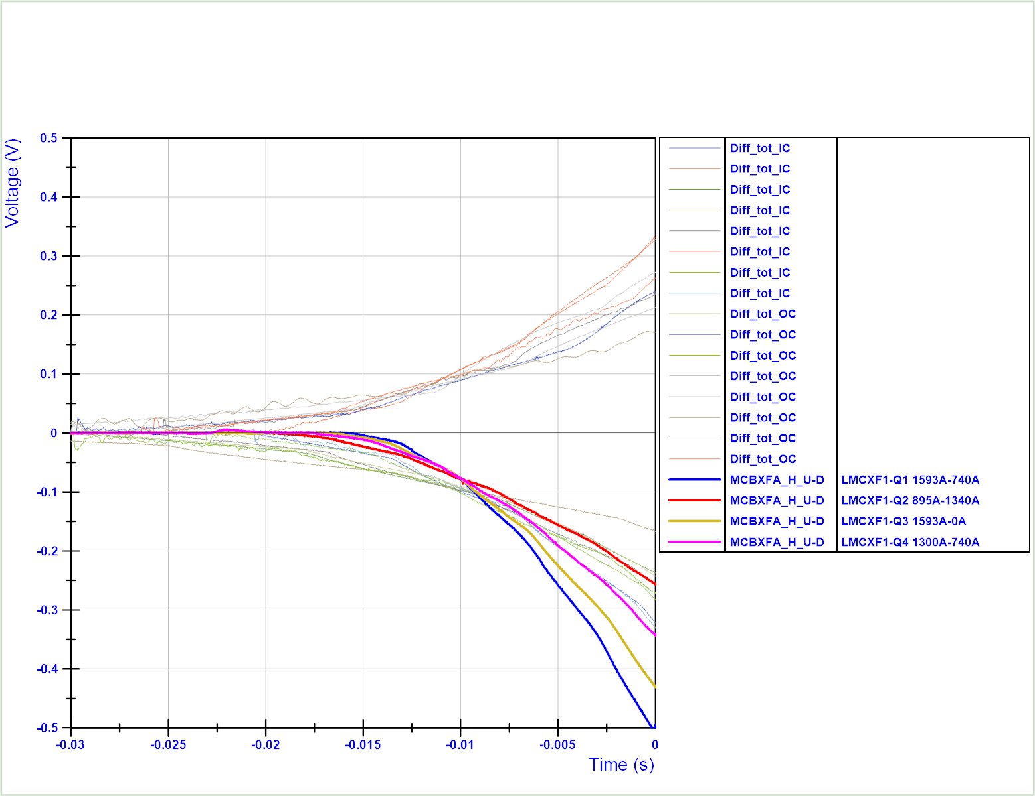
Quench voltage of MCBXFB and MCBXFA magnet in vertical tests compared to the 4 quenches of MCXBFAP1 in LMQXF1.

Slide 15
