Slide 1
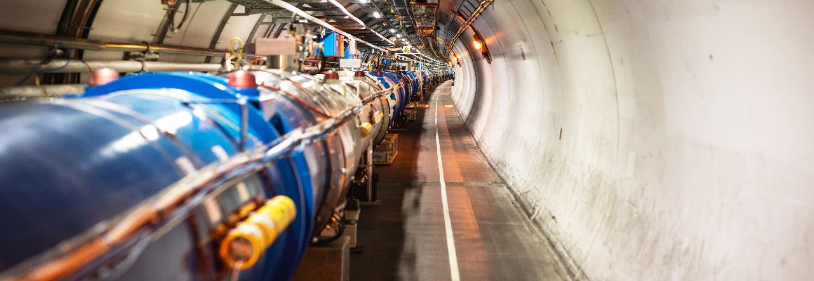

WELCOME TO CERN
Friday, January 10th 225
Notes:
THE WELCOME SLIDE
With this slide the speaker:
Introduces him/herself
Describes how this brief presentation aims to give an overview of CERN, as an introduction to the visit that will follow.

Slide 2
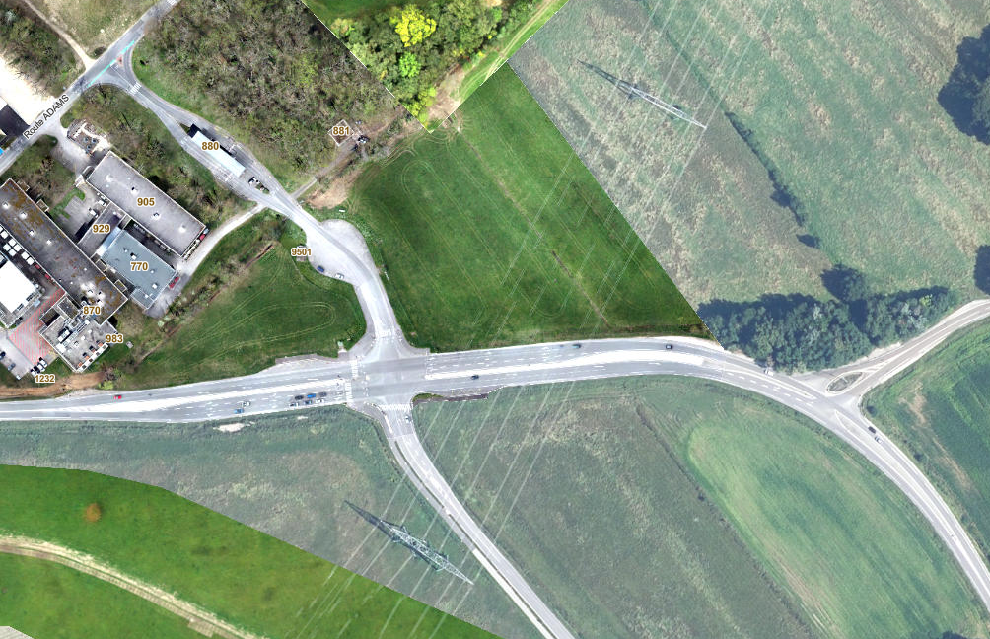
Meeting Point : Entrance of Prevessin site (FR)
Location:Maps
Adress: 9001, route de Saint-Genis, 01280 Prévessin-Moëns, France.
8h45

Slide 3
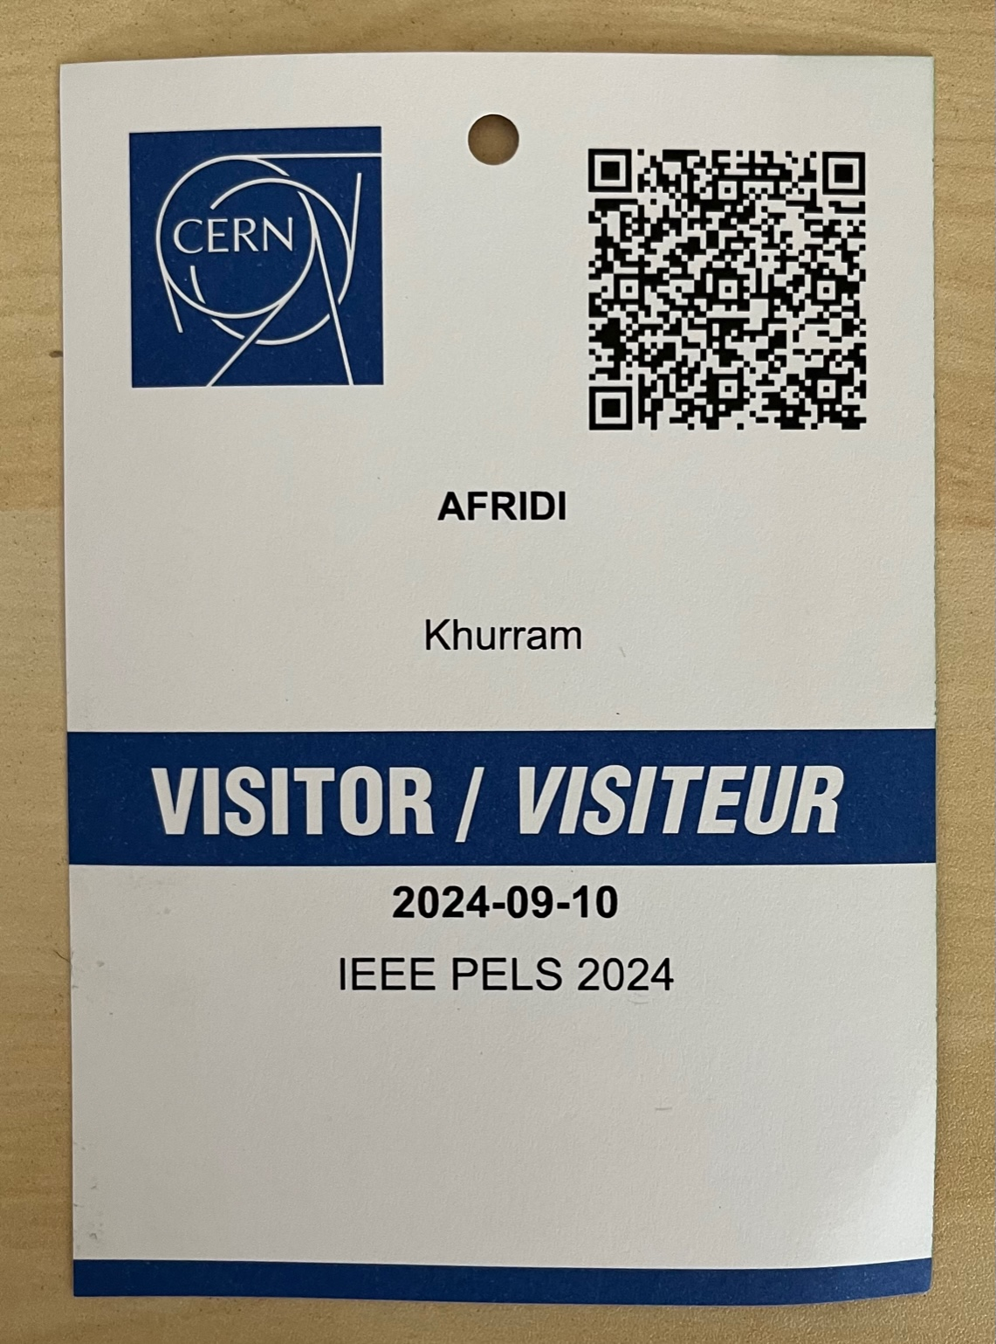
Visitor Badges
Keep with you during all day!
Family Name
First Name
HES-SO

Slide 4
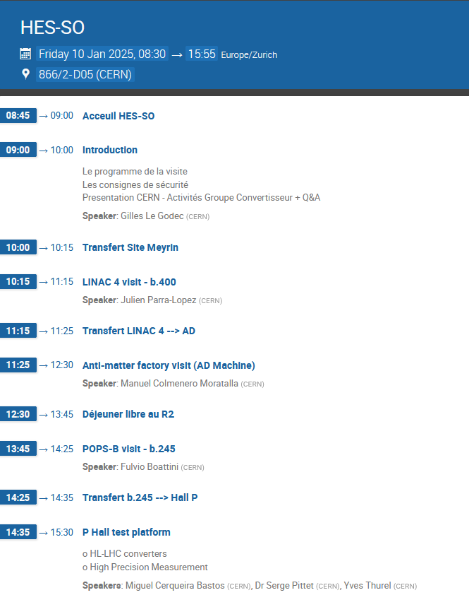
Program

Slide 5
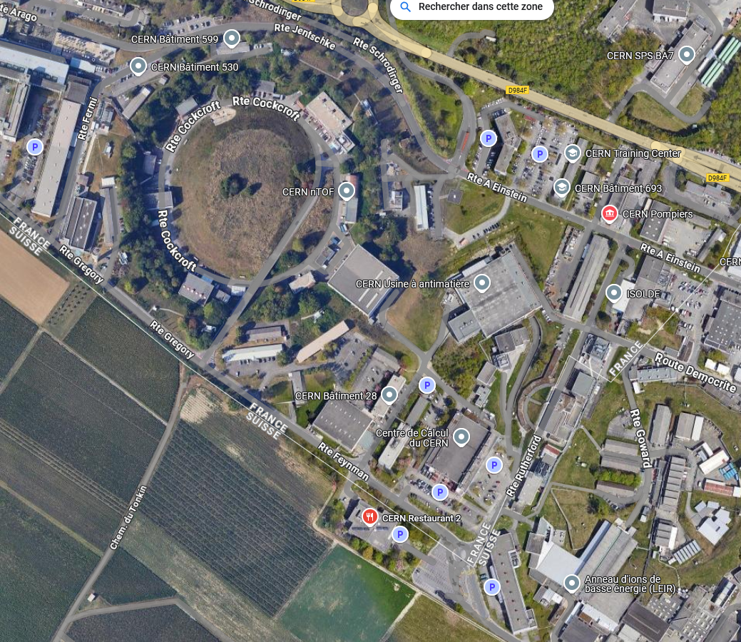
Program
P Hall
AD
POPS-B
R2
LINAC 4

Slide 6
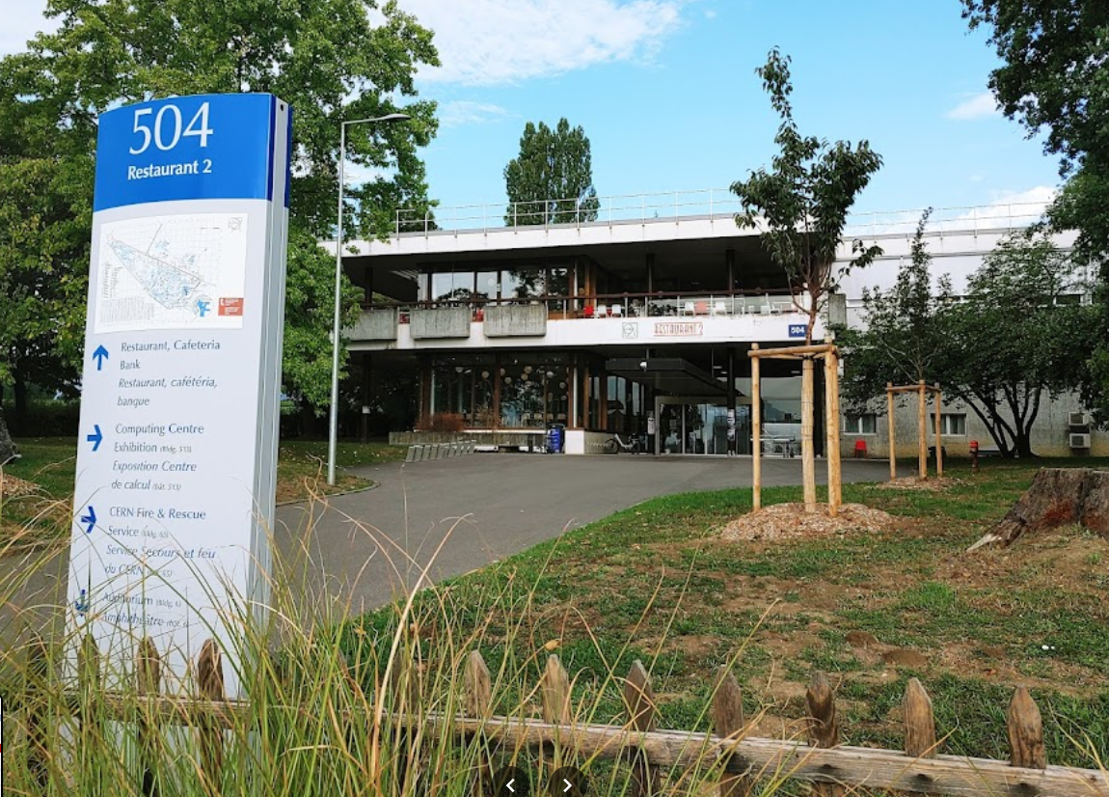
Lunch
CERN R2 Restaurant

Slide 7

Safety Rules (For the technical visits)
Keep your Visitor Badge with you and wear it visibly during the entire day!
Accessibility: The technical visits are not suitable for persons with reduced mobility.
The technical visits take place in CERN machine buildings, the floors may be uneven. We also need to pass a couple of stairs.
Wear closed flat shoes.
Please watch your step.
At all times, please respect the instructions provided by your guides!
Enjoy the visits!

Slide 8


Safety Rules (For the technical visits)
Electrical risks: Please do not touch!
Most of our installations are not in service due to our yearly winter technical stop…except in the P Hall test platforms that we will visit.
Please keep 1 meter distance from electrical installations
Strong magnetic and electric fields:
Access is not allowed neither for persons carrying medical assistive devices (heart rhythm devices) nor for pregnant women.
Enjoy the visits!

Slide 9
Thanks.
gilles.le.godec@cern.ch

