Slide 1
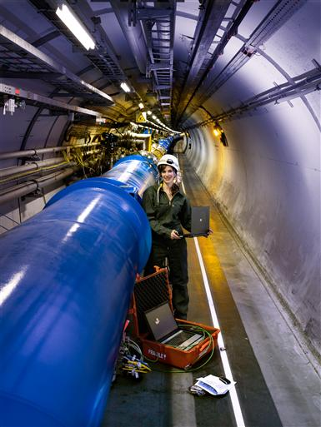

Slide 2
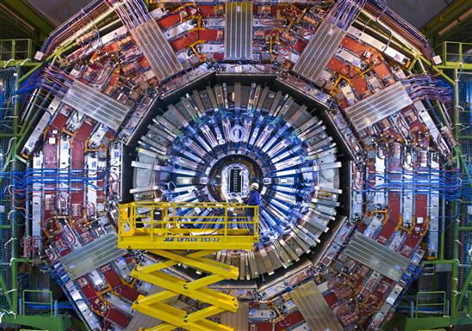
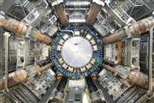
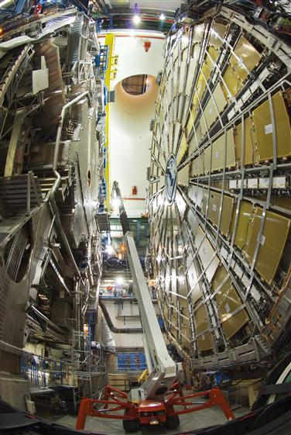
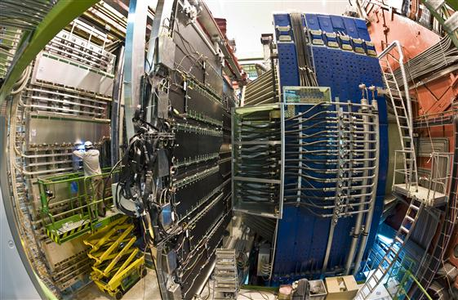

Slide 3
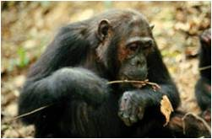

Slide 4



?
?

Slide 5


Slide 6
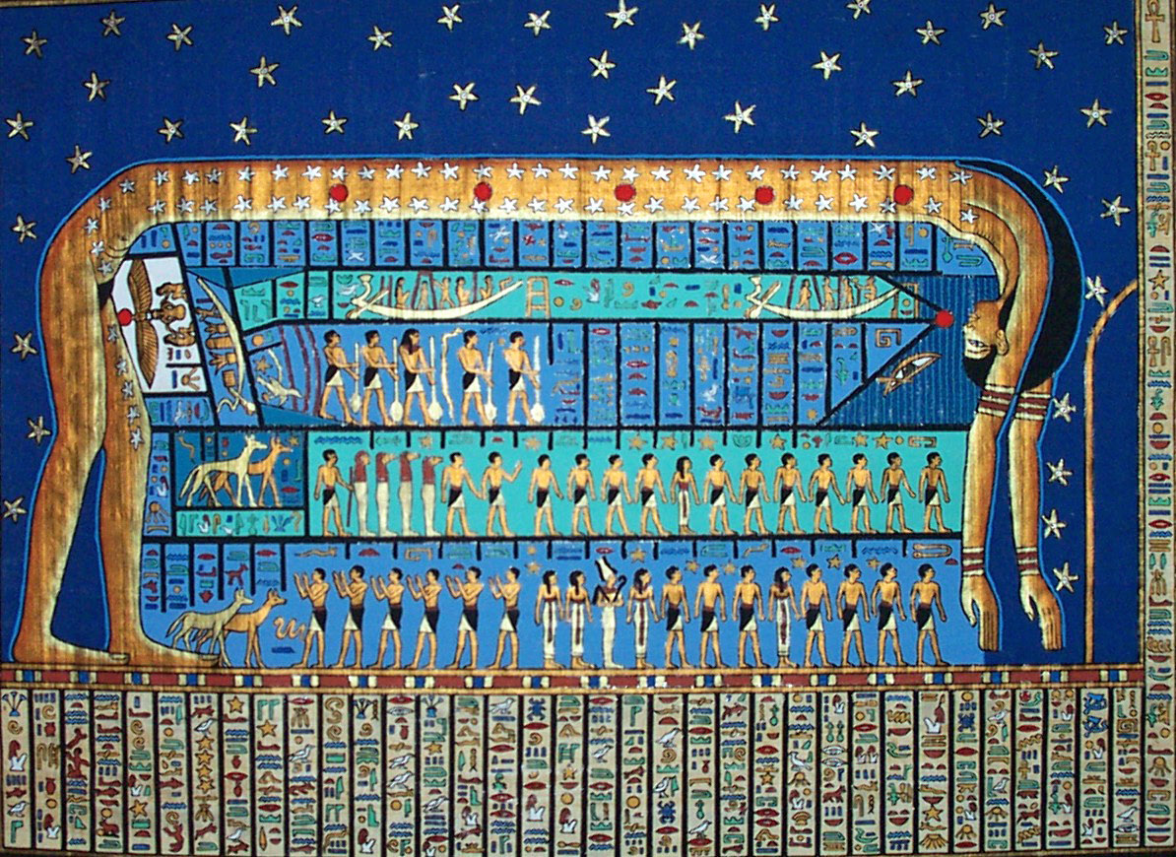

Slide 7
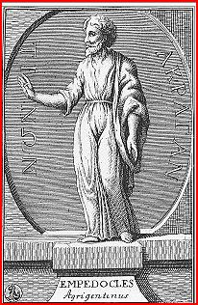

Slide 8
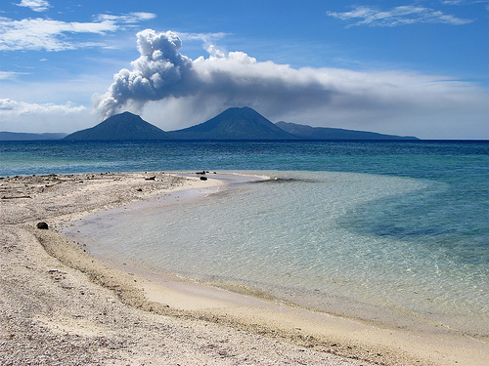
AR
FOGO
AGUA
TERRA

Slide 9
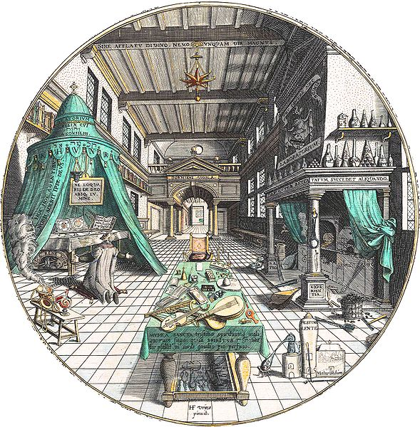

Slide 10
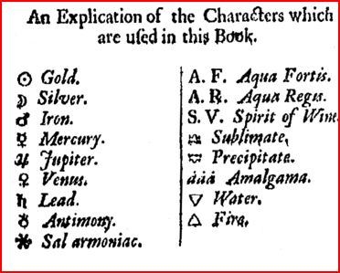

Slide 11
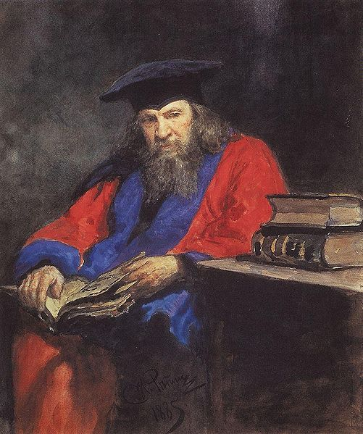
Dmitri Mendeleiev

Slide 12
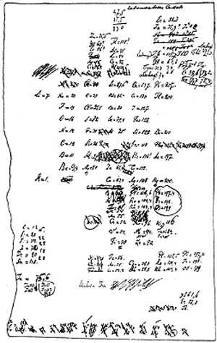

Slide 13
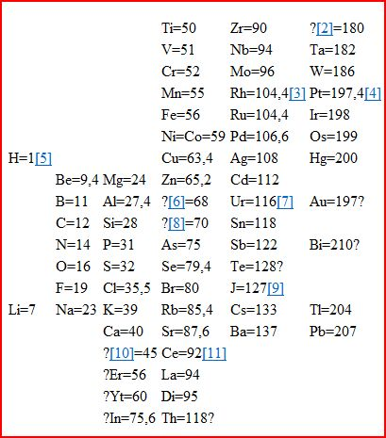

Slide 14
Electrão 1897 John Joseph Thomson.
Protão 1886 Eugene Goldstein
Neutrão 1932 James

Slide 15
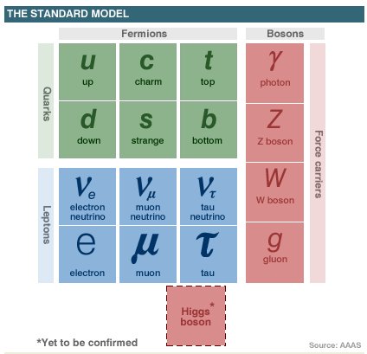

Slide 16
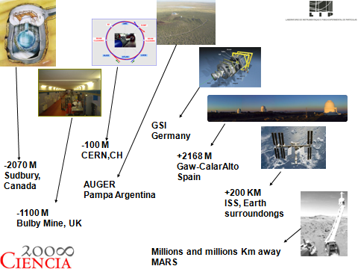

Slide 17
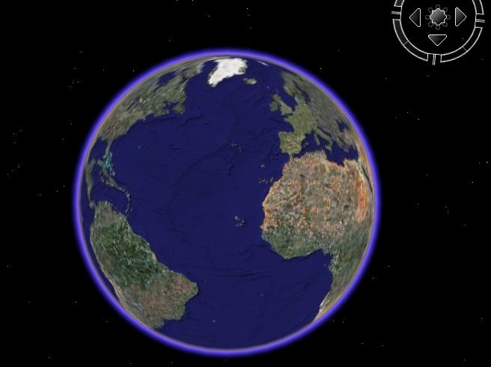




Bulby Mine
UK
GSI
Geermany
SUDBURY
CANADA
MARS
ISS
CERN
CH
Calar Alto
Spain
AUGER
Argentina

Slide 19
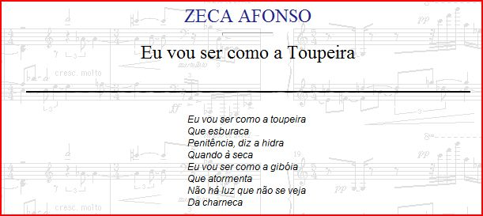
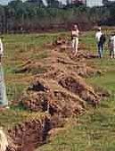



Slide 20
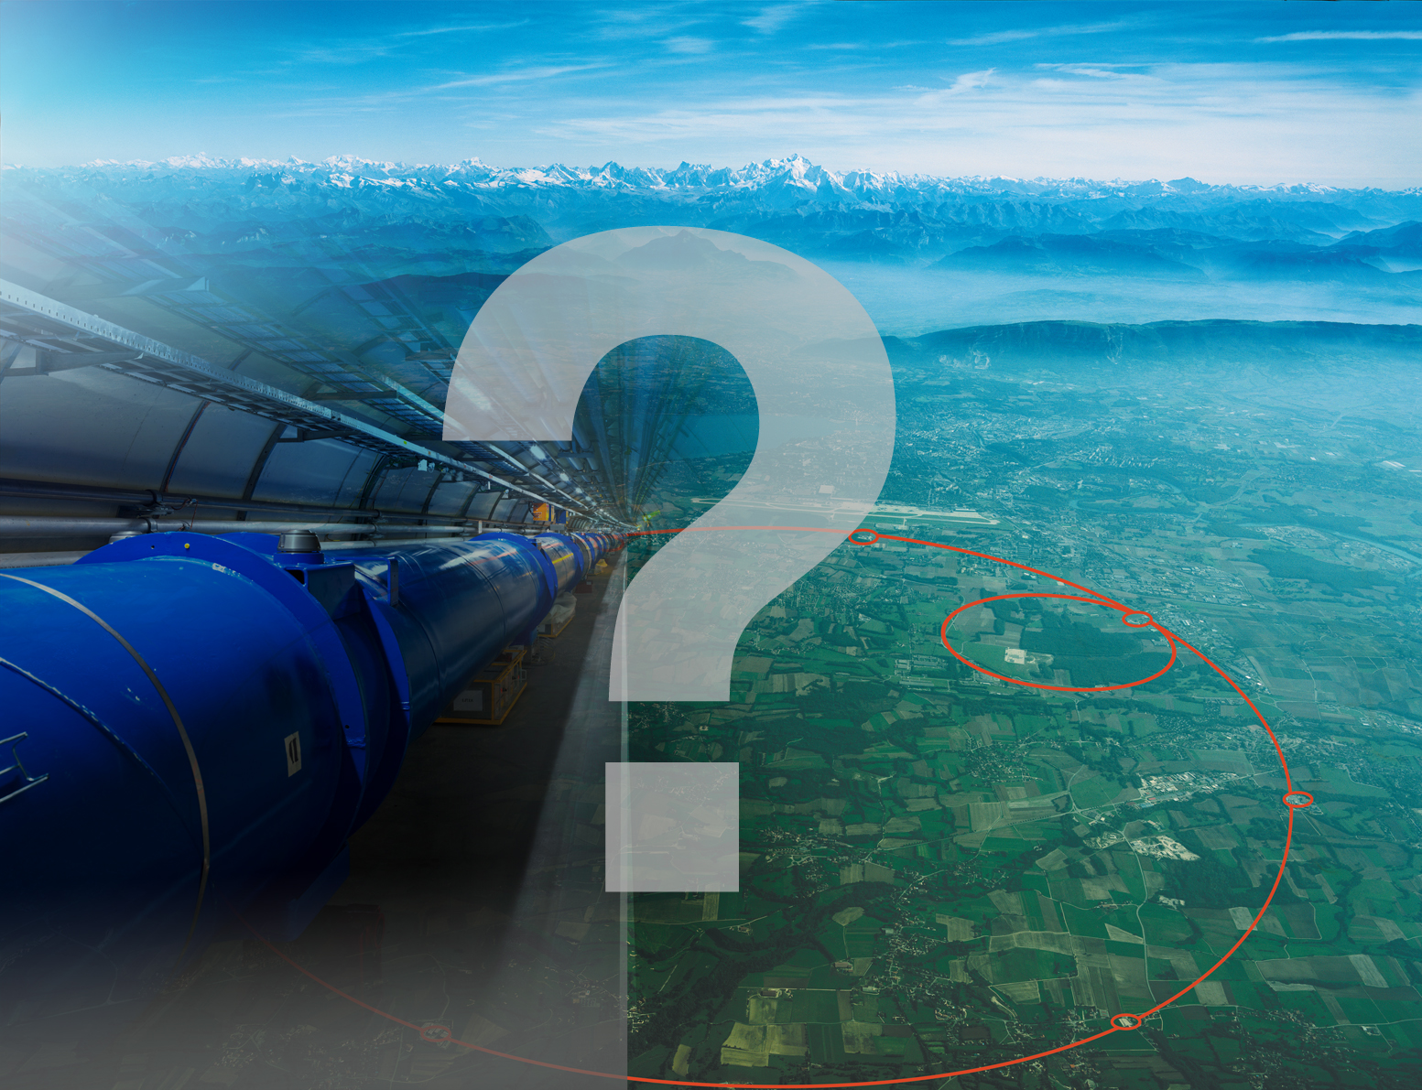

Slide 21
The cost of each new U.S. DDG 1000 destroyer nearly doubled to just under $6 billion after the Navy decided to halt the program at just three ships. The ships are being built by Northrop Grumman Corp (NOC.N) and General Dynamics Corp (GD.N), and come with a combat system built by Raytheon Co (RTN.N)..
a Nimitz-class carrier powered by two nuclear reactors and four steam turbines is 1,092 feet (333 m) long and costs about $4.5 billion
Segundo o jornal, "com os atrasos ocorridos no início do processo, esse preço (769,3 milhões de euros) disparou para 832,9 milhões de euros, sem juros um aumento de 8%. Com juros, esse valor supera os mil milhões de euro."

Slide 23


Slide 24
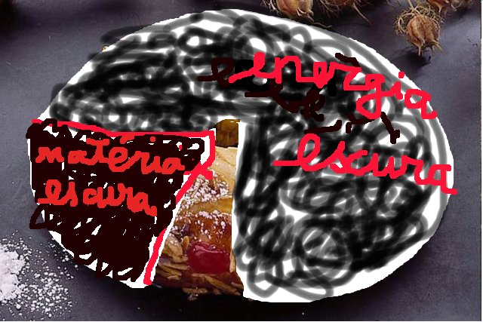

Slide 25
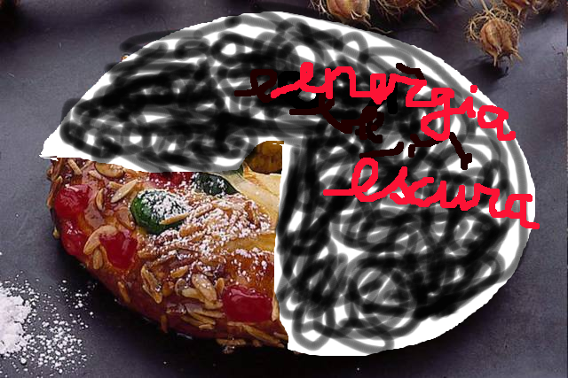

Slide 26
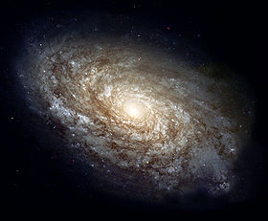

Slide 27
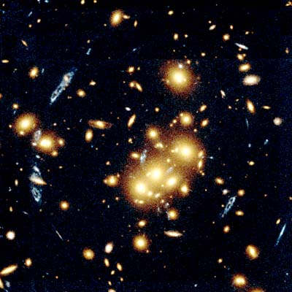

Slide 28
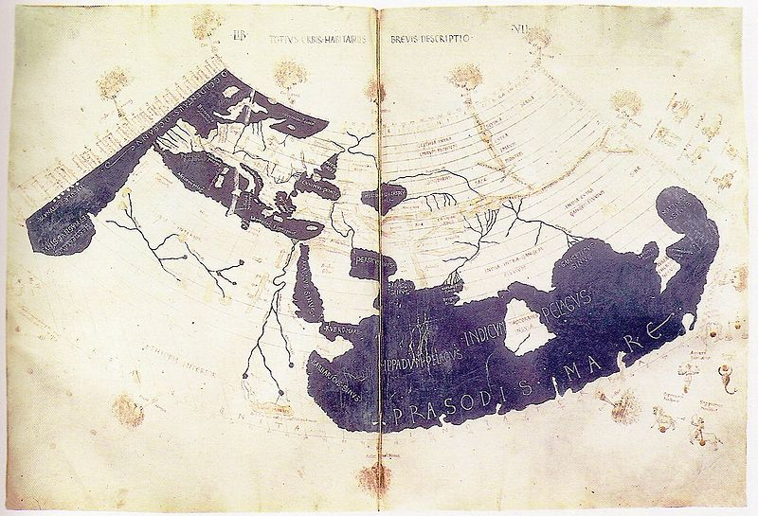

Slide 29
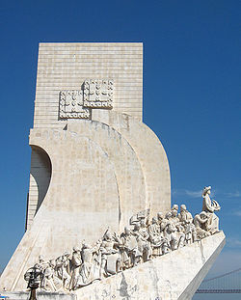

Slide 30
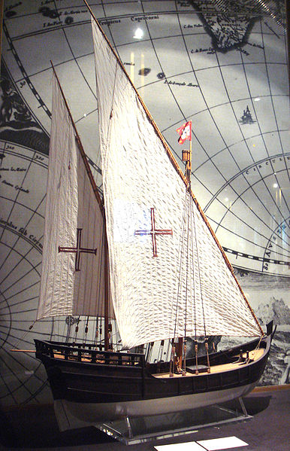

Slide 31
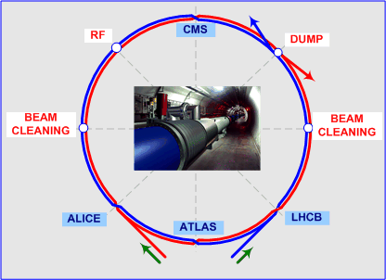

Slide 32


