Slide 1

National research policies and Research Council of Finland
Paula Eerola, 30 May 2025

Slide 2
R&D funding and policies in Finland

Slide 3
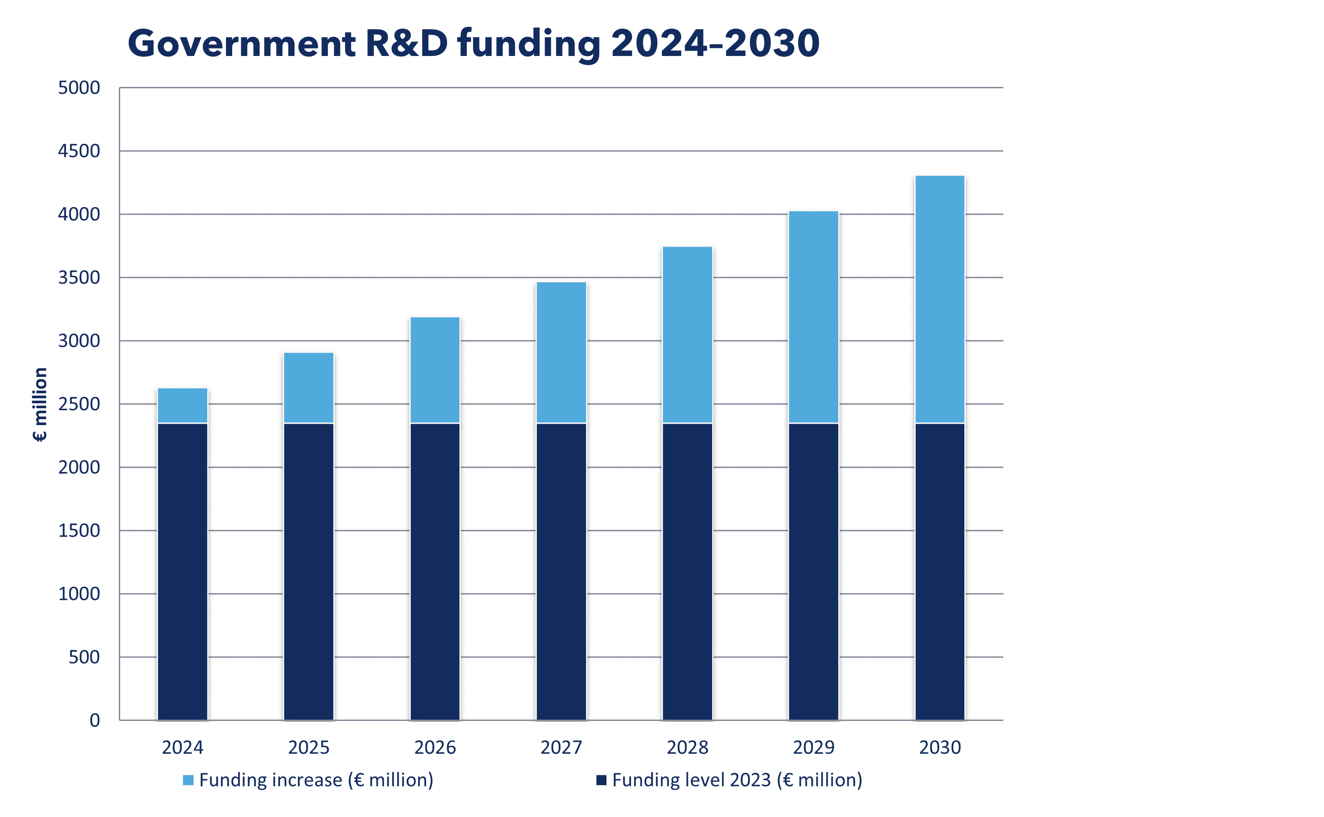
National agreement to raise Finland’s R&D spending from 3% to 4% of GDP by 2030
Goal 2030: 4% of GDP used for R&D (1/3 public – 2/3 private)
Increase productivity
Secure knowledge base and expert skills
Respond to societal challenges
Increase resilience
Facilitate the green/clean transition
Boost higher added value for exports

Slide 4
Public R&D funding to increase by €280m per year 2024–2030 (Act on R&D funding) – How will it be used?
Increased funding through Research Council of Finland and Business Finland
€255m for 1,000
new PhD student positions
€250m for LUMI-AI supercomputer (part of EuroHPC)
Investments in quantum technology, minerals technology, etc.
Increased R&D funding for universities
Secure host organisation funding for EU R&D projects

Slide 5

About the RCF

Slide 6

The roles of the RCF
* RCF is a governmental agency under the Ministry of Education and Culture.
* Steered by the RCF Act and a yearly performance agreement between the RCF and MEC.
* Research funding
  Researchers and research projects
  Research environments such as infrastructures
  Thematic funding and cooperation
  Membership fees to international research organisations
* Research expertise
  Data about the research system
  Science policy advice nationally and internationally
  Representing Finland in international organisations and acting as a contact point

Slide 7




Our vision
Our mission
Our values
Bold research for Finland and the world
To open up new avenues for excellent, responsible and high-impact research
Openness Transparency Reliability
Equality and nondiscrimination

Slide 8

Excellent research and expertise make Finland a leading country in sustainable growth
Forge
We fund research environments that strengthen cutting-edge science
Spark
Shift
We provide
long-term funding for bold research ideas
We fund research that
helps solve societal
challenges together
SKILLED PEOPLE
Notes:
Akatemian rahoituskokonaisuus - mitä näillä tavoitellaan
Otamme huomioon TKI-tavoitteet huomioon koko rahoituskokonaisuudessamme.

Slide 9
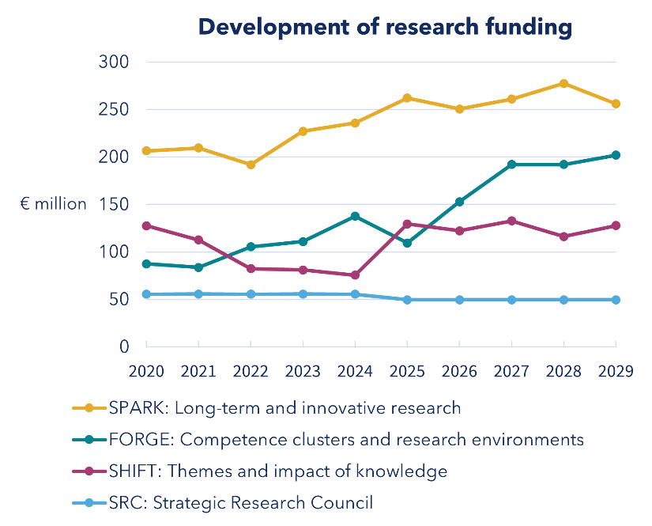
A versatile and multi-sector funding portfolio
Our funding for long-term and innovative research is at an all-time high.
We facilitate new initiatives by making sure the innovation path starts wide.
We enable the transfer of new knowledge and skills to society.
Source: RCF and SRC; General Government Fiscal Plan 2026–2029, within limits.
Notes:
Huomio kehityssuuntaan (2025—2029): suurin osa rahoituksesta pitkäjänteiseen ja uutta luovaan tutkimukseen, osaamiskeskittymiin ja tutkimusympäristöihin kolmannes, temaattiseen ja tiedon vaikuttavuutta edistävään tutkimukseen 20—25 %.

Slide 10






Key RCF figures 2024
Our funding for scientific research
€488m
New research projects launched
634
FTEs with our funding
~ 3,500
Projects funded in RCF winter call
412
Success rate in RCF winter call
15%
Operating costs as percentage of funding budget
2.0%

Slide 11
Disruptive technologies (12) |  | Environment and natural resources (7) | Health, well-being, and education (8) | Resilient society (3)
EuroHPC JU* European high performance computing (Hosting country) | CERN European Organization for Nuclear Research | ACTRIS-ERIC The Aerosols, Clouds, and Trace Gases Research Infrastructure (Hosting country) | BBMRI-ERIC Biobanking and Biomolecular Resources RI | CESSDA-ERIC Consortium of European Social Science Data Archives
IML Mittag-Leffler Institute | EFDA-JET Joint European Torus, MEAE** | AnaEE-ERIC Analysis and Experimentation on Ecosystems | EATRIS-ERIC European Advanced Translational Research Infrastructure (UEF****) | CLARIN-ERIC Common Language Resource and Technology Infrastructure
NeIC Nordic e-Infrastructure Collaboration | ESA European Space Agency, MEAE** | EISCAT (+3D) European Incoherent Scatter Association | ELIXIR European life science infrastructure for biological information | ESS-ERIC European Social Survey
 | ESO European Southern Observatory | EMBRC-ERIC European Marine Biological Resource Center | EMBL incl. EMBC European Molecular Biology Laboratory
 | ESRF European Synchrotron Radiation Facility | EURO-ARGO ERIC European contribution to the ARGO Program, MTC*** | EU-OPENSCREEN-ERIC European high-capacity screening network
 | FAIR Facility for Antiproton and Ion Research | GBIF Global Biodiversity Information Facility | Euro-BioImaging-ERIC European Research Infrastructure for biomedical Imaging (Hosting country)
 | ITER International Thermonuclear Experimental Reactor, MEAE** | ICOS-ERIC Integrated carbon observation system (Hosting country) | INFRAFRONTIER-ERIC The European Infrastructure for phenotyping and archiving of model mammalian genomes
 | JHR MTR Jules Horowitz Materials Testing Reactor, MEAE** |  | Instruct-ERIC Integrated Structural Biology Infrastructure
 | MAX IV Synchrotron Radiation Facility
Memberships in 24 international research infrastructures ~25M€/year (RCF+MEC)
* Paid directly by Ministry of Education and Culture
** Ministry of Economic Affairs and Employment
*** Ministry of Transport and Communication
**** University of Eastern Finland

Slide 12
RCF decision-making bodies
RCF Board
Finnish Research Infrastructure Committee
Chair
15 members
Scientific councils
Chair, 10 members
Strategic Research Council
Chair
8 members
Scientific Council for Biosciences, Health and the Environment
Scientific Council for Social Sciences and Health
Scientific Council for Natural Sciences and Engineering
Administration Office
The decision-makers are members of the Finnish scientific community (distinguished professors or researchers). RCF officials do not make any funding decisions. Political decision-makers do not participate in the review process or decision-making.

Slide 13
RCF Administration Office
President
Operations Management Unit
Funding Opportunities Unit
Impact and Science Policy Unit
Finance
Application and Decision Support
Science Policy and International Affairs
Administration
Scientific Review and Evaluation
Impact Work and Grant Management
Information Management
Programme and Research Infrastructure Funding
Communications and Public Relations

