Slide 1





MAT – Materials for Accelerator Technology
Accelerator Technology and Applications:
FCC, CLIC
Flyura Djurabekova
RECFA visit to Finland

Slide 2

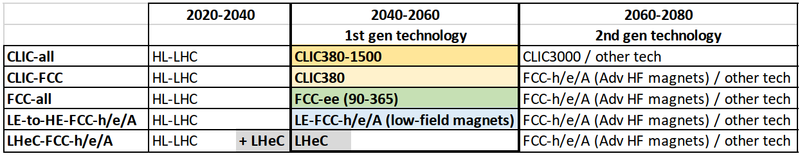
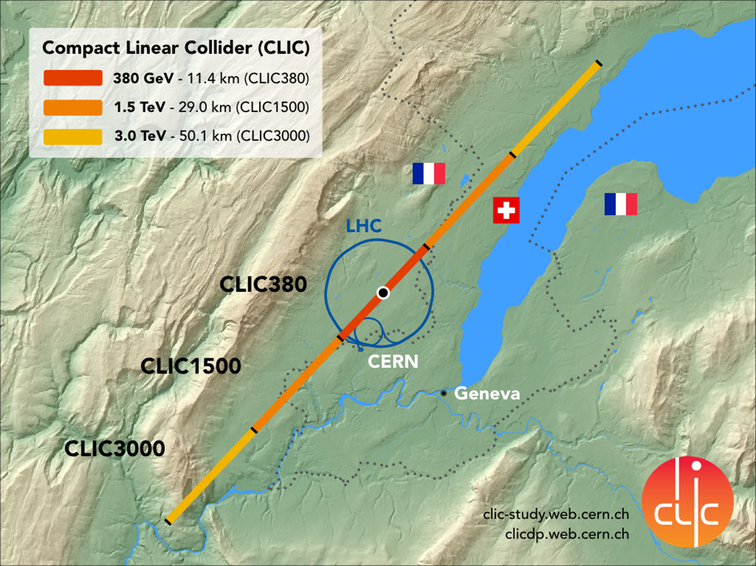
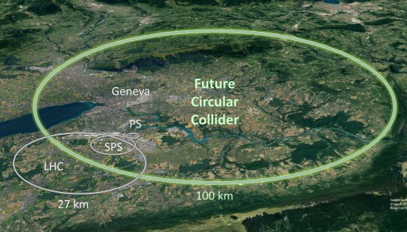
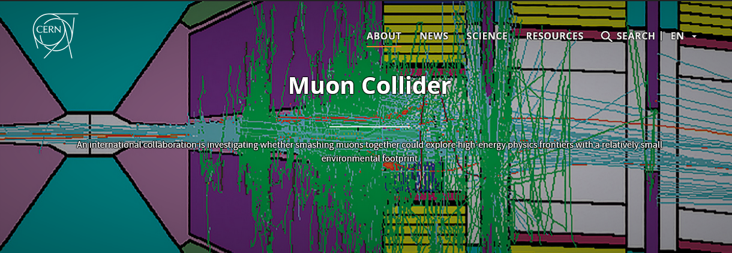
Accelerator technologies at CERN

Slide 3
Scientific scope of MAT
CLIC+IMCC
Development of multiscale model to explain vacuum arcing phenomenon
LHC Modelling of blistering on Cu surfaces of RFQ structures for proton beam injectors
FAIR
Physics of SHI interaction with materials for high energy physics applications
FCC
Growth of high quality of Nb films for superconducting cavities

Slide 4

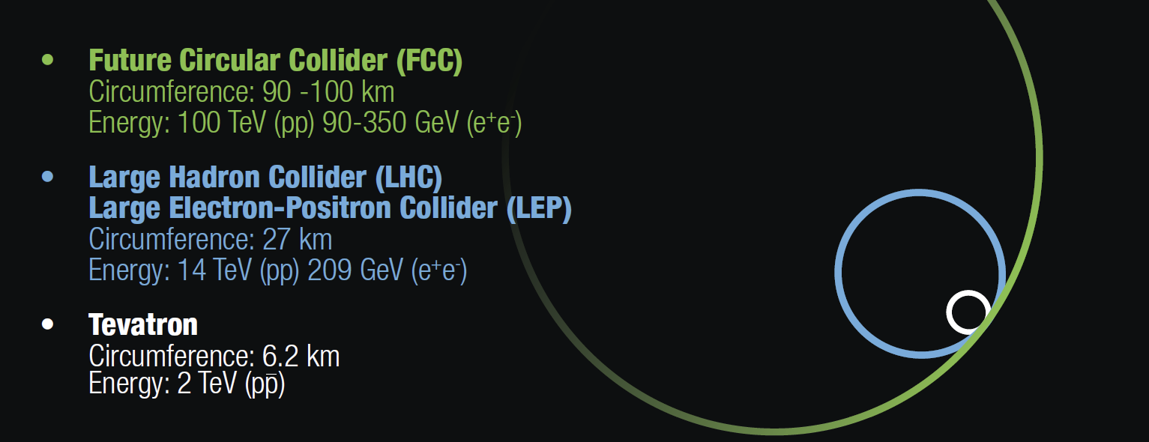

Towards Future Circular Collider
The proposed FCC 91-km-long circular tunnel around CERN is planned to house a new research infrastructure for particle physics.
The collider is planned in stages:
1. Initially an electron–positron collider (FCC-ee) will allow precise measurement of the properties of the Higgs boson and other Standard Model particles.
2. At the second step, the energy frontier proton collider (FCC-hh) will be built to reach collision energies of 100 TeV or higher (i.e. 8 times the energy of the LHC)
3. These require development of superconducting and magnet technologies.

Slide 5
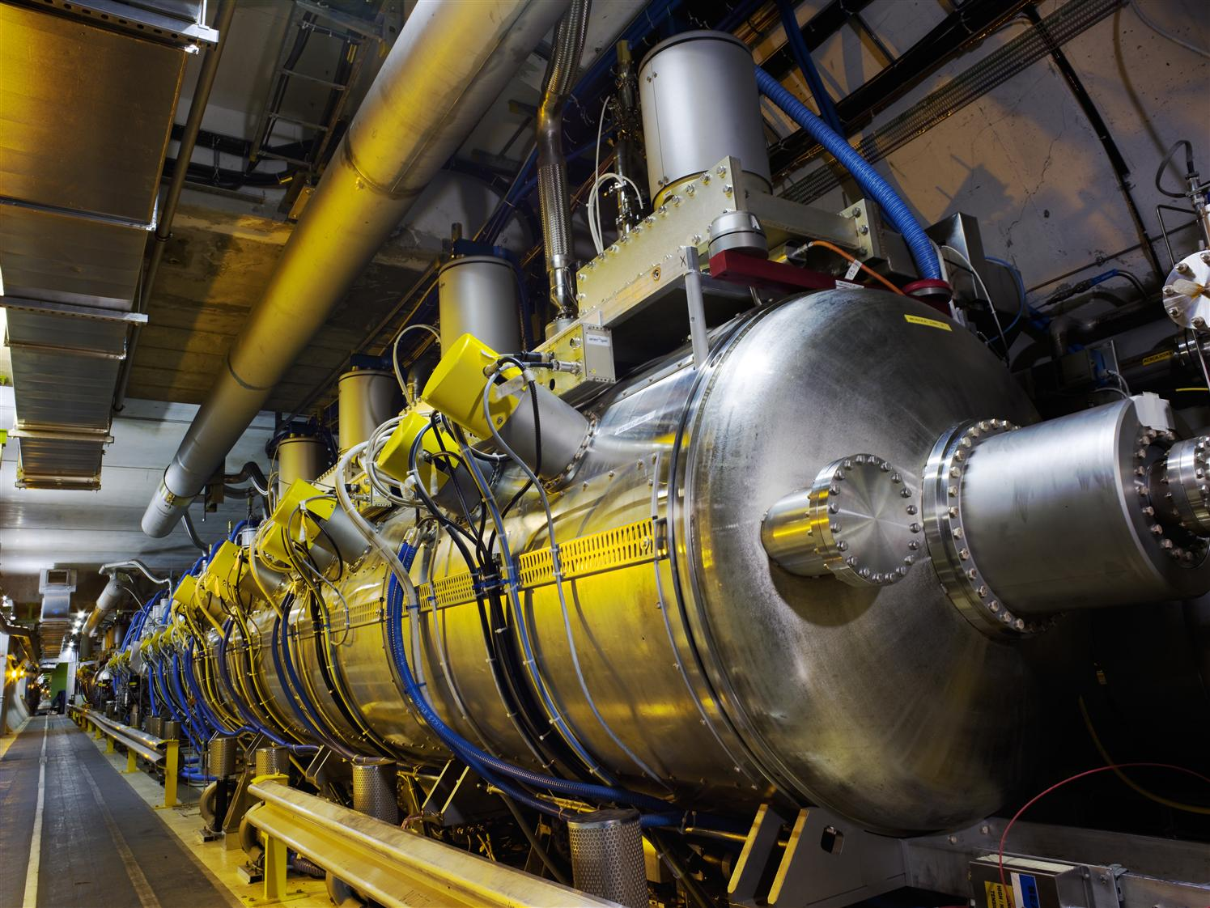
Superconducting RF system
The RF system is the most important part of FCC-ee, which is designed to compensates for the energy loss on synchrotron radiation by re-acceleration of the charged particles.
The RF system will provide the optimum configuration for each collision energy to reach the maximum beam current and beam performance in each mode of operation.
High quality SRF cavilities are needed for the best performance

Slide 6
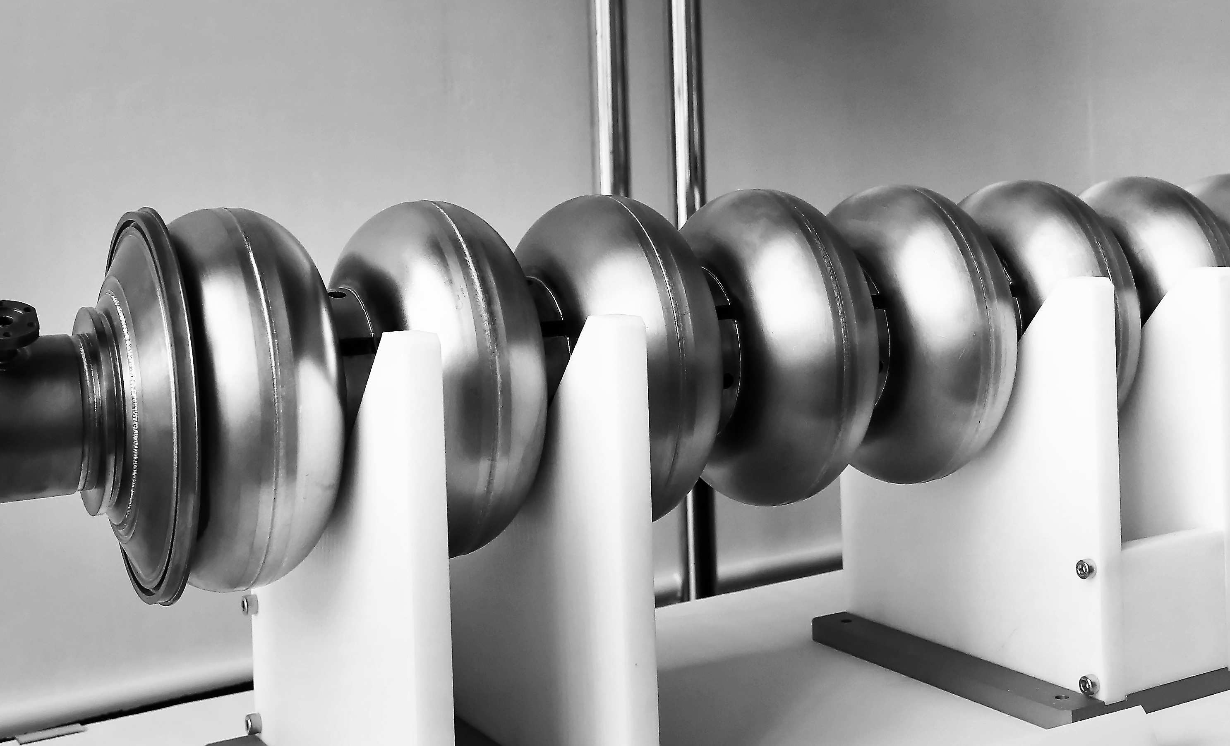
HiPIMS deposited Nb films
Because of superior superconducting properties for a single element material, Nb presents an excellent choice for building superconducting cavities for FCC.
However, the required quantity of this material makes the project prohibitively expensive!
Solution:
  Use Nb thin film deposited on a cheaper Cu substrate
  The advantages are:
    Good thermal stability at cryogenic temperatures
    Low production costs
    Low sensitivity of performance to ambient magnetic fields
HiPIMS offers optimal condition for efficient growth
Precise understanding of thin film growth mechanisms is very important for quality of the film with respect to its durability and superconducting properties.
The niobium-coated copper
Superconducting radio frequency (SRF) cavities

Slide 7
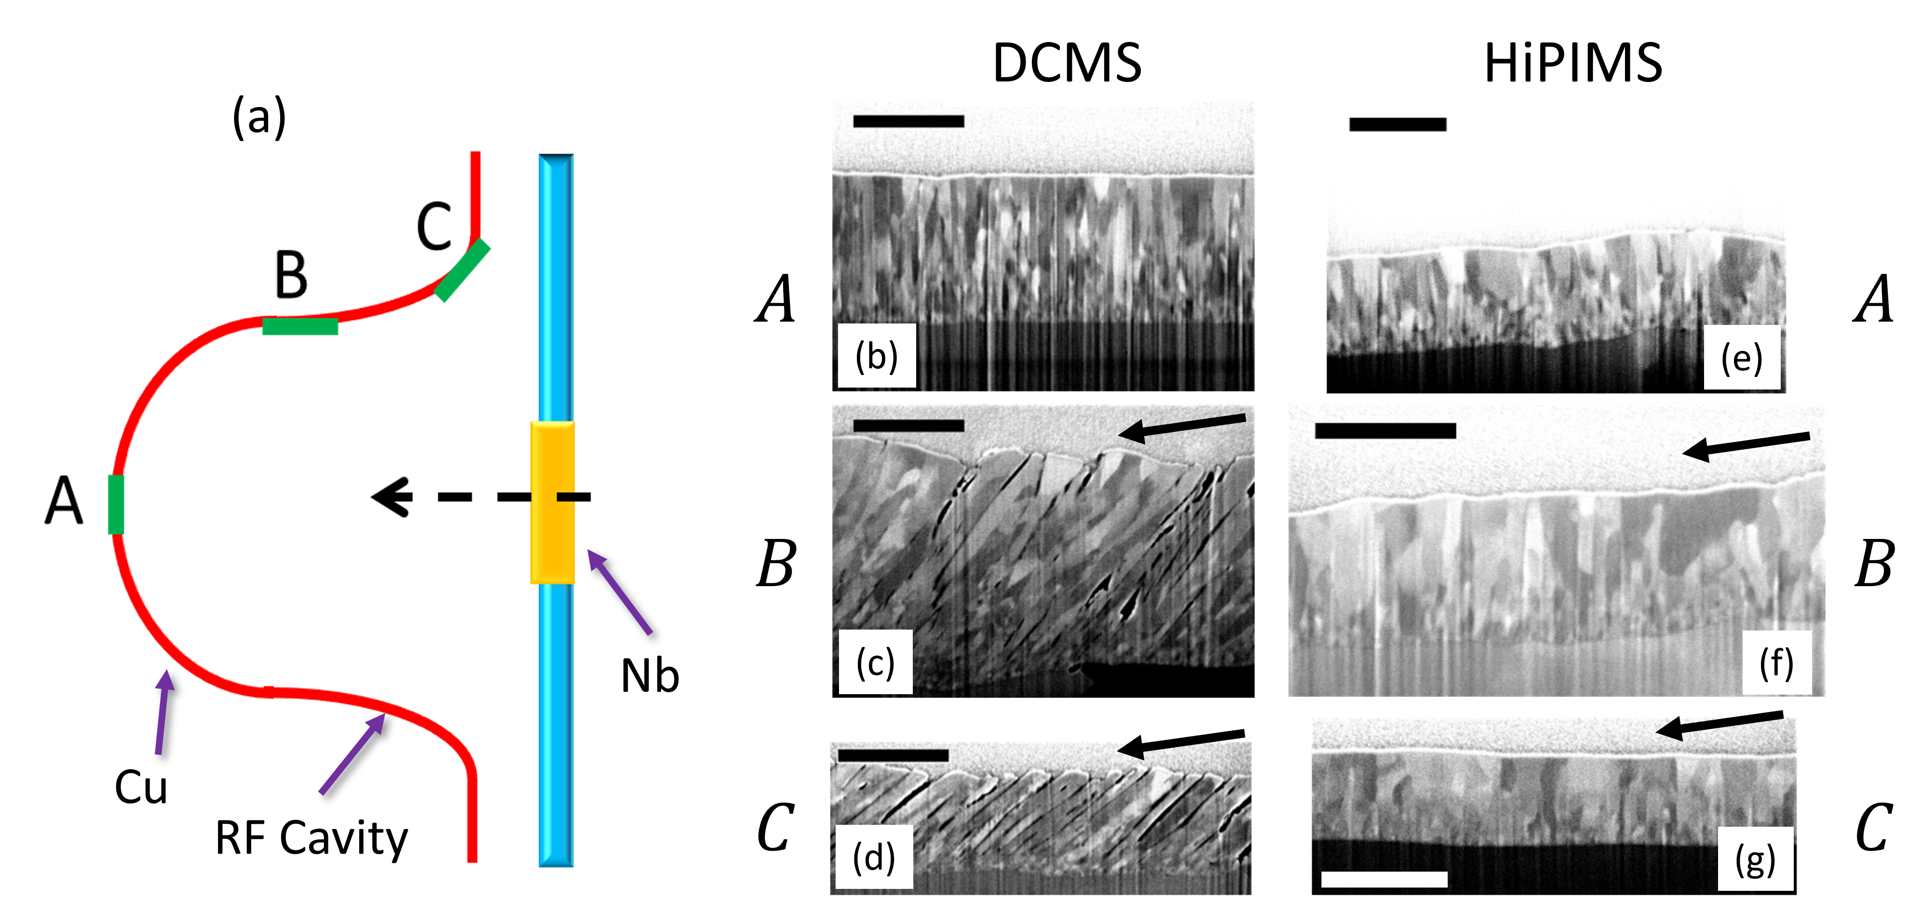
Experimental deposition
Schematic illustration of the deposition geometry and SEM images of film quality
Deposition Parameter | DCMS | HiPIMS
Voltage (V) | 375 | 590
Current (A) | 3.47 (time-averaged) | 344 (peak)
Pulsing Frequency (Hz) | - | 100
Pulse Width (μs) | - | 200
Pressure (Pa) | 0.23 | 0.23
Deposition time (h) | 1 | 1.5
Substrate bias potential (V) | 0 | -75
SEM analysis on three different areas:
Area A: At the equatorial position of the cavity ➔ vapor flux conditions near-to-normal
Area B: On the flat slope of the cavity ➔ oblique-angle incidence
Area C: At the iris position ➔ oblique-angle incidence

Slide 8
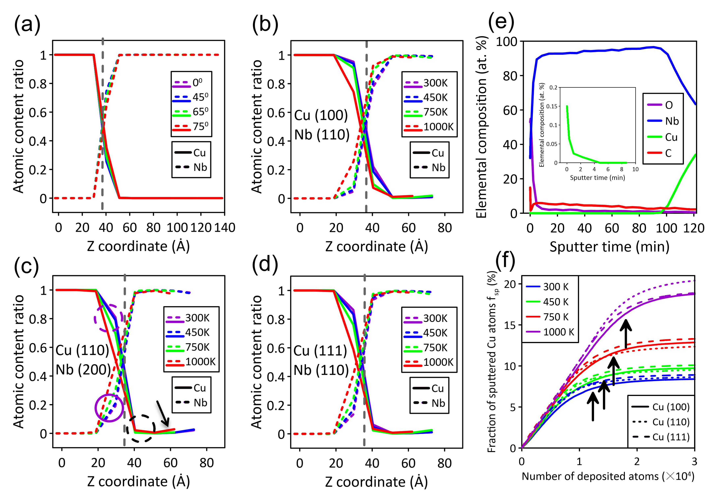
Simulation results: atomic mixing in Nb/Cu interface & Sputtered Cu
DCMS
HiPIMS
XPS
Intermixing layer for both methods is only ∼2 nm
In HiPIMS, the deeper interface location into the Cu substrate due to the energetic impacts of Nb ions at the surface
Amount of Cu changes with temperature for Cu(100) and (111) in the Nb side, while not changing for Cu(110), the black dashed circle
HiPIMS
HiPIMS
HiPIMS
The fraction of sputtered atoms saturates at 1000 K, more than double the rate at room temperature.
Cu erosion persists on (110) film surfaces but plateaus at 1000 K on other surfaces.

Slide 9

FCC Week 2026
Next FCC Week in 2026 (expected number of participants 500-600) is planned to be organized in University of Helsinki to attract high energy and accelerator physicists from Scandinavia and Baltic countries

Slide 10
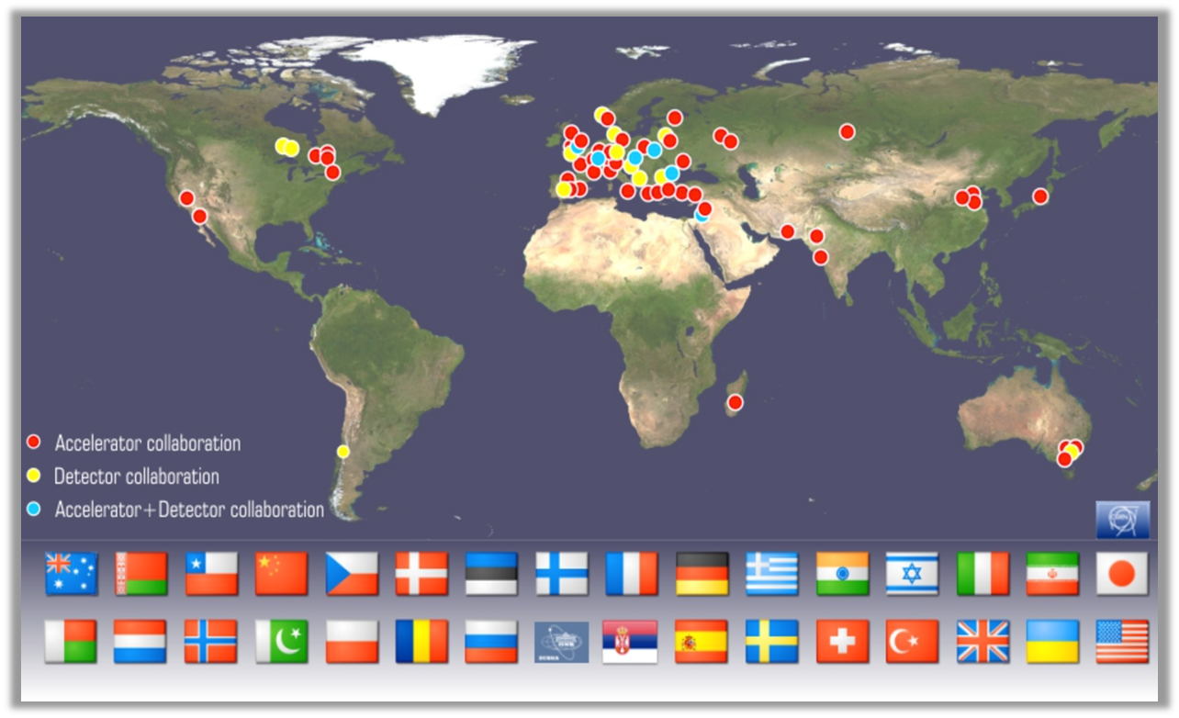
CLIC collaboration
Accelerator collaboration approximately 50 institutes and the detector collaboration about 29.

Slide 11
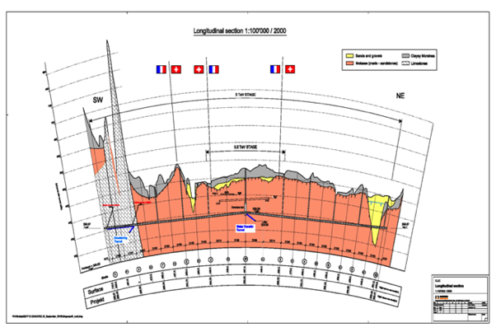
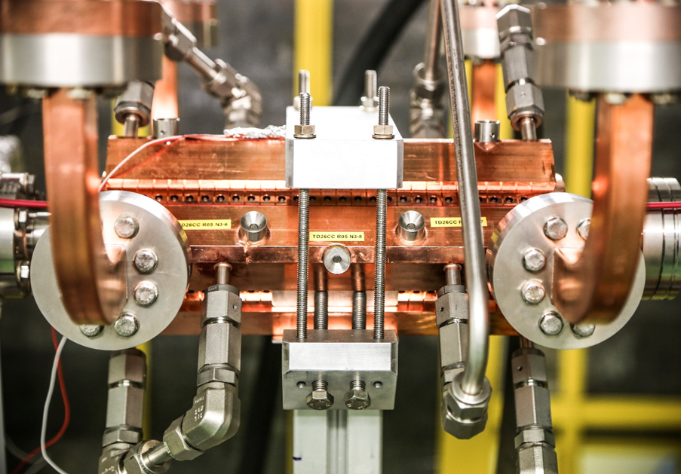
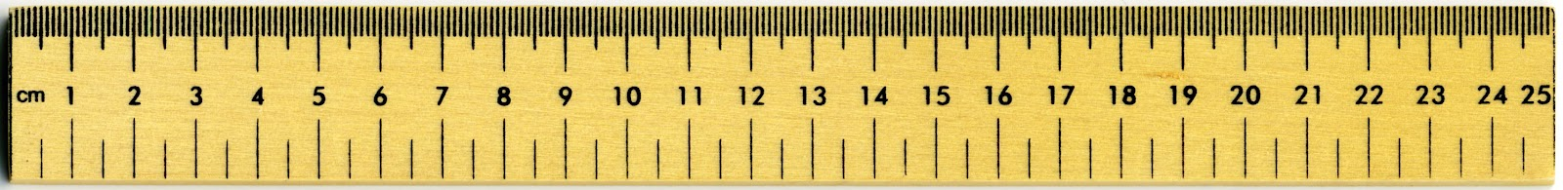
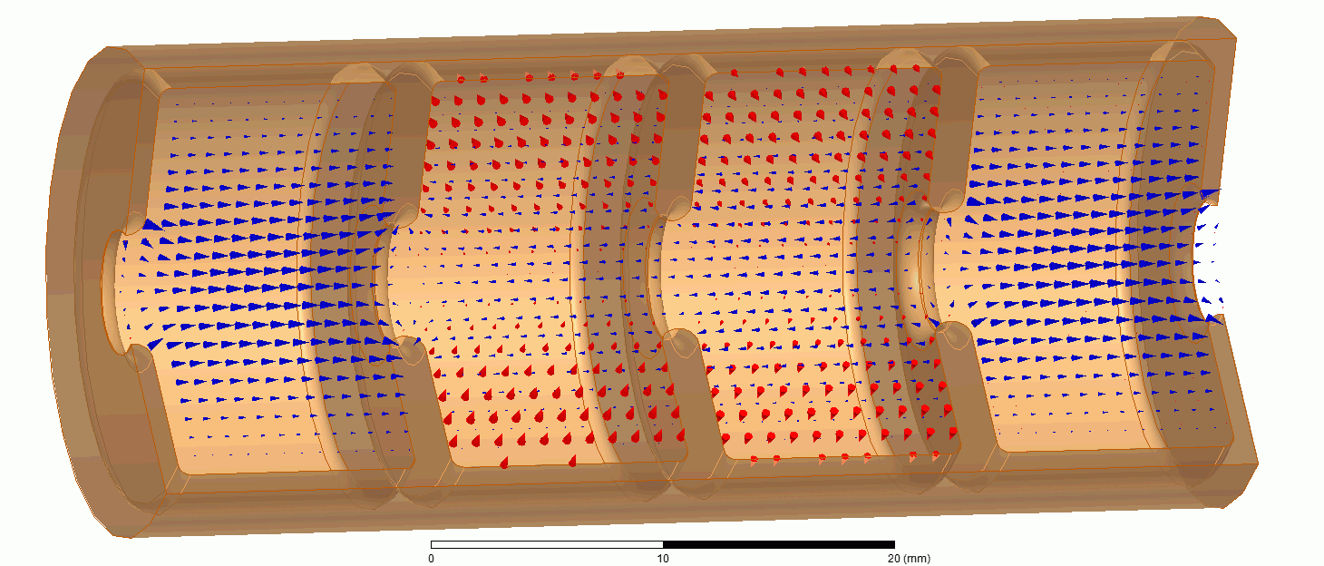
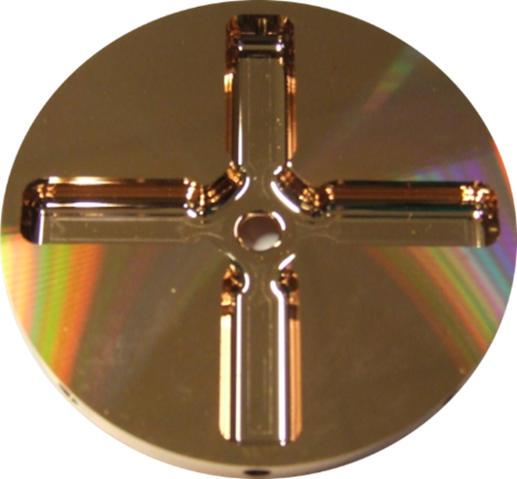
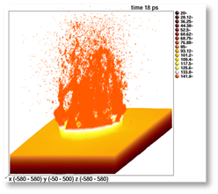
Accelerating structures for linear accelerator
In this project, we focus on accelerating structures:
  11.994 GHz, X-band
  100 MV/m accelerating gradient
  Input power ≈50 MW
  Pulse length ≈200 ns
  Repetition rate 50-400 Hz
Micron–precision disk
beam propagation direction
Walter Wuensch, CERN

Slide 12
Highlight of research: Hybrid atomistic-continuum simulations
Simulated tip shape illustrated by the MD atoms (in the box) and the constant "virtual" atoms (out of the box).
The color coding represents the steady-state temperature dis-
tribution for constant shape. The inset illustrates the atom
charges q_{i} by the color coding and, the corresponding forces
by the black-line arrows.

Slide 13
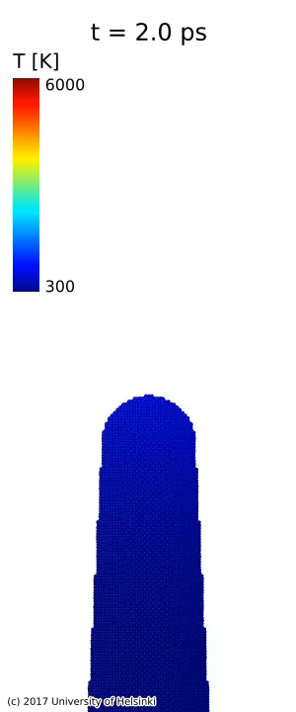
Full dynamics of 90 nm tall nanotip with F₀=0.8 GV/m
  [A. Kyritsakis et. al, J. Phys. D: Appl. Phys. 51, 225203 (2018)]
The current understanding of the phenomenon is described in the invited review submitted to Reviews of Modern Physics: W. Wuensch, S. Calatroni, F. Djurabekova, Y. Ashkenazy, A. Kyritsakis, Fundamental mechanisms of vacuum arcing initiation.

Slide 14
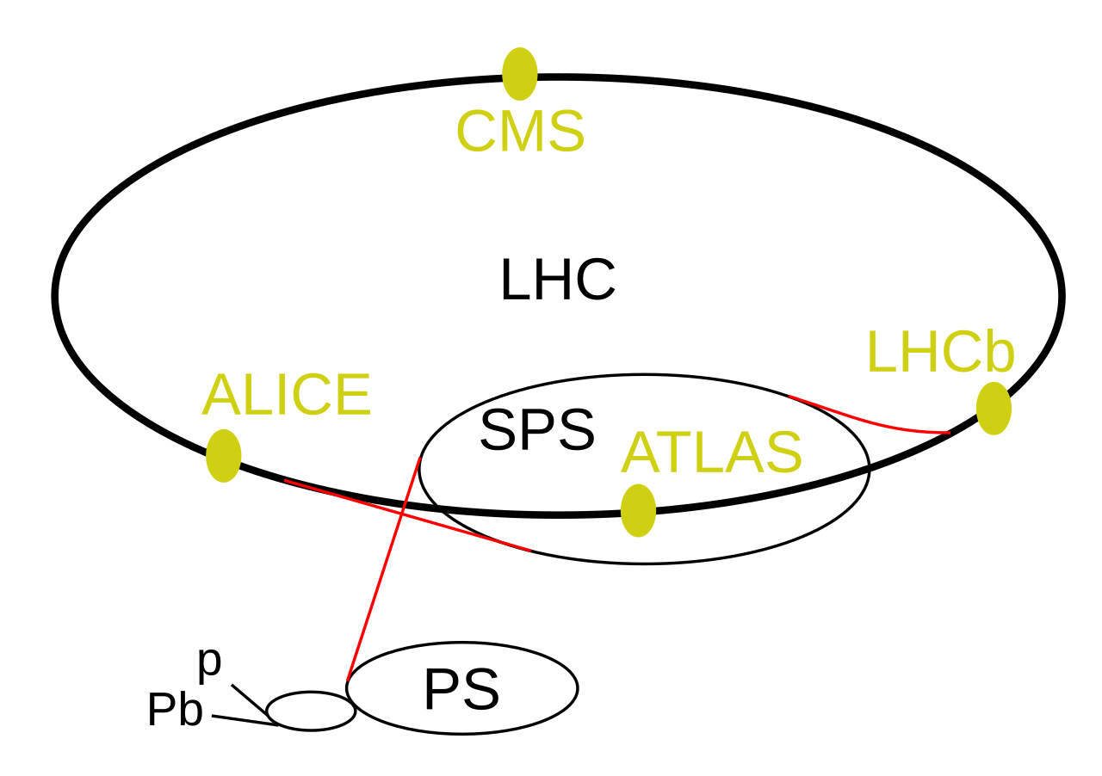
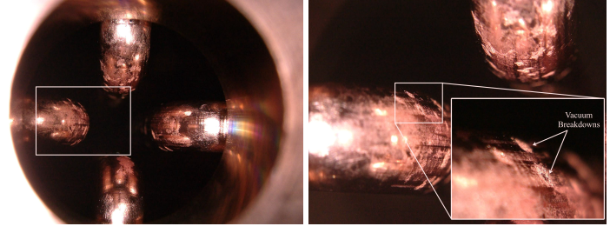
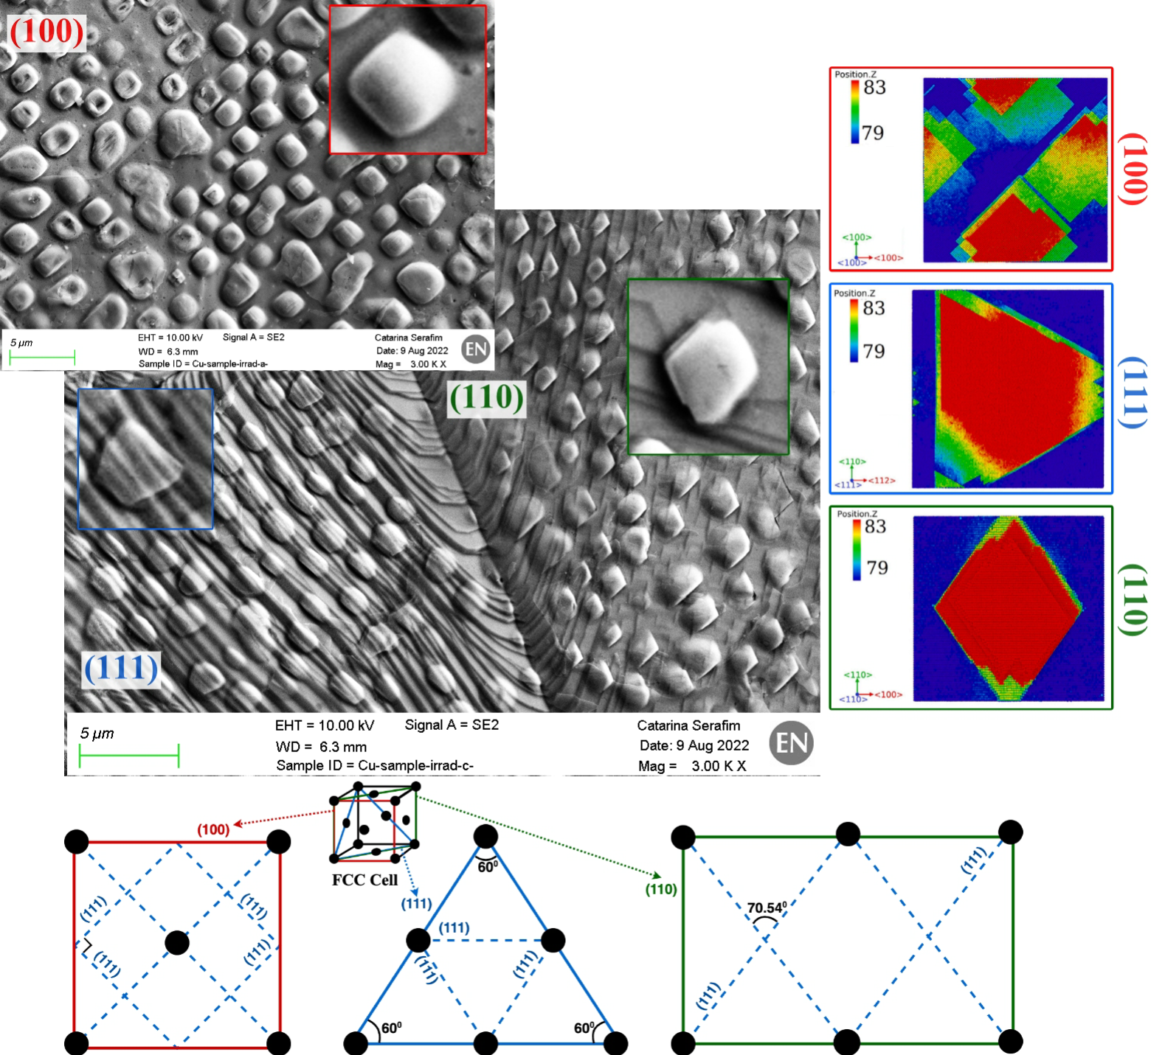
Contribution to LHC
The fundamental component of linear accelerating structures is the Radio-Frequency-Quadrupole (RFQ) which allows for high ions intensities in a very compact structure.
The frequent breakdowns within the structure were connected to bubbles
We explained the formation of the bubbles but also determined that they are harmless, but the responsibility for the breakdowns lies with carbon contamination
Endoscope optical images taken on the front of the LINAC4 RFQ interior vanes, at CERN.

Slide 15
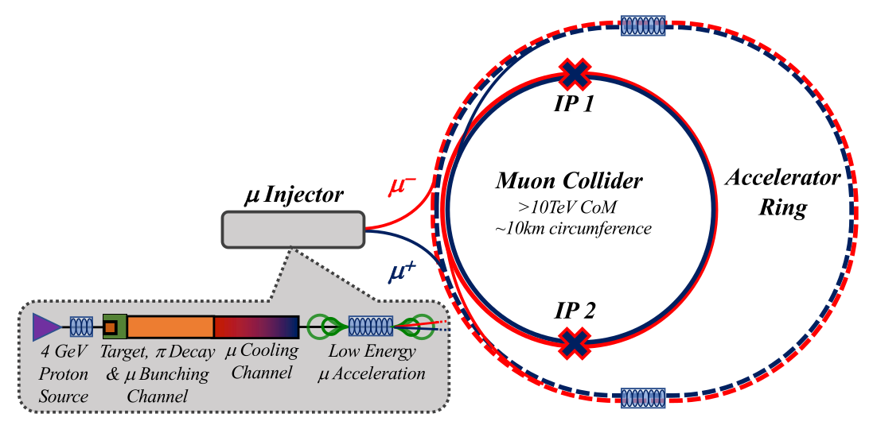
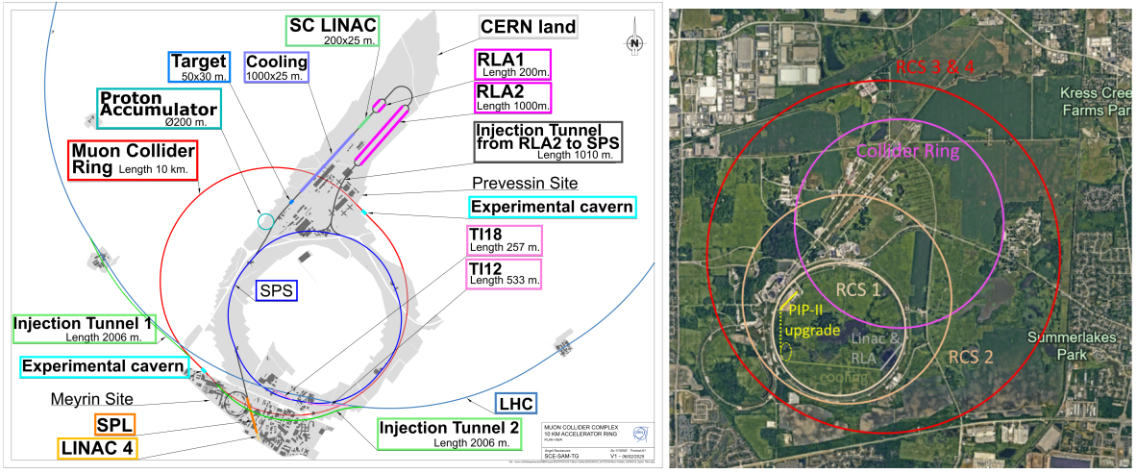
International Muon Collider
Collaboration (IMCC)
[1]
New Muon Collider to replace the Large Hadron Collider
5 GeV multiple MW high energy proton beam generates the muons
Target area is separated from the accelerator vacuum by a proton beam window
The beam window is under heavy irradiation by highly energetic proton beam
[2]
[1] Notari, Lorenzo, et al. "Materials adopted for particle beam windows in relevant experimental facilities." Physical Review Accelerators and Beams 27.2 (2024): 024801.
[2] Accettura, C., et al. "Interim report for the international muon collider collaboration (IMCC)." arXiv preprint arXiv:2407.12450 (2024).

Slide 16
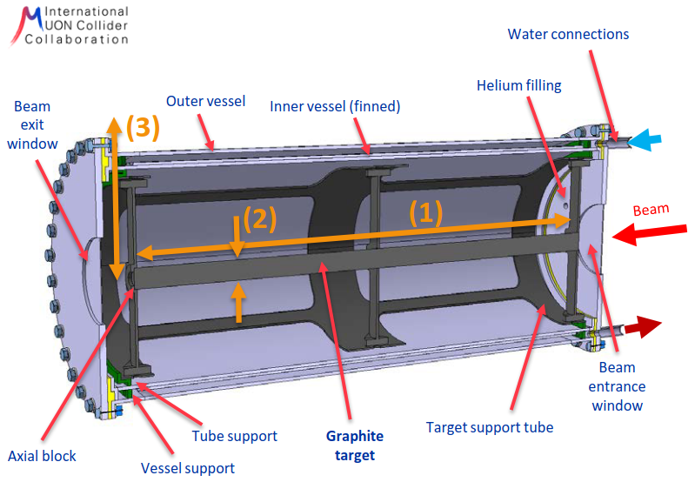
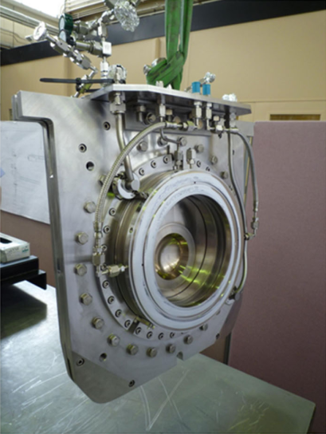
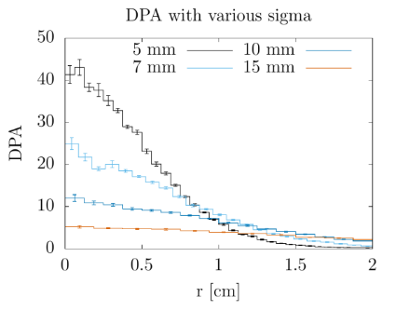
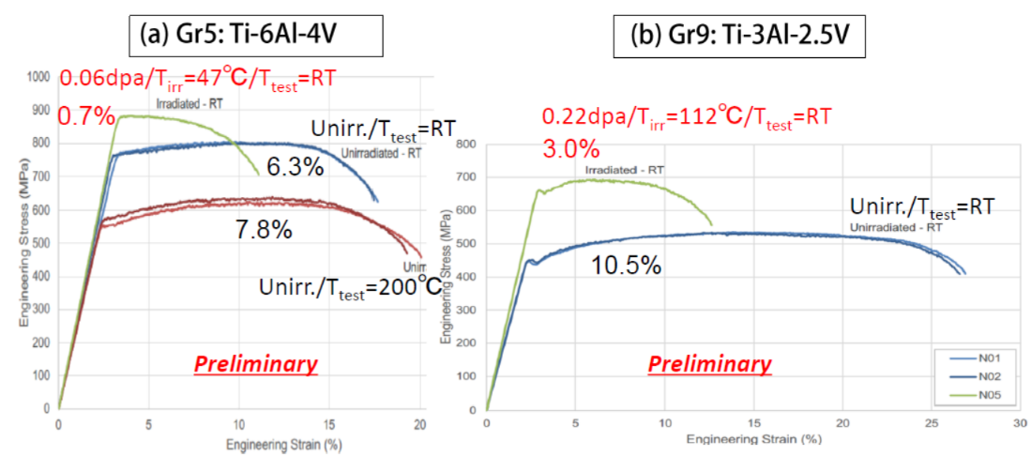
Radiation effect in beam windows and shielding materials
The high-energy proton beam causes significant stress on the proton beam window
Requirements: transparent, thermomechanical stress, pressure loads, leak tight
These properties depend on the nanostructure and our knowledge should be enhanced
Current preferred window material is beryllium
Example of a beam window at J-PARC neutrino facility in Japan [4]
Target region [3]
[3]
[3] Lechner, Anton, et al. “Report from IMCC WG* on Beam-matter interactions / target systems.” slides (2023)
[4] Notari, Lorenzo, et al. "Materials adopted for particle beam windows in relevant experimental facilities." Physical Review Accelerators and Beams 27.2 (2024): 024801.
[5] Ishida, Taku, et al. "Radiation damage studies on titanium alloys as high intensity proton accelerator beam window materials." Proceedings of the 14th International Workshop on Spallation Materials Technology. 2020.
[5]

Slide 17
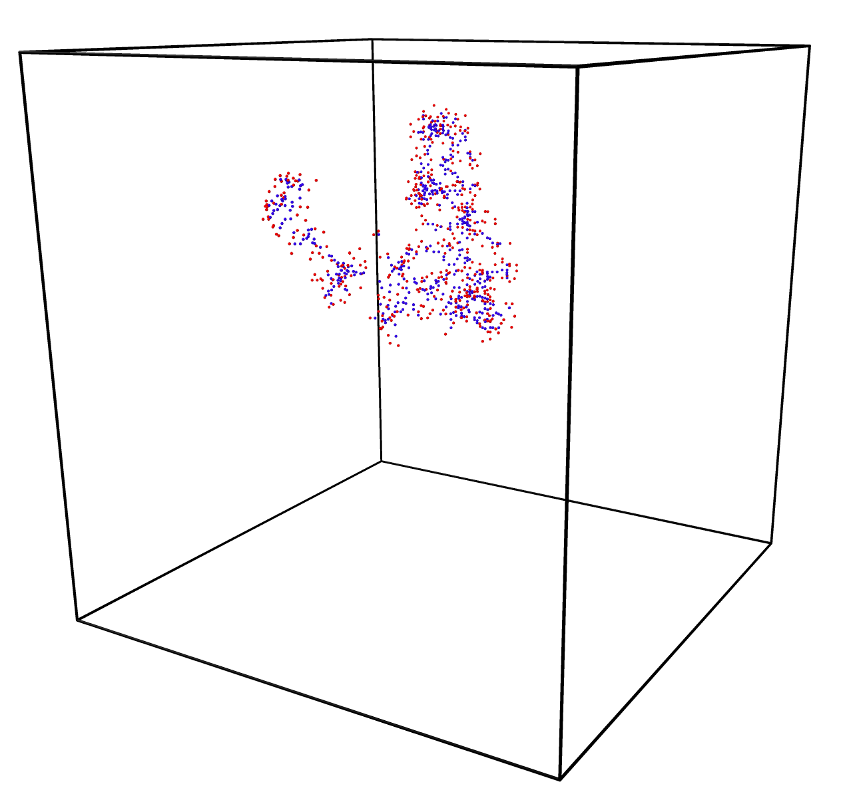
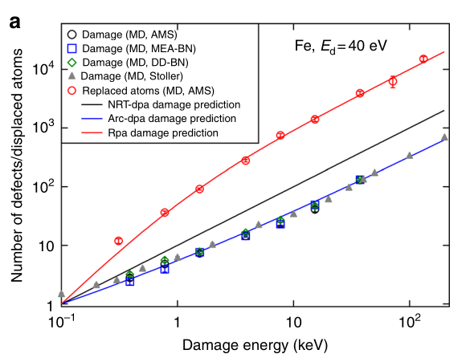
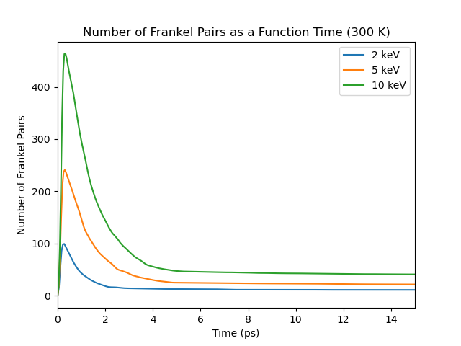
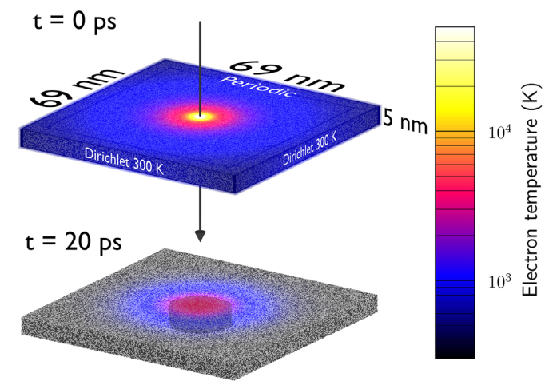
Simulation approach
Molecular dynamics allows us to see how damage is formed during irradiation events
Kinetic Monte Carlo shows the long-time evolution of the damage
Two-temperature molecular dynamics reveals the heating caused by swiftly moving ions
[6]
[7]
[6] Nordlund, Kai, et al. "Improving atomic displacement and replacement calculations with physically realistic damage models." Nature communications 9.1 (2018): 1084.
[7] Leino, Aleksi A., et al. "GeV ion irradiation of NiFe and NiCo: Insights from MD simulations and experiments." Acta Materialia 151 (2018): 191-200.

Slide 18
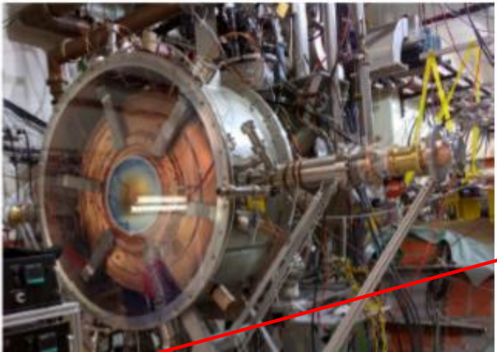
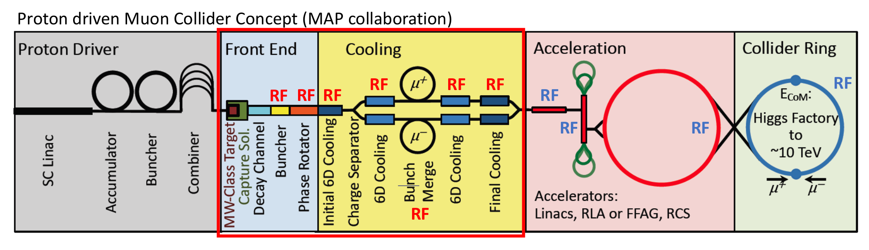
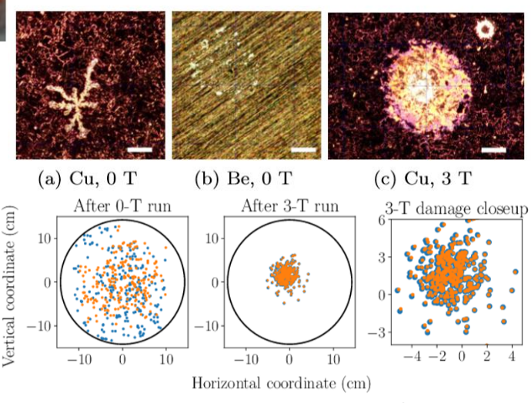
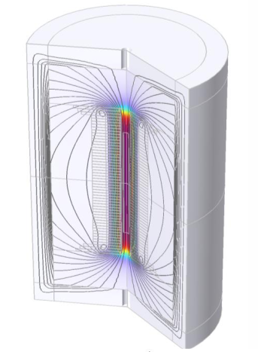
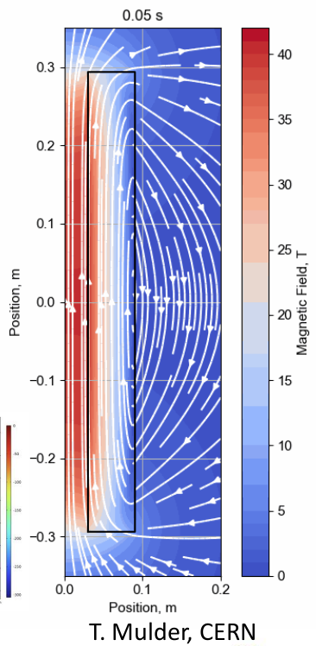
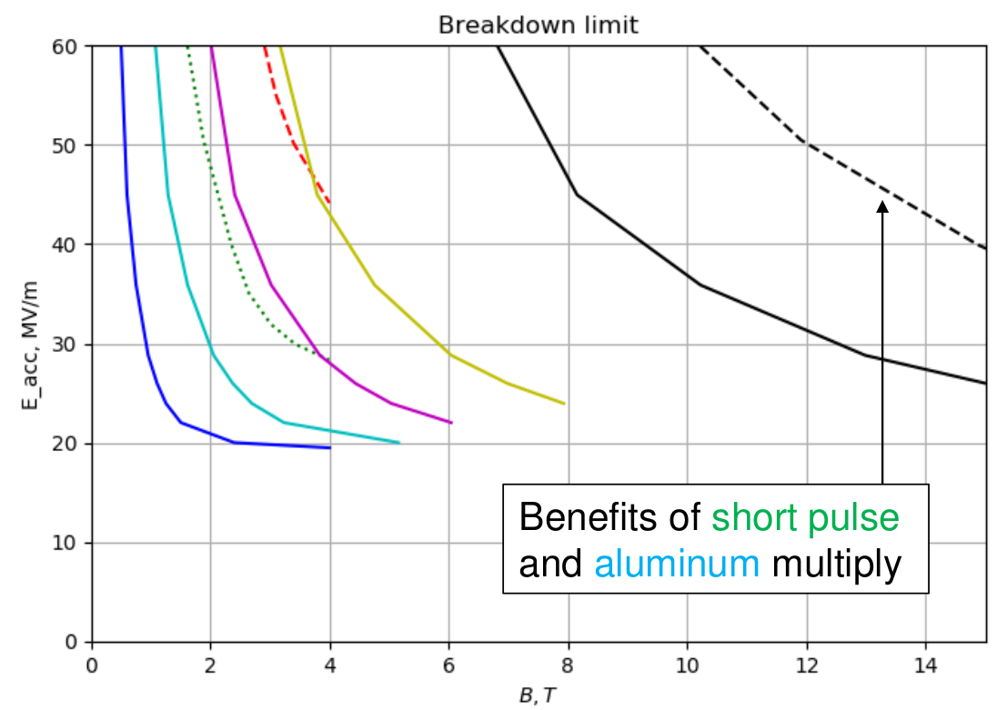
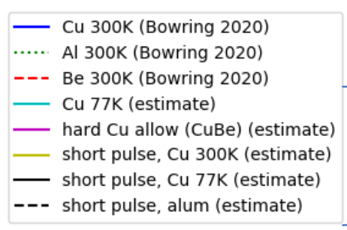
RF structures for Muon Collider – link to CLIC project
High Gradient
High magnetic field (>40 T)
High radiation
RF cavities for muon cooling
Muon accelerators require tightly focused, alternating sections of deceleration and acceleration immersed in strong solenoidal fields
In these cooling channels, the benefits of beam cooling must outweigh heating, but added magnetic fields also tend to lower breakdown thresholds
Needs for
testing in high B field!
[Courtesy of Dr. Alexej Grudiev]

Slide 19
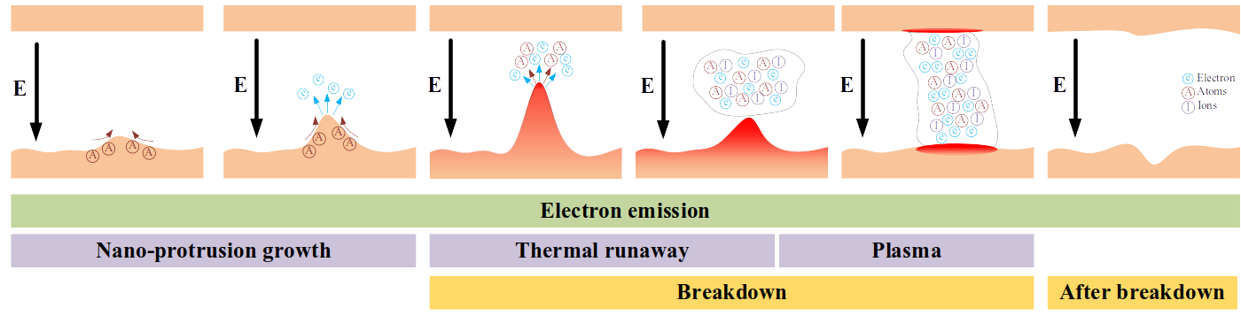

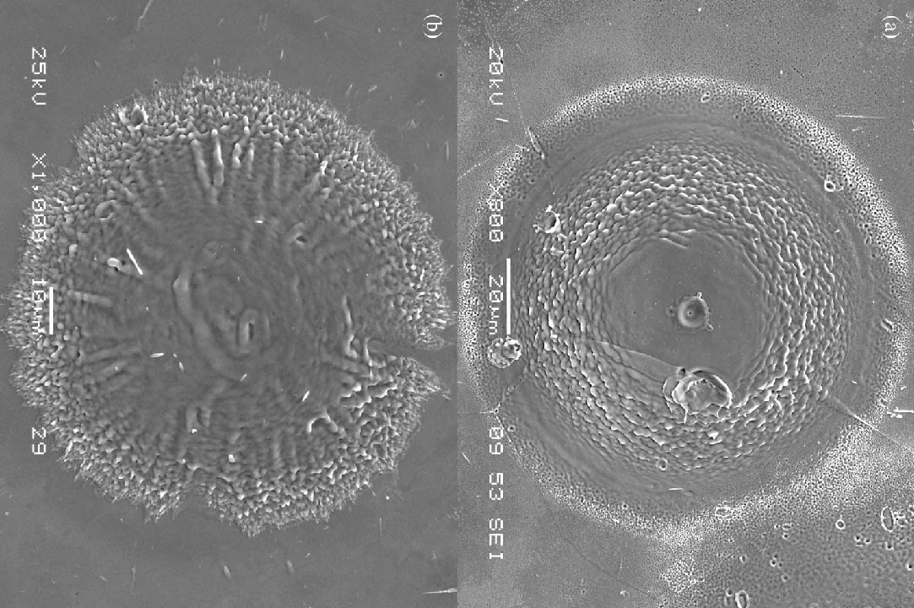
Vacuum Arcs and Accelerators
Knowledge transferred from CLIC project: The model of a vacuum arc as an electrical discharge in a vacuum
*
Whether driven by direct current (DC) or radio-frequency (RF) fields—involves complex interactions between electrode surfaces, emitted plasmas, and external magnetic fields
Vacuum arcs cause the problems for accelerators:
Damage of the accelerator's components
Beam losses
The Role of Magnetic Fields:
**
In magnetic fields, RF cavities experience a greater likelihood of breakdown per pulse—even at lower field gradients—than they do when operated without any magnetic field.
* [Y. Li et al., Phys. Plasmas 31 040502 (2024)]
** [C. H. Castano Giraldo et al., IEEE Trans. Plasma Sci. 40 1217–1222 (2012)]

Slide 20
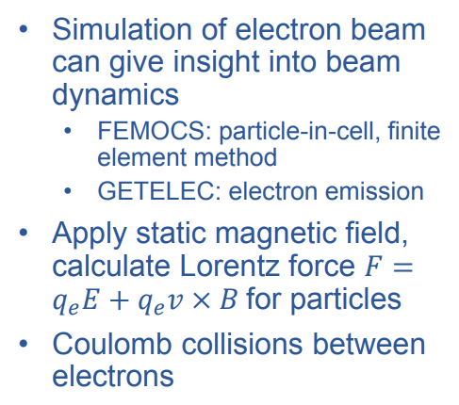
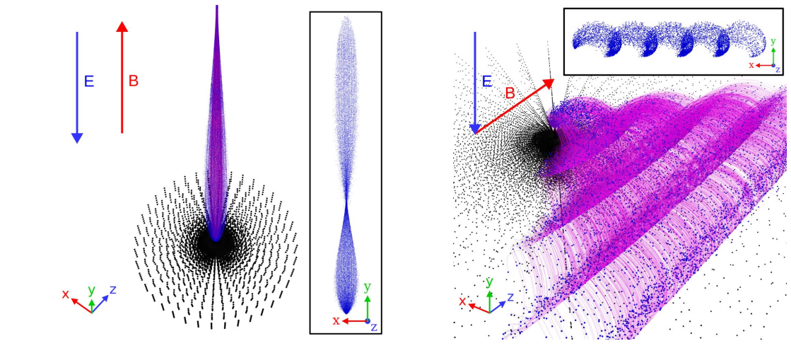
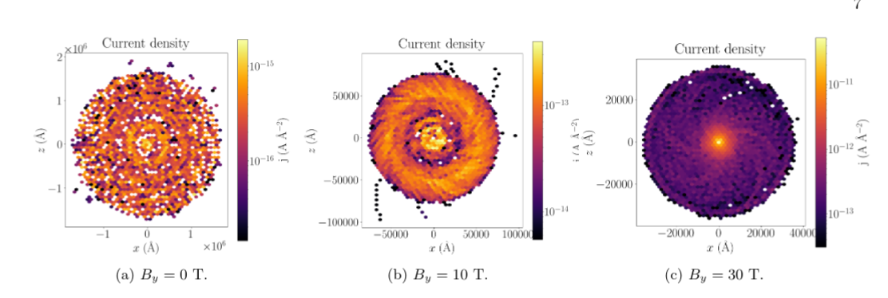
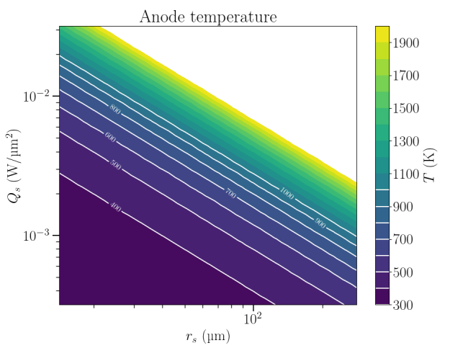
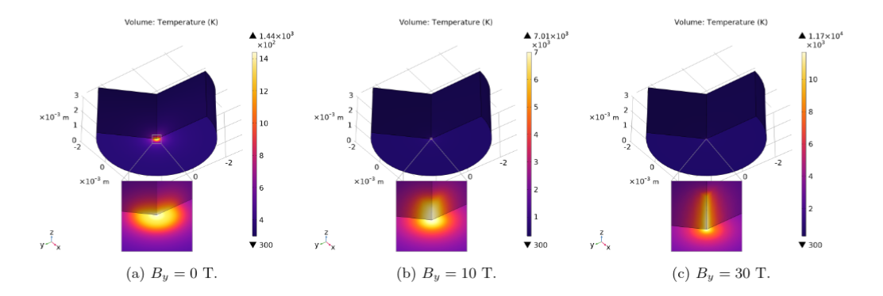
Simulation of Vacuum Arcs
Different materials
(Cu, Be, Al...)
Temperatures
Electric field
Magnetic field direction and strength
Morphological changes of surface?(with MD)
Possible to capture:
[R. Koitermaa et al., manuscript under review, 2025]

Slide 21
Thank you for your attention!

