Slide 1



Superconducting accelerator magnets at
Tampere University
Tiina Salmi, Academy Research Fellow
RECFA visit, Helsinki, May 2025

Slide 2
Outline
Mini CV
Magnets for accelerators: Research at TAU since 2020
Statistics: People, funding, publications
Summary and future prospects

Slide 3
Mini CV (personal research history)
D. Sc. Electrical Engineering, TAU, 2015. Title of Docent in Applied superconductivity, TAU 2022.
2020 – present, Academy Research Fellow, TAU
2015 –2020: Postdoctoral researcher TAU: Integrating quench protection analysis into the design of 16 T Nb₃Sn dipoles designed for the Future Circular Collider (FCC). The methods and tools are still in use. Included a 6-month research stay at CERN. (Academy of Finland Postdoc funding for 3 years)
2013 –2015 PhD student, TAU: Quench protection for Nb₃Sn (low-temperature superconductor) and ReBCO (high-temperature superconductor) based accelerator magnets.
2010 –2013, Research scholar at LBNL, Berkeley, USA: Quench protection for the high-field Nb₃Sn accelerator magnets for the LHC luminosity upgrade. The designed heaters formed the basis for the MQXF heaters for HiLumi magnets. Heater modeling method still in use.
2009 Technical Student at CERN: Quench analysis and protection design for a fast cycled NbTi accelerator magnet. 2008, Summer Student at CERN: Calibration of ALICE silicon pixel detector, internal website design.
Research funding and grants: Since 2015 obtained or managed over 2 530 000 € external funding from Academy of Finland, Business Finland, CERN, or EU H2020
Publications: About 75 peer-reviewed publications, one book chapter

Slide 4
Magnets for accelerators, research at TAU since 2020
FEM modeling methods for HTS magnet design
Protection analyses for the 1-m long Nb3Sn demonstrators for FCC
Analytical protection analyses for the Muon collider dipoles and quadrupoles (LTS and HTS)
Laboratory upgrade and small scale HTS experiments
Exploration of using AI-based surrogate models and design optimization

Slide 5
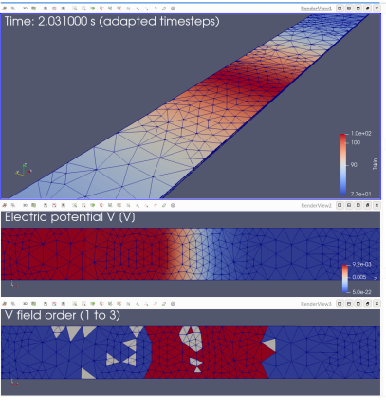
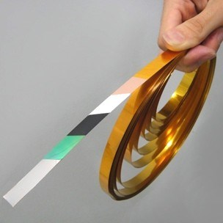
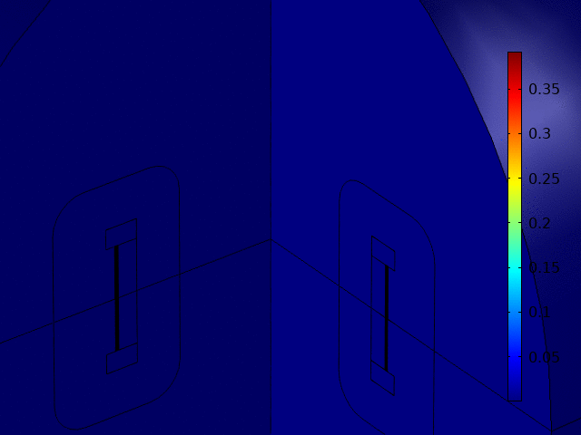
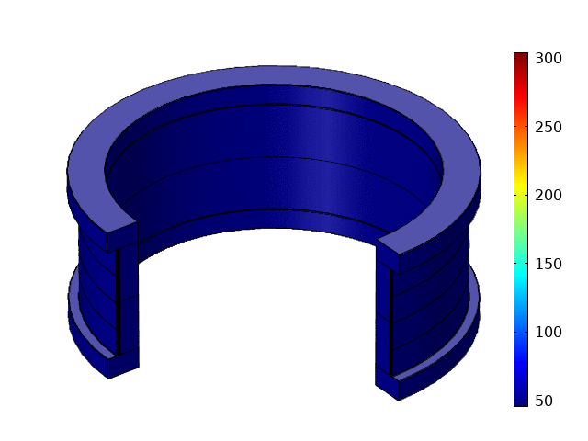
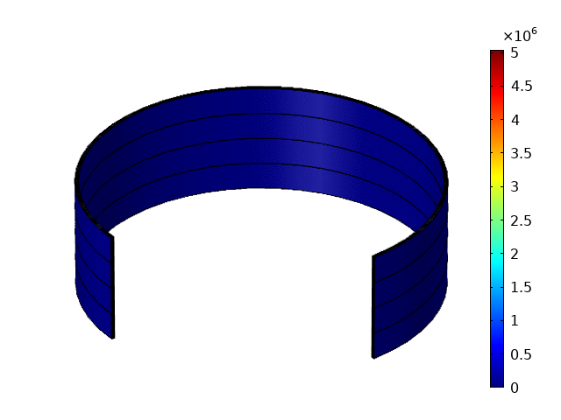
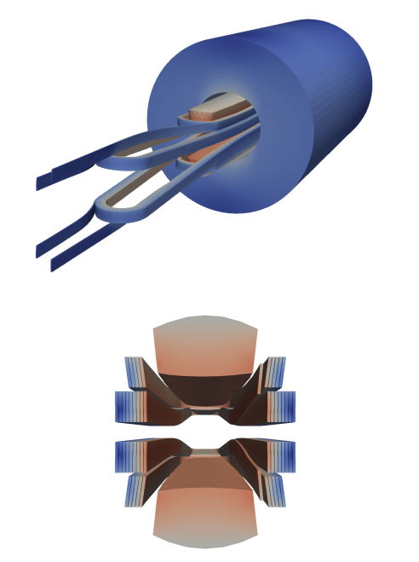
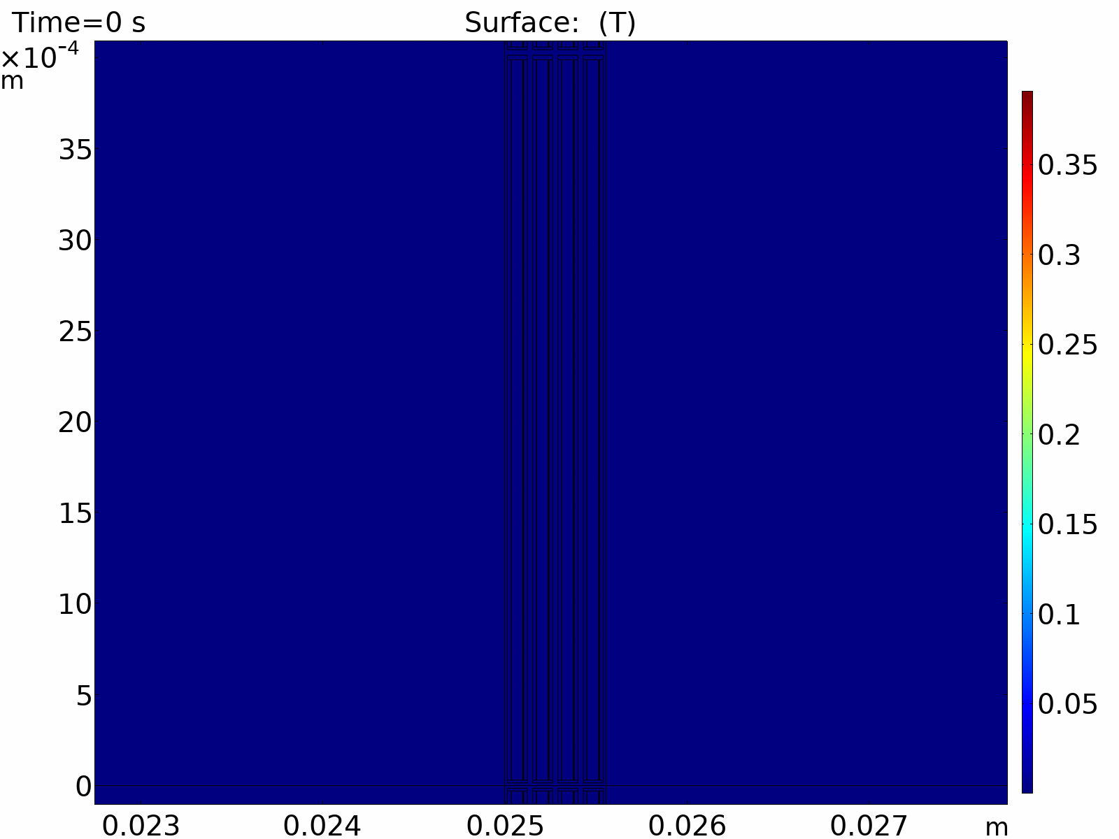
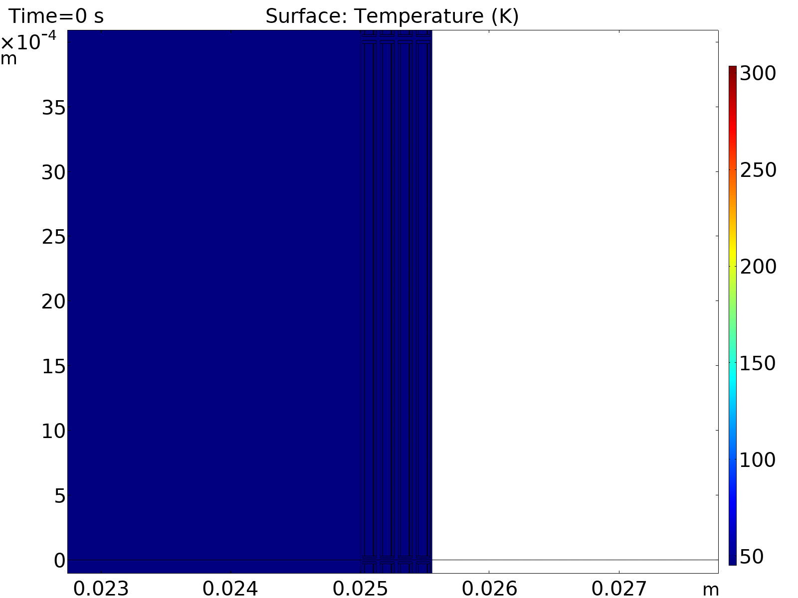
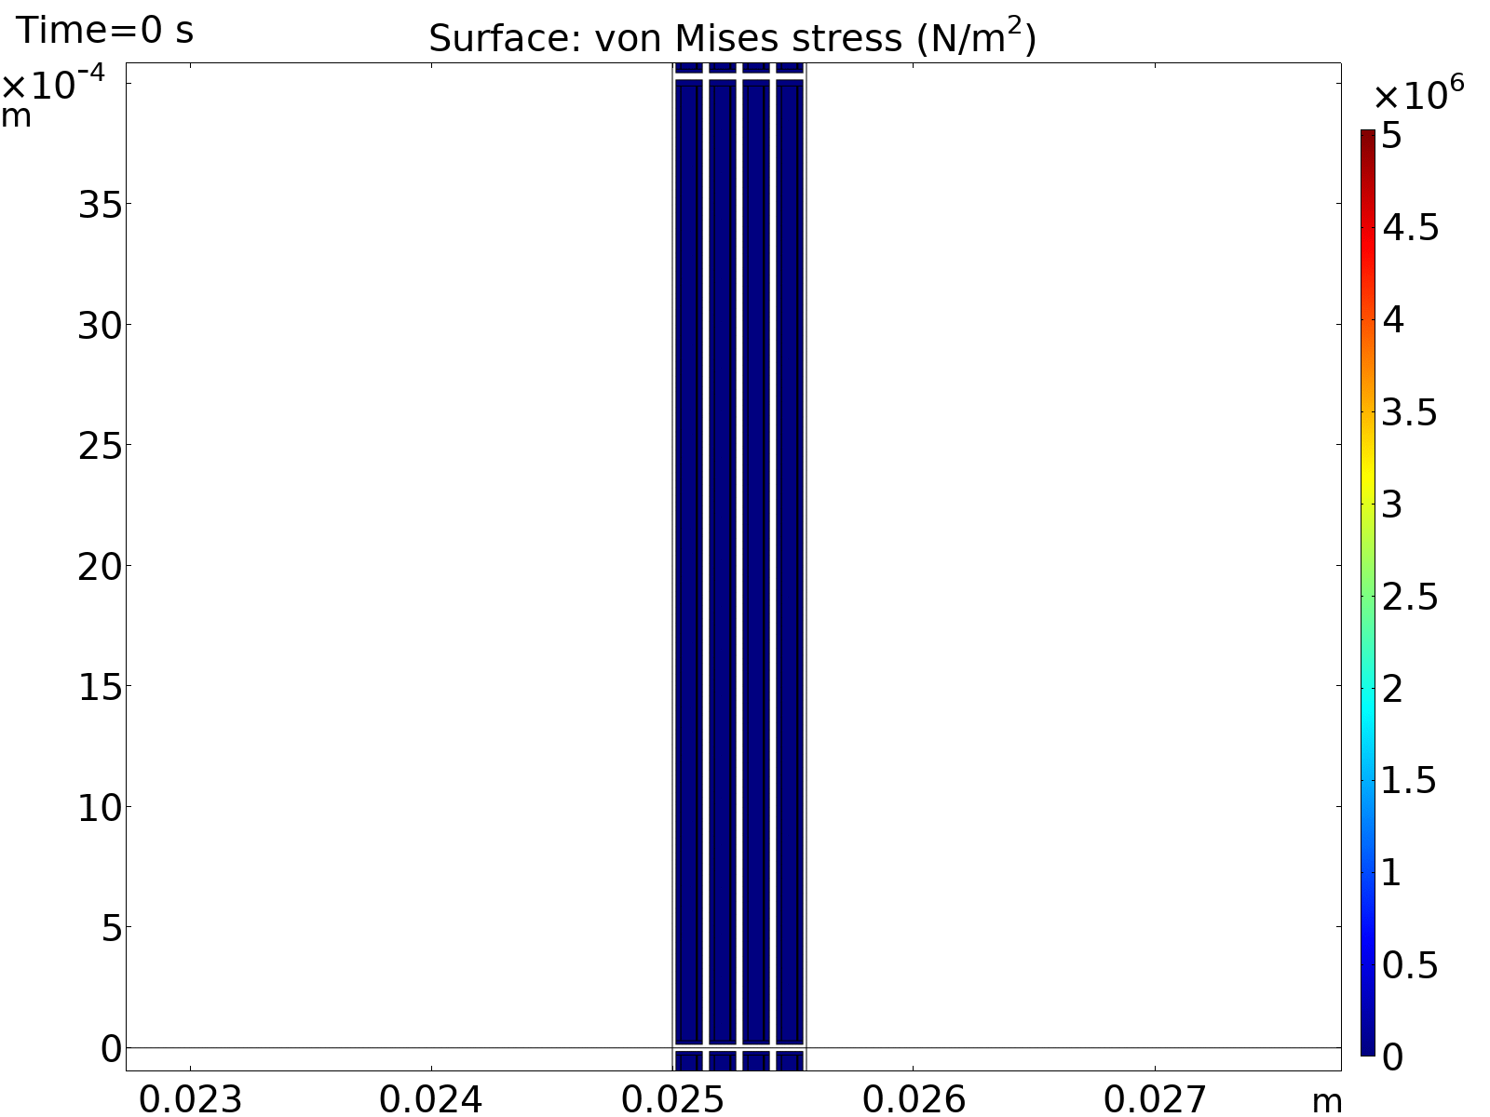
FEM modeling methods for HTS magnet design
HTS (ReBCO) magnet modeling challenging due to non-linear material properties, thin material layers with large aspect ratio, often requires 3D geometry
Electromagnetic, thermal and mechanical models developed
Used e.g. for CERN Feather-2 dipole demonstrator magnet electromagnetic and quench simulations
Electro-Magnetic
Quench
Mechanical
Fujikura ReBCO tape, demonstration of hp-adaptive FEM and CERN Feather-2 electromagnetic simulation (A. Halbach, now at Quanscient, www.Sparselizard.org and https://quanscient.com/ )
Example of coupled multiphysics simulation for HTS solenoid (D. Sotnikov, now at PSI))

Slide 6
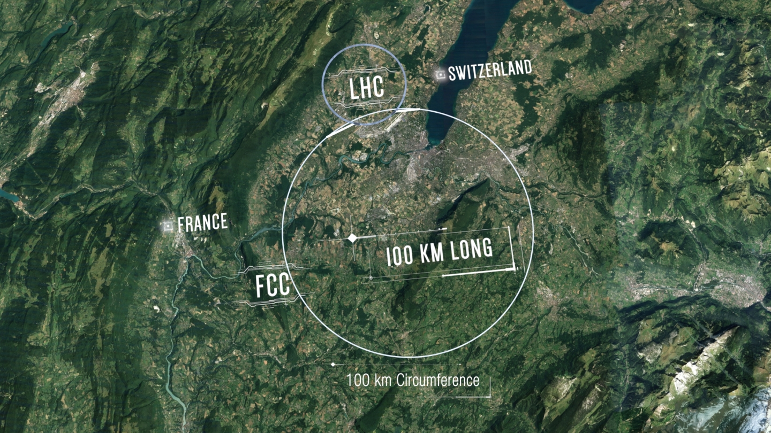
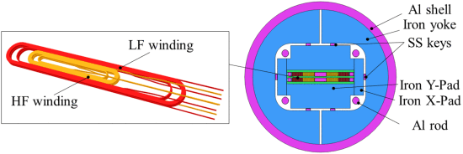
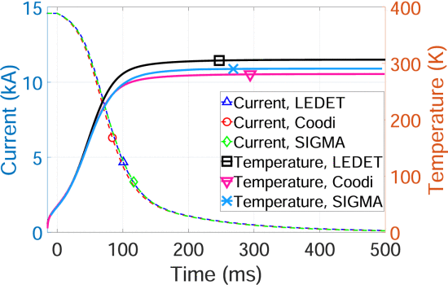
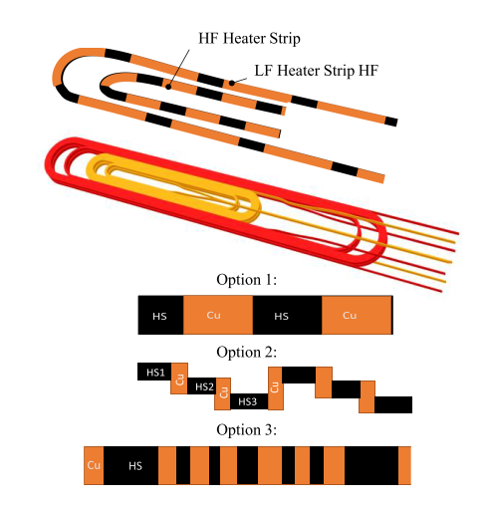
Protection analyses for the 1-m long Nb₃Sn demonstrators for FCC
FCC conceptual design 2015-2020 based on 16 T Nb3Sn dipoles
1-m long 14 T demonstrators to be built at CEA, INFN and CIEMAT
TAU contribution to CEA demonstrator R2D2: Analysis of protection options, improving the quench heater modeling method and making it openly available
Protection options: Quench heaters or CLIQ
  After quench the magnet energy transforms to heat via resistive heating in the quenched cable
  Goal is heat the entire coil after quench so that the stored energy dissipates unifromly
  Heaters are stainless steel strips on coil surface, CLIQ is based on inducing magnet current oscillations and AC-losses
FCC layout proposal (CERN), R2D2 dipole coil and cross-section (CEA), example current decay and hotspot temperature in R2D2 (D. Liu, now at LUT), protection heater layout examples (T. Salmi)

Slide 7
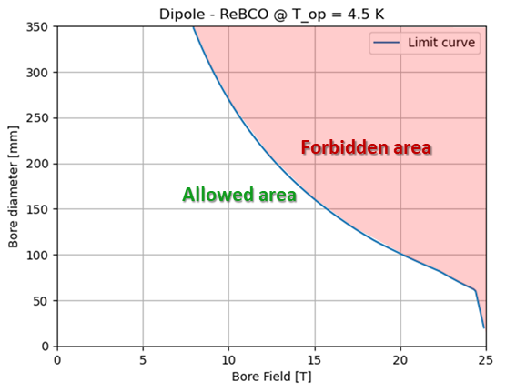
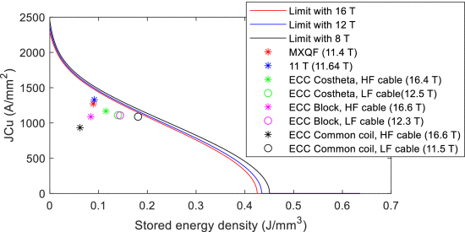
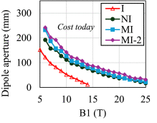
Analytical protection analyses for the Muon collider magnets (LTS and HTS)
Muon Collider design space exploration: Define dipole field, quadrupole gradient and aperture combinations that are not impossible with foreseeable magnet technology
Analytical estiations accounting cost, superconductor Jc limitation, mechanical stress, and protection
TAU contribution: Protection limit and disucssions troughout the process
Allowable design space for ReBCO diples (INFN) and protection limit in insulated, non-insulated, and metal-insulated ReBCO dipoles with today’s conductor cost (T. Salmi)
Protection limit in Nb3Sn magnets and comparison with resent magnets and magnet designs (T. Salmi)

Slide 8
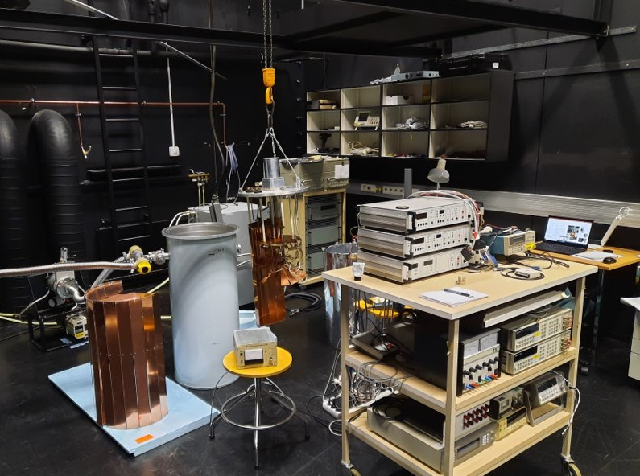
Laboratory upgrade and small scale HTS experiments
Lab revival with BF co-innovation funding (SMARAGDI)
  Conduction cooling for 10 – 50 K
  LN2 testing at 77 K
  (LHe variable temperature cryostat with background field available, but not installed)
Material characterization at low temperatures, e.g. new materials (3D printed metals) and thermal and electric properties required for simulation inputs
Small scale experiments to support modeling, e.g., degradation after different bending scenarios in solenoid winding
Targeted experiments: Ongoing HTS degradation vs. peak quench temperature
Collaboration with companies
TAU Cryolab
Notes:
Material characterization at low temperatures, e.g. new materials (3D printed metals) and thermal and electric properties required for simulation inputs
Small scale experiments to support modeling, e.g., degradation after different bending scenarios in solenoid winding
Targeted experiments: Ongoing HTS degradation vs. peak quench temperature
Collaboration with companies

Slide 9
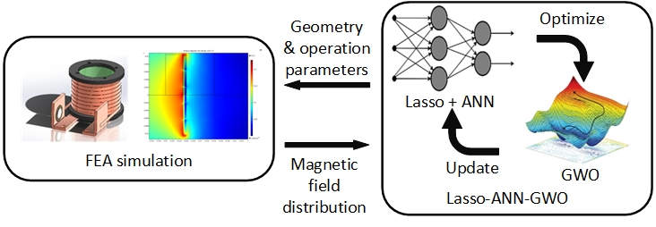
Exploration of using AI-based surrogate models and design optimization
Multiphysics FEM simulations require a lot of time, expertice of model development, and model run time can be long too
Surrogate models are e.g. trained neural networks that predic the output based on input parameters. Training data can be from FEM simulations.
  Faster run time, accessible by ”everybody”, can be integrated with larger modeling schemes
Successful cases with automatized input generation and accurate model development at TAU
  Heater delays modeling
  Initial quench evolution in HTS tape
  Solenoid magnetic field, combined with combined with new design optimization algorithm
Schematic with adaptive surrogate model based design optimization (D. Wu)

Slide 10
Statistics
People for accelerator magnet related projects during 2020-2025:
5 postdocs, 1 PhD student, (1 visiting postdoc), 1(2) MSc students, 1(2)BSc students, 2 researchers, …. + 1 academy research fellow
  Current: PhD student defends the thesis in August, 1 post-doc part time (1 BSc student)
Funding:
  Superconducting magnets beyond 20 T, A.o.F. project, 2019 – 2023, 875 k€
  SMARAGDI - Smart Magnets for Accelerator Research and diaGnostic Data Infrastructures, BF Co-Innovation project, 2020-2022, 1.1 M€
  High-field magnet quench protection, A.o.F. Research Fellow project, 2020-2026, 782 k€
Publications:
  ~30 peer reviewed publications since 2020 (authored or co-authored by T. Salmi)
  2 MSc thesis, 2 BSc thesis, 1 PhD thesis

Slide 11
Summary and future prospects
Our strengths are in quench protection analyses and in different types of modeling
  Aim is to continues developing these and complement with dedicated experiments
  Aim is to keep collaborating with accelerator projects and explore synergies with energy sector.
  Funding application(s) submitted and more in plans
  Interesting synergy in near future via collaboration with the innovative transformer proposal by Prof. Paavo Rasilo (ERC consolidator grant 2025, includes superconductors)
Notes:
Continuity

