Slide 1
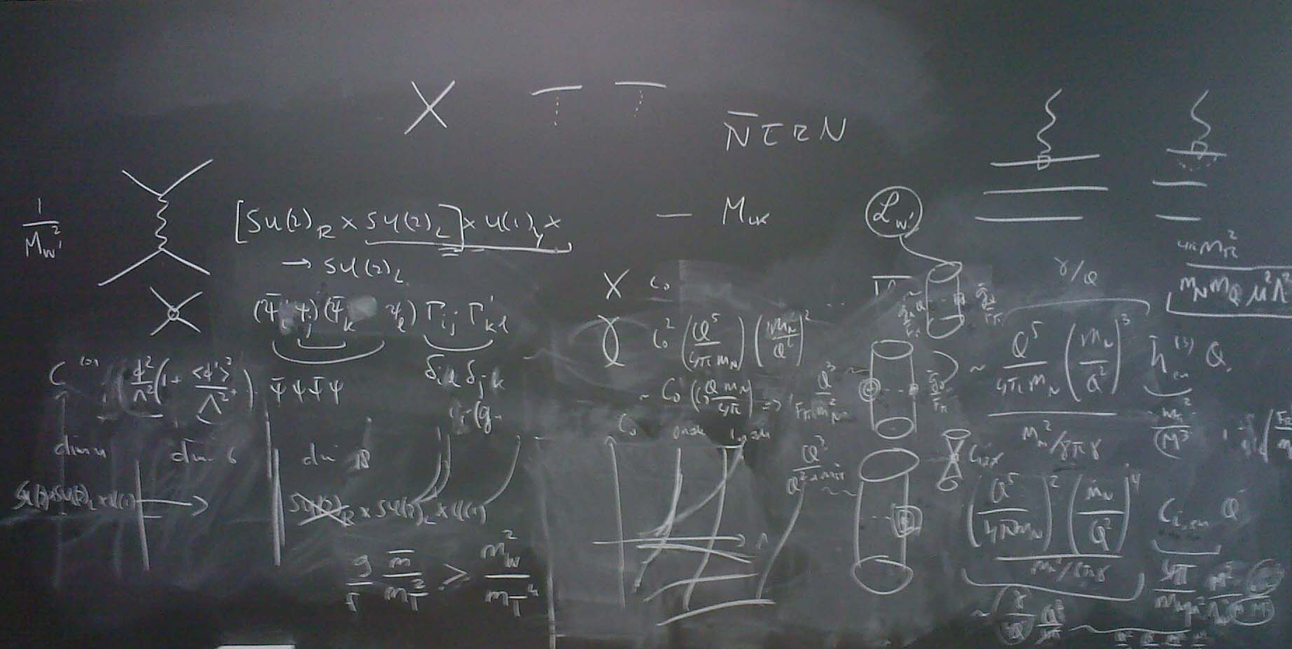

Particle theory in finland: institutes, researchers, and highlight results
Aleksi Vuorinen
Department of Physics, University of Helsinki and Helsinki Institute of Physics

Slide 2
Particle theory in Finland
Particle physics = Physics of fundamental particles and fields, including also string theory, but leaving out early-Universe cosmology (talk by Weir) and nearby fields such as nuclear physics and astrophysics
  Main focus on current research, not teaching
Finland = Research conducted within Finnish universities and research institutes, not necessarily by Finnish nationals
  Many active Finnish theorists abroad – from Bern to MIT, and from PhD students to full professors – but none of them discussed here
Questions to be addressed:
  Where – and by whom – is the research performed?
  What are current focus areas and recent highlight results?

Slide 3
Research locations and groups

Slide 4
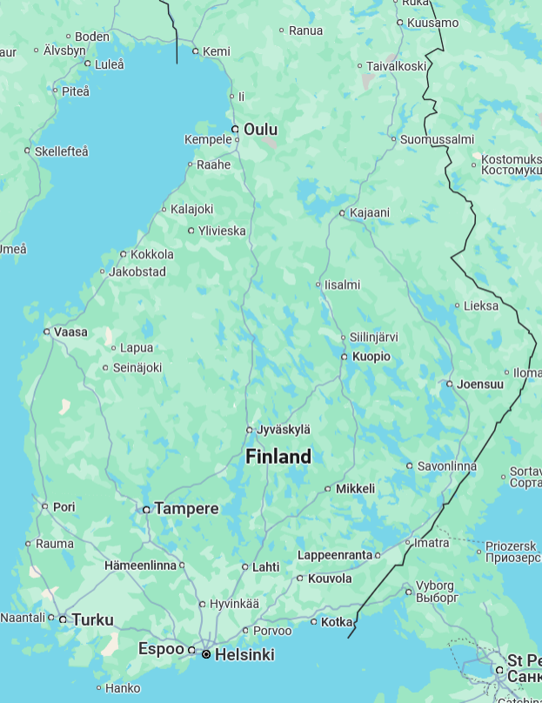
Finland is a small country with only two hubs for particle theory:
Univ. of Helsinki: broad res. portfolio, home of Helsinki Institute of Physics
Jyväskylä: strong groups in 2 fields – heavy ions & cosmology (Weir’s talk)
Phys. departments in 6 more universities, with varying connections to HEP theory:
Theoretical astrophysics in Turku, nucl. theory in Jyväskylä, experimental particle physics in three universities
Strong condensed matter theory groups in Aalto and Tampere

Slide 5
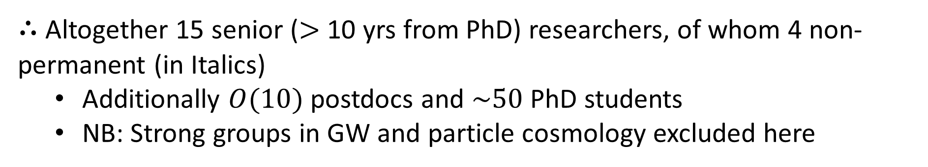
Senior researchers and topics in particle theory
 | BSM pheno (incl. collider & early-Universe physics) | Heavy-ion physics (incl. EIC) | Particle physics of neutron stars | Mathematical physics
Helsinki | Huitu, Lebedev, Tuominen Heikinheimo | Paatelainen | Jokela, Vuorinen Paatelainen | Keski-Vakkuri, Tureanu
Jyväskylä | - | Eskola, Lappi, Mäntysaari, Paukkunen Helenius, Niemi | - | -
$∴$ Altogether 15 senior ($>$ 10 yrs from PhD) researchers, of whom 4 non-permanent (in Italics)
  Additionally $O(10)$ postdocs and $\sim 50$ PhD students
  NB: Strong groups in GW and particle cosmology excluded here

Slide 6
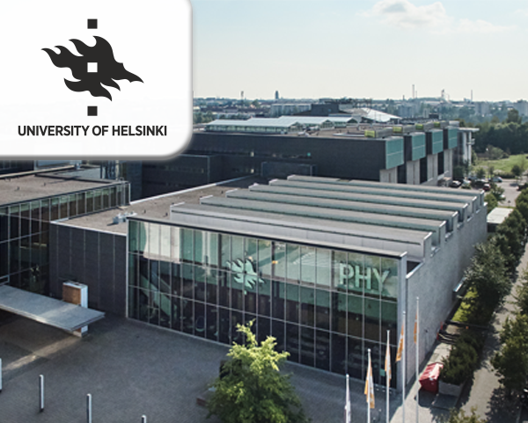
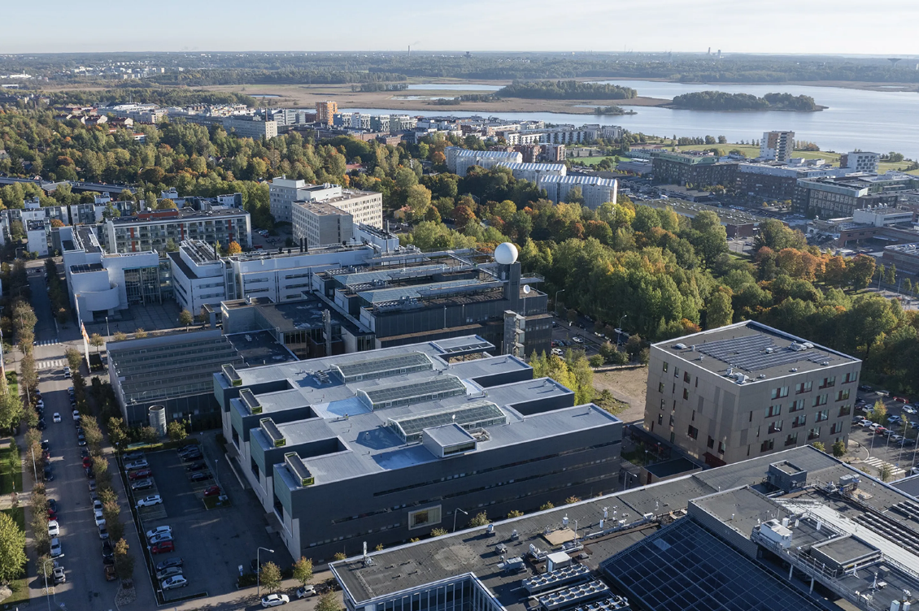
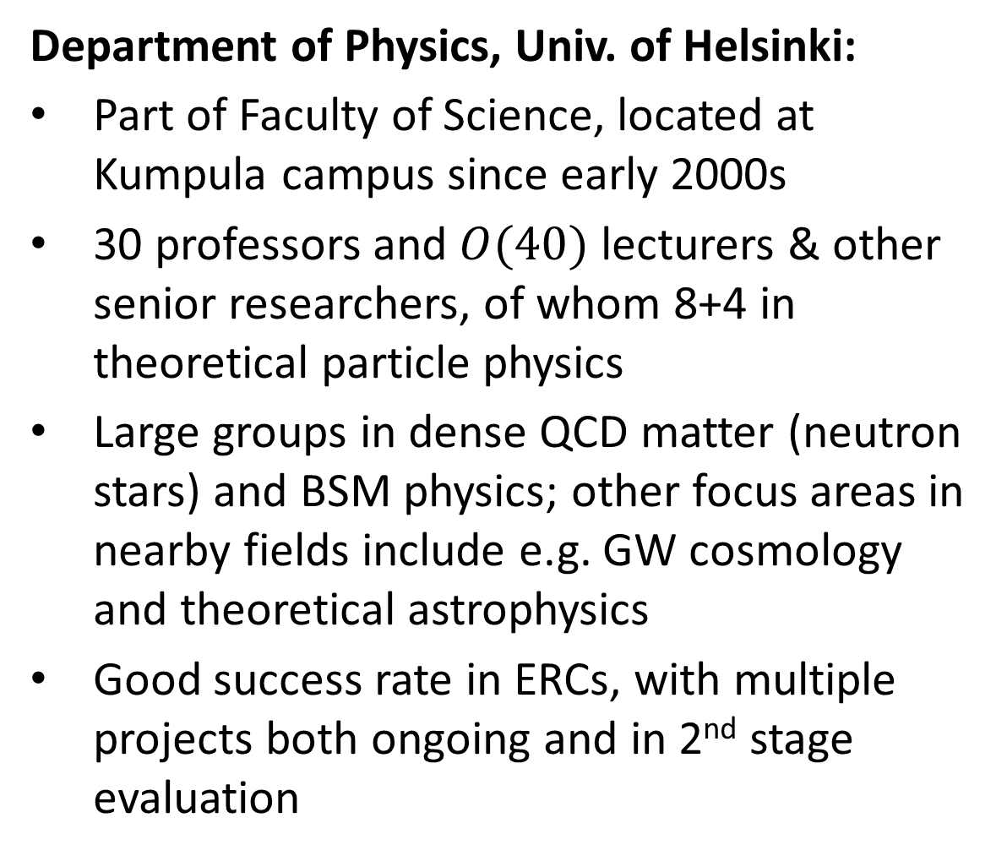
Department of Physics, Univ. of Helsinki:
Part of Faculty of Science, located at Kumpula campus since early 2000s
30 professors and $O(40)$ lecturers & other senior researchers, of whom 8+4 in theoretical particle physics
Large groups in dense QCD matter (neutron stars) and BSM physics; other focus areas in nearby fields include e.g. GW cosmology and theoretical astrophysics
Good success rate in ERCs, with multiple projects both ongoing and in 2nd stage evaluation

Slide 7
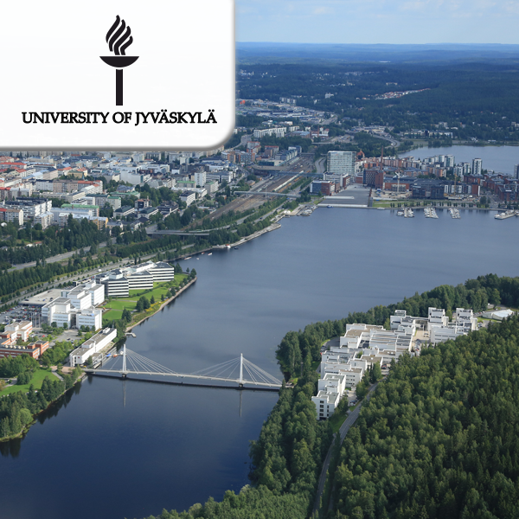
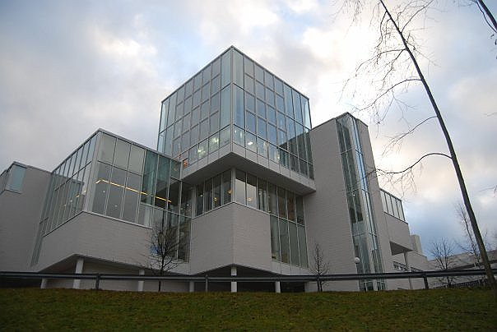
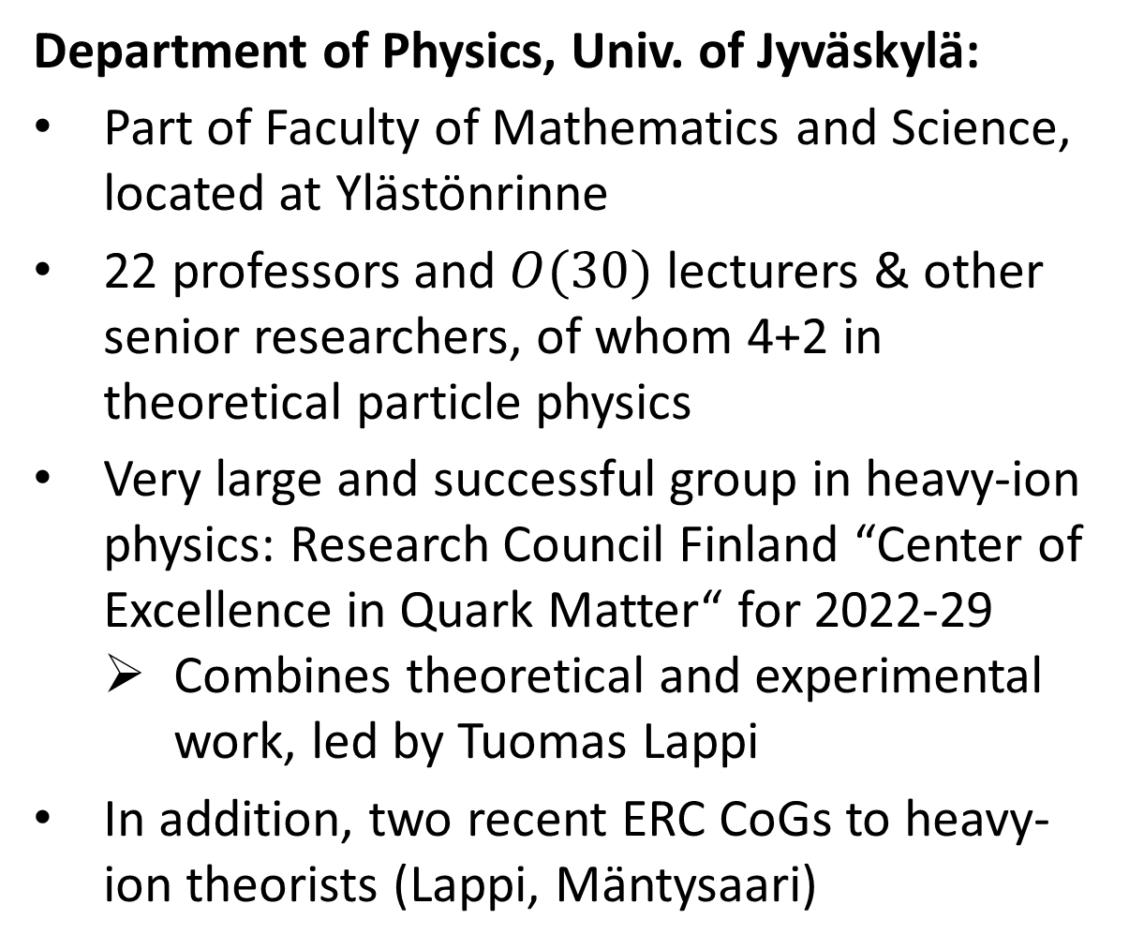
Department of Physics, Univ. of Jyväskylä:
Part of Faculty of Mathematics and Science, located at Ylästönrinne
22 professors and $O(30)$ lecturers & other senior researchers, of whom 4+2 in theoretical particle physics
Very large and successful group in heavy-ion physics: Research Council Finland “Center of Excellence in Quark Matter“ for 2022-29
  Combines theoretical and experimental work, led by Tuomas Lappi
In addition, two recent ERC CoGs to heavy-ion theorists (Lappi, Mäntysaari)

Slide 8


Slide 9
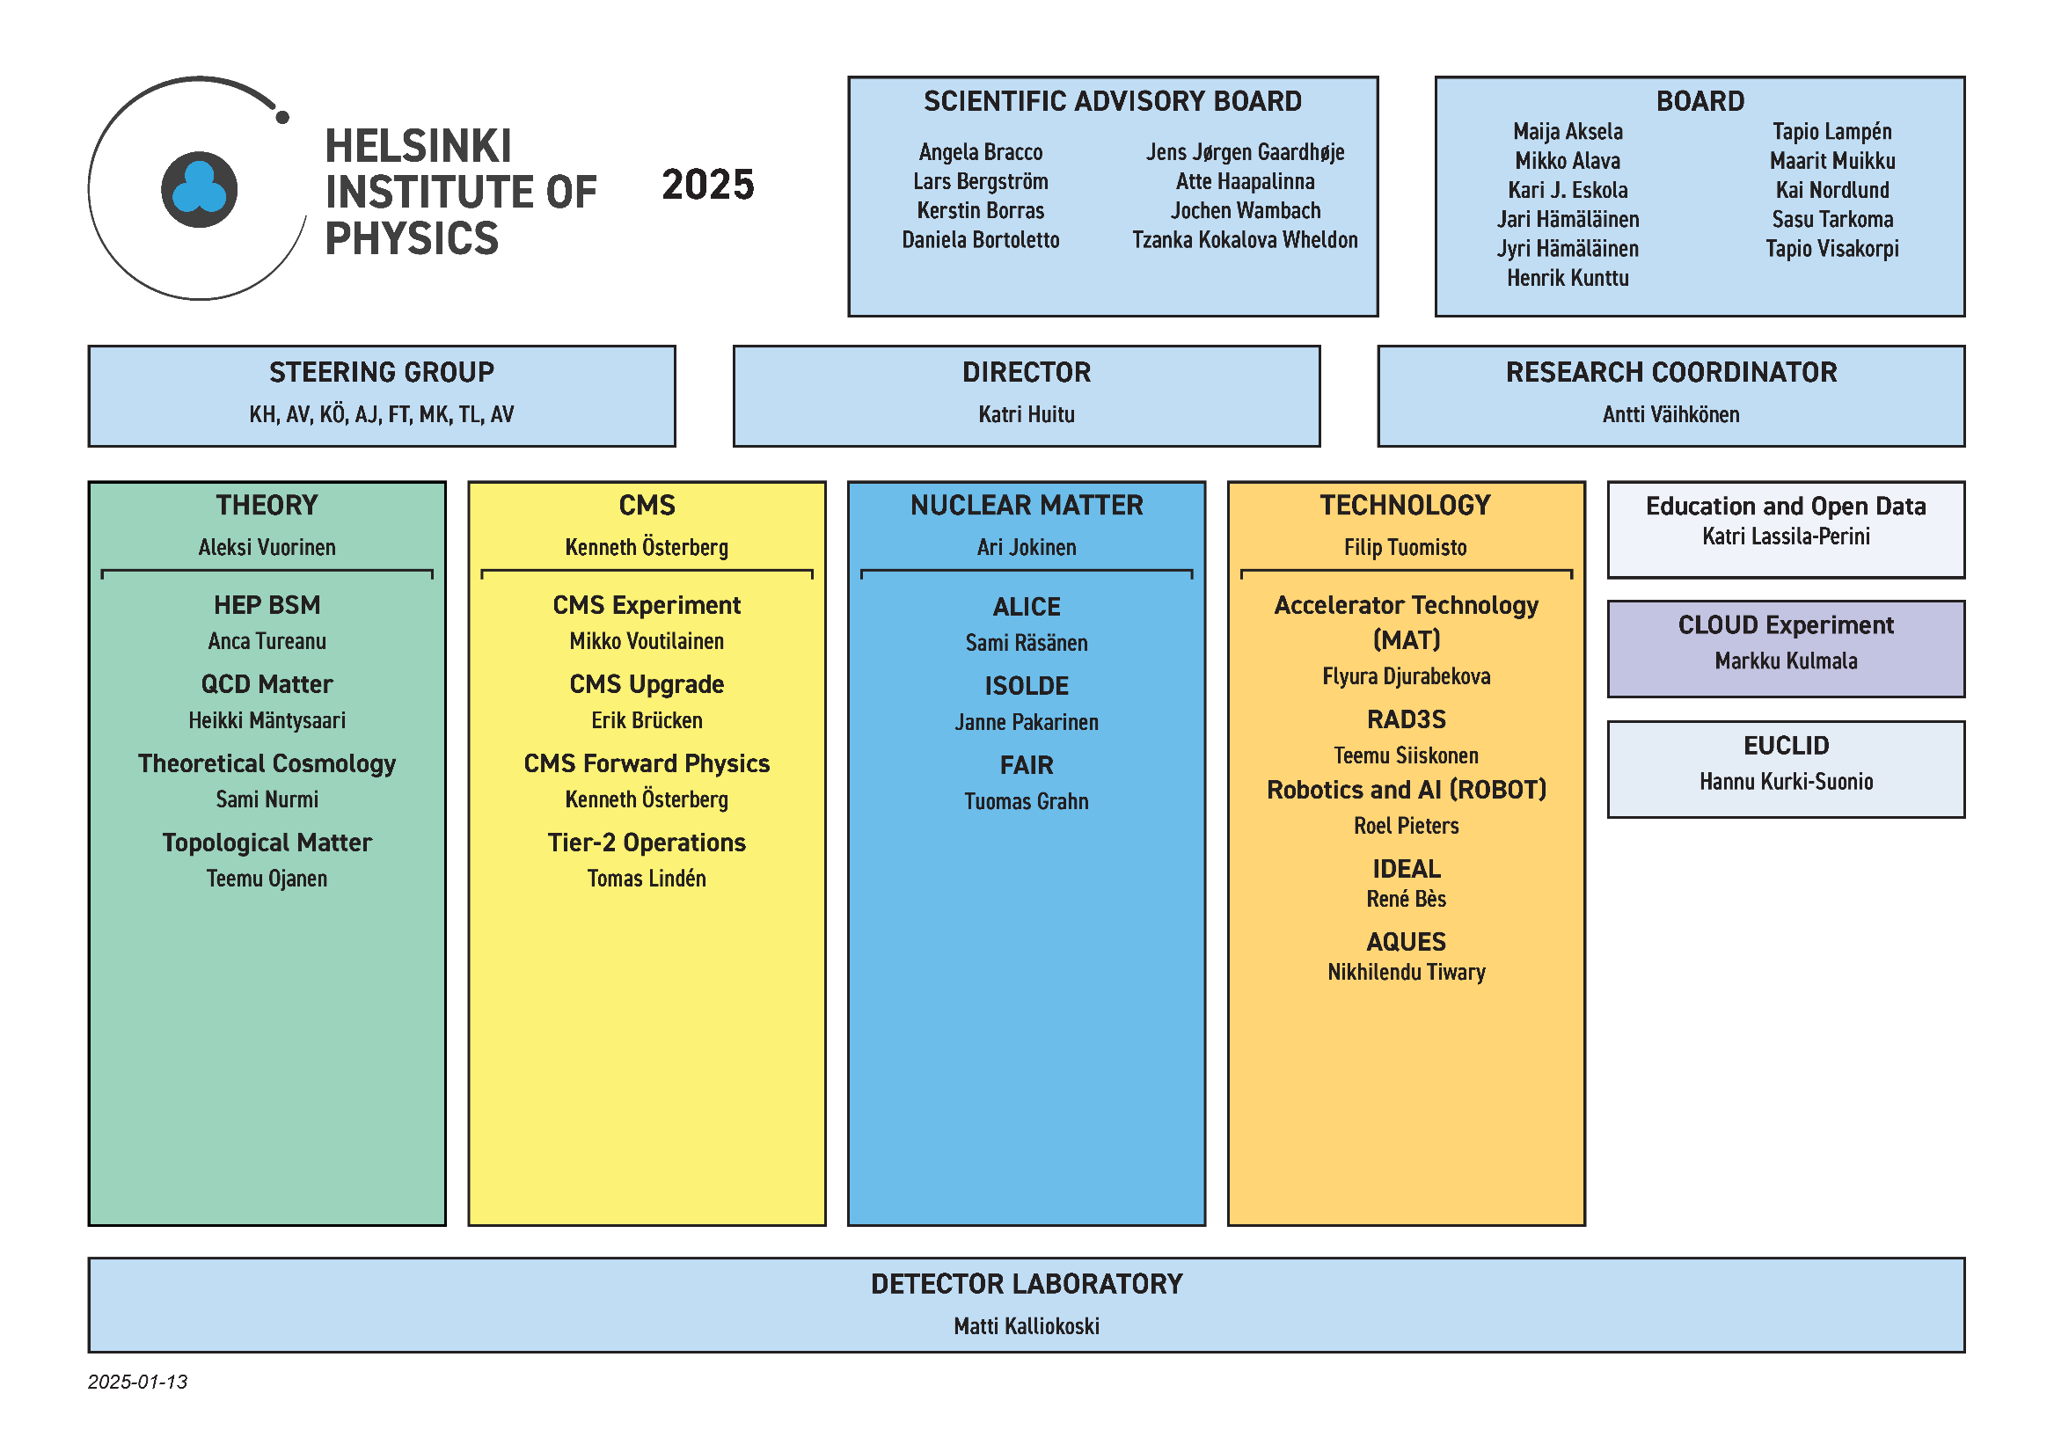

Slide 10
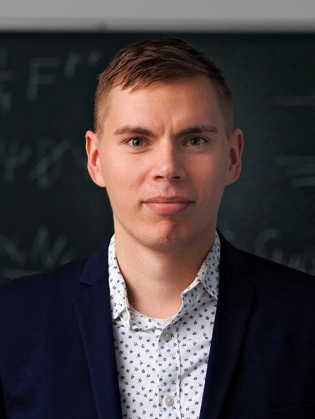
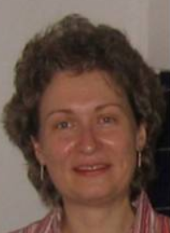
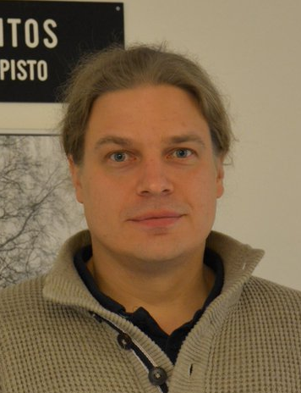

HIP Theory Programme:
Four projects of 3+3-year duration, calls every three years (2022, 2025,…)
Dual impact: strengthening Finnish theory research & boosting careers of promising young scientists
Complementary to (mostly high-energy) experimental activity within HIP, but independent in choice of topics
In recent years, four stable themes: QCD matter, (B)SM phenomenology (both started 1/23), cosmology, and condensed matter physics (1/20-)
H. Mäntysaari (JKL)
A. Tureanu (HEL)
S. Nurmi (JKL)
T. Ojanen (TAM)

Slide 11
Highlights from recent research

Slide 12
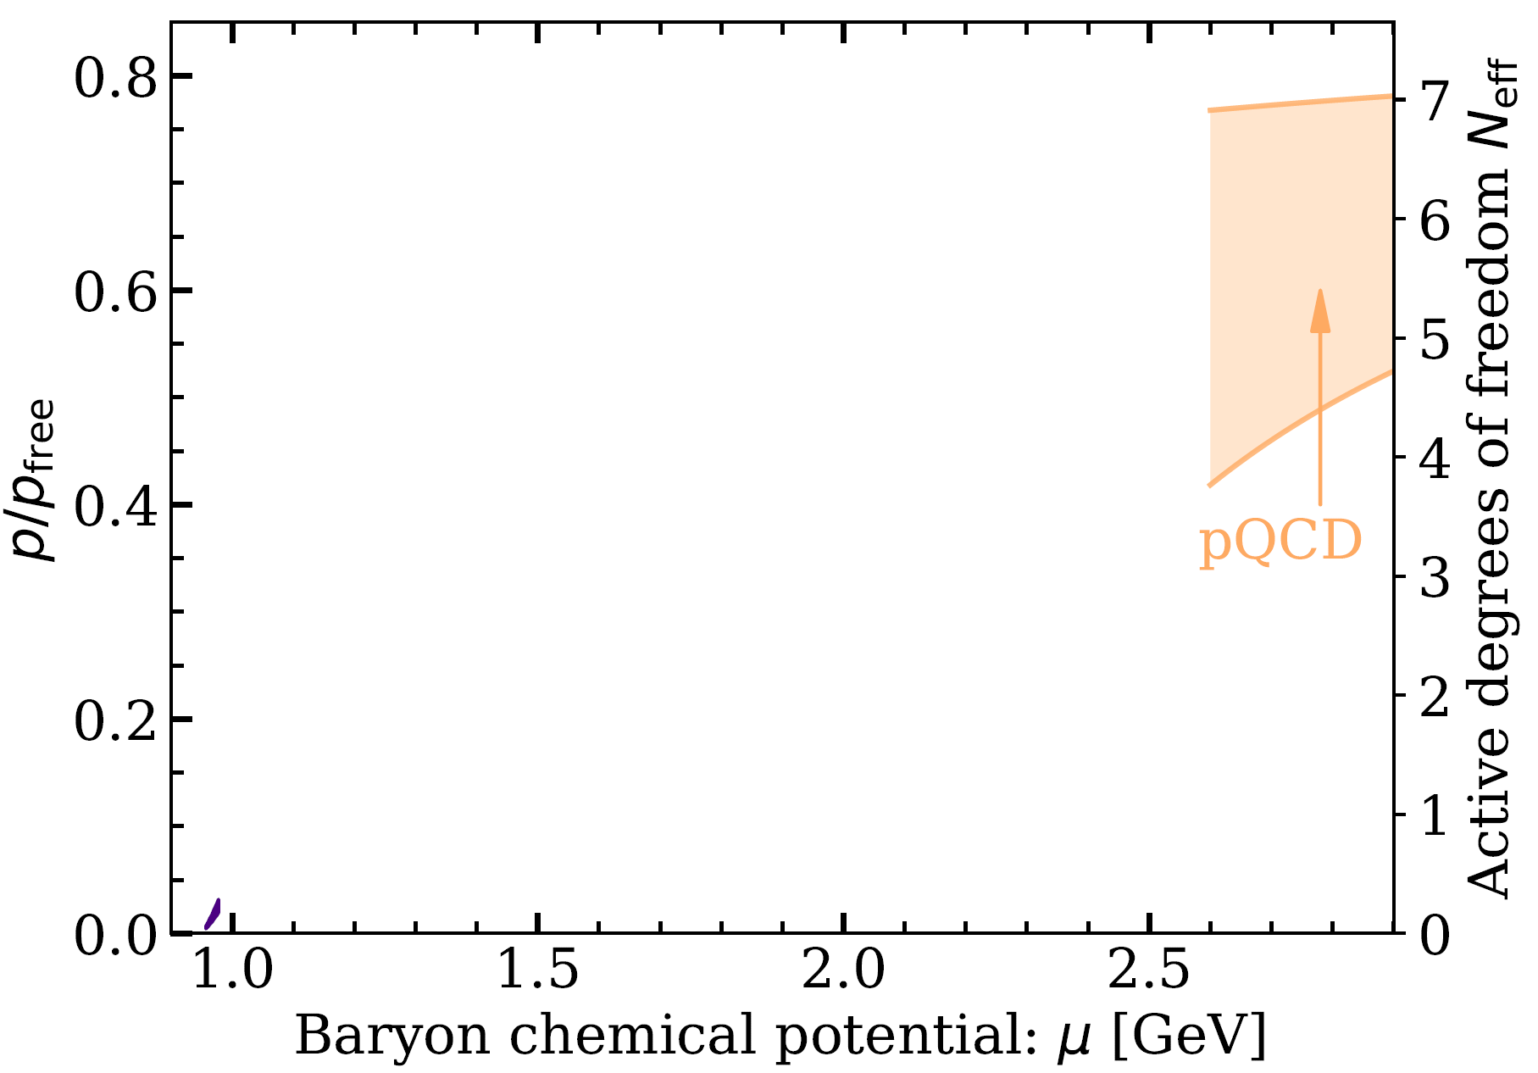
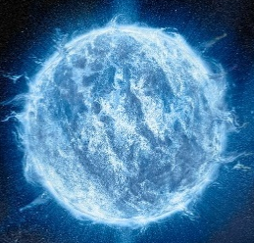
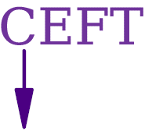
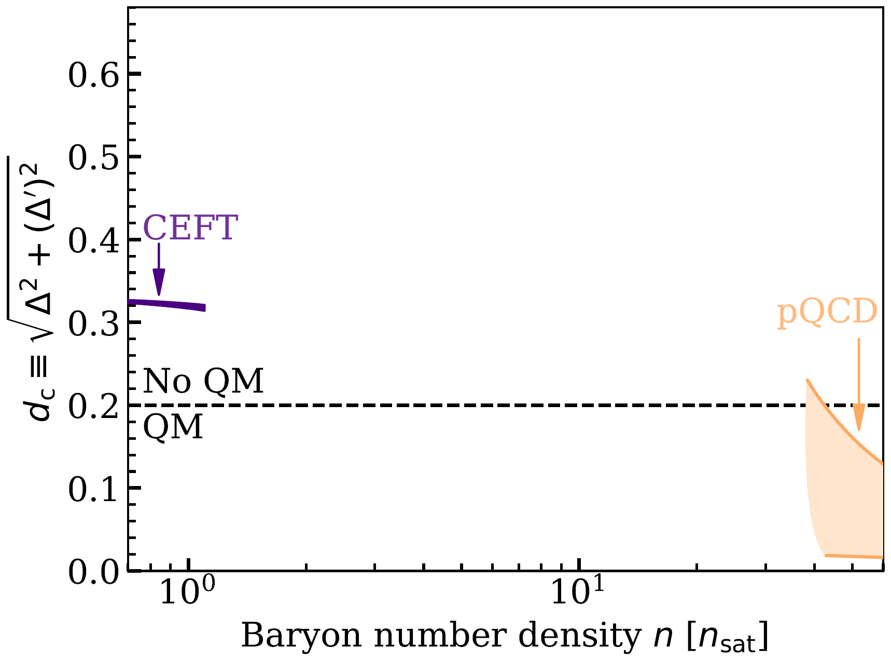

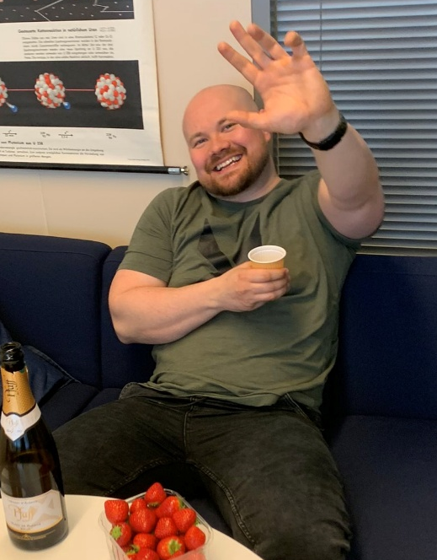
Example 1: Model-independent bounds for neutron-star matter
Major challenge in NS physics: properties of dense QCD matter – controlling stellar structure and composition – only known at low and high density
Approach of Helsinki group (Nättilä, Paatelainen, AV): Systematic use of observational data & ab-initio limits
Notes:
Starting from the first research line, the problem we address is evident from these two figures that show the existing first-principles results for the thermodynamic properties of cold neutron-star matter – quantities that dictate the macroscopic structure of the stars. As visible here, they are under control only in the limits of low and high densities, where either Chiral Effective Field Theory or perturbative QCD is applicable.
***CLICK***
As an alternative for the use of phenomenological models, my group has pioneered a model-independent approach where the neutron-star-matter equation of state is interpolated between these limits and constrained by astrophysical observations.

Slide 13
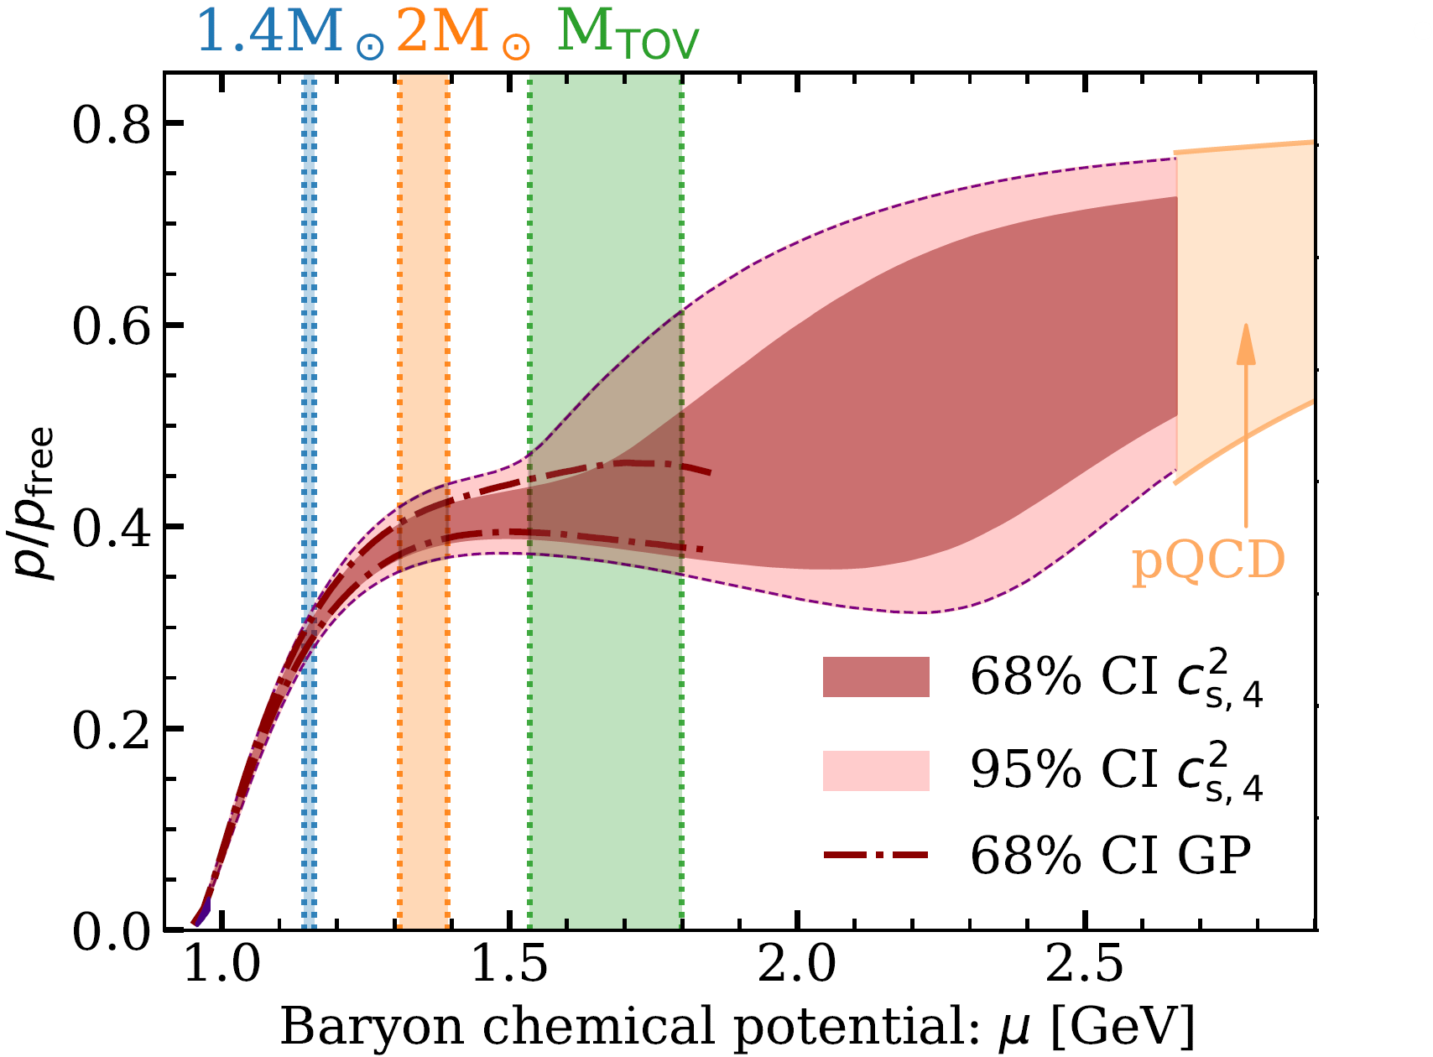
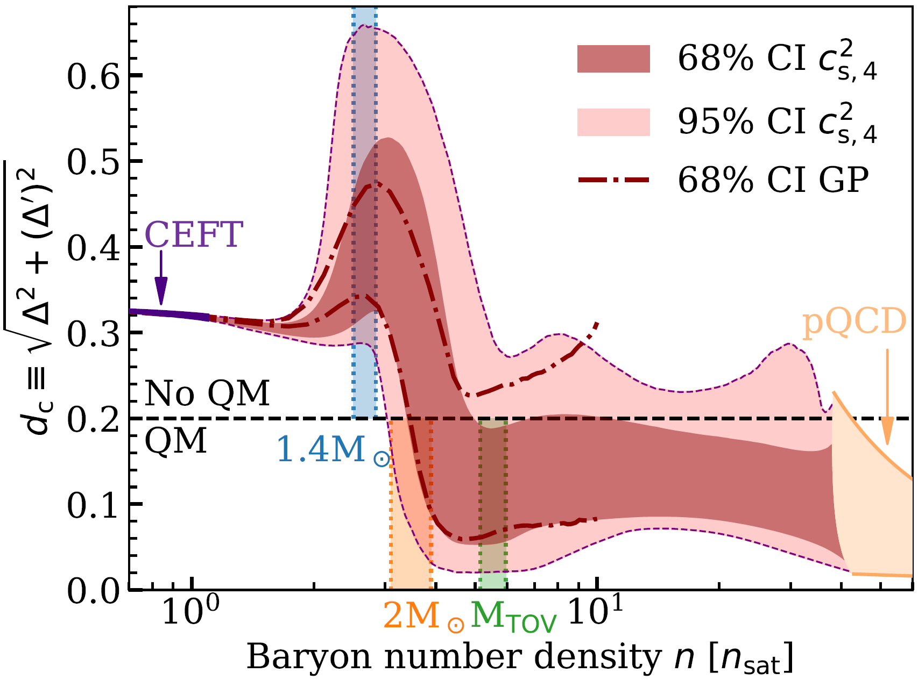
Example 1: Model-independent bounds for neutron-star matter
Major challenge in NS physics: properties of dense QCD matter – controlling stellar structure and composition – only known at low and high density
Approach of Helsinki group (Nättilä, Paatelainen, AV): Systematic use of observational data & ab-initio limits
Accurate equation of state (EoS) at all densities
Evidence for quark-matter cores in massive NSs
Annala et al., Nature Phys. 16 (2020), Nature Comms. 14 (2023)
Notes:
This has already led to results of very high impact, including the most accurate model-independent EoS for neutron-star matter and strong evidence for the presence of deconfined matter inside massive neutron stars – a decades old problem of nuclear astrophysics.
To turn such results into a robust discovery of quark-matter cores requires, however, advances from all sides: low densities, high densities, and observations.

Slide 14
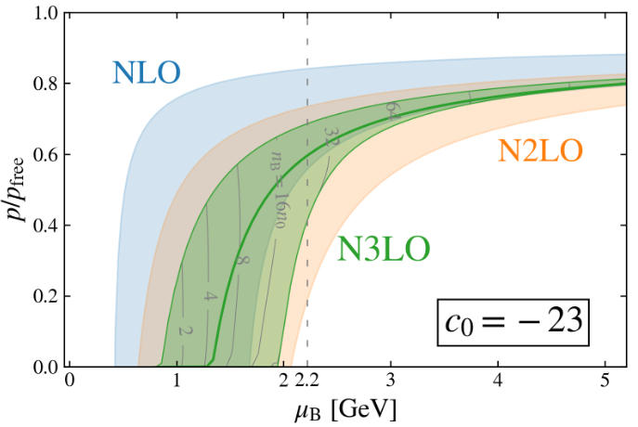
Example 1: Model-independent bounds for neutron-star matter
Major challenge in NS physics: properties of dense QCD matter – controlling stellar structure and composition – only known at low and high density
Approach of Helsinki group (Nättilä, Paatelainen, AV): Systematic use of observational data & ab-initio limits
Accurate equation of state (EoS) at all densities
Evidence for quark-matter cores in massive NSs
Major breakthrough from high-density side incoming:
Full NNNLO EoS missing only one number
Vital tool: new method from collider physics – dense Loop Tree Duality (dLTD)
Goal: solid evidence for quark-matter cores
Annala et al., Nature Phys. 16 (2020), Nature Comms. 14 (2023)
(estimated)
Gorda, Paatelainen, Säppi, Seppänen, PRL 131 (2023); Kärkkäinen et al., Accepted to PRL (2025)
Notes:
At high density, there is a particularly alluring opportunity: a new computational tool we have recently developed in my group – the dense Loop Tree Duality – has made completing the N3LO pressure of cold quark matter viable for the first time ever.
As seen from the lower plot here, this is expected to dramatically improve the accuracy of the quantity, which will have a huge impact on the neutron-star-matter EoS at all densities. We expect to reach this milestone result during the first two years of the LoopsToStars project, and it may alone be enough for a definitive discovery of quark-matter cores.

Slide 15
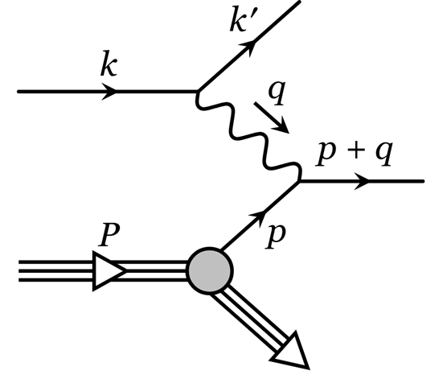
Example 2: Deep inelastic scattering (DIS) at small x (= high energy)
Electron-Ion Collider (EIC) currently being built at RHIC, aiming to use DIS with spin-polarized beams of electrons and ions to study nuclear matter
Notes:
Starting from the first research line, the problem we address is evident from these two figures that show the existing first-principles results for the thermodynamic properties of cold neutron-star matter – quantities that dictate the macroscopic structure of the stars. As visible here, they are under control only in the limits of low and high densities, where either Chiral Effective Field Theory or perturbative QCD is applicable.
***CLICK***
As an alternative for the use of phenomenological models, my group has pioneered a model-independent approach where the neutron-star-matter equation of state is interpolated between these limits and constrained by astrophysical observations.

Slide 16
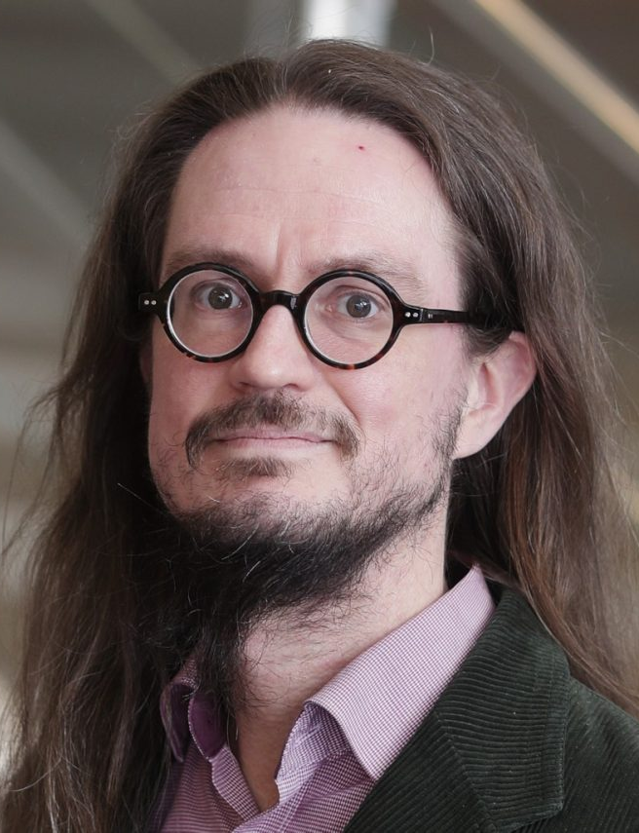

Example 2: Deep inelastic scattering (DIS) at small x (= high energy)
Electron-Ion Collider (EIC) currently being built at RHIC, aiming to use DIS with spin-polarized beams of electrons and ions to study nuclear matter
A team from Jyväskylä (Lappi, Mäntysaari) and Helsinki (Paatelainen) are world leaders in light-cone perturbation theory and color-glass-condensate phys.
Notes:
Starting from the first research line, the problem we address is evident from these two figures that show the existing first-principles results for the thermodynamic properties of cold neutron-star matter – quantities that dictate the macroscopic structure of the stars. As visible here, they are under control only in the limits of low and high densities, where either Chiral Effective Field Theory or perturbative QCD is applicable.
***CLICK***
As an alternative for the use of phenomenological models, my group has pioneered a model-independent approach where the neutron-star-matter equation of state is interpolated between these limits and constrained by astrophysical observations.

Slide 17
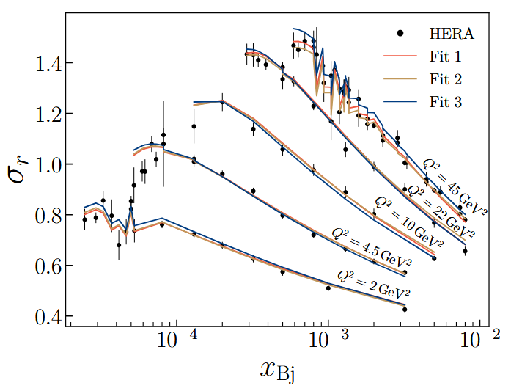
Example 2: Deep inelastic scattering (DIS) at small x (= high energy)
Electron-Ion Collider (EIC) currently being built at RHIC, aiming to use DIS with spin-polarized beams of electrons and ions to study nuclear matter
A team from Jyväskylä (Lappi, Mäntysaari) and Helsinki (Paatelainen) are world leaders in light-cone perturbation theory and color-glass-condensate phys:
Needed for cross sections of several precision probes of gluon saturation
Ultimate goal to solve one of the last uncharted frontiers of QCD: small-x regime of QCD matter
Beuf, Lappi, Paatelainen, PRL 129 (2022)
Hänninen, Mäntysaari, Paatelainen, Penttala, PRL 130 (2023)
Beuf, Lappi, Mäntysaari, Paatelainen, Penttala JHEP 05 (2024)
Notes:
Starting from the first research line, the problem we address is evident from these two figures that show the existing first-principles results for the thermodynamic properties of cold neutron-star matter – quantities that dictate the macroscopic structure of the stars. As visible here, they are under control only in the limits of low and high densities, where either Chiral Effective Field Theory or perturbative QCD is applicable.
***CLICK***
As an alternative for the use of phenomenological models, my group has pioneered a model-independent approach where the neutron-star-matter equation of state is interpolated between these limits and constrained by astrophysical observations.

Slide 18
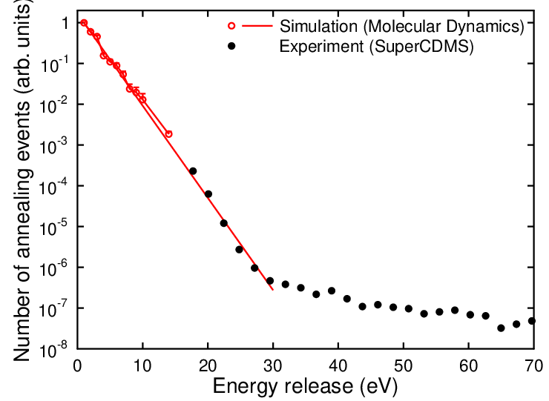
Example 3: Crystal defects and energy loss in dark-matter detectors
Detector technologies are becoming sensitive to eV recoil energies:
Allows searching for light DM; understanding of detector material’s atom-level response needed
Experiments currently limited by unidentified background (low-energy excess)
Notes:
Starting from the first research line, the problem we address is evident from these two figures that show the existing first-principles results for the thermodynamic properties of cold neutron-star matter – quantities that dictate the macroscopic structure of the stars. As visible here, they are under control only in the limits of low and high densities, where either Chiral Effective Field Theory or perturbative QCD is applicable.
***CLICK***
As an alternative for the use of phenomenological models, my group has pioneered a model-independent approach where the neutron-star-matter equation of state is interpolated between these limits and constrained by astrophysical observations.

Slide 19
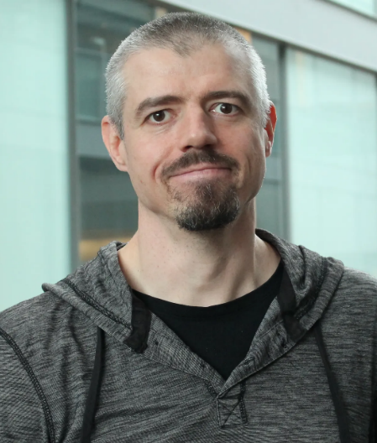
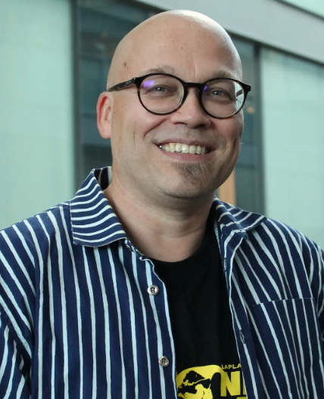
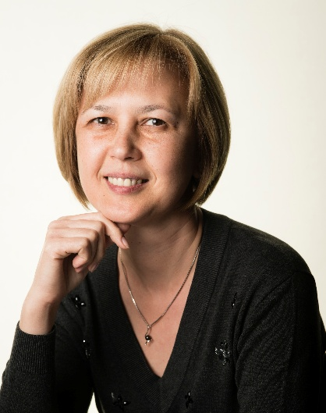
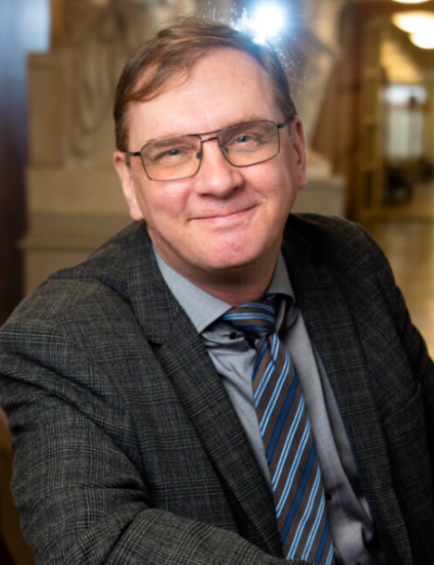
Example 3: Crystal defects and energy loss in dark-matter detectors
Detector technologies are becoming sensitive to eV recoil energies:
Allows searching for light DM; understanding of detector material’s atom-level response needed
Experiments currently limited by unidentified background (low-energy excess)
In Helsinki, collaboration of part. th. (Heikinheimo, Tuominen) & mat. phys. (Djurabekova, Nordlund)
Notes:
Starting from the first research line, the problem we address is evident from these two figures that show the existing first-principles results for the thermodynamic properties of cold neutron-star matter – quantities that dictate the macroscopic structure of the stars. As visible here, they are under control only in the limits of low and high densities, where either Chiral Effective Field Theory or perturbative QCD is applicable.
***CLICK***
As an alternative for the use of phenomenological models, my group has pioneered a model-independent approach where the neutron-star-matter equation of state is interpolated between these limits and constrained by astrophysical observations.

Slide 20
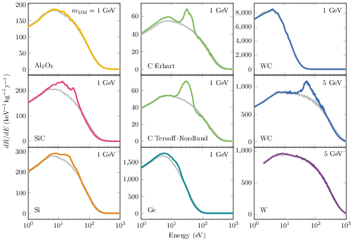
Example 3: Crystal defects and energy loss in dark-matter detectors
Detector technologies are becoming sensitive to eV recoil energies:
Allows searching for light DM; understanding of detector material’s atom-level response needed
Experiments currently limited by unidentified background (low-energy excess)
In Helsinki, collaboration of part. th. (Heikinheimo, Tuominen) & mat. phys. (Djurabekova, Nordlund)
Novel insights into phenomena affecting the low-energy spectrum
Unprecedented sensitivity to low-mass DM
Heikinheimo et al., PRD 106 (2022), PRD 109 (2024);
Sassi et al., PRD 106 (2022); Nordlund et al., 2408.07518
Notes:
Starting from the first research line, the problem we address is evident from these two figures that show the existing first-principles results for the thermodynamic properties of cold neutron-star matter – quantities that dictate the macroscopic structure of the stars. As visible here, they are under control only in the limits of low and high densities, where either Chiral Effective Field Theory or perturbative QCD is applicable.
***CLICK***
As an alternative for the use of phenomenological models, my group has pioneered a model-independent approach where the neutron-star-matter equation of state is interpolated between these limits and constrained by astrophysical observations.

Slide 21
Final thoughts

Slide 22
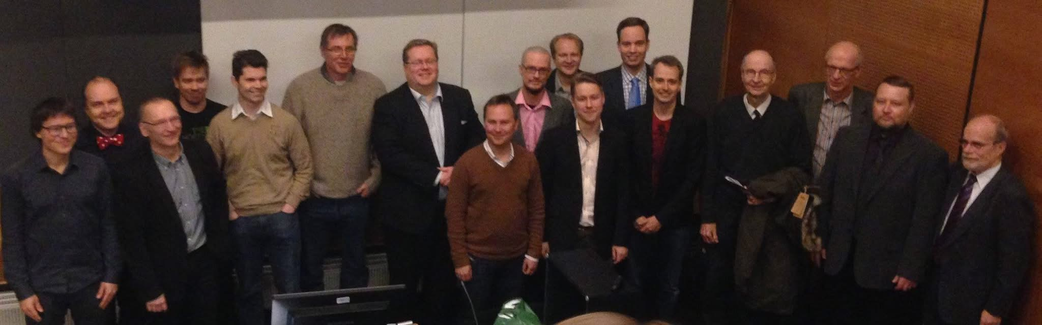
Finnish high-energy theory: where are we and what next?
Finland is a small country, so specialization to a few topics and directions vitally important to keep up with international top
  Particularly strong history in thermal QFT due to Keijo Kajantie, with e.g. all Finnish HEP-theory ERCs from this tradition

Slide 23
Finnish high-energy theory: where are we and what next?
Finland is a small country, so specialization to a few topics and directions vitally important to keep up with international top
  Particularly strong history in thermal QFT due to Keijo Kajantie, with e.g. all Finnish HEP-theory ERCs from this tradition
The recent success stories covered here all result from interplay between theory and phenomenology, with direct motivation from experiments: LIGO/ET/CE, EIC, LUX/PandaX/XENON,…

Slide 24
Finnish high-energy theory: where are we and what next?
Finland is a small country, so specialization to a few topics and directions vitally important to keep up with international top
  Particularly strong history in thermal QFT due to Keijo Kajantie, with e.g. all Finnish HEP-theory ERCs from this tradition
The recent success stories covered here all result from interplay between theory and phenomenology, with direct motivation from experiments: LIGO/ET/CE, EIC, LUX/PandaX/XENON,…
Recurring theme: with no direct evidence of BSM particles from LHC, strong motivation to 1) understand SM physics to improved precision & 2) search hints of new physics in complementary ways

Slide 25
Thank you!

