Slide 1


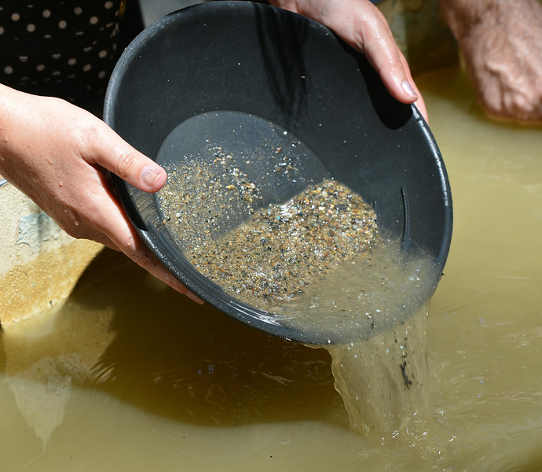


Towards AI-assisted Neutrino Flavor Theory Design
Max Fieg (Fermilab)
With: Jason Baretz, Vijay Ganesh, Aishik Ghosh, Victoria Knapp-Perez, Jake Rudolph, and Daniel Whiteson
2506.08080 Lepton-Photon 2025

Slide 2
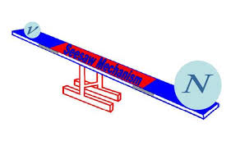
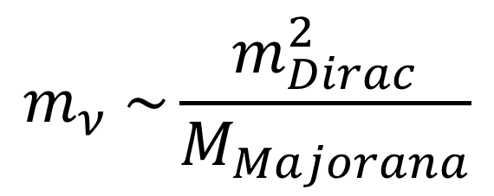
Neutrino Mass Problem
Newsflash: Neutrinos have mass
Guaranteed new physics
Renormalizability requires some new physics
Upcoming experiments will pin down oscillation parameters, and mass ordering
Seesaw mechanism?
$$m_{ν} \sim \frac{m_{Dirac}^{2}}{M_{Majorana}}$$
mass

Slide 3
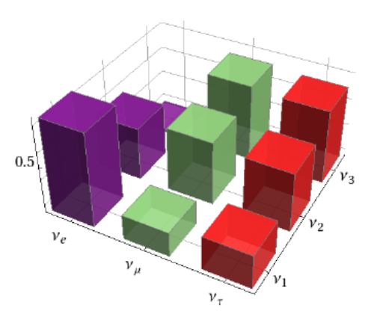
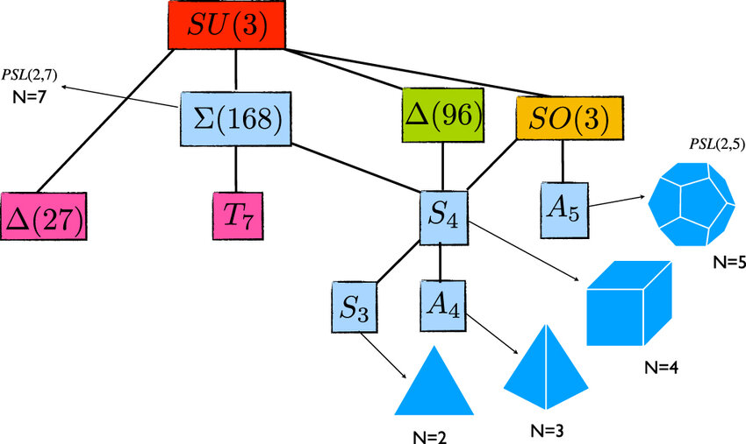


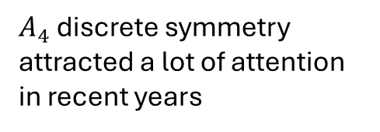
Flavor Problem
Nature gave us a confusing fermion spectrum
Mass hierarchies $m_{τ}/m_{e}≈3477$
Large leptonic mixings
Broken flavor symmetries to explain mixing?
$A_{4}$ discrete symmetry attracted a lot of attention in recent years
$$A_{4}∼({1,1}^{′},1^{′′},3)$$

Slide 4
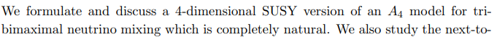
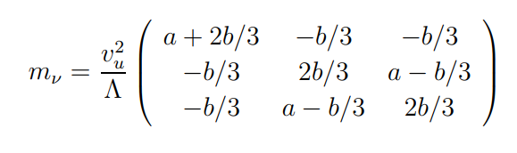
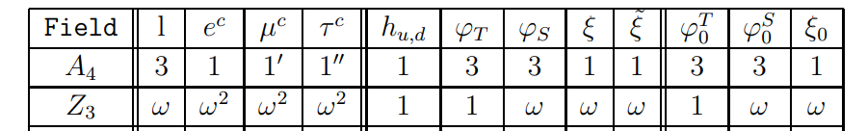
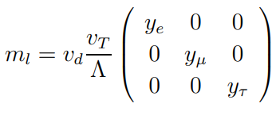

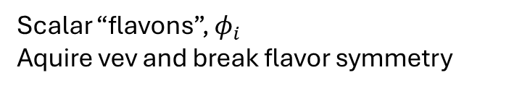

A Discrete Flavor Model
In early 2000s, the “Tri-Bimaximal” PMNS was consistent with data
Looked to be screaming for a symmetry explanation
G. Altarelli, and F. Feruglio (2005) provided a natural solution
$$U_{TBM}=\left(\begin{matrix}\frac{\sqrt{2}}{3} & \frac{1}{\sqrt{3}} & 0 \\ −\frac{1}{\sqrt{6}} & \frac{1}{\sqrt{3} } & \frac{1}{\sqrt{2}} \\ −\frac{1}{\sqrt{6}} & \frac{1}{\sqrt{3 }} & −\frac{1}{\sqrt{2}}\end{matrix}\right)$$
↔
↔
Scalar “flavons”, $φ_{i}$
Aquire vev and break flavor symmetry
$$A_{4}∼({1,1}^{′},1^{′′},3)$$

Slide 5
Altarelli and Feruglio calculated many useful things for their model:
Completed with a seesaw mechanism, calculated flavon SSB, higher order corrections, integrated quarks, and related to the modular group.
Important work with key insights that are still valuable
Today, the Tri-Bimaximal form is ruled out ☹

Slide 6
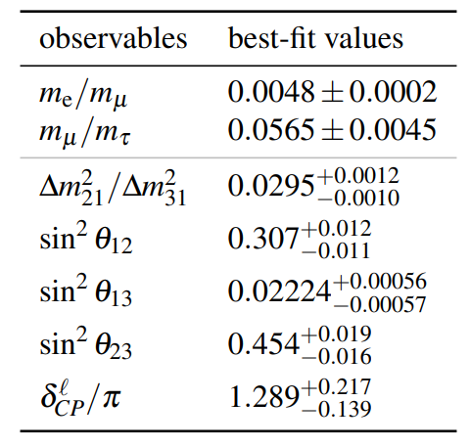

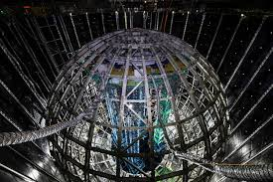
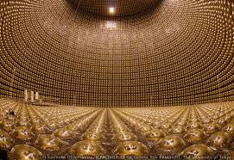
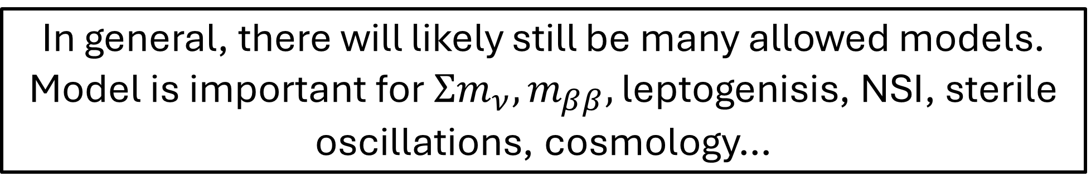
Experiments will continue to rule out models
JUNO
Hyper-K
…and point towards new models!
In general, there will likely still be many allowed models.
Model is important for $Σm_{ν},m_{ββ},$ leptogenisis, NSI, sterile oscillations, cosmology…

Slide 7




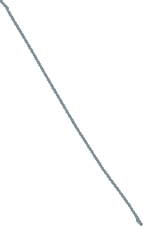






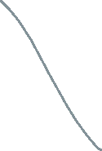





How to look for good models in the space of possibilities?
Some abstract model space
Discrete symmetries
Charge assignments
Particle content
TBM
UV completions
Type-I Seesaw Mechanism
= Good model

Slide 8
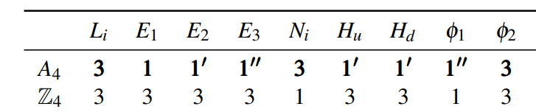
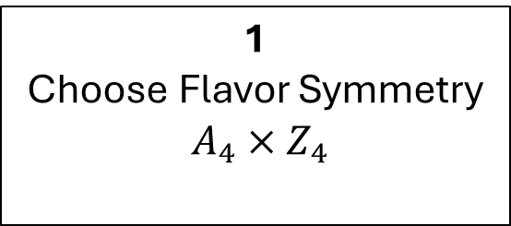


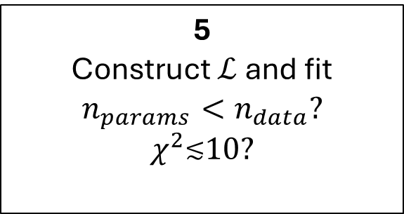

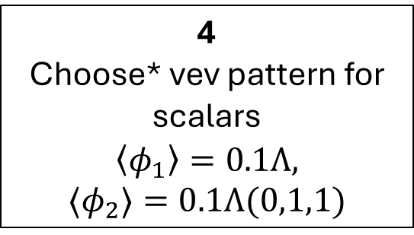
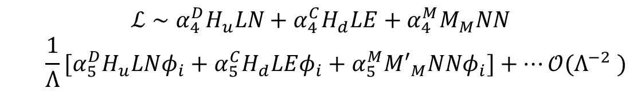
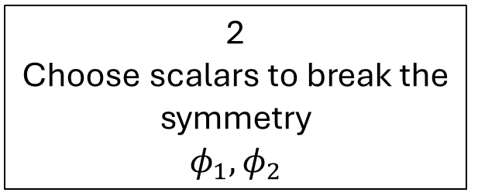
Seesaw Flavor Model Example, the usual way
$$ℒ∼{α_{4}^{D}H}_{u}LN+α_{4}^{C}H_{d}LE+α_{4}^{M}M_{M}NN$$
$${ \frac{1}{Λ}[α_{5}^{D}H}_{u}LNφ_{i}+α_{5}^{C}H_{d}LEφ_{i}+α_{5}^{M}{M′}_{M}NNφ_{i}]+…𝒪(Λ^{−2} )$$
$$M_{Dirac}$$
$$M_{Charged}$$
$$M_{Majorana}$$
1
Choose Flavor Symmetry
$$A_{4}×Z_{4}$$
2
Choose scalars to break the symmetry
$$φ_{1},φ_{2}$$
3
Assign charges to all
particles in model
4
Choose* vev pattern for scalars
$$\left\langle φ_{1}\right\rangle =0.1Λ,$$
$$⟨φ_{2}⟩=0.1Λ(0,1,1)$$
5
Construct $ℒ$ and fit
$$n_{params}<n_{data}?$$
$$χ^{2}\text{≲}10?$$
6
Bad model: back to 1 ☹
Good model: calculate more things! ☺

Slide 9

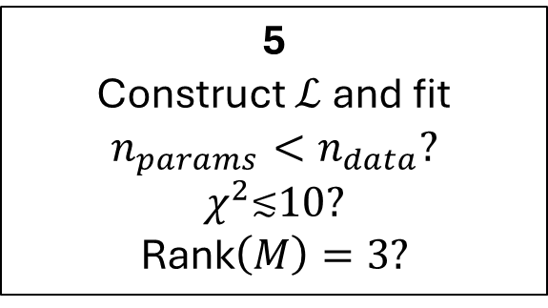
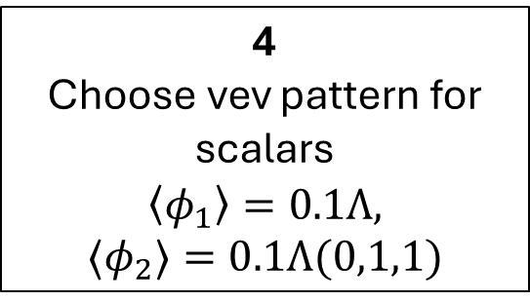
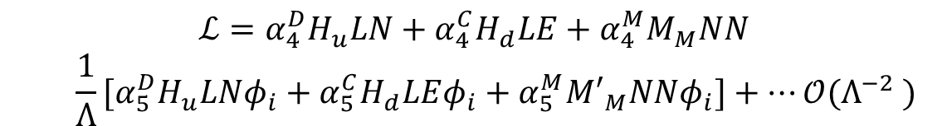

Seesaw Flavor Model Example, the usual way
$$ℒ={α_{4}^{D}H}_{u}LN+α_{4}^{C}H_{d}LE+α_{4}^{M}M_{M}NN$$
$${ \frac{1}{Λ}[α_{5}^{D}H}_{u}LNφ_{i}+α_{5}^{C}H_{d}LEφ_{i}+α_{5}^{M}{M′}_{M}NNφ_{i}]+…𝒪(Λ^{−2} )$$
$$M_{Dirac}$$
$$M_{Charged}$$
$$M_{Majorana}$$
1
Choose Flavor Symmetry
$$A_{4}×Z_{4}$$
2
Choose scalars to break the symmetry
$$φ_{1},φ_{2}$$
3
Assign charges to all
particles in model
4
Choose vev pattern for scalars
$$\left\langle φ_{1}\right\rangle =0.1Λ,$$
$$⟨φ_{2}⟩=0.1Λ(0,1,1)$$
5
Construct $ℒ$ and fit
$$n_{params}<n_{data}?$$
$$χ^{2}\text{≲}10?$$
Rank$\left(M\right)=3?$
6
Bad model: back to 1 ☹
Good model: calculate more things! ☺

Slide 10
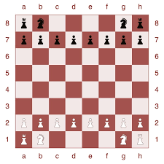
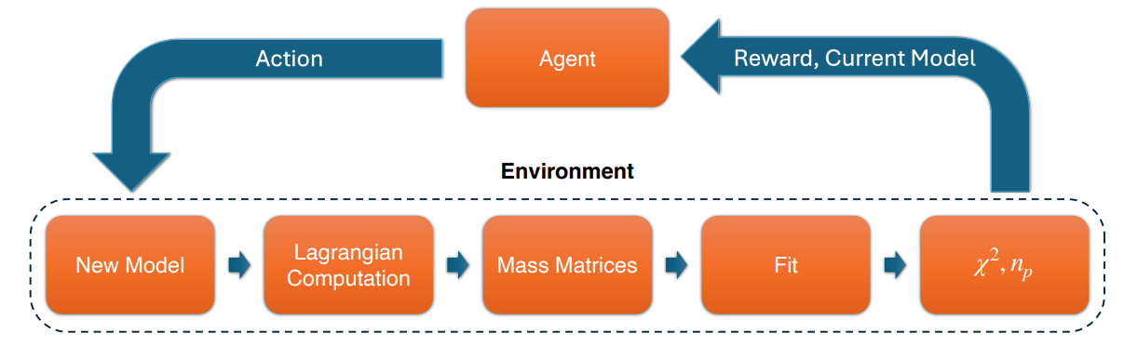
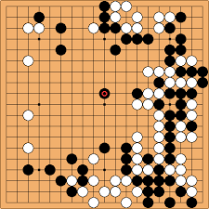
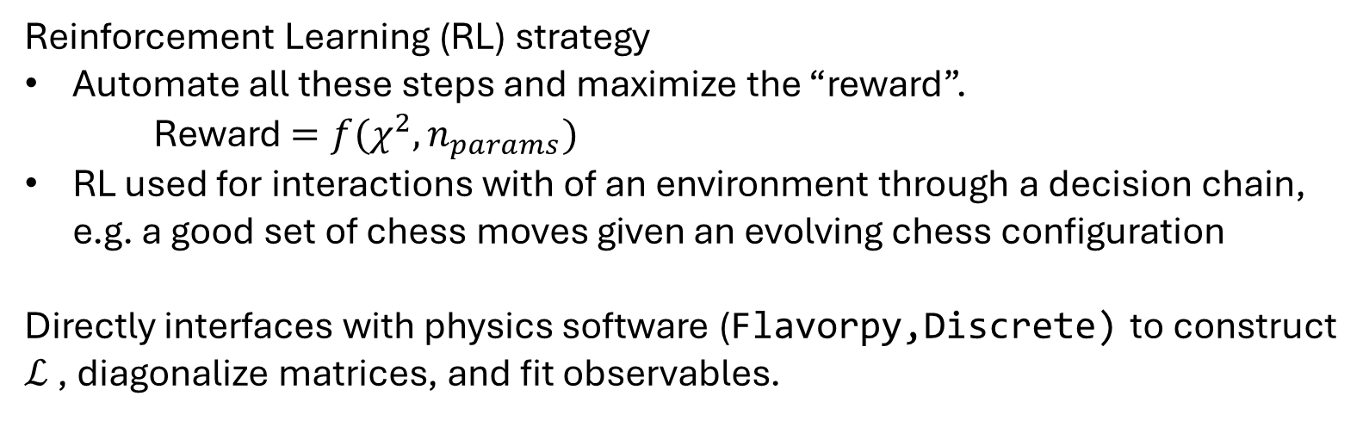
Autonomous Model Builder - AMBer
Reinforcement Learning (RL) strategy
Automate all these steps and maximize the “reward”.
Reward $=f(χ^{2},n_{params})$
RL used for interactions with of an environment through a decision chain, e.g. a good set of chess moves given an evolving chess configuration
Directly interfaces with physics software (Flavorpy,Discrete) to construct $ℒ$ , diagonalize matrices, and fit observables.

Slide 11

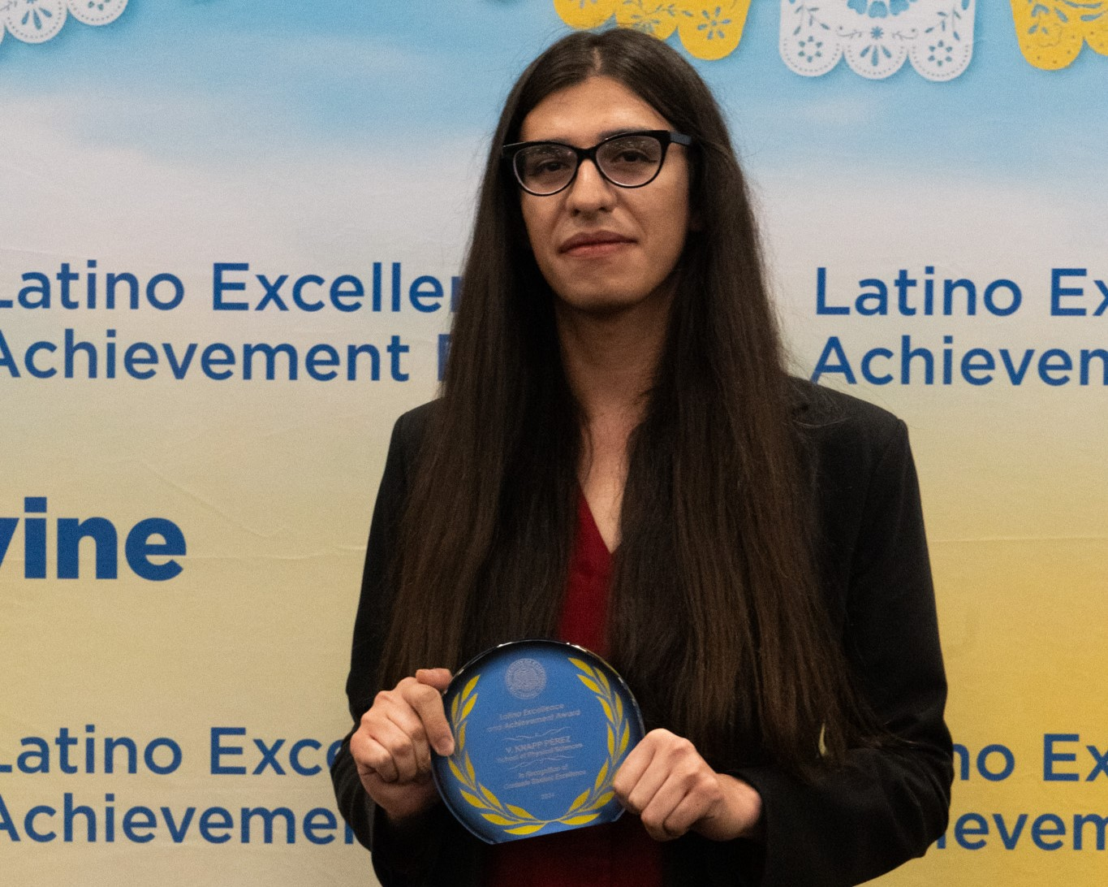
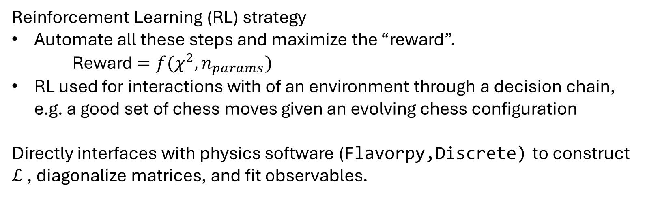
Autonomous Model Builder - AMBer
Reinforcement Learning (RL) strategy
Automate all these steps and maximize the “reward”.
Reward $=f(χ^{2},n_{params})$
RL used for interactions with of an environment through a decision chain, e.g. a good set of chess moves given an evolving chess configuration
Directly interfaces with physics software (Flavorpy,Discrete) to construct $ℒ$ , diagonalize matrices, and fit observables.
Jake Rudolph &
Victoria Knapp-Perez

Slide 12
Let’s walk through how AMBer works

Slide 13






AMBer - 2NNs, the “agent”
Environment
Policy Network
Value Network
Space of Lepton Flavor Seesaw Models
Agent-Environment
Interaction
$$φ_{i}$$
$$⟨φ_{i}⟩$$
“Policy” a probability distribution of actions to select from
Add particle
Change irrep
Choose vev
…
Value network learns to predict the reward
$$A_{4}$$
$$T_{19}$$
$$Z_{N}$$
Networks share a loss function composed of:
Value loss: for accurately predicting the reward
Policy loss: for choosing better policies
Entropy loss: for exploring

Slide 14
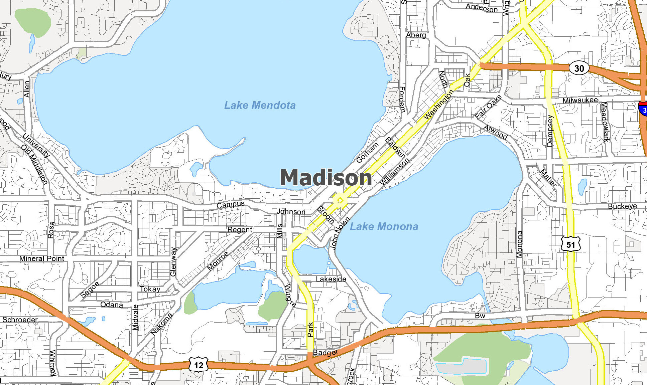


The Model Space = Madison (cartoon version)
AMBer - 2NNs, the “agent”
Policy Network
Value Network

Slide 15






The Model Space = Madison (cartoon version)
AMBer - 2NNs, the “agent”
Policy Network
Value Network
First iteration
AMBer will bumble around changing the model somewhat randomly
Will not find much success early on
If no good models found AMBer is reset to a random point in model space
Change irrep
Add particle
1
Change $⟨φ_{i}⟩$

Slide 16

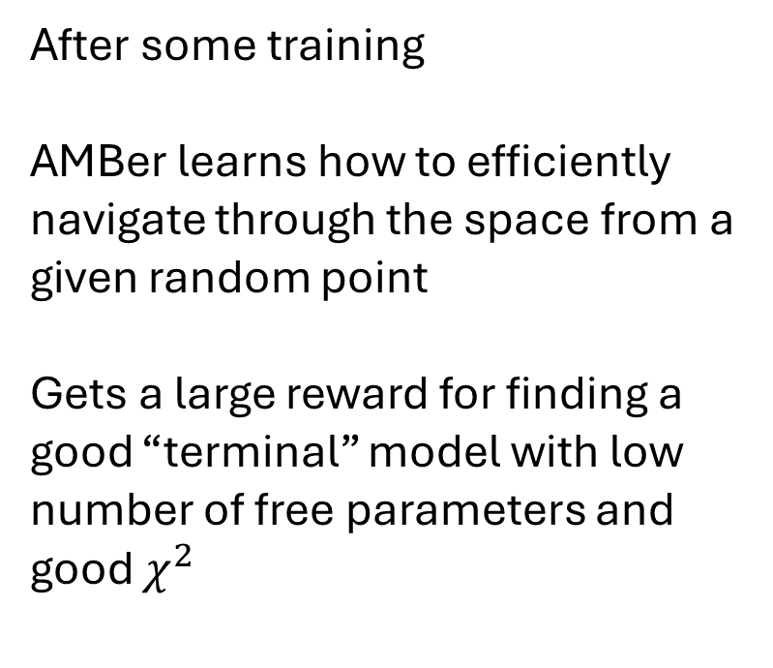




The Model Space = Madison (cartoon version)
AMBer - 2NNs, the “agent”
Policy Network
Value Network
After some training
AMBer learns how to efficiently navigate through the space from a given random point
Gets a large reward for finding a good “terminal” model with low number of free parameters and good $χ^{2}$
1

Slide 17







The Model Space = Madison (cartoon version)
AMBer - 2NNs, the “agent”
Policy Network
Value Network
Every so often we will reweight the reward to push AMBer to look for better models
Also helps to avoid overconverging
1

Slide 18
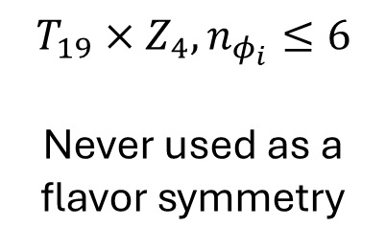

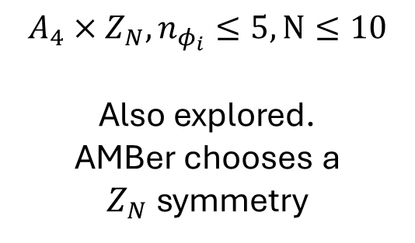
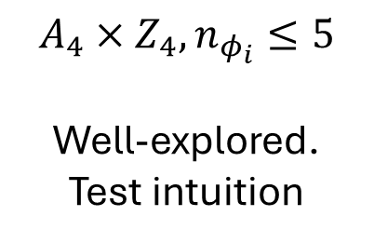
We deploy AMBer on 3 Model Sub-spaces
$$A_{4}×Z_{4}, n_{φ_{i}}≤5$$
Well-explored.
Test intuition
$$A_{4}×Z_{N}, n_{φ_{i}}≤5,N≤10$$
Also explored.
AMBer chooses a $Z_{N}$symmetry
$$T_{19}×Z_{4}, n_{φ_{i}}≤6$$
Never used as a flavor symmetry
We used an auto encoder to present these spaces on a plot

Slide 19
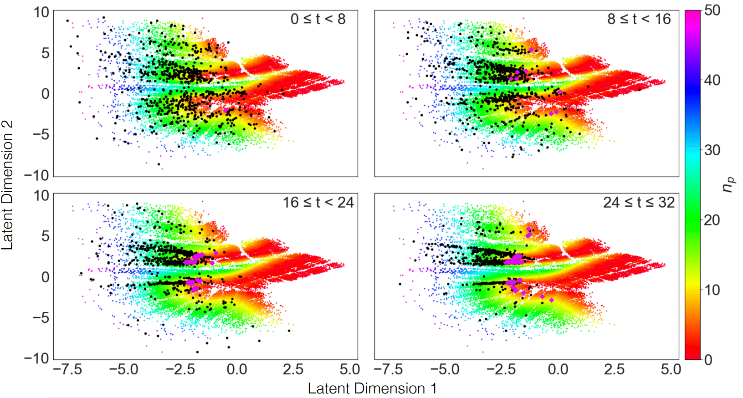
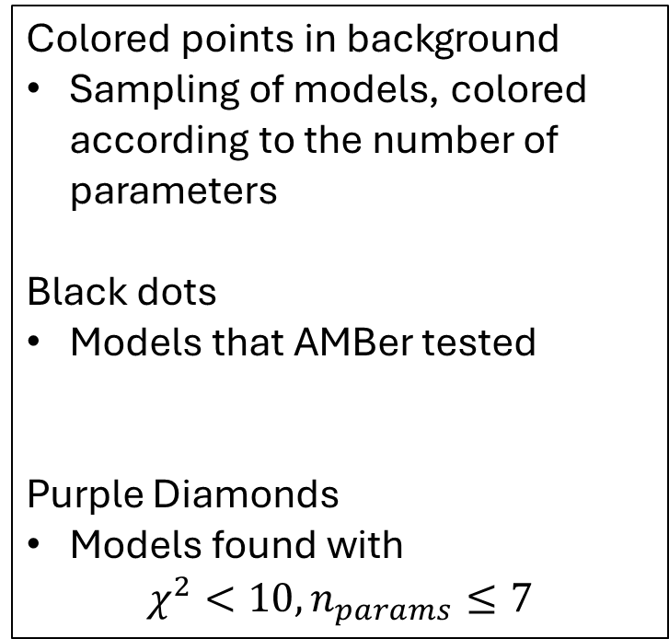
Model Space
Compress model space to two latent/abstract dimensions (autoencoder)
Colored points in background
Sampling of models, colored according to the number of parameters
Black dots
Models that AMBer tested
Purple Diamonds
Models found with
$$χ^{2}<10, n_{params}≤7$$
What does the performance look like?

Slide 20
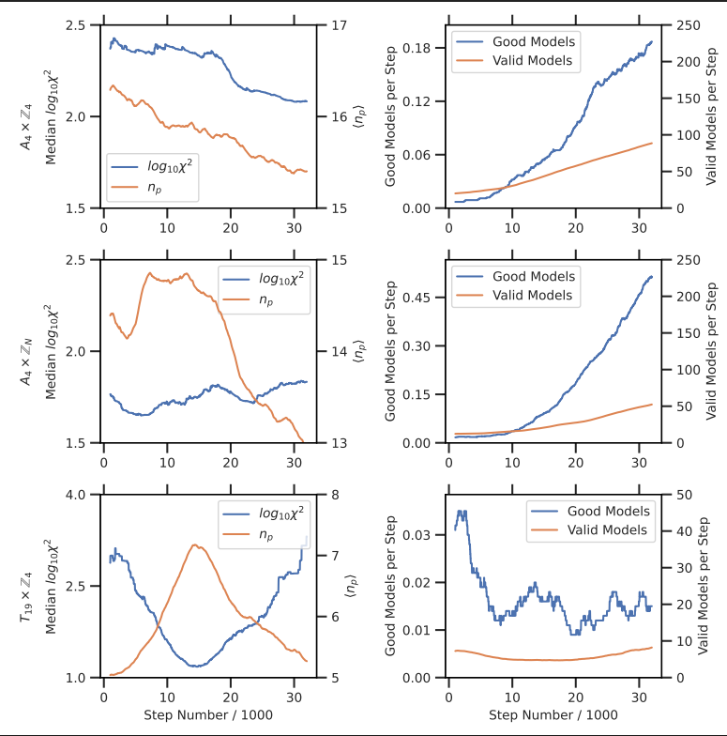
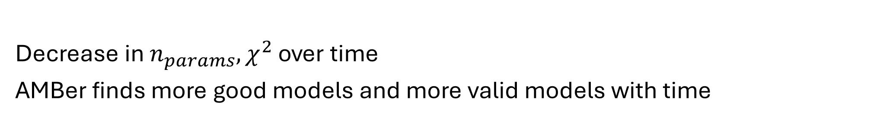


Search in $A_{4}×Z_{4}$
$$Search Time$$
Decrease in $n_{params},χ^{2}$ over time
AMBer finds more good models and more valid models with time

Slide 21
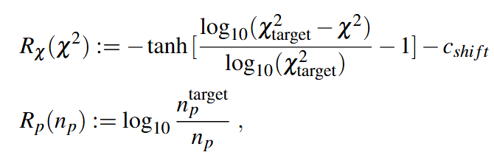
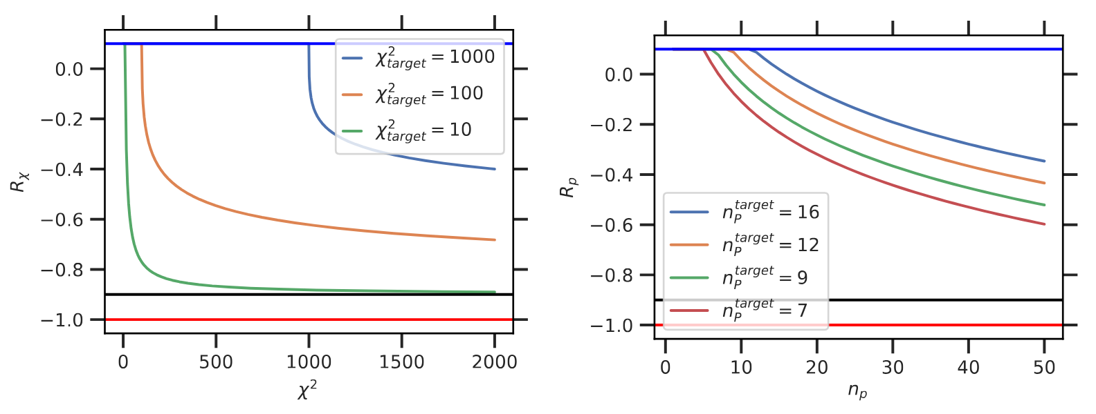
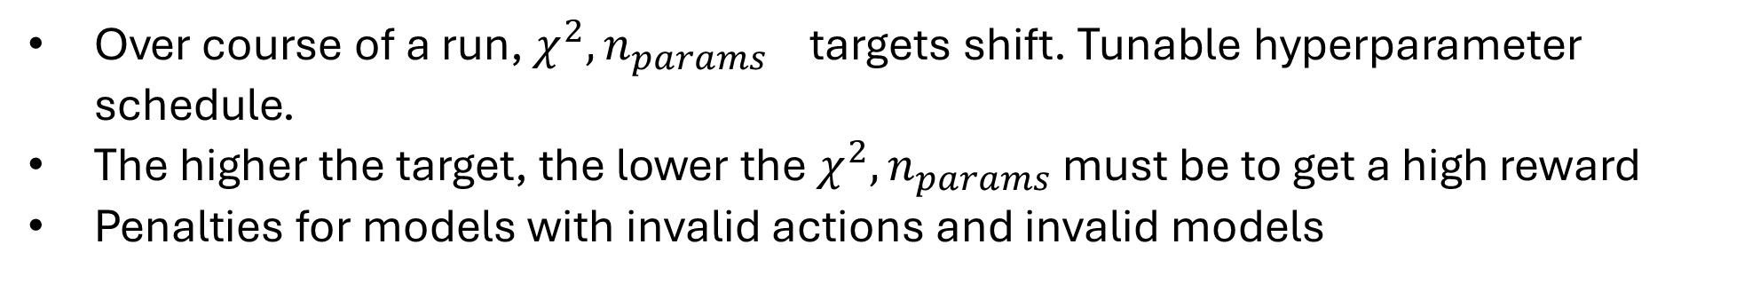
Rewards and Penalties
Over course of a run, $χ^{2},n_{params}$ targets shift. Tunable hyperparameter schedule.
The higher the target, the lower the $χ^{2}, n_{params}$ must be to get a high reward
Penalties for models with invalid actions and invalid models

Slide 22
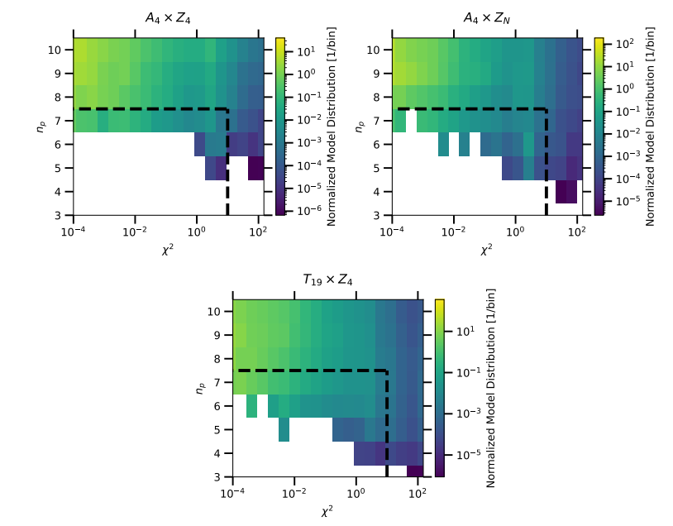
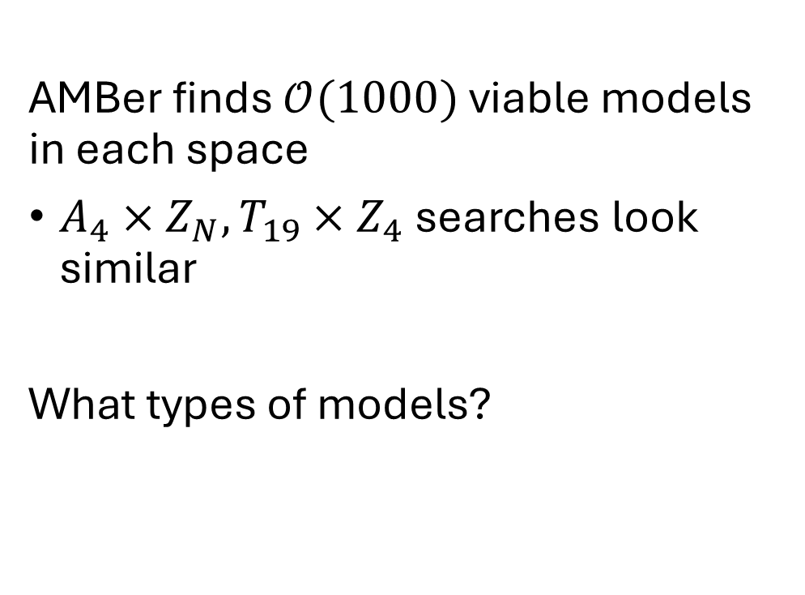
Distribution of found models
AMBer finds $𝒪(1000)$ viable models in each space
$A_{4}×Z_{N}, T_{19}×Z_{4}$ searches look similar
What types of models?
Viable models

Slide 23
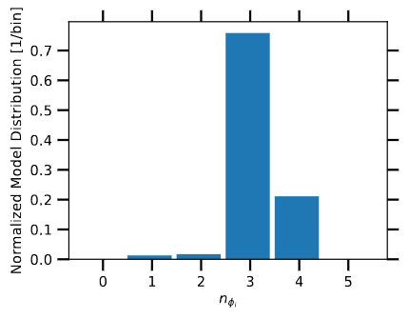



$$A_{4}×Z_{4}$$
$$N_{i}$$
$$L_{i}$$
$$E_{i}$$
$$L_{i}∼3, N_{i}∼3, E_{i}\sim 1$$
Minimize parameters while maintaining mass hierarchy
Tends to choose around 3 flavons

Slide 24



$$A_{4}×Z_{N}$$
Key difference with this search is encouragement to explore large $Z_{N}$
Distribution of $A_{4}$ charges looks similar
Prefers some extra scalar fields

Slide 25




$$T_{19}×Z_{4}$$
More democratic distribution of $T_{19}$ charges
Bigger group than $A_{4}$
Something to learn here

Slide 26

Some important notes
AMBer should be seen as a first pass!
Many more things to calculate $m_{ββ},Σm_{ν}$, RGE running…
AMBer filters through a symmetry space to do some busy work for you
Scalar potential $V\left(φ_{i}\right)$+ SSB
We assume scalar potential can be constructed to give the $\{\left\langle φ_{i}\right\rangle \}$ which we choose from
“Mode Collapse” + model degeneracies
Raw number of models found can be misleading.
Some models may be related by unitary transformations
AMBer can overconverge to a subset of the model space

Slide 27


Summary and future directions
We developed AMBer
Reinforcement learning approach, to search through for flavor models in the lepton sector
Interfaces with software and works just like a human by picking particles, assigning charges, and fitting parameters
We reproduce some patterns already observed by human model builders
Though human intuition is extremely valuable!
AMBer is just a tool/filter, not a replacement!
Can likely be extended
Quark sector
Modular groups
Entire catalog of discrete symmetries
Other fields of particle physics (ask me!)

Slide 28
Thank You!

Slide 29
backup

Slide 31


Slide 32


Slide 33


Slide 34


Slide 35


Slide 36


Slide 37



Slide 38


Slide 39


Slide 40


Search in $A_{4}×Z_{N}$
$$Search Time$$
Some tradeoff between $χ^{2}, n_{params}$

Slide 41

Search in $T_{19}×Z_{4}$
$$Search Time$$
Some difficulty learning the

Slide 42


$χ^{2}$ profile
Fitted parameters can sometimes experience some fine-tuning
We did not try to prevent this
May prove to be useful to penalize searches that have excessive fine-tuning

