Slide 1
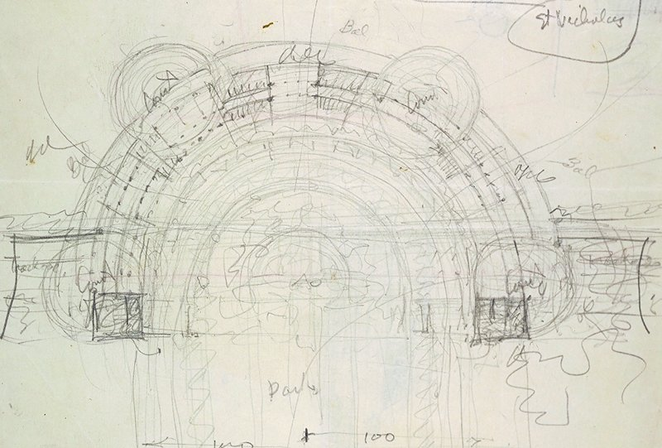



800 MHz SRF R&D for FCC-ee
August 25, 2025
Kellen McGee
FNAL

Slide 2

FCC week: 2025
M. Benedikt, FCC Collaboration
FCC Feasibility Study has been concluded with the submission of the Feasibility Study Report to the ESPP, as requested by CERN Council.
  Volume 1: Physics, Exp, Detectors (280p) https://arxiv.org/abs/2505.00272
  Volume 2: Accelerators, technical infrastructure, safety (627p) https://arxiv.org/abs/2505.00274
  Volume 3: Civil Engineering, Infrastructure, sustainability (357p) https://arxiv.org/abs/2505.00273
A coherent baseline design for the FCC integrated programme has been developed, including a well-advanced territorial implementation scenario, in line with desired CE construction start by 2032/33.
FCC-ee design level enables moving towards technical design and prototyping phase, well aligned with overall schedule and towards preparing input for potential project decision by 2027/28.
”FCC-ee: Your questions answered” –A. Blondel, P. Janot, ed. et al.
https://arxiv.org/pdf/1906.02693

Slide 3
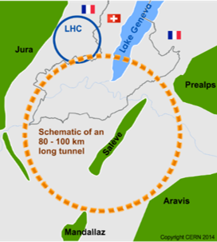
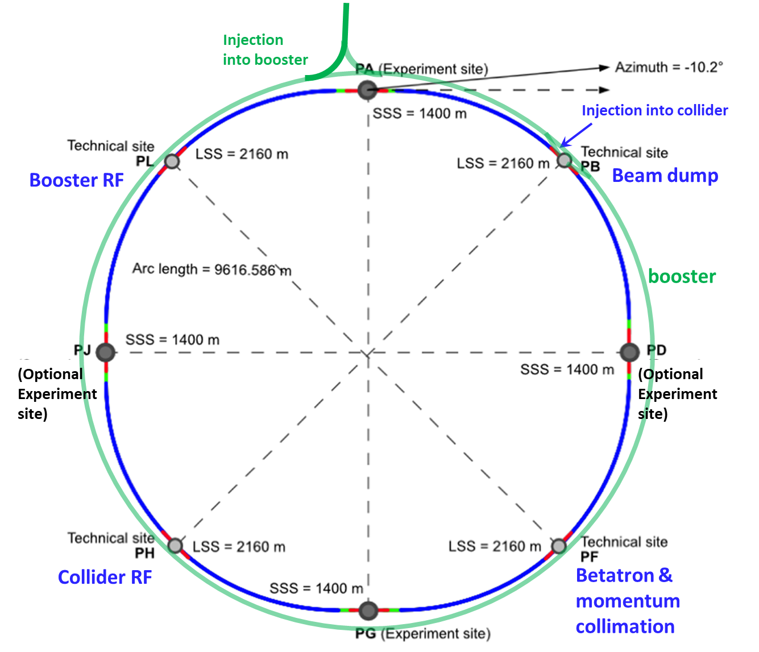
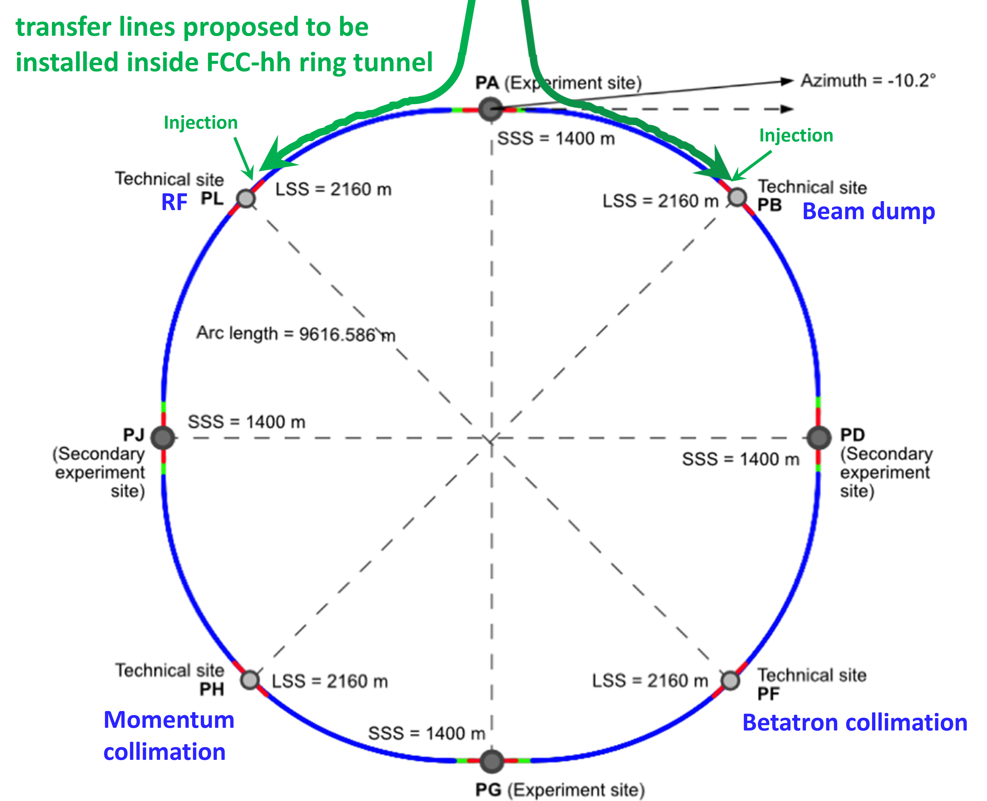
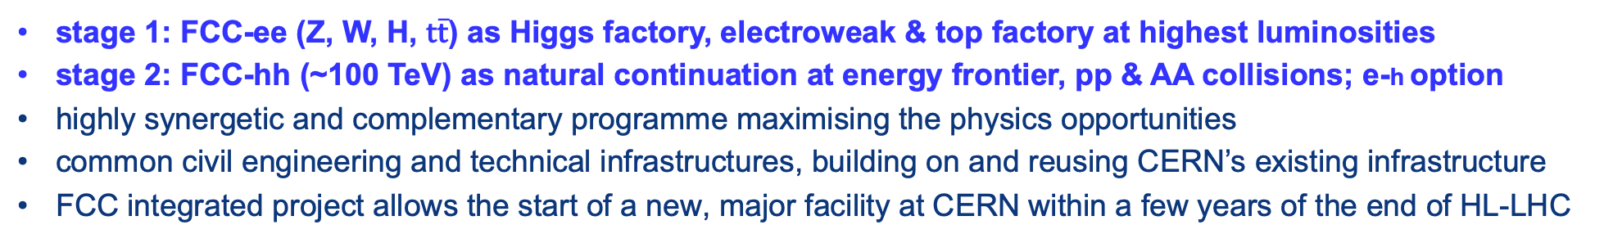
FCC integrated program – scope and timeline
M. Benedikt, FCC Collaboration
stage 1: FCC-ee (Z, W, H, $\text{t}\overline{\text{t}}$) as Higgs factory, electroweak & top factory at highest luminosities
stage 2: FCC-hh (~100 TeV) as natural continuation at energy frontier, pp & AA collisions; e-h option
highly synergetic and complementary programme maximising the physics opportunities
common civil engineering and technical infrastructures, building on and reusing CERN’s existing infrastructure
FCC integrated project allows the start of a new, major facility at CERN within a few years of the end of HL-LHC
FCC-ee
FCC-hh
2020 - 2045
2045 - 2065
2070 - 2100

Slide 4
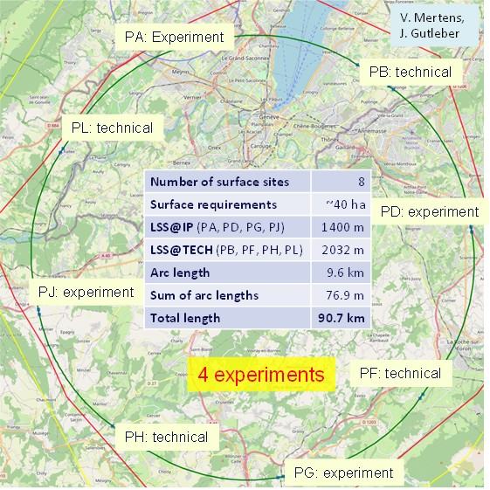
Reference layout and implementation:PA31 - 90.7 km
M. Benedikt, FCC Collaboration
Layout chosen out of ~ 100 initial variants, based on geology and surface constraints (land availability, access to roads, etc.), environment, (protected zones), infrastructure (water, electricity, transport), machine performance etc.
Overall lowest-risk baseline:
90.7 km ring, 8 surface points,
4-fold symmetry
Reference layout was the basis for:
Surface sites optimisation and land reservation with host states CH and FR
Environmental initial-state study

Slide 5
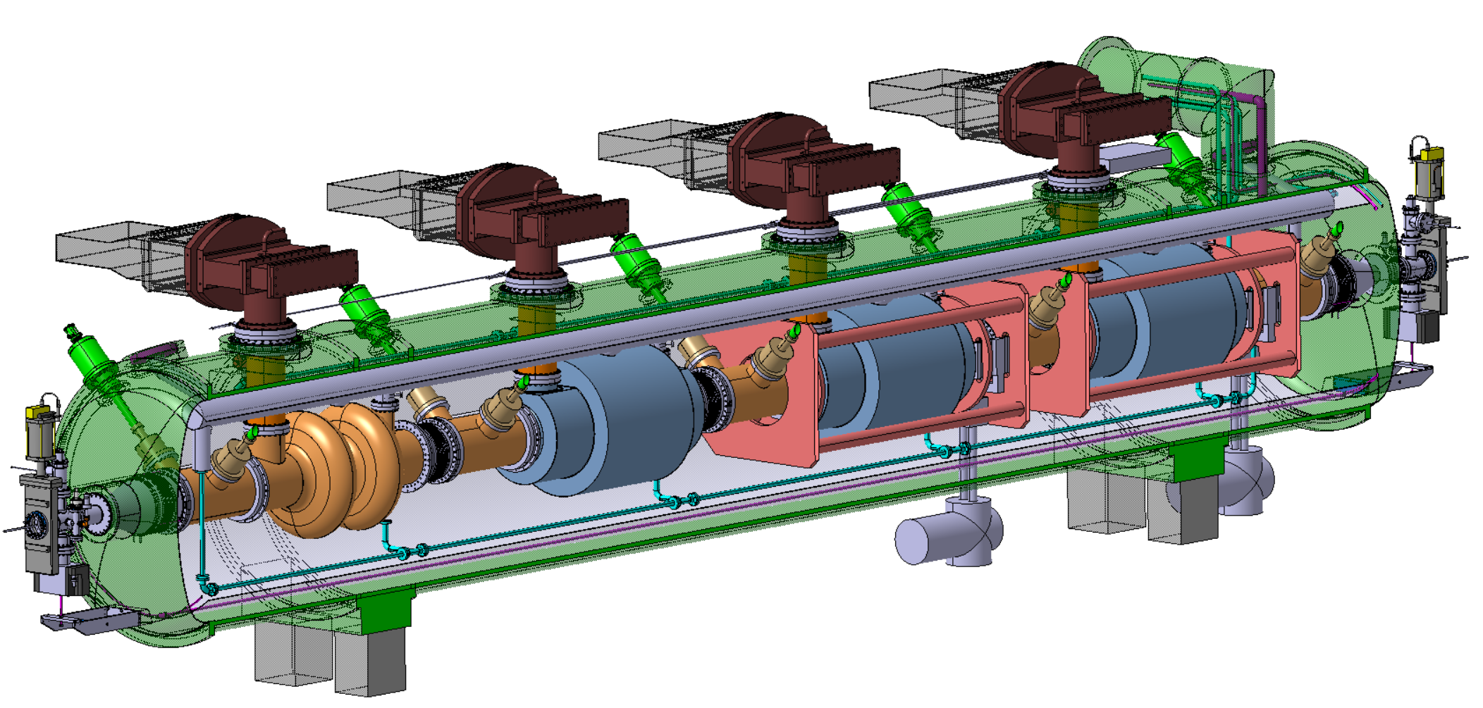
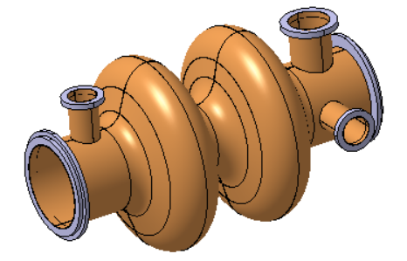
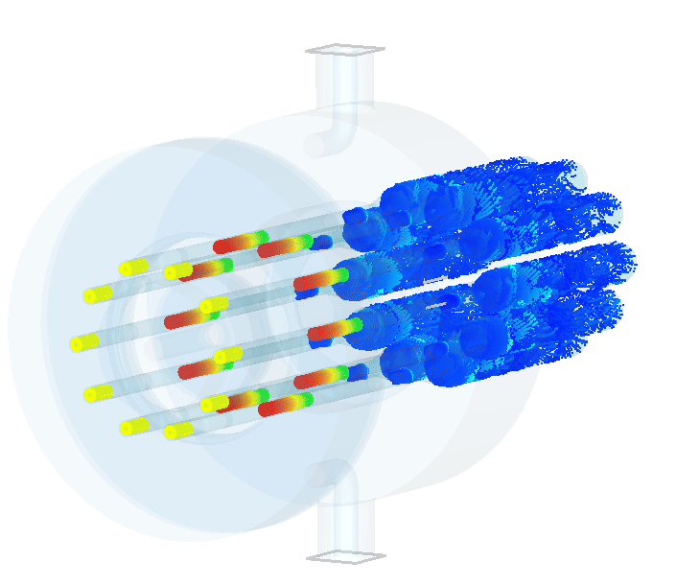
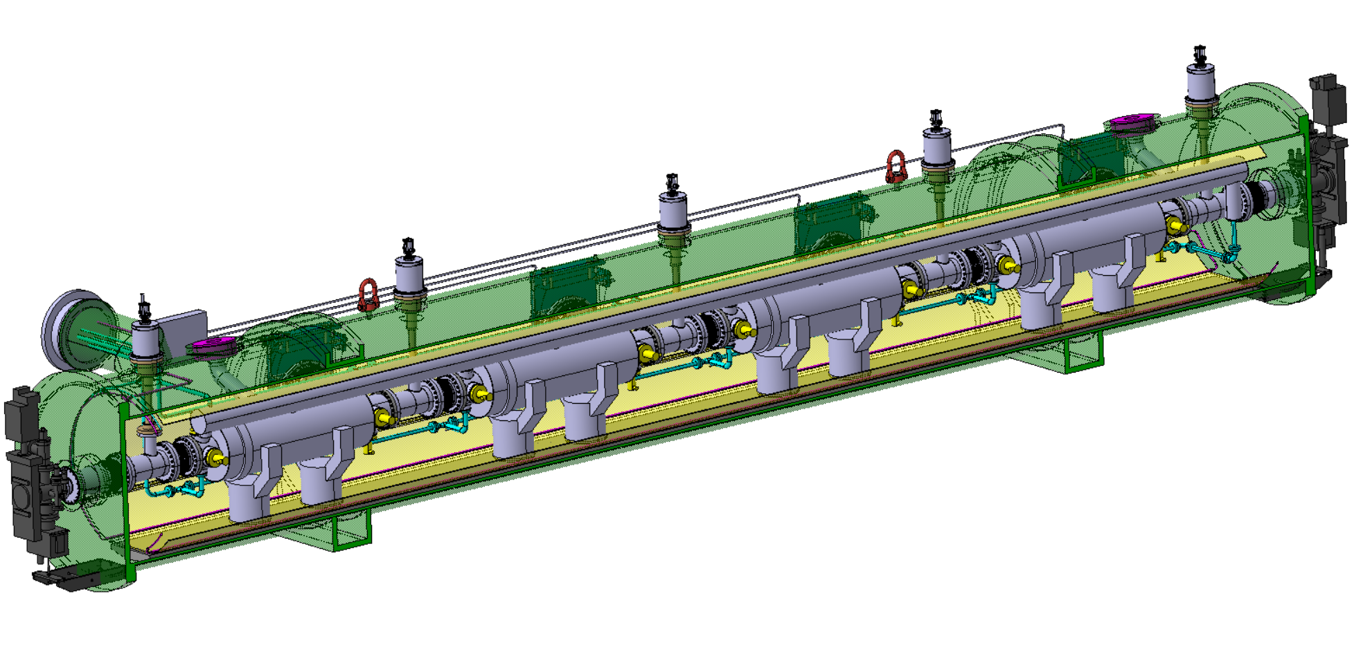
FCC-ee RF system – key technology, R&D ongoing
M. Benedikt, FCC Collaboration
400 MHz Collider
Power source: Multibeam Tristron
Very efficient ~90 % ! <<OPEX
3 m long
50 kV
500 kW, CW
X 264
X 66
Superconducting elliptical cavity
400 MHz, 2-cell, copper Nb coated
1.5 m. long
400 MHz Cryomodule
X 264
800 MHz Collider + Booster
X (408 + 448 booster)
X (102 + 112 booster)
X 204
+ 448 x 10 kW SSA booster
Superconducting elliptical cavity
800 MHz, 6-cell, bulk Nb
Nb₃Sn if R&D is successful
800 MHz Cryomodule

Slide 6
800 MHz SRF cavities and surface processing
01

Slide 7
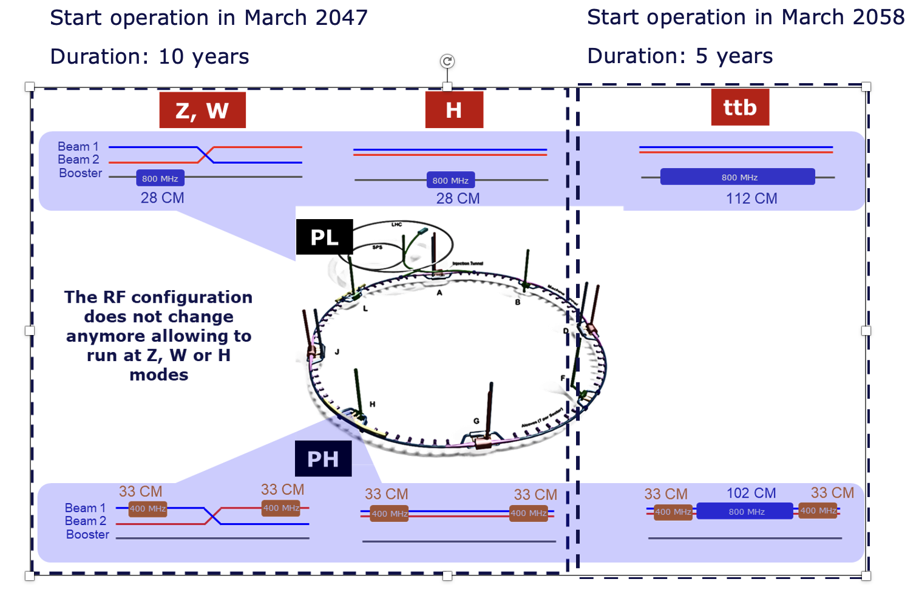
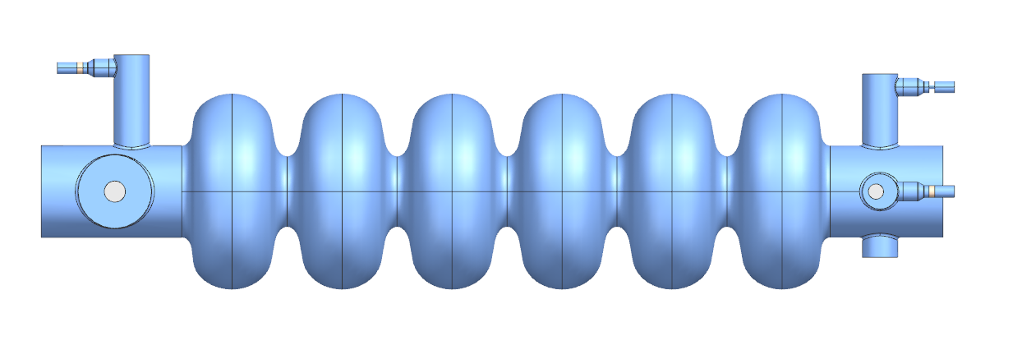
800 MHz SRF for FCC-ee
Introduction
800 MHz, 6-cell cavity performance goals
  Operation: Q0 = 3x10¹⁰ at E_{acc} = 20 MV/m
  Vertical test: Q0 = 3.8x10¹⁰ at E_{acc} = 24.5 MV/m
Phase 1: Z,W, and H operating points
  High-current machine: higher-order mode excitation
  Reverse phase operation enables Z,W, and H OPs
Phase 2: TTb operating point
  High-gradient machine
448 booster + 408 collider
= 856 cavities/214 CM
Booster: 112 cavities/28 CM
Booster | Z | W | ZH
 | RPO | RPO
Total RF voltage [MV] | 80 | 401.9 | 1961
Beam current [mA] | 16.2 | 6.2 | 2
RF Frequency [MHz] | 801.58
Operating temp. [K] | 2
Cavity voltage at extraction [MV] | 5.6 | 13.5 | 17.5
# cell/cavity | 6
Eacc [MV/m] | 4.9 | 12 | 15.6
Q0 | 3E+10
Max RF power [kW] | 42
Coupling QL | 1E+07
# CM (with 4 cav/CM) | 28
# cavities | 112

Slide 8
800 MHz SRF for FCC-ee
Introduction
800 MHz, 6-cell cavity performance goals
  Operation: Q0 = 3x10¹⁰ at E_{acc} = 20 MV/m
  Vertical test: Q0 = 3.8x10¹⁰ at E_{acc} = 24.5 MV/m
Phase 1: Z,W, and H operating points
  High-current machine: higher-order mode excitation
  Reverse phase operation enables Z,W, and H OPs
Phase 2: TTb operating point
  High-gradient machine
448 booster + 408 collider
= 856 cavities/214 CM
Booster: 112 cavities/28 CM
Booster | Z | W | ZH
 | RPO | RPO
Total RF voltage [MV] | 80 | 401.9 | 1961
Beam current [mA] | 16.2 | 6.2 | 2
RF Frequency [MHz] | 801.58
Operating temp. [K] | 2
Cavity voltage at extraction [MV] | 5.6 | 13.5 | 17.5
# cell/cavity | 6
Eacc [MV/m] | 4.9 | 12 | 15.6
Q0 | 3E+10
Max RF power [kW] | 42
Coupling QL | 1E+07
# CM (with 4 cav/CM) | 28
# cavities | 112
370 CM, ~1,500 cavities

Slide 9
Reaching high Q0
Recent advances in high-Q high-gradient SRF cavities
“2/0” N-doping: Bulk EP, High T (degassing+stress release) bake, light EP, N-Doping (2min doping/0min annealing), Post-doping+cold EP, HPR+VT assembly, RF test.
N-doping¹
  2012-13 FNAL: Doubled Q, reversed R_{BCS} dependence on E_{acc}
  Industrialized at 1.3 GHz to deliver LCLS-II
Medium temperature baking^{2,3}
  Simple one-step chemical processing (FNAL)
  300C, 3-hour bake dissolves the native oxide layer and diffuses oxygen into the niobium bulk
    Mechanism not fully understood, but seems to have traits in common with N-doping, despite differences in diffusion depth: See H. Hu, Hu, Hannah. "Decoupling of Nitrogen and Oxygen Impurities in Nitrogen Doped SRF Cavities." , Jun. 2024.
Sensitivity to trapped magnetic flux increases in both cases
    “Sensitivity” measures the amount of residual resistance generated per unit of trapped magnetic flux
    “Increased sensitivity” means your accelerator is more vulnerable to the effects of trapped flux
      Mitigation strategies include fast cooldown, improved magnetic hygene
¹ A. Grassellino et al, Supercond. Sci. Technol. 26, 102001 (2013).
Bulk EP, High T (degassing+stress release) 800-950C 3h, light EP, mid-T furnace bake 300C 3h, HPR, VT assembly, RF test.
² S. Posen, et al., Phys.Rev.Applied., Volume 13, Issue 1, Jan 2020 (FNAL)
³ H. Ito, et al., Prog of Theor. and Exp. Phys., Volume 2021, Issue 7, July 2021

Slide 10
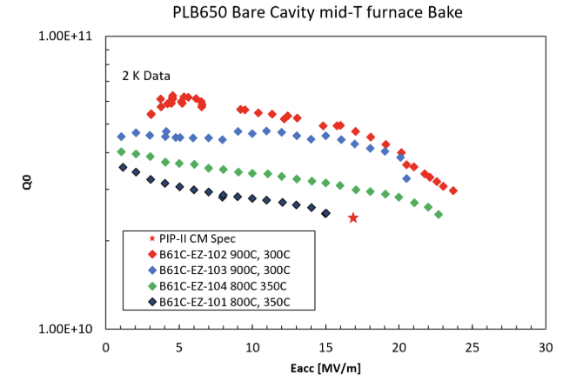
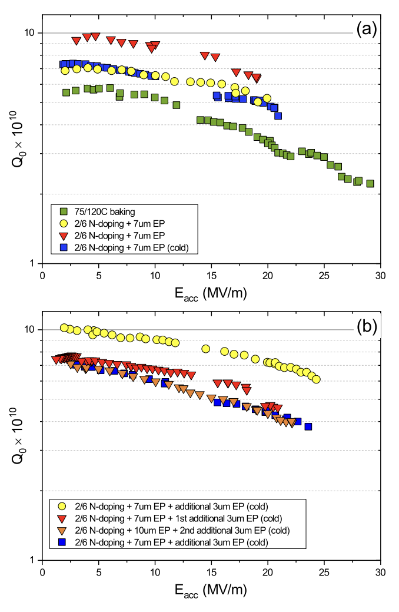
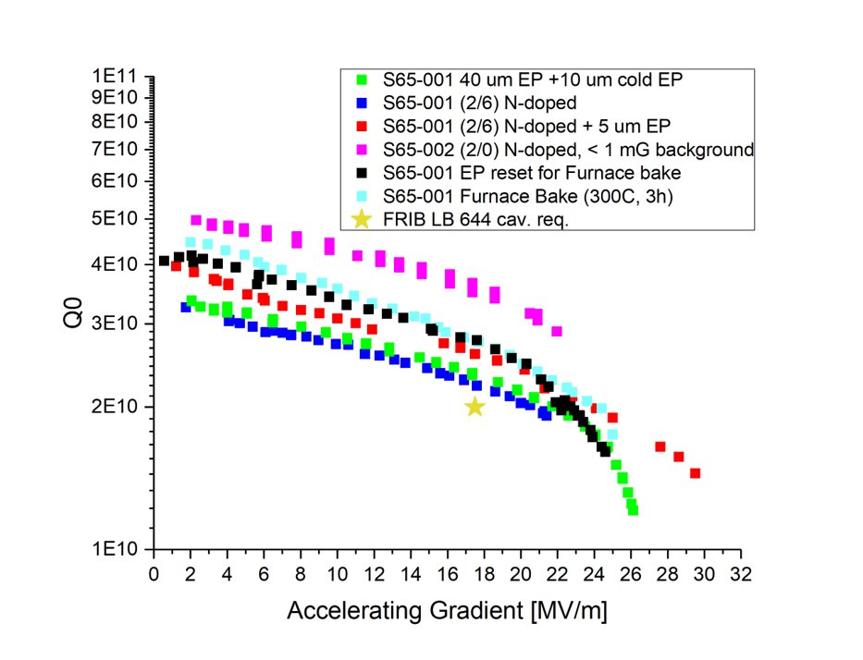
Technical perspective: SRF
PIP-II HB650: N-doping
PIP-II LB650: Mid-T
FRIB 644 MHz: various

Slide 11
Technical perspective: SRF
PIP-II HB650: N-doping
PIP-II LB650: Mid-T
FRIB 644 MHz: various

Slide 12
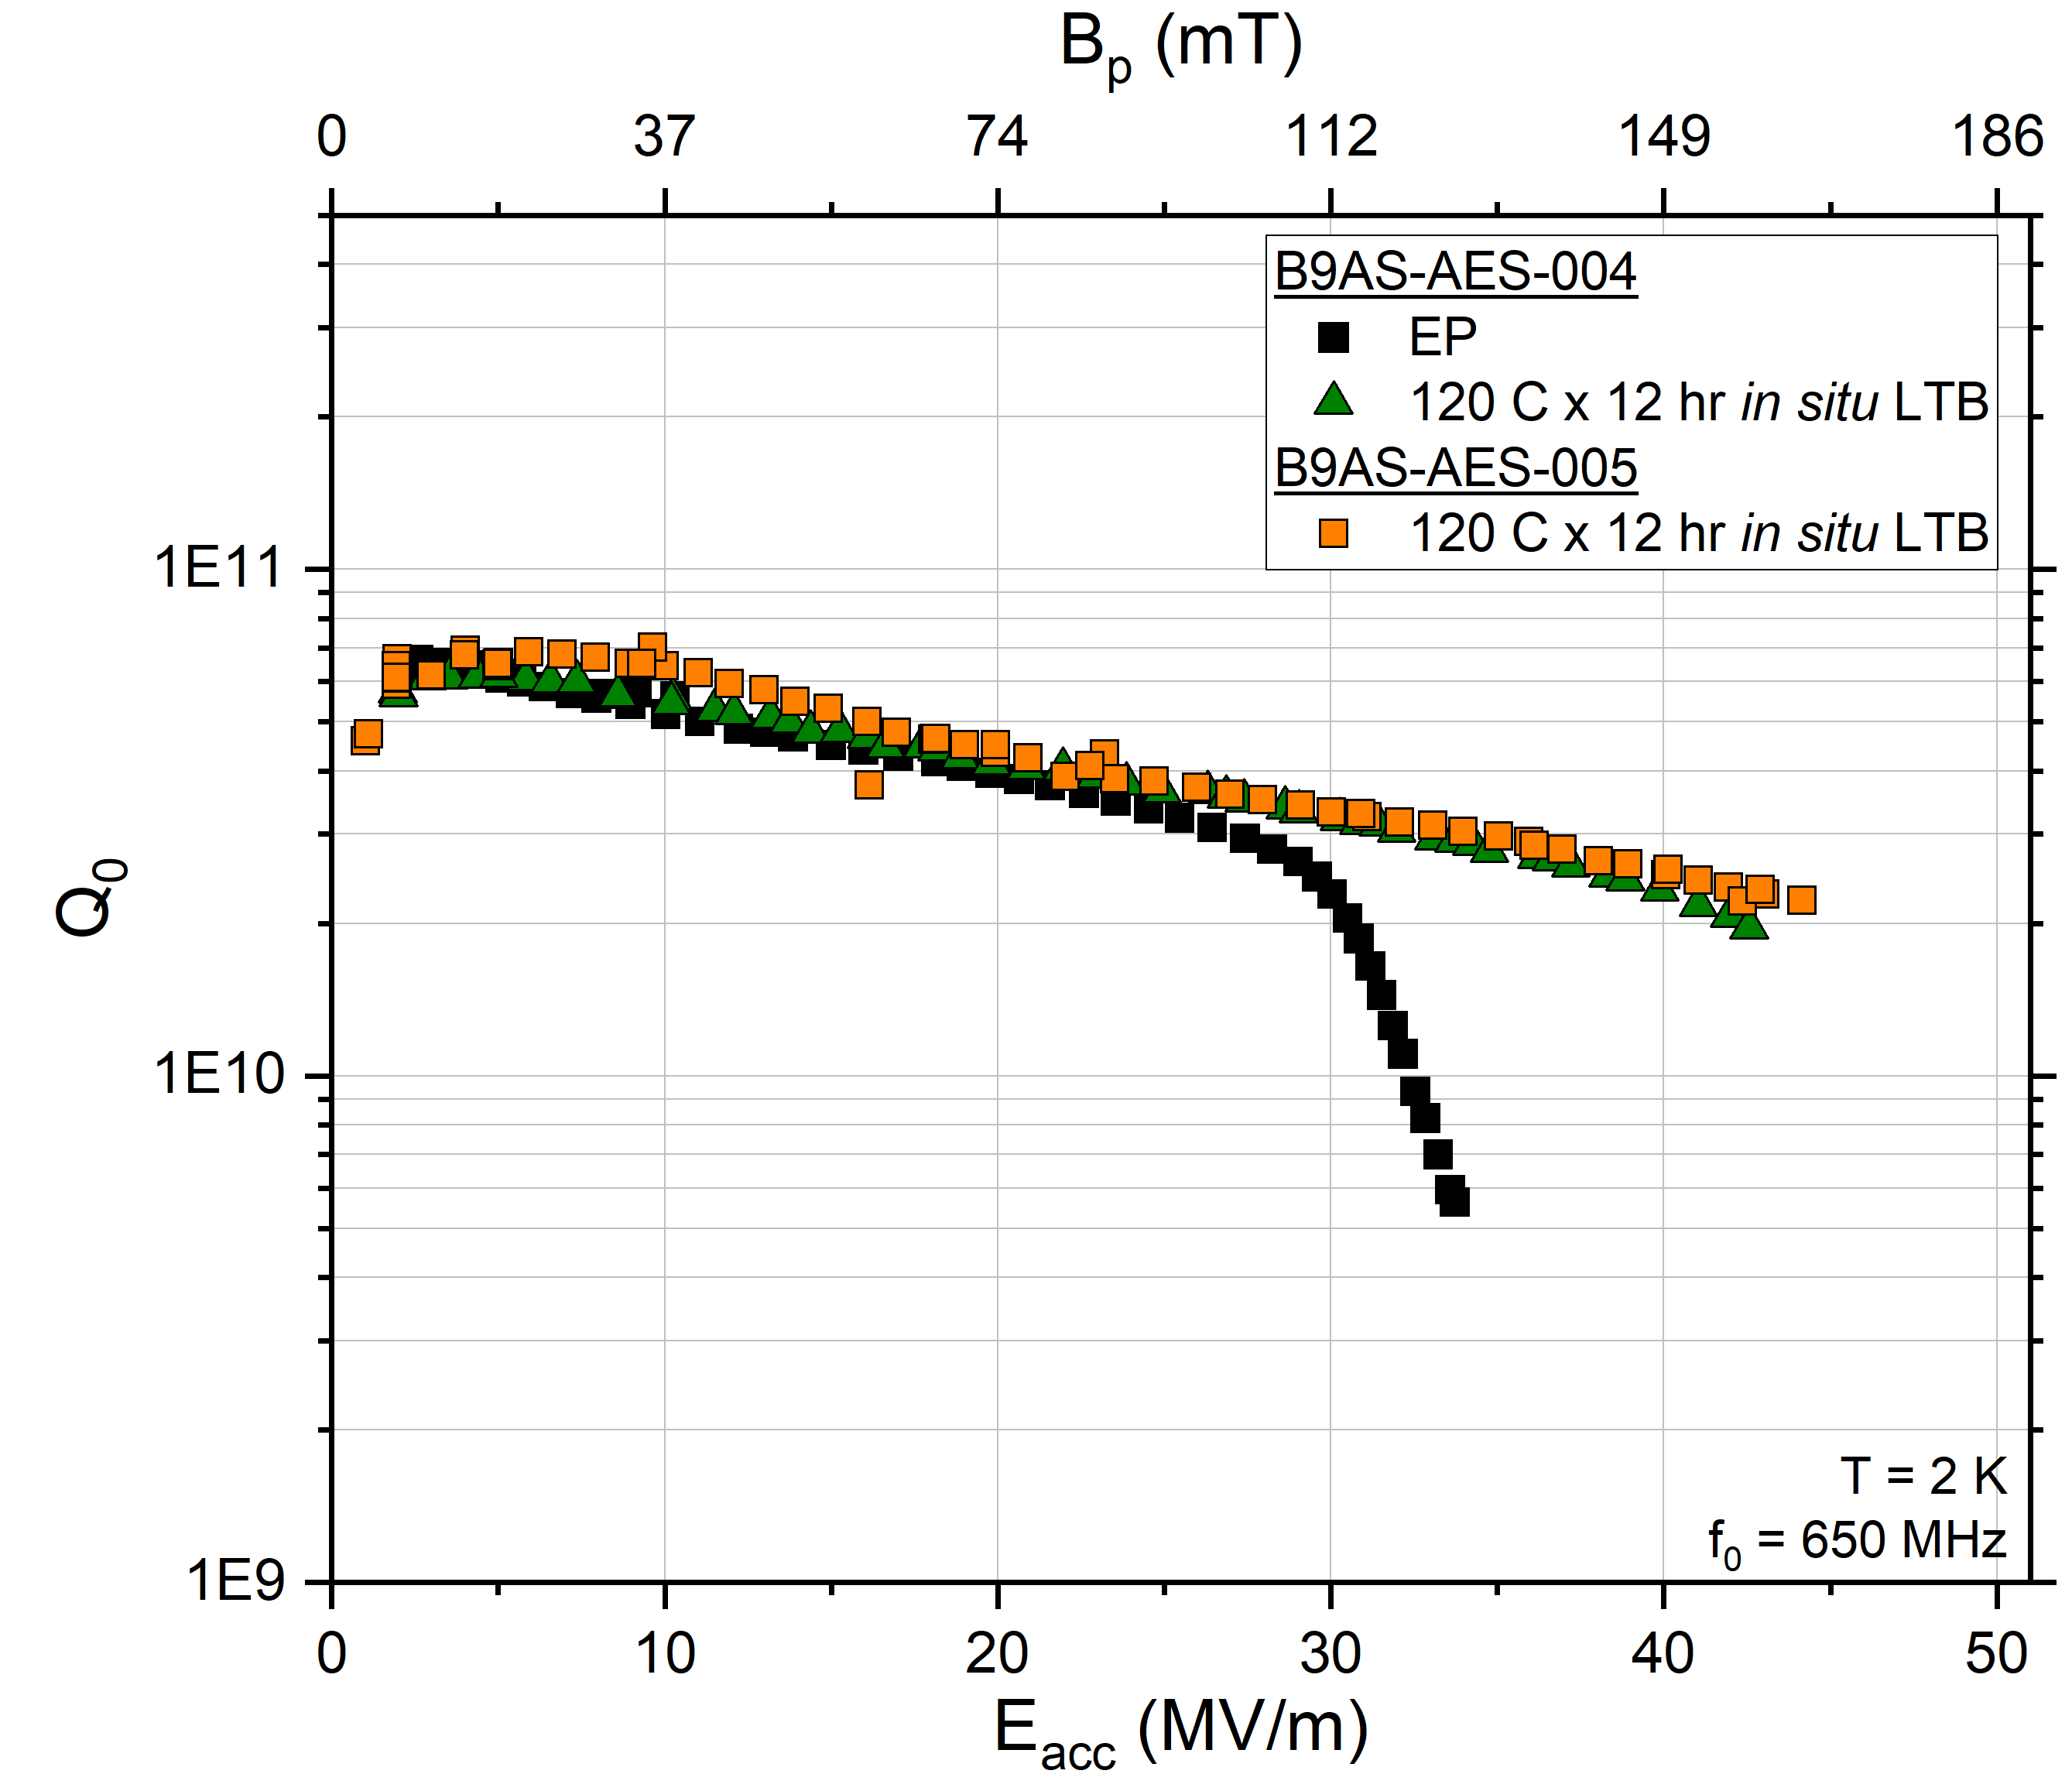
Technical perspective: SRF
PIP-II HB650: N-doping
PIP-II LB650: Mid-T
1-cell 650 MHz
FRIB 644 MHz: various
“Optimized EP”

Slide 13
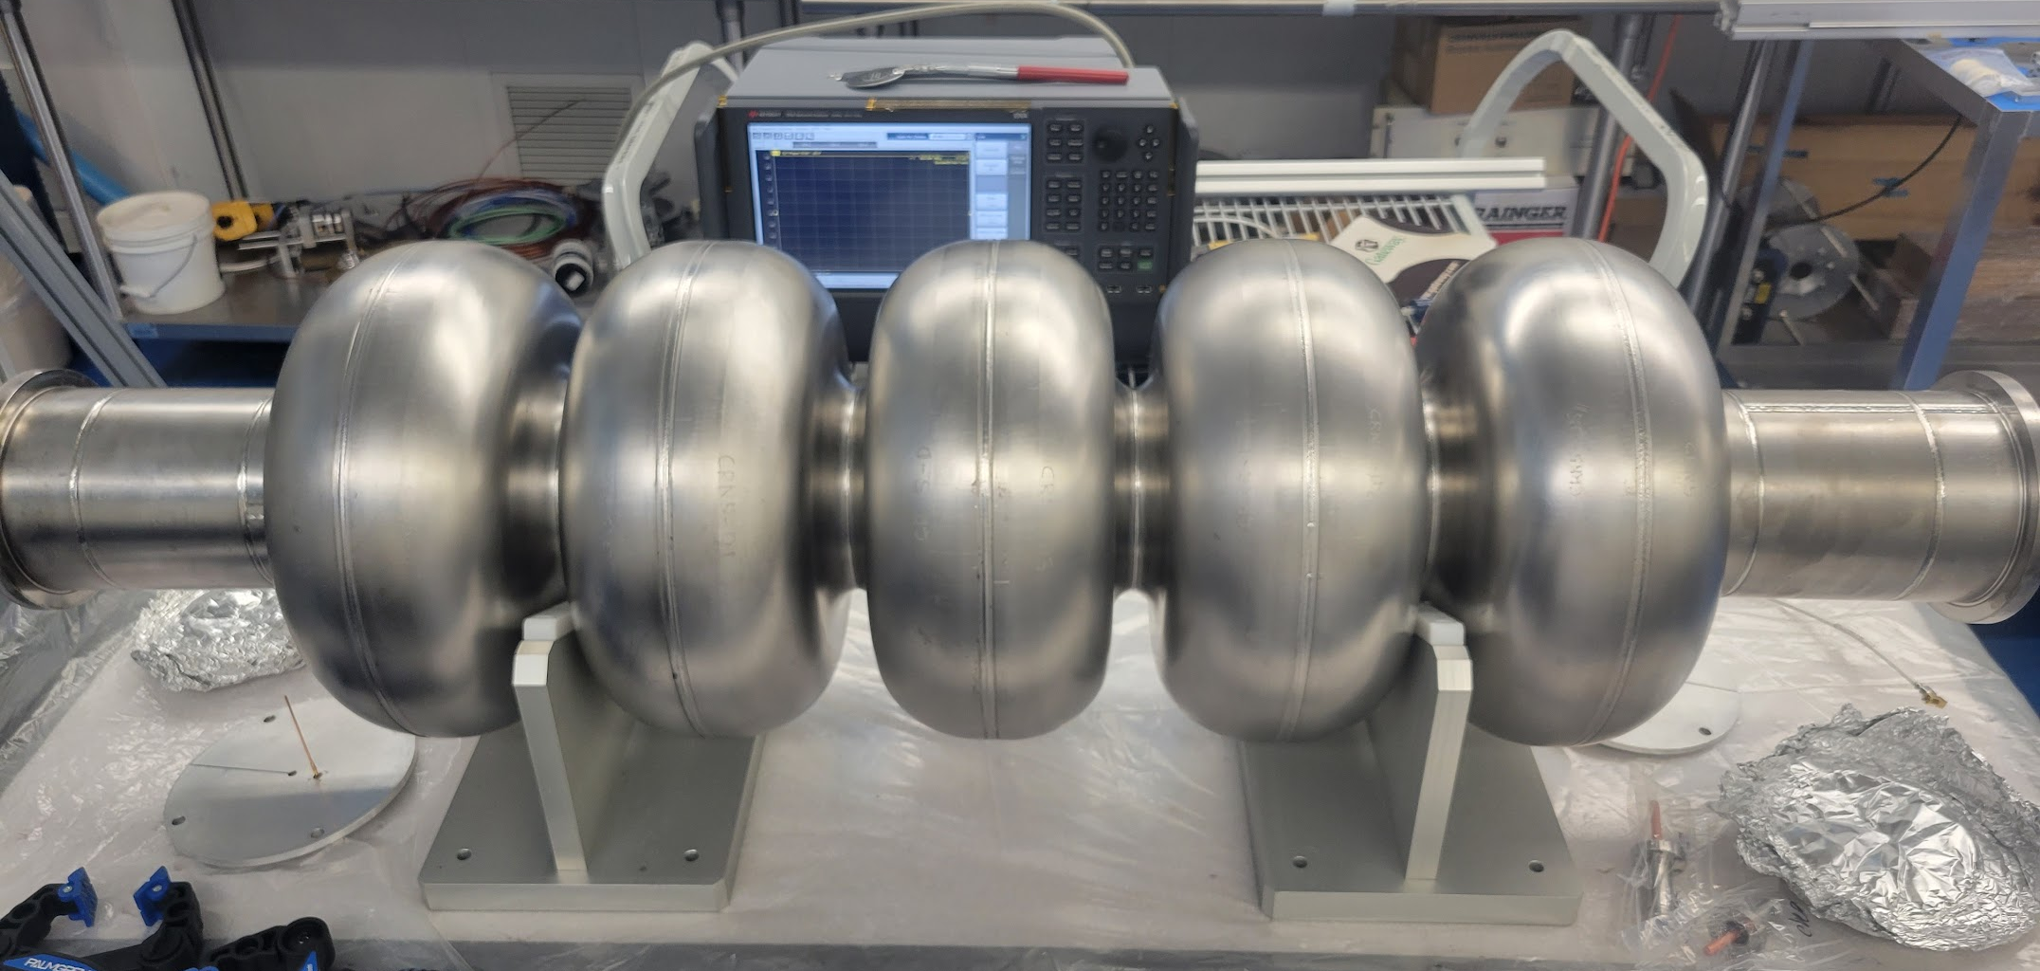
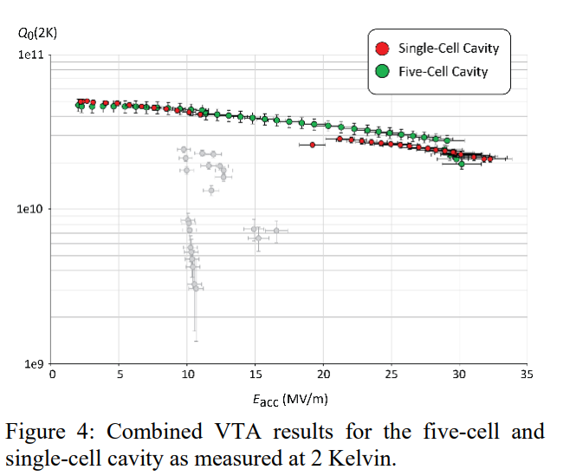
800 MHz 5-cell cavity
First experiments
Cavity fabricated at JLab, currently at FNAL
High-power RF cold-test baseline electropolish
  Q₀~3x10¹⁰ at 25 MV/m
  Quench at 27 MV/m
Explore advanced techniques for >26% improvement in Q₀
  Mid-T baking complete 7/2025!
    Cold-test expected Fall 2025
  N-doping?
  Nb3Sn (future)
F. Marhauser et al. 802 MHz ERL Cavity Design and Development (cern.ch) IPAC 2018 THPAL146

Slide 14
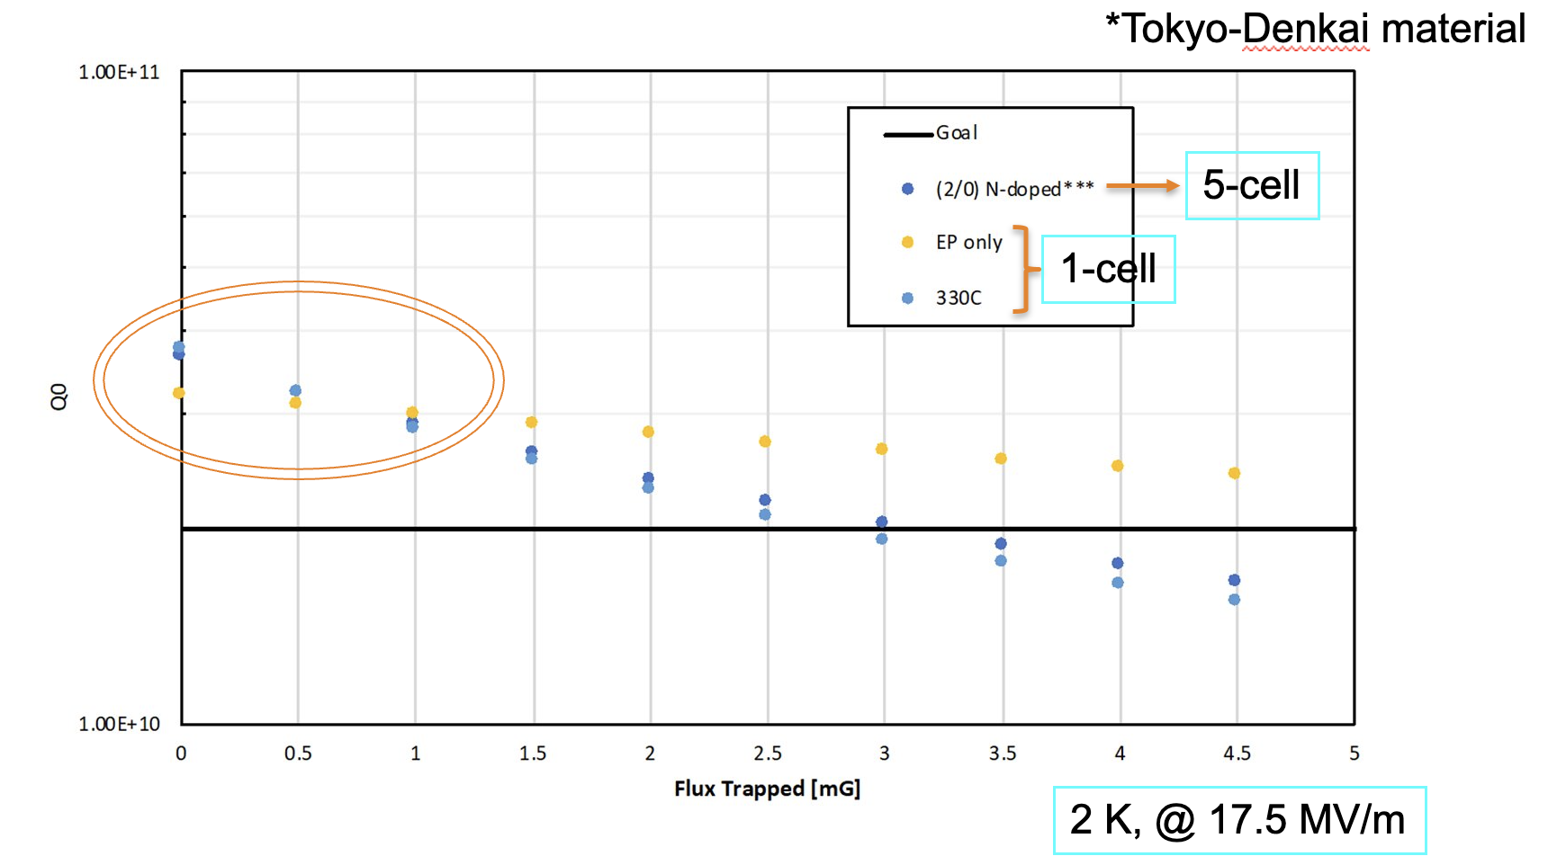
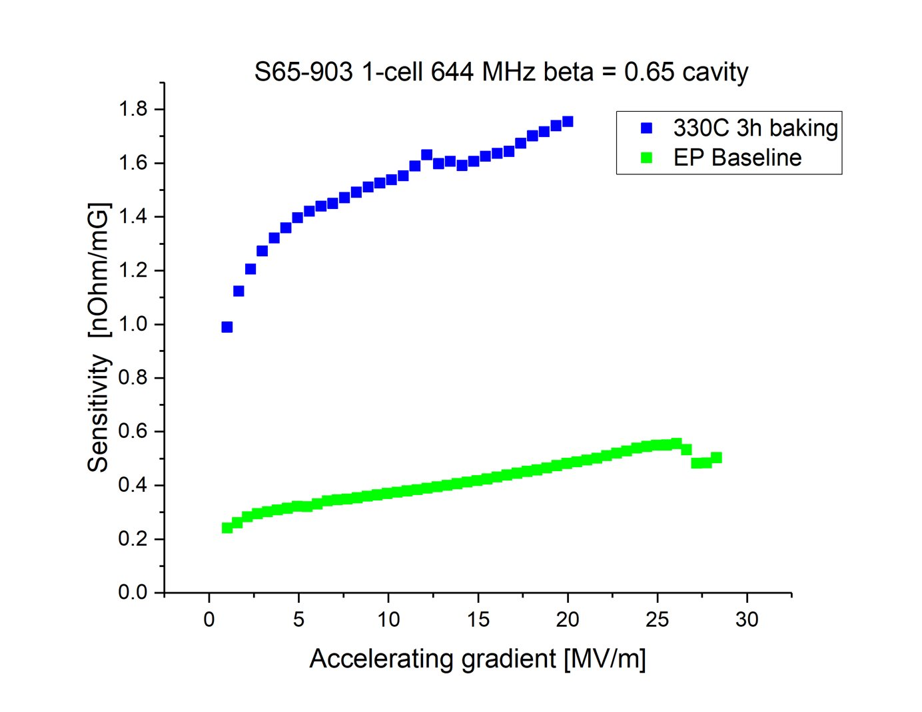
Production challenges
PIP-II LB650: Mid-T
Magnetic flux trapping and implications
Flux trapping degrades Q!
  Varies within Nb batches
  Highly correlated with Nb texture
  Difficult/impossible to control at the Nb vendor level
Mid-T baking

Slide 15
Mechanical design and analysis of 800 MHz cavities and cryomodules at FNAL
02

Slide 16
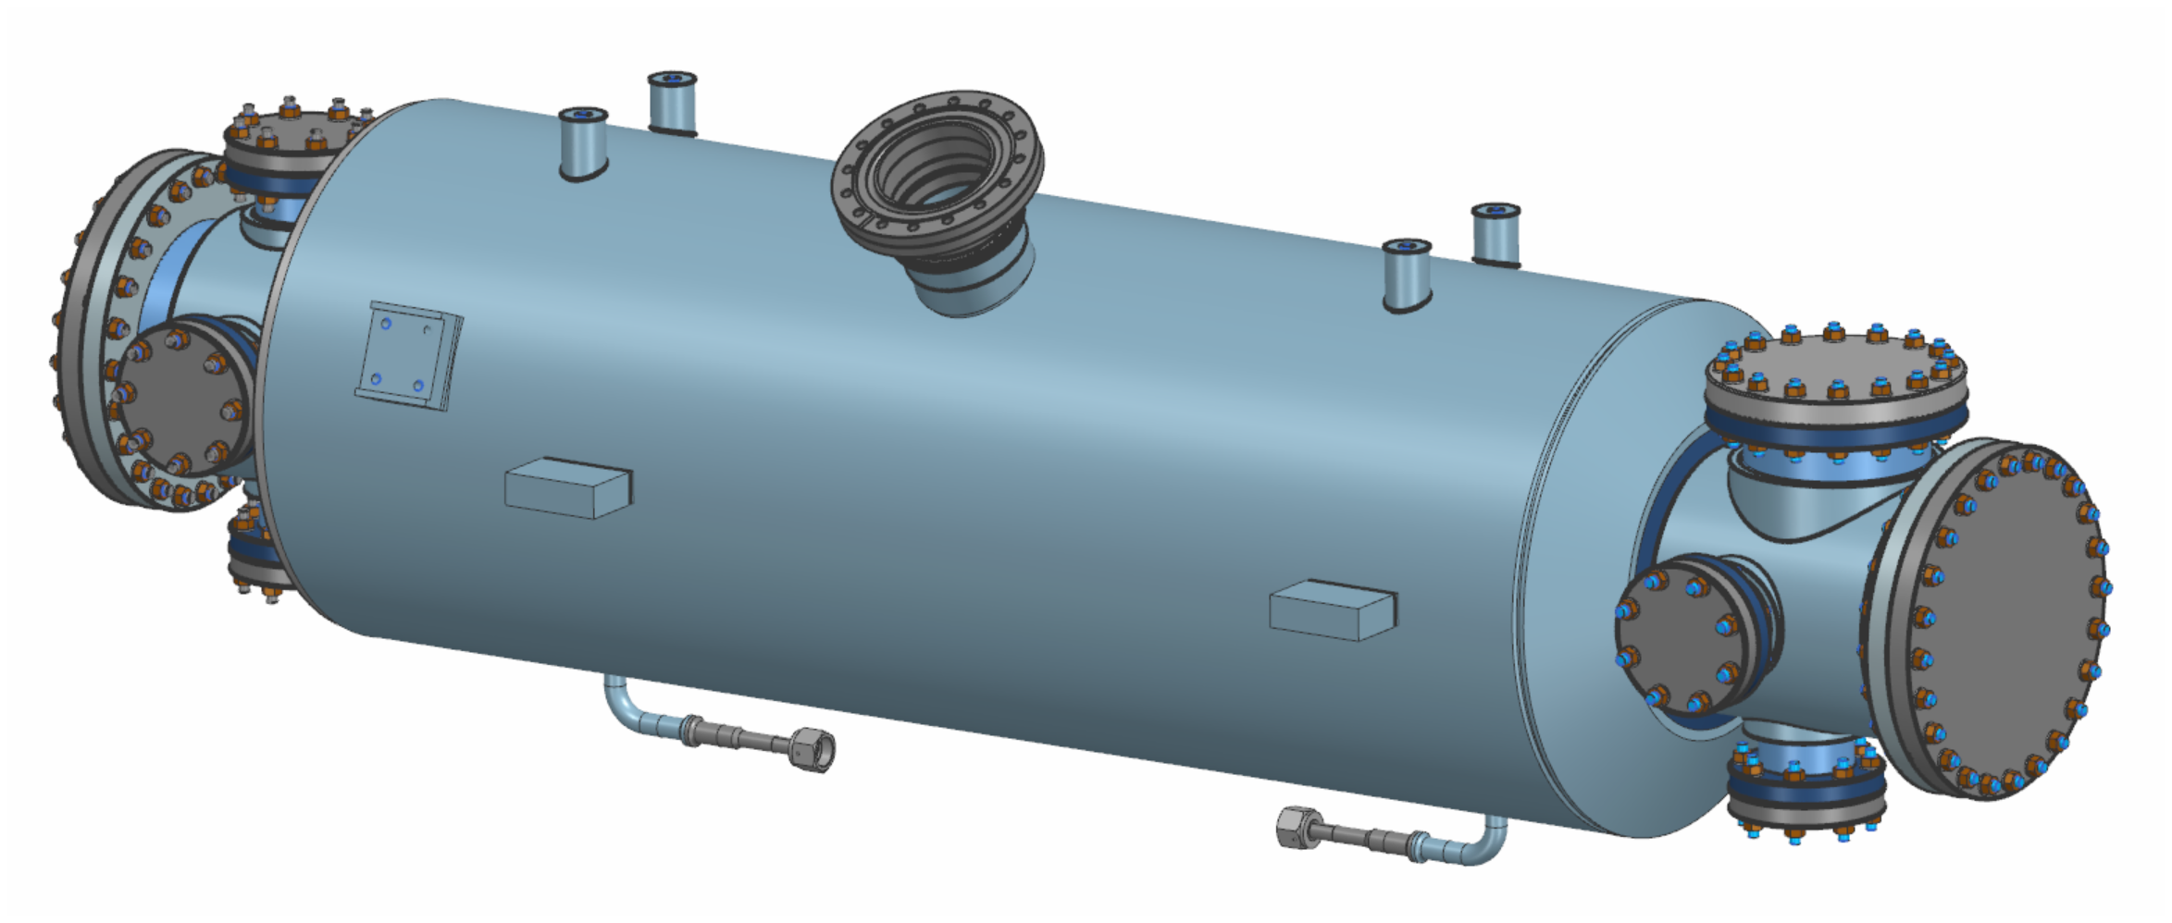
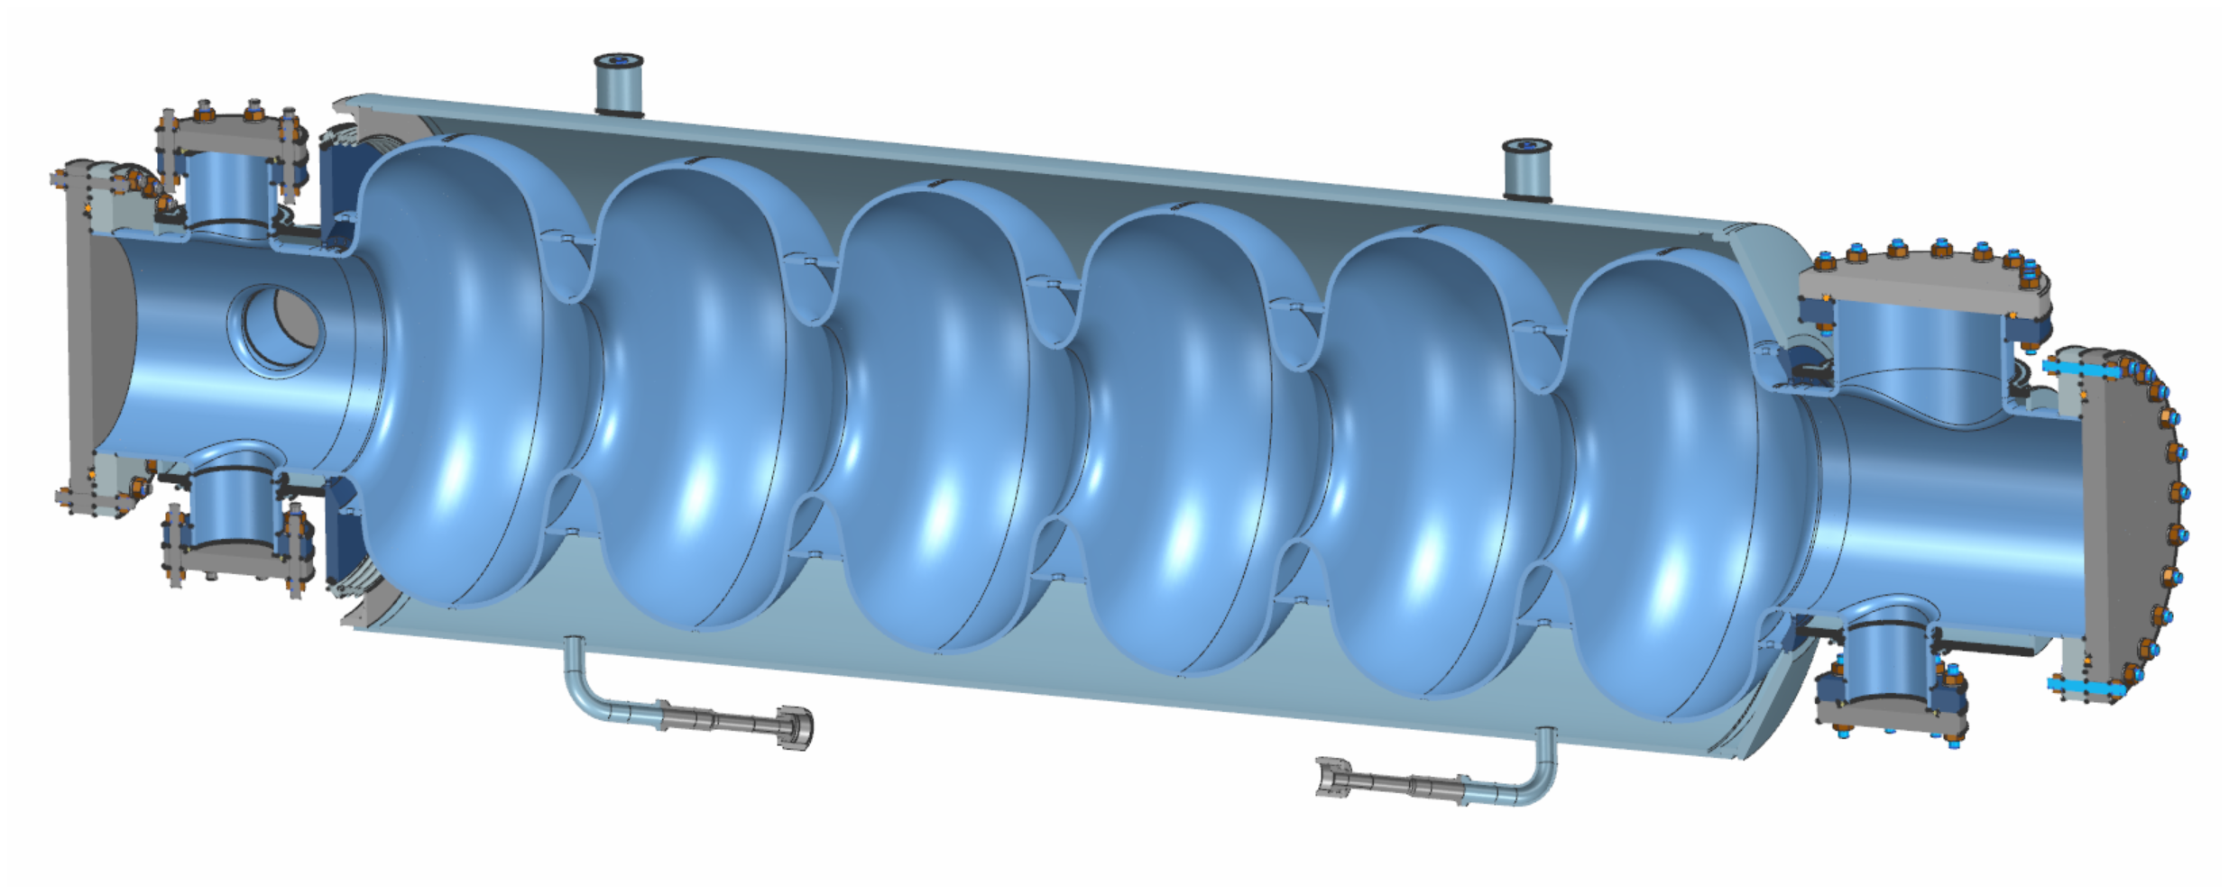
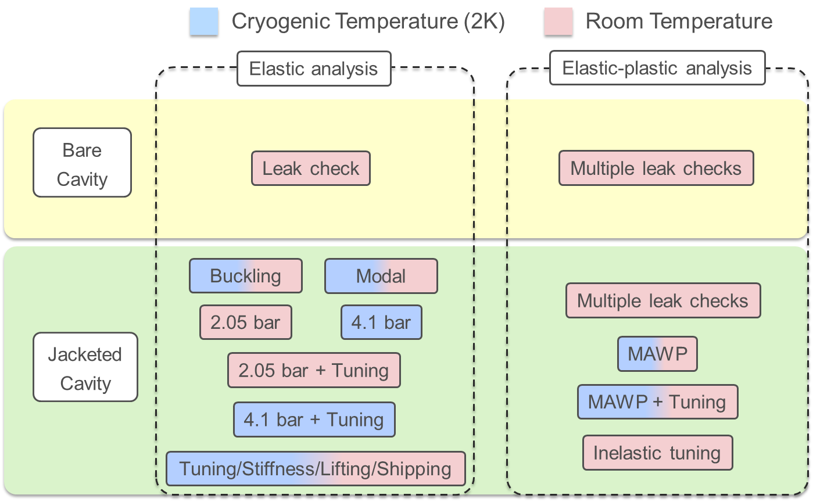
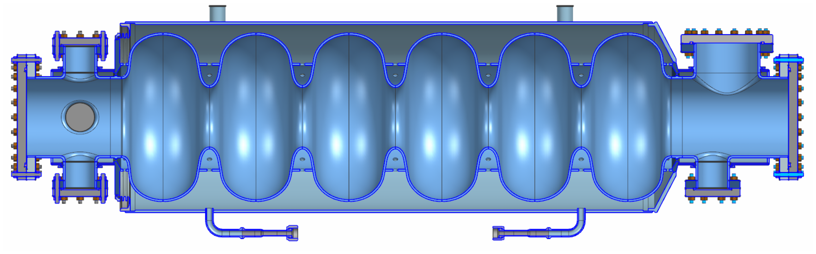
3D Model and planned analysis
Mattia Parise, FNAL
Cavity mechanical design and jacket integration underway!
  The MAWP primarily determined using design-by-analysis per Part 5 of Division 2 of ASME boiler and pressure vessel code. Part 4 is used to verify the FEA, guide the design of the bellows and openings, and set minimum thicknesses for the main shell and cavity ends
  Additional analysis, specific to SRF cavities, are carried out to check tunability and structural stability during leak checks.

Slide 17
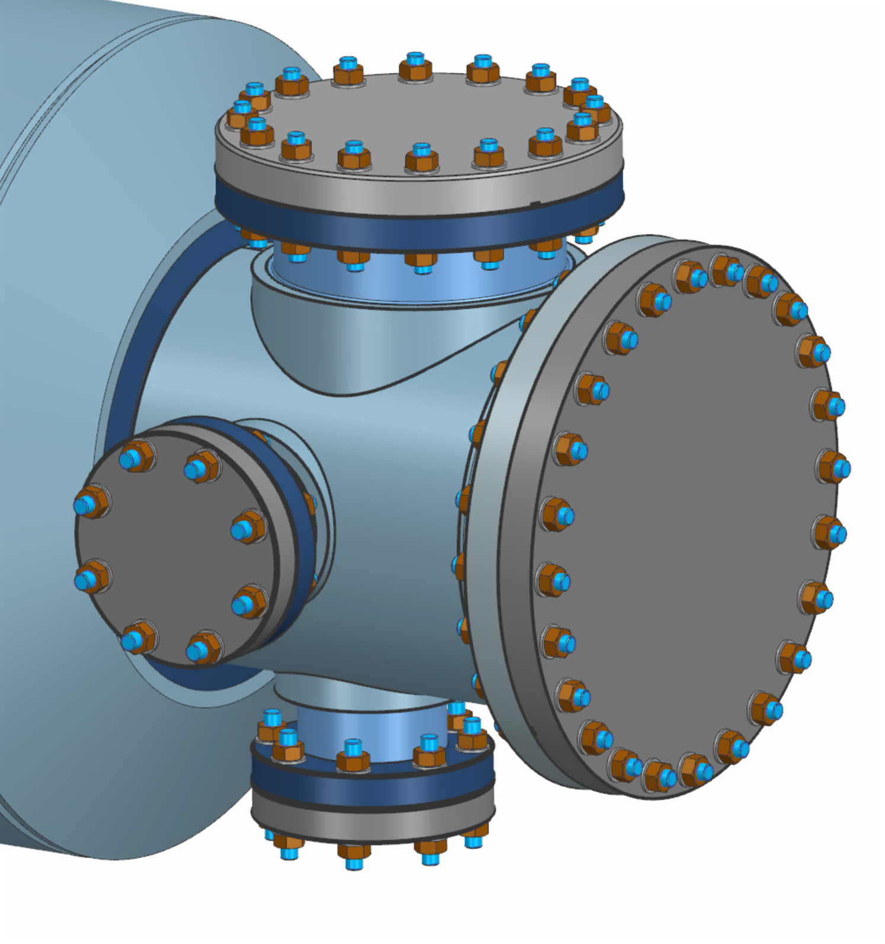
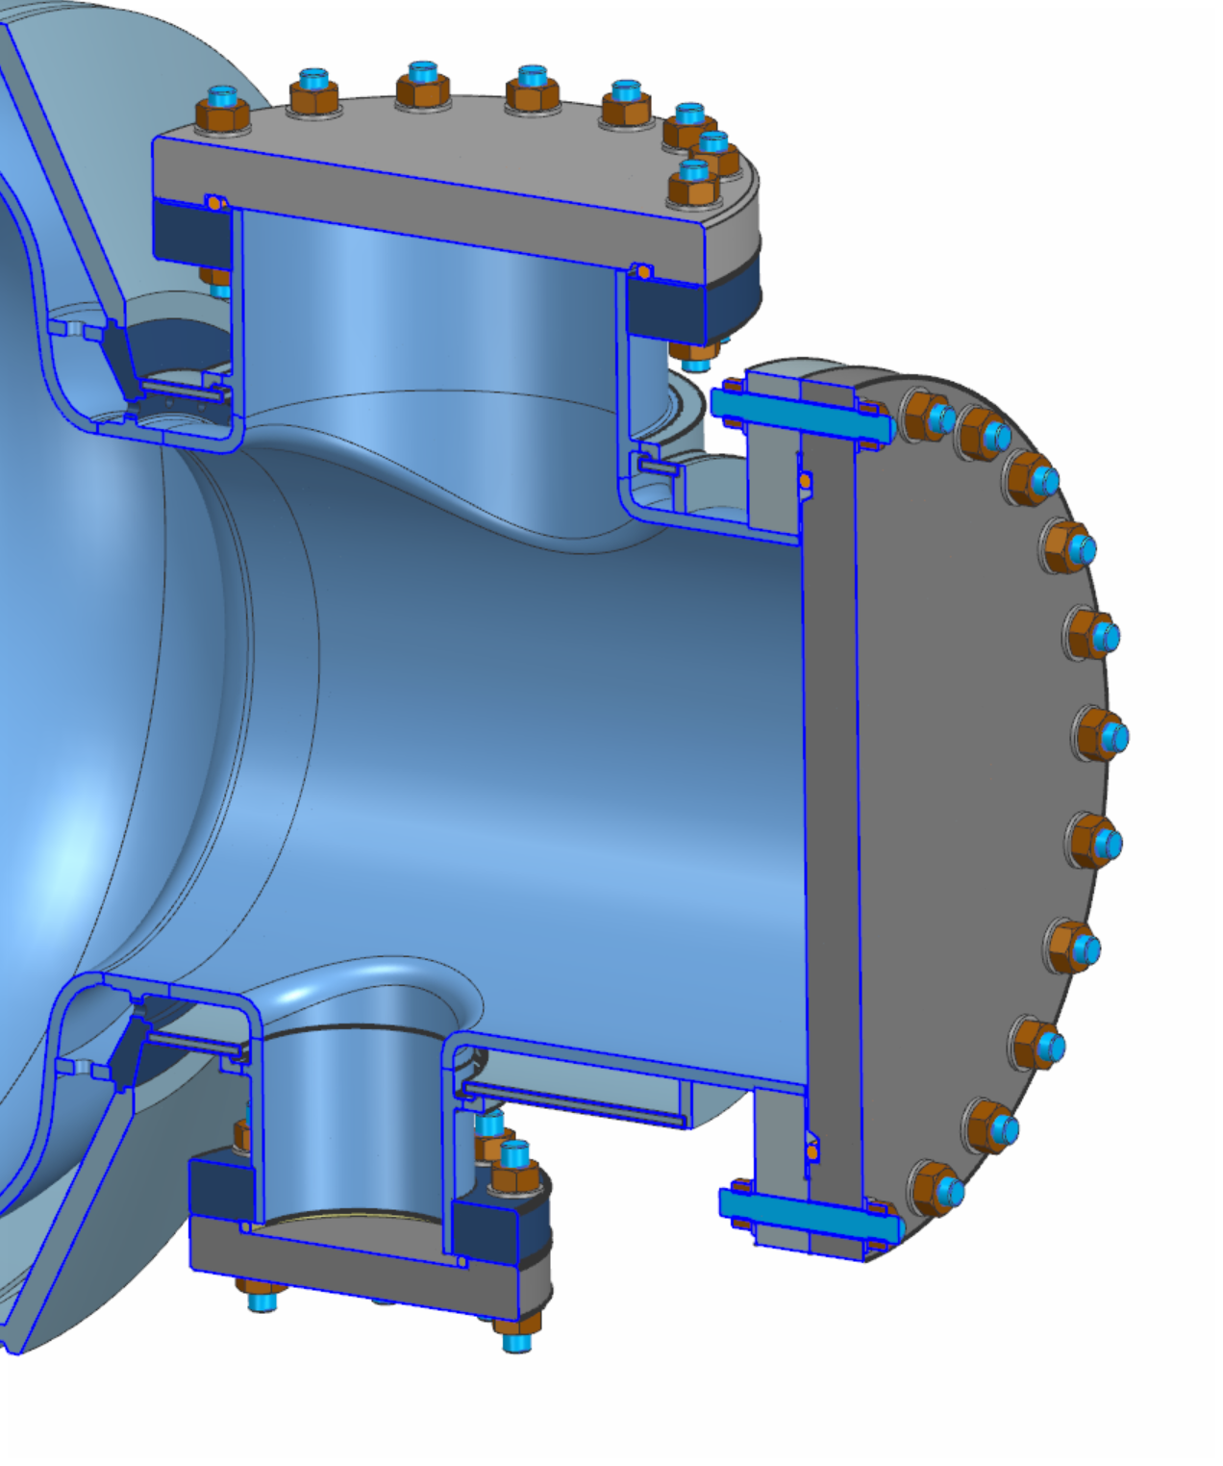
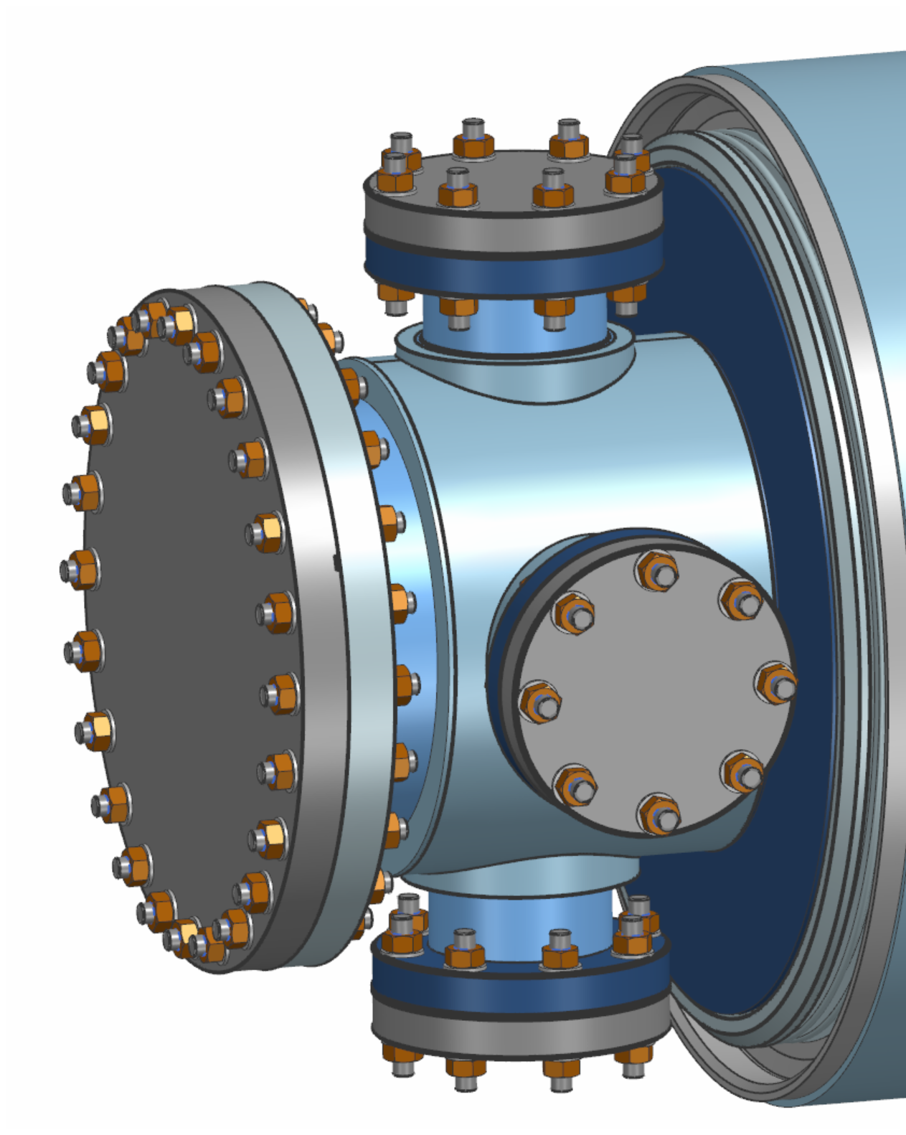
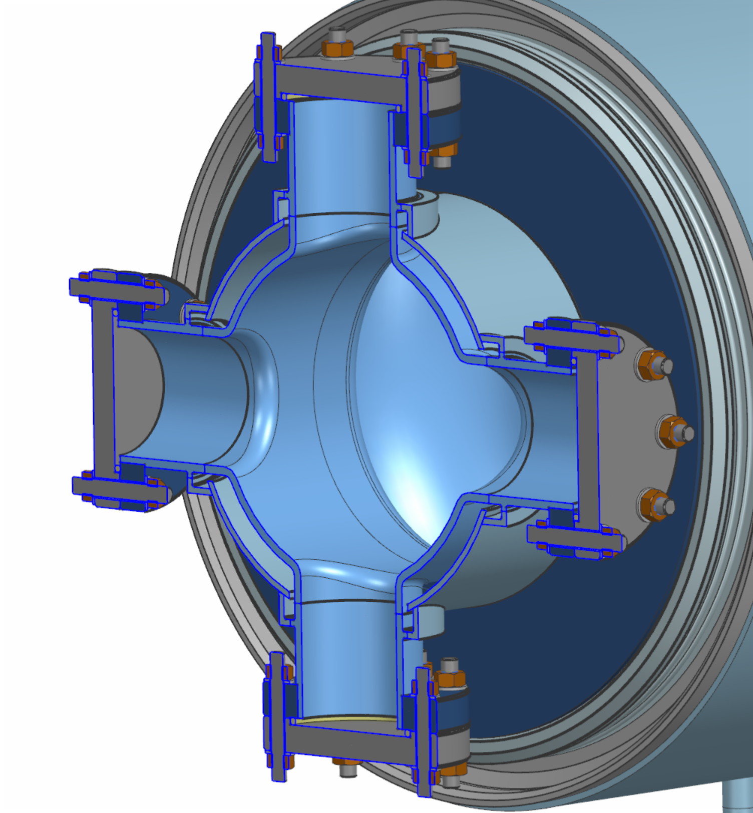
3D Model and planned analysis
Mattia Parise, FNAL
Progress on conceptual mechanical designs
  Complex higher order mode (HOM) port design
  Single cavity design for booster and collider
  Potential need for active cooling on the HOM ports, studies ongoing
Detailed weldmap, fabrication plans to be optimized

Slide 18
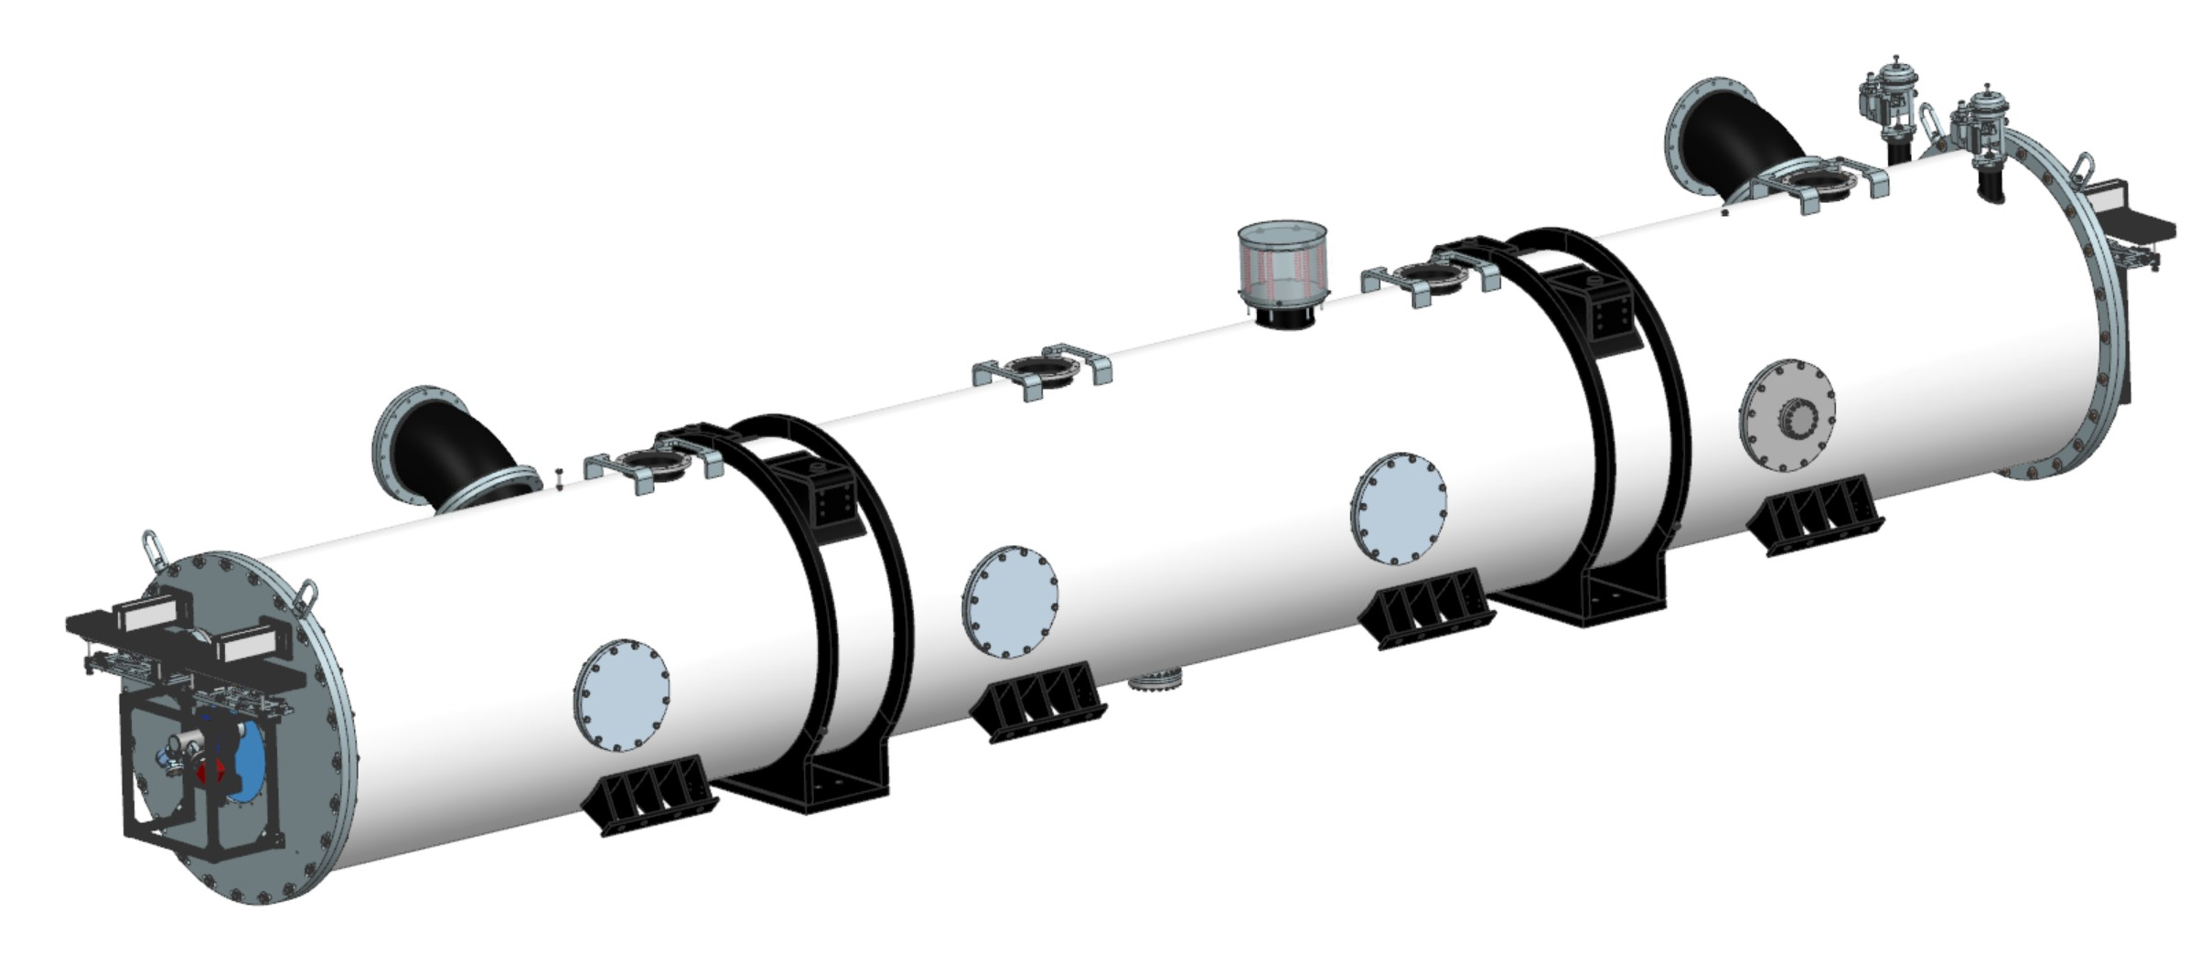
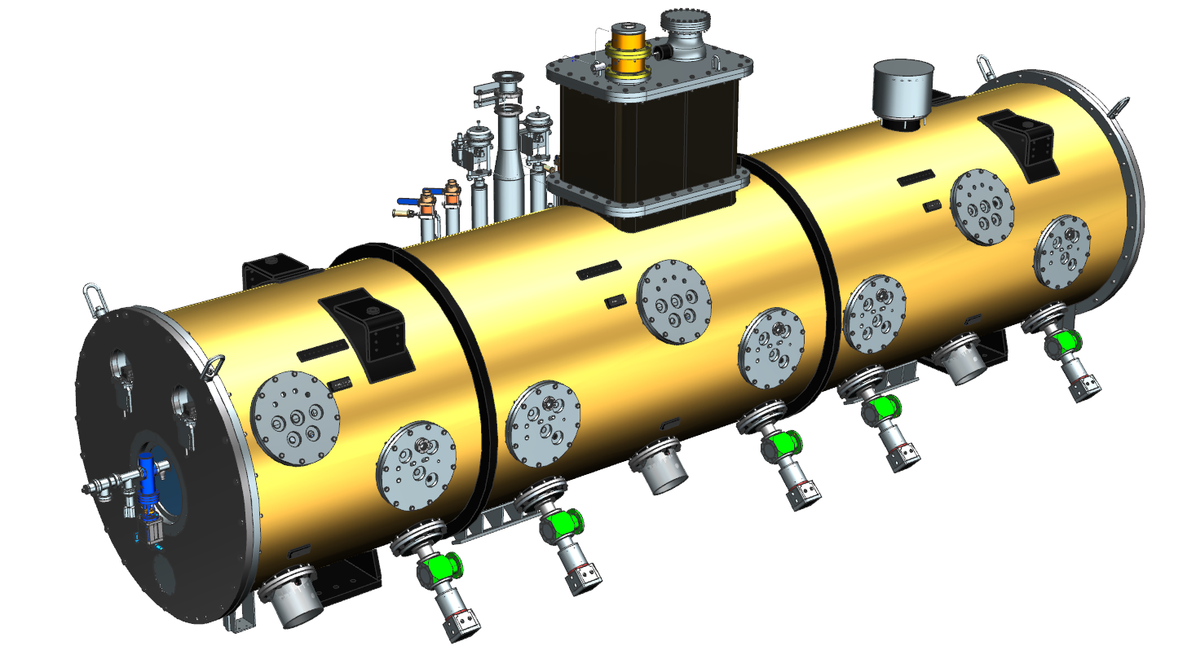
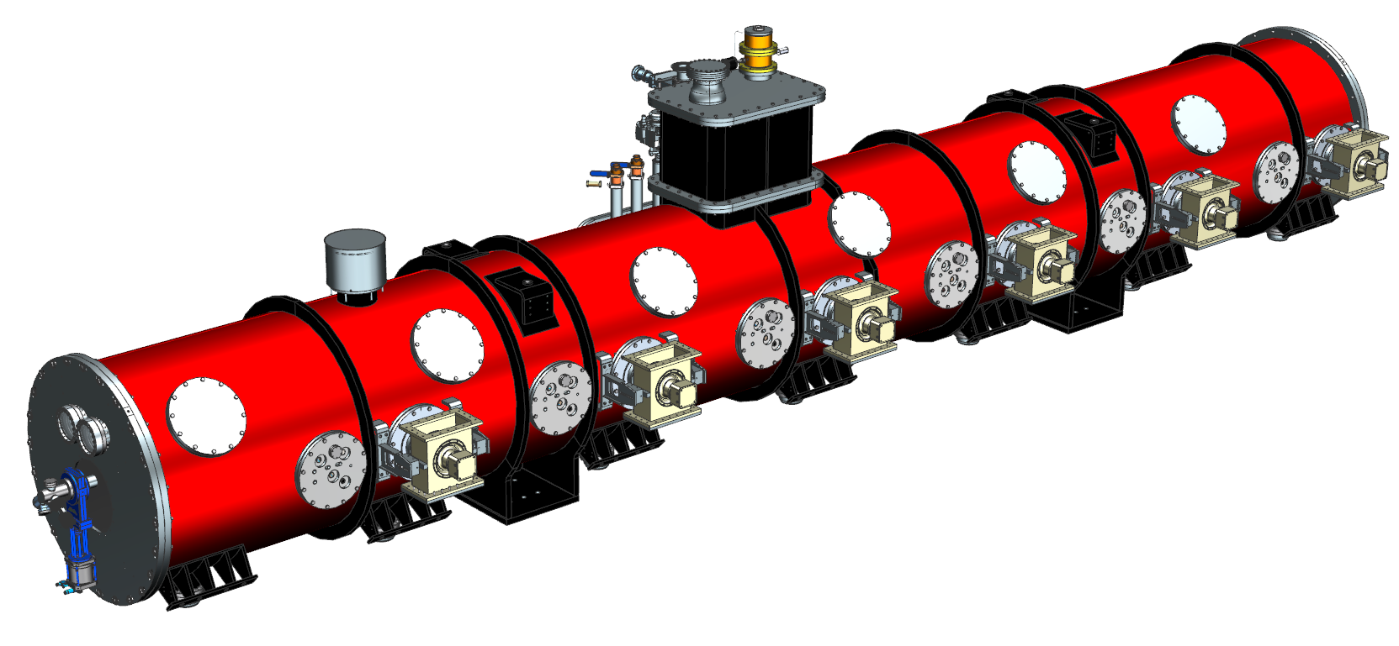
Preliminary design of FCC 800MHz Cryomodule
Vincent Roger, FNAL
The FCC 800 MHz CM design is based on SSR2 and HB650 PIP-II CMs with the following main differences:
  Heat exchangers and valves are integrated into the Cryogenic Distribution System (CDS).
  A “Jumper” will be used to interface with CDS through welded connection into the tunnel (no u-tubes).
  Couplers are actively cooled with helium.
FCC 800 MHz cryomodule
“Final Design of the Pre-Production SSR2 Cryomodule for PIP-II Project at Fermilab”, V. Roger et al., Proceedings of LINAC 2022
“Design of the 650 MHz High Beta Prototype Cryomodule for PIP-II at Fermilab”, V. Roger et al., Proceedings of SRF 2021
PIP-II SSR2 cryomodule
PIP-II HB650 cryomodule

Slide 19
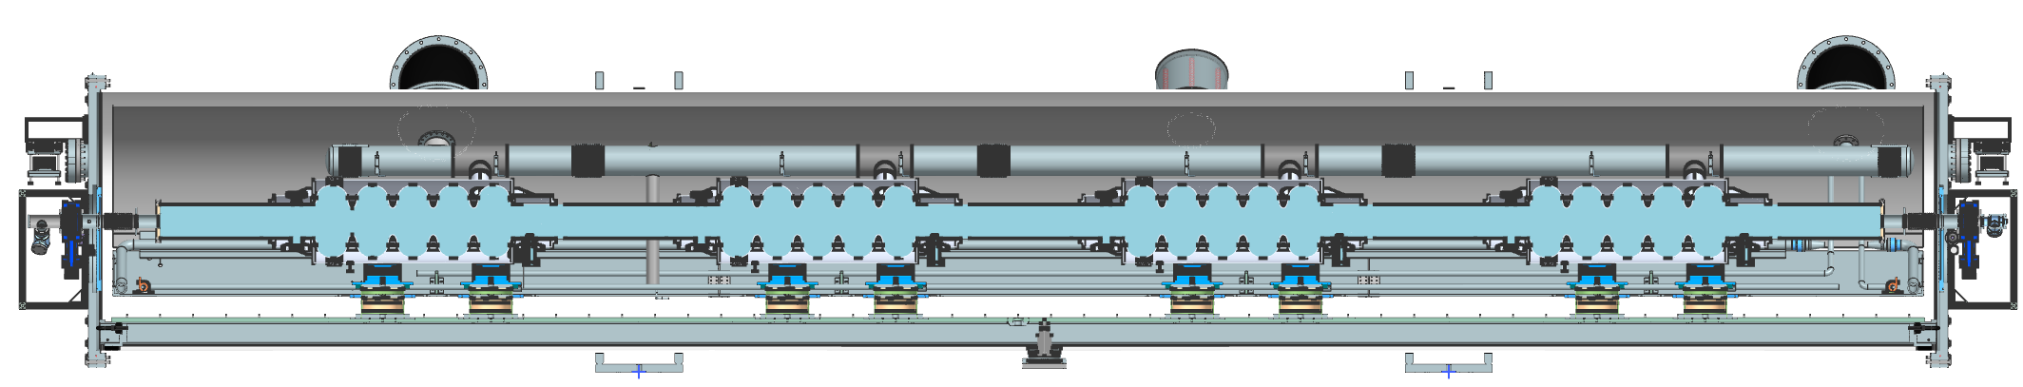
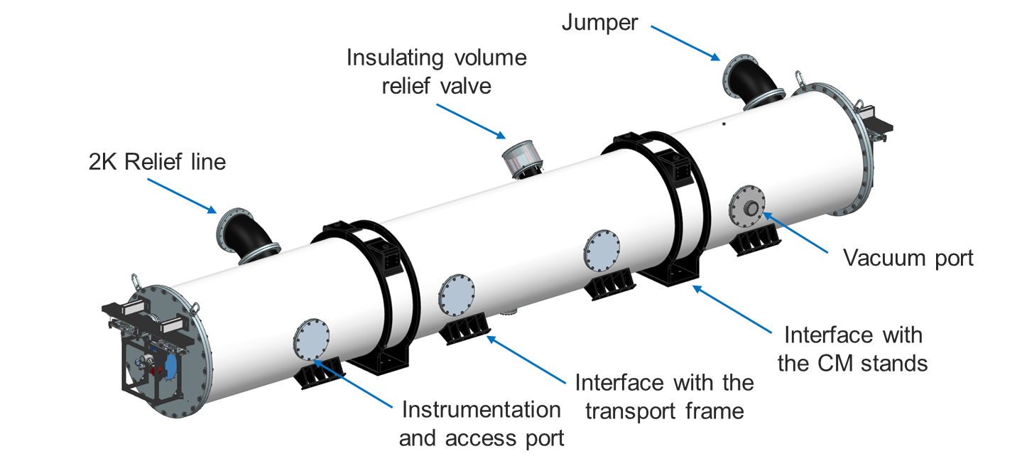
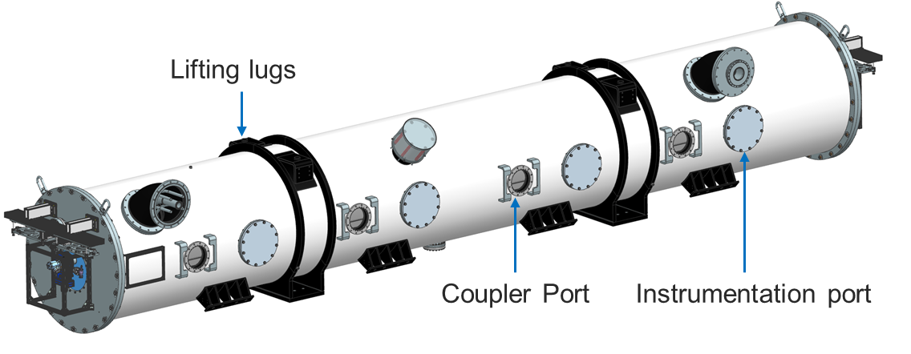
Preliminary design of FCC 800MHz Cryomodule
Vincent Roger, FNAL
The fine segmentation is the current baseline configuration for the FCC 800 MHz cryomodule-draws heavily on PIP-II.
The connections to cryogenics and relief lines are made through “jumpers”, welded connections.

Slide 20
Preliminary design of FCC 800MHz Cryomodule
Vincent Roger, FNAL
Through collaborative efforts with CERN, this design aligns with the functional, technical and interface requirements.
Fits within the dimensional envelopes for the two different locations in the accelerator: collider and booster

Slide 21
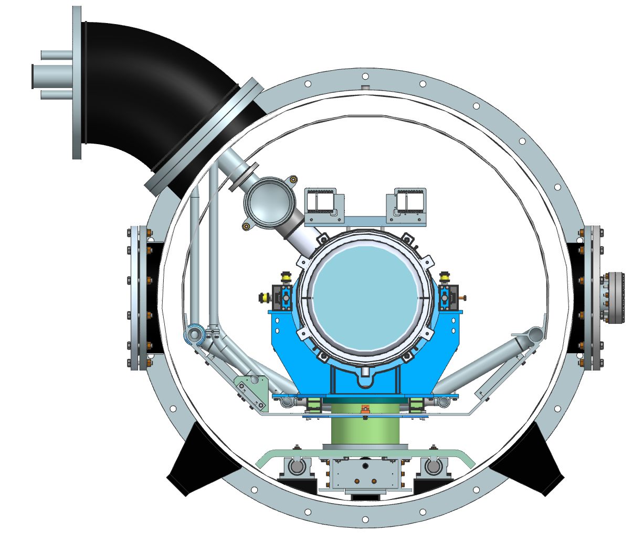
Preliminary design of FCC 800MHz Cryomodule
Cross-section
Jumper interface
Two-Phase helium pipe
Targets for HBCAM
Cavity, 2K
C-Shape parts
HTTS, 35-50K
Thermal shield
CD Line
Cavity support
LTTS, 5-10K
Bearings
Strongback

Slide 22
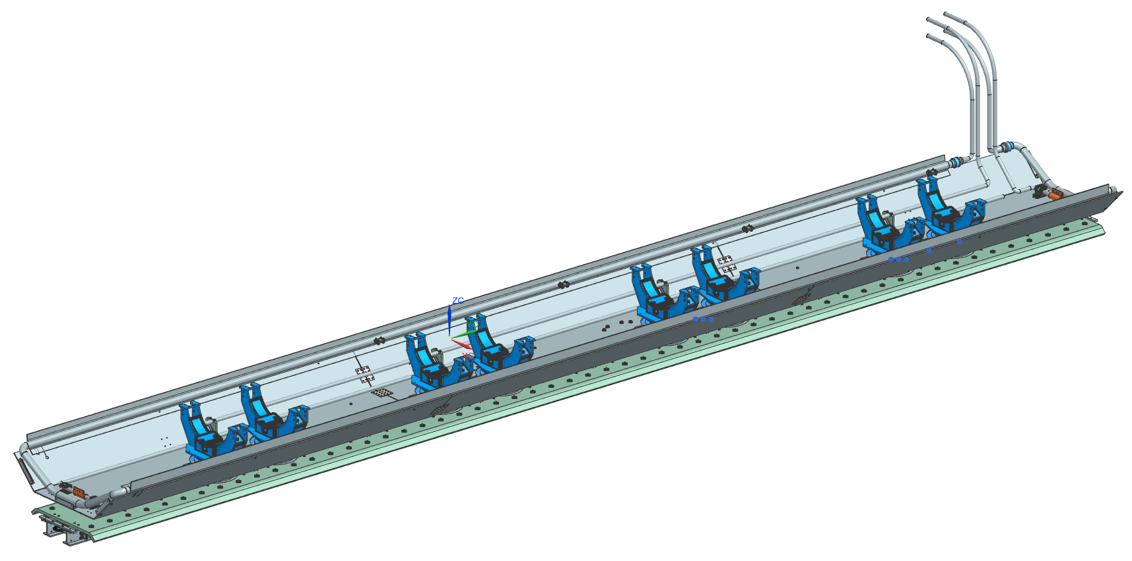
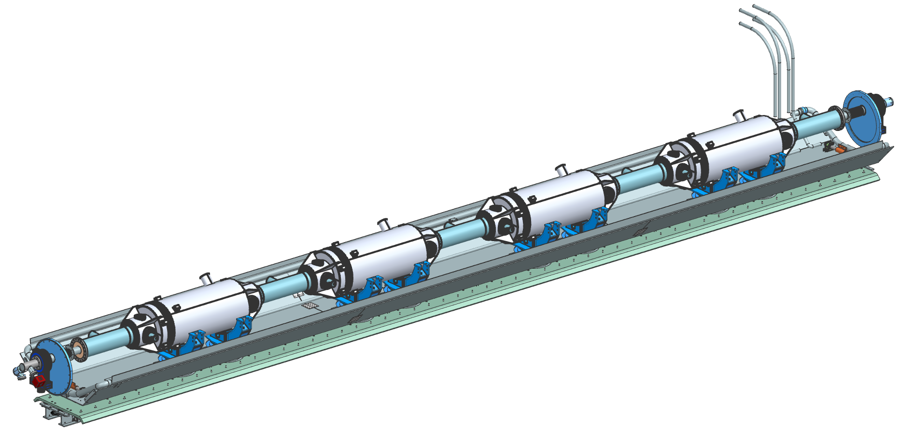
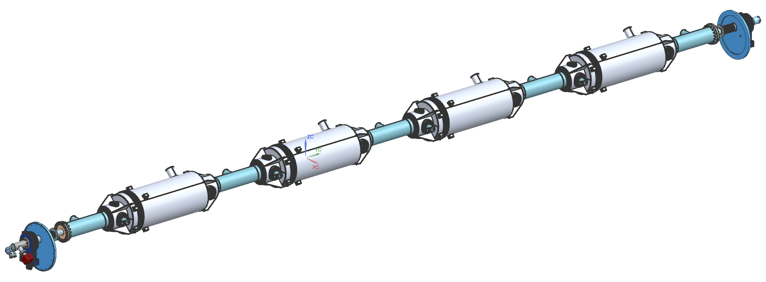
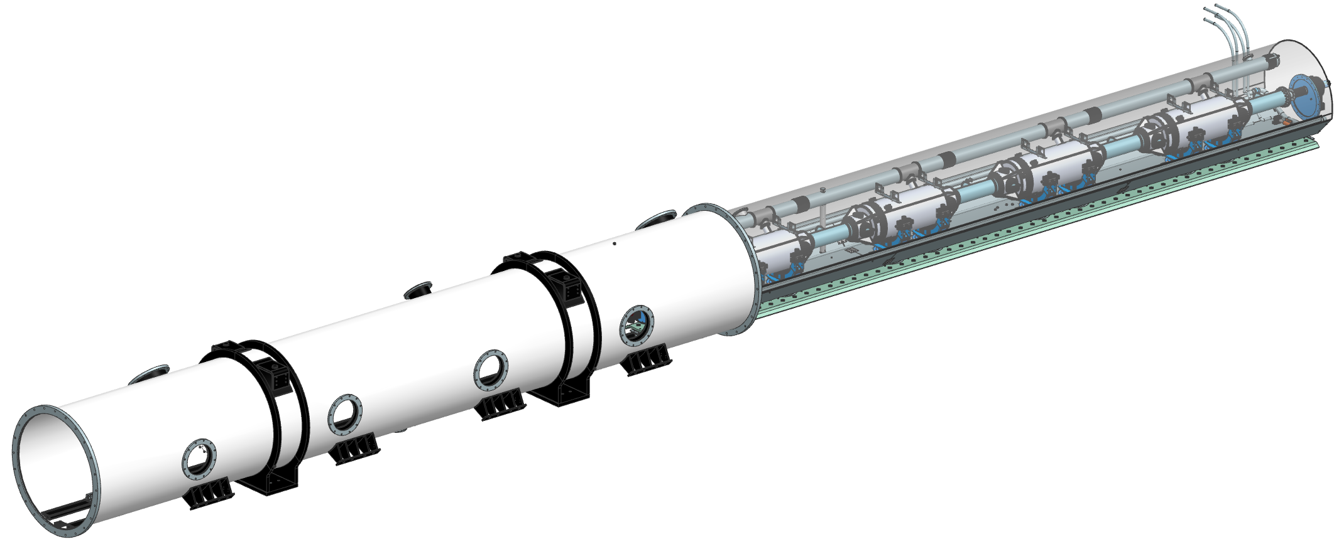
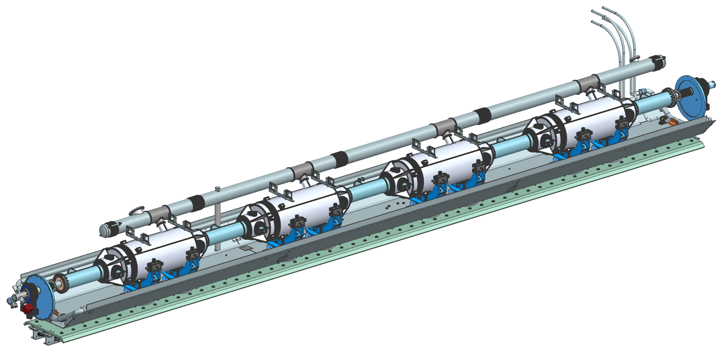
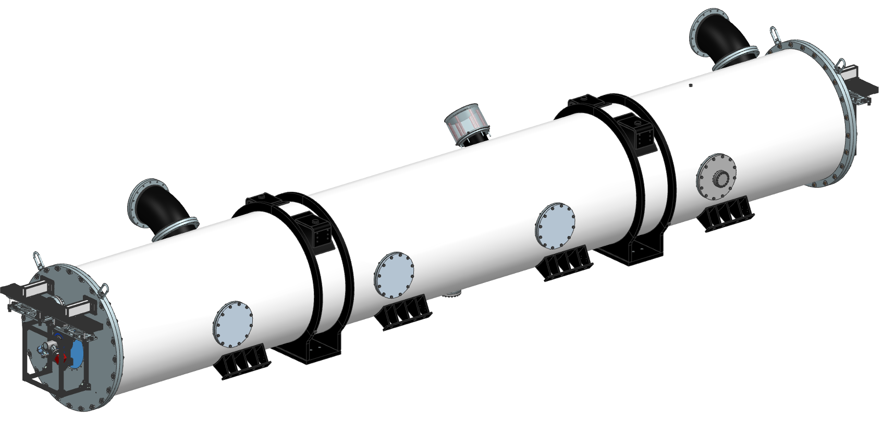
FCC 800MHz cryomodule assembly phases
Based on PIP-II assembly process
Phase 1a: Beamline assembly in the cleanroom
Phase 1b: Strongback Assembly
Phase 1c: Strongback and
Beamline Merge
Phase 2: Coldmass Assembly
Phase 3: Insertion of Coldmass
into Vacuum Vessel
Phase 4: Finalization and Quality controls

Slide 23
800 MHz SRF for FCC engineering next steps
Need to establish pressure vessel code before engaging in any serious structural design (ASME code vs PED regulations)
Determine need/feasibility of fast cooldown design
Choose coupler cooling schemes - heatload management
FNAL is writing preliminary technical specifications, RF, mechanical interfaces
CERN fabricating 1-cell Nb cavities w/FNAL mechanical design
  1-cell program for developing and optimizing surface processing technique
Full jacketed cavity mechanical design progressing

Slide 24
Summary
FCC 800 MHz cavity performance goals are challenging but seem within reach of current advanced techniques
800 MHz SRF R&D program well underway at FNAL
  5-cell mid-t bake RF test planned/ 1-cell fabrication @ CERN
800 MHz CM design underway at FNAL+CERN
  Active and fruitful collaboration ongoing
  Funding support on US side remains a challenge, and timing is becoming critical
FNAL currently writing preliminary technical specifications, RF, mechanical interfaces for CERN
Thanks and credit to our CERN SRF R&D colleagues:
Vittorio Parma, Calum Sharp, Fabien Cottenot, Franck Peauger, Karin Canderan, Marc Timmins, Marco Garlasche, Sebastian Calvo, Shahnam Gorgi-Zadeh

