Slide 1


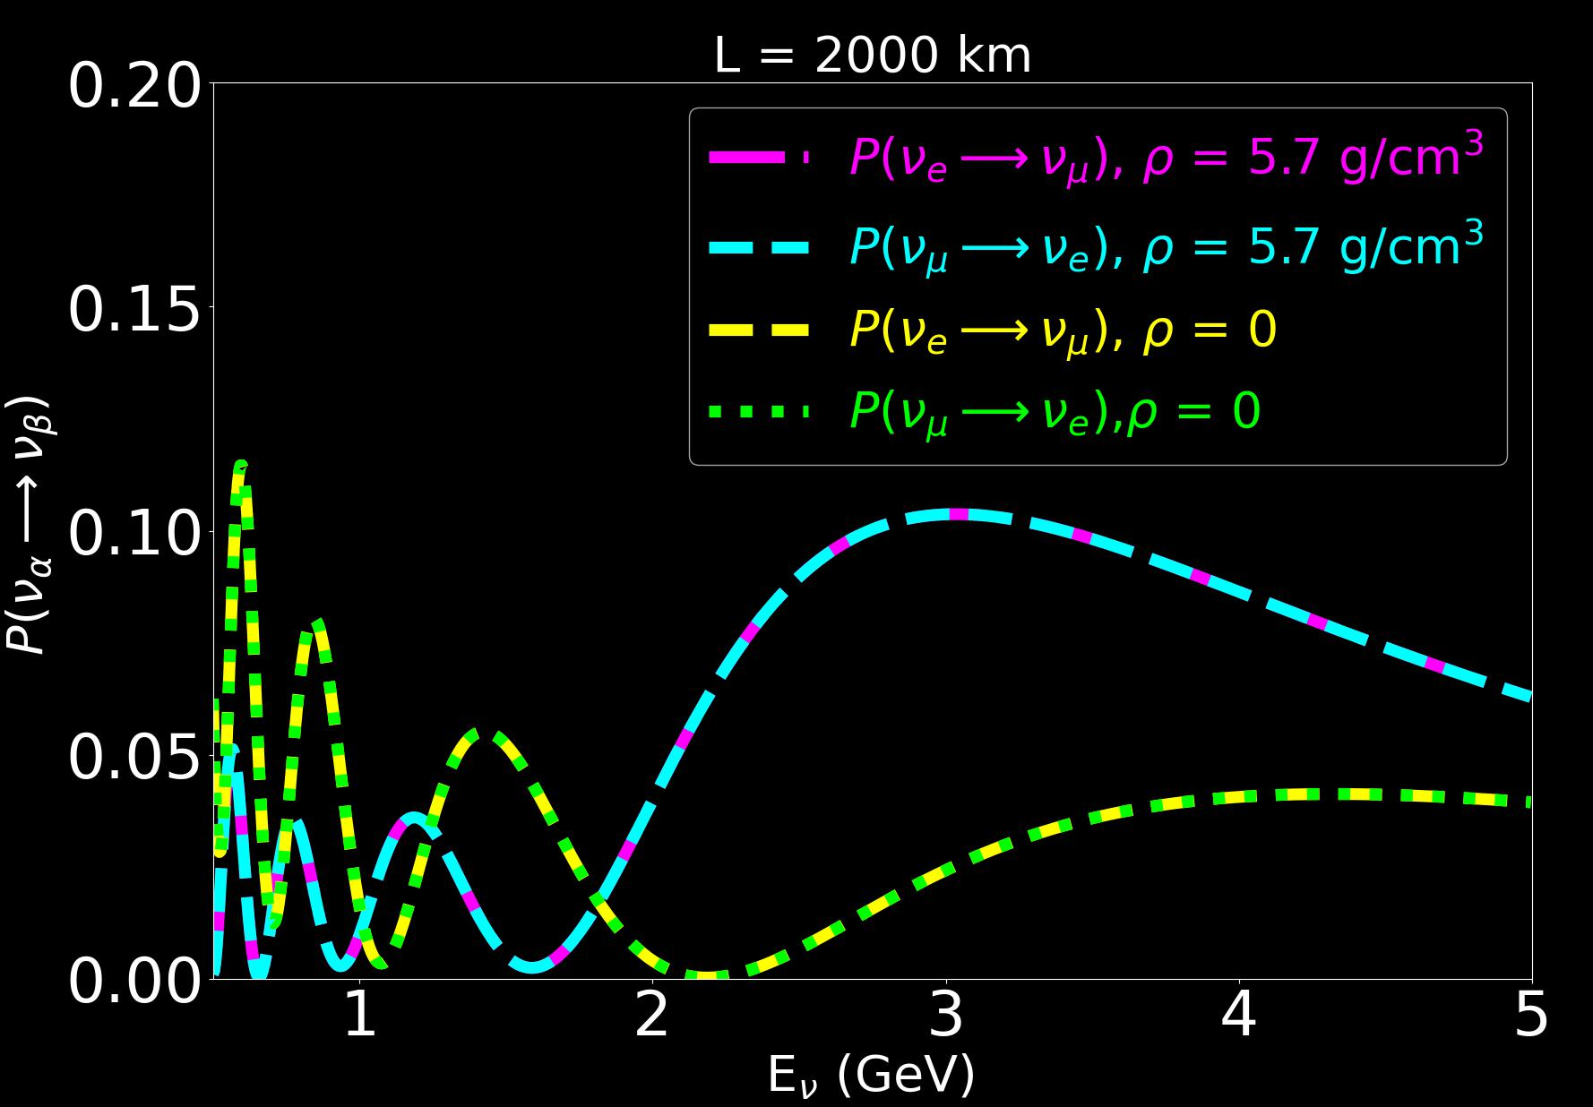
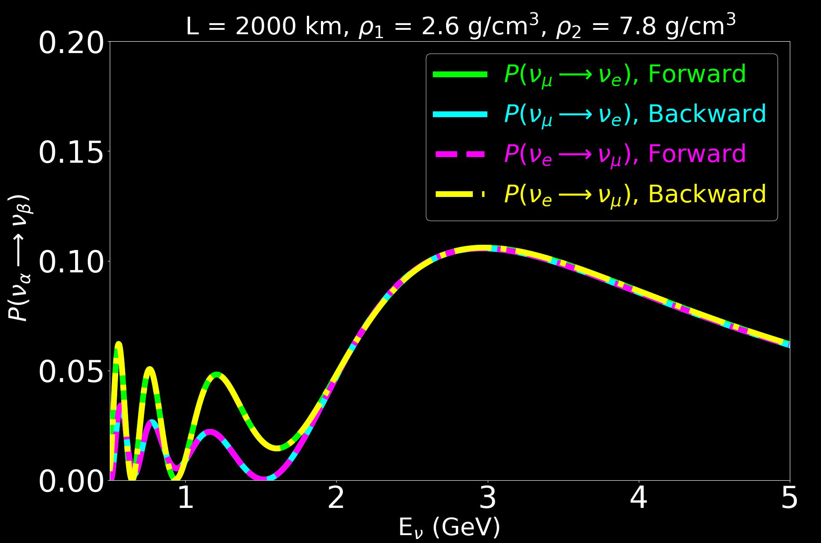

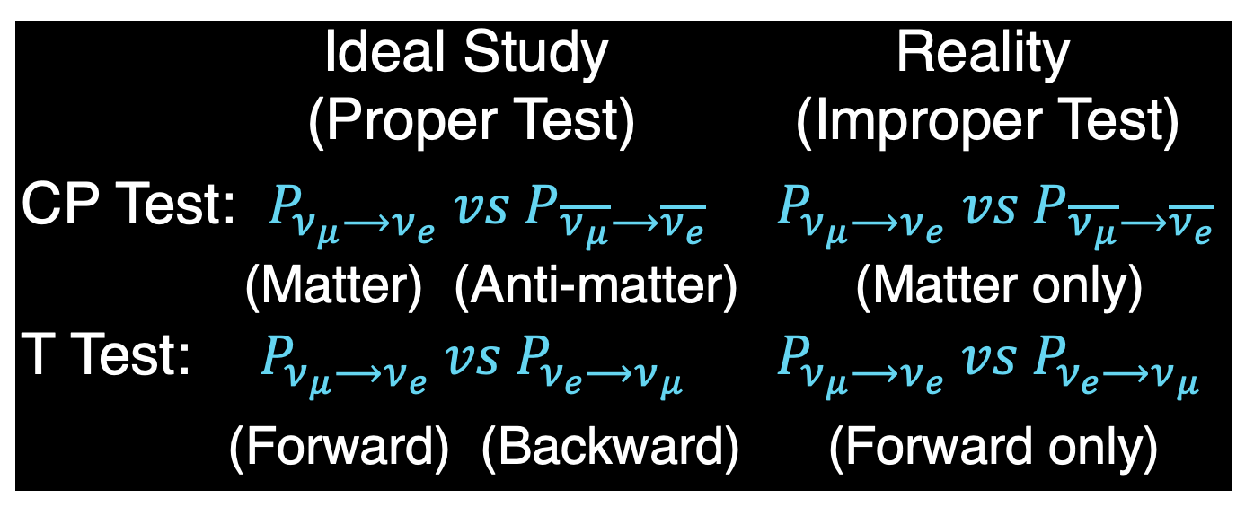

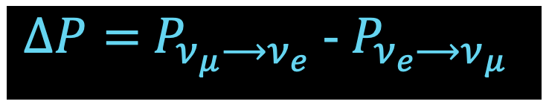
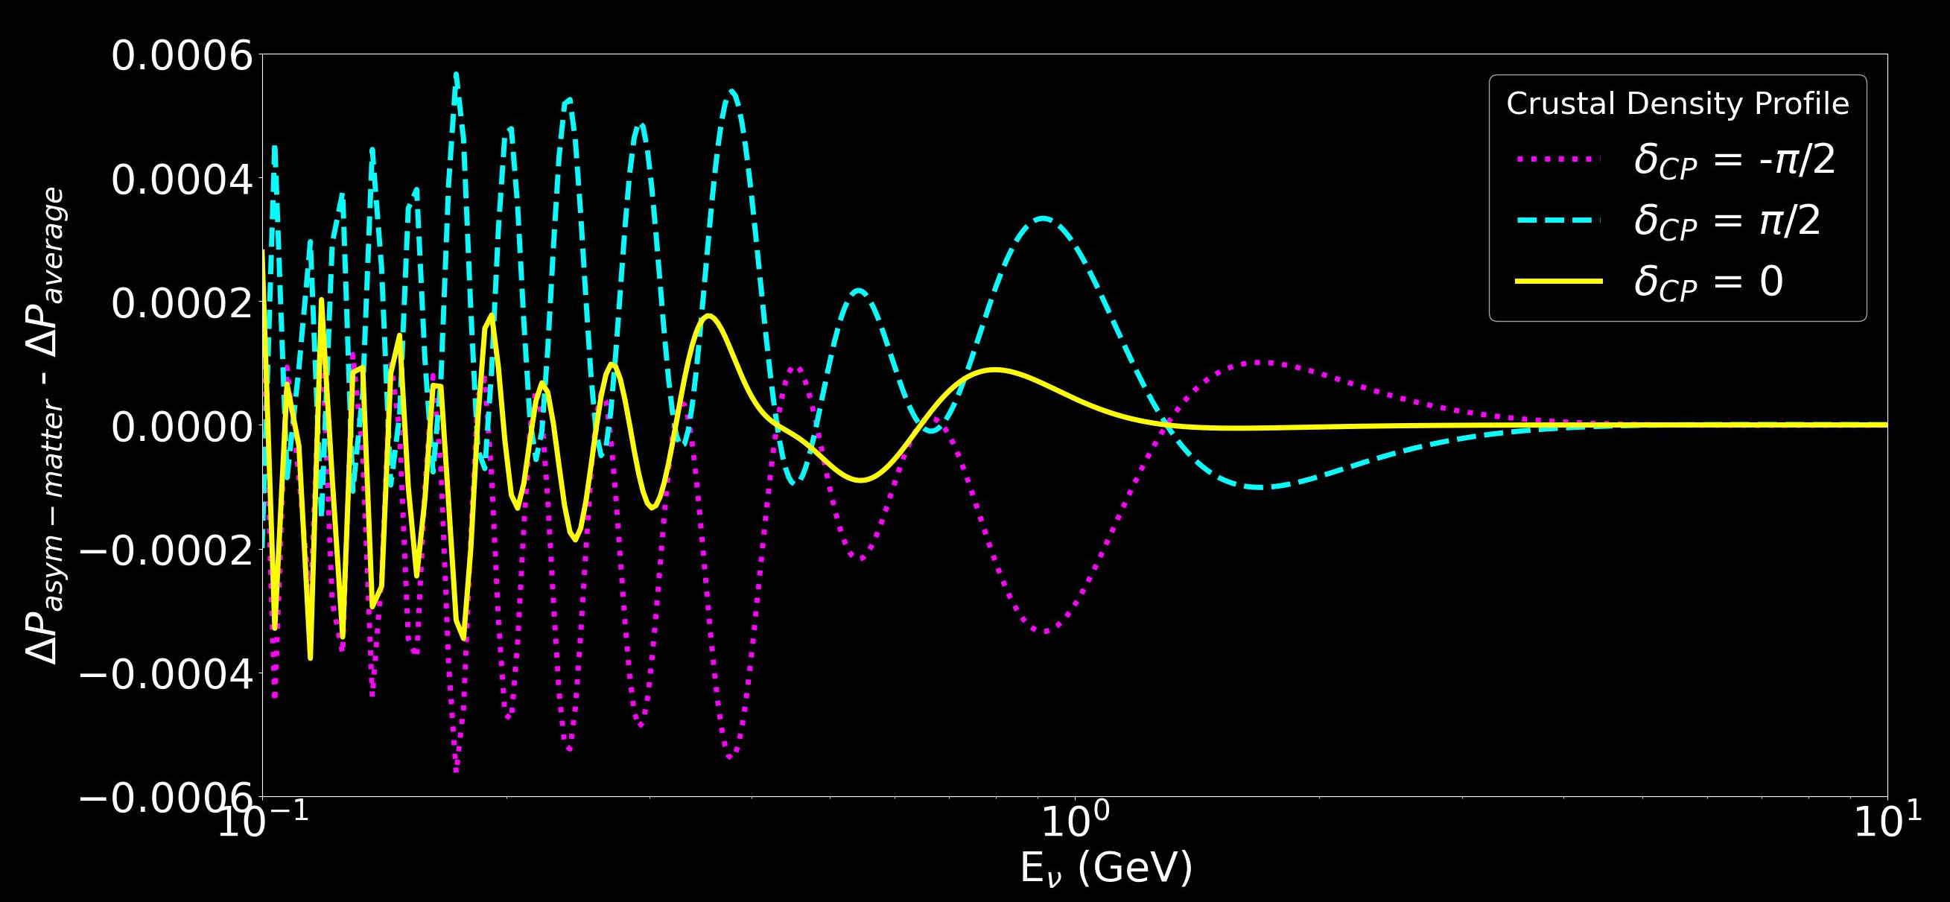
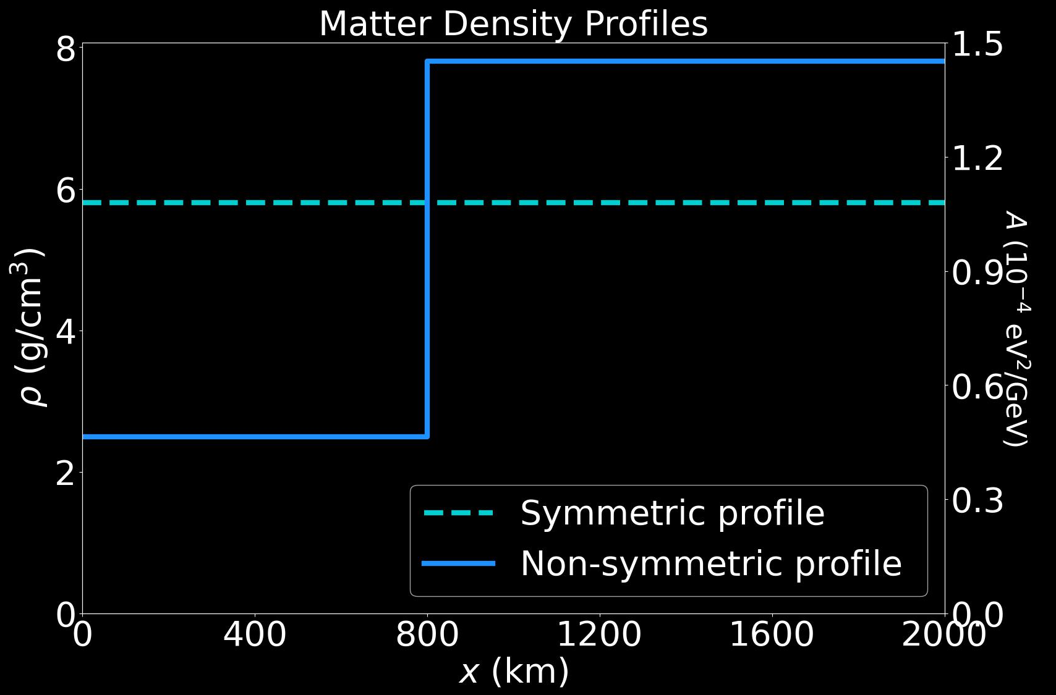


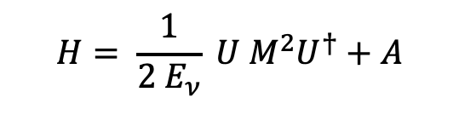
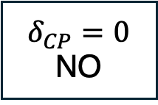
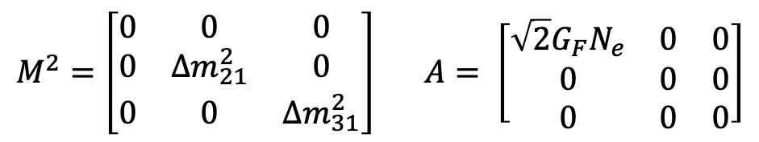
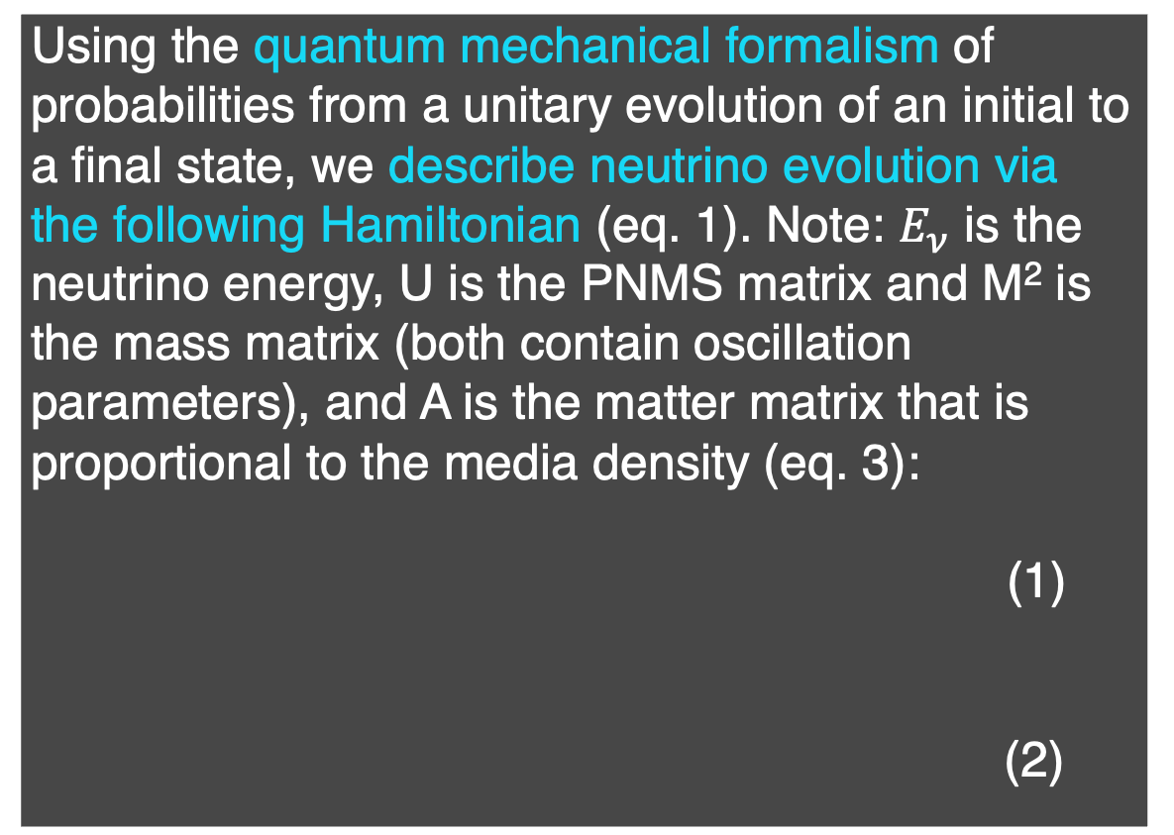
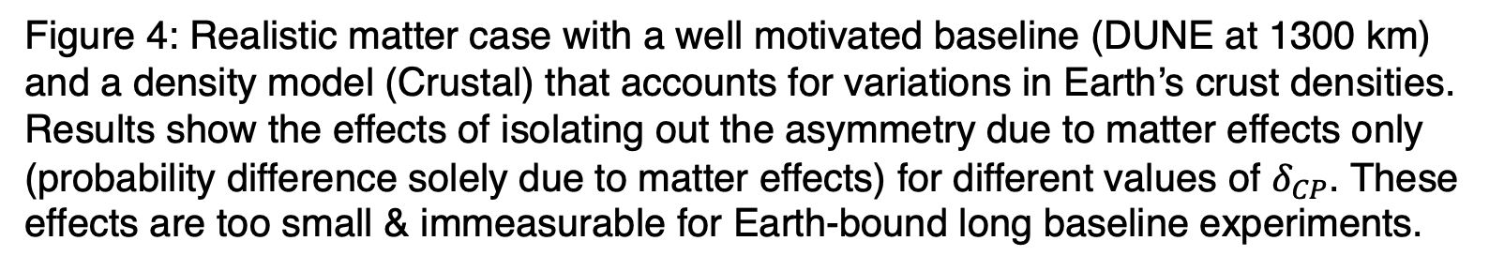
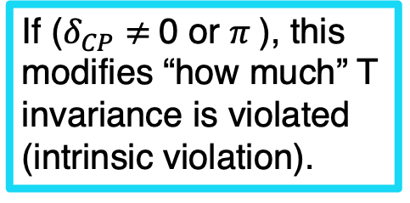

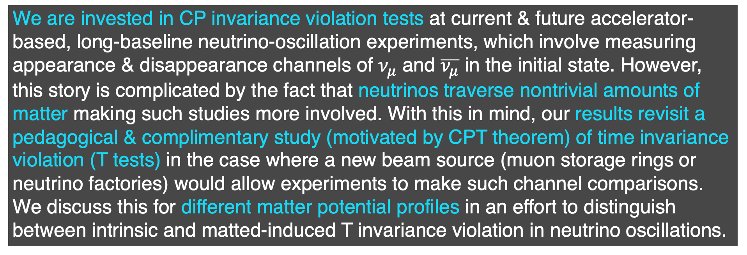
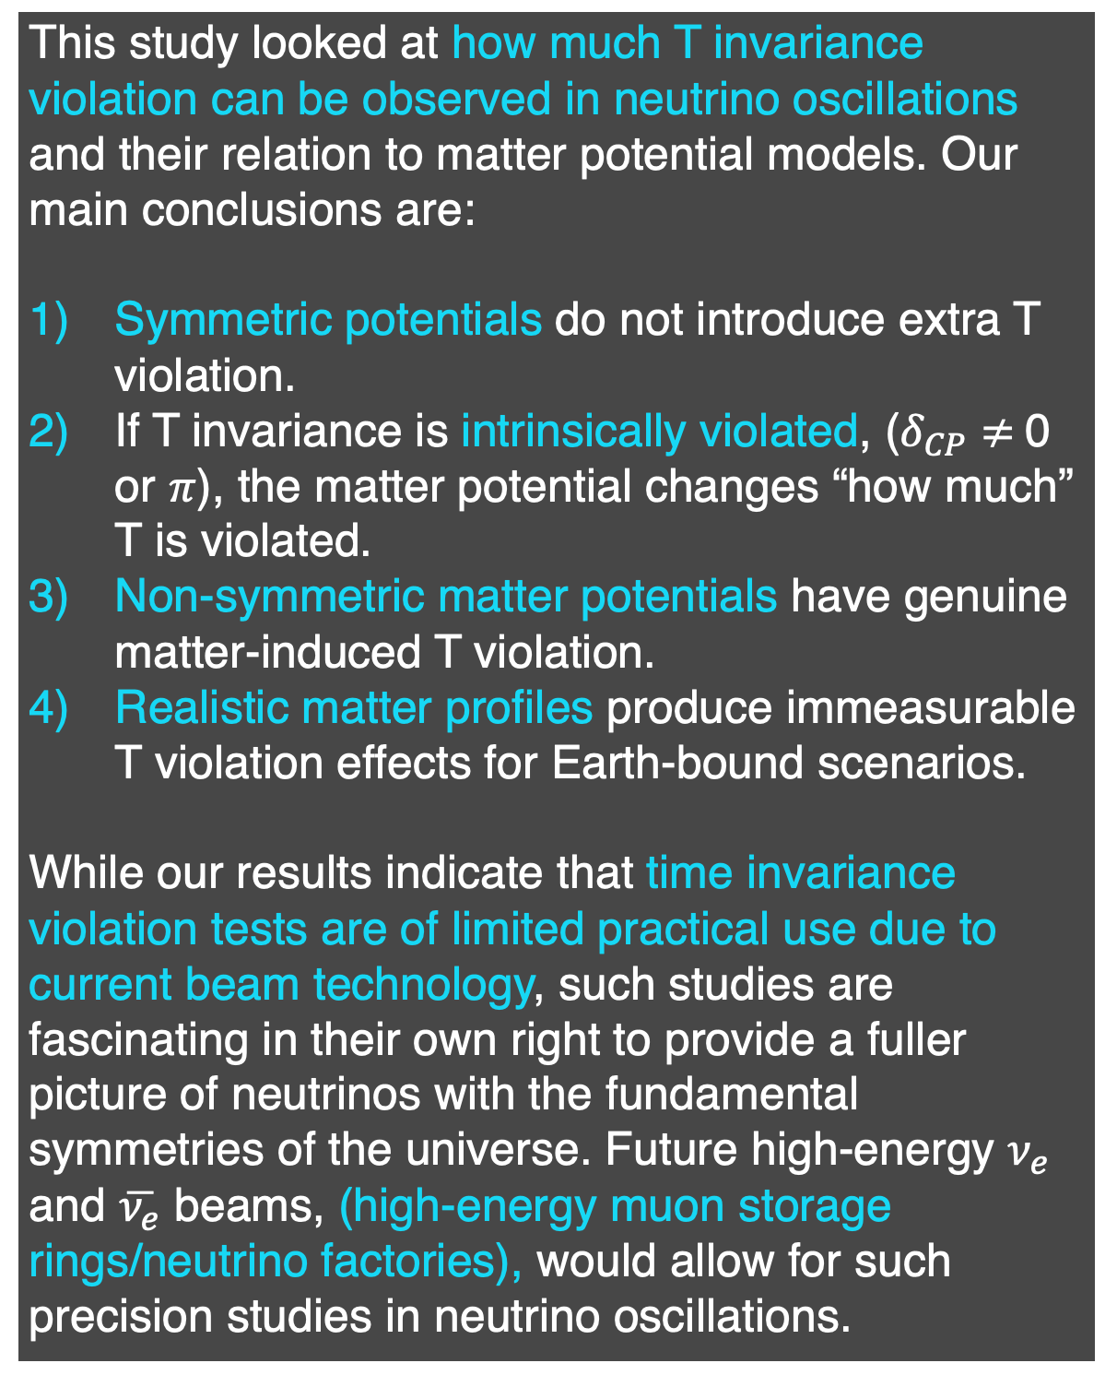
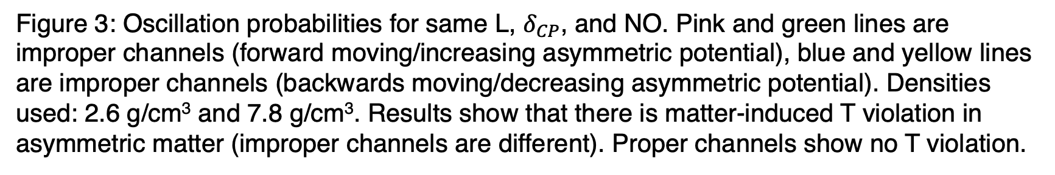
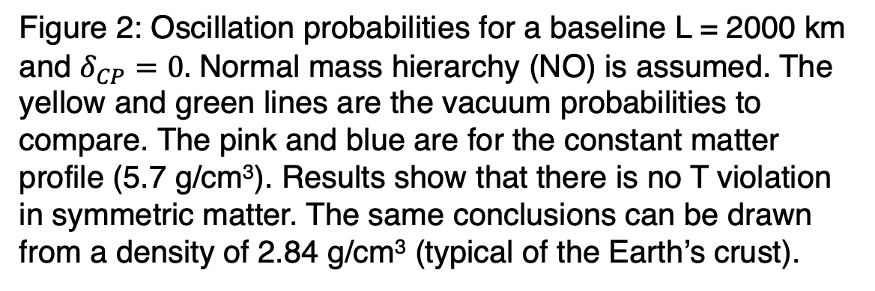
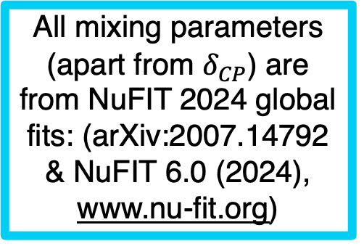
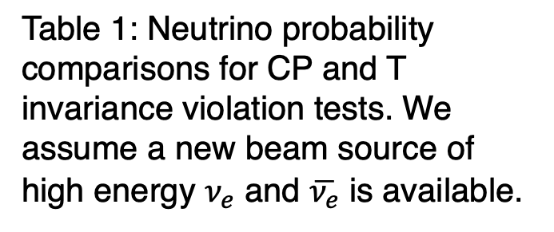

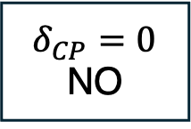
How Matter Matters:
The Story of Time Invariance Violation in Neutrino Oscillations
Olivia Meredith Bitter, Northwestern University
(Based on OMB, André de Gouvêa, Kevin Kelly: Phys. Rev. D 111, 055023 (2025))
Introduction
Symmetric/Constant Matter Profile Example
Results
Asymmetric/Non-Constant Matter Profile Example
We are invested in CP invariance violation tests at current & future accelerator-based, long-baseline neutrino-oscillation experiments, which involve measuring appearance & disappearance channels of $ν_{μ}$ and $\overline{ν_{μ}}$ in the initial state. However, this story is complicated by the fact that neutrinos traverse nontrivial amounts of matter making such studies more involved. With this in mind, our results revisit a pedagogical & complimentary study (motivated by CPT theorem) of time invariance violation (T tests) in the case where a new beam source (muon storage rings or neutrino factories) would allow experiments to make such channel comparisons. We discuss this for different matter potential profiles in an effort to distinguish between intrinsic and matted-induced T invariance violation in neutrino oscillations.
Figure 2
If ($δ_{CP}$ $≠$0 or $π$), this modifies “how much” T invariance is violated (intrinsic violation).
Figure 3
$$δ_{CP}=0$$
NO
$$δ_{CP}=0$$
NO
All mixing parameters (apart from $δ_{CP}$) are from NuFIT 2024 global fits: (arXiv:2007.14792 & NuFIT 6.0 (2024), www.nu-fit.org)
$α$, $β$ -> [$μ, e]$
$α$, $β$ -> [$μ, e]$
The Invariance Tests
Background
To understand nuances in CP and T tests, we define proper tests as the precise theoretical comparison vs what an experiment measures, improper tests.
Table 1
This is what an experiment can measure!
Figure 2: Oscillation probabilities for a baseline L = 2000 km and $δ_{CP}=0.$ Normal mass hierarchy (NO) is assumed. The yellow and green lines are the vacuum probabilities to compare. The pink and blue are for the constant matter profile (5.7 g/cm³). Results show that there is no T violation in symmetric matter. The same conclusions can be drawn from a density of 2.84 g/cm³ (typical of the Earth’s crust).
Figure 3: Oscillation probabilities for same L, $δ_{CP}$, and NO. Pink and green lines are improper channels (forward moving/increasing asymmetric potential), blue and yellow lines are improper channels (backwards moving/decreasing asymmetric potential). Densities used: 2.6 g/cm³ and 7.8 g/cm³. Results show that there is matter-induced T violation in asymmetric matter (improper channels are different). Proper channels show no T violation.
Realistic case:
Time-Violation Induced by Non-Symmetric Matter Profile
Crustal Profile: EGU2013-2658 (European Geophysical Union (EGU) General Assembly), 2013
Table 1: Neutrino probability comparisons for CP and T invariance violation tests. We assume a new beam source of high energy $ν_{e}$ and $\overline{ν_{e}}$ is available.
Using the quantum mechanical formalism of probabilities from a unitary evolution of an initial to a final state, we describe neutrino evolution via the following Hamiltonian (eq. 1). Note: $E_{ν}$ is the neutrino energy, U is the PNMS matrix and M² is the mass matrix (both contain oscillation parameters), and A is the matter matrix that is proportional to the media density (eq. 3):
(1)
(2)
Discussion/Conclusion
This study looked at how much T invariance violation can be observed in neutrino oscillations and their relation to matter potential models. Our main conclusions are:
Symmetric potentials do not introduce extra T violation.
If T invariance is intrinsically violated, ($δ_{CP}$ $≠$0 or $π$), the matter potential changes “how much” T is violated.
Non-symmetric matter potentials have genuine matter-induced T violation.
Realistic matter profiles produce immeasurable T violation effects for Earth-bound scenarios.
While our results indicate that time invariance violation tests are of limited practical use due to current beam technology, such studies are fascinating in their own right to provide a fuller picture of neutrinos with the fundamental symmetries of the universe. Future high-energy $ν_{e}$ and $\overline{ν_{e}}$ beams, (high-energy muon storage rings/neutrino factories), would allow for such precision studies in neutrino oscillations.
Think of T invariance tests as measuring if a movie played forwards or backwards are identical. This corresponds to an increasing asymmetric matter potential (fig 1) vs a mirrored/decreasing one.
$$H= \frac{1}{2 E_{ν}} U M^{2}U^{†}+A$$
$$M^{2}=\left[\begin{matrix}0 & 0 & 0 \\ 0 & Δm_{21}^{2} & 0 \\ 0 & 0 & Δm_{31}^{2}\end{matrix}\right] A= \left[\begin{matrix}\sqrt{2}G_{F}N_{e} & 0 & 0 \\ 0 & 0 & 0 \\ 0 & 0 & 0\end{matrix}\right]$$
DUNE-like parameters
Figure 4
Types of Matter Profiles
Figure 1: Matter potential profiles of the medium through which a neutrino propagates. This is for a hypothetical density. Forward playing T is represented by the increasing 2 step piecewise profile, while backward playing T is represented by a mirrored or decreasing 2 step piecewise profile (latter not pictured).
Figure 4: Realistic matter case with a well motivated baseline (DUNE at 1300 km) and a density model (Crustal) that accounts for variations in Earth’s crust densities. Results show the effects of isolating out the asymmetry due to matter effects only (probability difference solely due to matter effects) for different values of $δ_{CP}$. These effects are too small & immeasurable for Earth-bound long baseline experiments.
Acknowledgements
Figure 1
O. M. B. and A. dG. thank Woodkensia Charles and Grace Reesman for discussions and collaboration at the very early stages of this work. This work was supported in part by the U.S. Department of Energy (DOE) Grants No. de-sc0010143 and No. de-sc0010813 and in part by the National Science Foundation under Grants No. PHY-1630782 and No. PHY-1748958.

