Slide 1
News with CuCr1Zr contract: US strategy and schedule 10/02/25 Lucas Hermida Supervised by Carla Piccinni

Slide 2
Outline
Zollern visit to CERN
Pre-series production updates
Series production updates
Ultrasound test updates

Slide 3
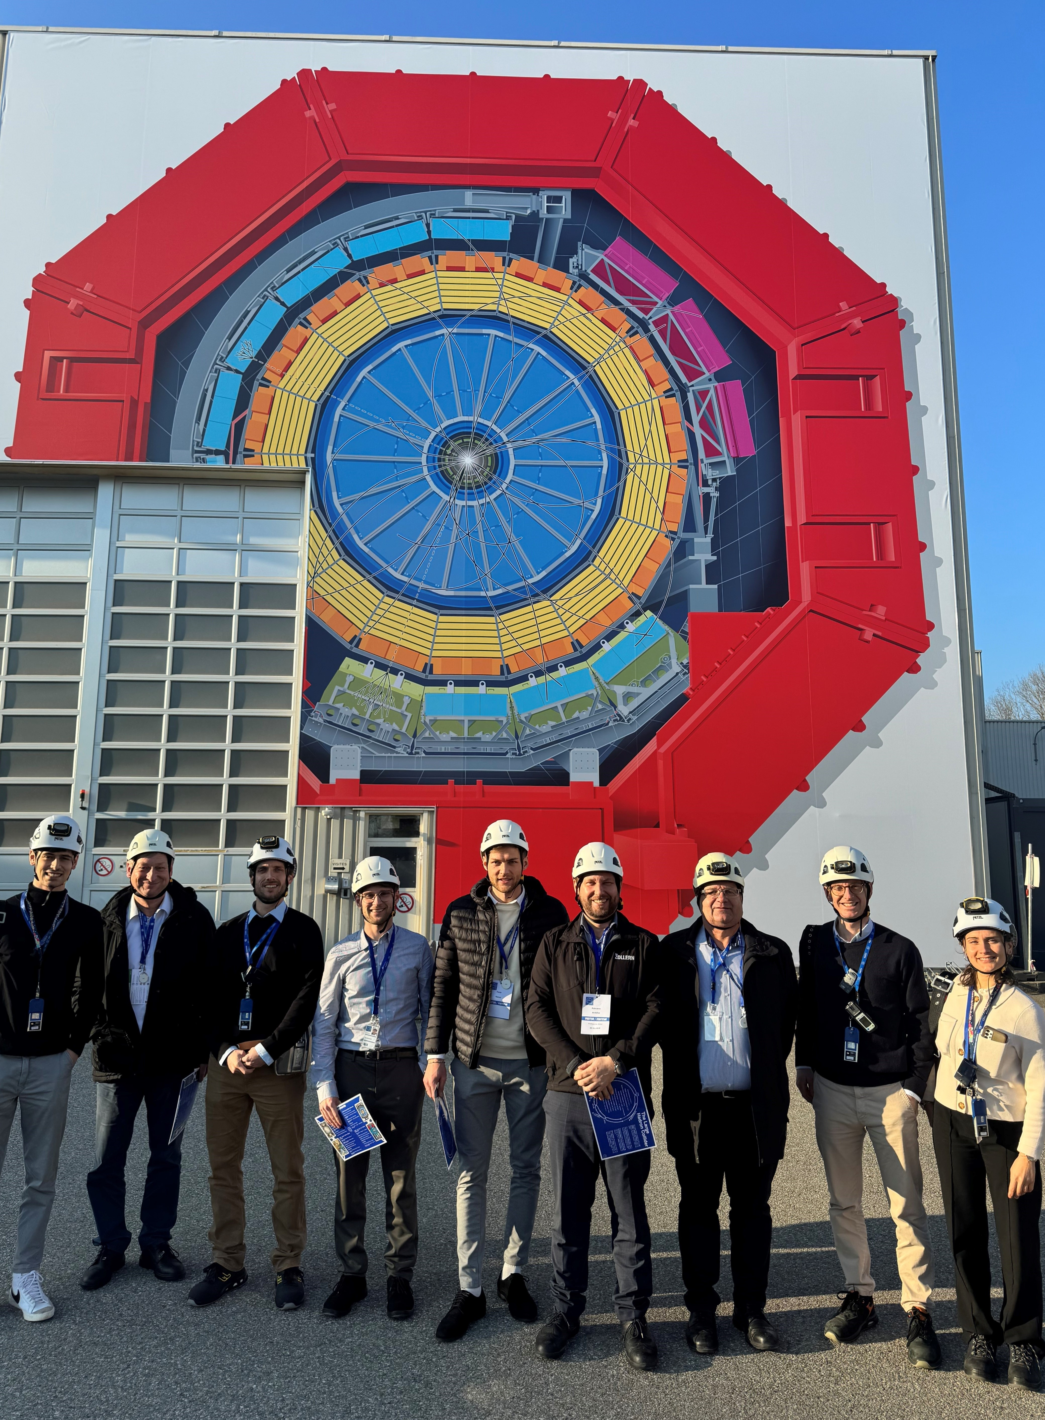
Zollern visit to CERN
The visit took place the 5th of January.
Zollern thanked the team for their professionalism and hospitality.
Some key updates were shared in the discussions.

Slide 4
Pre-series production updates
Zollern received the purchase order CA1228316 the 03/10/24;
1 block sent back
Type of blank | Length [mm] | Width [mm] | Thickness [mm] | Quantity pre-series | First delivery (18/12/24) | Second delivery (30/01/25) | Third delivery (awaiting; ~17/02)
a | 1400 | 100 | 20 | 8 | 7 (6) | N/A | 2
b | 950 | 80 | 20 | 2 | N/A | 2 | N/A
c | 950 | 80 | 35 | 7 | N/A | 7 | N/A
d | 1000 | 85 | 35 | 2 | 2 | N/A | N/A
e | 1400 | 90 | 40 | 2 | 2 | N/A | N/A
f | 80 | 110 | 55 | 2 | N/A | 2 | N/A
g | 1300 | 90 | 60 | 4 | N/A | N/A | 4
Zollern stated that the third delivery will happen 17th of February.

Slide 5
Series production updates
Type of blank | Block dimensions [mm] |  |  | Quantities for series | Delivery date
 | L | w | b
a | 1400 | 100 | 20 | 141 | 27.05.2025
b | 950 | 80 | 20 | 11 | 14.04.2025
c | 950 | 80 | 25 | 82 | 14.05.2025
d | 1000 | 85 | 35 | 10 | 10.04.2025
e | 1400 | 90 | 40 | 46 | 06.06.2025
f | 560 | 110 | 55 | 2 | 03.04.2025
g | 1300 | 90 | 60 | 29 | 22.05.2025
The date for the forging process completion has been delayed from the 17th of March to the 9th of April.
After the forging process, there are from 3 to 4 weeks of machining process.

Slide 6
Ultrasound test updates
There are 2 main alternatives for the testing frequency:
Testing with the 2 MHz probe
Accepted only if backwall echo reduction and discontinuities meet the specification.
Zollern to confirm capacity to replace rejected blocks within the production.
Testing with the 4MHz probe
Provides higher resolution for detecting backwall echo losses, and we are pushing for this alternative.
Acceptance criteria:
Backwall echo losses must not exceed those measured in pre-series blocks.
Size of areas with backwall echo losses >20% must not exceed those in pre-series.

Slide 7
Thank you for your attention!

