Slide 1
New production of Edge Welded Bellows: status and delivery dates
C. Piccinni
WP5.2 Meeting - 10/02/25

Slide 2
Outline
Outcome of latest cycling test
Details of new production
Estimated delivery dates

Slide 3
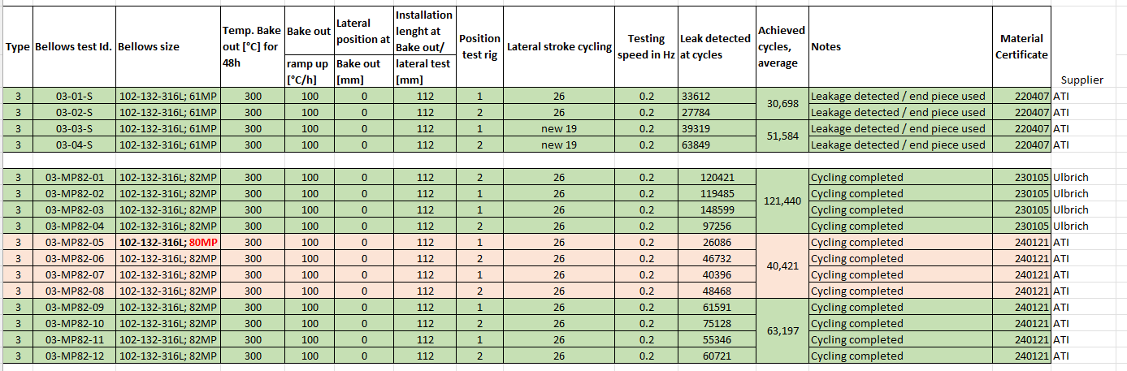
Outcome of latest cycling test
Type Double Beam (LHCTCLPX_160)

Slide 4
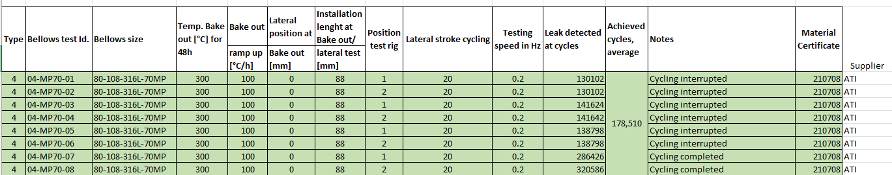
Outcome of latest cycling test
Type Single Beam (LHCTCTP_0054)

Slide 5
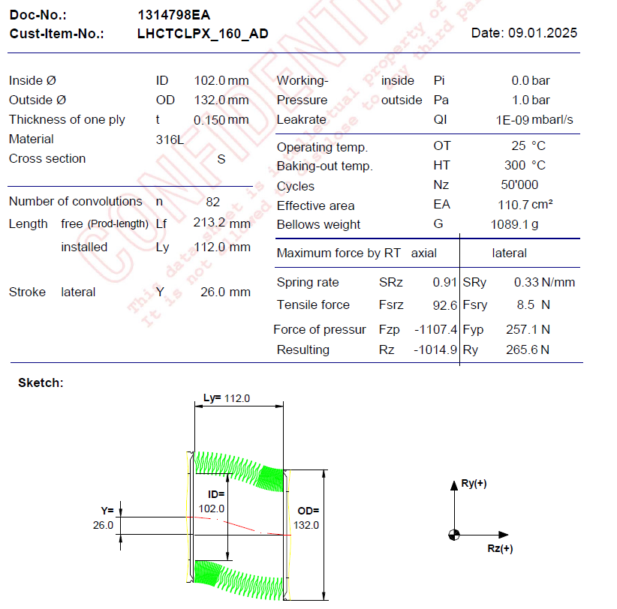
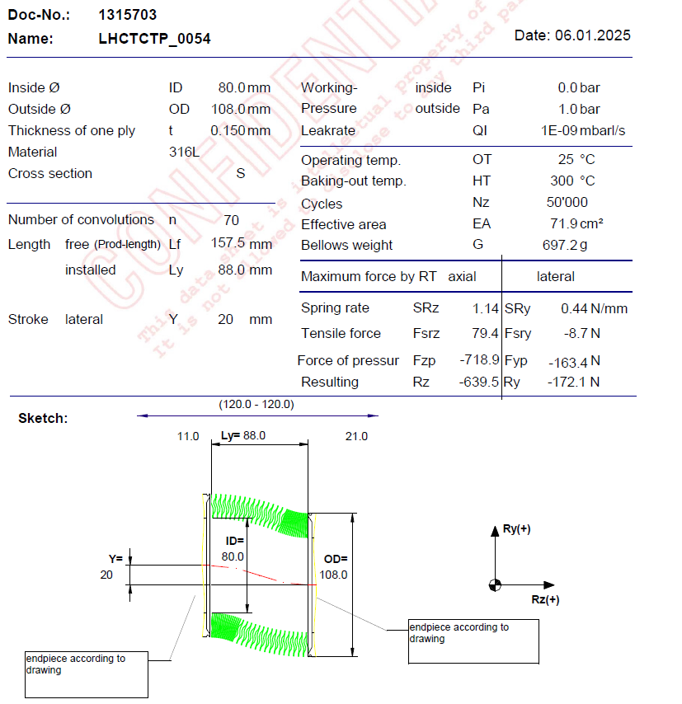
Details of new production
Updated datasheet provided by VAT (for both types)
Type Double Beam (LHCTCLPX_160)
Type Single Beam (LHCTCTP_0054)

Slide 6
Details of new production
Type | Qty | Order confirmation | Estimated delivery date | Status
LHCTCLPX_160 | 75 | Received the 27/01/25 | 21/02/2025 | All collars machined and quality controlled. ~ 10 collars to be re-machined because of nonconformities.
LHCTCTP_0054 | 110 | Received the 02/02/25 | 19/03/2025 | Raw material for convolutions to be procured (in view of full production with same material). Collars machined and being quality controlled.
8 additional bellows per type ordered, to be cycled at CERN

Slide 7
Thank you for your attention

