Slide 1

WP5.2 – Transport Analysis Collimator Jaws
Updates & Further Proceedings
L. Hannemann, F. Carra, M. Guinchard, L. Puddu
10/03/2025

Slide 2
Updates
Influence of gravity on natural frequencies
Vibrational Input in z-direction and x-direction
Other collimator components to be checked
Transportation frame proposal by CINEL
Experimental verification proposals

Slide 3
Collimators Configurations
Considered collimator jaws:
Key Structural Elements Analysed:
Collimator Design | Material
TCTPXH | Inermet180
TCTPM
TCLP
TCLPX
TCSPM | Copper Coated Graphite
Absorber blocks
Shafts
Cooling pipes
Overall stress evaluation

Slide 4
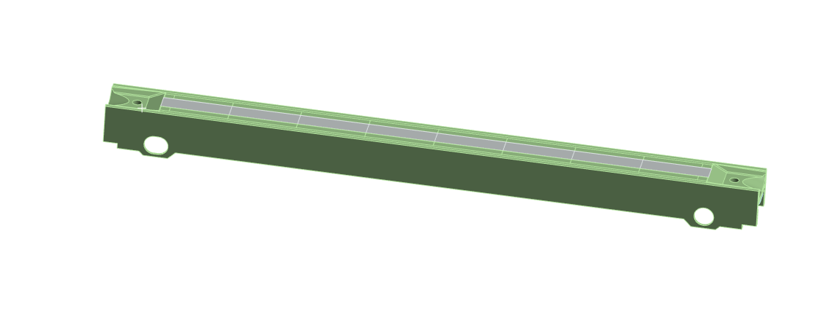
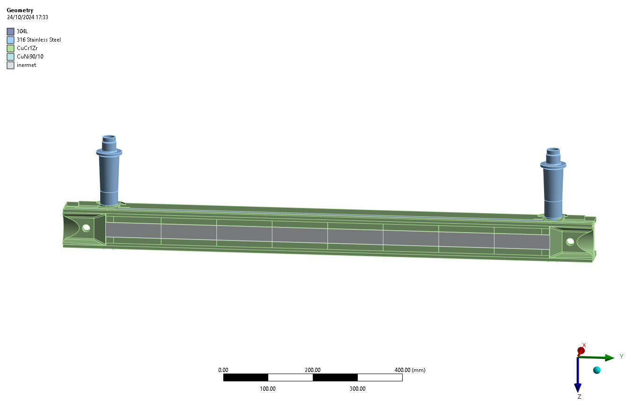
Structural & Vibrational Analysis Setup
Static Structural: Loads of the clamping system
Modal
Jaw without shaft
Static Structural: Loads of the clamping system
Modal
Jaw with shaft
Random Vibrations: Norm
Random Vibrations: Experimental Data

Slide 5
Comparison of Jaws Modal Analysis
Collimator | First Natural Frequency without shaft | First Natural Frequency with shaft
TCLP | 132 Hz | 77Hz
TCLPX | 88 Hz | 80.6 Hz
TCSPM | 146 Hz | 90 Hz
TCTPM | 126 Hz | 60 Hz
TCTPXH | 107 Hz | 78 Hz
Natural Frequency without shaft is higher than natural frequency with shaft for all collimators
Gravity had no influence on the natural frequencies

Slide 6
Material Properties and Acceptance Criteria
A Safety Factor of 3 was used due to the high reliability needs for the components
Components | Material | Yield Strength | Compressive strength | Flexural Strength | Acceptance Criteria
Absorber Blocks | Inermet180 | 614 MPa | - | - | <205 MPa
 | Graphite | - | 130 MPa | 60 MPa | <43.3 MPa (compr.) / <20 MPa (flex.)
Shafts | SS-316L | 205 MPa | - | - | <68.3 MPa
Cooling pipes | Cu-Ni 90-10 | 109.2 MPa | - | - | <36.4 MPa
Housing | CuCrZr | 460 MPa | - | - | <153.3 MPa

Slide 7
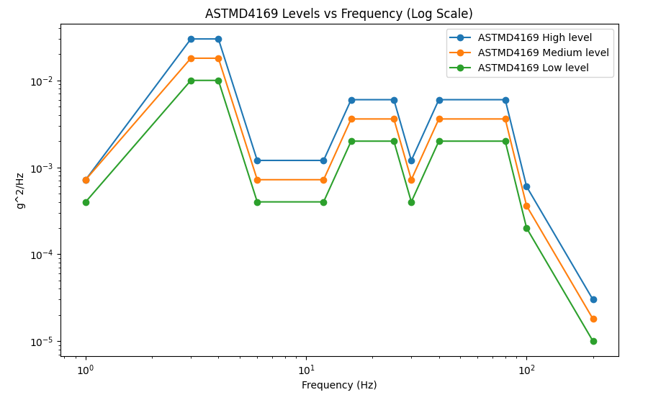
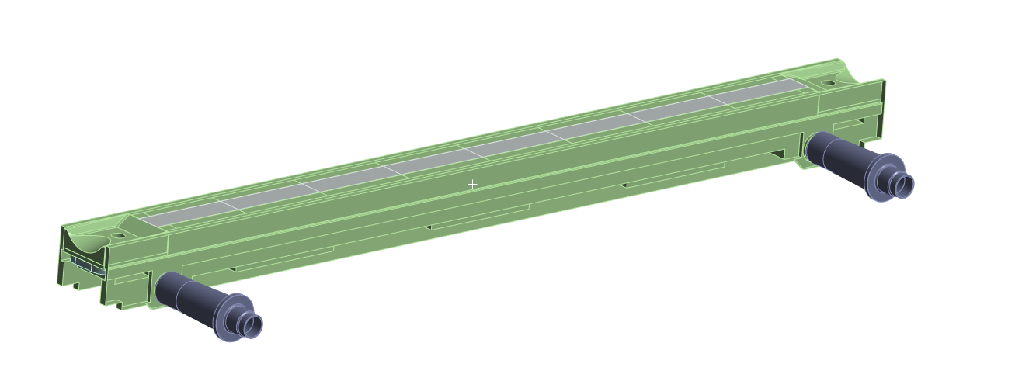
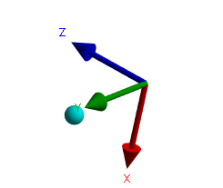
Random Vibrations – PSD Norm Input
Acceleration PSD
Input
Random Vibrations
ASTMD4169 Norm
Evaluate the durability of packaging for products transported by road (trucks, vans, etc.)
3 PSD levels provided by standard
High level PSD applied in z-direction and x- direction on the shafts.

Slide 8

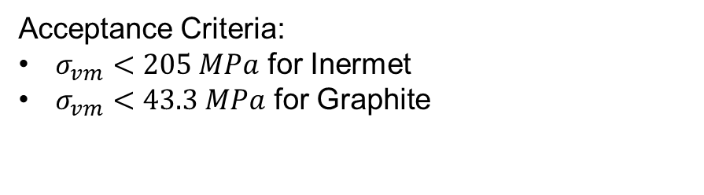
Absorber Blocks - Peak Stress Evaluation (ASTMD4169 Input)
Collimator | Block Material | Equivalent Von Mises Stress z- direction | Equivalent Von Mises Stress x- direction
TCLP | Inermet180 | 2.9 MPa | 2.5 MPa
TCLPX | Inermet180 | 0.9 MPa | 1.9 MPa
TCSPM | Graphite | 0.1 MPa | 0.6 MPa
TCTPM | Inermet180 | 1.7 MPa | 5.5 MPa
TCTPXH | Inermet180 | 2.9 MPa | 12 MPa
Acceptance Criteria:
$σ_{vm}<205 MPa$​ for Inermet
$σ_{vm}<43.3 MPa$​ for Graphite

Slide 9
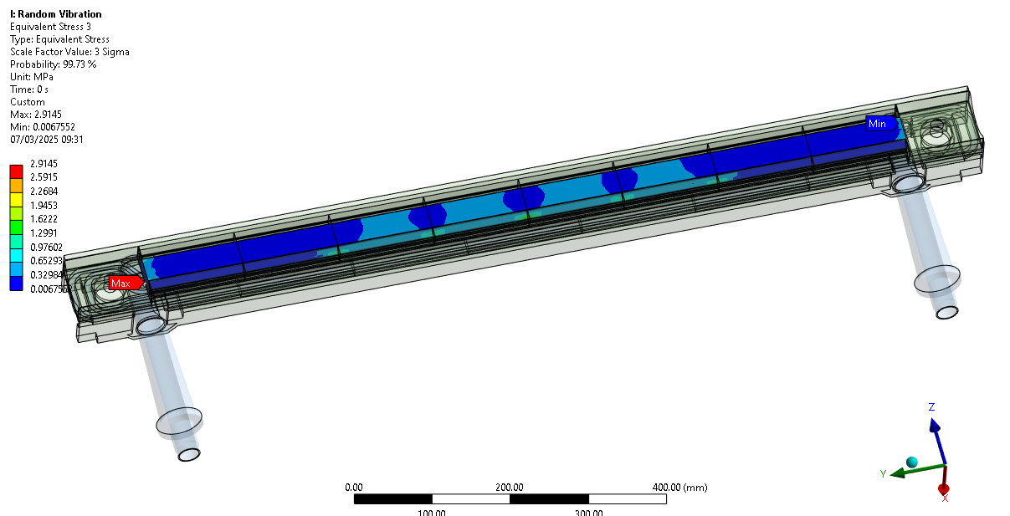
TCTPXH Stress on Absorber Blocks – ASTMD z-Direction Input

Slide 10
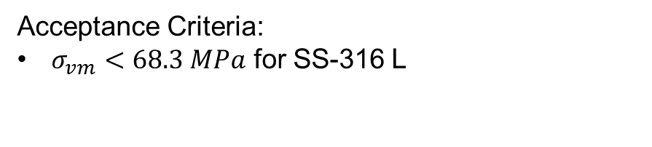
Shafts- Peak Stress Evaluation (ASTMD4169 Input)
Collimator | Equivalent Von-Mises Stress z-direction | Equivalent Von-Mises Stress x-direction
TCLP | 5.0 MPa | 17.0 MPa
TCLPX | 10.6 MPa | 27.0 MPa
TCSPM | 4.5 MPa | 10.4 MPa
TCTPM | 8.6 MPa | 25.9 MPa
TCTPXH | 3.2 MPa | 13.1 MPa
Acceptance Criteria:
$σ_{vm}<68.3 MPa$​ for SS-316 L

Slide 11
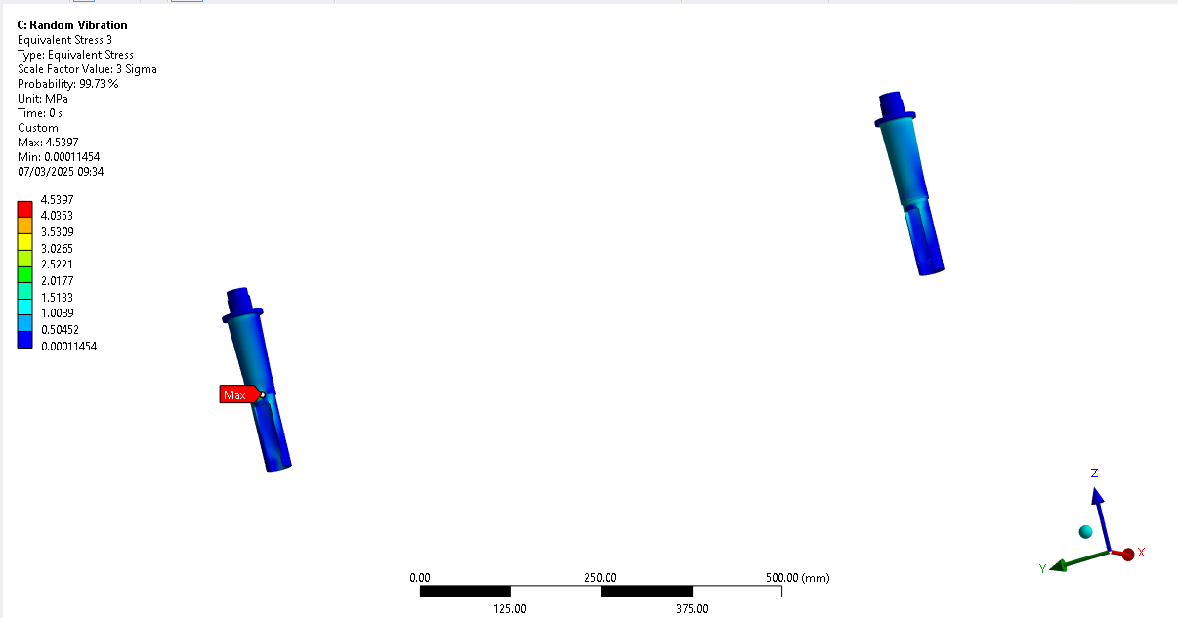
TCSPM Stress on Shafts - ASTMD z-Direction Input

Slide 12
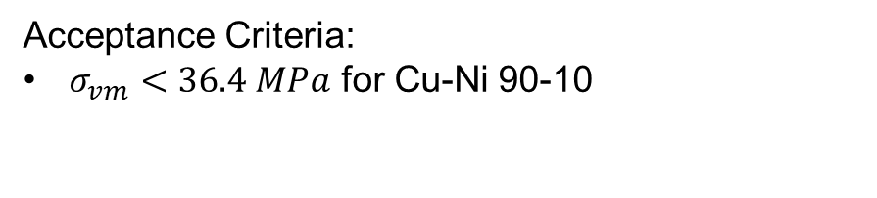
Cooling Pipes- Peak Stress Evaluation (ASTMD4169 Input)
Collimator | Equivalent Von-Mises Stress z-direction | Equivalent Von-Mises Stress x-direction
TCLP | 0.6 MPa | 1.7 MPa
TCLPX | 1.8 MPa | 6.0 MPa
TCSPM | 0.4 MPa | 0.4 MPa
TCTPM | 0.9 MPa | 3.0 MPa
TCTPXH | 0.5 MPa | 1.4 MPa
Acceptance Criteria:
$σ_{vm}<36.4 MPa$​ for Cu-Ni 90-10

Slide 13
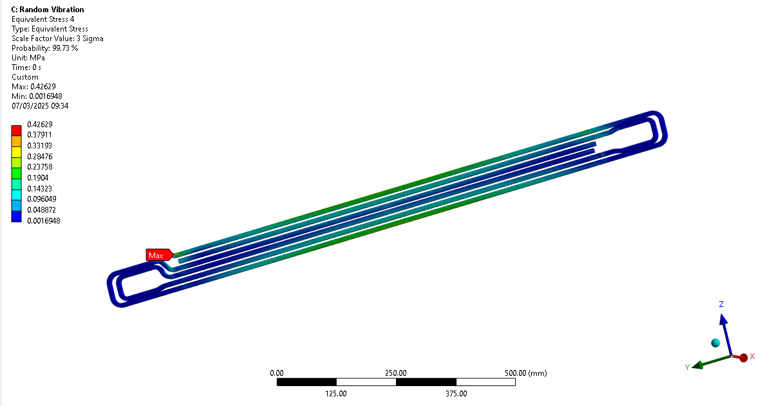
TCSPM Stress on Cooling Pipes - ASTMD z-Direction Input

Slide 14

Peak Stress Evaluation Overalll (ASTMD4169 Input)
Collimator | Equivalent Von-Mises Stress z-direction | Equivalent Von-Mises Stress x-direction
TCLP | 6.7 MPa – on housing above shaft | 20.6 MPa - on housing over shaft
TCLPX | 10.4 MPa – on the end of the shaft | 27.0 MPa - on the end of the shaft
TCSPM | 5.1 MPa - on housing above shaft | 10.3 MPa – on the shaft
TCTPM | 8.7 MPa - on housing above shaft | 25.9 MPa - on the shaft
TCTPXH | 3.2 MPa - on the shaft | 13.1 MPa - on the shaft
Acceptance Criteria:
$σ_{vm}<153.3 MPa$​ for CuCrZr
$σ_{vm}<68.3 MPa$​ for SS-316 L

Slide 15
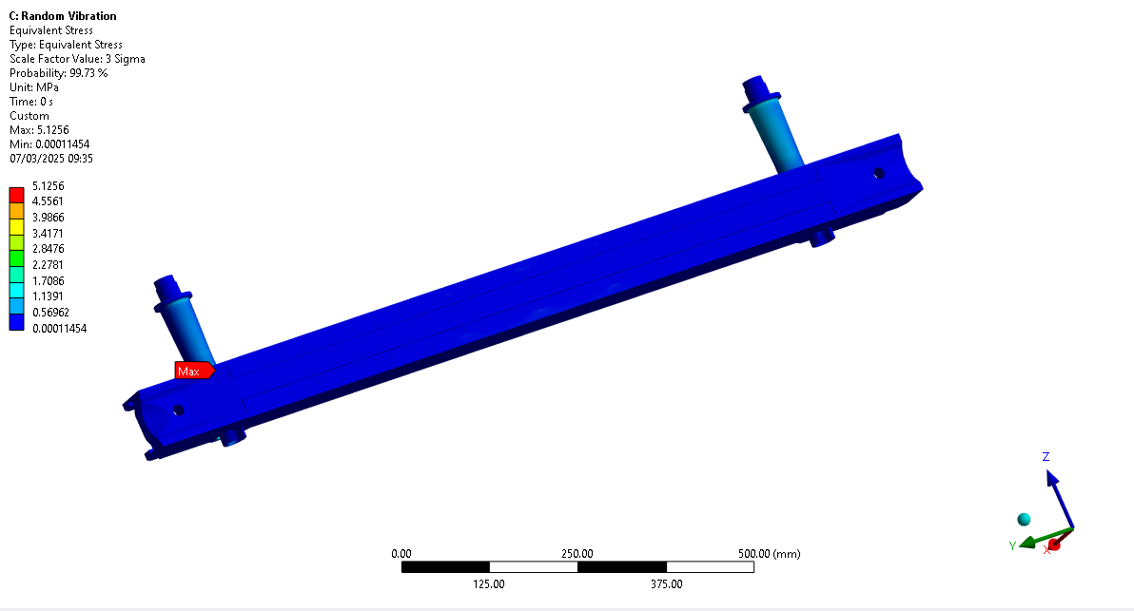
TCSPM Overall Stress - ASTMD z-Direction Input

Slide 16
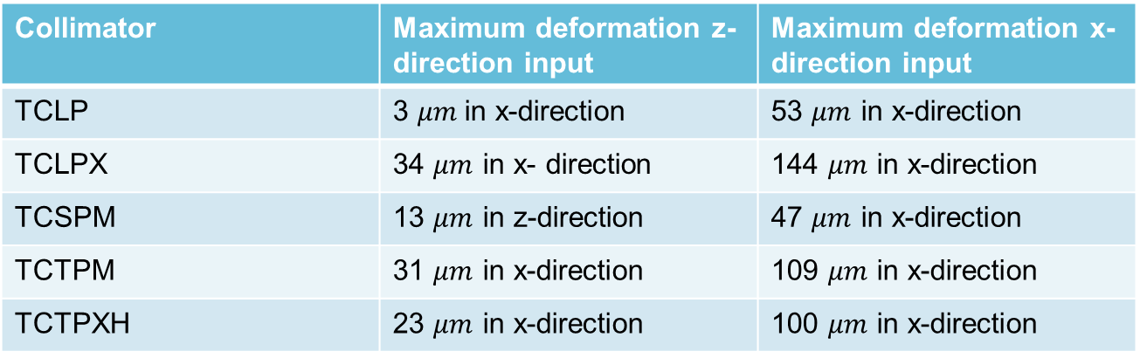
TCLP Directional Overall Deformation – ASTMD Input
Collimator | Maximum deformation z- direction input | Maximum deformation x- direction input
TCLP | 3 $μm$in x-direction | 53 $μm$ in x-direction
TCLPX | 34 $μm$ in x- direction | 144 $μm$ in x-direction
TCSPM | 13 $μm$ in z-direction | 47 $μm$ in x-direction
TCTPM | 31 $μm$ in x-direction | 109 $μm$ in x-direction
TCTPXH | 23 $μm$ in x-direction | 100 $μm$ in x-direction
→ No clash to be expected with other components

Slide 17
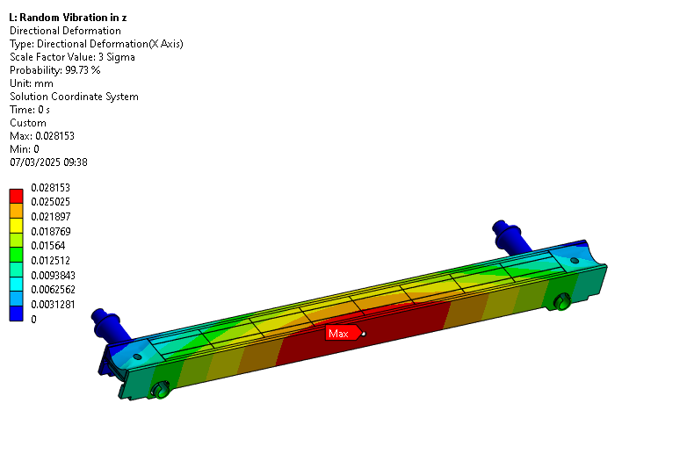
TCLP Directional Overall Deformation – ASTMD z- Direction Input

Slide 18
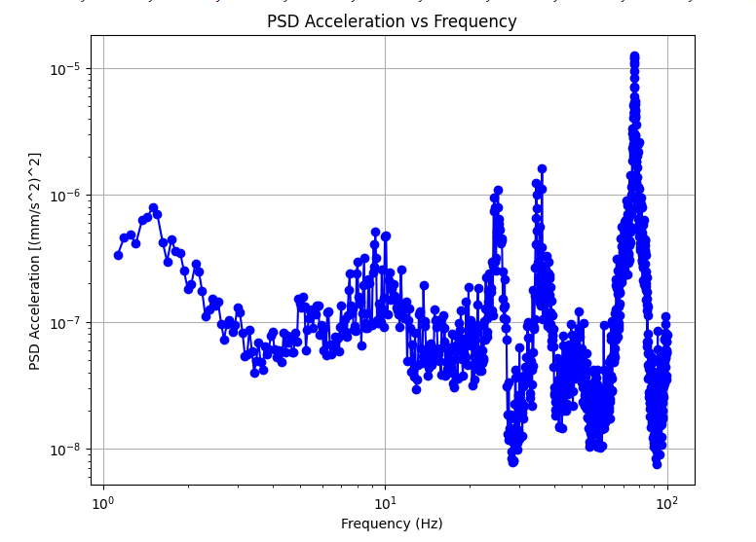
Random Vibrations – Experimental Input
EDMS reference: https://edms.cern.ch/document/2755675/2
Maximum PSD acceleration on the frame of the cryomodule in z-direction
Acceleration PSD
Input
Random Vibrations

Slide 19
Absorber Blocks - Peak Stress Evaluation (Experimental Input)
Collimator | Equivalent Von- Mises Stress z- Direction | Equivalent Von-Mises Stress x- Direction
TCLP | 0.6 MPa | 1.8 MPa
TCLPX | 2.8 MPa | 7.7 MPa
TCSPM | 0.1 MPa | 0.3 MPa
TCTPM | 1.3 MPa | 3.9 MPa
TCTPXH | 1.6 MPa | 12.0 MPa
Acceptance Criteria:
$σ_{vm}<205 MPa$​ for Inermet
$σ_{vm}<43.3 MPa$​ for Graphite

Slide 20
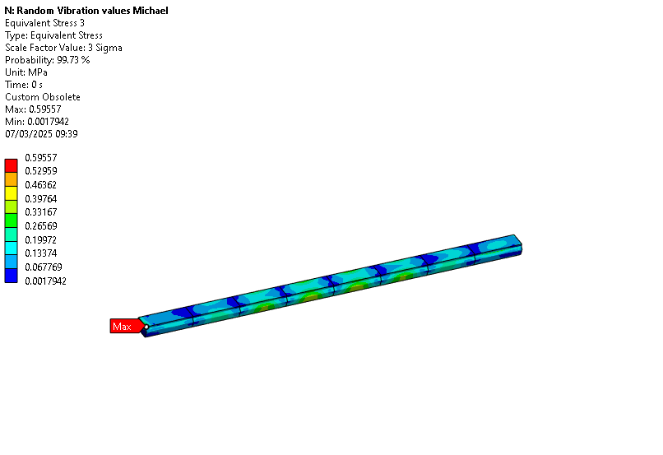
TCLP Stress on Absorber Blocks- Experimental Input Z-Direction

Slide 21
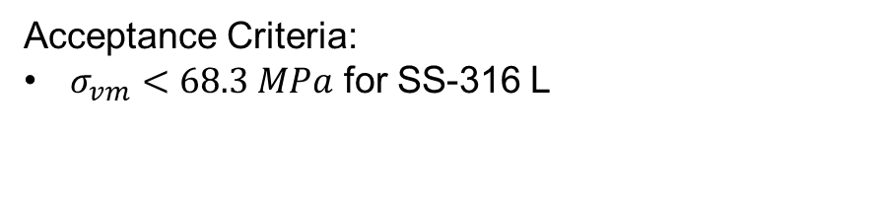
Shafts- Peak Stress Evaluation (Experimental Input)
Collimator | Equivalent Von-Mises Stress z-direction | Equivalent Von-Mises Stress x-direction
TCLP | 7.9 MPa | 12.3 MPa
TCLPX | 7.9 MPa | 25 MPa
TCSPM | 9.8 MPa | 10.2 MPa
TCTPM | 16.0 MPa | 19.3 MPa
TCTPXH | 2.7MPa | 13.1 MPa
Acceptance Criteria:
$σ_{vm}<68.3 MPa$​ for SS-316 L

Slide 22
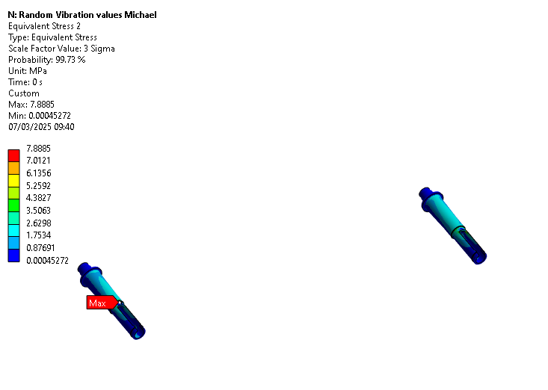
TCLP Stress on Shafts – Experimental Input Z-Direction

Slide 23
Cooling Pipes- Peak Stress Evaluation (Experimental Input)
Collimator | Equivalent Von-Mises Stress z-direction | Equivalent Von-Mises Stress x-direction
TCLP | 0.2 MPa | 0.4 MPa
TCLPX | 1.9 MPa | 5.7 MPa
TCSPM | 0.9 MPa | 0.4 MPa
TCTPM | 0.9 MPa | 2.1 MPa
TCTPXH | 0.7 MPa | 1.4 MPa
Acceptance Criteria:
$σ_{vm}<36.4 MPa$​ for Cu-Ni 90-10

Slide 24
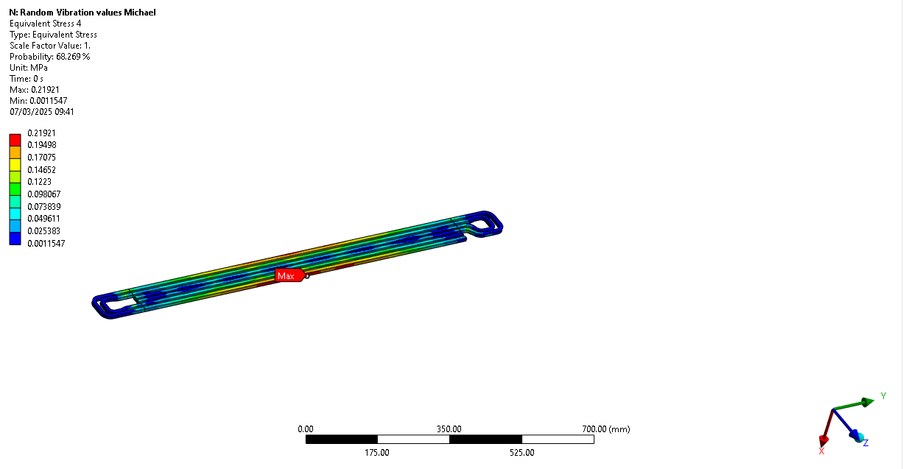
TCLP Stress on Cooling Pipes – Experimental Input Z-Direction

Slide 25

Peak Stress Evaluation Overall (Experimental Input)
Collimator | Equivalent Von-Mises Stress z-direction | Equivalent Von-Mises Stress x-direction
TCLP | 9.4 MPa - on housing above shaft | 20.6 MPa - on housing over shaft
TCLPX | 7.9 MPa - on the end of the shaft | 27.0 MPa - on the end of the shaft
TCSPM | 11.08 MPa - on housing above shaft | 10.35 MPa - on the shaft
TCTPM | 16.3 MPa - on housing above shaft | 25.9 MPa - on the shaft
TCTPXH | 2.7 MPa - on the shaft | 13.1 MPa - on shaft
Acceptance Criteria:
$σ_{vm}<153.3 MPa$​ for CuCrZr
$σ_{vm}<68.3 MPa$​ for SS-316 L

Slide 26
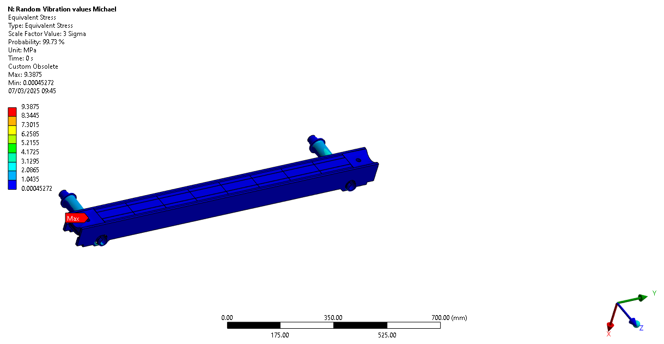
TCLP – Overall Stress Experimental Input Z-Direction

Slide 27
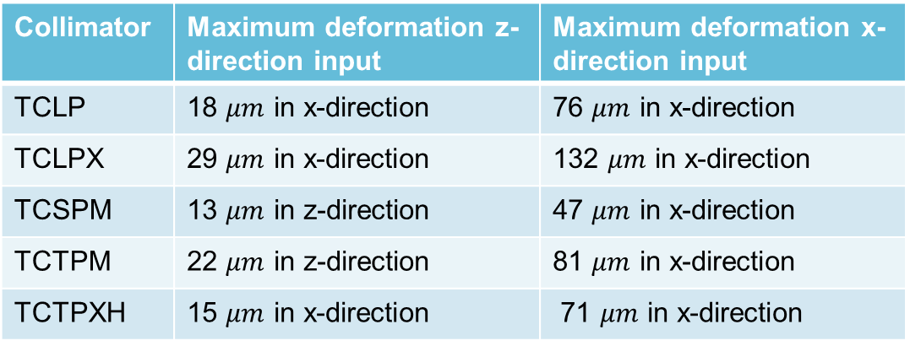
TCLP Directional Overall Deformation – Experimental Input
Collimator | Maximum deformation z- direction input | Maximum deformation x- direction input
TCLP | 18 $μm$ in x-direction | 76 $μm$ in x-direction
TCLPX | 29 $μm$ in x-direction | 132 $μm$ in x-direction
TCSPM | 13 $μm$ in z-direction | 47 $μm$ in x-direction
TCTPM | 22 $μm$ in z-direction | 81 $μm$ in x-direction
TCTPXH | 15 $μm$ in x-direction | 71 $μm$ in x-direction
→ No clash to be expected with other components

Slide 28
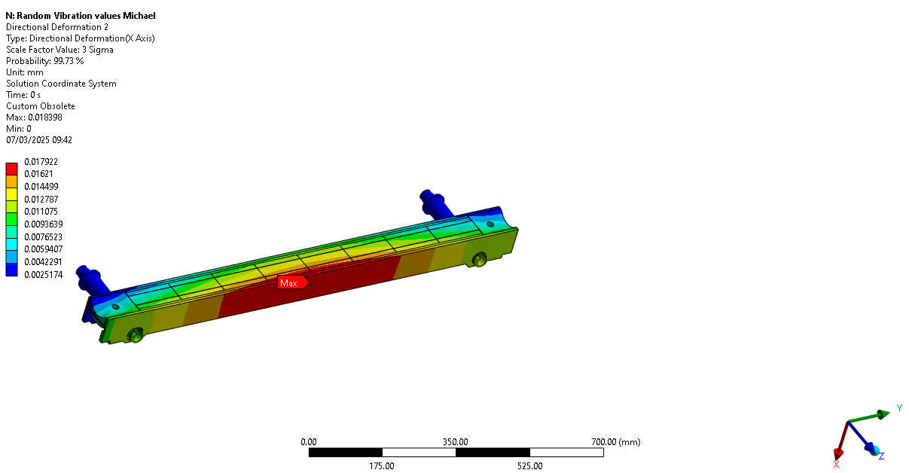
TCLP Directional Deformation – Experimental Input Z-Direction

Slide 29
Conclusion of Simulations
The loads remain within the acceptance criteria in all cases.
Deformations are very low → no risk of clash
Load orientation in the Z-direction is preferable over the X-direction, though both remain acceptable.
Gravity has no influence on the natural frequencies.
The maximum load occurs on the housing or the shaft.

Slide 30
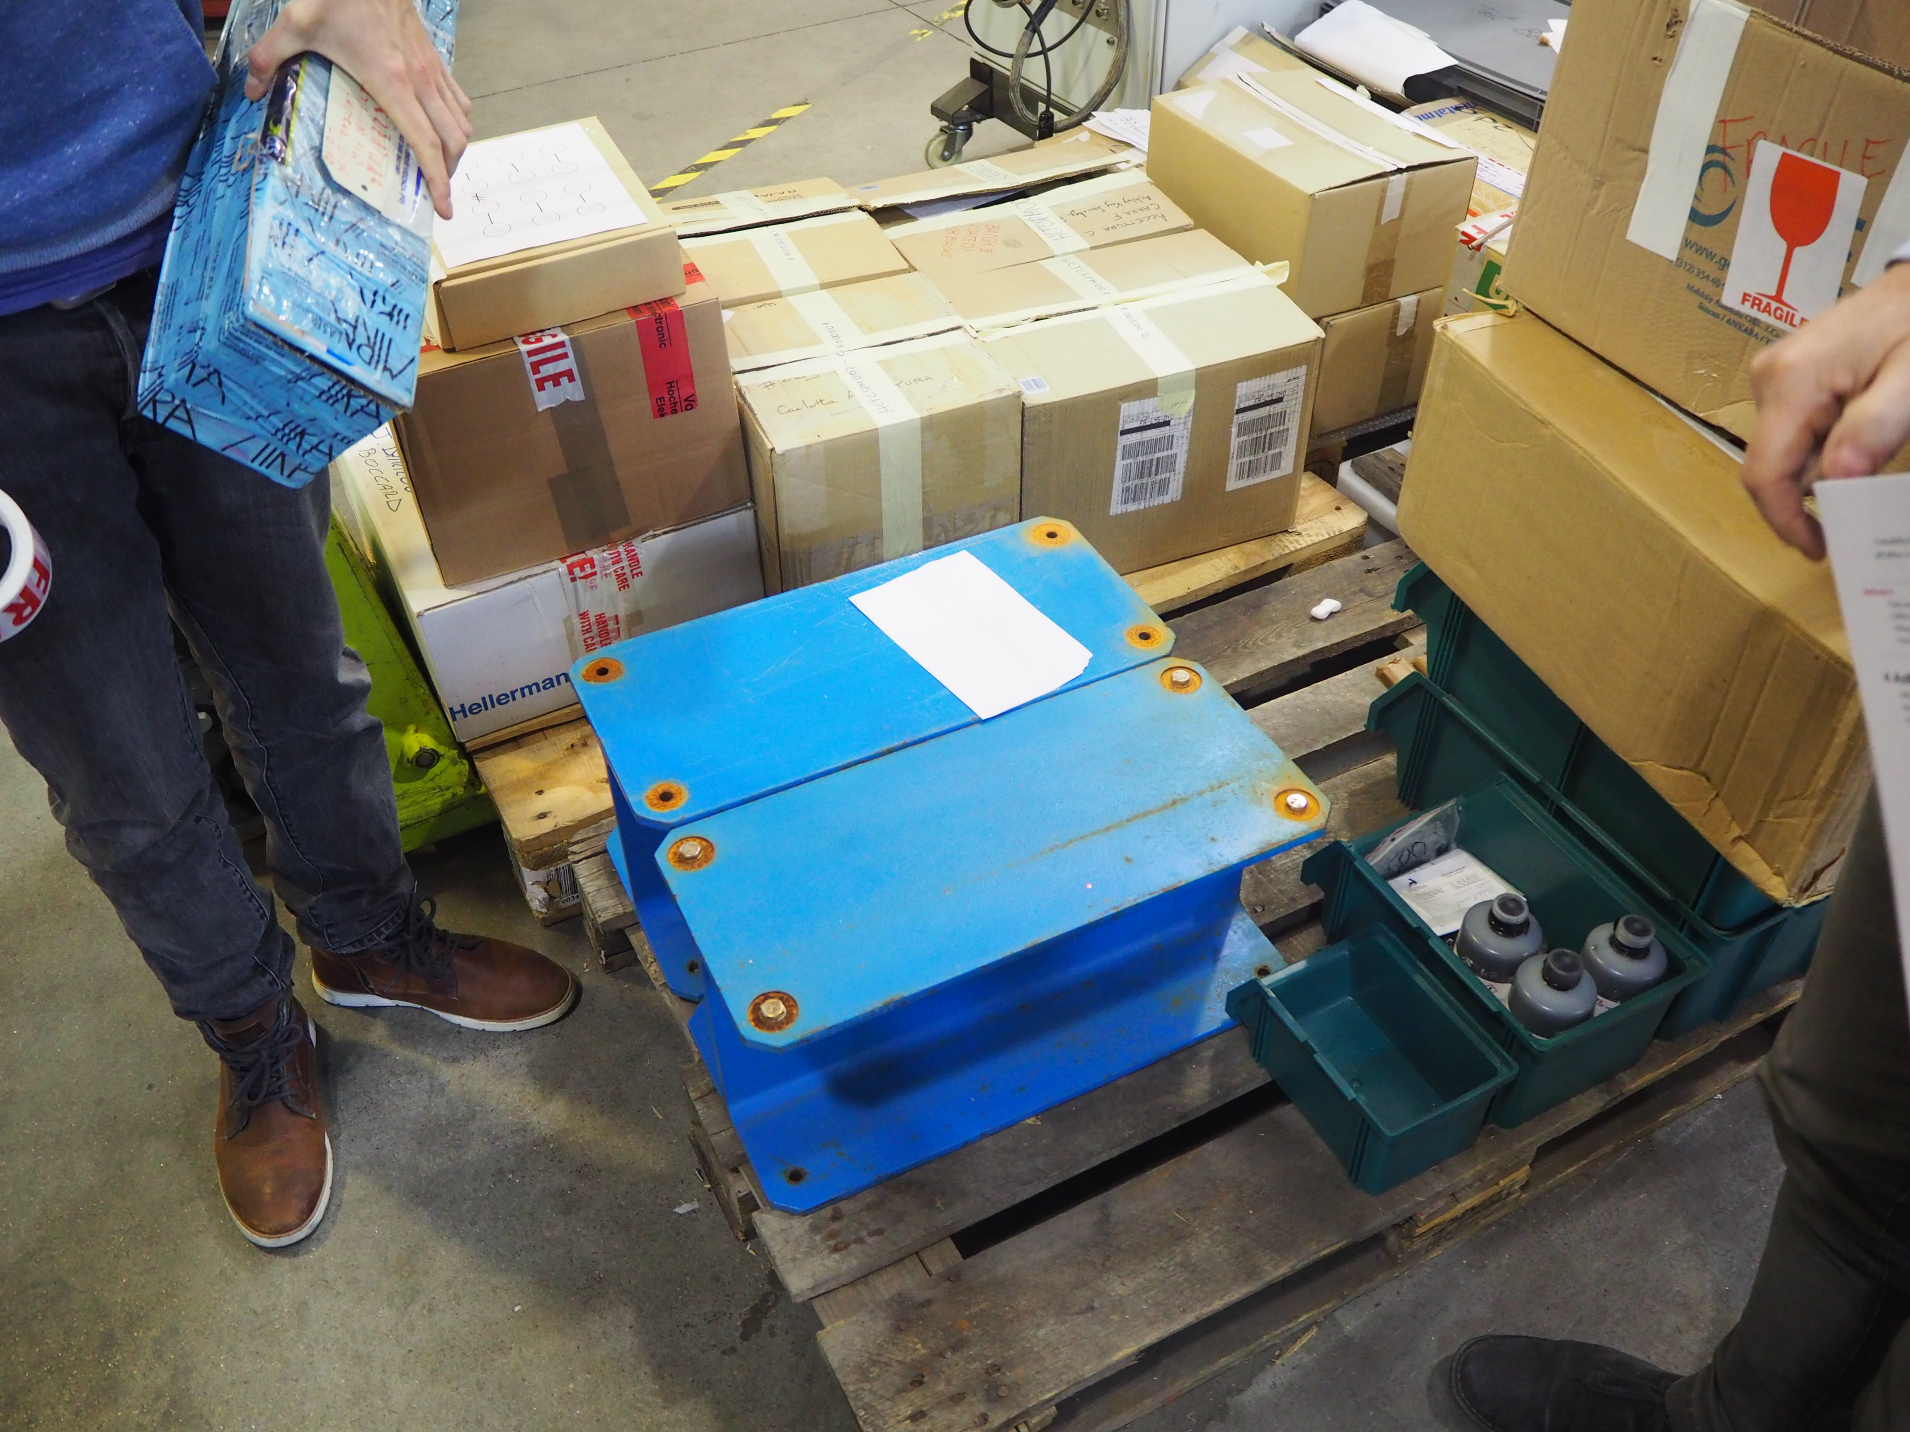
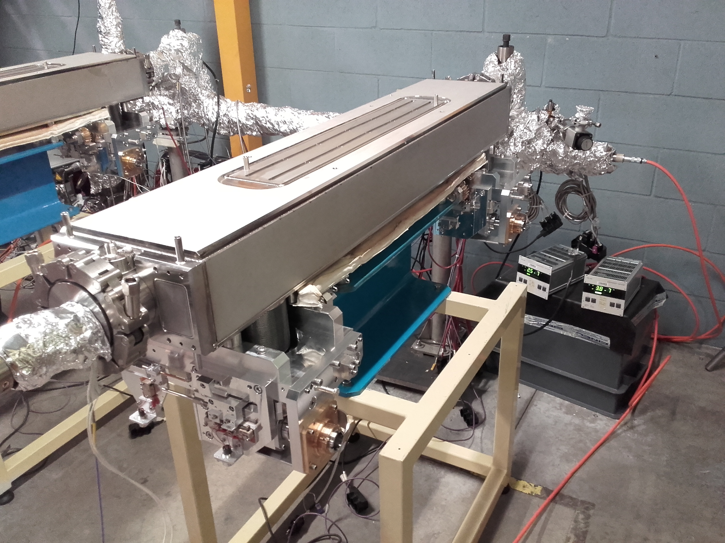
CINEL Transportation Frame

Slide 31
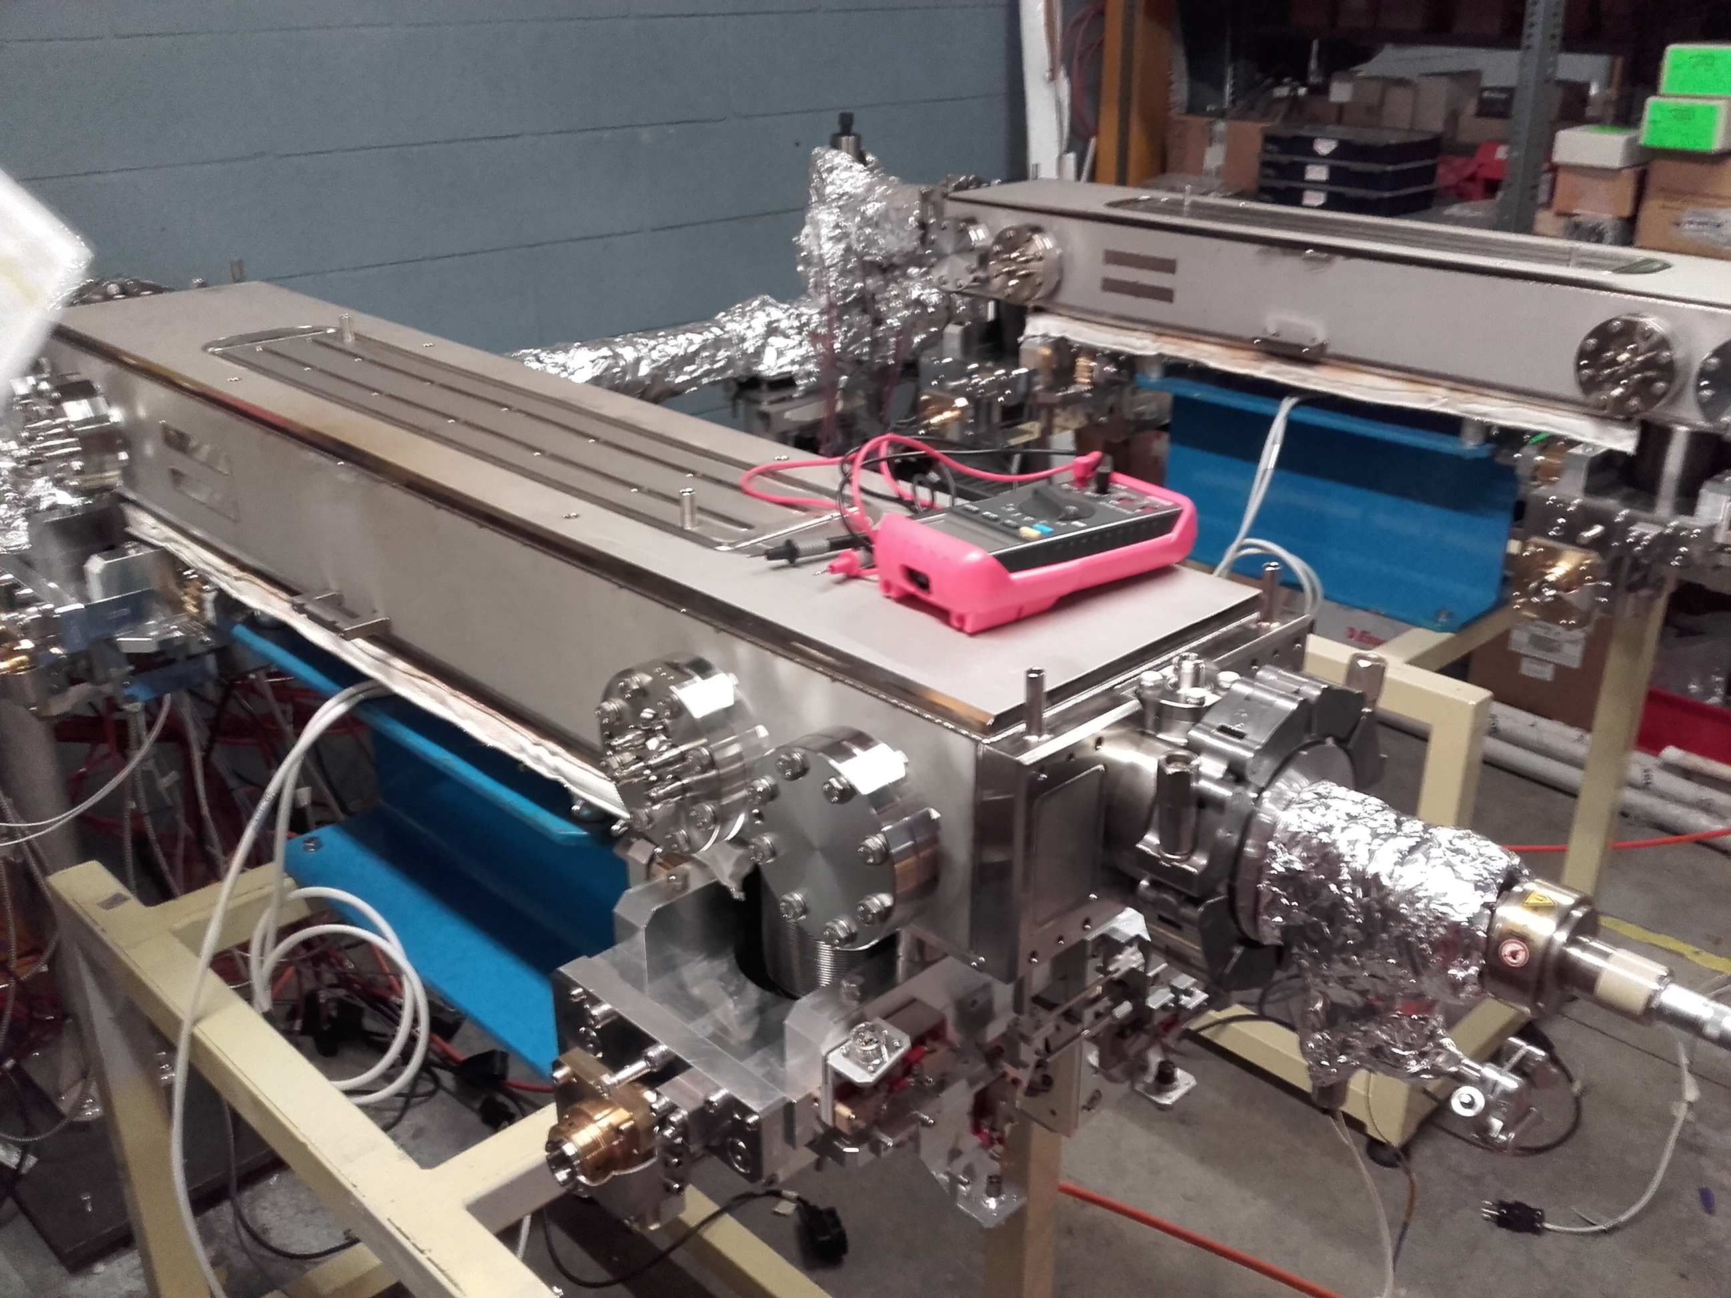
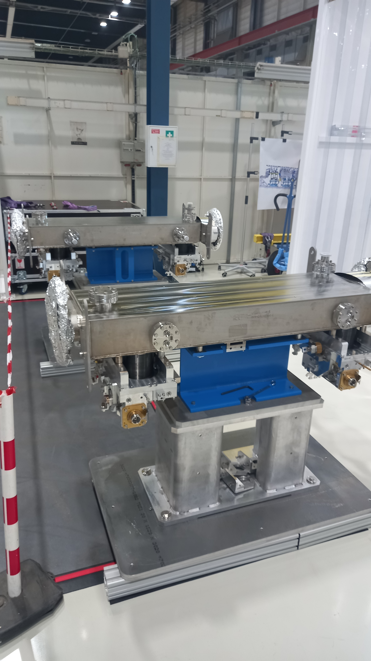
CINEL Transportation Frame

Slide 32
CINEL Transportation Frame
To be confirmed:
  Final transportation frame layout
  Damper specifications and positioning

Slide 33
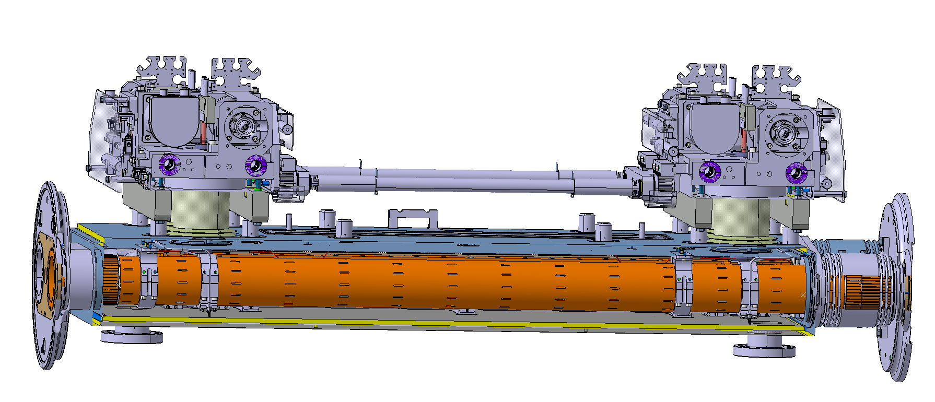
Failure modes of other components to consider
Drift Tube: Buckling, resonance-induced vibration, localized stress concentrations leading to cracks.
Bolted/Fastened Connections: Loosening due to vibration

Slide 34
Experimental Verification
Modal analysis of pre-series jaw
Monitoring of the first transport
Review the transportation frame provided by CINEL
Shaker test on jaw mock-up to check for screw loosening

Slide 35
Experimental Verification
Why Perform Model Correlation?
Simulation of natural frequencies of Jaws
Confirm the accuracy of the finite element model (FEM).
Identify discrepancies between simulations and real-world behavior.
Improve confidence in the model for further analyses.
Ensure reliable predictions for operational conditions and transport effects.
Model Correlation
Experimental Test of first natural frequencies

Slide 36
Thank you for your attention

Slide 37
Background – Collimator Setup TCLP
TCLP Collimator cross Section
Jaw with shafts in vertical orientation
shafts
tapering
Assembly: The jaws are fixed to two shafts and are positioned within a housing.
Orientation: Vertical orientation during transport.
Absorber blocks
Clamping system

Slide 38
First Step: Modal Analysis
Jaw without shafts
Objective of Simulation:
  Conduct a modal analysis on the jaw without the shaft to evaluate its vibrational characteristics.
Reasoning:
  Benchmark simulation results against real measurements on a jaw in the same condition.
  Validate the accuracy of the simulation through comparison with actual data.
Expected Outcome:
  If the simulation accurately reflects real measurements, it confirms the reliability of further vibrational analysis.
  A successful modal benchmarking provides confidence that subsequent simulations will accurately predict vibrational behavior.

Slide 39
First Step: Modal Analysis
Jaw without shafts
Objective of Simulation:
  Conduct a modal analysis on the jaw without the shaft to evaluate its vibrational characteristics.
Reasoning:
  Benchmark simulation results against real measurements on a jaw in the same condition.
  Validate the accuracy of the simulation through comparison with actual data.
Expected Outcome:
  If the simulation accurately reflects real measurements, it confirms the reliability of further vibrational analysis.
  A successful modal benchmarking provides confidence that subsequent simulations will accurately predict vibrational behavior.

Slide 40
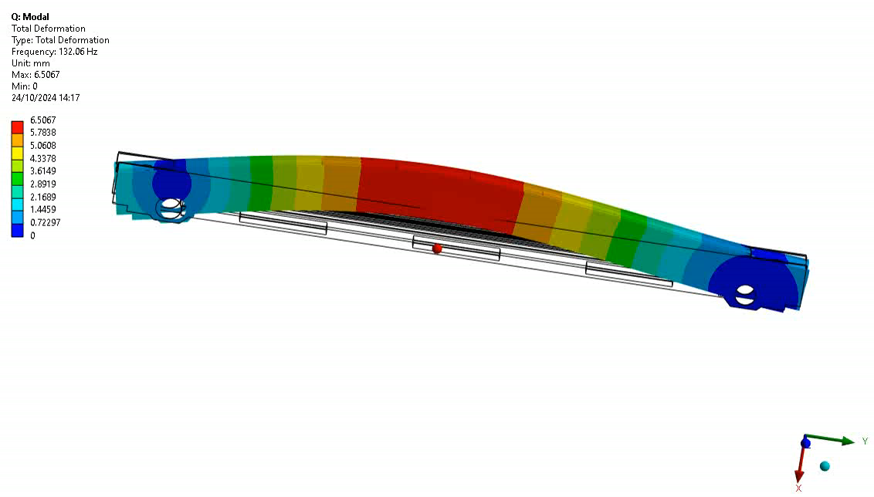
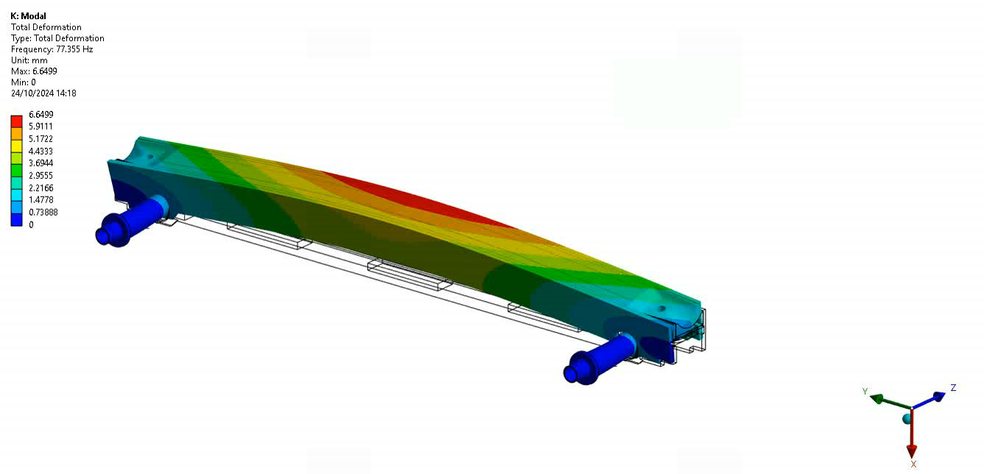
TCLP First Bending Modes
Jaw without shaft
Jaw with shaft
First bending moment: 132Hz
First bending moment: 77Hz

Slide 41
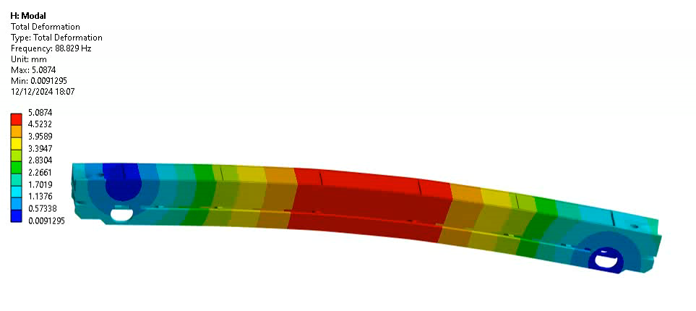
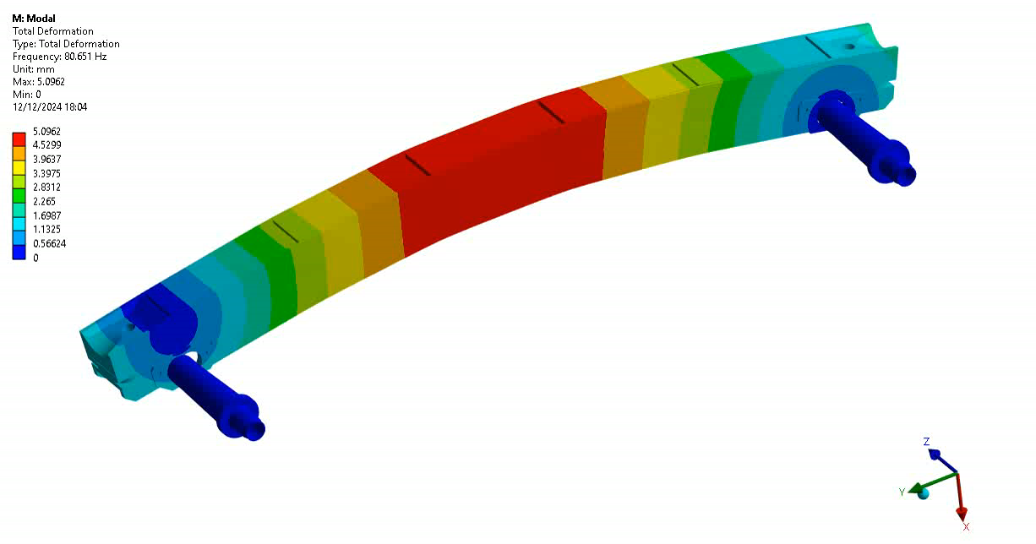
TCLPX First Bending Mode
First Bending Mode: 88Hz
First Bending Mode: 80.6 Hz

Slide 42
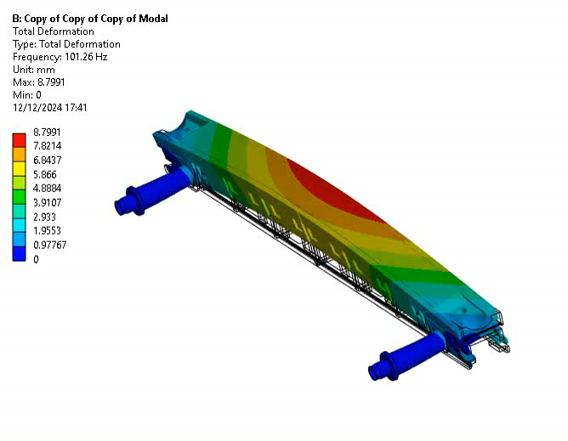
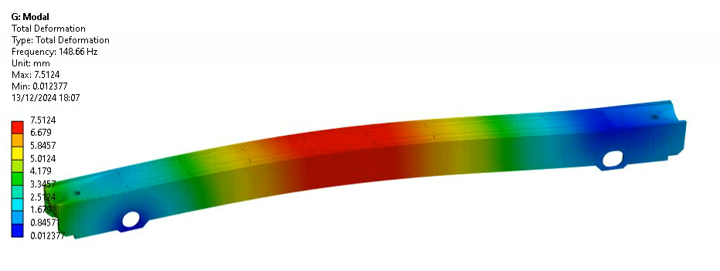
TCSPM First Bending Mode
First Bending mode: 146 Hz
First Bending mode: 90.5 Hz

Slide 43
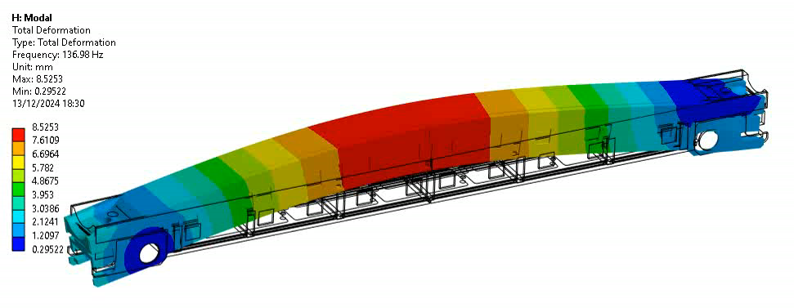

TCSP First Bending Mode
First Bending Mode: 136 Hz
First Bending Mode: 101 Hz

Slide 44
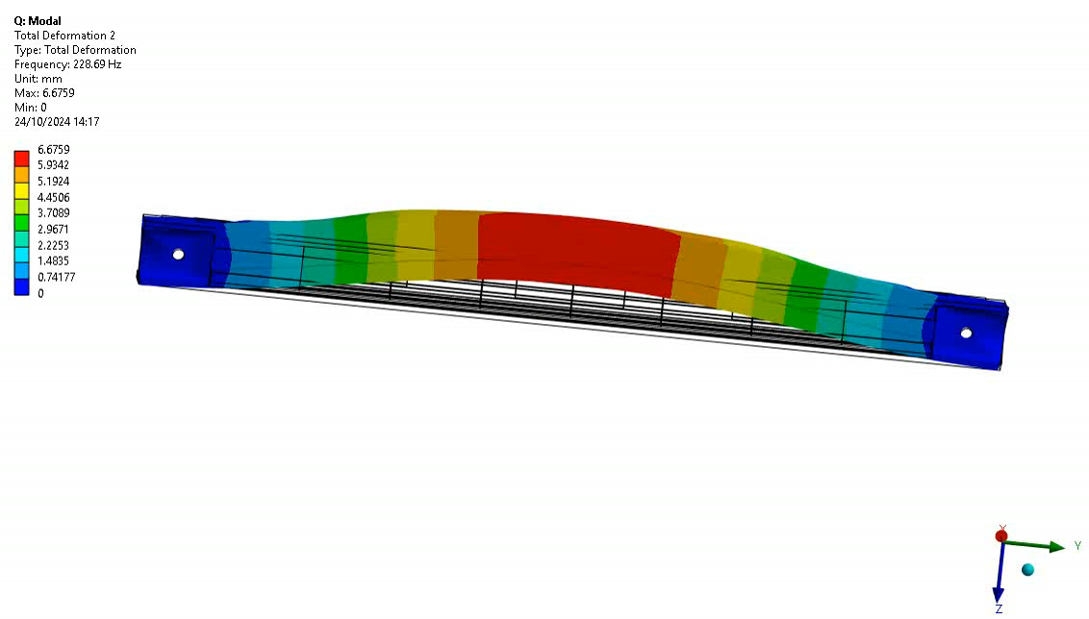
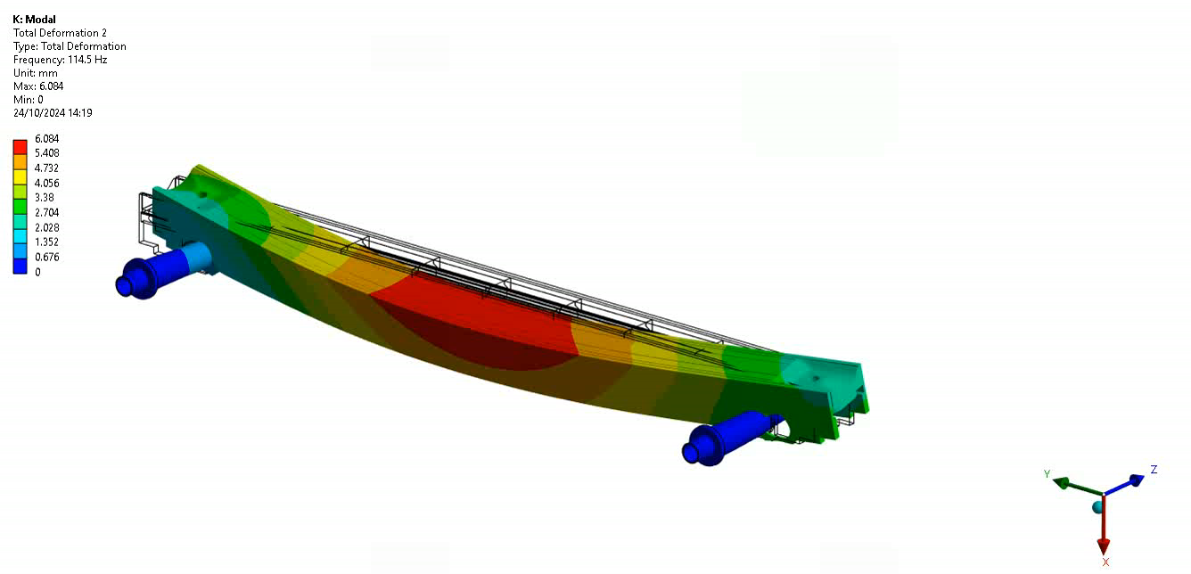
Second Bending Modes
Jaw without shaft
Jaw with shaft
Second bending moment: 228 Hz
Second bending moment: 114 Hz

Slide 45
Maximum Stress on Components with Standard
Input: ASTMD High standard load in z-direction and in x-direction

Slide 46
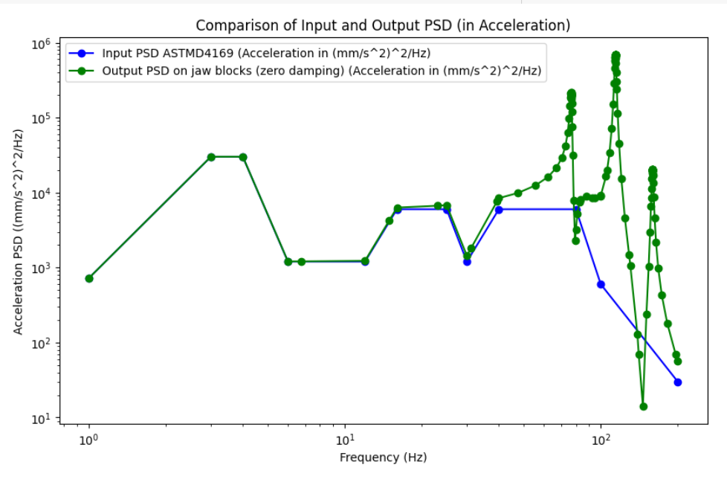
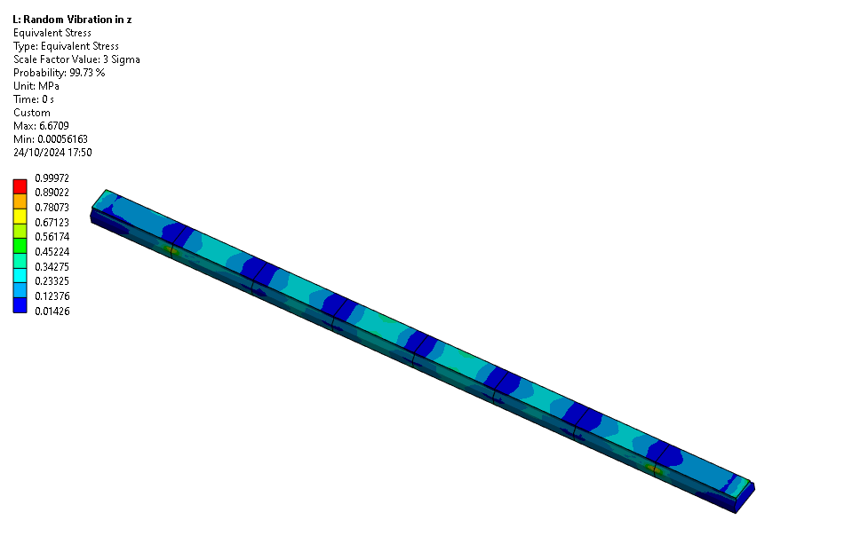
TCLP: Stress on Blocks for ASTMD4169 Input
Z-Direction
Maximum stress:
1 MPa for a scale factor of 3 sigma

Slide 47
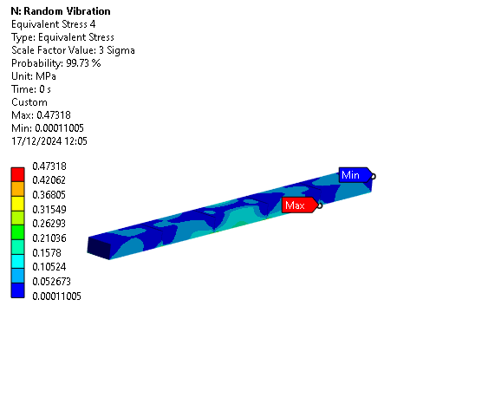
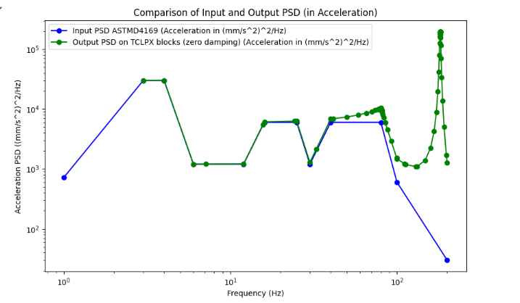
TCLPX: Stress on Blocks for ASTMD4169 Input Z-Direction

Slide 48
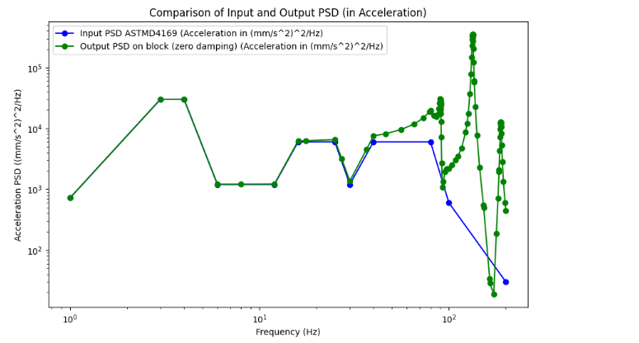
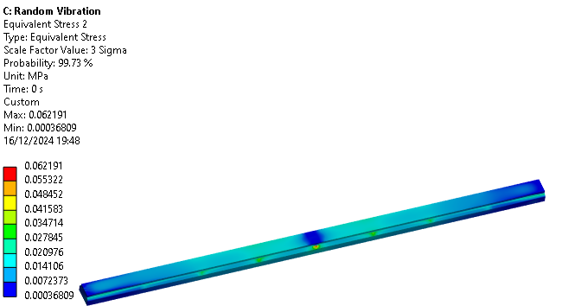
TCSPM: Stress on Blocks for ASTMD4169 Input Z-Direction
Maximum stress:
0.06 MPa for a scale factor of 3 sigma

Slide 49
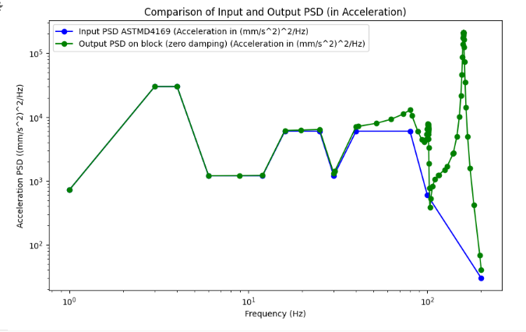
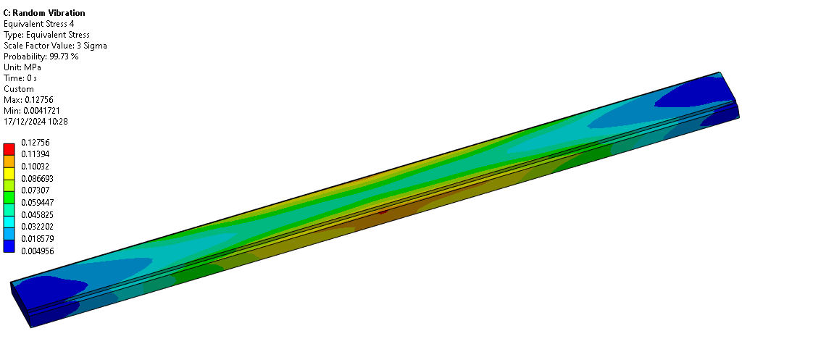
TCSP: Stress on Block for ASTMD4169 Input Z-Direction
Maximum stress:
0.12 MPa for a scale factor of 3 sigma

Slide 50
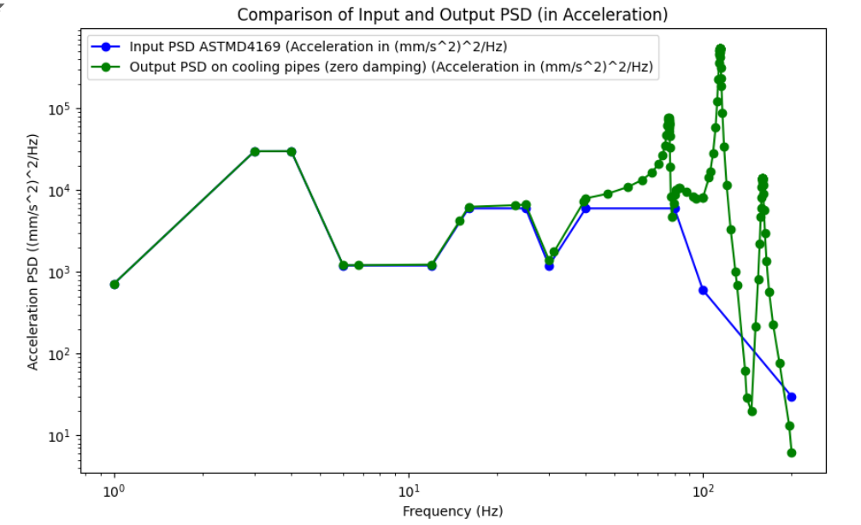
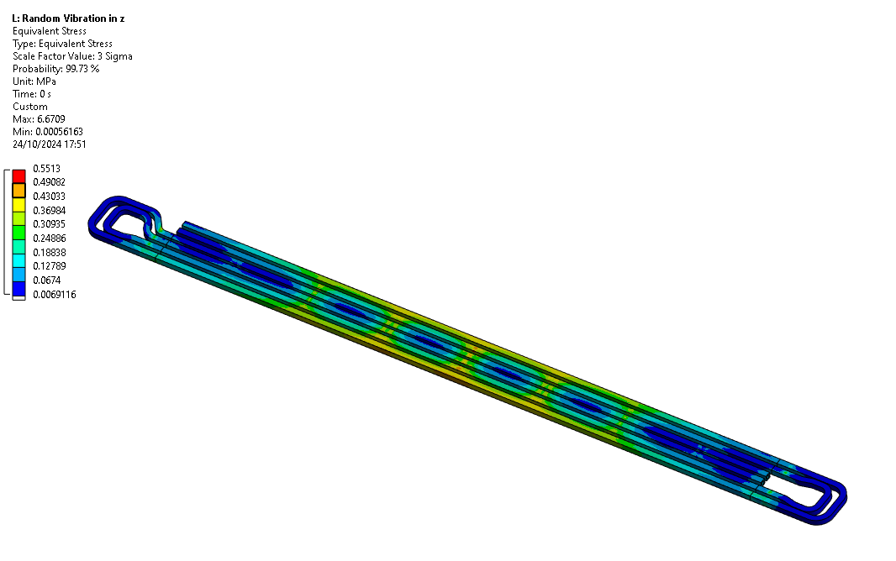
TCSP: Stress on Blocks for ASTMD4169 Input
Z-Direction
Maximum stress:
0.5 MPa for a scale factor of 3 sigma

Slide 51
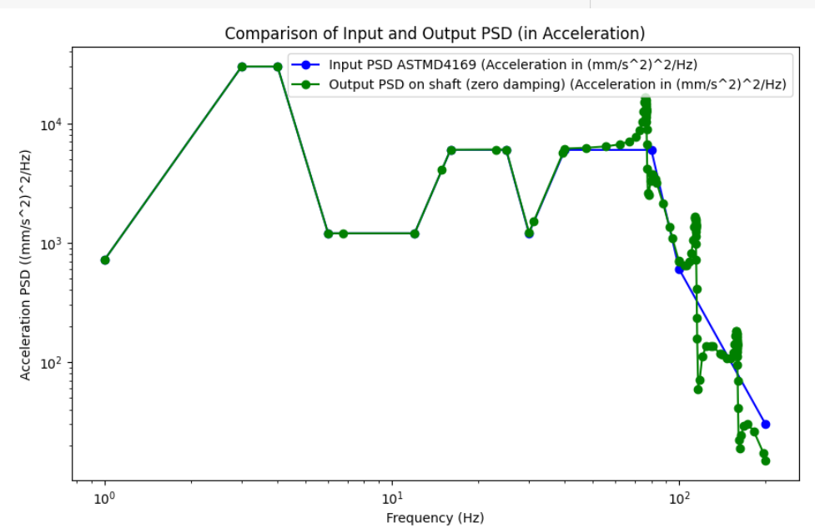
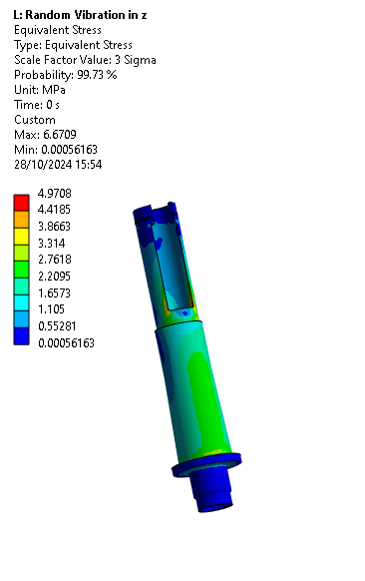
TCSP: Stress on Shafts for ASTMD4169 Input
Z-Direction
Maximum stress:
5 MPa for a scale factor of 3 sigma

Slide 52

TCLP: Max Stress for ASTMD4169 Input
Maximum overall stress:
6.7 MPa for a scale factor of 3 sigma

Slide 53

TCLPX: Max Stress for ASTMD4169 Input
Maximum overall stress:
8.7 MPa for a scale factor of 3 sigma

Slide 54

TCSPM: Max Stress for ASTMD4169 Input
Maximum overall stress:
5.1 MPa for a scale factor of 3 sigma

Slide 55

Comparison ASTMD4169 Input
Z- and X- direction
 | Directional Deformation in x-direction [mm] | Directional deformation in z- direction [mm]
Blocks | 0.095 | 0.026
Shaft | 0.05 | 0.002
Cooling pipes | 0.1 | 0.01

Slide 56


TCLP: Stress on Blocks for Z-Frame Input

Slide 57


TCLPX: Stress on Blocks for Z-Frame Input

Slide 58


TCSPM: Stress on Blocks for Z-Frame Input
Very little response of the block to the acceleration PSD input

Slide 59


TCSP: Stress on Blocks for Z-Frame Input

Slide 60


Stress on Shafts for Z-Frame Input

Slide 61


Stress on Cooling pipes for Z-Frame Input

Slide 62

TCLP Material Properties and Collimator Setup
Material | Yield Strength [MPa] | Youngs Modulus [GPa]
Steel 304 L | 210 | 200
Steel 316L | 205 | 190
CuCr1Zr | 293 | 130
CuNi90/10 | 109.2 | 142
Inermet180 | 613 | 360

Slide 63

TCLPX Material Properties and Setup
Material | Yield Strength [MPa] | Youngs Modulus [GPa]
Steel 316L | 205 | 190
CuCr1Zr | 293 | 130
CuNi90/10 | 109.2 | 142
Inermet180 | 613 | 360

Slide 64

TCSPM Material Properties and Setup
Material | Yield Strength [MPa] | Youngs Modulus [GPa]
Steel 316L | 205 | 190
CuCr1Zr | 293 | 360
CuNi90/10 | 109.2 | 142
Graphite |  | 11.5
Glidcop |  | 128

Slide 65

TCLP: Maximum Stress for Z-Frame Input
Maximum overall stress on the CuCr1Zr housing:
9.3 MPa for a scale factor of 3 sigma

Slide 66

TCLPX: Maximum Stress for Z-Frame Input
Maximum overall stress on the CuCr1Zr housing:
8.1 MPa for a scale factor of 3 sigma

Slide 67

TCSPM: Maximum Stress for Z-Frame Input
Maximum overall stress on the CuCr1Zr housing:
11.08 MPa for a scale factor of 3 sigma

Slide 68
Summary TCLP
 | Max Equivalent Stress [MPa] |  | Max Directional Deformation [mm]
 | ASTMD4169 | Cryomodule z-frame | ASTMD4169 | Cryomodule z-frame
Blocks | 1 | 0.72 | 0.03 (x-direction) | 0.02 (z-direction)
Shaft | 4.97 | 7.87 | 0.0014 (x- direction) | 0.013 (x-direction)
Cooling pipes | 0.55 | 0.65 | 0.027 (x-direction) | 0.017 (z-direction)
Z-direction input

